Slide 1

The Mad Hedge Fund Trader
“A World Gone Mad”
With John Thomas
from San Francisco, CA, December 16, 2015
www.madhedgefundtrader.com
Notes:
*

Slide 2
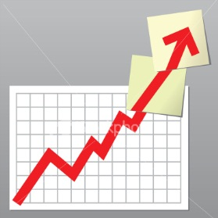
Trade Alert Performance
Hiding in Cash Until the Fed Decision
*January +0.53% Final *July +6.42% Final
*February +7.73% Final *August +1.27% Final
*March +3.00% Final *September +11.99% Final
*April +6.62% Final *October Final -6.19%
*May +5.15% Final *November MTD 5.78%
*June +3.68% Final *December -3.40%
*2015 Year to Date +40.41%
compared to +1.5% for the Dow Average
*Trailing 1 year return +39.38%, +193.22% since inception,
*Average annualized return of 38.64%

Slide 3
Portfolio Review
Stopped Out of Aggressive “RISK ON”
Keeping Cash Until Markets Sort Themselves Out
Mad Hedge Fund Trader
Model Trading Book
Asset Class Breakdown
Risk Adjusted Basis
current capital at risk
Risk On
World is Getting Better
(DIS) 1/$100-$105 call spread | 10.00%
Risk Off
World is Getting Worse
None
total net position | 10.00%
Expiration P&L
41.86% YTD

Slide 4
Paid Subscriber Trailing 12 Month Audited Return +39.38%

Slide 5
60 Months Since Inception
Daily Audited Performance
Averaged annualized return +38.64%

Slide 6

Strategy Outlook-Run For Cover
*Collapse of energy has spilled into junk bonds and regional banks, triggering global “RISK OFF,” basically, all asset classes lost money in 2015, expect for a handful of technology stocks and your home
*Poor December liquidity adds a turbocharger, impending Fed decision a supercharger
*With US QE now gone for 14 months, the QE trades are all unwinding at once.
*All asset classes are now trading against fundamentals, does it last until this afternoon, or next year?
*ECB disappoints in language, but expands QE
*Oil breaks $40, targeting $32
*Gold is still dead in the water
*Large foreign buying has arrested decline in ags

Slide 7

Trading Against Fundamentals
Blame the oil crash, the junk bond crash, the Fed interest rate decision, and December year end effects
*Stocks- Earnings to rise in 2016, but prices are falling
*Bonds-Fed is raising rates today, but yields are falling
*Commodities-no recession in sight, but prices hit 2009 lows
*Currencies- QE expanding and yields falling,
but currencies are rising
*Precious Metals –fear at year highs, but metals hugging lows
*Volatility-rising as unkowns are about to disappear and we enter a quiet period
*The Ags –new lows as El Nino is about to destroy crops
*Real estate-still rising in the face of Fed rate rises and high prices

Slide 8
The Bill Davis View
A $1,500 Upgrade for the Mad Day Trader Service
Buys:
Martin Marietta (MLM) $143 Target to $156
3 M Co (MMM) $153 Target to $162
CF Industries (CF) $40.63 Target to $50
(CF is oversold. Buy on a close above 40.63)
FireEye, Inc. (FEYE) $19 Target to $23
GoPro, Inc. (GPRO) $17 Target to $25
(If it breaks under 15.63, look for new lows)
Avago Technologies (AVGO) $138 Target to $155
Sells:
Buffalo Wild Wings (BWLD) $170 Target to $150
Cracker Barrel (CBRL) $139 Target to $120
3M Co. (MMM) $155 Target to $140
Celgene Corp (CELG) $119 Target to $100
PVH Corp (PVH) $87 Target to $75
WABCO Holdings (WBC) $104 Target to $94

Slide 9

The Global Economy-The Data Are Still OK
*Hot November nonfarm payroll of 211,000 boosts stocks, headline unemployment drops to 5.0%, the last excuse for the Fed to NOT raise rates is gone
*Strong dollar cut ES exports and cut GDP by 0.50% this year
*US net worth fell $1.2 trillion in Q3 to $85.2 trillion, thanks to weak stocks
*German GDP set to rise thanks to stimulus of 1 million immigrants
*Japanese Q3 GDP revised up from -0.8% to
+1.0%, cancelling out the recession
*Next to come is a “RISK ON” global
synchronized growth in 2016

Slide 10
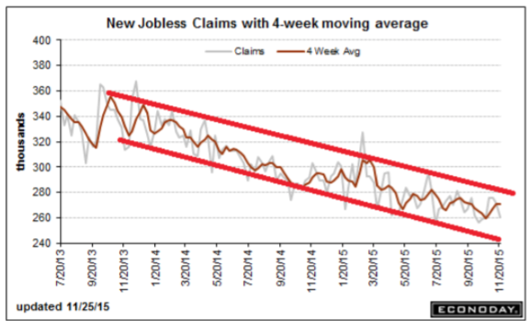
Weekly Jobless Claims – Another Run at the Lows
+13,000 to 282,000 headed for Full Unemployment at 5%-Global Recovery a Driver

Slide 11

Bonds-Its All About Junk
*Europe’s failure to substantially cut interest rates demolishes the Treasury bond market, yields spike 8 bp in 5 minutes
*GLOBAL “RISK OFF” then drives yields back down to middle of recent range
*Junk Bonds ETF (HYG) sees $3.5 billion in redemptions in one week, at 9%, yields are finally coming back in line with risk, get ready for the “BUY”
*Non energy junk is starting to offer real value
*Buy (TBT) on any dip for more
strength in 2016, “RISK ON”
markets will return next year

Slide 12
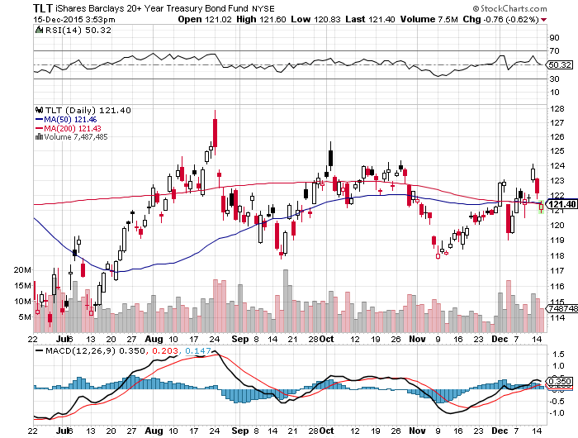
Ten Year Treasury Yield (TLT) 2.26% took profits on the 12/$124-$127 vertical bear put debit spread

Slide 13
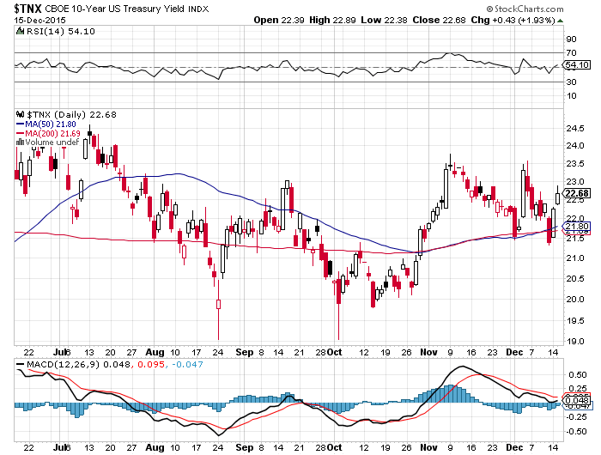
Ten Year Treasury Yield ($TNX) 2.26%
2.35% Ceiling Holds, so will the 2.0% floor

Slide 14
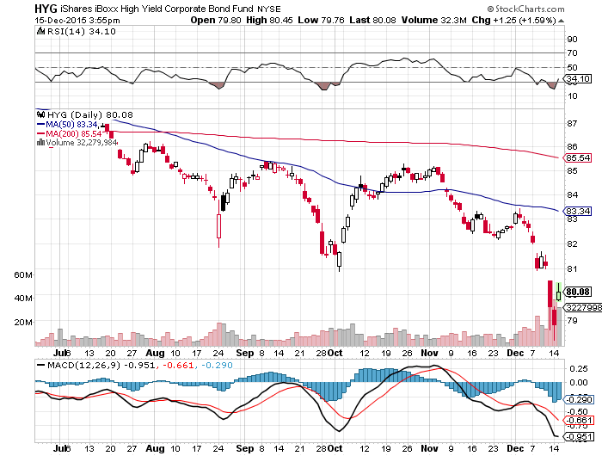
Junk Bonds (HYG) 9% Yield
A Great Coincident Indicator

Slide 15
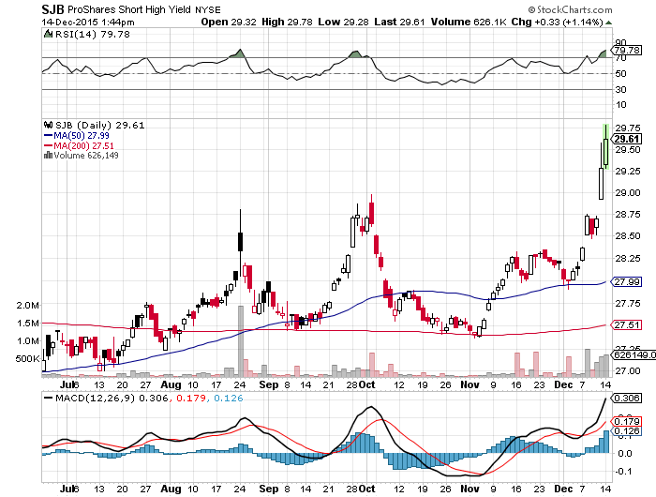
Short Junk Bond ETF (SJB)
Stock of the Week

Slide 16
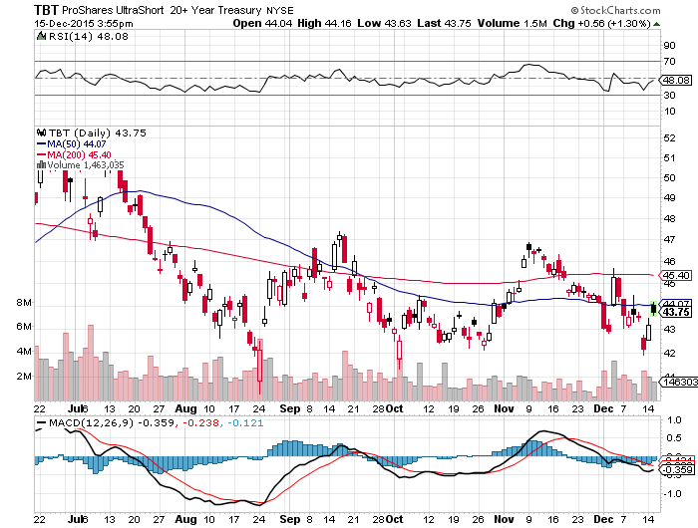
2X Short Treasuries (TBT)-Big Trade of 2016?
Back in “BUY” Territory

Slide 17
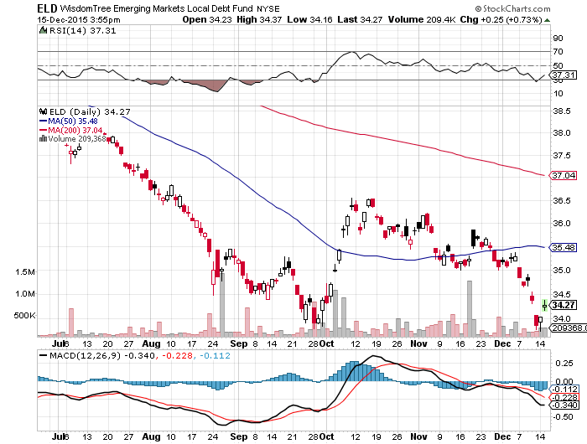
Emerging Market Debt (ELD) 7.73% Yield-

Slide 18
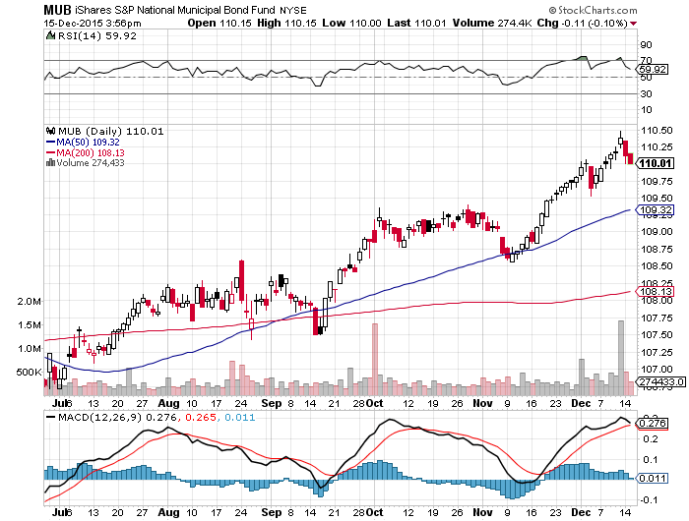
Municipal Bonds (MUB)-1.67% yield
Mix of AAA, AA, and A rated bonds-flight to safety

Slide 19

Stocks-Rush to Cash
*Simultaneous break of 50 and 200-day moving average triggers big “RISK OFF” move
*Junk bond managers dumping equities to hedge holdings that can’t be sold, adding to downside pressure on stocks.
*Oil continues free fall, dragging down the general market, energy has plunged from 12% to 6$ of the (SPY), they have fallen so far they have almost become irrelevant
*Heightened fears of terrorism further eating into confidence
*Still looking for single digit returns in the US next year, versus double digit in Europe and Japan, thanks to weak Euro and Yen
*Investors looking forward to a 2016
earnings recovery, but multiple shrinkage
as rising interest rates eat into valuations

Slide 20
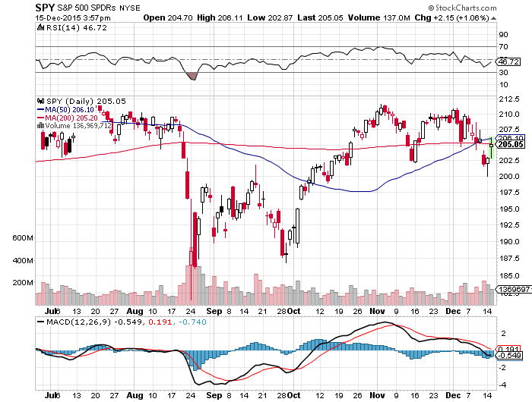
S&P 500-50 Day MA Holds took profits on long the 12/$185-$190 vertical bull debit spread
Awaiting a “Golden Cross” at yearend

Slide 21
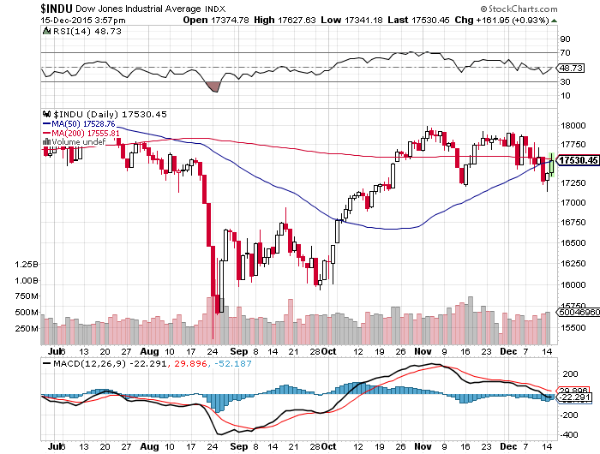
Dow Average-

Slide 22
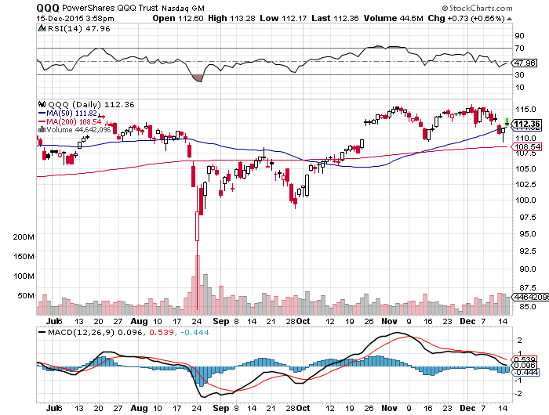
NASDAQ (QQQ)-The Strongest Chart

Slide 23
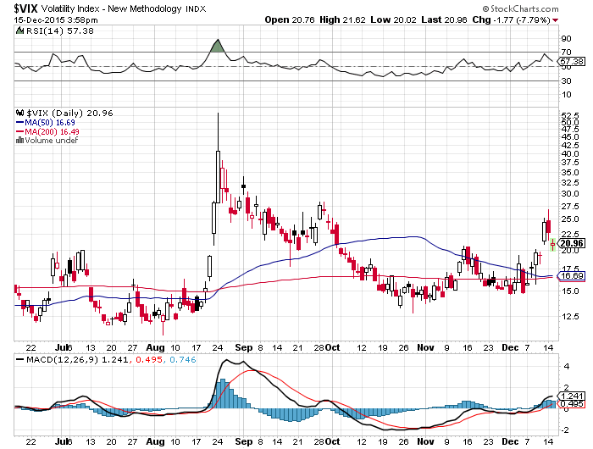
(VIX)-The Spike is Here

Slide 24
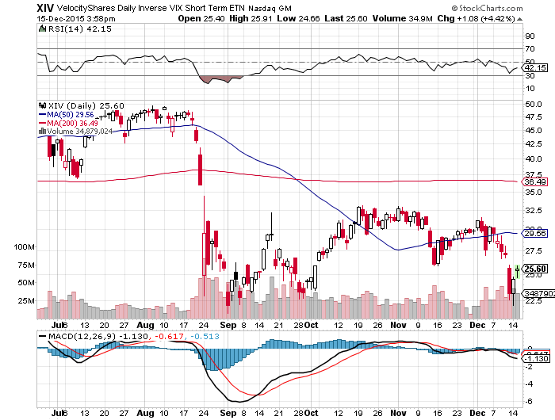
(XIV)-Velocity Shares Daily Inverse VIX Short Term ETN took profits on 10% long the (XIV), look for big Volatility sell off in January vols will stay low for most of 2016

Slide 25
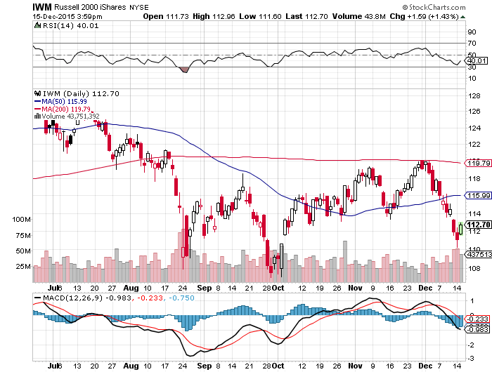
Russell 2000 (IWM)-

Slide 26
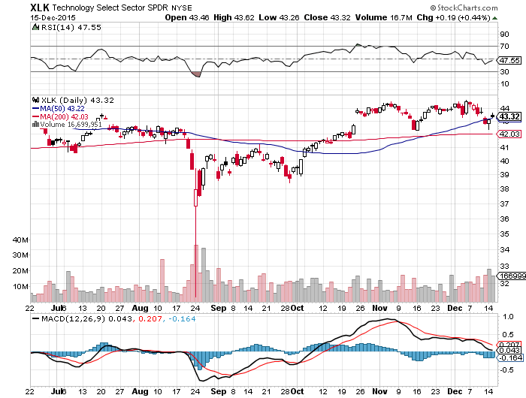
Technology Sector SPDR (XLK), (ROM)
(AAPL), (MSFT), (VZ), (T), (FB), (IBM)

Slide 27
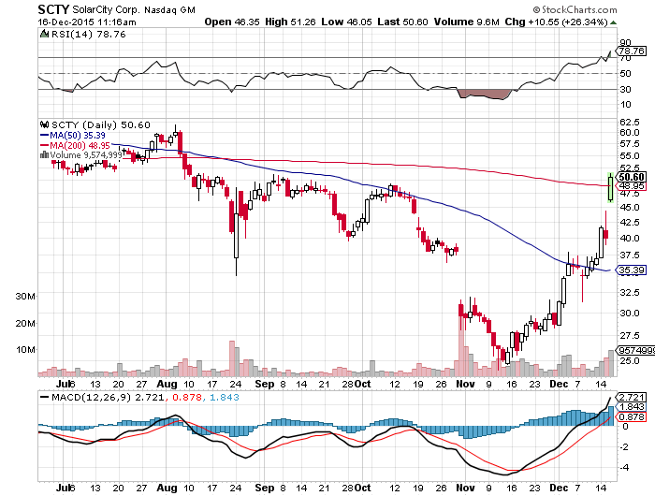
Stock of the Week (SCTY)
Solar investment tax credit extended 5 years will pour $125 billion into new solar investment

Slide 28
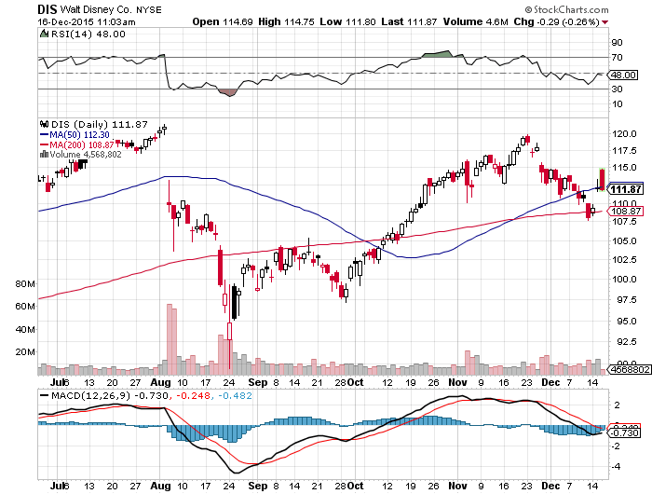
Walt Disney Co. (DIS) long the 1/$100-$105 vertical bull call debit spread
“Star Wars” Kicks in

Slide 29
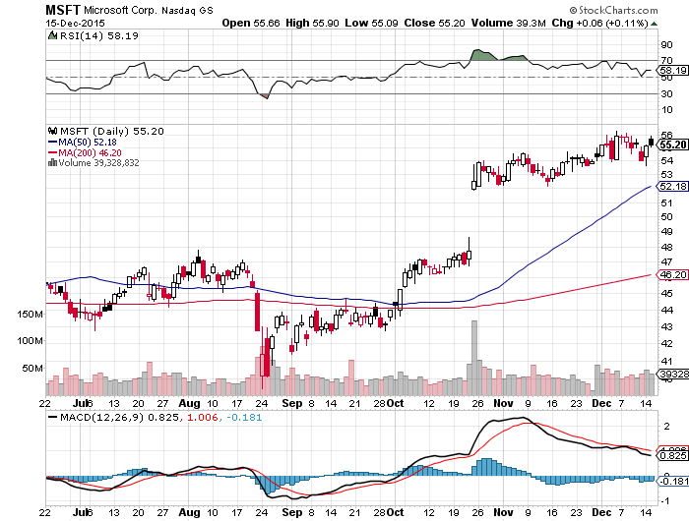
Microsoft (MSFT) took profits on long the 1/$50-$52.50 vertical bull call debit spread

Slide 30
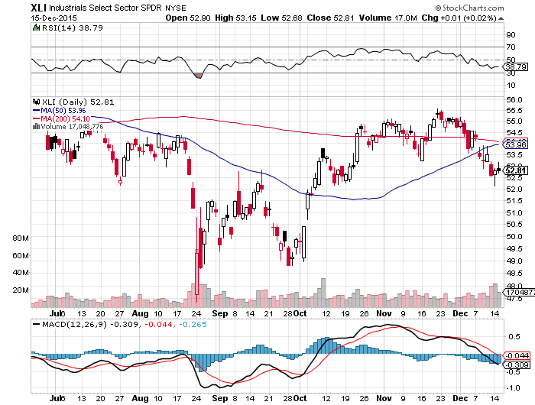
Industrials Sector SPDR (XLI)-Dow Mainstay
(GE), (MMM), (UNP), (UTX), (BA), (HON)

Slide 31
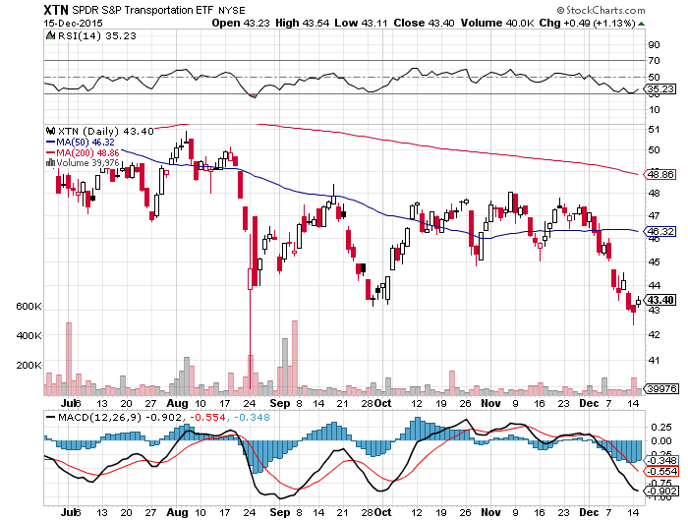
Transports Sector SPDR (XTN)-Another Dow Mainstay
(ALGT), (ALK), (JBLU), (LUV), (CHRW), (DAL),

Slide 32
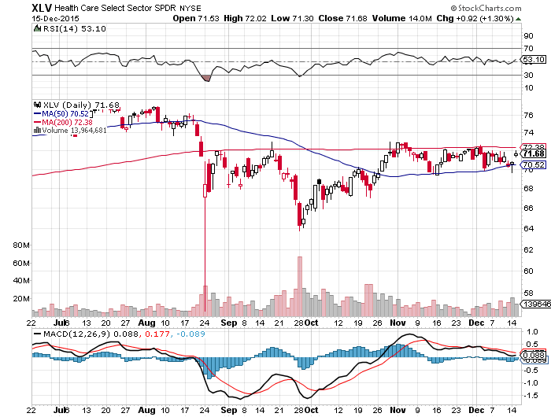
Health Care Sector SPDR (XLV), (RXL)
(JNJ), (PFE), (MRK), (GILD), (ACT), (AMGN)

Slide 33
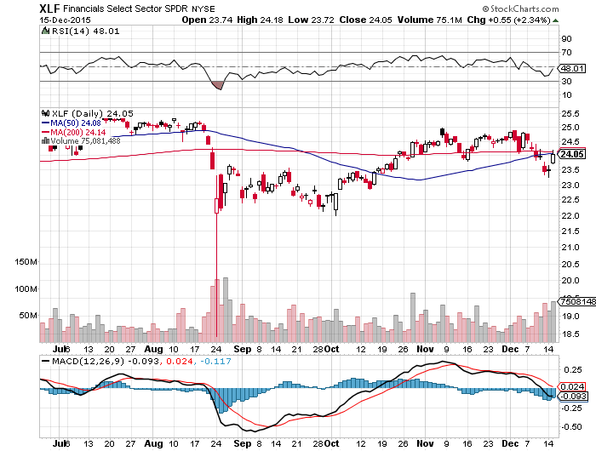
Financial Select SPDR (XLF)-
(BLK/B), (WFC), (JPM), (BAC), (C), (GS)

Slide 34
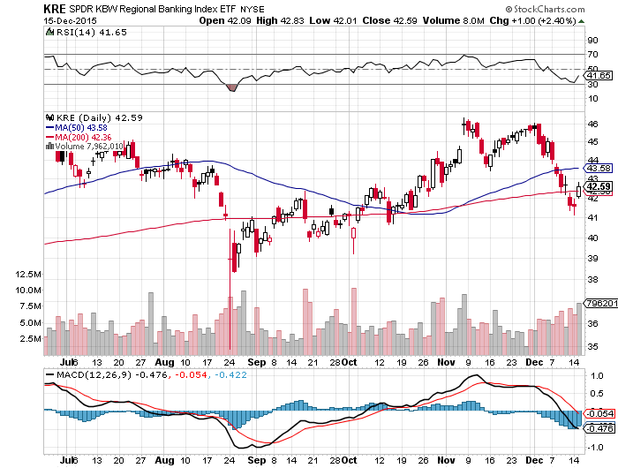
Regional Bank Basket (KRE)-Uptrend Intact
(MTG), (RDN), (SIVB), (CFG), (CFR), (BXS)

Slide 35
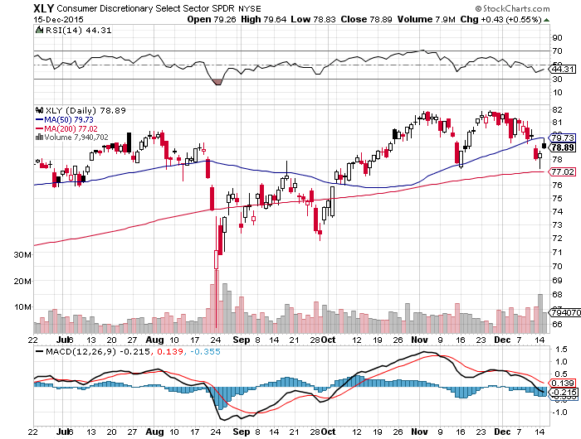
Consumer Discretionary SPDR (XLY)
(DIS), (AMZN), (HD), (CMCSA), (MCD), (SBUX)

Slide 36
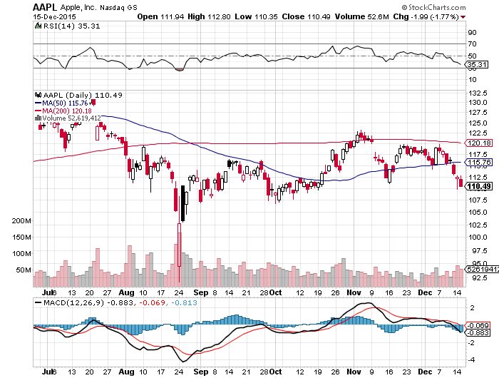
Apple (AAPL) –
Back to waiting for the next real catalyst-the iPhone 7
Buy after Q1 earnings in April to avoid post Christmas dip

Slide 37
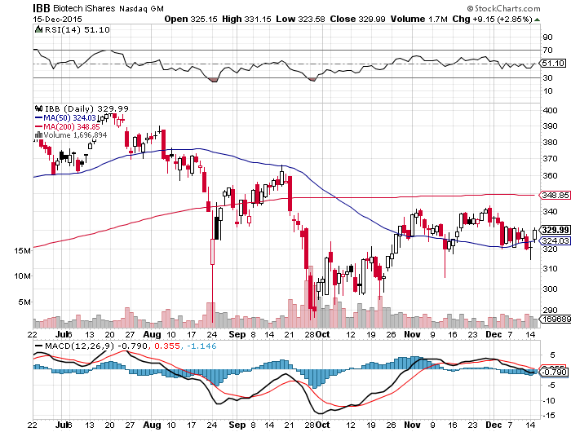
Biotech iShares (IBB)-

Slide 38
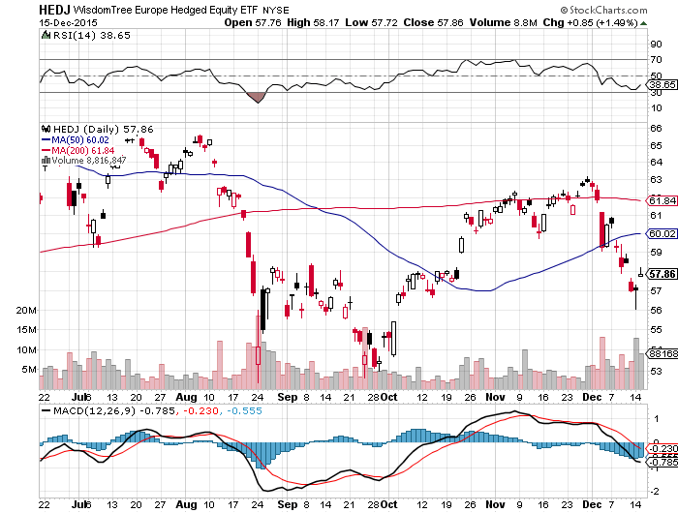
Europe Hedged Equity (HEDJ)-Hedged Japan Equity
Great Entry Point setting up

Slide 39
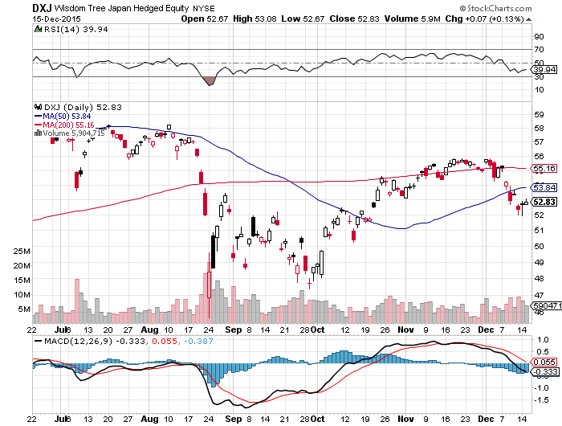
Japan (DXJ)-Hedged Japan Equity
Same for Japan

Slide 40
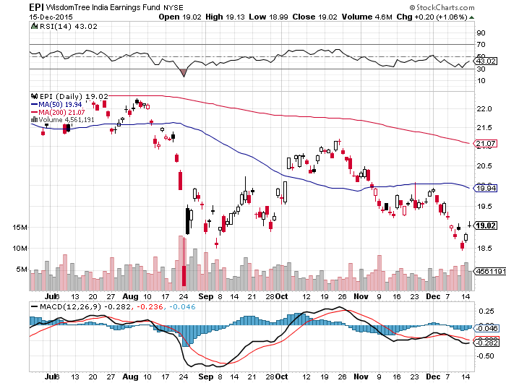
India (EPI)-

Slide 41
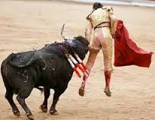
Foreign Currencies-Short Squeeze
*Mario Draghi disappoints again, cuts Euro interest rates by only 10 bp from -0.20 to -0.30%, triggers massive Euro short covering rally
*ECB further disappoints, keeping QE at E60 billion a months
*Germans successfully block Draghi from more aggressive QE, but Draghi walks it back in the press the next day
*The US will be simultaneously raising
rate while Europe cuts rates for the first
time since 1994, sets up a perfect
long dollar trade
*But December’s “RISK OFF” markets are
forcing traders to cash out of shorts
all at once

Slide 42
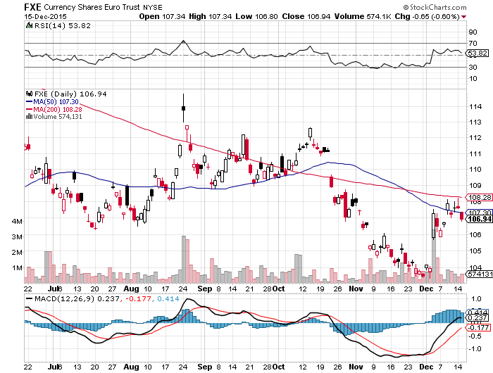
Euro ($XEU), (FXE), (EUO)-Short a Double Position
STOPPED OUT of the 12/$108-$111 vertical bear put debit spread

Slide 43
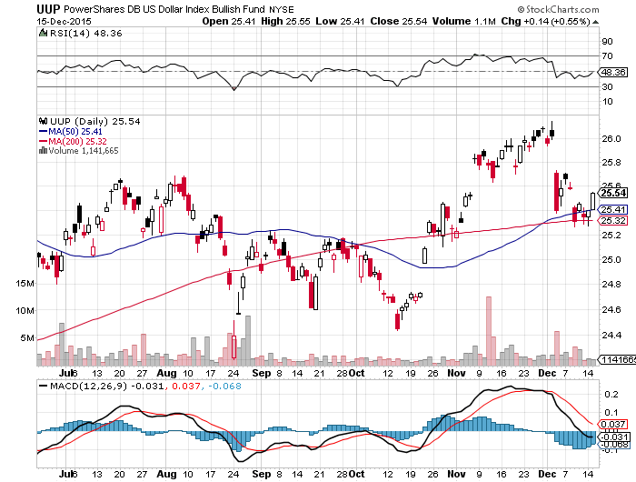
Long Dollar Index (UUP)-Up, Up and Away

Slide 44
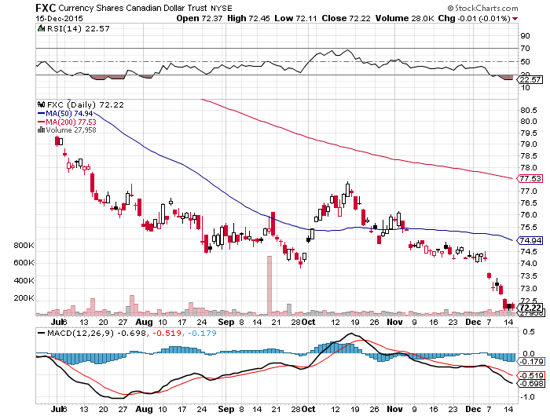
Canadian Dollar (FXC)-Commodity Disaster

Slide 45
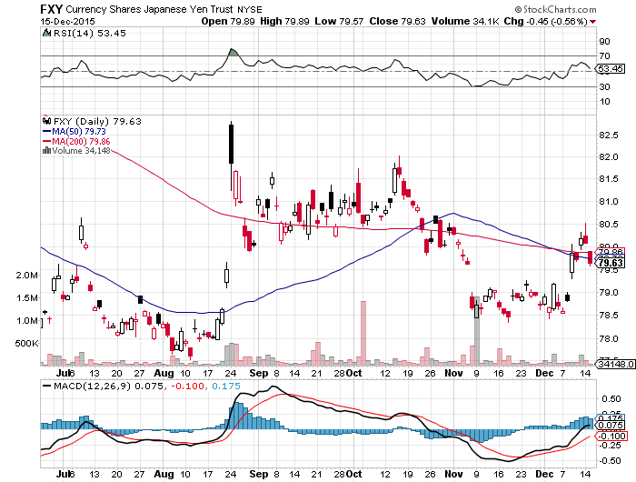
Japanese Yen (FXY)-More QE Coming took profits on long 12/$82-$84 vertical bear put debit spread

Slide 46
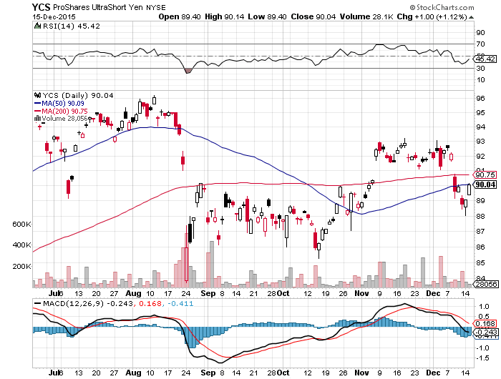
Short Japanese Yen ETF (YCS)

Slide 47
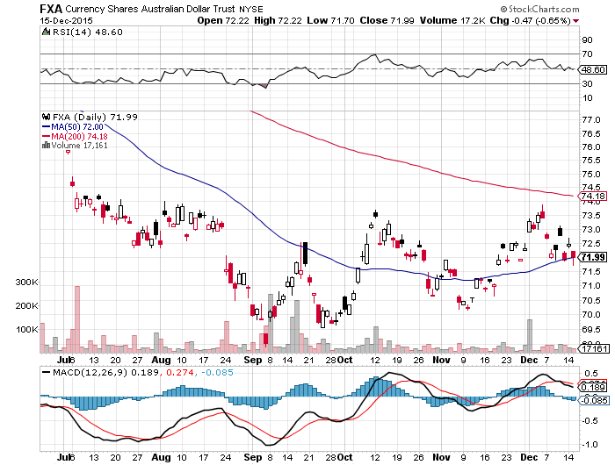
Australian Dollar (FXA)

Slide 48
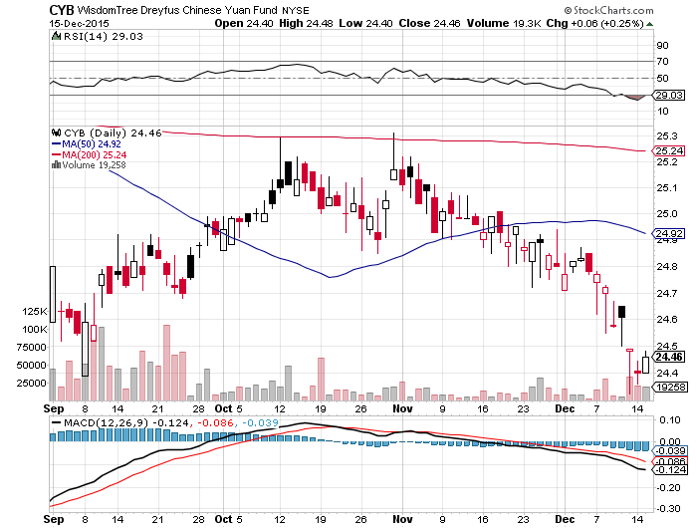
Chinese Yuan- (CYB)-China Stabilizes

Slide 49
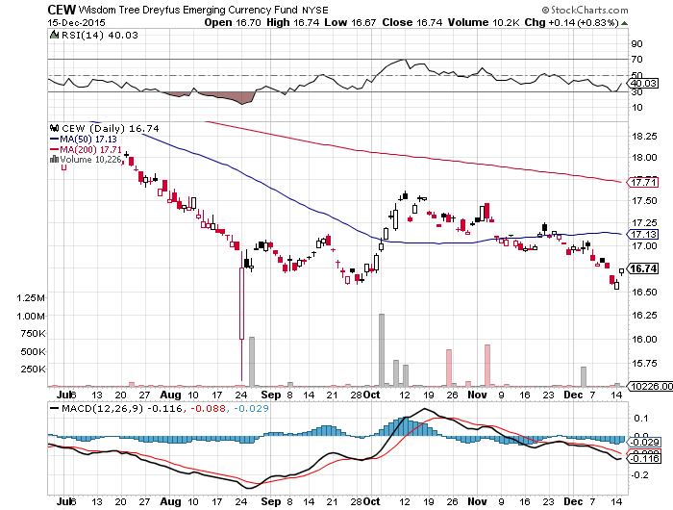
Emerging Market Currencies (CEW)

Slide 50
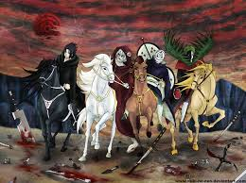
Energy-Armageddon is Here!
*OPEC meeting fails to cut supplies, sends crude into free fall
*Cushing, Oklahoma is full, and contangos are exploding
*Market is now looking at $32 a barrel, and then $20 on a spike down
*Major Iran supply, 500 million barrels/day, is approaching in 2016
*Saudi Arabia and Iraq refuse to cut back production to save the market
*Default rate on oil company debt is expected to rise from 4% to 25% in 2016
*Natural gas break to a new 13 year low
*US is still overproducing, frackers refuse to cut back
enough, there should be now new wills drilled, not 535
*No sign that a recovering China will bring back demand
*Copper collapses

Slide 51
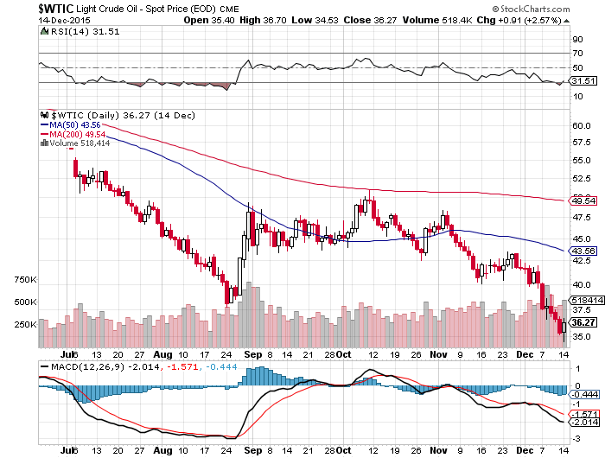
Oil-Won’t Bottom Until 2016
A New Run at the Lows

Slide 52
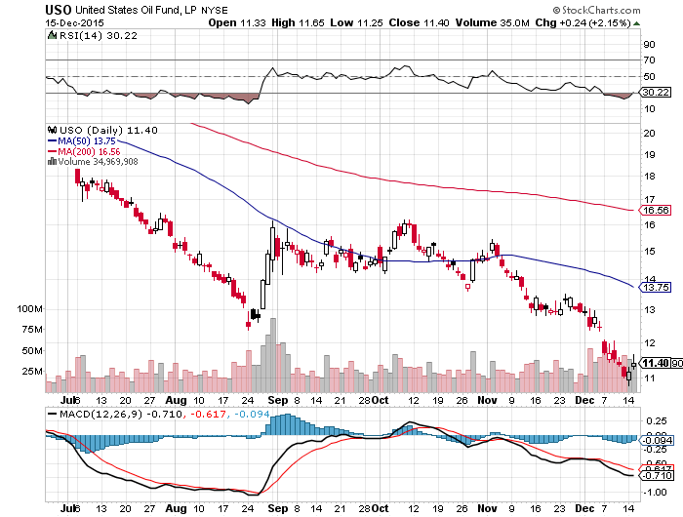
United States Oil Fund (USO)

Slide 53
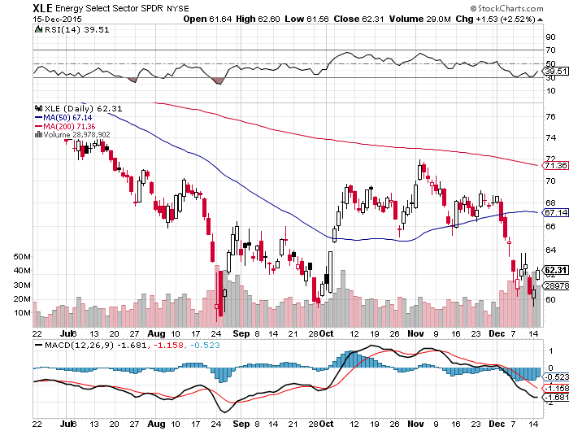
Energy Select Sector SPDR (XLE)
(XOM), (CVX), (SLB), (KMI), (EOG), (COP)
Back in Synch with Oil Prices

Slide 54
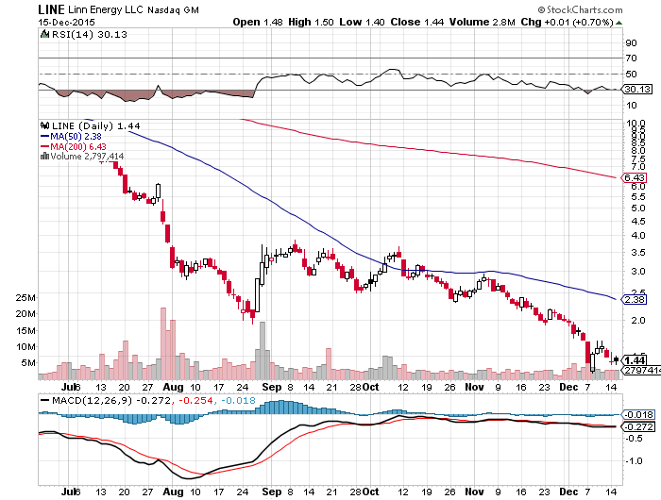
MLP’s (LINE)-Dividend Suspended!
Shares fall to option value-Entire industry has become high risk how long can they maintain leverage in the face of non-recovering oil prices?

Slide 55
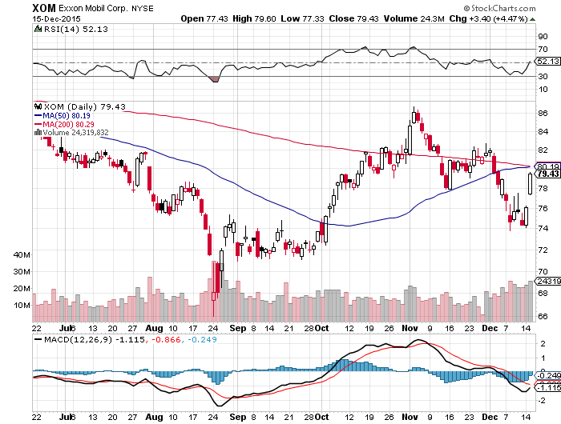
Exxon (XOM)-

Slide 56
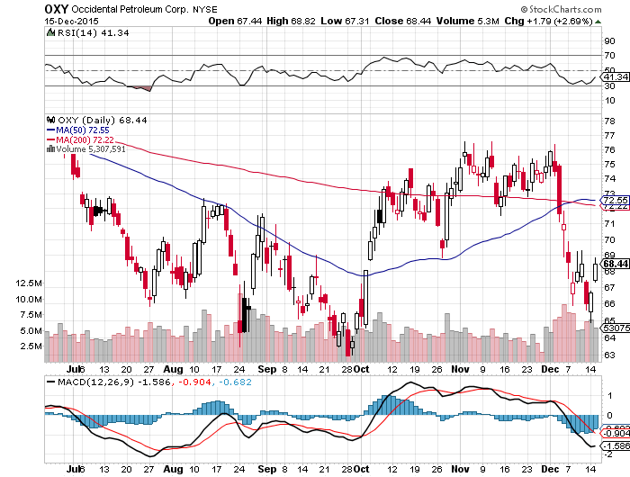
Occidental Petroleum (OXY)-

Slide 57
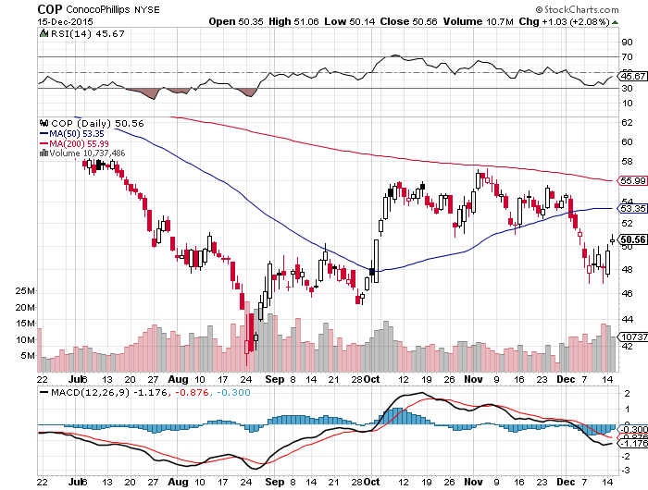
Conoco Phillips (COP)-

Slide 58
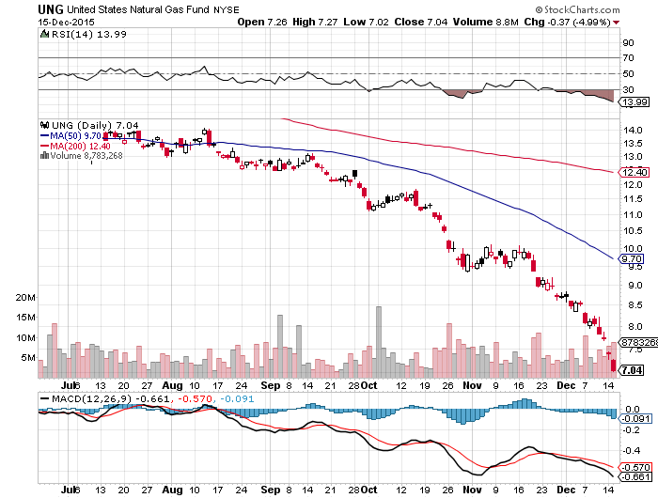
Natural Gas (UNG)-New Lows on Warm Winter

Slide 59
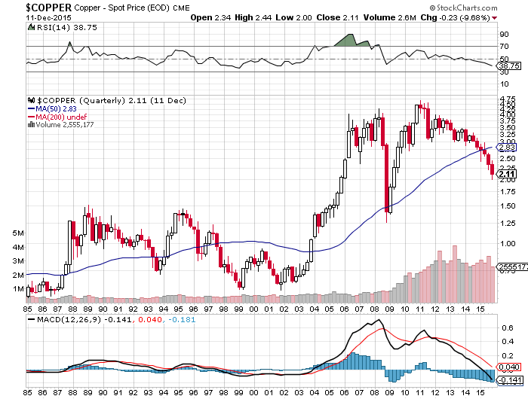
Copper-New 6 Year Low

Slide 60
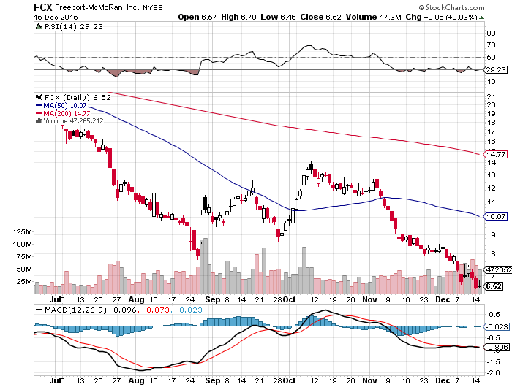
Freeport McMoRan (FCX)-Carl Icahn in Play

Slide 61

Precious Metals-Capitulation
*Anglo American (AAL.L) cuts dividend, to zero lays off 85,000
*Gold short bets in the futures market hit all time highs
*Oil bottom will also call the bottom in the barbarous relic
*Where are the Indian buyers?
*December Fed rate hike is the final nail in gold’s coffin, look for a run down to $1,000 by yearend
*Stay away, gold stocks are
a better play on a dip
with their earnings and dividend
support
*No room for gold in a paper
chasing world

Slide 62

Gold (GLD)-Bouncing Along a Bottom

Slide 63
Market Vectors Gold Miners ETF- (GDX)

Slide 64

Anglo American- (AAL.L) eliminates dividend-bombs away

Slide 65

Silver (SLV)-

Slide 66

Silver Miners (SIL)

Slide 67

Platinum (PPLT)-The Volkswagen Effect new chapter of the “Clean Diesel” Scandal

Slide 68

Palladium (PALL)-The Non Diesel Play

Slide 69

Agriculture-Also Bouncing Along a Bottom
*Next year, the US will lose its position as the world’s largest exporter of wheat to Russia, thanks to a strong dollar and the collapsing Ruble
*Election result in Argentina could brings policy changes that flood the global wheat market
*Falling Ag incomes means rising risk for Midwestern banks, on top of oil losses
*New lows in global commodity
collapse isn’t helping
*No trade, there are NO fish to fry

Slide 70

(CORN) – New Lows!

Slide 71

(WEAT)-New Lows!

Slide 72

Ag Commodities ETF (DBA)- New Lows

Slide 73

Real Estate-Slowing
*Refi’s are soaring to beat interest rate rise, now 60.7% of all mortgages
* Merger trend among homebuilders is accelerating, consolidating industry
*Rising prices allow 1 million homeowners to emerge from underwater positions, freeing up inventory, underwater rate falls from 16.9% to 13.4% YOY, negative equity still 41% in Las Vegas, followed by Kansas City (38.1%) and Atlanta (37.9%)
*October pending home sales down -.2%
*Traders loading up on these stocks
expecting a strong Spring 2016
*Predicted rush to buy homes to beat
the fed interest rate hike is unfolding
*Case Shiller S&P 500 National index
continues upward grind

Slide 74

July S&P/Case–Shiller Home Price Index
+4.7% YOY, Denver, San Francisco, Dallas
+5.5% YOY

Slide 75

US Home Construction Index (ITB)
(DHI), (LEN), (PHM), (TOL), (NVR)

Slide 76

Trade Sheet
So What Do We Do About All This?
*Stocks- buy the big dips in best value names only
*Bonds-the top is in, sell rallies, buy (TBT)
*Commodities-stand aside, buy the next oil down leg
*Currencies- Sell short the Yen and Euro on rallies
*Precious Metals –stand aside, wait for new low
*Volatility-sell short spikes over $20 through (XIV)
*The Ags –stand aside
*Real estate-buy the homebuilders LT

Slide 77

Take a Well Earned Rest and
Spend Your Profits!
Next Strategy Webinar
12:00 EST Wednesday,
January 6, 2016
San Francisco, CA
USA!
GREAT JOB THIS YEAR TEAM!!
Good Luck and Good Trading!
Notes:
*

