Slide 1

Mad Day Trader
Bill Davis
Webinar – January 13, 2016

Slide 2
On today’s webinar, I want to review the markets from a short term and a longer term perspective.
And share an the outlook for 2016.

Slide 3
Let’s start by looking at the Daily Charts for the major indexes and the sentiment indicators.

Slide 4
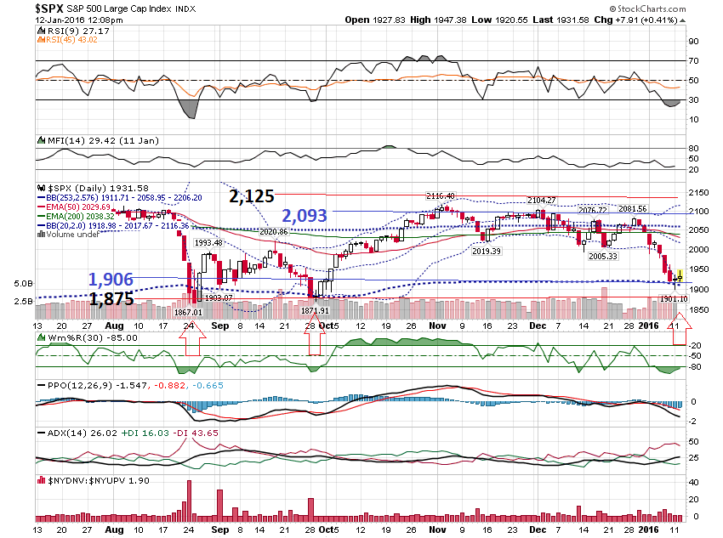

Slide 5
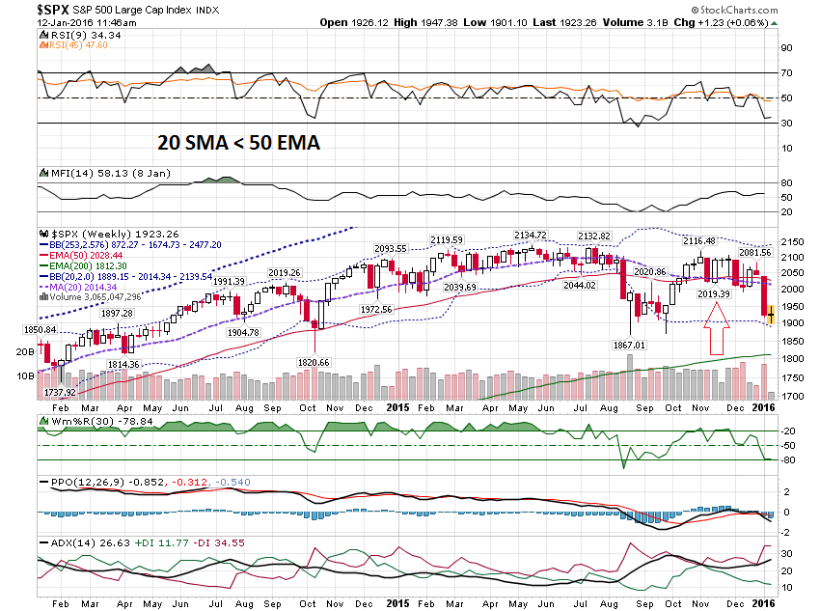

Slide 6
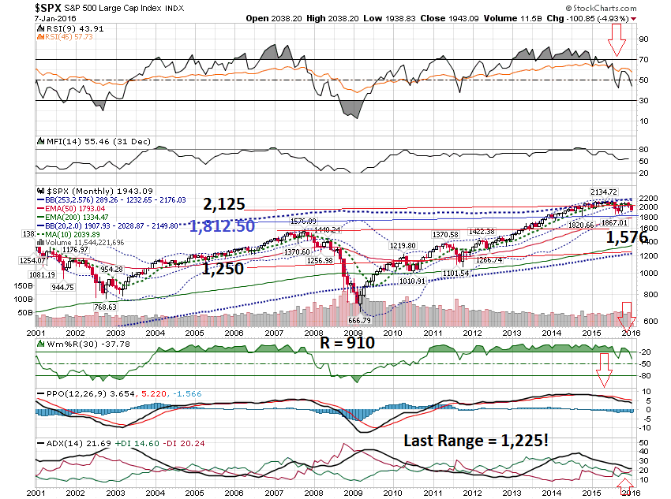

Slide 7
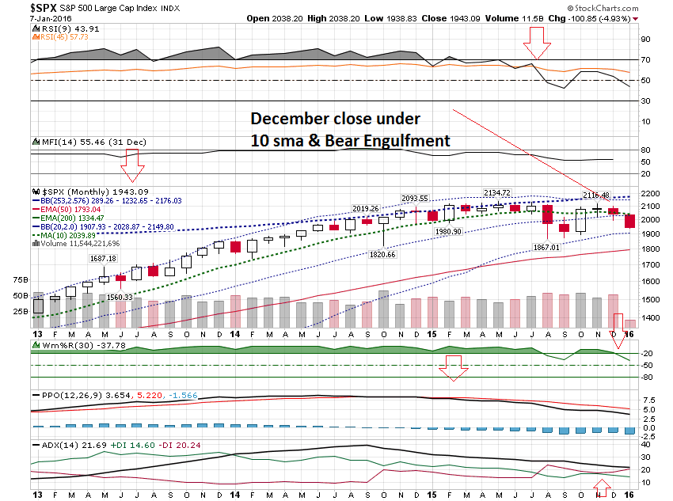

Slide 8
Let’s look at some sentiment indicators …

Slide 9
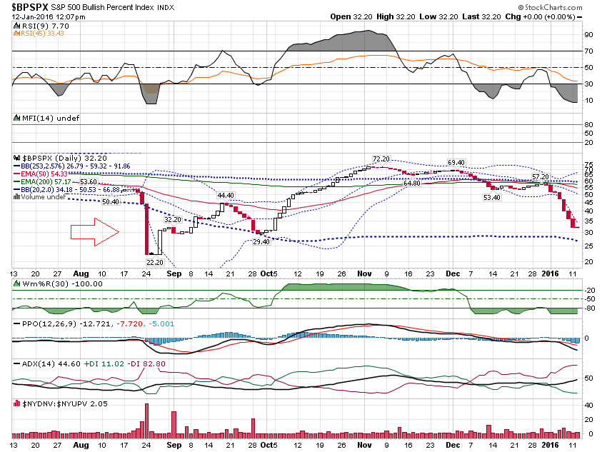

Slide 10
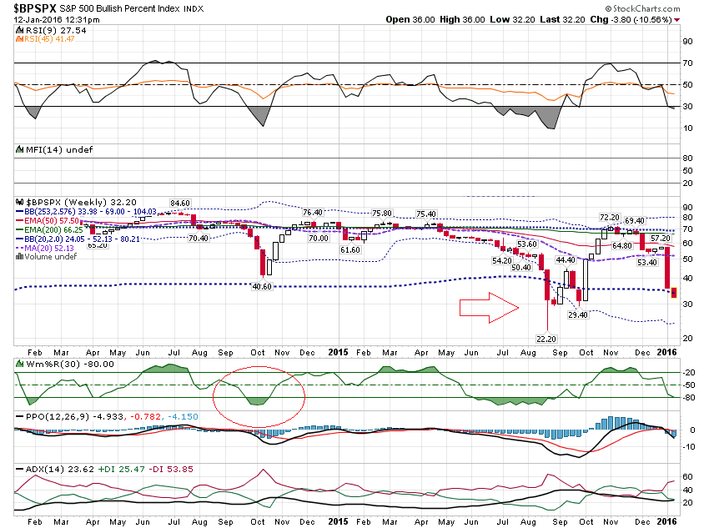

Slide 11
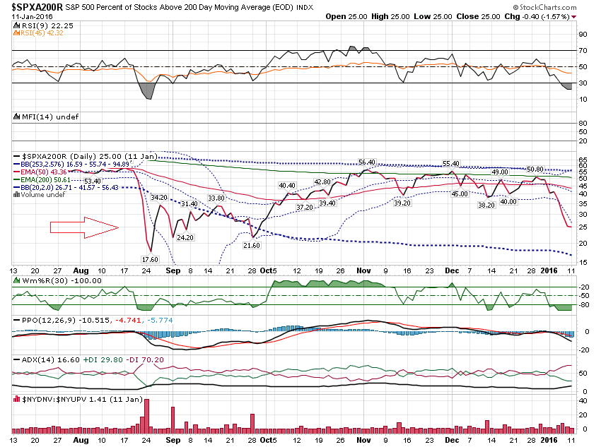

Slide 12
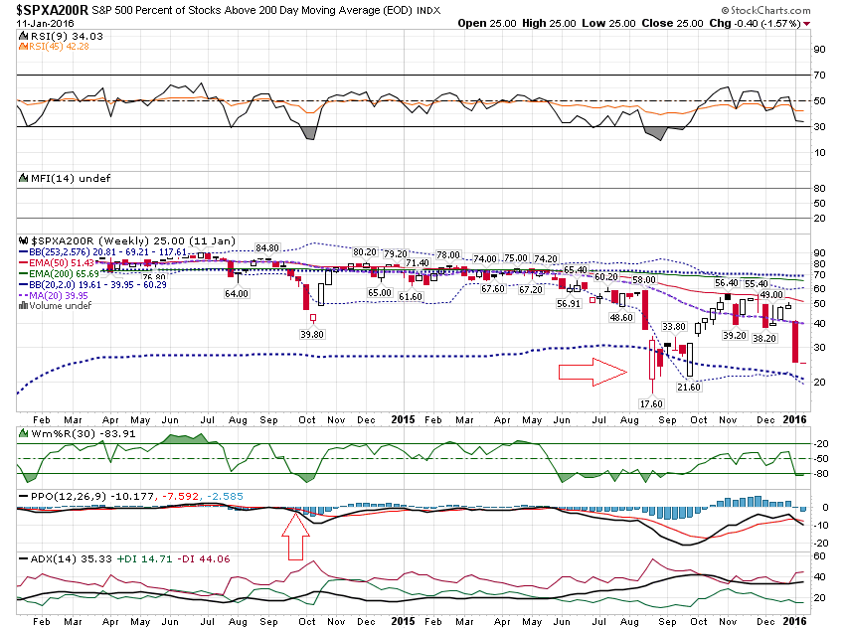

Slide 13
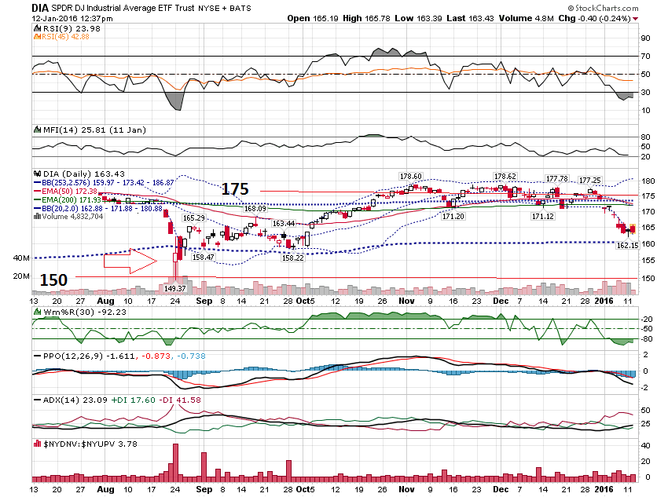

Slide 14
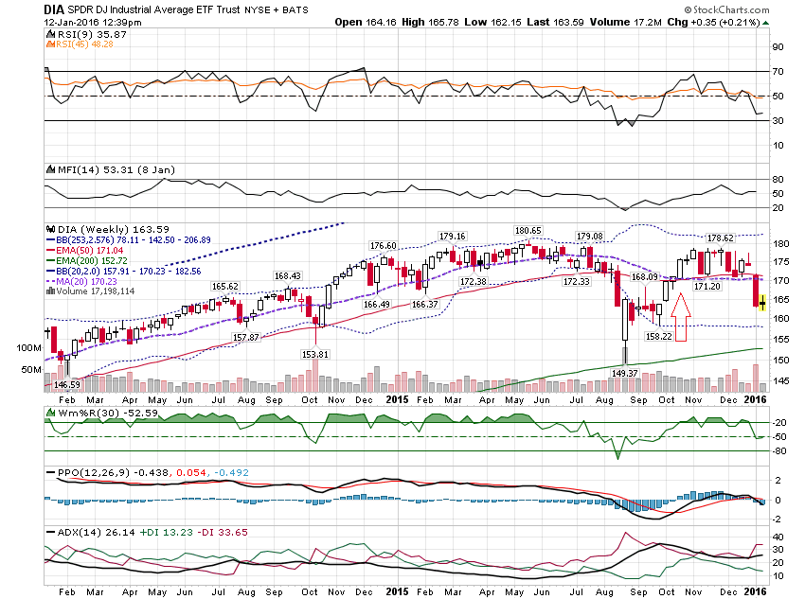

Slide 15
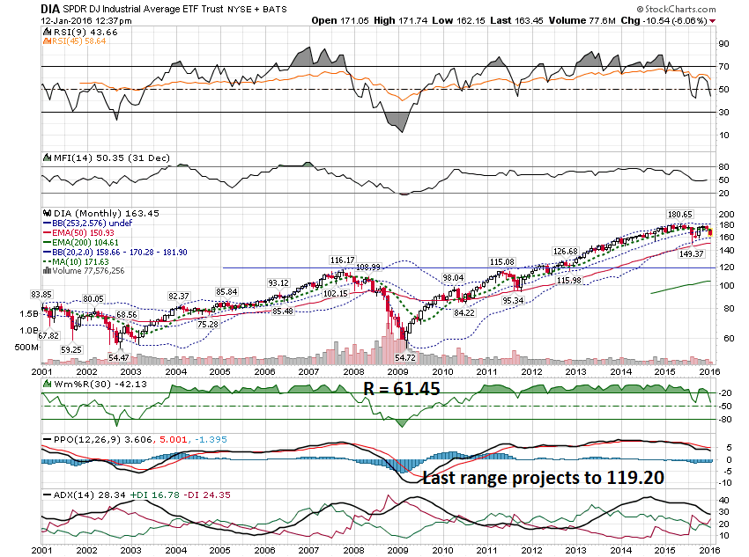

Slide 16
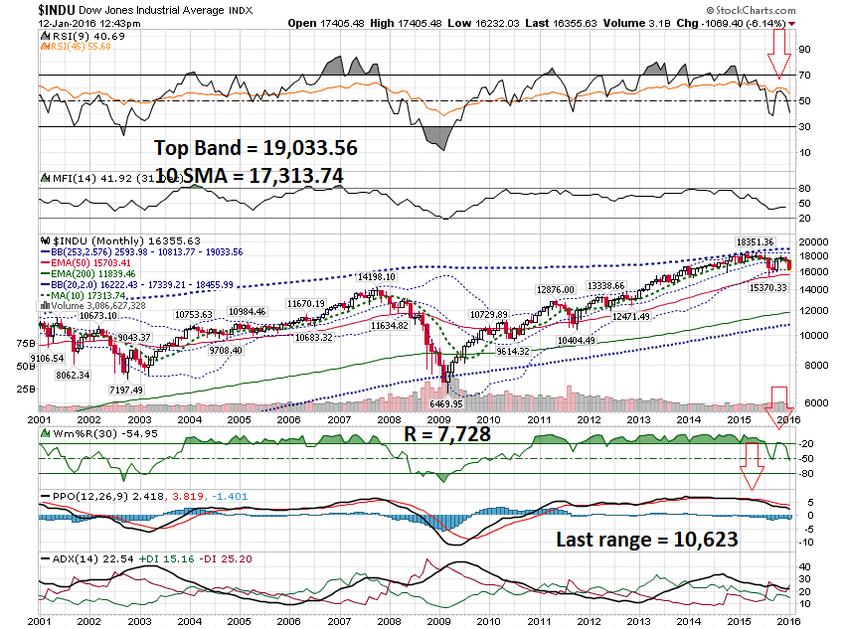

Slide 17
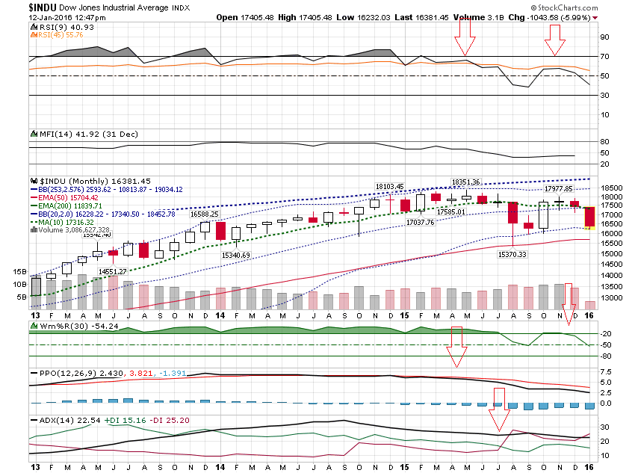

Slide 18
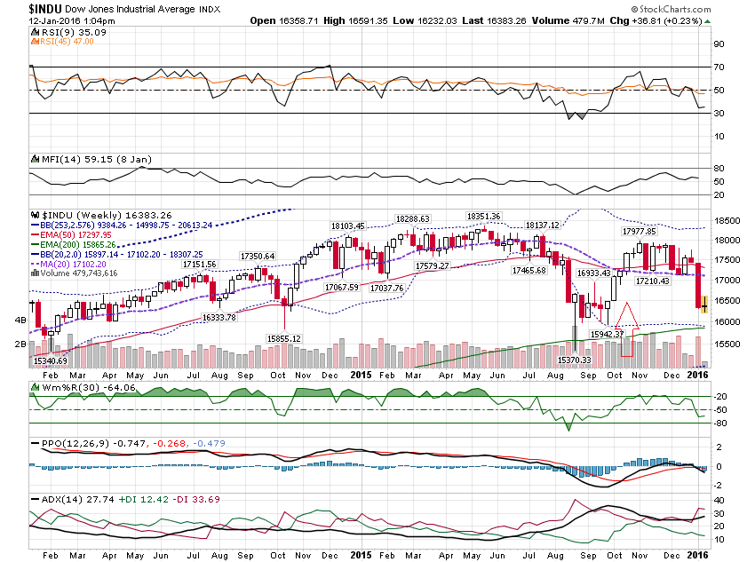

Slide 19
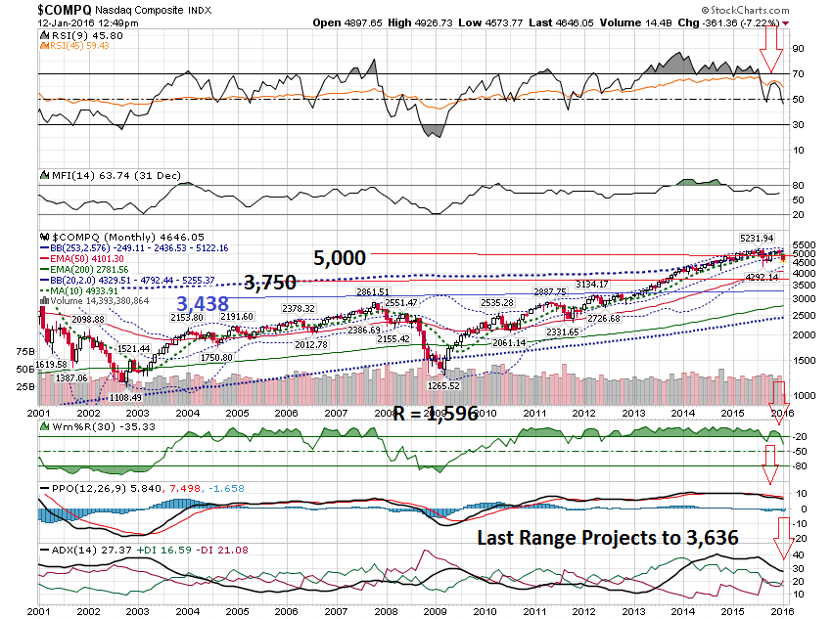

Slide 20
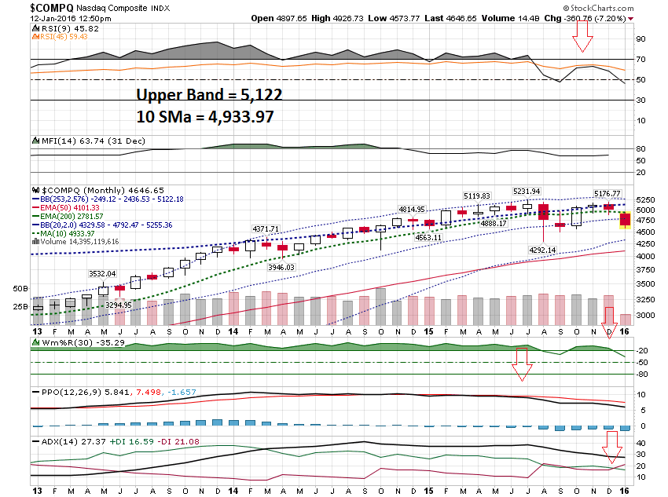

Slide 21
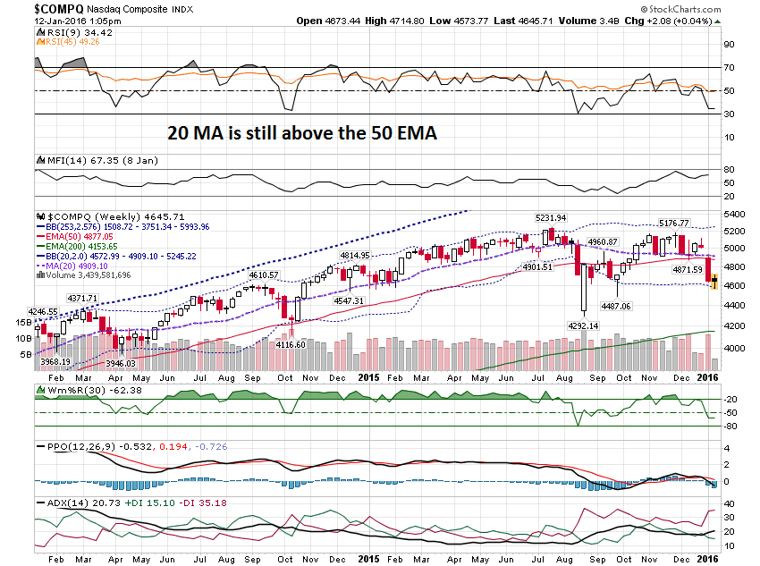

Slide 22
Let’s summarize:
1) All markets have sold off against their top extreme Bollinger Band
2) All markets have closed under the 10 period simple moving average on their monthly charts
3) All markets have had the
Williams %R Cross under -20 on their Monthly Charts.

Slide 23
All markets have had the
ADX indicator move into a bear trend on their monthly charts.

Slide 24
On the weekly charts, the NASD Composite is the only market not to have the bearish
20 sma cross under the 50 ema.

Slide 25
I wanted to look at the long term charts of a few other markets …

Slide 26
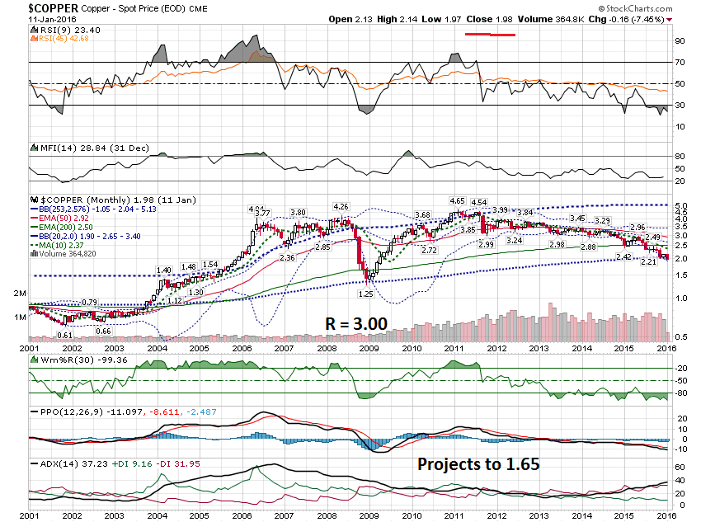

Slide 27
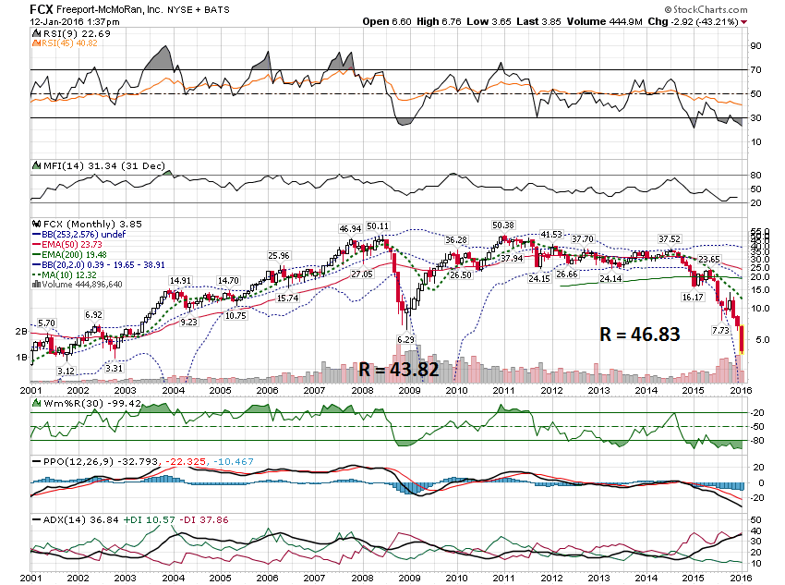

Slide 28
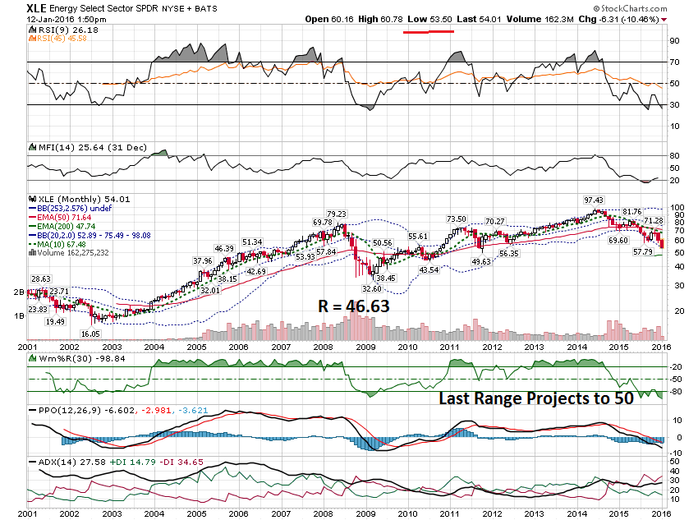

Slide 29
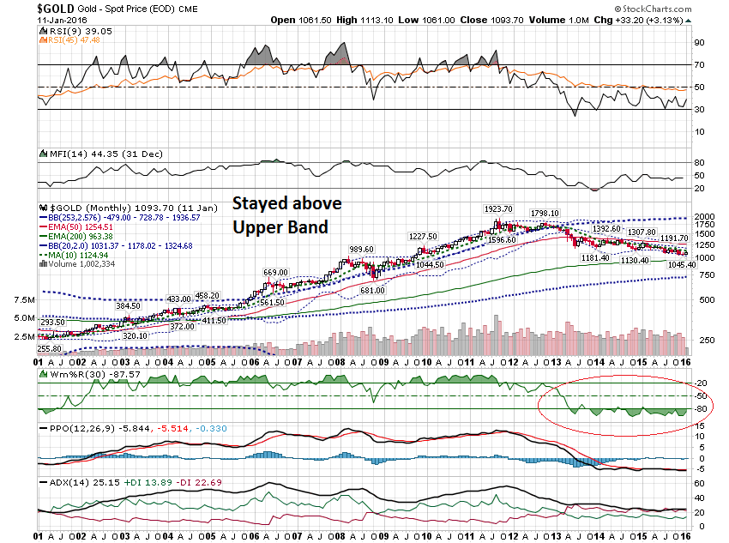

Slide 30
Thanks for watching!
Bill Davis
Mad Day Trader
January 13, 2016 davismdt@gmail.com

