Slide 1
Mad Day Trader
Bill Davis
Webinar – January 27, 2016

Slide 2
Today, I want to look at the sentiment indicators and the weekly charts. Then I want to share the extreme set ups. Before I do that, I want to go back to something I wrote back last August.

Slide 3
Last August 2015, I wrote a special report based on what I saw coming in the markets and outlined various scenarios that I felt could happen.

Slide 4
That report is available for download in the members area, in case you did not read it. One of the things I mentioned was a potential problem with China. And here is something I wrote back then. Here is the chart from that report …

Slide 5
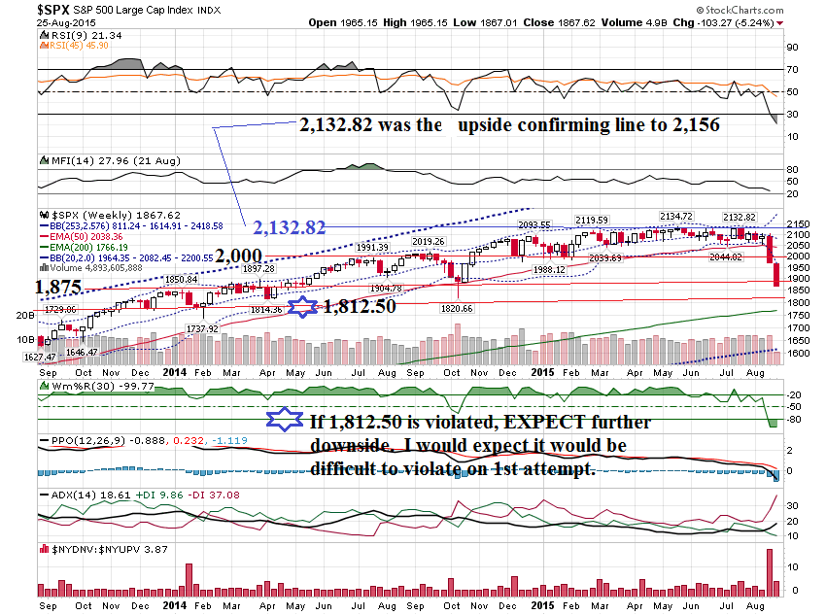

Slide 6
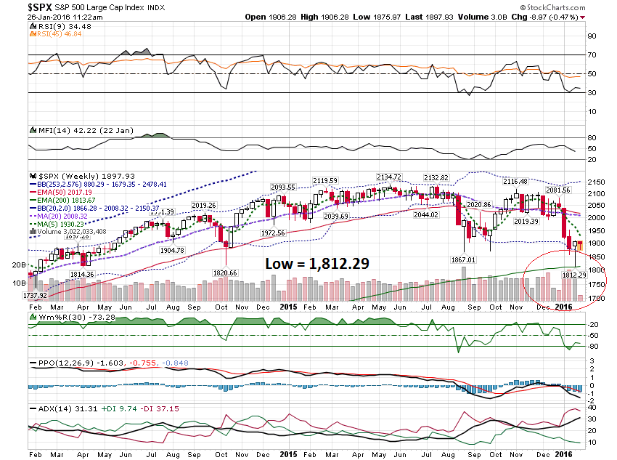

Slide 7
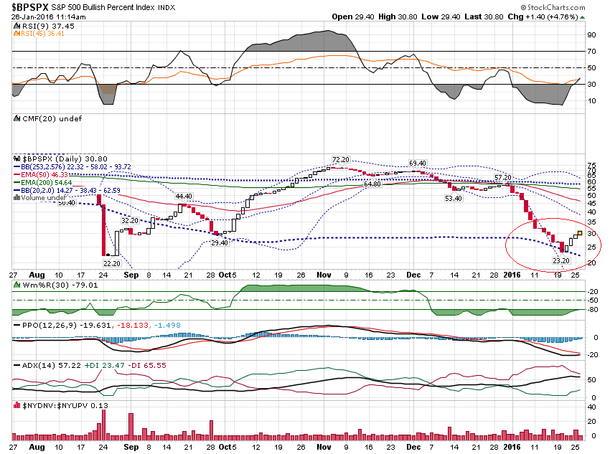

Slide 8
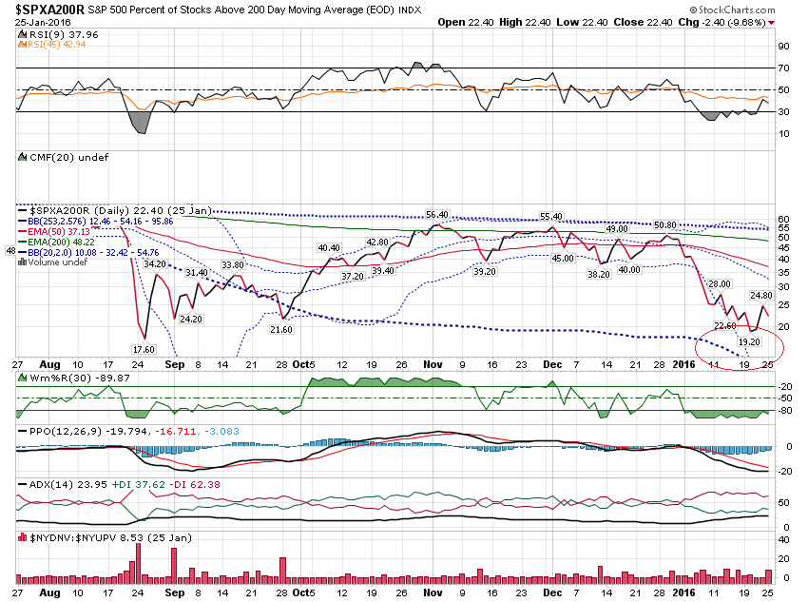

Slide 9
Because the markets have been sold oversold, I thought I would switch gears and discuss trading the Dead Cat Bounce.

Slide 10
How do we find these deals? Simple. If a stock is under the Extreme Bollinger Band, it is OVERSOLD.

Slide 11
This should contain 99.9% of all price action, so a violation of either the lower or upper band becomes a significant event.

Slide 12
The Extreme Bollinger Band setting uses a 253 day lookback, with a 2.576 Standard Deviation.

Slide 13
There are 2 scenarios I look for: Higher Timeframe < LBB & Lower Timeframe > LBB LBB = Lower Bollinger Band

Slide 14
Scenario 2: Higher Timeframe > LBB & Lower Timeframe < LBB LBB = Lower Bollinger Band

Slide 15
When a Lower Band is violated, I usually expect a retest of the lower band. (Same on the Upside as well.)

Slide 16
Examples: Scenario 1

Slide 17
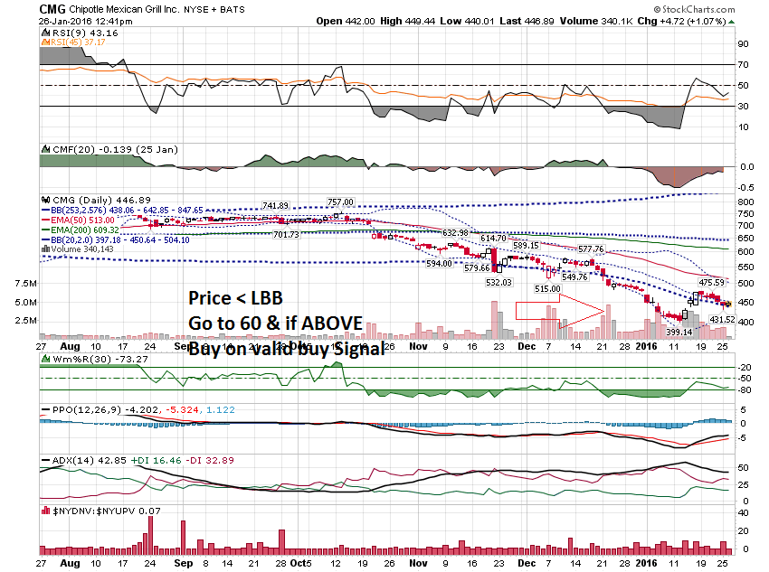

Slide 18
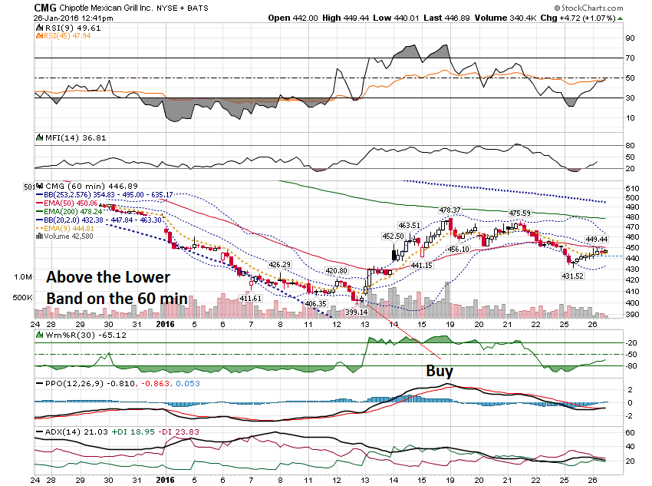

Slide 20
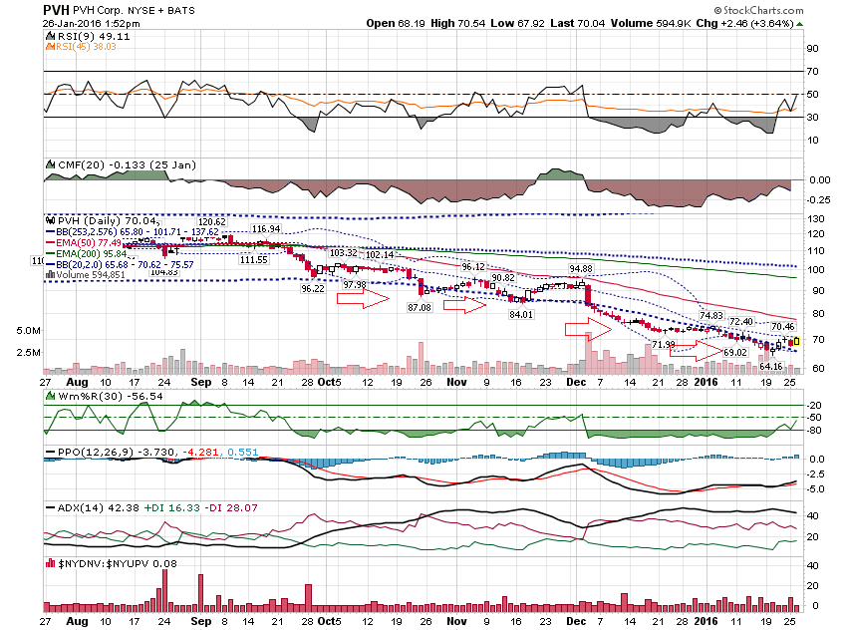

Slide 21
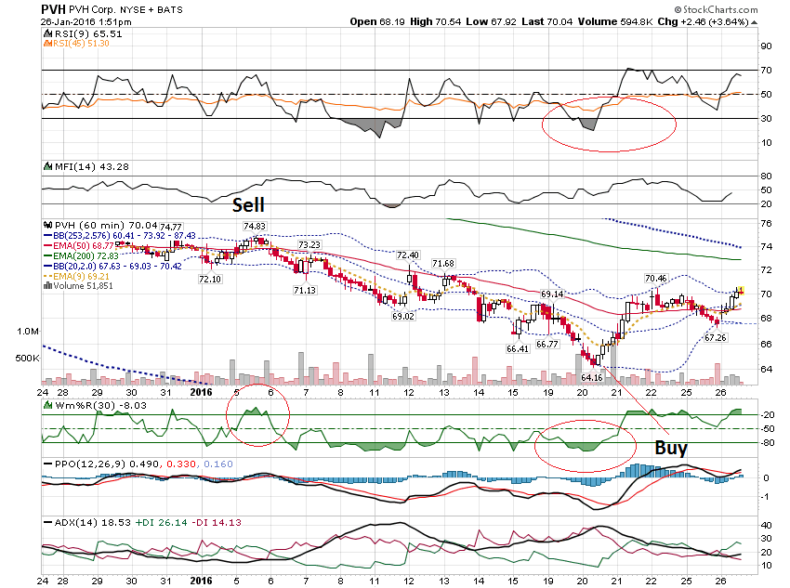

Slide 22
Let’s look at Scenario 2: Higher Timeframe > LBB & Lower Timeframe < LBB

Slide 23
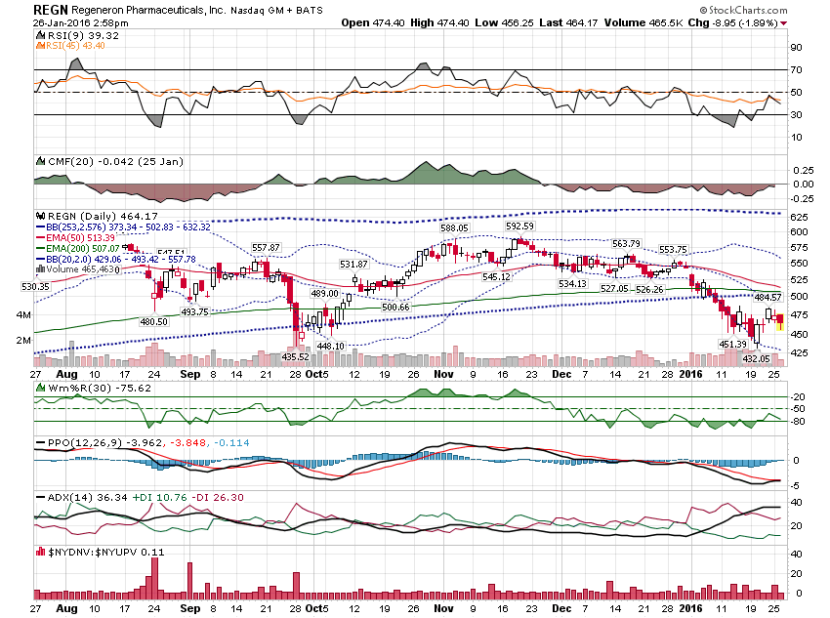

Slide 24
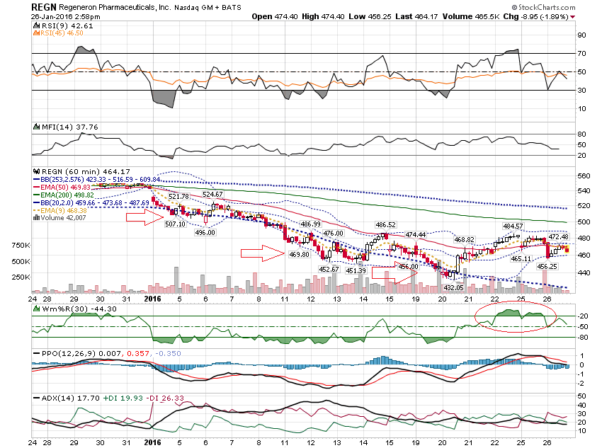

Slide 25
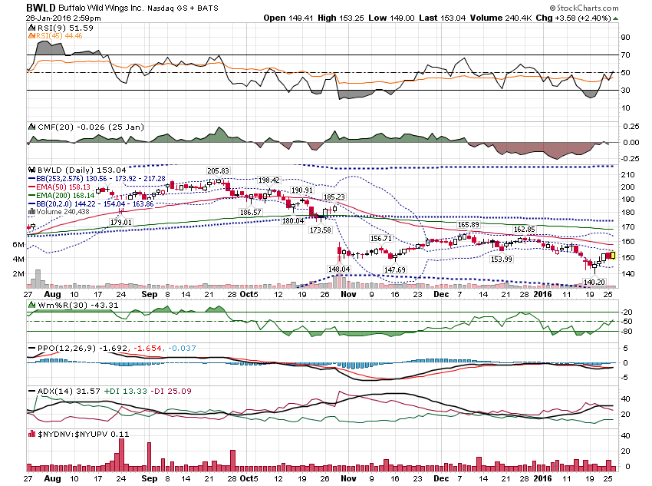

Slide 26
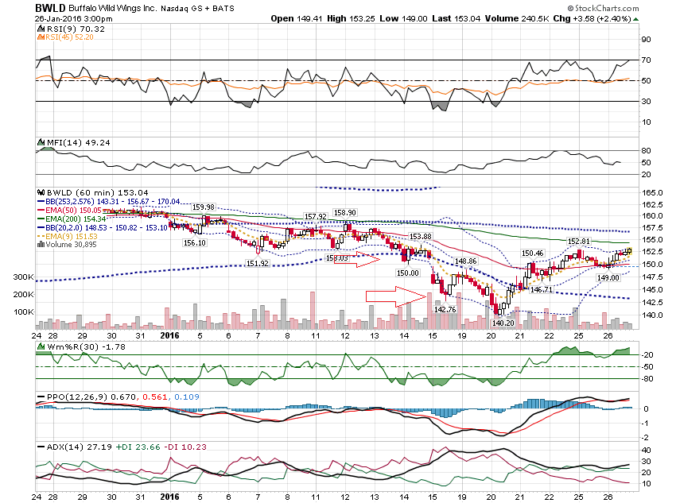

Slide 27
Thanks for watching! Bill Davis Mad Day Trader January 27, 2016 davismdt@gmail.com

