Slide 1

The Mad Hedge Fund Trader
“The New Year Hangover”
With John Thomas
from San Francisco, CA, January 6, 2016
www.madhedgefundtrader.com
Notes:
*

Slide 2

Trade Alert Performance
Hiding in Cash Until the New Year
*January +1.77% MTD *July +6.42% Final
*February +7.73% Final *August +1.27% Final
*March +3.00% Final *September +11.99% Final
*April +6.62% Final *October Final -6.19%
*May +5.15% Final *November MTD 5.78%
*June +3.68% Final *December -4.94%
*2016 Year to Date +1.77%
compared to -2.0% for the Dow Average
*Trailing 1 year return +37.94%, +193.45% since inception,
5.96% short of all-time high
*Average annualized return of 37.70%

Slide 3
Portfolio Review
Running a Small Cautiously Opportunistic Hedged Book
current capital at risk
Risk On
World is Getting Better
(TLT) 2/$126-$129 puts spread | 10.00%
(TLT) 1/$125-$128 put spread | 10.00%
(SPY) 1/$185-$190 call spread | 10.00%
(XIV) | 10.00%
Risk Off
World is Getting Worse
(GLD) 2/$95-$100 call spread | -10.00%
total net position | 30.00%
Expiration P&L
5.74% YTD

Slide 4
Paid Subscriber Trailing 12 Month Audited Return +41.04%

Slide 5
61 Months Since Inception
Daily Audited Performance
Averaged annualized return +38.05%

Slide 6

Strategy Outlook-Run For Cover
*Prospect of small returns, China crash, and oil hugging the bottom starts 2016 in “RISK OFF” mode
*Selling now to buy back later, the burden of proof is now on the bulls, switching from buying dips to selling rallies
*Bank of Japan expands QE to include ETF’s and other assets, further stimulating the global economy
*We may not see substantial new Euro QE in 2016,
making Euro a buy
*Oil outlook is dire
*Gold getting a new lease on life as risk hedge
*New lows in ags despite the arrival of el nino

Slide 7
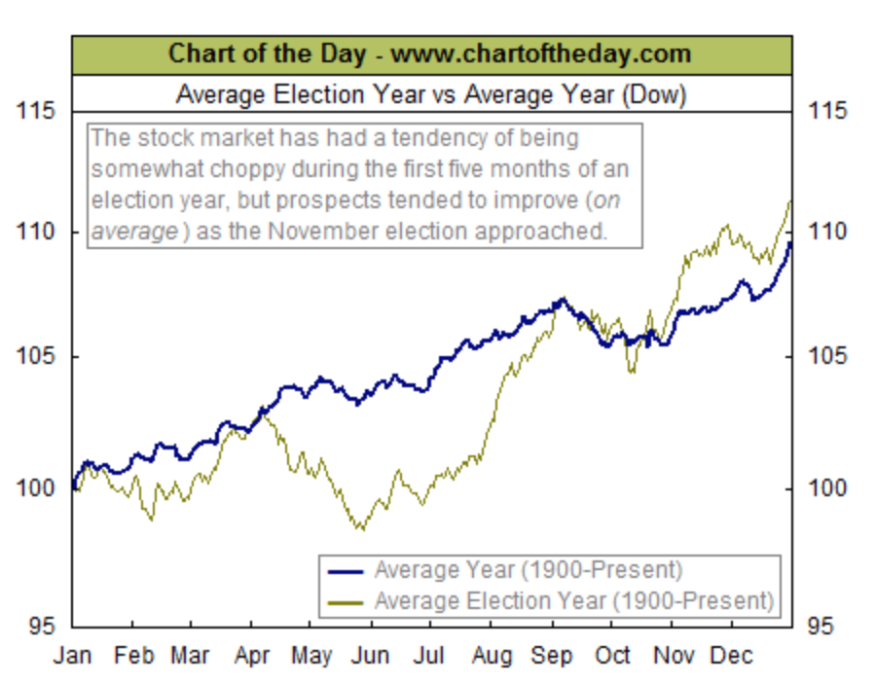
Chart of the Year-The Presidential Cycle

Slide 8
The Bill Davis View
A $1,500 Upgrade for the Mad Day Trader Service
Buys:
Apple (AAPL) $100 Target to $112
Expeditors Int (EXPE) $43 Target to $49
Royal Caribbean (RCL) $95 Target to $105
Becton Dickinson (BDX) $150 Target to $158
Dycom Industries (DY) $73 Target to $83
Sells:
Buffalo Wild Wings (BWLD) $170 Target to $150
3M Co. (MMM) $150 Target to $140
Alibaba Group (BABA) $81 Target to $74
CF Industries (CF) $50 Target to $31
Linkedin (LNKD) $240 Target to $200

Slide 9

The Global Economy-Finding its Footing
*Fed final raises rates 25 BP with unanimous decision, but follow with extremely dovish comments. How long until the next one?
*Strong dollar cut ES exports and cut GDP by 0.50% in 2015, but will be less of a problem in 2016
*German GDP set to rise thanks to stimulus of 1 million immigrants
*Japan bouncing back from mini recession
*Chinese government stimulates economy once
again, with $3.5 trillion in reserves will continue to
do so
*Next to come is a “RISK ON” global
synchronized growth in 2016
once we get through New Year effects

Slide 10
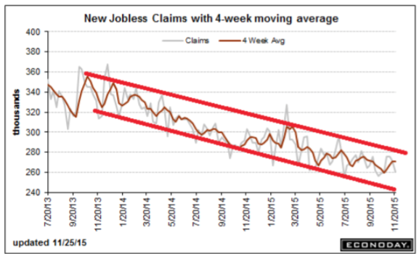
Weekly Jobless Claims – Another Run at the Lows
-12,000 to 260,000 headed for Full Unemployment at 5%-Global Recovery a Driver

Slide 11

Bonds-Stuck in the Mud
*Will be stuck in a 30 basis point range until next Fed rate hike, even if it is a year off-creates great straddle selling opportunities
*GLOBAL “RISK OFF” then drives yields back down to middle of recent range
*Junk Bonds ETF (HYG) still weak
due to energy issue defaults, MLP’s now yielding 10%-15%
*Non energy junk is starting to offer real value
*Junk crash highlighting risk
management, bringing new
focus on muni bond market
*Buy (TBT) on any dip for more
strength in 2016, “RISK ON”
markets will return later in
the year

Slide 12
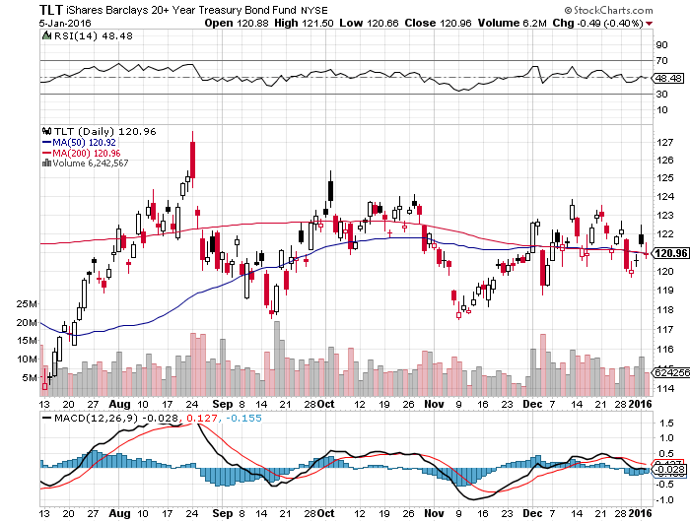
Ten Year Treasury Yield (TLT) 2.26% took profits on the 12/$124-$127 vertical bear put debit spread rolled into 2/$126-129 vertical bear put debit spread went double long the 1/$125-$128 vertical bear put debit spread-expires in 7 trading days!

Slide 13
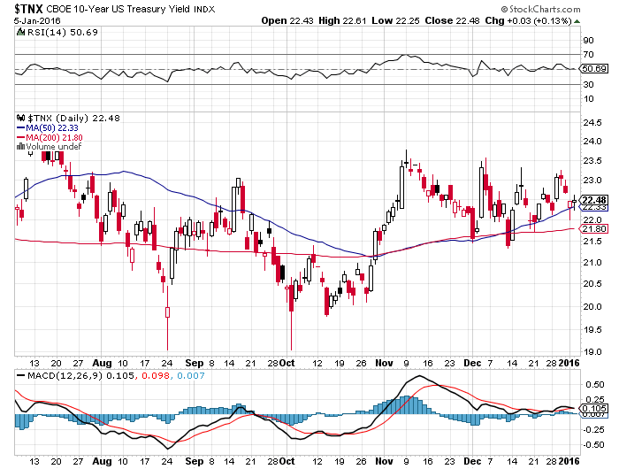
Ten Year Treasury Yield ($TNX) 2.24%
2.35% Ceiling Holds, so will the 2.0% floor

Slide 14
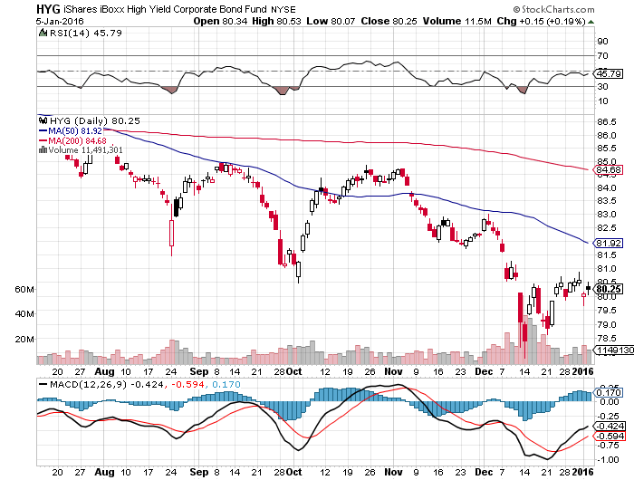
Junk Bonds (HYG) 9% Yield
A Great Coincident Indicator

Slide 15
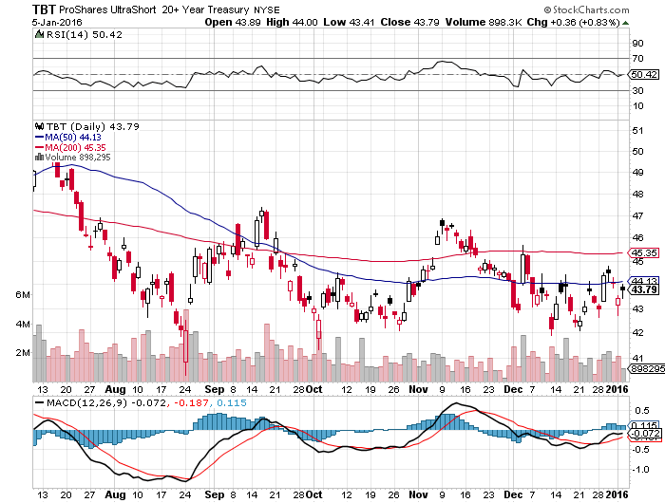
2X Short Treasuries (TBT)-Big Trade of 2016?
Back in “BUY” Territory

Slide 16
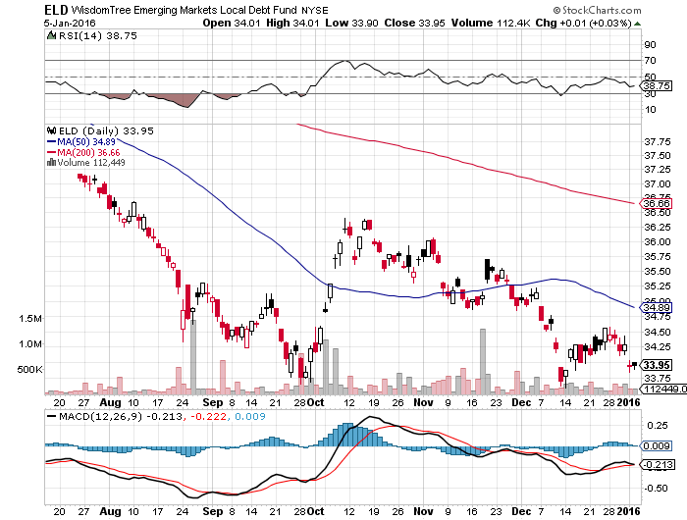
Emerging Market Debt (ELD) 7.73% Yield-

Slide 17
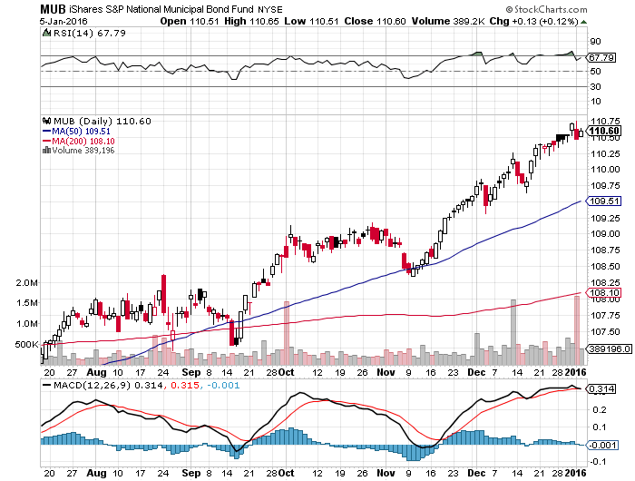
Municipal Bonds (MUB)-1.67% yield
Mix of AAA, AA, and A rated bonds-flight to safety

Slide 18
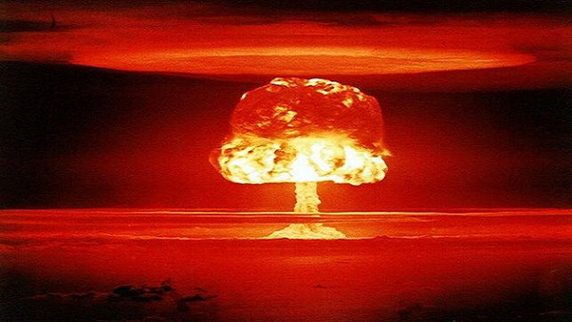
Stocks-Rush to Cash
*Prospect of small single digit returns for stocks in 2016 triggers big SELL in 2016
*Chinese Selling ban expires for $125 billion worth of stocks on Friday, prompts 7% selloff in Shanghai, Beijing responds with new $20 billion stock support plan
*Oil continues as a major driver of short term stock prices, will become a major positive when it turns-we are now all oil traders
*North Korean nuclear test triggers panic selling
*All global markets moving in synch now, which means DOWN
*Traders dumping FANG stocks on tax loss
selling
*Investors looking forward to a 2016
earnings recovery, but multiple shrinkage
as rising interest rates eat into valuations

Slide 19
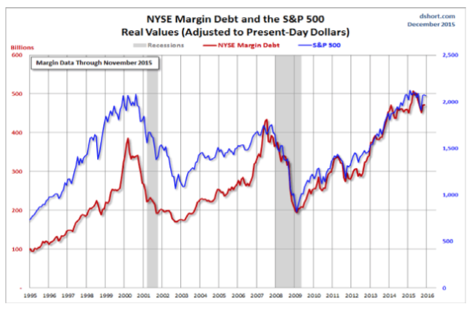

Slide 20
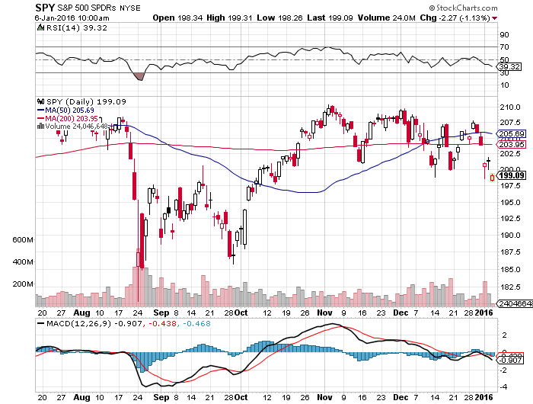
S&P 500-Breakdown! took profits on long the 12/$185-$190 vertical bull debit spread rolled into long 1/$185-$190 call spread-7 days to expiration!

Slide 21
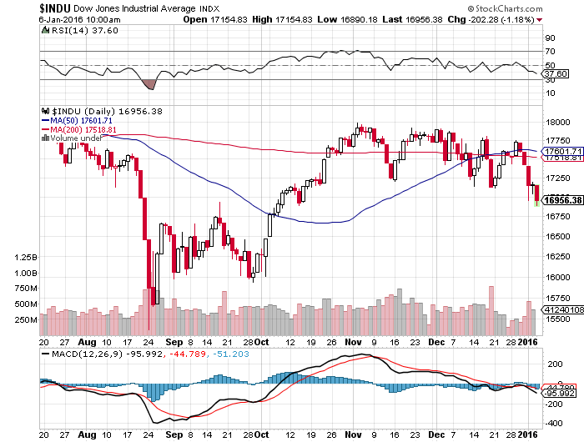
Dow Average-

Slide 22
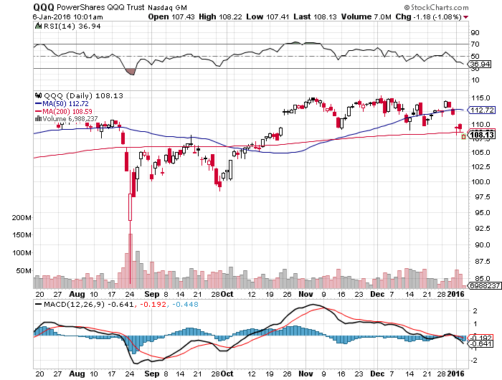
NASDAQ (QQQ)-Break of 200-Day Moving Average!

Slide 23
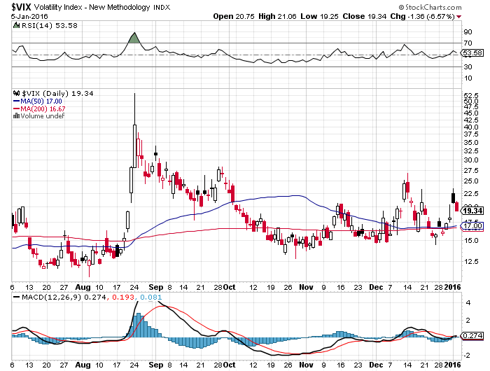
(VIX)-The Spike is Here

Slide 24
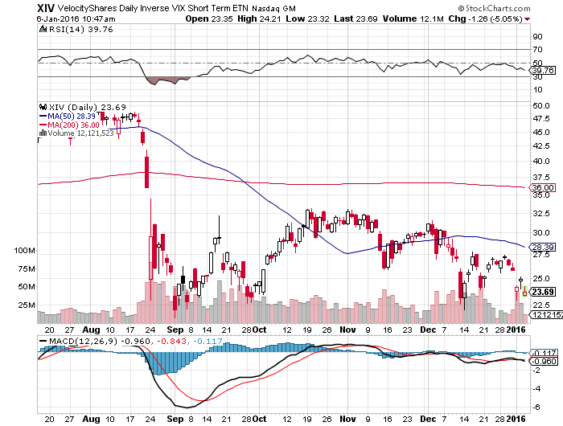
(XIV)-Velocity Shares Daily Inverse VIX Short Term ETN
10% long at $23.69

Slide 25
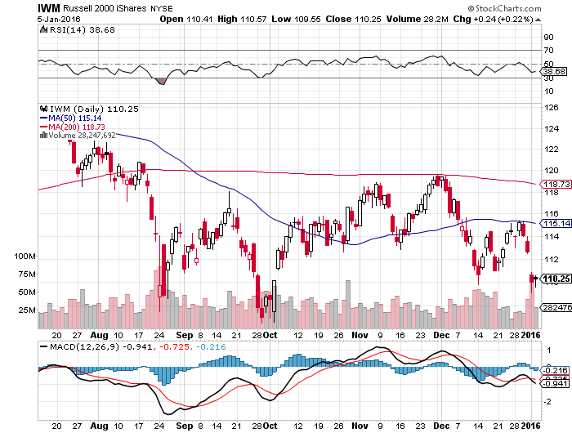
Russell 2000 (IWM)-

Slide 26
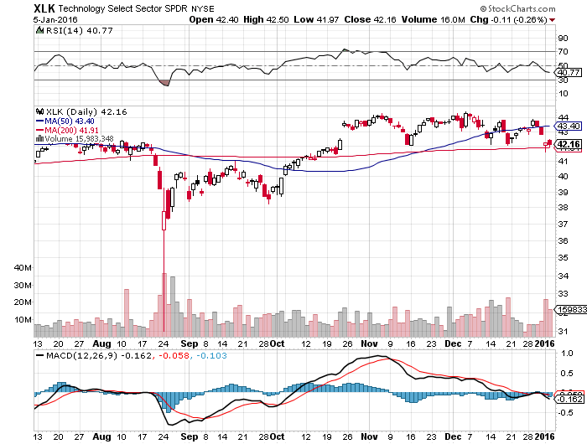
Technology Sector SPDR (XLK), (ROM)
(AAPL), (MSFT), (VZ), (T), (FB), (IBM)

Slide 27
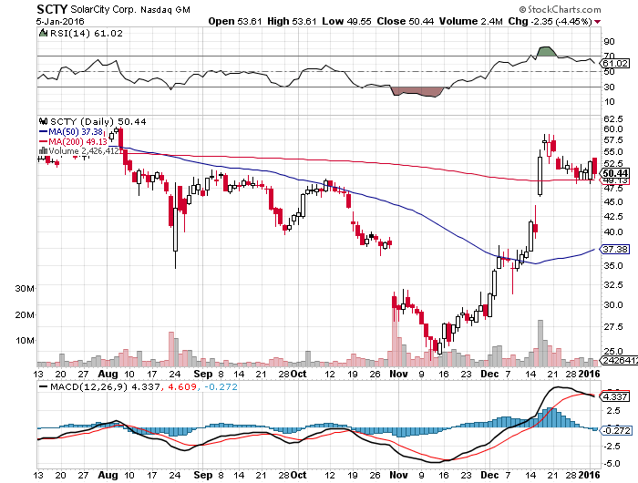
Stock of the Week (SCTY)
Solar investment tax credit extended 5 years will pour $125 billion into new solar investment

Slide 28
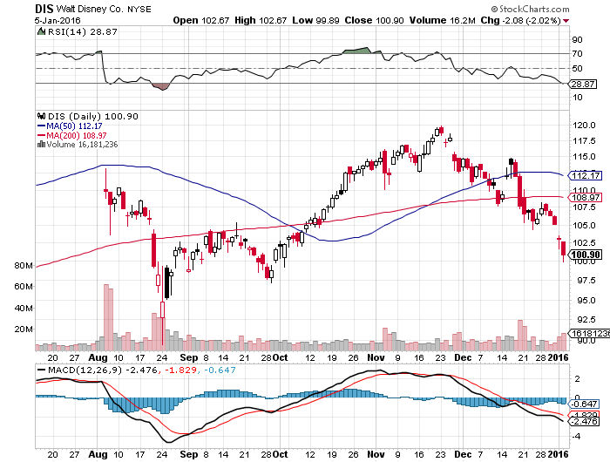
Walt Disney Co. (DIS) stopped out of long the 1/$100-$105 vertical bull call debit spread
“Star Wars” Kicks in but stock didn’t-Signal for sick market

Slide 29
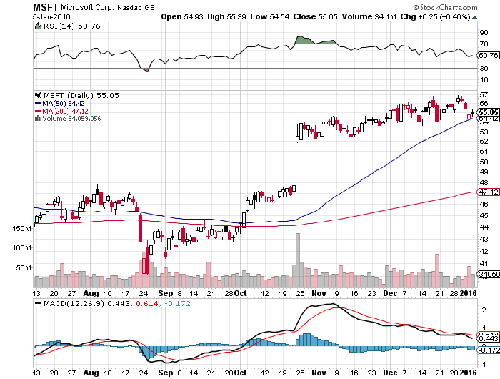
Microsoft (MSFT) took profits on long the 1/$50-$52.50 vertical bull call debit spread

Slide 30
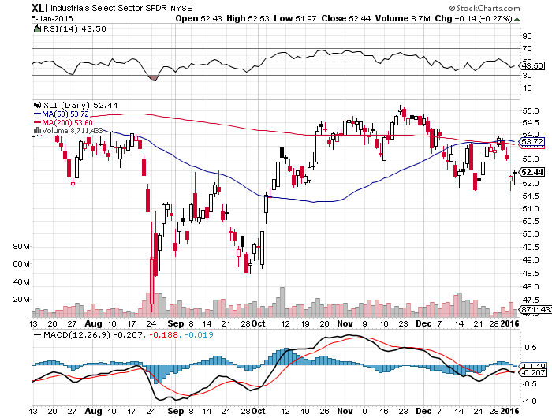
Industrials Sector SPDR (XLI)-Dow Mainstay
(GE), (MMM), (UNP), (UTX), (BA), (HON)

Slide 31
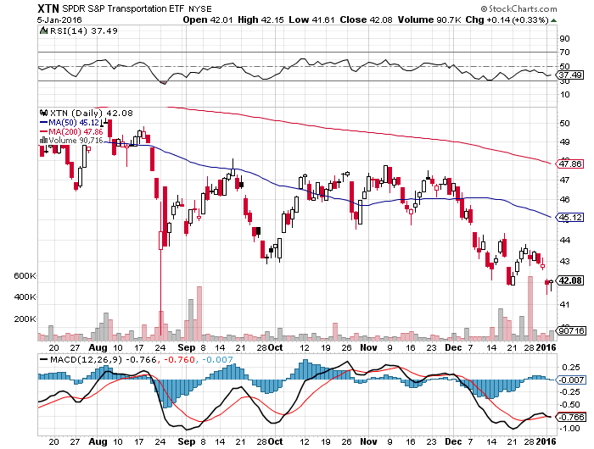
Transports Sector SPDR (XTN)-Another Dow Mainstay
(ALGT), (ALK), (JBLU), (LUV), (CHRW), (DAL),

Slide 32
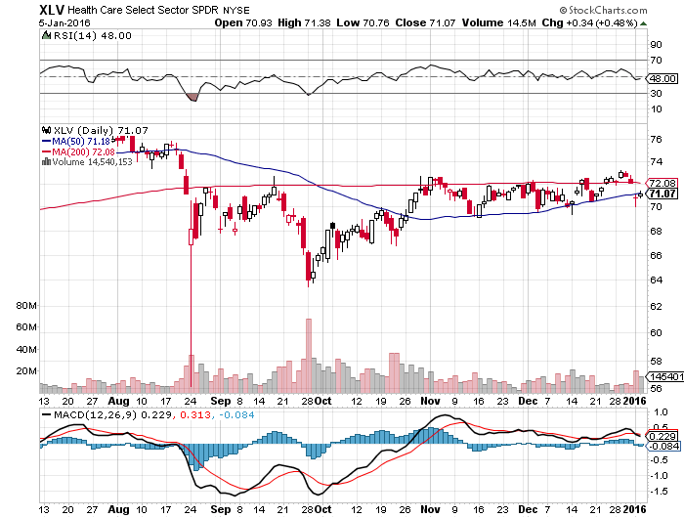
Health Care Sector SPDR (XLV), (RXL)
(JNJ), (PFE), (MRK), (GILD), (ACT), (AMGN)

Slide 33
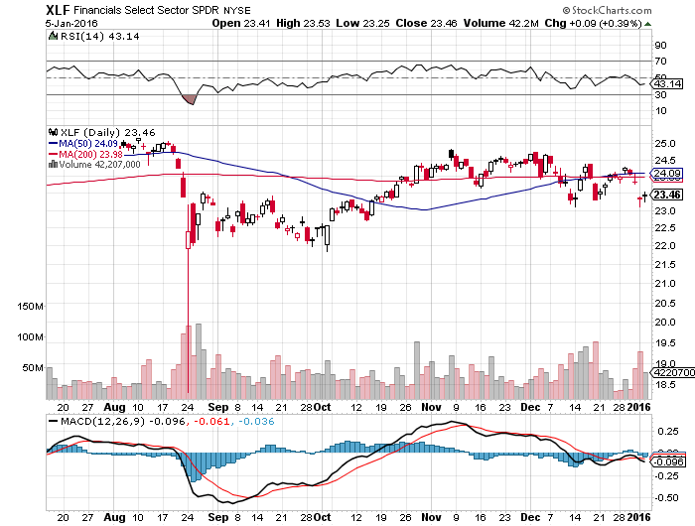
Financial Select SPDR (XLF)-
“One and Done” Means “Stay Away”
(BLK/B), (WFC), (JPM), (BAC), (C), (GS)

Slide 34
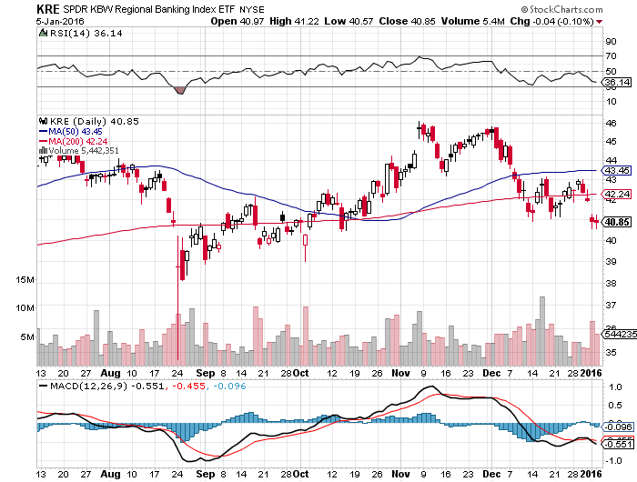
Regional Bank Basket (KRE)-Same Here
(MTG), (RDN), (SIVB), (CFG), (CFR), (BXS)

Slide 35
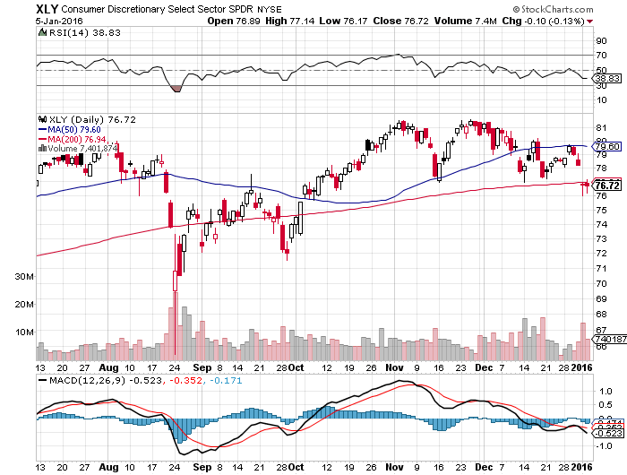
Consumer Discretionary SPDR (XLY)
Target to Buy on a dip-Will bounce back fastest
(DIS), (AMZN), (HD), (CMCSA), (MCD), (SBUX)

Slide 36
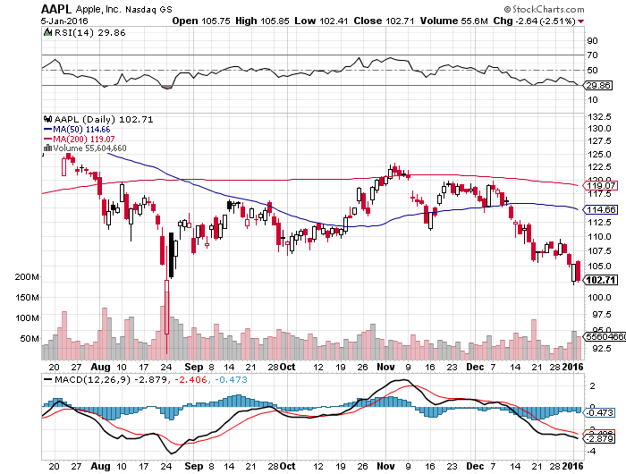
Apple (AAPL) –iPhone production cut 30%
Back to waiting for the next real catalyst-the iPhone 7
Buy after Q1 earnings in April to avoid post Christmas dip

Slide 37
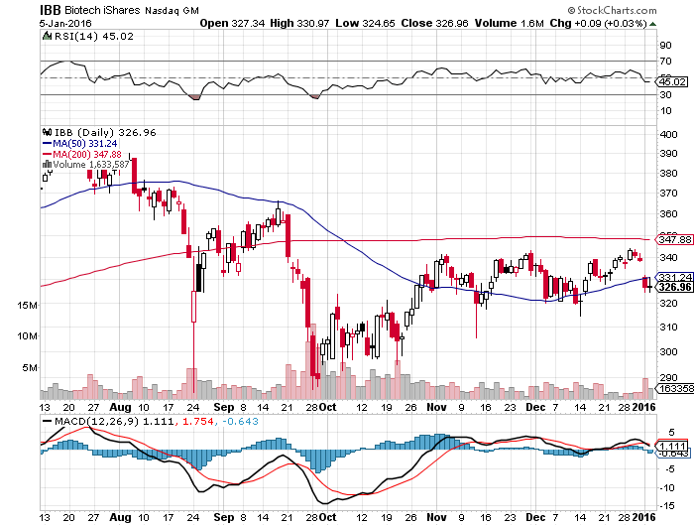
Biotech iShares (IBB)-A Political Football in 2016

Slide 38
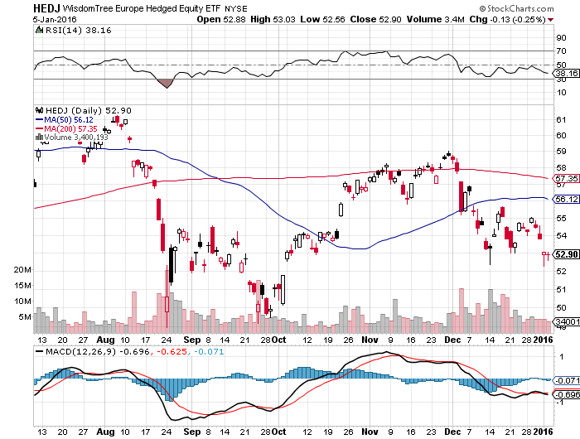
Europe Hedged Equity (HEDJ)up-Hedged Japan Equity
Great Entry Point setting - Load the boat at $50

Slide 39
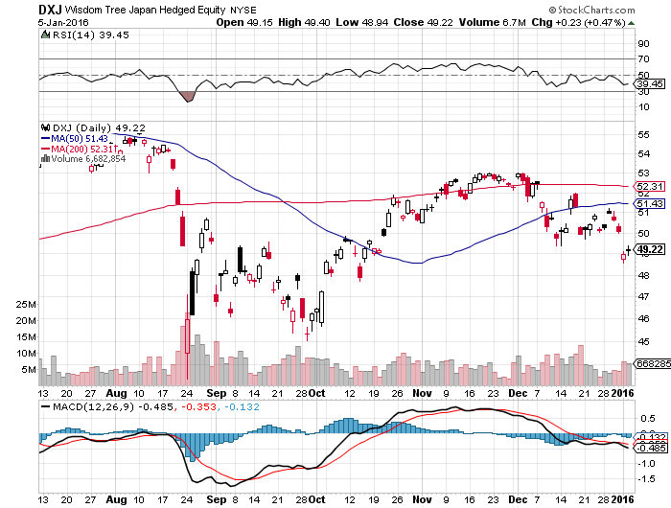
Japan (DXJ)-Hedged Japan Equity another nice entry point-Load the boat at $45

Slide 40
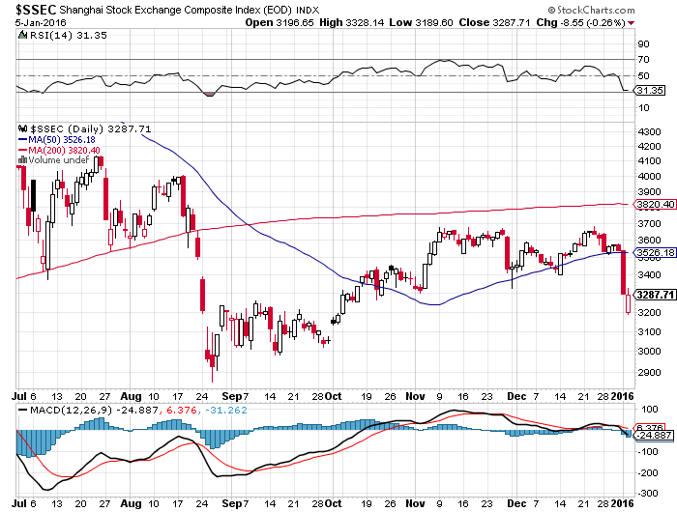
China ($SSEC)-
The Bad Boy Market and font of volatility

Slide 41

Foreign Currencies-Could Be a Boring Year
*Bank of Japan QE asset expansion knocks the stuffing out of the yen, with no increase in overall amount
*European consensus is for new no additional QE in 2016, just a continuance of existing levels, could lead to stable or rising Euro
*Low improvement in European economies could lend further Euro support
*If to Fed goes with “one and done” on rate rises, the strong dollar will take an extended vacation
*With no interest rate moves anywhere,
this could be a year of low volatility
for currencies
*Only hope is for a commodity recovery
to bring emerging currencies back to life

Slide 42
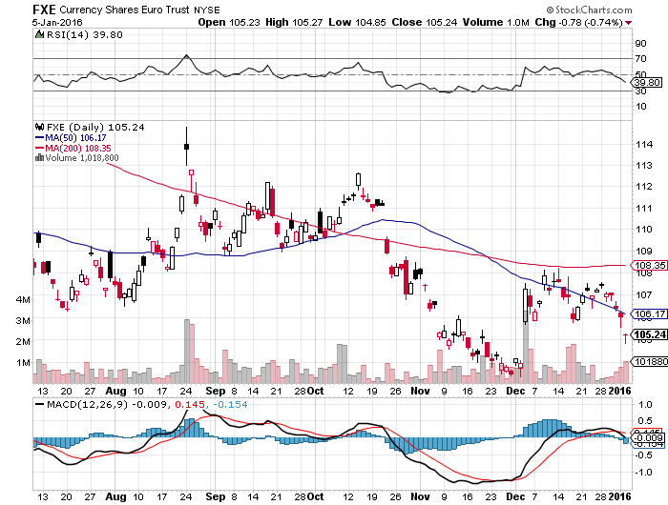
Euro ($XEU), (FXE), (EUO)-Short a Double Position look to BUY at bottom of the range-no breakdown this time

Slide 43
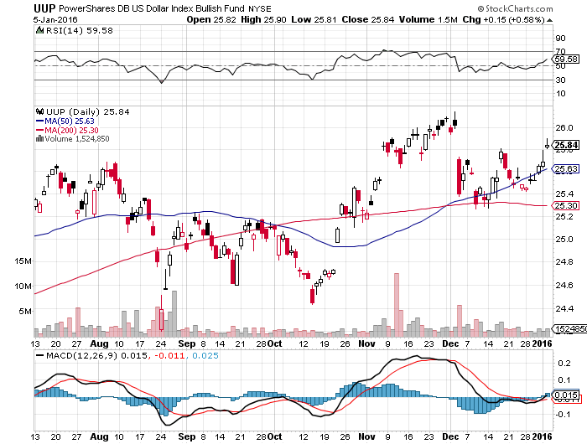
Long Dollar Index (UUP)-Topping out

Slide 44
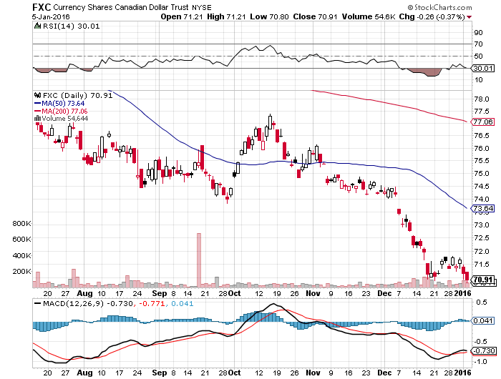
Canadian Dollar (FXC)-Commodity Disaster

Slide 45
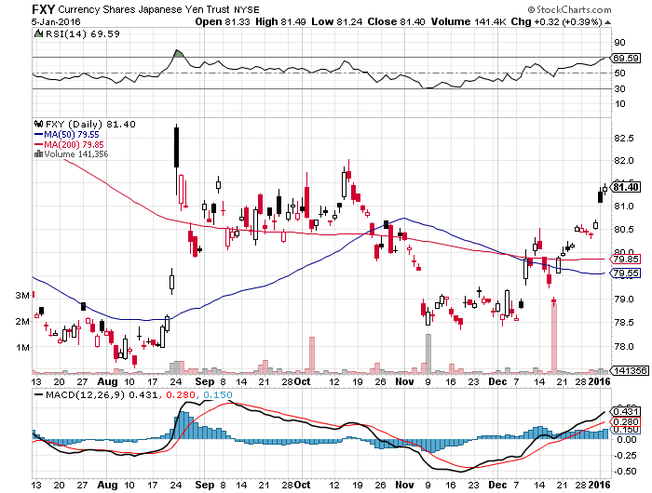
Japanese Yen (FXY)-More QE Coming took profits on long 12/$82-$84 vertical bear put debit spread

Slide 46
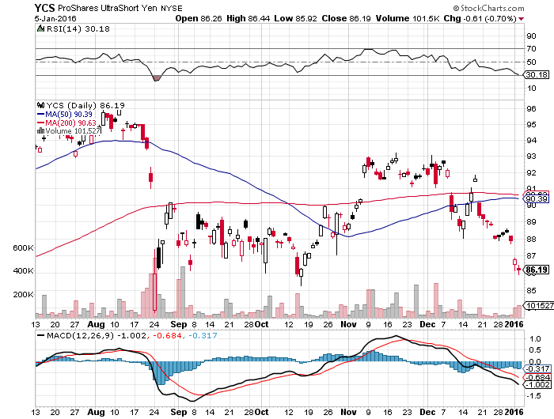
Short Japanese Yen ETF (YCS)

Slide 47
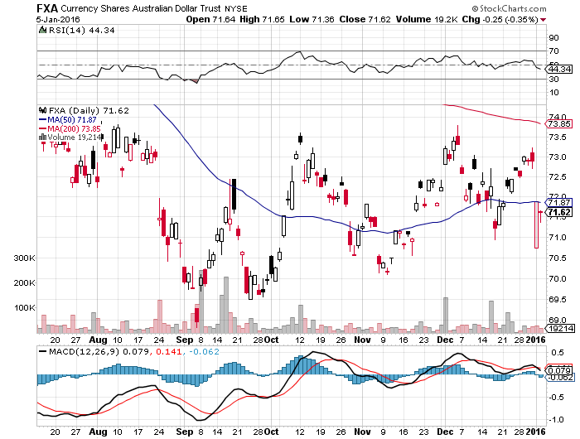
Australian Dollar (FXA)

Slide 48
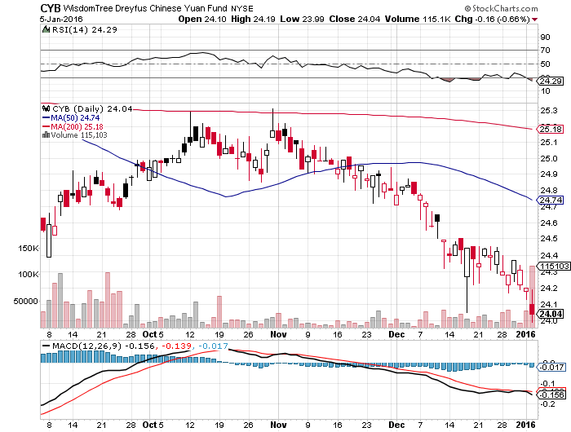
Chinese Yuan- (CYB)-Selling Off on Stock Crash

Slide 49
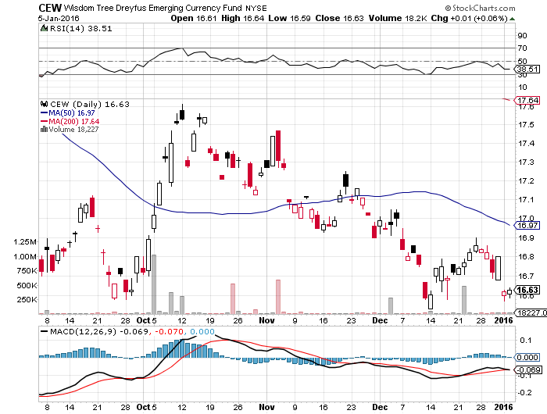
Emerging Market Currencies (CEW)

Slide 50

Energy-Armageddon is Here!
*El nino brought unusually warm in the US east and Midwest, taking natural gas down to new 13 year lows
*Cushing, Oklahoma is full, and contangos are exploding
*Market is now looking at $32 a barrel, and then $20 on a spike down
*Saudi Arabia looking to crush prices as enemy Iran brings new supplies on the the market
*50 tankers anchored in the Gulf, possibly 100 world wide, unable to unload due to lack of storage
*Three dozen companies file for bankruptcy in
North Dakota, many more to come, state
motto becomes “Chapter 11’
*OPEC says $10 trillion in new energy
investment needed to avoid another oil spike

Slide 51
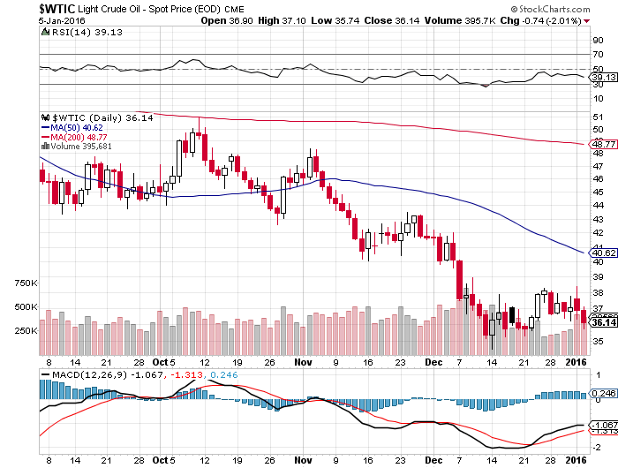
Oil-Won’t Bottom Until later in 2016
A New Run at the Lows

Slide 52
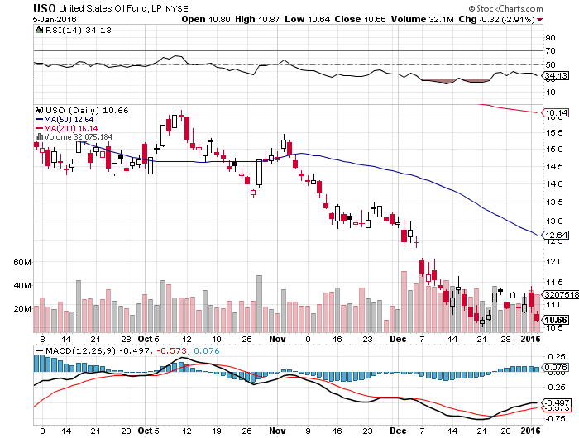
United States Oil Fund (USO)

Slide 53
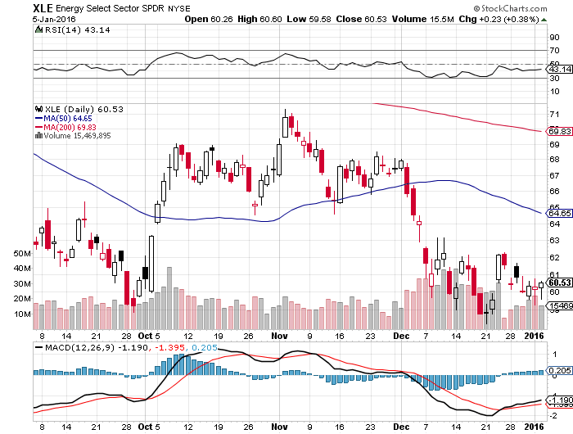
Energy Select Sector SPDR (XLE)
(XOM), (CVX), (SLB), (KMI), (EOG), (COP)

Slide 54
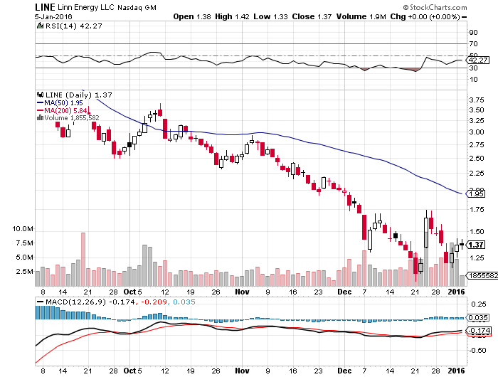
MLP’s (LINE)-Dividend Suspended!
Shares fall to option value-Entire industry has become high risk how long can they maintain leverage in the face of non-recovering oil prices?

Slide 55
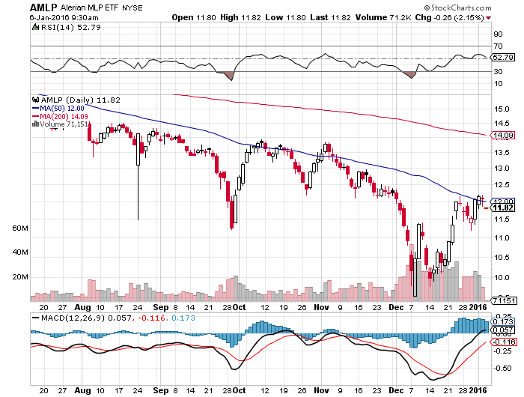
Alerian MLP ETF (AMLP)-
Basket Approach is the Only Safe Play here

Slide 56
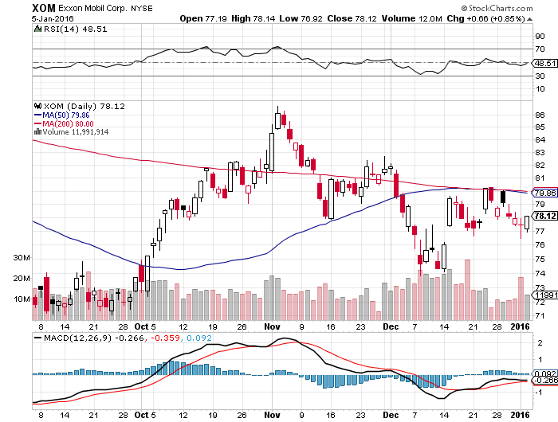
Exxon (XOM)-

Slide 57
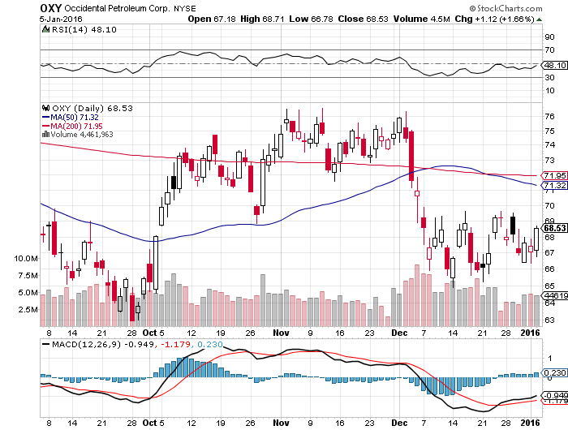
Occidental Petroleum (OXY)-

Slide 58
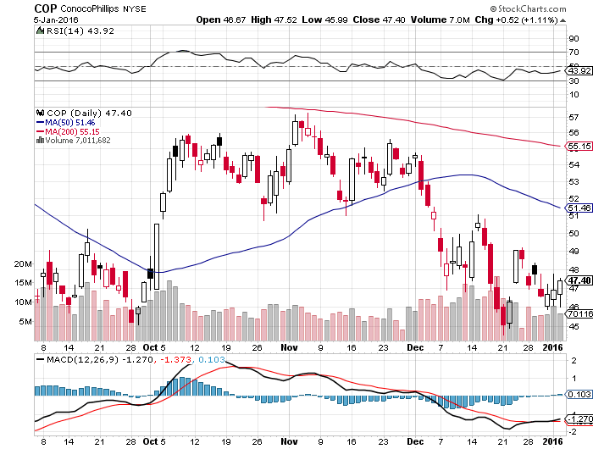
Conoco Phillips (COP)-

Slide 59
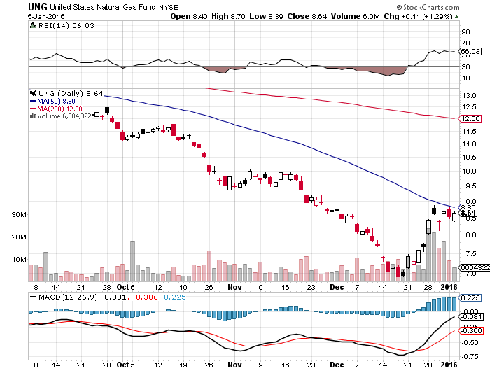
Natural Gas (UNG)-New Lows on Warm Winter

Slide 60
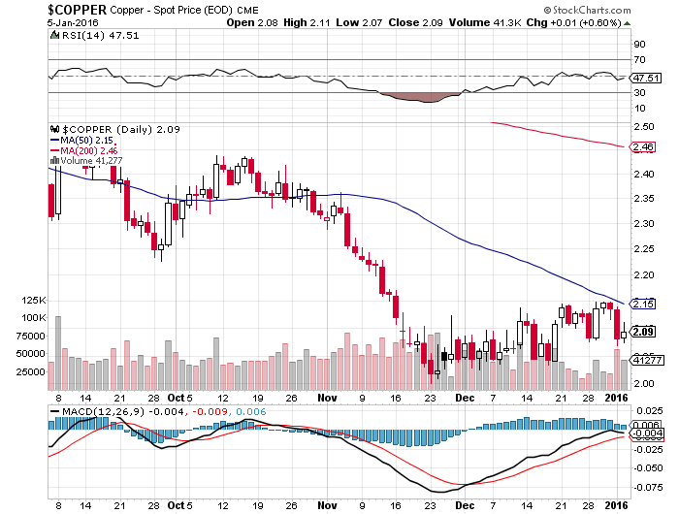
Copper-New 6 Year Low

Slide 61
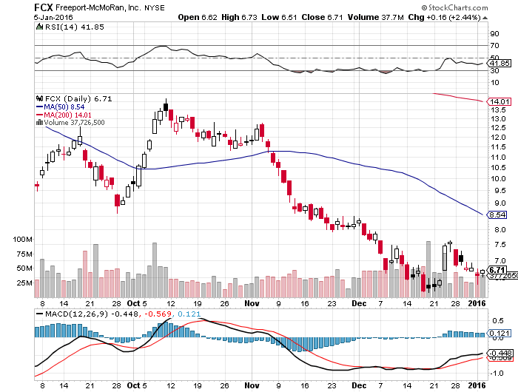
Freeport McMoRan (FCX)-
Carl Icahn Slips on a Banana Peel

Slide 62

Precious Metals-The Rally Has Begun
*China is the only large buyer of gold out there, raising reserves by 50% to
1,743 metric tons since 2009, but holdings still at only 1.6% of total reserves, compared to 40%-60% for other industrialized countries-is long term bullish
*Russia is also a big buyer, as sanctions push them out of all dollar based assets
*Oil bottom will also call the bottom in the barbarous relic, they’re all linked
*Commercial short positions have been
wound down to near zero. End of year effect,
or cause for a turn
*Will Indian buying be the tipping point,
when it appears?
*Gold gets new life as a
“RISK OFF” hedge

Slide 63

Gold (GLD)-Nailed the Breakout!!
Long the $95-$100 vertical bull call debit spread

Slide 64

Market Vectors Gold Miners ETF- (GDX)

Slide 65

Silver (SLV)-

Slide 66

Silver Miners (SIL)

Slide 67

Platinum (PPLT)-The Volkswagen Effect new chapter of the “Clean Diesel” Scandal

Slide 68

Palladium (PALL)-The Non Diesel Play

Slide 69

Agriculture-Also Bouncing Along a Bottom
*El nino coming through as the strongest in history, 5 consecutive days of heavy snow here in Nevada, 5 more to come. Sierras already have 130% of a full winter’s snow!
*Brings near perfect growing conditions in the
Midwest and prospects of another weak
year for ag prices in 2016
*The world will over produce wheat
for a third consecutive year, 732 million
tonne supple vs 711 tonne demand
*Brazilian soybean crop starting to
fail because of El Nino cased lack
of rain
*No trade, there are NO fish to fry

Slide 70

(CORN) – New Lows!

Slide 71

(WEAT)-New Lows!

Slide 72

Ag Commodities ETF (DBA)- New Lows

Slide 73

Real Estate-Looking Good
*Late stage home price revival should continue for years, home shortages becoming endemic on coasts, mortgage rates actually fall after Fed rate rise
*November existing home sales down a shocking -10.5%, new paperwork disclosures at closing blamed, pending home sales down 0.9%
* November new home sales up +4.3% to 490,000
*Millennials finally started to move to the suburbs in large numbers, are now one third of the home buying market
*Flat to modestly rising rates will allow home prices to continue grinding up
*Rising rents forcing millennials into
first time home purchases
*Case Shiller S&P 500 National index
continues upward grind

Slide 74

July S&P/Case–Shiller Home Price Index
+5.2% YOY, Denver, San Francisco, Dallas

Slide 75

US Home Construction Index (ITB)
(DHI), (LEN), (PHM), (TOL), (NVR)

Slide 76

Trade Sheet
So What Do We Do About All This?
*Stocks- sell rallies
*Bonds-the top is in, sell rallies, buy (TBT)
*Commodities-stand aside, buy the next oil down leg
*Currencies- Sell short the Yen and Euro on rallies, buy on dips
*Precious Metals –buy on dips
*Volatility-sell short spikes over $20 through (XIV)
*The Ags –stand aside - avoid the disaster
*Real estate-buy the homebuilders LT

Slide 77

Take a Well Earned Rest and
Spend Your Profits!
Next Strategy Webinar
12:00 EST Wednesday,
January 20, 2016
San Francisco, CA
USA!
GREAT JOB THIS YEAR TEAM!!
Good Luck and Good Trading!
Notes:
*

