Slide 1
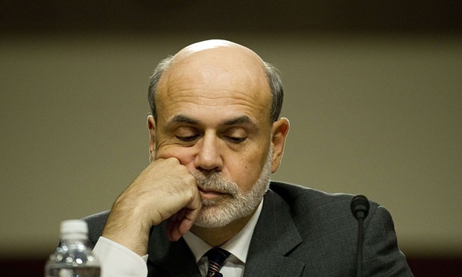
The Mad Hedge Fund Trader
“The Bitter Harvest of QE”
With John Thomas
from San Francisco, CA, January 20, 2016
www.madhedgefundtrader.com
Notes:
*

Slide 2

Trade Alert Performance
Hiding in Cash Until the New Year
*January +1.02% MTD
*July +6.42% Final
*February +7.73% Final *August +1.27% Final
*March +3.00% Final *September +11.99% Final
*April +6.62% Final *October Final -6.19%
*May +5.15% Final *November MTD 5.78%
*June +3.68% Final *December -4.94%
*2016 Year to Date +1.02%
compared to -2.0% for the Dow Average
*Trailing 1 year return +42.32%, +192.70% since inception,
5.96% short of all-time high
*Average annualized return of 37.91%

Slide 3
Portfolio Review
Running a Big, Aggressive, But Market Neutral Book
current capital at risk
Risk On
World is Getting Better
(TLT) 2/$130-$133 put spread | 10.00%
(XIV) | 10.00%
(SPY) 2/$170-$175 call spread | 10.00%
Risk Off
World is Getting Worse
(GLD) 2/$95-$100 call spread | -10.00%
(SPY) 2/$200-$205 put spread | -10.00%
total net position | 10.00%
Expiration P&L
6.03% YTD

Slide 4
Paid Subscriber Trailing 12 Month Audited Return +42.32%

Slide 5
61 Months Since Inception
Daily Audited Performance
Averaged annualized return +37.91%

Slide 6

Strategy Outlook-Run For Cover
*It’s all about the flight to cash, all asset classes are being dumped indiscriminately
*The markets are on fast forward, ETF’s, derivatives, and high frequency traders are exacerbating the moves
*Simultaneous capitulation sell offs occurring in energy, base metals, and all commodities
*US stocks approaching my downside targets for 2016, (SPY) $182 and $174
*Another emerging market crisis is setting up, which may
give us the final flush
*No chance of any more Fed rate hikes this year
*Gold getting a new lease on life as risk hedge
*New lows in ags despite the arrival of el nino

Slide 7
The Bill Davis View
A $1,500 Upgrade for the Mad Day Trader Service
Wednesday January 20, 2016 Deals
Buys:
Apple (AAPL) $98 Target to $109
(Buy on a close above 98)
Dycom Industries (DY) $62 Target to $72
Expeditors Int (EXPE) $103 Target to $110
Dycom Industries (DY) $62 Target to $72
United Parcel (UPS) $90 Target to $98
Salesforce (CRM) $69 Target to $75
Sells:
Buffalo Wild Wings (BWLD) $170 Target to $150
Federal Express (FDX) $131 Target to $122
Universal Health (UHS) $112 Target to $102
Vertex Pharm. (VRTX) $102 Target to $87
Harman Intl (HAR) $82 Target to $71
Skyworks Sol. (SWKS) $64 Target to $56

Slide 8

The Global Economy-Recession Risks
*Market crash leads many to believe that a recession is coming, but so far, it is nowhere to be seen in the numbers
*Market jitters dash the hopes of another Fed rate rise, boosting bonds and weakening dollar
*German GDP still stronger than expected, will spill over to the rest of Europe
*Japan bouncing back from mini recession
*China 2015 GDP comes in at 6.9%,
a 25 year low, 4.5% is probably
the real number, which is not bad,
more interest rate cuts coming
*Next to come is a “RISK ON” global
synchronized growth in 2016
once we get through New Year effects

Slide 9
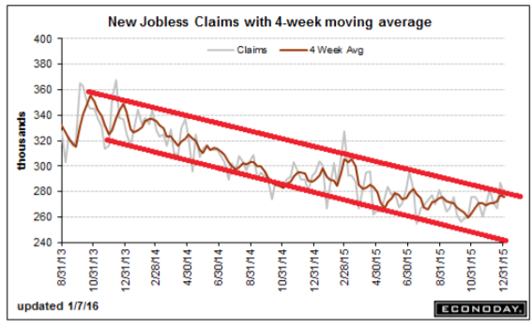
Weekly Jobless Claims – Another Run at the Lows
+7,000 to 284,000
Get Ready for an Ugly January Nonfarm Payroll

Slide 10

Bonds-Flight to Safety
*Equity crash triggers big flight to safety bid, prospect of no more Fed rate rises boosts all fixed income, except junk
*GLOBAL “RISK OFF” then drives yields back down to bottom of a one year range
*Junk Bonds energy sub index now yielding 17.43%, anticipating a default rate of over 50%
*Non energy junk is starting to offer real value
*Buy (TBT) on any dip for more
strength in 2016, “RISK ON”
markets will return later in
the year

Slide 11
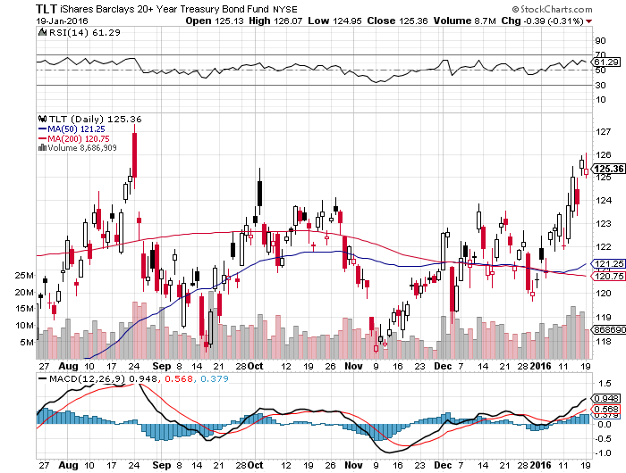
Ten Year Treasury Yield (TLT) 2.03% stopped out of long the 2/$126-129 vertical bear put debit spread long the 2/$130-133 vertical bear put debit spread

Slide 12
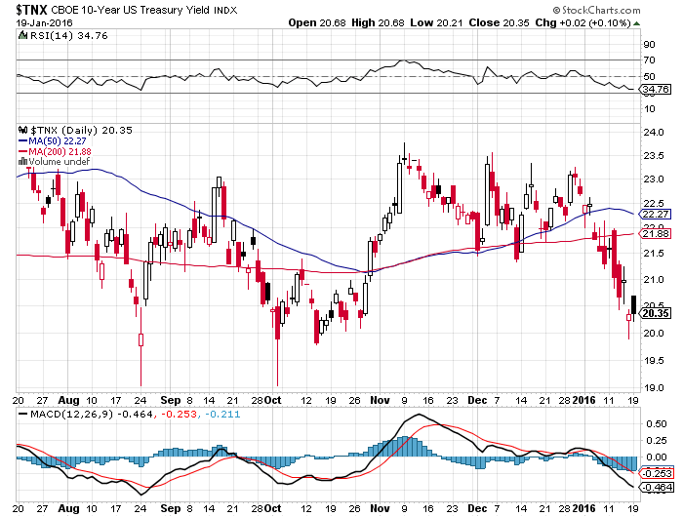
Ten Year Treasury Yield ($TNX) 2.03%
2.35% Ceiling Holds, so will the 2.0% floor

Slide 13
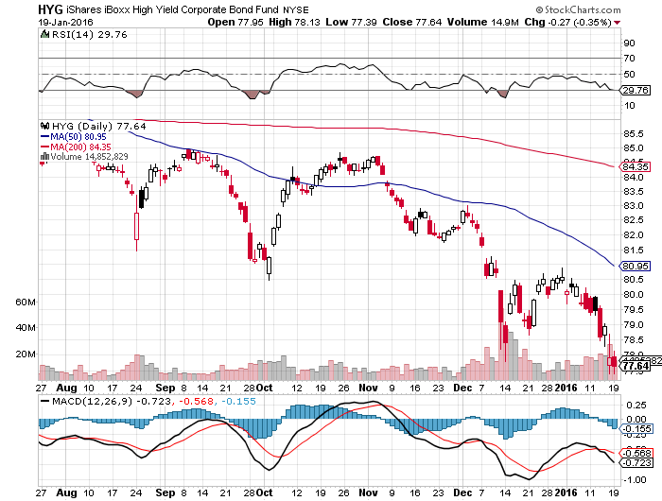
Junk Bonds (HYG) 8.56% Yield
A Great Risk Coincident Indicator

Slide 14
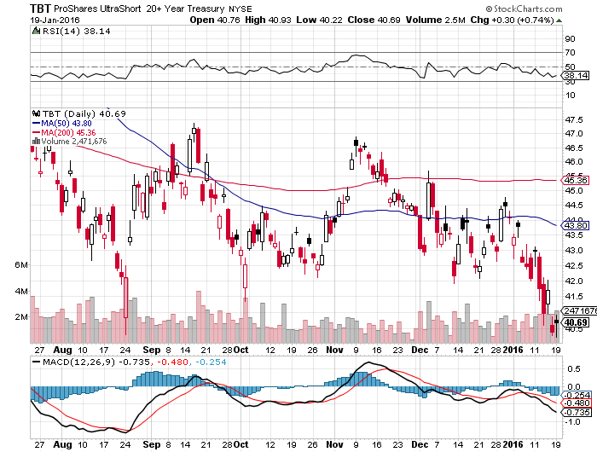
2X Short Treasuries (TBT)-Big Trade of 2016?
Back in “BUY” Territory

Slide 15
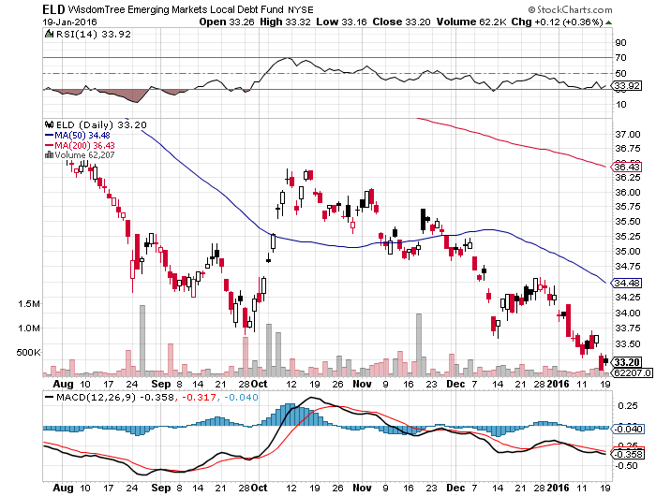
Emerging Market Debt (ELD) 6.06% Yield-

Slide 16
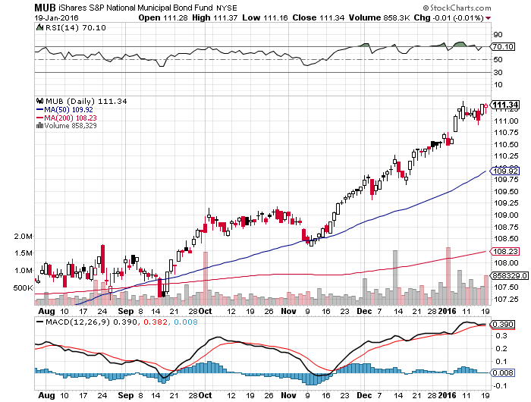
Municipal Bonds (MUB)-1.53% yield
Mix of AAA, AA, and A rated bonds-flight to safety

Slide 17
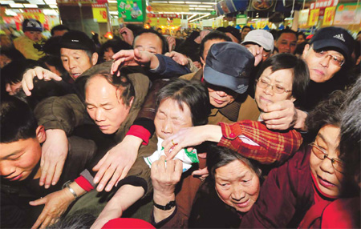
Stocks-Rush to Cash
*$1.3 trillion in market cap lost since January 1, earnings multiple plunge from
18X to 16.5 X in two weeks, targeting 15.5X
*50% of (SPY) stocks yield more than Treasury bonds, more than at the 2008 crash
*$200 billion in equity mutual fund selling since the end of 2014, cash levels at all time highs
*Collapsing oil prices are creating massive budget deficits in Saudi Arabia and the Persian Gulf states that is forcing them to dump US stocks to raise money
*As junk bond market crashes, poor liquidity
causes spill over selling into stocks
*Oil continues as a major driver of short
term stock prices, will become a major
positive when it turns-we are now all oil traders
*Corporate stock buy backs absent as
companies enter quiet period, 75% return
by February 5

Slide 18
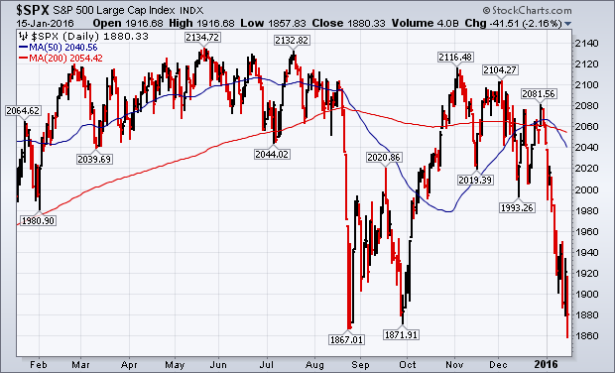
S&P 500-Breakdown! long 1/$170-$175 vertical bull call spread long 2/$200-$205 vertical bear put spread, looking to buy more on a rally

Slide 19
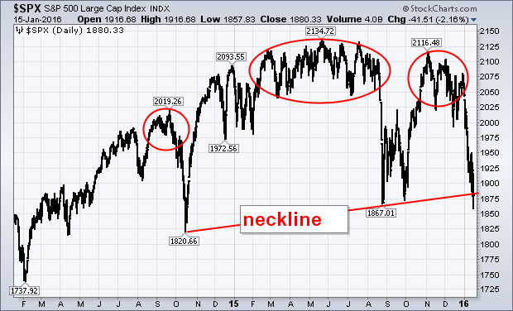
S&P 500-The Long View
Price Earnings Multiple now at 16X, down One Full Point, in 2016

Slide 20
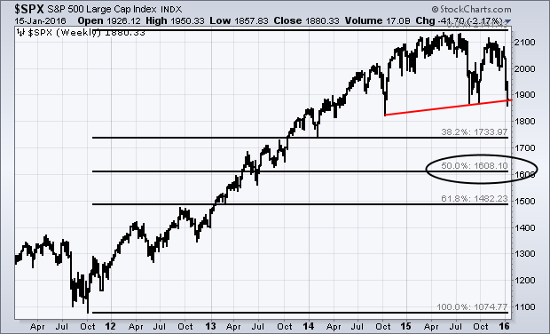
S&P 500-The Really Long View
Next Stop $1,740, PE 14X

Slide 21
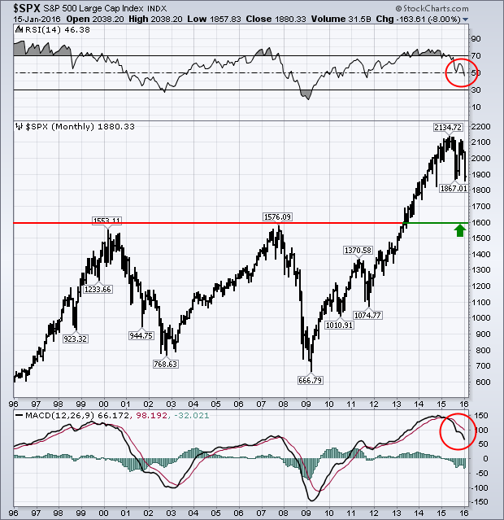
S&P 500-The 20 Year View
Worst Case Scenario $1,600, down -25%, PE 13X

Slide 22
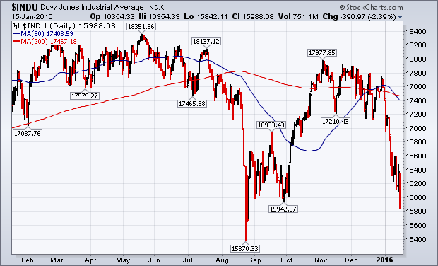
Dow Average-

Slide 23
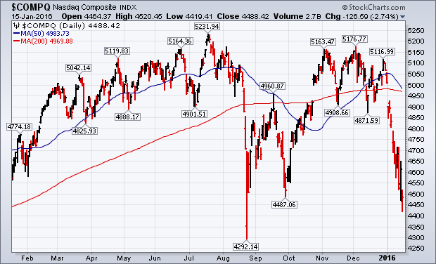
NASDAQ (QQQ)-Break of 200-Day Moving Average!

Slide 24
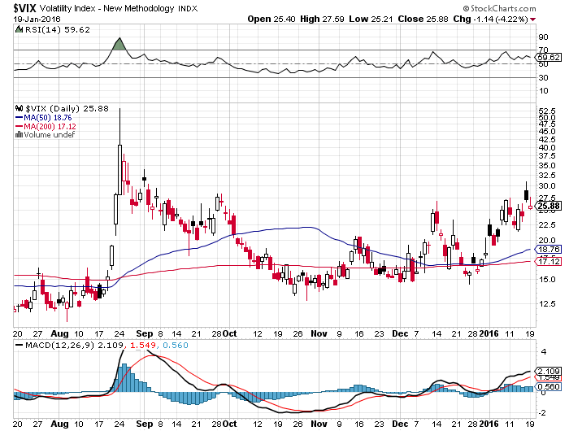
(VIX)-The Spike is Here

Slide 25
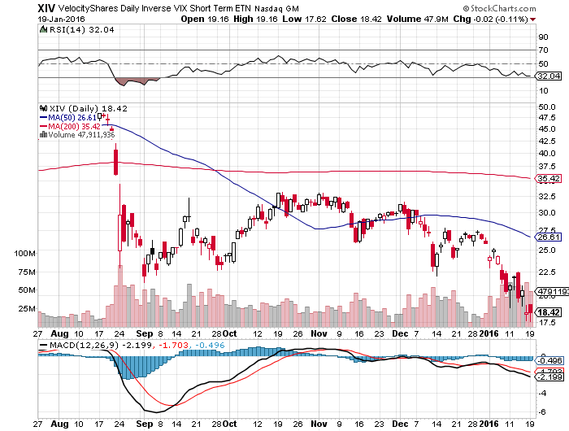
(XIV)-Velocity Shares Daily Inverse VIX Short Term ETN
Took Profit on half of position, still 10% long at $23.69

Slide 26
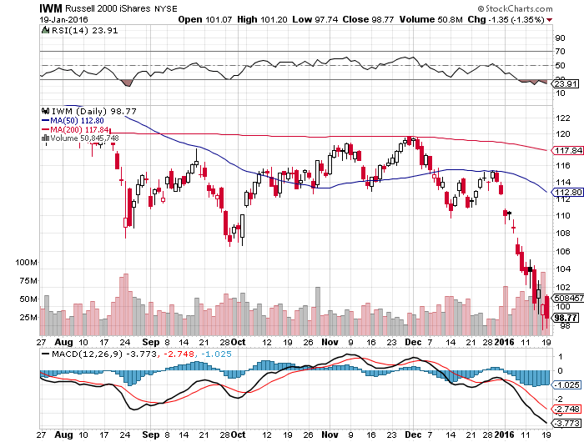
Russell 2000 (IWM)-

Slide 27
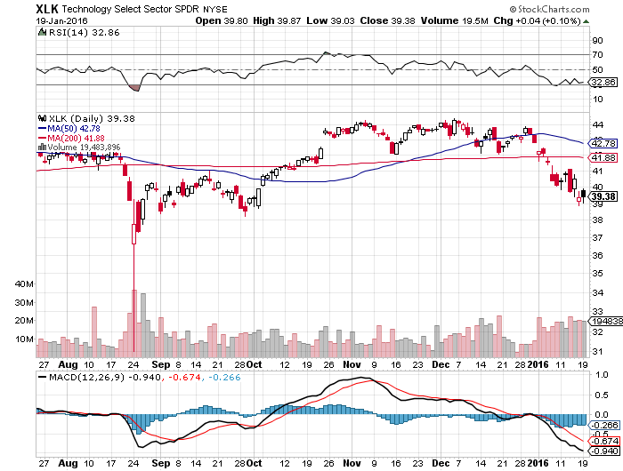
Technology Sector SPDR (XLK), (ROM)
(AAPL), (MSFT), (VZ), (T), (FB), (IBM)

Slide 28
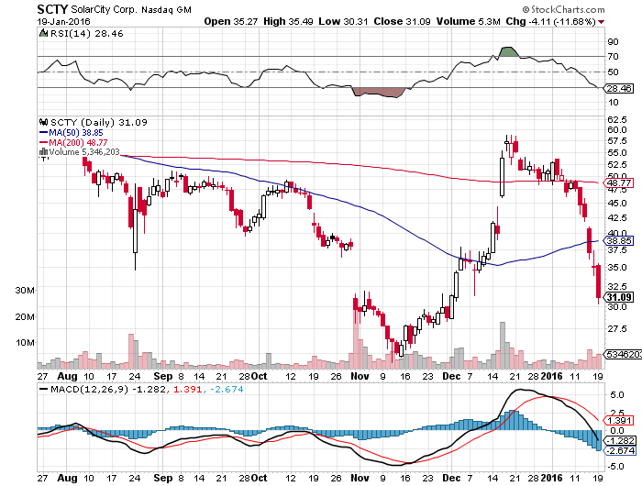
Stock of the Week (SCTY)
Solar investment tax credit extended 5 years will pour $125 billion into new solar investment

Slide 29
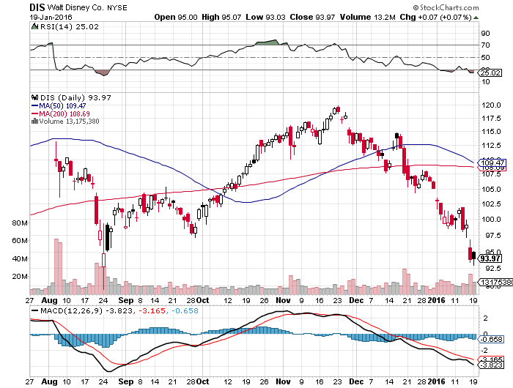
Walt Disney Co. (DIS)
“Star Wars” Kicks in but stock didn’t-Signal for sick market

Slide 30
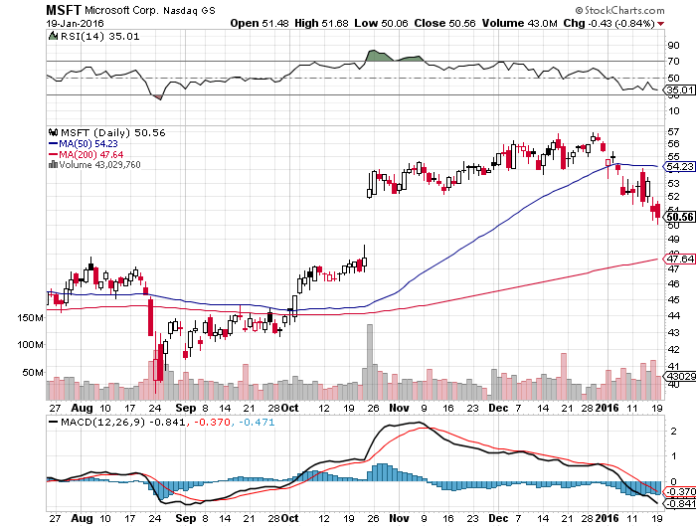
Microsoft (MSFT) took profits on long the 1/$50-$52.50 vertical bull call debit spread

Slide 31
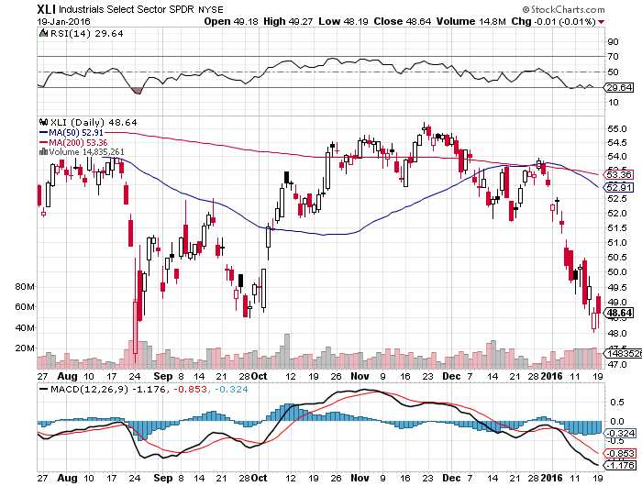
Industrials Sector SPDR (XLI)-Dow Mainstay
(GE), (MMM), (UNP), (UTX), (BA), (HON)

Slide 32
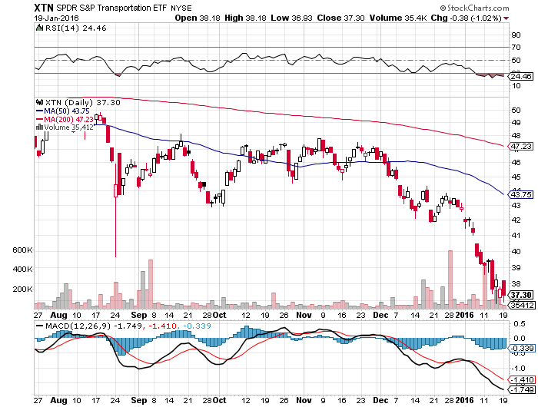
Transports Sector SPDR (XTN)-Another Dow Mainstay
(ALGT), (ALK), (JBLU), (LUV), (CHRW), (DAL),

Slide 33
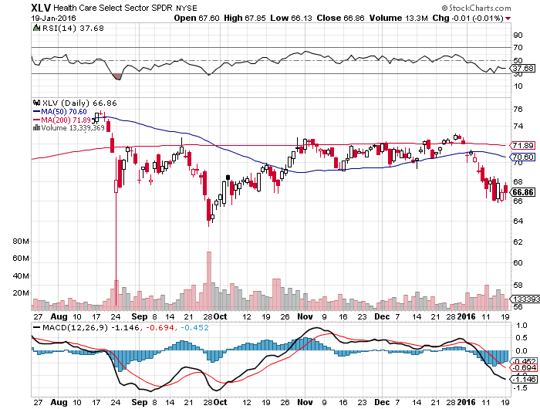
Health Care Sector SPDR (XLV), (RXL)
(JNJ), (PFE), (MRK), (GILD), (ACT), (AMGN)

Slide 34
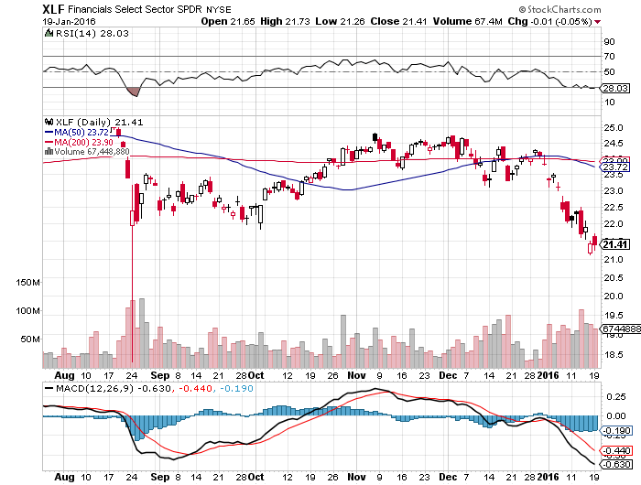
Financial Select SPDR (XLF)-
“One and Done” Means “Stay Away”
(BLK/B), (WFC), (JPM), (BAC), (C), (GS)

Slide 35
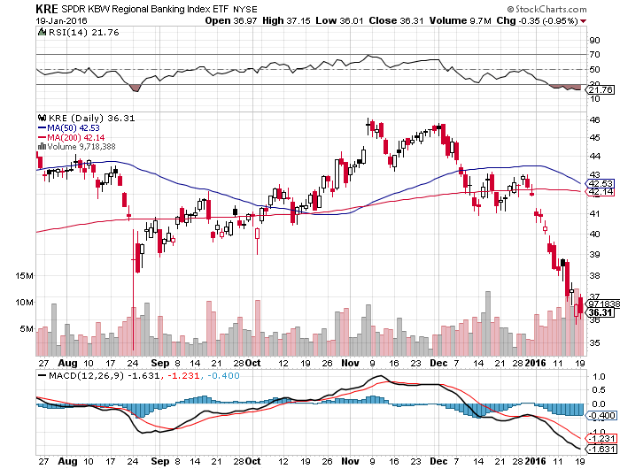
Regional Bank Basket (KRE)-Same Here
(MTG), (RDN), (SIVB), (CFG), (CFR), (BXS)

Slide 36
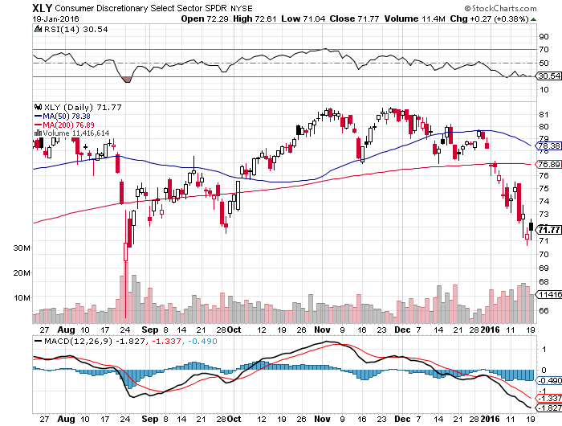
Consumer Discretionary SPDR (XLY)
Target to Buy on a dip-Will bounce back fastest
(DIS), (AMZN), (HD), (CMCSA), (MCD), (SBUX)

Slide 37
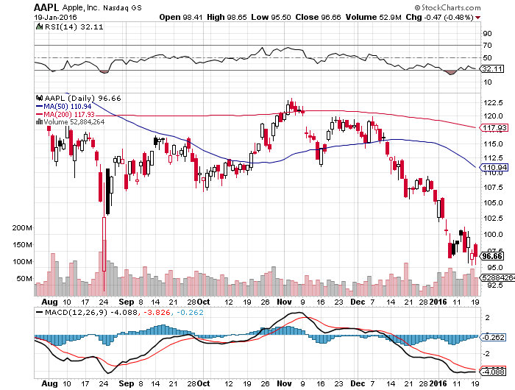
Apple (AAPL) –iPhone production cut 30%
Back to waiting for the next real catalyst-the iPhone 7
Buy after Q1 earnings in April to avoid post Christmas dip

Slide 38
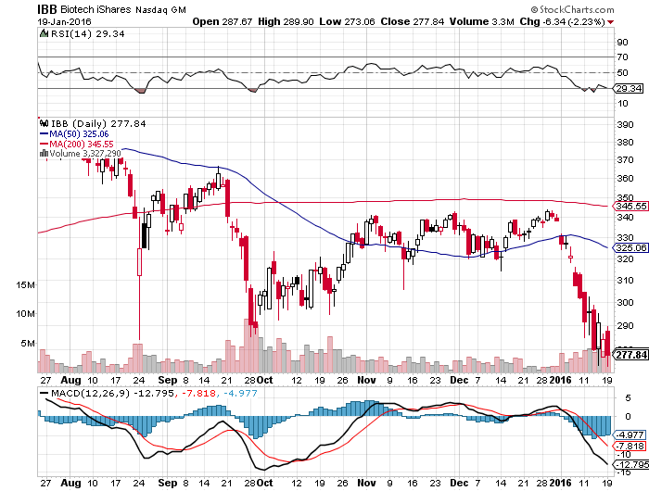
Biotech iShares (IBB)-A Political Football in 2016

Slide 39
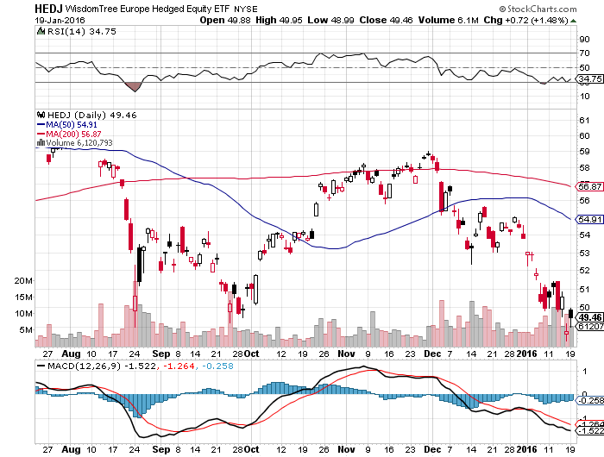
Europe Hedged Equity (HEDJ)up-Hedged Japan Equity
Great Entry Point setting - Load the boat at $50 on “RISK ON”

Slide 40
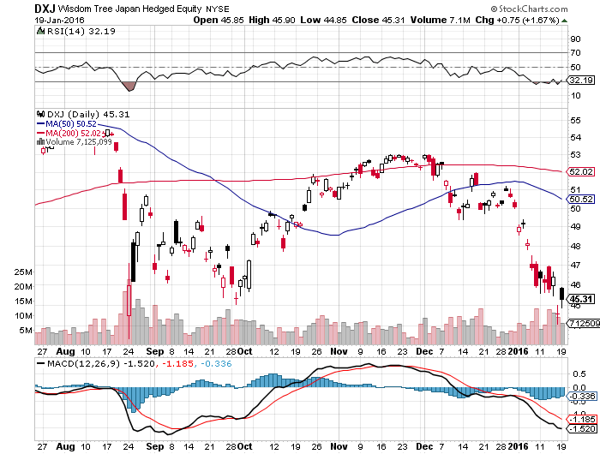
Japan (DXJ)-Hedged Japan Equity another nice entry point-Load the boat at $45 on “RISK ON”

Slide 41
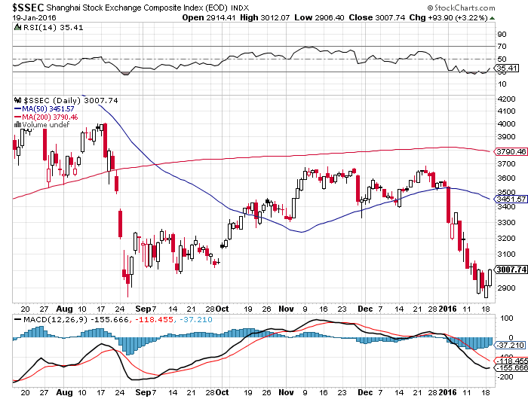
China ($SSEC)-
The Bad Boy Market and font of volatility

Slide 42

Foreign Currencies-Could Be a Boring Year
*Goodbye Fed rate hikes means goodbye strong dollar
*Ongoing commodity collapse takes commodity currencies to new lows
*No new rate cuts or QE takes the yen to a one year high
*Slow improvement in European economies could lend further Euro support
*With no interest rate moves anywhere,
this could be a year of low volatility
for currencies
*With equities, energy, and commodities
crashing, focus is elsewhere
*Only hope is for a commodity recovery
to bring emerging currencies back to life

Slide 43
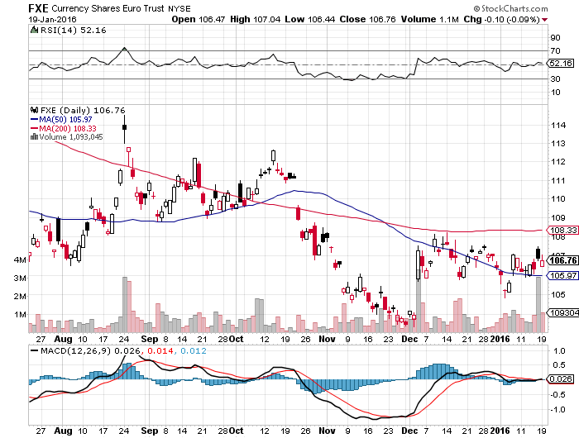
Euro ($XEU), (FXE), (EUO)-Short a Double Position look to BUY at bottom of the range-no breakdown this time

Slide 44
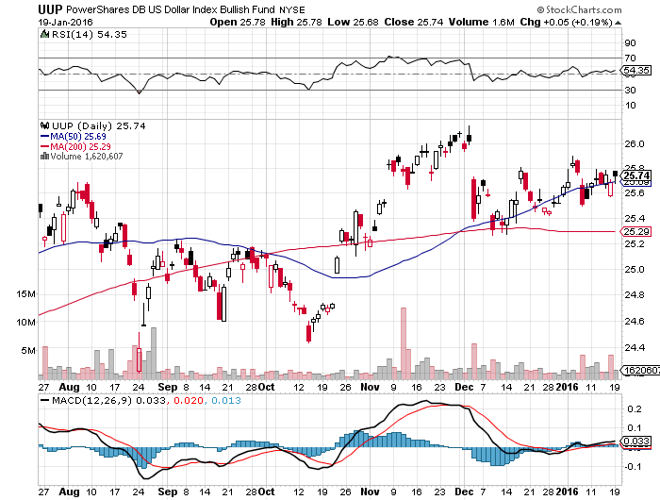
Long Dollar Index (UUP)-Topping out

Slide 45
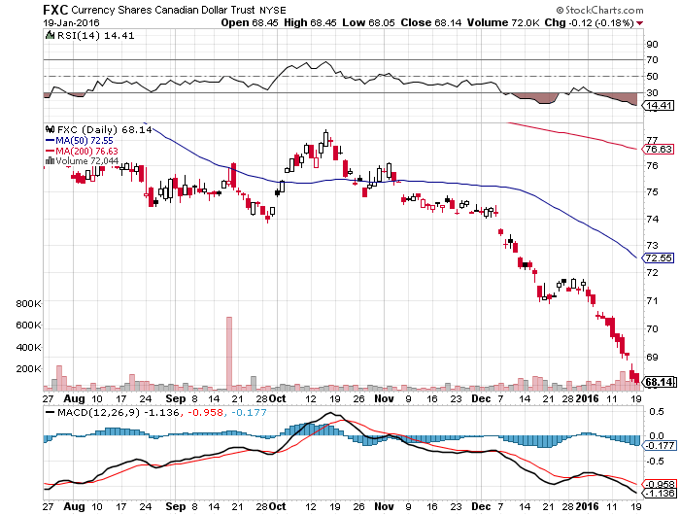
Canadian Dollar (FXC)-Commodity Disaster

Slide 46
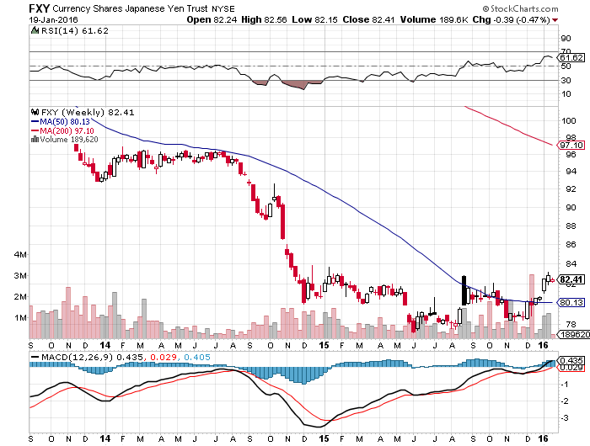
Japanese Yen (FXY)-At a One Year High

Slide 47
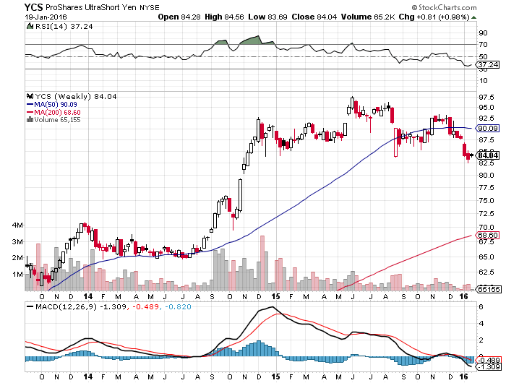
Short Japanese Yen ETF (YCS)

Slide 48
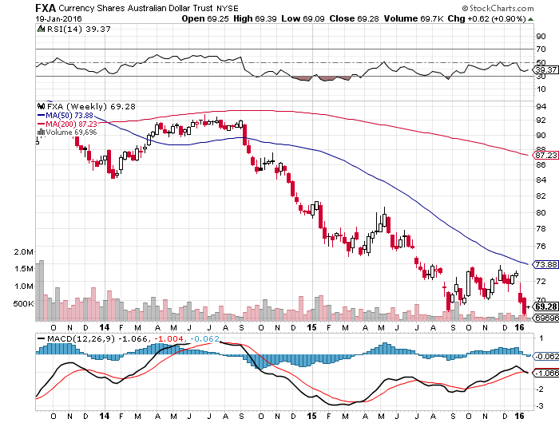
Australian Dollar (FXA)- New Low!

Slide 49
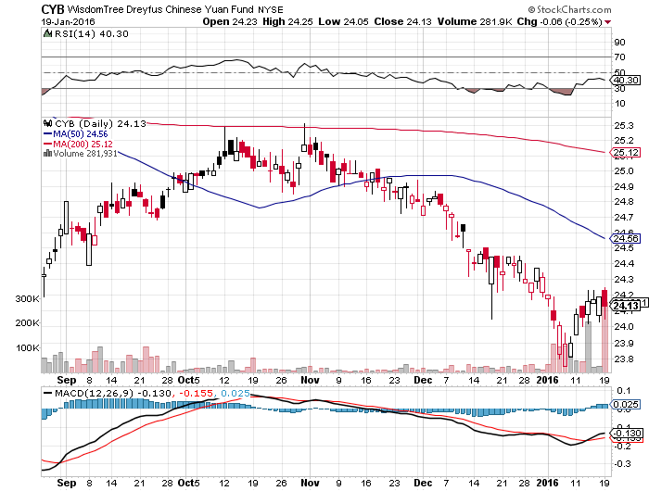
Chinese Yuan- (CYB)-Selling Off on Stock Crash

Slide 50
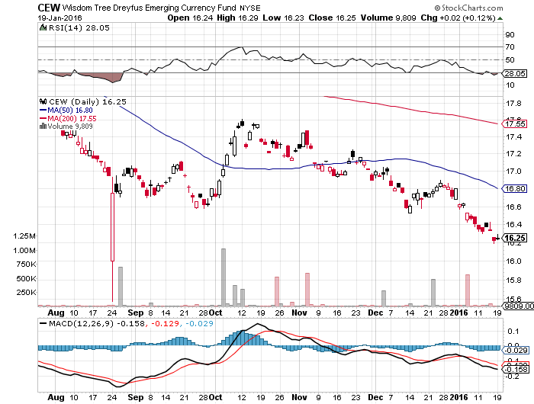
Emerging Market Currencies (CEW)

Slide 51

Energy-Capitulation
*Chinese oil imports rise to a new all time high on a volume basis to 7.85 million b/d, could be signaling the beginning of the end of the oil crash.
*Market is now targeting $20 a barrel
*Contangos are narrowing
*20 VLCC’s left Iran on Monday to deliver 500,000 barrels/day to the global market, aiming for 2 million barrels/day in a year
*Iran potential peak production after industry
modernization could be 12 million b/d,
greater than Saudi Arabia
*Much of the energy industry now facing
bankruptcy
*Massive lay offs hitting the oil patch

Slide 52
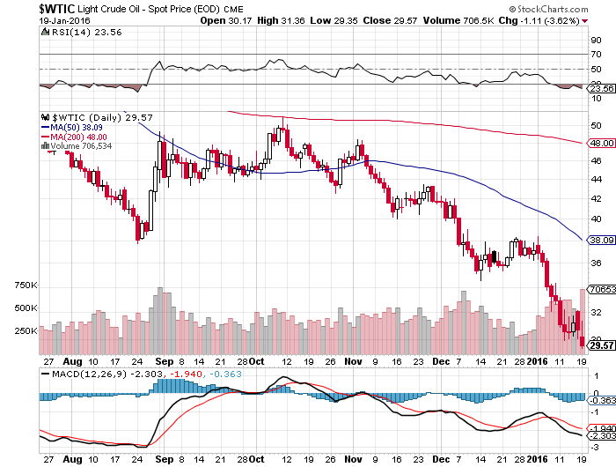
Oil-Won’t Bottom Until later in 2016
A New Run at the Lows

Slide 53
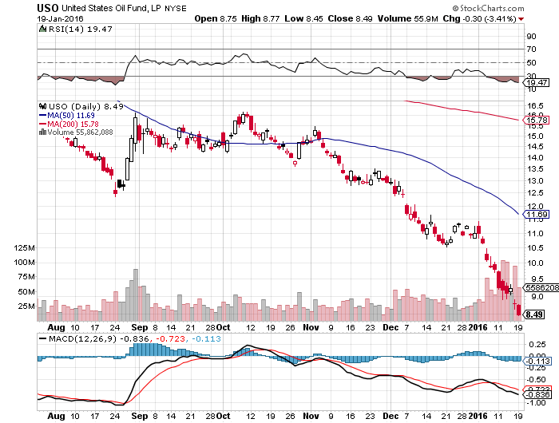
United States Oil Fund (USO) watching the 4/$9.00 calls at $0.73, double on a $5 oil rally

Slide 54
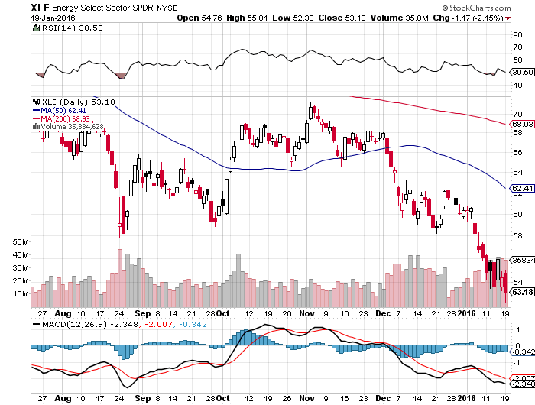
Energy Select Sector SPDR (XLE)
(XOM), (CVX), (SLB), (KMI), (EOG), (COP)

Slide 55
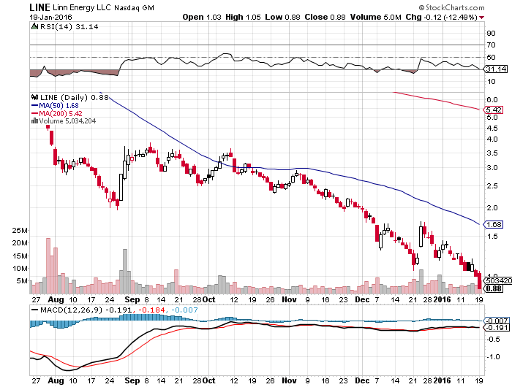
MLP’s (LINE)-Dividend Suspended!
Shares fall to option value-Entire industry has become high risk how long can they maintain leverage in the face of non-recovering oil prices?

Slide 56
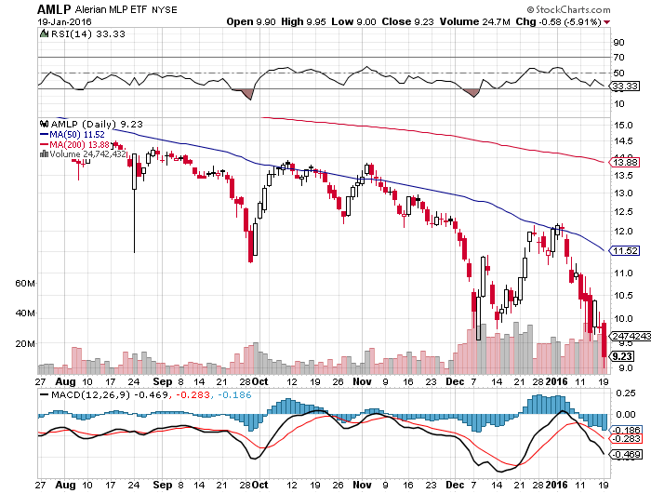
Alerian MLP ETF (AMLP)-
Basket Approach is the Only Safe Play here

Slide 57
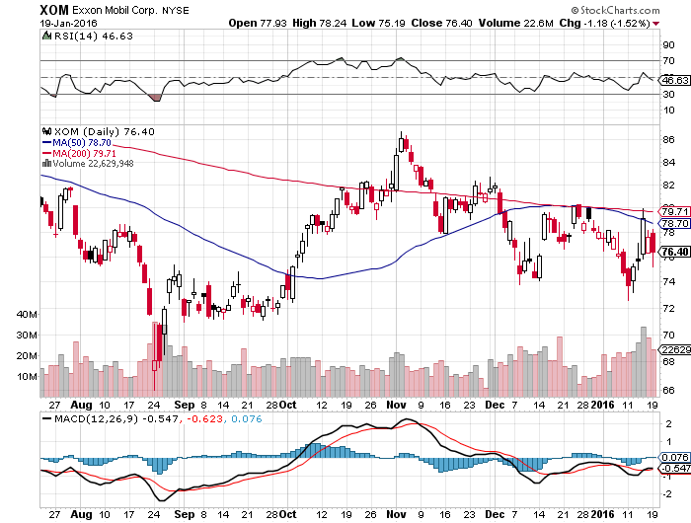
Exxon (XOM)-

Slide 58
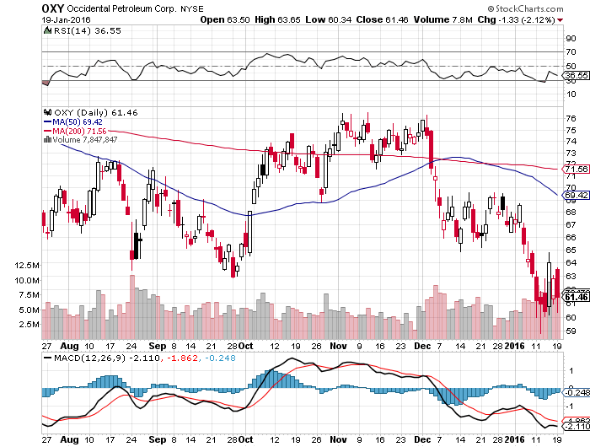
Occidental Petroleum (OXY)-

Slide 59
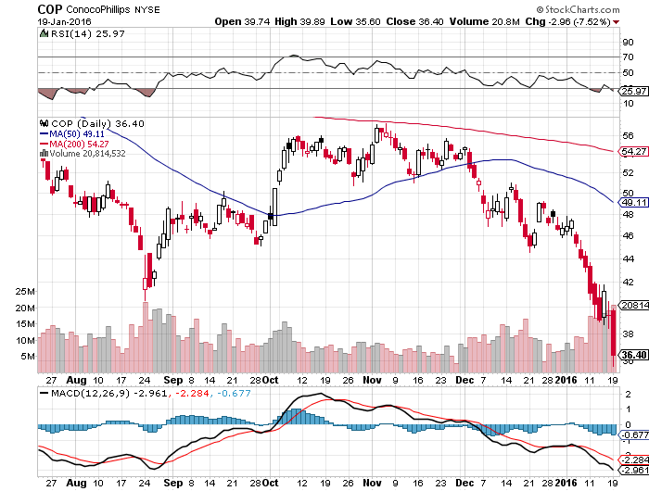
Conoco Phillips (COP)-

Slide 60
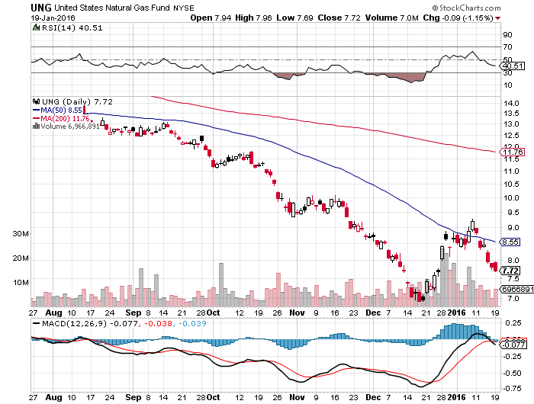
Natural Gas (UNG)-New Lows on Warm Winter

Slide 61
Copper-Yikes!

Slide 62

Freeport McMoRan (FCX)-Carl Icahn Slips on a Banana Peel

Slide 63

Precious Metals-Signs of a LT Bottom
*Middle east gold sales capping prices as the rush to raise cash to meet huge budget deficits
*Gold producing industry holding smallest net short position in the futures market in history
*Oil bottom will also call the bottom in the barbarous relic, they’re all linked
*Production peaked in Q4, will decline for years,
3% in 2016 and 15%-20% over 3-4 years
as no new mines come on stream and
ore grades fall
*Lack of new discoveries also supporting prices
*Is the new bull market here?

Slide 64

Gold (GLD)-Nailed the Breakout!!
Long the $95-$100 vertical bull call debit spread

Slide 65

Market Vectors Gold Miners ETF- (GDX) stopped out of 2/$12.50-$13.50 bull call spread destroyed by crashing commodities

Slide 66

Silver (SLV)-

Slide 67
Silver Miners (SIL)

Slide 68

Platinum (PPLT)-The Volkswagen Effect new chapter of the “Clean Diesel” Scandal

Slide 69

Palladium (PALL)-The Non Diesel Play

Slide 70

Agriculture-Also Bouncing Along a Bottom
*El nino is ravaging the West Coast, ending the drought, rain almost every day in January
*Brings near perfect growing conditions in the
Midwest and prospects of another weak
year for ag prices in 2016
*Dollar still demolishing US exports
*No trade, there are NO fish to fry

Slide 71

(CORN) – Finally, a Bounce!

Slide 72

(WEAT)-New Lows!

Slide 73

Ag Commodities ETF (DBA)- New Lows

Slide 74

Real Estate-The Last Bull Market
*Bond rally causes 30 year fixed mortgages to plunge to 3.75%, enabling buyers to get more house
*January Home Building Sentiment Index falls to 60, down from 65 on October, will rise from here as a strong Spring market approaches
*Prices for the best asset class of 2015 keep rising
* Mortgage applications bounce back hard, 21.3% week to week, as buyers return from the holidays
*Apartment vacancies on the rise for the first time in a decade as renters shift to buyers
*$8.6 billion in US commercial real estate
purchases by Chinese in 2015 could tail
off as the economy there weakens
*Case Shiller S&P 500 National index
continues upward grind

Slide 75

July S&P/Case–Shiller Home Price Index
+5.2% YOY, Denver, San Francisco, Dallas

Slide 76

US Home Construction Index (ITB)
(DHI), (LEN), (PHM), (TOL), (NVR)

Slide 77

Trade Sheet
So What Do We Do About All This?
*Stocks- sell rallies
*Bonds-the top is in, sell rallies, buy (TBT)
*Commodities-stand aside, the bottom is coming
*Currencies- Sell short the Yen and Euro on rallies, buy on dips
*Precious Metals –buy on dips
*Volatility-sell short spikes over $25 through (XIV)
*The Ags –stand aside - avoid the disaster
*Real estate-buy the homebuilders LT

Slide 78

Take a Well Earned Rest and
Spend Your Profits!
Next Strategy Webinar
12:00 EST Wednesday,
February 3, 2016
San Francisco, CA
USA!
GREAT JOB THIS YEAR TEAM!!
Good Luck and Good Trading!
Notes:
*

