Slide 1

Mad Day Trader
Bill Davis
Webinar – February 10, 2016

Slide 2
On the last webinar, we looked at the markets from the bigger picture and today I would like to revisit that and look at the S & P 500 and the QQQ.

Slide 3
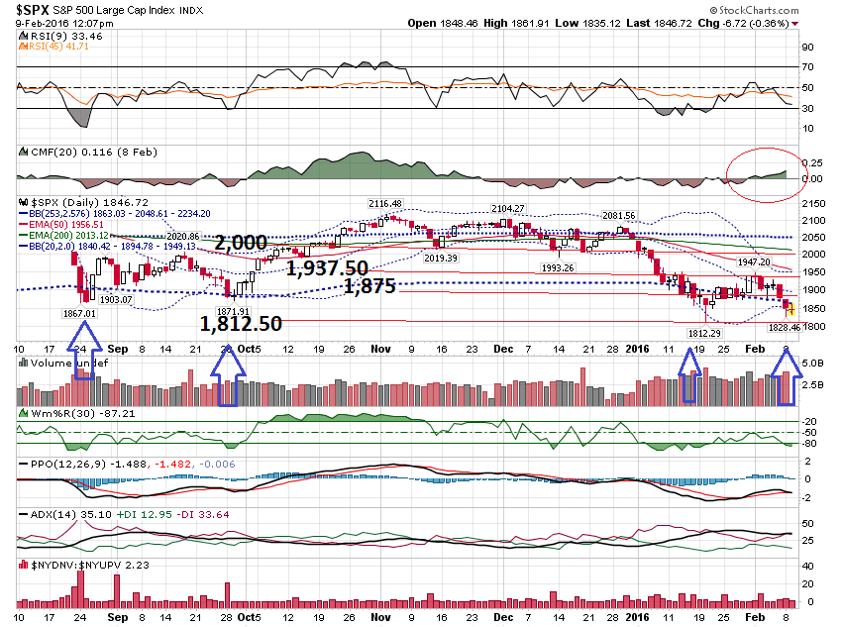

Slide 4
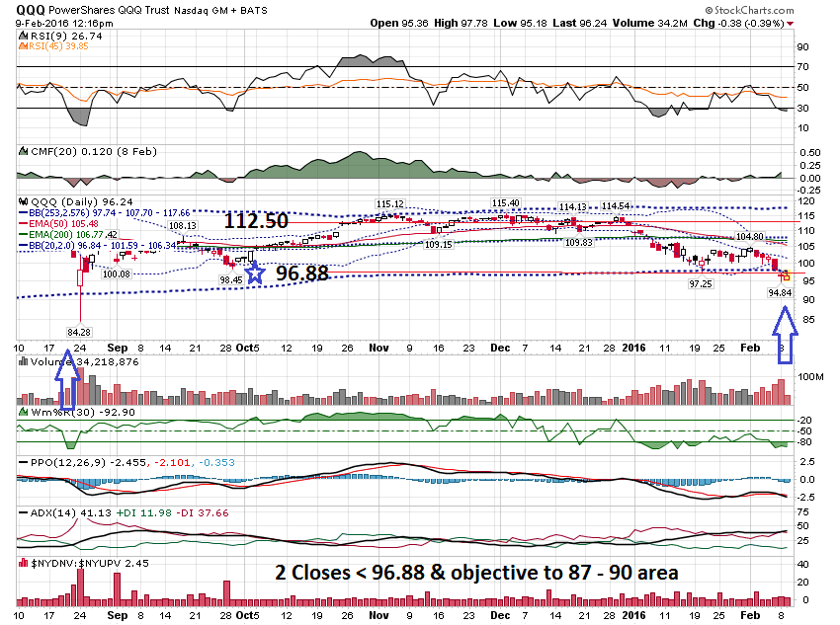

Slide 5
Because we are in Earnings
Season, I want to discuss earnings and trading off earnings.

Slide 6
I do NOT advocate trading before earnings. That is because the option premiums are inflated by the market makers.
The market makers know that people will straddle a stock, so they inflate the premiums

Slide 7
If you have ever traded before earnings and wondered why the stock moved in your direction and you still lost money, that is the reason.

Slide 8
Another key concept is that the price action the day before an earnings announcement typically has no bearing on the next day’s price action.

Slide 9
I believe you are better off trading AFTER the announcement when the high implied volatility has been removed.

Slide 10
The best set ups will have an extreme gap move.

Slide 11
Scenarios:
Gap Up & Fills Gap
Gaps Up & Continues Up
Gaps Down & Fills Gap
Gaps Down & Continues Down

Slide 12
How can you tell which one it will do?

Slide 13
After a stock gaps off earnings, mark the high and low of the 1st bar on a 60 minute chart and trade in the direction of the violation.

Slide 14
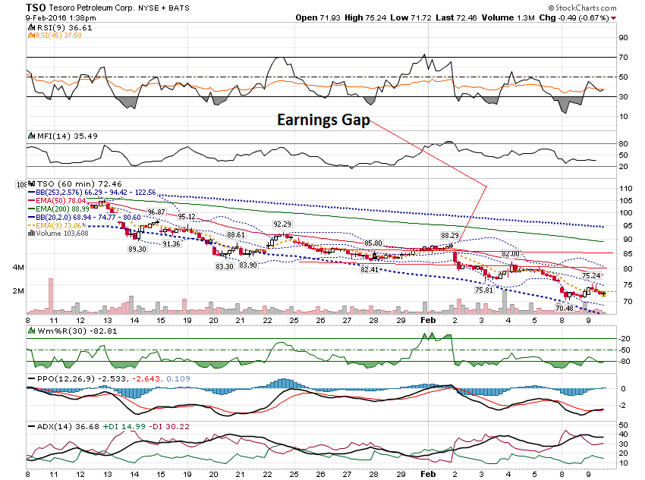

Slide 15
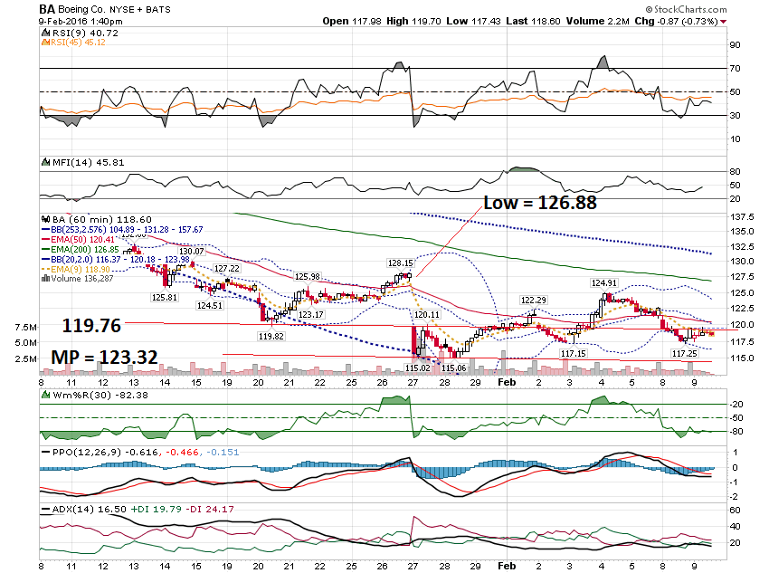

Slide 16
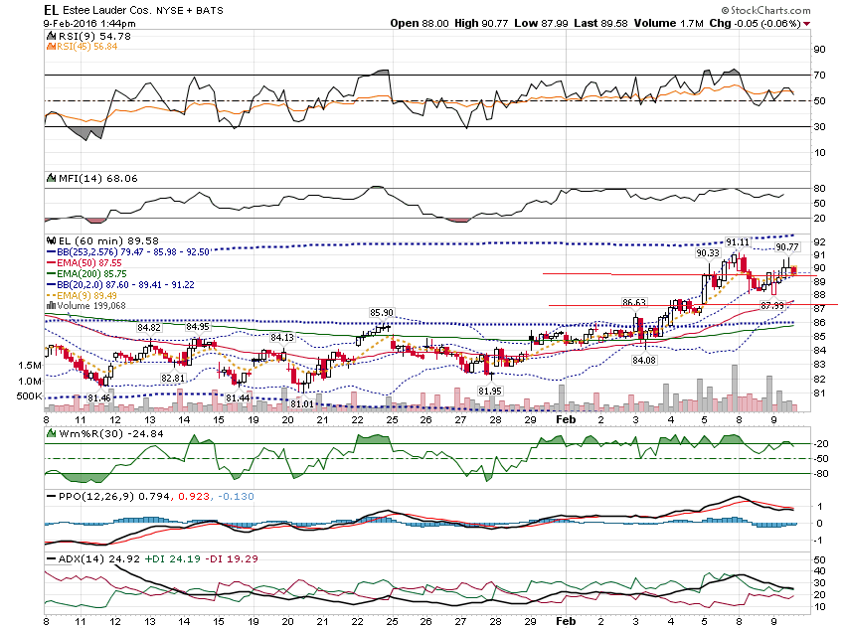

Slide 17
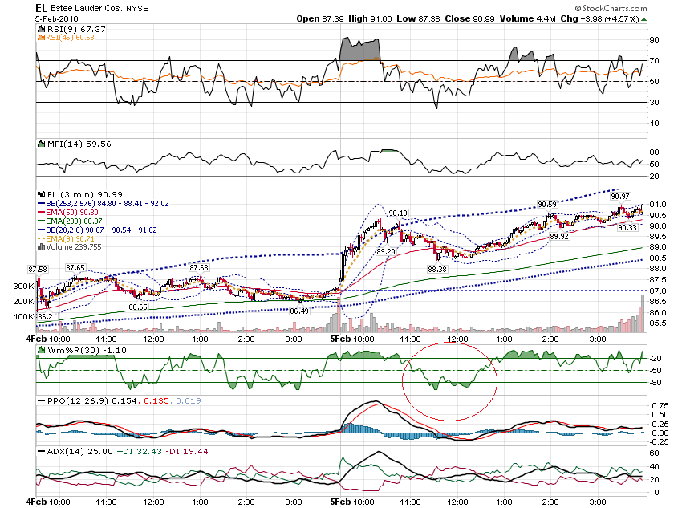

Slide 18
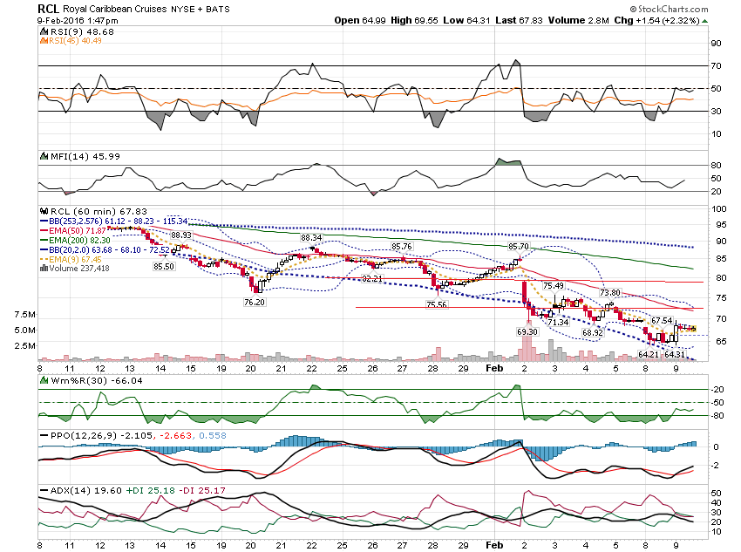

Slide 19
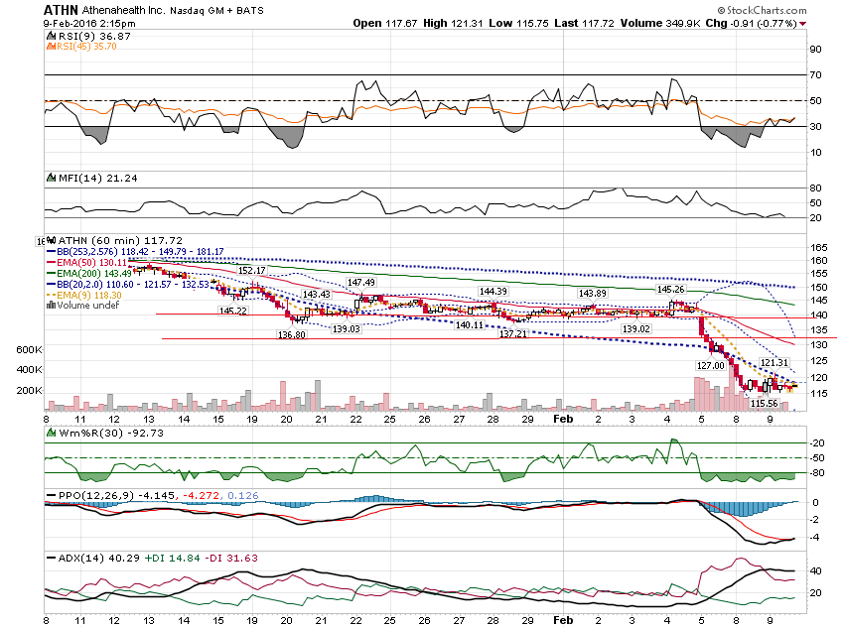

Slide 20
Granddaddy of
Earnings Moves …
LNKD

Slide 21
I want to show some charts the day before earnings.

Slide 22
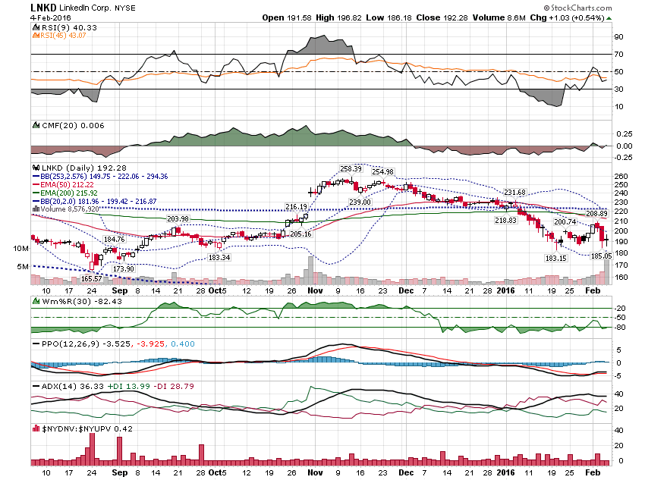

Slide 23
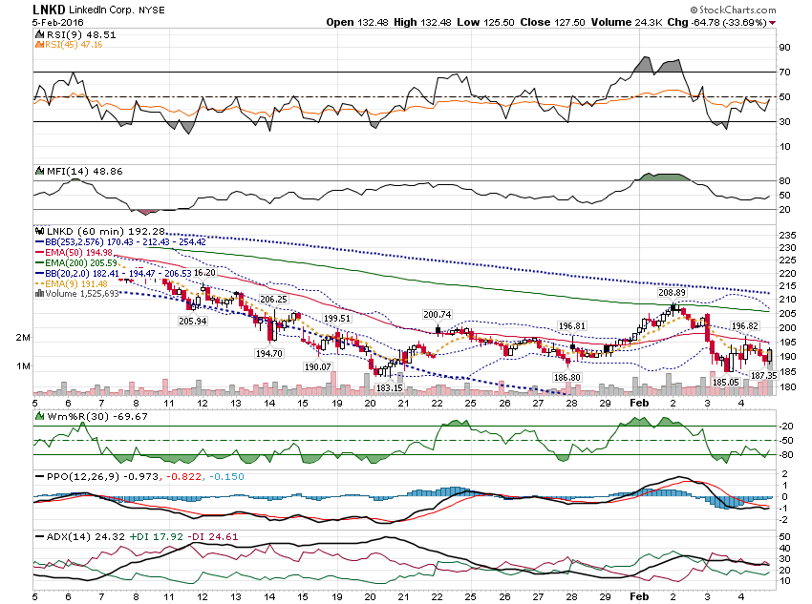

Slide 24
Let’s look at LNKD
After Earnings …

Slide 25
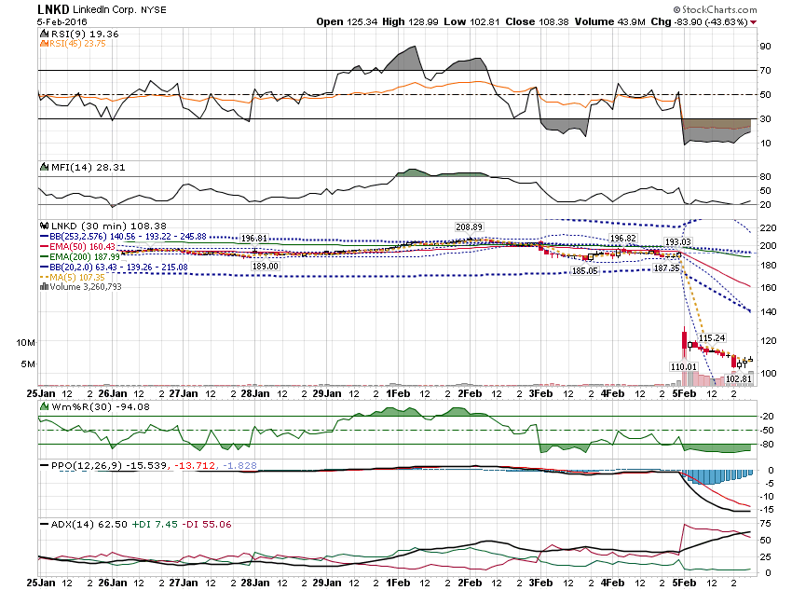

Slide 26
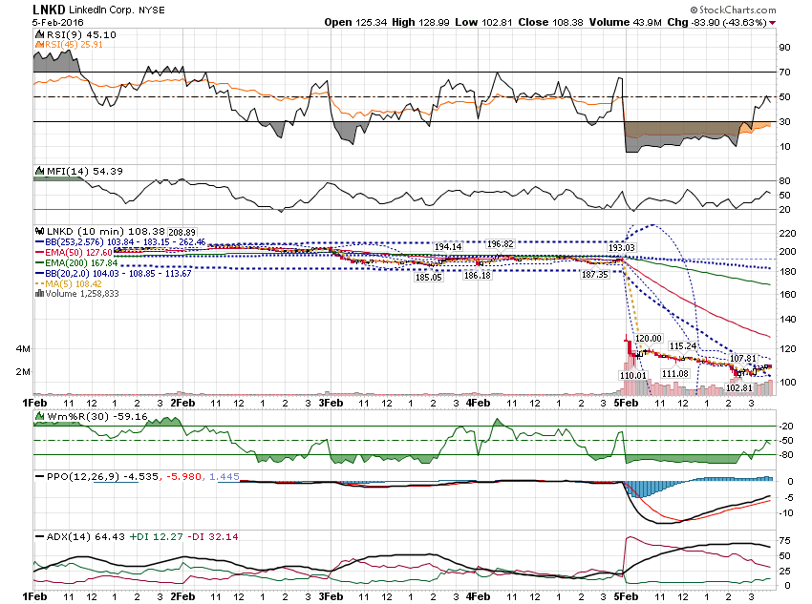

Slide 27
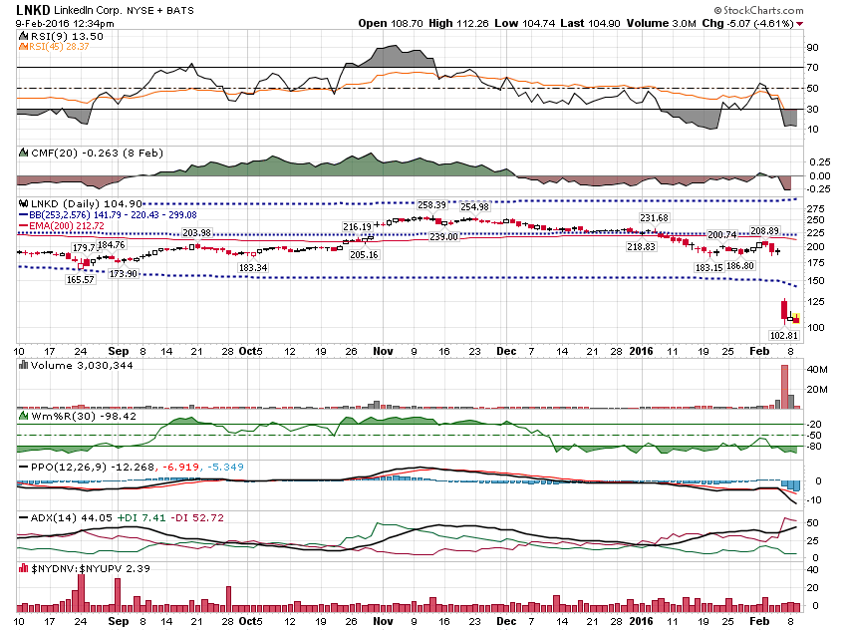

Slide 28
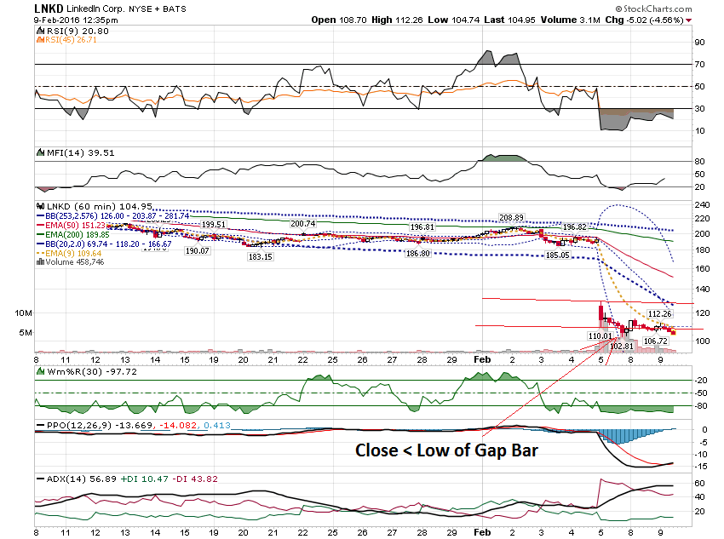

Slide 29
One way to enter a trade like this is to scale down to a 10 minute chart and get short when it is gets overbought.

Slide 30
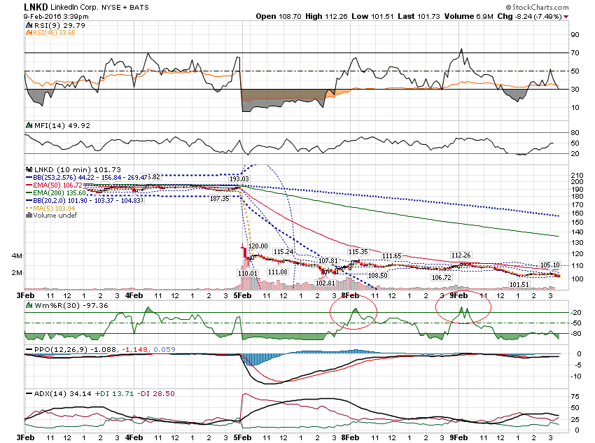

Slide 31
Pre Earnings Trade:
Debit Spread –
B 192.50 Put $12.40 - $83
S $182.50 Put $8.50 – 73.60
$3.90 - $9.40
Net = $5.50 or 141%

Slide 32
Lottery Trade:
OI Vol
130 Put 0.01 6 140
130 Put 20.73 541 140

Slide 33
Thanks for watching!
Bill Davis
Mad Day Trader
February 10, 2016 davismdt@gmail.com

