Slide 1
Mad Day Trader
Bill Davis
Webinar – February 24, 2016

Slide 2
Last webinar we discussed trading around earnings and more specifically, trading after an Earnings move.

Slide 3
On this webinar, I want to talk about how to determine the shorter term trends. And take a look at the S & P 500 again from a long to short term perspective.

Slide 4
First, I want to look at the sentiment indicators that I prefer.

Slide 5
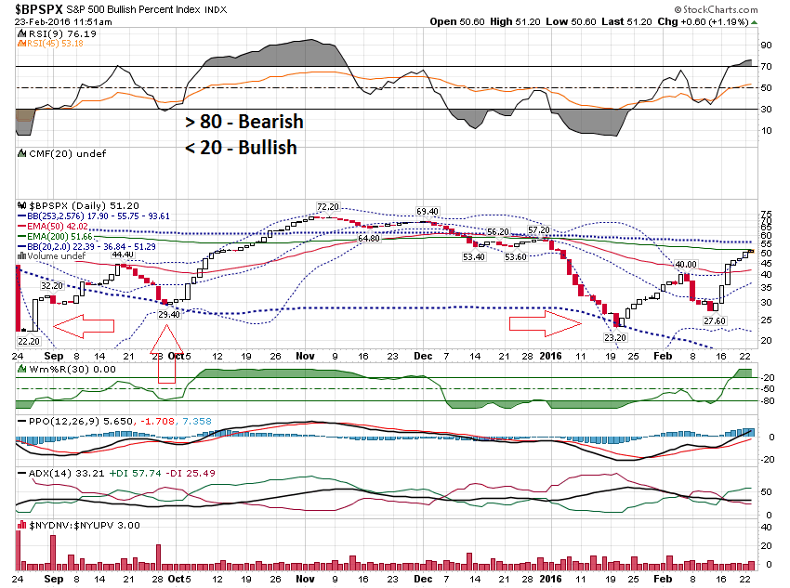

Slide 6
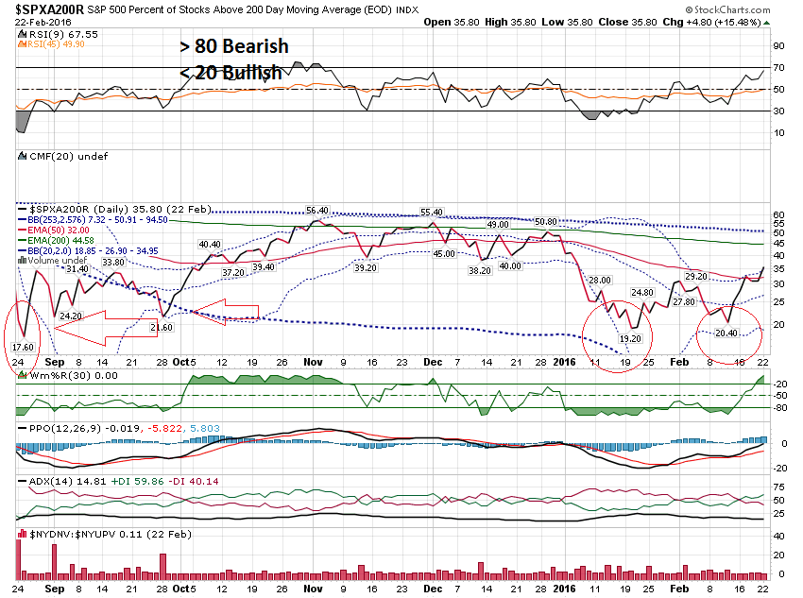

Slide 7
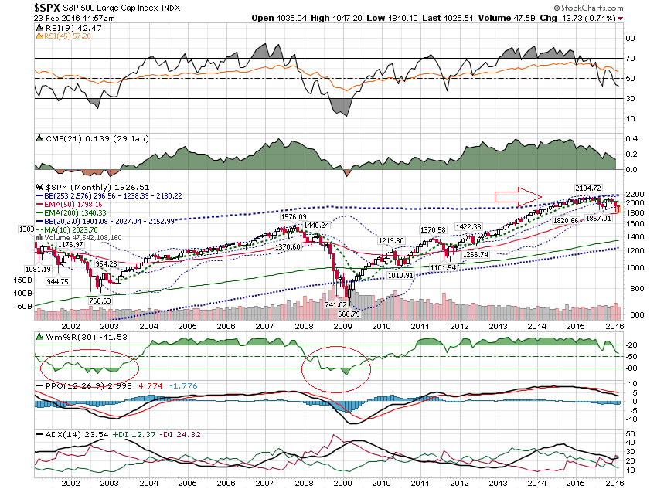

Slide 8
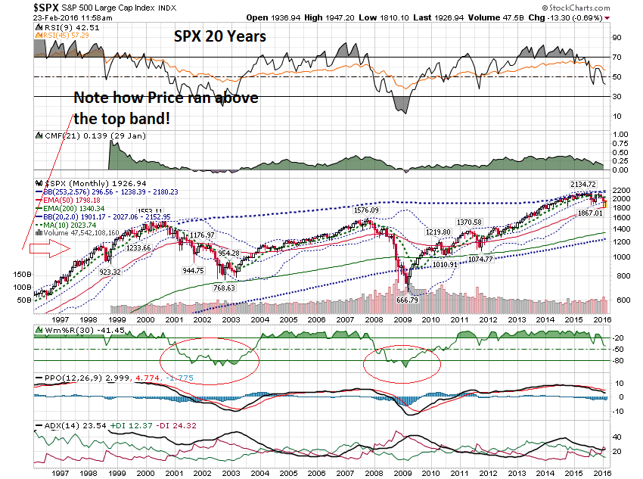

Slide 9
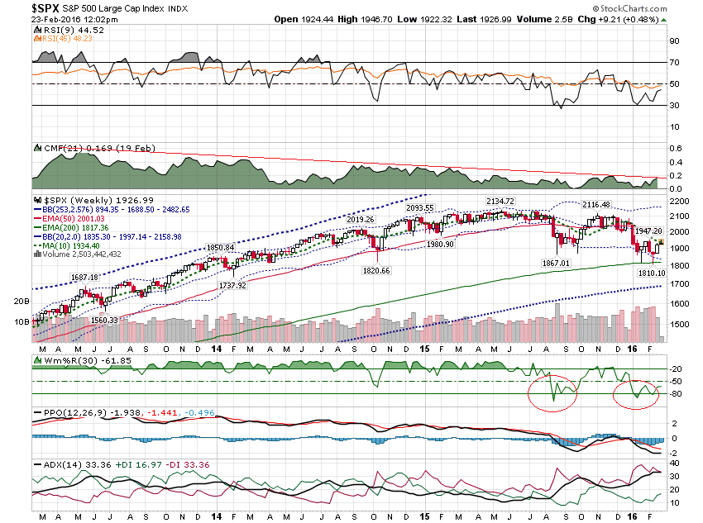

Slide 10
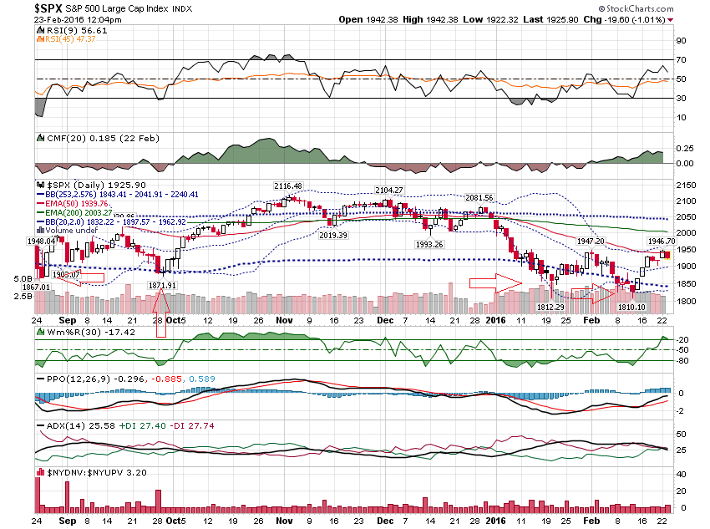

Slide 11
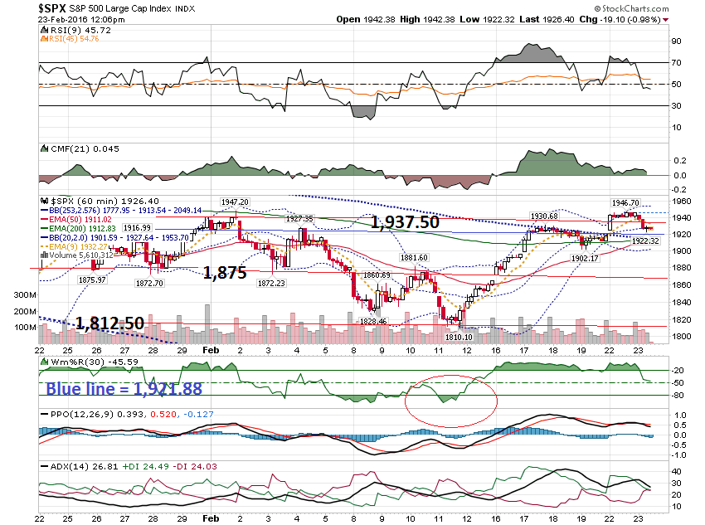

Slide 13
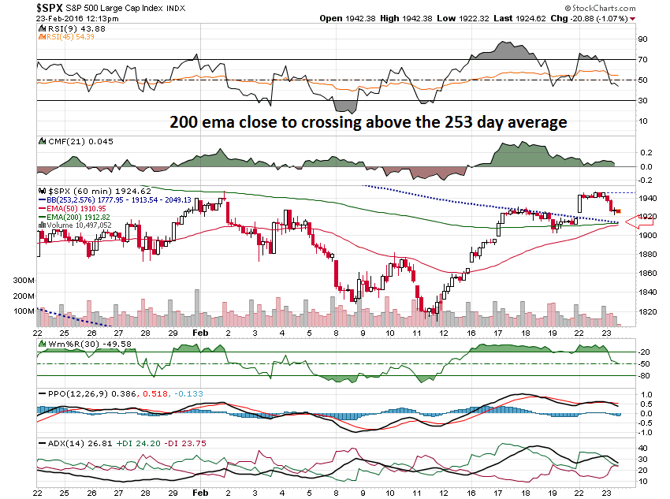

Slide 14
Received Tues @ 11:45 AM Bill: I watch the SPX and VIX closely. Beautiful setup today with pullback to the 1921.88 line. However, the VIX overshot its 2031 line to 21.07. I know the levels are not pin point lines in the sand. My question is regarding probabilities. How much does this kind of extra VIX move temper the probability of a good bounce in the SPX off its minor support line -- 1921.88. ( We have gotten a good bounce as it turned out. )

Slide 15
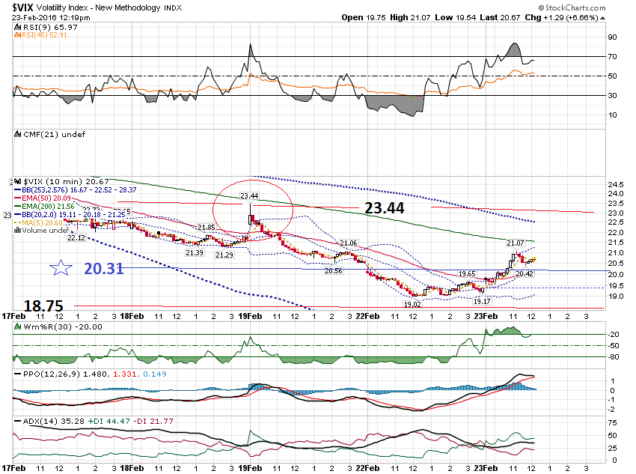

Slide 16
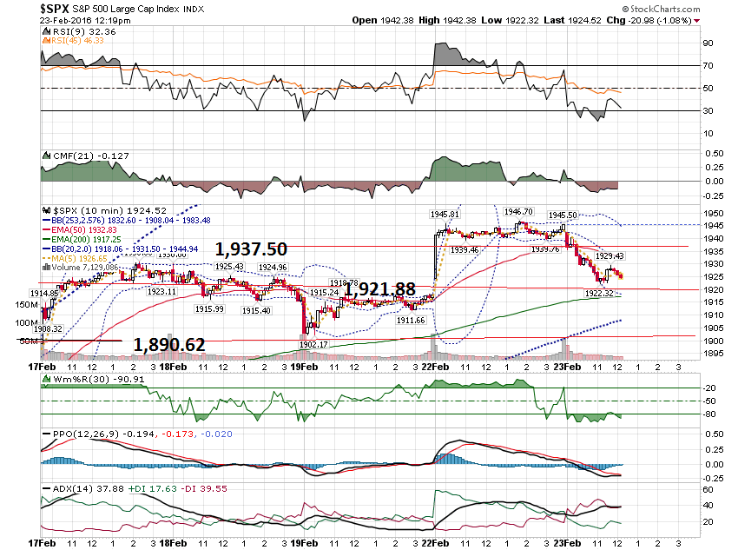

Slide 17
If you are trading short term … what do you do? And what to you expect?

Slide 18
I am reactionary. I want to see the VIX come back and get under the 20.31 level. That should signal that a short term bottom should be setting up!

Slide 19
Let’s see what happened …

Slide 20
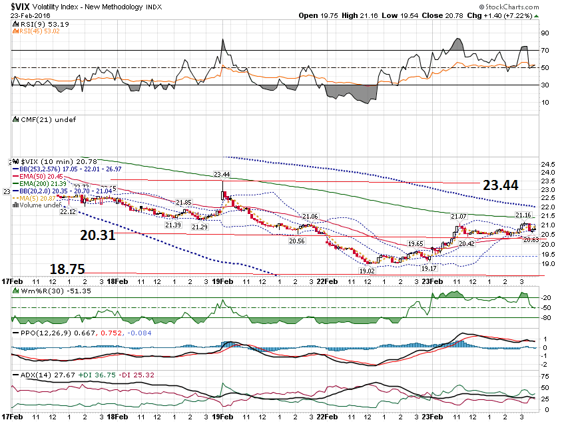

Slide 21
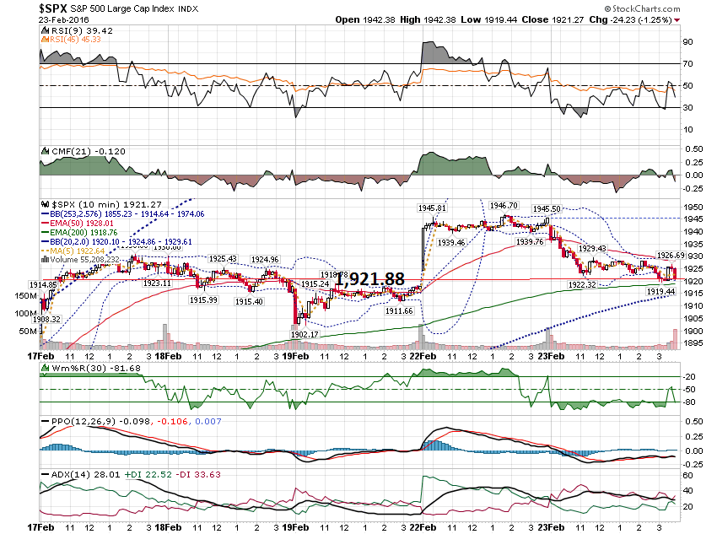

Slide 22
With the VIX & S & P 500 bouncing off a level, to go a shorter timeframe and scalp the overbought & oversold setups.

Slide 23
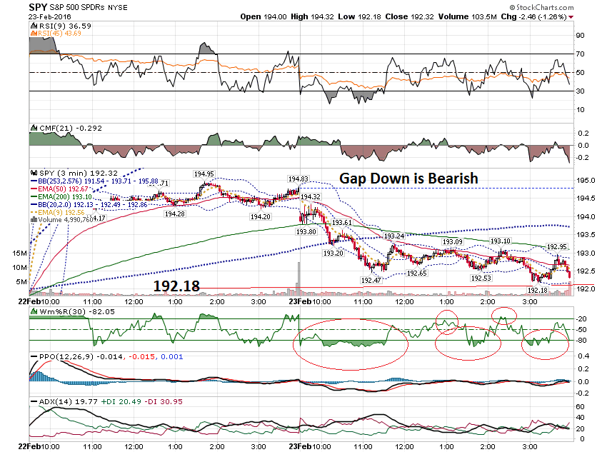

Slide 24
By the way, this is how I responded to the your fellow member’s question … R_ _ _, That is a good question. Usually the VIX will come back to test the line again, ie the 20.31 line. If it holds, the VIX should head up and then the 1,921.88 line will fail. If it gets back under the 20.31 line, look for the market to reverse up. Bill

Slide 25
Hi Bill, Could you please elaborate during the webinar on your strategy for our portfolio for the coming weeks? Kind regards, M

Slide 26
The first comment I want to make is this. If you look at any of our open position, they are all closer to their lows than their highs.

Slide 27
The second comment is when would I consider adding to any position? And if you noticed by now, I tend to never panic with a position.

Slide 28
Regarding adding a position, I will only do it if a certain technical conditions set up. At the minimum, I want to see the 60 minute chart move into an uptrend.

Slide 29
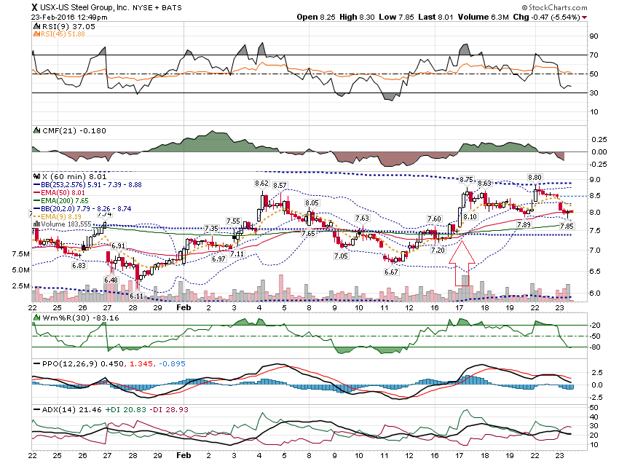

Slide 30
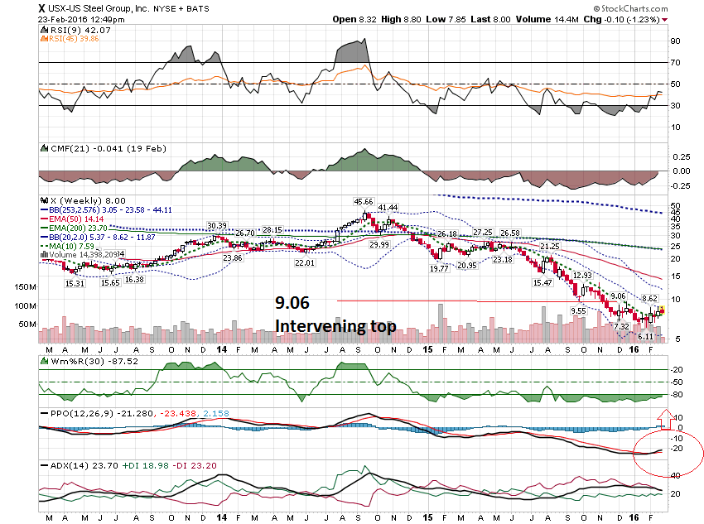

Slide 31
I want to close with one other stock that reported earnings last week.

Slide 32
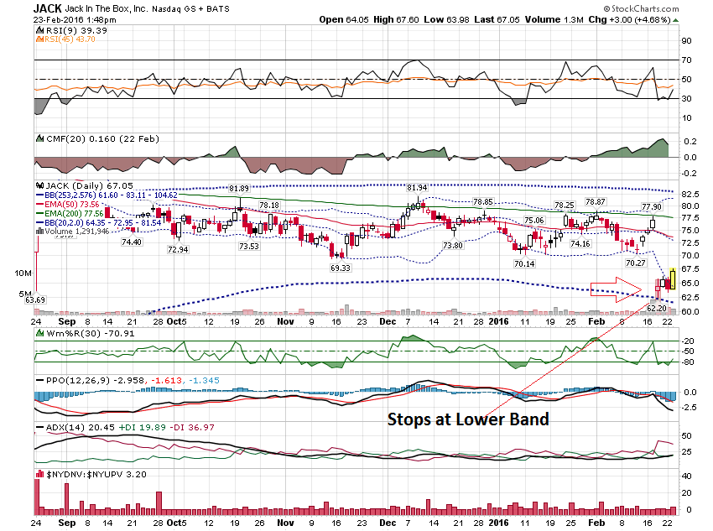

Slide 33
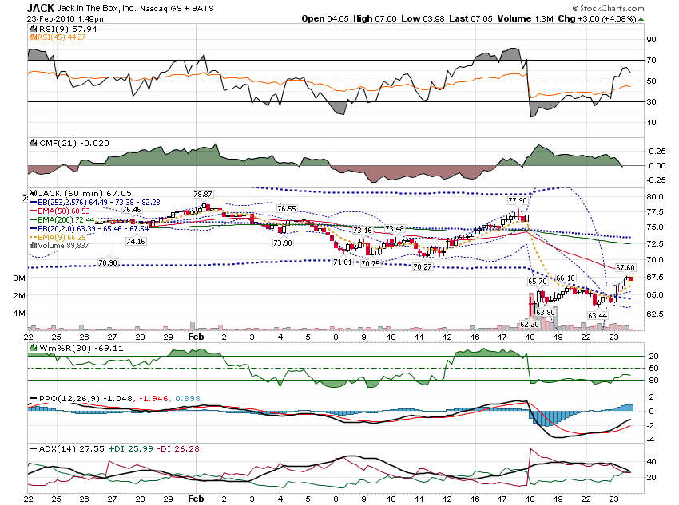

Slide 34
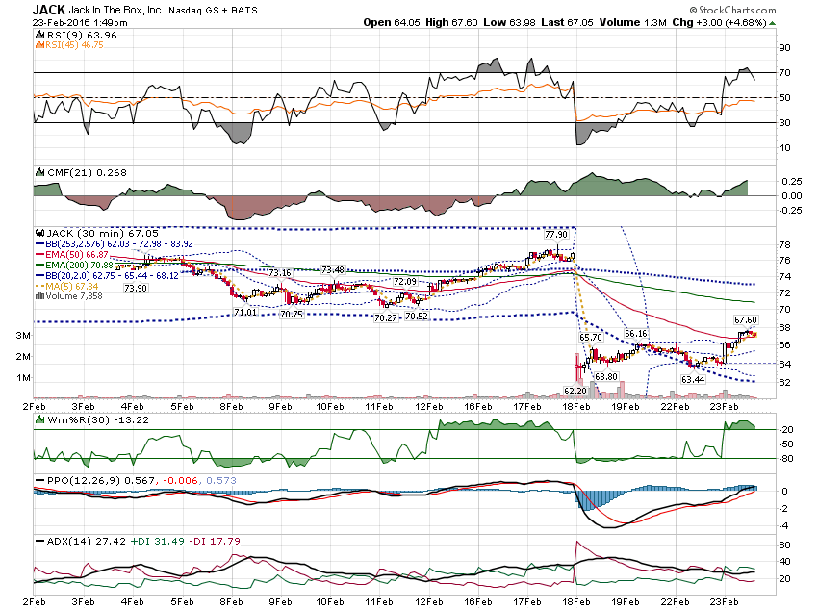

Slide 35
Thanks for watching! Bill Davis Mad Day Trader February 24, 2016 davismdt@gmail.com

