Slide 1

The Mad Hedge Fund Trader
“More QE!”
With John Thomas
from San Francisco, CA, February 3, 2016
www.madhedgefundtrader.com
Notes:
*

Slide 2


Slide 3
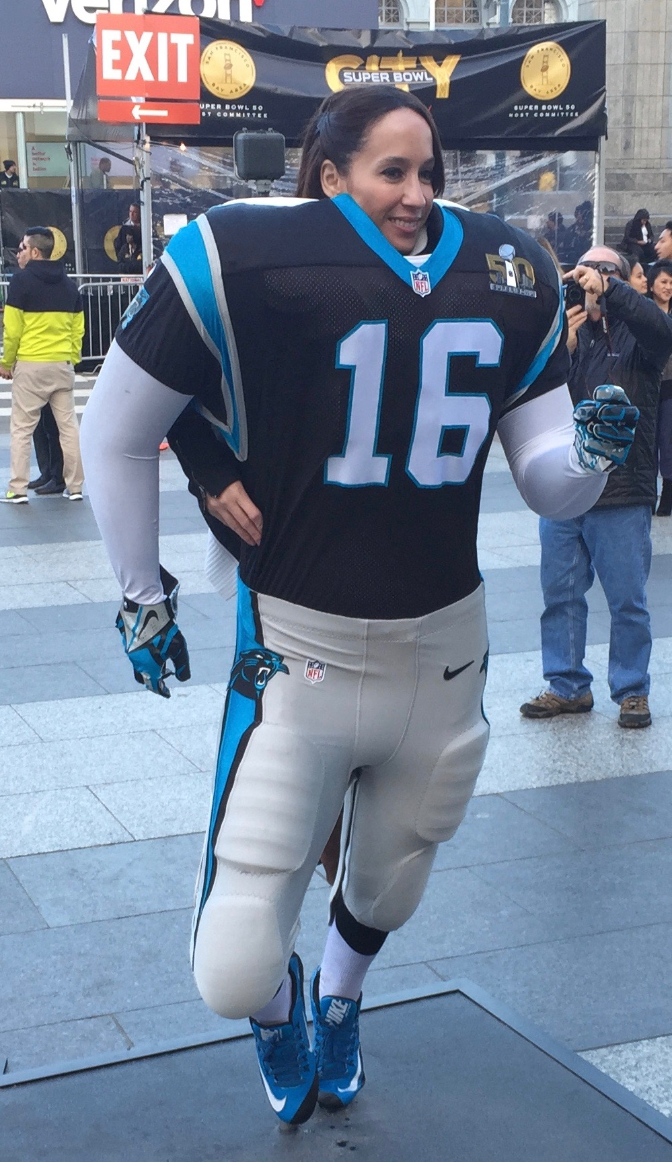

Slide 4

Trade Alert Performance
Hiding in Cash Until the New Year
*January +1.23% Final *July +6.42% Final
*February -1.72% MTD *August +1.27% Final
*March +3.00% Final *September +11.99% Final
*April +6.62% Final *October Final -6.19%
*May +5.15% Final *November MTD 5.78%
*June +3.68% Final *December -4.94%
*2016 Year to Date -0.49%
compared to -6.3% for the Dow Average
*Trailing 1 year return +37.00%, +191.2% since inception,
5.96% short of all-time high
*Average annualized return of 37.00%

Slide 5

January Trade Alert Analysis
Working Hard to Stay Above Water
*15 Trade Alerts closed
*13 made money (87%) after netting out losses on hedges (SPY) puts vs call spreads
*Without (GDX) (-4.81%) and (TLT) (-2.96%), we would have been up 9.0% for the month
*2 bad trades nearly wiped out 13 good ones
due to unprecedented or once a decade
type events
*The great trades are getting wiped out by the
unbelievable trades
*Flat is a win in this environment, when markets
settle down you will make it big

Slide 6
Portfolio Review
Staying Small and Neutral to Sleep at Night
current capital at risk
Risk On
World is Getting Better
(XIV) | 10.00%
(SPY) 2/$176-$181 call spread | 10.00%
(SPY) 2/$173-$178 call spread | 10.00%
Risk Off
World is Getting Worse
(SPY) 3/$200-$205 put spread | -10.00%
(SPY) 4/$182 puts | -5.00%
total net position | 15.00%
Expiration P&L
7.11% YTD

Slide 7
Paid Subscriber Trailing
12 Month Audited Return +37.00%

Slide 8
62 Months Since Inception
Daily Audited Performance
Averaged annualized return +37.00%

Slide 9

Strategy Outlook-Run For Cover
*In a global financial crash, all correlations go to ONE. SELL EVERYTHING!
*A new round of Japanese QE prompts global “RISK ON” rally. Are Europe and the US next?
*Oil and commodities put in “A” bottom, but not “THE” bottom
*US stocks approaching my downside targets for 2016, (SPY) $182 and $174
*Another emerging market crisis is setting up, which may
give us the final flush
*No chance of any more Fed rate hikes this year
*Gold is the best performing asset class of 2016, up 6%
*El Nino finally gives the ags a break

Slide 10
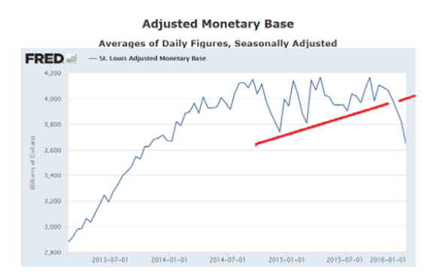
Here is the Problem!

Slide 11
The Bill Davis View
A $1,500 Upgrade for the Mad Day Trader Service
Buys:
Martin Marietta (MLM) $125 Target to $137
Cirrus Logic (CRUS) $29 Target to $37
3 M Co. (MMM) $140 Target to $160
Facebook (FB) $102 Target to $116
Xilinx, Inc (XLNX) $45 Target to $52
Sells:
Apple (AAPL) $100 Target to $87
Buffalo Wild Wings (BWLD) $170 Target to $140
American Express (AXP) $61 Target to $50
Netflix (NFLX) $94 Target to $84
Baidu, Inc (BIDU) $159 Target to $148
Tesla Motors (TSLA) $187 Target to $175
Under Armour (UA) $83 Target to $62

Slide 12

The Global Economy-QE Again!
There is No US Recession Coming!
*2016 US GDP expectations have fallen from 2.81% a year ago to 2.17% today, come on at 0.70% for Q4, consumer spending is great, but capital spending is weak
*Friday nonfarm payroll will tell all
*Market jitters dash the hopes of another Fed rate rise, boosting bonds and weakening dollar
*European economic numbers are slowly turning positive as QE kicks in
*Japan launches another surprise round of QE with negative interest rates, frightened by December export drop of 4.4%, for sixth month in a row, signaling an economic slowdown
*Chinese QE adds more fuel to the fire
*Next to come is a “RISK ON” global
synchronized growth in 2016
once we get through New Year effects

Slide 13
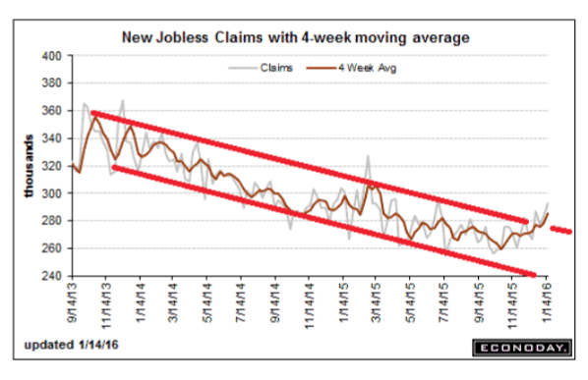
Weekly Jobless Claims –The Most Worrying Statistic
-16,000 to 278,000
Breaking the Downtrend?

Slide 14
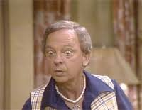
Bonds-Unbelievable!
*Equity crash triggers big flight to safety bid, prospect of no more Fed rate rises boosts all fixed income, except junk
*GLOBAL “RISK OFF” then drives yields back down to bottom of a one year range, and then a major breakdown
*Bond yields have now fallen 60 basis points since Fed rate rise, unbelievable!
*Foreigners pouring rivers of
money into the US as a safe haven
*Non energy junk is starting
to offer real value
*New highs for munis
*Japan cancels ten year auction
fearing negative yields

Slide 15
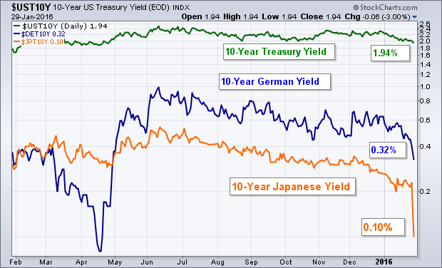
Global Rate Collapse

Slide 16
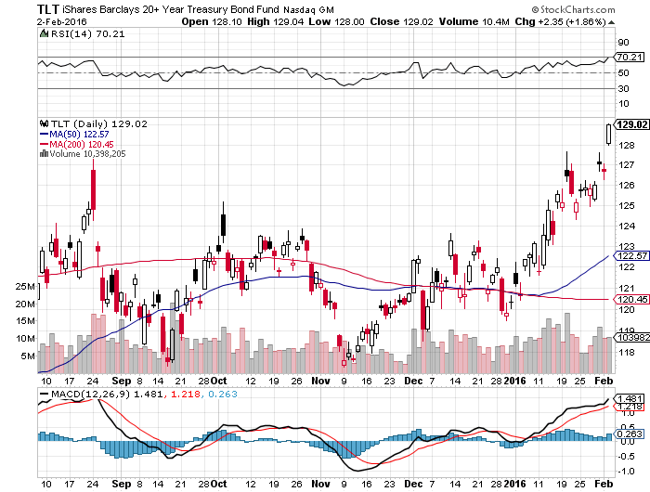
Ten Year Treasury Yield (TLT) 1.79% stopped out of long the 2/$126-129 vertical bear put debit spread stopped out of long the 2/$130-133 vertical bear put debit spread

Slide 17
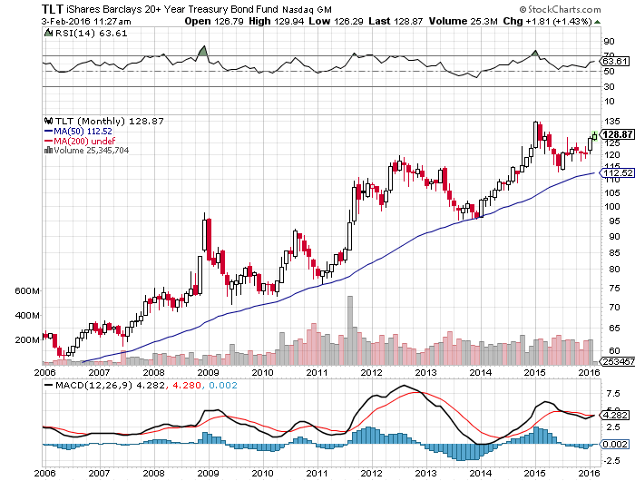
Ten Year Treasury Yield (TLT) 1.79%
Is This Where We’re Headed?

Slide 18
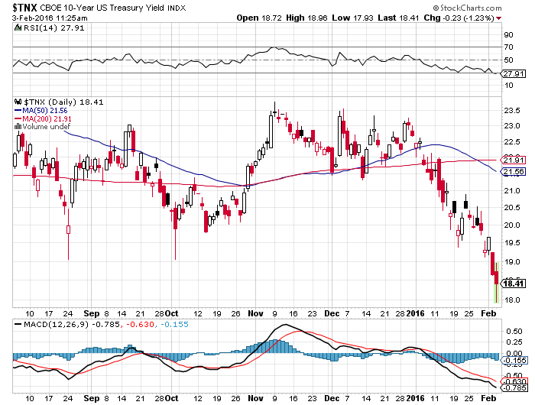
Ten Year Treasury Yield ($TNX) 1.79%
2.35% Ceiling Holds, But the 2.00% floor breaks

Slide 19
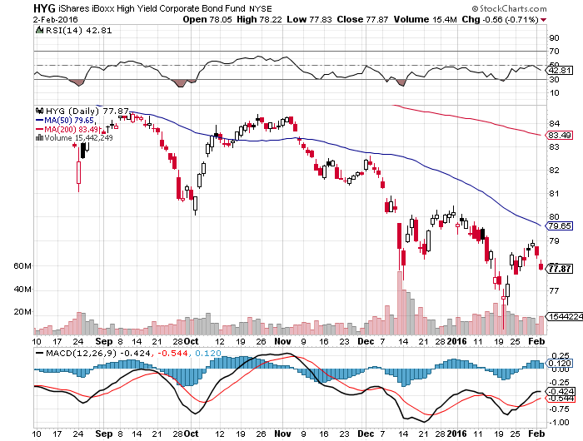
Junk Bonds (HYG) 8.56% Yield
A Great Risk Coincident Indicator

Slide 20
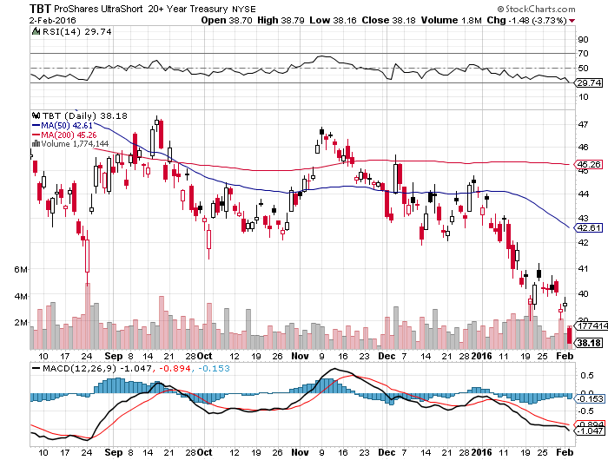
2X Short Treasuries (TBT)-
Not Yet the Big Trade of 2016?
Back in “BUY” Territory

Slide 21
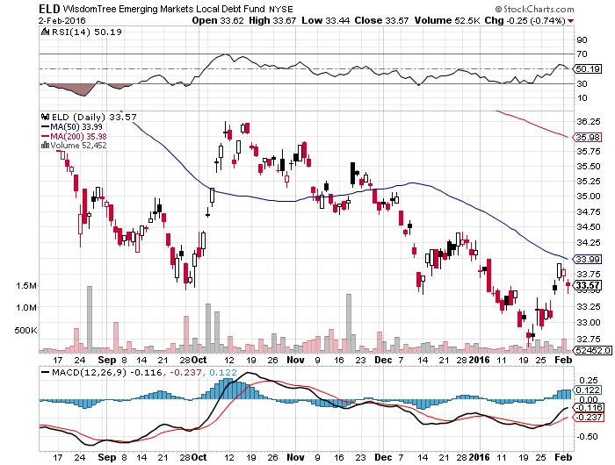
Emerging Market Debt (ELD) 6.06% Yield-

Slide 22
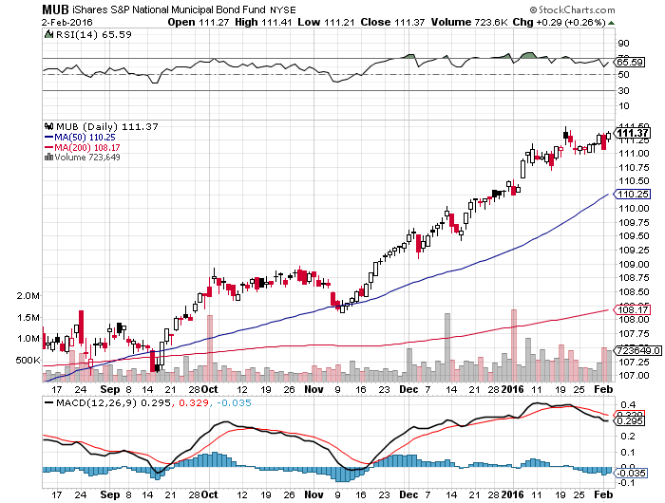
Municipal Bonds (MUB)-1.50% yield-New High
Mix of AAA, AA, and A rated bonds-flight to safety

Slide 23

Stocks-Volatility!!
*Indices are masking a stealth bear market, average stock was down 26% last year, buy (SPY) was down only 2%
*Health care and technology now have lowest price earnings multiples since 1985, are only industries can can cut prices faster than deflation, is why they lead over long term
*Earning are coming in down small YOY, but are up small ex oil
*Companies with high amounts of debt and leverage (oil and banks) are getting slaughtered, while those with no debt and cash flow (technology and biotech) are the ones to buy on this dip
*Sovereign wealth selling accelerates as oil falls,
with banks as their biggest holdings
*We are all oil traders now
*Corporate stock buy backs absent as
companies enter quiet period, 75% return
by February 5
*Rising market participants with falling market makers
is creating new volatility

Slide 24
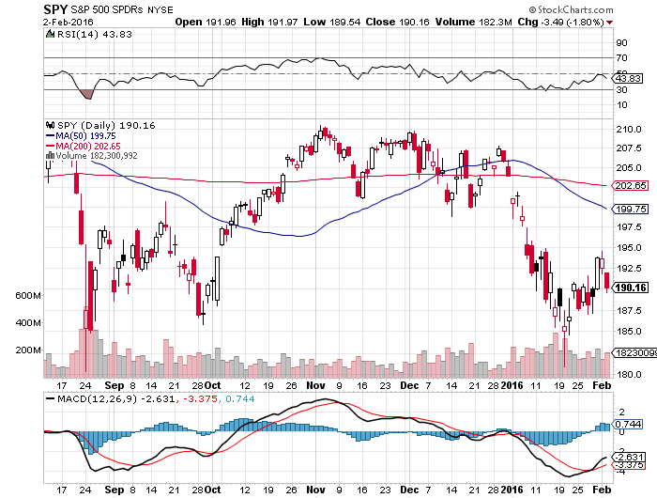
S&P 500-Breakdown!
Took profits on 2/$169-$174 and 2/$170-$175 call spreads stopped out of $195-200 put spread long 1/$176-$181 vertical bull call spread long 2/$200-$205 vertical bear put spread, looking to buy more on a rally

Slide 25
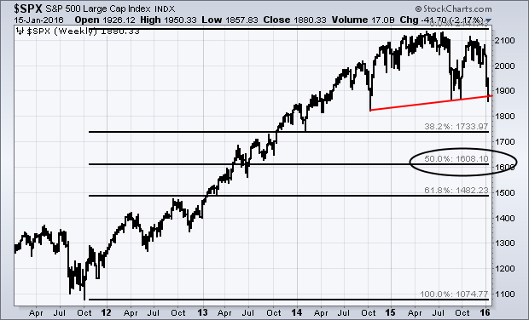
S&P 500-The Really Long View
Worst Case $1,740, PE 15X

Slide 26
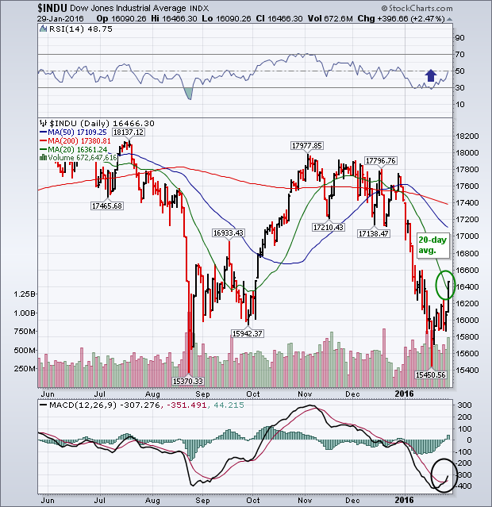
Dow Average-

Slide 27
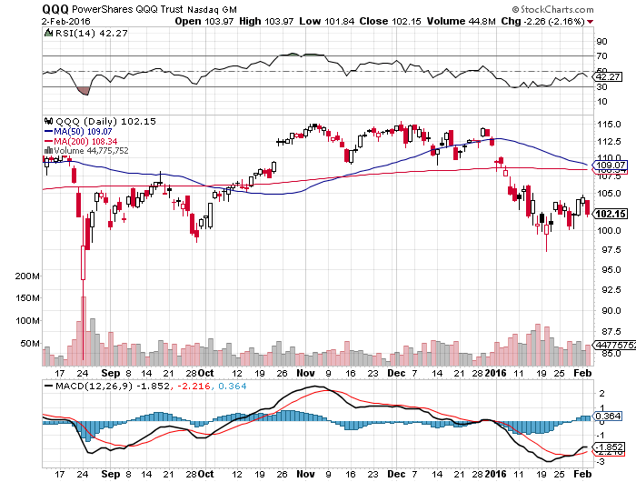
NASDAQ (QQQ)-Break of 200-Day Moving Average!

Slide 28
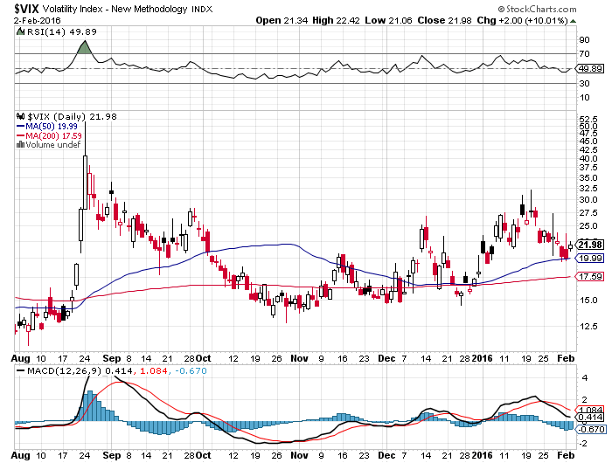
(VIX)-The Spike is Here

Slide 29
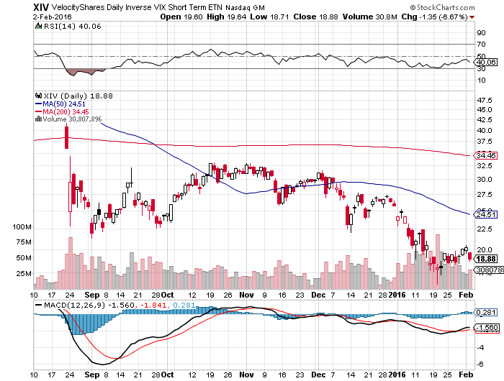
(XIV)-Velocity Shares Daily Inverse VIX Short Term ETN
Took Profit on half of position, still 10% long at $23.69, trading against it with (SPY) puts and put spreads

Slide 30
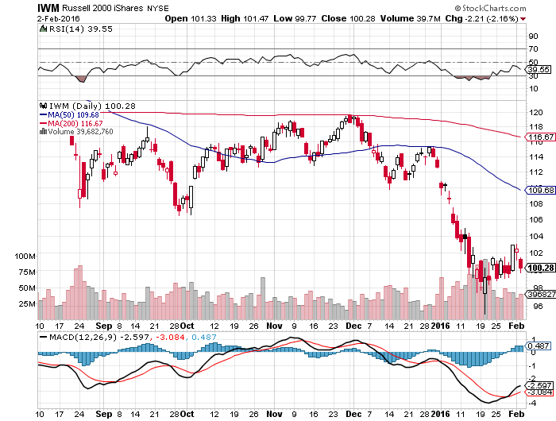
Russell 2000 (IWM)-

Slide 31
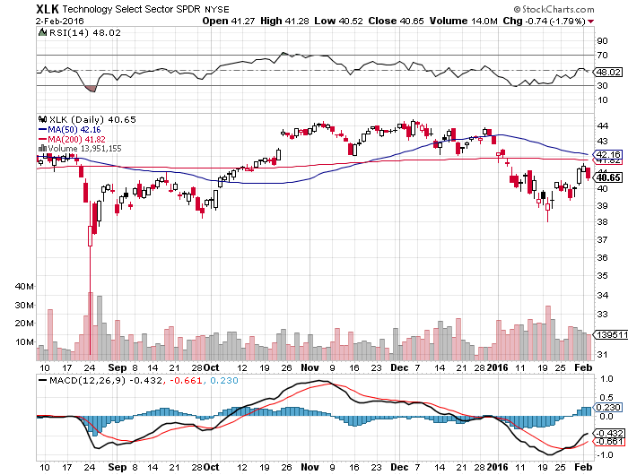
Technology Sector SPDR (XLK), (ROM)
(AAPL), (MSFT), (VZ), (T), (FB), (IBM)

Slide 32
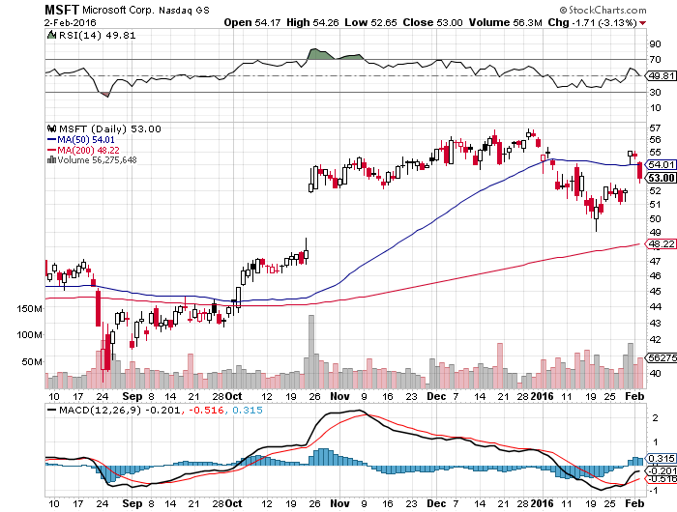
Microsoft (MSFT) took profits on long the 1/$50-$52.50 vertical bull call debit spread

Slide 33
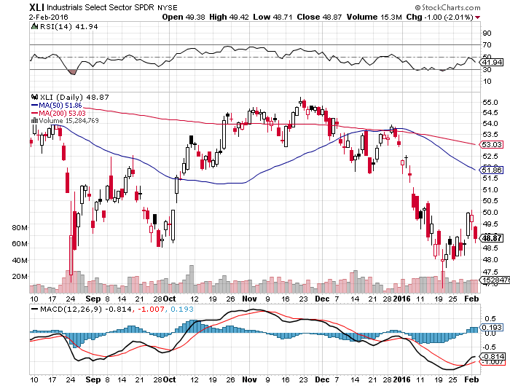
Industrials Sector SPDR (XLI)-Dow Mainstay
(GE), (MMM), (UNP), (UTX), (BA), (HON)

Slide 34
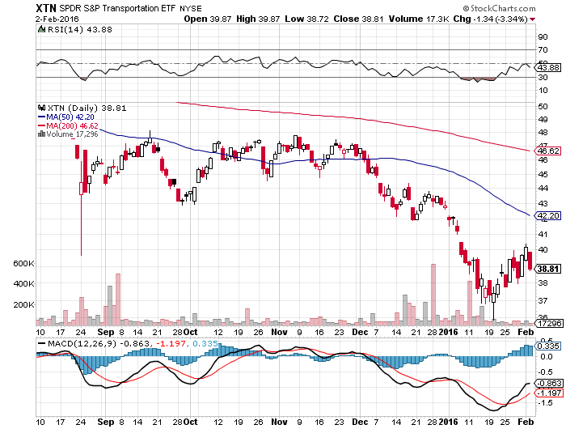
Transports Sector SPDR (XTN)-Another Dow Mainstay
(ALGT), (ALK), (JBLU), (LUV), (CHRW), (DAL),

Slide 35
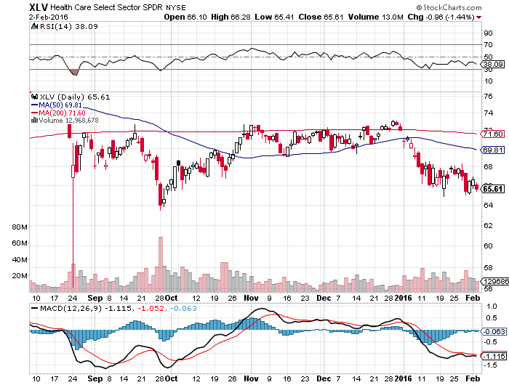
Health Care Sector SPDR (XLV), (RXL)
(JNJ), (PFE), (MRK), (GILD), (ACT), (AMGN)

Slide 36
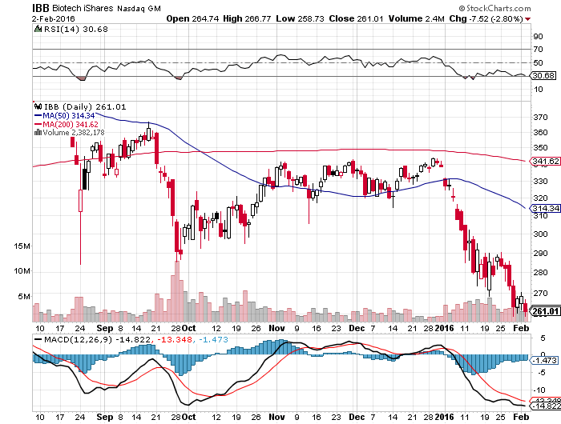
Biotech iShares (IBB)-A Political Football in 2016

Slide 37
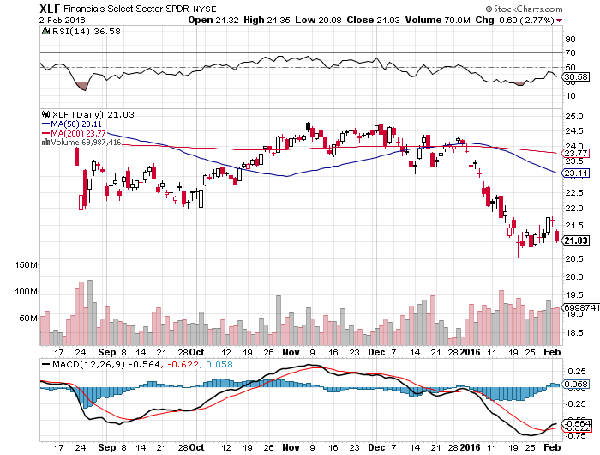
Financial Select SPDR (XLF)-
“One and Done” Means “Stay Away”
(BLK/B), (WFC), (JPM), (BAC), (C), (GS)

Slide 38
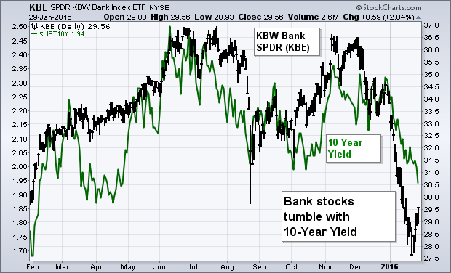
Regional Bank Basket (KRE)-Same Here
(MTG), (RDN), (SIVB), (CFG), (CFR), (BXS)

Slide 39
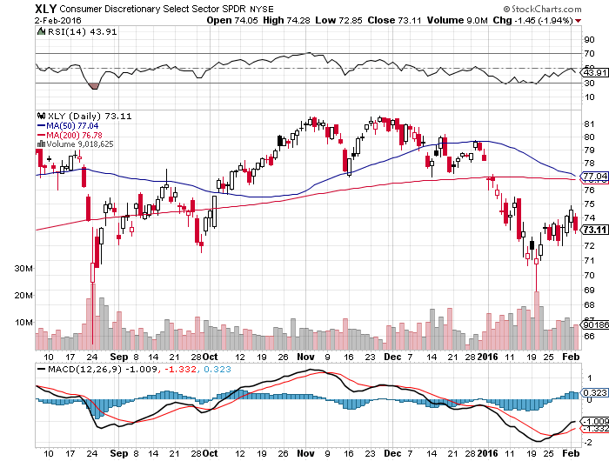
Consumer Discretionary SPDR (XLY)
Target to Buy on a dip-Will bounce back fastest
(DIS), (AMZN), (HD), (CMCSA), (MCD), (SBUX)

Slide 40
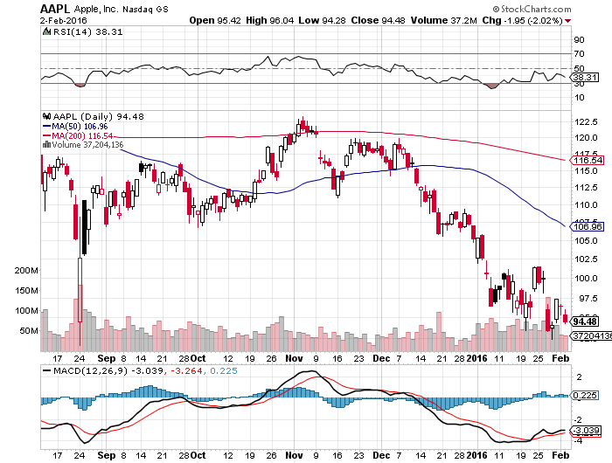
Apple (AAPL) –iPhone production cut 30%
Back to waiting for the next real catalyst-the iPhone 7
Buy after Q1 earnings in April to avoid post Christmas dip

Slide 41
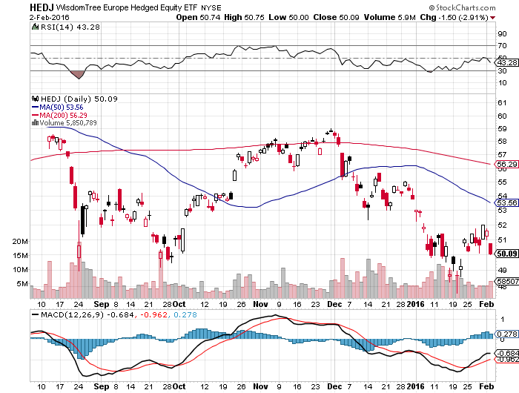
Europe Hedged Equity (HEDJ)up-Hedged Japan Equity
Great Entry Point setting - Load the boat at $50 on “RISK ON”

Slide 42
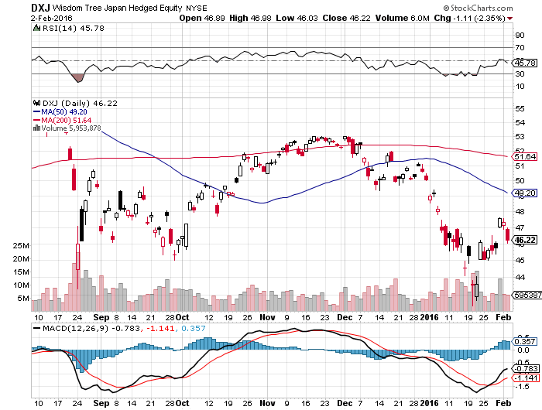
Japan (DXJ)-Hedged Japan Equity another nice entry point-Load the boat at $45 on “RISK ON”

Slide 43
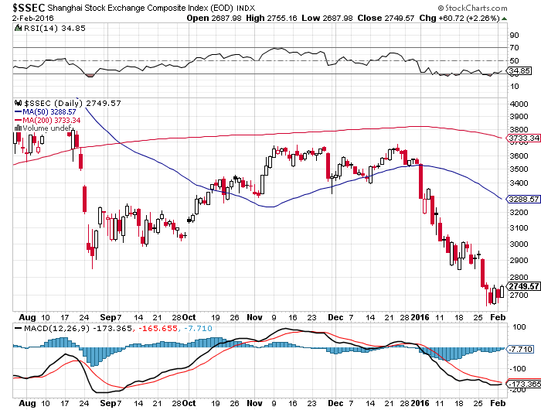
China ($SSEC)-
The Bad Boy Market and font of volatility

Slide 44
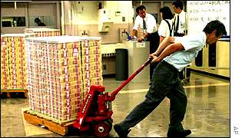
Foreign Currencies-QE Rules!
*Japan launches another wave of QE, with negative interest rates, joining Europe and Switzerland. Japanese banks and yen are crushed, Is the US next?
*ECB President Mario Draghi hints at more QE in March, rallying all risk markets
*Ongoing commodity collapse takes commodity currencies to new lows
*Slow improvement in European economies could lend further Euro support
*With no interest rate moves anywhere,
this could be a year of low volatility
for currencies
*Oil crash takes Russian Ruble to new all
time low at 84 to the dollar, capital fleeing
Russia

Slide 45
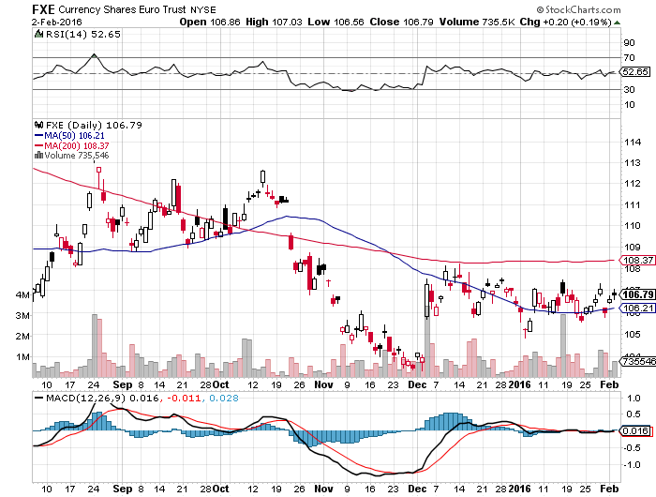
Euro ($XEU), (FXE), (EUO)-Short a Double Position look to BUY at bottom of the range-no breakdown this time

Slide 46
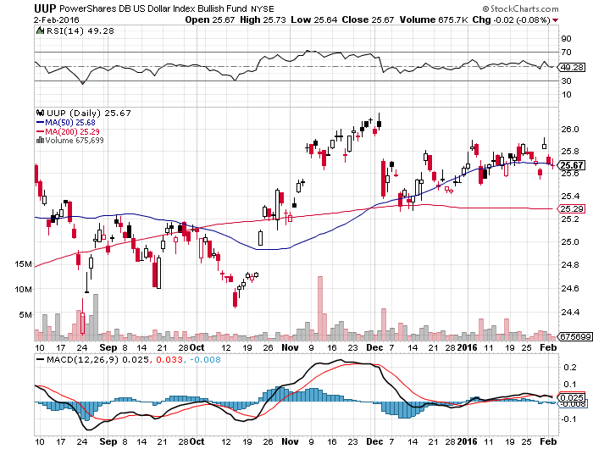
Long Dollar Index (UUP)-Topping out

Slide 47
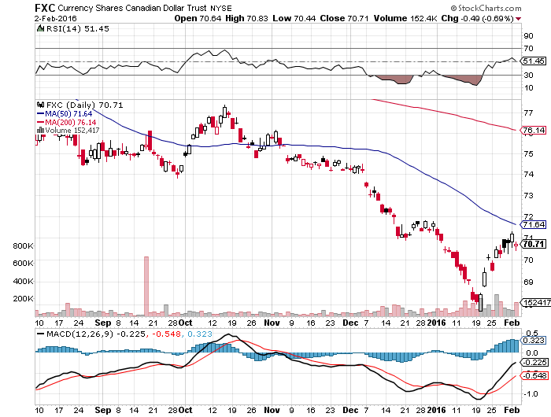
Canadian Dollar (FXC)-Commodity Disaster

Slide 48
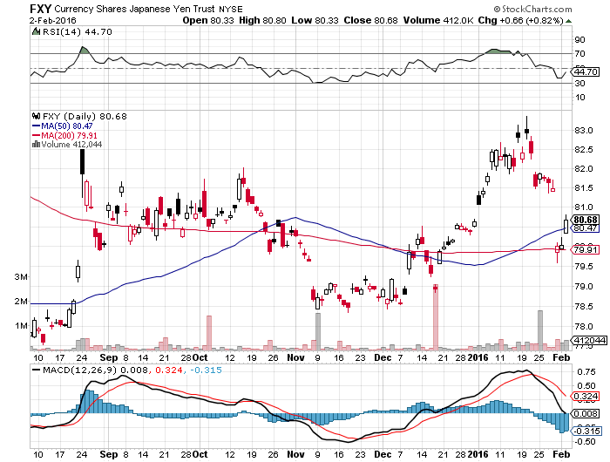
Japanese Yen (FXY)-At a One Year High

Slide 49
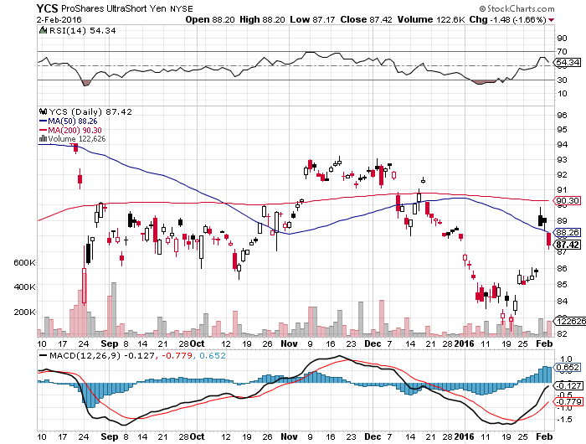
Short Japanese Yen ETF (YCS)

Slide 50
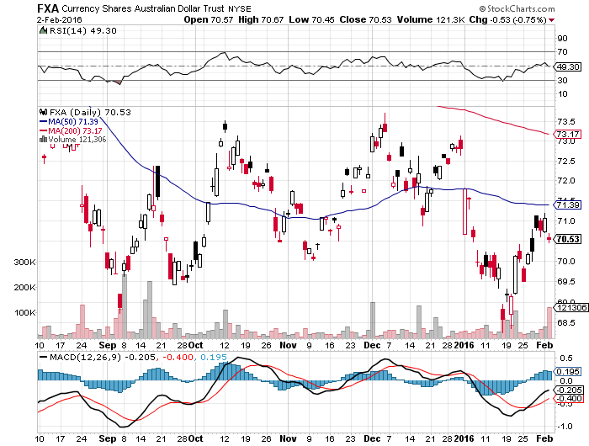
Australian Dollar (FXA)- New Low!

Slide 51
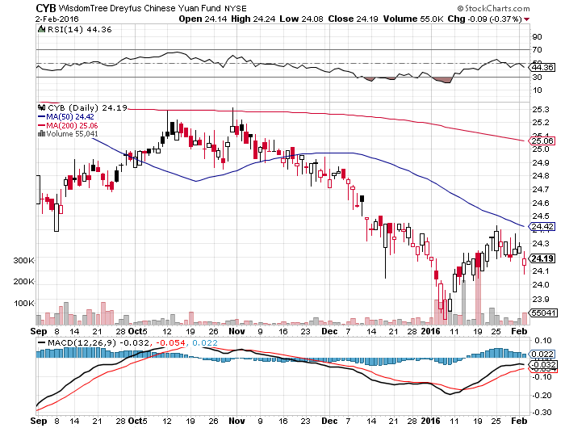
Chinese Yuan- (CYB)-Selling Off on Stock Crash

Slide 52
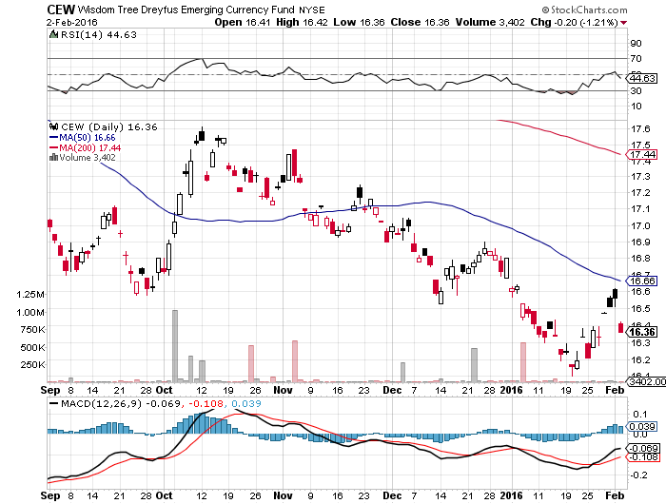
Emerging Market Currencies (CEW)

Slide 53
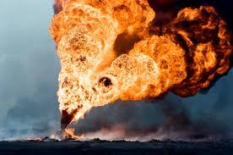
Energy-Looking for a Bottom
*Monetary collapse is the primary cause of oil crash, no oversupply or weakening demand. 7 years of free money and massive government subsidies created $1 trillion misinvestment first and foremost in energy
*Schlumberger lays off 10,000, announces massive $10 billion share buy back program. Triggering $3 oil rally
*Saudi oil minister says no cut back in production, prompts $2 oil dump
*15 cent drop in gasoline cost this year to $1.79/gallon, new seven year low
*Crude + products build of 14.1 million barrels
last week, vs. 5 year average of 2.6 million barrels
*US oil production down only 200,000 b/d,
not the 500,000 b/d expected, because of banks
and private equity entrance

Slide 54
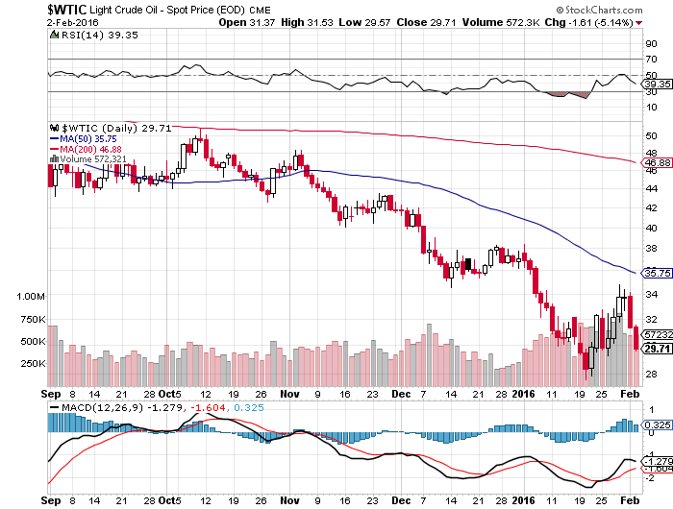
Oil-Won’t Bottom Until later in 2016
A New Run at the Lows

Slide 55
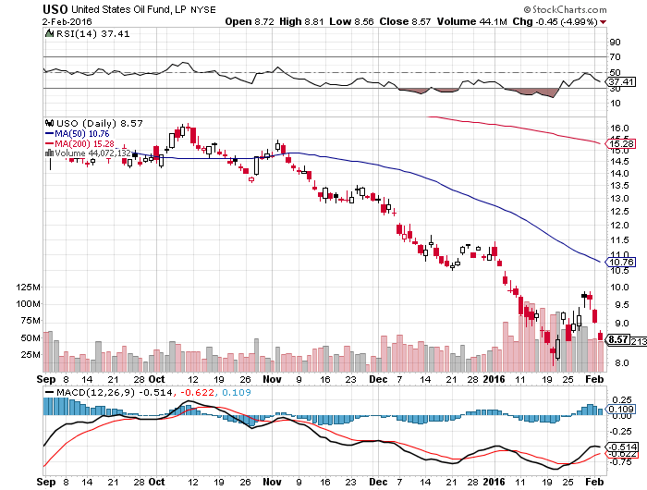
United States Oil Fund (USO) watching the 4/$9.00 calls at $0.73, They did double on a $5 oil rally

Slide 56
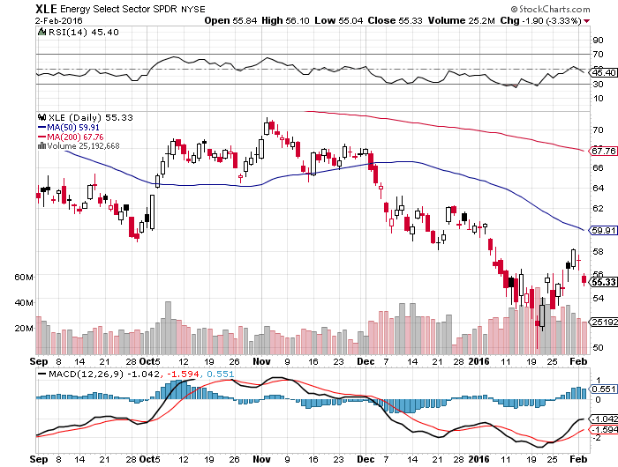
Energy Select Sector SPDR (XLE)
(XOM), (CVX), (SLB), (KMI), (EOG), (COP)

Slide 57
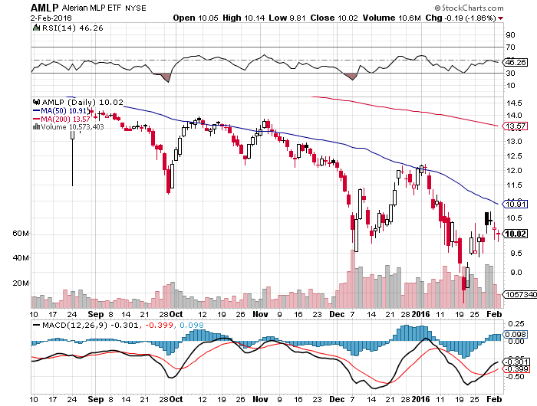
Alerian MLP ETF (AMLP)-
Basket Approach is the Only Safe Play here

Slide 58
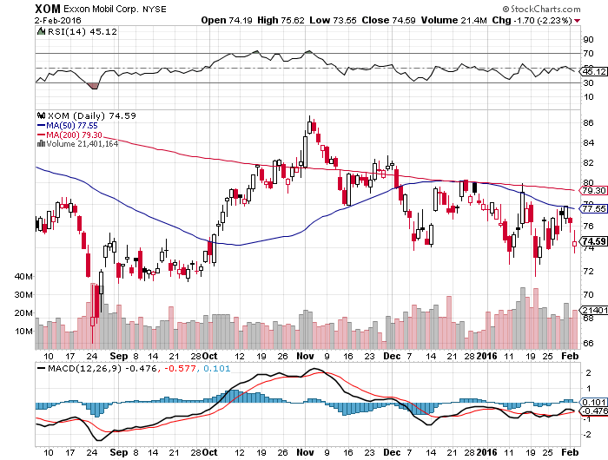
Exxon (XOM)-

Slide 59
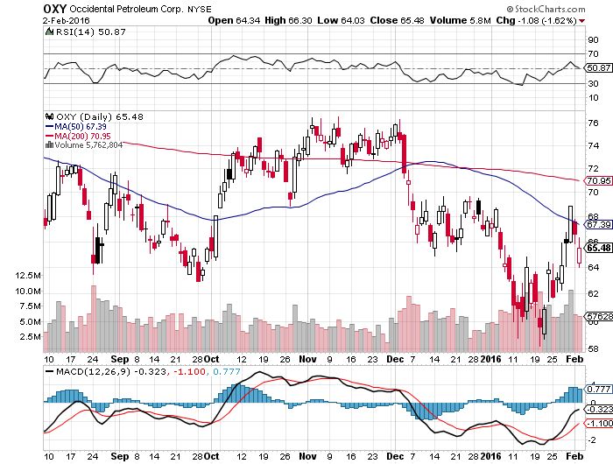
Occidental Petroleum (OXY)-

Slide 60
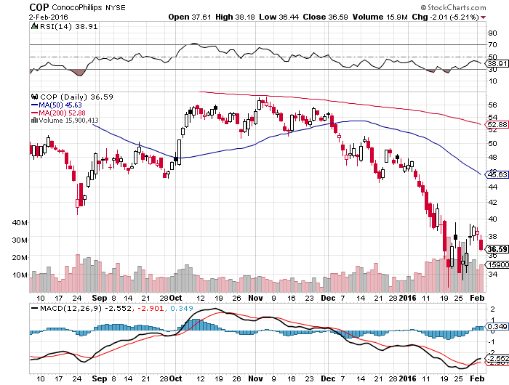
Conoco Phillips (COP)-

Slide 61
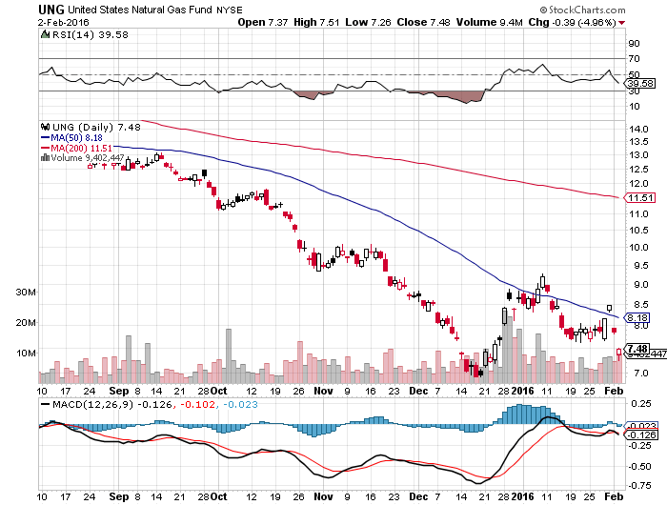
Natural Gas (UNG)-New Lows on Warm Winter

Slide 62

Copper-Yikes!

Slide 63

Freeport McMoRan (FCX)-Carl Icahn Slips on a Banana Peel

Slide 64

Precious Metals-The Bull Lives!
*Middle east gold sales capping prices as the rush to raise cash to meet huge budget deficits
*Gold producing industry holding smallest net short position in the futures market in history
*Oil bottom will also call the bottom in the barbarous relic, they’re all linked
*Production peaked in Q4, will decline for years,
3% in 2016 and 15%-20% over 3-4 years
as no new mines come on stream and
ore grades fall
*Lack of new discoveries also supporting prices
*Is the new bull market here?

Slide 65

Gold (GLD)-Nailed the Breakout!!
Took profits on long the $95-$100 vertical bull call debit spread

Slide 66

Market Vectors Gold Miners ETF- (GDX) stopped out of 2/$12.50-$13.50 bull call spread destroyed by crashing commodities

Slide 67

Silver (SLV)-

Slide 68

Silver Miners (SIL)-Finally Kicks In

Slide 69

Platinum (PPLT)-The Volkswagen Effect new chapter of the “Clean Diesel” Scandal

Slide 70

Palladium (PALL)-The Non Diesel Play

Slide 71

Agriculture-An El Nino Boost
*Margin calls forcing farmers to dump grain at low prices, capping any rallies, some Midwest banks are calling in loans as their oil loans go bad
*Big storm hits the east coast, misses the prime growing areas of the Midwest, good news for winter crops and bad for prices
*Dollar still demolishing US exports
*An El Nino boost, but the trend is
still down,
as with all other commodities
*No trade, there are NO fish to fry

Slide 72

(CORN) – Finally, a Bounce!

Slide 73

(WEAT)-New Lows!

Slide 74

Ag Commodities ETF (DBA)- New Lows

Slide 75

Real Estate-The Last Bull Market
*December existing home sales rocket a blockbuster 14.7%, to 5.46 million units, new homes up 10.8% to 544,000
*December Housing Starts down -2.5% to an annualized 1.15 million units, still only half of peak levels, Housing Permits down -2.9%, but better than expected
*US Housing inventory at a 30 year low, impossible to buy a home in a good school district
*We are still 40% below normalized housing starts, meaning new construction has to double
*Millennials are finally having kids, so new household formation is about to take off
*Apartment vacancies on the rise for the
first time in a decade as renters shift to buyers
*The housing boom has another
decade to home
*Case Shiller S&P 500 National index
continues upward grind

Slide 76

December S&P/Case–Shiller Home Price Index
+5.3% YOY, Denver, San Francisco, Dallas

Slide 77


Slide 78

US Home Construction Index (ITB)
(DHI), (LEN), (PHM), (TOL), (NVR)

Slide 79

Trade Sheet
So What Do We Do About All This?
*Stocks- sell rallies, buy capitulation days
*Bonds-the top is near, sell rallies, buy (TBT)
*Commodities-stand aside, the bottom is coming
*Currencies- Sell short the Yen and Euro on rallies, buy on dips
*Precious Metals –buy on dips
*Volatility-sell short spikes over $25 through (XIV)
*The Ags –stand aside - avoid the disaster
*Real estate-buy the homebuilders LT

Slide 80

Next Strategy Webinar
12:00 EST Wednesday,
February 17, 2016
San Francisco, CA
USA!
Good Luck and Good Trading!
Notes:
*

