Slide 1
Mad Day Trader
Bill Davis
Webinar – March 9, 2016

Slide 2
Major Indexes

Slide 3
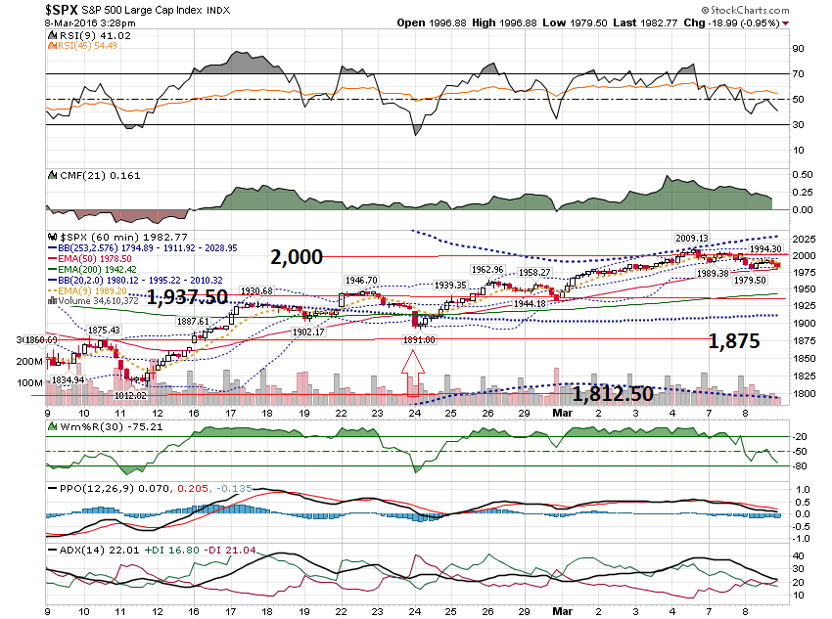

Slide 4
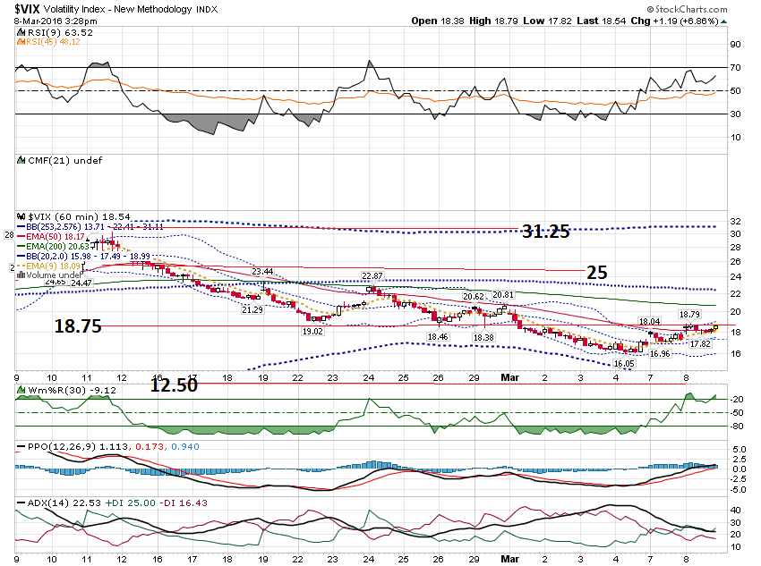

Slide 5
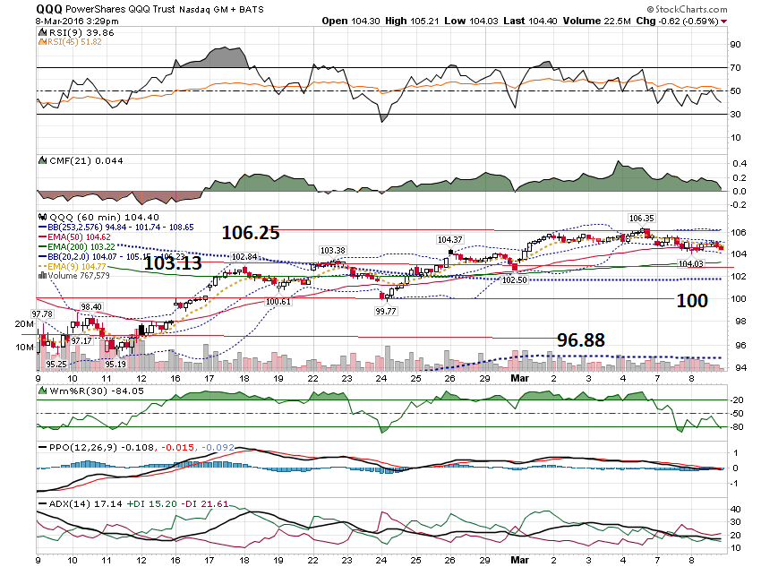

Slide 6
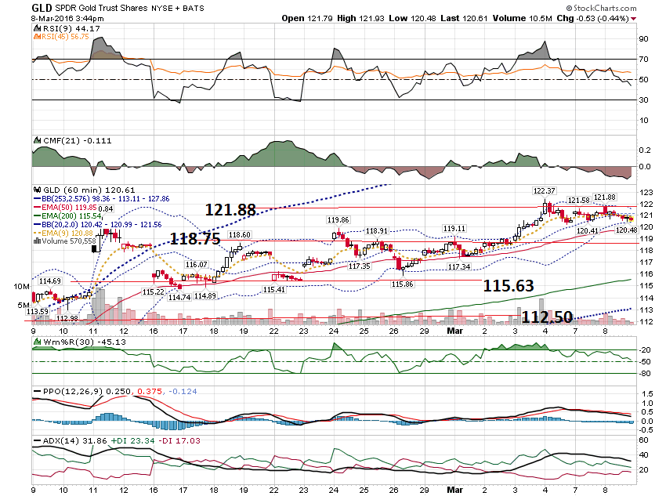

Slide 7
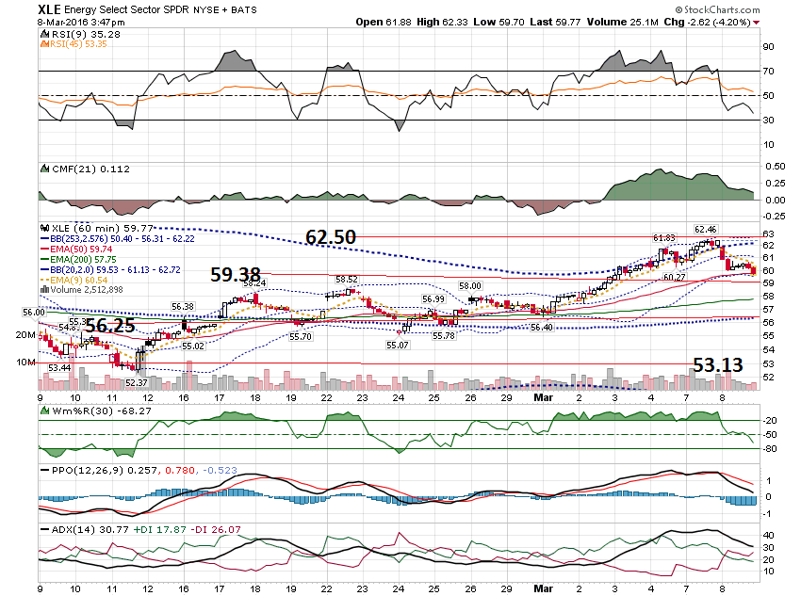

Slide 8
Could you please give your view on the recent divergence between IWM and QQQ. Usually they are the first to point to a new trend, but recently the IWM kept on rising (whilst strongly overbought) and the QQQ was the weakest of the pack.

Slide 9
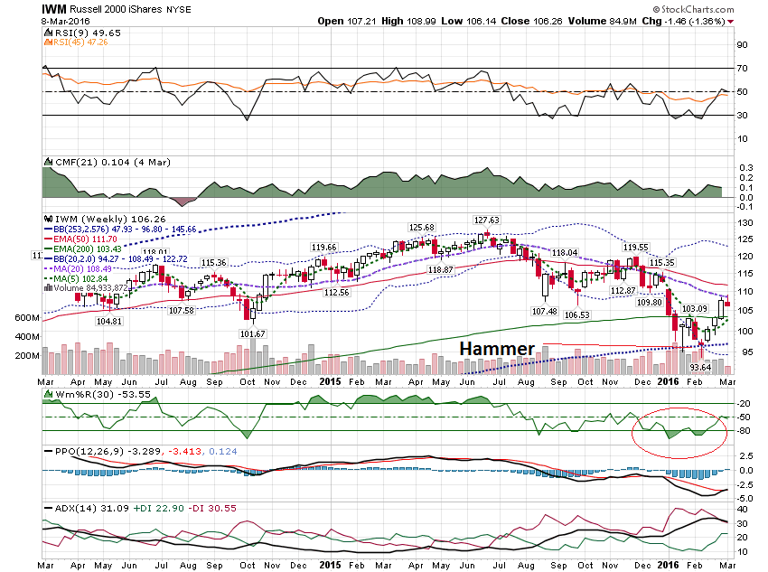

Slide 10
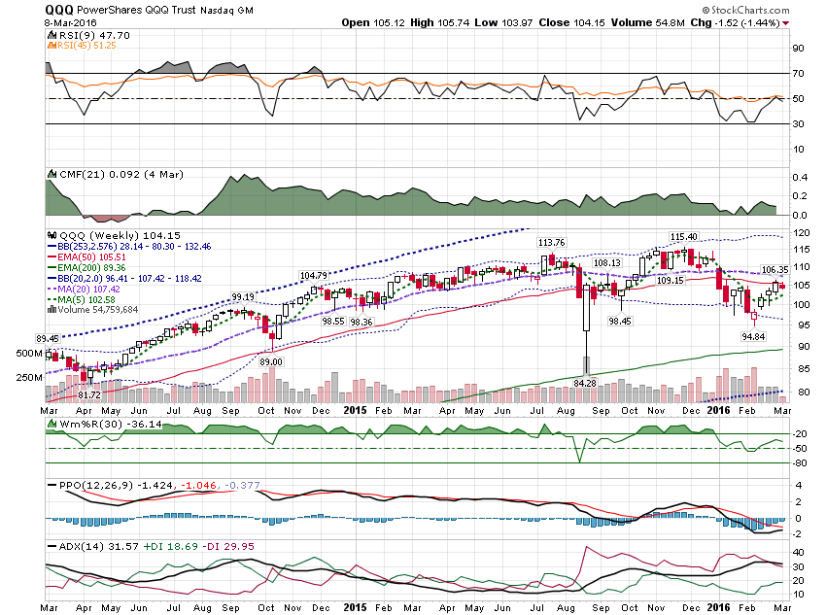

Slide 11
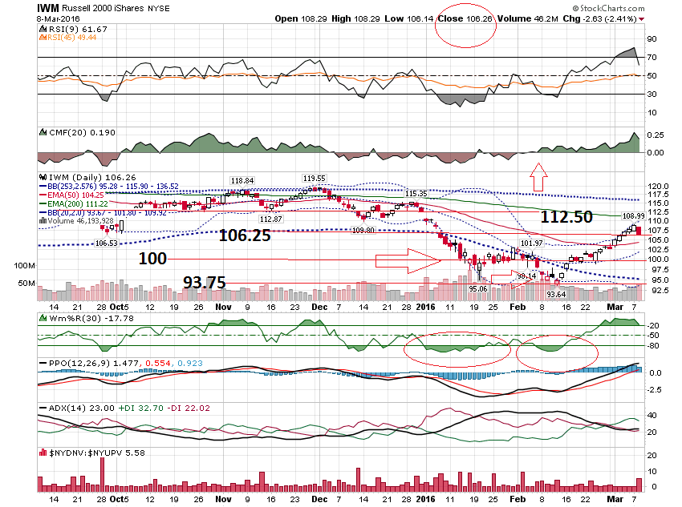

Slide 12
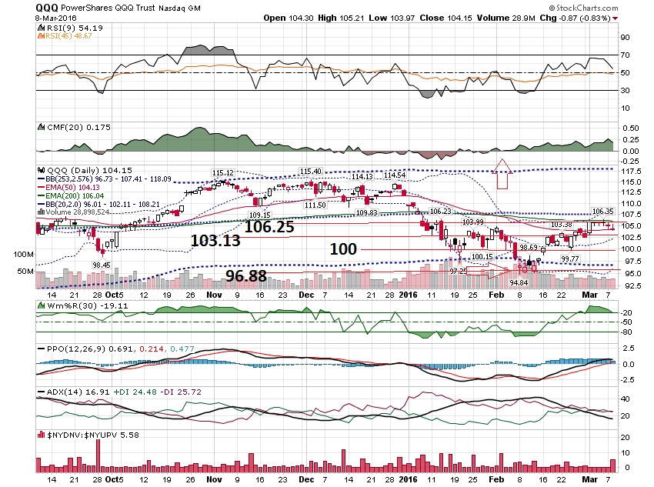

Slide 13
I want to take a look at a company that reported yesterday. That company is SHAK.

Slide 14
SHAK reported and gapped down $5 or 11.84%. How can we estimate the move?

Slide 15
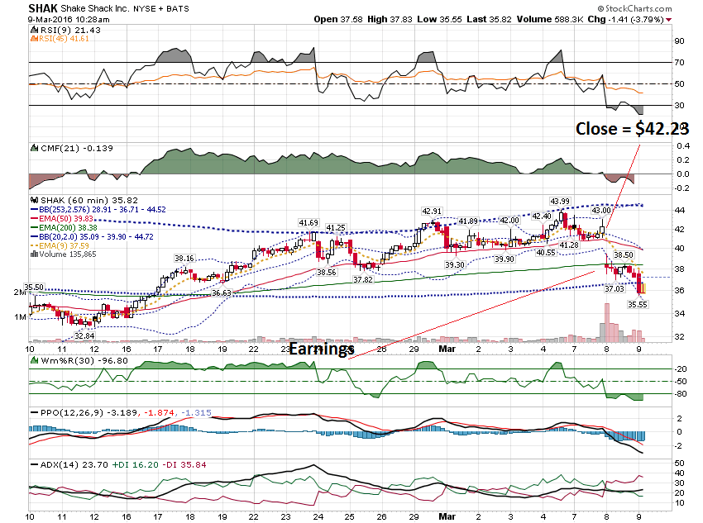

Slide 16
Let’s estimate the projected move. SHAK closed at $42.23 $42 Call - $2.53 $42 Put - $2.40 Total = $4.93 or 11.67% Actual move was $5 or 11.84%

Slide 17
Add a 50% cushion to the 11.67% projected move. 11.67 x 1.50% = 17.50%. $42.23 x 1.175 = $49.62 $42.23 x -1.175 = $34.84

Slide 18
Let’s structure spreads with a 150% cushion. Call Side: $50 Call = $.29 $55 Call - $.10 Net = $.19 or 3.8%.

Slide 19
Put side: $34 Put = $.25 $29 Put - $.05 Net = $.20 or 4%

Slide 20
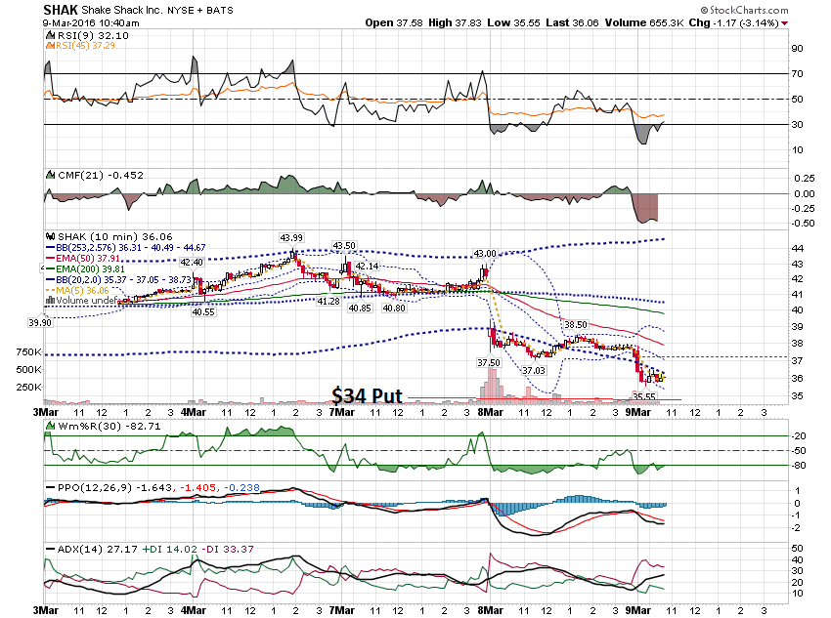

Slide 21
The $42 Weekly Put on SHAK went from about $2.40 to $6.00.

Slide 22
Every month I post a pdf of the companies announcing buybacks in the previous month. These stocks can be good candidates to watch.

Slide 23
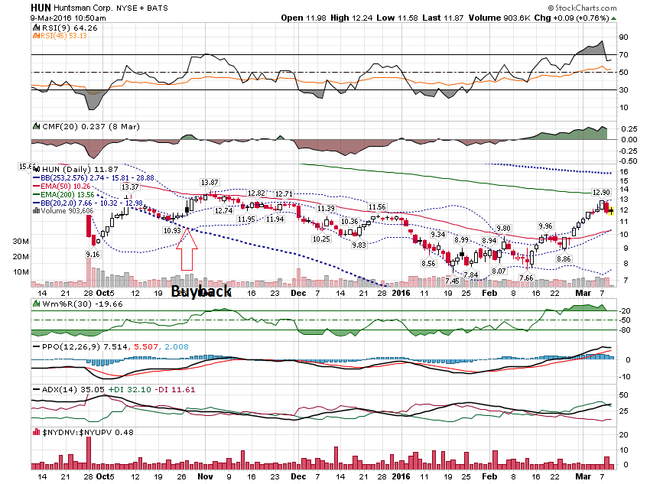

Slide 24
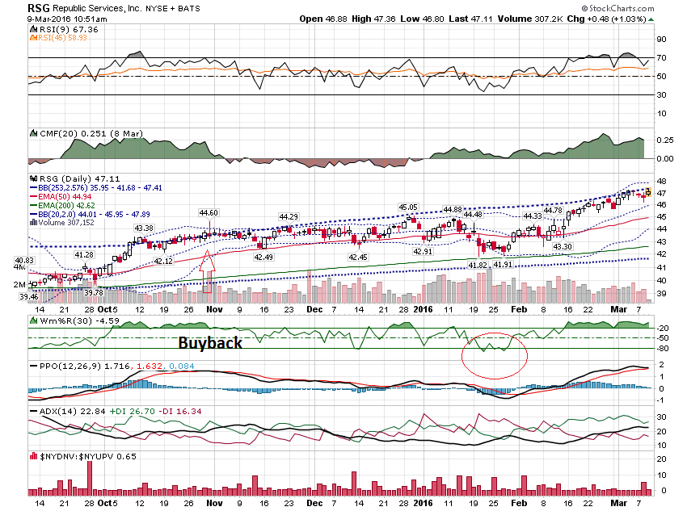

Slide 25
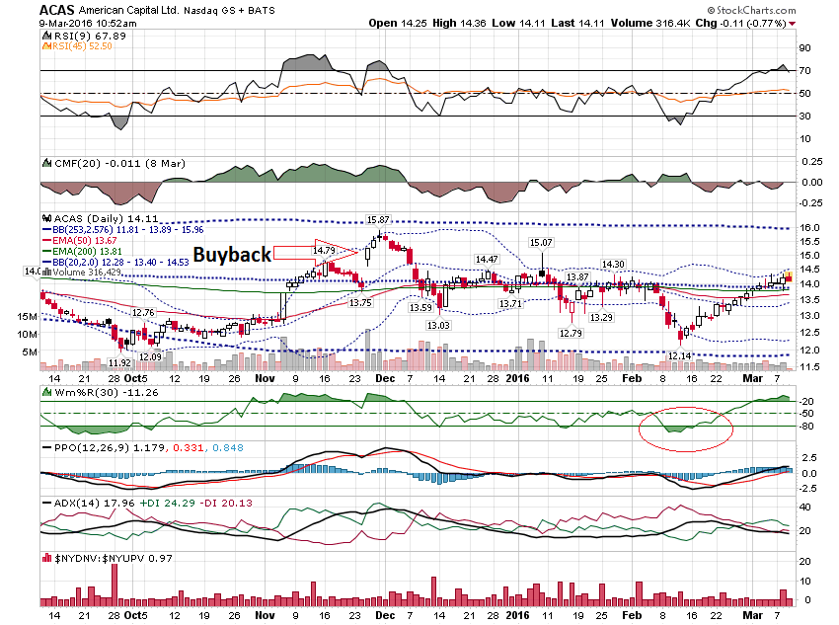

Slide 26
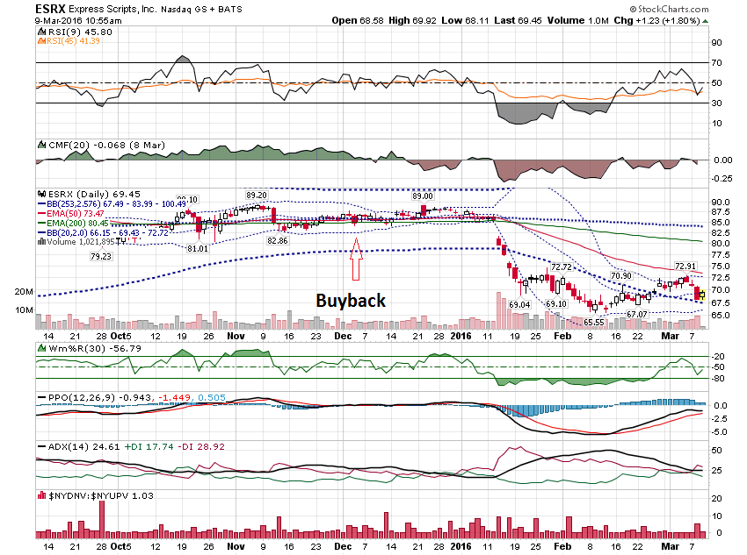

Slide 27
Thanks for watching! Bill Davis Mad Day Trader March 9, 2016 davismdt@gmail.com

