Slide 1
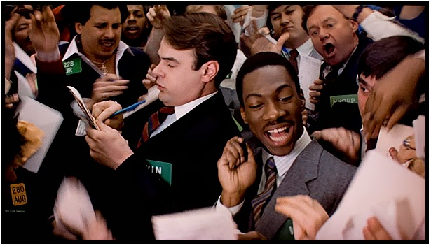
The Mad Hedge Fund Trader
“Short Squeeze!!”
With John Thomas
from San Francisco, CA, March 2, 2016
www.madhedgefundtrader.com
Notes:
*

Slide 2

Trade Alert Performance
Making Big Profits in Dire Market Conditions
*January +1.23% Final *July +6.42% Final
*February +3.96% FINAL *August +1.27% Final
*March -1.54% MTD *September +11.99% Final
*April +6.62% Final *October Final -6.19%
*May +5.15% Final *November MTD 5.78%
*June +3.68% Final *December -4.94%
*2016 Year to Date +5.73%
compared to -2.2% for the Dow Average
*Trailing 1 year return +41.68%, +197.41% since inception,
2.00% short of all-time high
*Average annualized return of 37.60%

Slide 3
Portfolio Review
Running Aggressive Risk Management
for great returns-March 1, 2016 Position Sheet
current capital at risk
Risk On
World is Getting Better
(SPY) 3/$177-$182 calls | 10.00%
(SPY) 3/$176-$181 call spread | 10.00%
(FXY) 3/$89-$92 put spread | 10.00%
Risk Off
World is Getting Worse
(SPY) 3/$201-$204 put spread | -10.00%
(SPY) 4/$182 puts | -5.00%
(GLD) 3/$107-$112 call spread | -10.00%
total net position | 5.00%
Expiration P&L
7.65% YTD

Slide 4

The Method to My Madness
A Very Wide Large Short Strangle with multiple cross hedges
The bottom line: sleep well at night with low volatility and big profits
*Deep in-the-money (SPY) call spreads hedge the deep in-the-money (SPY) put spreads and visa versa by bringing in extra income
*(SPY) 4/$182 outright puts hedge the the deep in-the-money (SPY) call spreads and provide flash crash insurance
*Short (FXY) and (FXE) hedges deep
in-the-money (SPY) call spreads
*(FXY) and (FXE) hedges the the
deep in-the-money (SPY) put spreads
and (SPY) 4/$182 outright puts

Slide 5
Paid Subscriber Trailing 12 Month Audited Return +41.68%

Slide 6
63 Months Since Inception
Daily Audited Performance
Averaged annualized return +37.60%

Slide 7

Short Term Strategy Outlook-
*It took only a few positive economic data points to flip the market from ‘RISK OFF” to ‘RISK ON” and trigger a massive short covering rally, but another downside test is coming in March
*World breaks out with QE fever and negative interest rates (NIRP)
*Oil and commodities put in “A” bottom, but not “THE” bottom
*US stocks have now defined the 2016 wedge formation between (SPX) 1812 and 2000, will take 6 for months to resolve to the upside
*No chance of any more Fed rate hikes this year
*Gold is the best performing asset class of 2016, at one
point up 20%, since December, the bull market is back
*Dollar is DOA, better trades elsewhere
*El Nino gives no respite to the ags

Slide 8
The Bill Davis View
A $1,500 Upgrade for the Mad Day Trader Service
Buys:
Alphabet (GOOGL) $730 Target to $782
First Solar (FSLR) $65 Target to $73
B & G Foods (BGS) $35.10 * Target to $41
Buy on Stop at $35.10, limit of $35.30
Chubb, Ltd (CB) $117 Target to $120
Clorox (CLX) $125 Target to $132
Sells:
Alibaba (BABA) $74 Target to $68
Anacor Pharm (ANAC) $70 Target to $58
Jack in the Box (JACK) $72 Target to $63
Linkedin (LNKD) $140 Target to $100

Slide 9

The Global Economy-QE Again!
The Immaculate Correction-Bear Market With No Recession
*US GDP Q4 GDP revised up from 0.7% to 1.0%, but US consumer confidence nosedives to 92.2, the lowest since July, as stock market negative wealth effect kicks in, Chicago February PMI plunges from 55.6 to 47.6
*Jobs are still rocking, with 4.9% unemployment and weekly jobless claims at decade lows, is the most important coincident indicator to consider.
*Oil crash is having an outsized effect on US economy. It only accounts for 2% of GDP, but generated 70% of industrial capacity growth during 2009-14. in 2015 it fell 35%, giving us a 2% GDP
*A recession has NEVER occurred in the face of FALLING oil prices,
LOW interest rates, or a WEAK foreign economies
*China QE as bank reserve requirements eased and industrial
profits fall by 2.3% in 2015
*Next to come is a “RISK ON” global
synchronized growth in H2 2016
once we get through New Year effects

Slide 10
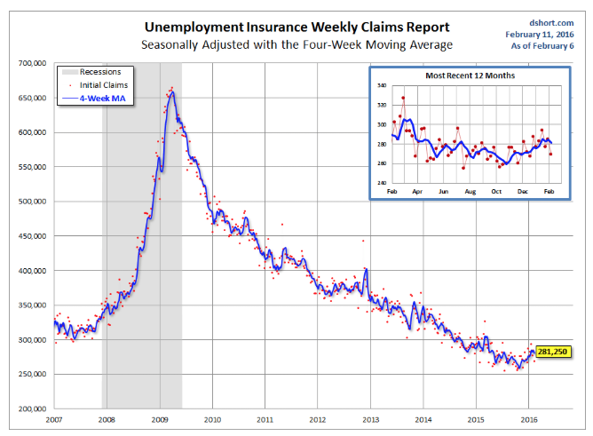
Weekly Jobless Claims –The Most Important Statistic
+10,000 to 272,000
The Downtrend Lives!-Show Me the Recession!

Slide 11

Bonds-Stalling at the Highs
*Global “RISK ON” move causes bond prices to back off quickly, yields to rise
*$5.5 trillion in global debt now has negative interest rates, a quarter of the world supply
*10 Year Japanese government bonds now yielding only -0.8%
*Bond yields have now fallen 90 basis points since Fed rate rise, unbelievable!
*Foreigners pouring rivers of
money into the US as a safe haven
*Non energy junk is starting
to offer real value

Slide 12
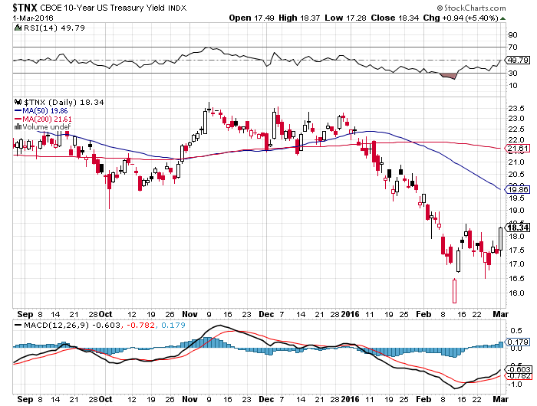
Ten Year Treasury Yield ($TNX) 1.83%
The Reversal is In

Slide 13
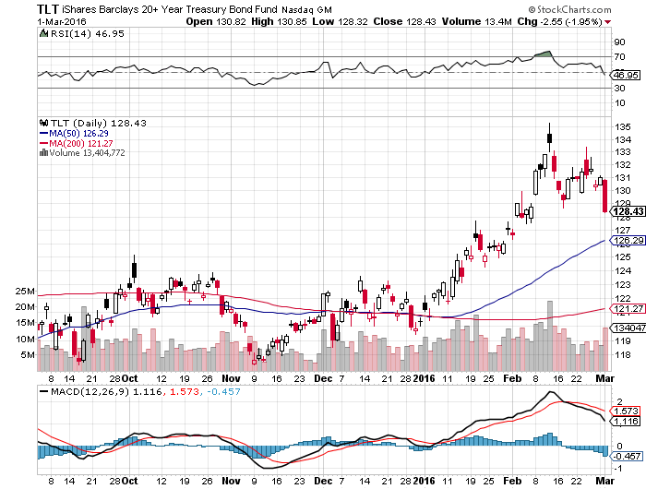
Ten Year Treasury ETF (TLT) 1.83%
The Reversal is In

Slide 14
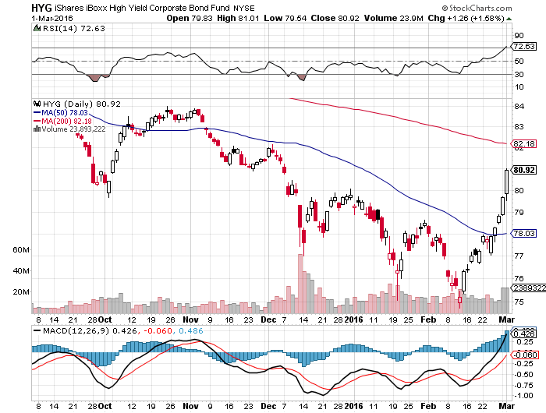
Junk Bonds (HYG) 9.22% Yield
A Great Risk Coincident Indicator

Slide 15
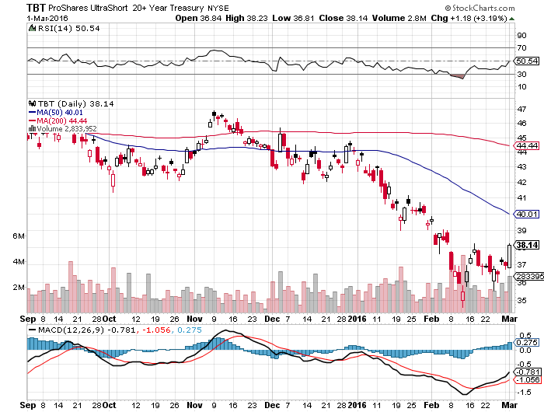
2X Short Treasuries (TBT)-Not Yet the Big Trade of 2016?
Back in “BUY” Territory

Slide 16
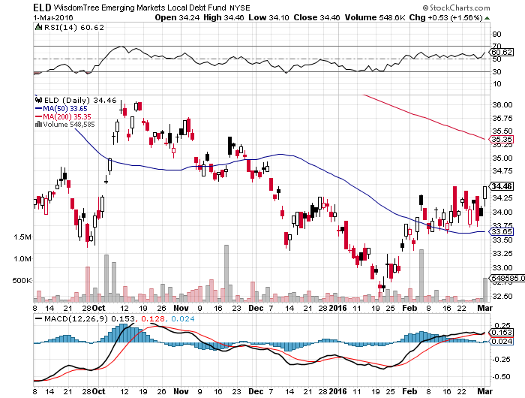
Emerging Market Debt (ELD) 8.39% Yield-

Slide 17
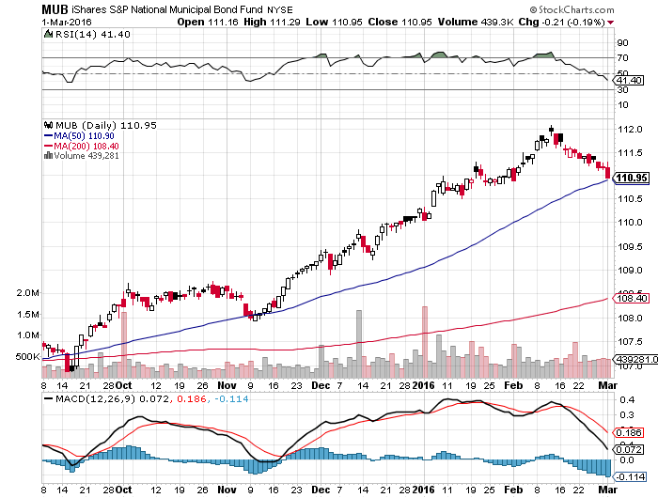
Municipal Bonds (MUB)-1.35% yield-New High
Mix of AAA, AA, and A rated bonds-flight to safety

Slide 18
Stocks-Short Covering
*West Texas bounce allows oil and commodity stocks to lead a ferocious short covering rally
*Big institutions and hedge funds on bank shares to lead the next cycle upward
*Rally was mostly short covering on declining volume, and another retest of higher lows is in the cards for March
*The “Narrowing Wedge” scenario is playing out, with a big triangle formation setting up over the next six months, with lower highs and higher lows between 1812 and 2000
*Election is starting to have a drag on
stock prices, with uncertainty rising
*A Trump win would trigger a 1929
or 1987 style market crash

Slide 19
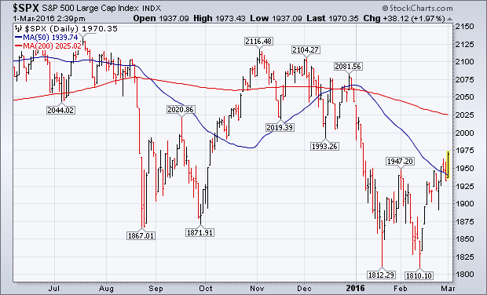
S&P 500-Short Squeeze! long 2/$173-$178 and 2/$176-$181 vertical bull call spread expired at max profit took profits on long 3/$170-$175 vertical bull call spread
$198-$203 vertical bear put spread

Slide 20
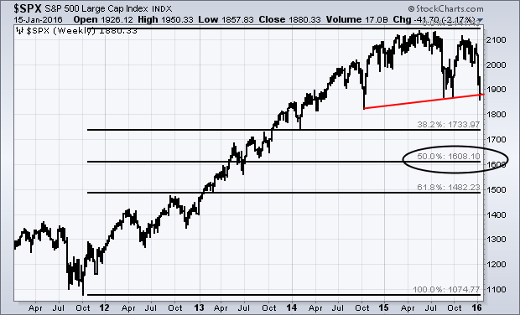
S&P 500-The Really Long View
The Bottom That Held
$1740

Slide 21
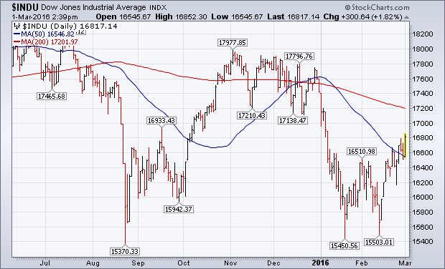
Dow Average-Major Support Bunching Around $15,500

Slide 22
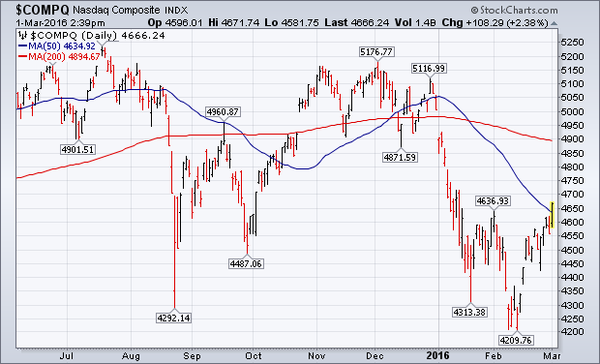
NASDAQ (QQQ)-Break of 500-Day Moving Average!
Is where traders will pour back into

Slide 23
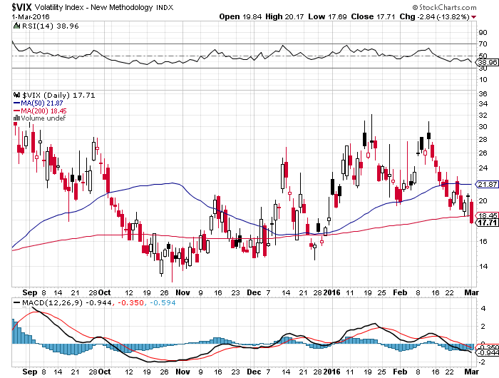
(VIX)-The Spike is Here

Slide 24
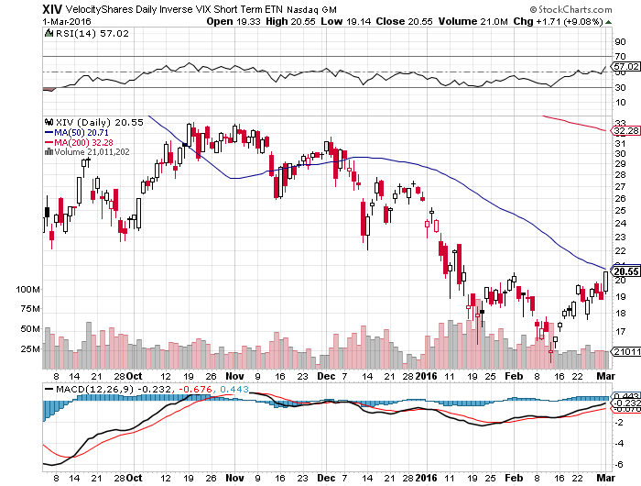
(XIV)-Velocity Shares Daily Inverse VIX Short Term ETN
Bailed BECAUSE OF TRACKING ERROR

Slide 25
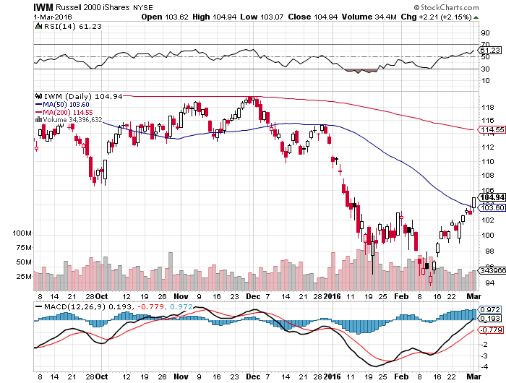
Russell 2000 (IWM)-

Slide 26
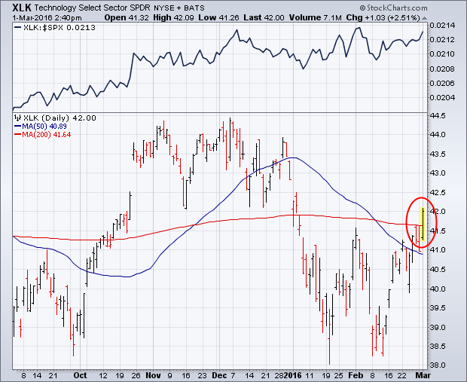
Technology Sector SPDR (XLK), (ROM)
(AAPL), (MSFT), (VZ), (T), (FB), (IBM)

Slide 27
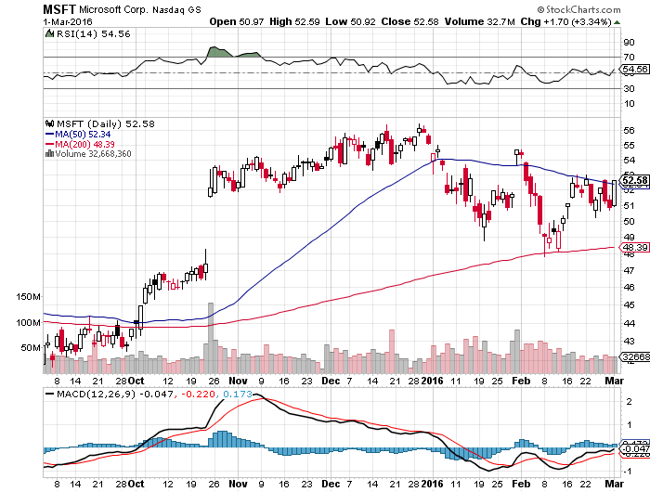
Microsoft (MSFT) took profits on long the 1/$50-$52.50 vertical bull call debit spread

Slide 28
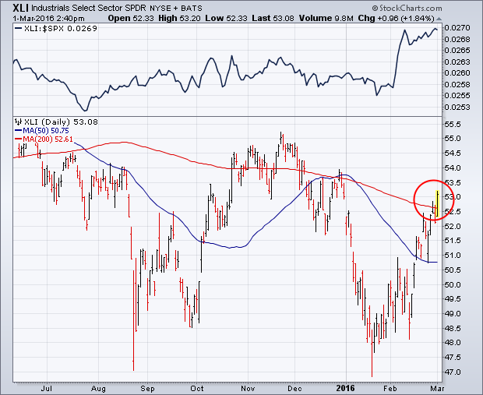
Industrials Sector SPDR (XLI)-Dow Mainstay
(GE), (MMM), (UNP), (UTX), (BA), (HON)

Slide 29
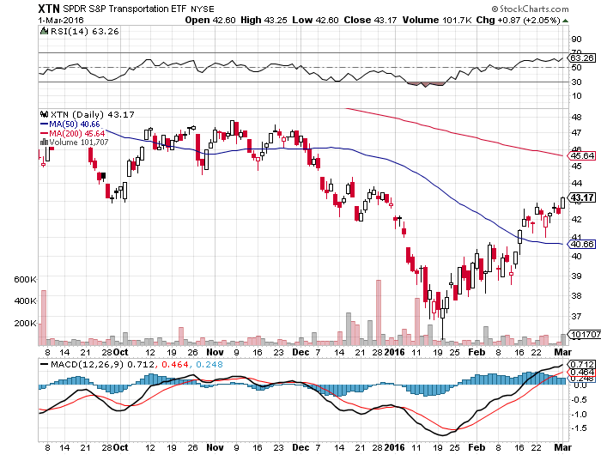
Transports Sector SPDR (XTN)-Another Dow Mainstay
(ALGT), (ALK), (JBLU), (LUV), (CHRW), (DAL),

Slide 30
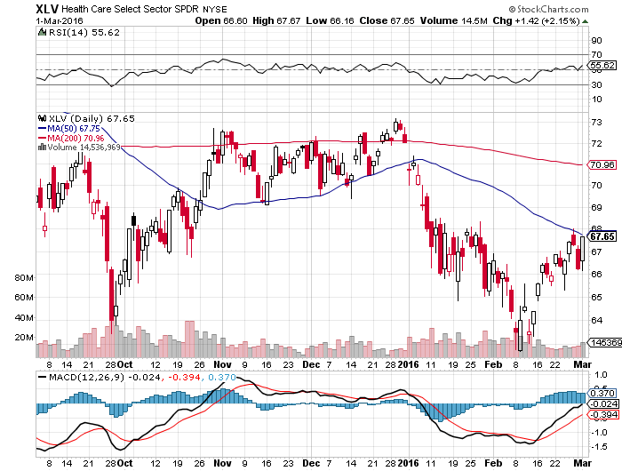
Health Care Sector SPDR (XLV), (RXL)
(JNJ), (PFE), (MRK), (GILD), (ACT), (AMGN)

Slide 31
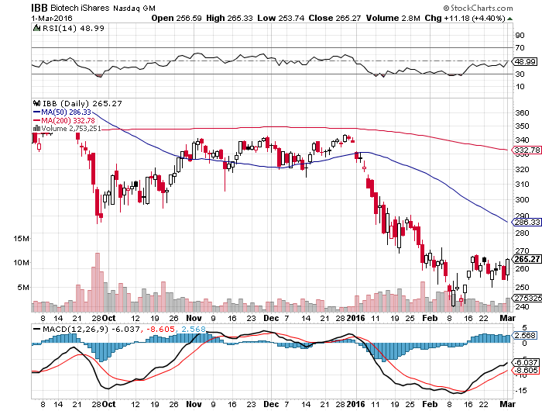
Biotech iShares (IBB)-A Political Football in 2016

Slide 32
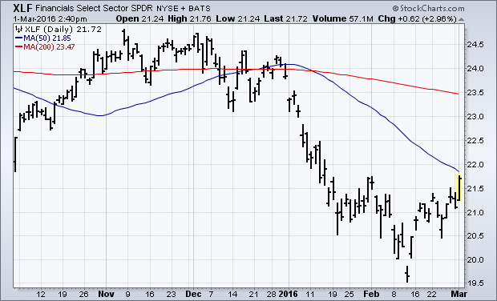
Financial Select SPDR (XLF)-
(BLK/B), (WFC), (JPM), (BAC), (C), (GS)

Slide 33
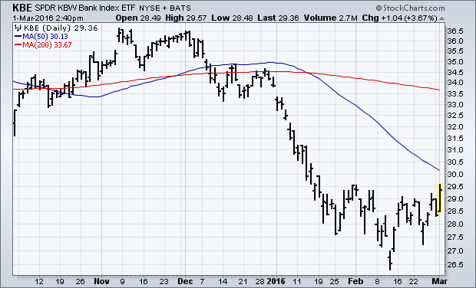
KBW Bank Index (KBE)-
Hit a trend line going back to 2009-Triggered monster rally

Slide 34
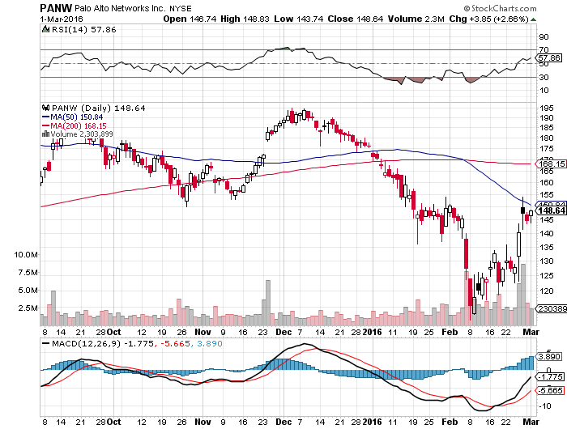
Palo Alto Networks (PANW)-
Obama asks for $19 Billion of Cyber Security Upgrades

Slide 35
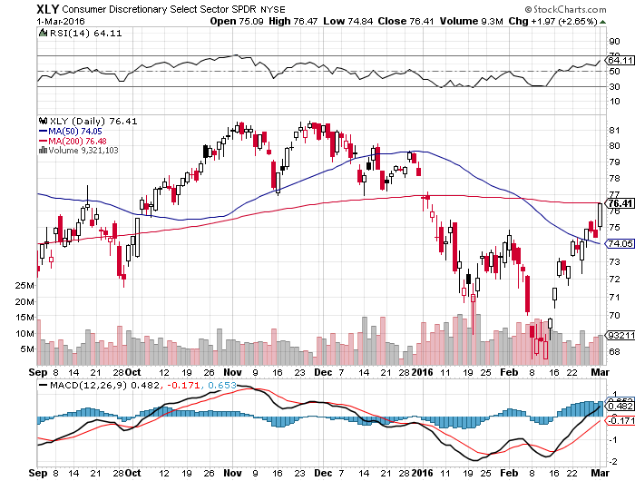
Consumer Discretionary SPDR (XLY)
Target to Buy on a dip-Will bounce back fastest
(DIS), (AMZN), (HD), (CMCSA), (MCD), (SBUX)

Slide 36
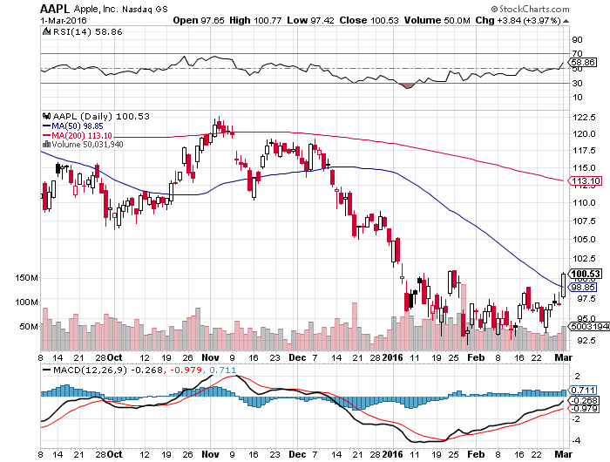
Apple (AAPL) –iPhone production cut 30%
Back to waiting for the next real catalyst-the iPhone 7
Buy after Q1 earnings in April to avoid post Christmas dip, $105 billion stock buy backs done

Slide 37
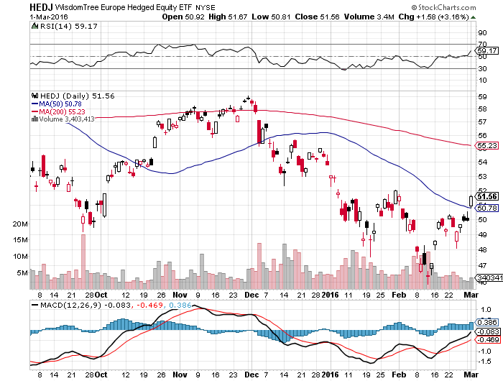
Europe Hedged Equity (HEDJ)-Hedged Japan Equity
Great Entry Point setting - Load the boat at $46 on “RISK ON”

Slide 38
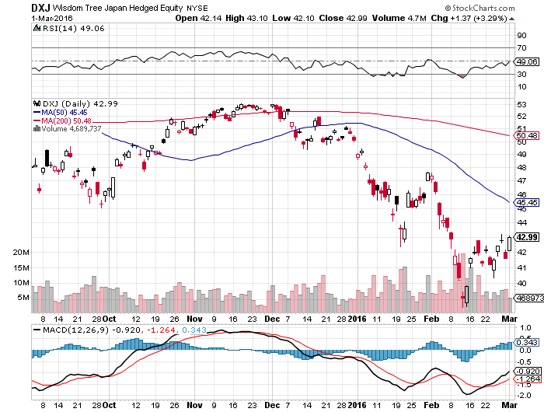
Japan (DXJ)-Hedged Japan Equity
Yen Short Covering Rally Crushes the Market

Slide 39
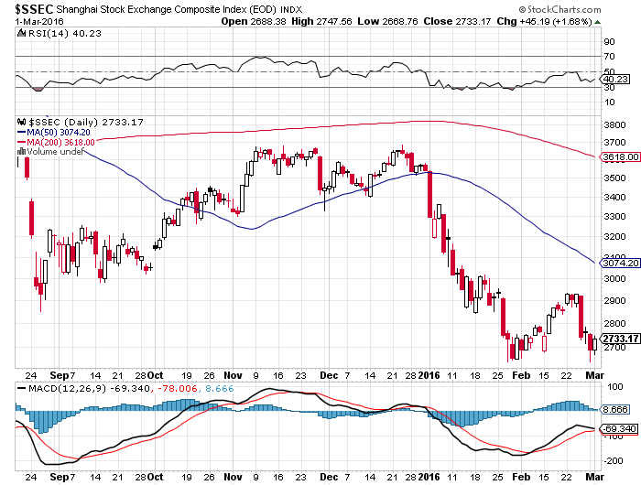
China ($SSEC)-
The Bad Boy Market and font of volatility

Slide 40
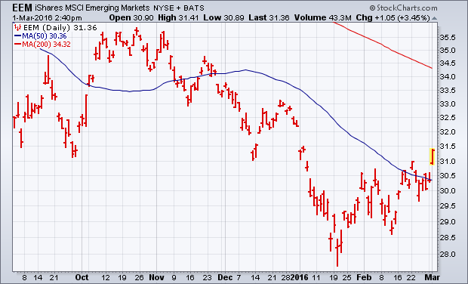
Emerging Markets (EEM)-
Loves the oil and commodity bounce

Slide 41
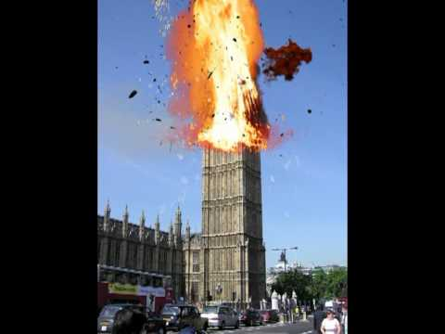
Foreign Currencies-”Brexit!”
*”Brexit” destroys the British pound on EC exit prospect, down 10% in a week, referendum is June 23, plan that summer vacation, IS DRAGGING DOWN THE EURO FOR THE SHORT TERM
*Expect more Japanese QE because the yen at this level will destroy the economy, but BOJ already owns 77% of outstanding government debt,
SELL YEN!
*Commodity rebound breathes new life into commodity currencies
*Slow improvement in European economies could lend further Euro support
*With no interest rate moves anywhere,
this could be a year of low volatility
for currencies
*Weak Chinese economy has made shorting
the Yuan a new hedge fund favorite

Slide 42
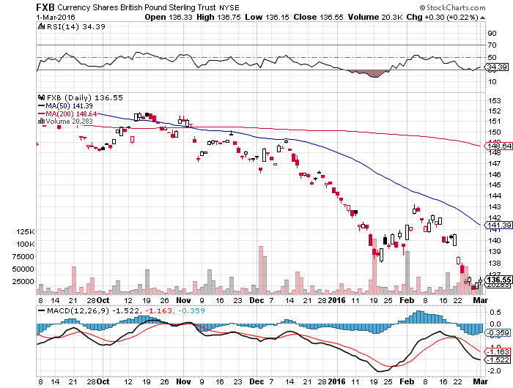
British Pound (FXB)-Political Disaster!

Slide 43
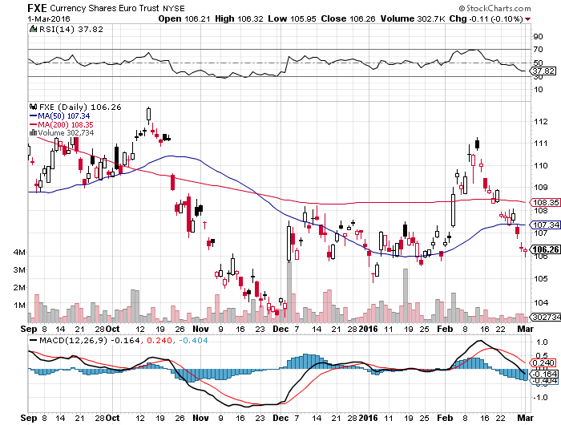
Euro ($XEU), (FXE), (EUO)-Short a Double Position stopped out of long the (FXE) 3/$103-$106 vertical bull call spread on “Brexit” fears, prospect of more QWE next week

Slide 44
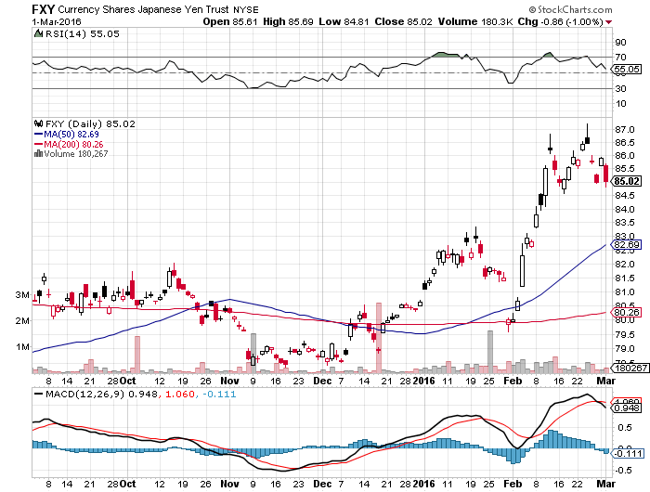
Japanese Yen (FXY)-At a One Year High
Long the (FXY) $89-$92 vertical bear put spread- expires in 12 days

Slide 45
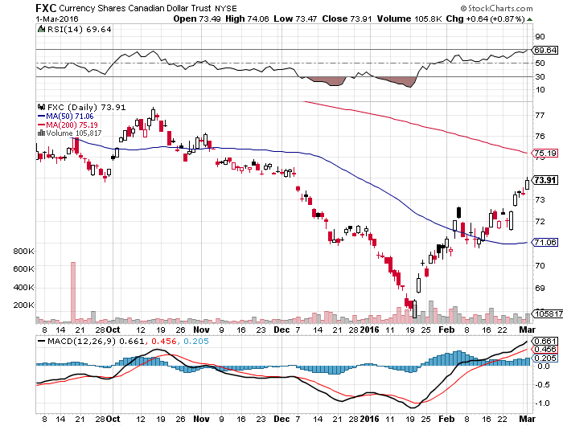
Canadian Dollar (FXC)-Commodity Rebound

Slide 46
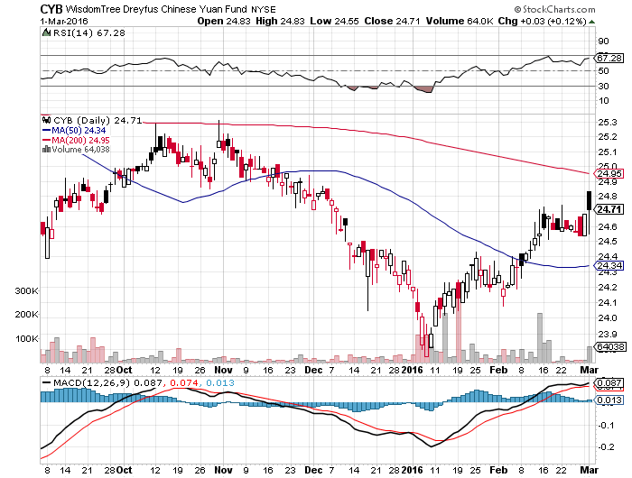
Chinese Yuan- (CYB)-Sell Rallies on Weakening Economy
A New Hedge Fund Favorite

Slide 47

Energy-Oil is Everywhere-Probing for a Bottom
*Saudi oil minister Ali al-Naimi says output cuts “ridiculous”, but prices rally 20% anyway, Putin calling for more producer meetings-boosting prices
*Total US oil stocks at an all time high at 249 million barrels, and the trend is still up, despite weekly volatility, latest week aggregate is up 7.4 million barrels
*Iran joins production capping agreement
*Devon Energy issues 69 million shares at $19 to raise capital down 70% from the top, 15% of the float, oversubscribed 3:1, another bottoming sign
*US rigs finally fall sharply, down 49 to 439
in only two weeks, down from the 1,600 top
*Russia can’t cap wells because they aren’t
insulated, the must continue to over produce
*Continental Resources closes Bakken fracking
operations

Slide 48
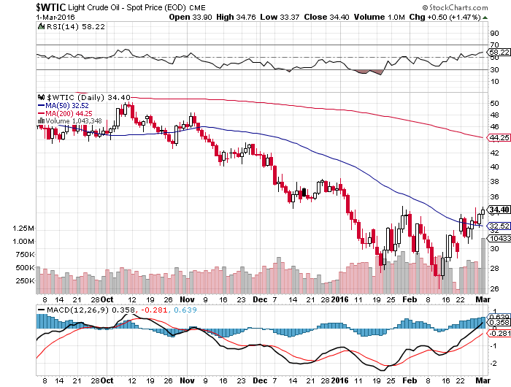
Oil-Won’t Bottom Until later in 2016
The “W” is In

Slide 49
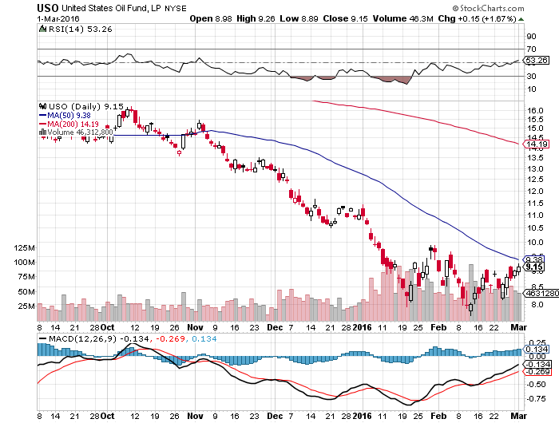
United States Oil Fund (USO) took profits on long the 5/$8.00 calls

Slide 50
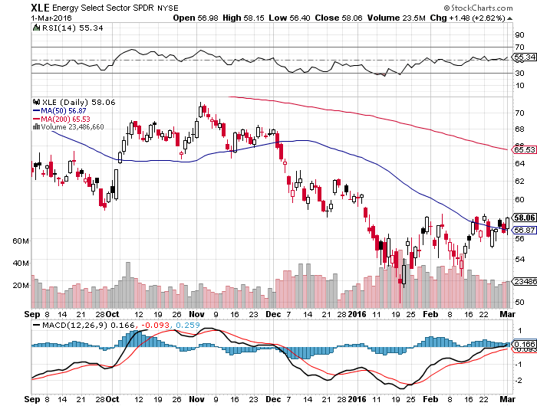
Energy Select Sector SPDR (XLE)
(XOM), (CVX), (SLB), (KMI), (EOG), (COP)

Slide 51
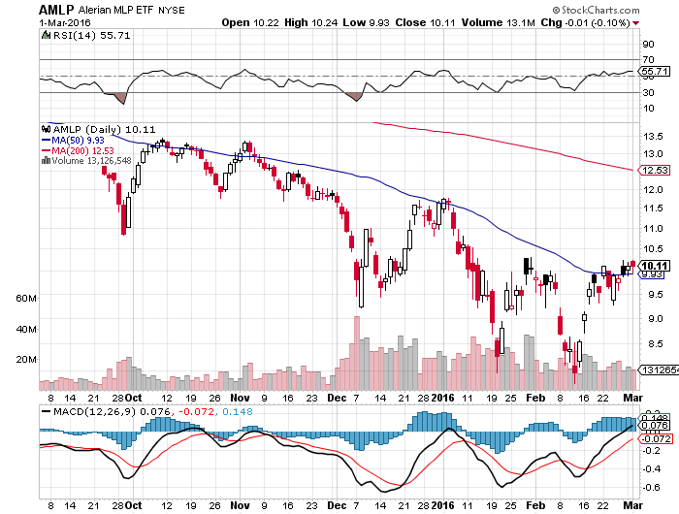
Alerian MLP ETF (AMLP)-11.39% Yield
Basket Approach is the Only Safe Play here

Slide 52
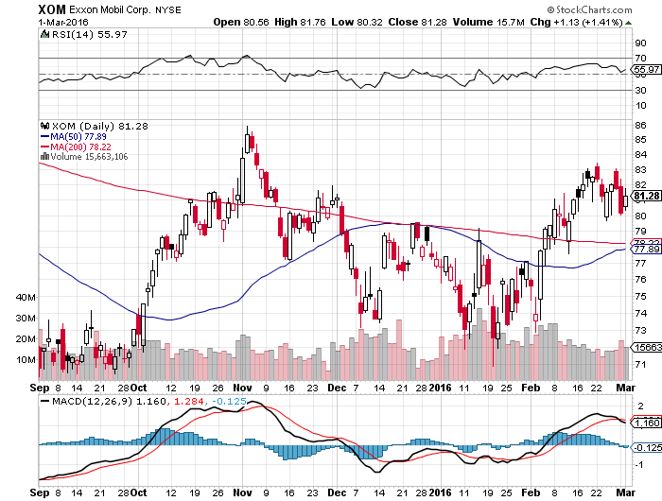
Exxon (XOM)-

Slide 53
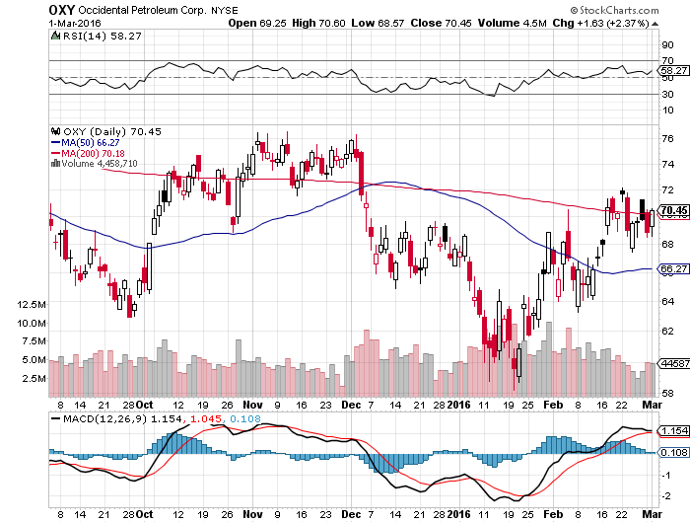
Occidental Petroleum (OXY)-

Slide 54
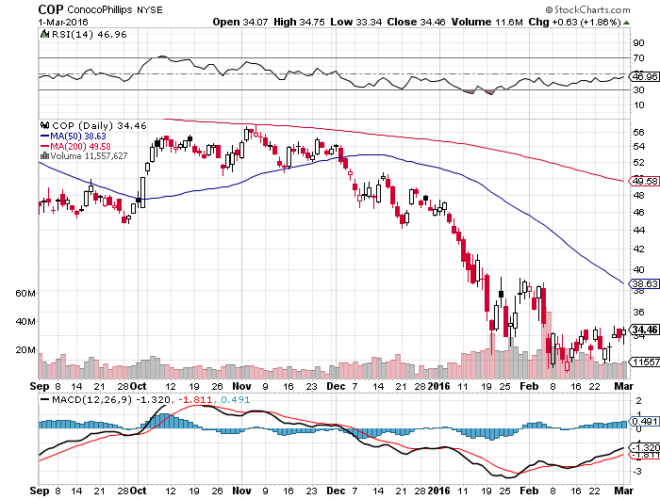
Conoco Phillips (COP)-The Buffet Favorite
Down 62% from the top-just cut dividend

Slide 55
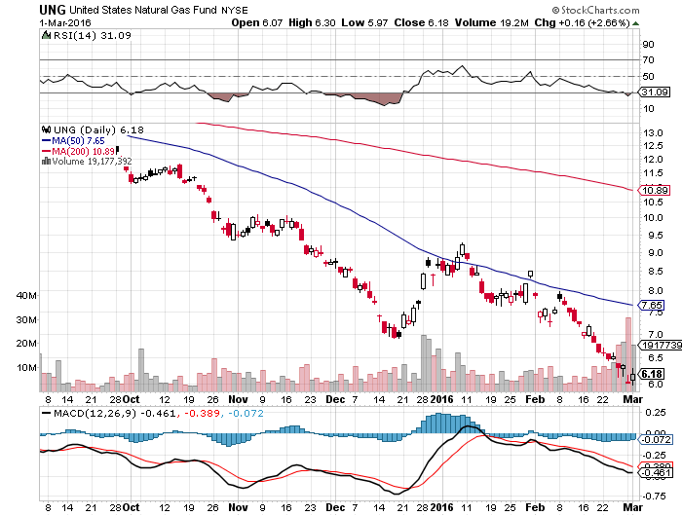
Natural Gas (UNG)-New Lows on Warm Winter

Slide 56
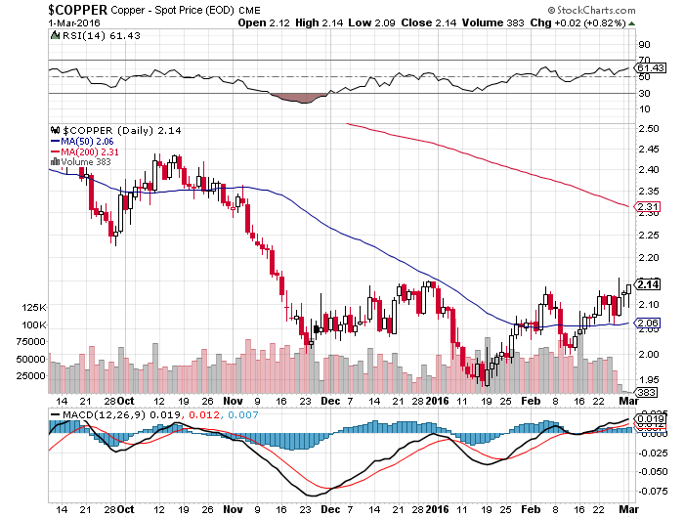
Copper-Trying to Forge a Bottom

Slide 57
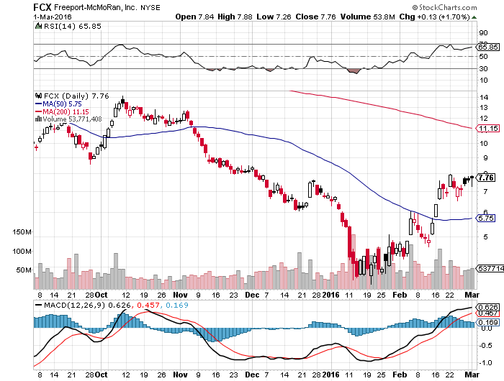
Freeport McMoRan (FCX)-Doubled off $3 bottom

Slide 58
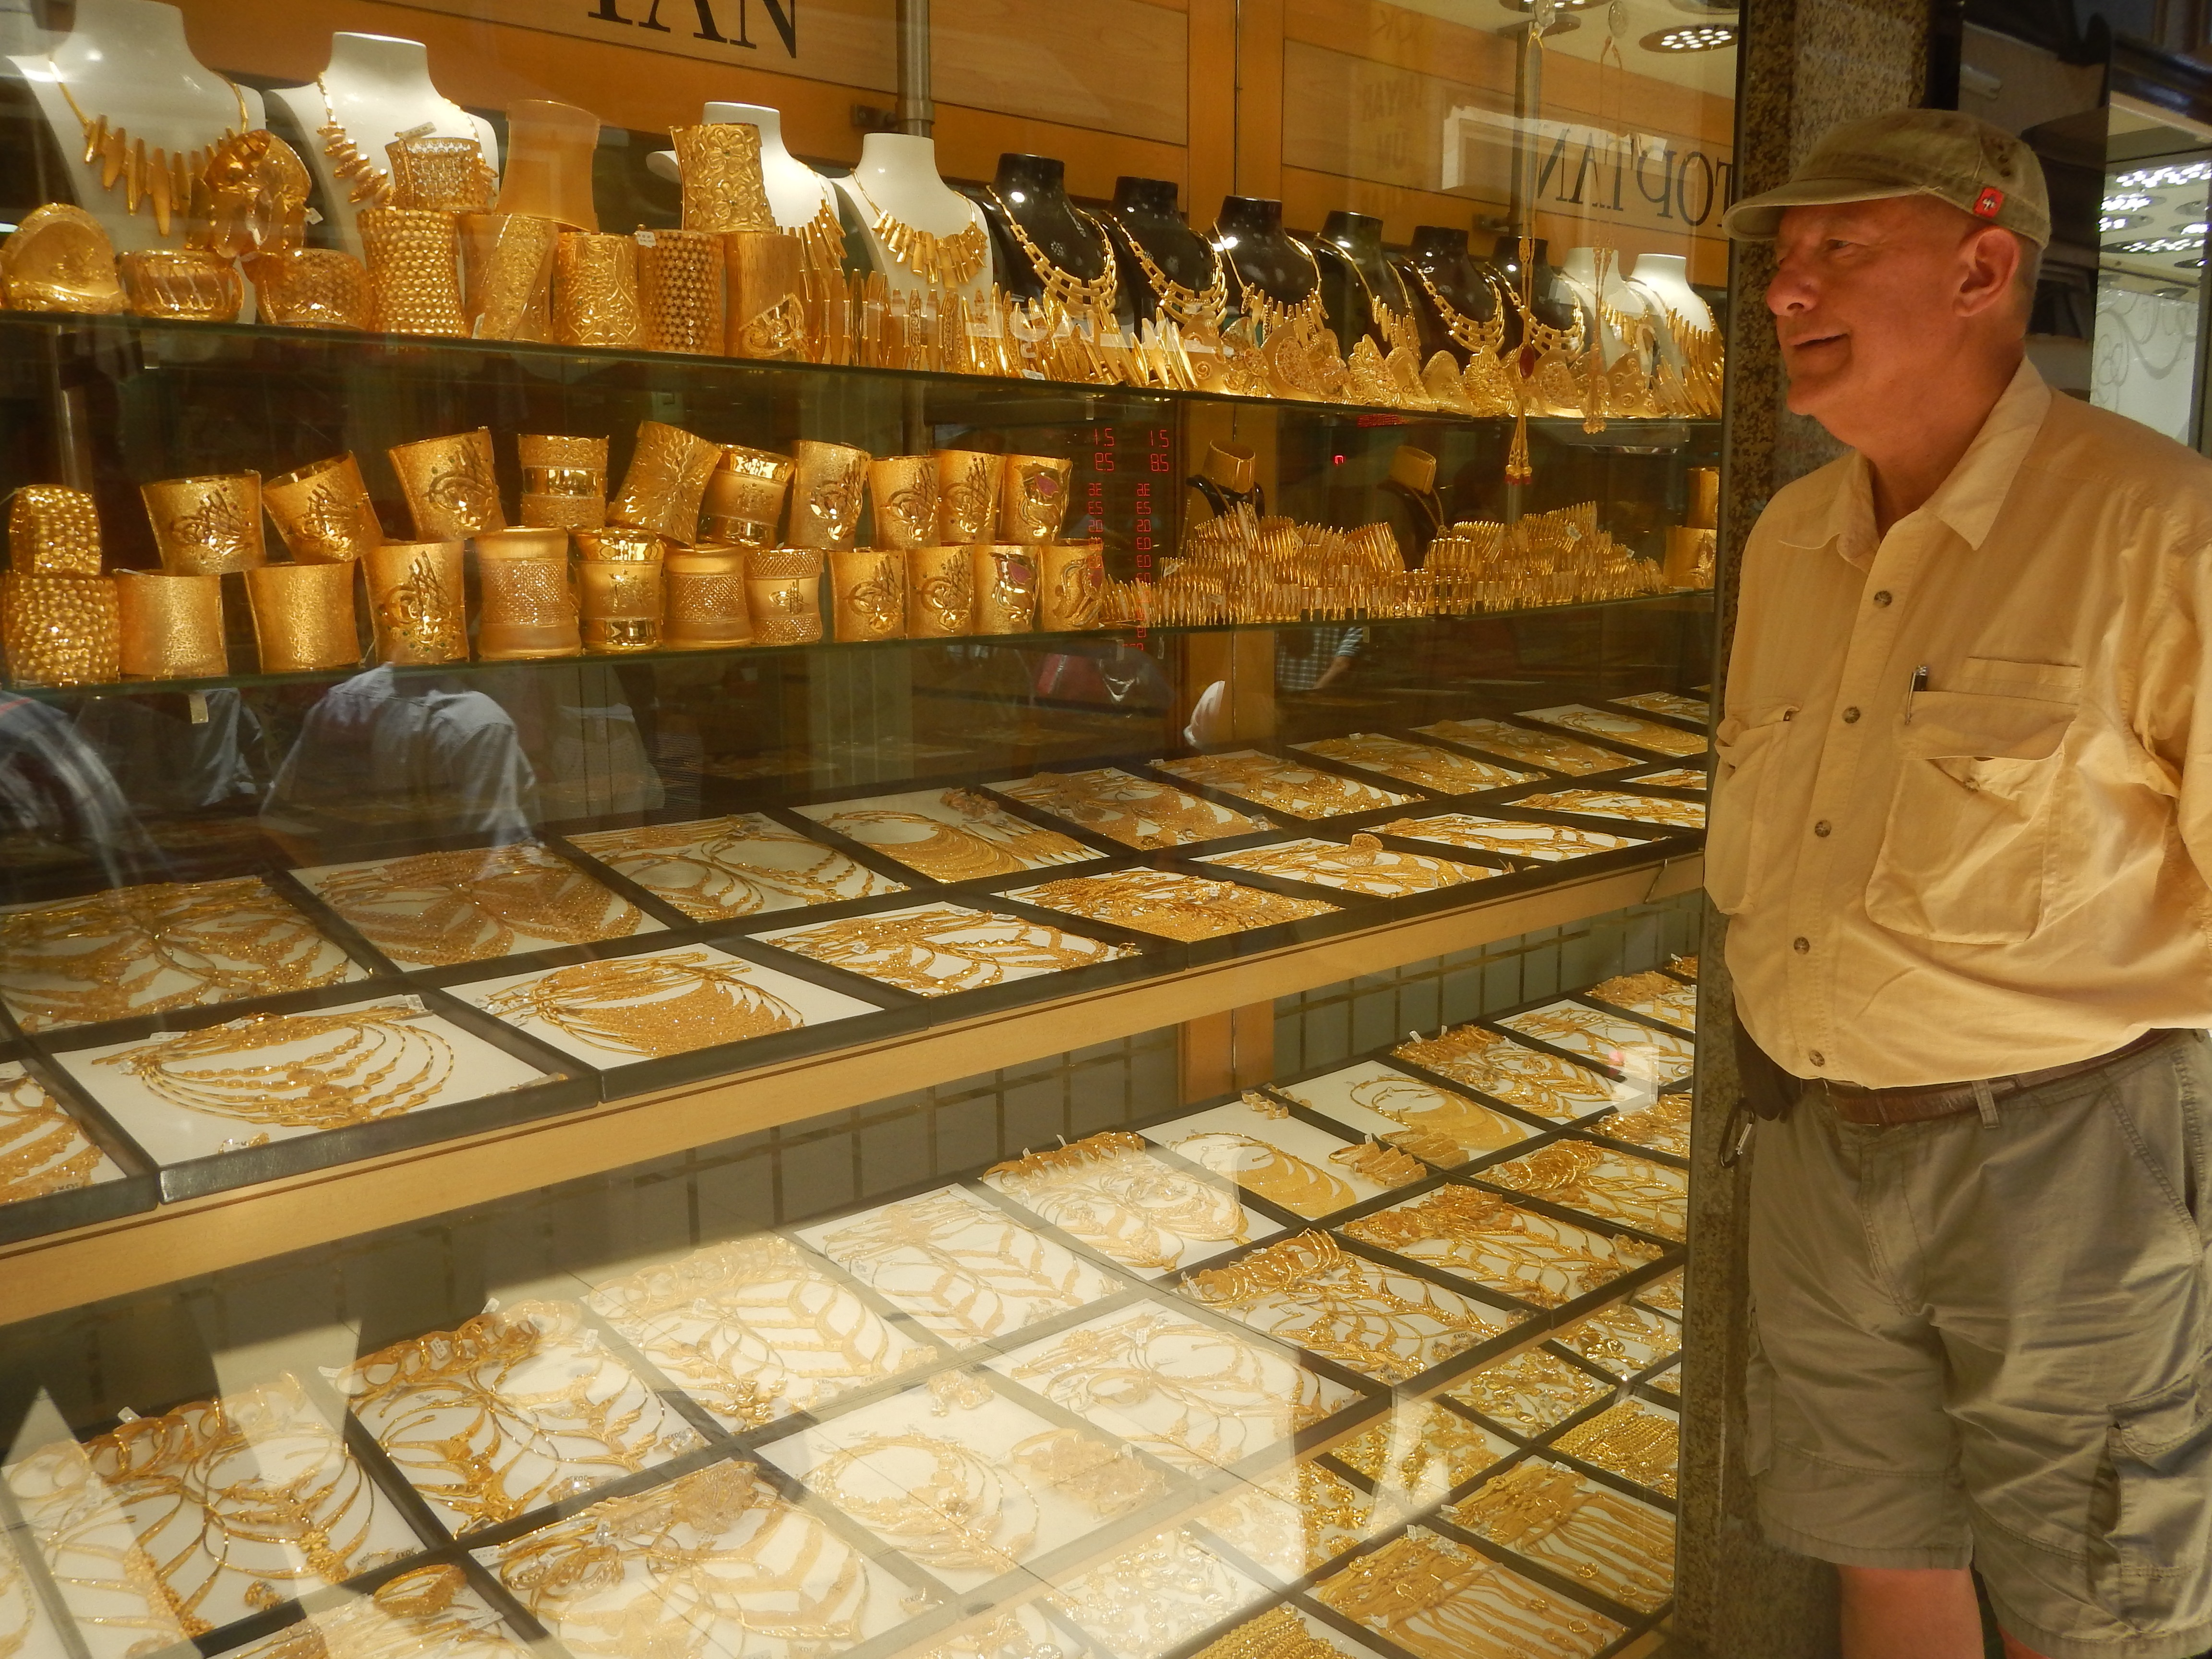
Precious Metals-The Bull Lives!-Buy Dips!
*Global panic piles new cash into gold, gold shares (GDX) rocket 40%-100%
*Upside break of 200 day moving average signals new bull market
*No new Indian import duties triggers new wave of buying
*Production peaked in Q4, will decline
for years, 3% in 2016 and 15%-20%
over 3-4 years as no new mines come
on stream and ore grades fall
*Spec position leaps from flat to a
large long in a very short time
*The new bull market here!

Slide 59
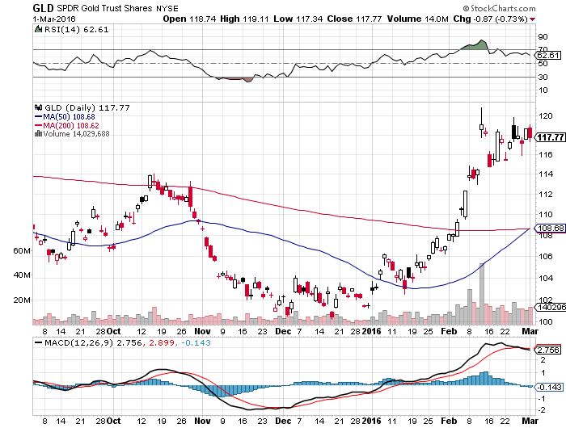
Gold (GLD)-Nailed the Breakout!!
Took profits on long the $95-$100 vertical bull call debit spread long the $107-$112 vertical bull call spread

Slide 60
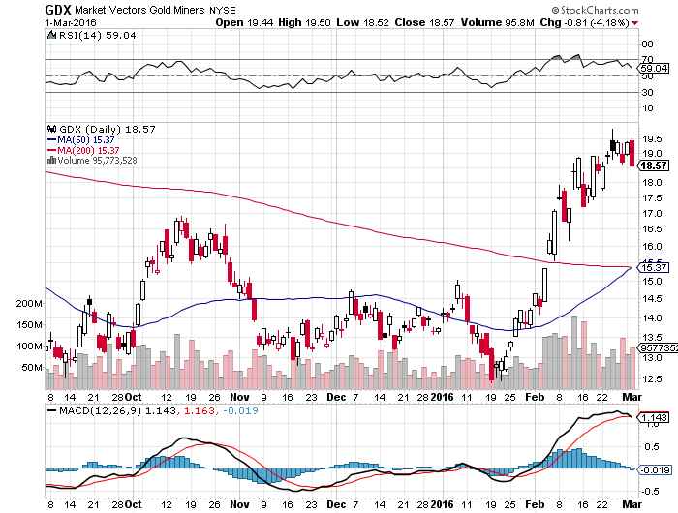
Market Vectors Gold Miners ETF- (GDX)

Slide 61
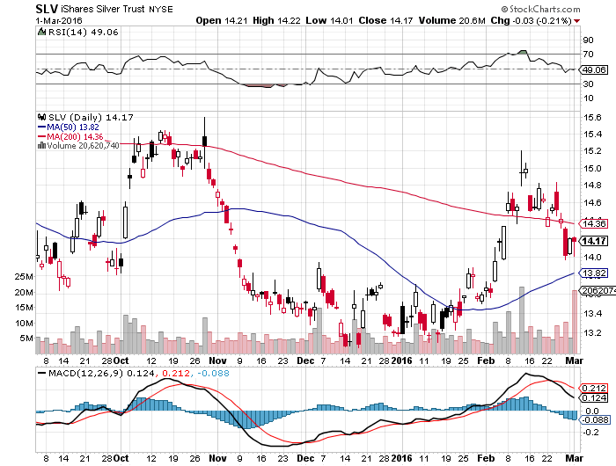
Silver (SLV)-

Slide 62

Silver Miners (SIL)-Finally Kicks In

Slide 63

Platinum (PPLT)-The Volkswagen Effect new chapter of the “Clean Diesel” Scandal

Slide 64

Palladium (PALL)-The Non Diesel Play

Slide 65

Agriculture-An El Nino Boost
*Agriculture is becoming the next energy crisis, as persistently low prices sink farm incomes to the 2002 lows.
*Current prices for corn, wheat, and soybeans now lower than the cost of production
*Dollar still demolishing US exports,
US wheat is shut out of global market
*Warm winter is presaging another
record year for crop production
*US loses No. wheat export
position to Canada because of
strong dollar
*No trade, there are NO fish to fry

Slide 66

(CORN) – More New lows!

Slide 67

(WEAT)-New Lows!

Slide 68

Ag Commodities ETF (DBA)- New Lows

Slide 69

Real Estate-The Last Bull Market
*January existing home sales up 11% YOY to an annualized 5.47 million units, a rebound for the new mortgage rules slow down, but new homes down -9.2%
*Inventories hit a seven year low at a 5.8 month supply, median prices up 8.8% YOY,
*US Housing inventory at a 30 year low, impossible to buy a home in a good school district
*We are still 40% below normalized housing starts, meaning new construction has to double
*Millennials are finally having kids, so new
household formation is about to take off
*Case Shiller S&P 500 National index
continues upward grind

Slide 70

December S&P/Case–Shiller Home Price Index
+5.7% YOY and accelerating, Denver, San Francisco, Dallas

Slide 71

US Home Construction Index (ITB)
(DHI), (LEN), (PHM), (TOL), (NVR)

Slide 72

Trade Sheet
So What Do We Do About All This?
*Stocks- sell rallies, but buy the capitulation days too
*Bonds-the top is near, sell rallies, buy (TBT)
*Commodities-stand aside, the bottom is coming
*Currencies- Sell short the Yen and Euro on rallies, buy on dips
*Precious Metals –buy on dips
*Volatility-sell short spikes over $25 through (XIV)
*The Ags –stand aside - avoid the disaster
*Real estate-buy the homebuilders LT

Slide 73

Next Strategy Webinar
12:00 EST Wednesday,
March 16, 2016
San Francisco, CA
USA!
Good Luck and Good Trading!
Notes:
*

