Slide 1

The Mad Hedge Fund Trader
“Flip Flopping Fed”
With John Thomas
from San Francisco, CA, March 30, 2016
www.madhedgefundtrader.com
Notes:
*

Slide 2

Trade Alert Performance
Making Big Profits in Dire Market Conditions
*January +1.23% Final *July +6.42% Final
*February +4.50% FINAL *August +1.27% Final
*March -2.39% MTD *September +11.99% Final
*April +6.62% Final *October Final -6.19%
*May +5.15% Final *November MTD 5.78%
*June +3.68% Final *December -4.94%
*2016 Year to Date +3.34%
compared to 0% for the Dow Average
*Trailing 1 year return +35.00%, +195.02% since inception,
4.00% short of all-time high
*Average annualized return of 37.60%

Slide 3
Portfolio Review
Keeping a Small Book
Looking to Fade the Next Extreme Move
current capital at risk
Risk On
World is Getting Better
(GLD) 4/$109-$112 call spread | 10.00%
Risk Off
World is Getting Worse
(SPY) 4/$182 puts | -5.00%
(SPY) 4/$208-$213 put spread | -10.00%
total net position | -15.00%
Expiration P&L
5.30% YTD

Slide 4
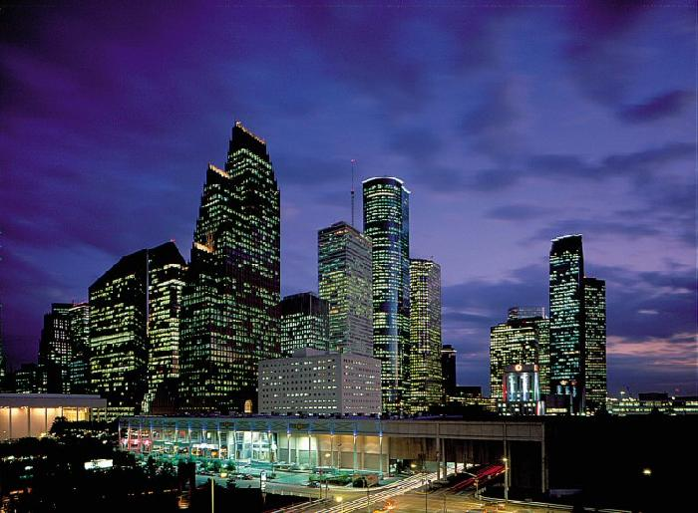
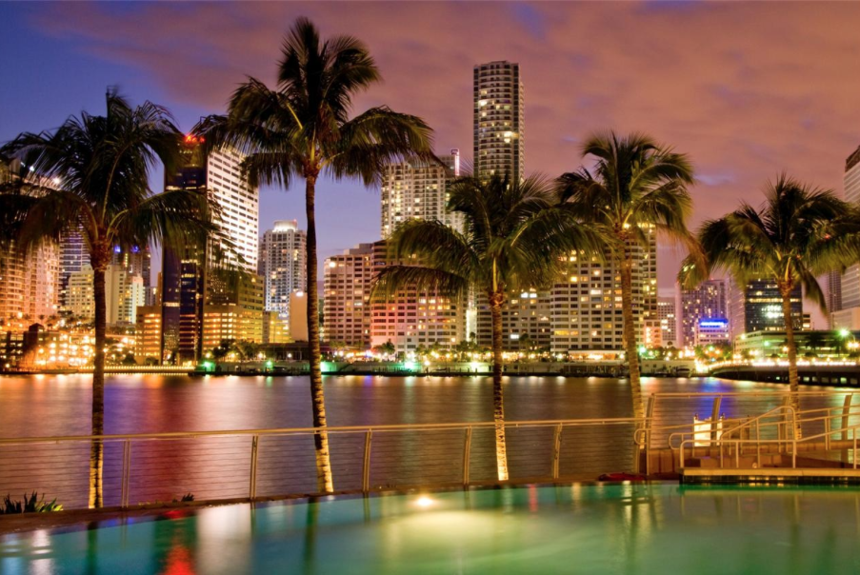
MHFT Global Strategy Luncheons
Buy tickets at www.madhedgefundtrader.com go to “LUNCHES” then “USA”
Houston
April 15, 2016
Miami
April 18, 2016

Slide 5

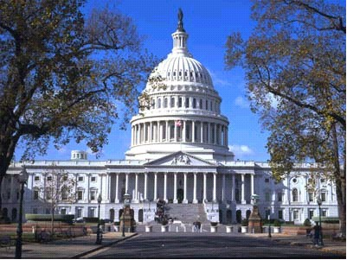
MHFT Global Strategy Luncheons
Buy tickets at www.madhedgefundtrader.com go to “LUNCHES” then “USA”
Atlanta
April 19, 2016
Washington DC
April 20, 2016

Slide 6


MHFT Global Strategy Luncheons
Buy tickets at www.madhedgefundtrader.com go to “LUNCHES” then “USA”
Boston
April 21, 2016
New York City
April 22, 2016

Slide 7
MHFT Global Strategy Luncheons
Buy tickets at www.madhedgefundtrader.com go to “LUNCHES” then “USA”
Chicago
April 25, 2016

Slide 8
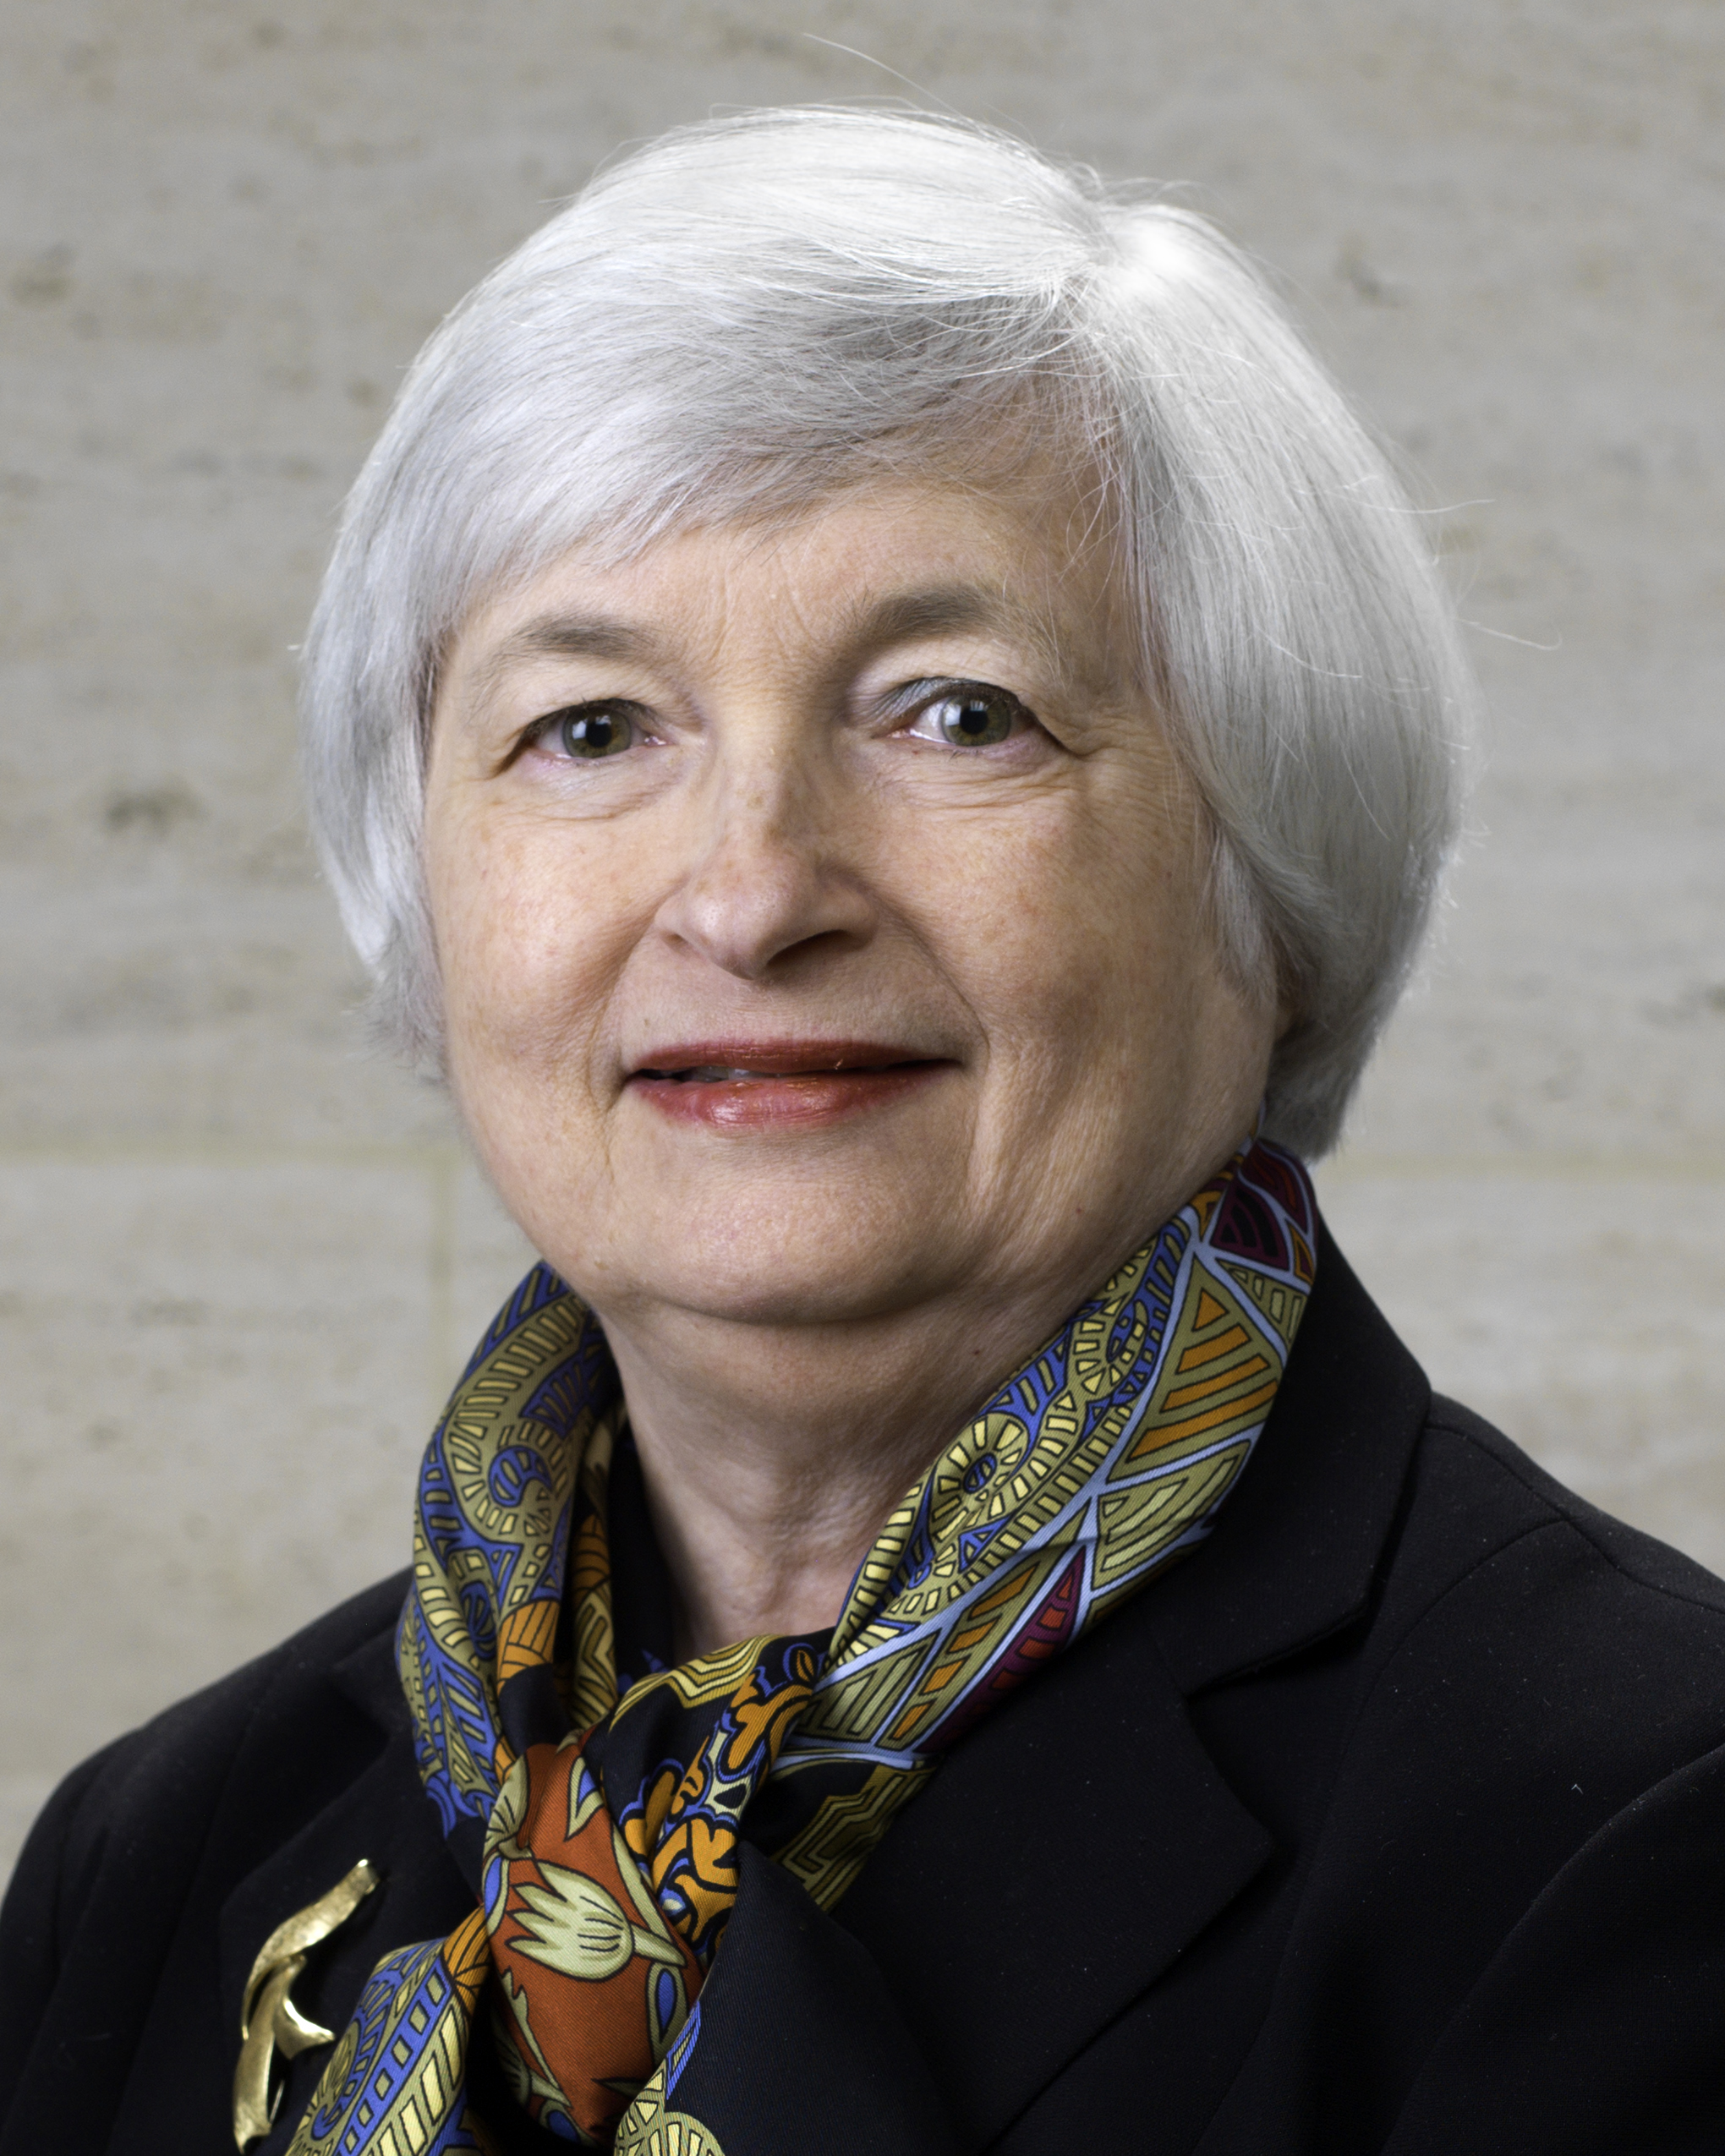
Janet Speaks!
No More Interest Rate Hikes Until December
Read the Hidden Meaning of Her Words:
*”Greater gradualism”
*”Less favorable economic conditions”
*Weaker foreign economies”
“Inflation expectations drifting down”
“Jobless figures overstated by part time
workers”

Slide 9

The Method to My Madness
Running small book in an overbought market, and while I’m wrong
*Try to breakeven when I’m wrong and be up big when I’m right
*Keeping small book in order to fade the next extreme move in any asset class
*Hanging on to small (SPY) $182 put position costs a lot of money in a market that goes up every day, 5% of performance lost this year
*With volatility at $13 everyone is nervous
*Gold has been the only reliable winner
*Record number of stop losses this year costing
another 10% in performance, (FXE), (GDX), (SPY),
(FXY)

Slide 10
Paid Subscriber Trailing 12 Month Audited Return +33.15%

Slide 11
64 Months Since Inception
Daily Audited Performance
Averaged annualized return +36.56%

Slide 12

Short Term Strategy Outlook-
*Flip flopping Fed is driving traders crazy, James Bullard says increase
“May not be far off.” Rate hike = RISK OFF”, no rate hike = “RISK ON”
*April Fed rate hike now being discussed, so is “RISK OFF” coming?
*Oil bottom at $26 looking more convincing, but expect a retest in coming weeks
*US stocks have now defined the 2016 wedge formation between (SPX) 1812 and 2010, will take 6 for months to resolve to the upside
*Bonds now baking in 1 more rate rise this year, and maybe 2
*Gold takes a rest after a great run, traders taking profits
when they can
*Dollar is DOA, continues sideways move, boosting stocks
*Will La Nina boost the ags?

Slide 13
The Bill Davis View
A $1,500 Upgrade for the Mad Day Trader Service
Buys:
Amazon (AMZN) $568 Target to $600
Chubb, Ltd (CB) $118 Target to $122
Accenture Ltd. (ACN) $108 Target to $120
Amgen, Inc. (AMGN) $146 Target to $153
Linkedin Corp. (LNKD) $109 Target to $140
Vertex Pharm (VRTX) $75 Target to $88
Sells:
Shake Shack (SHAK) $39 Target to $27
General Dynamics (GD) $133 Target to $127
G-III Apparel Group (GIII) $50 Target to $41
United Therapeutics (UTHR) $122 Target to $108

Slide 14
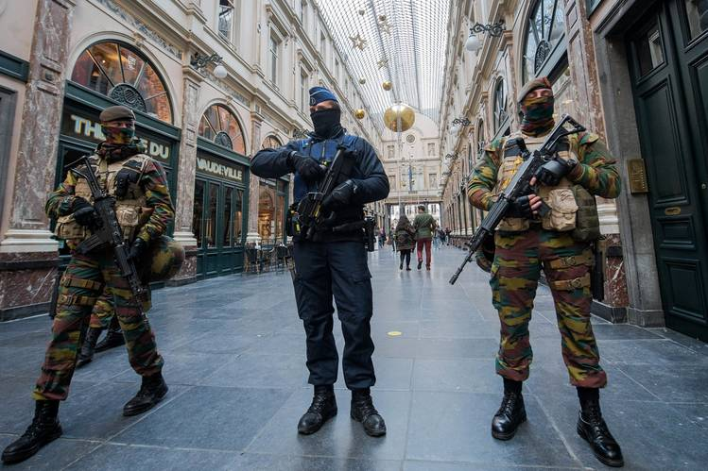
The Global Economy-Attack!
*Brussels terrorist attacks place a dark cloud over the European economy
*US Q1 GDP revised up from 1.0% to 1.4%, driven by consumer spending of gas savings-TOLD YOU SO! March consumer confidence up from 94.0 to a strong 96.2.
*China cuts interest rates by .33% adding more QE to bolster sagging economy, Japan considering axing consumption tax hike from 8% to 10% due next year
*US jobs growth one of the few global economic mainstays, look for 200K+ print on Friday
*Expect one more oil down leg to trigger global “RISK OFF” move
*All commodities hit with sharp selloffs,
the first test is here
*Next to come is a “RISK ON” global
synchronized growth in H2 2016
once we get through New Year effects

Slide 15
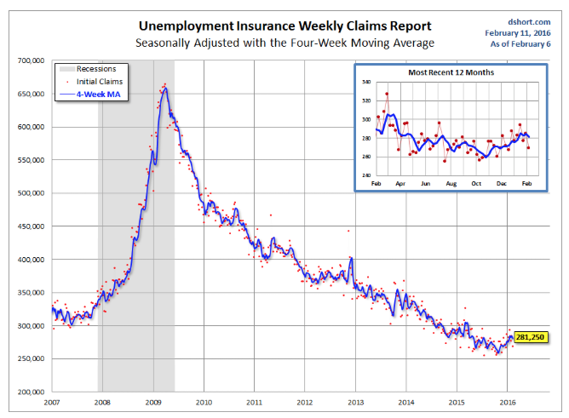
Weekly Jobless Claims –The Most Important Statistic
-6,000 to 265,000
The Downtrend Lives!-Show Me the Recession!

Slide 16
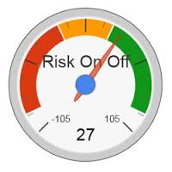
Bonds-Trade the New Range
*Bonds yields back off from lows, now dead in the middle of the 1.58%-2.30% 2016 range
*Bonds now totally driven by this week’s outlook on Fed interest rate policy
*JGB’s hit a new record low of -0.10%
*Emerging market debt makes
a huge recover on commodities rally,
then levels out
*Same with energy Junk
*Buy the dip for the next round
of “RISK OFF”

Slide 17
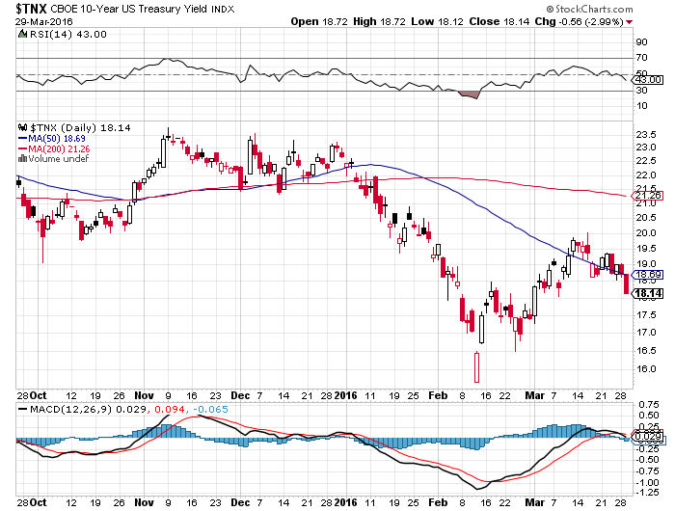
Ten Year Treasury Yield ($TNX) 1.81%
The Reversal is In

Slide 18
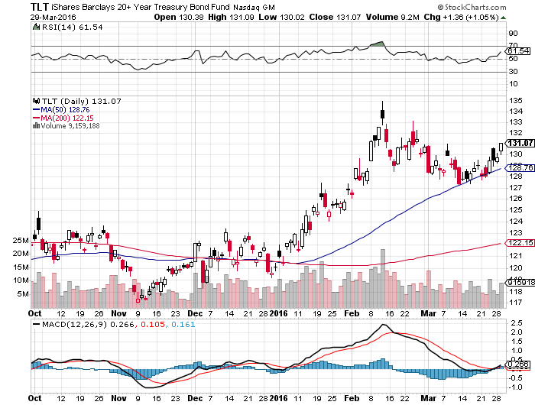
Ten Year Treasury ETF (TLT) 1.81%
The Reversal is In

Slide 19
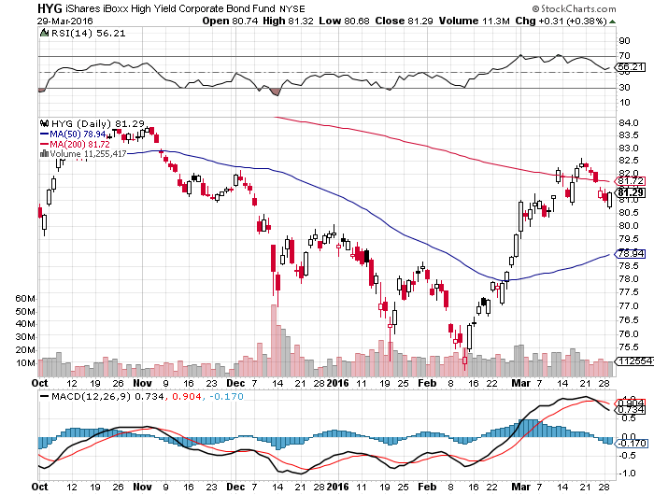
Junk Bonds (HYG) 6.95% Yield
A Great Risk Coincident Indicator

Slide 20
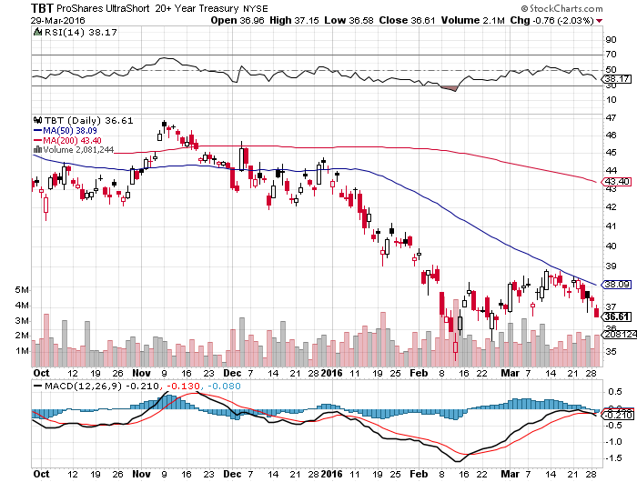
2X Short Treasuries (TBT)-Not Yet the Big Trade of 2016?
Back in “BUY” Territory

Slide 21
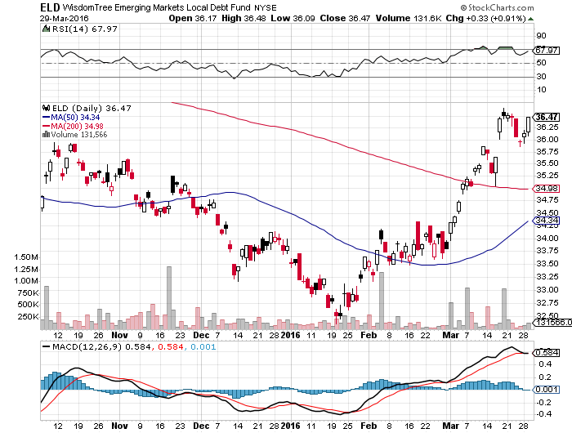
Emerging Market Debt (ELD) 5.82% Yield-

Slide 22
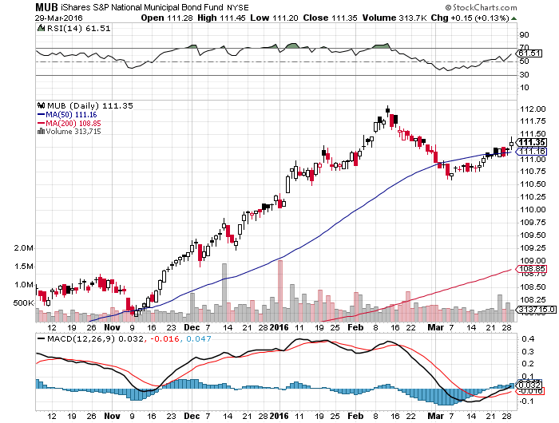
Municipal Bonds (MUB)-1.45% yield-New High
Mix of AAA, AA, and A rated bonds-flight to safety

Slide 23

Stocks-Confidence is Low
*Stocks about to stall at the top, market is the most overbought in history, with 92.5% of stocks over 50 day moving average
*Confidence in rally is low, with short covering accounting for most of the move to 2,000, traders are terrified to take on new positions with (VIX) at $13
*Shorts are all gone now, but no one wants to play on the long side
*The “Narrowing Wedge” scenario is playing out, with a big triangle formation setting up over the next six months, with lower highs and higher lows between 1812 and 2010, earnings not there to move to new all time high
*Brussels attack brings geopolitics back on
the table
*Only one more month of seasonable
stock strength, “Sell in May” is coming

Slide 24
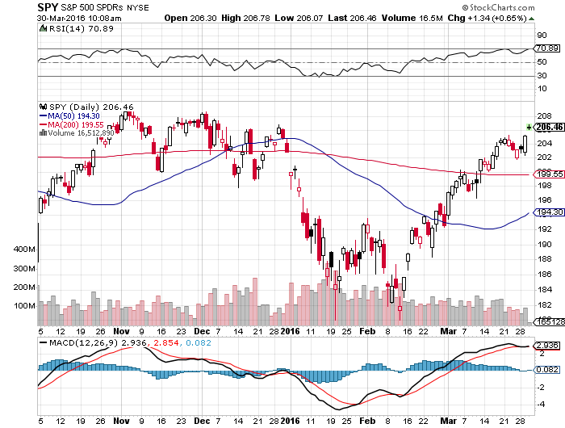
S&P 500-Short Squeeze!

Slide 25
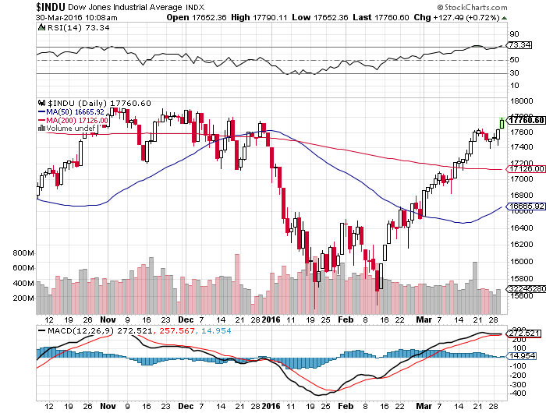
Dow Average-Topping Out Too

Slide 26
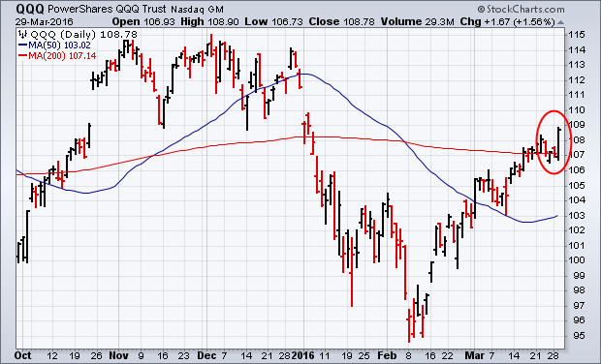
NASDAQ (QQQ)-Break of 500-Day Moving Average!
Is where traders will pour back into

Slide 27
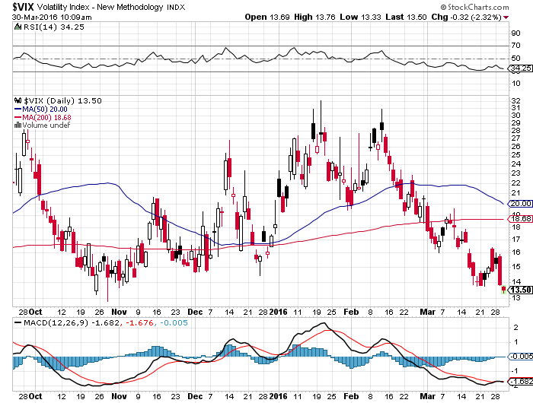
(VIX)-Back to the Bottom

Slide 28
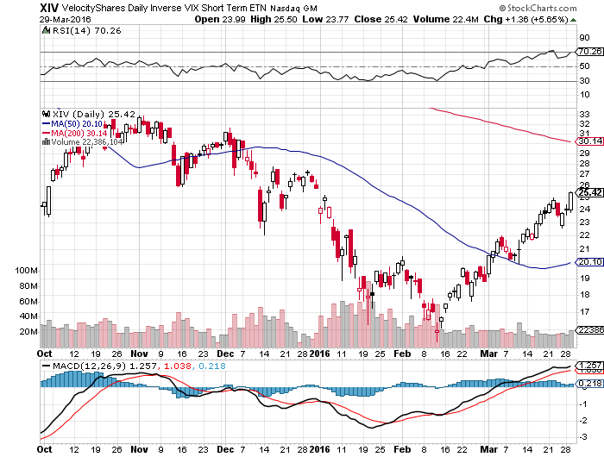
(XIV)-Velocity Shares Daily Inverse VIX Short Term ETN

Slide 29
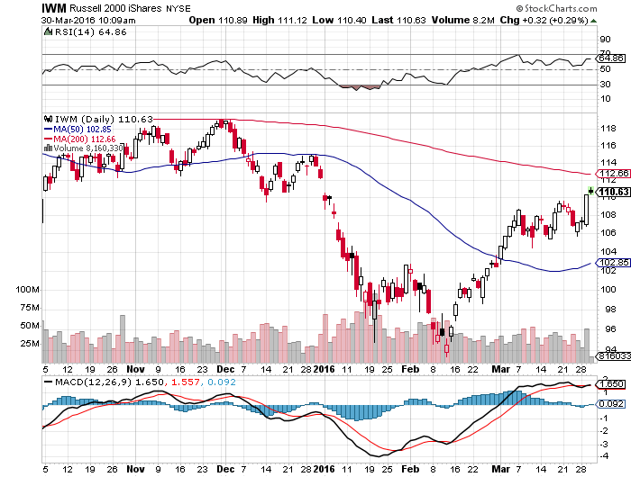
Russell 2000 (IWM)-The Weakest Link took profits on the $112-$117 vertical bear put spread

Slide 30
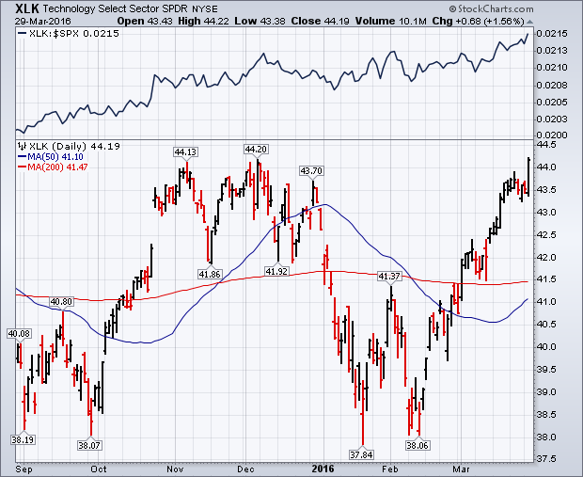
Technology Sector SPDR (XLK), (ROM)
(AAPL), (MSFT), (VZ), (T), (FB), (IBM)

Slide 31
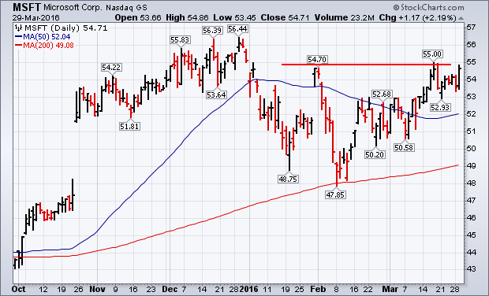
Microsoft (MSFT) looking to go long on next dip

Slide 32
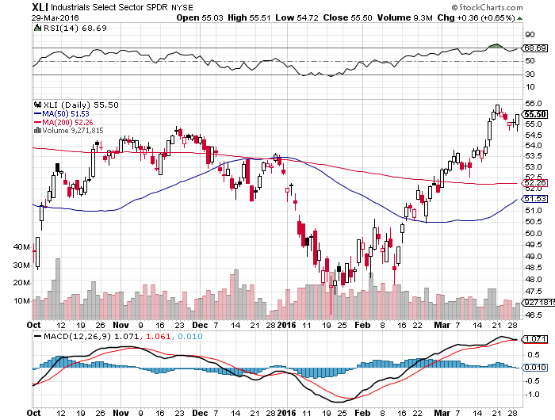
Industrials Sector SPDR (XLI)-Dow Mainstay
(GE), (MMM), (UNP), (UTX), (BA), (HON)

Slide 33
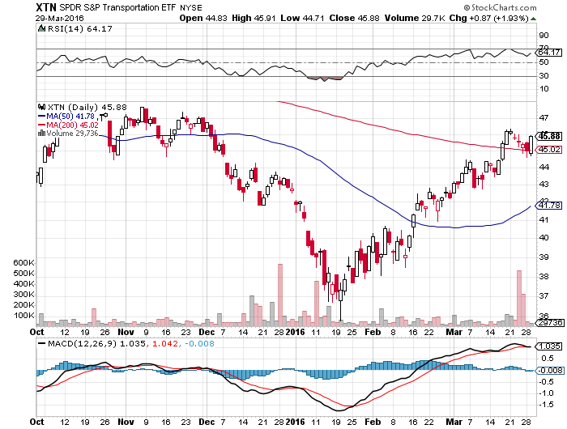
Transports Sector SPDR (XTN)-Another Dow Mainstay
(ALGT), (ALK), (JBLU), (LUV), (CHRW), (DAL),

Slide 34
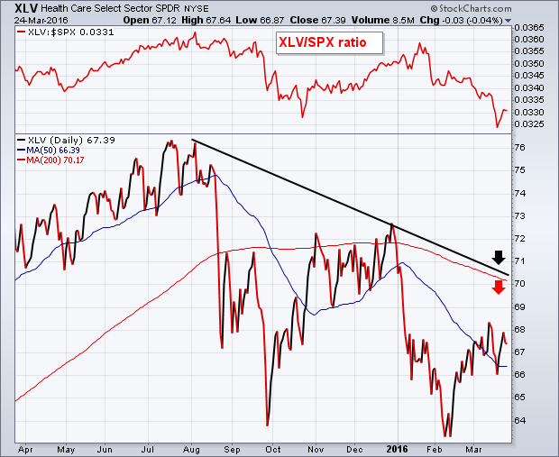
Health Care Sector SPDR (XLV), (RXL)
(JNJ), (PFE), (MRK), (GILD), (ACT), (AMGN)

Slide 35
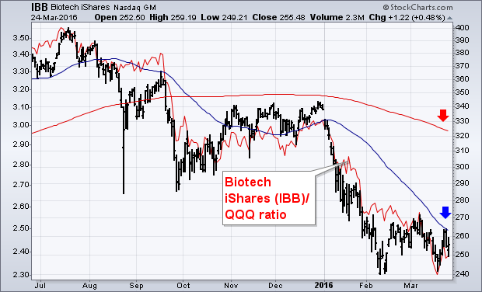
Biotech iShares (IBB)-A Political Football in 2016

Slide 36
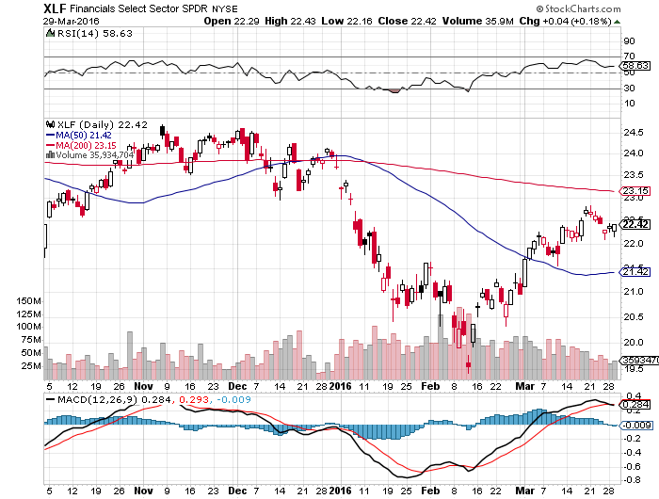
Financial Select SPDR (XLF)-
(BLK/B), (WFC), (JPM), (BAC), (C), (GS)

Slide 37
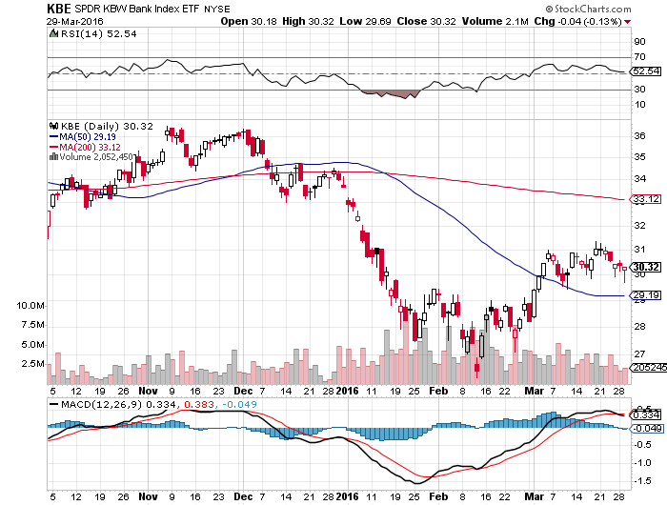
KBW Bank Index (KBE)- love those rising rate prospects

Slide 38
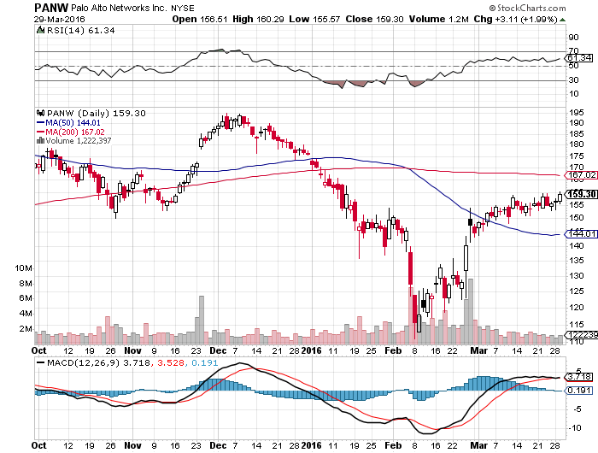
Palo Alto Networks (PANW)-

Slide 39
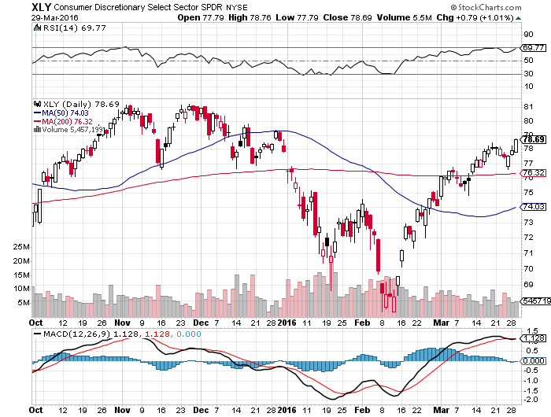
Consumer Discretionary SPDR (XLY)
(DIS), (AMZN), (HD), (CMCSA), (MCD), (SBUX)
A Major Leader of the Rally

Slide 40
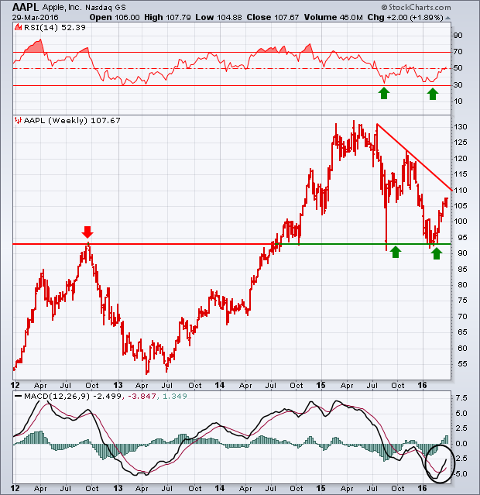
Apple (AAPL) –Buy the Dips
Back to waiting for the next real catalyst-the iPhone 7
Buy after Q1 earnings in April to avoid post Christmas dip, $105 billion stock buy backs done

Slide 41
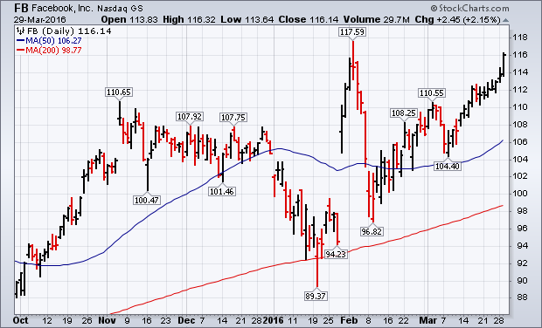
Facebook (FB) –The Big One That Got Away

Slide 42
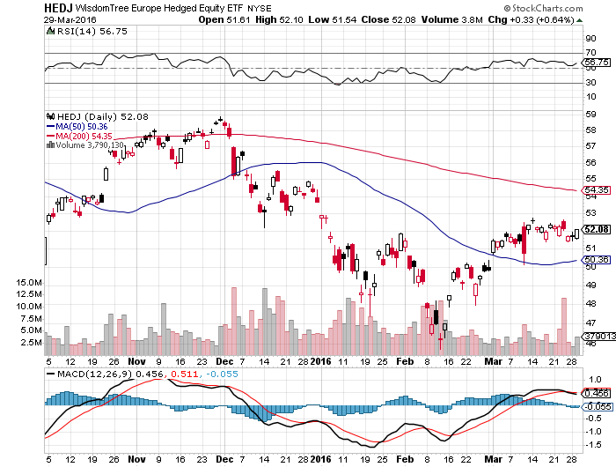
Europe Hedged Equity (HEDJ)-Hedged Japan Equity
Capped by strong euro and Brussels attack

Slide 43
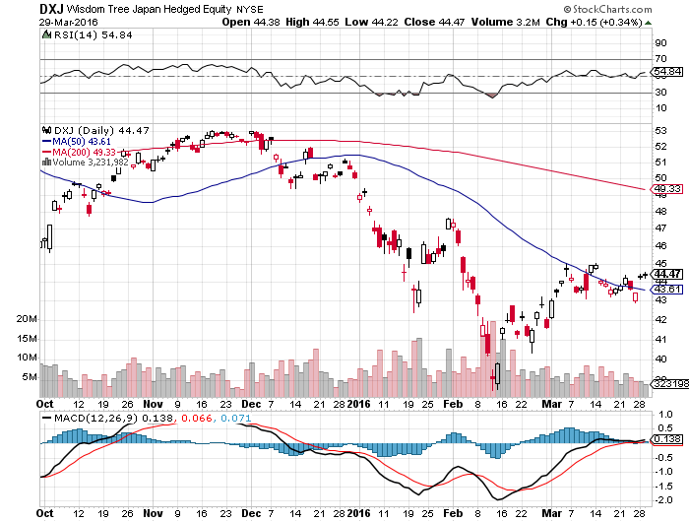
Japan (DXJ)-Hedged Japan Equity
Capped by strong yen?

Slide 44
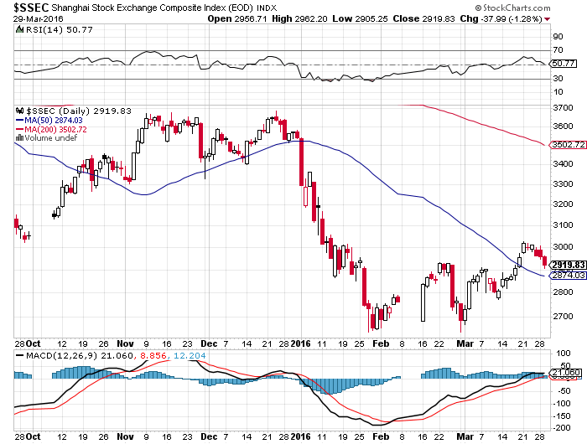
China ($SSEC)-
The Bad Boy Market and font of volatility

Slide 45
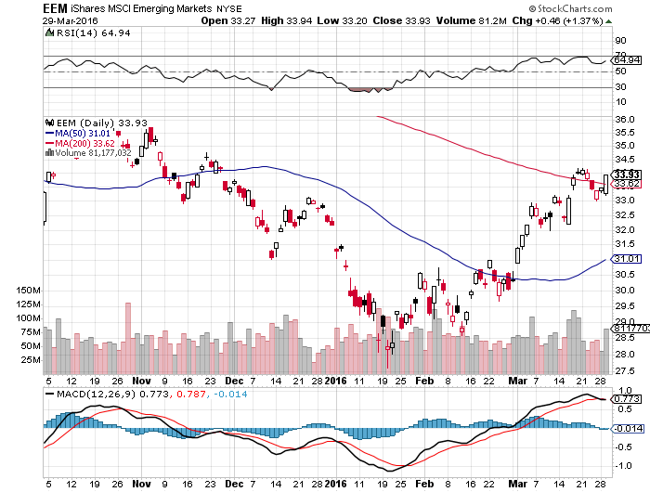
Emerging Markets (EEM)-
Loves the oil and commodity bounce

Slide 46
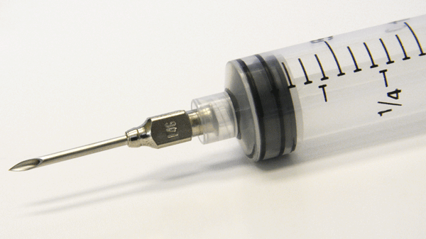
Foreign Currencies-Another Dose of QE
*Yellen comments put the kibosh on any interest rate rise for the foreseeable future, demolishing the dollar
*Brussels terrorist attack increases chances of England pulling out of the EC, killing off the pound
*Janet comments breath new life into the yen, torpedoing Nikkei
*Commodity rebound breathes
new life into commodity currencies,
won’t last forever
*With no interest rate moves anywhere,
this could be a year of low volatility
for currencies

Slide 47
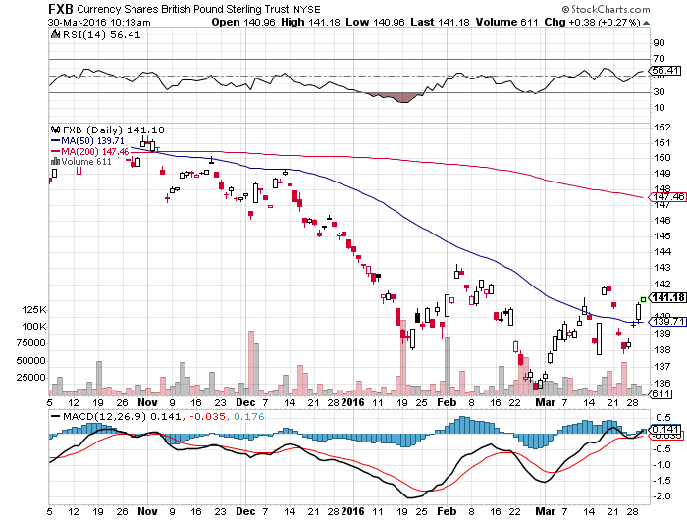
British Pound (FXB)-Political Disaster!

Slide 48
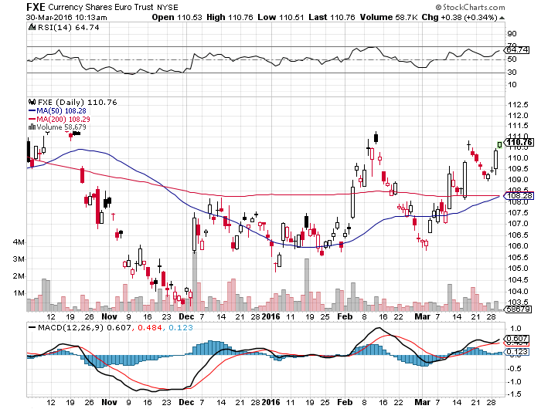
Euro ($XEU), (FXE), (EUO)- on “Brexit” fears, prospect of more QWE next week

Slide 49
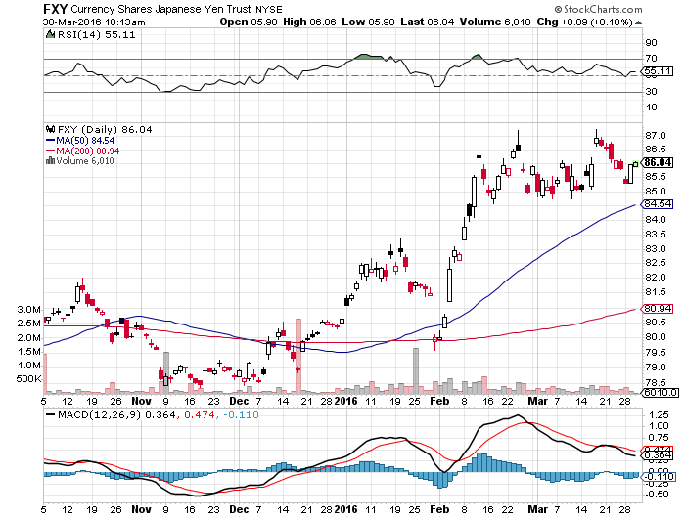
Japanese Yen (FXY)-At a One Year High

Slide 50
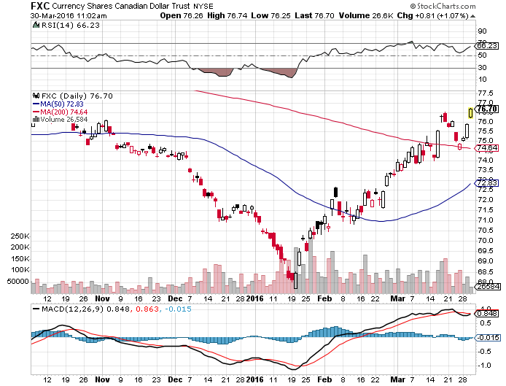
Canadian Dollar (FXC)-Commodity Rebound

Slide 51
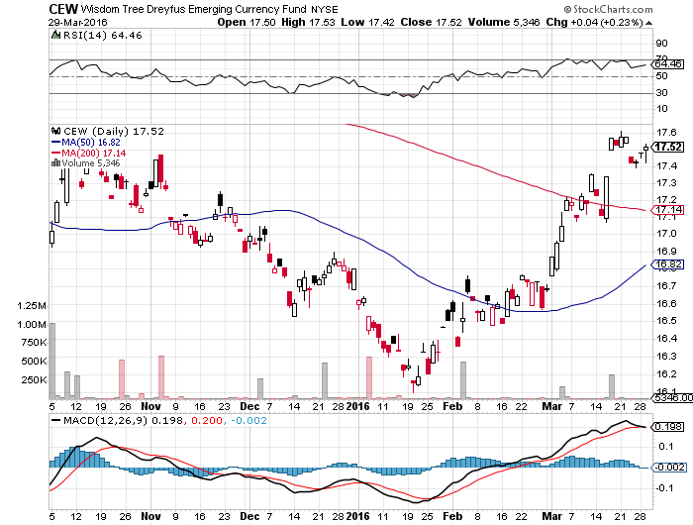
Emerging Market Currencies (CEW)

Slide 52
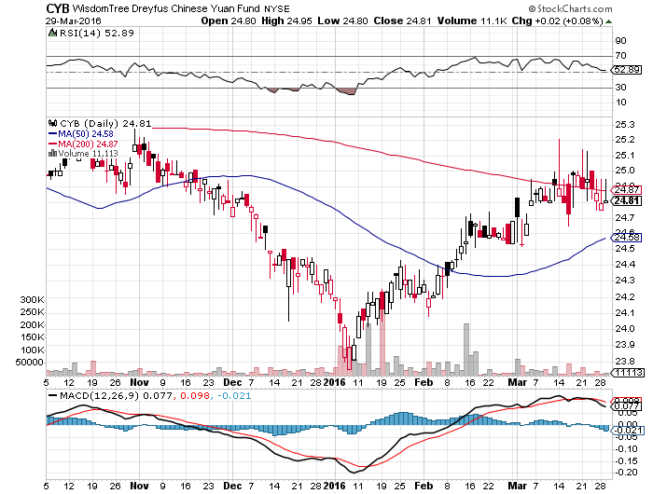
Chinese Yuan- (CYB)-Sell Rallies on Weakening Economy
A New Hedge Fund Favorite

Slide 53

Energy-Topping Out
*$150 billion in energy debt defaults since oil collapse
*Monster 9.4 million inventory build last week says supply still a huge issue
*$40 oil is the “live or die” level for many smaller companies, 1,000 DUC wells waiting to come online over $40/barrel
*Australia’s Woodside Petroleum cancels mammoth $40 offshore LNG project
*At least 50% of all US energy debt at risk of default, bankruptcies are coming
*US rig count in free fall, down 15 to 372
down 3,700 globally to 2,600 now, and down
from the 1981 peak of 6,200
*Oil approaching levels where bankers will
demand new hedges to protect loans
*Futures long is a record 364,000 contracts,
meaning risk is high

Slide 54
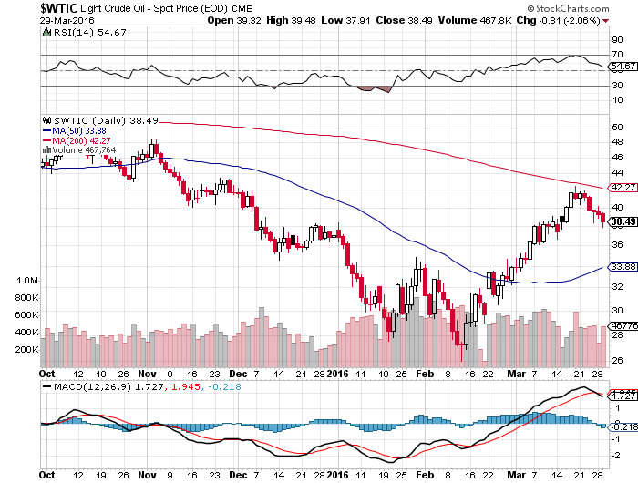
Oil-The Bottom is in, The Retest is On

Slide 55
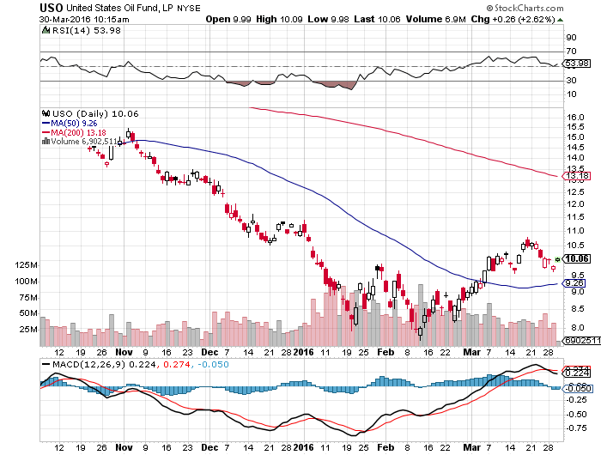
United States Oil Fund (USO) took profits on long the 5/$8.00 calls too soon

Slide 56
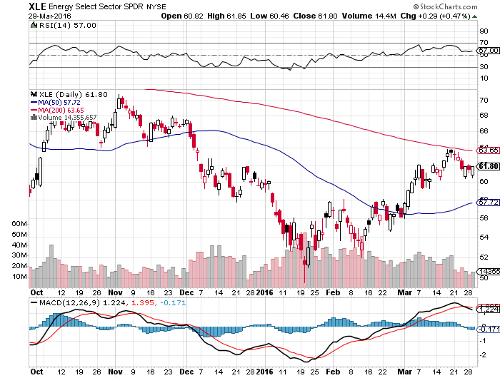
Energy Select Sector SPDR (XLE)
(XOM), (CVX), (SLB), (KMI), (EOG), (COP)

Slide 57
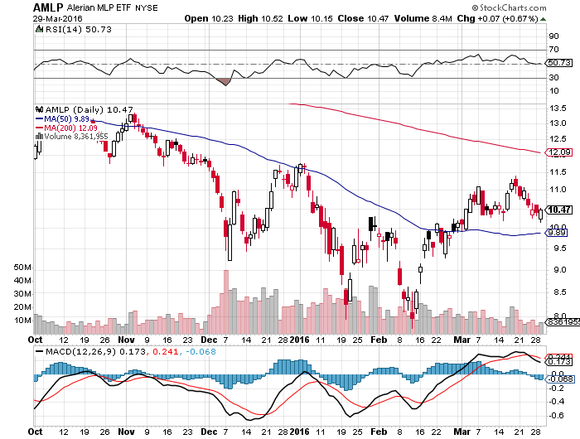
Alerian MLP ETF (AMLP)-9.08% Yield
Basket Approach is the Only Safe Play here

Slide 58
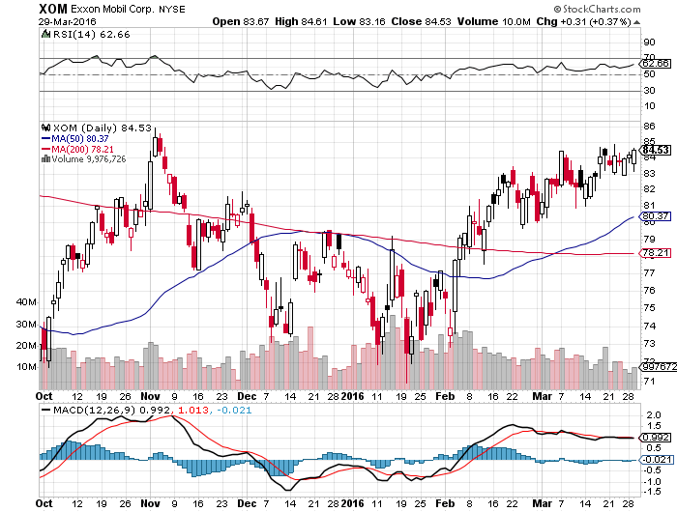
Exxon (XOM)-

Slide 59
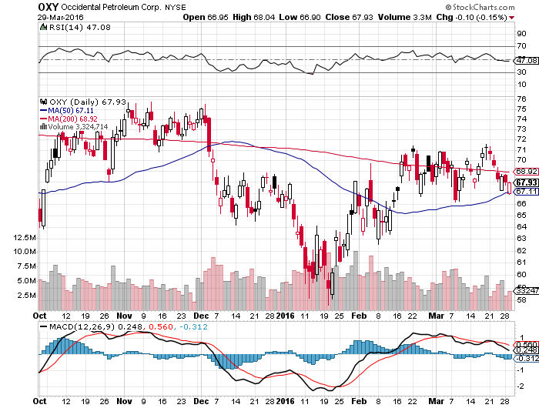
Occidental Petroleum (OXY)-

Slide 60
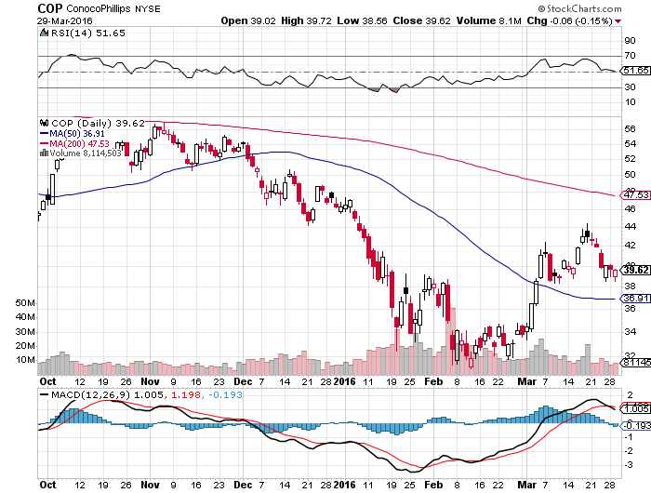
Conoco Phillips (COP)-The Buffet Favorite

Slide 61
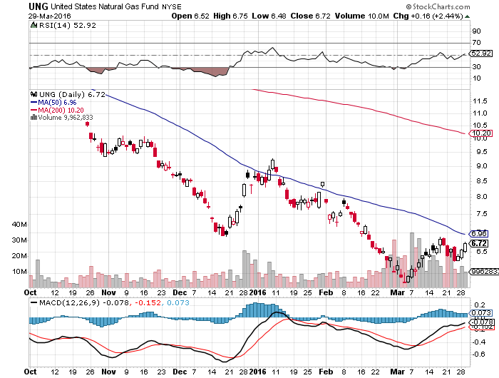
Natural Gas (UNG)-Dragged Up By Oil

Slide 62

Copper-The Bottom is In

Slide 63

Freeport McMoRan (FCX)-Tripled off $3 bottom

Slide 64

Precious Metals-The Yellen Assist
*Round of profit taking hits gold, the best performing asset of 2016
*(GLD) physical gold holdings up 25% this year to 824 metric tonnes
*Indian jewelers, worlds biggest buyers, not participating in the recent run up
*Gold is starting to show signs of upside exhaustion, time to take a break, but still a lot of buyers below
*Venezuela dumps much of its gold reserves
to meet a cash crunch
*Spec positions now near highs,
adding risk

Slide 65

Gold (GLD)-Looking for a Dip long long the 4/$109-$112 vertical bull call spread-12 trading days to expiration

Slide 66

Market Vectors Gold Miners ETF- (GDX)

Slide 67

Silver (SLV)-

Slide 68

Silver Miners (SIL)-Finally Kicks In

Slide 69

Platinum (PPLT)-The Volkswagen Effect

Slide 70

Palladium (PALL)-

Slide 71

Agriculture-From El Nino to La Nina
*Dry weather finally hits the Midwest, cutting yields and putting upward pressure on prices
*As el nino winds down will an la nina follow, creating ideal growing conditions?
*Strong Dollar still demolishing US exports,
US wheat is shut out of global market
*Corn stockpiles still near record highs,
are there to cap every rally
*No trade, there are NO fish to fry

Slide 72

(CORN) – More New lows!

Slide 73

(WEAT)-Finally a Bounce!

Slide 74

Ag Commodities ETF (DBA)- New Lows

Slide 75

Real Estate-Ticking Along
*February pending home sales rocket to 5.1%, existing home sales down -7.1% to 5.08 million units
*Mortgage applications down 3.3%
*March homebuilder sentiment remains high at 58
*Red hot commercial real estate starting to cool nationally
*”Brexit” fears starting to drive flight capital from London to New York, Chinese flight capital becoming a big factor in local markets like San Francisco, Los Angeles, and New York
*We are still 40% below normalized
housing starts, meaning new construction
has to double
*Case Shiller S&P 500 National index
continues upward grind, January +5.4%

Slide 76

December S&P/Case–Shiller Home Price Index
+5.4% YOY, Portland, San Francisco, lead

Slide 77

US Home Construction Index (ITB)
(DHI), (LEN), (PHM), (TOL), (NVR)

Slide 78

Trade Sheet
So What Do We Do About All This?
*Stocks- sell rallies, market is extremely overbought
*Bonds-the top is in, fade the next big rally
*Commodities-the bottom is in, buy big dips
*Currencies- Sell short the Yen on rallies
*Precious Metals –buy on dips
*Volatility-sell short spikes over $25, buy dip to $14
*The Ags –stand aside - avoid the disaster
*Real estate-buy the homebuilders LT

Slide 79

To buy lunch tickets, please go to www.madhedgefundtrader.com , click on “LUNCHES,” “USA”, and then your desired city
Next Strategy Webinar
12:00 EST Wednesday,
April 13, 2016
San Francisco, CA
USA!
Good Luck and Good Trading!
Notes:
*

