Slide 1
Mad Day Trader
Bill Davis
Webinar – April 6, 2016

Slide 2
Today I want to discuss the markets and then the sentiment indicators and then end by looking at some intra day moves.

Slide 3
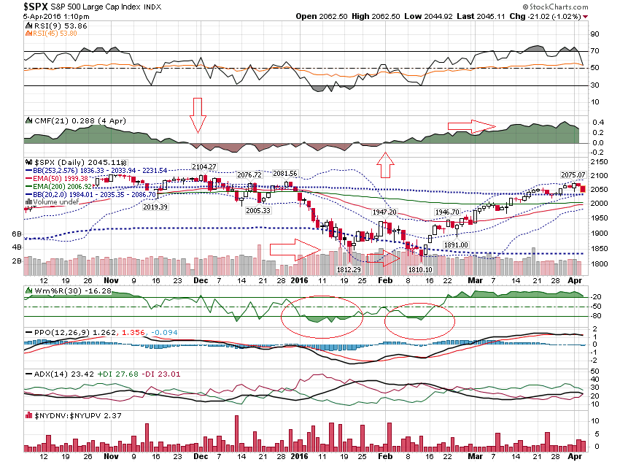

Slide 4
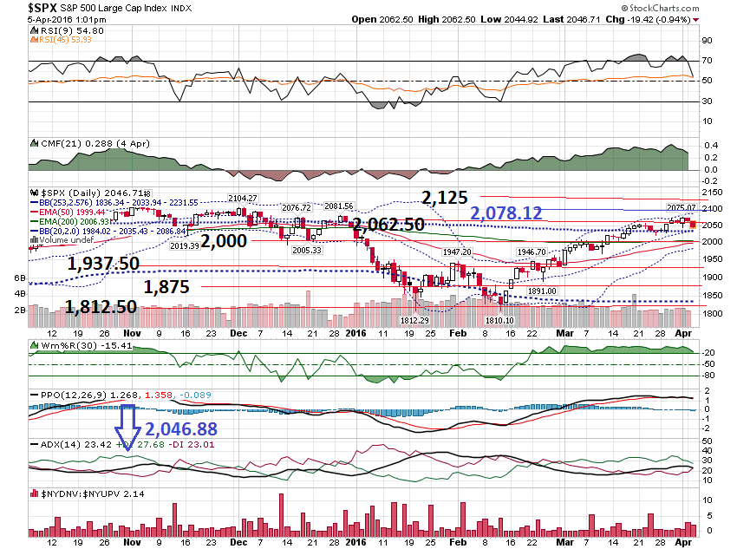

Slide 5
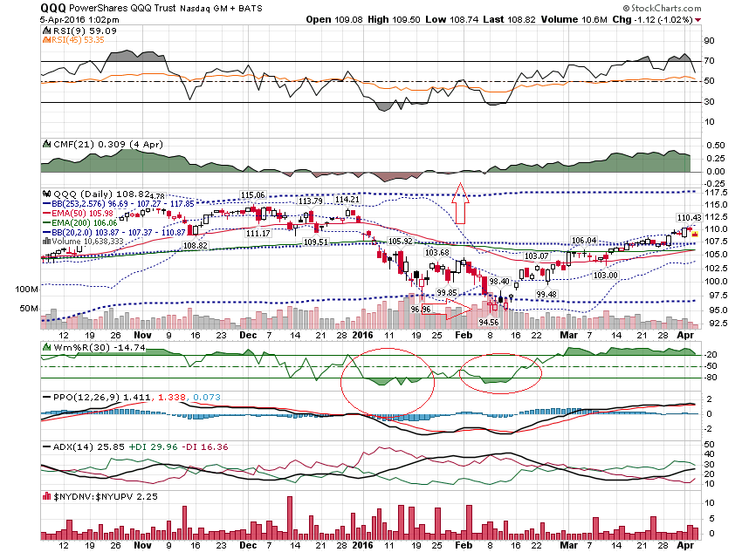

Slide 6
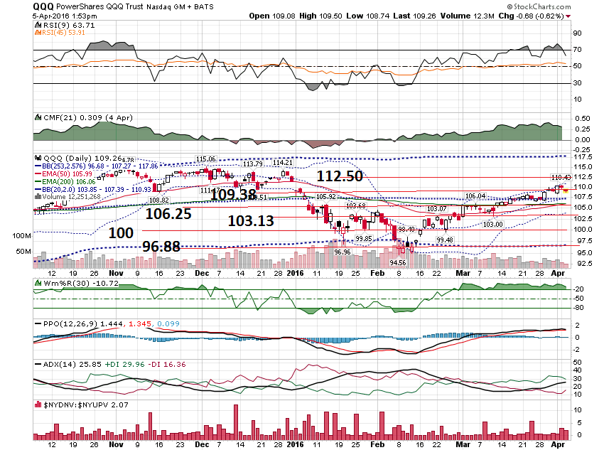

Slide 7
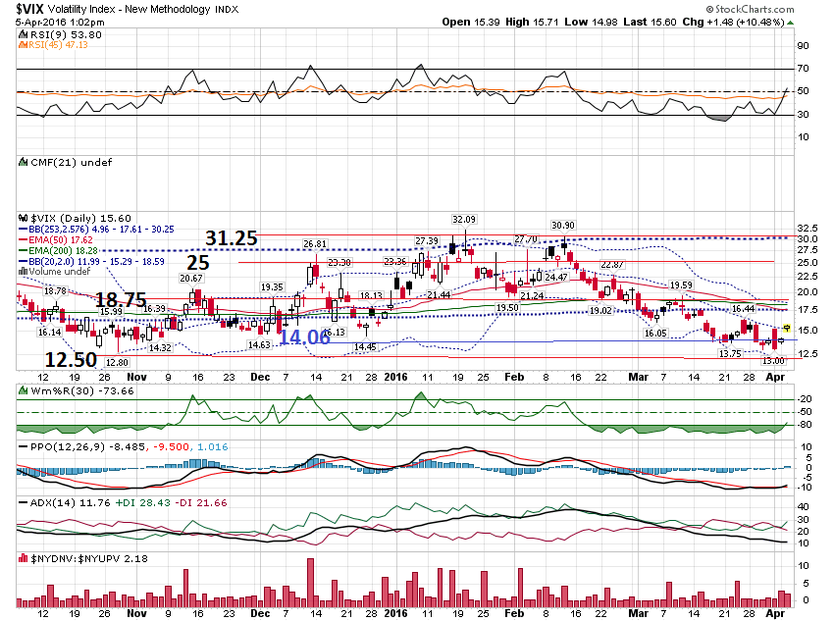

Slide 8
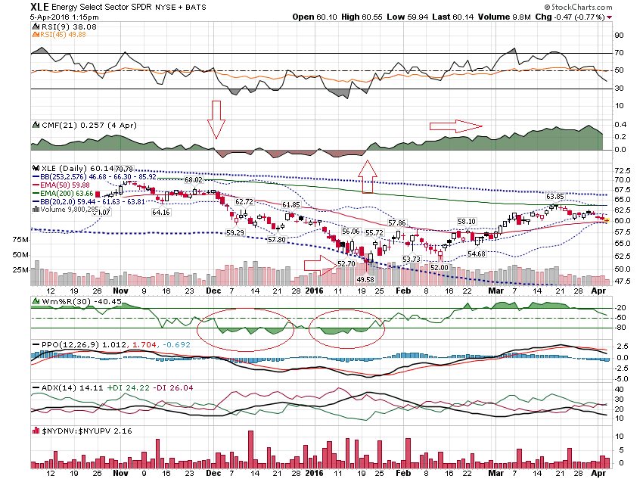

Slide 9
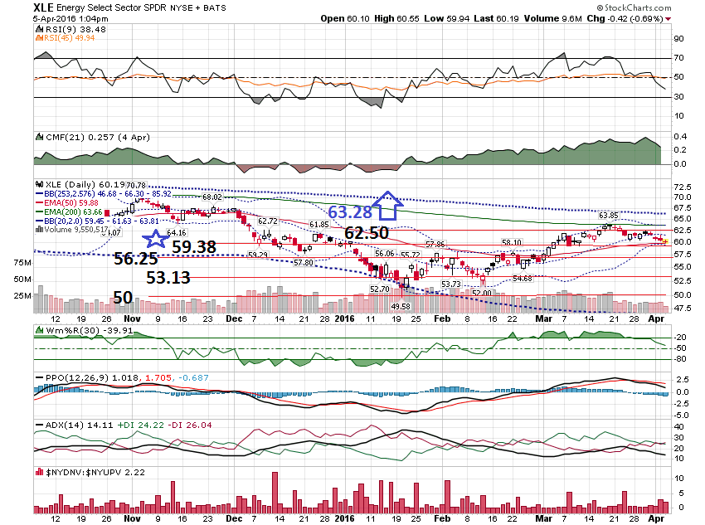

Slide 10
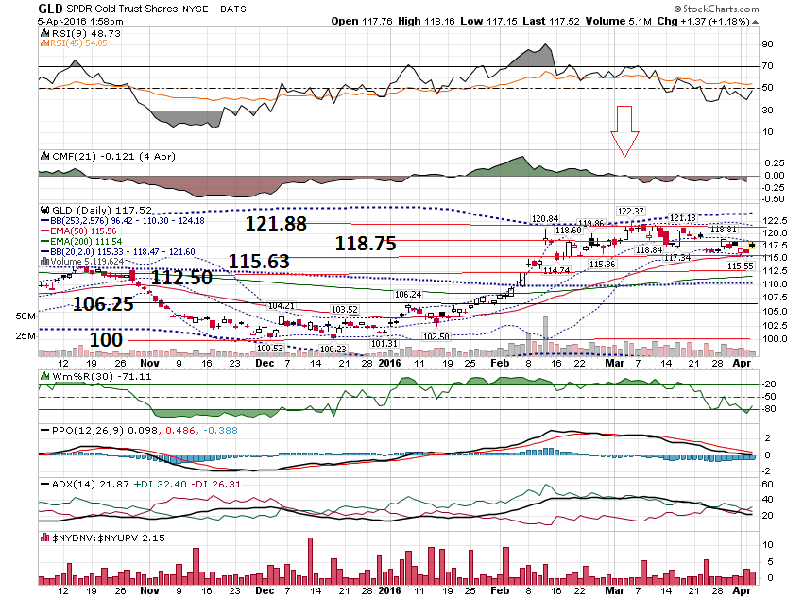

Slide 11
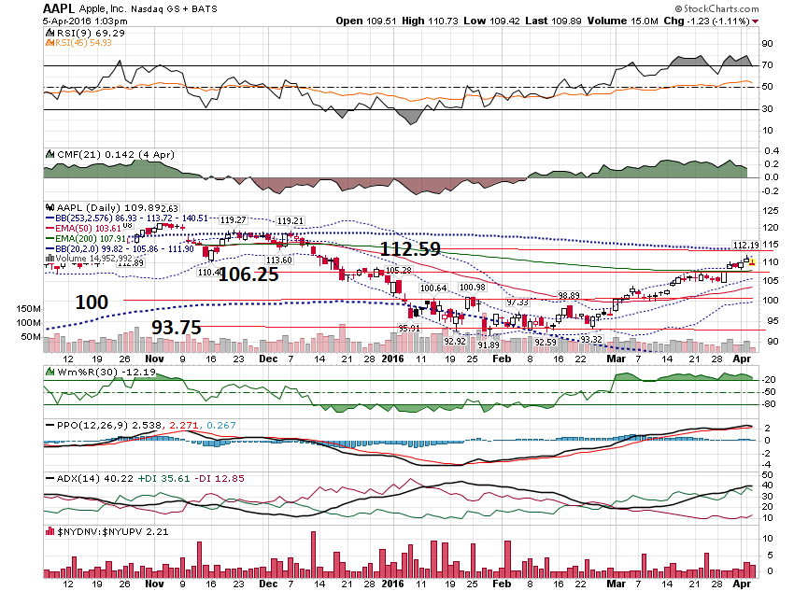

Slide 12
Sentiment Indicators 2 Year View

Slide 13
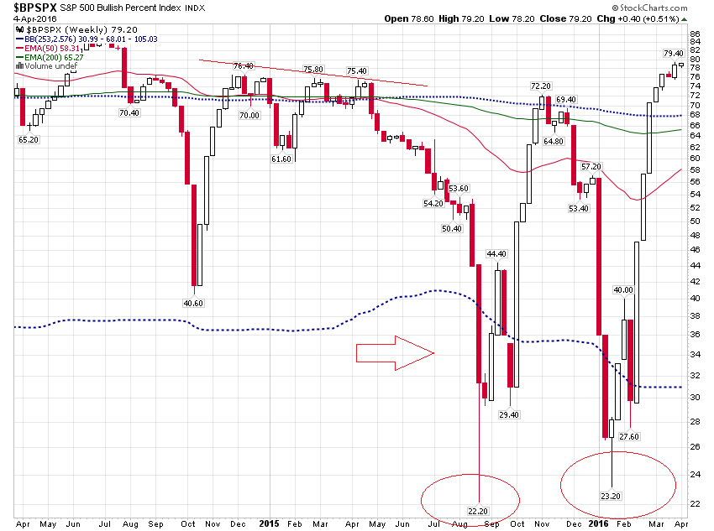

Slide 14
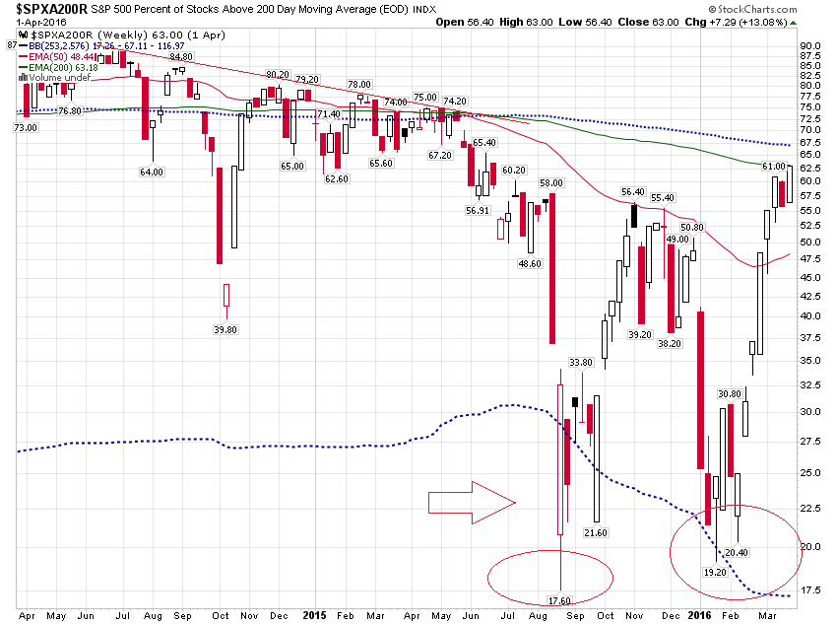

Slide 15
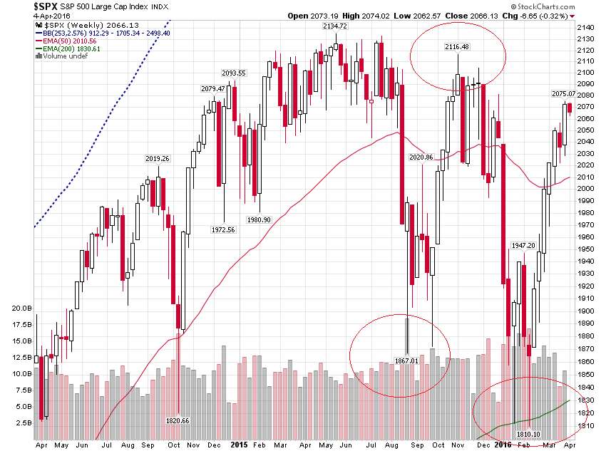

Slide 16
Sentiment Indicators 4 Year View

Slide 17
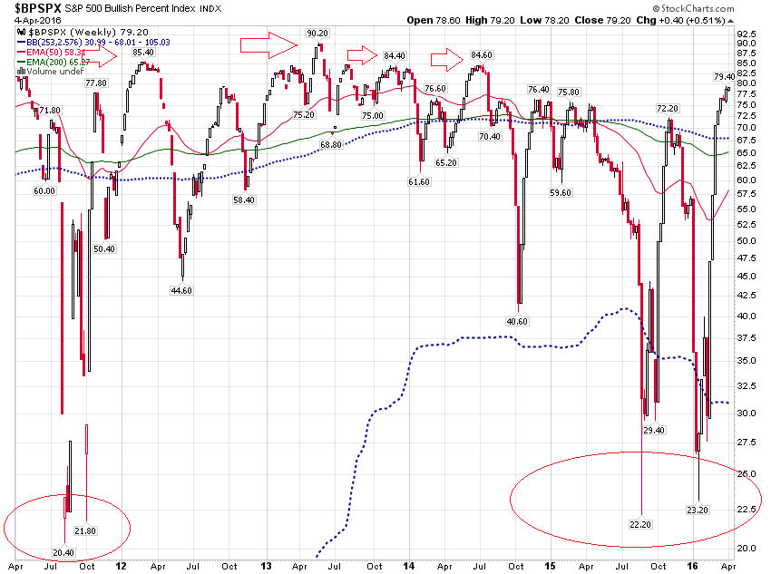

Slide 18
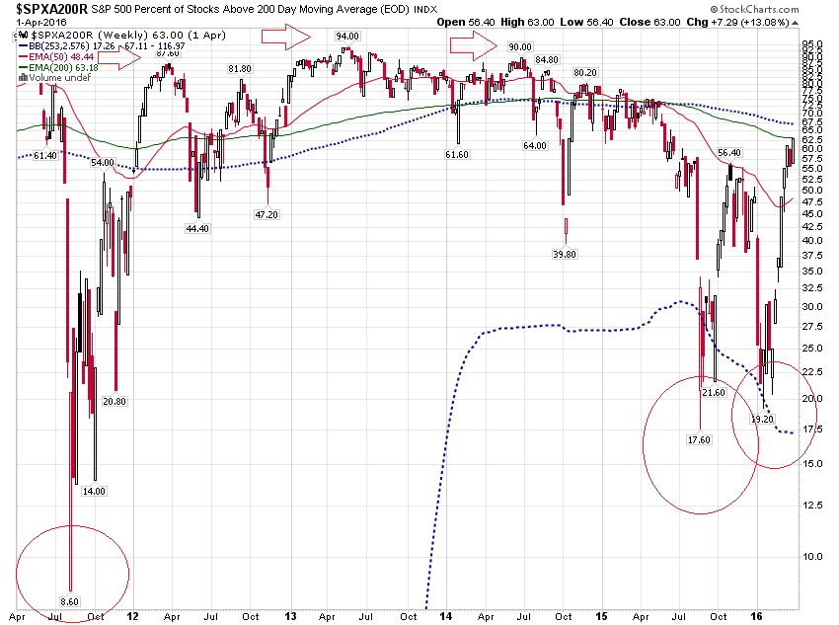

Slide 19
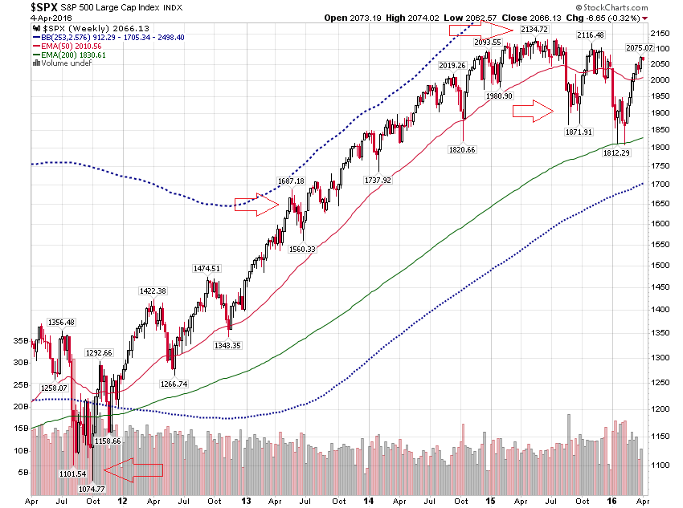

Slide 20
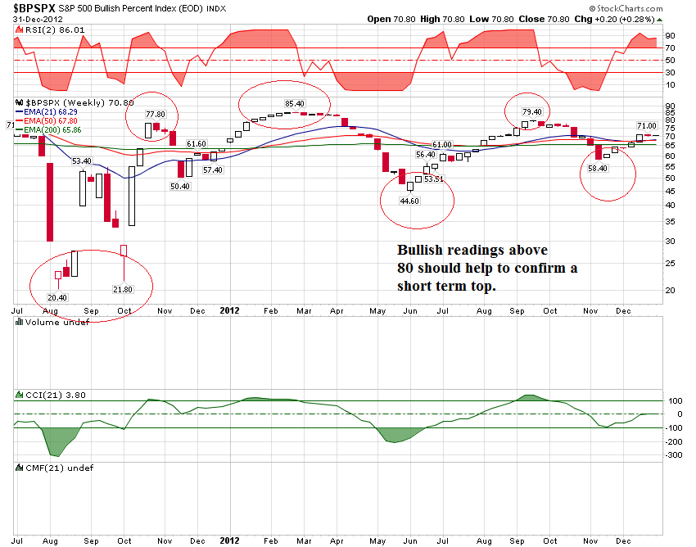

Slide 21
Intra Day Movement on April 5, 2016

Slide 22
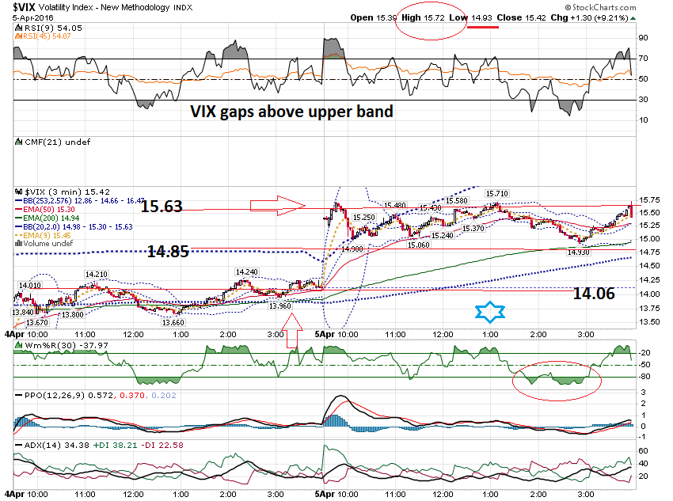

Slide 23
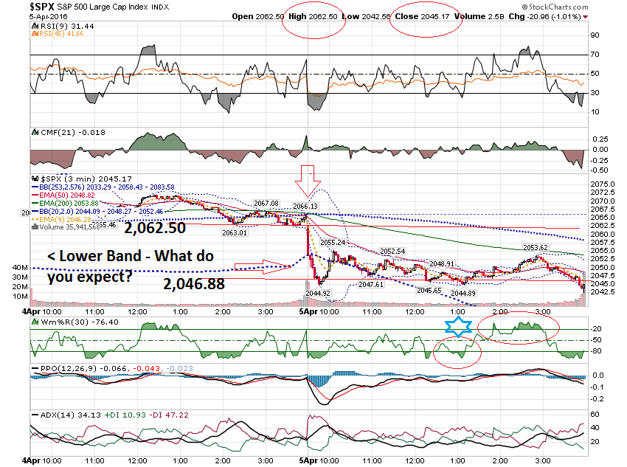

Slide 24
Thanks for watching! Bill Davis Mad Day Trader April 6, 2016 davismdt@gmail.com

