Slide 1

The Mad Hedge Fund Trader
“Contrary Indicators”
With John Thomas
from San Francisco, CA, April 13, 2016
www.madhedgefundtrader.com
Notes:
*

Slide 2

Trade Alert Performance
Making Big Profits in Dire Market Conditions
*January +1.23% Final *July +6.42% Final
*February +4.50% FINAL *August +1.27% Final
*March -2.42% Final *September +11.99% Final
*April +0.19% MTD *October Final -6.19%
*May +5.15% Final *November MTD 5.78%
*June +3.68% Final *December -4.94%
*2016 Year to Date +3.50%
compared to 0% for the Dow Average
*Trailing 1 year return +26.68%, +195.48% since inception,
3.93% short of all-time high
*Average annualized return of 36.08%

Slide 3
Portfolio Review
Keeping a Very Small Book
Looking to Fade the Next Extreme Move
current capital at risk
Risk On
World is Getting Better
(GLD) 4/$109-$112 call spread | 10.00%
Risk Off
World is Getting Worse
(SPY) 4/$182 puts | -5.00%
(SPY) 5/$212-$217 put spread | -10.00%
Expiration P&L
4.80% YTD

Slide 4
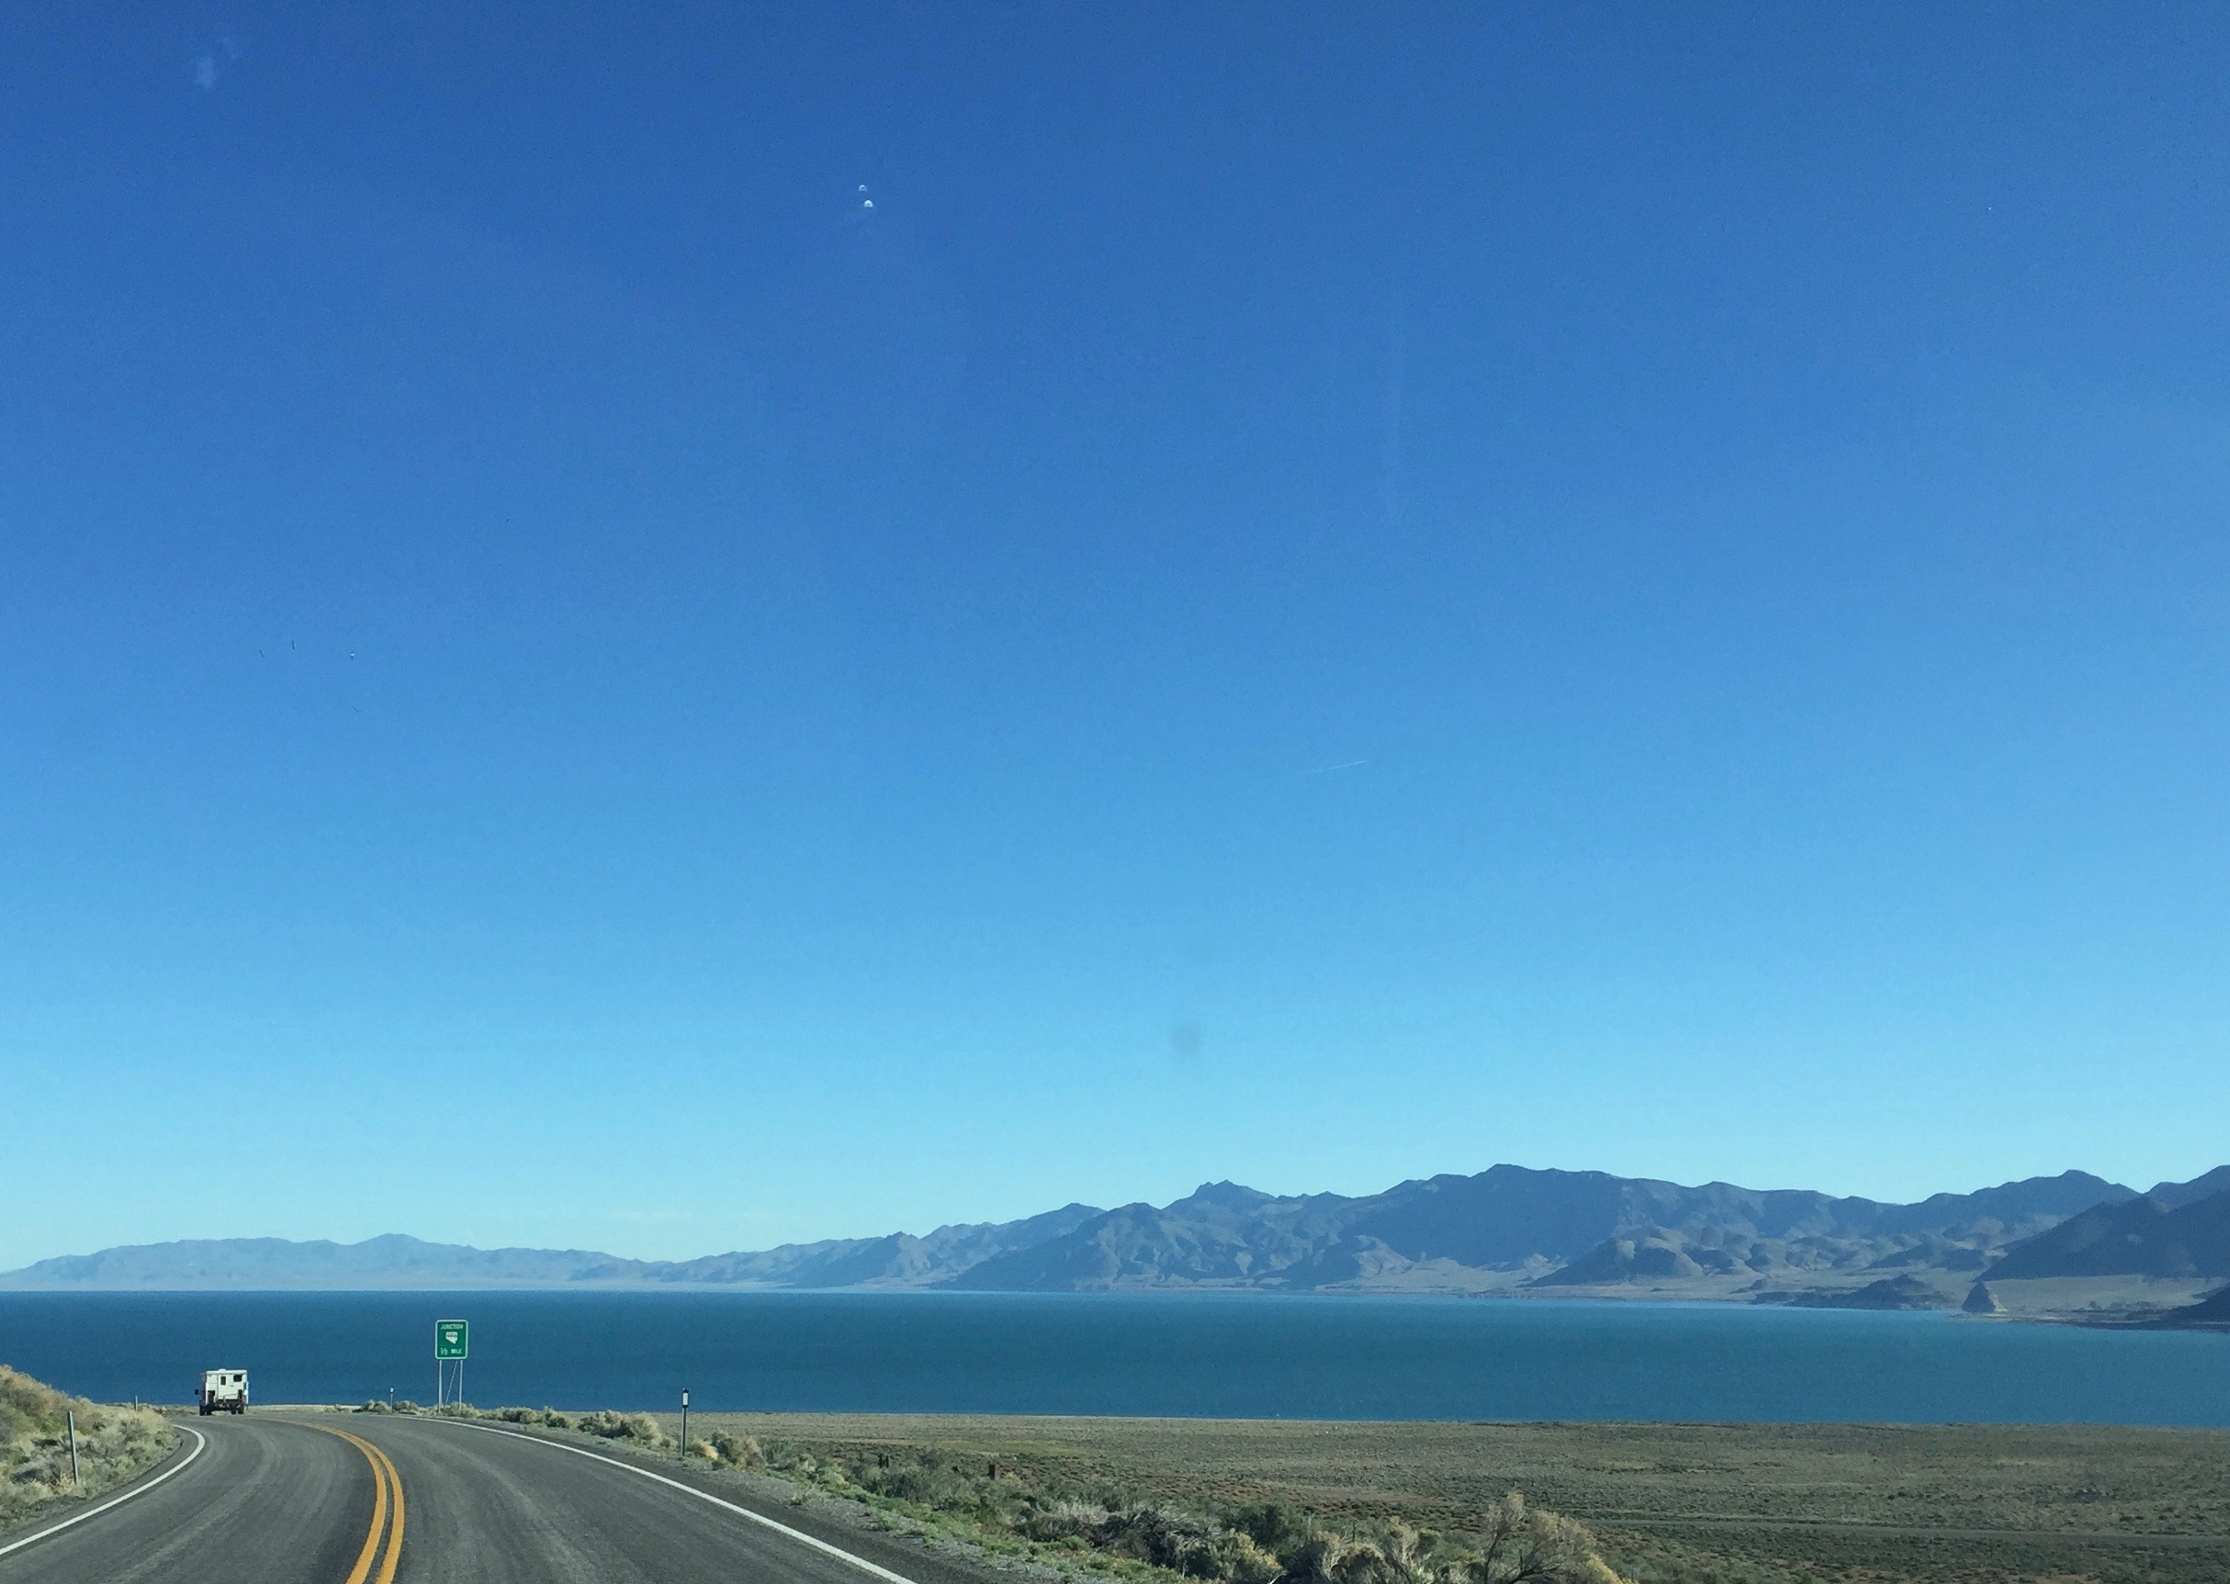

Slide 5
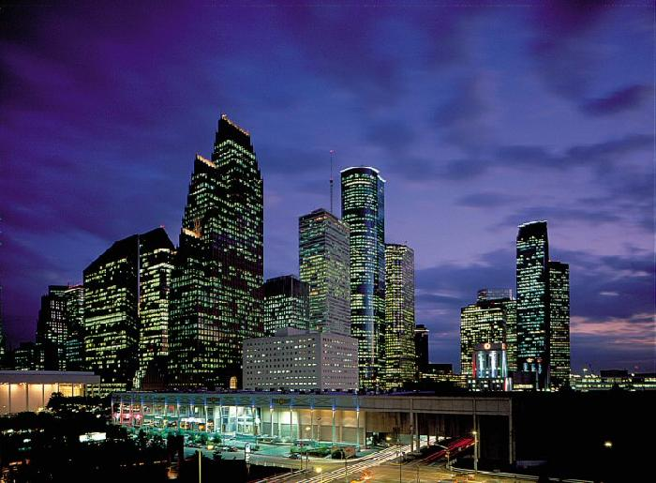
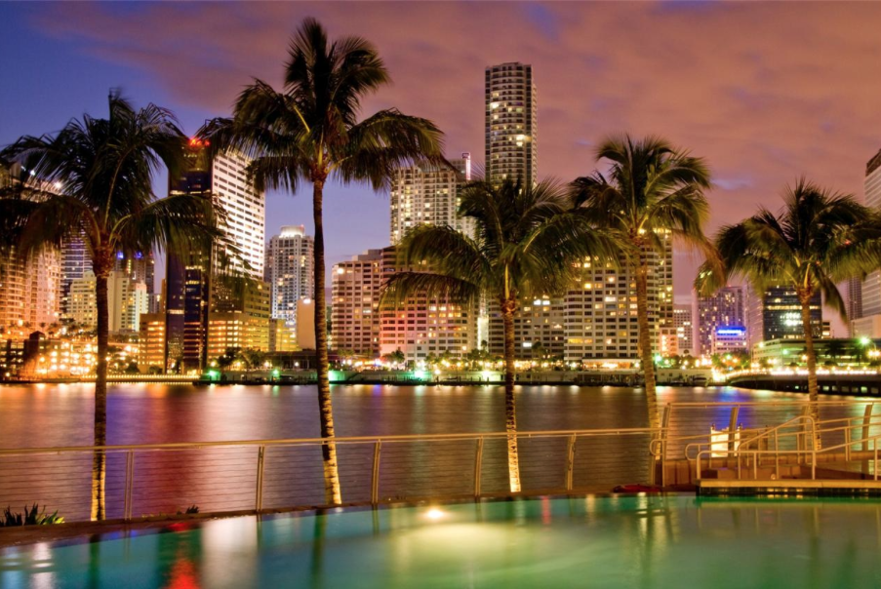
MHFT Global Strategy Luncheons
Buy tickets at www.madhedgefundtrader.com go to “LUNCHES” then “USA”
Houston
April 15, 2016
Miami
April 18, 2016

Slide 6

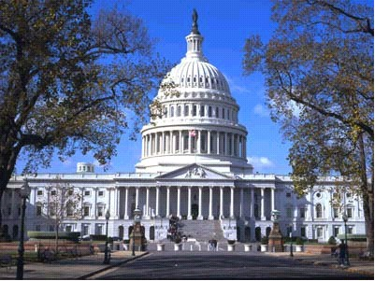
MHFT Global Strategy Luncheons
Buy tickets at www.madhedgefundtrader.com go to “LUNCHES” then “USA”
Atlanta
April 19, 2016
Washington DC
April 20, 2016

Slide 7


MHFT Global Strategy Luncheons
Buy tickets at www.madhedgefundtrader.com go to “LUNCHES” then “USA”
Boston
April 21, 2016
New York City
April 22, 2016

Slide 8
MHFT Global Strategy Luncheons
Buy tickets at www.madhedgefundtrader.com go to “LUNCHES” then “USA”
Chicago
April 25, 2016

Slide 9

The Method to My Madness
Running small book in an overbought market, waiting to jump on the next meltdown
*Hanging on to my advantage of being just short of an all time high
*Try to breakeven when I’m wrong and be up big when I’m right
*Keeping small book in order to fade the next extreme move in any asset class
*Small (SPY) $182 put position about to expire worthless
*With volatility at $15 everyone is nervous
*Gold has been the only reliable winner
*Record number of stop losses this year costing
another 10% in performance, (FXE), (GDX), (SPY),
(FXY)

Slide 10
Paid Subscriber Trailing 12 Month Audited Return +26.68%

Slide 11
65 Months Since Inception
Daily Audited Performance
Averaged annualized return +36.08%

Slide 12

Short Term Strategy Outlook-
*Markets stall ahead of earnings and OPEC meeting
*Oil bottom at $26 looking more convincing, after April 23 Doha meeting
*US stocks have now defined the 2016 wedge formation between (SPX) 1812 and 2010, will take 6 for months to resolve to the upside
*Bonds now baking in 1 more rate rise this year, and maybe 2
*Stock/oil link seems to be broken, will it continue?
*Gold still has its mojo, spilling into silver
*Delayed interest rate hikes collapse dollar,
postpones stock market selloff
*Disastrous Planting Expectations Report
still destroying all ags

Slide 13
The Bill Davis View
A $1,500 Upgrade for the Mad Day Trader Service
Buys:
Celgene Corp (CELG) $101.50 Target to $110
Aetna, Inc. (AET) $108.30 Target to $115
Amazon.com (AMZN) $595 Target to $610
Boeing Co, (BA) $128 Target to $137
Darden Rest (DRI) $65.40 Target to $69
Priceline.com (PCLN) $1,283 Target to $1,360
Netflix, Inc (NFLX) $105.50 Target to $120
Sells:
F5 Networks, Inc (FFIV) $99 Target to $94
Deckers Outdoor (DECK) $57 Target to $52
Polo Ralph Lauren (RL) $94 Target to $89
Chiplotle Mexican (CMG) $468 Target to $437
First Solar Inc. (FSLR) $59 Target to $50
Sell if it closes under $59

Slide 14

The Global Economy-Indecisive
Losing Momentum
*March nonfarm payroll comes in at 214,000, sustaining strong trend, US ISM Service Sector Index in March up from 53.4 to 54.5, JOLTS down from 5.6 to 5.5 million
*Pan European unemployment rates holds at a high 10.3% in 19 countries, Germany the strongest at 4.3% and Greece at 24%
*IMF downgrades global growth forecast from 3.4% to 3.2%
*Chinese debt downgraded to “negative” by S&P due to slowing economy
*Japan Q1 tankan report comes in exceptionally weak, tanking stocks there
*Expect one more oil down leg to trigger global “RISK OFF” move
*All commodities hit with sharp selloffs,
the first test is here
*Next to come is a “RISK ON” global
synchronized growth in H2 2016
once we get through New Year effects

Slide 15
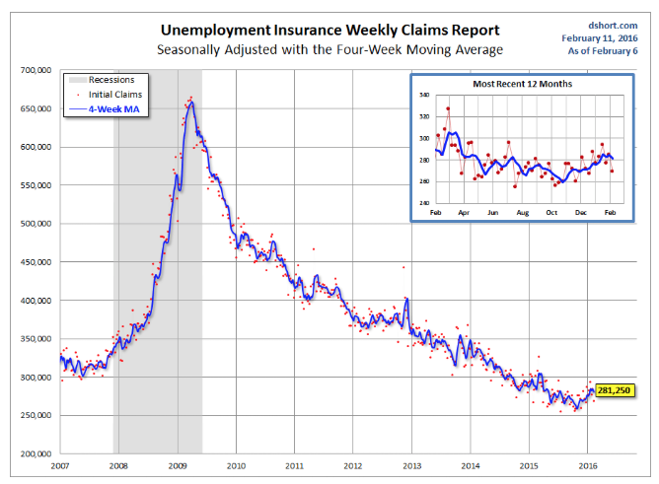
Weekly Jobless Claims –The Most Important Statistic
-9,000 to 267,000
The Downtrend Lives!-Show Me the Recession!

Slide 16

Bonds-Stalling
*Bonds prices stalling just short of year highs
*Both ands and stocks have been rising simultaneously, a rare event
*JGB’s hit a new record low of -0.11%, German bunds at 0.12%
*Emerging market debt hangs on to huge gains,
thanks to oil and commodity boost
*Same with energy Junk
*Weird, contrary indicators,
we got the “RISK OFF” bond and FX moves
without the ‘RISK OFF” move in stocks

Slide 17
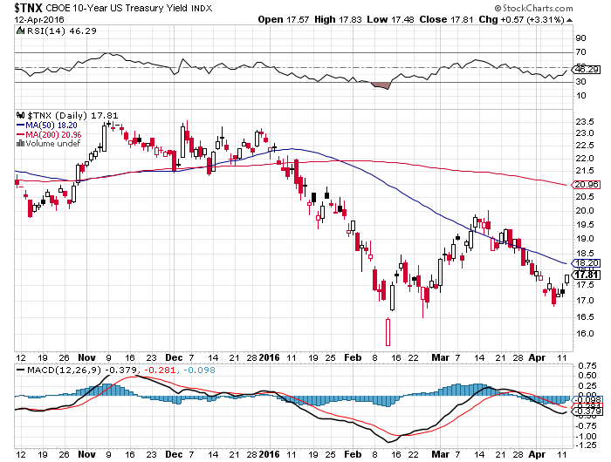
Ten Year Treasury Yield ($TNX) 1.78%
The Reversal is In

Slide 18
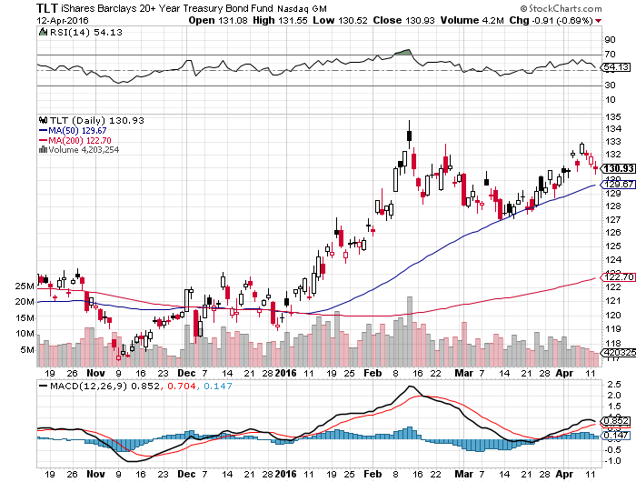
Ten Year Treasury ETF (TLT) 1.78%
The Reversal is In

Slide 19
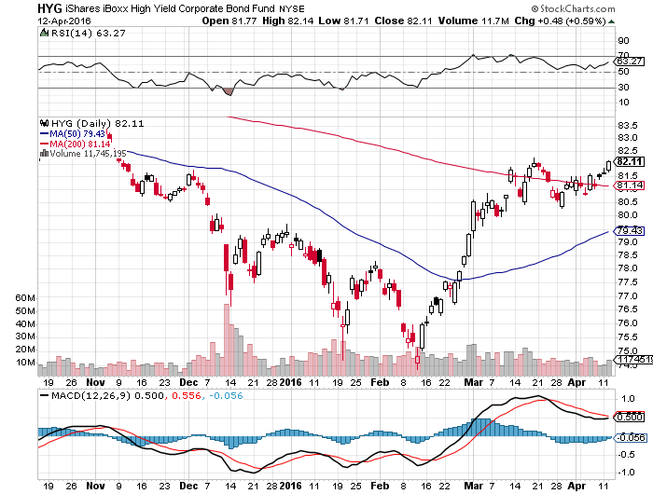
Junk Bonds (HYG) 6.95% Yield
A Great Risk Coincident Indicator

Slide 20
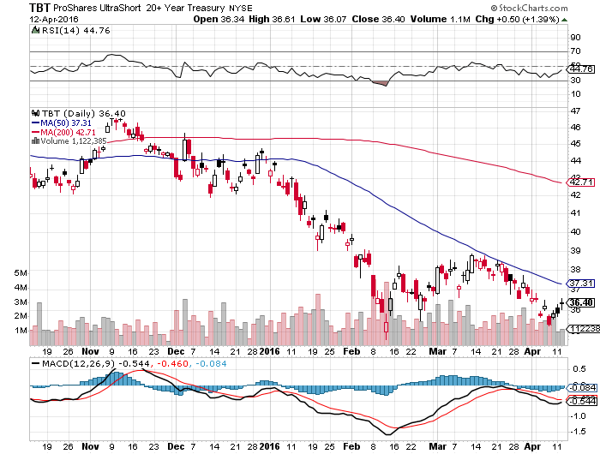
2X Short Treasuries (TBT)-Not Yet the Big Trade of 2016?
Back in “BUY” Territory

Slide 21
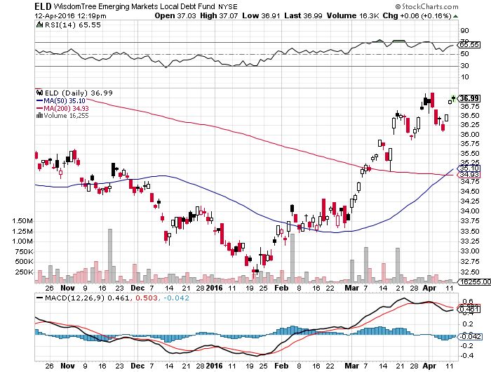
Emerging Market Debt (ELD) 5.82% Yield-

Slide 22
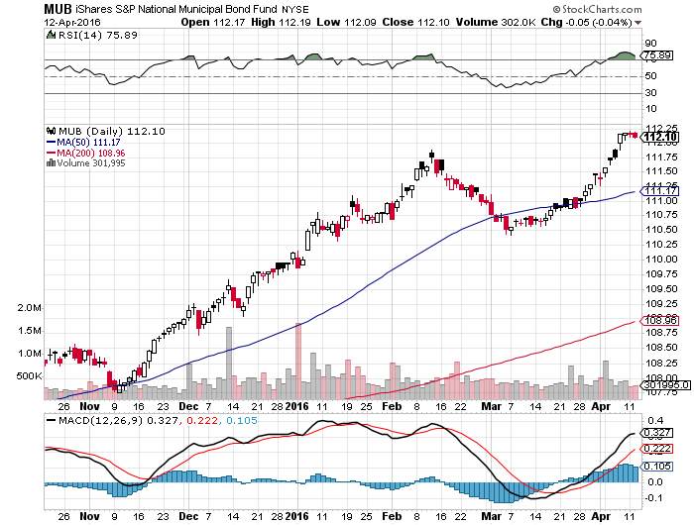
Municipal Bonds (MUB)-1.45% yield-New High
Mix of AAA, AA, and A rated bonds-flight to safety

Slide 23

PP
Pyramid Lake
in North Nevada
Home of the world’s largest trout

Slide 24

Stocks-A Rolling Top
*Stocks about to stall at the top, working off an extremely overbought condition,
Will Doha meeting mark the top? Markets already at yearend targets
*$130 billion taken out of equity mutual funds over the past year, everyone is underweight equities
*Shorts are all gone now, but no one wants to play on the long side
*The “Narrowing Wedge” scenario is playing out, with a big triangle formation setting up over the next six months, with lower highs and higher lows between 1812 and 2012, earnings not there to move to new all time high
*20% of S&P 500 companies have dividend yields
higher than their own bond yields
*Only one more month of seasonable
stock strength, “Sell in May” is coming,
is Doha the trigger?

Slide 25
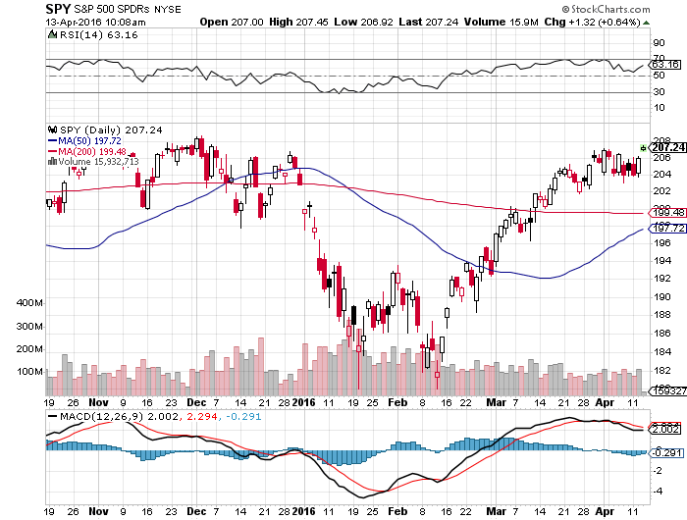
S&P 500- long $112-$117 bear put spread

Slide 26
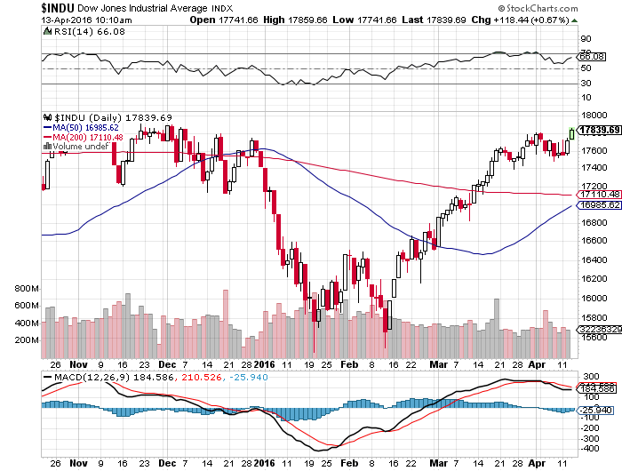
Dow Average-Topping Out Too

Slide 27
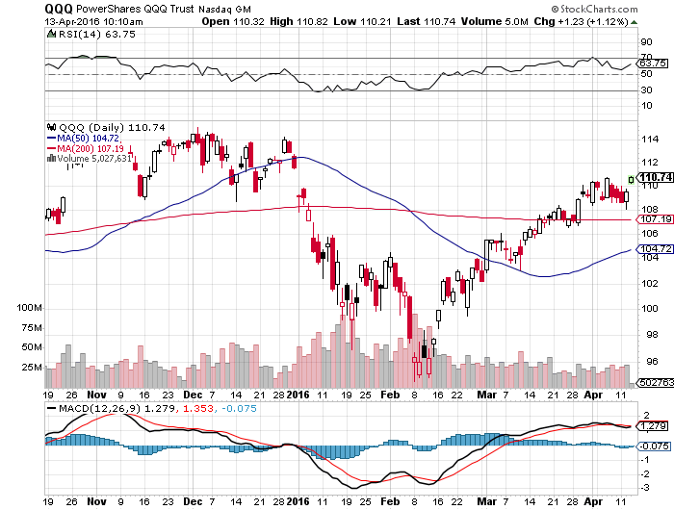
NASDAQ (QQQ)-

Slide 28
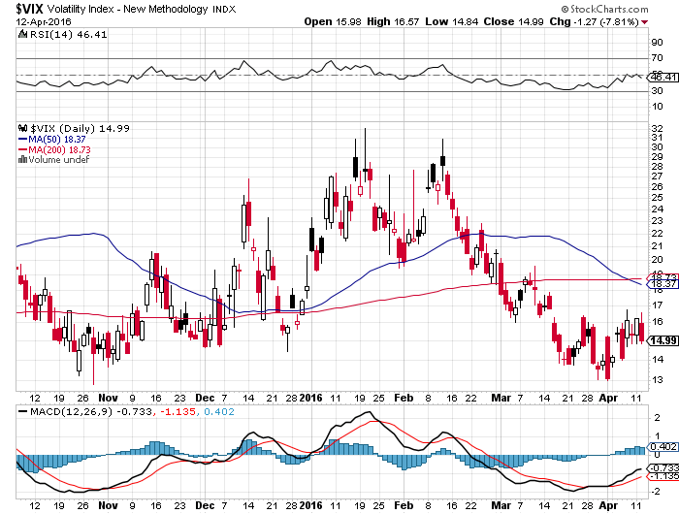
(VIX)-Back to the Bottom

Slide 29
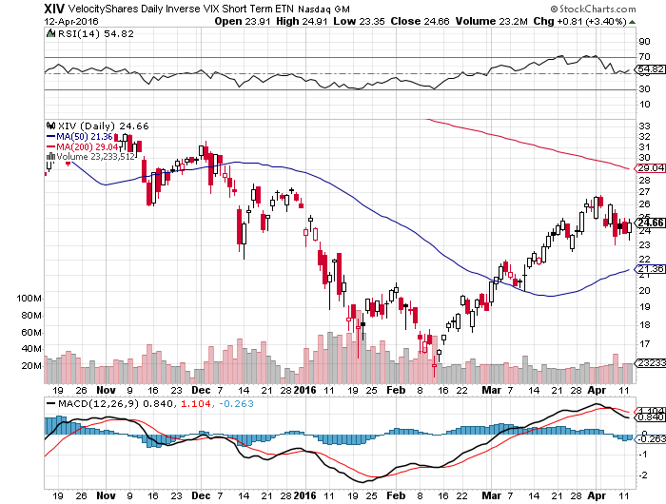
(XIV)-Velocity Shares Daily Inverse VIX Short Term ETN

Slide 30
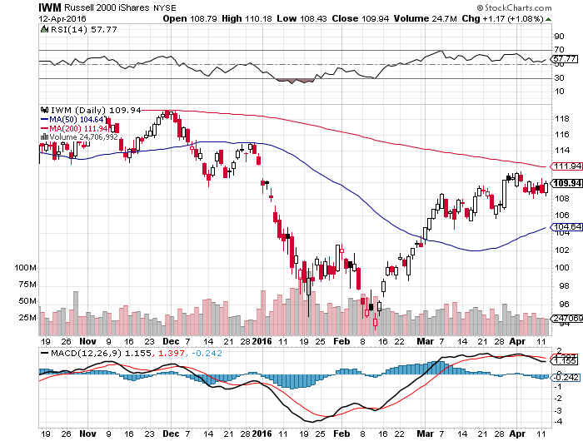
Russell 2000 (IWM)-Watch Carefully took profits on the $112-$117 vertical bear put spread

Slide 31
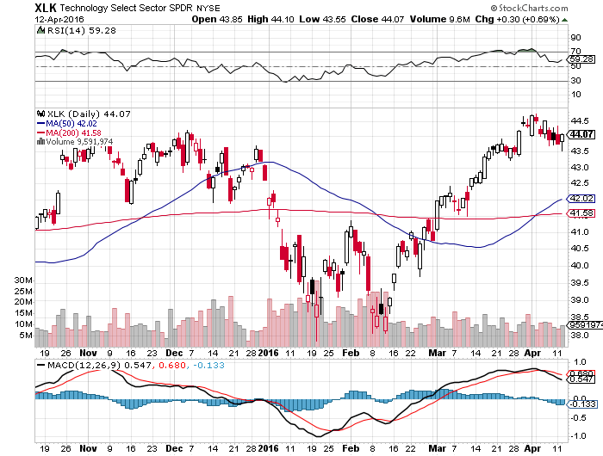
Technology Sector SPDR (XLK), (ROM)
(AAPL), (MSFT), (VZ), (T), (FB), (IBM)

Slide 32
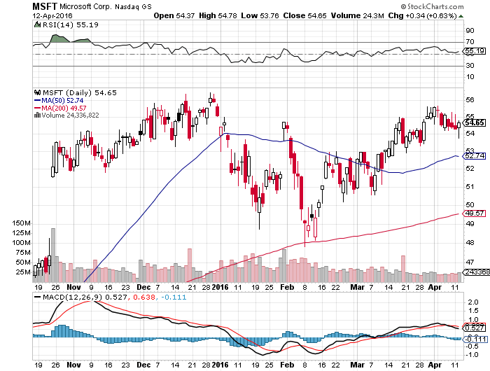
Microsoft (MSFT) looking to go long on next dip

Slide 33
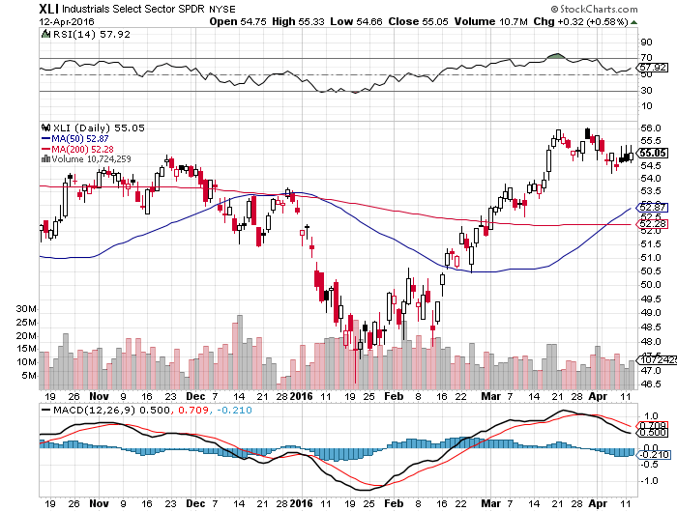
Industrials Sector SPDR (XLI)-Dow Mainstay
(GE), (MMM), (UNP), (UTX), (BA), (HON)

Slide 34
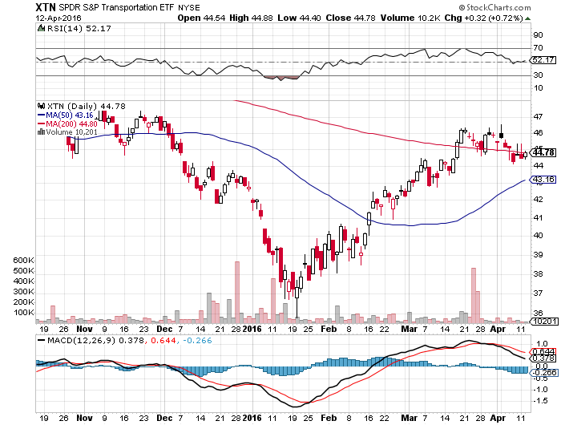
Transports Sector SPDR (XTN)-Another Dow Mainstay
(ALGT), (ALK), (JBLU), (LUV), (CHRW), (DAL),

Slide 35
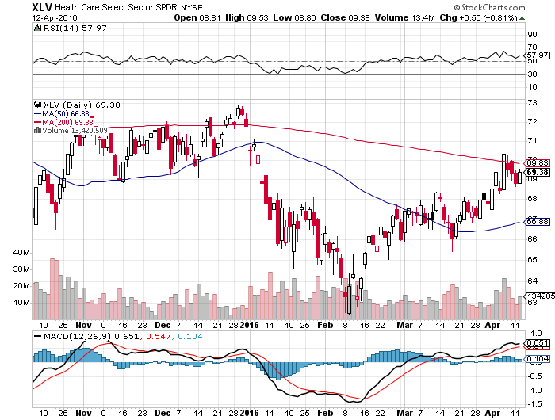
Health Care Sector SPDR (XLV), (RXL)
(JNJ), (PFE), (MRK), (GILD), (ACT), (AMGN)

Slide 36
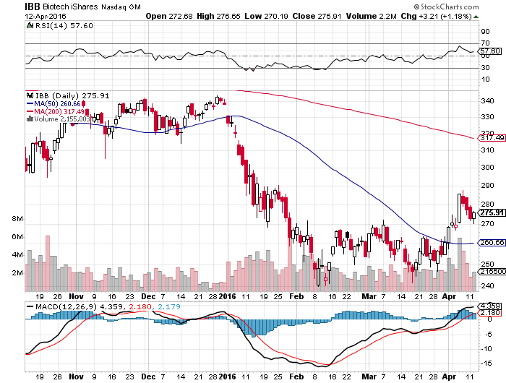
Biotech iShares (IBB)-A Political Football in 2016

Slide 37
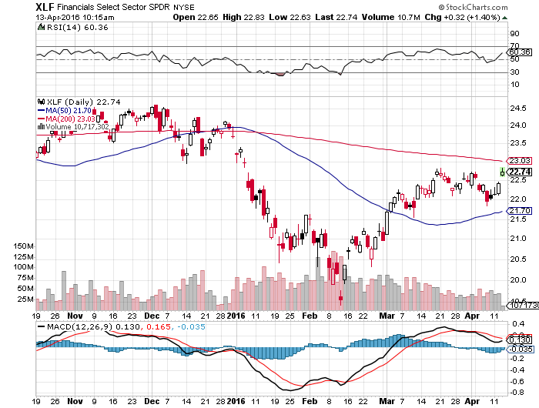
Financial Select SPDR (XLF)-JPM boost
(BLK/B), (WFC), (JPM), (BAC), (C), (GS)

Slide 38
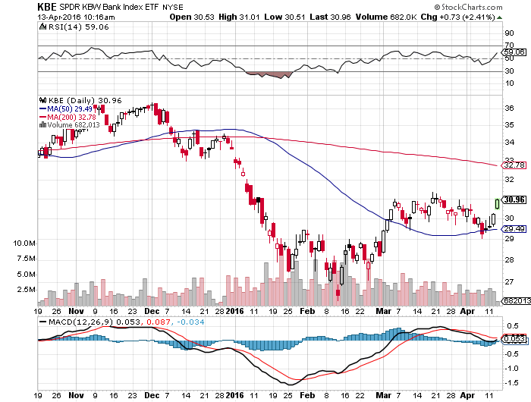
KBW Bank Index (KBE)-

Slide 39
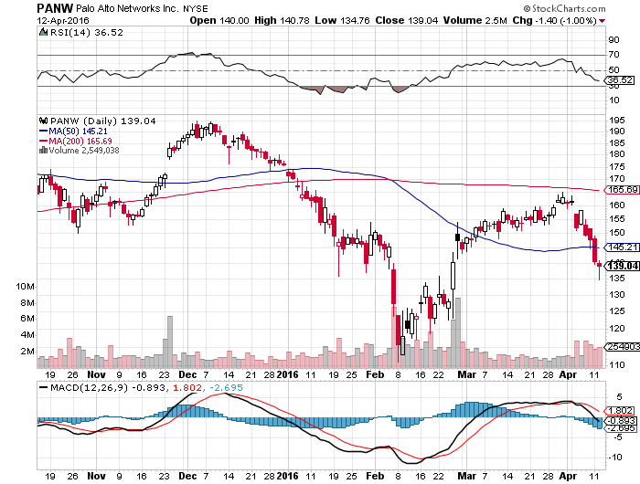
Palo Alto Networks (PANW)- another entry point setting up

Slide 40
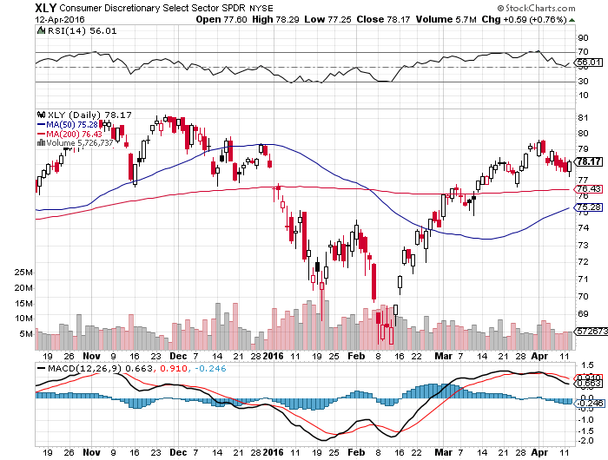
Consumer Discretionary SPDR (XLY)
(DIS), (AMZN), (HD), (CMCSA), (MCD), (SBUX)
A Major Leader of the Rally

Slide 41
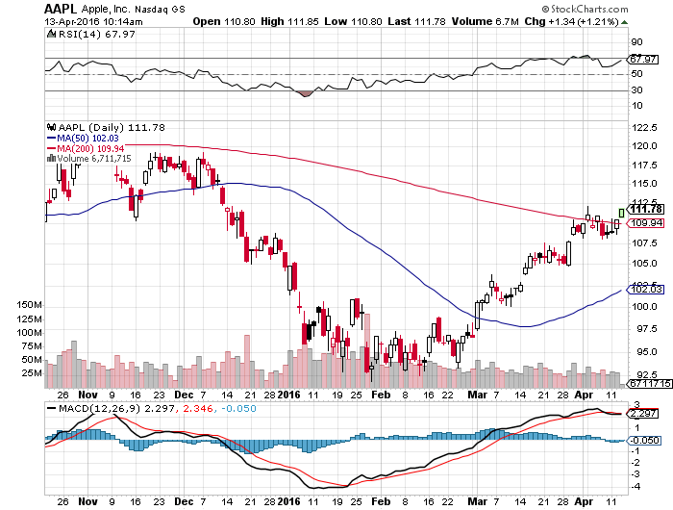
Apple (AAPL) –Buy the Dips
Back to waiting for the next real catalyst-the iPhone 7
Buy after Q1 earnings in April to avoid post Christmas dip, $105 billion stock buy backs done

Slide 42
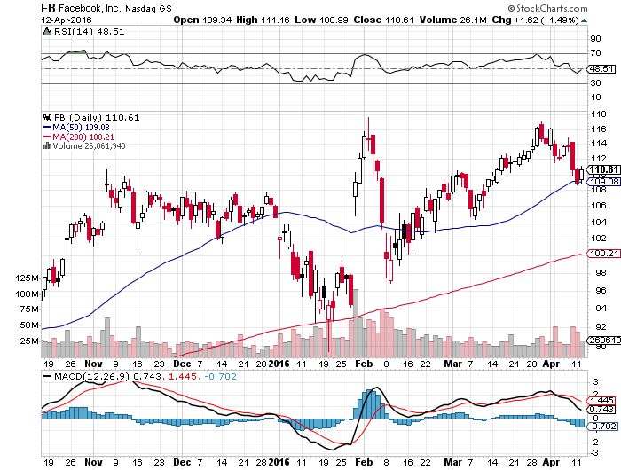
Facebook (FB) –The Big One That Got Away

Slide 43
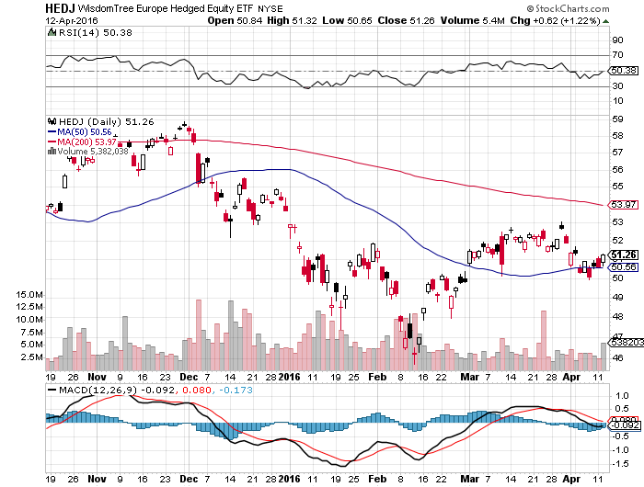
Europe Hedged Equity (HEDJ)-Hedged Japan Equity
Capped by strong euro and Brussels attack

Slide 44
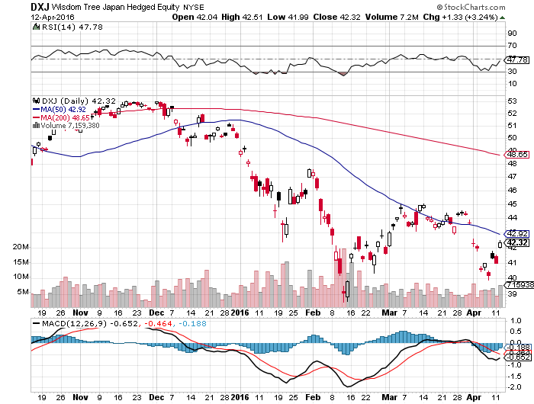
Japan (DXJ)-Hedged Japan Equity
Capped by strong yen?

Slide 45
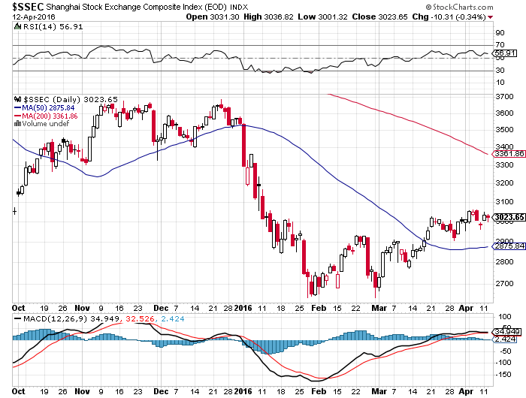
China ($SSEC)-
The Bad Boy Market and font of volatility

Slide 46
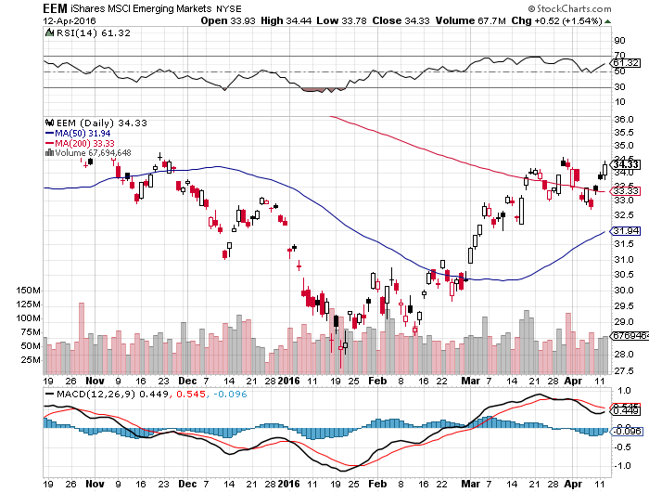
Emerging Markets (EEM)-
Loves the oil and commodity bounce

Slide 47


Slide 48
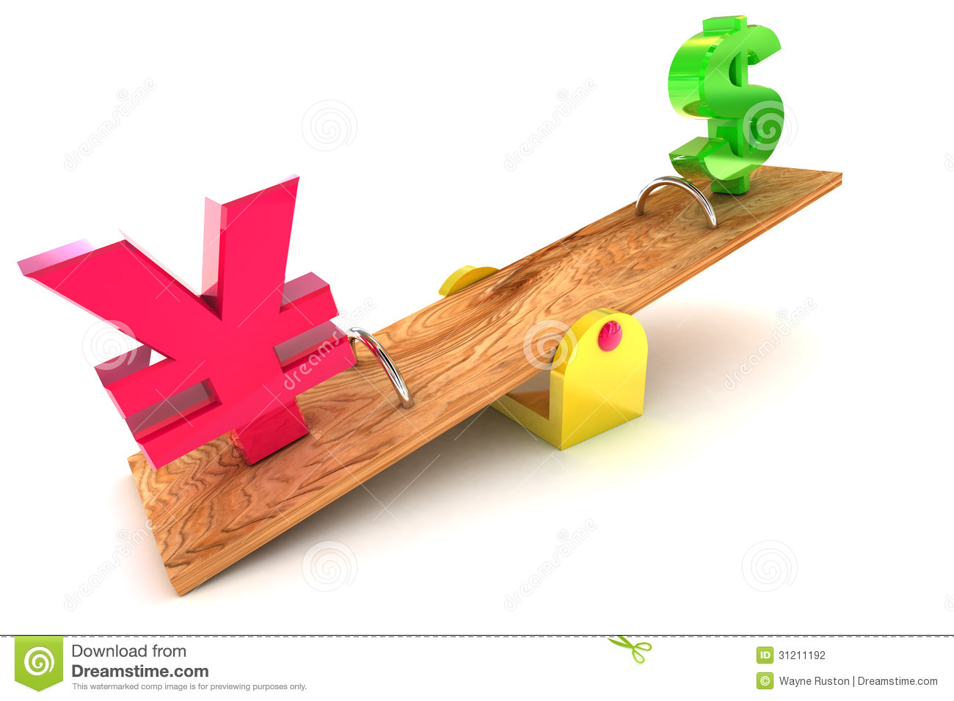
Foreign Currencies-Yen Breakout=“RISK OFF”
*Yellen comments put the kibosh on any interest rate rise for the foreseeable future, demolishing the dollar
*Yen hits a one year high in hedge fund unwinds of short positions, PM Abe is reluctant to intervene unless the move up becomes extreme
*Janet comments breath new life into the yen, torpedoing Nikkei
*Commodity correction cuts the knees
out from under (FXA), (FXC)
*With no interest rate moves anywhere,
this could be a year of low volatility
for currencies

Slide 49
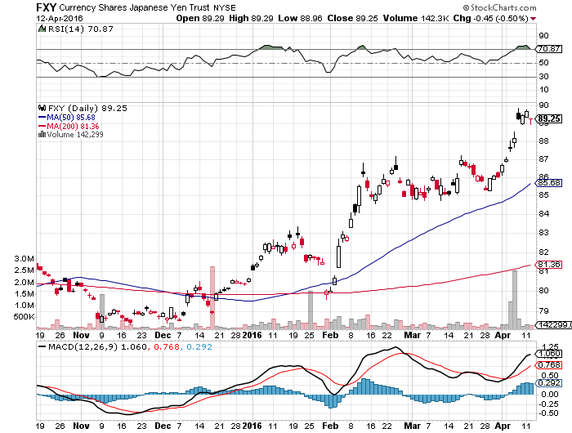
Japanese Yen (FXY)-At a One Year High

Slide 50
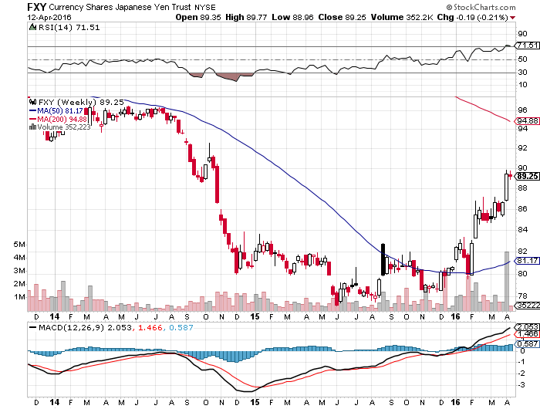
Japanese Yen (FXY)-2 Year Chart

Slide 51
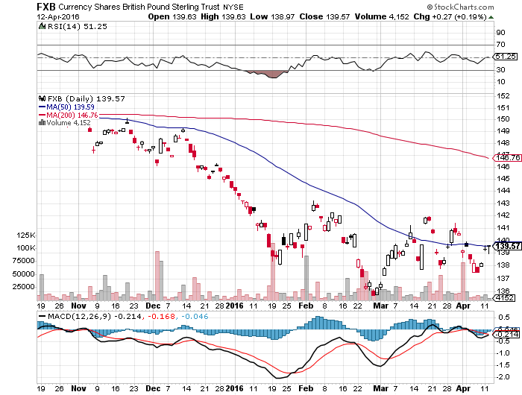
British Pound (FXB)-Political Disaster!

Slide 52
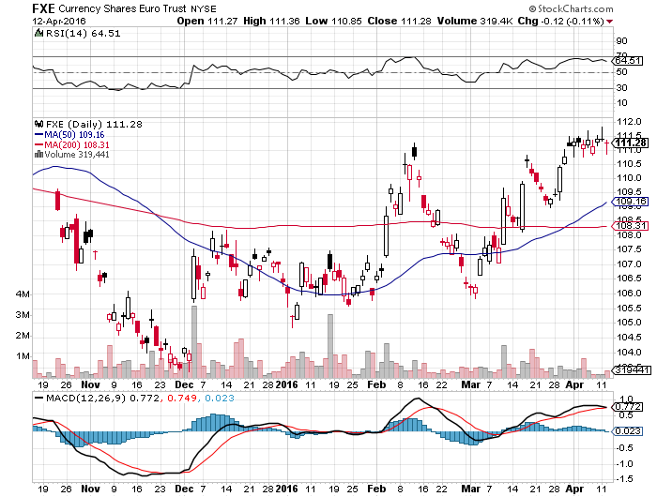
Euro ($XEU), (FXE), (EUO)- on “Brexit” fears, prospect of more QWE next week

Slide 53
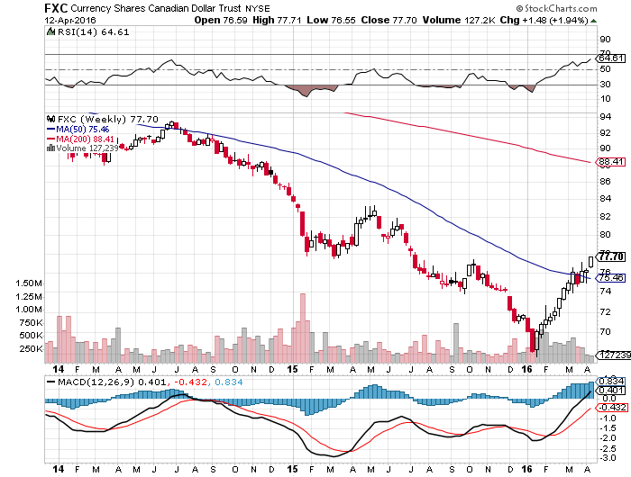
Canadian Dollar (FXC)-Love That Strong Oil

Slide 54
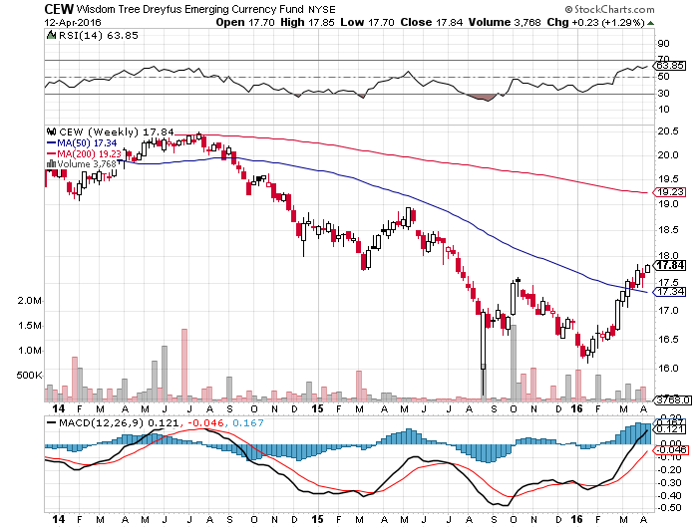
Emerging Market Currencies (CEW)

Slide 55
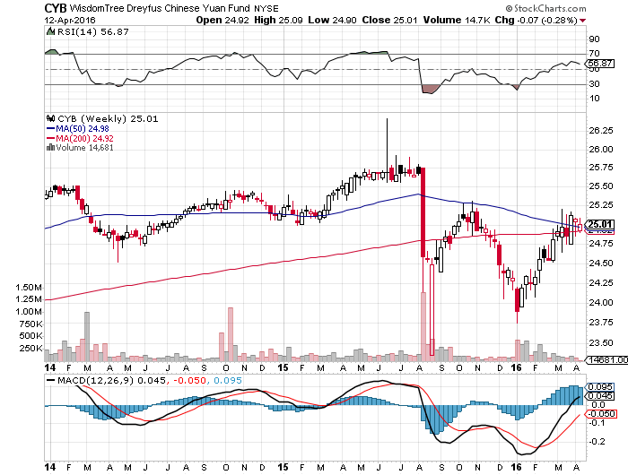
Chinese Yuan- (CYB)-Sell Rallies on Weakening Economy
A New Hedge Fund Favorite

Slide 56


Slide 57

Energy-The Rumor Mill
*Everything hangs on the big Doha OPEC-Non-OPEC meeting on April 17, it was the talk of meetings that triggered the big rally from $26, rumors of Saudi-Russian production freeze send oil soaring
*US production has fallen from 9.6 million barrels/day to 9.0 million, but drillers are rapidly cutting costs per barrel
*Comptroller of the Currency issues new, tough rules for energy lending, with a debt:operating income ratios of 4:1 vs 2:1 industry average, expect a lot of loans to be called in triggering bankruptcies, local banks to suffer
*How high can oil rise in the face of record inventories and a huge supply overhang?
Consumers saving $800 million/day at current prices
*Contagos reemerging, pointing to more negative price action
*Oil major capex falling from $800 billion
to $400 billion this year
*Natural Gas storage now at a record
2.47 trillion cubic feet, 50% higher than a year ago
as warm weather exacerbates supply/demand,
industry looking at “negative” prices

Slide 58
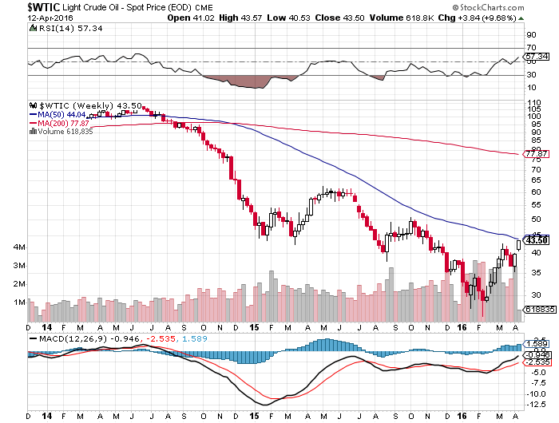
Oil-The Bottom is in,
The First Retest Was Successful

Slide 59
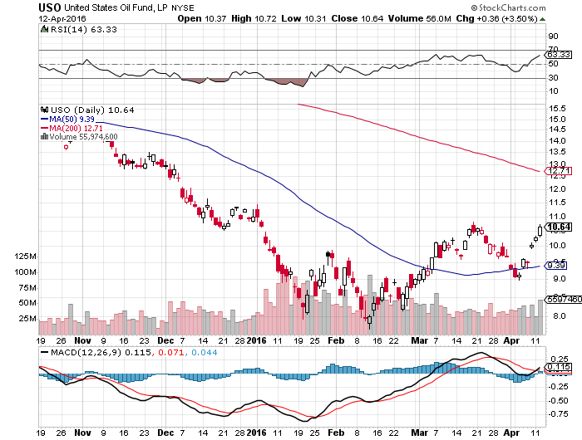
United States Oil Fund (USO) took profits on long the 5/$8.00 calls too soon

Slide 60
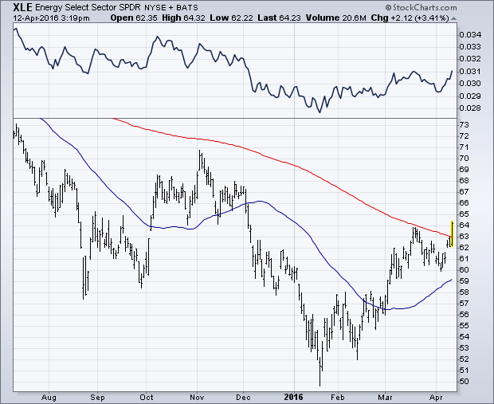
Energy Select Sector SPDR (XLE)
(XOM), (CVX), (SLB), (KMI), (EOG), (COP)

Slide 61
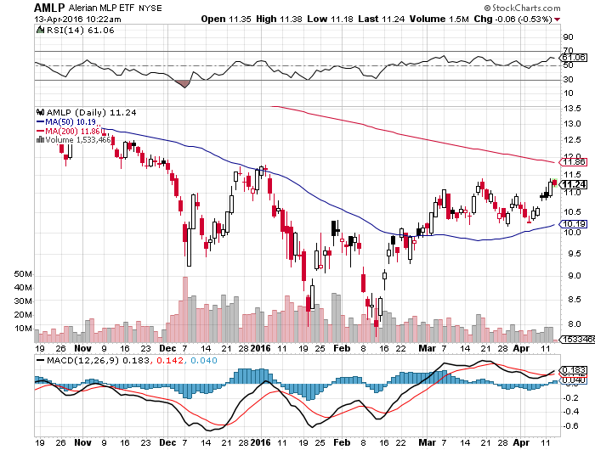
Alerian MLP ETF (AMLP)-9.08% Yield
Basket Approach is the Only Safe Play here

Slide 62
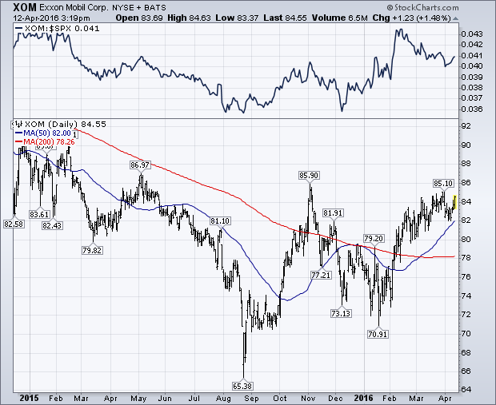
Exxon (XOM)-Gotta Love That Dividend

Slide 63
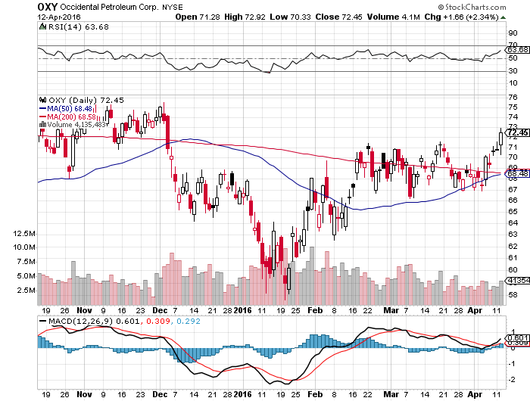
Occidental Petroleum (OXY)-

Slide 64
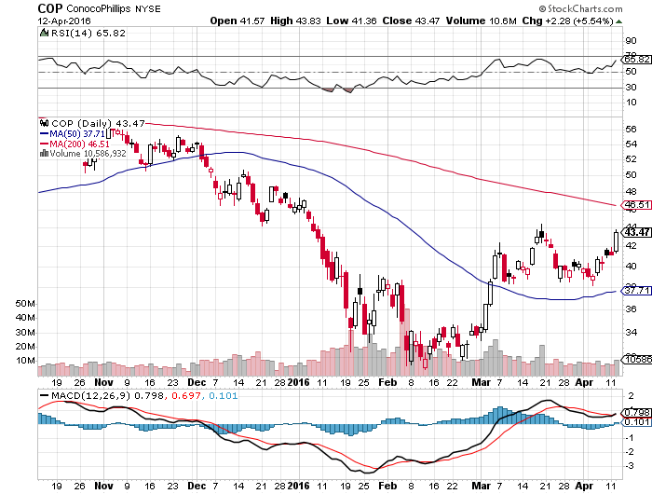
Conoco Phillips (COP)-The Buffet Favorite

Slide 65
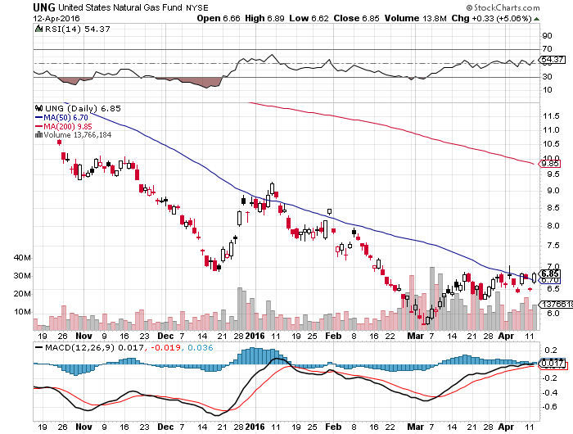
Natural Gas (UNG)-Dragged Up By Oil

Slide 66
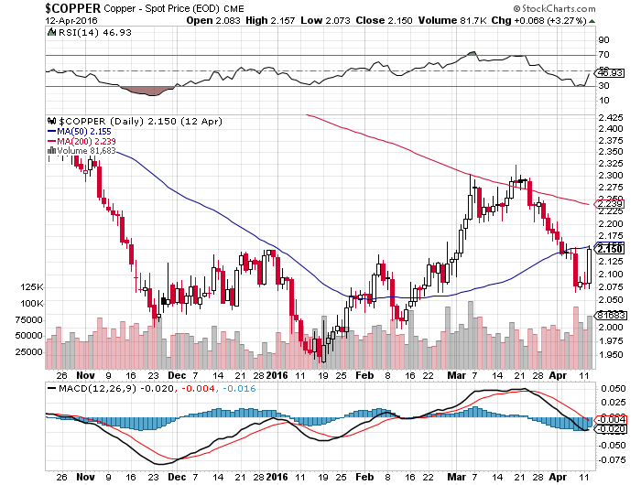
Copper-The Bottom is In

Slide 67

Freeport McMoRan (FCX)-Tripled off $3 bottom

Slide 68

Precious Metals-The “RISK OFF” Assist
*The First decent “RISK OFF” day, and it’s off to the races again for gold
*Central banks ramp up gold buying to 483 tonnes in 2015, still increasing, were net sellers for 20 years until 2010
*Nearly half the gold buying from Russia looking to dodge US economic sanctions, China another big buyer
*Oil producing nations of the Middle East have been big gold sellers to fund deficits creating by oil crash
*Import taxes still keeping the Indians out of
the market, one of the world’s largest buyers
*Spec positions now near highs,
adding risk, while volume has been falling,
never a good sign

Slide 69

Gold (GLD)-Looking for a Dip long long the 4/$109-$112 vertical bull call spread-2 trading days to expiration

Slide 70

Market Vectors Gold Miners ETF- (GDX)

Slide 71

Silver (SLV)-

Slide 72

Silver Miners (SIL)-Finally Kicks In

Slide 73

Platinum (PPLT)-The Volkswagen Effect

Slide 74

Palladium (PALL)-

Slide 75


Slide 76

Agriculture-From El Nino to La Nina
*Planting expectations Report calls for major increase in all crops in 2016, crushing prices, Canadian crops also expected to be huge
*Farmers’ response to low prices is to increase volume, driving prices down further
*Corn forecast jumps from 173 to 175.8 million bushels
*Strong Dollar still demolishing US exports,
US wheat is shut out of global market
*Corn stockpiles still near record highs,
are there to cap every rally
*Without surprise bad weather this is
going to be another awful year for the ags
*No trade, there are NO fish to fry

Slide 77

(CORN) – More New lows!

Slide 78

(WEAT)-New Lows!

Slide 79

Ag Commodities ETF (DBA)-

Slide 80

Real Estate-Ticking Along
*Global NIRP drags US 30-year fixed to new lows at 2.7%, may go lower
*US negative home equity has fallen from the 30% peak to 15%, freeing up some inventory
*Many homes foreclosed during crash were turned into rentals b new institutional owners, eliminating inventory in current upturn
*3 million homes still underwater, largely in Florida
*New disclosure rules ending anonymous home ownership, scaring off foreign flight capital
*Nervousness about the economy
starting to cool off the hottest markets
*Case Shiller S&P 500 National index
continues upward grind, January +5.4%

Slide 81

December S&P/Case–Shiller Home Price Index
+5.4% YOY, Portland, San Francisco, lead

Slide 82

US Home Construction Index (ITB)
(DHI), (LEN), (PHM), (TOL), (NVR)

Slide 83


Slide 84

Trade Sheet
So What Do We Do About All This?
*Stocks- sell rallies, buy the next big dip
*Bonds-the top is in, fade the next big rally
*Commodities-the bottom is in, buy big dips
*Currencies- stand aside, wait for yen move to burn out
*Precious Metals –buy on dips
*Volatility-sell short spikes over $25, buy dips to $14
*The Ags –stand aside - avoid the disaster
*Real estate-buy the homebuilders LT

Slide 85

To buy lunch tickets, please go to www.madhedgefundtrader.com , click on “LUNCHES,” “USA”, and then your desired city
Next Strategy Webinar
12:00 EST Wednesday,
April 27, 2016
San Francisco, CA
USA!
Good Luck and Good Trading!
Notes:
*

