Slide 1
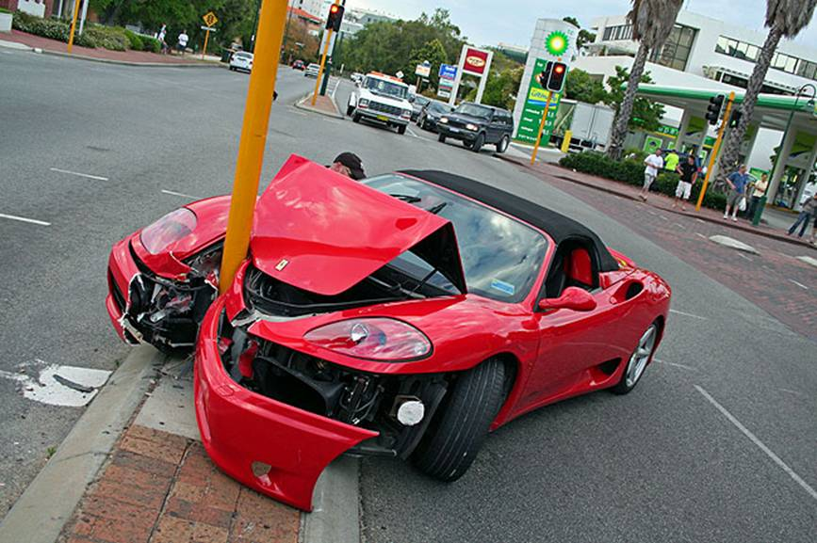
The Mad Hedge Fund Trader
“Tech Wreck”
With John Thomas
from San Francisco, CA, April 27, 2016
www.madhedgefundtrader.com
Notes:
*

Slide 2
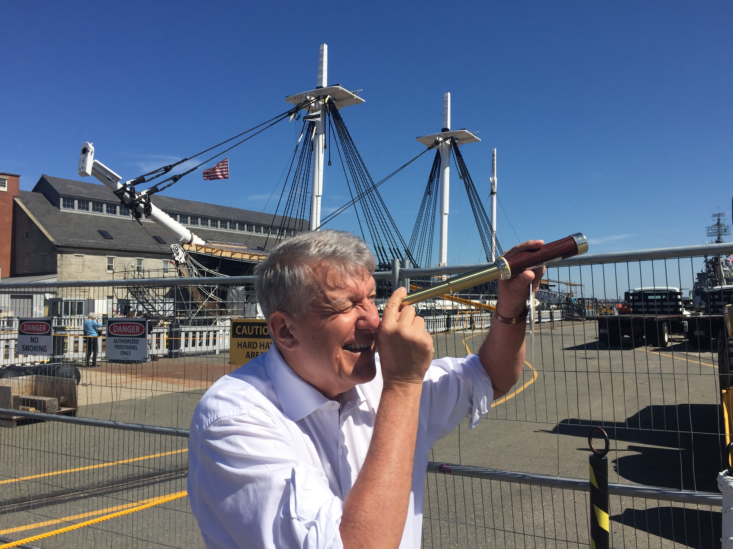

Slide 3
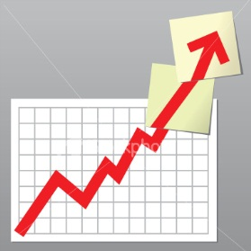
Trade Alert Performance
Making Big Profits in Dire Market Conditions
*January +1.23% Final *July +6.42% Final
*February +4.50% FINAL *August +1.27% Final
*March -2.42% Final *September +11.99% Final
*April -0.56% MTD *October Final -6.19%
*May +5.15% Final *November MTD 5.78%
*June +3.68% Final *December -4.94%
*2016 Year to Date +2.75%
compared to 3.4% for the Dow Average
*Trailing 1 year return +26.68%, +194.25% since inception,
3.93% short of all-time high
*Average annualized return of 35.86%

Slide 4
Portfolio Review
Keeping a Very Small Book
Looking to Fade the Next Extreme Move
current capital at risk
Risk On
World is Getting Better
(AAPL) 6/$85-$90 call spread | 10.00%
Risk Off
World is Getting Worse
(SPY) 5/$212-$217 put spread | -10.00%
total net position | 0%
Expiration P&L
5.79% YTD

Slide 5

The Method to My Madness
Running small book in an overbought market, waiting to jump on the next meltdown
*Hanging on to my advantage of being just short of an all time high
*Try to breakeven when I’m wrong and be up big when I’m right
*Keeping small book in order to fade the next extreme move in any asset class
*With volatility at $15 everyone is nervous
*Gold has been the only reliable winner
*Use the tech wreck to get into good long term
positions

Slide 6
Paid Subscriber Trailing 12 Month Audited Return +25.23%

Slide 7
65 Months Since Inception
Daily Audited Performance
Averaged annualized return +35.86%

Slide 8

Short Term Strategy Outlook-
*Risk in markets is high, with many cross asset class divergences, therefore I am keeping positions to a minimum, cash levels at all time high among individuals ad institutions
*Oil bottom at $26 looking rock solid, rally on Doha failure points to higher highs
*US stocks have now defined the 2016 wedge formation between (SPX) 1812 and 2010, will take 6 for months to resolve to the upside
*Bonds trading a range at a very high level,
setting up a wedge for a December rate hike
*Gold running out of steam, buy the dip
*Delayed interest rate hikes collapse dollar,
postpones stock market selloff
*Disastrous USDA report bring another Ag selloff

Slide 9
The Bill Davis View
A $1,500 Upgrade for the Mad Day Trader Service
Buys:
Caterpillar, Inc (CAT) $77 Target to $85
Sears Holdings (SHLD) $15.60 Target to $22
Goldman Sachs (GS) $156 Target to $175
Priceline.com (PCLN) $1,325 Target to $1,385
Darden Rest (DRI) $62 Target to $70
Sells:
Western Digital (WDC) $47 Target to $37
F5 Networks, Inc (FFIV) $111 Target to $94
Netflix, Inc. (NFLX) $105 Target to $89
Shake Shack (SHAK) $41 Target to $32

Slide 10

The Global Economy-Indecisive
Losing Momentum
*All eyes on April 26-27 Fed meeting, zero chance of a rate hike, March US industrial production down -0/6%, Factory Production -0.3%, and Mining -2.9%
*ECB Leaves interest rates unchanged
*Europe waiting for the latest leg of QE to kick in, weak dollar stalling stocks
*China flat line is allowing global stocks to hang on to recent big gains
*Japan still reeling from the “yen shock”
*Oil will peak out here, but don’t expect new lows
*All commodities holding up surprisingly well
anticipating H2 recovery and a strong 2017
*Next to come is a “RISK ON” global
synchronized growth in H2 2016
once we get through New Year effects

Slide 11
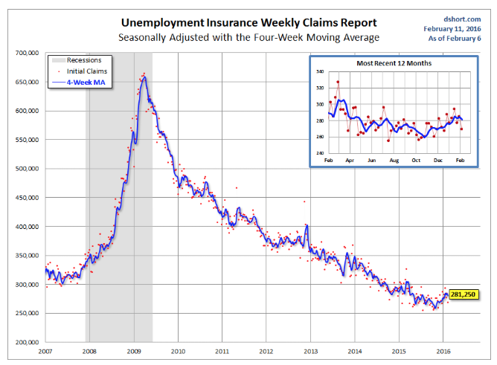
Weekly Jobless Claims –The Most Important Statistic
-13,000 to 247,000-Lowest since 1973!
The Downtrend Lives!-Show Me the Recession!

Slide 12
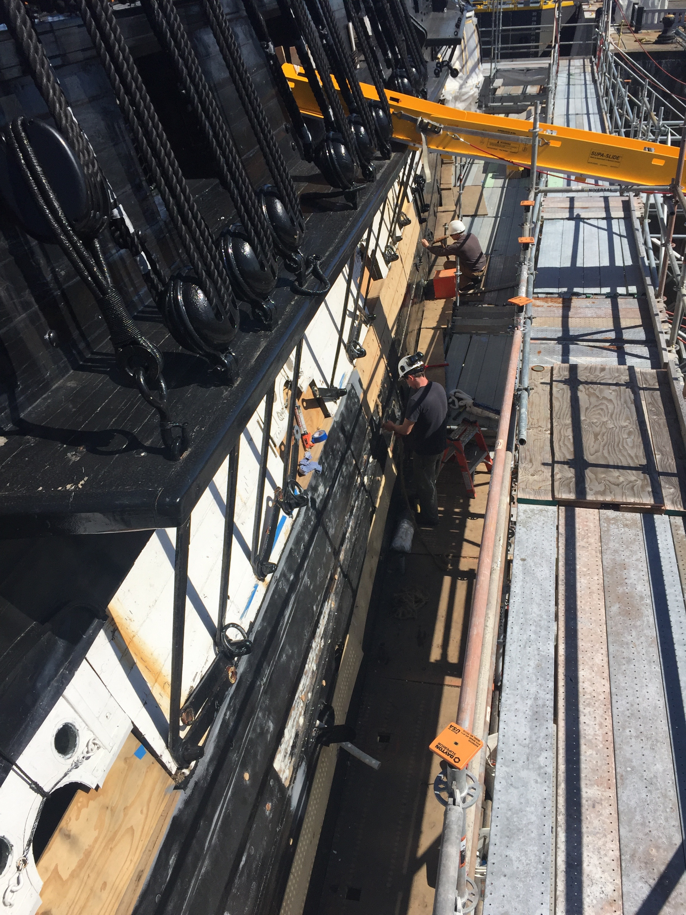

Slide 13
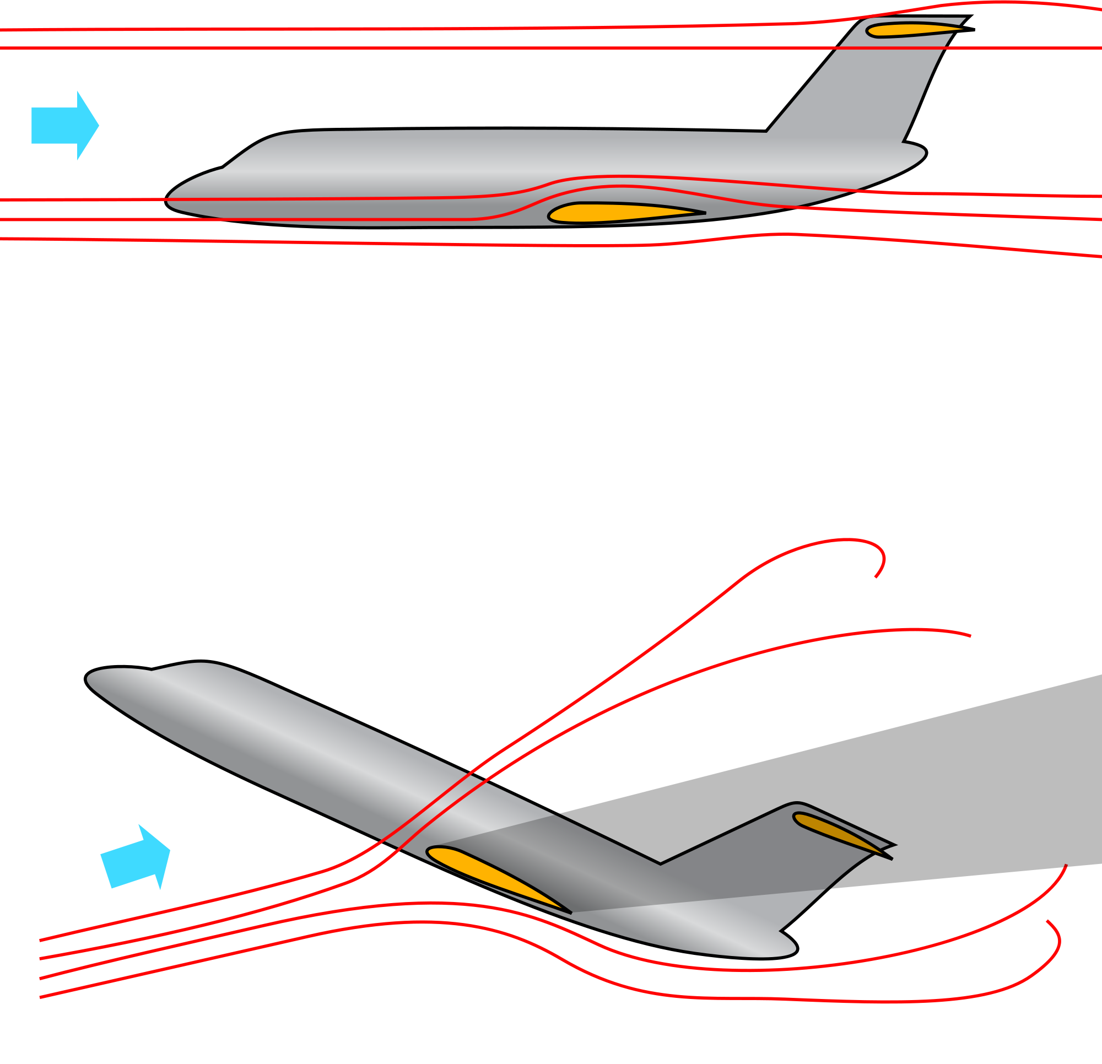
Bonds-Stalling
*Fears of a Fed rate hike are back on the table, but they are unwarranted
*Bonds finally delinked from stocks
*JGB’s hit a new record low of -0.11%, German bunds pop back up to 0.30%
*Emerging market debt hangs on to huge gains,
thanks to oil and commodity boost
*Same with energy Junk
*Stampede for yield is shutting
primary dealers out of the market
for the 30 year, with individuals
and foreigners soaking up the
bulk of the paper

Slide 14
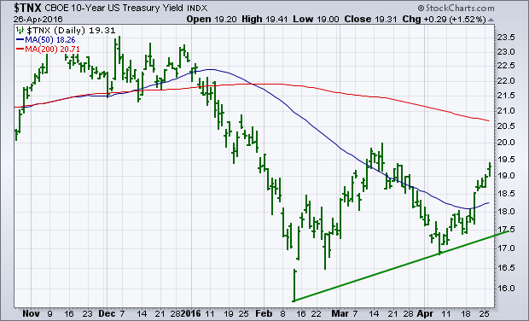
Ten Year Treasury Yield ($TNX) 1.89%
The Reversal is In

Slide 15
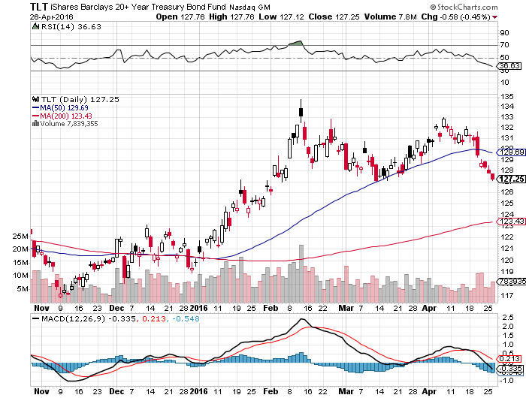
Ten Year Treasury ETF (TLT) 1.89%
The Reversal is In

Slide 16
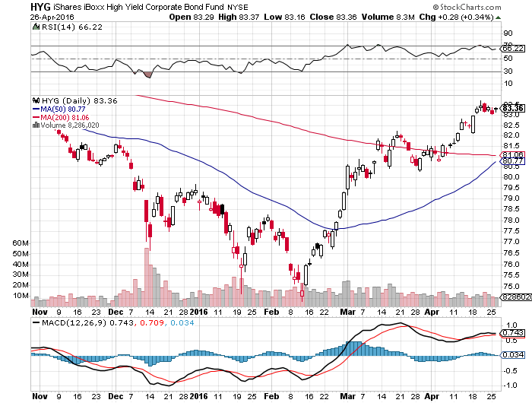
Junk Bonds (HYG) 6.65% Yield
A Great Risk Coincident Indicator

Slide 17
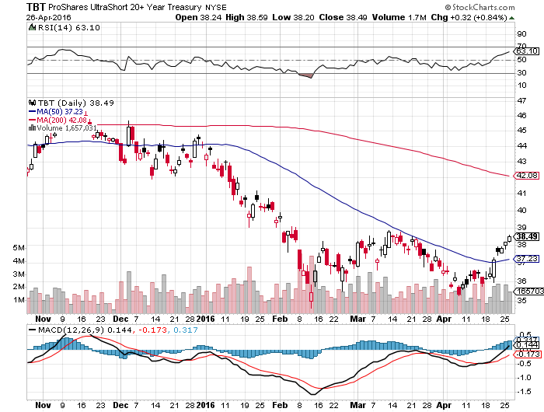
2X Short Treasuries (TBT)-Not Yet the Big Trade of 2016?
Back in “BUY” Territory

Slide 18
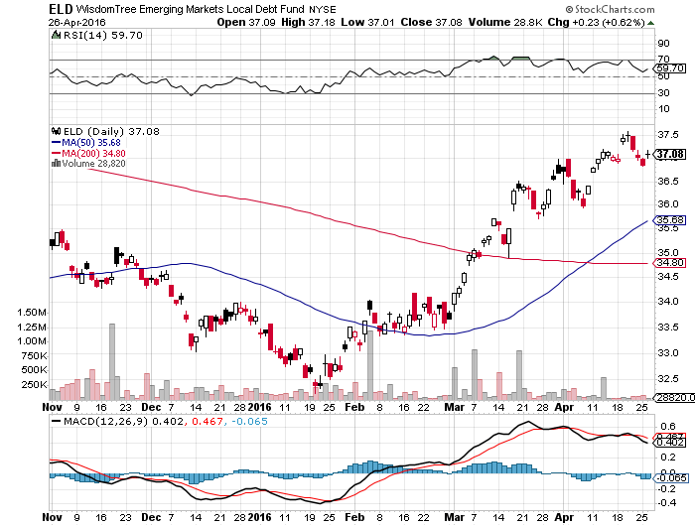
Emerging Market Debt (ELD) 6.00% Yield-

Slide 19
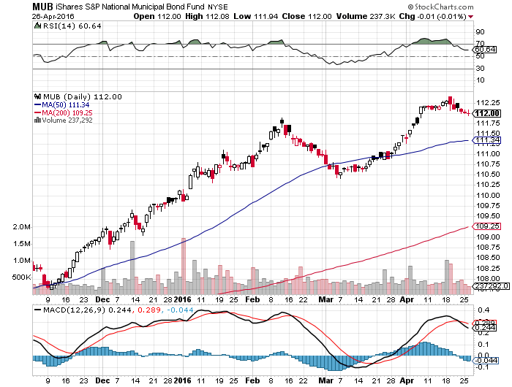
Municipal Bonds (MUB)-1.36% yield-New High
Mix of AAA, AA, and A rated bonds-flight to safety

Slide 20
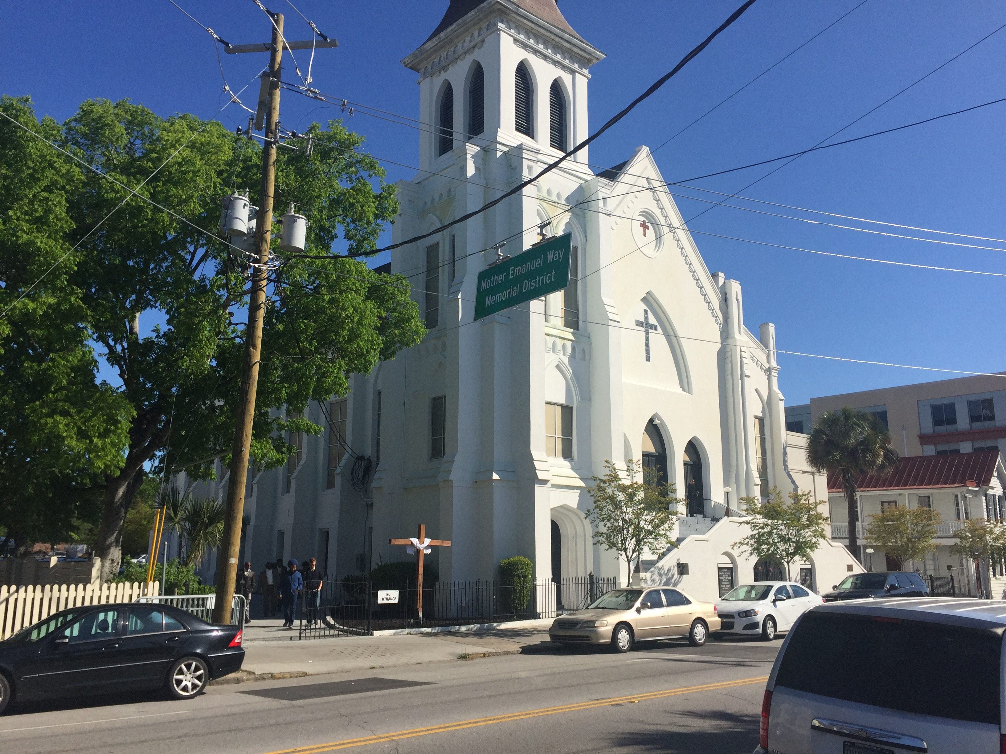

Slide 21
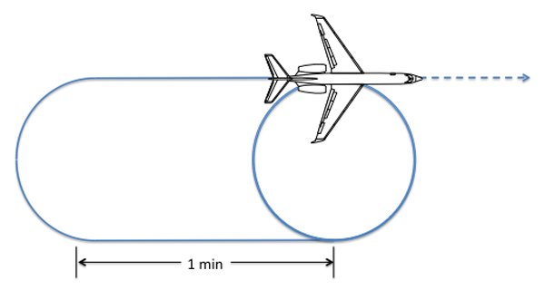
Stocks-Holding Pattern
*Everything is on hold until the big earnings reports are out, do we get a 10% correction this summer? Or the flat line of death? Is the dollar bottoming out here?
*Almost every company drastically cut forecasts, and then beat it on the announcement,
tech wrecks as the ATM effect kicks in
*Banks report big earnings cuts, but not as bad as expected, reserving for $1.5 billion in energy loan losses
*Shorts are all gone now, but no one wants to play on the long side
*The “Narrowing Wedge” scenario is playing out, with a big triangle formation setting up over the next six months, with lower highs and higher lows between 1812 and 2012, earnings not there to move to new all time high
*How much stock do you want to buy ahead
of “Sell in May”
*How much stock do you want to buy at a
PE multiple of 19X?

Slide 22
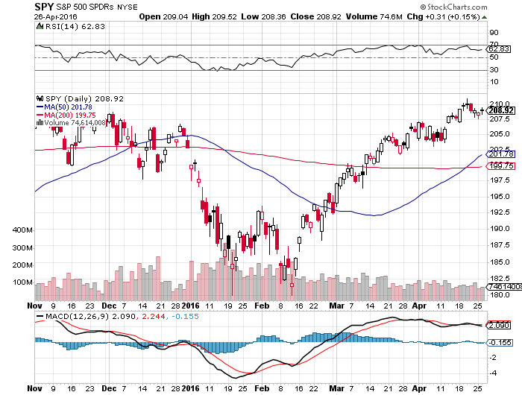
S&P 500- long 5/$112-$117 bear put spread

Slide 23
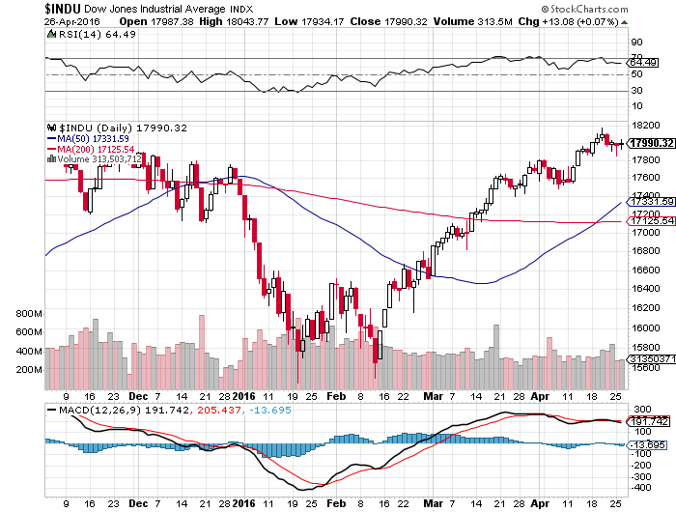
Dow Average-Topping Out Too

Slide 24
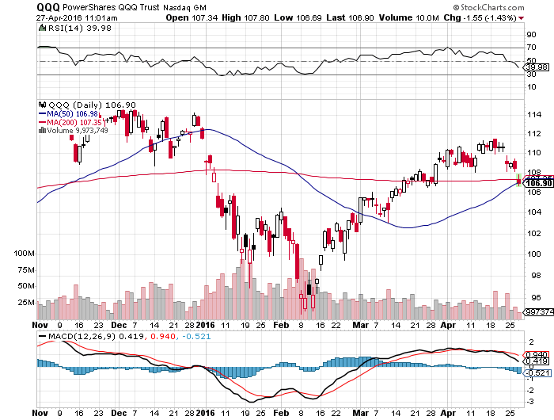
NASDAQ (QQQ)-

Slide 25
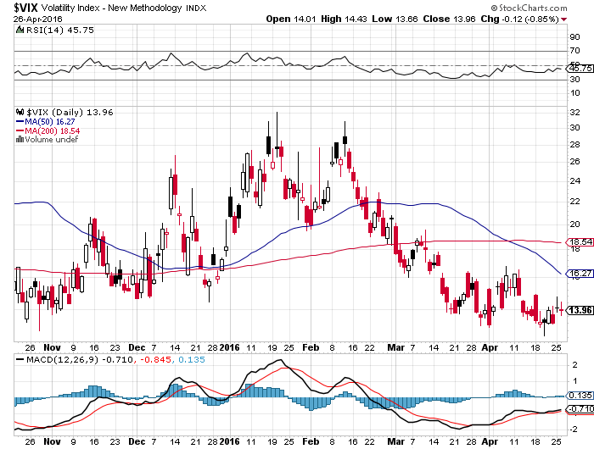
(VIX)-Back to the Bottom

Slide 26
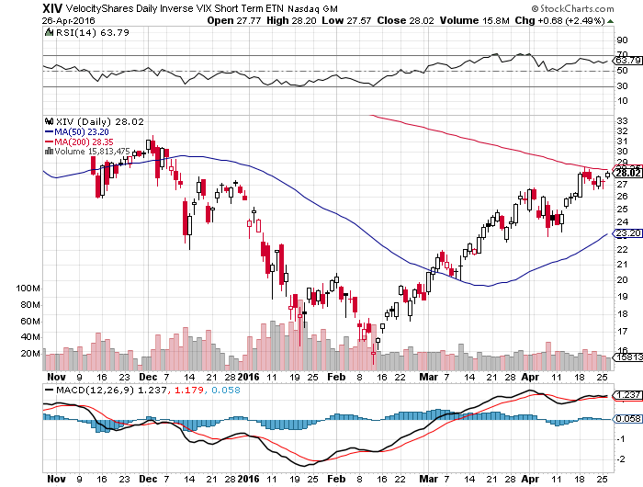
(XIV)-Velocity Shares Daily Inverse VIX Short Term ETN

Slide 27
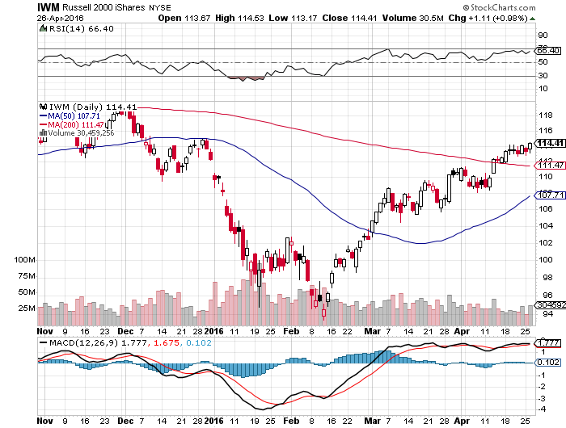
Russell 2000 (IWM)-Watch Carefully took profits on the $112-$117 vertical bear put spread

Slide 28
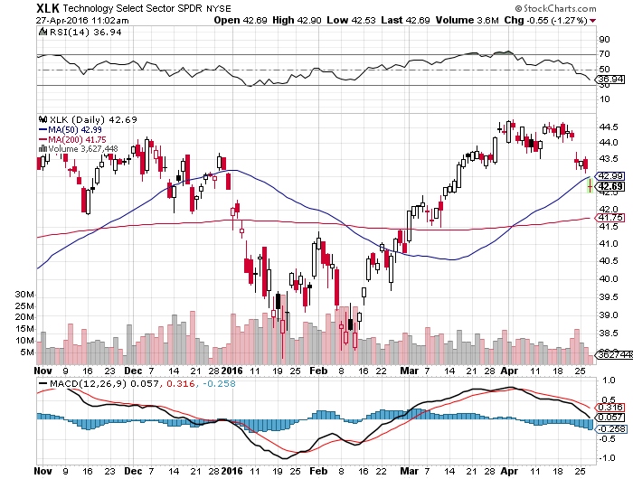
Technology Sector SPDR (XLK), (ROM)
(AAPL), (MSFT), (VZ), (T), (FB), (IBM)

Slide 29
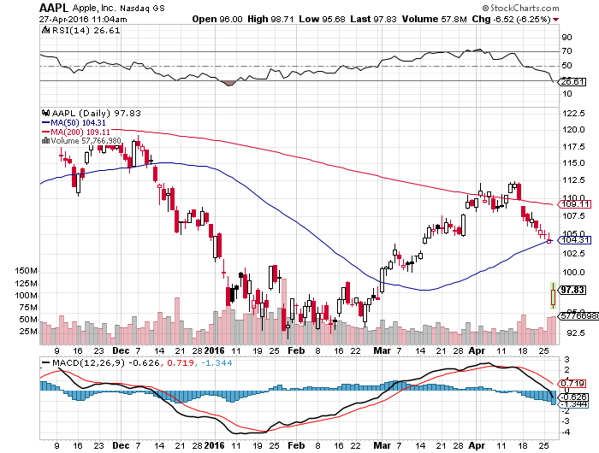
Apple (AAPL) –Buy the Dips
Back to waiting for the next real catalyst-the iPhone 7
Huge Q1 earnings disappointment, as expected-the window is open long the 6/$85-$90 bull call spread

Slide 30
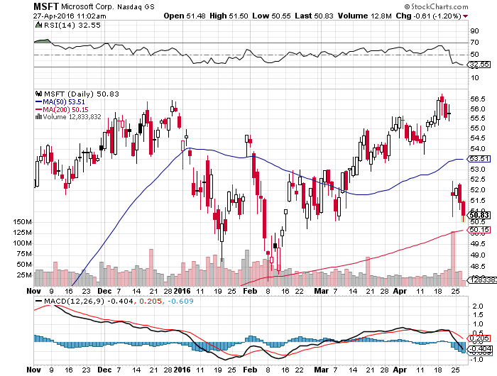
Microsoft (MSFT)
Disappointment creates an entry point

Slide 31
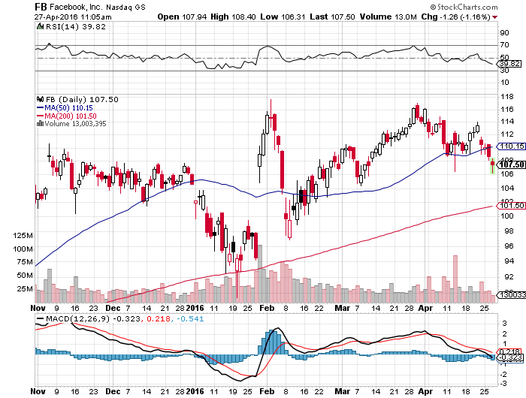
Facebook (FB)
Tech Wreck creates an entry point

Slide 32
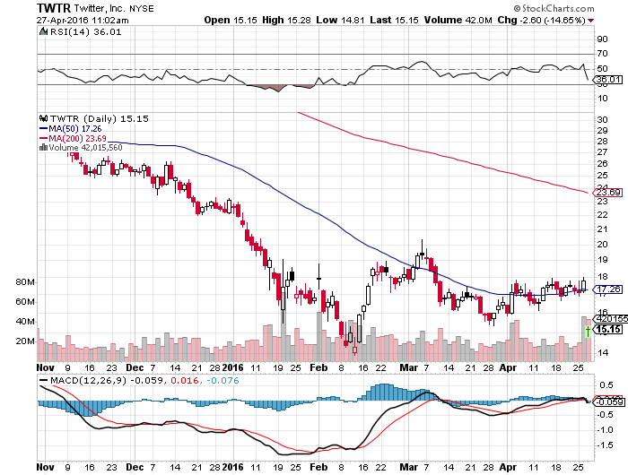
Twitter (TWTR)
Disappointment creates an entry point

Slide 33
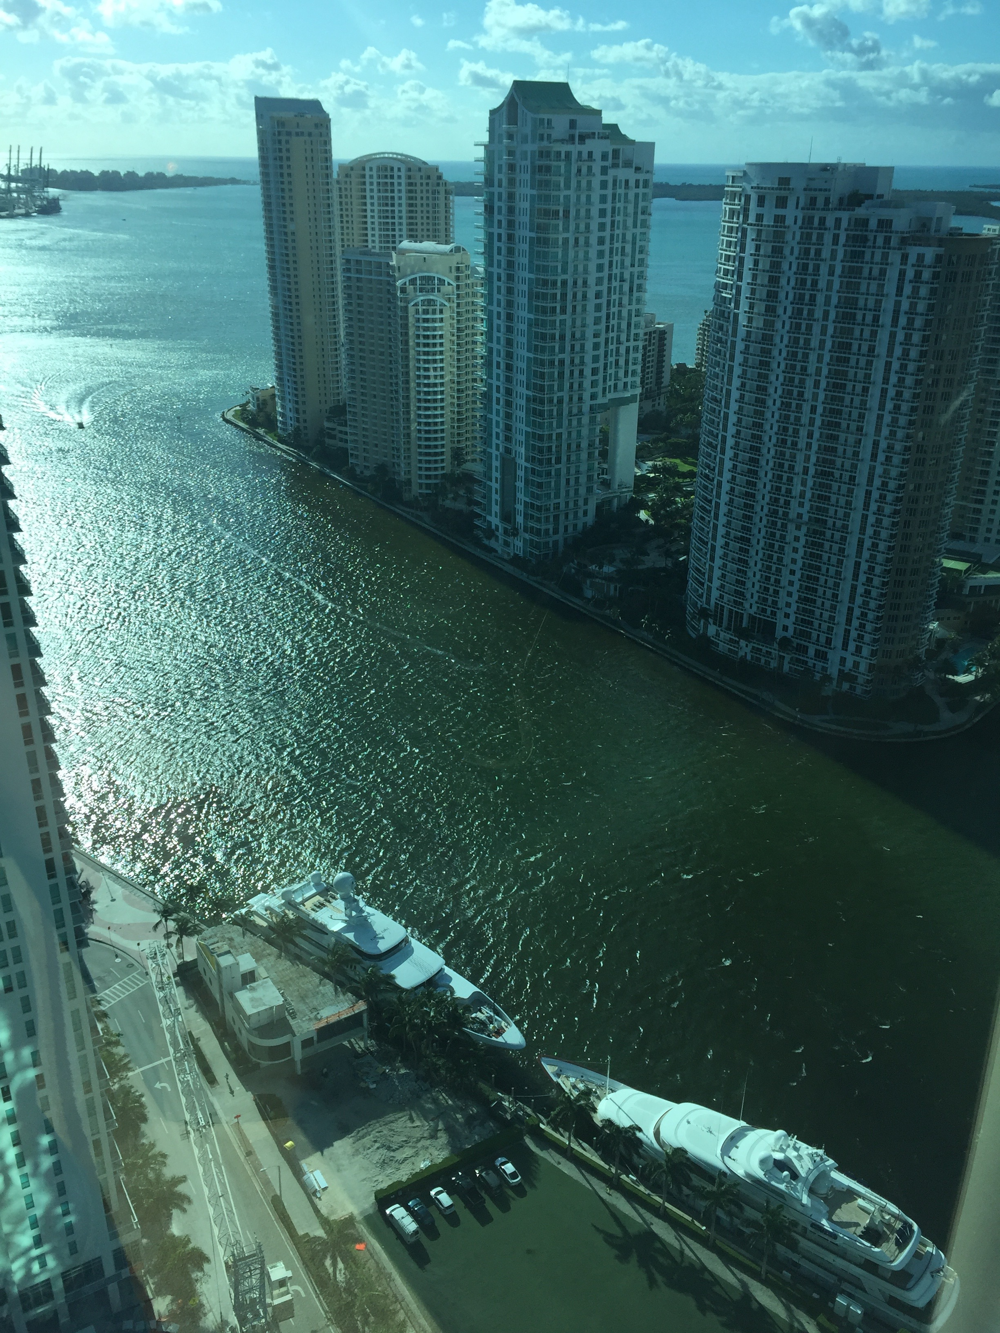

Slide 34
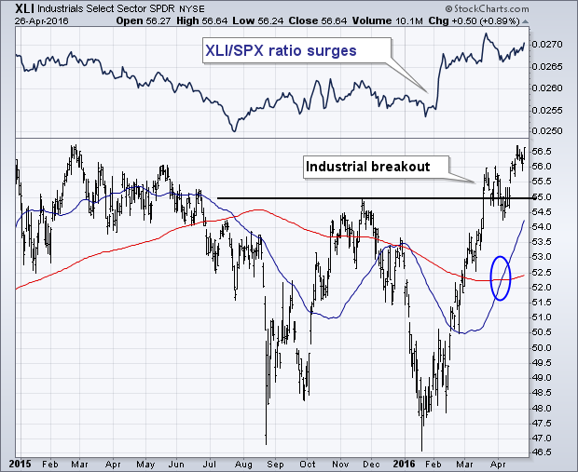
Industrials Sector SPDR (XLI)-Dow Mainstay
(GE), (MMM), (UNP), (UTX), (BA), (HON)

Slide 35
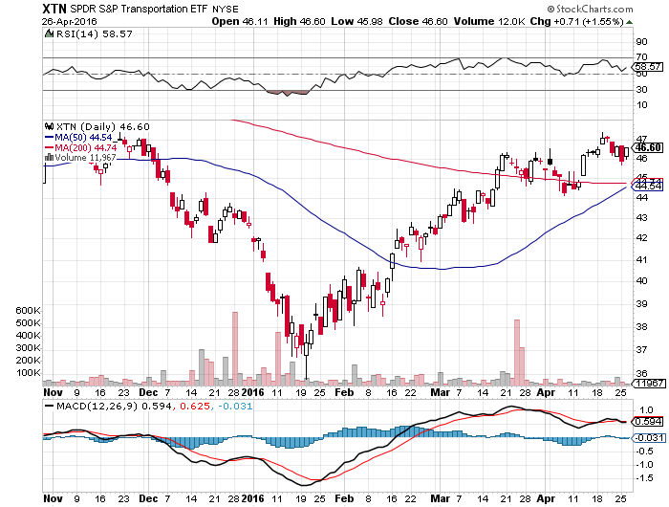
Transports Sector SPDR (XTN)-Another Dow Mainstay
(ALGT), (ALK), (JBLU), (LUV), (CHRW), (DAL),

Slide 36
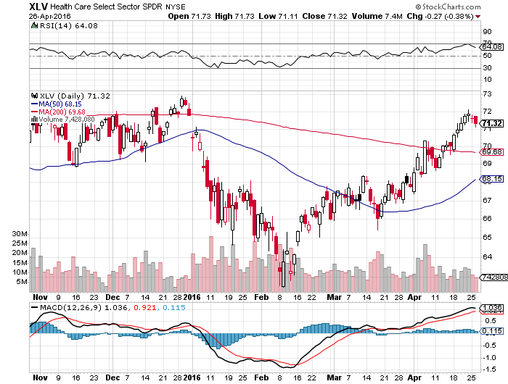
Health Care Sector SPDR (XLV), (RXL)
(JNJ), (PFE), (MRK), (GILD), (ACT), (AMGN)

Slide 37
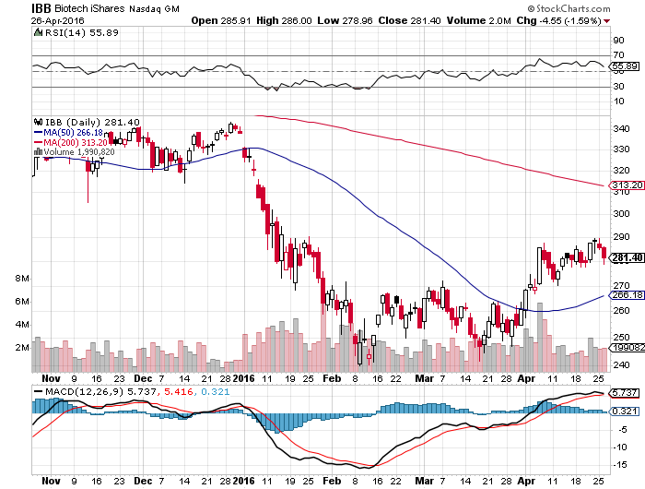
Biotech iShares (IBB)-A Political Football in 2016

Slide 38
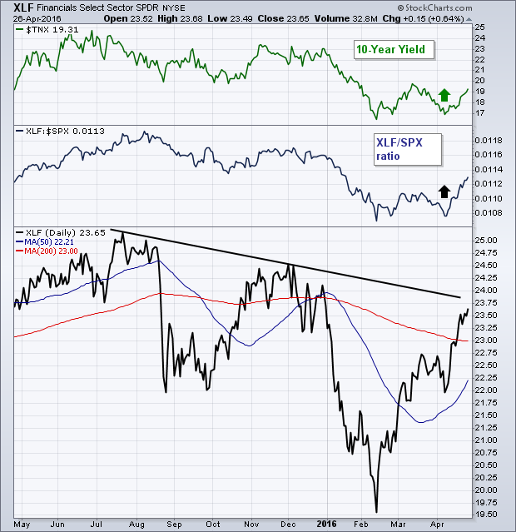
Financial Select SPDR (XLF)-JPM boost
(BLK/B), (WFC), (JPM), (BAC), (C), (GS)

Slide 39
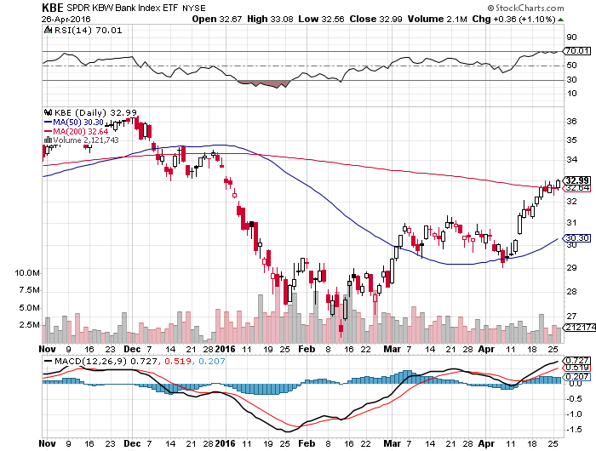
KBW Bank Index (KBE)-

Slide 40
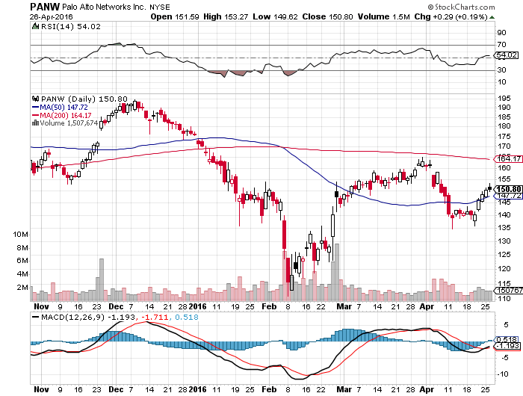
Palo Alto Networks (PANW)- another entry point setting up

Slide 41
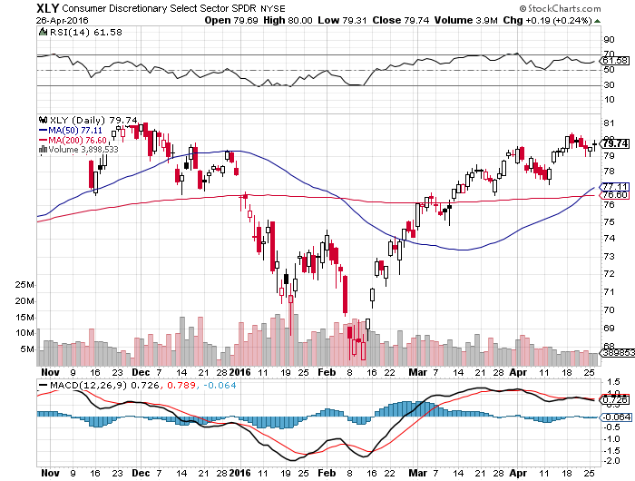
Consumer Discretionary SPDR (XLY)
(DIS), (AMZN), (HD), (CMCSA), (MCD), (SBUX)
A Major Leader of the Rally

Slide 42
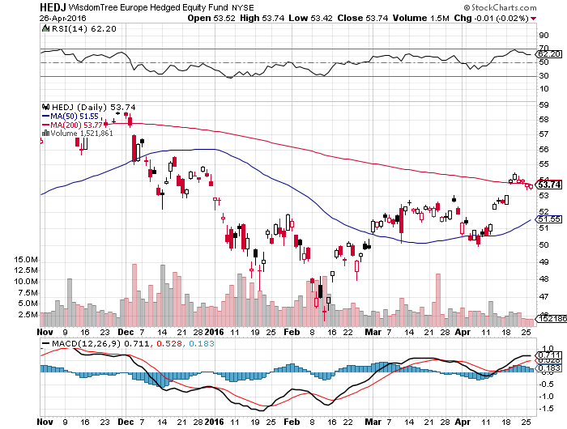
Europe Hedged Equity (HEDJ)-Hedged Japan Equity
Capped by strong euro and Brussels attack

Slide 43
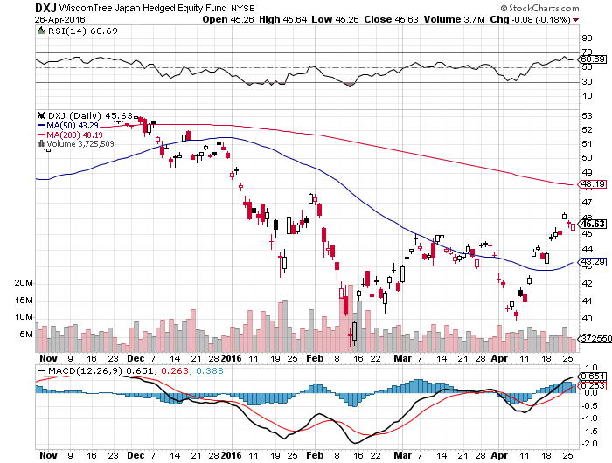
Japan (DXJ)-Hedged Japan Equity
Capped by strong yen?

Slide 44
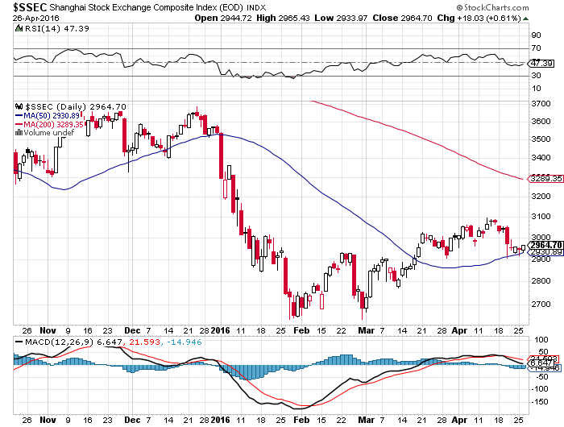
China ($SSEC)-
The Bad Boy Market and font of volatility

Slide 45
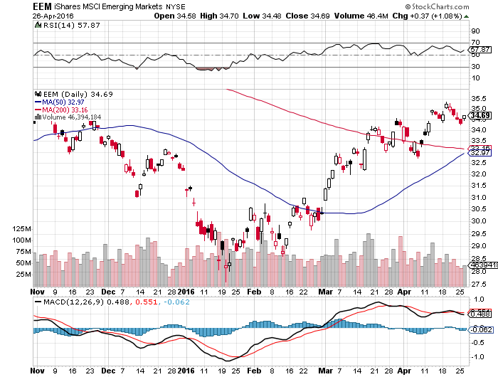
Emerging Markets (EEM)-
Loves the oil and commodity bounce

Slide 46
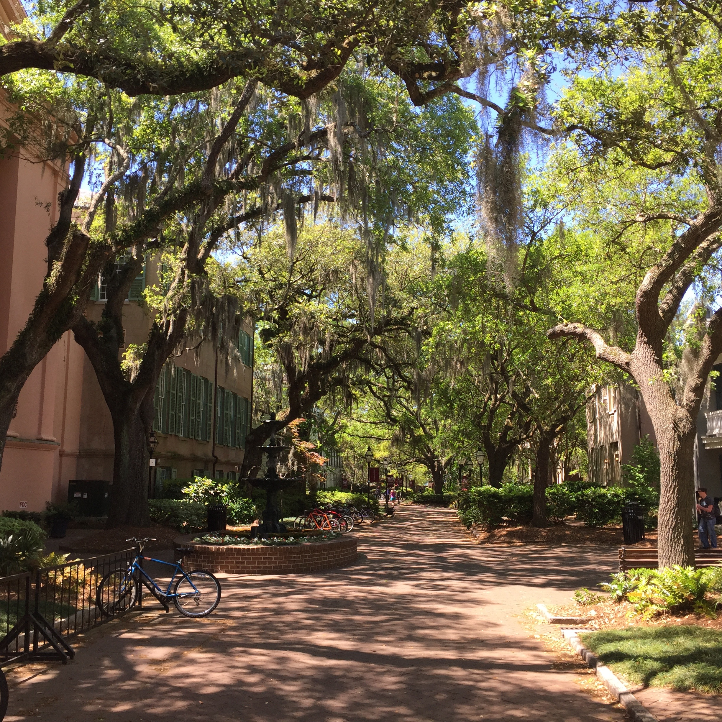

Slide 47

Foreign Currencies-The Yen Conundrum
*Bank of Japan meets this week, the saber rattling for another easing of monetary conditions has begun. They are desperate to weaken the yen, but with NIRP in force they are running out of tricks, earthquakes are helping
*Fed easing is driving the yen up and Japan is helpless to do anything about it. Massive capital outflows from Japan fleeing NIRP, should b yen weakening
*However, as the world’s third largest
oil importer, Japan is saving $125 billion
a year on the oil crash, which is
hugely yen supportive
*”Brexit” failure ahead in the polls
42% to 43%, expect big (FXB) rally
*When does the dollar start to
discount the next rate hike?

Slide 48
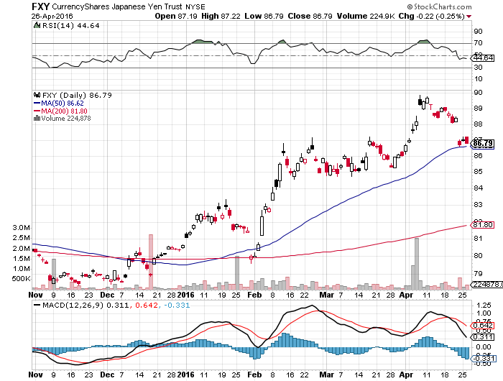
Japanese Yen (FXY)-At a One Year High

Slide 49
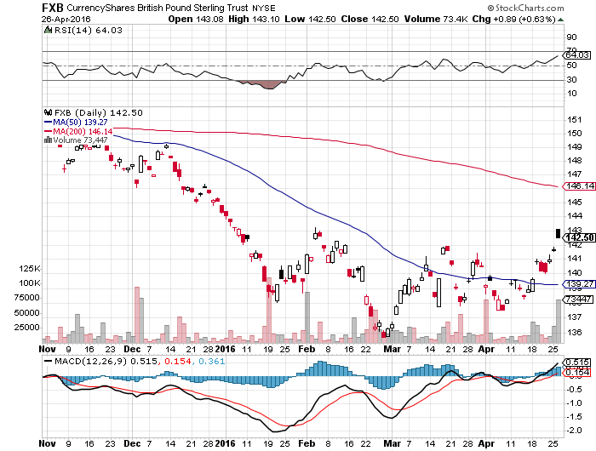
British Pound (FXB)-Rally on Failing Brexit Prospects

Slide 50
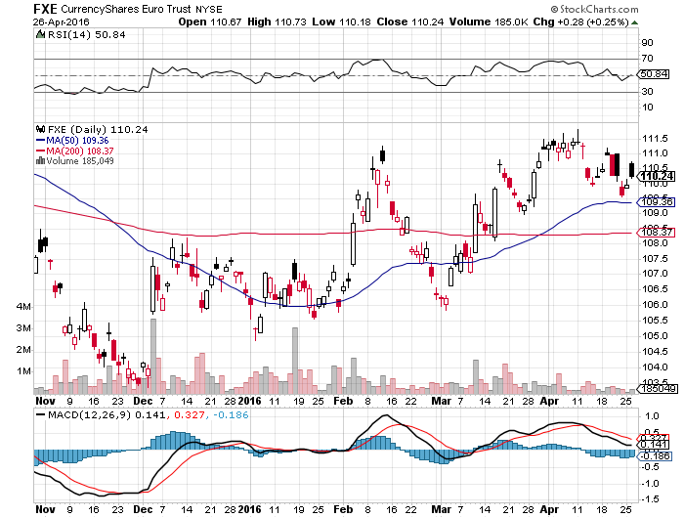
Euro ($XEU), (FXE), (EUO)- on “Brexit” fears, prospect of more QWE next week

Slide 51
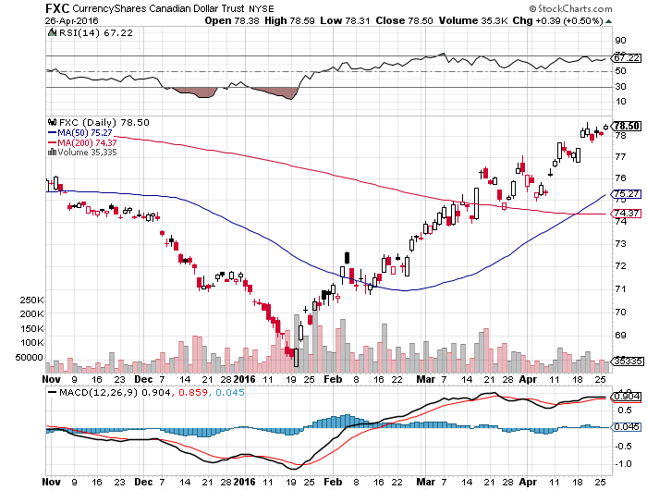
Canadian Dollar (FXC)-Love That Strong Oil

Slide 52
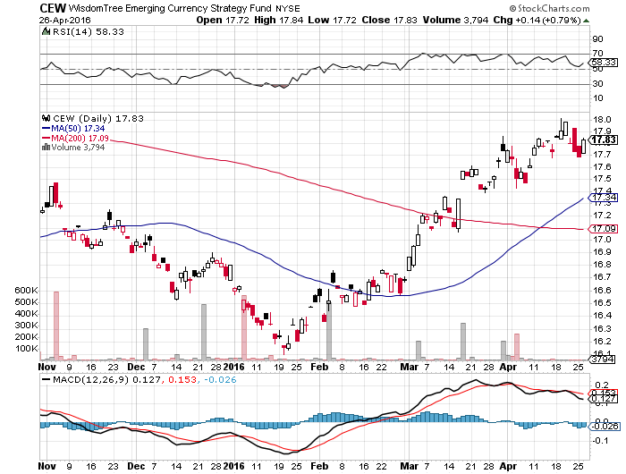
Emerging Market Currencies (CEW)

Slide 53
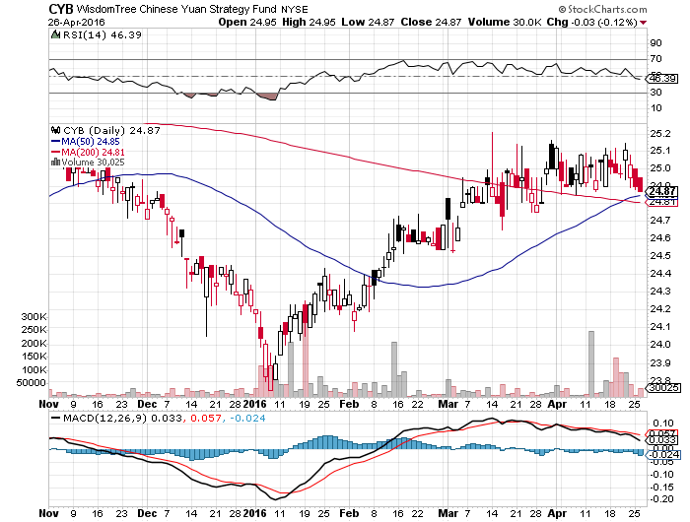
Chinese Yuan- (CYB)-Sell Rallies on Weakening Economy
Rolling Over?

Slide 54
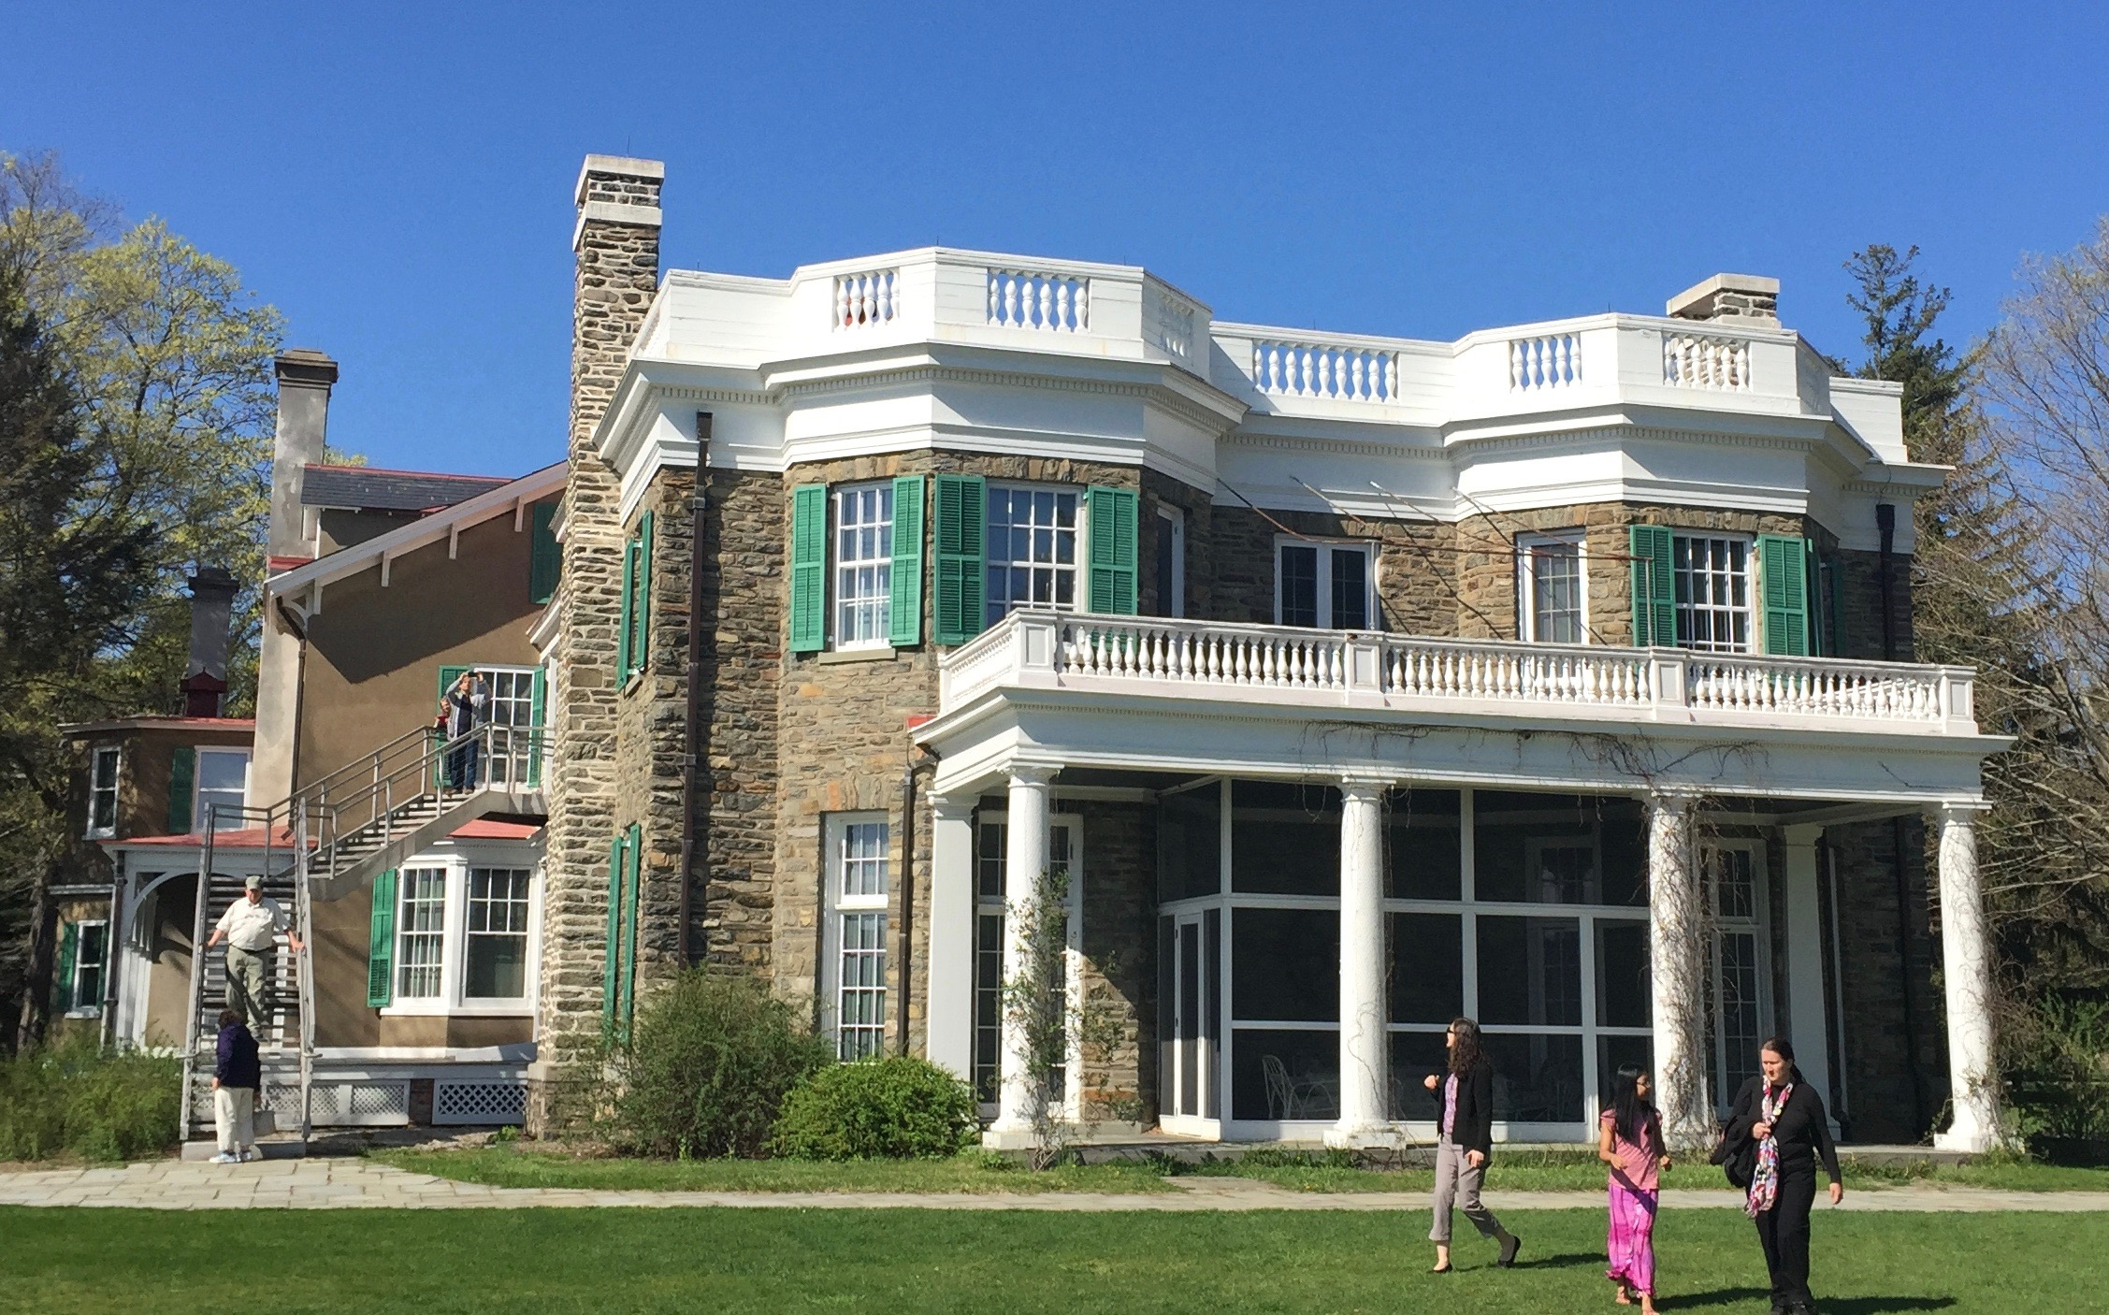

Slide 55
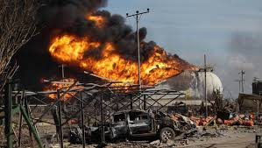
Energy-Failure!
*Doha meeting bombs, but oil bounces anywhere to new 2016 highs, points to underlying strength despite short term fundamentals, Is $52 in the cards by yearend?
*Iran ramps up production faster than anyone expected, but will soon me the limitations of its antiquated infrastructure
*Libya and Iraq substantially increasing production too
*Kuwait oil strike comes and goes, putting 2.8 million barrels a day at risk, but creates no net effect on the market
*Rig count keeps falling to 440, a new low
*Venezuela is hovering on the brink, possibly creating
the next oil price spike, Schlumberger pulls all its people
out because of nonpayment
*weekly inventories higher, but Mexican refinery
explosion sends prices higher

Slide 56
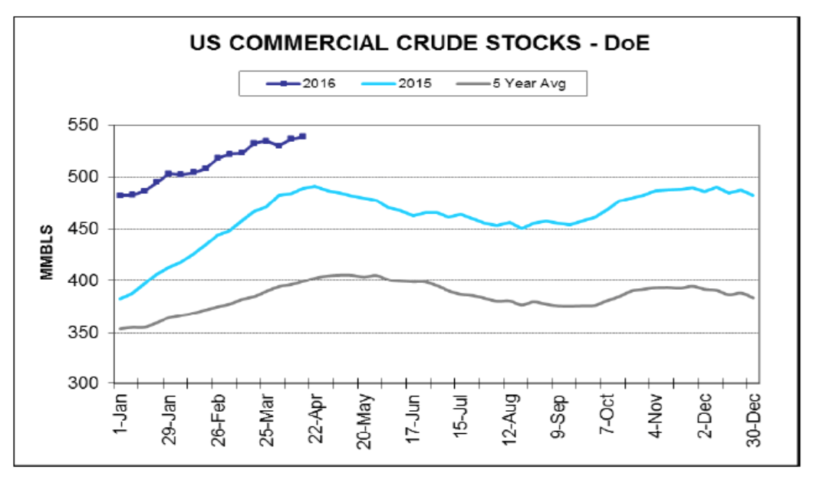

Slide 57
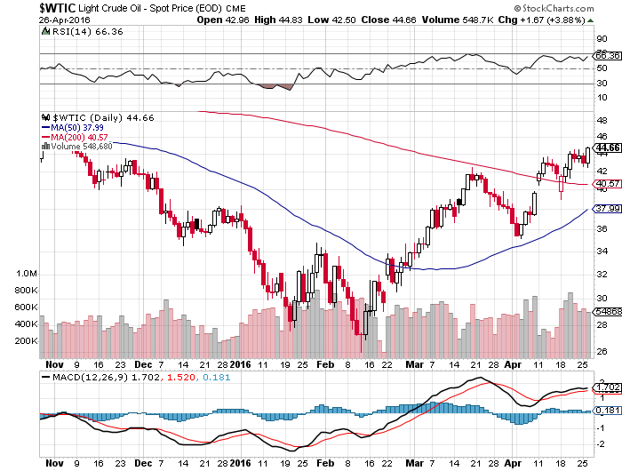
Oil-The Bottom is in,
The First Retest Was Successful

Slide 58
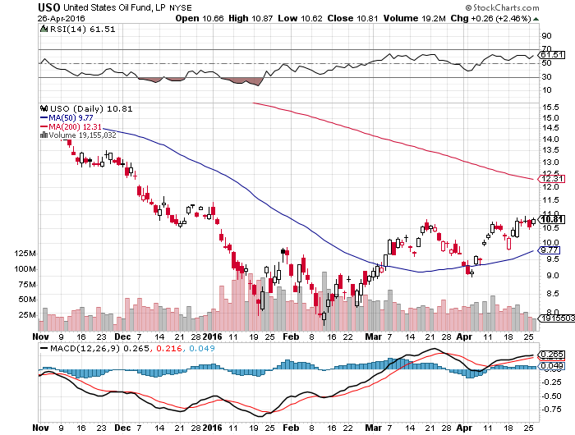
United States Oil Fund (USO) took profits on long the 5/$8.00 calls too soon

Slide 59

Energy Select Sector SPDR (XLE)
(XOM), (CVX), (SLB), (KMI), (EOG), (COP)

Slide 60

Alerian MLP ETF (AMLP)-9.08% Yield
Basket Approach is the Only Safe Play here

Slide 61

Exxon (XOM)-Holds up on credit downgrade

Slide 62

Occidental Petroleum (OXY)-

Slide 63

Conoco Phillips (COP)-The Buffet Favorite

Slide 64

Natural Gas (UNG)-Headed for Negative Prices

Slide 65

Copper-The Bottom is In

Slide 66


Slide 67

Precious Metals-The “RISK OFF” Assist
*Gold is building a sideways wedge on the charts, building a launching pad for the next upside breakout
*Central banks and momentum traders are underpinning the market
with bids below
*Gold is the only asset class that does well in all market scenariois, up or down
*Negative interest rates giving gold a huge
boost, since it cost money to place deposits in
bank in Europe and Japan
*Spec positions now near highs,
adding risk, while volume has been falling,
never a good sign

Slide 68

Gold (GLD)-Looking for a Dip took profits the 4/$109-$112 vertical bull call spread

Slide 69

Market Vectors Gold Miners ETF- (GDX)

Slide 70

Silver (SLV)-

Slide 71

Silver Miners (SIL)-Finally Kicks In

Slide 72

Platinum (PPLT)-The Volkswagen Effect

Slide 73

Palladium (PALL)-

Slide 74


Slide 75

Agriculture-From El Nino to La Nina
*Draught conditions in Brazil triggering monster short covering rally in the ags, which it quickly gives up, not good
*Good weather allows early US planting of corn, oats, and rice this year
*Recent weak dollar helping exports, but not enough
*Without surprise bad weather this is
going to be another awful year for the ags
*No trade, there are NO fish to fry

Slide 76

(CORN) – Killed!

Slide 77

(WEAT) That’s Gotta Leave a Bruise!

Slide 78

Ag Commodities ETF (DBA)-

Slide 79


Slide 80

Real Estate-Ticking Along
*Existing home sales up 1.5% YOY to 5.33 million units, housing starts down a shocking 8.8%,
*Rising prices, falling inventories, and still tough loan requirements still shutting first time buyers out of the market
*Extreme inventory shortage cutting into sales, with only a 4.5 month supply, driving prices upward
*Jan-Feb stock crash fed into weaker sales of the plus $1 million market
*High end Miami is in free fall
*February Case Shiller S&P 500 National index
continues upward grind, January +5.4%
*San Francisco is finally cooling off,
a precurser of weak tech stocks?

Slide 81

February S&P 500/Case–Shiller Home Price Index
+5.4% YOY, Seattle, Denver, Portland

Slide 82

US Home Construction Index (ITB)
(DHI), (LEN), (PHM), (TOL), (NVR)

Slide 83


Slide 84

Trade Sheet
So What Do We Do About All This?
*Stocks- sell rallies, buy the next big dip
*Bonds-the top is in, fade the next big rally
*Commodities-the bottom is in, buy big dips
*Currencies- stand aside, wait for yen move to burn out
*Precious Metals –buy on dips
*Volatility-sell short spikes over $25, buy dips to $12
*The Ags –stand aside - avoid the disaster
*Real estate-buy the homebuilders LT

Slide 85

To buy lunch tickets, please go to www.madhedgefundtrader.com , click on “LUNCHES,” “USA”, and then your desired city
Next Strategy Webinar
12:00 EST Wednesday,
May 11, 2016
San Francisco, CA
USA!
Good Luck and Good Trading!
Notes:
*

