Slide 1

Mad Day Trader
Bill Davis
Webinar – May 18, 2016

Slide 2
Indexes covered in the Daily Update

Slide 3
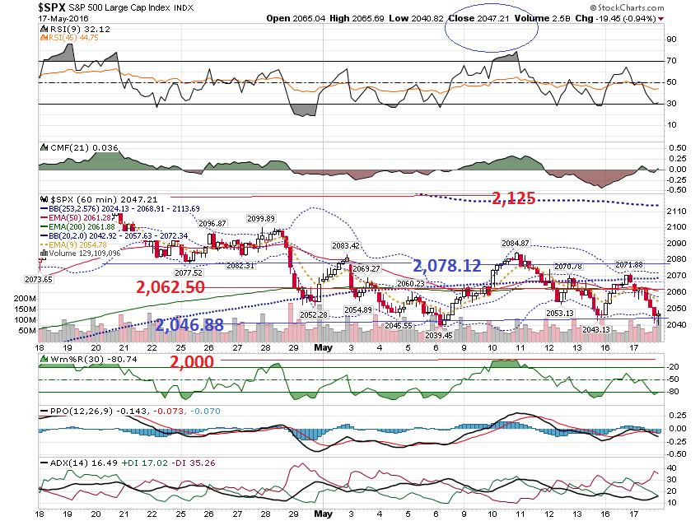

Slide 4
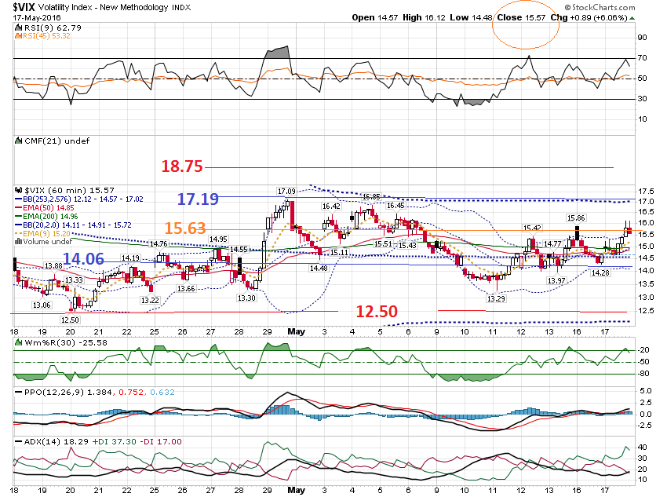

Slide 5
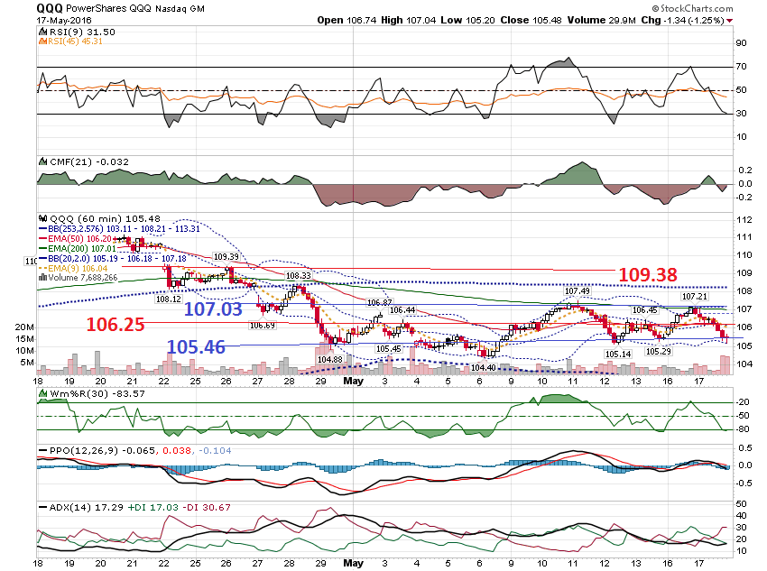

Slide 6
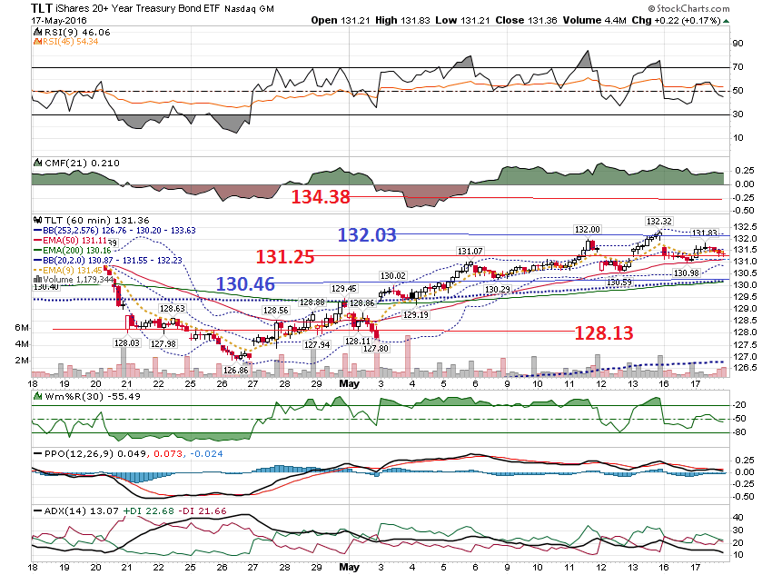

Slide 7
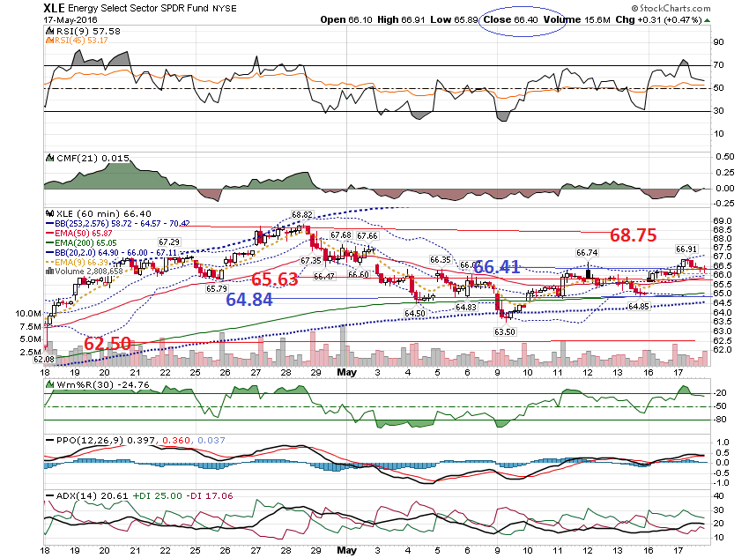

Slide 8
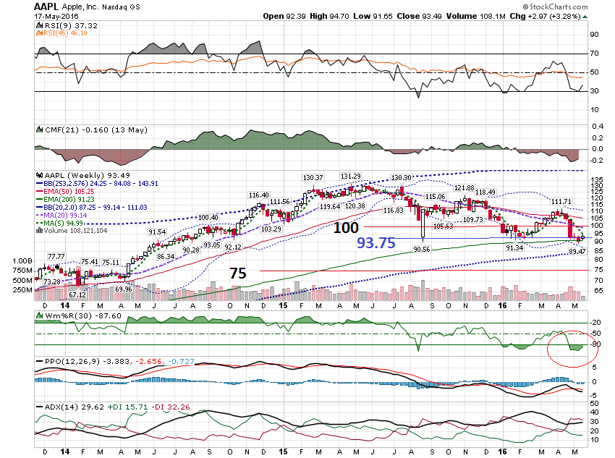

Slide 9
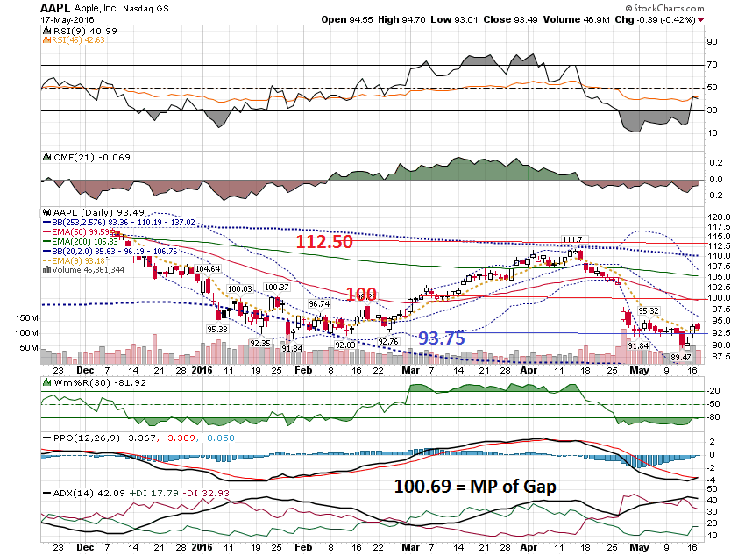

Slide 10
Metals

Slide 11
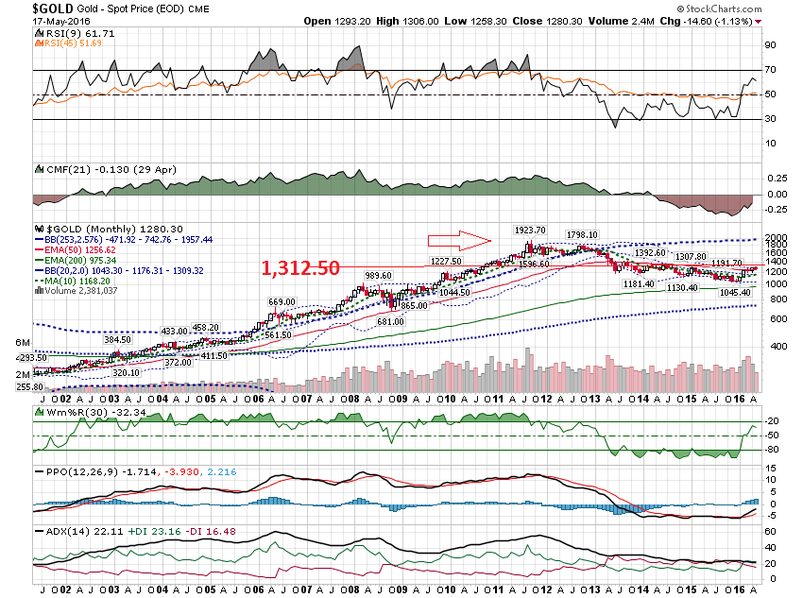

Slide 12
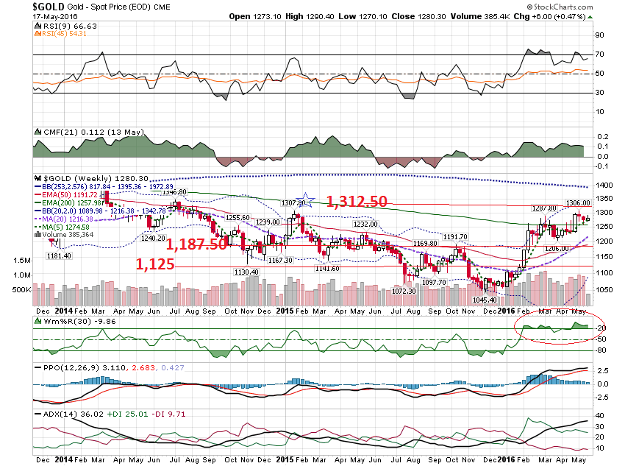

Slide 13
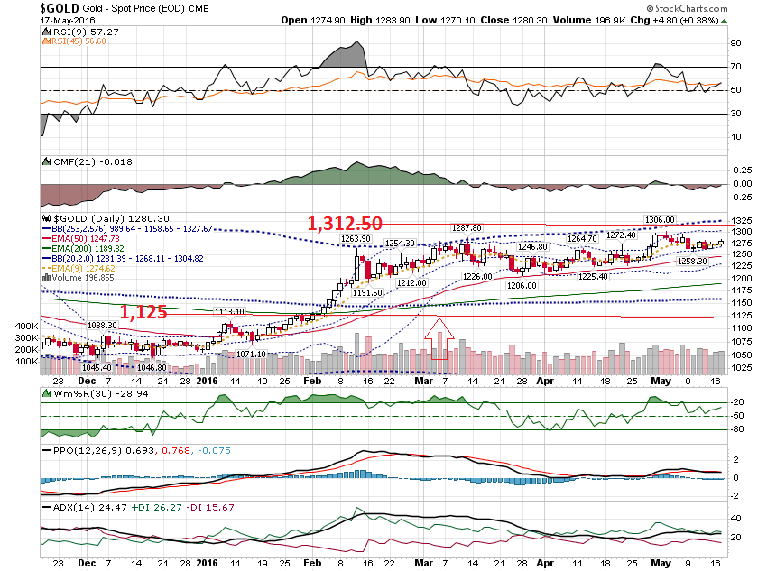

Slide 14
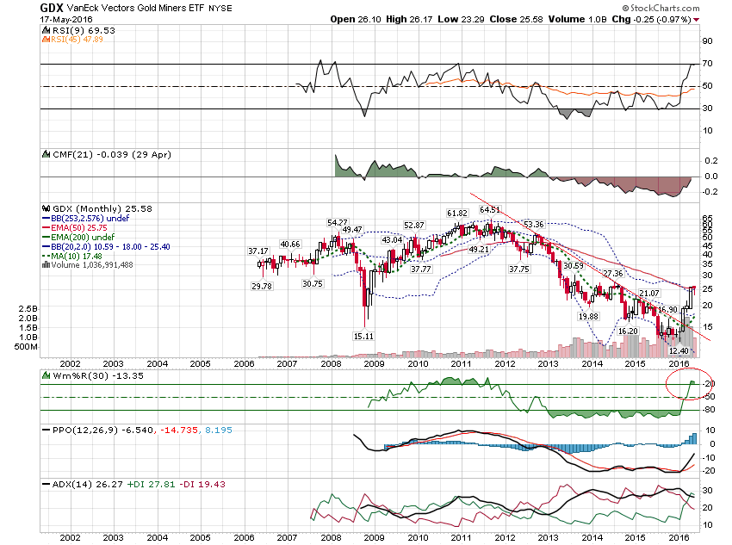

Slide 15
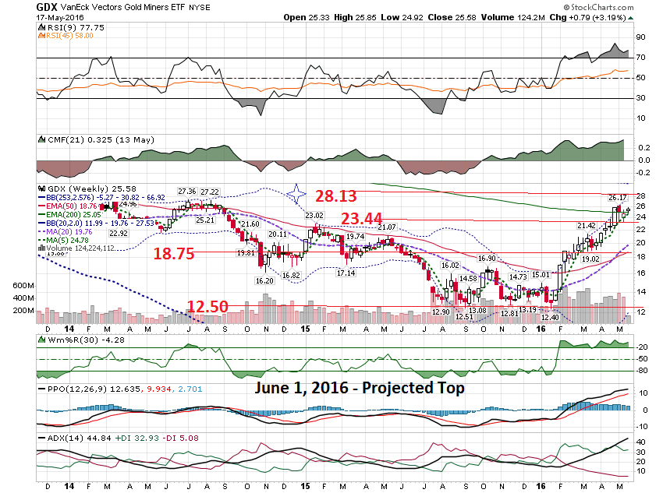

Slide 16
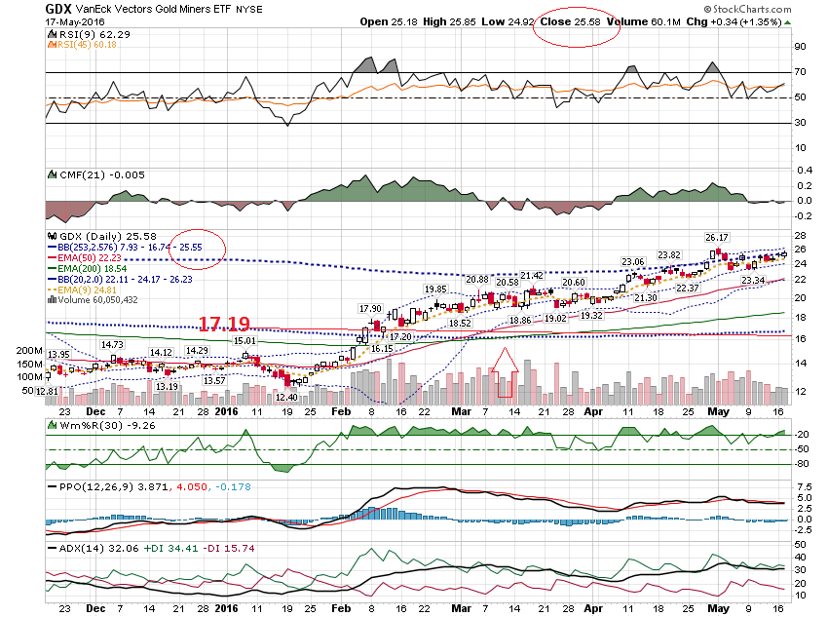

Slide 17
Earnings

Slide 18
PCLN
Calls:
$1,495 call - $3.30
$1,490 call - $3.55
Puts:
$1,210 Put - $3.90
$1,205 Put - $3.41
From last Webinar

Slide 19
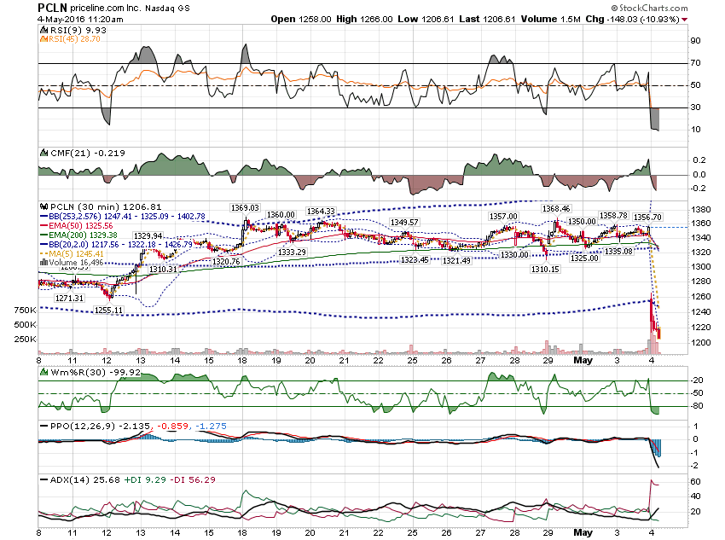

Slide 20
PCLN
Charts after the Close on May 4, 2016

Slide 21
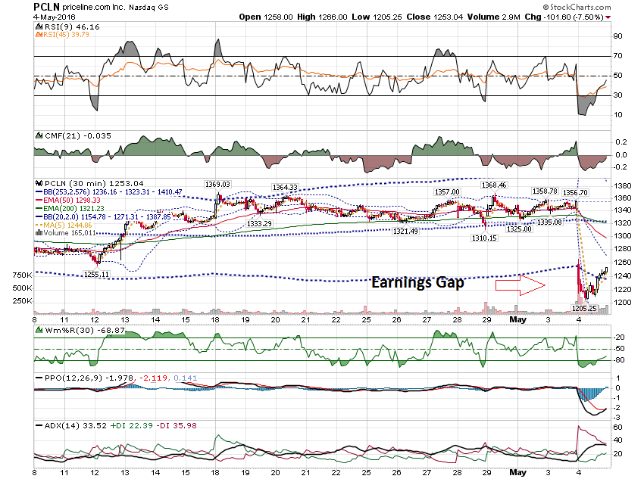

Slide 22
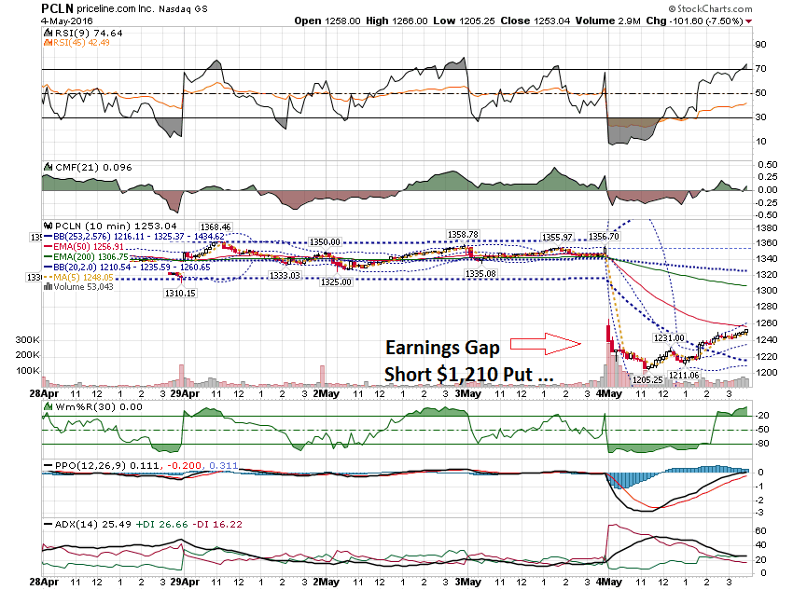

Slide 23
Where is price objective for PCLN?

Slide 24
PCLN Objectives
Objective 1 = MP of Gap - $1,305
Objective 2 = Mid Band - $1,299
Objective 3 = Gap Gill - $1,342

Slide 25
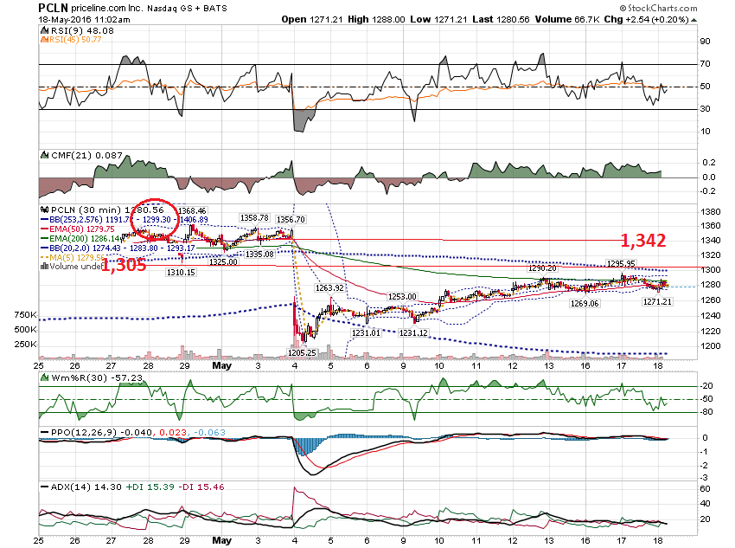

Slide 26
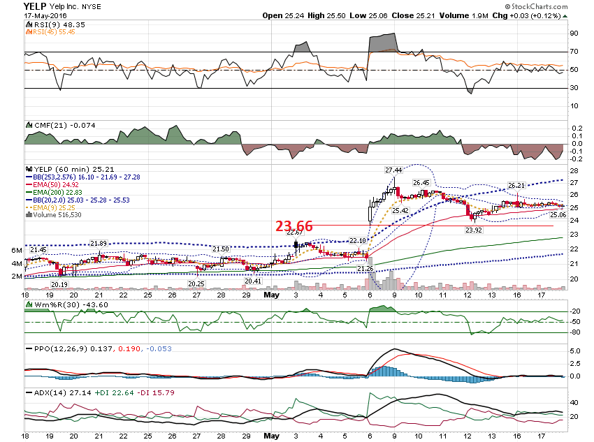

Slide 27
Thanks for watching!
Bill Davis
Mad Day Trader
May 18, 2016 davismdt@gmail.com

