Slide 1

The Mad Hedge Fund Trader
“It’s All About the Dollar”
With John Thomas
from San Francisco, CA, May 11, 2016
www.madhedgefundtrader.com
Notes:
*

Slide 2
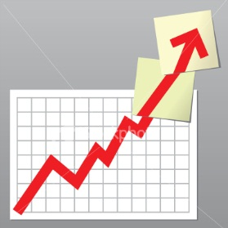
Trade Alert Performance
Making Big Profits in Dire Market Conditions
*January +1.23% Final *July +6.42% Final
*February +4.50% FINAL *August +1.27% Final
*March -2.42% Final *September +11.99% Final
*April -2.10% FINAL *October Final -6.19%
*May +6.54% MTD *November MTD 5.78%
*June +3.68% Final *December -4.94%
*2016 Year to Date +7.75%
compared to 2.9% for the Dow Average
*Trailing 1 year return +27.60%, +198.90 since inception,
0.40% short of all-time high
*Average annualized return of 36.72%

Slide 3
Portfolio Review
Running a Large Aggressive Short Dated Book
on a strong dollar move
Risk On
World is Getting Better
(FXY) 5/$91-$94 put spread | 10.00%
(FXE) 5/$113-$116 put spread | 10.00%
Risk Off
World is Getting Worse
(SPY) 6/$212-$217 put spread | -10.00%
(SPY) 5/$210-$213 put spread | -10.00%
(SPY) 5/$209-$214 put spread | -10.00%
(GLD) 5/$115-$118 call spread | -10.00%
total net position | -20.00%
Expiration P&L
14.74% YTD

Slide 4

The Method to My Madness
Running small book in an overbought market, waiting to jump on the next meltdown
*Using a strong dollar window to get aggressive and blast through to a new all time high
*Staying partly market neutral to reduce P&L volatility
*Keeping a short dated book to minimize risk, with 7 days to expiration
*With volatility at $13 everyone is nervous
*Gold has been the only reliable winner,
running fourth monthly long position
*Use the tech and biotech wrecks to get into good
long term positions over the summer

Slide 5
Paid Subscriber Trailing 12 Month Audited Return +27.60%

Slide 6
65 Months Since Inception
Daily Audited Performance
Averaged annualized return +36.72%

Slide 7

Short Term Strategy Outlook-Strong Dollar
*Dollar looks to stay strong through May, short all weak dollar plays, including stock, commodities, energy, and foreign currencies
*Dollar has averaged a 3% gain for the last seven Mays on international trade flows
*Oil bottom at $26 looking rock solid, rally on Doha failure points to higher highs
*US stocks have now defined the 2016 wedge formation between (SPX) 1812 and 2010, will take 6 for months to resolve to the upside
*Bonds trading a range at a very high level,
setting up a wedge for a December rate hike
*Gold takes a new run at the highs, buy the $50 dips
*Disastrous USDA report bring another Ag selloff

Slide 8
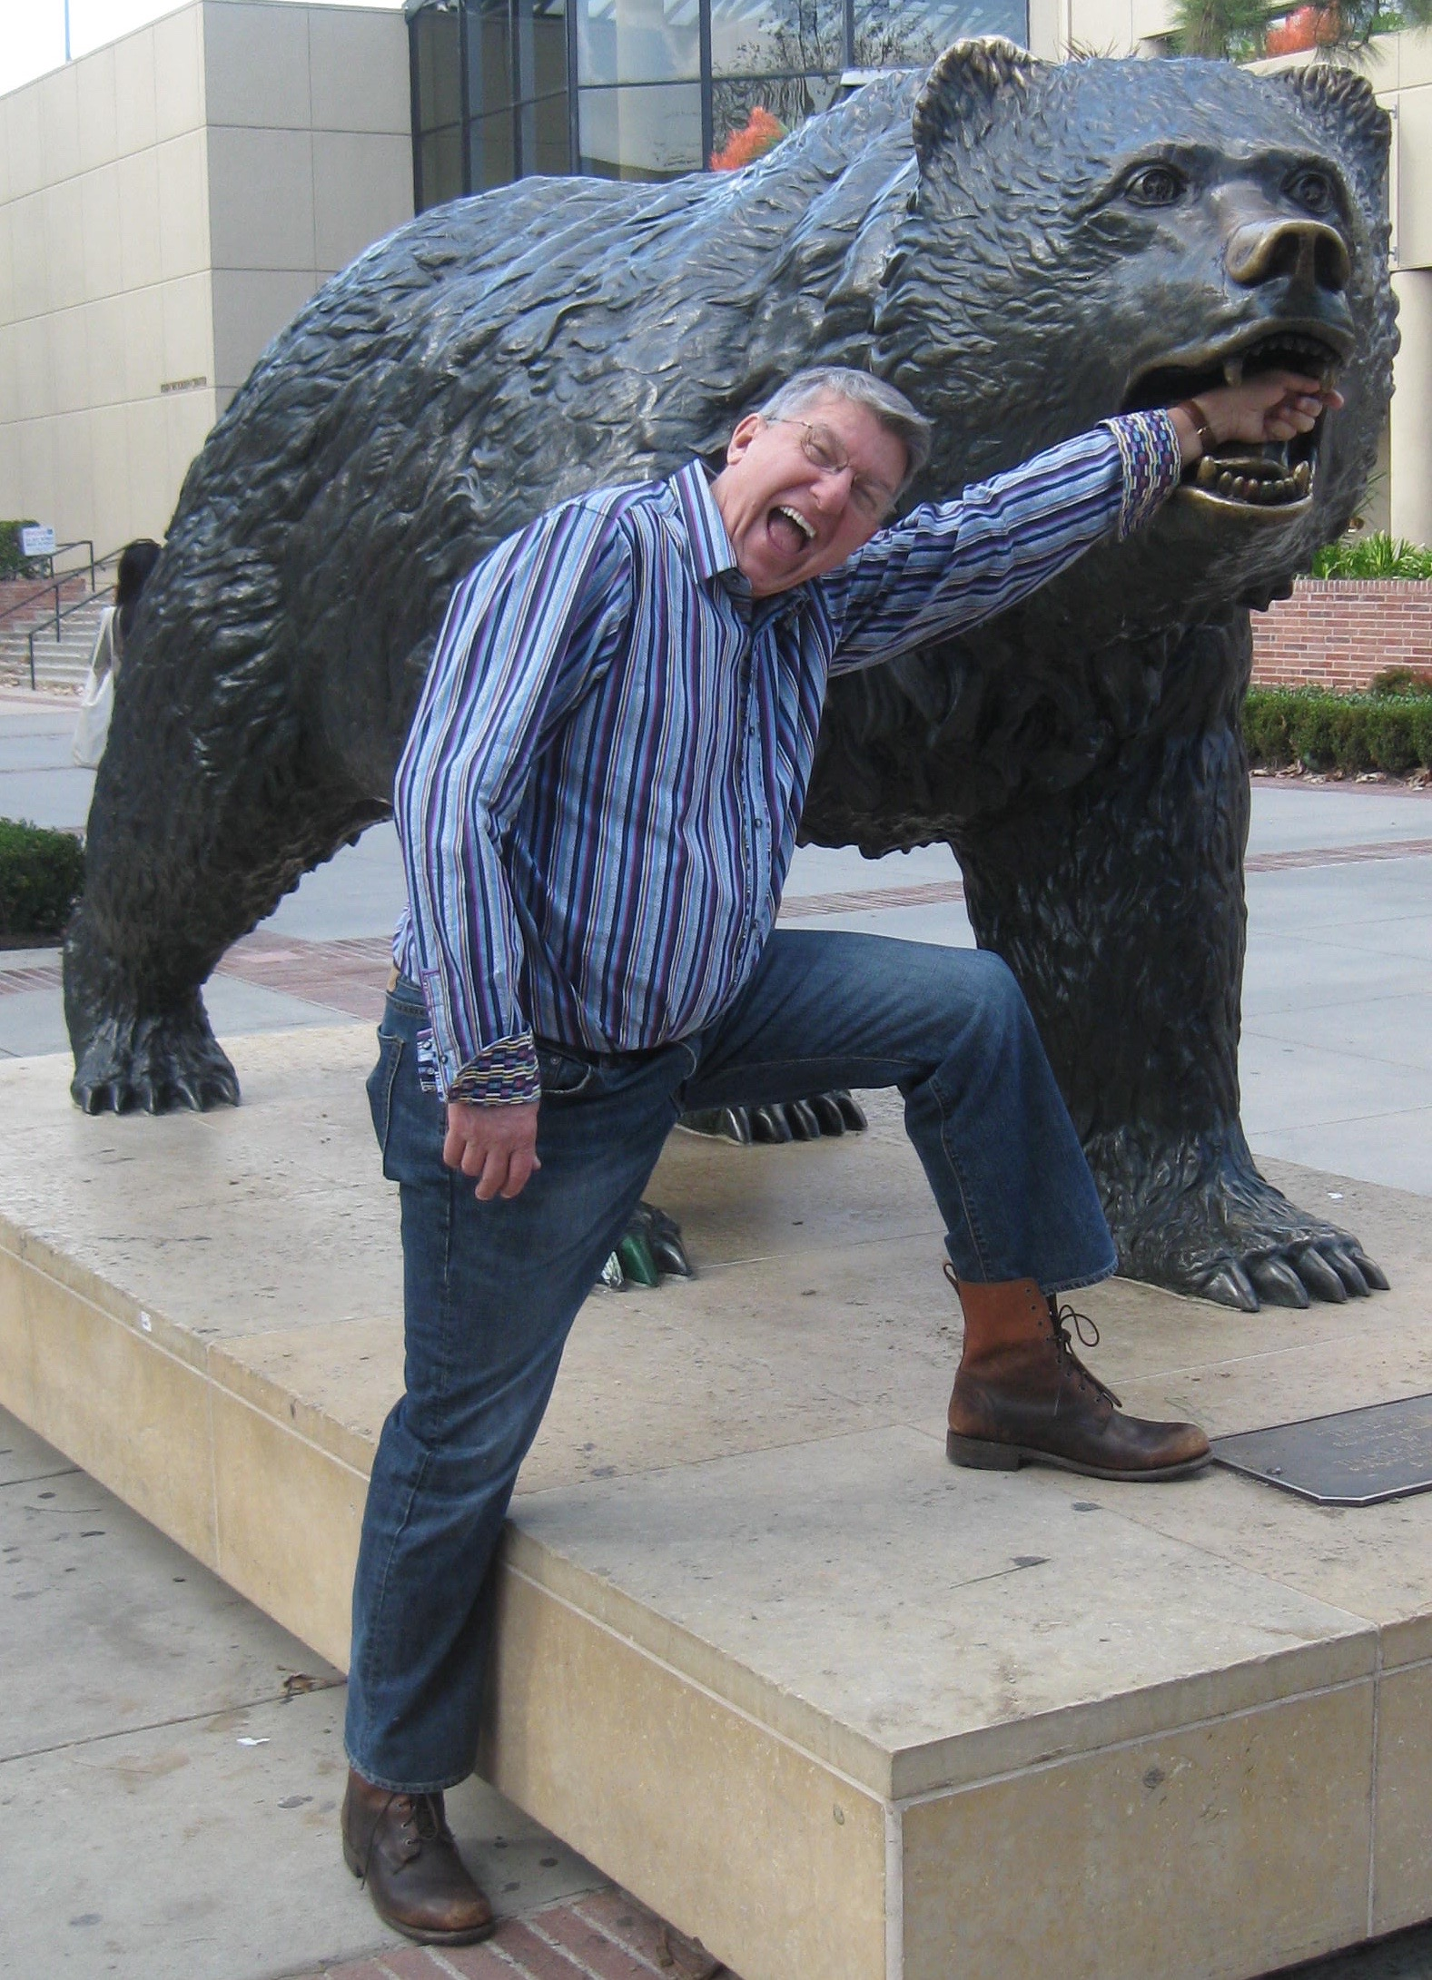

The May Effect
*Dollar has average a 3% gain over the
last seven Mays
Buy
Dollar (UUP)
US Treasury bonds (TLT)
Sell
Stocks (SPY), (QQQQ), (IWM)
Commodities (FCX)
Energy (USO), (UNG)
Yen (FXY), Euro (FXE), Aussie (FXA)
Junk Bonds (HYG)
Emerging Markets (EEM)

Slide 9
The Bill Davis View
A $1,500 Upgrade for the Mad Day Trader Service
Buys:
First Solar Inc. (FSLR) $50 Target to $59
Goldman Sachs (GS) $156 Target to $170
Rovi Corp (ROVI) $16 Target to $19
Tesla Motors (TSLA) $200 Target to $225
Lam Research (LRCX) $75 Target to $87
KLA-Tencor (KLAC) $60 Target to $72
Sells:
Baidu, Inc. (BIDU) $169 Target to $150
Chipotle Mexican (CMG) $469 Target to $406
Allergan plc (AGN) $240 Target to $210
Buffalo Wild Wings (BWLD) $144 Target to $130
Under Armour (UA) $41 Target to $37

Slide 10

The Global Economy-The Dollar Bites
*Europe had the top performing major economy in Q1, supporting the Euro
*US April ISM jumps from 54.5 to 55.7, factory orders up 1.1%, but the US data is mixed at best.
*Surprise 25 basis point cut by Reserve Bank of Australia underlies commodity dependence
*China flat line is allowing global stocks to hang on to recent big gains, recovery on the horizon?
*Japan still reeling from the “yen shock”
*Oil will peak out here, but don’t expect new lows
*Next to come is a “RISK ON” global
synchronized growth in H2 2016
now that the US Q1 mini recession is behind us

Slide 11
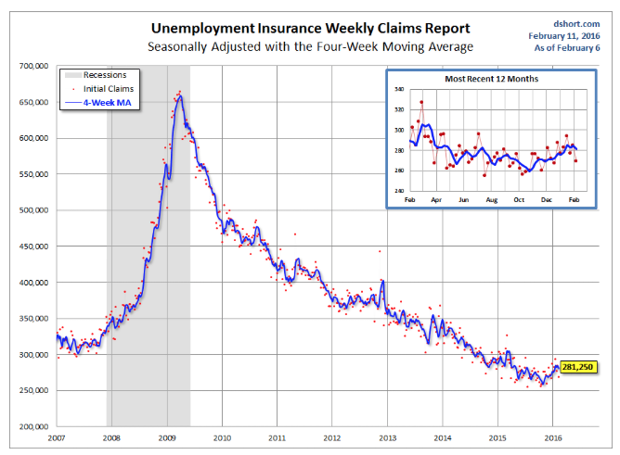
Weekly Jobless Claims –The Most Important Statistic
-13,000 to 247,000-Lowest since 1973!
The Downtrend Lives!-Show Me the Recession!

Slide 12

Bonds-A New Run at the Highs
*April nonfarm payroll demolishes a June Fed rate higher, the market is now looking at December at the earliest
*One good global “RISK OFF” move and bonds take a run at new all times highs in prices, lows in 10 year Treasury yields at 1.36%
*JGB’s hit a new record low of -0.13%, German bunds slump back down to 0.14%
*Emerging market debt gives up recent gains, thanks to strong dollar and weak oil and commodities
*Same with energy Junk
*Most investors and hedge fund are
on the wrong side of this trade,
giving it extra juice

Slide 13
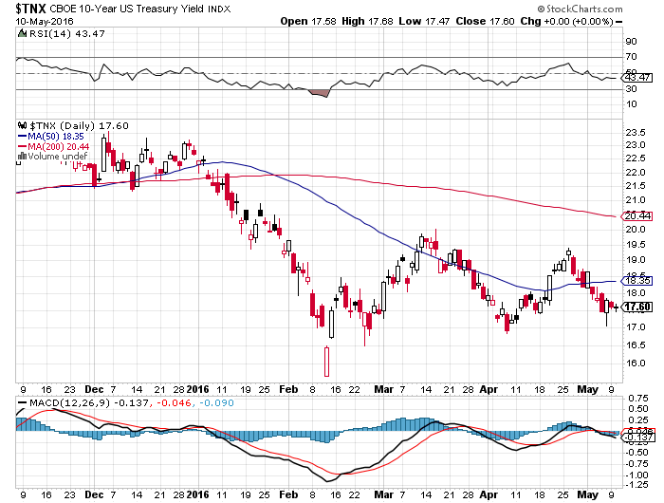
Ten Year Treasury Yield ($TNX) 1.76%
Trading the Range

Slide 14
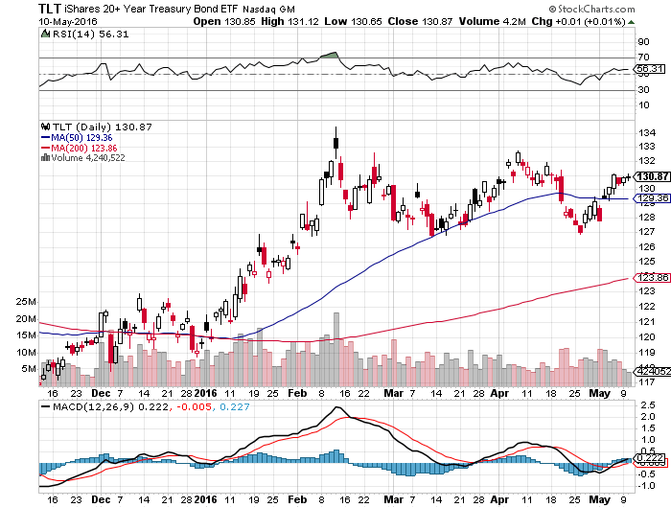
Ten Year Treasury ETF (TLT) 1.76%

Slide 15
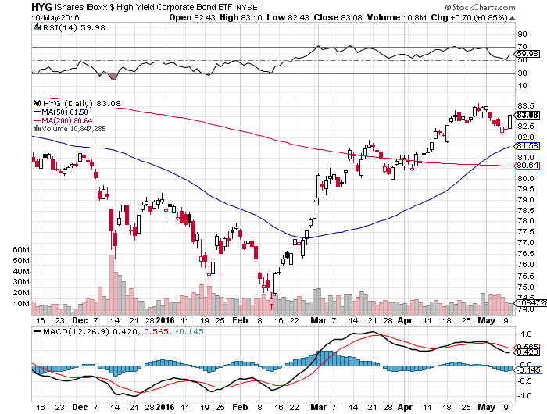
Junk Bonds (HYG) 6.65% Yield
A Great Risk Coincident Indicator

Slide 16
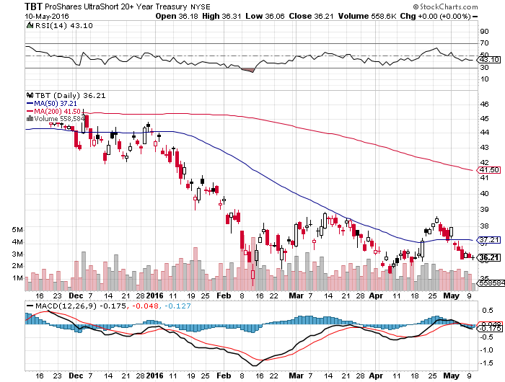
2X Short Treasuries (TBT)-Not Yet the Big Trade of 2016?
Back in “BUY” Territory

Slide 17
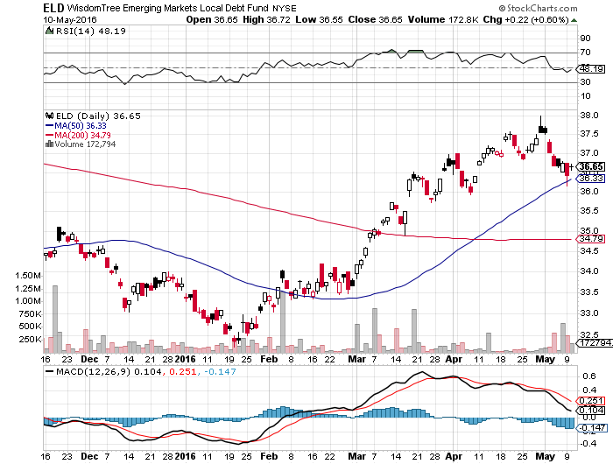
Emerging Market Debt (ELD) 6.00% Yield-

Slide 18
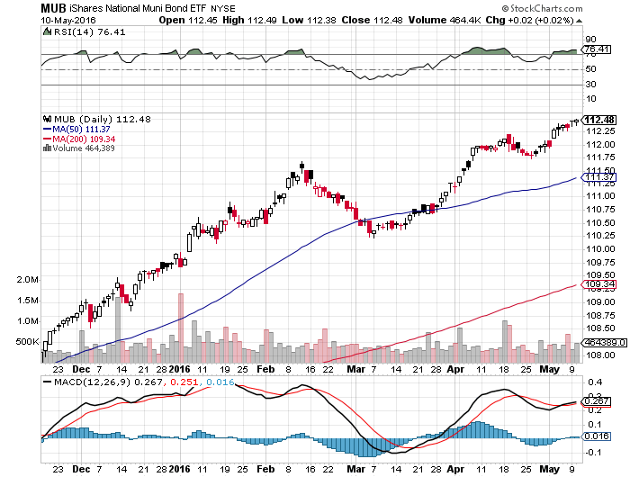
Municipal Bonds (MUB)-1.36% yield-New High
Mix of AAA, AA, and A rated bonds-flight to safety

Slide 19

Stocks-Altitude Sickness
*
Stocks at top of 2 year range with decade high valuations at a 19X multiple, with immediate risks to the downside. Do we hold at $2040, or retest $1,812? Rotation from growth to value stocks continues
*The “Narrowing Wedge” scenario is playing out, with a big triangle formation setting up over the next six months, with lower highs and higher lows between 1812 and 2012, earnings not there to move to new all time high
*Almost every company drastically cut forecasts, and then beat it on the announcement,
tech wrecks as the ATM effect kicks in
*Shorts are all gone now, but no one wants
to play on the long side
*The tech wreck is still on as the “ATM effect” kicks in
*How much stock do you want to buy ahead
of “Sell in May”? The calendar is hugely
against us for the next three months

Slide 20
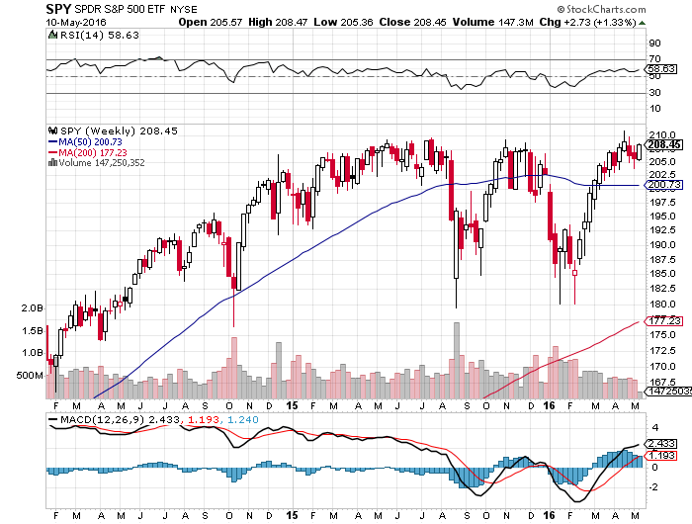
S&P 500- long 9/$109-$114, 9/$110-$110, 6/$112-$117 bear put spreads

Slide 21
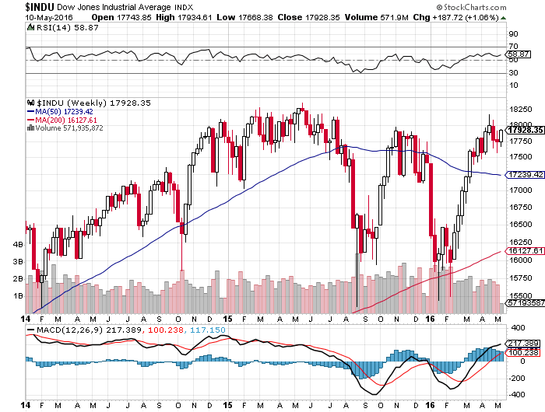
Dow Average-Topping Out Too

Slide 22
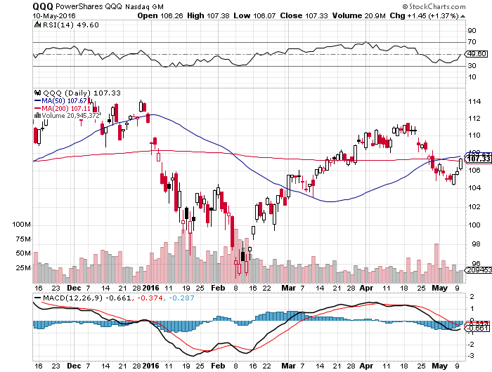
NASDAQ (QQQ)-

Slide 23
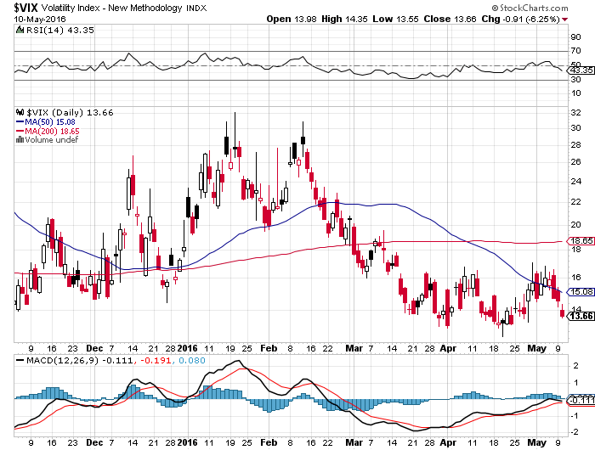
(VIX)-Back to the Bottom

Slide 24
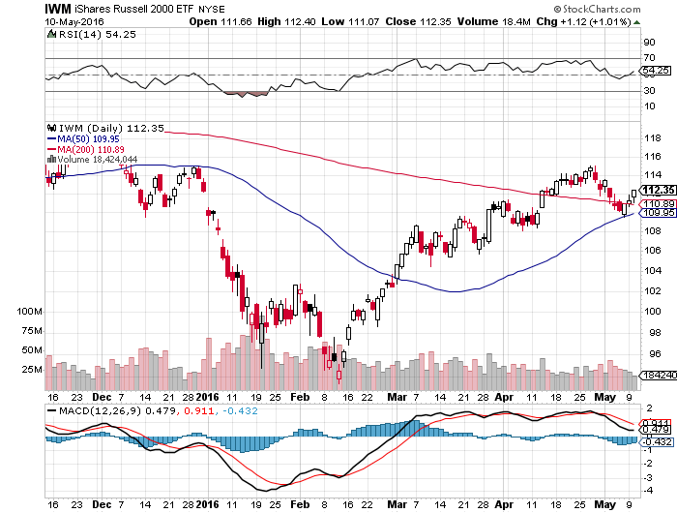
Russell 2000 (IWM)-Watch Carefully took profits on the $112-$117 vertical bear put spread

Slide 25
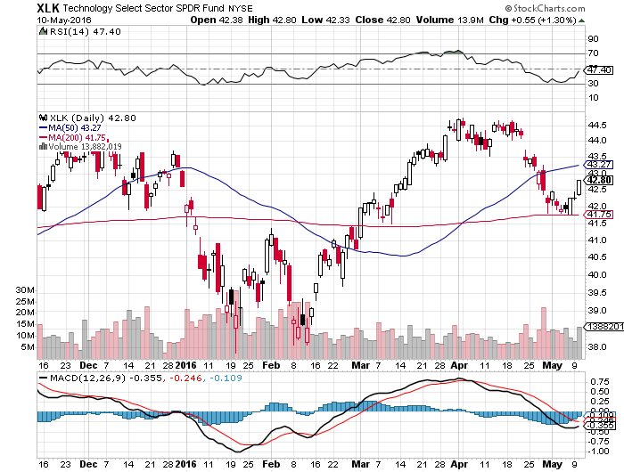
Technology Sector SPDR (XLK), (ROM)
(AAPL), (MSFT), (VZ), (T), (FB), (IBM)

Slide 26
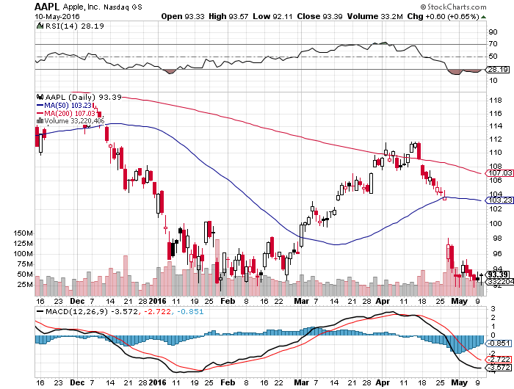
Apple (AAPL) –Buy the Dips
Back to waiting for the next real catalyst-the iPhone 7
Huge Q1 earnings disappointment, “risk off” could take us to the $80’s

Slide 27
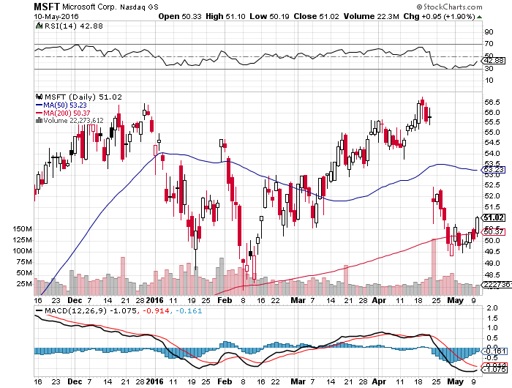
Microsoft (MSFT)
Disappointment creates an entry point

Slide 28
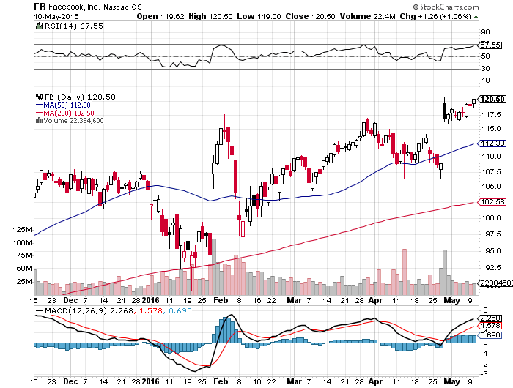
Facebook (FB)
Tech Wreck creates an entry point

Slide 29
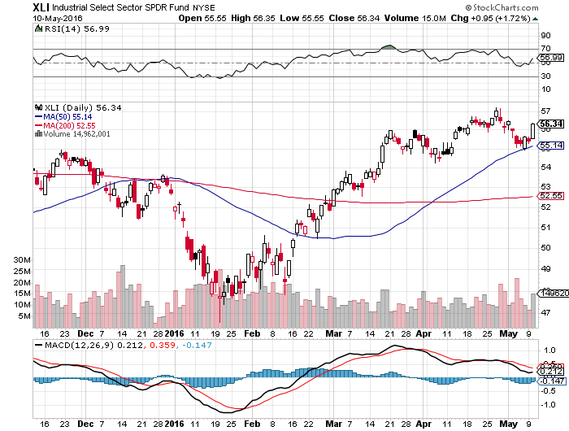
Industrials Sector SPDR (XLI)-Dow Mainstay
(GE), (MMM), (UNP), (UTX), (BA), (HON)

Slide 30
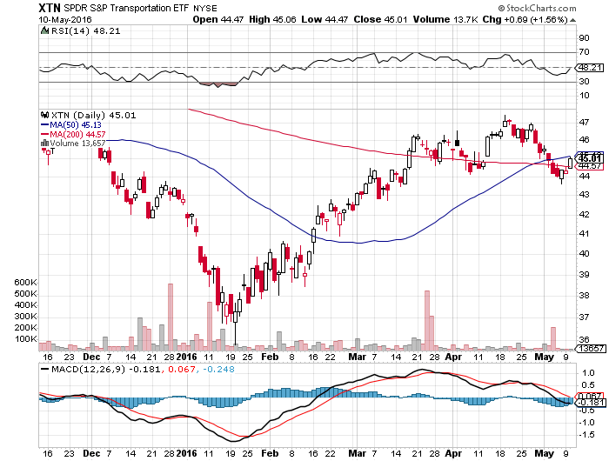
Transports Sector SPDR (XTN)-Another Dow Mainstay
(ALGT), (ALK), (JBLU), (LUV), (CHRW), (DAL),

Slide 31
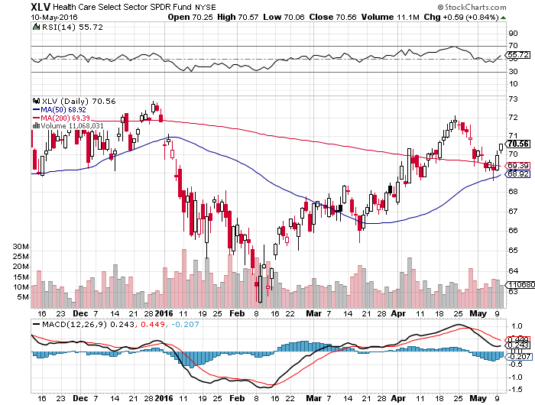
Health Care Sector SPDR (XLV), (RXL)
(JNJ), (PFE), (MRK), (GILD), (ACT), (AMGN)

Slide 32
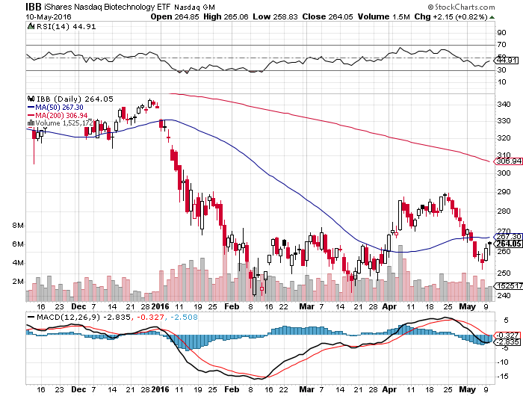
Biotech iShares (IBB)-A Political Football in 2016

Slide 33
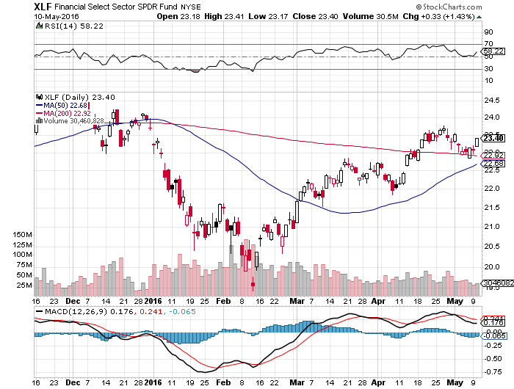
Financial Select SPDR (XLF)-JPM boost
(BLK/B), (WFC), (JPM), (BAC), (C), (GS)

Slide 34
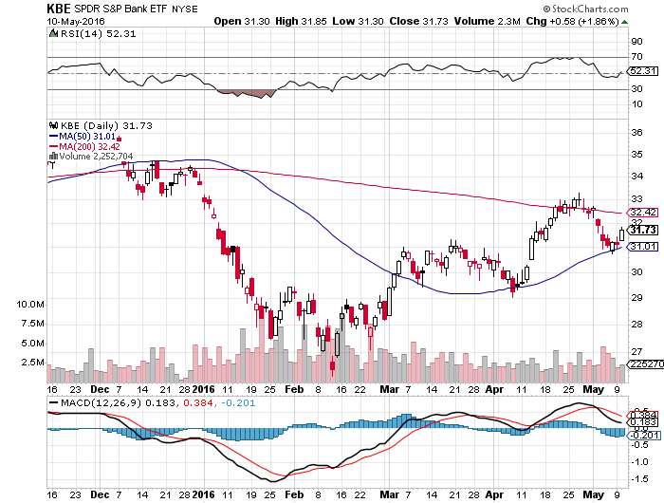
KBW Bank Index (KBE)-

Slide 35
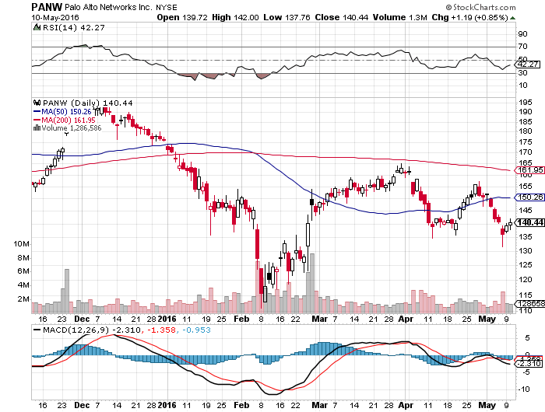
Palo Alto Networks (PANW)- another entry point setting up

Slide 36
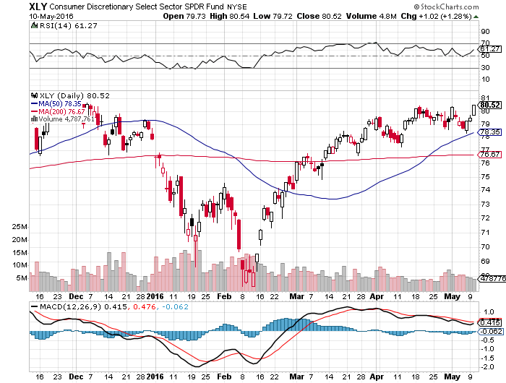
Consumer Discretionary SPDR (XLY)
(DIS), (AMZN), (HD), (CMCSA), (MCD), (SBUX)
A Major Leader of the Rally

Slide 37
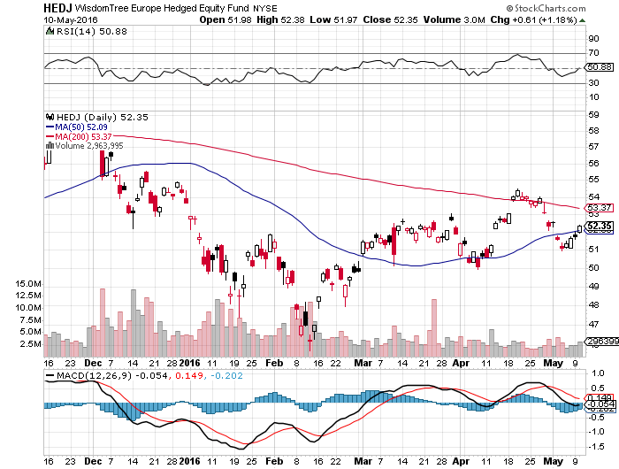
Europe Hedged Equity (HEDJ)-Hedged Japan Equity
Capped by strong euro and Brussels attack

Slide 38
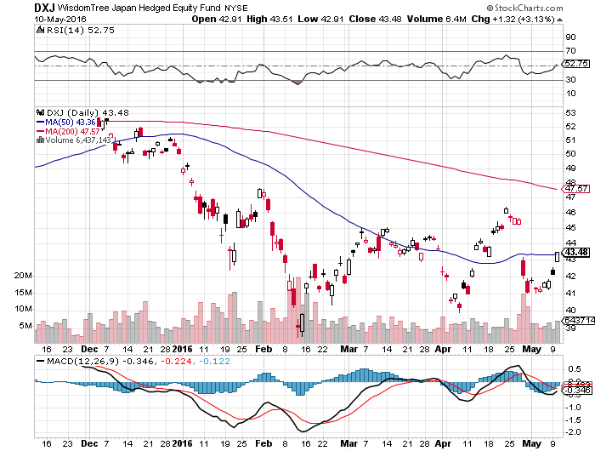
Japan (DXJ)-Hedged Japan Equity
Weak Yen Spike

Slide 39
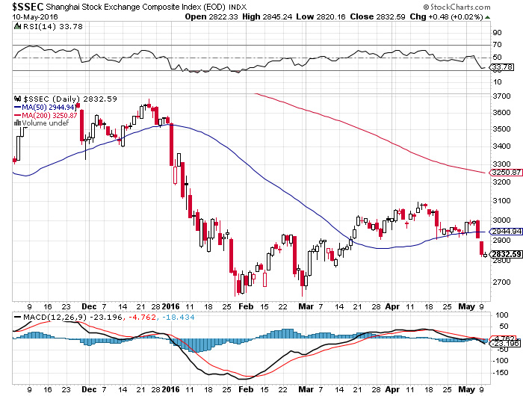
China ($SSEC)-
The Bad Boy Market and font of volatility

Slide 40
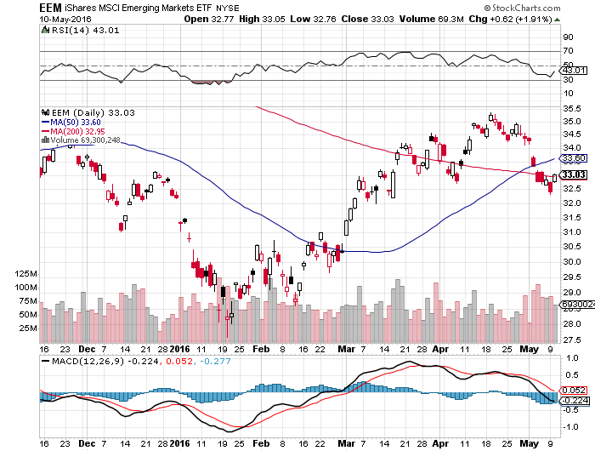
Emerging Markets (EEM)-
Oil is Dragging it Down

Slide 41

Foreign Currencies-Dollar Bounce
*Fed interest rate hike delay breathes new life into the greenback, causing most foreign currencies to peak out last week
*Japan crushes yen with “intervention” comments
*Strong yen is a function of short term CTA momentum traders, not capital flows or long term fundamentals
*RBA rate cut slaughters the Australian dollar
(FXA)
*”Brexit” failure ahead in the polls
42% to 43%, expect big (FXB) rally

Slide 42
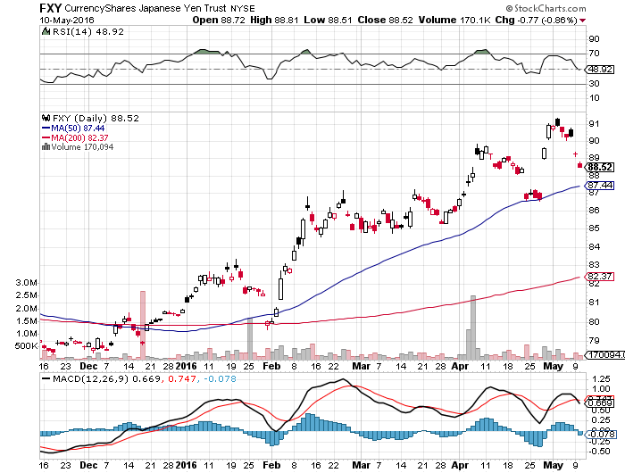
Japanese Yen (FXY)-Intervention! long 5/$94-$91 vertical bear put spread-7 days to expiration

Slide 43
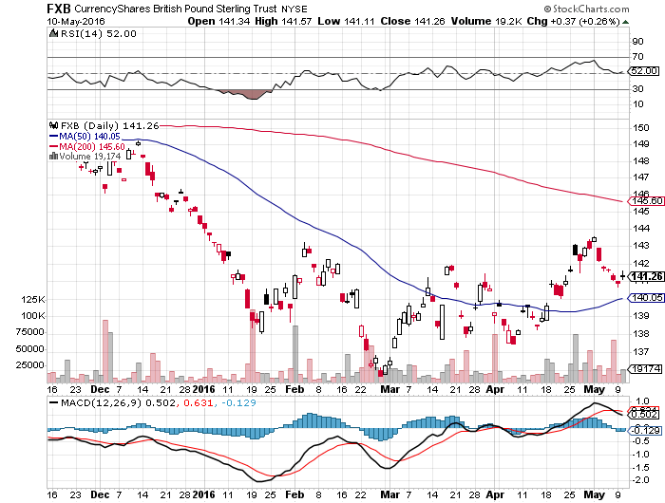
British Pound (FXB)- 6 More Weeks of Brexit Fears

Slide 44
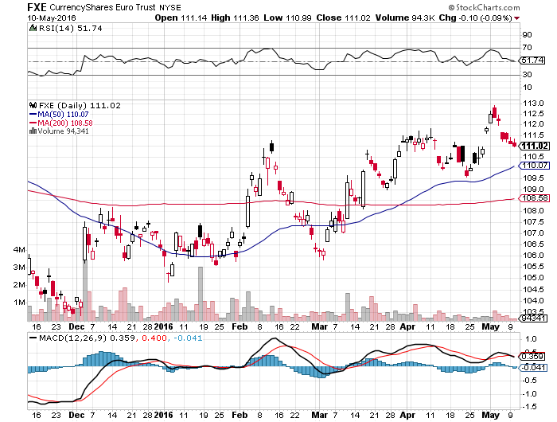
Euro ($XEU), (FXE), (EUO)- “Brexit” fears Dead Weight long 5/$113-$116 vertical bear put spread-7 days to expiration

Slide 45
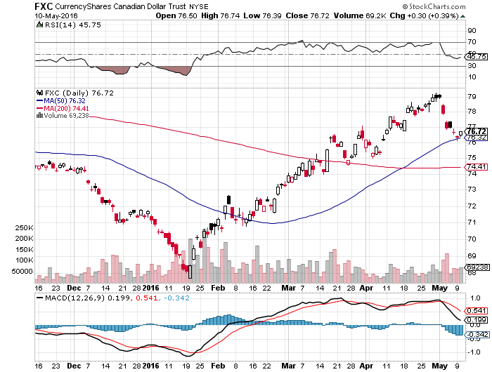
Canadian Dollar (FXC)-Strong Dollar and Alberta Fires Hurt

Slide 46
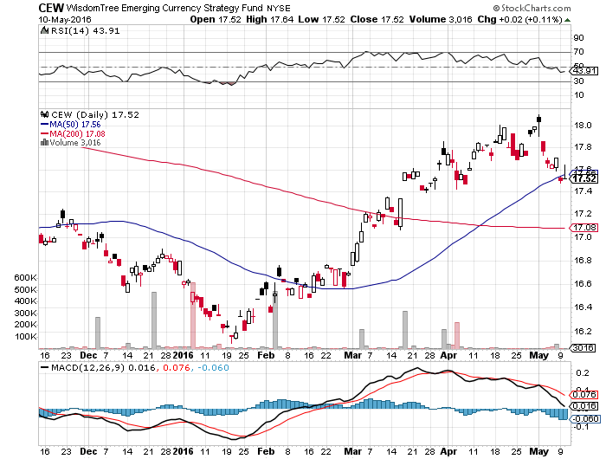
Emerging Market Currencies (CEW)

Slide 47
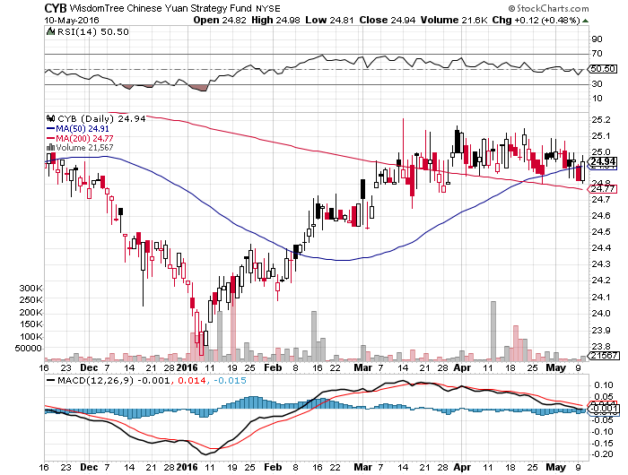
Chinese Yuan- (CYB)-Sell Rallies on Weakening Economy Rolling Over?

Slide 48

Energy-Taking a Break
*At 94 million barrels a day, the world is still producing 2 million b/d more than it needs
*Almost all of the buying of oil this year has been short covering
*Huge Alberta fires take 500,000 b/d in tar sands off line, but prices barely move
*Stronger US dollar weighing on short term trading, but look to a move $52 by yearend
*Iran ramps up production faster than anyone expected, but will soon me the limitations of its antiquated infrastructure
*Success against ISIS means more Iraq production is coming on stream too
*Rig count keeps falling down 11 to 332
*Venezuela is hovering on the brink,
possibly creating the next oil price spike,
Schlumberger pulls all its people
out because of nonpayment

Slide 49
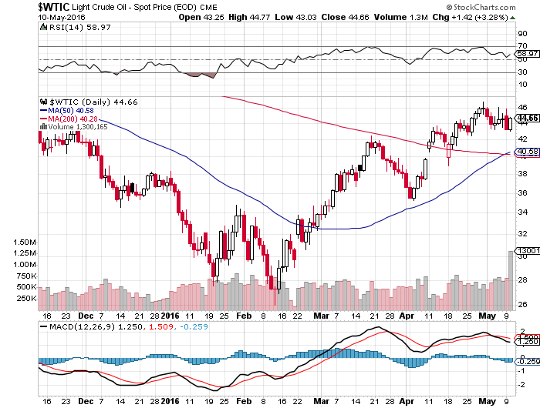
Oil-Topping Out

Slide 50
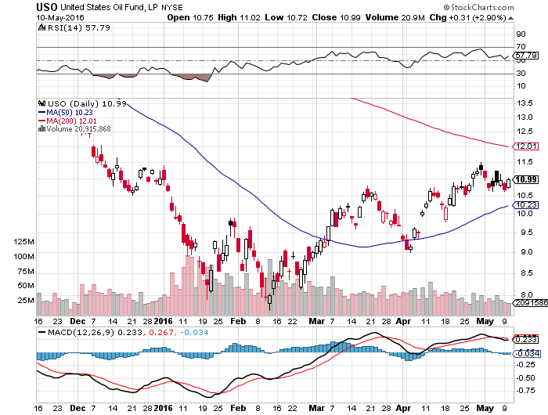
United States Oil Fund (USO) long 5/$$11.50-$12.50 vertical bear put spread

Slide 51
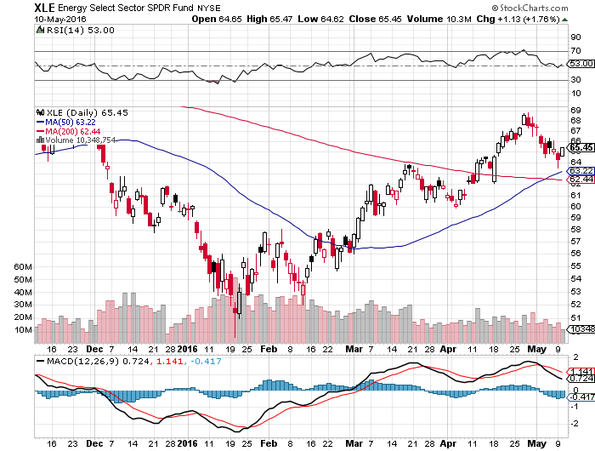
Energy Select Sector SPDR (XLE)
(XOM), (CVX), (SLB), (KMI), (EOG), (COP)

Slide 52
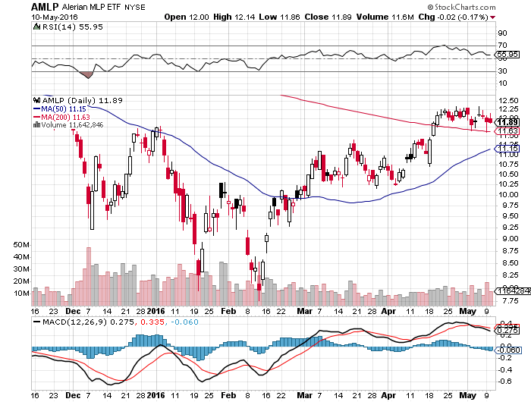
Alerian MLP ETF (AMLP)-9.08% Yield
Basket Approach is the Only Safe Play here

Slide 53
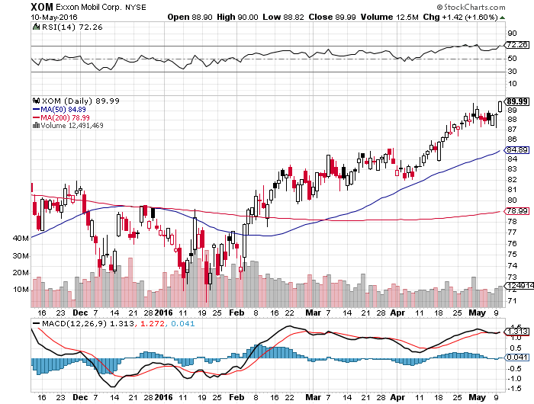
Exxon (XOM)-love that dividend!

Slide 54
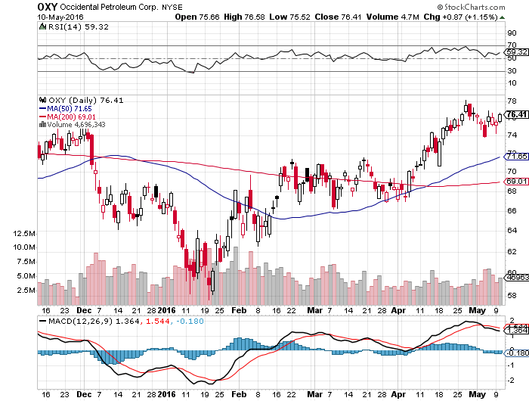
Occidental Petroleum (OXY)-

Slide 55
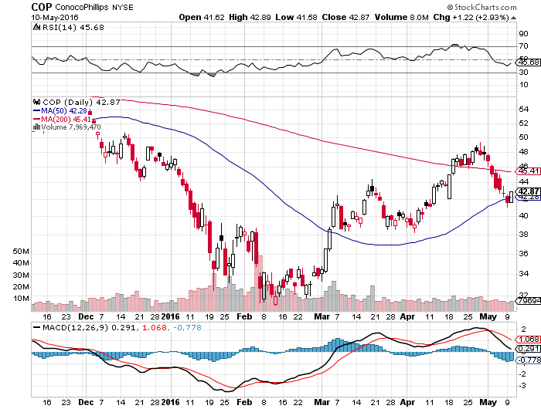
Conoco Phillips (COP)-The Buffet Favorite

Slide 56
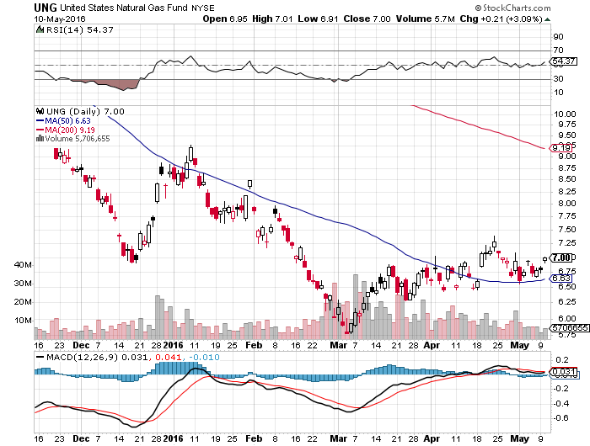
Natural Gas (UNG)-Headed for Negative Prices

Slide 57
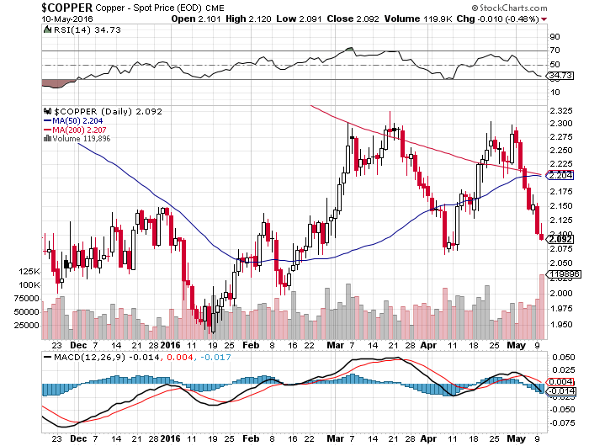
Copper-The Bottom is In

Slide 58
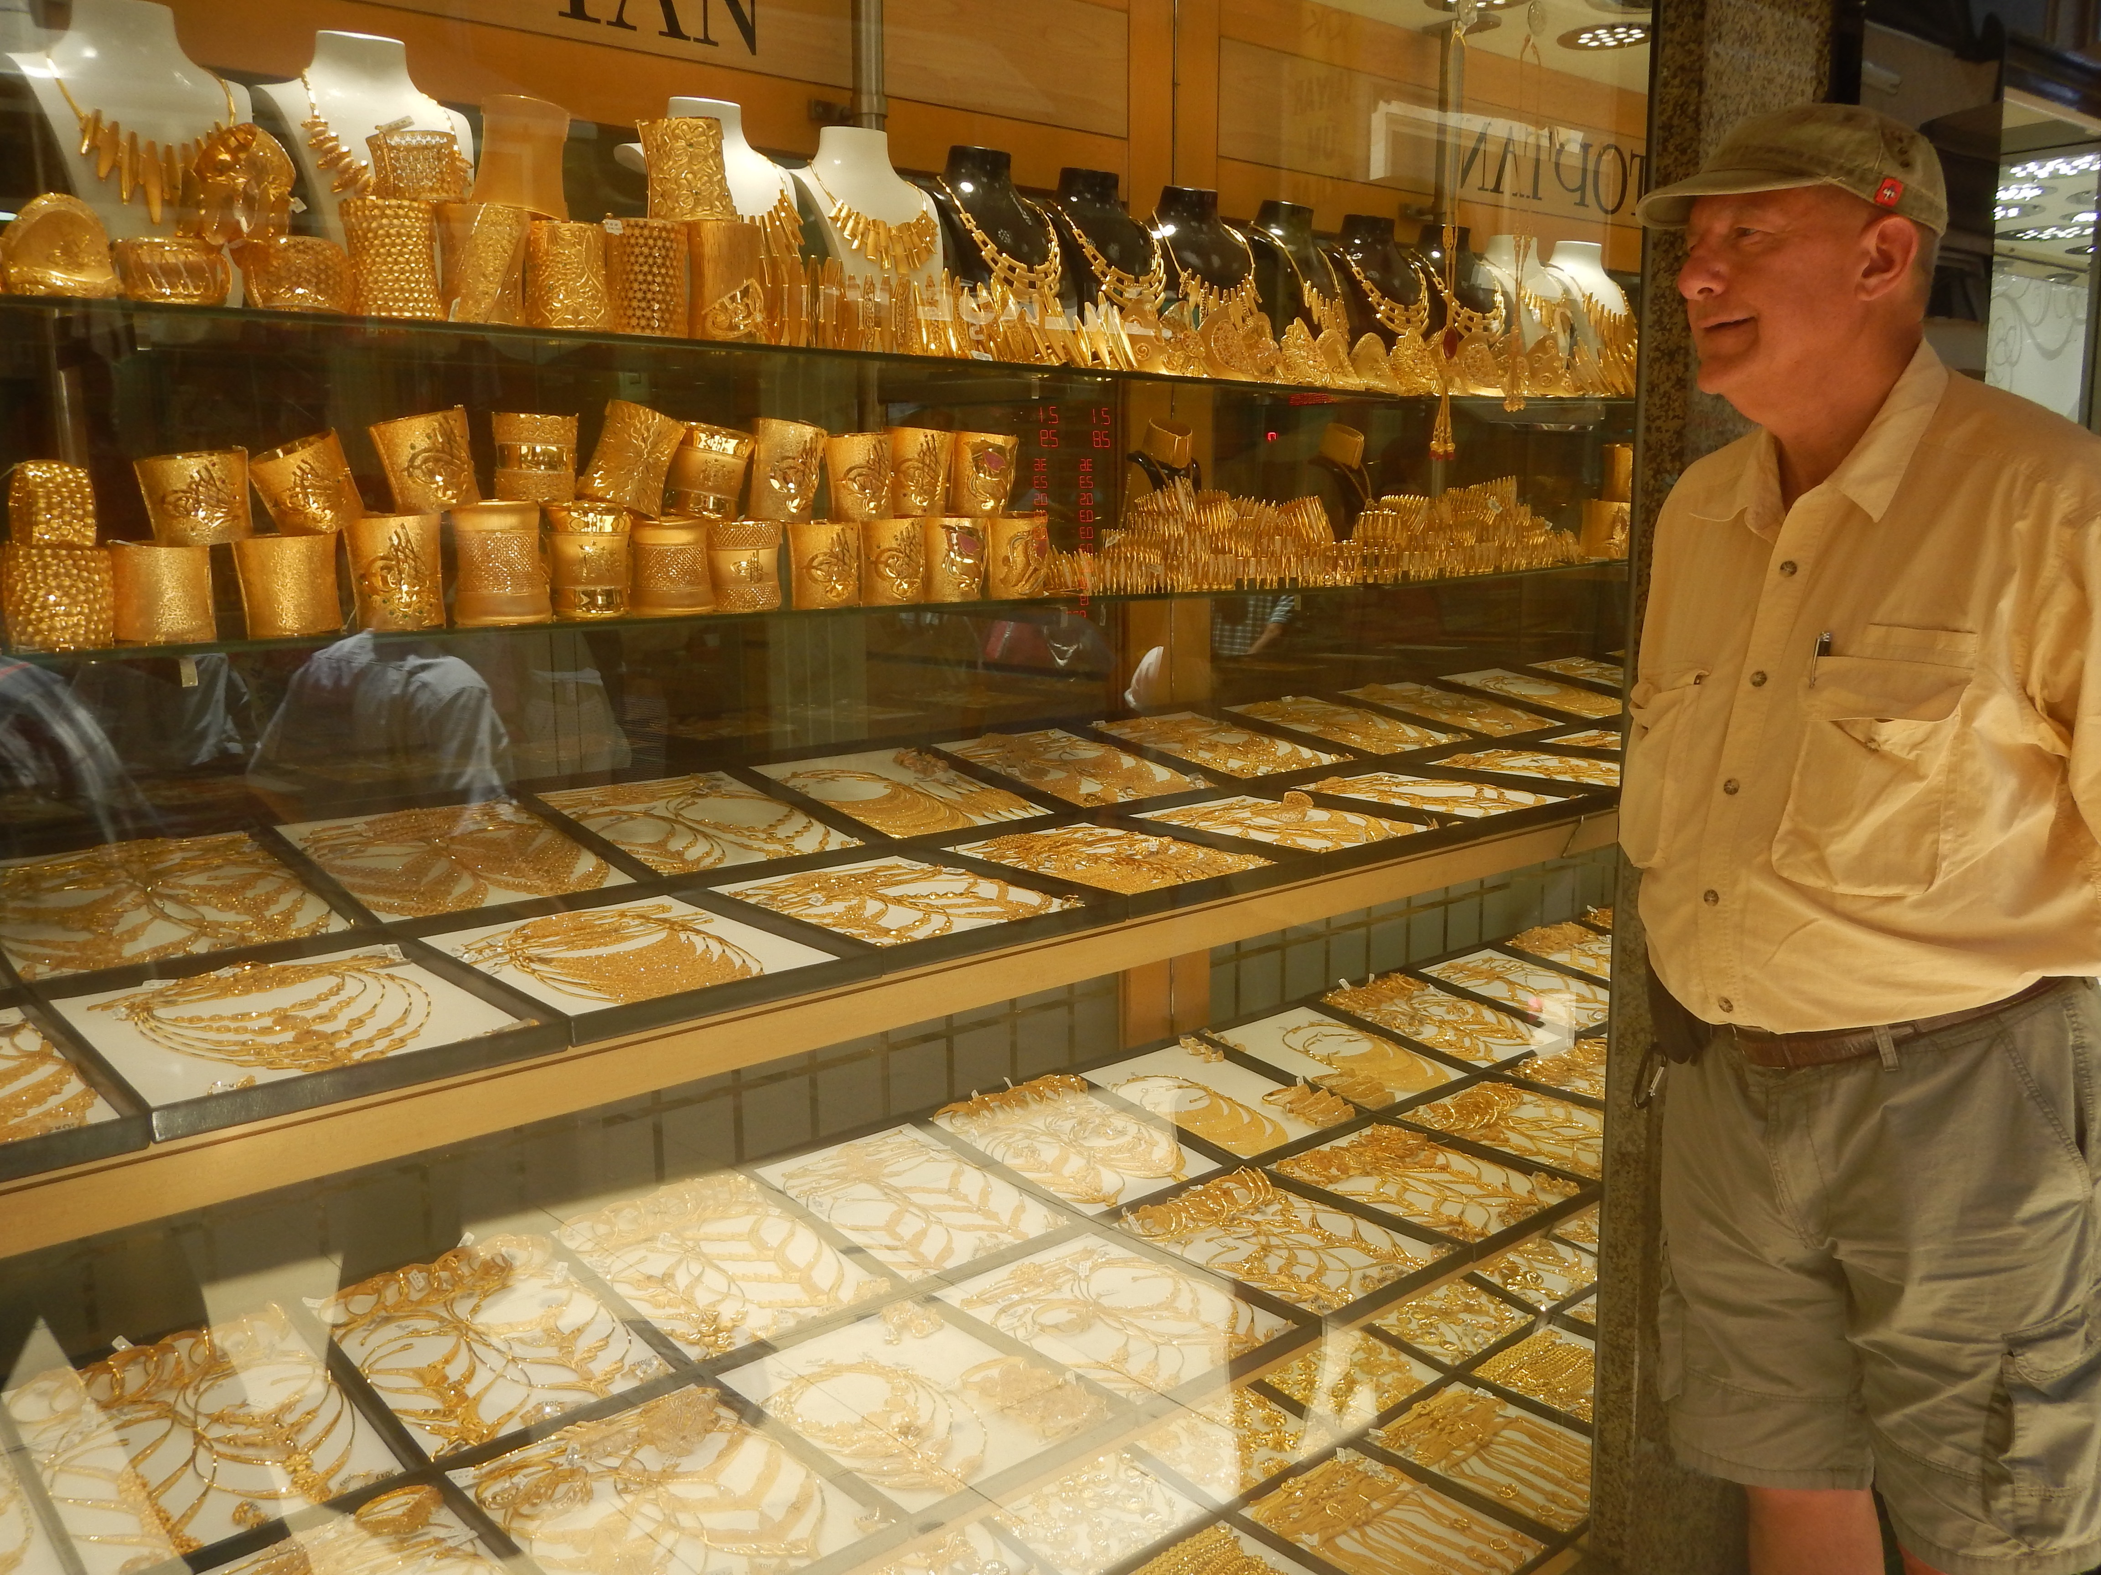
Precious Metals-The “RISK OFF” Assist
*After 2 ½ month consolidation, gold break out to the upside and now challenging upside resistance
*However, after the sharpest 90 day move in history, it is now the most overbought in history, trading risk is high, Spec positions now near highs, while volume has been falling, never a good sign
*Gold is the only asset class that does well in all market scenarios, up or down
*Negative interest rates giving gold a huge
boost, since it cost money to place deposits in
bank in Europe and Japan

Slide 59
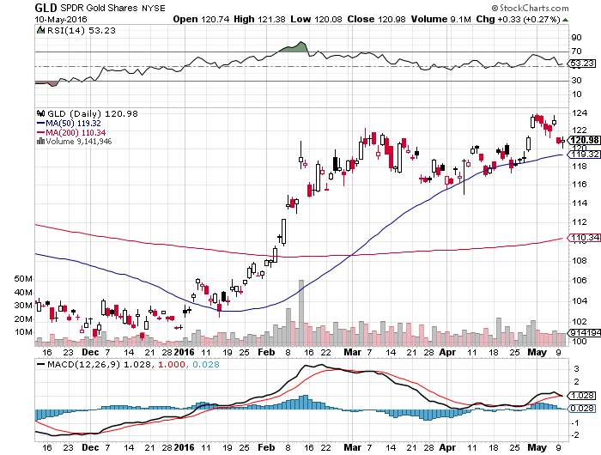
Gold (GLD)-Looking for a Dip took profits the 4/$109-$112 vertical bull call spread long 5/$115-$118 call spread-expires in 7 days

Slide 60
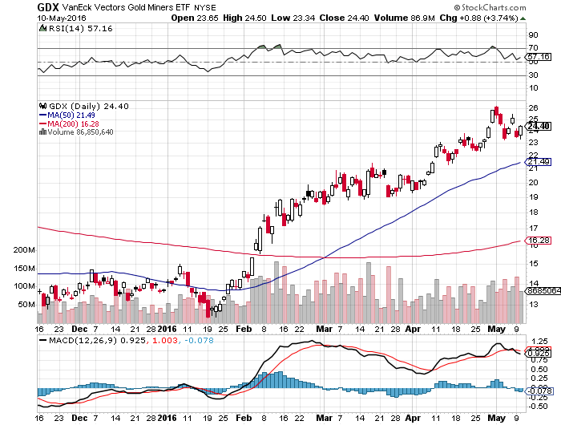
Market Vectors Gold Miners ETF- (GDX)

Slide 61
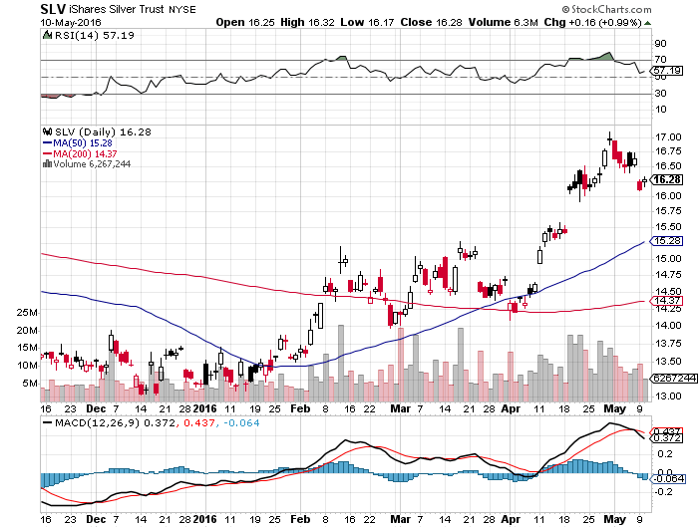
Silver (SLV)-

Slide 62
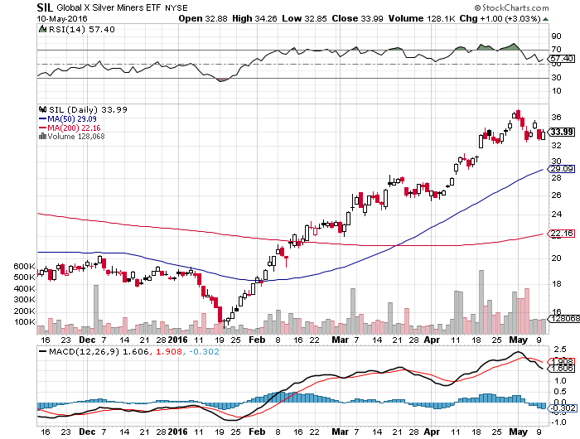
Silver Miners (SIL)-Finally Kicks In

Slide 63

Platinum (PPLT)-The Gold Effect

Slide 64

Palladium (PALL)-

Slide 65

Agriculture-From El Nino to La Nina
*USDA surveys point to new all time record crops in 2016
*Draught conditions in Brazil triggering monster short covering rally in the ags, which it quickly gives up, not good
*Good weather allows early US planting of corn, oats, and rice this year
*Recent weak dollar helping exports, but not enough
*Without surprise bad weather this is
going to be another awful year for the ags
*No trade, there are NO fish to fry
*My main job here is to keep traders
away from this sector this year

Slide 66

(CORN) – Killed!

Slide 67

(WEAT) That’s Gotta Leave a Bruise!

Slide 68

Ag Commodities ETF (DBA)-

Slide 69

Real Estate-Ticking Along
*New move lower focuses attention on real estate plays
*Weekly mortgage application down 3.4%, March pending home sales down -1.4%
*Subleasing rates are rising in San Francisco. Sign of a market top, or of companies taking out options on future growth in an incredibly tight market
*Rising prices, falling inventories, and still tough loan requirements still shutting first time buyers out of the market
*Extreme inventory shortage cutting into sales,
with only a 4.5 month supply, driving prices upward
*February Case Shiller S&P 500 National index
continues upward grind, January +5.4%

Slide 70

February S&P 500/Case–Shiller Home Price Index
+5.4% YOY, Seattle, Denver, Portland

Slide 71

US Home Construction Index (ITB)
(DHI), (LEN), (PHM), (TOL), (NVR)

Slide 72

Trade Sheet
So What Do We Do About All This?
*Stocks- sell rallies, buy the next big dip
*Bonds-look for another run at the highs
*Commodities-strong dollar triggers profit taking
*Currencies- sell yen and Euro in May
*Precious Metals –buy on dips
*Volatility-sell short spikes over $25, buy dips to $12
*The Ags –stand aside - avoid the disaster
*Real estate-buy the homebuilders LT

Slide 73

To buy lunch tickets, please go to www.madhedgefundtrader.com , click on “LUNCHES,” and then your desired country and city
Next Strategy Webinar
12:00 EST Wednesday,
May 25, 2016
San Francisco, CA
USA!
Good Luck and Good Trading!
Notes:
*

