Slide 1

The Mad Hedge Fund Trader
“Here Comes the Next Flip Flop”
With John Thomas
from San Francisco, CA, May 25, 2016
www.madhedgefundtrader.com
Notes:
*

Slide 2
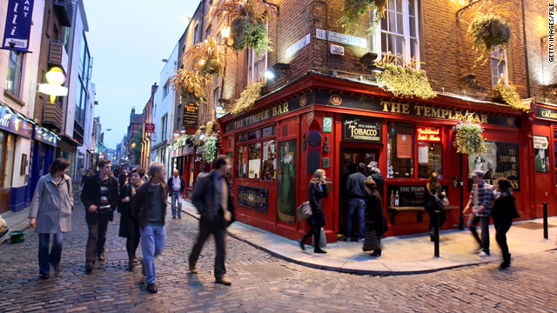
MHFT Global Strategy Luncheons
Buy tickets at www.madhedgefundtrader.com
London, England
June 20
Dublin, Ireland
June 29

Slide 3
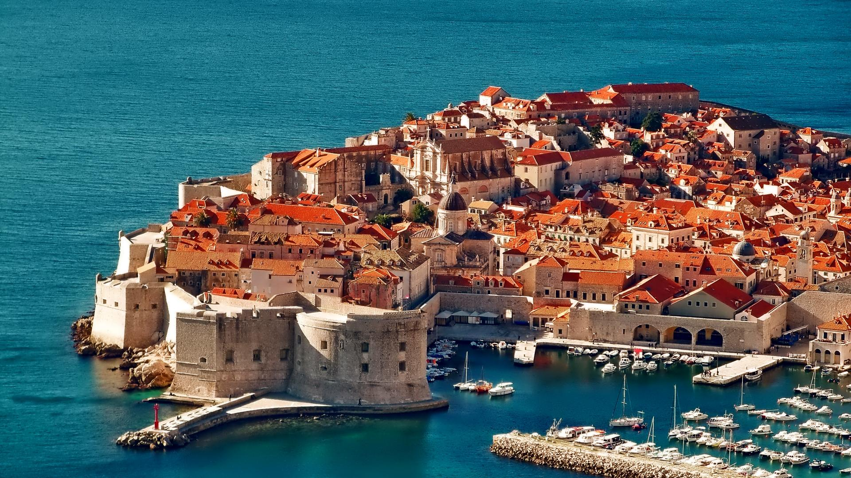
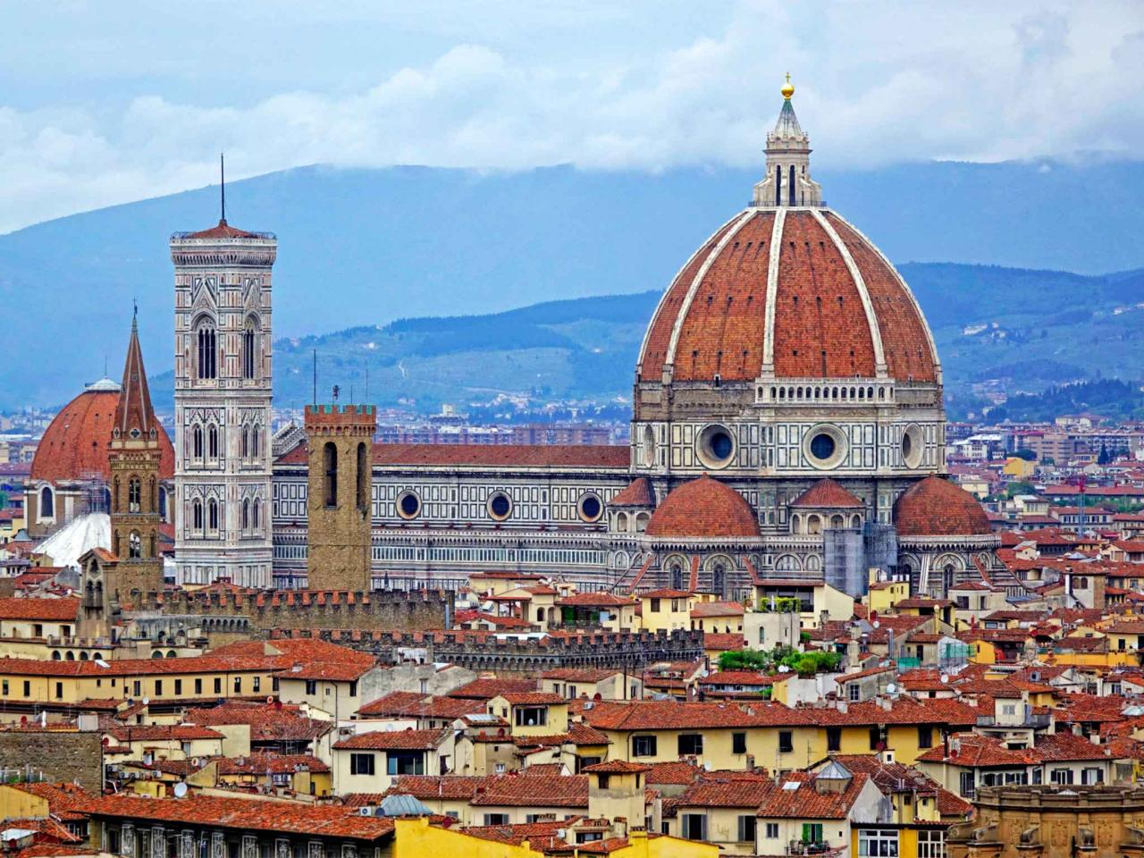
MHFT Global Strategy Luncheons
Buy tickets at www.madhedgefundtrader.com
Dubrovnik, Croatia
July 7
Florence, Italy
July 11

Slide 4
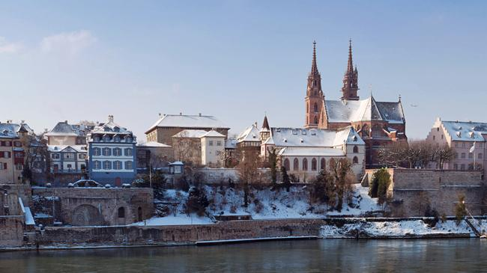
MHFT Global Strategy Luncheons
Buy tickets at www.madhedgefundtrader.com
Zermatt, Switzerland
July 22
Basel, Switzerland
July 27

Slide 5

Trade Alert Performance
Making Big Profits in Dire Market Conditions
*January +1.23% Final *July +6.42% Final
*February +4.50% FINAL *August +1.27% Final
*March -2.42% Final *September +11.99% Final
*April -2.10% FINAL *October Final -6.19%
*May +8.92% MTD *November MTD 5.78%
*June +3.68% Final *December -4.94%
*2016 Year to Date +10.14%
compared to 0.50% for the Dow Average
*Trailing 1 year return +25.80%, +201.81 since inception,
a new all time high all-time high
*Average annualized return of 37.25%

Slide 6
Portfolio Review
Running a Large Aggressive Short Dated Book
on a strong dollar move
current capital at risk
Risk On
World is Getting Better
Risk Off
World is Getting Worse
(FXY) 6/$91-$94 put spread | -10.00%
(TLT) 6/$124-$127 call spread | -10.00%
(SPY) 6/$210-$215 put spread | -10.00%
(SPY) 6/$212-$217 put spread | -10.00%
total net position | -40.00%
Expiration P&L
10.90% YTD

Slide 7

The Method to My Madness
Running small book in an overbought market, waiting to jump on the next meltdown
*In May, I made a big bet that a strong dollar would drive all trades and I won.
*Then markets became irrational, and I gave a chunk back
*In June, I’m betting that the Fed will flip flop again, and reverse its latest tightening statement
*That means running a flat, or “RISK OFF” book into June 17
*Rate rise prospect scared me out of gold for a month
*Use the tech and biotech wrecks to get into good
long term positions over the summer

Slide 8
Paid Subscriber Trailing 12 Month Audited Return +25.80%

Slide 9
65 Months Since Inception
Daily Audited Performance
Averaged annualized return +37.25%

Slide 10

Short Term Strategy Outlook-Strong Dollar
*European rally triggers another short squeeze, but it’s not sustainable
*Dollar looks to stay strong through May, short all weak dollar plays, including stock, commodities, energy, and foreign currencies
*Dollar has averaged a 3% gain for the last seven Mays on international trade flows
*Oil bottom at $26 looking rock solid, $60 by yearend is now on the table
*US stocks have now defined the 2016 wedge formation between (SPX) 1812 and 2010, will take 3 for a true upside breakout
*Despite the Fed shock, bonds trading a range at a very high level,
setting up a wedge for a December rate hike
*Rate rise chance takes gold off the table
*Disastrous USDA report bring another Ag selloff

Slide 11
The Bill Davis View
A $1,500 Upgrade for the Mad Day Trader Service
Buys:
Priceline (PCLN) $1,265 Target to $1,375
Facebook (FB) $106 Target to $125
Vertex Pharm (VRTX) $87 Target to $110
Microsoft (MSFT) $52 Target to $58
Amazon.com (AMZN) $700 Target to $740
Quest Diagnostics (DGX) $75 Target to $85
Sells:
Chipotle Mexican (CMG) $500 Target to $375
Fosl Group (FOSL) $35 Target to $25
Humana, Inc (HUM) $180 Target to $162
Allergan plc (AGN) $240 Target to $210
Buffalo Wild Wings (BWLD) $144 Target to $130
Deere & Co. (DE) $81 Target to $74

Slide 12
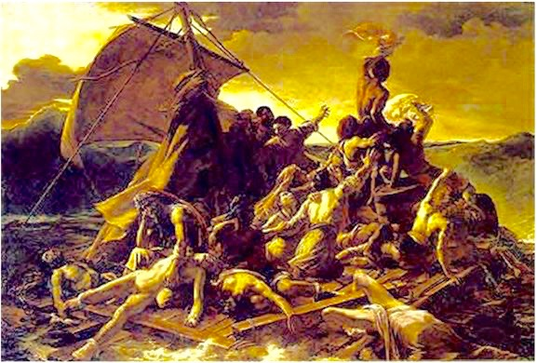
The Global Economy-Choppy
*Hints of June Fed rate rise suggest that the US economy may be stronger than we realize
*German GDP sees strongest growth in 2 years, from 0.3% to 0.7%, Europe had the top performing major economy in Q1, supporting the Euro
*US April Retail Sales pops 1.3%, much better than expected, PPI first gain in three months
*New commodity weakness undermines Australia
*No news from China is good news
*Falling yen brings Japan back to life
*Oil stalling here, but pain trade is still to
the upside
*Next to come is a “RISK ON” global
synchronized growth in H2 2016
now that the US Q1 mini recession is behind us

Slide 13
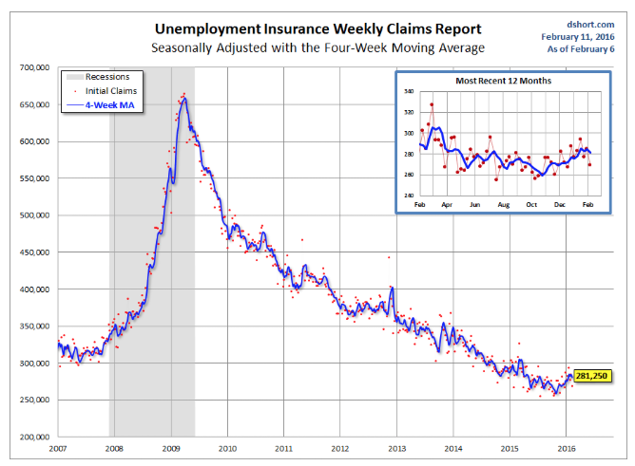
Weekly Jobless Claims –The Most Important Statistic
-16,000 to 278,000-Lowest since 1973!
The Downtrend Lives!-Show Me the Recession!

Slide 14

Bonds-Fed Shock
*April Fed minutes chop 3.5 points on bonds quickly, then hold
*One good global “RISK OFF” move and bonds take a run at new all times highs in prices, lows in 10 year Treasury yields at 1.36%
*JGB’s rally to -0.11%, German bunds to 0.18%
*Emerging market debt gives up recent gains, thanks to strong dollar and weak oil and commodities
*”RISK ON” takes junk bonds
(HYG) up to new highs

Slide 15
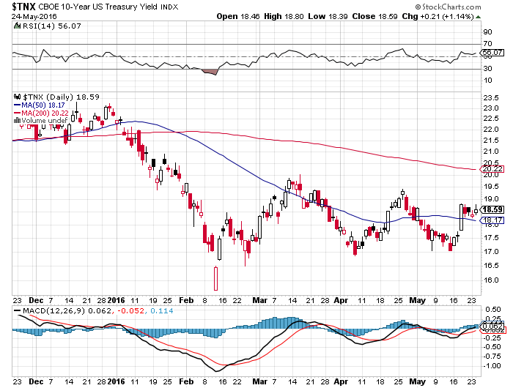
Ten Year Treasury Yield ($TNX) 1.86%
Trading the Range

Slide 16
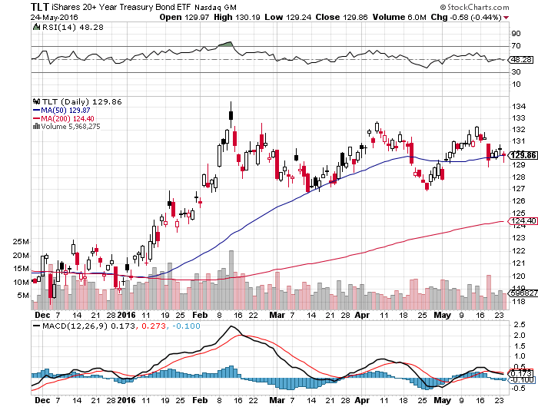
Ten Year Treasury ETF (TLT) 1.76% long 6/$124-$127 vertical bull call spread

Slide 17
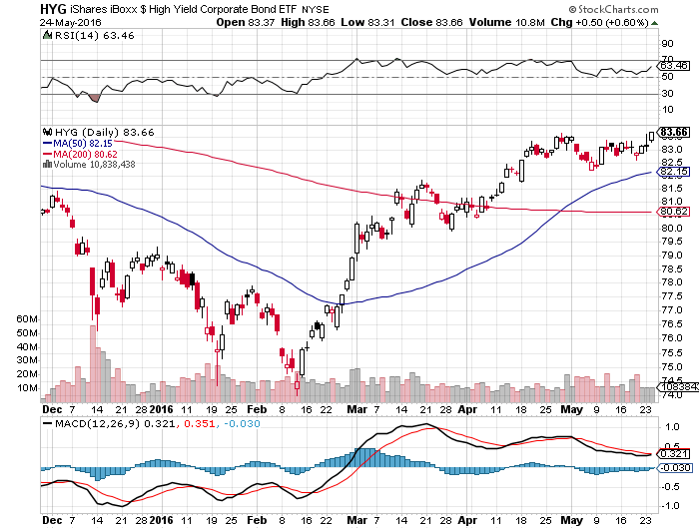
Junk Bonds (HYG) 6.68% Yield
A Great Risk Coincident Indicator-”RISK ON” means new highs

Slide 18
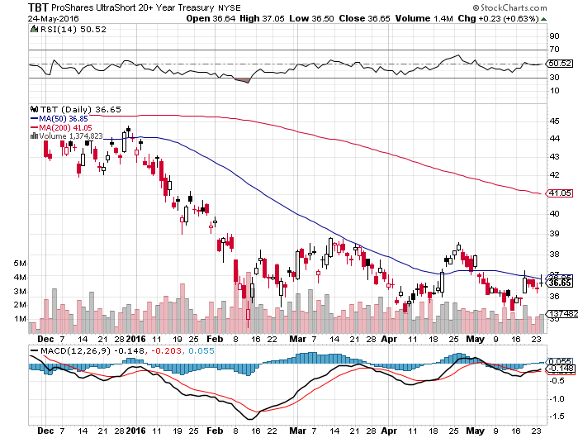
2X Short Treasuries (TBT)-Not Yet the Big Trade of 2016?
Back in “BUY” Territory

Slide 19
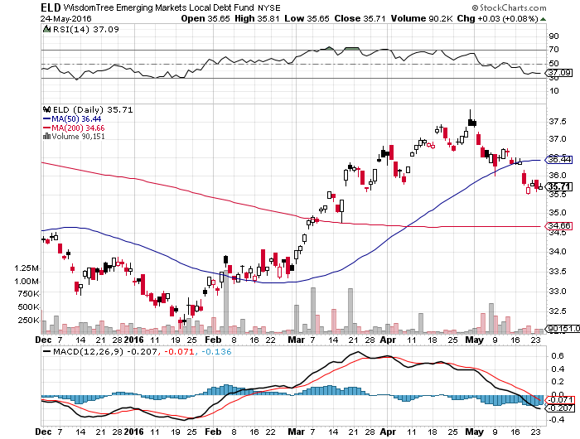
Emerging Market Debt (ELD) 5.81% Yield- strong dollar woes

Slide 20
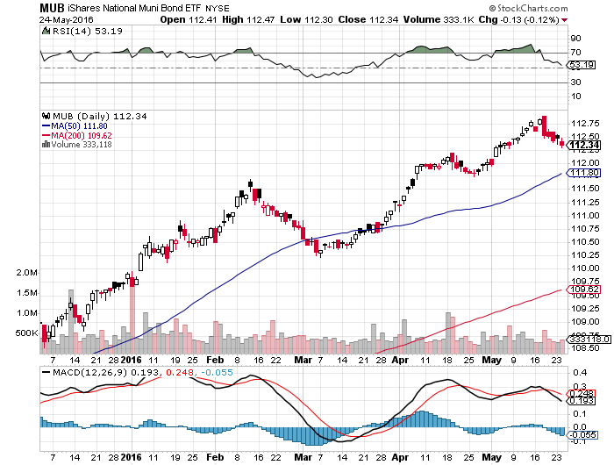
Municipal Bonds (MUB)-1.31% yield-New High
Mix of AAA, AA, and A rated bonds-flight to safety

Slide 21

Stocks-Limited Upside
*European rally on fading “Brexit”, strong new home sales, big M&A deals, and failure to crash all conspire to produce a monster rally
*But with stocks at top of 2 year range with decade high valuations at a 19X multiple, the upside is limited, and $2012 will hold. Rotation from growth to value stocks continues
*When the dollar is strong, and you must buy stocks, you buy small caps (IWM)
*Shorts are all gone now, but no one wants
to play on the long side
*Hot money rushes back into tech
as losing hedge funds desperately
chase performance
*How much stock do you want to buy ahead
of “Sell in May”? The calendar is hugely
against us for the next three months

Slide 22
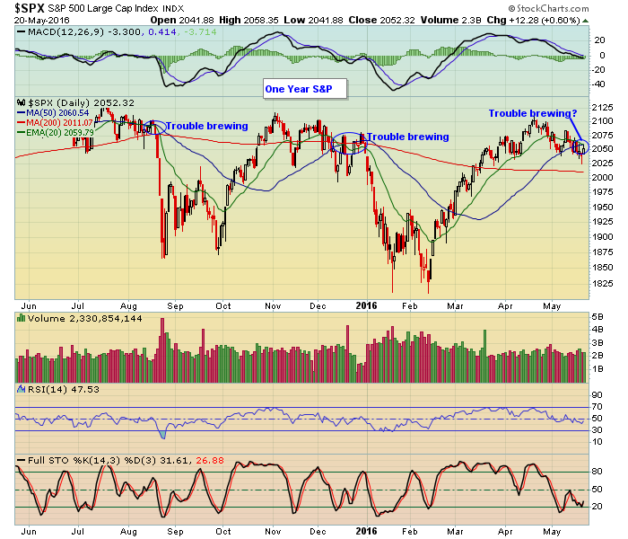
S&P 500- long 6/$210-$215, 6/$212-$217 bear put spreads-16 days to expiration

Slide 23
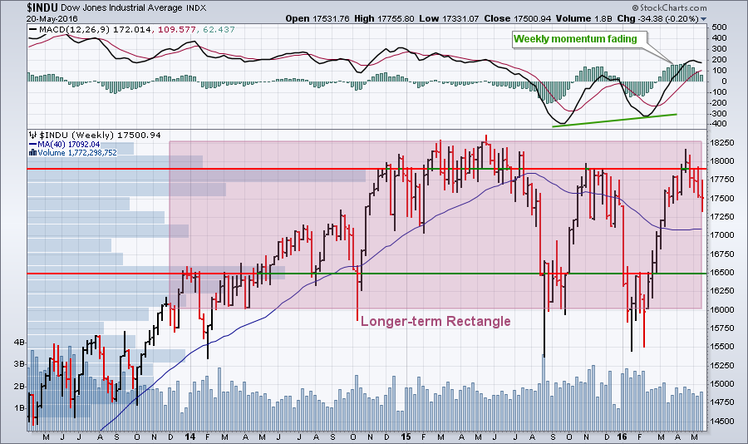
Dow Average-Topping Out Too

Slide 24
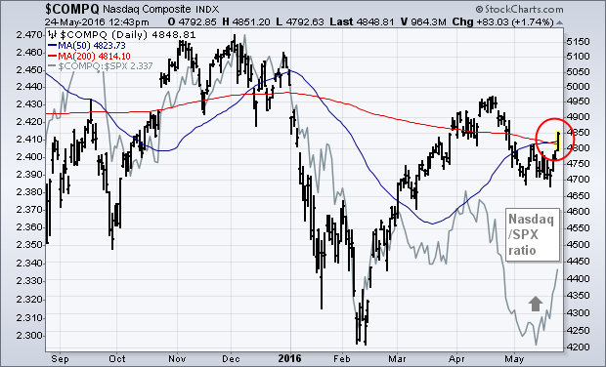
NASDAQ (QQQ)-

Slide 25
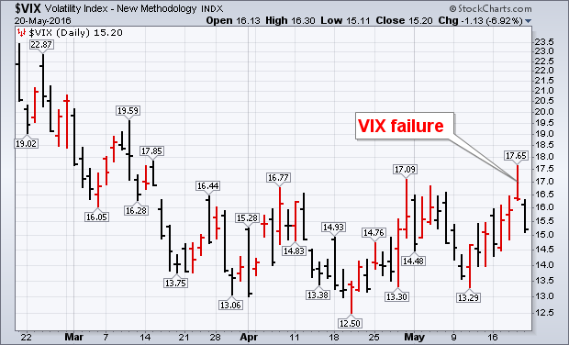
(VIX)-Back to the Bottom

Slide 26
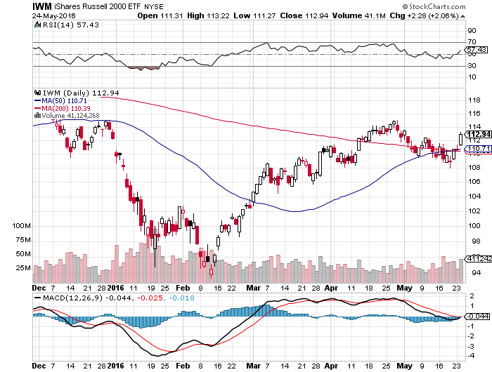
Russell 2000 (IWM)-So Close, Yet So Far stopped out of long the 6/$114-$117 vertical bear put spread

Slide 27
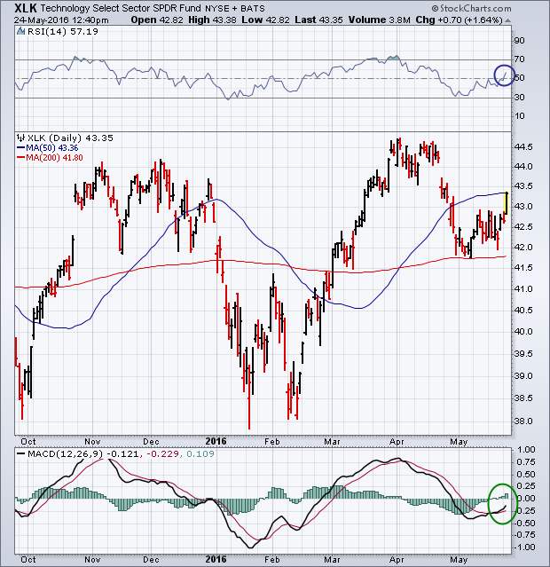
Technology Sector SPDR (XLK), (ROM)
(AAPL), (MSFT), (VZ), (T), (FB), (IBM)

Slide 28
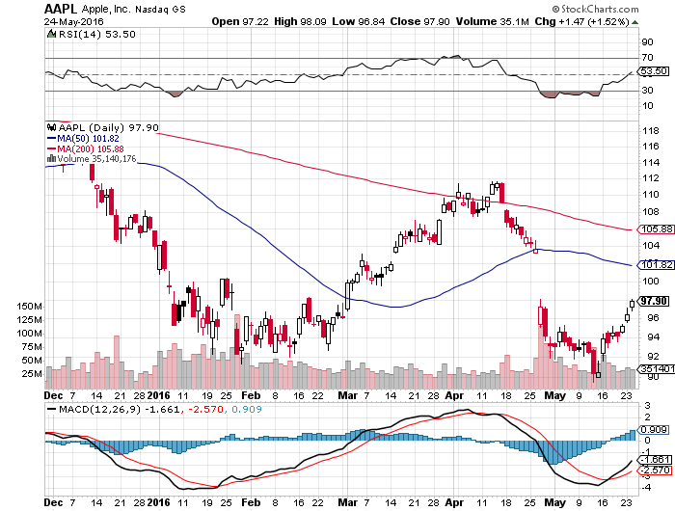
Apple (AAPL) –Buy the Dips
Back to waiting for the next real catalyst-the iPhone 7
The “Buffet Put Option” kicks in with $1 billion purchase

Slide 29
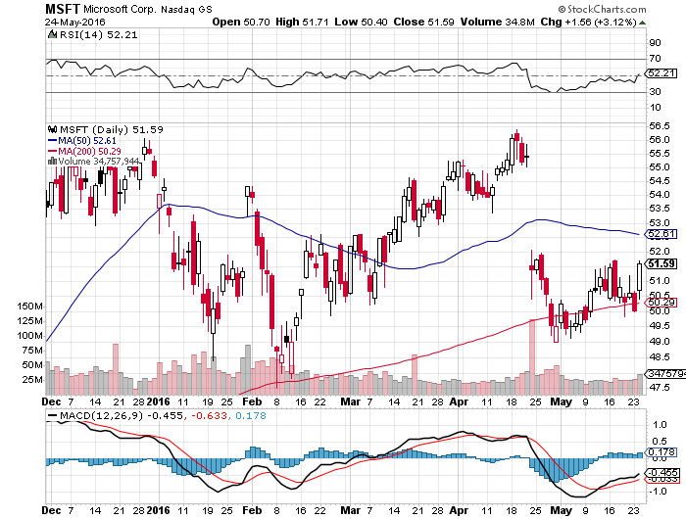
Microsoft (MSFT)
Disappointment creates an entry point

Slide 30
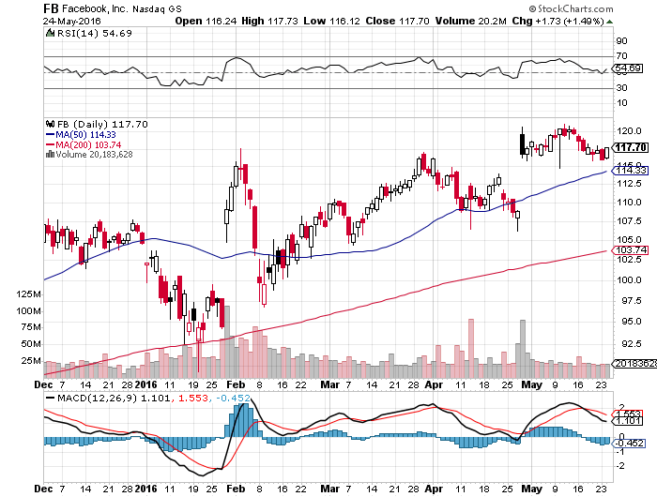
Facebook (FB)
Tech Wreck creates an entry point

Slide 31
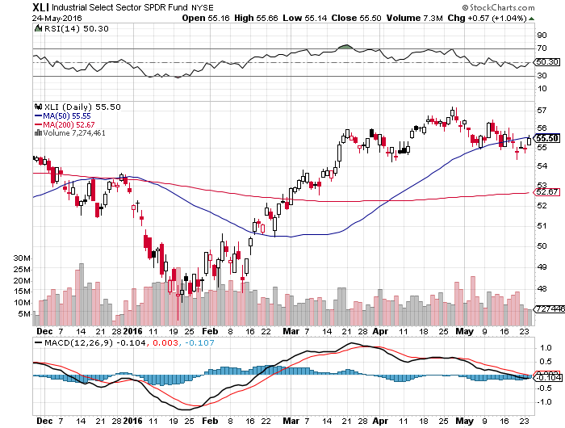
Industrials Sector SPDR (XLI)-Dow Mainstay
(GE), (MMM), (UNP), (UTX), (BA), (HON)

Slide 32
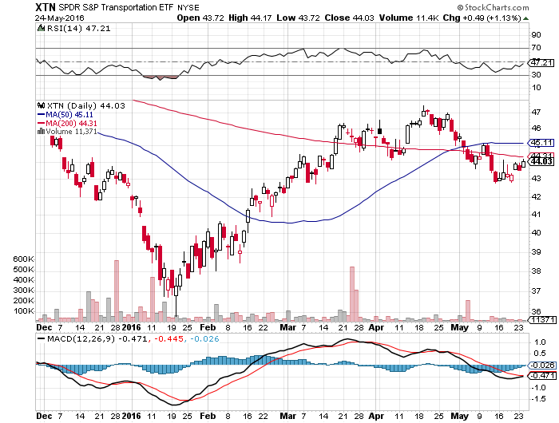
Transports Sector SPDR (XTN)-Another Dow Mainstay
(ALGT), (ALK), (JBLU), (LUV), (CHRW), (DAL),

Slide 33
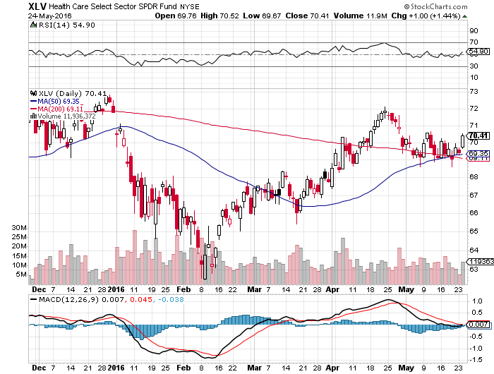
Health Care Sector SPDR (XLV), (RXL)
(JNJ), (PFE), (MRK), (GILD), (ACT), (AMGN)

Slide 34
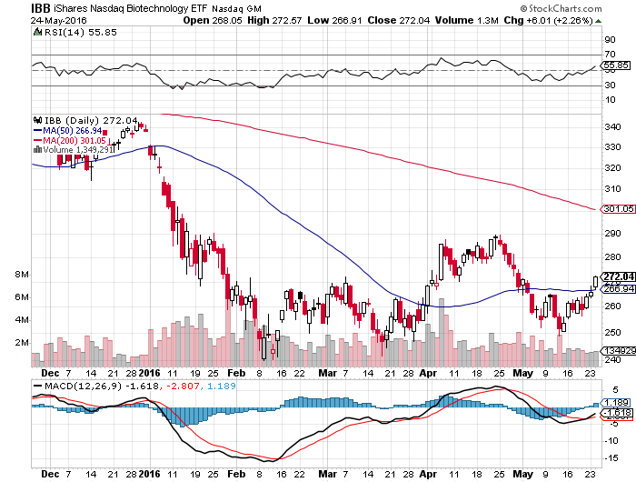
Biotech iShares (IBB)-A Political Football in 2016

Slide 35
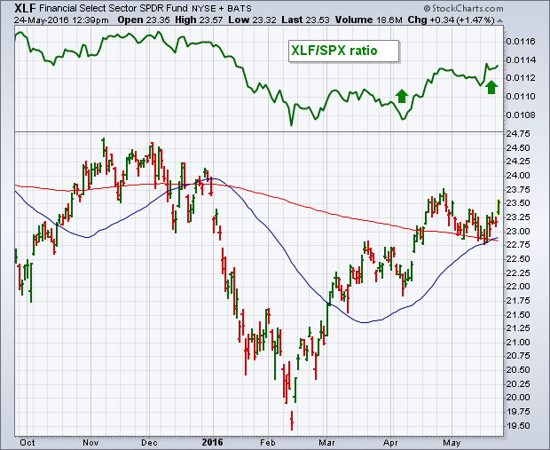
Financial Select SPDR (XLF)-A big Fed Assist higher interest rates mean higher bank stocks
(BLK/B), (WFC), (JPM), (BAC), (C), (GS)

Slide 36
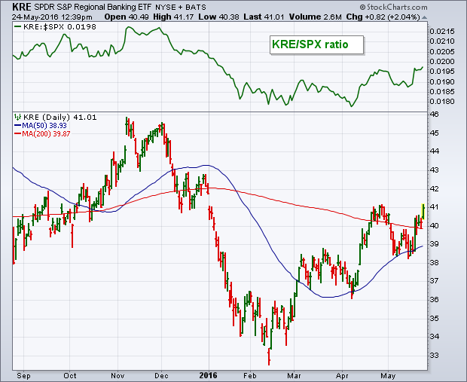
KRE Regional Bank ETF (KRE)-

Slide 37
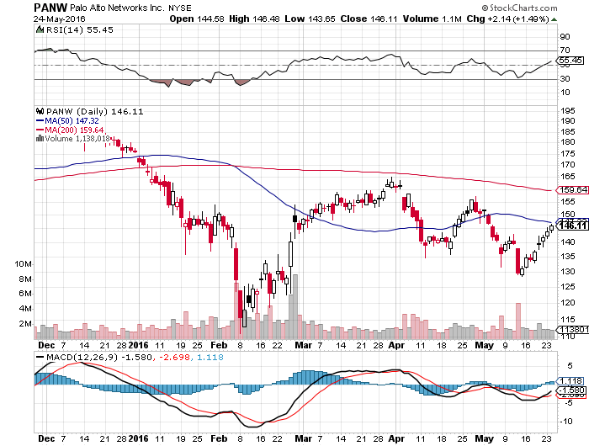
Palo Alto Networks (PANW)- another entry point setting up

Slide 38
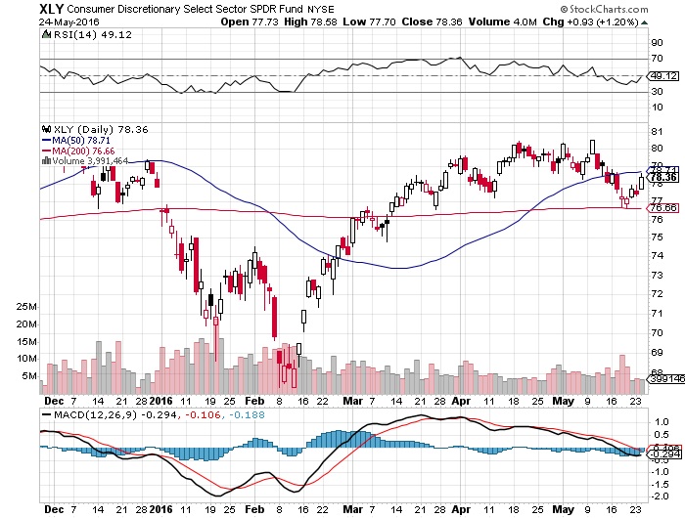
Consumer Discretionary SPDR (XLY)
(DIS), (AMZN), (HD), (CMCSA), (MCD), (SBUX)
A Major Leader of the Rally

Slide 39
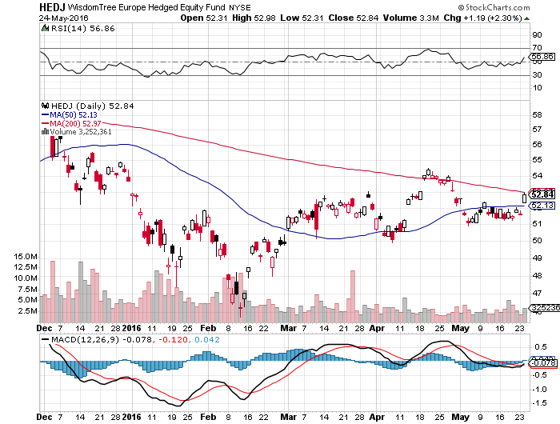
Europe Hedged Equity (HEDJ)-Hedged Japan Equity
Capped by strong euro and Brussels attack

Slide 40
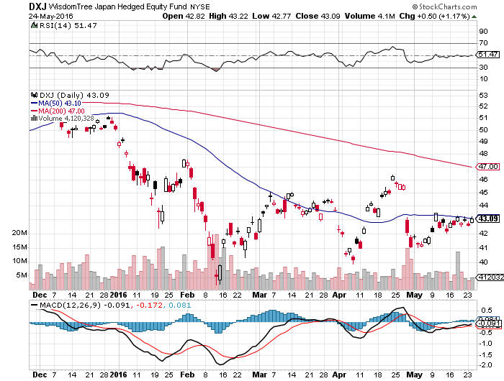
Japan (DXJ)-Hedged Japan Equity
Weak Yen Spike

Slide 41
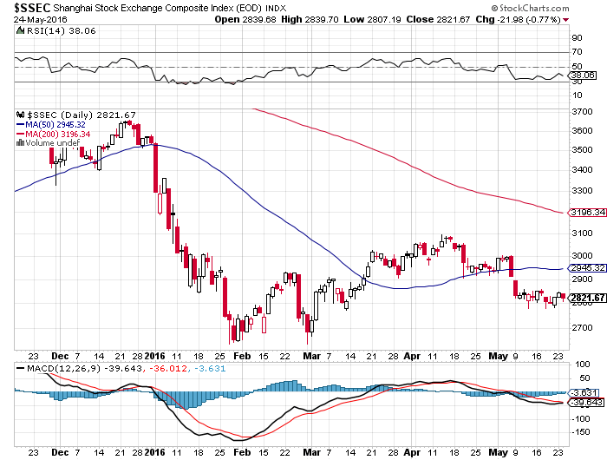
China ($SSEC)-
The Bad Boy Market and font of volatility

Slide 42
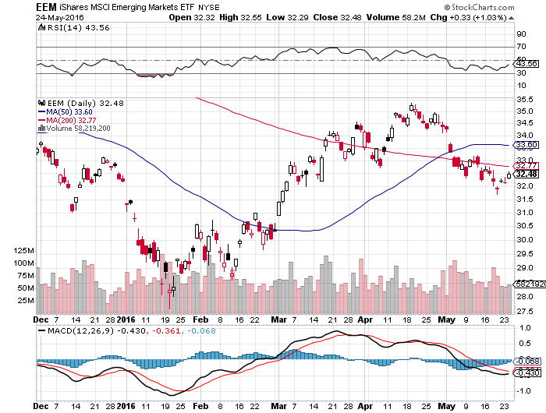
Emerging Markets (EEM)-
Oil is Dragging it Down

Slide 43
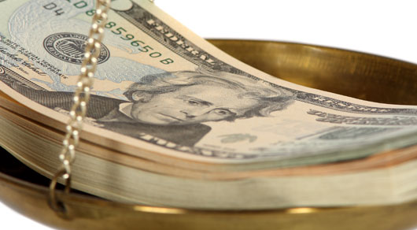
Foreign Currencies-Dollar Fed Boost
*Fed interest rate hike warning gives US dollar a new leg up, should continue until June 17 meeting
*Japan G7 meeting gives the yen a one day respite, then resumes downtrend with a vengeance. The top is definitely in for 2016
*”Brexit” polls still running even,
but should favor staying in the
referendum run up, causing
short covering rally in the pound
*As commodities top out,
the Aussie (FXA) and Loonie (FXC)
dive

Slide 44
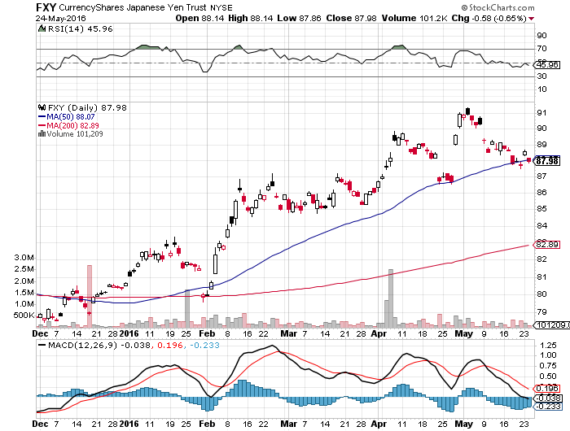
Japanese Yen (FXY)-Intervention!
Long 6/$94-$91 vertical bear put spread-16 days to expiration

Slide 45
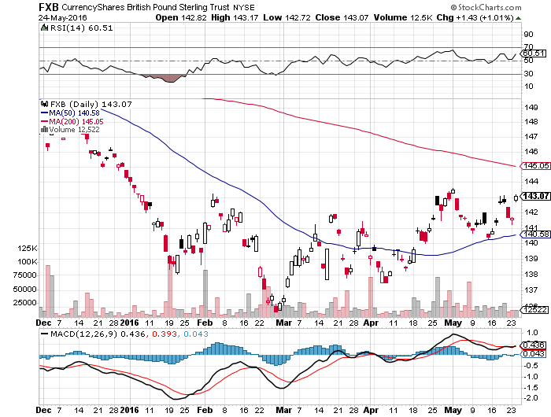
British Pound (FXB)-
Short Covering Ahead of June 23 Referendum

Slide 46
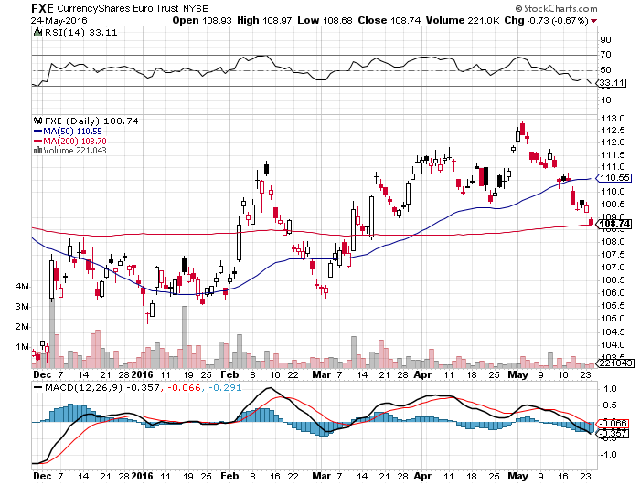
Euro ($XEU), (FXE), (EUO)- “Brexit” fears Dead Weight took profits on long 5/$113-$116 vertical bear put spread

Slide 47
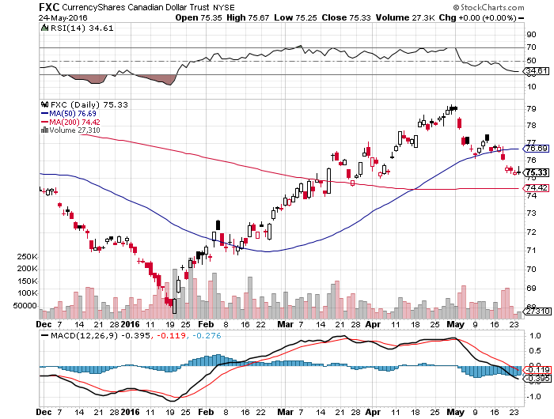
Canadian Dollar (FXC)-Strong Dollar and Alberta Fires Hurt

Slide 48
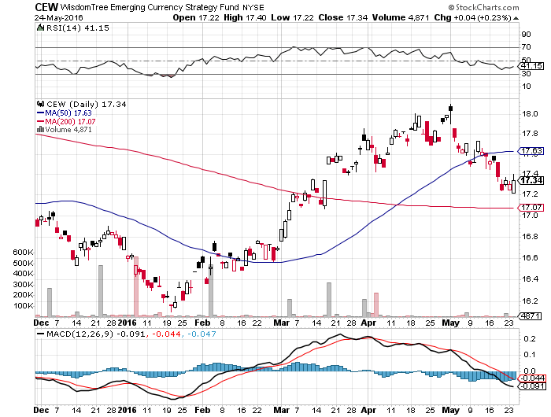
Emerging Market Currencies (CEW)

Slide 49
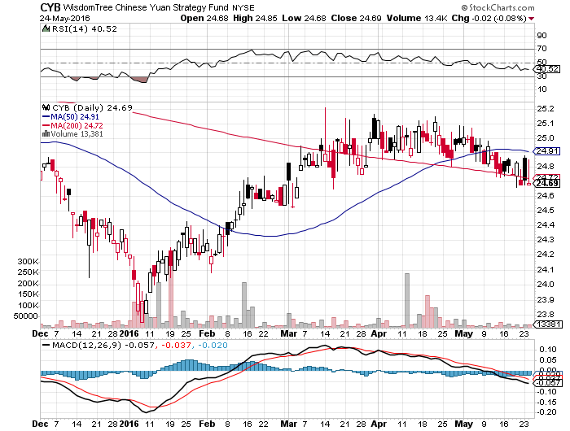
Chinese Yuan- (CYB)-Sell Rallies on Weakening Economy Rolling Over?

Slide 50
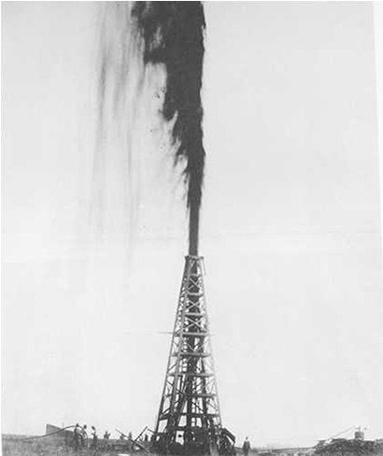
Energy-Levitating
* No one wants to chase oil at a one year high, but no one wants to sell short either
*At 94 million barrels a day, the world is still producing 2 million b/d more than it needs
*Almost all of the buying of oil this year has been short covering
*Huge Alberta fires still keeping up to 1 million barrels/day off the tar sands off the market
*Stronger US dollar still weighing on prices
*Iran ramps up production faster than anyone
expected, but will soon me the limitations
of its antiquated infrastructure
*US Rig count is flattening at a 5 year low

Slide 51
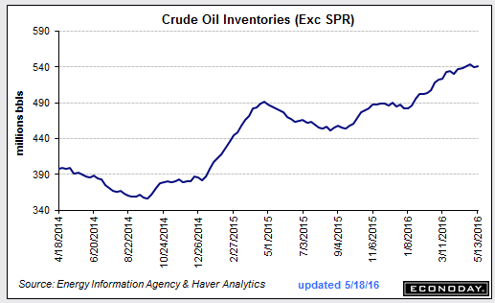
100% Move into Rising Inventories-Go Figure

Slide 52
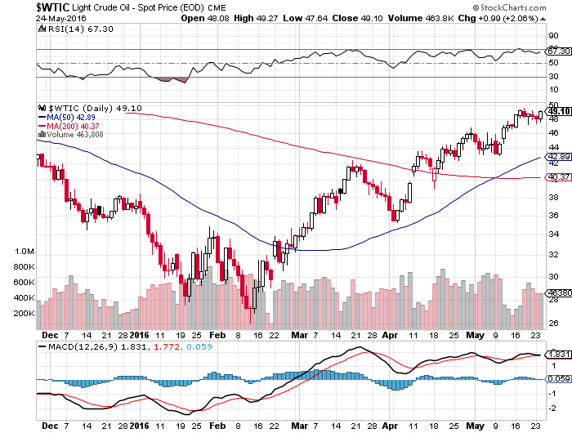
Oil-Topping Out

Slide 53
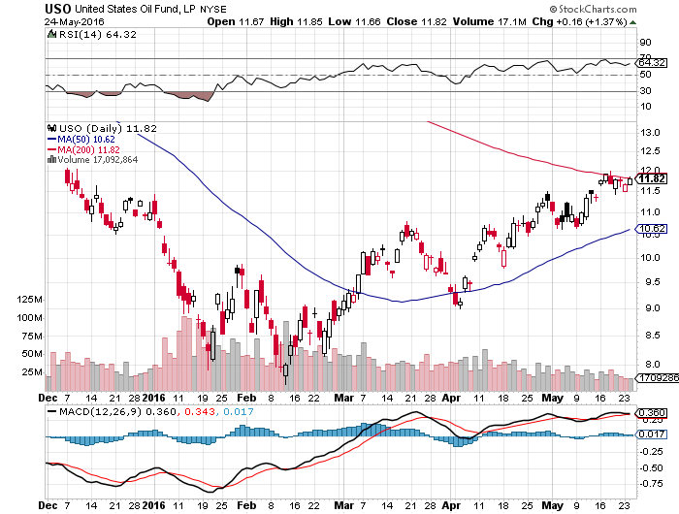
United States Oil Fund (USO) took profits on long 5/$$11.50-$12.50 vertical bear put spread

Slide 54
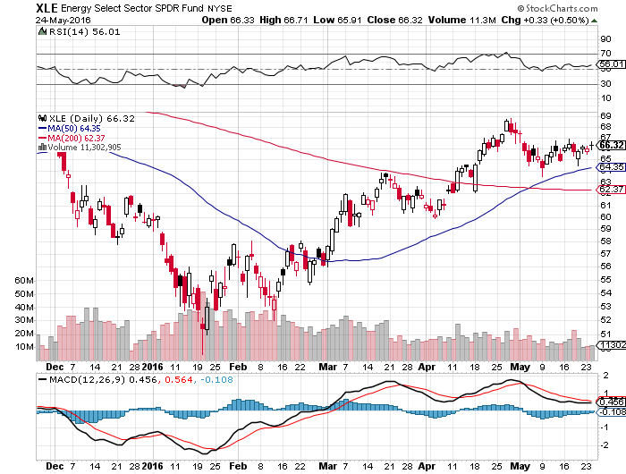
Energy Select Sector SPDR (XLE)
(XOM), (CVX), (SLB), (KMI), (EOG), (COP)

Slide 55
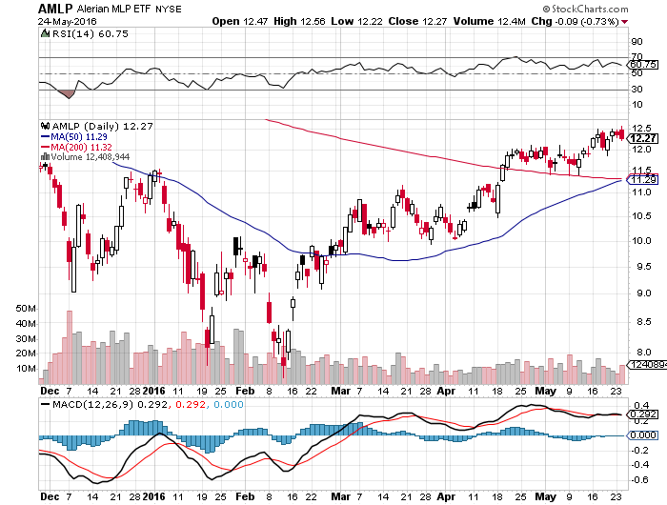
Alerian MLP ETF (AMLP)-9.08% Yield
Basket Approach is the Only Safe Play here

Slide 56
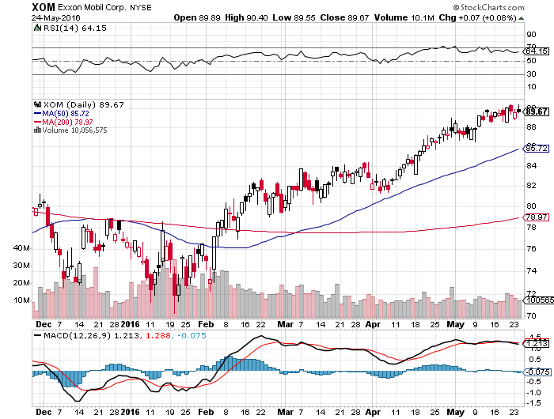
Exxon (XOM)-love that dividend!

Slide 57
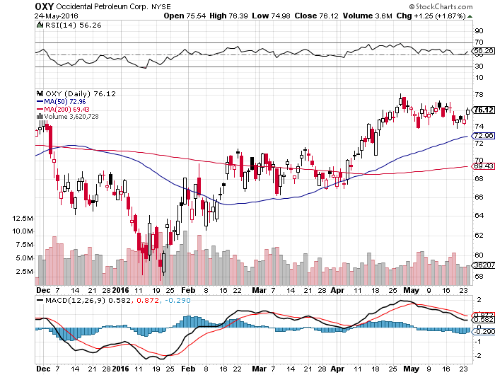
Occidental Petroleum (OXY)-

Slide 58
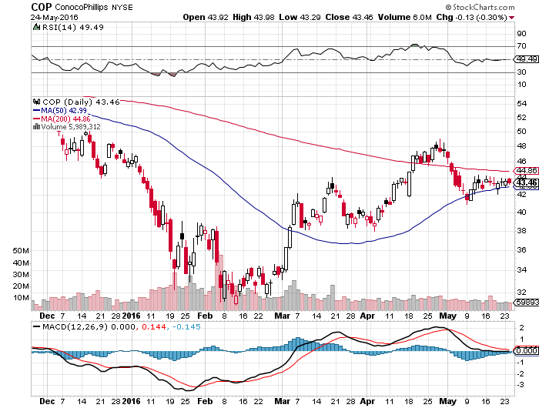
Conoco Phillips (COP)-The Buffet Favorite

Slide 59
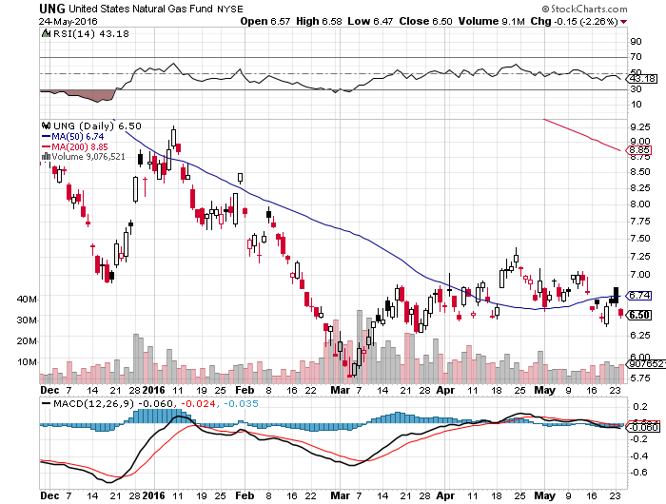
Natural Gas (UNG)-Headed for Negative Prices

Slide 60

Copper-The Bottom is In

Slide 61

Precious Metals-Fed Ambush
*Prospect of an imminent Fed rates rise takes the air out of the gold trade
*All other low interest rate plays, like utilities, take a similar hit
*With the most leverage, gold miners take the biggest hit
*Silver, Platinum, and Palladium all follow gold into the penalty box
*The only other driver of precious metals,
inflation, prices is nowhere to be seen

Slide 62

Gold (GLD)-Stand aside took profits the 4/$109-$112 vertical bull call spread stopped out of long 5/$115-$118 call spread

Slide 63

Market Vectors Gold Miners ETF- (GDX)

Slide 64

Silver (SLV)-

Slide 65

Silver Miners (SIL)-

Slide 66

Platinum (PPLT)-The Gold Effect

Slide 67

Palladium (PALL)-

Slide 68

Agriculture-Slap in the Face
*USDA surveys point to new all time record crops in 2016
*It’s all about soybeans, the only crop to bring decent price action in 2016
*Good weather allows early US planting of corn, oats, and rice this year
*Dollar delivers another slap in the face
*Without surprise bad weather this is
going to be another awful year for the ags
*No trade, there are NO fish to fry
*My main job here is to keep traders
away from this sector this year

Slide 69

(CORN) – Recovery

Slide 70

(WEAT) Flat on its back

Slide 71

(SOYB) On Fire

Slide 72

Ag Commodities ETF (DBA)-

Slide 73

Real Estate-Ticking Along
*April new home sales hit 8 year high, homebuilders rocket
*April existing home sales +1.7% to 5.45 million annual rate, falling in west where prices are highest
*Median home price +6.3% to $232,500, home shortage accelerating price rises
*Median home prices in west now 57% higher than national median at $365,000
*Rising prices, falling inventories, and still tough loan requirements still shutting first time buyers out of the market
*NAHB Builder Sentiment Index unchanged
at 58, meaning that new supply is on the way
*March Case Shiller S&P 500 National index
continues upward grind, January +5.0%

Slide 74

March S&P 500/Case–Shiller Home Price Index
+5.0% YOY, Seattle, Denver, Portland

Slide 75

US Home Construction Index (ITB)
(DHI), (LEN), (PHM), (TOL), (NVR)

Slide 76

Trade Sheet
So What Do We Do About All This?
*Stocks- sell rallies, buy the next big dip
*Bonds-buy dips, trading range until June 17
*Commodities-stand aside on strong dollar
*Currencies- sell yen and Euro on strong dollar
*Precious Metals –stand aside on rate rise risk
*Volatility-sell short spikes over $25, buy dips to $12
*The Ags –stand aside - avoid the disaster
*Real estate-buy the homebuilders LT

Slide 77

To buy lunch tickets, please go to www.madhedgefundtrader.com , click on “LUNCHES,” and then your desired country and city
Next Strategy Webinar
12:00 EST Wednesday,
June 8, 2016
San Francisco, CA
USA!
Good Luck and Good Trading!
Notes:
*

