Slide 1
Mad Day Trader
Bill Davis
Webinar – June 1, 2016

Slide 2
Indexes

Slide 3
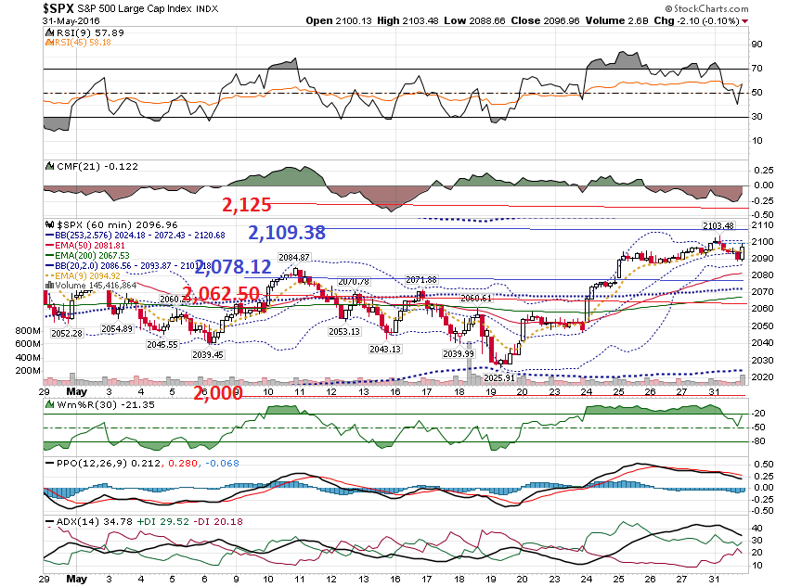

Slide 4
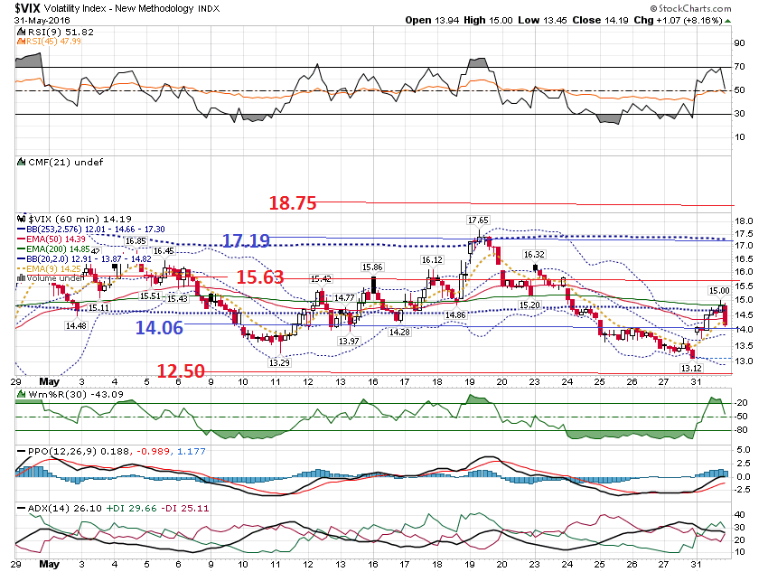

Slide 5
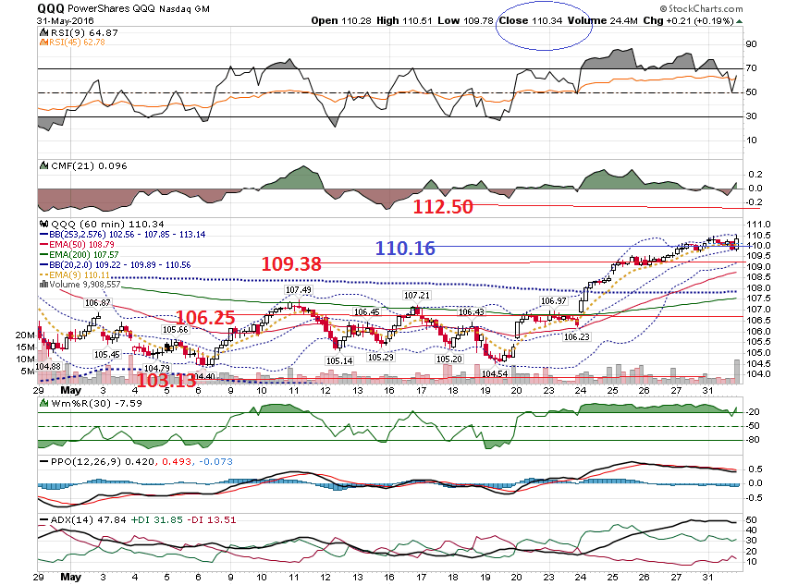

Slide 6
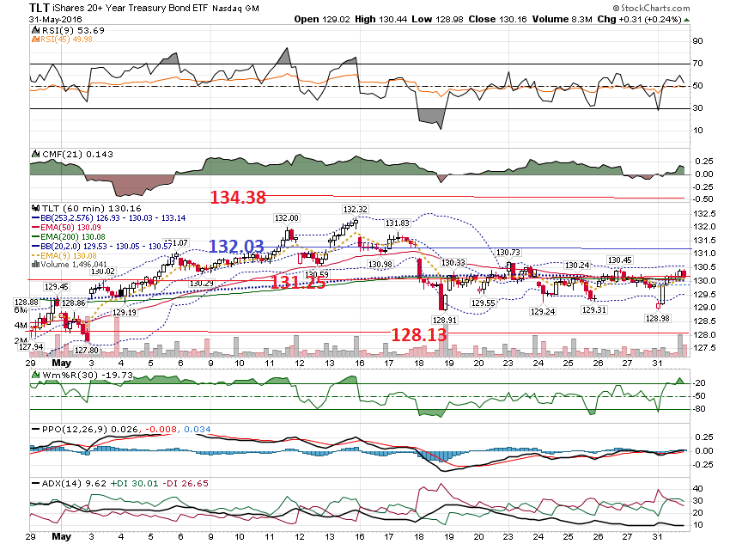

Slide 7
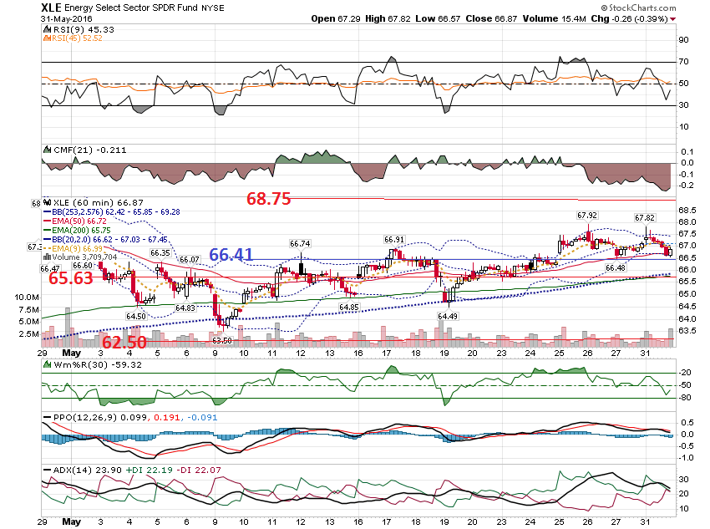

Slide 8
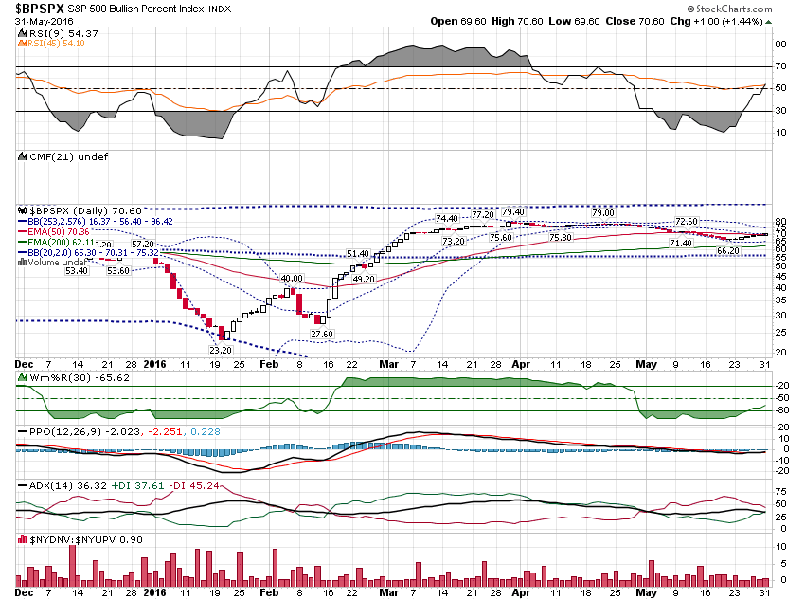

Slide 9
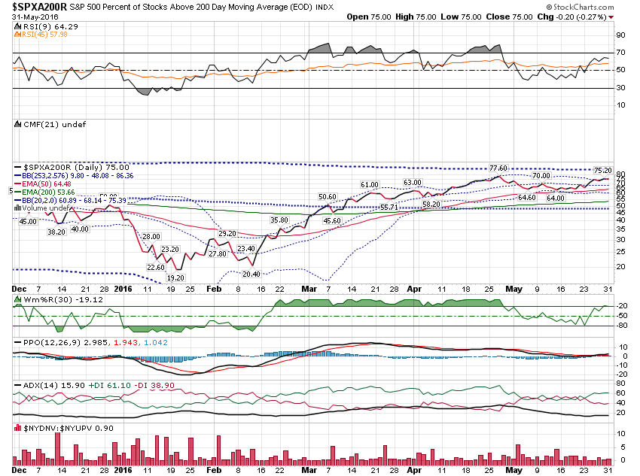

Slide 10
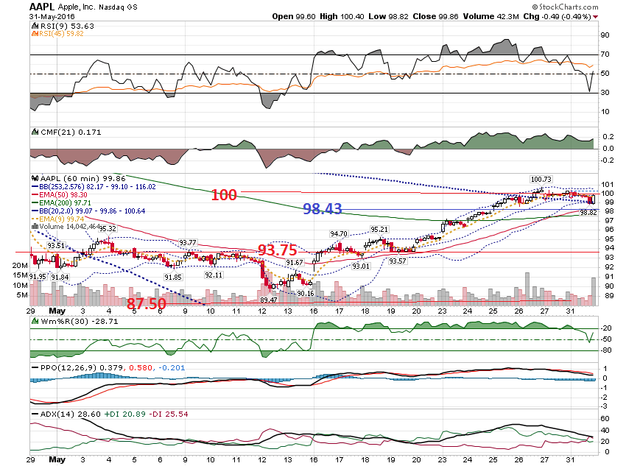

Slide 11
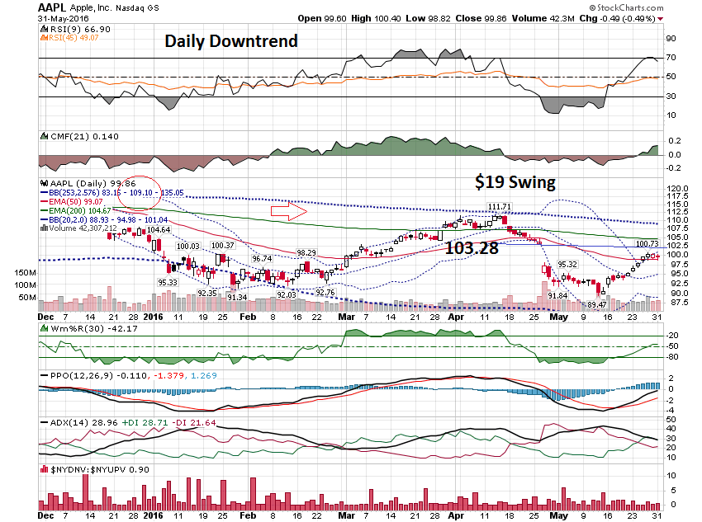

Slide 12
Gold

Slide 13
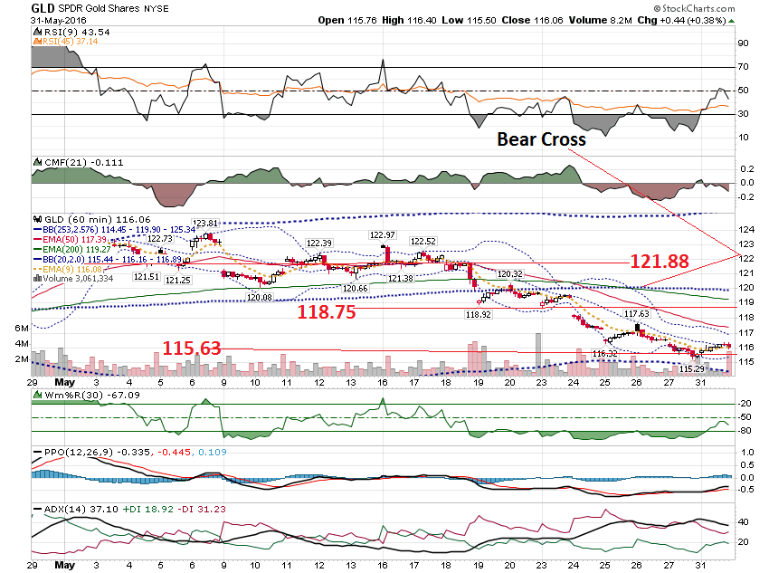

Slide 14
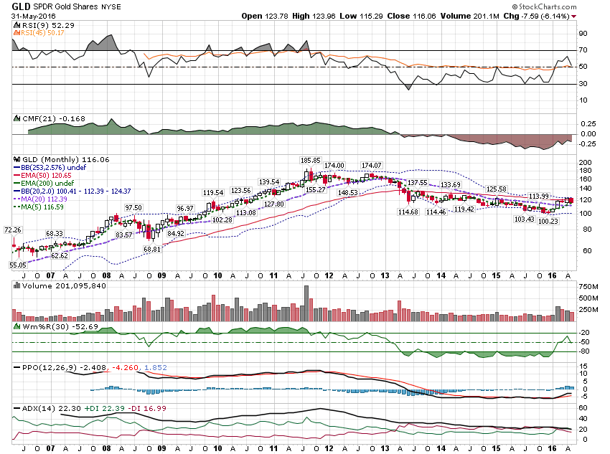

Slide 15
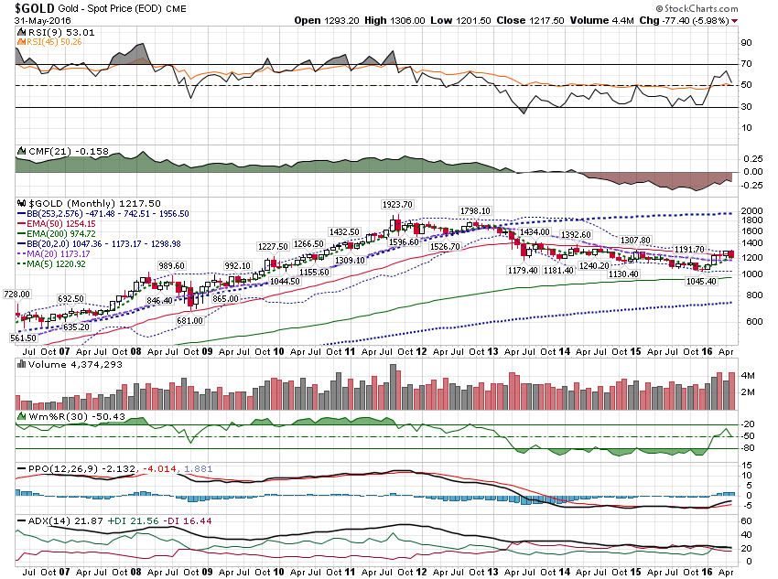

Slide 16
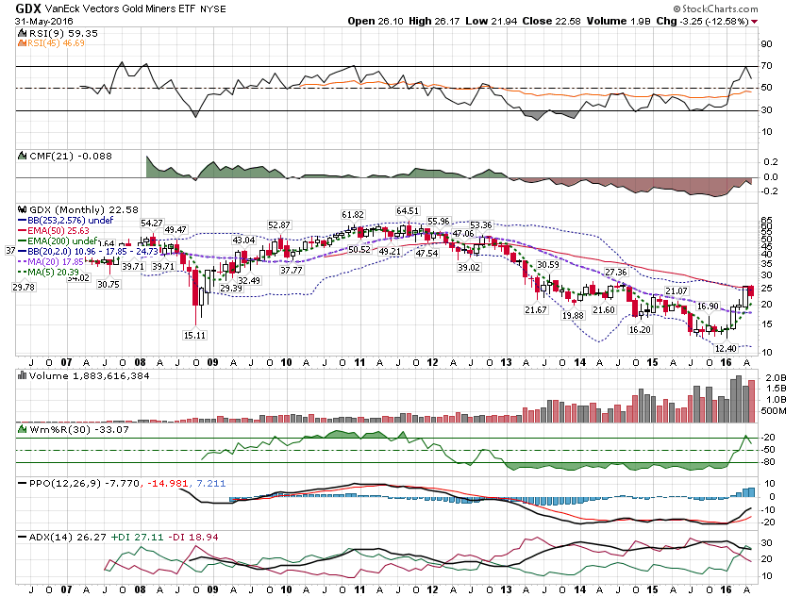

Slide 17
Trending Stocks

Slide 18
Taken From May 25, 2016 Daily Update Watch list: Bullish Stocks: LLL, ZBH, DHR, CRL, LOW, ALGN, APA, NVDA, DGX, CRL Bearish Stocks: GS, AMGN, FLT, ANTM, CMI, CVS, CELG, WBA, YUM

Slide 19
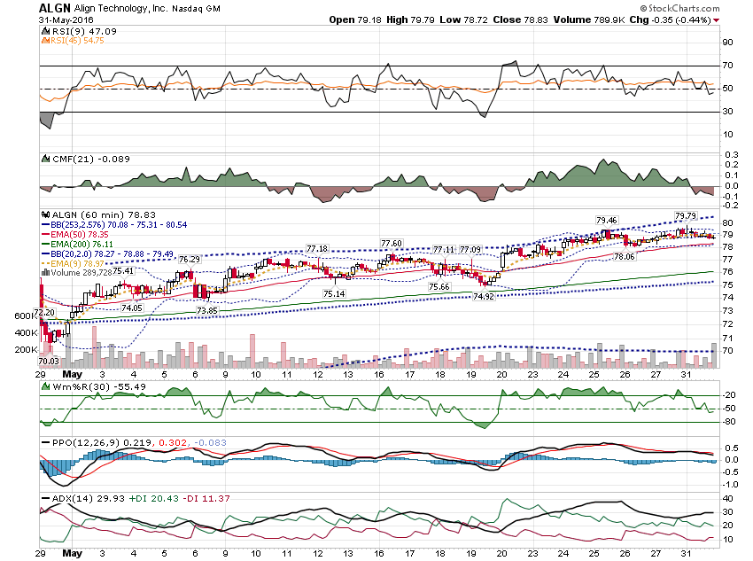

Slide 20
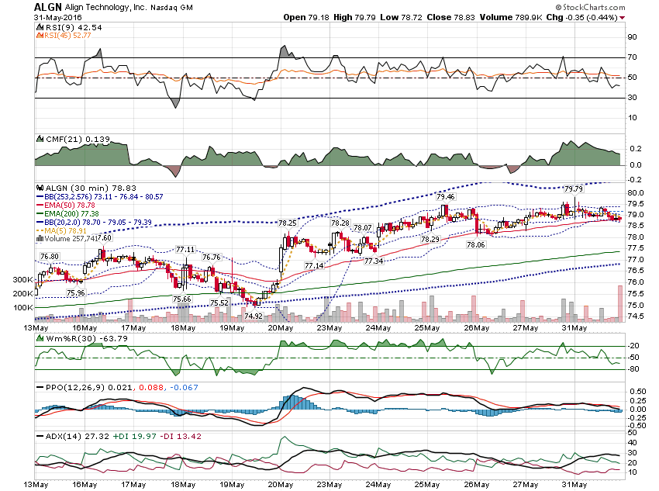

Slide 21
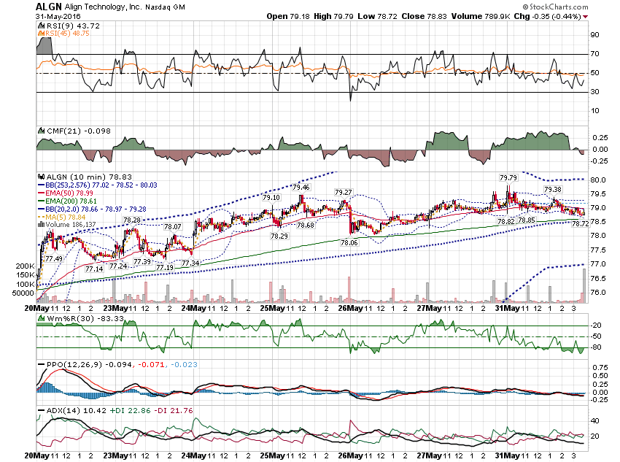

Slide 22
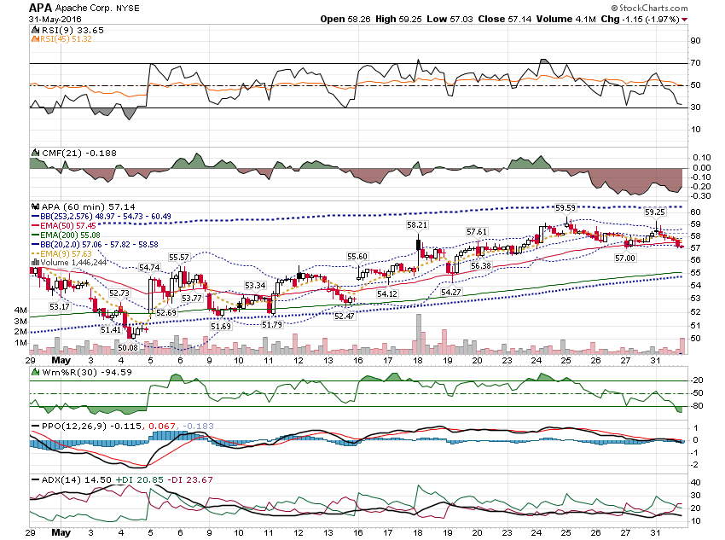

Slide 23
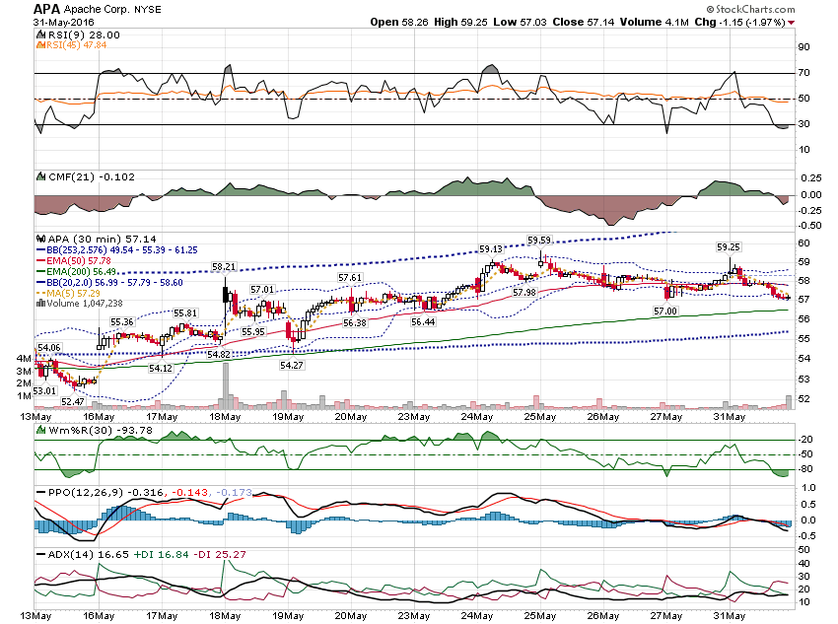

Slide 24
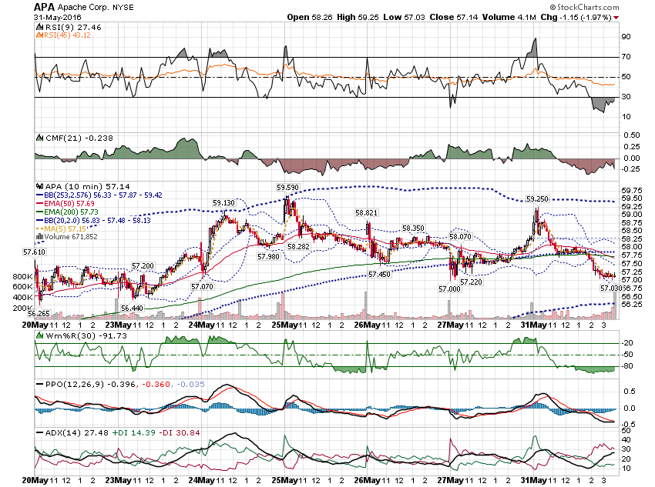

Slide 25
Bearish

Slide 26
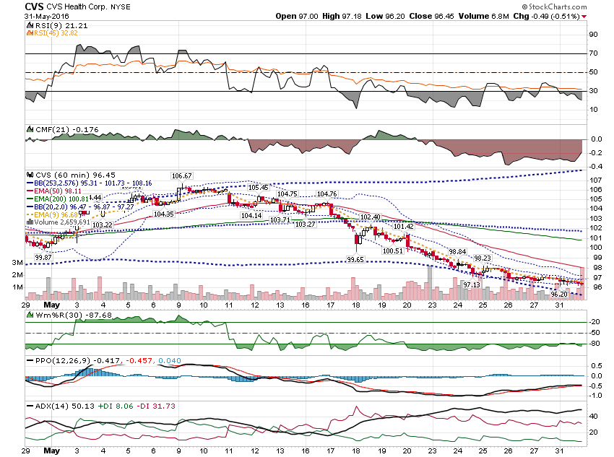

Slide 27
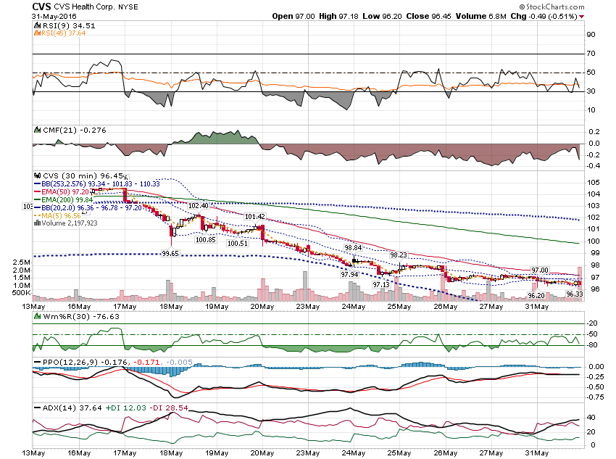

Slide 28
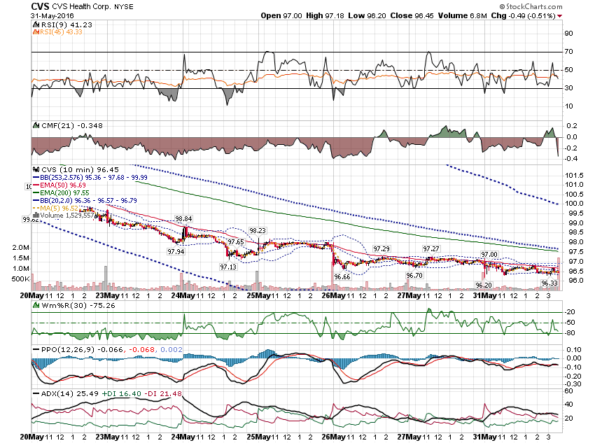

Slide 29
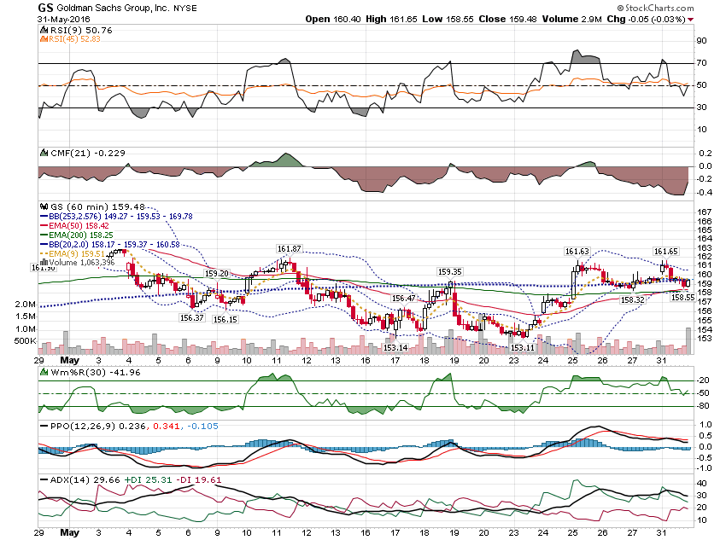

Slide 30
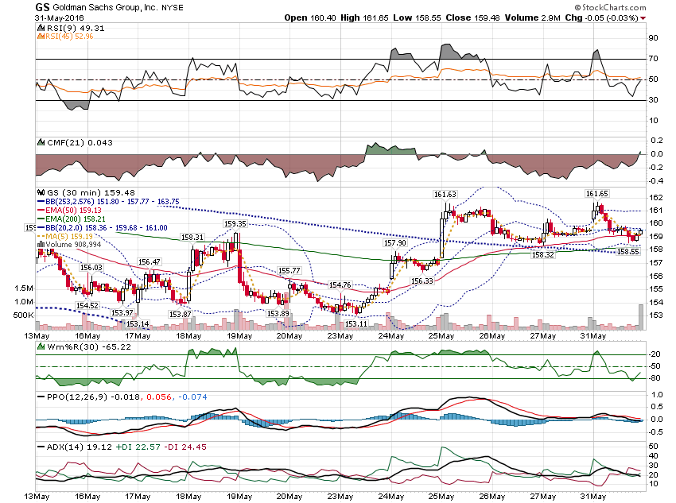

Slide 31
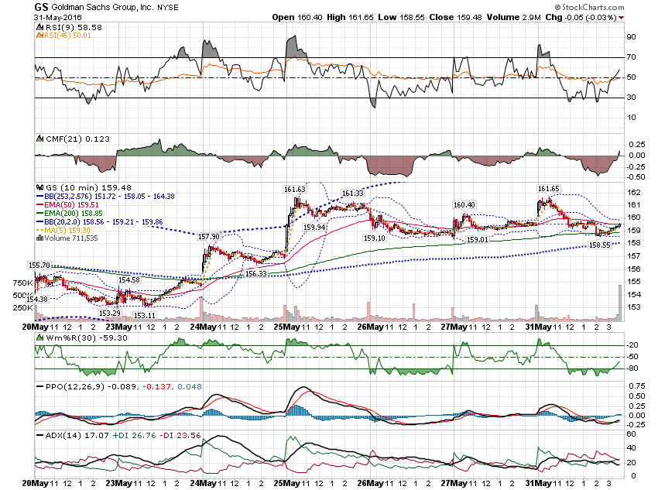

Slide 32
Thanks for watching! Bill Davis Mad Day Trader June 1, 2016 davismdt@gmail.com

