Slide 1
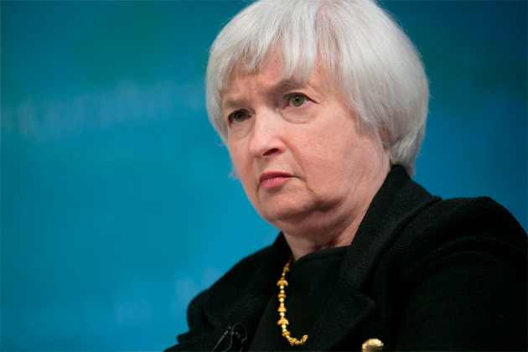
The Mad Hedge Fund Trader “Will She, or Won’t She?”
With John Thomas from San Francisco, CA, June 8, 2016 www.madhedgefundtrader.com
Notes:
*

Slide 2
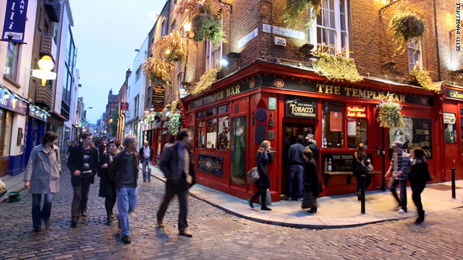
MHFT Global Strategy Luncheons Buy tickets at www.madhedgefundtrader.com
London, England June 20
Dublin, Ireland June 29

Slide 3
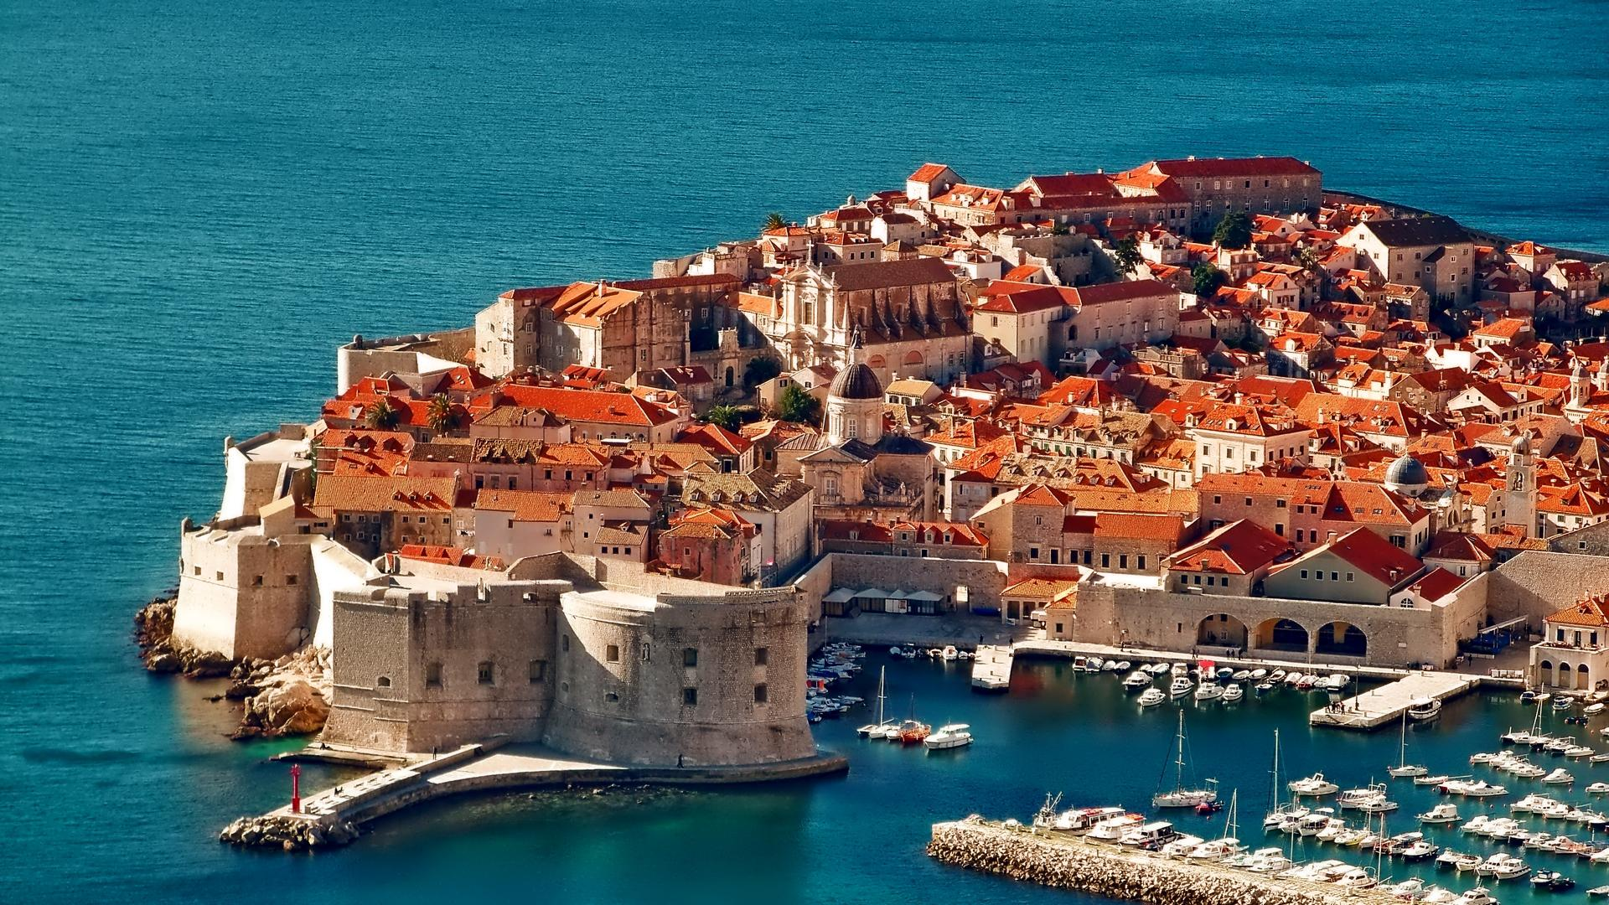
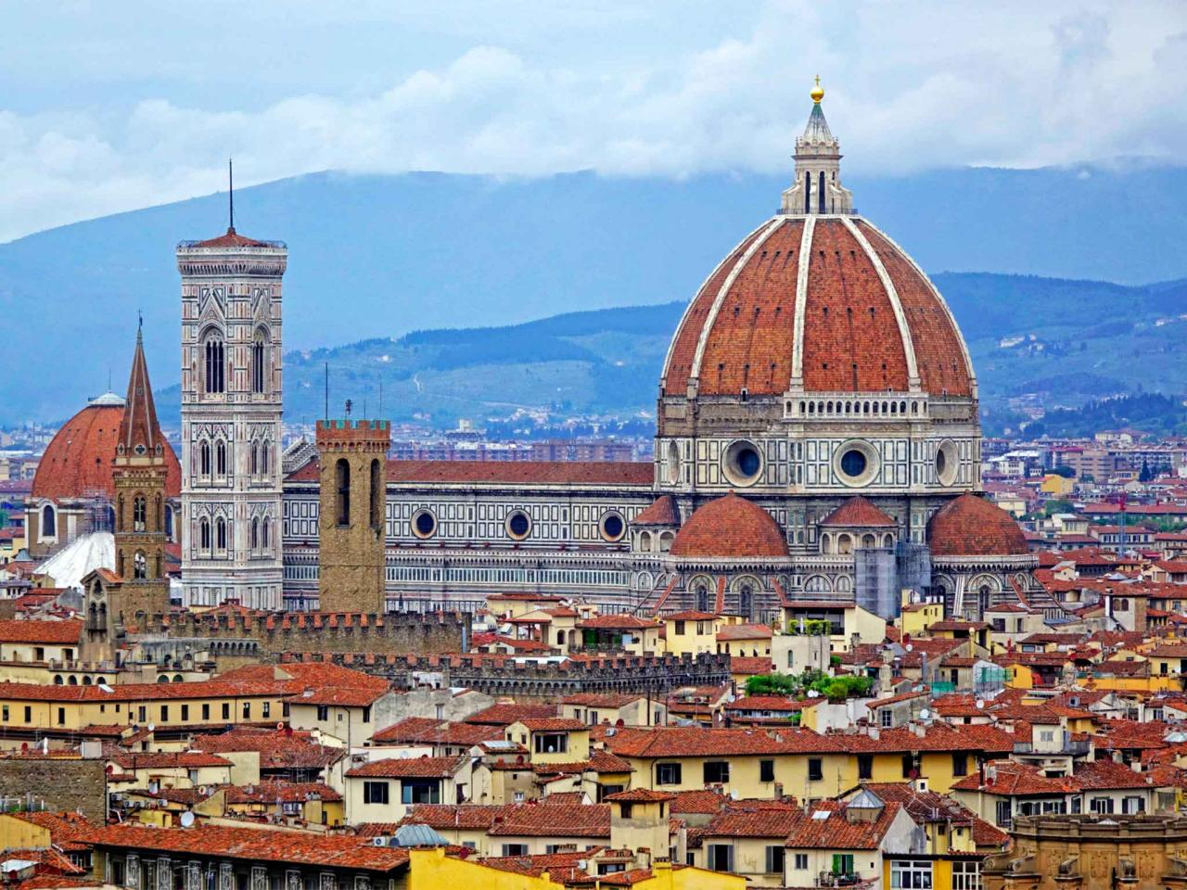
MHFT Global Strategy Luncheons Buy tickets at www.madhedgefundtrader.com
Dubrovnik, Croatia July 7
Florence, Italy July 9

Slide 4
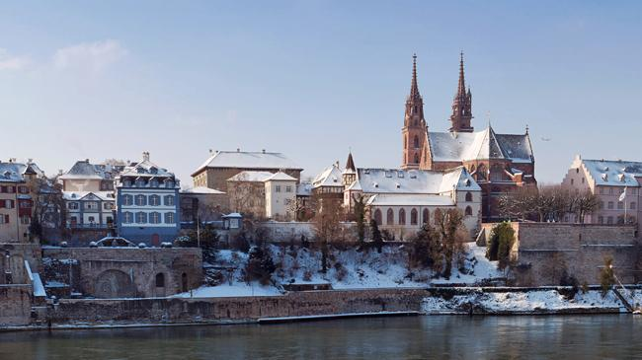
MHFT Global Strategy Luncheons Buy tickets at www.madhedgefundtrader.com
Zermatt, Switzerland July 22
Basel, Switzerland July 27

Slide 5

Trade Alert Performance Making Big Profits in Dire Market Conditions
*January +1.23% Final *July +6.42% Final *February +4.50% FINAL *August +1.27% Final *March -2.42% Final *September +11.99% Final *April -2.10% FINAL *October Final -6.19% *May +4.38% FINAL *November MTD 5.78% *June -0.06% MTD *December -4.94% *2016 Year to Date +5.53% compared to 3.0% for the Dow Average *Trailing 1 year return +25.80%, +201.81 since inception, a new all time high all-time high *Average annualized return of 37.25%

Slide 6
Portfolio Review Running a small Short Dated Book on a strong dollar move
Asset Class Breakdown
Risk Adjusted Basis
current capital at risk
Risk On
World is Getting Better
Risk Off
World is Getting Worse
(FXY) 6/$91-$94 put spread | -10.00%
total net position | -10.00%
Expiration P&L 7.17% YTD

Slide 7

The Method to My Madness Staying in Cash Until the Fed Decision
*In May, I made a big bet that a strong dollar would drive all trades and I won. *Then markets became irrational, and I gave a chunk back *In June, I’ve pulled out of the market awaiting the Fed’s June 15 interest rate decision *That means running a flat book into June 15, and the kneejerk reactions that will follow *Then wait for a soft pitch, a great entry point for a low risk, high return trade *Use the tech and biotech wrecks to get into good long term positions over the summer

Slide 8
Paid Subscriber Trailing 12 Month Audited Return +19.90%

Slide 9
66 Months Since Inception Daily Audited Performance Averaged annualized return +35.82%

Slide 10

Short Term Strategy Outlook-On the Sidelines
*May nonfarm payroll kills off any chance of a rate rise this month triggering global “RISK ON” rally *No rate rise stops the upside momentum of the dollar *Continuing supply disruptions keep oil going, $60 by yearend is now on the table *US stocks testing the two year ceiling, but will fail a few more times *Bonds still trading at a high range, but are begging to breakout to the upside *No rate rise takes gold off the floor *Rotten weather finally gives life to the ags *Weak copper prices show that China still doesn’t have the green light

Slide 11
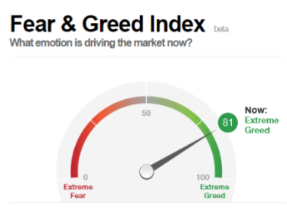
Yikes!

Slide 12
The Bill Davis View A $1,500 Upgrade for the Mad Day Trader Service
Buys:
Facebook (FB) $109 Target to $120
Amazon.com (AMZN) $688 Target to $750
CF Industries (CF) $29 Target to $36
Alphabet (GOOGL) $718 Target to $740
Broadcom Ltd (AVGO) $158 Target to $169
First Solar Inc. (FSLR) $50 Target to $68
Sells:
Chipotle Mexican (CMG) $438 Target to $375
Stamps.com (STMP) $94 Target to $81
Buffalo Wild Wings (BWLD) $150 Target to $138
Walt Disney Co. (DIS) $98 Target to $85
Boeing Co. (BA) $133 Target to $119

Slide 13
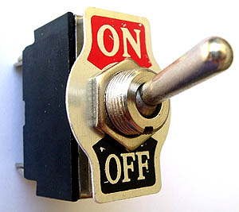
The Global Economy-On Again, Off Again
*Worst nonfarm payroll in 6 years reverses all trends and puts the Fed rate rise in doubt *Q1 GDP revised up from +0.50% to a warmer 0.80%, US April Durable Goods up a strong +3.4%, but May car sales were disastrous, with GM -25%, Ford down -18%, Fed Beige Book says economic is anemic at best *No news from China is good news *Weak Markit Purchasing Managers Report shows Japan going back into the tank thanks to earthquakes, planned consumption tax postponed for 2 years *Oil stalling here, but pain trade is still to the upside *Next to come is a “RISK ON” global synchronized growth in H2 2016 now that the US Q1 mini recession is behind us

Slide 14
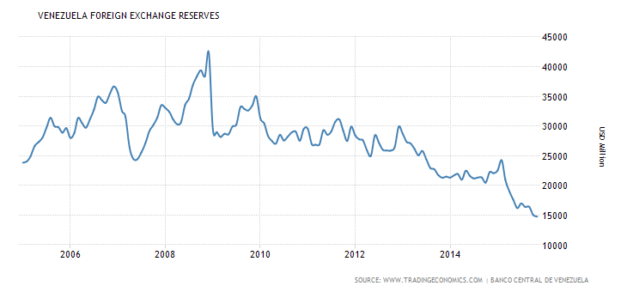
Here’s Your Next International Crisis

Slide 15
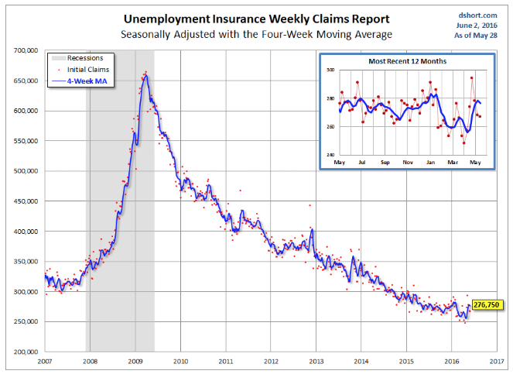
Weekly Jobless Claims –The Most Important Statistic -1,000 to 267,000-Lowest since 1973! The Downtrend Lives!-Show Me the Recession!

Slide 16
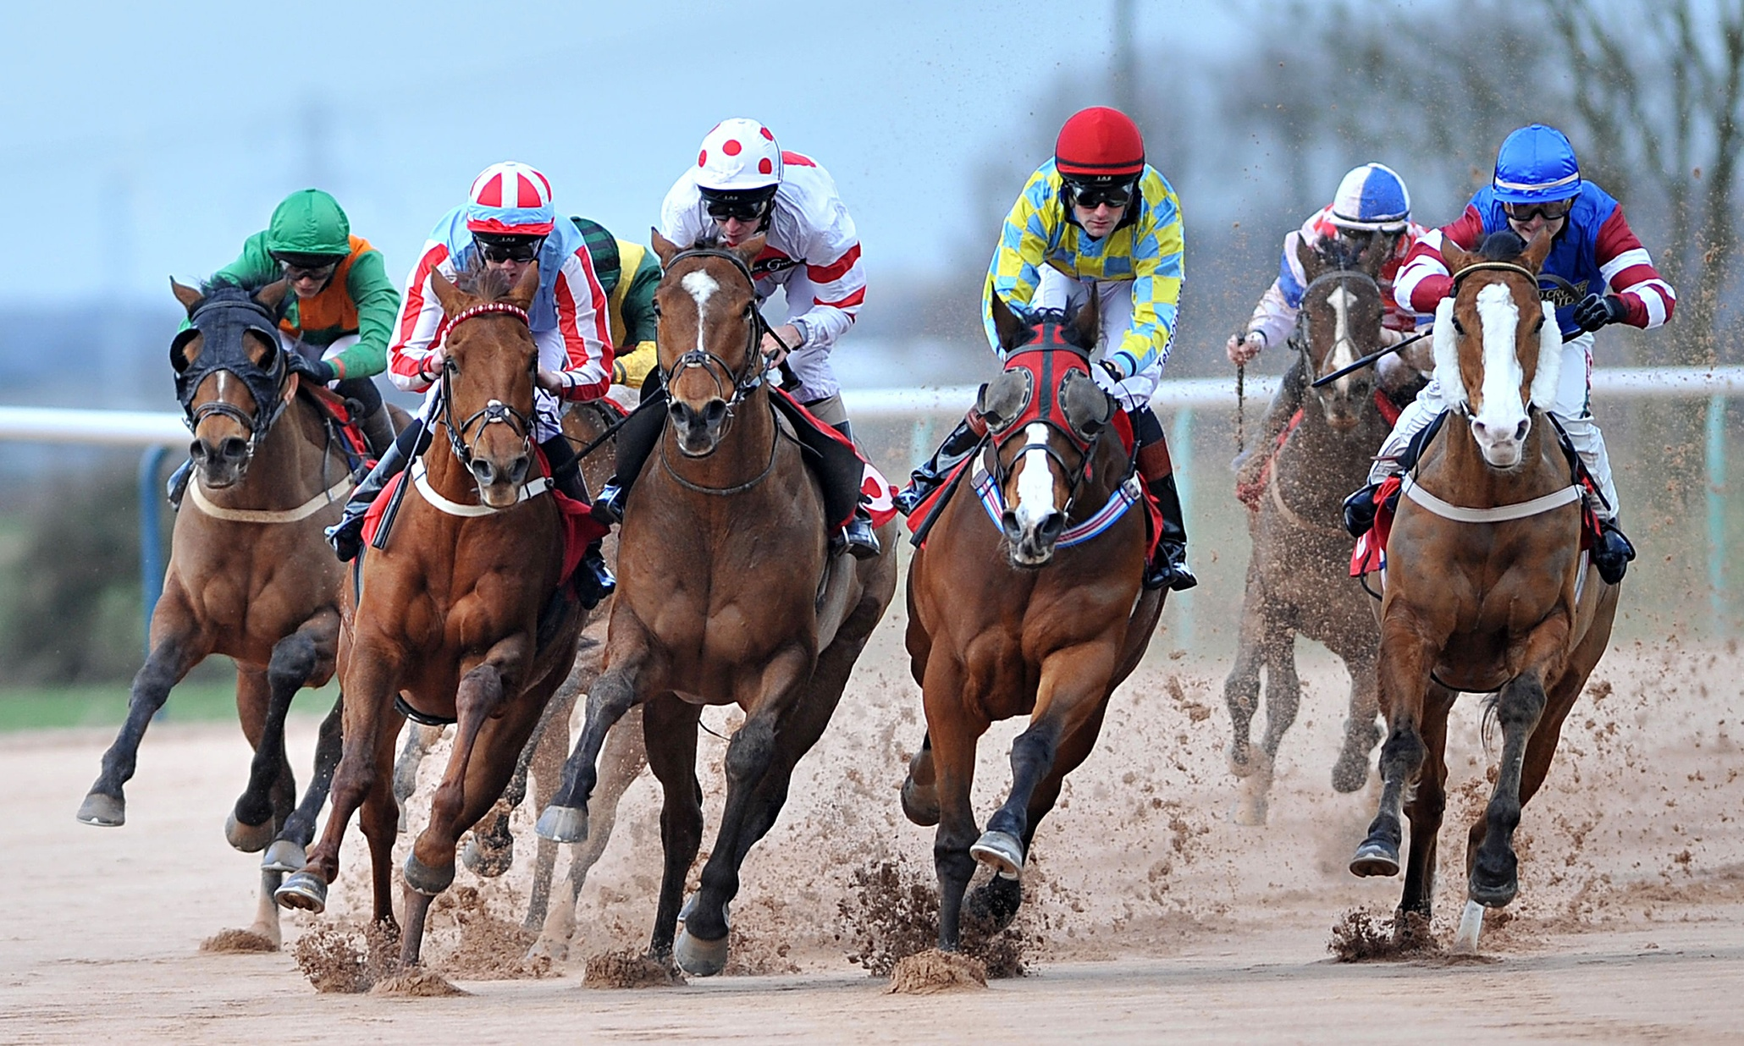
Bonds-Off to the Races
*Awful May Nonfarm payroll puts Fed rate rise on pause, causes bonds to rocket across the boat *One good global “RISK OFF” move and bonds take a run at new all times highs in prices, lows in 10 year Treasury yields at 1.36% *JGB’s rally to -0.11%, German bunds to 0.07% *Emerging market debt revives on no rate rise *”RISK ON” sends junk bonds (HYG) to new year highs

Slide 17
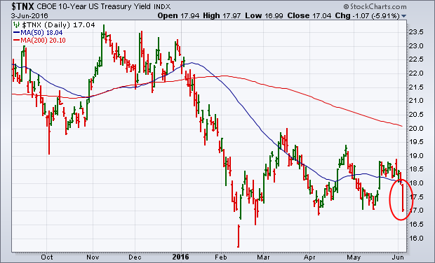
Ten Year Treasury Yield ($TNX) 1.70% Trading the Range

Slide 18
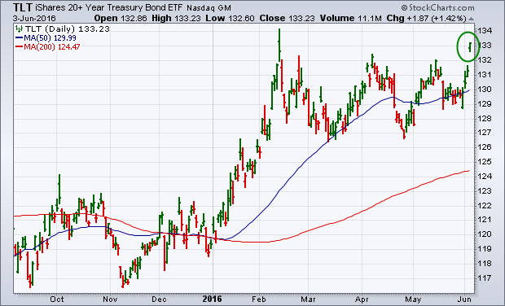
Ten Year Treasury ETF (TLT) 1.70% took profits on long 6/$124-$127 vertical bull call spread

Slide 19
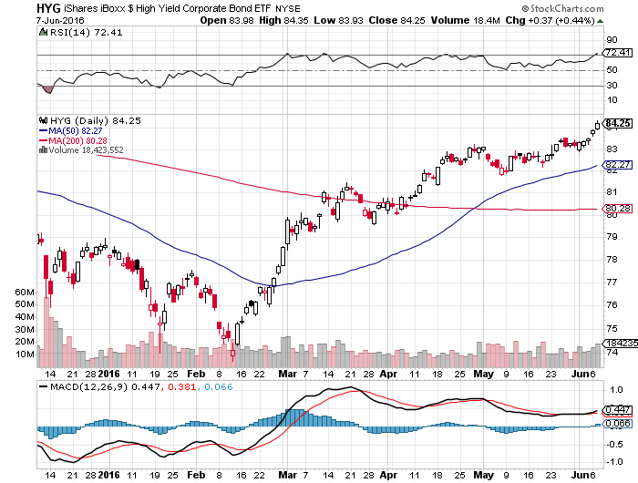
Junk Bonds (HYG) 6.68% Yield A Great Risk Coincident Indicator-”RISK ON” means new highs

Slide 20
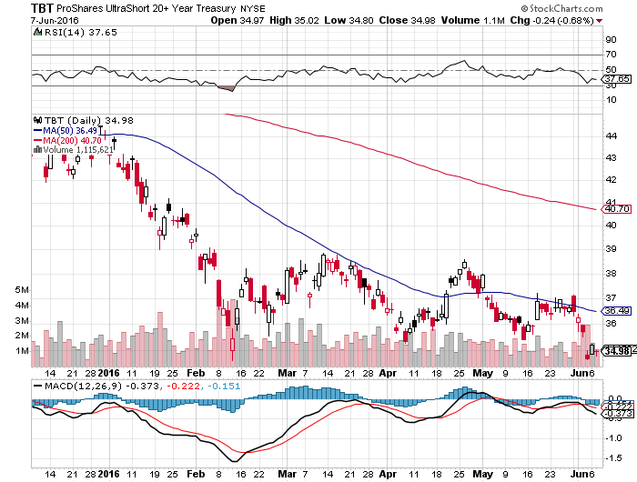
2X Short Treasuries (TBT)-Not Yet the Big Trade of 2016? Back in “BUY” Territory

Slide 21
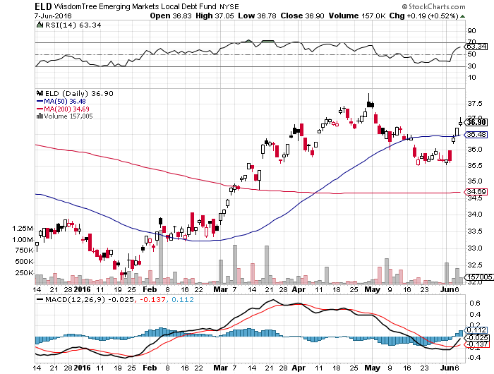
Emerging Market Debt (ELD) 5.81% Yield-

Slide 22
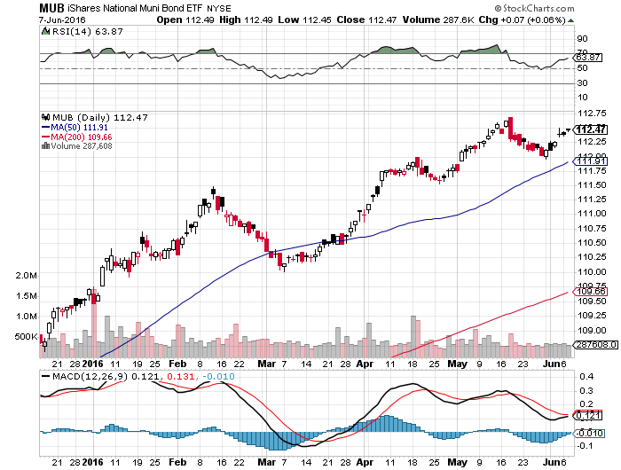
Municipal Bonds (MUB)-1.31% yield-New High Mix of AAA, AA, and A rated bonds-flight to safety

Slide 23

Stocks-Party On
*No interest rate rise brings “RISK ON” for stocks and new 2016 highs *But with stocks at top of 2 year range with decade high valuations approaching a 20X multiple, the upside is limited. Rotation from growth to value stocks continues *When the dollar is weak you stay away from stocks, as weak foreign earnings drag on multinational earnings *Shorts are all gone now, but no one wants to play on the long side *Short squeeze in pressing hedge funds to cover *Now that “Sell in May” is gone, do we get the June swoon?

Slide 24
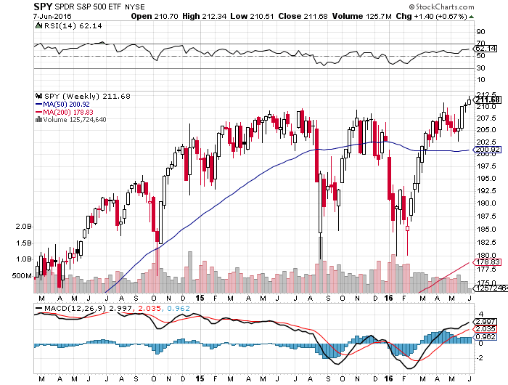
S&P 500- stopped out of 6/$210-$215, took profits on long 6/$212-$217

Slide 25
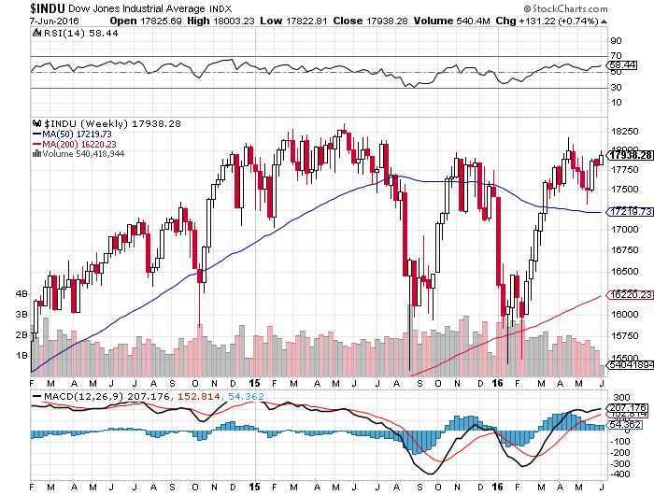
Dow Average-Topping Out Too

Slide 26
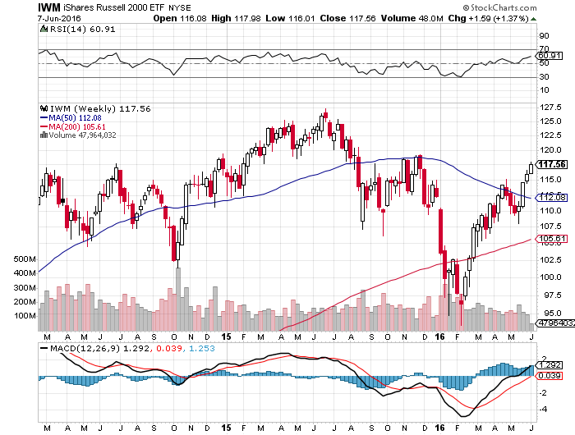
Russell 2000 (IWM)-Challenging the Highs

Slide 27
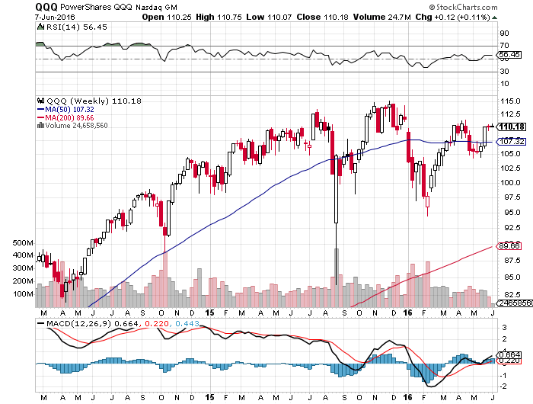
NASDAQ (QQQ)-

Slide 28
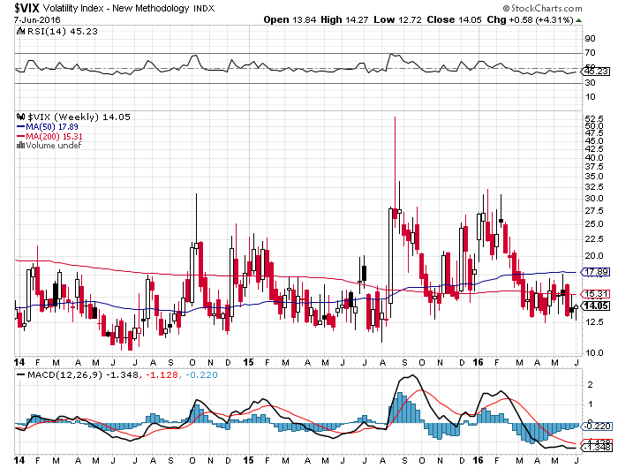
(VIX)-Back to the Bottom

Slide 29
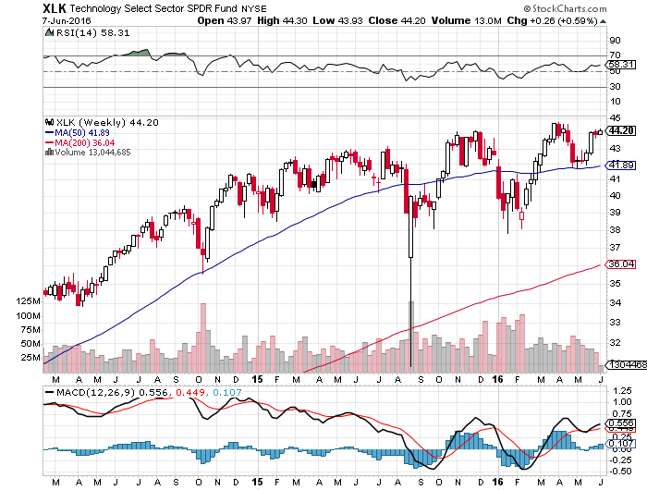
Technology Sector SPDR (XLK), (ROM) (AAPL), (MSFT), (VZ), (T), (FB), (IBM)

Slide 30
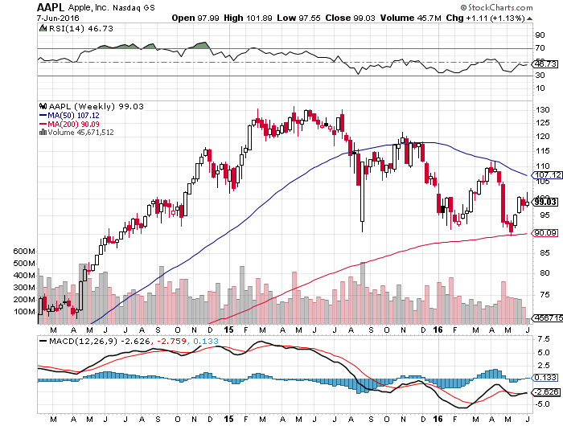
Apple (AAPL) –Buy the Dips Back to waiting for the next real catalyst-the iPhone 7 The “Buffet Put Option” kicks in with $1 billion purchase

Slide 31
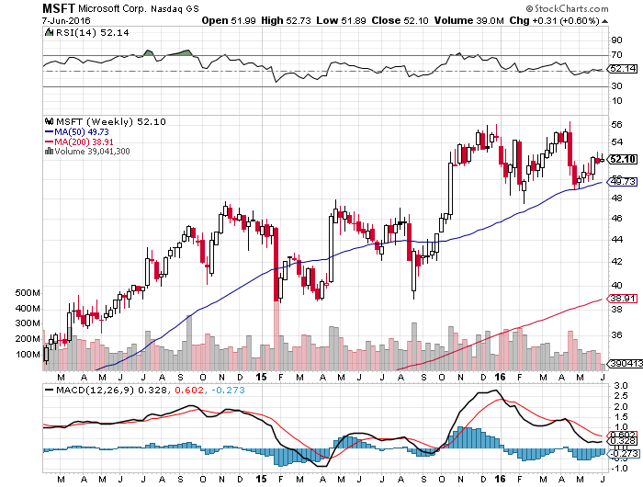
Microsoft (MSFT) Disappointment creates an entry point

Slide 32
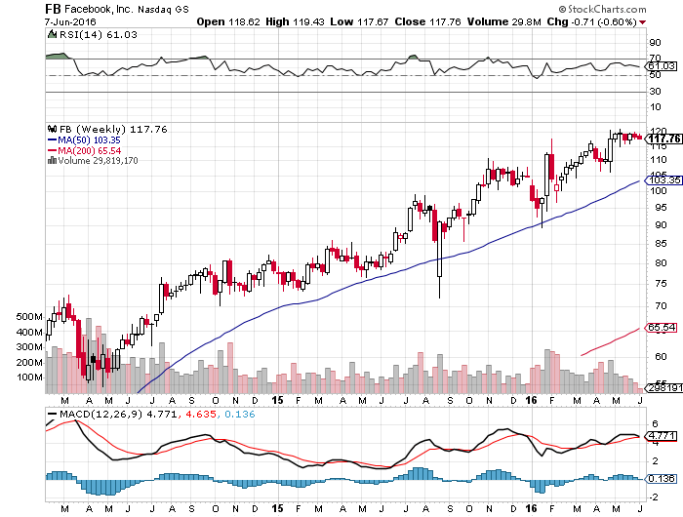
Facebook (FB) Tech Wreck creates an entry point

Slide 33
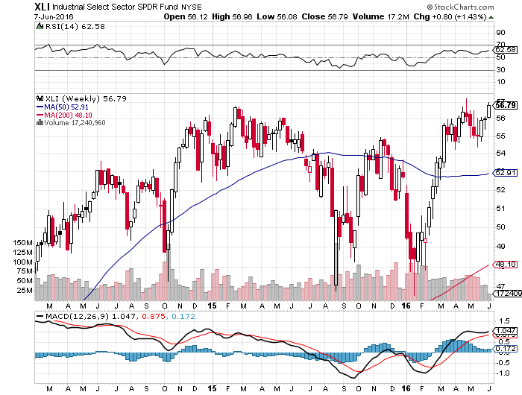
Industrials Sector SPDR (XLI)-Dow Mainstay (GE), (MMM), (UNP), (UTX), (BA), (HON)

Slide 34
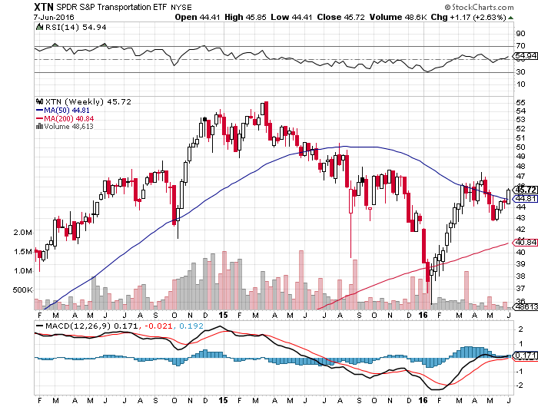
Transports Sector SPDR (XTN)-Another Dow Mainstay (ALGT), (ALK), (JBLU), (LUV), (CHRW), (DAL),

Slide 35
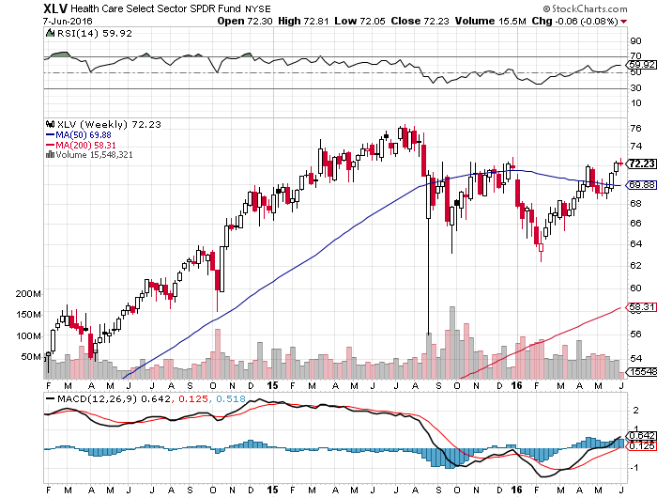
Health Care Sector SPDR (XLV), (RXL) (JNJ), (PFE), (MRK), (GILD), (ACT), (AMGN)

Slide 36
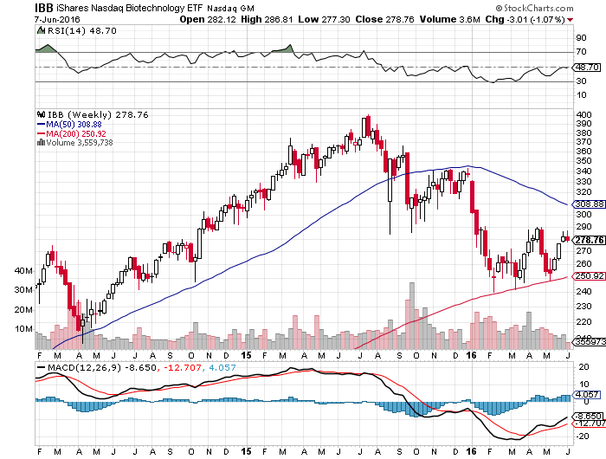
Biotech iShares (IBB)-A Political Football in 2016

Slide 37
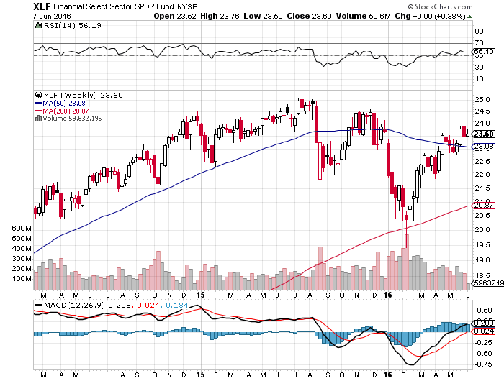
Financial Select SPDR (XLF)-A big Fed Assist lower interest rates mean lower bank stocks (BLK/B), (WFC), (JPM), (BAC), (C), (GS)

Slide 38
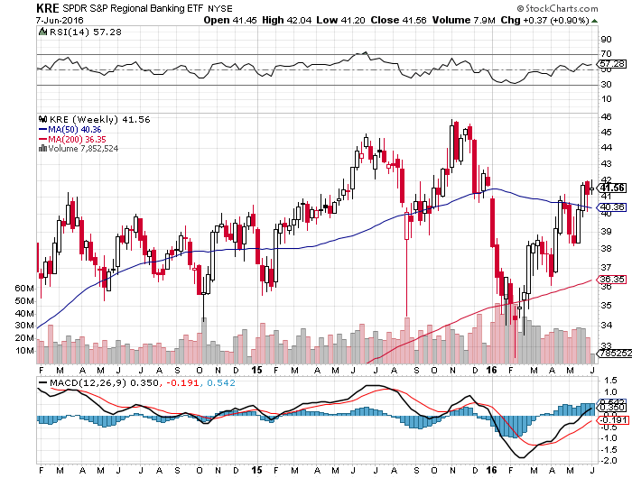
KRE Regional Bank ETF (KRE)-

Slide 39
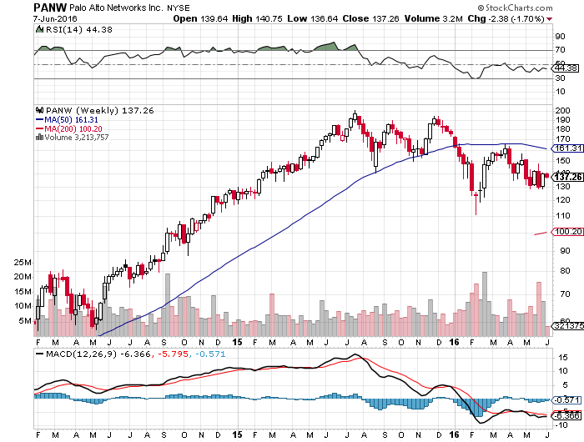
Palo Alto Networks (PANW)- another entry point setting up

Slide 40
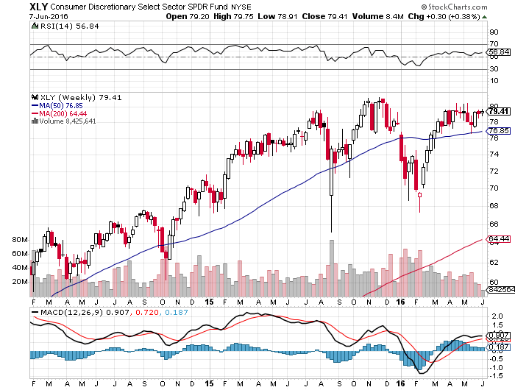
Consumer Discretionary SPDR (XLY) (DIS), (AMZN), (HD), (CMCSA), (MCD), (SBUX) A Major Leader of the Rally

Slide 41
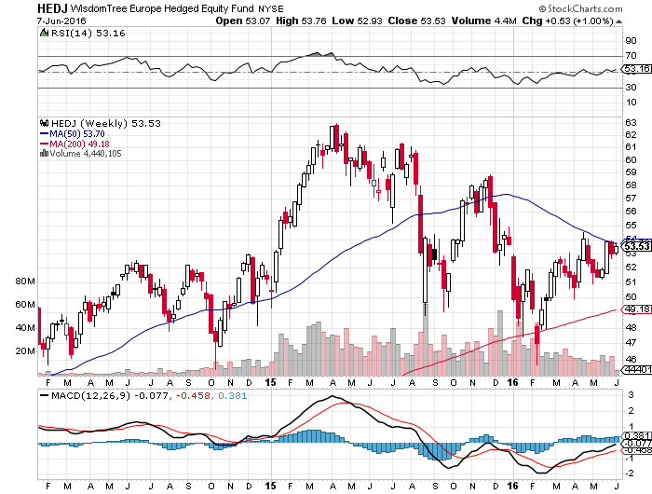
Europe Hedged Equity (HEDJ)-Hedged European Equity Capped by strong euro

Slide 42
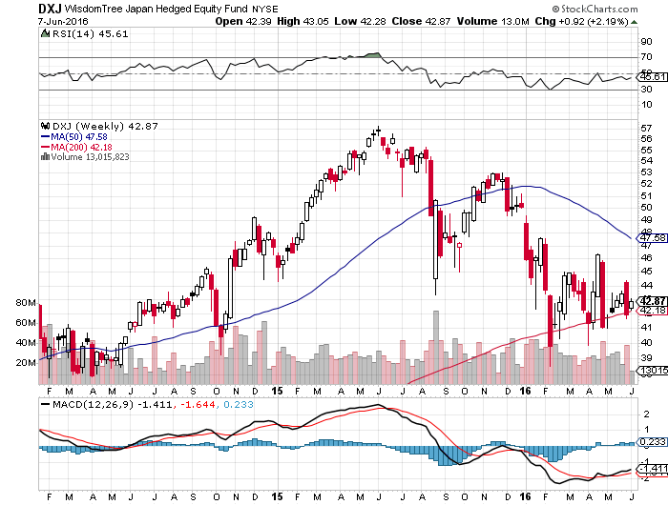
Japan (DXJ)-Hedged Japan Equity Strong Yen Problem

Slide 43
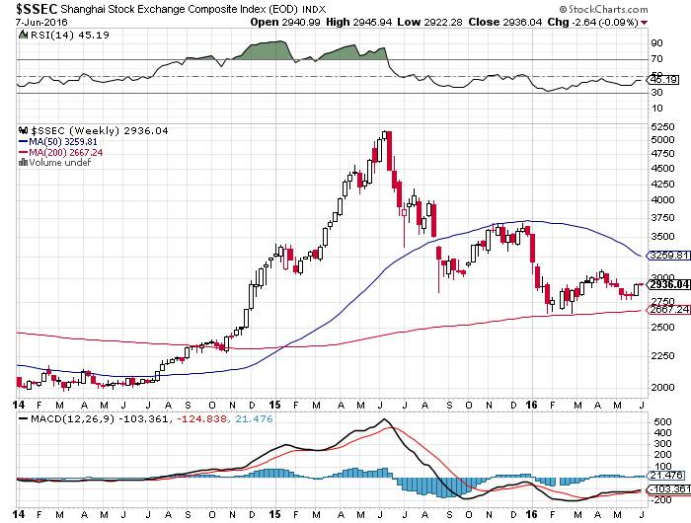
China ($SSEC)- The Bad Boy Market and font of volatility

Slide 44
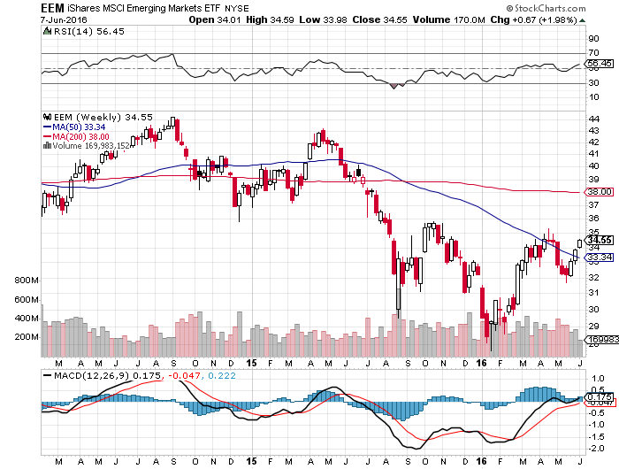
Emerging Markets (EEM)-

Slide 45

Foreign Currencies-Dollar Deflates
*Dovish Yellen talk deflates the dollar *Japan cancels 2017 consumption tax hike, Yen rockets, gets a second leg from fading Fed rate rise hopes *Chinese Yuan grinds down, as engineered by the government *”Brexit” polls still running even, but should favor staying in the referendum run up, causing short covering rally in the pound *Commodities rally revives the Aussie (FXA) and Loonie (FXC)

Slide 46
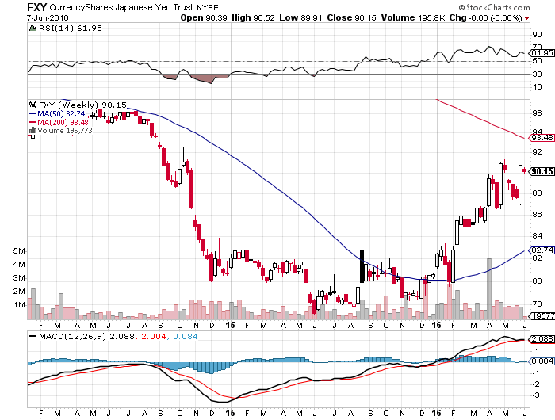
Japanese Yen (FXY)-Double Top Long 6/$94-$91 vertical bear put spread-7 days to expiration

Slide 47
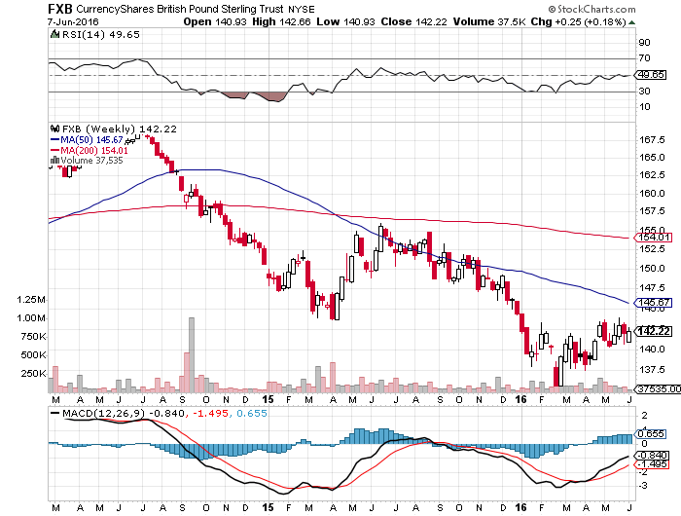
British Pound (FXB)- Short Covering Ahead of June 23 Referendum

Slide 48
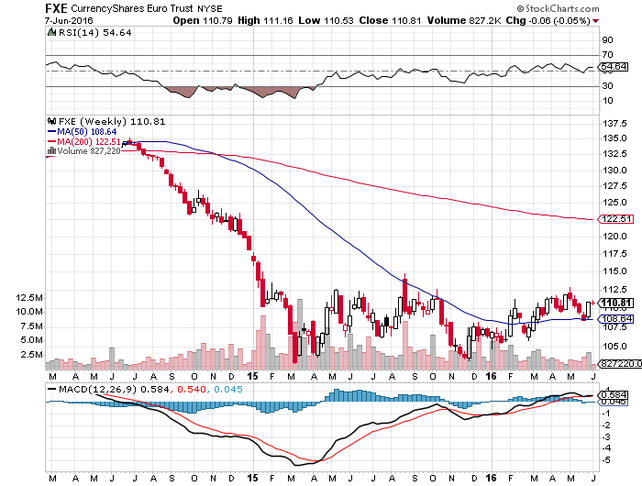
Euro ($XEU), (FXE), (EUO)- “Brexit” fears Dead Weight took profits on long 5/$113-$116 vertical bear put spread

Slide 49
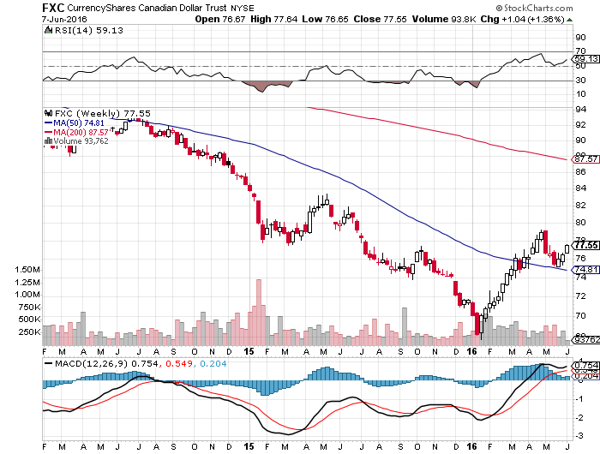
Canadian Dollar (FXC)-Strong Dollar and Alberta Fires Hurt

Slide 50
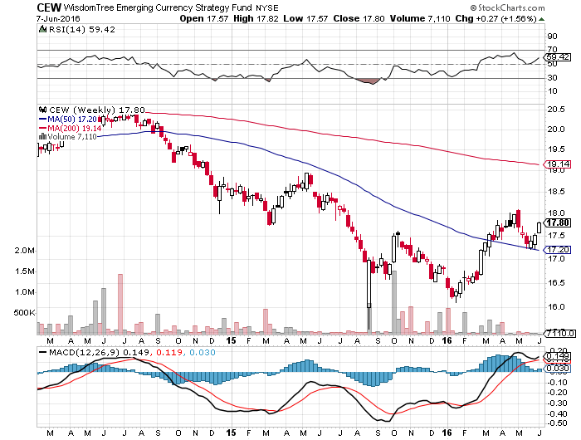
Emerging Market Currencies (CEW)

Slide 51
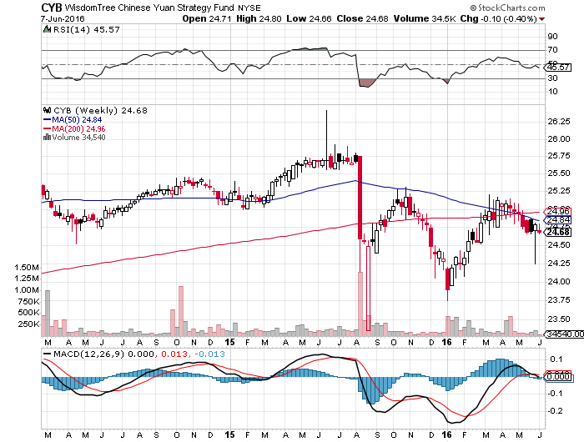
Chinese Yuan- (CYB)-Sell Rallies on Weakening Economy Rolling Over?

Slide 52
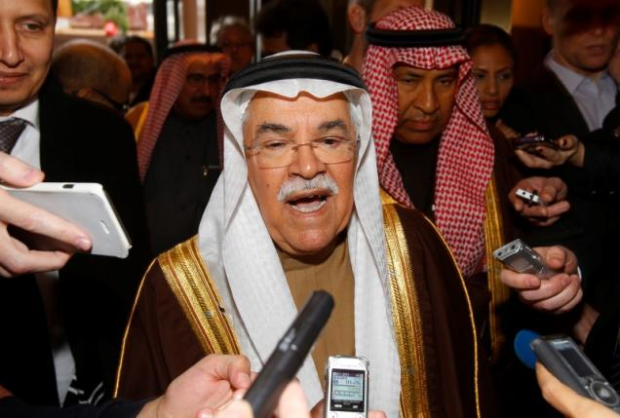
Energy-Levitating
*OPEC Vienna meeting falls flat, nothing accomplished, not production ceilings * No one wants to chase oil at a one year high, but no one wants to sell short either *At 94 million barrels a day, the world is structurally still producing 2 million b/d more than it needs *However, temporary supply disruptions of 3.5 million b/d in Canada, Libya, Nigeria, and Venezuela keeping prices high *$50 is a sweet spot that allows smaller producers to stay in business, buy cheap enough to keep the global economy growing *Stronger US dollar still weighing on prices, US rig count up 9 to 325 *Oil could stay in a $40-$60 range for a long time *Energy stocks have already discounted the rise to $60, so stay away

Slide 53
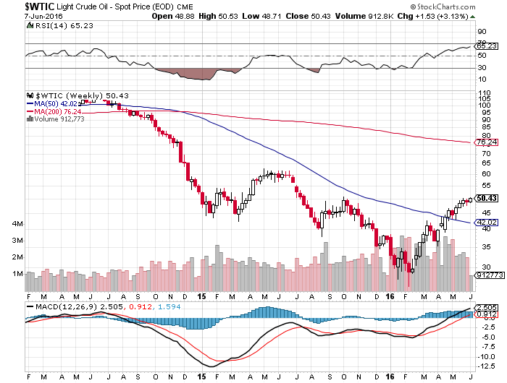
Oil-Topping Out

Slide 54
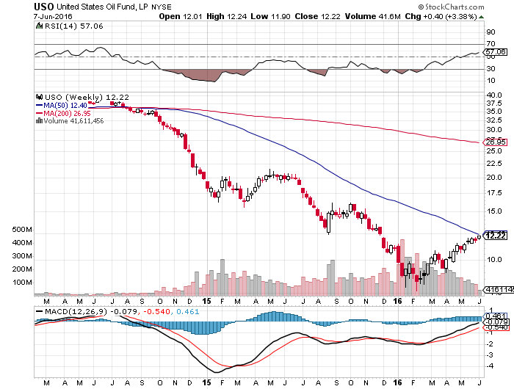
United States Oil Fund (USO) took profits on long 5/$$11.50-$12.50 vertical bear put spread

Slide 55
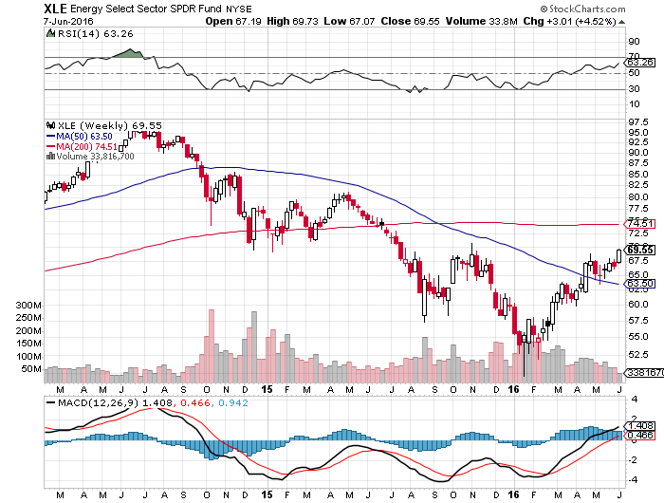
Energy Select Sector SPDR (XLE) (XOM), (CVX), (SLB), (KMI), (EOG), (COP)

Slide 56
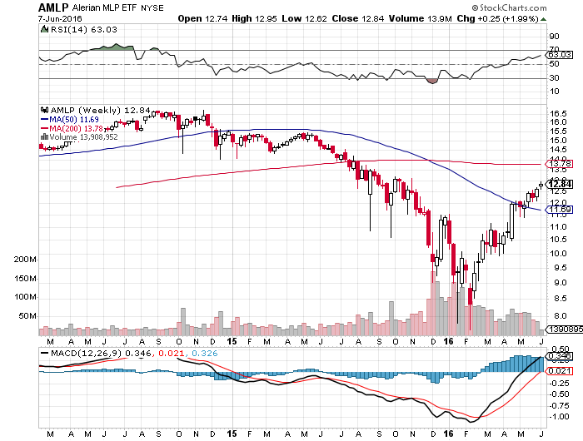
Alerian MLP ETF (AMLP)-9.08% Yield Basket Approach is the Only Safe Play here

Slide 57
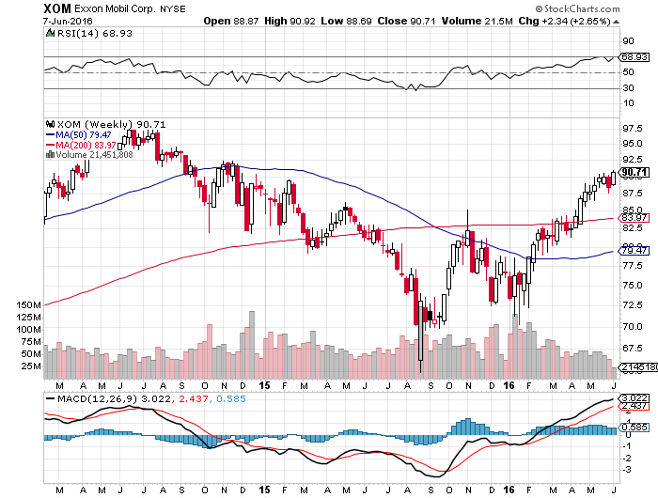
Exxon (XOM)-love that dividend!

Slide 58
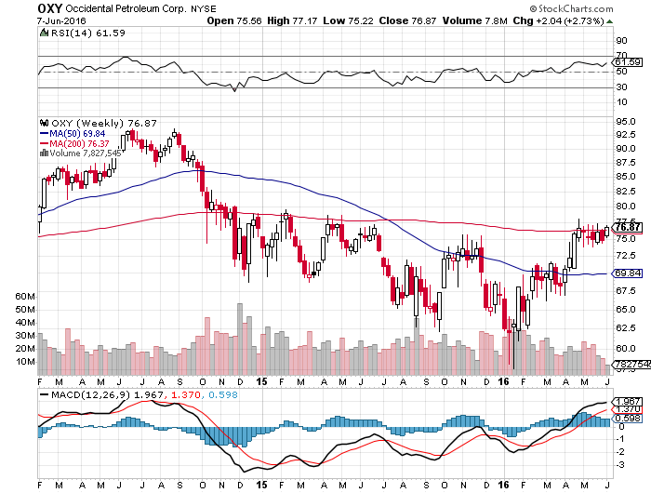
Occidental Petroleum (OXY)-

Slide 59

Conoco Phillips (COP)-The Buffet Favorite

Slide 60

Natural Gas (UNG)-Headed for Negative Prices

Slide 61

Copper-The Bottom is In

Slide 62

Precious Metals-Fed Revival
*Prospect of an imminent Fed rates rise diminishes, brings gold back to life *All other low interest rate plays, like utilities, recover *Indian jewelers, among the world’s largest buyers, find themselves with larger than usual inventories *Comex speculative futures positions have rapidly pared down, reducing long overhang *Everything now hangs on the Fed June 15 move

Slide 63

Gold (GLD)-Stand aside took profits the 4/$109-$112 vertical bull call spread stopped out of long 5/$115-$118 call spread

Slide 64

Market Vectors Gold Miners ETF- (GDX)

Slide 65

Silver (SLV)-

Slide 66

Silver Miners (SIL)-

Slide 67

Platinum (PPLT)-The Gold Effect

Slide 68

Palladium (PALL)-

Slide 69

Agriculture-Finally!
*Long awaited rotten weather finally causes Ag prices to surge across the board *Monster storms hit Texas and Oklahoma, dropping 20 inches in a weekend *Dollar collapse gives further boost *No trade, there are NO fish to fry *My main job here is to keep traders away from this sector this year

Slide 70

(CORN) – Recovery

Slide 71

(WEAT) Short Squeeze

Slide 72

(SOYB) On Fire

Slide 73

Ag Commodities ETF (DBA)-

Slide 74

Real Estate-Ticking Along
*30 year fixed rate loans approaching new all time lows, giving support to the market *In Europe, 5 year 5/1 ARMS can now be had for 1.8% *Subprime and “doc lite” loans making a comeback, Wells Fargo launches 3% down loan *Recent mortgage applications drop 4.1% on lack of inventory, which is down 3.6% YOY, with Portland, Kansas City, and Dallas the worst *Homebuilder stocks all beat forecasts, stocks rise *March Case Shiller S&P 500 National index continues upward grind, January +5.0%

Slide 75

March S&P 500/Case–Shiller Home Price Index +5.0% YOY, Seattle, Denver, Portland

Slide 76

US Home Construction Index (ITB) (DHI), (LEN), (PHM), (TOL), (NVR)

Slide 77

Trade Sheet So What Do We Do About All This?
*Stocks- stand aside-wait for a big dip to buy *Bonds-buy dips, trading range until June 17 *Commodities-buy dips long term *Currencies- sell yen *Precious Metals –stand aside on rate rise risk *Volatility-sell short spikes over $25, buy dips to $12 *The Ags –stand aside - *Real estate-buy the homebuilders LT

Slide 78

To buy lunch tickets, please go to www.madhedgefundtrader.com , click on “LUNCHES,” and then your desired country and city Next Strategy Webinar 12:00 EST Wednesday, July 6, 2016 Dubrovnik, Croatia
Good Luck and Good Trading!
Notes:
*

