Slide 1
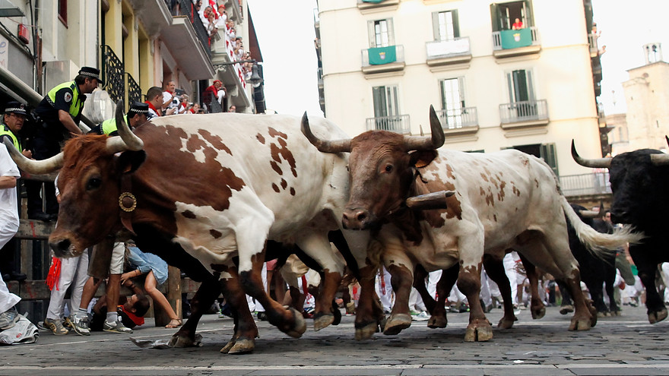
The Mad Hedge Fund Trader
“New Highs!”
With John Thomas
from Zermatt, Switzerland July 20, 2016
www.madhedgefundtrader.com
Notes:
*

Slide 2


Slide 3

MHFT Global Strategy Luncheons
Buy tickets at www.madhedgefundtrader.com
Zermatt, Switzerland
July 22
Basel, Switzerland
July 27

Slide 4
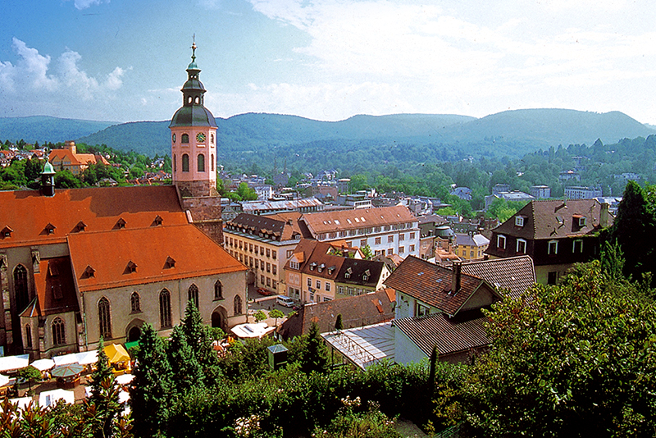
MHFT Global Strategy Luncheons
Buy tickets at www.madhedgefundtrader.com
Last Minute Addition!
Baden-Baden, Germany
July 26

Slide 5
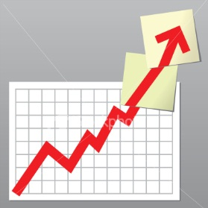
Trade Alert Performance
Making Big Profits in Dire Market Conditions
*January +1.23% Final *July +0.42% MTD
*February +4.50% Final *August +1.27% Final
*March -2.42% Final *September +11.99% Final
*April -2.10% Final *October Final -6.19%
*May +4.38% Final *November MTD 5.78%
*June -0.56% Final *December -4.94%
*2016 Year to Date +5.53%
compared to 6.3% for the Dow Average
*Trailing 1 year return +12.90%, +197.21% since inception,
*Average annualized return of 35.32%

Slide 6
Portfolio Review
Running a small Short Dated Book
on a strong dollar move
Mad Hedge Fund Trader
Model Trading Book
Asset Class Breakdown
Risk Adjusted Basis
Current Capital at Risk
Risk On
World is Getting Better
no position
Risk Off
World is Getting Worse
(SPY) 221-$224 put spread | -10.00%
total net position | -10.00%
Expiration P&L
6.90%

Slide 7

The Method to My Madness
Dipping a Toe Back Into the Water
*Starting to take small positions against the most extreme moves
*My sideways wedge with an eventual upside breakout model for stocks worked, but ended a month early
*Buy “RISK ON” assets on every substantial dip
*Wait the extra day and let the market come to you
*The game from here on is to position yourself for
a pre/post US presidential election stock melt up
and a global risk on rally

Slide 8
Paid Subscriber Trailing 12 Month Audited Return +12.90%-Staying Flat Just Short of an All Time High

Slide 9
67 Months Since Inception
Daily Audited Performance
Averaged annualized return +35.32%

Slide 10

Short Term Strategy Outlook
*Market has gone from Brexit to Brexit delay or Brexit cancellation in weeks
*No market impact from Republican convention. Trump isn’t going to talk about how much money he made in the stock market over the past seven years
*No chance of a rate rise in 2016 triggering global “RISK ON” rally
*Flight to safety bid sends dollar to new 2016 highs, except against the yen, the buck should remain strong for the rest of 2016
*Oil keeps gravitating back to $50, with supply and demand coming closer to balance
*Keep buying bonds on dips until proven wrong
*Gold uptrend still lives, buy dips
*Volatility at a bargain basement price, buy as a
hedge against other assets
*Stay away from ags, perfect weather to new lows.

Slide 11
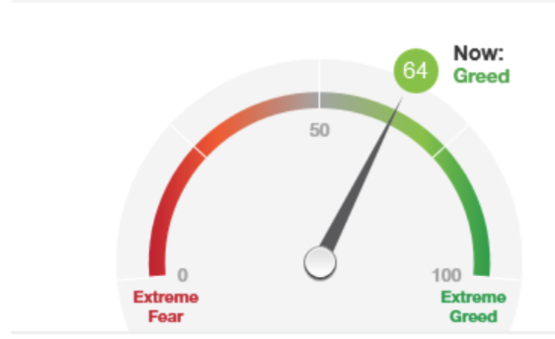
Brexit Took it only Back to the Mean

Slide 12
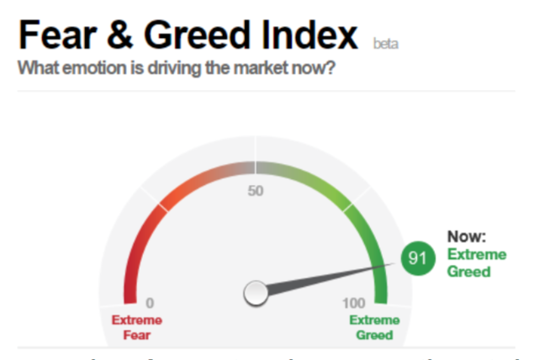
And then New All Time Highs

Slide 13
The Bill Davis View
A $1,500 Upgrade for the Mad Day Trader Service
Buys:
Baidu, Inc. (BIDU) $156 Target to $175
Chipotle Grill (CMG) $406 Target to $469
Franklin Resources (BEN) $33 Target to $39
Martin Marietta (MLM) $192 Target to $203
3M Co. (MMM) $176 Target to $185
Tesla Motors (TSLA) $223 Target to $230
Tesaro (TSRO) $87 Target to $92
Sells:
Red Hat, Inc (RHT) $74 Target to $62
Stamps.com (STMP) $75 Target to $67
Buffalo Wild Wings (BWLD) $142 Target to $133
ConocoPhilips (COP) $45 Target to $37

Slide 14

The Global Economy-The American Island of Stability
*UK economic data is worsening by the day, dragging Europe down with it
*Bank of Japan marks down 2016 inflation forecast from 2.0% to only 0.40%, so more helicopter money to come
*China reports GDP at an annualized 6.7%, new 6 year low
*All economic data points are now meaningless and useless, it will take three months for them to reflect the Brexit impact
*Upside momentum in oil has been broken
*Despite all this, US stocks and bonds are still the
most attractive, highest yielding assets in the
world, both should move to new highs
*Fortress American looking strong

Slide 15
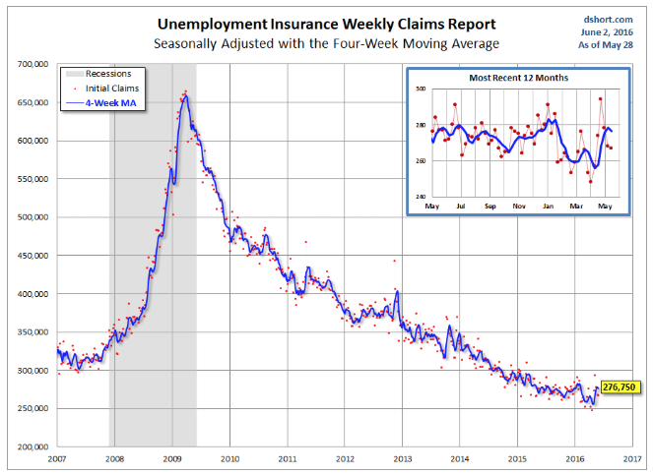
Weekly Jobless Claims –The Most Important Statistic
110,000 to 254,000-Lowest since 1973!
The Downtrend Lives!-Show Me the Recession!

Slide 16


Slide 17

Bonds-Backing Off
*Ten year US Treasuries back off 1.56% yield, but still maintaining Brexit breakout, so 1.00% is still on the table
*US Treasury reports $6 billion budget surplus in June, overall deficit holds at $400 million, down 75% from 2009 peak, exacerbating bond shortage
*JGBs ease to -0.24%, German bunds to -0.02%, the UK is next to see negative bonds rates
*Even emerging market debt rockets
thanks to high yields
* Junk bonds (HYG) maintain new
year highs on global “RISK ON”

Slide 18
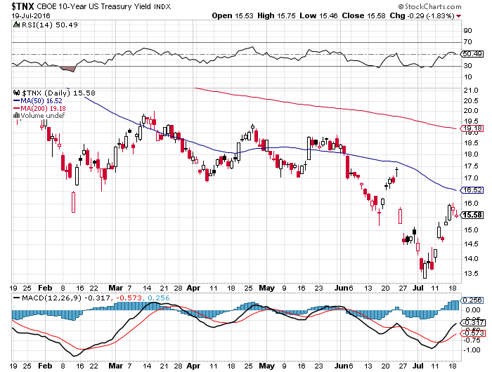
Ten Year Treasury Yield ($TNX) 1.56%
Classic Retest of Old Support

Slide 19
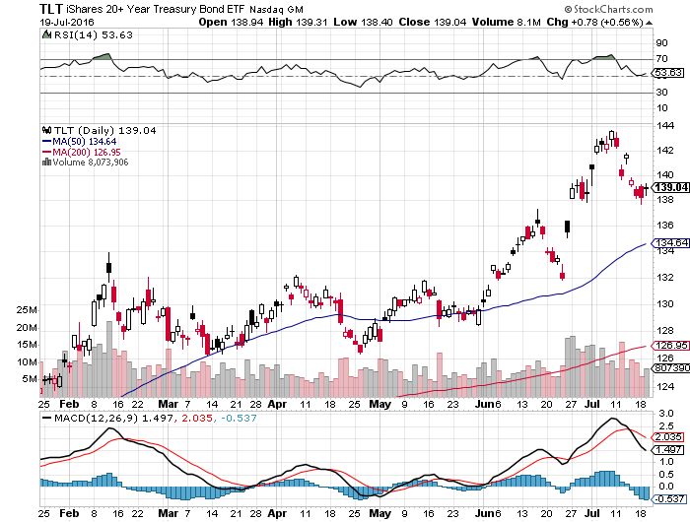
Ten Year Treasury ETF (TLT) 1.36%
Looking at long 6/$132-$135 vertical bull call spread

Slide 20
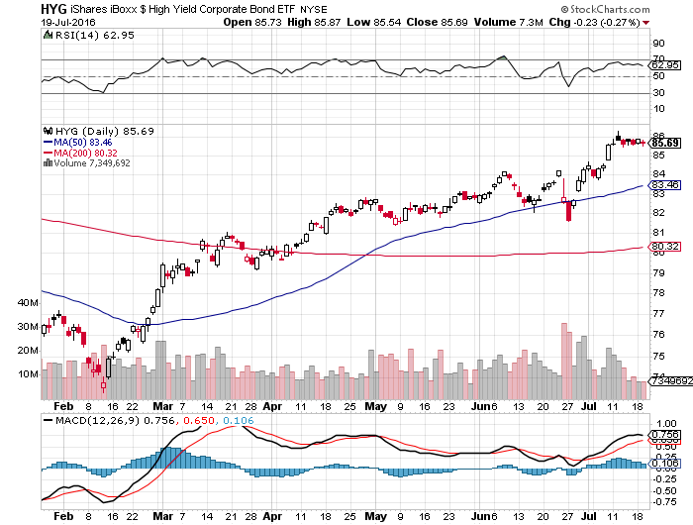
Junk Bonds (HYG) 6.33% Yield
A Great Risk Coincident Indicator-”RISK ON” means new highs

Slide 21
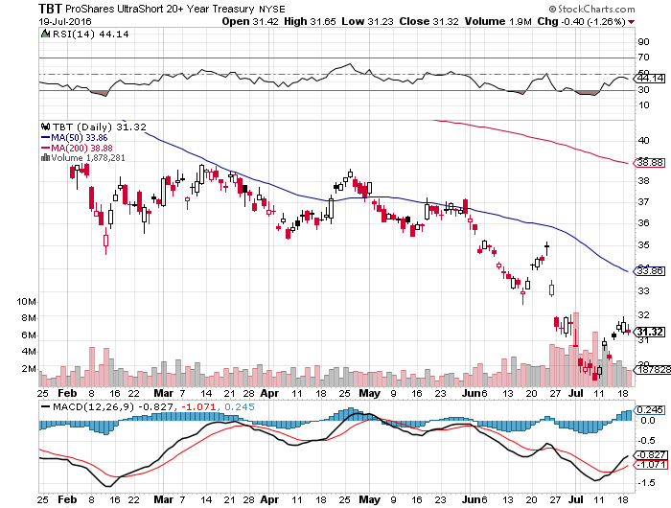
2X Short Treasuries (TBT)- Looking Like a 2017 Trade

Slide 22
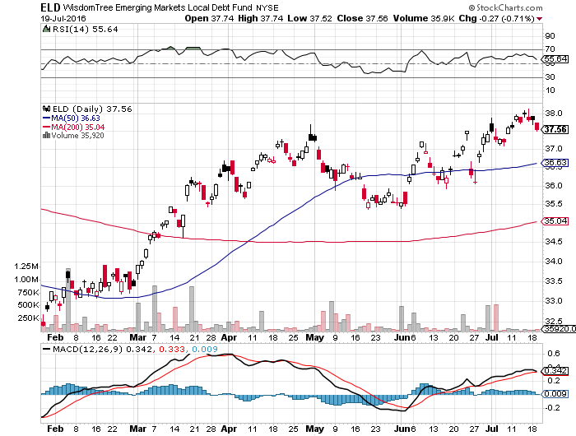
Emerging Market Debt (ELD) 5.75% Yield-

Slide 23
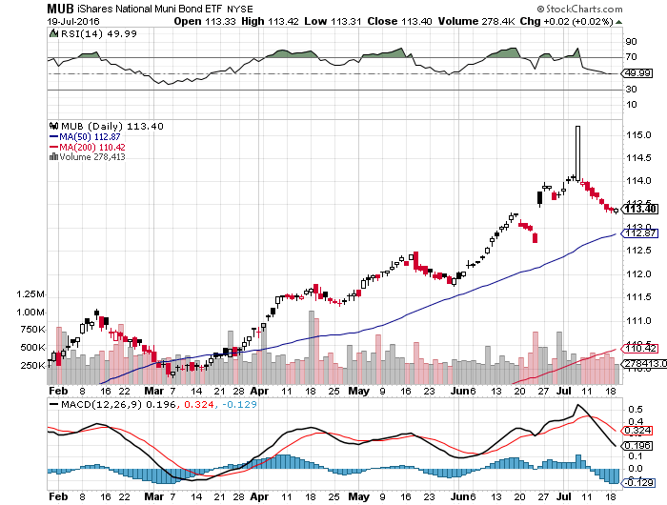
Municipal Bonds (MUB)-1.21% yield-New High
Mix of AAA, AA, and A rated bonds-flight to safety

Slide 24


Slide 25

Stocks-New Highs!
*Stocks are now a yield play, with the spread over ten year Treasury bonds jumping from 70 to 117 basis points, a leap of 67% that gave us our new highs
*Stocks are now a low return, high risk play with PE multiples approaching 20X
*Technical analysts going crazy, screaming “breakout” everywhere
*Volatility Index (VIX) back to lows of the year creating hedging opportunities
*Positive calendar still three months off,
the “Buy in October” that follows “Sell in May”
*Bounce back leaders reveal who will lead the yearend
rally, including big tech, big pharma, banks,
homebuilders, consumer discretionary, and biotech
*By the way, despite what they are saying today,
no one saw this coming

Slide 26
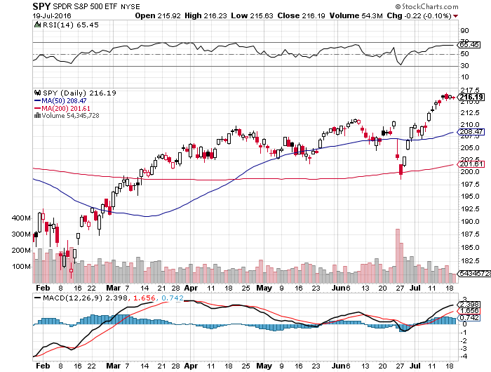
S&P 500-
Break Out At Last!

Slide 27
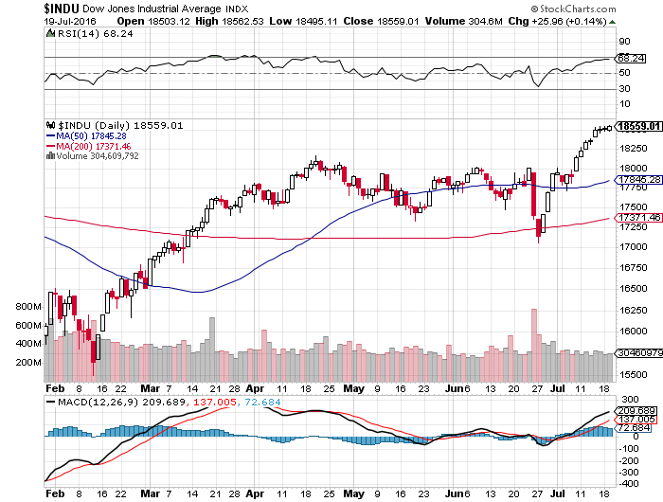
Dow Average-Up 8 Days in a Row

Slide 28
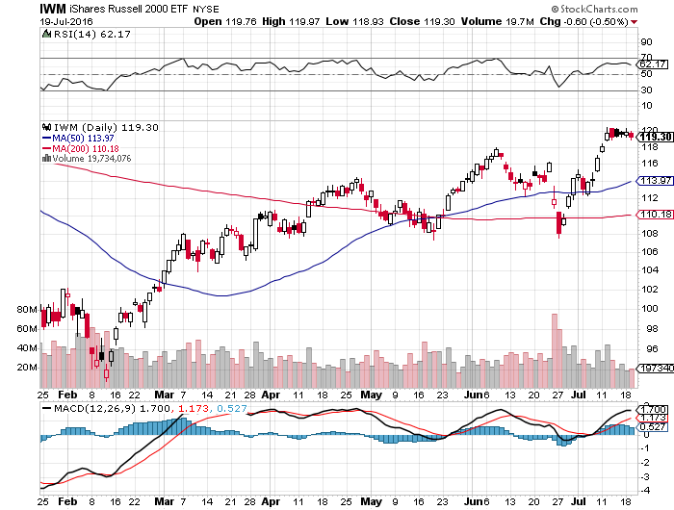
Russell 2000 (IWM)-The Leading Indicator is Lagging

Slide 29
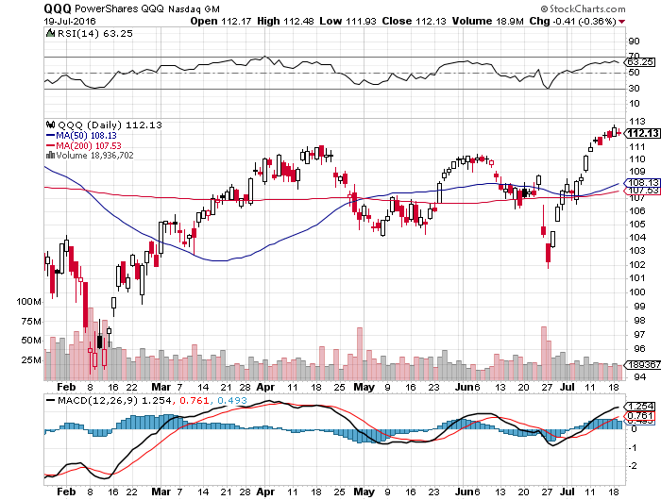
NASDAQ (QQQ)-
For Once, A Laggard

Slide 30
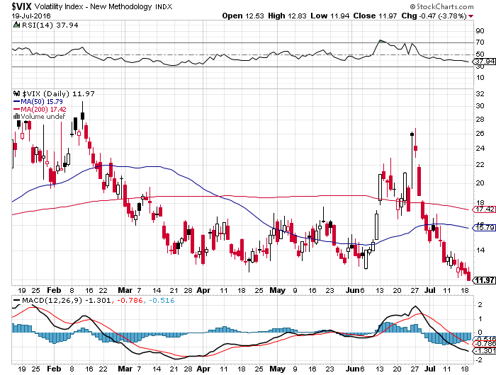
(VIX)-A New Decade Low

Slide 31
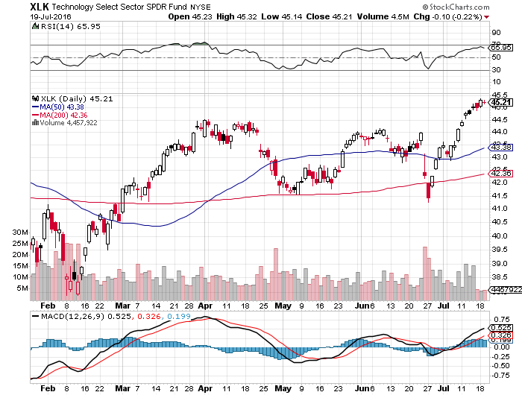
Technology Sector SPDR (XLK), (ROM)
(AAPL), (MSFT), (VZ), (T), (FB), (IBM)

Slide 32
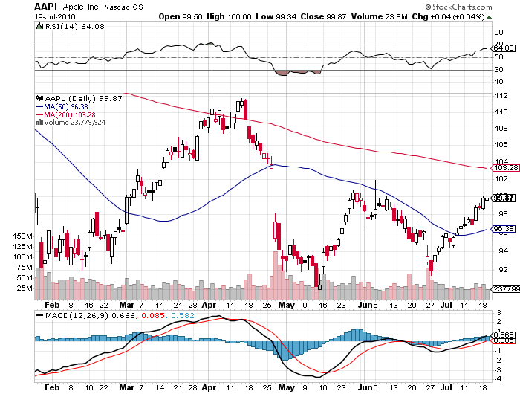
Apple (AAPL) –Buy the Dips
Back to waiting for the next real catalyst-the iPhone 7
The “Buffet Put Option” kicks in with $1 billion purchase

Slide 33
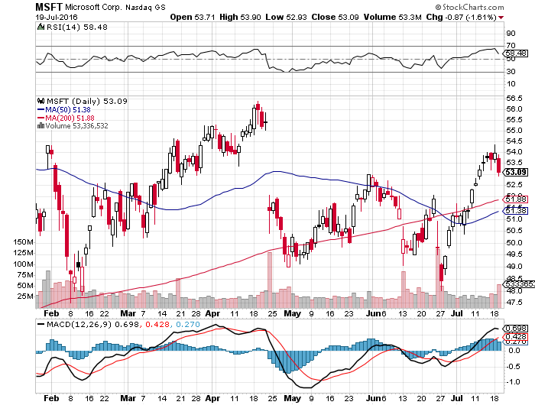
Microsoft (MSFT)
The New Big Cap Tech Leader

Slide 34
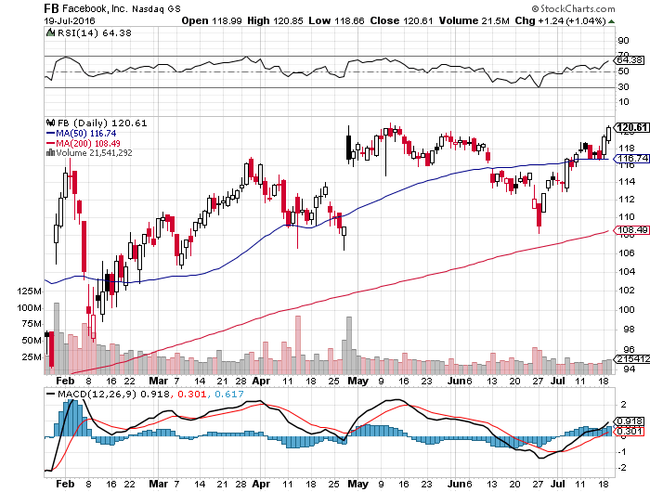
Facebook (FB)- The 50-Day Holds

Slide 35
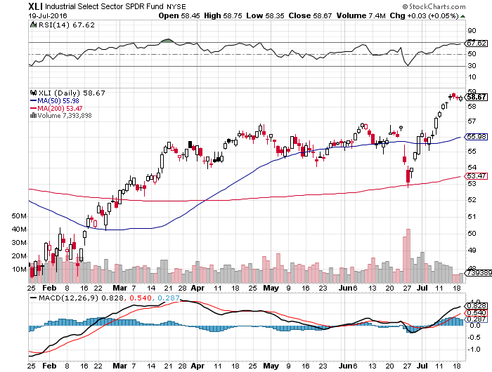
Industrials Sector SPDR (XLI)-Dow Mainstay
(GE), (MMM), (UNP), (UTX), (BA), (HON)

Slide 36
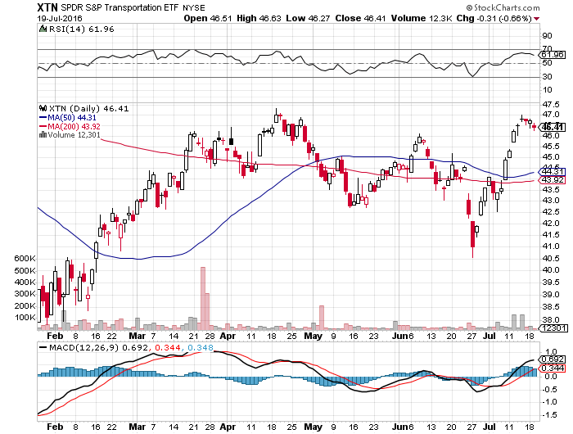
Transports Sector SPDR (XTN)-The Biggest Hit
(ALGT), (ALK), (JBLU), (LUV), (CHRW), (DAL),

Slide 37
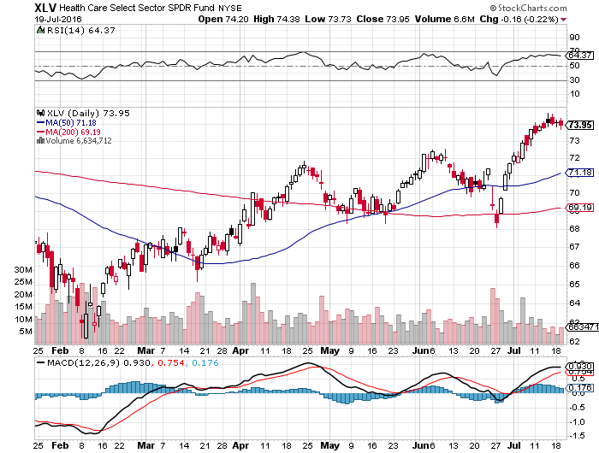
Health Care Sector SPDR (XLV), (RXL)
(JNJ), (PFE), (MRK), (GILD), (ACT), (AMGN)
Upside Breakout Came

Slide 38
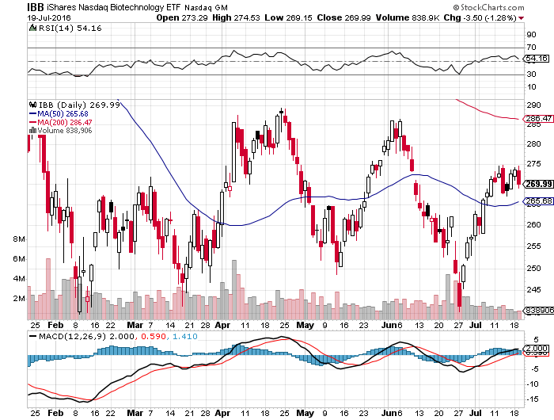
Biotech iShares (IBB)-A Political Football in 2016
Own for 2017

Slide 39
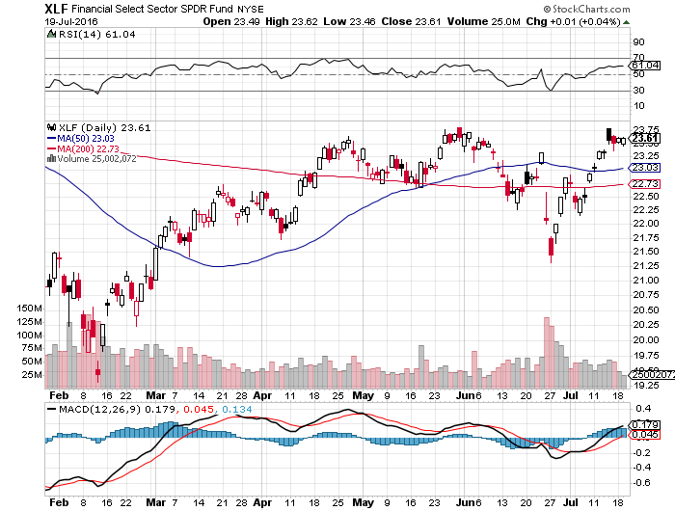
Financial Select SPDR (XLF)-A big Value Play
(BLK/B), (WFC), (JPM), (BAC), (C), (GS)

Slide 40
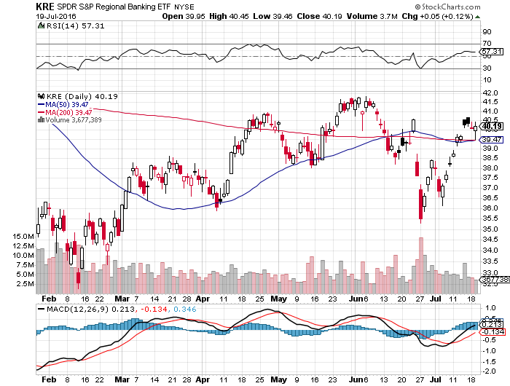
KRE Regional Bank ETF (KRE)-

Slide 41
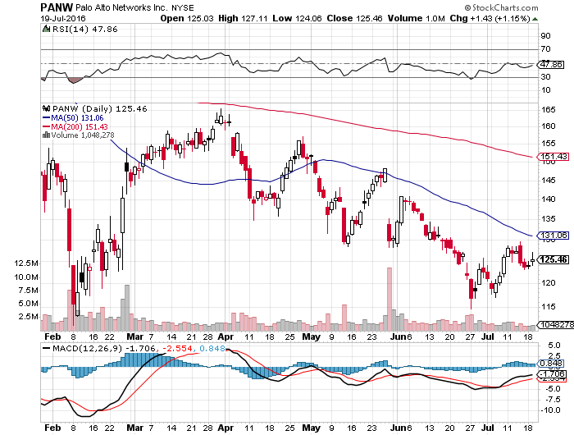
Palo Alto Networks (PANW)- another entry point setting up-Hacking Isn’t Going Away

Slide 42
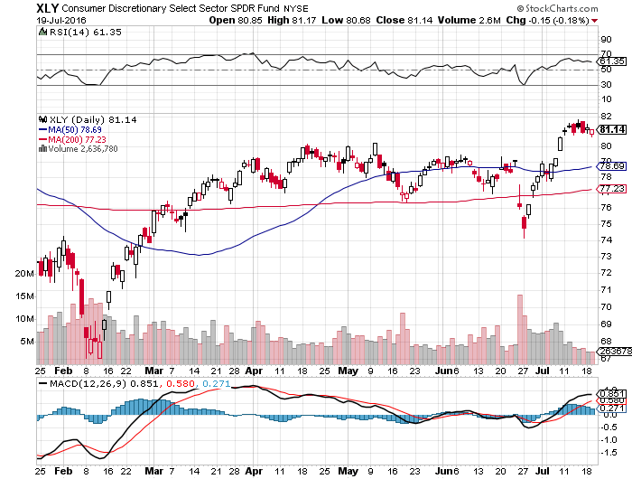
Consumer Discretionary SPDR (XLY)
(DIS), (AMZN), (HD), (CMCSA), (MCD), (SBUX)
A Major Leader of the Rally

Slide 43
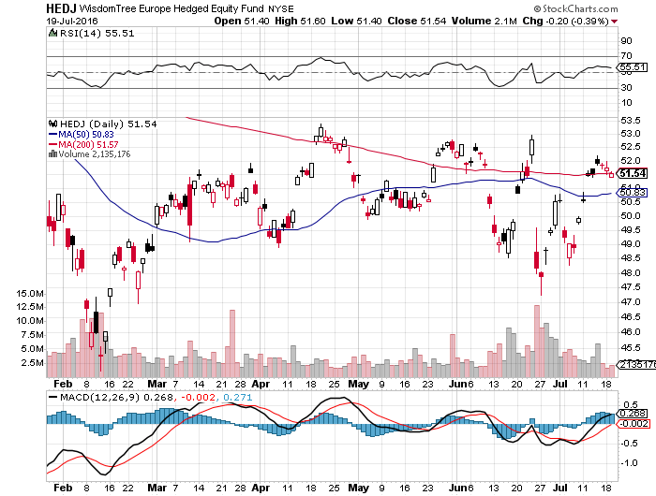
Europe Hedged Equity (HEDJ)-Hedged European Equity
Stay away while Europe suffers-No New High Here

Slide 44
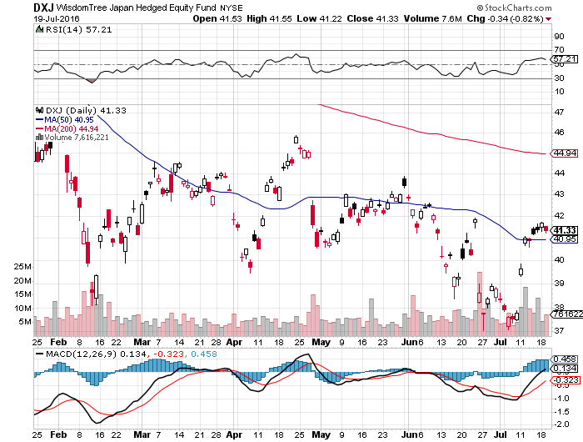
Japan (DXJ)-Hedged Japan Equity
Yen Finally Breaks

Slide 45
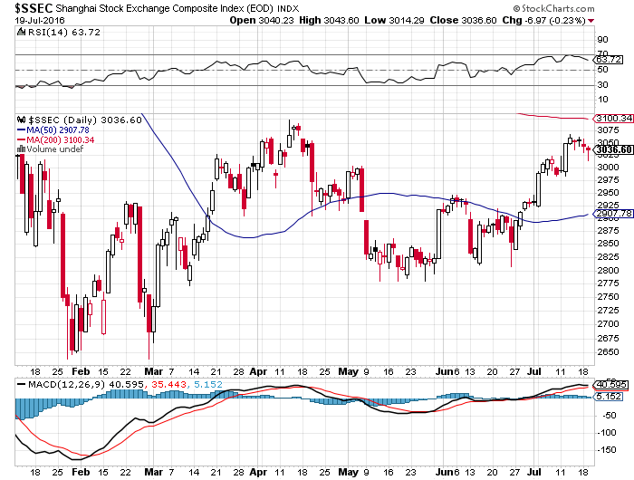
China ($SSEC)-
China Finally Participates

Slide 46
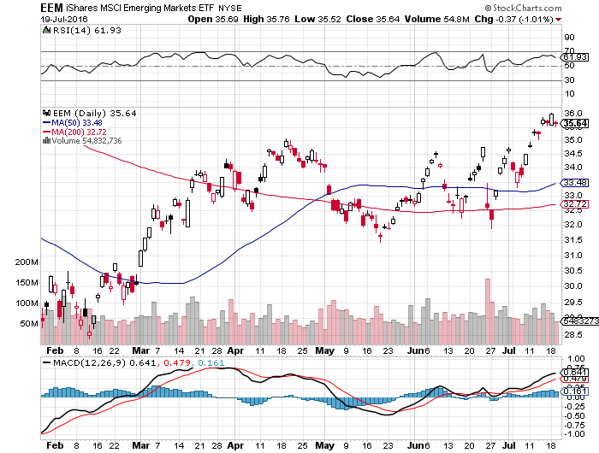
Emerging Markets (EEM)-

Slide 47


Slide 48
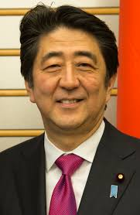
Foreign Currencies-¥100 was the Trigger Point
*Yen hits multiyear peak at ¥100, and then an Abe election win abruptly gives back 5%, the sharpest fall in decades as more “helicopter money” is coming
*With Europe in collapse, and a coup in Turkey, the Euro (FXE) is headed lower
*Chinese Yuan holds on better data, and Aussie rallies
*Steady oil brings a steady Loonie (FXC)
*Bank of England shocks all by keeping
interest rates steady at 0.5%, keeping
dry powder for worse days ahead?
*Collapsing Monetary Base is also pushing up
the buck

Slide 49
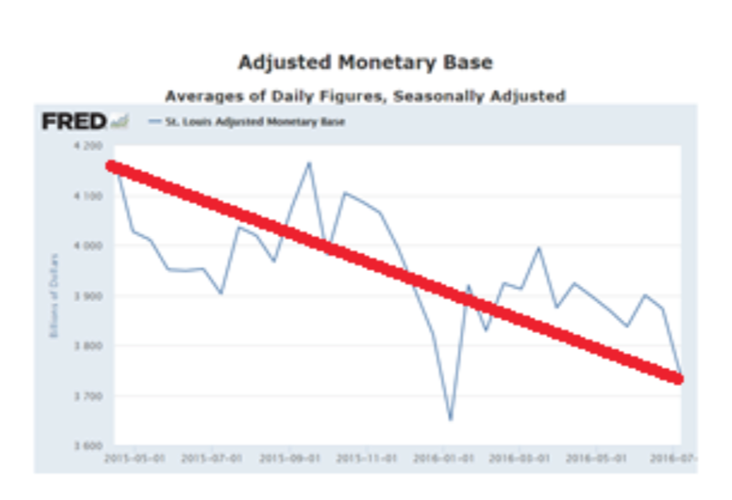
Falling Money Supply Means Stronger Dollar

Slide 50
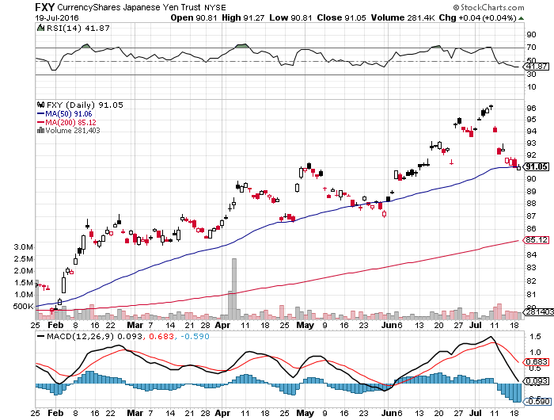
Japanese Yen (FXY)-2 Year High
The Worm Finally Returns-Sell Rallies

Slide 51
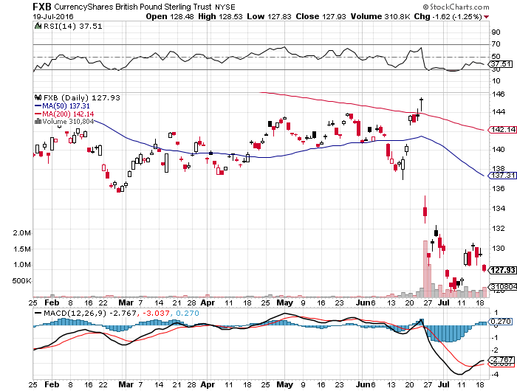
British Pound (FXB)-
Looking for new lows

Slide 52
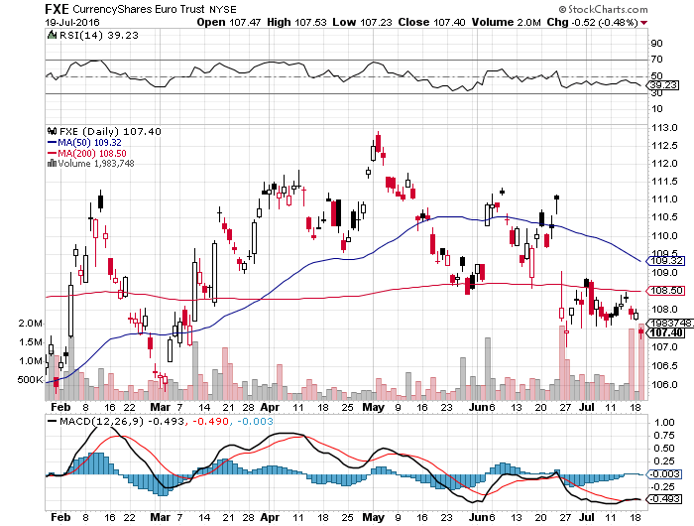
Euro ($XEU), (FXE), (EUO)- Fading Economy took profits on long 5/$113-$116 vertical bear put spread

Slide 53
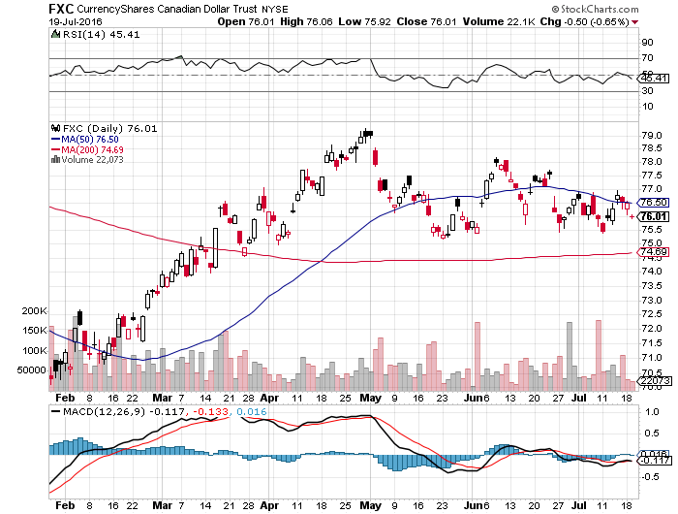
Canadian Dollar (FXC)-Flat Oil Disease

Slide 54
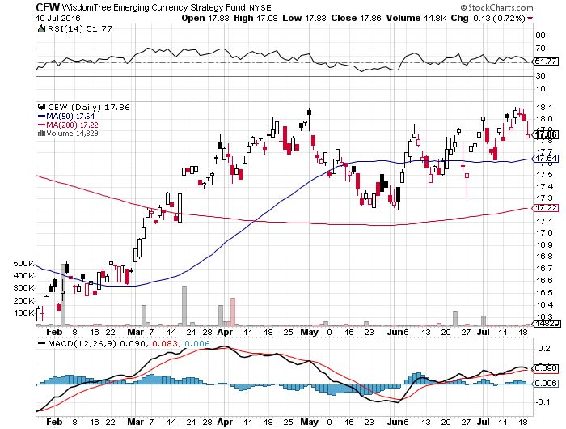
Emerging Market Currencies (CEW)

Slide 55
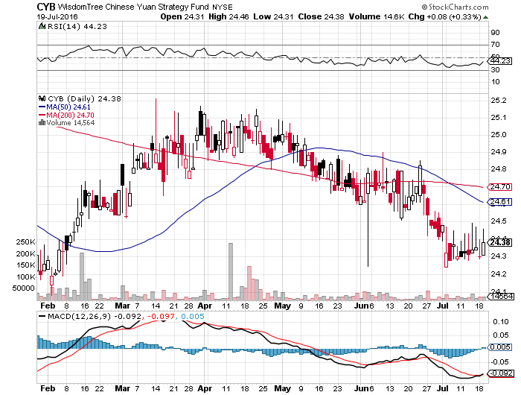
Chinese Yuan- (CYB)-Sell Rallies on Weakening Economy Rolling Over?

Slide 56
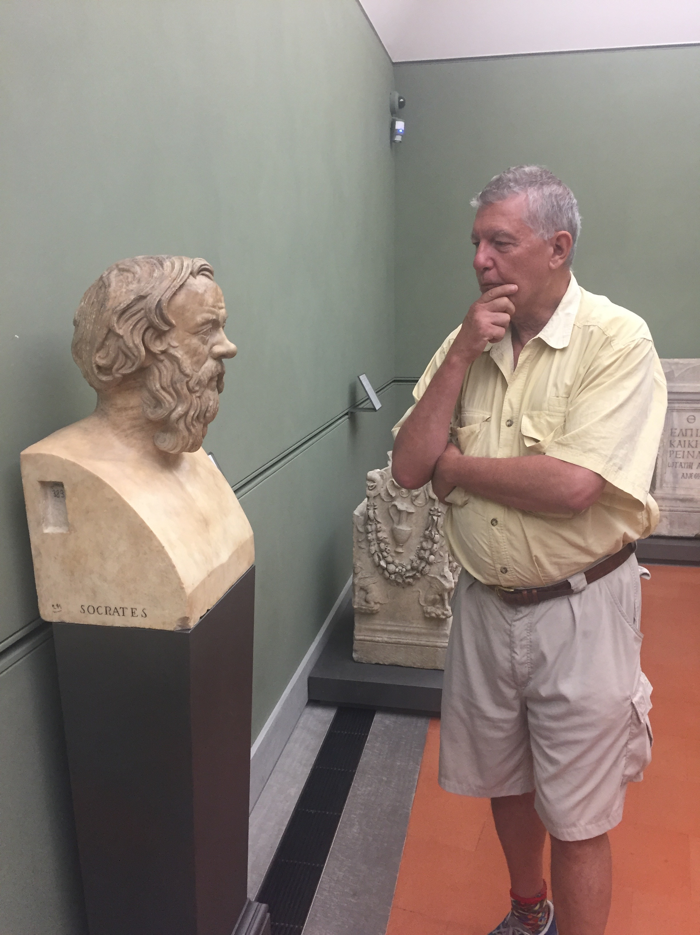

Slide 57

Energy-Global Growth Slowdown
*95 million barrels of oil afloat at sea and full land based storage still keeping a cap on prices
*Oil strike in Libya helps boost oil prices, removing 120,000 b/d from market
*Narrowing contangos are also helping, mean falling bidding for storage
*Stronger US dollar still weighing on prices
*Baker-Hughes US oil rig count up 7 to 347,
continuing a 7 week trend up, all gains in
Louisiana and New Mexico
*Oil could stay in a $40-$60 range for a long time
*Energy stocks have already discounted the
rise to $60, so stay away, but buy MLP baskets

Slide 58
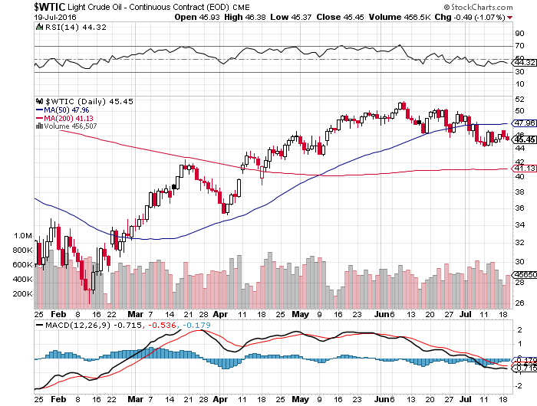
Oil-Topping Out

Slide 59
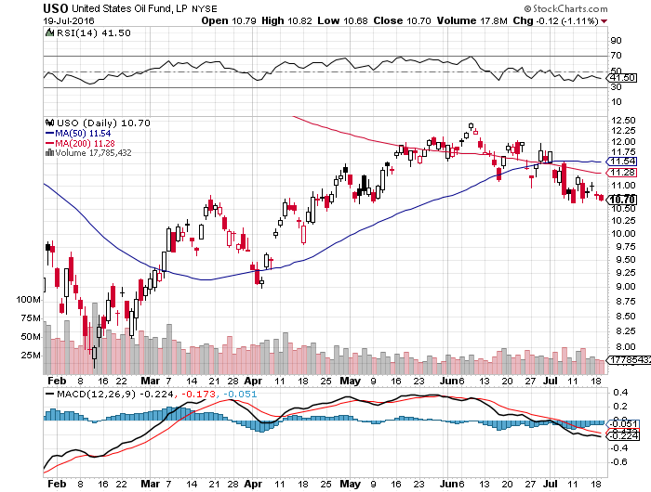
United States Oil Fund (USO)

Slide 60
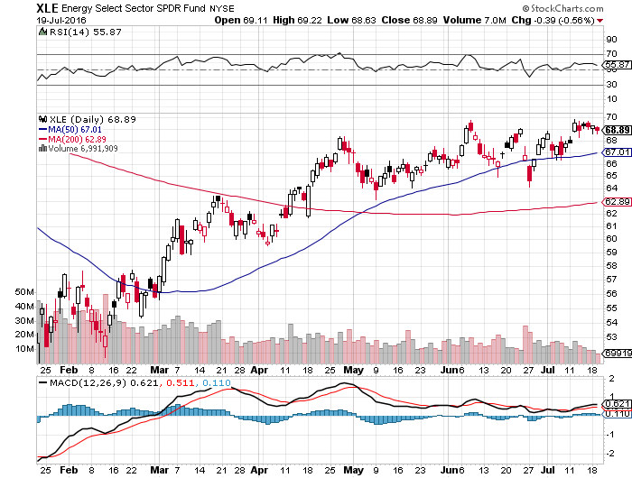
Energy Select Sector SPDR (XLE)
(XOM), (CVX), (SLB), (KMI), (EOG), (COP)

Slide 61
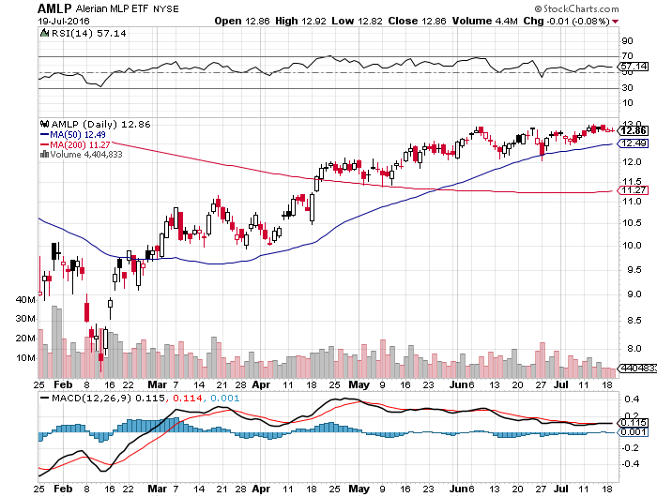
Alerian MLP ETF (AMLP)-6.84% Yield
Basket Approach is the Only Safe Play here

Slide 62
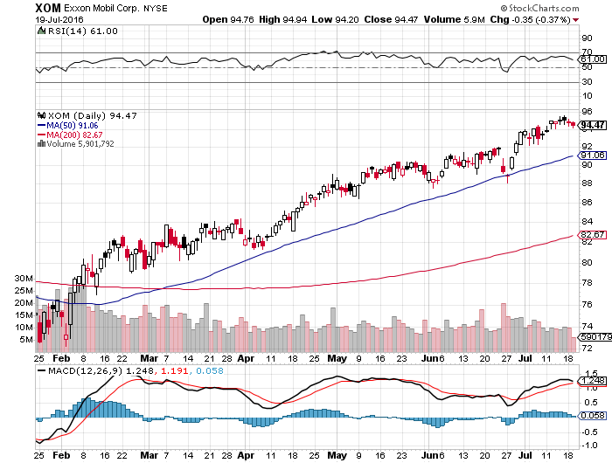
Exxon (XOM)-love that dividend!

Slide 63
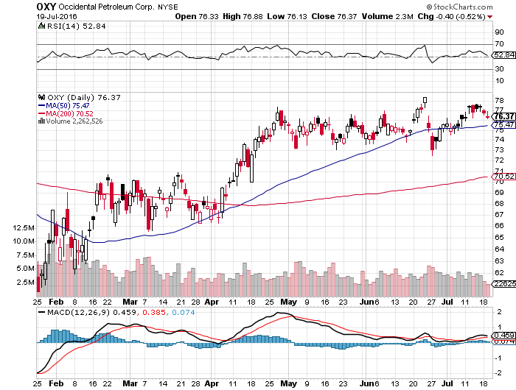
Occidental Petroleum (OXY)-

Slide 64
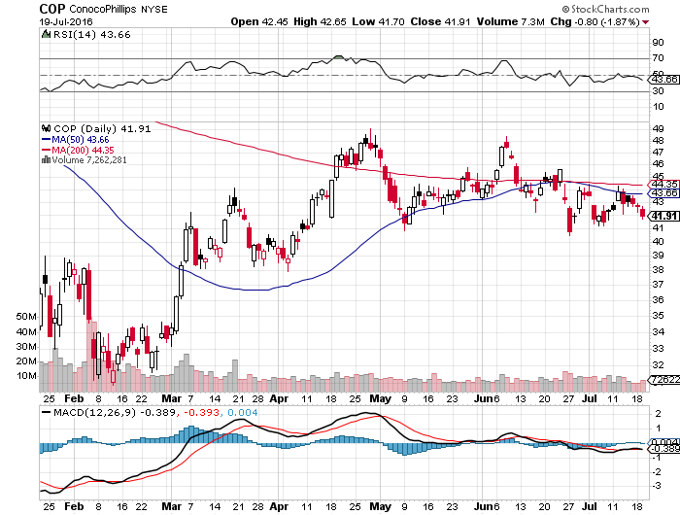
Conoco Phillips (COP)-The Buffet Favorite

Slide 65
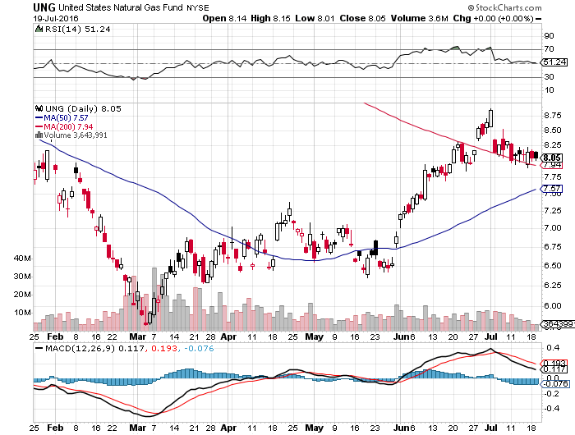
Natural Gas (UNG)-New 2016 Highs!

Slide 66

Copper-No Global Growth Scare Here

Slide 67


Slide 68

Precious Metals-Taking a Break
*Strong dollar gives gold a breather, but big hedge funds and CTA still keeping massive long positions
*China has stepped up selling in recent days, but the Indians aren't buying
*Massive drop in interest rates to negative numbers in many countries creates a de facto positive return on non yielding gold assets
*The opportunity cost of gold ownership
is now the lowest in history
*The secular bull market lives,
just waiting for the next round of
“RISK OFF”

Slide 69

Gold (GLD)-Buy Dips

Slide 70

Market Vectors Gold Miners ETF- (GDX)

Slide 71

Silver (SLV)-

Slide 72

Silver Miners (SIL)-

Slide 73

Platinum (PPLT)-The Gold Effect

Slide 74

Palladium (PALL)-

Slide 75


Slide 76

Agriculture-No Signs of Life
*Perfect US weather keeps ag prices hugging the lows
*Drought has abated in most parts of the country, except for Southern California
*Even two years of drought in India can’t help wheat
*No trade, there are NO fish to fry
*My main job here is to keep traders
away from this sector this year, and
that approach has worked one more time

Slide 77

(CORN) – Gave up all of 2016 Gains

Slide 78

(WEAT) New Lows!

Slide 79

(SOYB) The Sole Survivor

Slide 80

Ag Commodities ETF (DBA)-

Slide 81


Slide 82

Real Estate-Your Best Investment in 2016
*Ultra low interest rates trigger another refi boom as the Brexit bonus kicks in
*Volume up 21% on the week, applications up 113% YOY
*Conventional 30-year fixed rate plunges to 3.66%
*June housing starts +4.8% to 1,189,000 annual rate, +46% in NE, +17% in West
*June new housing permits +1.15%
*The REIT boom keeps powering on
with the reach for yield
*We are still 1 million annual units below
the pre-crash 2.2 million peak
*April Case Shiller S&P 500 National index
continues upward grind, January +5.0%

Slide 83

April S&P 500/Case–Shiller Home Price Index
+5.0% YOY, Seattle, Denver, Portland

Slide 84

General Growth Properties (GGP)

Slide 85

US Home Construction Index (ITB)
(DHI), (LEN), (PHM), (TOL), (NVR)
Another Big Brexit Winner

Slide 86

Trade Sheet
So What Do We Do About All This?
*Stocks- stand aside-wait for a big dip to buy
*Bonds-buy dips
*Commodities-buy dips long term
*Currencies- sell yen on rallies
*Precious Metals –buy dips
*Volatility-sell short spikes over $25, buy dips to $12
*The Ags –stand aside -
*Real estate-buy the homebuilders LT

Slide 87


Slide 88

To buy lunch tickets, please go to www.madhedgefundtrader.com , click on “STRATEGY LUNCH,” and then your desired Country and City
Next Strategy Webinar
12:00 EST Wednesday,
August 3, 2016
San Francisco, CA
Good Luck and Good Trading!
Notes:
*

