Slide 1

The Mad Hedge Fund Trader
“Brexit Brouhaha”
With John Thomas
from Dubrovnik, Croatia July 6, 2016
www.madhedgefundtrader.com
Notes:
*

Slide 2


Slide 3
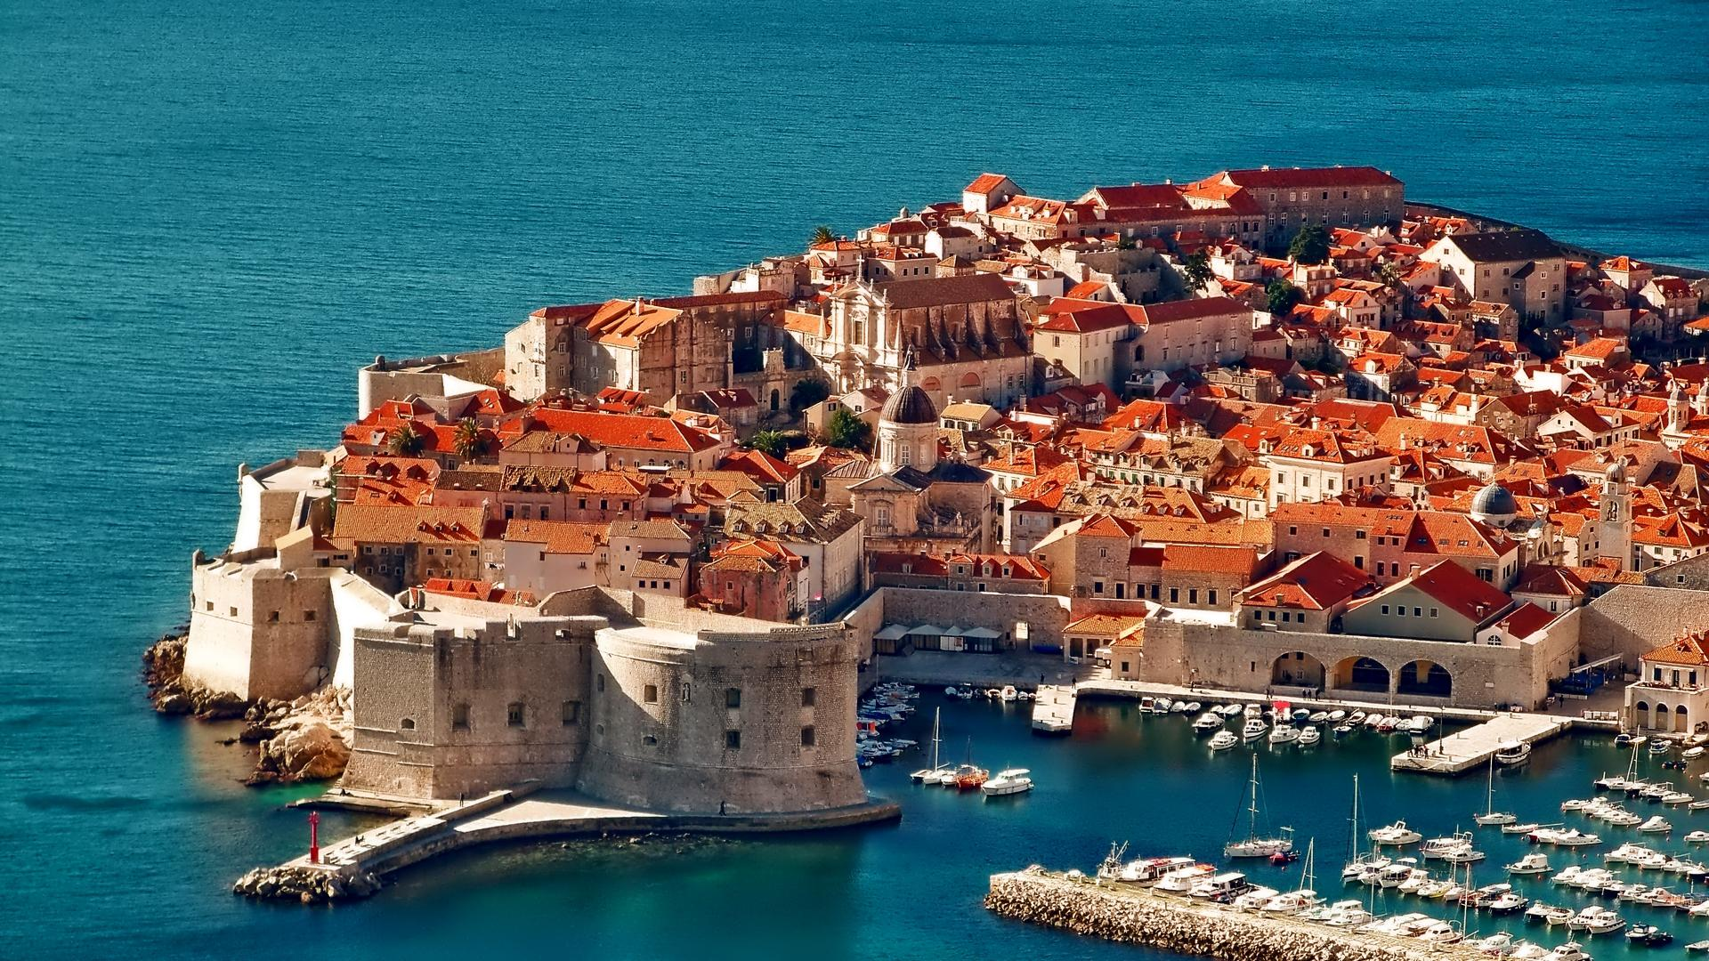
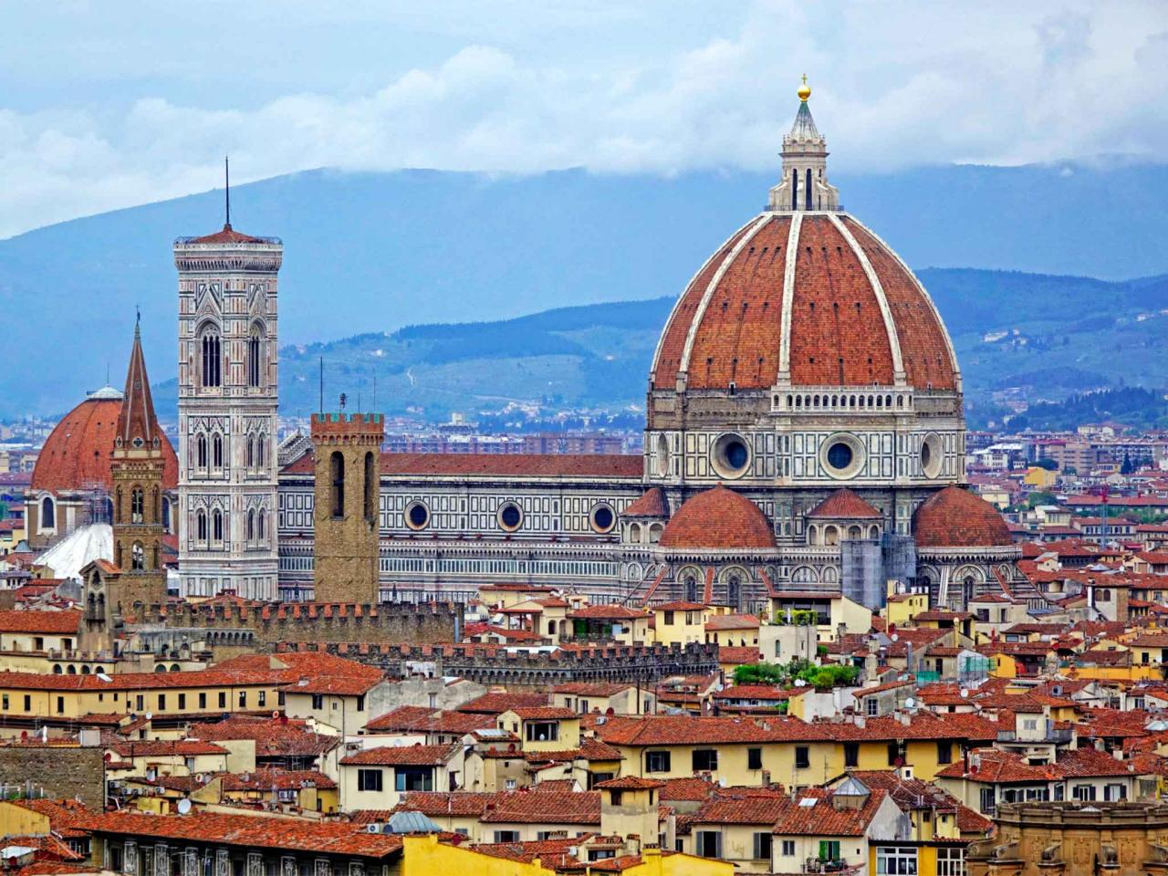
MHFT Global Strategy Luncheons
Buy tickets at www.madhedgefundtrader.com
Dubrovnik, Croatia
July 7
Florence, Italy
July 9

Slide 4

MHFT Global Strategy Luncheons
Buy tickets at www.madhedgefundtrader.com
Zermatt, Switzerland
July 22
Basel, Switzerland
July 27

Slide 5

Trade Alert Performance
Making Big Profits in Dire Market Conditions
*January +1.23% Final *July +0.00% MTD
*February +4.50% Final *August +1.27% Final
*March -2.42% Final *September +11.99% Final
*April -2.10% Final *October Final -6.19%
*May +4.38% Final *November MTD 5.78%
*June -0.56% Final *December -4.94%
*2016 Year to Date +5.08%
compared to 3.3% for the Dow Average
*Trailing 1 year return +17.24%, +196.76% since inception
*Average annualized return of 35.24%

Slide 6
Portfolio Review
Running a small Short Dated Book
on a strong dollar move
Mad Hedge Fund Trader
Model Trading Book
Asset Class Breakdown
Risk Adjusted Basis
current capital at risk
Risk On
World is Getting Better
no position
Risk Off
World is Getting Worse
no position
total net position | 0.00%

Slide 7

The Method to My Madness
Staying in Cash Until it Gets Easy Again
*Staying flat until this insane volatility dissipates
*My sideways wedge with an eventual upside breakout model for stocks is holding up well, but may only have a month to run
*You can make money on the big swings, but only if you stayed glued to a screen 24/7
*It’s almost not worth carrying overnight risk
in this environment
*The game from here on is to position yourself for
a pre/post US presidential election stock melt up
and a global risk on rally

Slide 8
Paid Subscriber Trailing 12 Month Audited Return +17.24%-Staying Flat Just Short of an All Time High

Slide 9
67 Months Since Inception
Daily Audited Performance
Averaged annualized return +35.24%

Slide 10

Short Term Strategy Outlook-It’s All About Brexit
*Brexit completely upends all short term asset class prediction, hedge funds missed it by a mile
*Brexit kills off any chance of a rate rise in 2016 triggering global “RISK ON” rally
*Flight to safety bid sends dollar to new 2016 highs, except against the yen, the buck should remain strong for the rest of 2016
*Oil keeps gravitating back to $50, but Brexit is negative for global growth,
even if it doesn’t happen
*Bonds blast off to a new all time high
*Gold loves uncertainty on steroids
*Volatility to remain high for the rest of 2016,
buy low, sell high

Slide 11

How This Year Ends
*Brexit risks send the UK into recession, cutting EC growth by a quarter
*EC slowdown spills over into China
*Global flight to safety bid sends US assets to new high, first for bonds, then stocks
*New ultra low US interest rates offset the drag created by weakening foreign economies
*Suddenly, US Investors realize that the (SPX) PE top in this cycle ratchets up from 20X to 26X earnings, providing 30% more upside for the indexes
*Strong dollar keeps energy and commodity
price inflation at bay
*US presidential election sets up a stock
market melt up
BUY THE BIG DIPS!

Slide 12
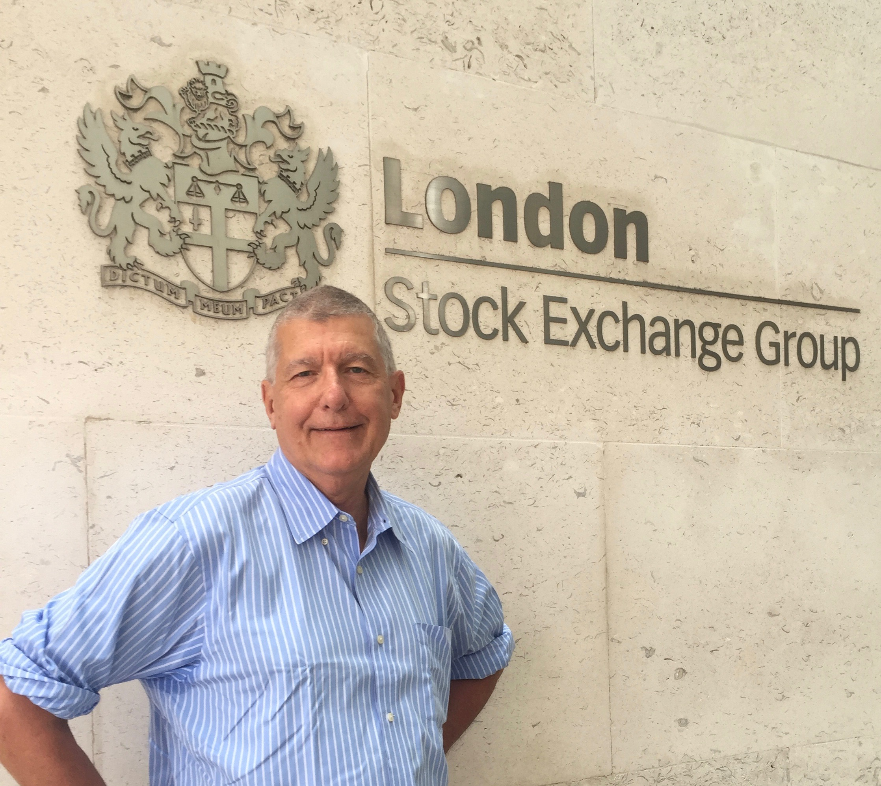
Brexit News Flash-It’s a Dead Duck
*Bank of England cuts bank reserve requirements to head off crisis
*Interest rate cuts to follow
*Chancellor of the Exchequer proposes cut in corporate tax rates to 15% to tykeep businesses home
*An industry group threatens to sue
the government if it enacts Article 50
giving notice of its EC departure,
demands passage by Parliament first,
which will never happen
*It’s rare that a government adopts my
advice in total and so rapidly, wish my
own would do the same

Slide 13
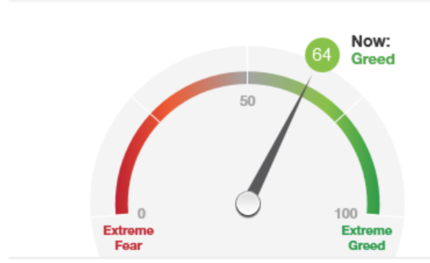
Brexit Takes it only Back to the Mean

Slide 14
The Bill Davis View
A $1,500 Upgrade for the Mad Day Trader Service
Buys:
Facebook (FB) $112 Target to $120
Amazon (AMZN) $724 Target to $750
Alexion Pharm (ALXN) $112 Target to $138
Baidu, Inc. (BIDU) $156 Target to $175
US Steel (X) $17 Target to $19.50
Align Tech. (ALGN) $78 Target to $83
Sells:
Valero Energy (VLO) $51 Target to $45
Rackspace (RAX) $21 Target to $17
Apple (AAPL) $100 Target to $88
Tesla Motors (TSLA) $225 Target to $190
Red Hat, Inc (RHT) $75 Target to $63

Slide 15
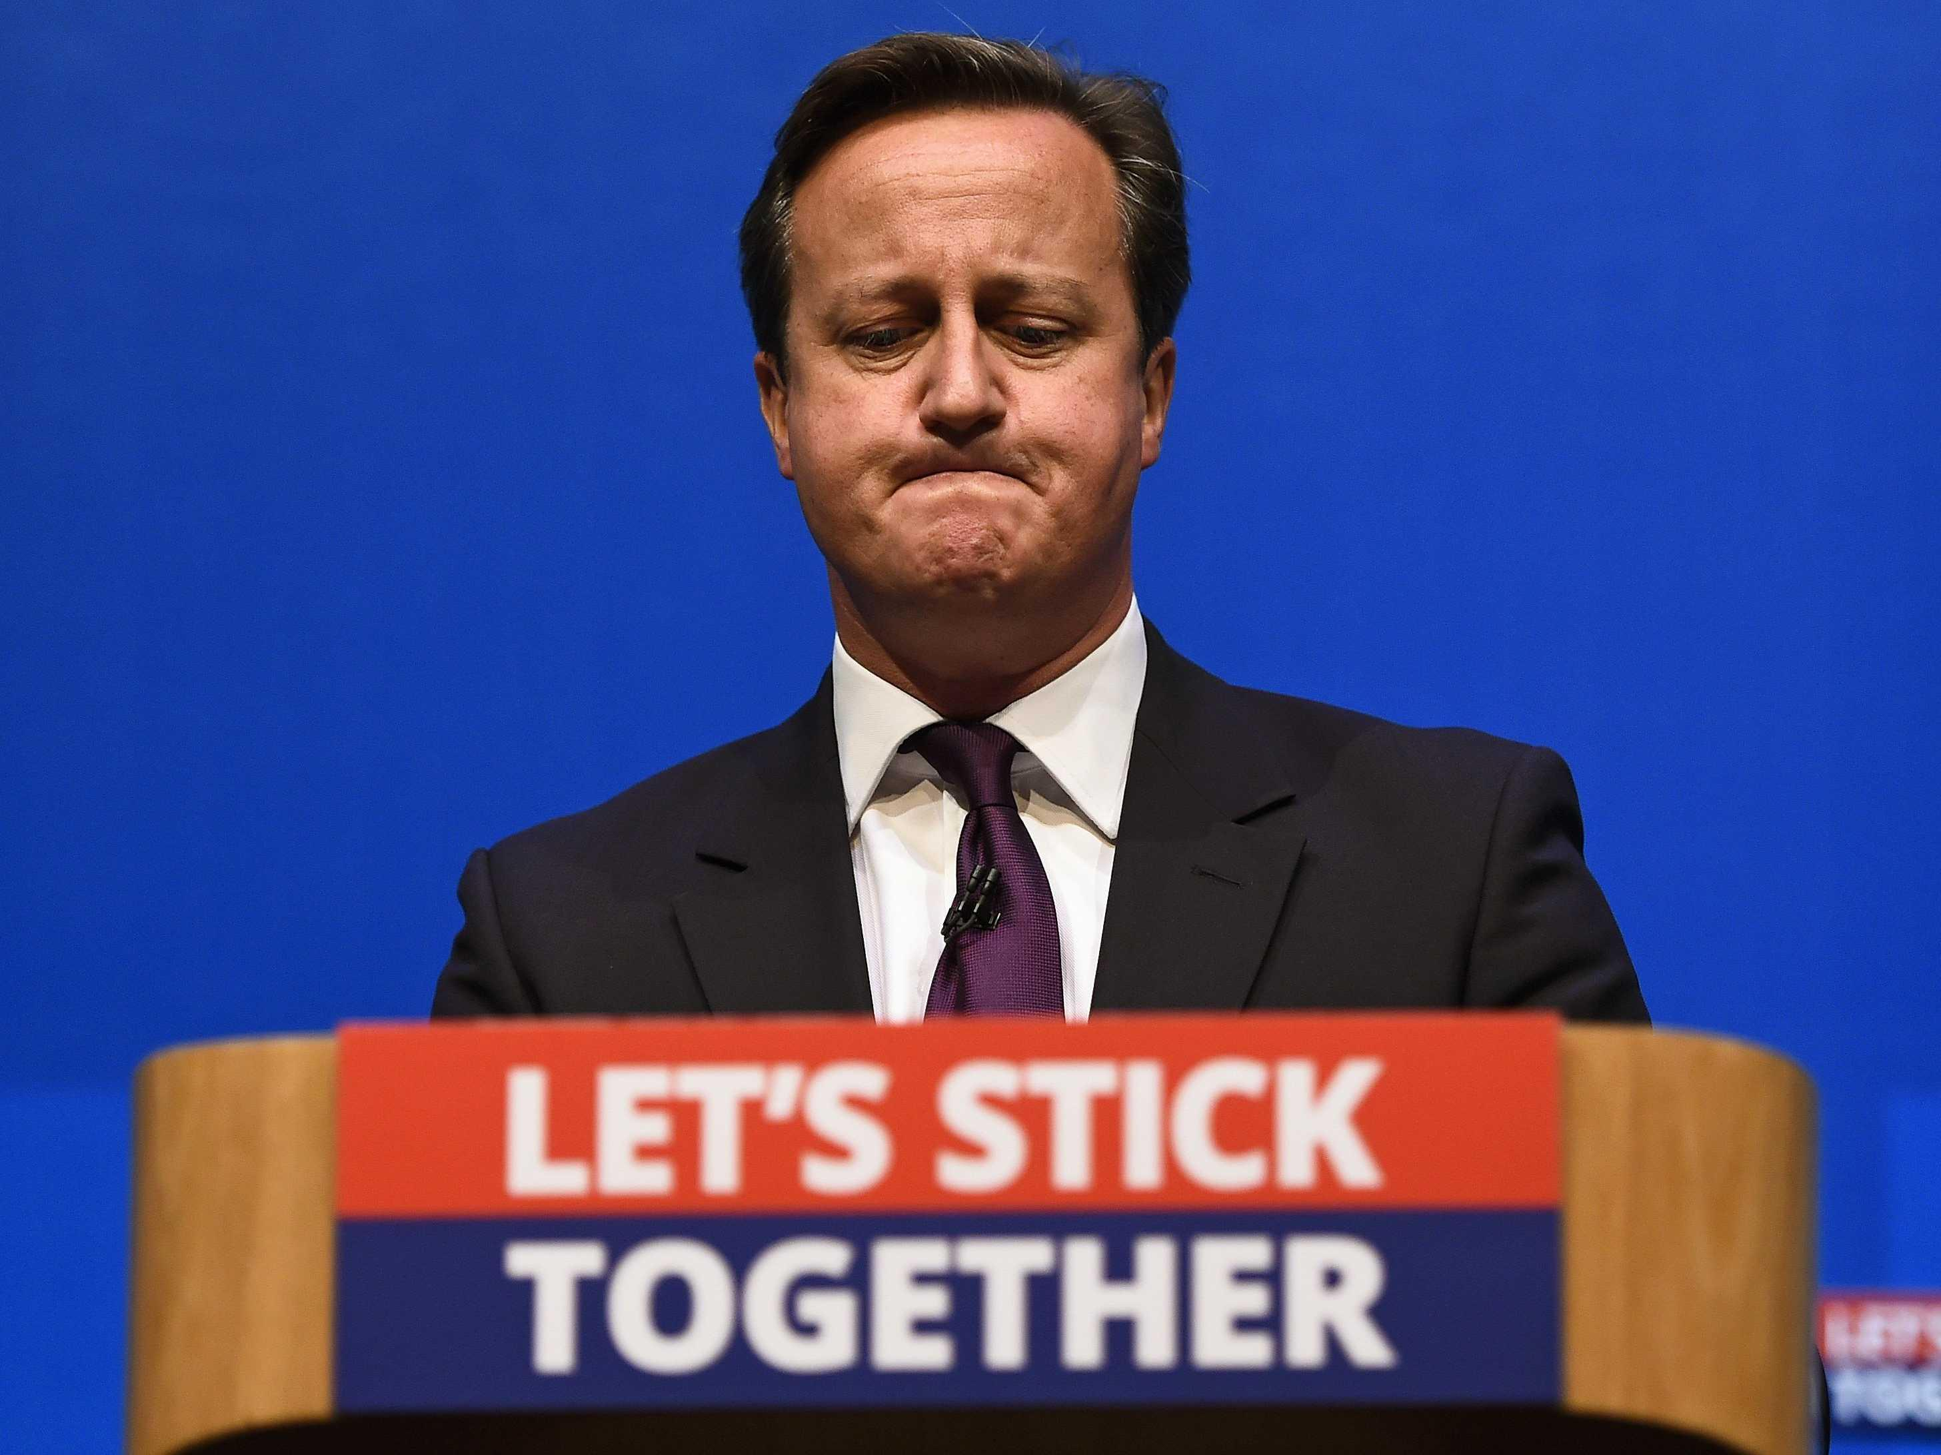
The Global Economy-Brexit Brings a Global Downgrade
*Brexit could cut US GDP growth by 0.25% as our largest trading partner goes back into recession, but new ultra low rates will add growth back into the leveraged sectors on the economy
*Europe may lose 25% of its GDP in One shot
*All major business decisions on hold as uncertainty reigns for at least 3 more months
*All economic data points are now meaningless and useless, it will take three months for them to reflect the Brexit impact
*Upside momentum in oil has been broken
*Despite all this, US stocks and bonds are still the
most attractive, highest yielding assets in the
world, both should move to new highs
*Yen spike drives another nail into the
Japanese economic coffin
*Fortress American looking strong

Slide 16
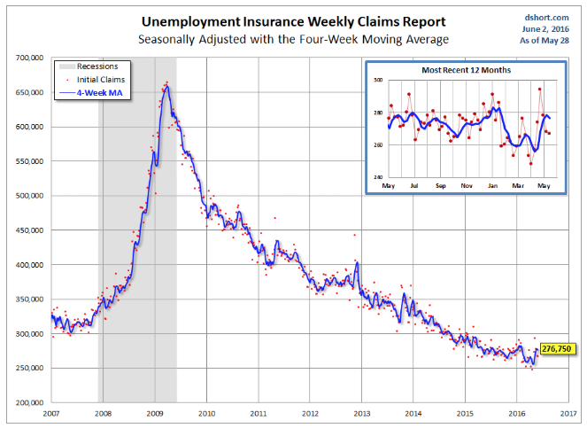
Weekly Jobless Claims –The Most Important Statistic
+10,000 to 268,000-Lowest since 1973!
The Downtrend Lives!-Show Me the Recession!

Slide 17
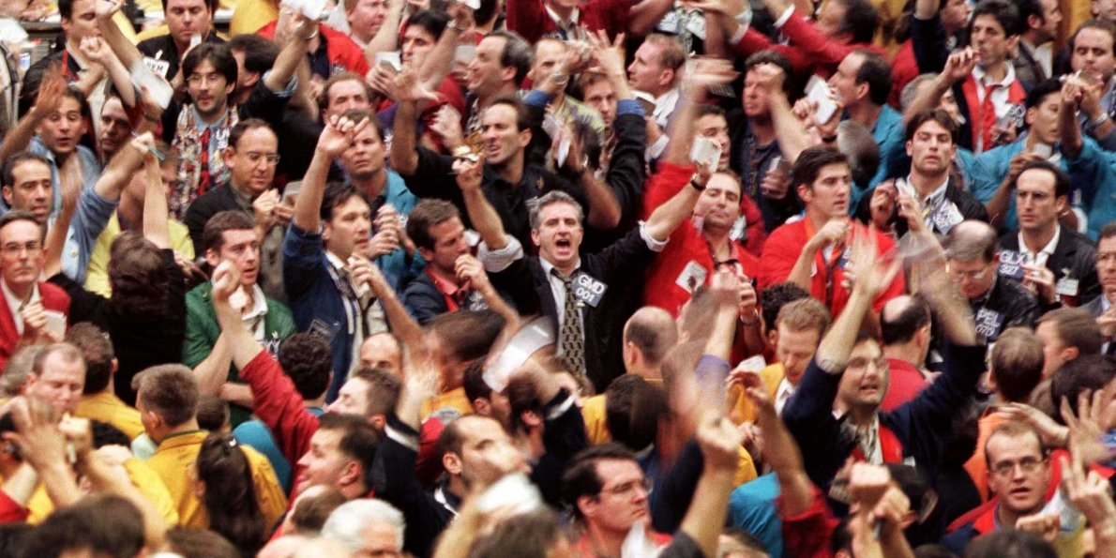
Bonds-Buying Panic!
*Brexit triggers panic stop loss buy in in fixed income assets around the world
*Ten year US Treasuries hit my 1.36% yield target, then push through to 1.34%, 1.00% is now on the table
*Bond surge assures the US sees negative interest rates when the US moves into the next recession
*JGB’s spike to -0.26%, German bunds to -0.15%, the UK is next to see negative bonds rates
*Even emerging market debt rockets,
despite poor fundamentals
* Junk bonds (HYG) hit new year highs

Slide 18
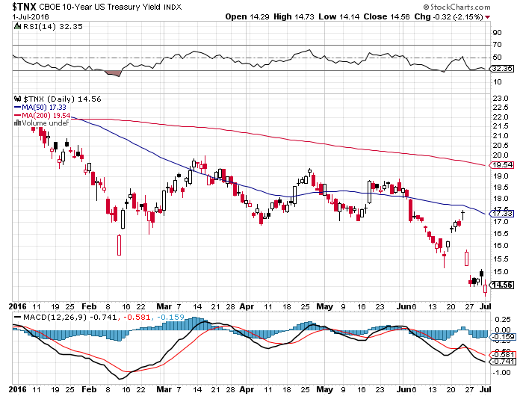
Ten Year Treasury Yield ($TNX) 1.36%
Breakout!

Slide 19
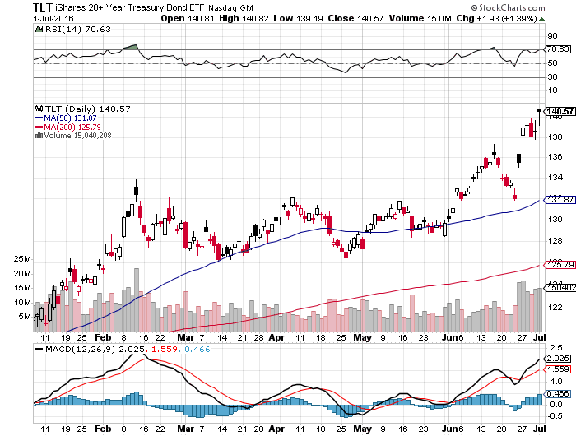
Ten Year Treasury ETF (TLT) 1.36% took profits on long 6/$124-$127 vertical bull call spread

Slide 20
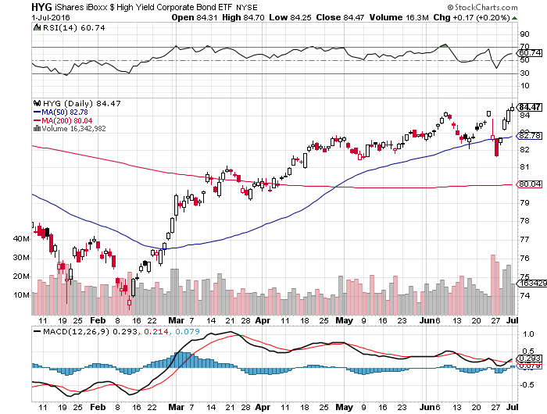
Junk Bonds (HYG) 6.33% Yield
A Great Risk Coincident Indicator-”RISK ON” means new highs

Slide 21
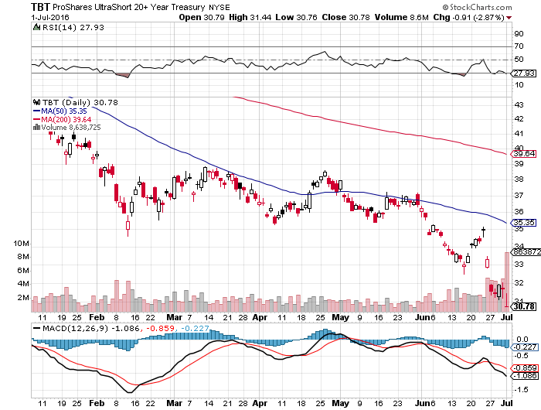
2X Short Treasuries (TBT)- Looking Like a 2017 Trade

Slide 22
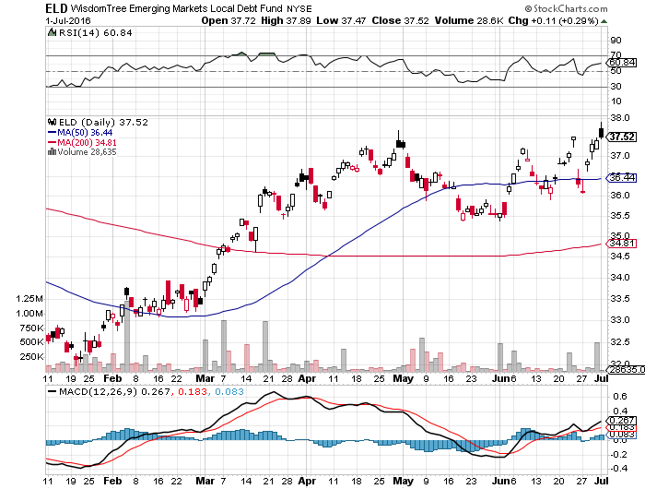
Emerging Market Debt (ELD) 5.75% Yield-

Slide 23
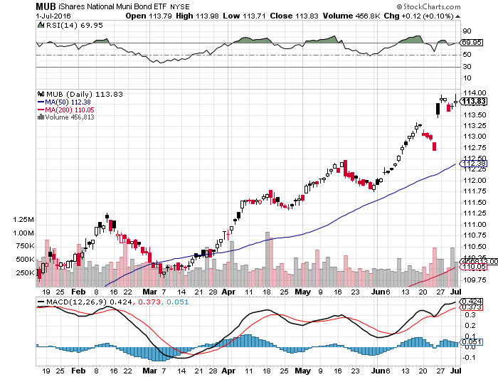
Municipal Bonds (MUB)-1.21% yield-New High
Mix of AAA, AA, and A rated bonds-flight to safety

Slide 24
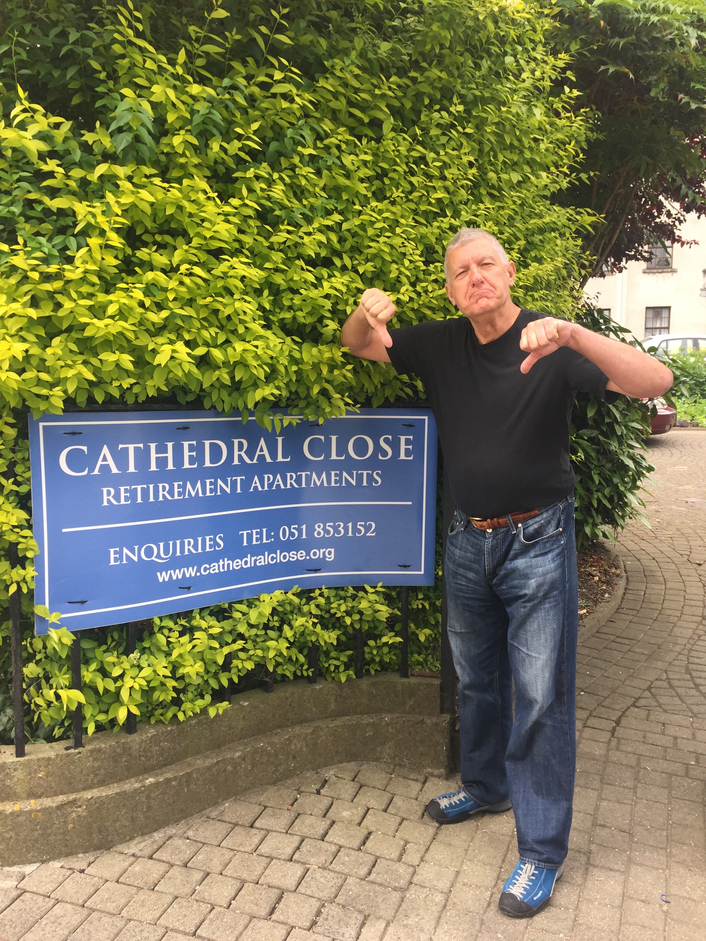

Slide 25

Stocks-Extreme Volatility
*If Brexit can’t knock stocks down, then they can only go up
*Expect another leg down as the economic data weakens over the summer, then an upside breakout going into the presidential election
*With uncertainty rampant, volatility will remain high
*Hedge funds totally missed Brexit, exacerbating all
market moves, with HFT’s feasting on the volatility
*Positive calendar still three months off,
the “Buy in October” that follows “Sell in May”
*Bounce back leaders reveal who will lead the yearend
rally, including big tech, big pharma, banks,
homebuilders, consumer discretionary, and biotech
*The game from here on is to buy the cheapest
long positions for a six month rally

Slide 26
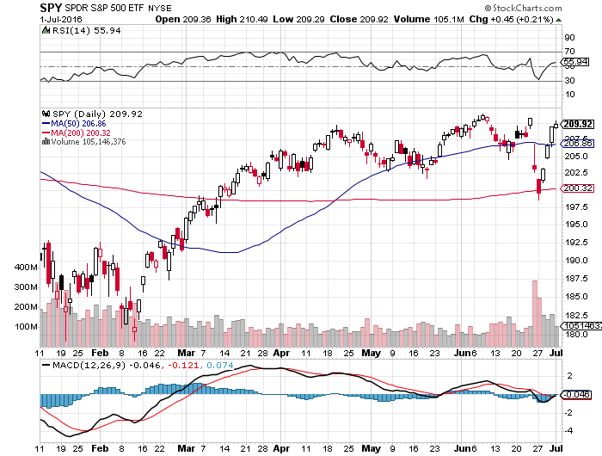
S&P 500-
The sideways wedge model is still good

Slide 27
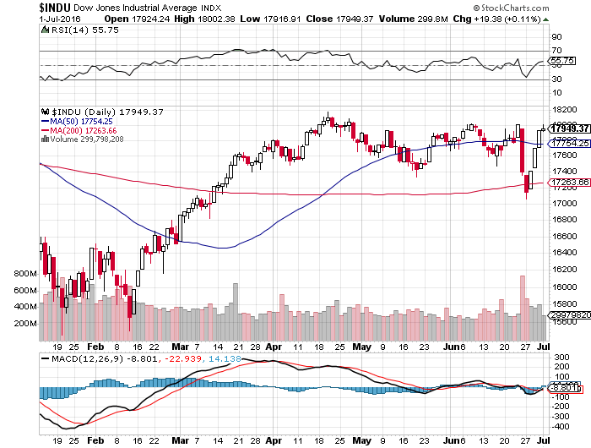
Dow Average-Topping Out Too

Slide 28
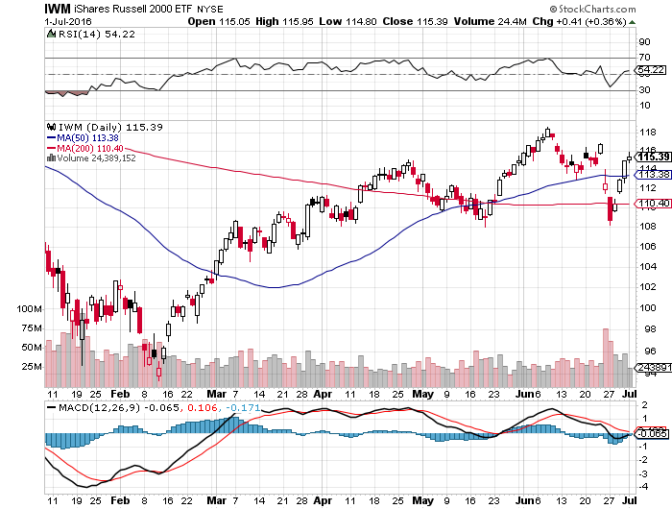
Russell 2000 (IWM)-The Leading Indicator is Lagging

Slide 29
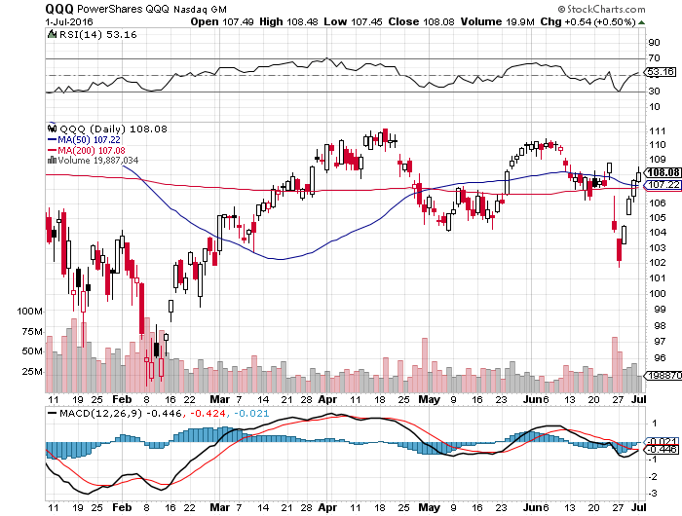
NASDAQ (QQQ)-
An End of Globalization Victim

Slide 30
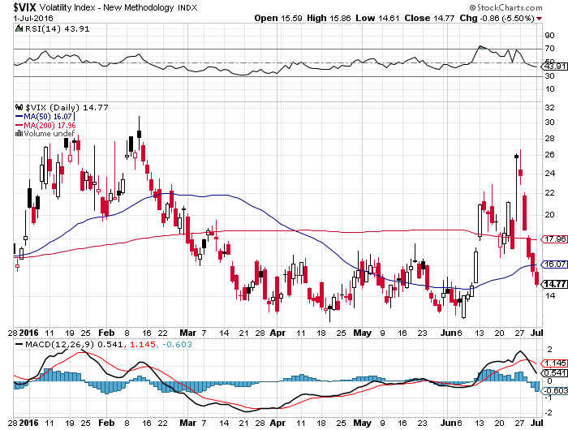
(VIX)-Another Spike Fails Again

Slide 31
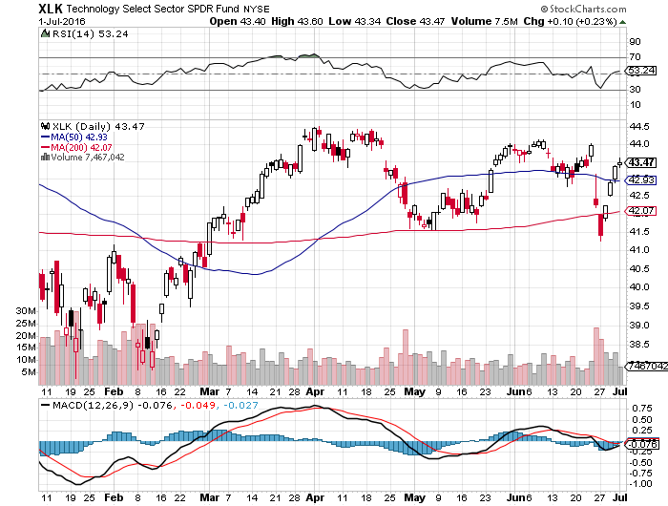
Technology Sector SPDR (XLK), (ROM)
(AAPL), (MSFT), (VZ), (T), (FB), (IBM)

Slide 32
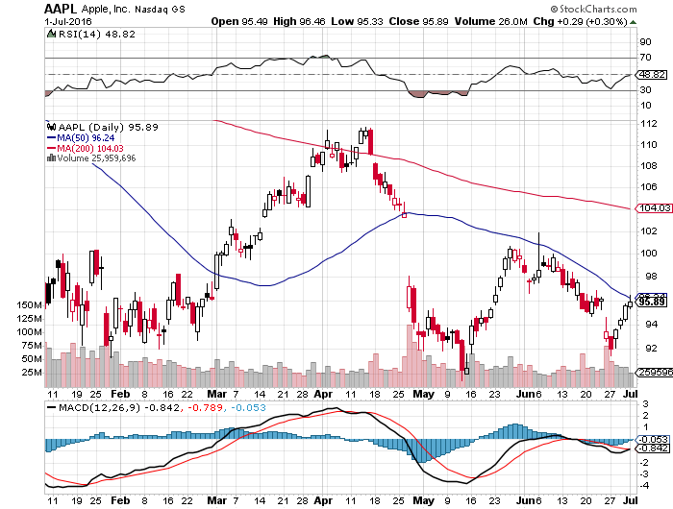
Apple (AAPL) –Buy the Dips
Back to waiting for the next real catalyst-the iPhone 7
The “Buffet Put Option” kicks in with $1 billion purchase

Slide 33
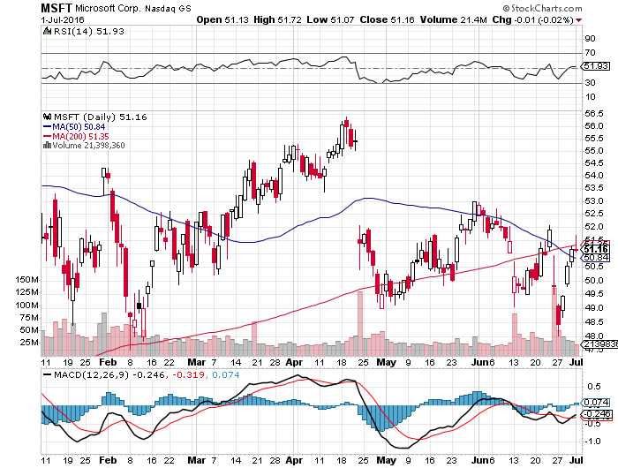
Microsoft (MSFT)
Disappointment creates an entry point

Slide 34
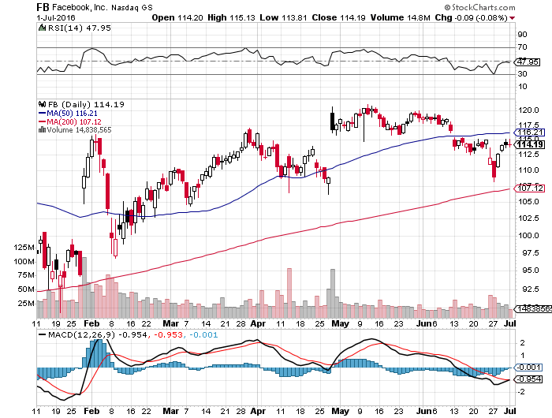
Facebook (FB)- The 200-Day Holds

Slide 35
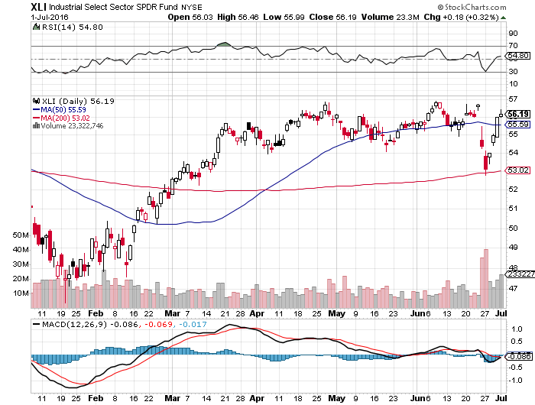
Industrials Sector SPDR (XLI)-Dow Mainstay
(GE), (MMM), (UNP), (UTX), (BA), (HON)

Slide 36
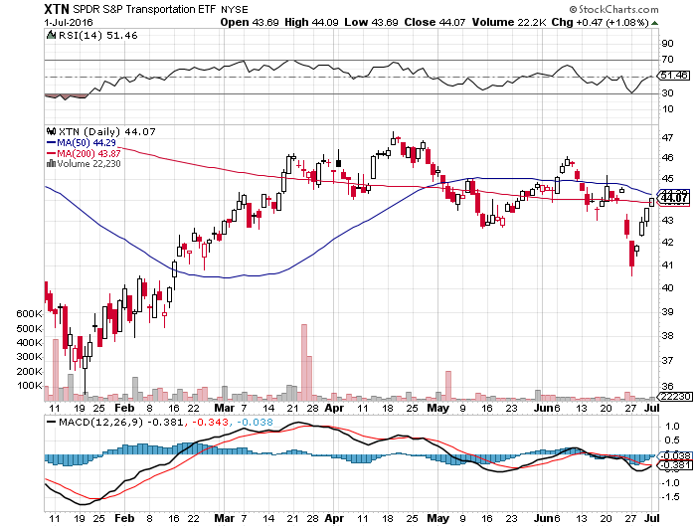
Transports Sector SPDR (XTN)-The Biggest Hit
(ALGT), (ALK), (JBLU), (LUV), (CHRW), (DAL),

Slide 37
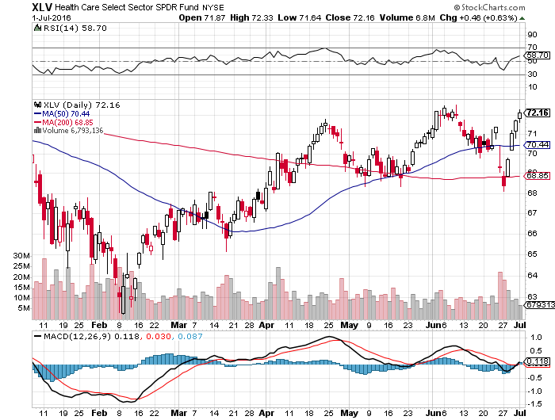
Health Care Sector SPDR (XLV), (RXL)
(JNJ), (PFE), (MRK), (GILD), (ACT), (AMGN)
Upside Breakout Coming

Slide 38
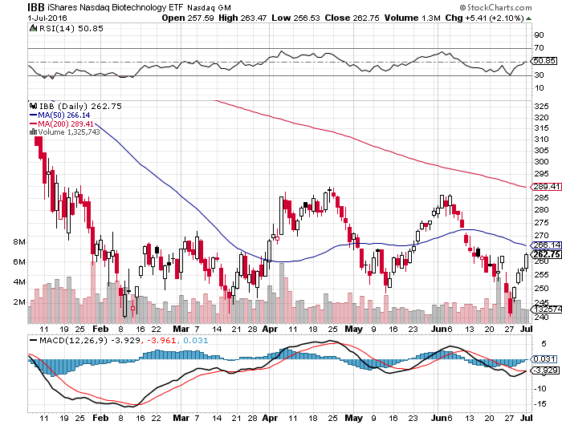
Biotech iShares (IBB)-A Political Football in 2016
Own for 2017

Slide 39
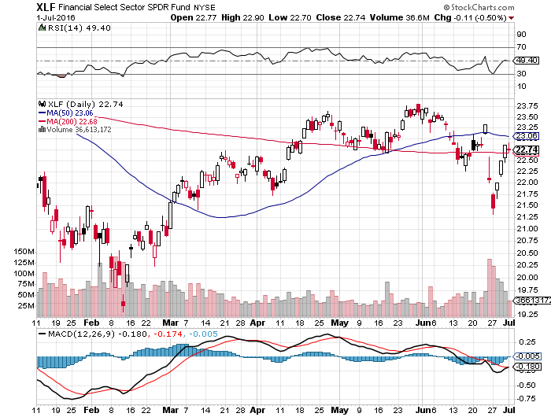
Financial Select SPDR (XLF)-A big Value Play lower interest rates mean lower bank stocks
(BLK/B), (WFC), (JPM), (BAC), (C), (GS)

Slide 40
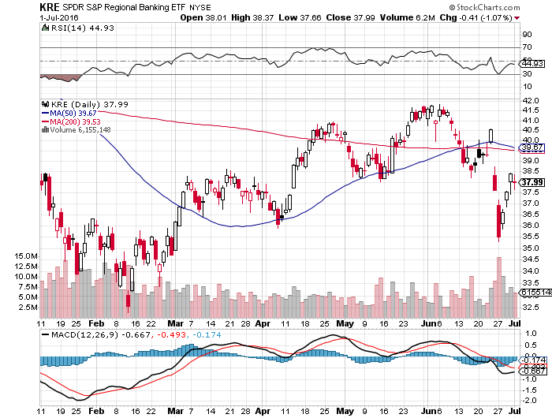
KRE Regional Bank ETF (KRE)-

Slide 41
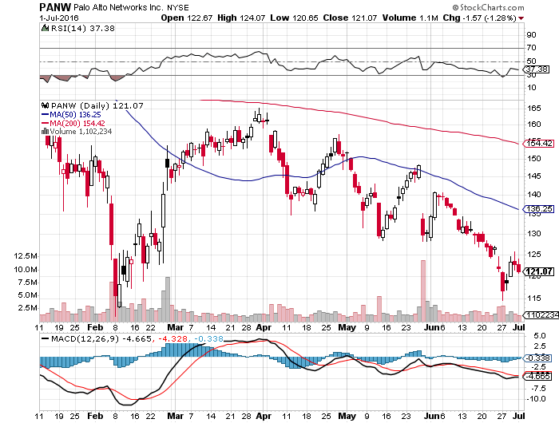
Palo Alto Networks (PANW)- another entry point setting up-Hacking Isn’t Going Away

Slide 42
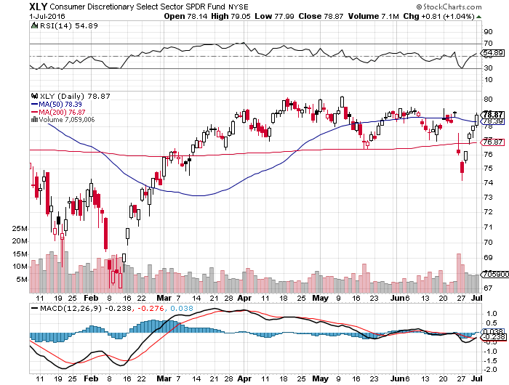
Consumer Discretionary SPDR (XLY)
(DIS), (AMZN), (HD), (CMCSA), (MCD), (SBUX)
A Major Leader of the Rally

Slide 43
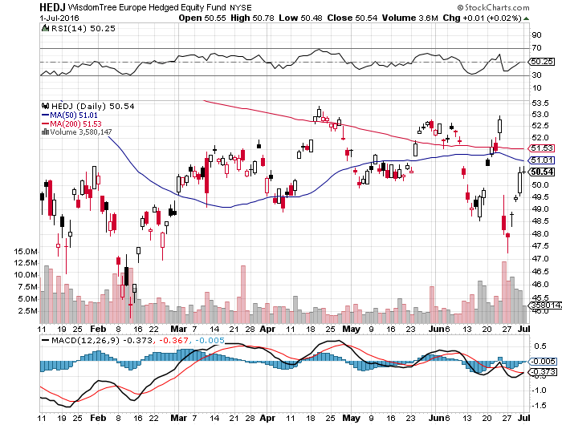
Europe Hedged Equity (HEDJ)-Hedged European Equity
Stay away while Europe suffers

Slide 44
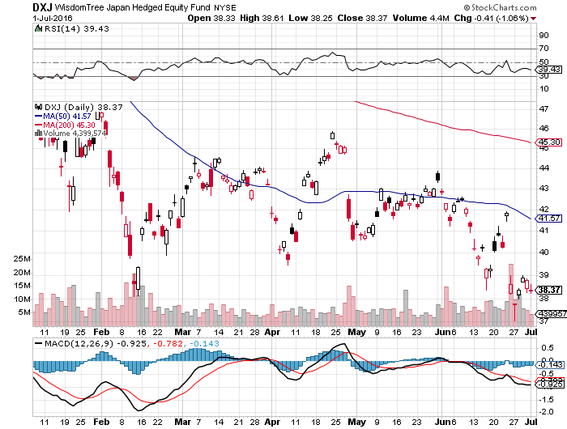
Japan (DXJ)-Hedged Japan Equity
Strong Yen Problem-Avoid

Slide 45
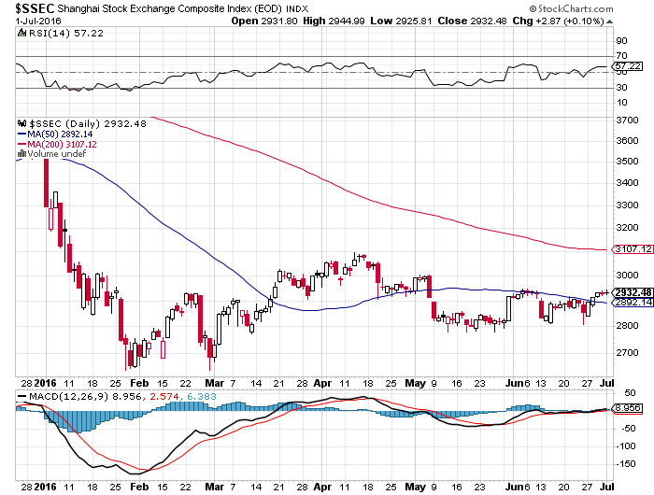
China ($SSEC)-
The Bad Boy Market and font of volatility

Slide 46
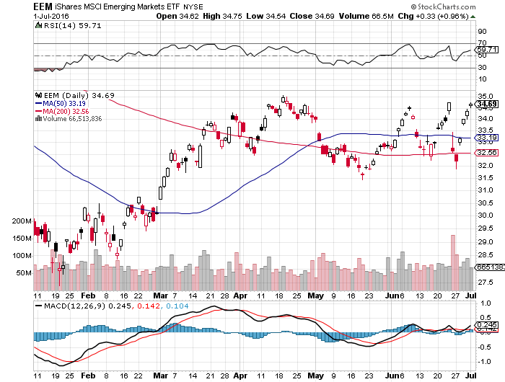
Emerging Markets (EEM)-

Slide 47


Slide 48

Foreign Currencies-Dollar Boost
*Massive “RISK OFF” creates huge dollar rally
*With Europe in collapse, the US is now even more likely to become the first country to raise rates
*Chinese Yuan falls sharply on global growth
slowdown prospects
*So do Commodities currencies of rally the
Aussie (FXA) and Loonie (FXC)
*The pound is down 10%, so the easy money
on the short side has been made
*Japanese yen up on a spike as hedge
funds cover shorts, BOJ intervention
is in the cards, ¥100 is the trigger point

Slide 49
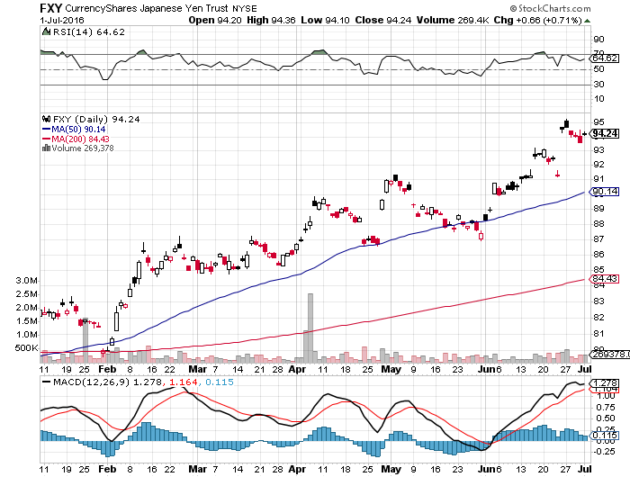
Japanese Yen (FXY)-2 Year High took profits on Long 6/$94-$91 vertical bear put spread the harder I work, the luckier I get

Slide 50
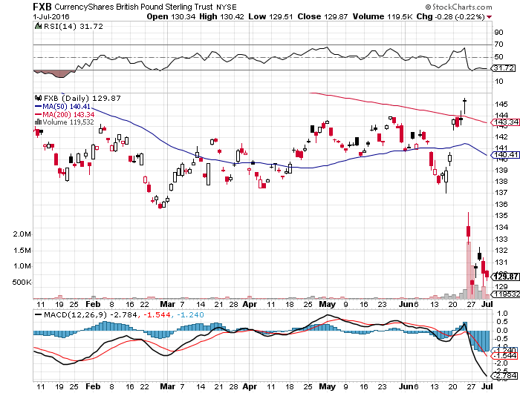
British Pound (FXB)-
Looking for new lows

Slide 51
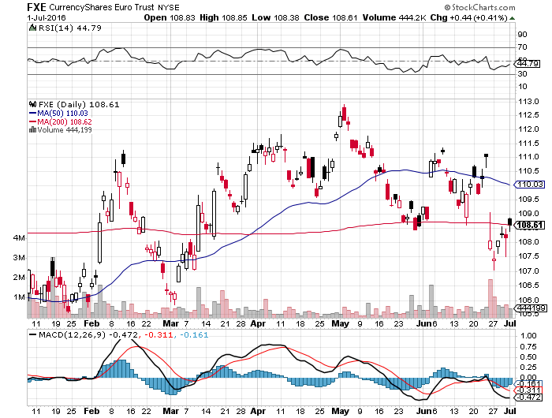
Euro ($XEU), (FXE), (EUO)- “Brexit” Shock Hits took profits on long 5/$113-$116 vertical bear put spread

Slide 52
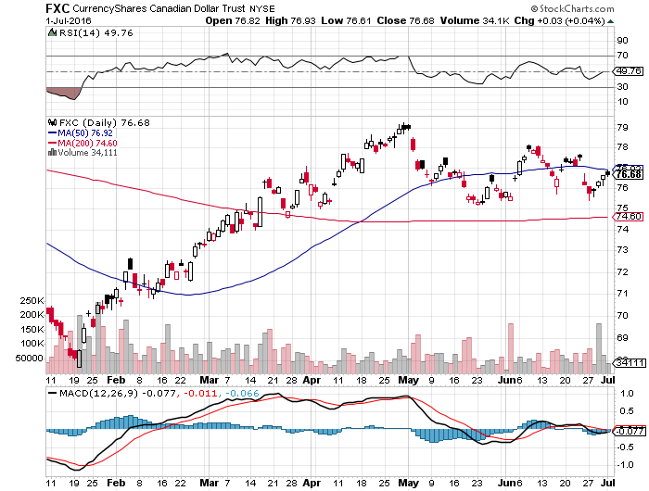
Canadian Dollar (FXC)-Global slowdown prospects

Slide 53
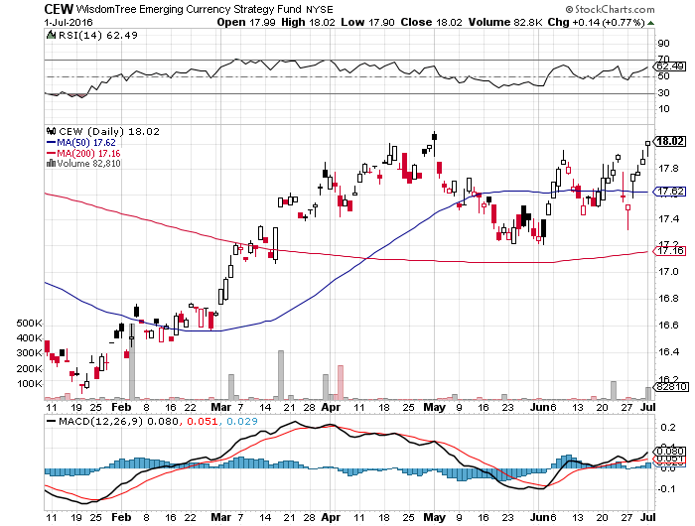
Emerging Market Currencies (CEW)

Slide 54
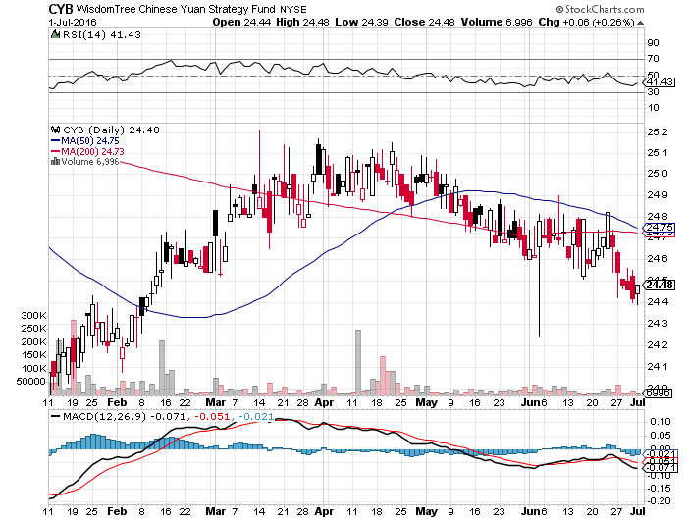
Chinese Yuan- (CYB)-
Sell Rallies on Weakening Economy Rolling Over?

Slide 55


Slide 56
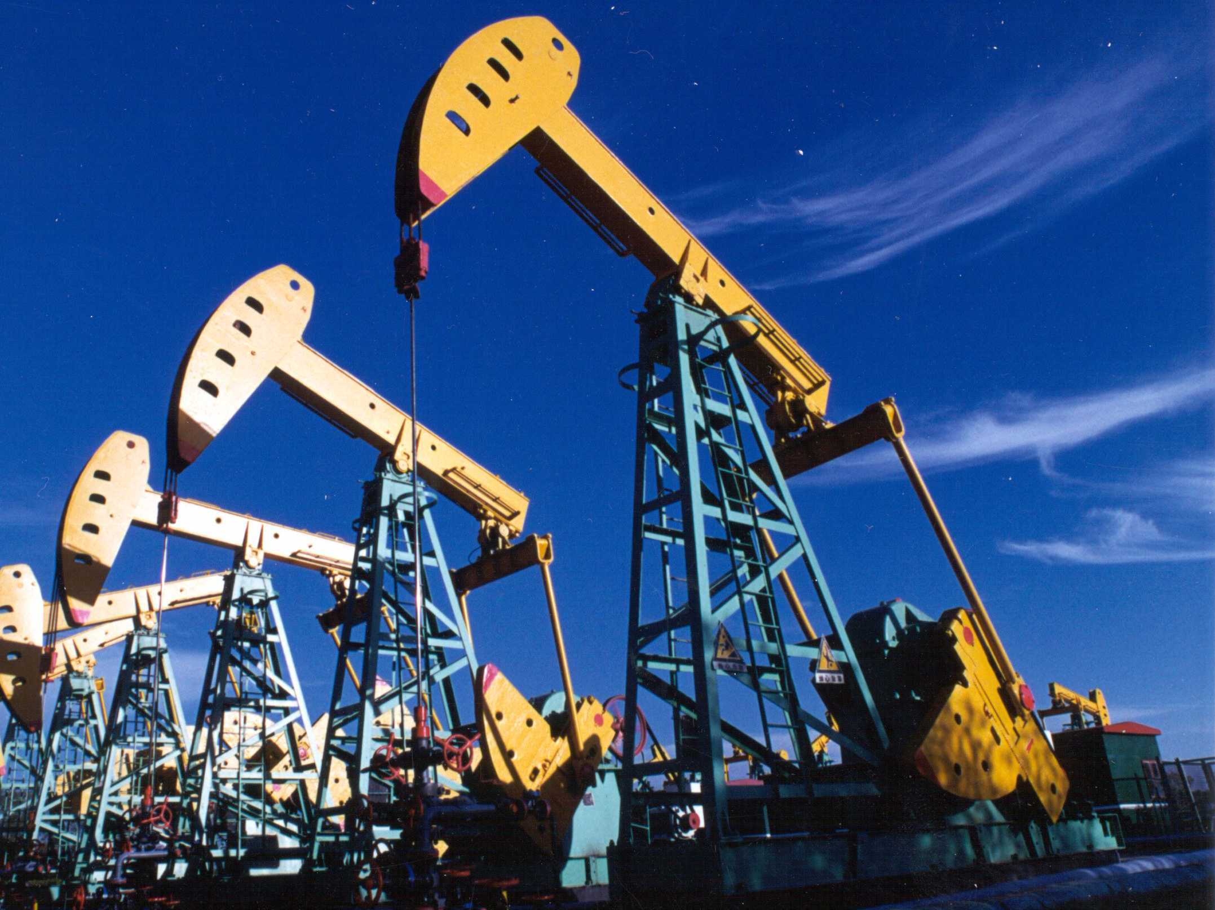
Energy-Global Growth Slowdown
*Brexit demolishes oil on global growth showdown fears, then it bounces back, setting up the new range
*India is surpassing China as the world’s largest marginal buyer of oil, with demand growing 9% a year, or 400,000 barrels a day, versus 4% a year
*At 94 million barrels a day, the world is structurally still producing 2 million b/d more than it needs, temporary disruptions have tightened the gap to 1 million barrels
*Stronger US dollar still weighing on prices,
*Baker-Hughes US oil rig count up 11 to 341,
continuing a 5 week trend up
*Oil could stay in a $40-$60 range for a long time
*Energy stocks have already discounted the
rise to $60, so stay away

Slide 57
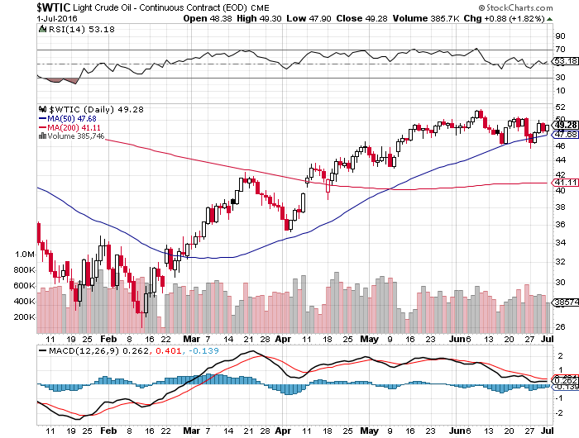
Oil-Topping Out

Slide 58
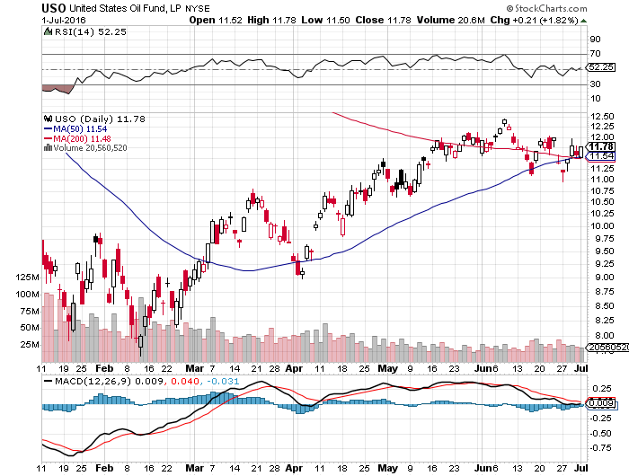
United States Oil Fund (USO)

Slide 59
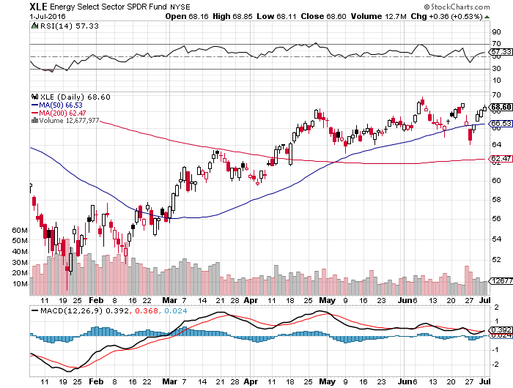
Energy Select Sector SPDR (XLE)
(XOM), (CVX), (SLB), (KMI), (EOG), (COP)

Slide 60
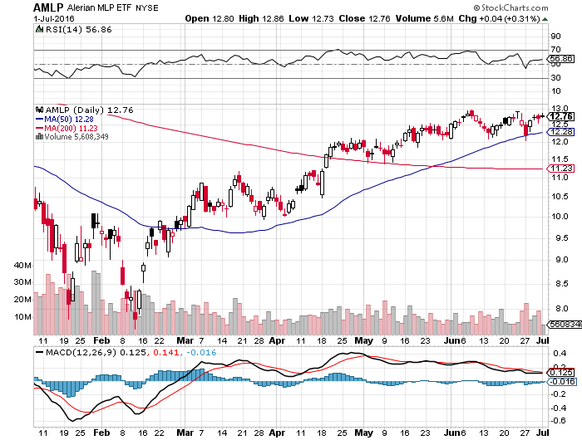
Alerian MLP ETF (AMLP)-6.84% Yield
Basket Approach is the Only Safe Play here

Slide 61
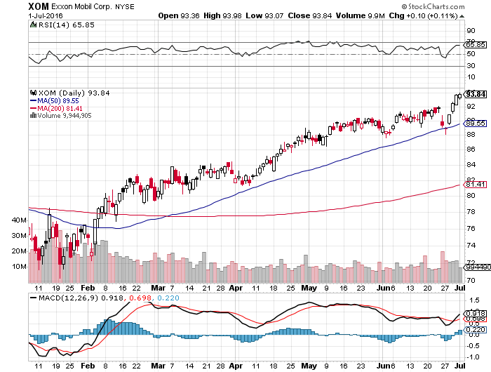
Exxon (XOM)-love that dividend!

Slide 62
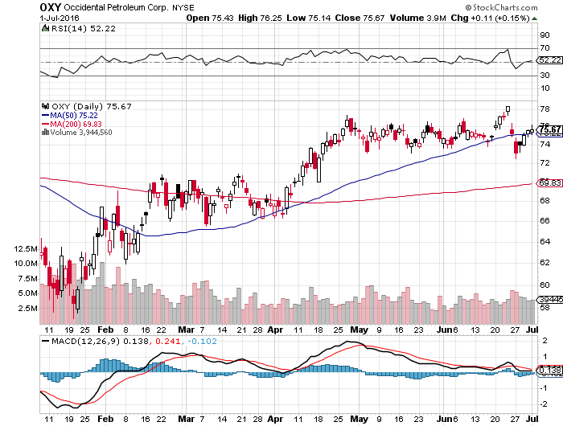
Occidental Petroleum (OXY)-

Slide 63
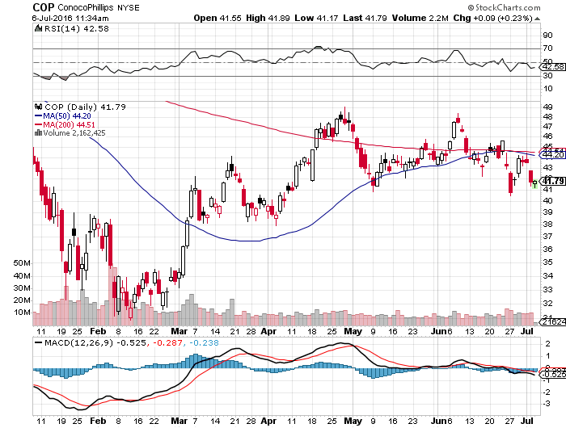
Conoco Phillips (COP)-The Buffet Favorite

Slide 64
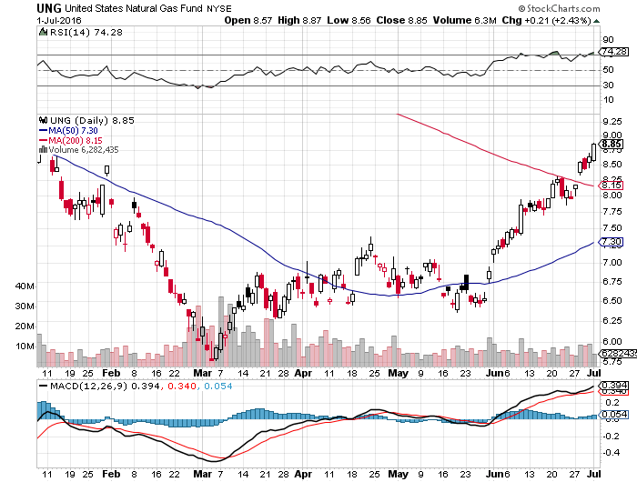
Natural Gas (UNG)-New 2016 Highs!

Slide 65

Copper-No Global Growth Scare Here

Slide 66


Slide 67

Precious Metals-New 2016 Highs!
*With the risk on paper assets rising, the popularity of a gold hedge is rising
*Massive drop in rates to negative numbers in many countries creates a de facto positive return on non yielding gold assets
*The opportunity cost of gold ownership is now the lowest in history
*Comex speculative futures positions
wound down in Mar and April, creating a
springboard for the current move
*The secular bull market lives

Slide 68

Gold (GLD)-Buy Dips

Slide 69

Market Vectors Gold Miners ETF- (GDX)

Slide 70

Silver (SLV)-

Slide 71

Silver Miners (SIL)-

Slide 72

Platinum (PPLT)-The Gold Effect

Slide 73

Palladium (PALL)-

Slide 74


Slide 75

Agriculture-Armageddon Again!
*The strong dollar strangles the nascent bull market in ags in the crib, sending many prices to new 2016 lows
*Wheat, the most dollar sensitive commodity, falls off a cliff
*Only Soybeans are showing any sign of life
*Decent US summer weather isn’t helping
*No trade, there are NO fish to fry
*My main job here is to keep traders
away from this sector this year, and
that approach has worked one more time

Slide 76

(CORN) – Gave up all of 2016

Slide 77

(WEAT) New Lows!

Slide 78

(SOYB) The Sole Survivor

Slide 79

Ag Commodities ETF (DBA)-

Slide 80


Slide 81

Real Estate-Your Best Investment in 2016
*Brexit vote brings ultra low interest rates and a boost to refi’s
*Low rates also give the homebuilders a new lease on life
*US REITS another big beneficiary of the rate collapse
*Apartment rents starting to cool in the hottest markets, down from 5.1% to 3.7% in Q2, but still at an all time high
*Median existing home price index at $239,700
finally hits a new all time high for the first time
in a decade
*San Francisco is the highest market in the country
with a $700,000 median price
*March Case Shiller S&P 500 National index
continues upward grind, January +5.0%

Slide 82

March S&P 500/Case–Shiller Home Price Index
+5.0% YOY, Seattle, Denver, Portland

Slide 83

US Home Construction Index (ITB)
(DHI), (LEN), (PHM), (TOL), (NVR)
Another Big Brexit Winner

Slide 84

Trade Sheet
So What Do We Do About All This?
*Stocks- stand aside-wait for a big dip to buy
*Bonds-buy dips
*Commodities-buy dips long term
*Currencies- sell yen on rallies
*Precious Metals –buy dips
*Volatility-sell short spikes over $25, buy dips to $12
*The Ags –stand aside -
*Real estate-buy the homebuilders LT

Slide 85


Slide 86

To buy lunch tickets, please go to www.madhedgefundtrader.com , click on “LUNCHES,” and then your desired Country and City
Next Strategy Webinar
12:00 EST Wednesday,
July 20, 2016
Zermatt, Switzerland
Good Luck and Good Trading!
Notes:
*

