Slide 1

The Mad Hedge Fund Trader
“The Correction is Here”
With John Thomas
from San Francisco, CA, August 3, 2016
www.madhedgefundtrader.com
Notes:
*

Slide 2


Slide 3

Trade Alert Performance
Making Profits in Dire Market Conditions
*January +1.23% Final *July +0.67% Final
*February +4.50% Final *August +0.91% MTD
*March -2.42% Final *September +11.99% Final
*April -2.10% Final *October Final -6.19%
*May +4.38% Final *November MTD 5.78%
*June -0.56% Final *December -4.94%
*2016 Year to Date +6.66%
compared to 2.9% for the Dow Average
*Trailing 1 year return +13.35%, +198.34% since inception,
*Average annualized return of 35.00%

Slide 4
Portfolio Review
All in Cash Waiting for the Next Window
No Positions

Slide 5

The Method to My Madness
Tipping a Toe Back Into the Water
*Starting to take small positions against the most extreme moves
*My sideways wedge with an eventual upside breakout model for stocks worked, but ended a month early
*Buy “RISK ON” assets on every substantial dip
*Wait the extra day and let the market come to you
*The game from here on is to position yourself for
a pre/post US presidential election stock melt up
and a global risk on rally

Slide 6
Paid Subscriber Trailing 12 Month Audited Return +13.35%-Taking Another Run at the Highs

Slide 7
68 Months Since Inception
Daily Audited Performance
Averaged annualized return +35.00%

Slide 8

Short Term Strategy Outlook
*Risk Taking has gone to sleep for the summer doldrums
*Volatility is trading close to decade lows, buy as a hedge against other assets
*No market impact from the party conventions
*No chance of a rate rise in 2016 massively focusing attention on all yield plays, especially stocks
*Oil trying to establish bottom of new range. $40 or $35
Stay away until market proves itself
*Keep buying bonds on dips until proven wrong
*Gold uptrend still lives, buy dips
*Stay away from ags, perfect weather to new lows.

Slide 9
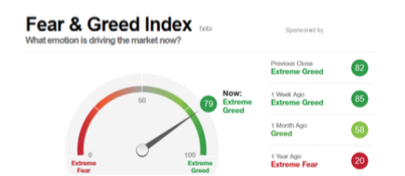
Middle Range of Greed at 79

Slide 10
The Bill Davis View
A $1,500 Upgrade for the Mad Day Trader Service
Buys:
Baidu, Inc. (BIDU) $156 Target to $175
Franklin Resources (BEN) $33 Target to $39
Amgen, Inc. (AMGN) $162 Target to $187
Apple, Inc. (AAPL) $100 Target to $112
CF Industries (CF) $23.50 Target to $28
Amazon, Inc (AMZN) $750 Target to $780
Sells:
Valeant Pharm. (VRX) $25 Target to $16
Red Hat, Inc (RHT) $74 Target to $62
Stamps.com (STMP) $82 Target to $62
Stericycle, Inc (SRCL) $100 Target to $80
Akamai Tech (AKAM) $55 Target to $48

Slide 11
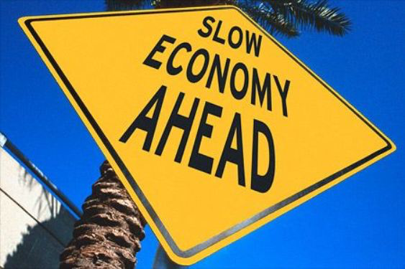
The Global Economy-Fading
*Fed minutes say that “near term risk to the economic rally have diminished” thanks to stock market rally
*US Q2 GDP comes in at a very weak 1.2%, Q1 revised down from 1.1% to 0.80%, on weak business investment, trade, and government spending, July Chicago PMI, 56.8 down to 55.8
*UK PMI Manufacturing plunges from 52.1 to 49.1, business confidence the lowest in history, Redemptions from Commercial Real Estate ETF’s frozen, all the wreckage of Brexit
*Bank of Japan disappoints with no new stimulus, PM Abe boosts planned infrastructure spending boost $274 billion, but yen doesn’t buy it
*Despite all this, US stocks and bonds are still the
most attractive, highest yielding assets in the
world, both should move to new highs
*Fortress American looking strong

Slide 12
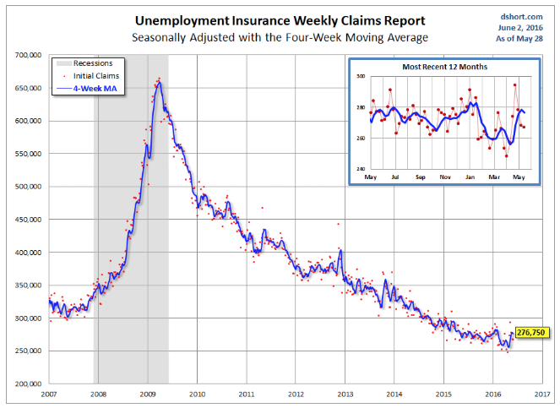
Weekly Jobless Claims –The Most Important Statistic
+14,000 to 264,000-Lowest since 1973!
The Downtrend Lives!-Show Me the Recession!

Slide 13


Slide 14
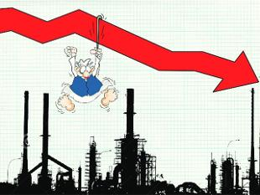
Bonds-Weak GDP Boost
*Ten year US Treasuries back off to 1.45% on poor Q2 GDP
*How soon do we break to new 60 year lows on yields?
*JGB’s ease to -0.14%, German bunds to -0.10%, the UK is next to see negative bonds rates
*Even emerging market debt rockets
thanks to high yields
* Junk bonds (HYG) maintain new
year highs on global “RISK ON”
*Keep buying until proven wrong

Slide 15
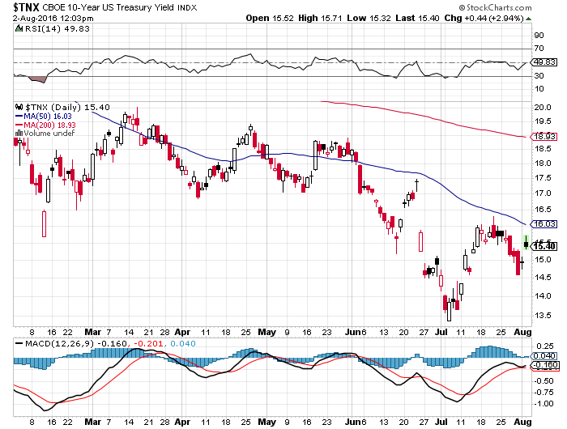
Ten Year Treasury Yield ($TNX) 1.54%
Classic Retest of Old Support

Slide 16
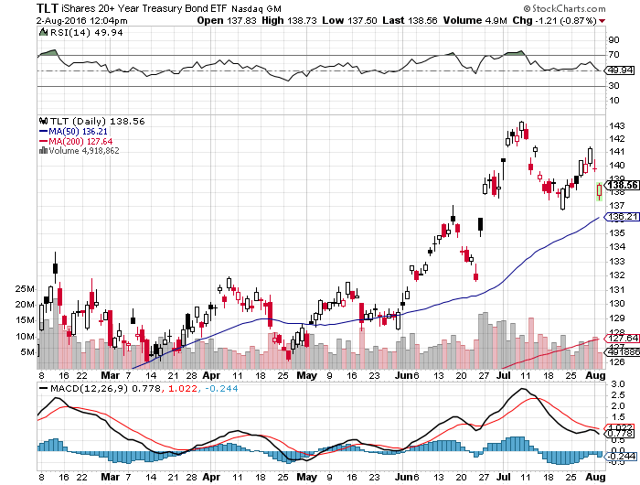
Ten Year Treasury ETF (TLT) 1.54%
Looking at long 9/$132-$135 vertical bull call spread

Slide 17
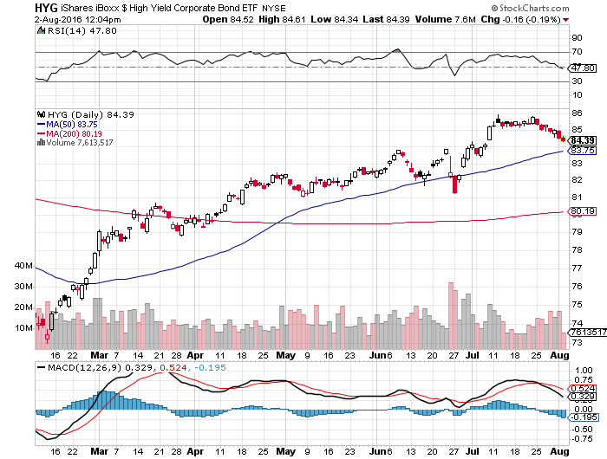
Junk Bonds (HYG) 6.33% Yield
A Great Risk Coincident Indicator-”RISK ON” means new highs

Slide 18
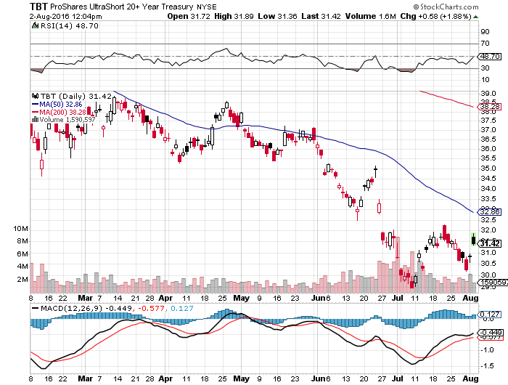
2X Short Treasuries (TBT)- Looking Like a 2017 Trade

Slide 19
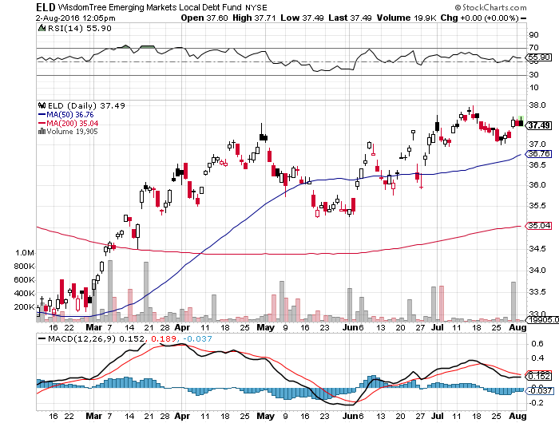
Emerging Market Debt (ELD) 5.75% Yield-

Slide 20
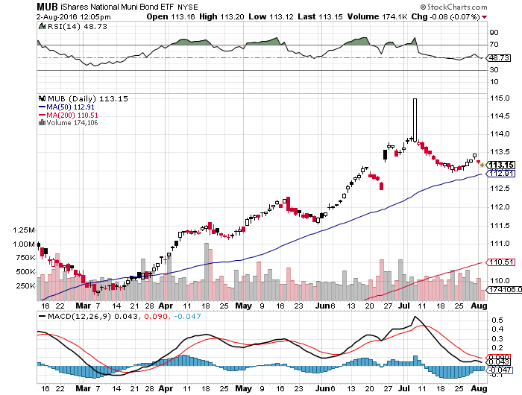
Municipal Bonds (MUB)-1.21% yield-New High
Mix of AAA, AA, and A rated bonds-flight to safety

Slide 21


Slide 22

Stocks-Gone to Sleep
*Stocks have flat lined for three weeks, we may be seeing a “TIME” correction and not a “PRICE” correction
*Weak 1.2% USGDP put the kibosh on any breakout soon, despite decent earnings reports
*Traders are reluctant to take positions ahead of August, which has a terrible record
*Stocks are now a low return, high risk play with PE multiples approaching 20X
*Volumes typical of summer doldrums
*Volatility Index (VIX) back to lows of the year creating hedging opportunities
*FANG stocks re accelerate as technology takes
market share from the old economy
*The world is looking for a tradable dip to “BUY”

Slide 23
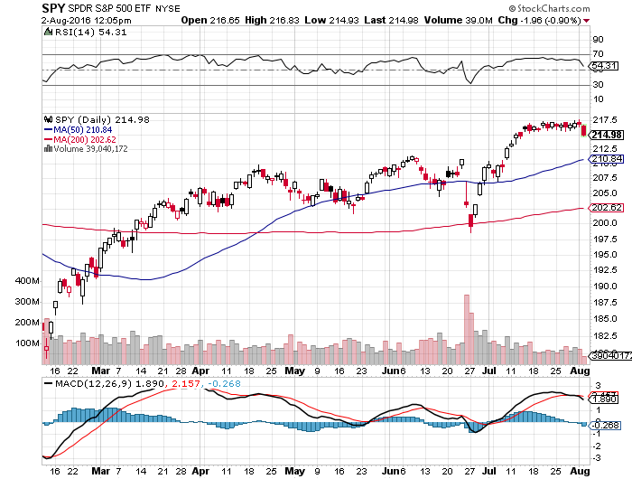
S&P 500-
Correction At Last!

Slide 24
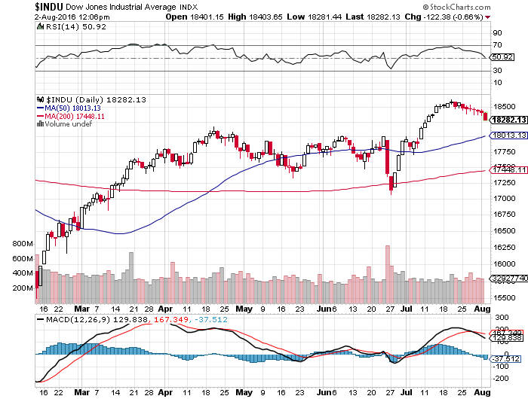
Dow Average-Down 8 Days in a Row Days

Slide 25
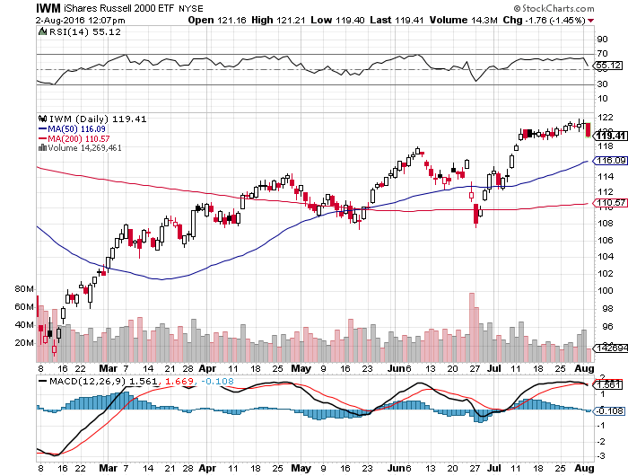
Russell 2000 (IWM)-Also on Vacation

Slide 26
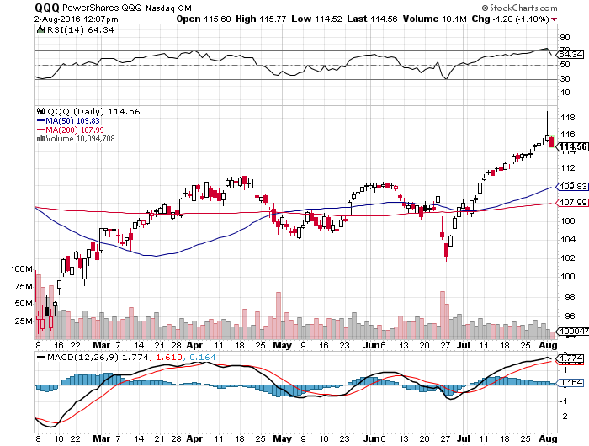
NASDAQ (QQQ)-
FANG is Back!

Slide 27
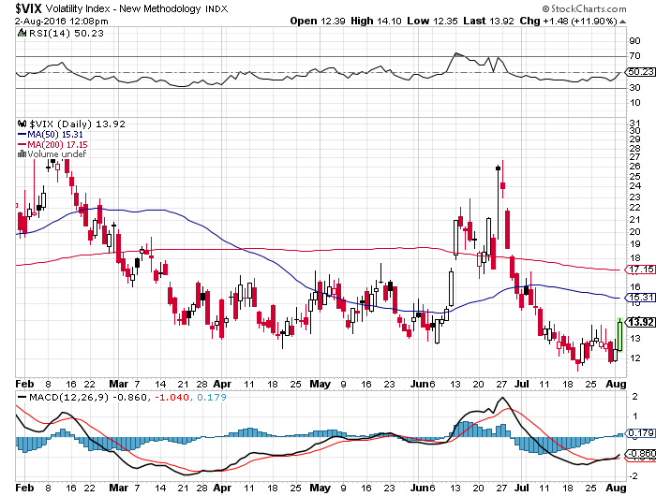
(VIX)-A New Decade Low

Slide 28
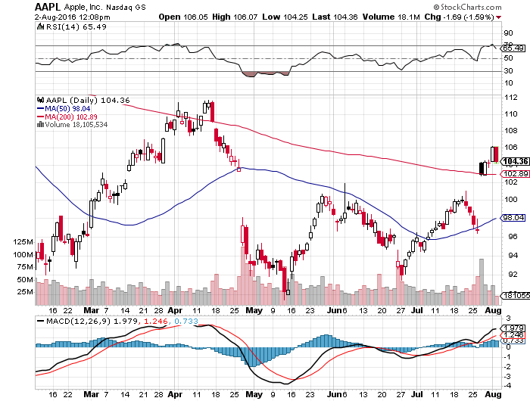
Apple (AAPL) –Buy the Dips
Back to waiting for the next real catalyst-the iPhone 7
The “Buffet Put Option” kicks in with $1 billion purchase

Slide 29
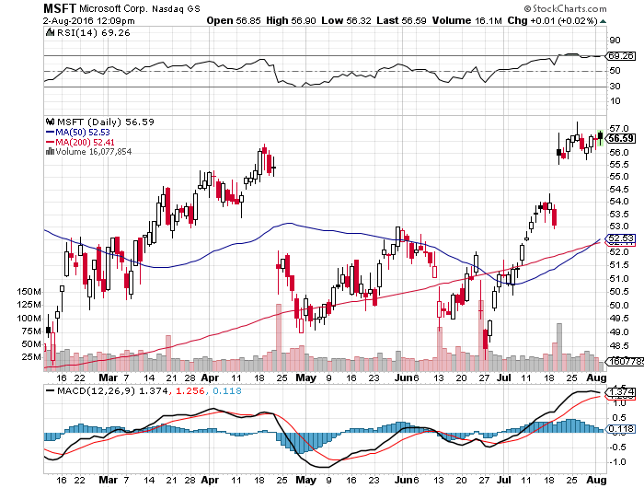
Microsoft (MSFT)
The New Big Cap Tech Leader

Slide 30
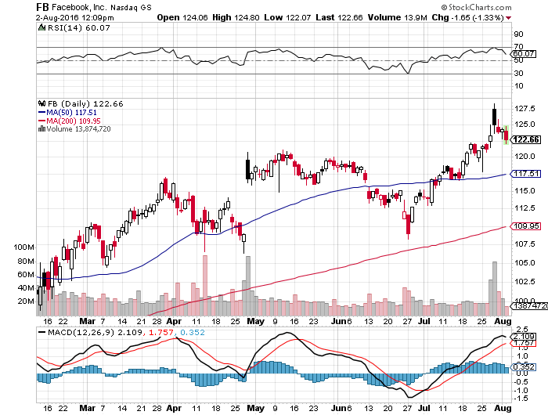
Facebook (FB)- The 200-Day Holds

Slide 31
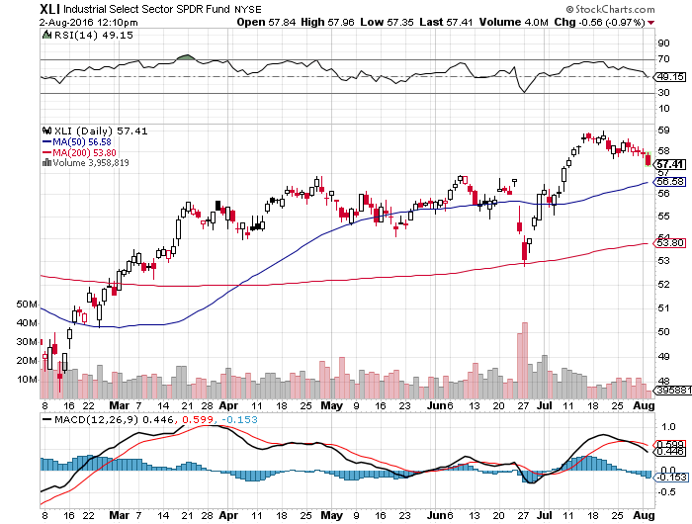
Industrials Sector SPDR (XLI)-Dow Mainstay
(GE), (MMM), (UNP), (UTX), (BA), (HON)

Slide 32
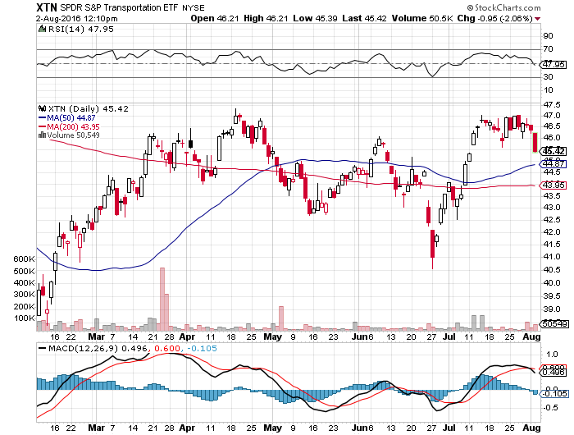
Transports Sector SPDR (XTN)-The Biggest Hit
(ALGT), (ALK), (JBLU), (LUV), (CHRW), (DAL)

Slide 33
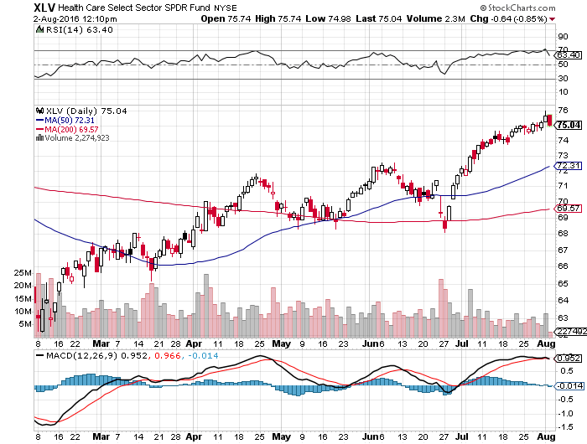
Health Care Sector SPDR (XLV), (RXL)
(JNJ), (PFE), (MRK), (GILD), (ACT), (AMGN)
Upside Breakout Came

Slide 34
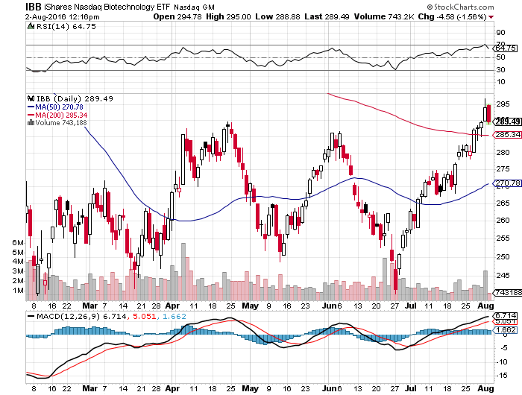
Biotech iShares (IBB)-A Political Football in 2016
Own for 2017

Slide 35
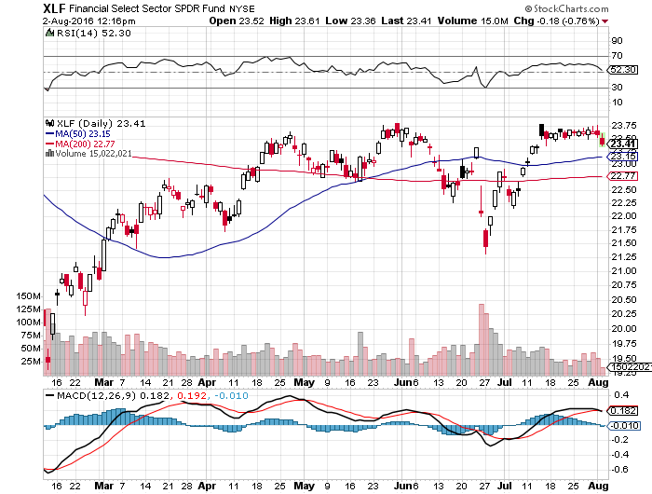
Financial Select SPDR (XLF)-A big Value Play
(BLK/B), (WFC), (JPM), (BAC), (C), (GS)

Slide 36
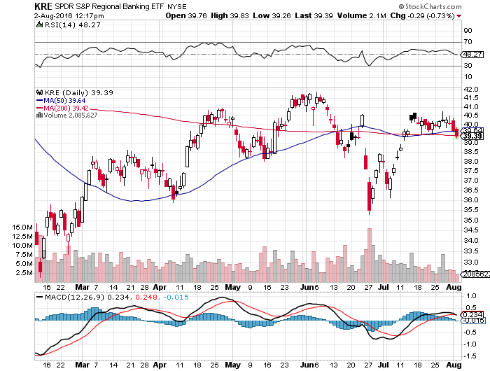
KRE Regional Bank ETF (KRE)-

Slide 37
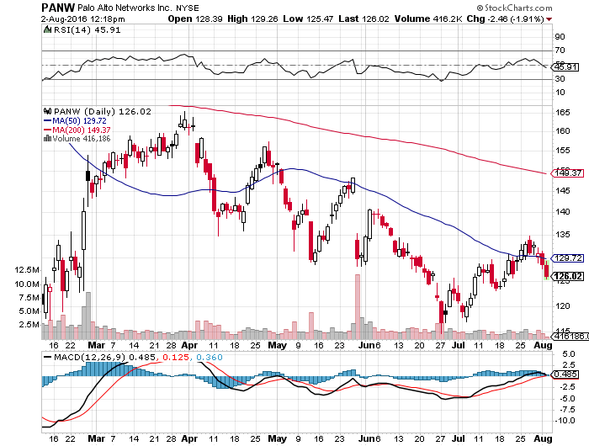
Palo Alto Networks (PANW)- another entry point setting up-Hacking Isn’t Going Away

Slide 38
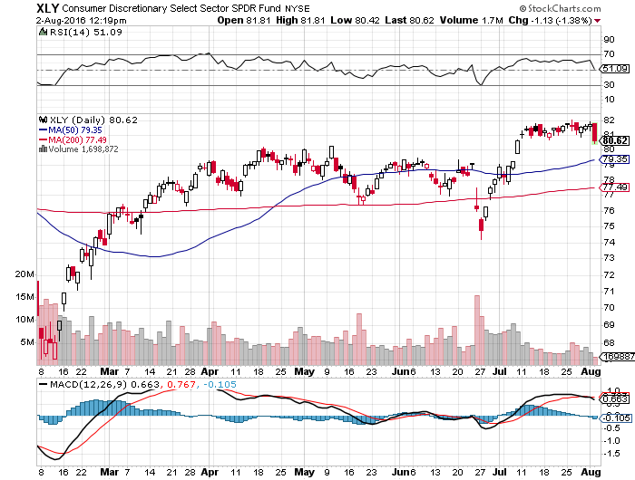
Consumer Discretionary SPDR (XLY)
(DIS), (AMZN), (HD), (CMCSA), (MCD), (SBUX)
A Major Leader of the Rally

Slide 39
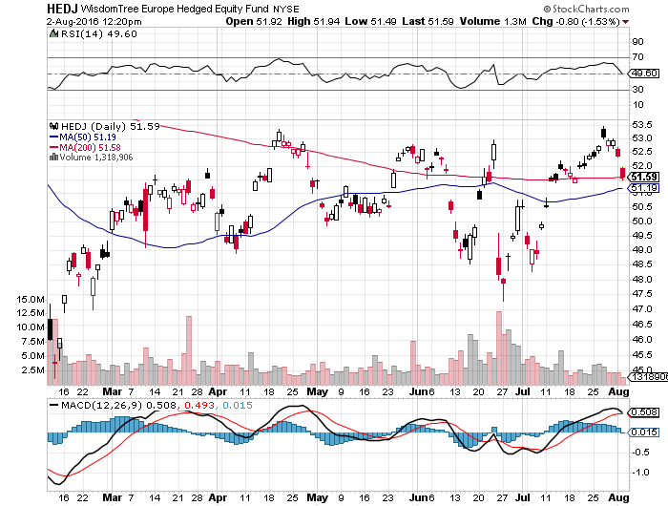
Europe Hedged Equity (HEDJ)-Hedged European Equity
Stay away while Europe suffers-No New High Here

Slide 40
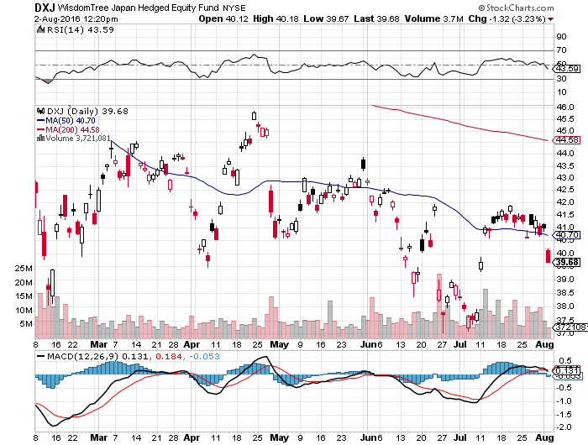
Japan (DXJ)-Hedged Japan Equity
Yen Finally Breaks

Slide 41
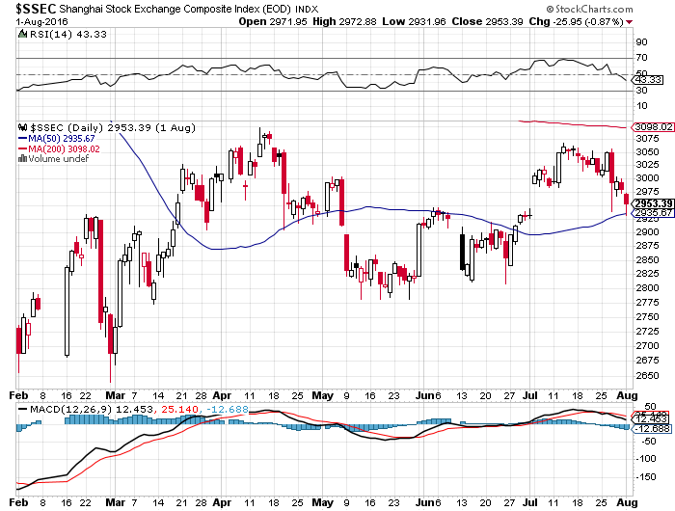
China ($SSEC)-
China Finally Participates

Slide 42
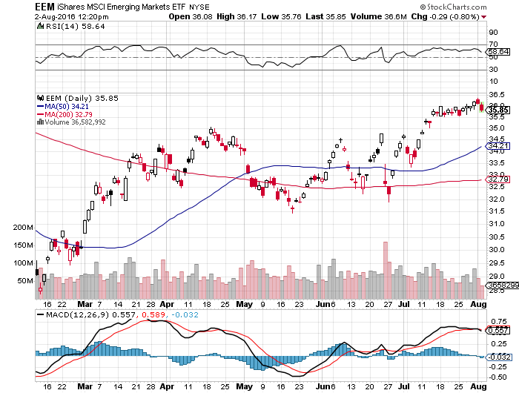
Emerging Markets (EEM)-

Slide 43


Slide 44
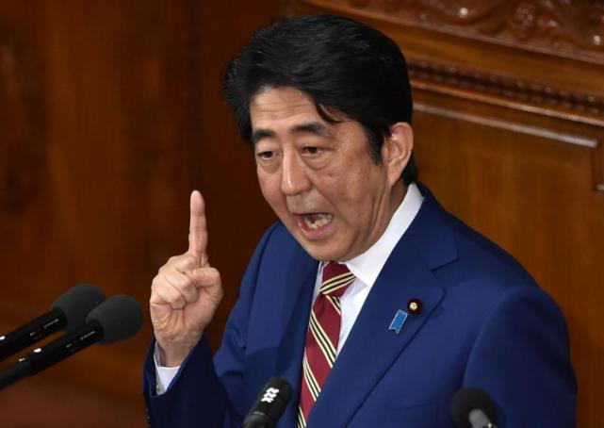
Foreign Currencies - “RISK OFF” IS BACK
*Weak US GDP gives Japanese yen a major boost, makes back half the recent selloff, signals generalized “RISK OFF”
*Yen goes the wrong way on Abe’s massive $274 billion stimulus program
*With Europe in collapse, and a coup in Turkey, the Euro (FXE) is headed lower
*Chinese Yuan rallies on better data
*Weak oil demolishes Loonie (FXC)

Slide 45
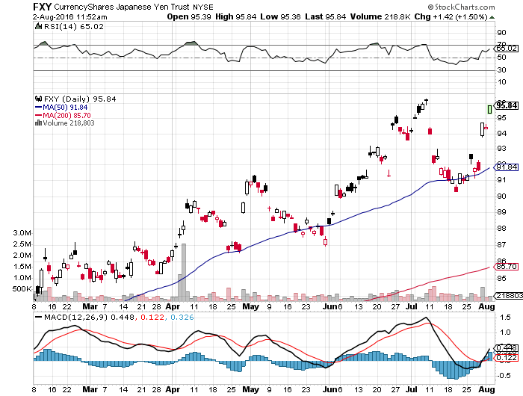
Japanese Yen (FXY)-2 Year High
Is This the Double Top?

Slide 46
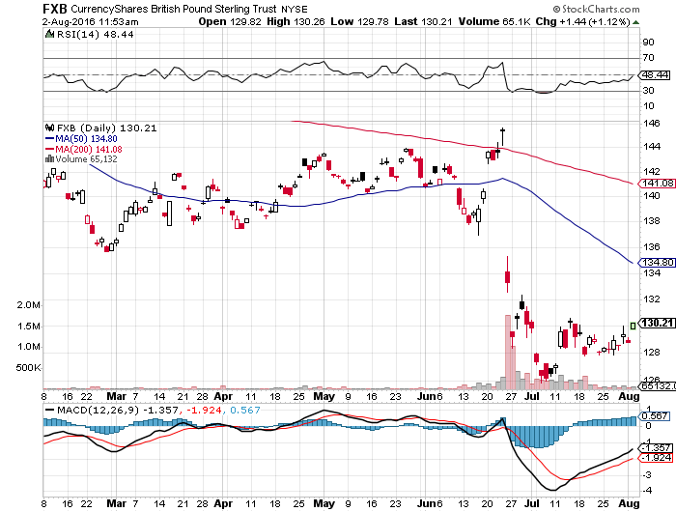
British Pound (FXB)-
Building a Base

Slide 47
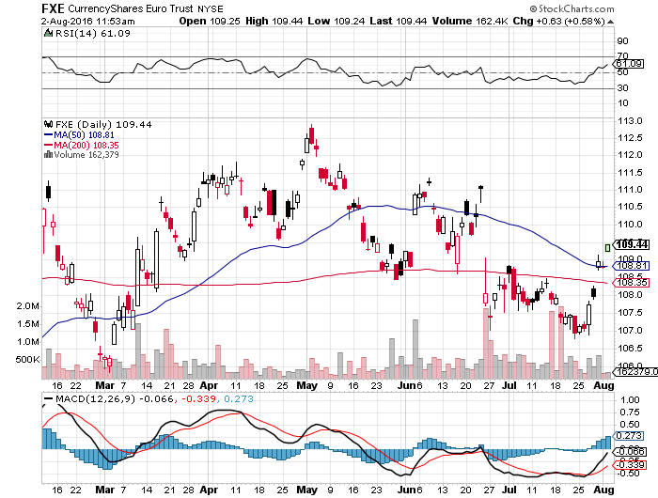
Euro ($XEU), (FXE), (EUO)- Fading Economy looking to buy the 9/$111-$114 bear put spread

Slide 48
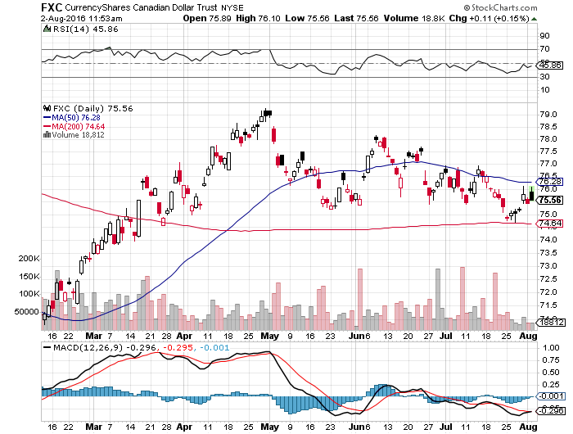
Canadian Dollar (FXC)-Falling Oil Disease

Slide 49
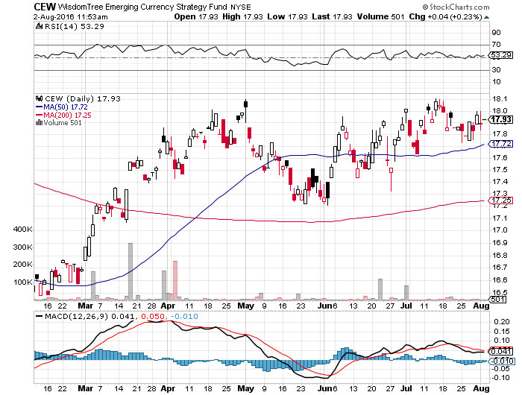
Emerging Market Currencies (CEW)

Slide 50
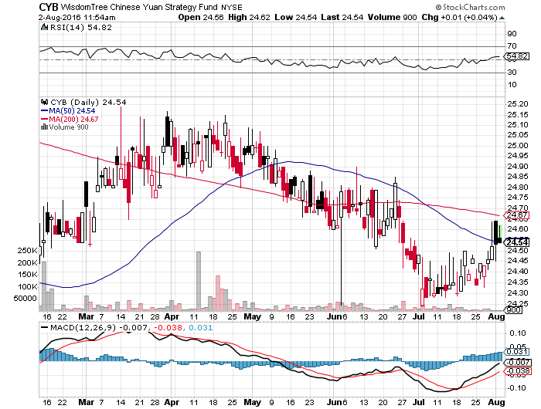
Chinese Yuan- (CYB)-

Slide 51


Slide 52
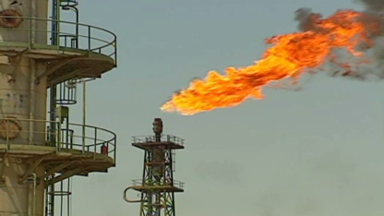
Energy-Searching for the next Bottom
*Oil in free fall again on gasoline over supply. $30 handle to be tested soon
*A very negative geopolitical backdrop, with disruptions everywhere, is being overwhelmed by pure over supply
*Contangos widening as producers bid for storage, driving prices down further
*Baker-Hughes US oil rig count up 3 to 347,
continuing an 8 week trend up,
*Oil now testing bottom of $40-$60 range,
a break takes us to $35 quickly
*Energy stocks finally giving back an
extreme and prolonged overbought
condition
*A huge speculative long position of
277,000 contracts now overhangs the market,
only 18% off of all time highs

Slide 53
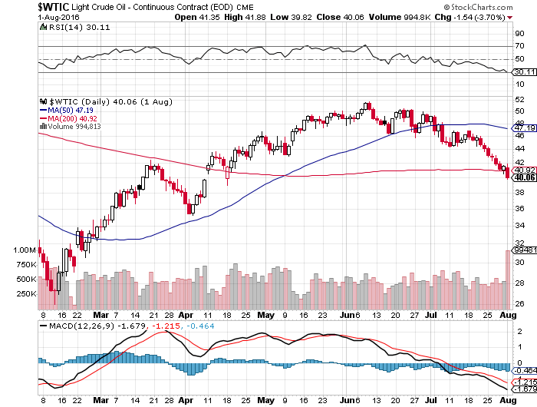
Oil-Testing the Bottom of the Range

Slide 54
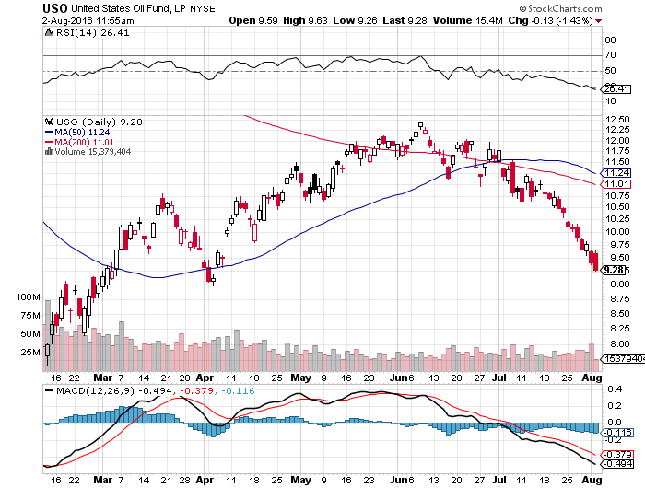
United States Oil Fund (USO)

Slide 55
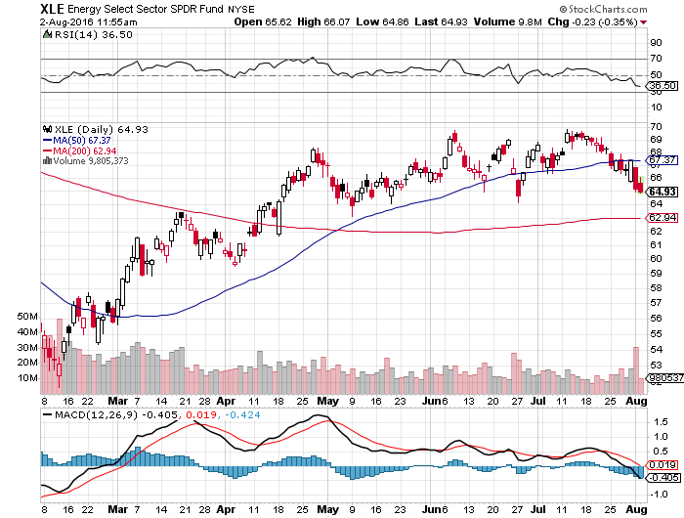
Energy Select Sector SPDR (XLE)
(XOM), (CVX), (SLB), (KMI), (EOG), (COP)

Slide 56
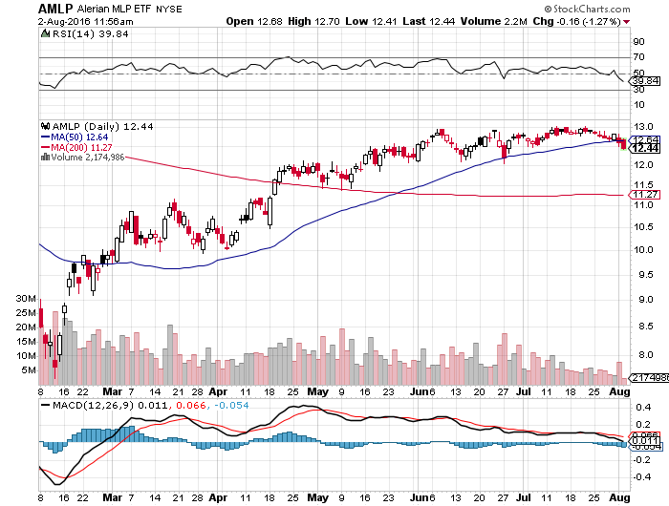
Alerian MLP ETF (AMLP)- 8.89% Yield
Basket Approach is the Only Safe Play here

Slide 57
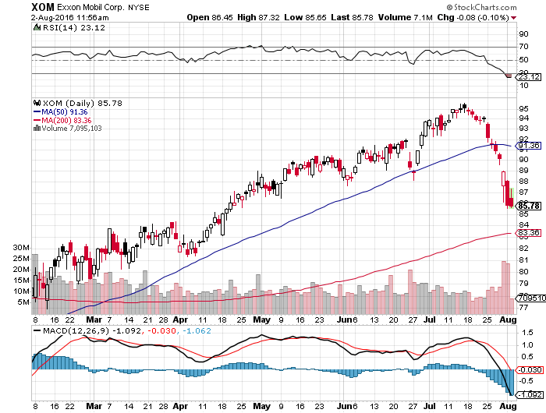
Exxon (XOM)-Dividend is Not Enough

Slide 58
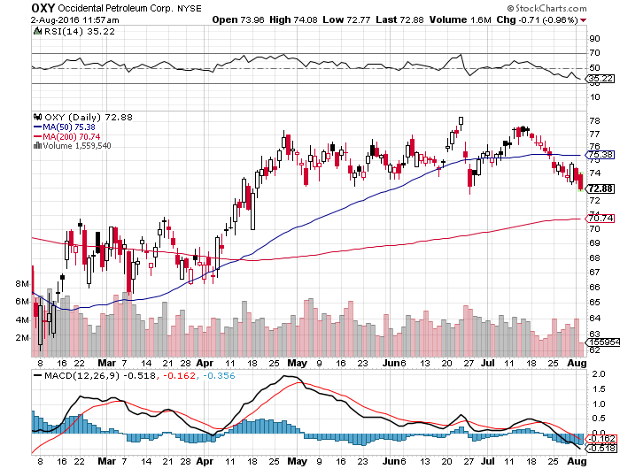
Occidental Petroleum (OXY)-

Slide 59
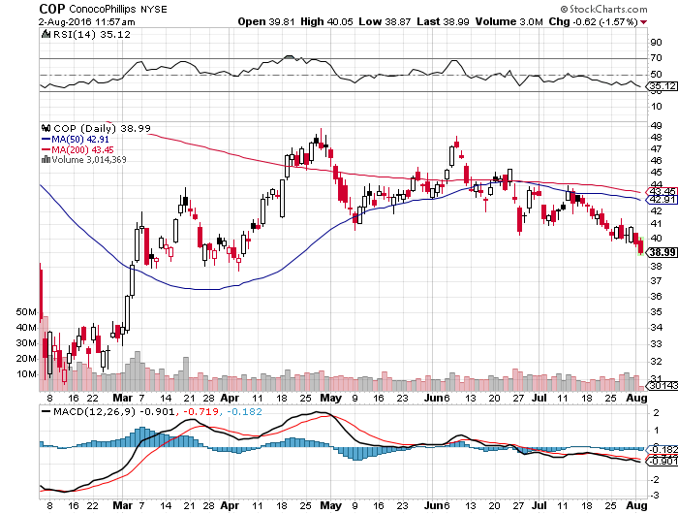
Conoco Phillips (COP)-The Buffet Favorite

Slide 60
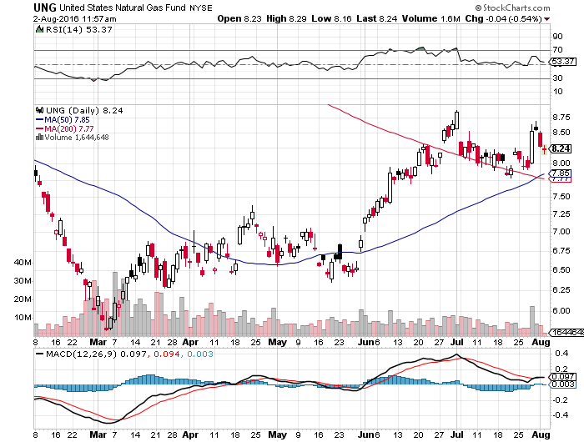
Natural Gas (UNG)-New 2016 Highs!

Slide 61
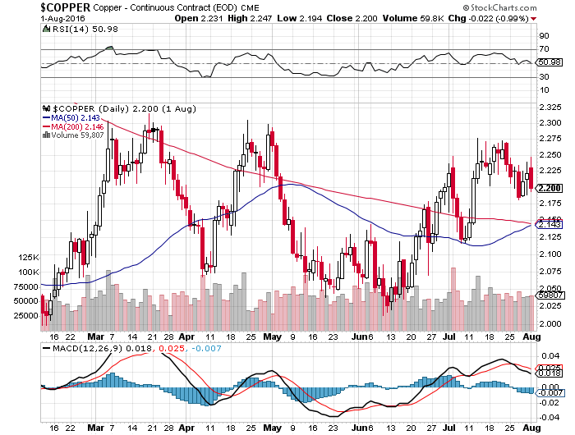
Copper-No Global Growth Scare Here

Slide 62
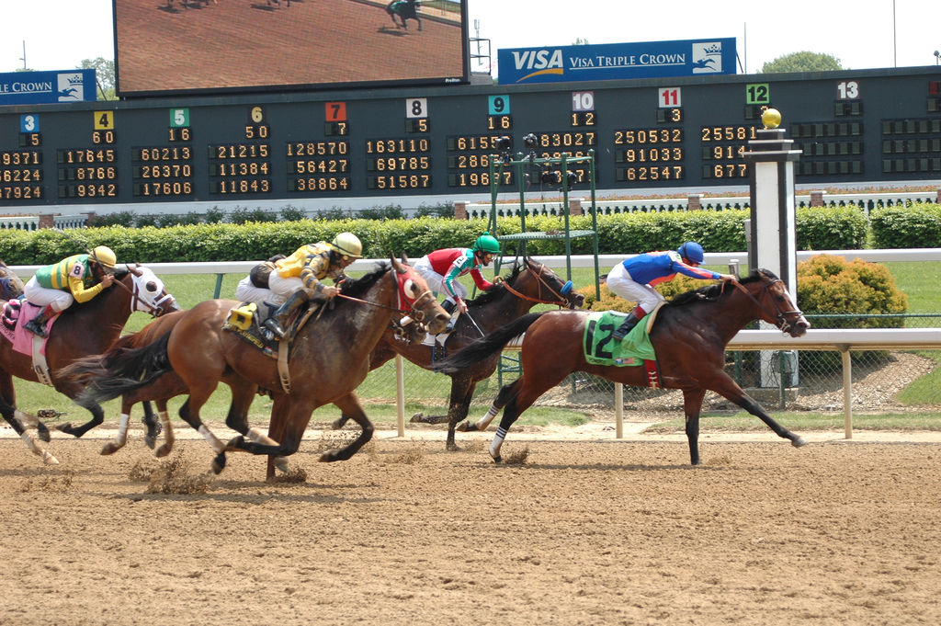
Precious Metals-Back to the Races
*“RISK OFF” send gold back up to the highs
*Buying has spilled into the other metals big time, with all posting new highs for the year
*Silver outperforms gold in a major way, has recovered half of peak prices
*Massive drop in rates to negative
numbers in many countries creates
a de facto positive return on non
yielding gold assets
*The opportunity cost of gold
ownership is now the lowest in history

Slide 63
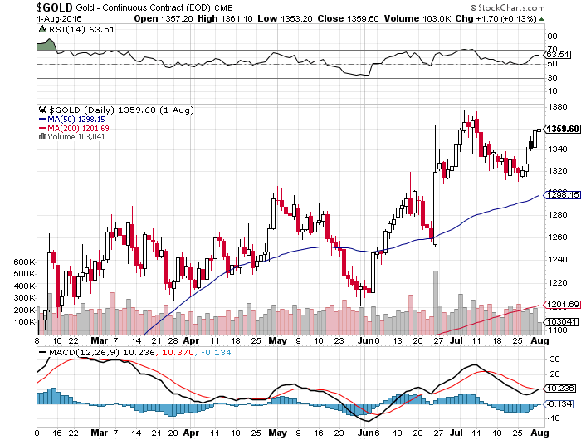
Gold (GLD)-Buy Dips

Slide 64
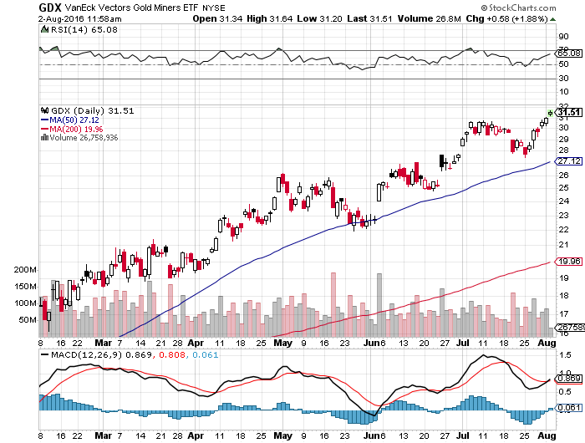
Market Vectors Gold Miners ETF- (GDX)

Slide 65

Silver (SLV)-

Slide 66

Silver Miners (SIL)-

Slide 67

Platinum (PPLT)-The Gold Effect

Slide 68

Palladium (PALL)-

Slide 69

Agriculture-Still More New Lows!
*Record crops, record production, record yield all bad news for the ags
*Large purchases of soybeans by China breaking the fall in prices there
*Drought has abated in most parts of the country, except for Southern California
*Not a single wheat sale to Egypt this year, our share taken over by Russia, thanks to strong dollar and weak Ruble
*No trade, there are NO fish to fry
*My main job here is to keep traders
away from this sector this year, and
that approach has worked one more time

Slide 70


Slide 71

(CORN) – Gave up all of 2016

Slide 72

(WEAT) New Lows!

Slide 73

(SOYB) No Longer the Sole Survivor

Slide 74

Real Estate-Slowing
*June new home sales jump from 572,000 to 592,000, and are up 25% YOY
*June pending home sales up a weak 0.2%
*Bloom finally coming off the rose in the San Francisco market
*Conventional 30-year fixed rate plunges to a new low of 3.45%, qualifies 1 million more new home buyers
*Return of home equity brings massive home improvement boom
*Soaring prices in big cities finally putting
a dent in apartment rentals
*The REIT boom keeps powering on
with the reach for yield
*May Case Shiller S&P 500 National index
continues upward grind, May +5.2%,
Portland, Seattle, Denver lead, San
Francisco lags

Slide 75

April S&P 500/Case–Shiller Home Price Index
+5.0% YOY, Portland, Seattle, Denver leaders

Slide 76

General Growth Properties (GGP)

Slide 77

US Home Construction Index (ITB)
(DHI), (LEN), (PHM), (TOL), (NVR)
Another Big Brexit Winner

Slide 78

Trade Sheet
So What Do We Do About All This?
*Stocks- stand aside-wait for a big dip to buy
*Bonds-buy dips
*Commodities-buy dips long term
*Currencies- sell yen and Euro on rallies
*Precious Metals –buy dips
*Volatility-sell short spikes over $25, buy dips to $12
*The Ags –stand aside
*Real estate-buy the homebuilders LT

Slide 79

Next Strategy Webinar
12:00 EST Wednesday,
August 17, 2016
San Francisco, CA
Good Luck and Good Trading!
Notes:
*

