Slide 1
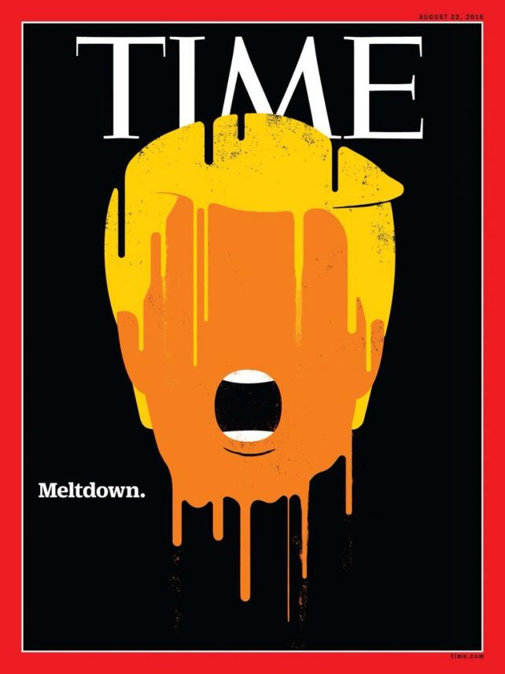
The Mad Hedge Fund Trader “THE MELT UP IS EARLY”
With John Thomas from San Francisco, CA, August 17, 2016 www.madhedgefundtrader.com
Notes:
*

Slide 2

In the Store Now for $49
Sectors and stocks that will lead the market for the next 20 years
https://members.madhedgefundtrader.com/roaring-twenties-book/

Slide 3

Mad Options Trader
*Net Trading Profits are up 20% in August on the weekly options *Demand for the new $1,500 a year service will be overwhelming *Get your upgrade order in now to avoid the month end crush *Email Nancy in Customer support at support@madhedgefundtrader.com and put “MOT Upgrade” in the subject line *Nancy will calculate a pro rata credit for the balance of your existing subscription, and then bill you new subscription fee less credit. MOT remains
free until August 31. *Upgrade now to avoid interruption of service *”Whiz” will guest host the August 31 biweekly Global Strategy Webinar with me

Slide 4

Trade Alert Performance Still Beating the Dow
*January +1.23% Final *July +0.67% Final *February +4.50% Final *August +2.94% MTD *March -2.42% Final *September +11.99% Final *April -2.10% Final *October -6.19% Final *May +4.38% Final *November 5.78% Final *June -0.56% Final *December -4.94% Final *2016 Year to Date +8.69% compared to 7.1% for the Dow Average *Trailing 1 year return +20.85%, +200.37% since inception, *Average annualized return of 35.35%

Slide 5
MHFT Global Strategy Luncheons Buy tickets at www.madhedgefundtrader.com
Portland, Oregon September 16
Incline Village, Nevada October 7

Slide 6

MHFT Global Strategy Luncheons Buy tickets at www.madhedgefundtrader.com
San Francisco, CA October 21
Las Vegas, Nevada November 18

Slide 7
Portfolio Review Playing Cautious
Current Capital at Risk
Risk On
World is Getting Better
(FXY) 8/$97-$100 put spread | 10.00%
(FXY) 9/$99-$102 put spread | 10.00%
Risk Off
World is Getting Worse
no position
total net position | 20.00%
Expiration P&L 9.80%

Slide 8

The Method to My Madness Dipping a Toe Back Into the Water
*Starting to take small positions against the most extreme moves *Early Trump Melt Down is Triggering Early Stock Melt Up *Buy “RISK ON” assets on every substantial dip *Wait the extra day and let the market come to you *The game from here on is to position yourself for a pre/post US presidential election stock melt up and a global risk on rally

Slide 9
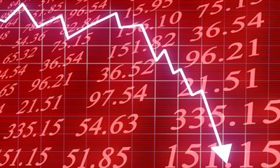
What Could Make the Market Sell Off?
*Geopolitical events aren’t working anymore, everyone has figured out that each one is a “BUY” *Oil takes a new run at $25/barrel, will kill energy sector *A shockingly negative monthly nonfarm payroll report *Fed raises interest rates in September *The end of the presidential election, 85 days off *Upside exhaustion when (SPY) hits +10% in 2016 at 2,247, is now up 7%

Slide 10
Paid Subscriber Trailing 12 Month Audited Return +20.85%-Taking Another Run at the Highs

Slide 11
68 Months Since Inception Daily Audited Performance Averaged annualized return +35.35%

Slide 12

Short Term Strategy Outlook
*Global central bank coordination to flood markets with money is lifting equities everywhere, QE with a turbocharger *Volatility is trading close to decade lows, buy as a hedge against other assets *Trump melt down moves up the pre election stock melt up *No chance of a rate rise in 2016, but Fed will tease us in September *Oil trying to establish bottom of new range, bounces hard on the first attempt to break $40 *Bonds will struggle until the next “RISK OFF” cycle *Gold uptrend still lives, but is stalled for now *Stay away from ags, perfect weather to bring new lows.

Slide 13
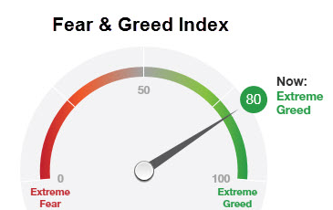
Middle Range of Greed at 80

Slide 14
The Bill Davis View A $1,500 Upgrade for the Mad Day Trader Service
Buys:
Baidu, Inc. (BIDU) $172 Target to $181
CF Industries (CF) $21 Target to $28
Amazon, Inc (AMZN) $765 Target to $781
Tesoro (TSO) $75 Target to $88
Amgen, Inc. (AMGN) $172 Target to $181
General Dynamics (GD) $150 Target to $158
Sells:
Akamai Tech (AKAM) $55 Target to $43
Signet Jewelers (SIG) $100 Target to $87
Anthem, Inc. (ANTM) $135 Target to $120
Incyte Corp (INCY) $91 Target to $75
Teva Pharm (TEVA) $55 Target to $48

Slide 15

The Global Economy-Choppy
*SF Fed John Williams says “We can pull our foot off the gas a bit” hinting at September rate hike, but July producer prices and retail sales came in very weak, July PPI off -0.4%, only auto sales still doing well, thanks to 0% interest rates *Fed Fund futures showing an 18% chance of a rate rise in September, 51% in December *German Q2 GDP a weak 0.40%, but is still the strongest in Europe, Brexit drag not yet reflected *Bank of England does surprise interest rate cut from 0.50% to 0.25%, lowest in history, launches UK QE, pound craters *Japan Q2 GDP comes in at only 0.2% vs. 0.7% expected, capital spending fell, and consumer spending is in the tank, but yen strengthens anyway *Despite all this, US stocks and bonds are still the most attractive, highest yielding assets in the world, both should move to new highs *Fortress American looking strong

Slide 16
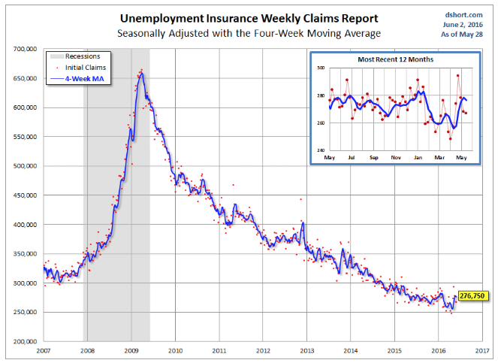
Weekly Jobless Claims –The Most Important Statistic +14,000 to 264,000-Lowest since 1973! The Downtrend Lives!-Show Me the Recession!

Slide 17

Bonds-Struggling at Highs
*Ten year US Treasuries rally to 1.54%, is the bull market over? *Global negative yielding debt hits $13.4 trillion *JGBs ease to -0.08%, German bunds to -0.09%, the UK is next to see negative bonds rates *Even emerging market debt rockets thanks to high yields * Junk bonds (HYG) maintain new year highs on global “RISK ON” *Watch the price action, we could be turning here

Slide 18
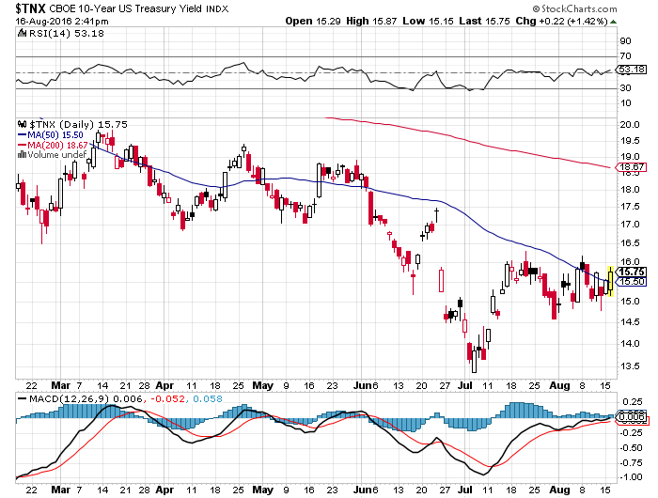
Ten Year Treasury Yield ($TNX) 1.54% Coiling for an Upside Breakout?

Slide 19
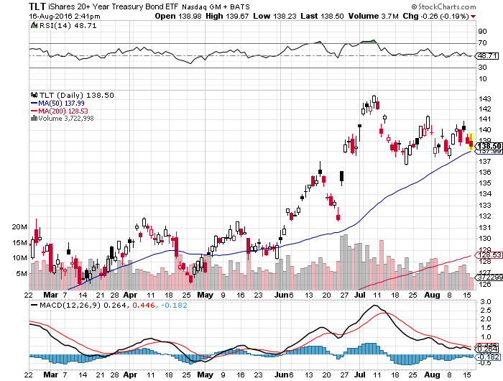
Ten Year Treasury ETF (TLT) 1.54% Looking at long 9/$132-$135 vertical bull call spread

Slide 20
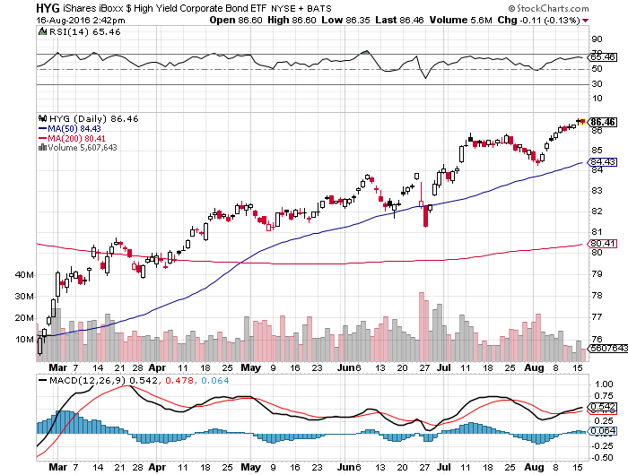
Junk Bonds (HYG) 6.33% Yield A Great Risk Coincident Indicator-”RISK ON” means new highs

Slide 21
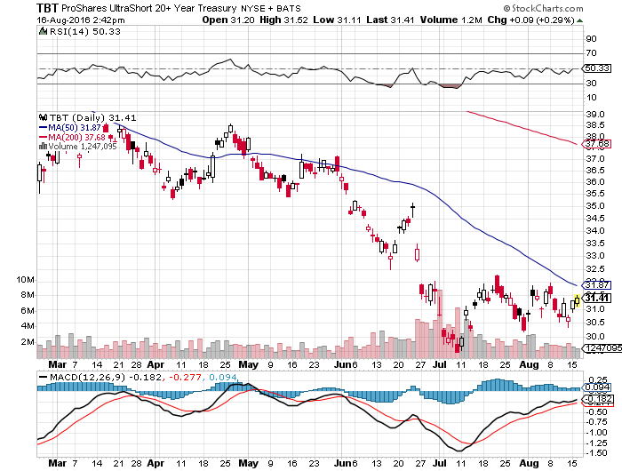
2X Short Treasuries (TBT)-Base Building

Slide 22
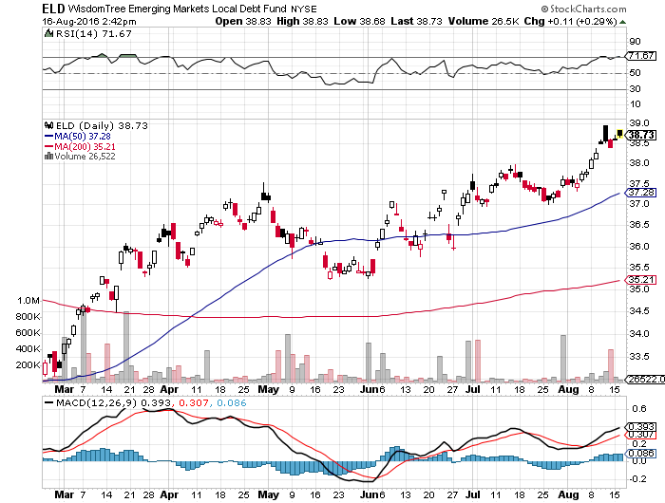
Emerging Market Debt (ELD) 5.75% Yield- Wow!

Slide 23
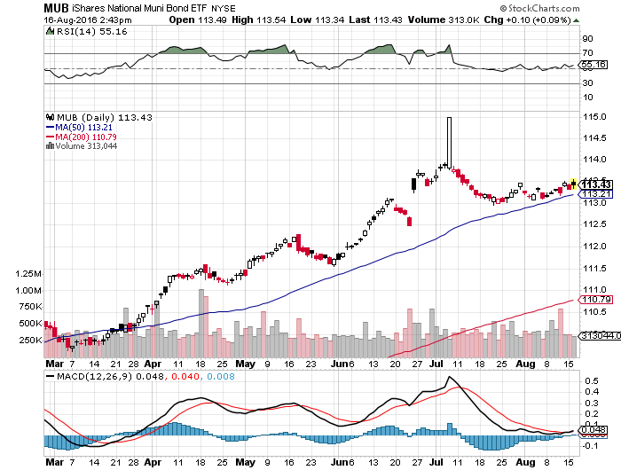
Municipal Bonds (MUB)-1.21% yield-New High Mix of AAA, AA, and A rated bonds-flight to safety

Slide 24
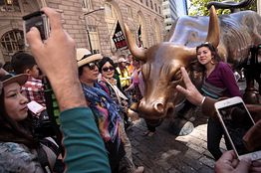
Stocks-Melt Up Light
*Stocks give us a very grudging upside breakout on non existent volume, deliver new daily highs in all indexes, but the conviction isn’t there *Much of smart money is now playing from the short side, Soros, Tudor Jones, David Tepper is cutting back, announced stock buy backs hit a four year low at $1.8 billion/day *Dancing to TINA: “There Is No Alternative” *Japanese government is now largest shareholder in the top Japanese companies, thanks to QE *Stocks are now a low return, high risk play with PE multiples approaching 20X *Volumes typical of summer doldrums, falling off a cliff *FANG stocks reaccelerate as technology takes market share from the old economy *The world is looking for a tradable dip to “BUY”

Slide 25
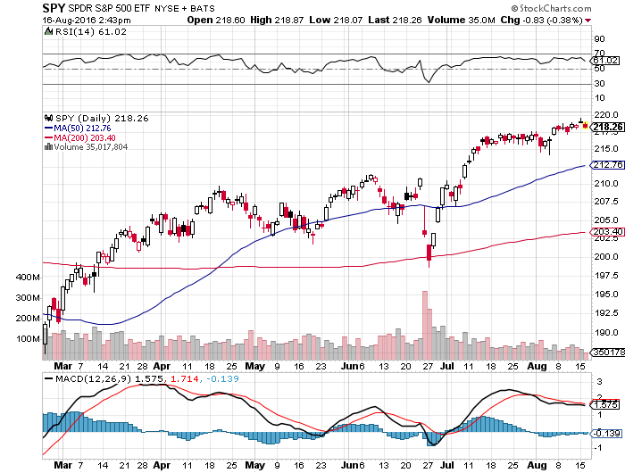
S&P 500- New Highs!

Slide 26
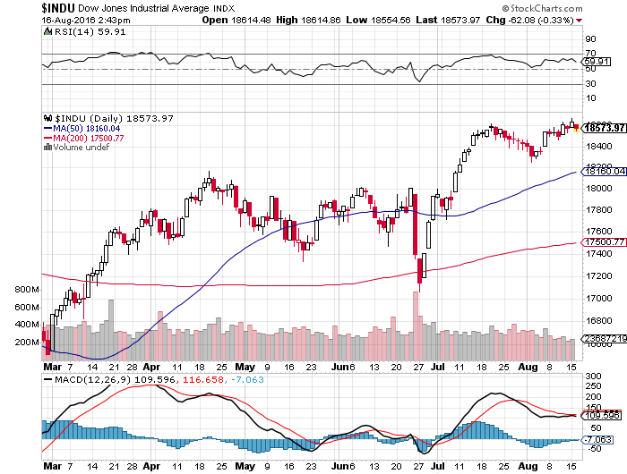
Dow Average-New Highs

Slide 27
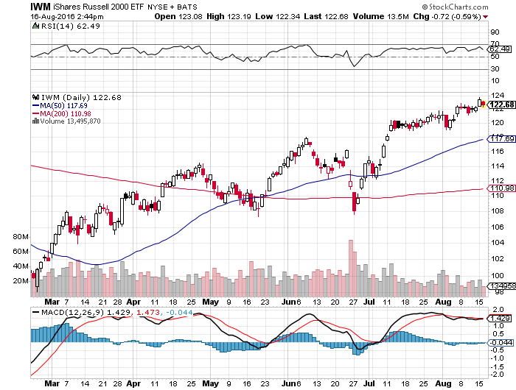
Russell 2000 (IWM)-

Slide 28
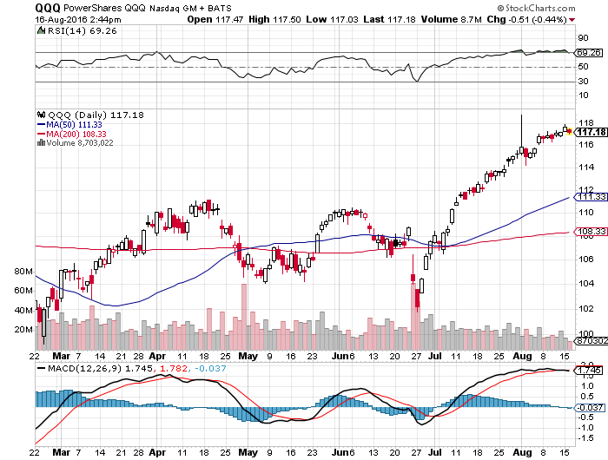
NASDAQ (QQQ)- FANG is Back!

Slide 29
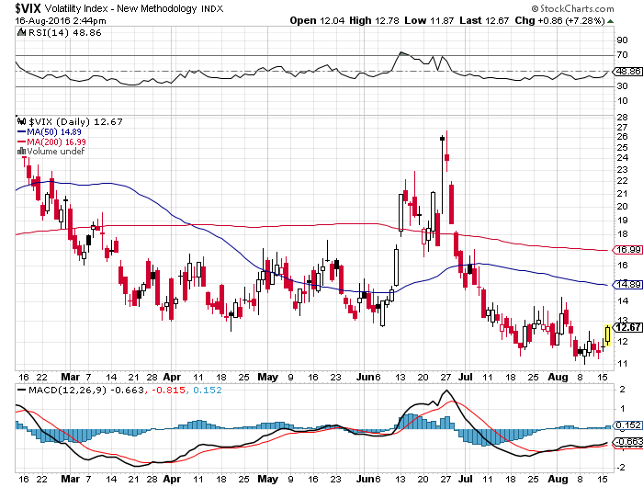
(VIX)-A New Decade Low

Slide 30
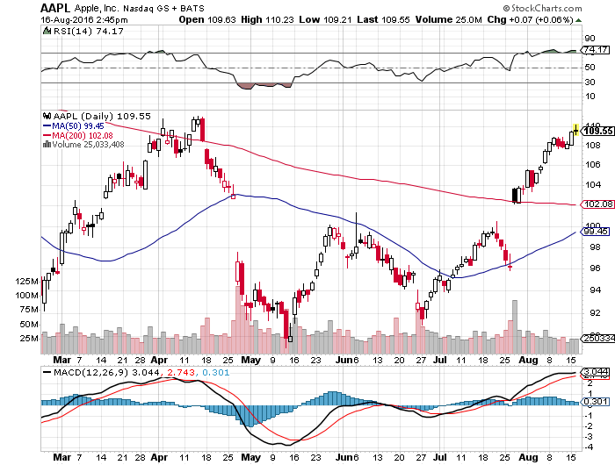
Apple (AAPL) –Buy the Dips Back to waiting for the next real catalyst-the iPhone 7 The “Buffet Put Option” kicks in with $1 billion purchase, then increases position by 55%

Slide 31
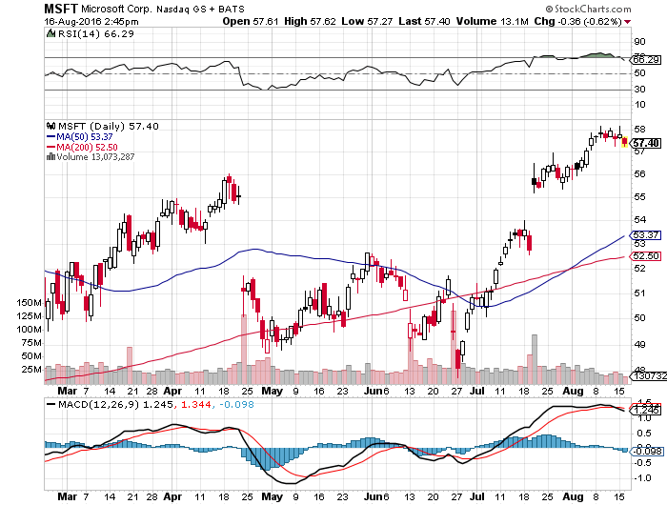
Microsoft (MSFT) The New Big Cap Tech Leader

Slide 32
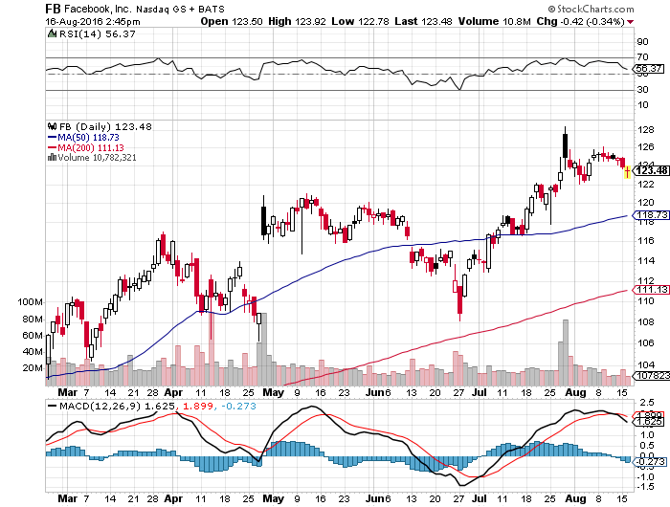
Facebook (FB)-

Slide 33
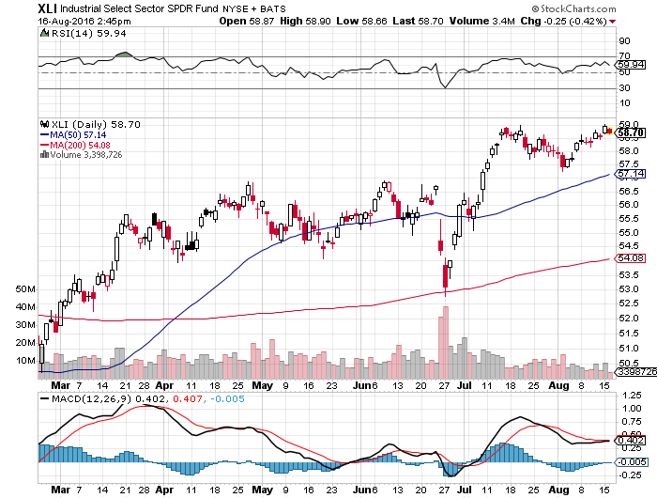
Industrials Sector SPDR (XLI)-Dow Mainstay (GE), (MMM), (UNP), (UTX), (BA), (HON)

Slide 34
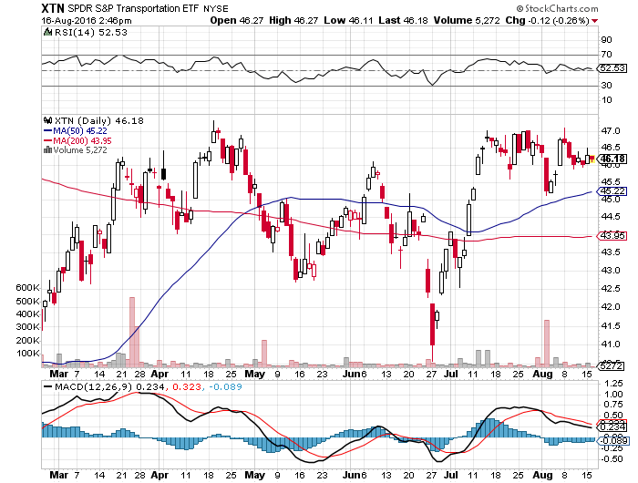
Transports Sector SPDR (XTN)-Upside Breakout Imminent (ALGT), (ALK), (JBLU), (LUV), (CHRW), (DAL)

Slide 35
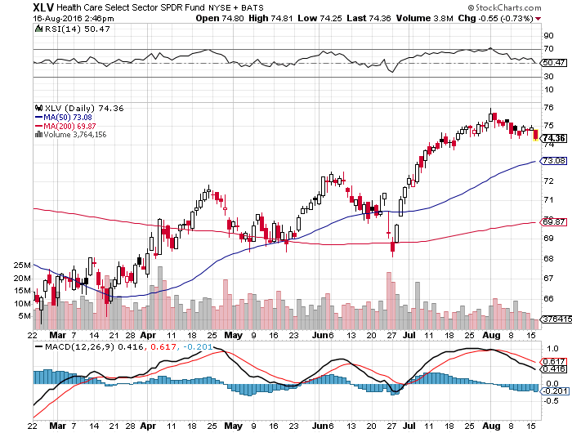
Health Care Sector SPDR (XLV), (RXL) (JNJ), (PFE), (MRK), (GILD), (ACT), (AMGN) Upside Breakout Came

Slide 36
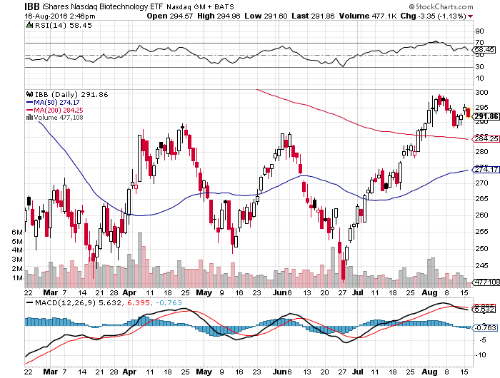
Biotech iShares (IBB)-A Political Football in 2016 Own for 2017

Slide 37
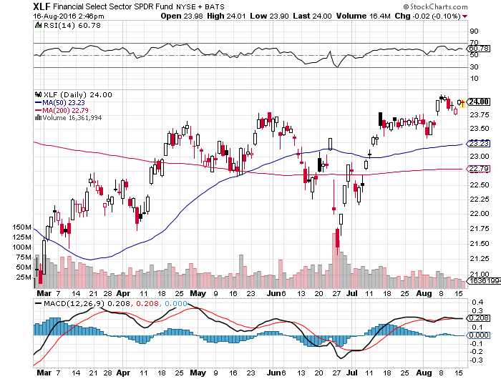
Financial Select SPDR (XLF)-A big Value Play (BLK/B), (WFC), (JPM), (BAC), (C), (GS)

Slide 38
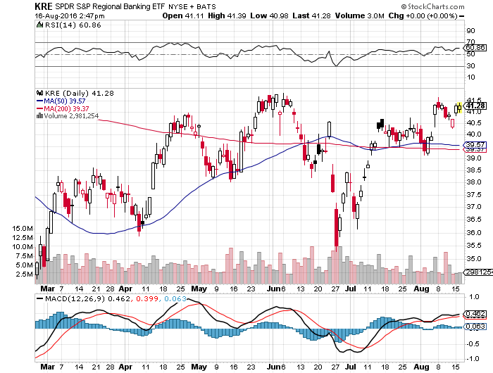
KRE Regional Bank ETF (KRE)- Breakout Coming

Slide 39
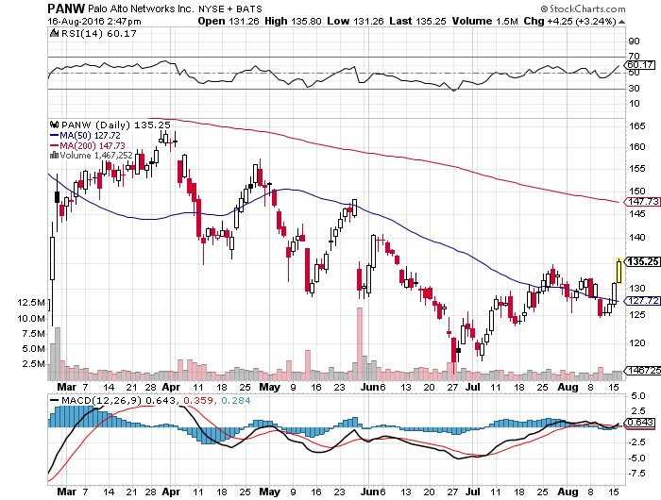
Palo Alto Networks (PANW)- another entry point setting up-Hacking Isn’t Going Away

Slide 40
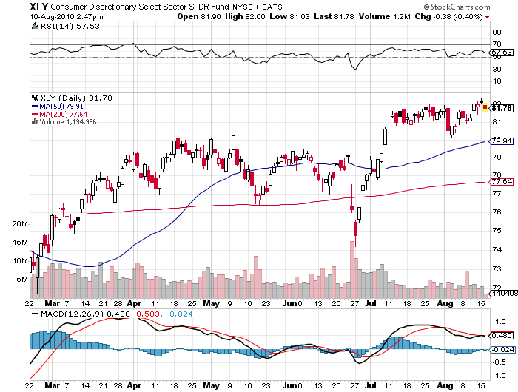
Consumer Discretionary SPDR (XLY) (DIS), (AMZN), (HD), (CMCSA), (MCD), (SBUX) A Major Leader of the Rally

Slide 41
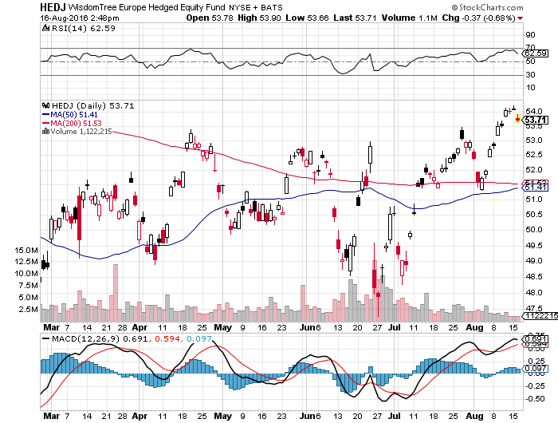
Europe Hedged Equity (HEDJ)-Hedged European Equity

Slide 42
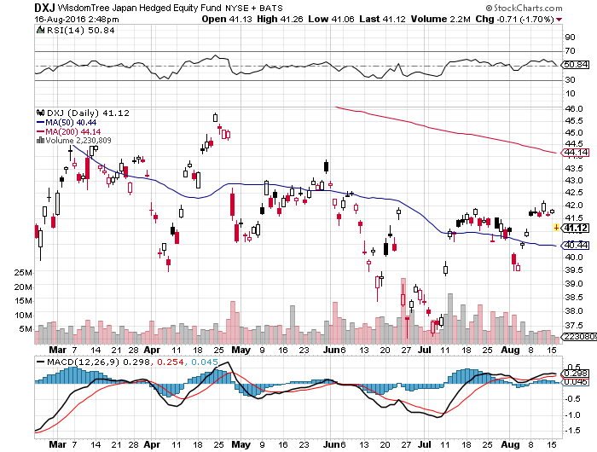
Japan (DXJ)-Hedged Japan Equity Killed by Strong Yen

Slide 43
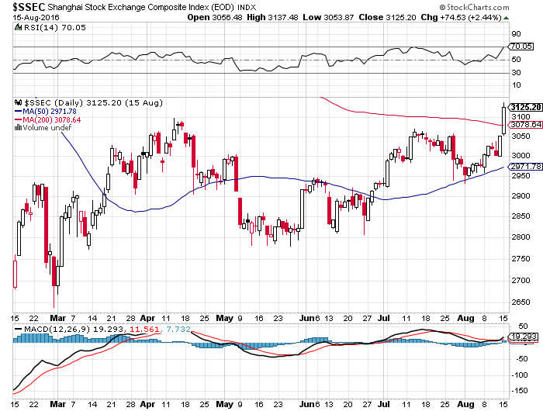
China ($SSEC)- China Finally Participates

Slide 44
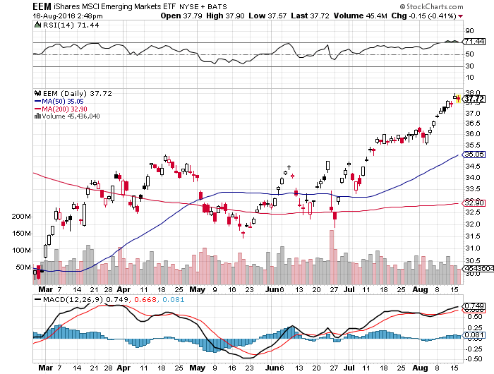
Emerging Markets (EEM)- Off to the Races

Slide 45
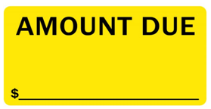
Foreign Currencies-Negative Rates Are the Driver
*Japanese yen breaks out two year highs, given up exactly one half of three year bear market, more yen weakening government action is imminent *However, JGBs have just rallied from -0.29% to 0.09%, prospects of positive rates are holding yen up *With the government now owning most of the bonds in Japan, it is running out of paper to buy, allowing rates to drift up *Outlook of negative rates for longer is pulling down the Euro, taking a run at new multi year lows *Oil recovery gives Aussie (FXA) and Loonie (FXC) a lift *Chinese Yuan (CYB) holding on mixed economic data

Slide 46
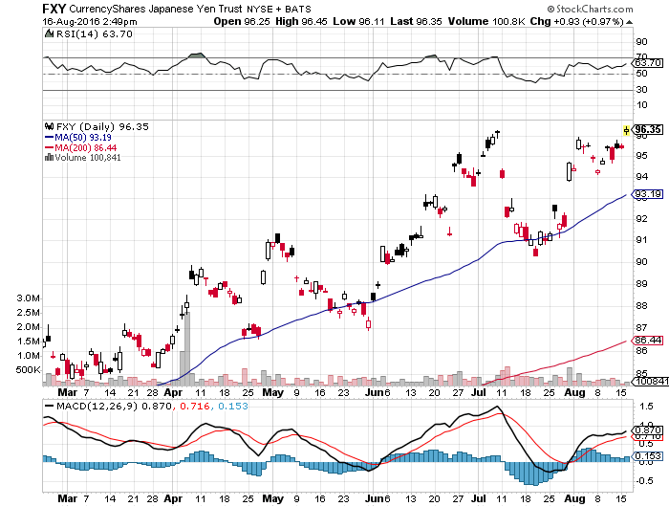
Japanese Yen (FXY)-2 Year High long the 8/$97-100 put spread-expires in 2 days long the 9/$99-102 put spread-expires in 21 days

Slide 47
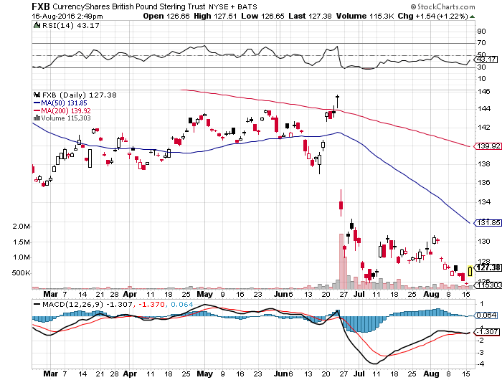
British Pound (FXB)-New Lows on Weakening Economy

Slide 48
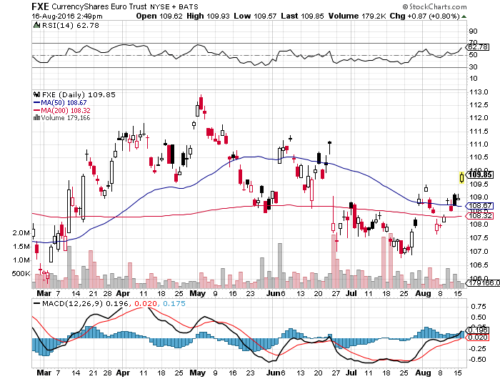
Euro ($XEU), (FXE), (EUO)- Fading Economy looking to buy the 9/$111-$114 bear put spread

Slide 49
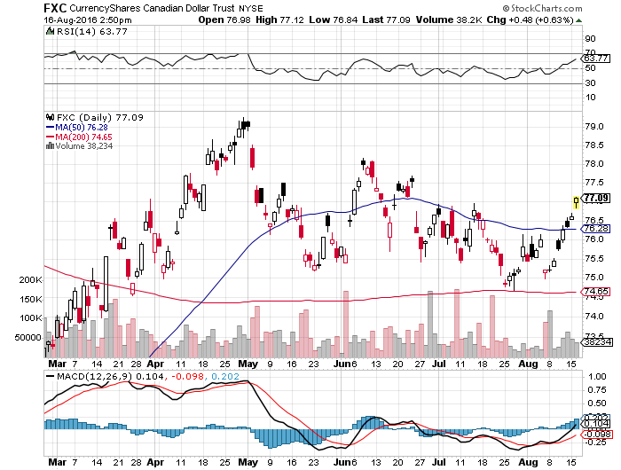
Canadian Dollar (FXC)-Strong Oil Boost

Slide 50
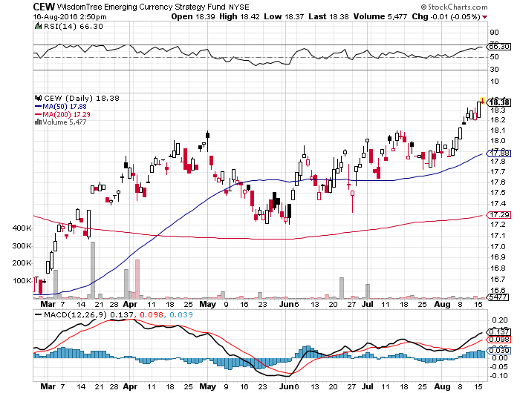
Emerging Market Currencies (CEW)

Slide 51
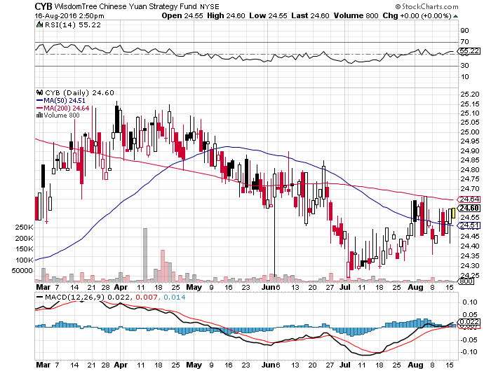
Chinese Yuan- (CYB)-

Slide 52
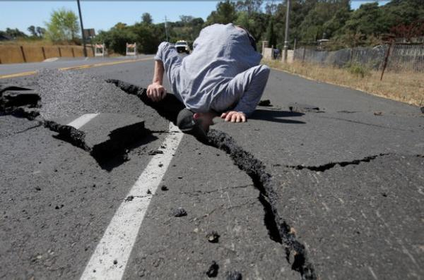
Energy-Bouncing Off the Bottom
*Saudi oil production hits all time high of 10.67 million b/d in July *New Saudi Oil minister says that he would be willing to discuss “ways to stabilize oil prices”, sparking sharp 10% rise *Oil is in over supply up and down the entire products spectrum *Alternatives jump 70% in five years, with Germany leading at 36% of electric power, accelerating demise of oil *Baker-Hughes US oil rig count up 17 to 381, continuing a 10 week trend up, *Oil now stuck in $40-$60 range, a break takes us to $35 quickly

Slide 53
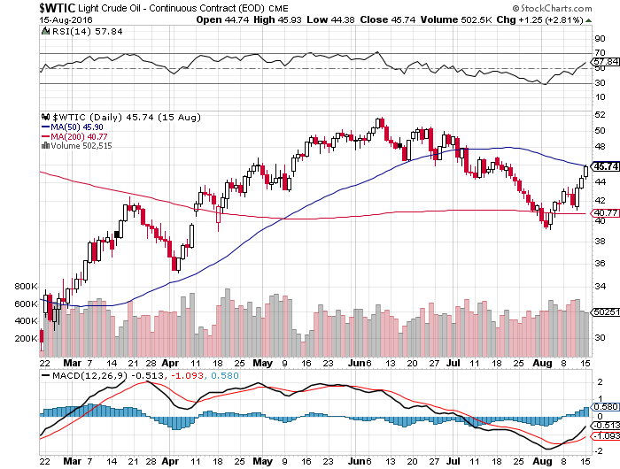
Oil-Hard Bounce

Slide 54
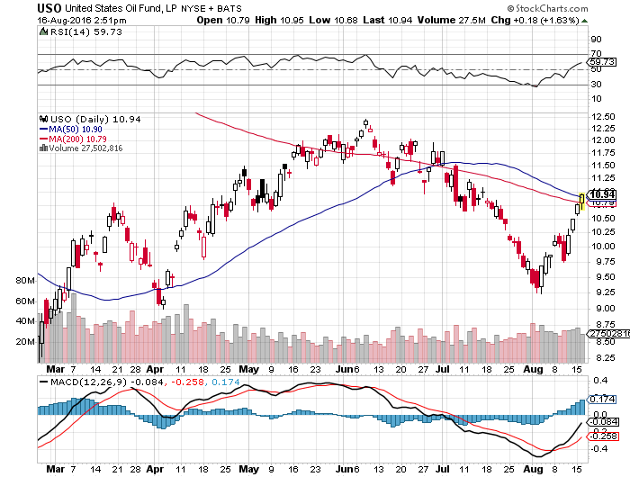
United States Oil Fund (USO)

Slide 55
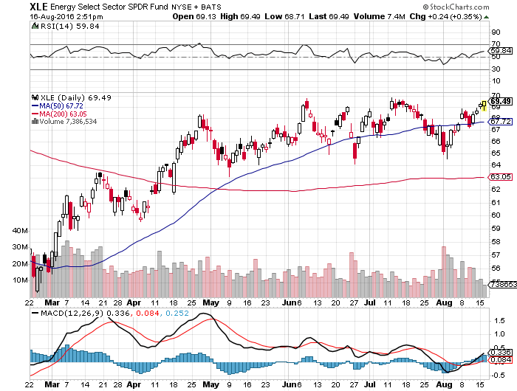
Energy Select Sector SPDR (XLE) (XOM), (CVX), (SLB), (KMI), (EOG), (COP)

Slide 56
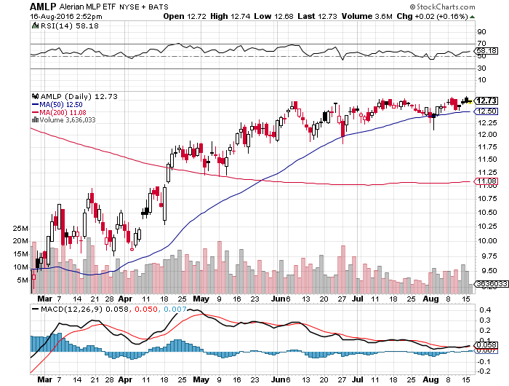
Alerian MLP ETF (AMLP)- 8.89% Yield Basket Approach is the Only Safe Play here

Slide 57
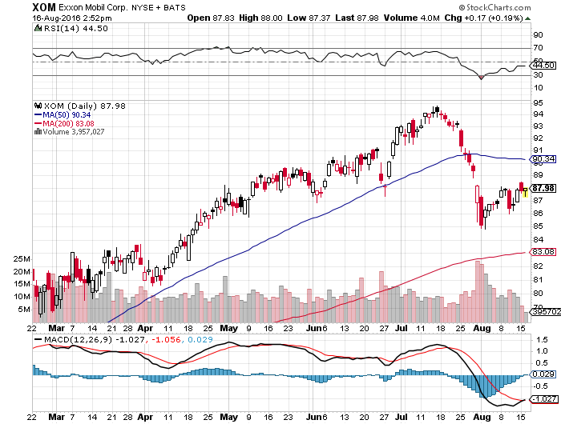
Exxon (XOM)-Dividend is Not Enough

Slide 58
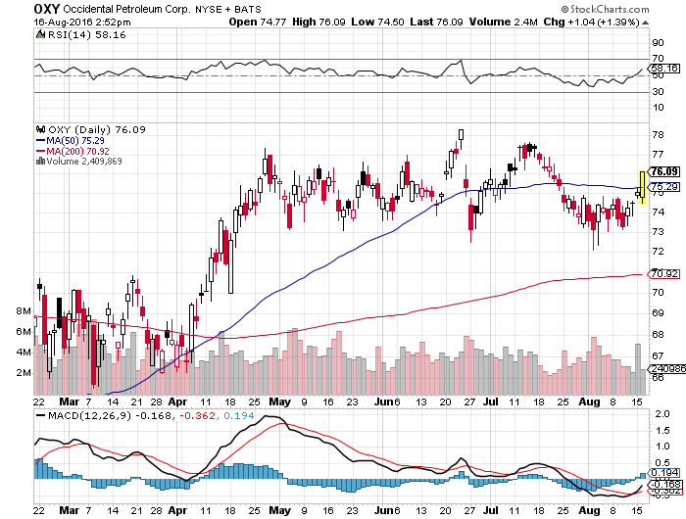
Occidental Petroleum (OXY)-

Slide 59
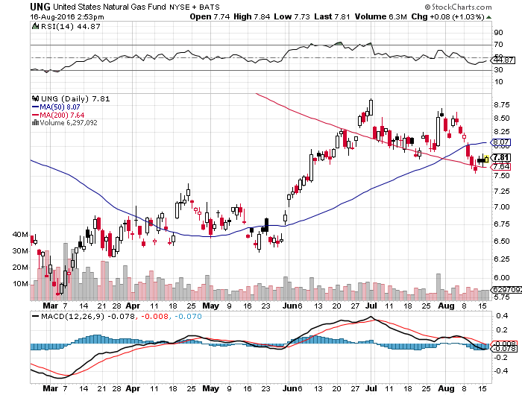
Natural Gas (UNG)-New 2016 Highs!

Slide 60
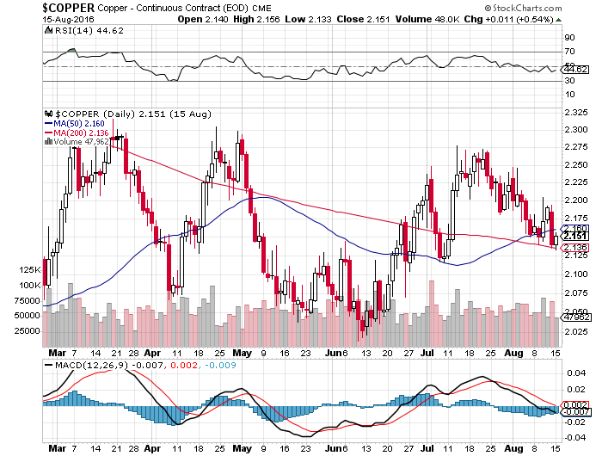
Copper-Capped on Over Supply

Slide 61

Precious Metals-Waiting for the Fed
*With stocks going to new highs daily, gold takes a break *Another tea cup, triangle formation setting up on the charts, Presaging another upside breakout *Massive drop in rates to negative numbers in many countries creates a de facto positive return on non yielding gold assets *The opportunity cost of gold ownership is now the lowest in history *If Fed fails to raise rates in September, look for a new leg up

Slide 62
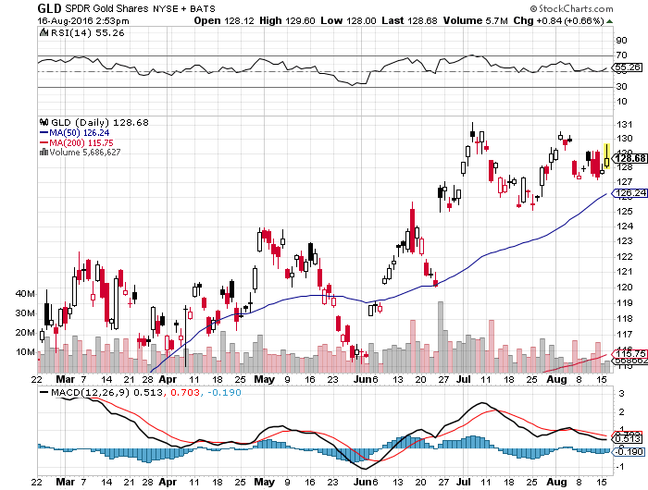
Gold (GLD)-Buy Dips

Slide 63
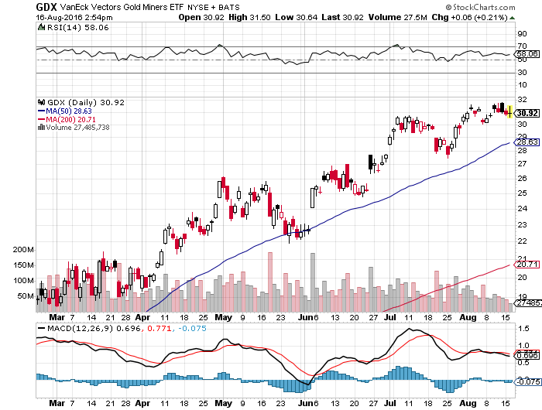
Market Vectors Gold Miners ETF- (GDX)

Slide 64
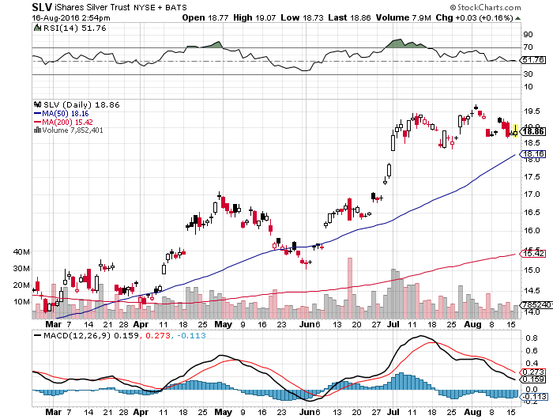
Silver (SLV)-

Slide 65

Silver Miners (SIL)-

Slide 66

Platinum (PPLT)-The Gold Effect

Slide 67

Palladium (PALL)-

Slide 68

Agriculture-Still More New Lows!
*Friday USDA WASDE report was terrible *Corn crop forecast now 15 billion bushels, yields up big *However, prices DID NOT FALL! *Massive floods in Louisiana, 36 inches in 48 hours, give another boost *No trade, there are NO fish to fry *My main job here is to keep traders away from this sector this year, and that approach has worked one more time

Slide 69

(CORN) – New Lows!

Slide 70

(WEAT) New Lows!

Slide 71

(SOYB) No Longer the Sole Survivor

Slide 72

Real Estate-Shortage of Supply
*June new home sales hit eight year high, July New Home Sales up 2.1% *US home ownership drops to 62.9%, a 51 year low *July homebuilder sentiment rises from 58 to 60 thanks to home shortage *Weekly Mortgage Applications jump 7% on low rates *Conventional 30-year fixed rate plunges to a new low of 3.40%, qualifies 1 million more new home buyers *London high end real estate in free fall, thanks to Brexit *May Case Shiller S&P 500 National index continues upward grind, May +5.2%, Portland, Seattle, Denver lead, San Francisco lags

Slide 73

April S&P 500/Case–Shiller Home Price Index +5.0% YOY, Portland, Seattle, Denver leaders

Slide 74

General Growth Properties (GGP) Yield Play Profit Taking

Slide 75

US Home Construction Index (ITB) (DHI), (LEN), (PHM), (TOL), (NVR) Another Big Brexit Winner

Slide 76

Trade Sheet So What Do We Do About All This?
*Stocks- stand aside-wait for a big dip to buy *Bonds-buy dips *Commodities-buy dips long term *Currencies- sell Yen and Euro on rallies *Precious Metals –buy dips *Volatility-sell short spikes over $25, buy dips to $12 *The Ags –stand aside *Real estate-buy the homebuilders LT

Slide 77

To buy lunch tickets, please click http://members.madhedgefundtrader .com/category/luncheons/usa/ and select the city of your choice Next Strategy Webinar 12:00 EST Wednesday August 31, 2016 San Francisco, CA
Good Luck and Good Trading!
Notes:
*

