Slide 1

The Mad Hedge Fund Trader “Taper Tantrum Part II”
With John Thomas from San Francisco, CA, September 14, 2016 www.madhedgefundtrader.com
Notes:
*

Slide 2

Options Trading for Beginners
In the Store Now for $48
Introductory Basic Options Video Training Course
https://members.madhedgefundtrader.com/otfb-order/

Slide 3
MHFT Global Strategy Luncheons Buy tickets at http://members.madhedgefundtrader.com/category/luncheons/usa/
Portland, Oregon September 16
Incline Village, Nevada October 7

Slide 4
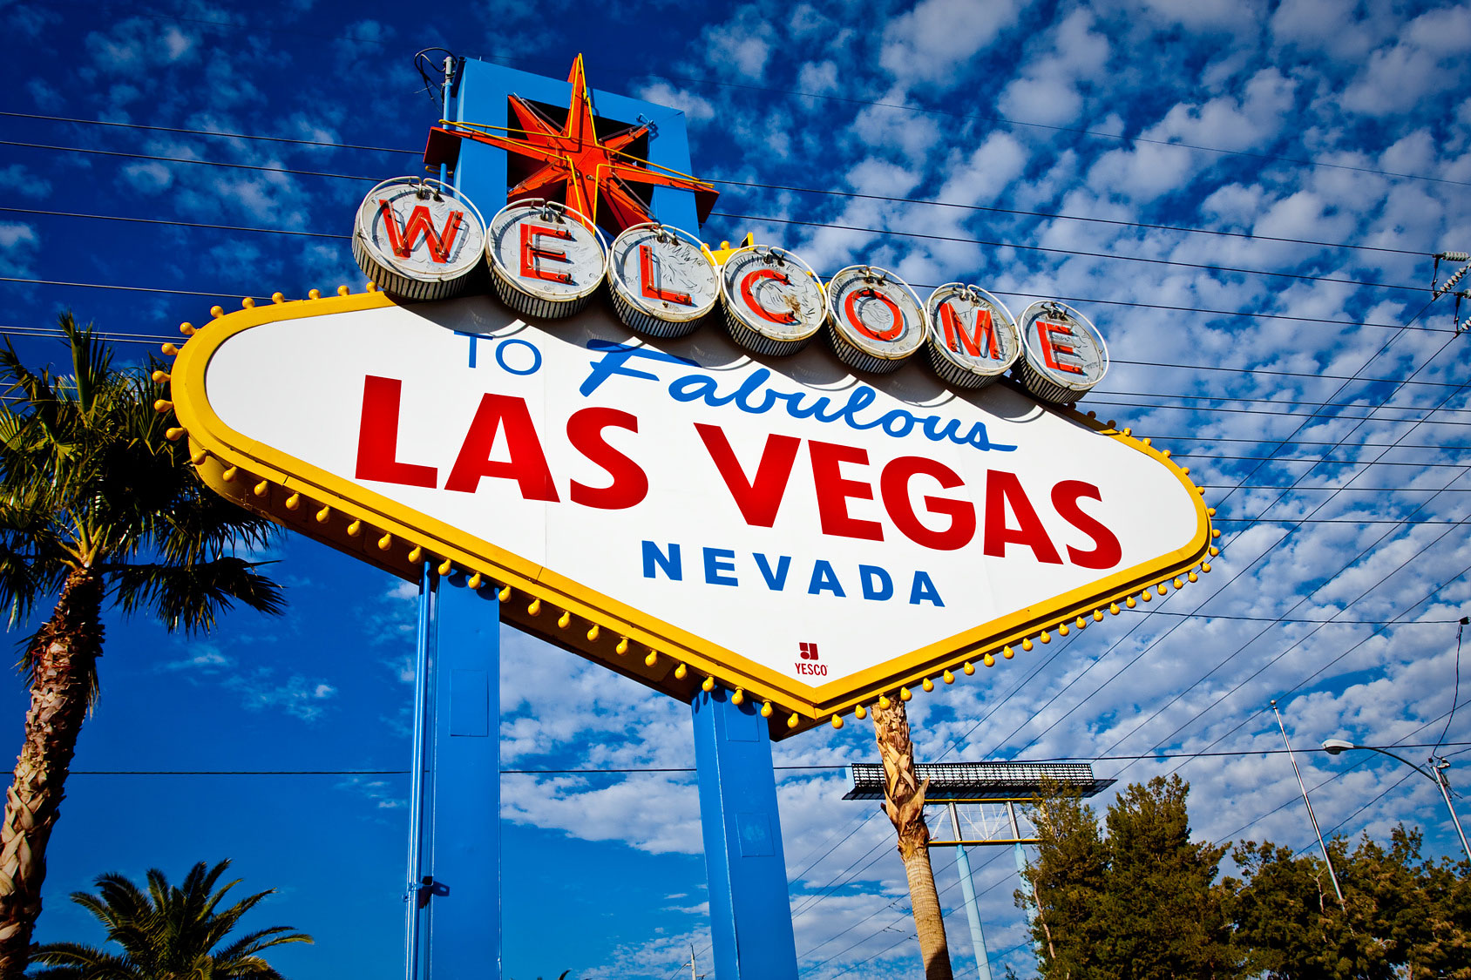
MHFT Global Strategy Luncheons Buy tickets at http://members.madhedgefundtrader.com/category/luncheons/usa/
San Francisco, CA October 21
Las Vegas, Nevada November 18

Slide 5

Trade Alert Performance New All Time High!!
*January +1.23% Final *July +0.67% Final *February +4.50% Final *August +7.52% Final *March -2.42% Final *September -1.51% MTD *April -2.10% Final *October -6.19% Final *May +4.38% Final *November 5.78% Final *June -0.56% Final *December -4.94% Final *2016 Year to Date +10.79% compared to 3.8% for the Dow Average *Trailing 1 year return +23.95%, +205.16% since inception, *Average annualized return of 35.35%

Slide 6
Portfolio Review Running a small tech long, still 80% cash
Mad Hedge Fund Trader
Model Trading Book
Asset Class Breakdown
Risk Adjusted Basis
Current Capital at Risk
Risk On
World is Getting Better
(AMZN) 10/$720-$750 call spread | 10.00%
(FB) 10/$120-$125 call spread | 10.00%
Risk Off
World is Getting Worse
No Positions
total net position | 20.00%
Expiration P&L 17.20%

Slide 7
Paid Subscriber Trailing 12 Month Audited Return +23.95% - At All Time Highs

Slide 8
69 Months Since Inception Daily Audited Performance Averaged annualized return +35.21%

Slide 9
The Bill Davis View A $1,500 Upgrade for the Mad Day Trader Service
Buys:
Costco Corp (COST) $150 Target to $165
Illumina, Inc. (ILMN) $162 Target to $200
DaVita Inc. (DVA) $64 Target to $75
Baidu, Inc. (BIDU) $181 Target to $200
Amazon, Inc (AMZN) $756 Target to $781
Martin Marietta (MLM) $175 Target to $190
Alphabet Inc. (GOOGL) $785 Target to $800
Sells:
Chubb Ltd. (CB) $126 Target to $120
Buffalo Wild Wings (BWLD) $162 Target to $152
Harman Intl (HAR) $85 Target to $75
Signet Jewelers (SIG) $86 Target to $72
Express Scripts (ESRX) $72 Target to $65

Slide 10

The Method to My Madness Leading with my Chin
*Got caught buying a market top with four big tech stocks *Have a moderate long in tech betting that the Fed won’t raise interest rates, but got caught unhedged by the sudden return of volatility *However, sudden volatility spike has shaken me out of half of positions, may get completely stopped out of more by next week *Buy “RISK ON” assets on every substantial dip, the rally should resume after the Fed meeting *If you’re not in the market already, stay in cash until after the Fed meeting *The game from here on is to position yourself for a pre/post US presidential election stock melt up and a global risk on rally

Slide 11

Short Term Strategy Outlook
*A Clinton November win is priced into the market. If we have to UNprice it, a 10% correction could hit very quickly *Prospect of imminent US interest rate hike now driving all asset classes *Volatility finally spikes, there will be more to come, buy dips *No chance of a rate hike in 2016, but Fed will tease us in September *Oil will trade the $40-$50 range for the rest of 2016 and attempt an upside break out going into yearend *Bonds roll over and die, the 35 year bull market is over, sell every substantial rally *Rate hike fears also hitting all precious metals *Stay away from ags, perfect weather to bring new lows.

Slide 12
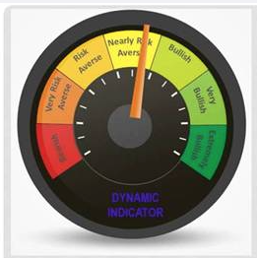
Risk Indicators Showing Neutral

Slide 13
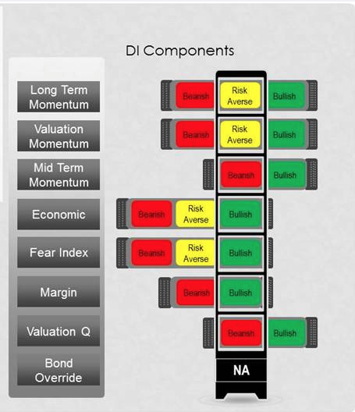

Slide 14

The Global Economy-OFF TARGET
*August Nonfarm Payroll disappointments at 151,000, triggering broader “RISK OFF” move, headline unemployment holds at a decade low 4.9% *Almost all recent data releases have been surprisingly weak, augurs against Fed action next week *US August Auto Sales sales flat at an all time high of 17 million units annualized, August ISM Manufacturing Index plunges from 52.6 to 49.9, ISM Services hits 6 year low-under 50 is bad news *ECB keeps interest rates unchanged, QE kept at €80 billion a month, German July Industrial Production 0.20%, a 2 year low *Despite all this, US stocks and bonds are still the most attractive, highest yielding assets in the world, both should move to new highs

Slide 15
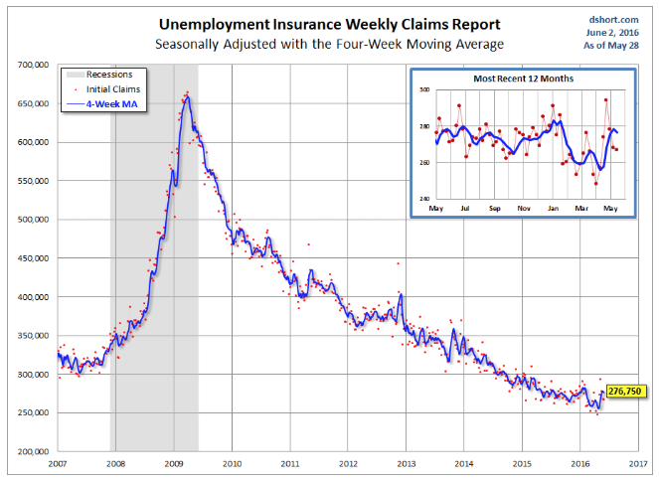
Weekly Jobless Claims –The Most Important Statistic 6,000 to 259,000-Lowest since 1973! The Downtrend Lives!-Show Me the Recession!

Slide 16
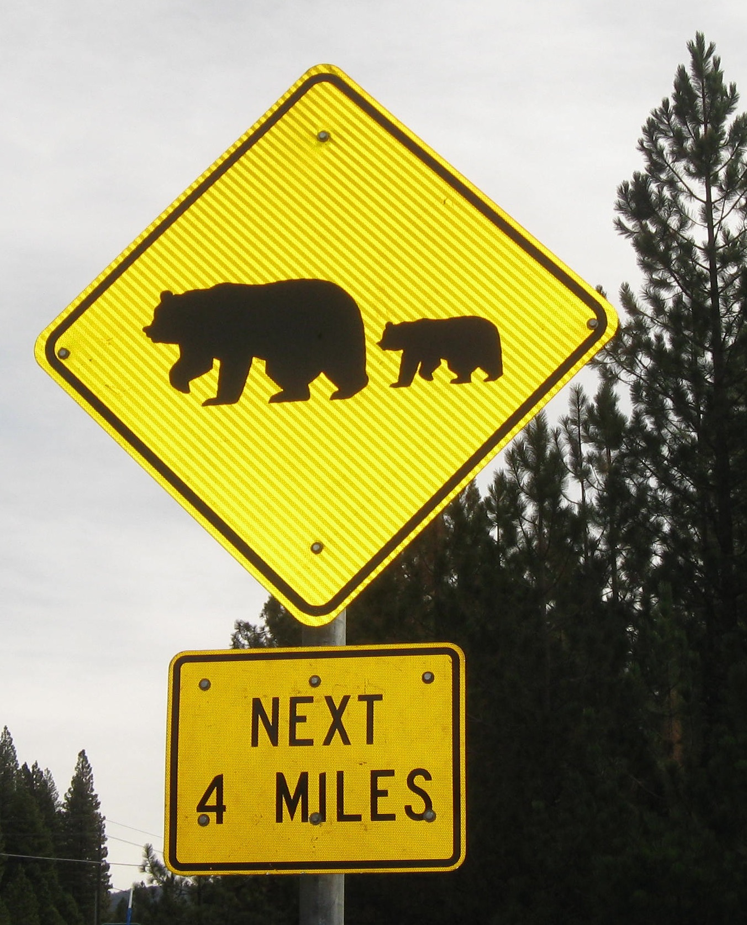
Bonds-The Bear Market is Here
*JGB selloff spills over to global bond markets, make it all the way up to a -0.02% yield, down from -0.38% yield, takes US 10 year yields up from 1.53% to 1.70% *Rest of the high yield sectors, like REIT’s, emerging markets, junk, and telecoms, get slaughtered *Avoid all government bonds like the plague, the most overprices area of debt markets *German bunds dive to -0.01%, ECB running out of QE paper to buy *Emerging market debt craters * Junk bonds (HYG) lose stock market support

Slide 17
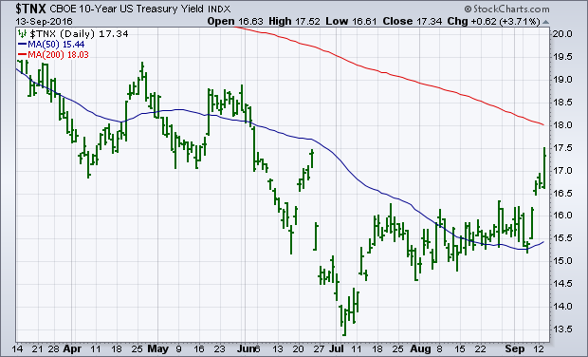
Ten Year Treasury Yield ($TNX) 1.76% Coiling for an Upside Breakout?-YES!

Slide 18
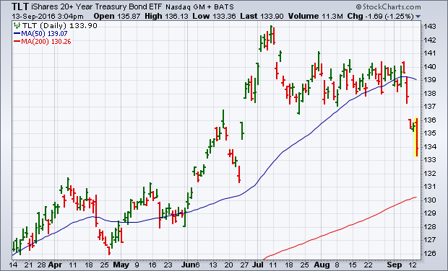
Ten Year Treasury ETF (TLT) 1.76% took profits on long 9/$143-$146 vertical bear put spread took profits on long 9/$142-$145 vertical bear put spread

Slide 19
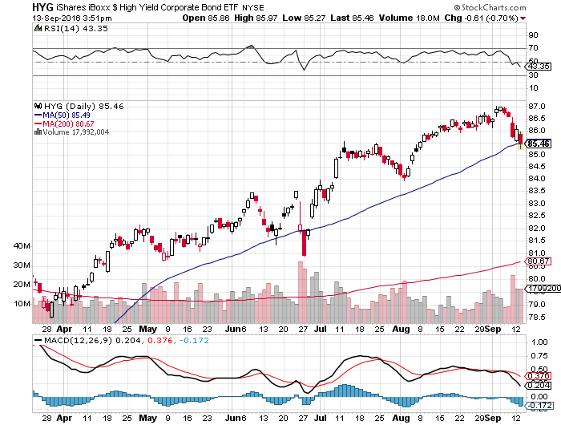
Junk Bonds (HYG) 6.33% Yield A Great Risk Coincident Indicator-”RISK ON” means new highs, buy all dips

Slide 20
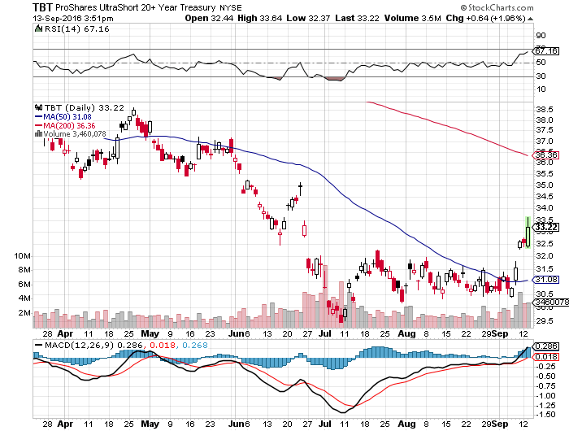
2X Short Treasuries (TBT)-At Last!

Slide 21
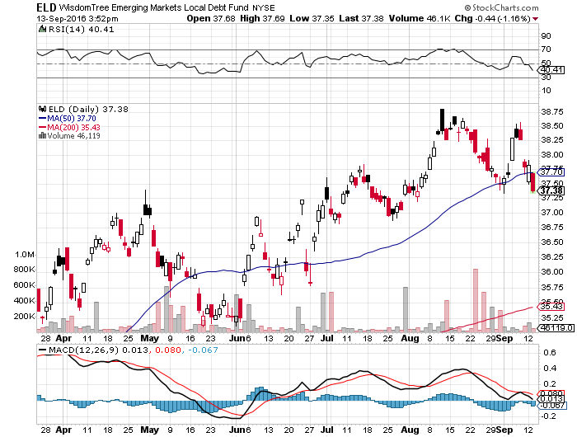
Emerging Market Debt (ELD) 5.75% Yield-

Slide 22
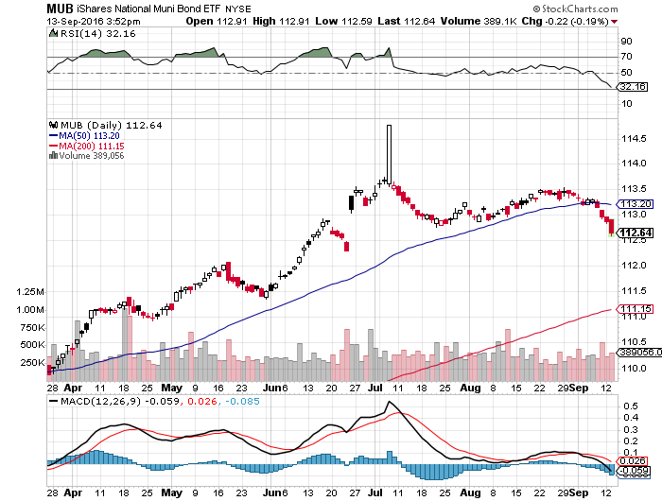
Municipal Bonds (MUB)-1.21% yield-New High Mix of AAA, AA, and A rated bonds

Slide 23

Stocks-
*Machine and algorithm driven selling delivers three consecutive 1% moves, after none for two months on no real news, volatility spikes 45% in one day, momentum and high yield stocks take biggest hit *September is historically the best performing VIX month of the year, big move up has been coiling for months *Yield plays take the biggest hits, the shift into cyclicals is still on *Emerging markets dive 10% *FANG stocks still providing major leadership *Banks hold up well as a hedge against rising rates *The world is looking for a tradable dip to “BUY,” will September be your last chance this year?

Slide 24
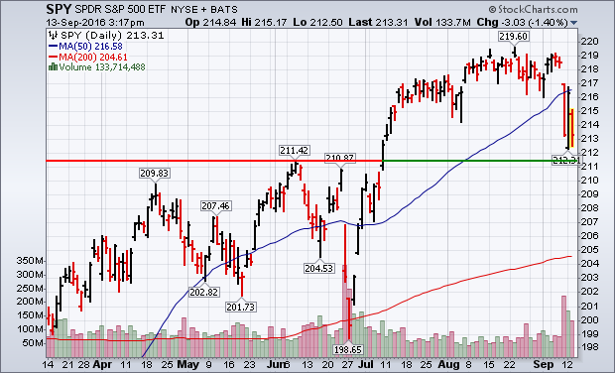
S&P 500-Breakdown!

Slide 25
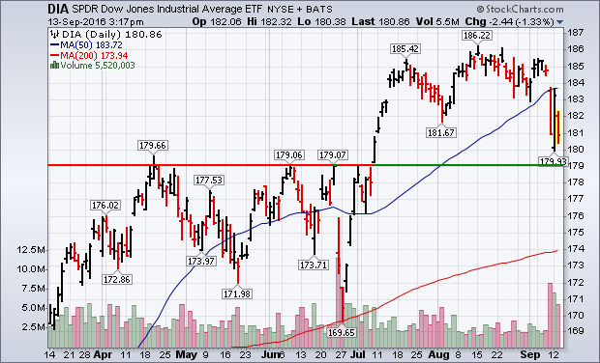
Dow Average-New Highs

Slide 26
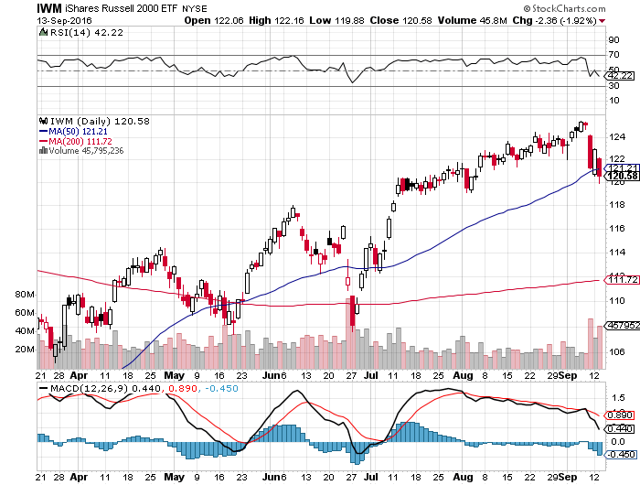
Russell 2000 (IWM)-

Slide 27
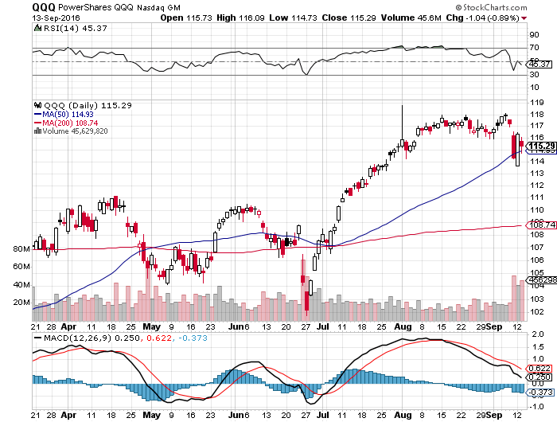
NASDAQ (QQQ)- FANG is Taking a Break

Slide 28
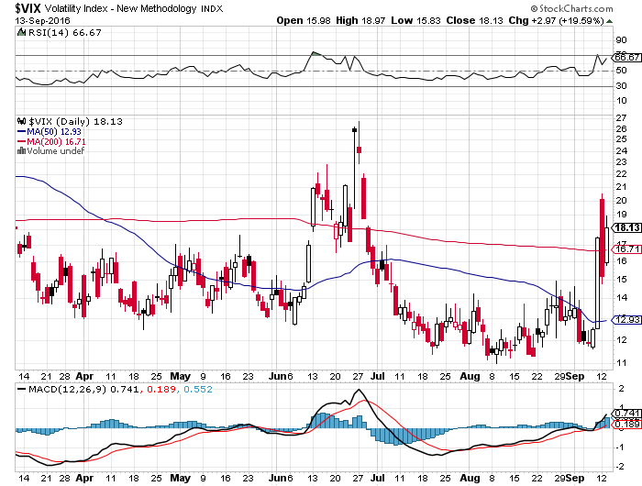
(VIX)-Off to the Races

Slide 29
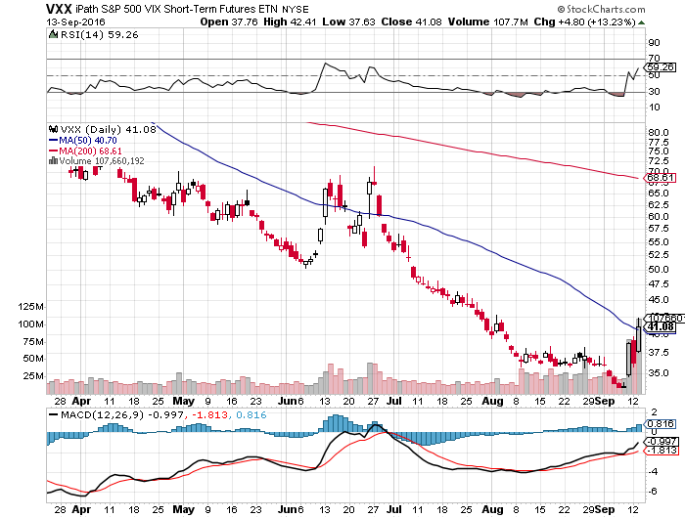
iPath S&P 500 VIX Short Term Futures ETN (VXX) took profits on long 9/$30-$33 vertical bull call spread

Slide 30
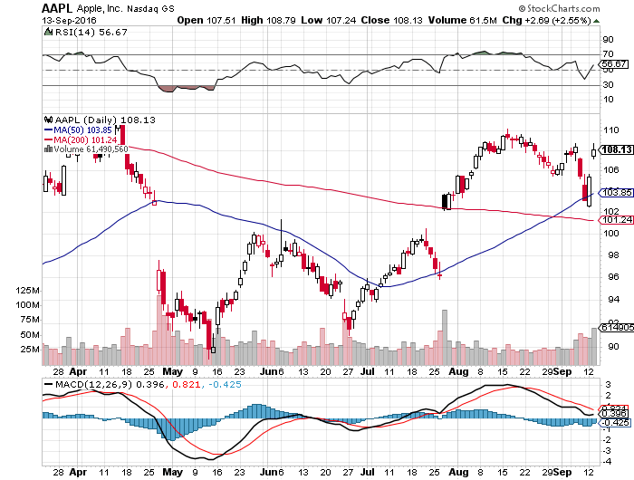
Apple (AAPL) –

Slide 31
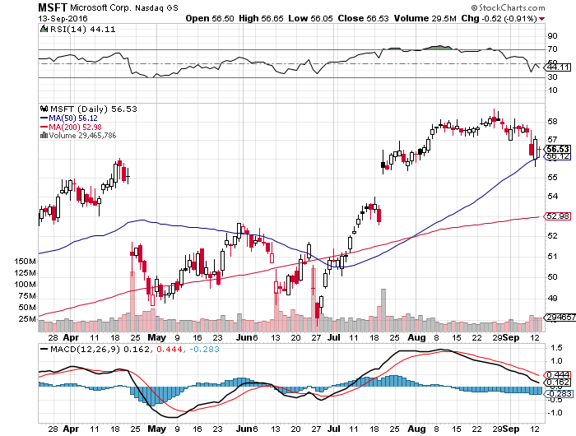
Microsoft (MSFT)

Slide 32
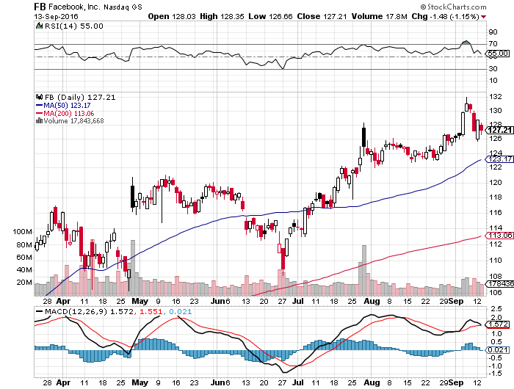
Facebook (FB)- long 10/$120-$125 call spread

Slide 33
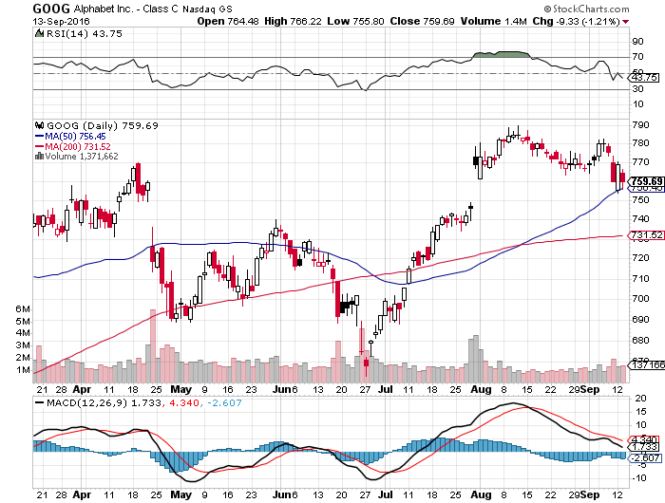
Alphabet (GOOG)- stopped out of long 10/$720-$750 call spread for small loss

Slide 34
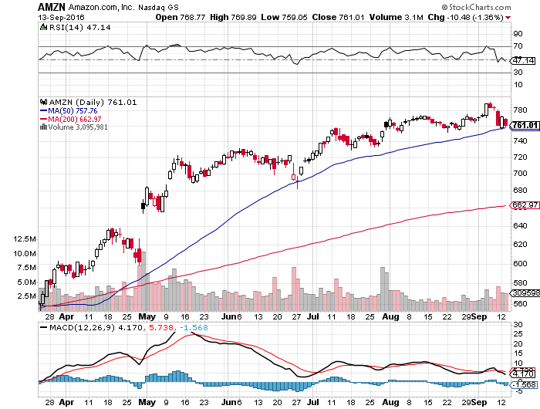
Amazon (AMZN)- long 10/$720-$730 call spread

Slide 35
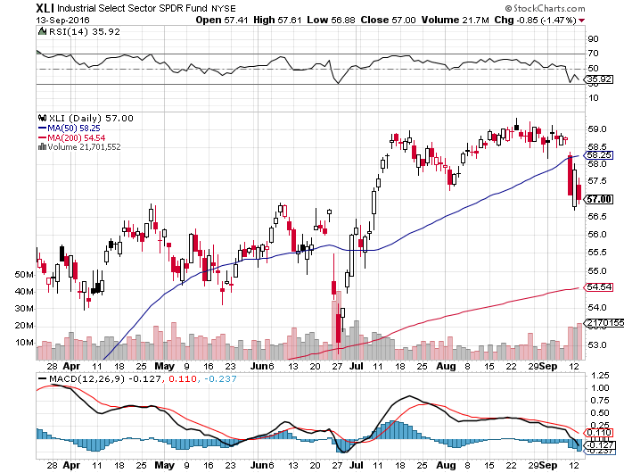
Industrials Sector SPDR (XLI)-Dow Mainstay (GE), (MMM), (UNP), (UTX), (BA), (HON)

Slide 36
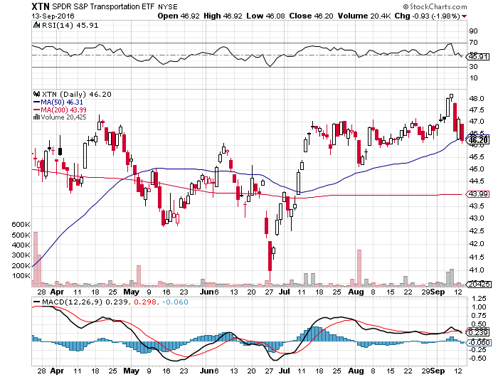
Transports Sector SPDR (XTN)-Upside Breakout Imminent (ALGT), (ALK), (JBLU), (LUV), (CHRW), (DAL)

Slide 37
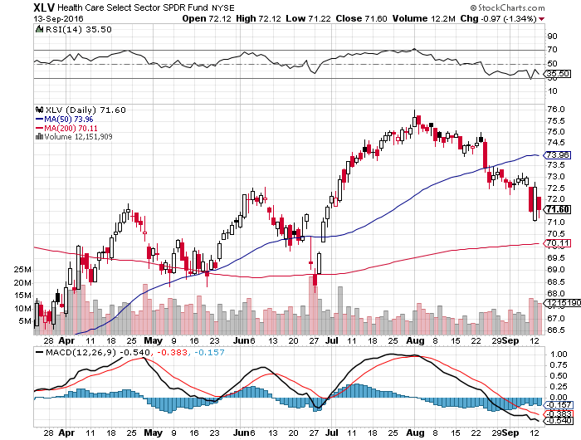
Health Care Sector SPDR (XLV), (RXL) (JNJ), (PFE), (MRK), (GILD), (ACT), (AMGN) The Epipen Hit and Hillary Win

Slide 38
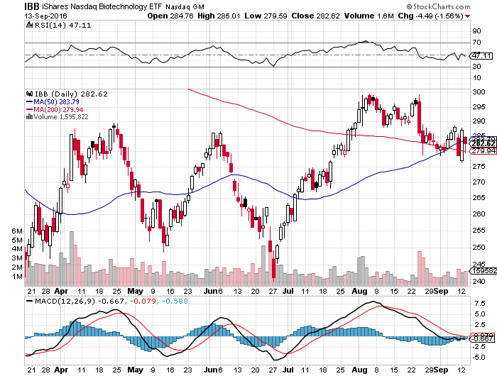
Biotech iShares (IBB)-A Political Football in 2016 Own for 2017

Slide 39
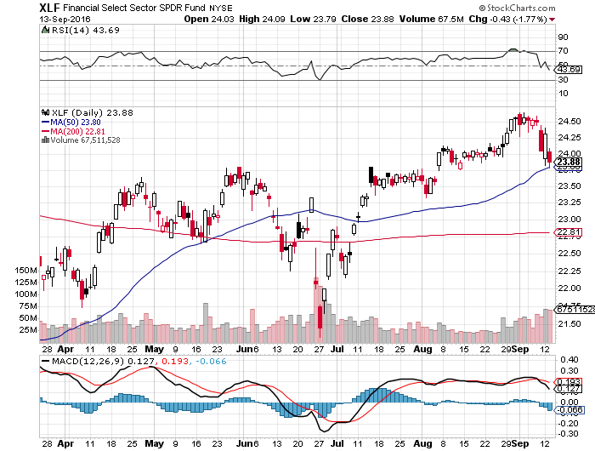
Financial Select SPDR (XLF)-A big Value Play (BLK/B), (WFC), (JPM), (BAC), (C), (GS)

Slide 40
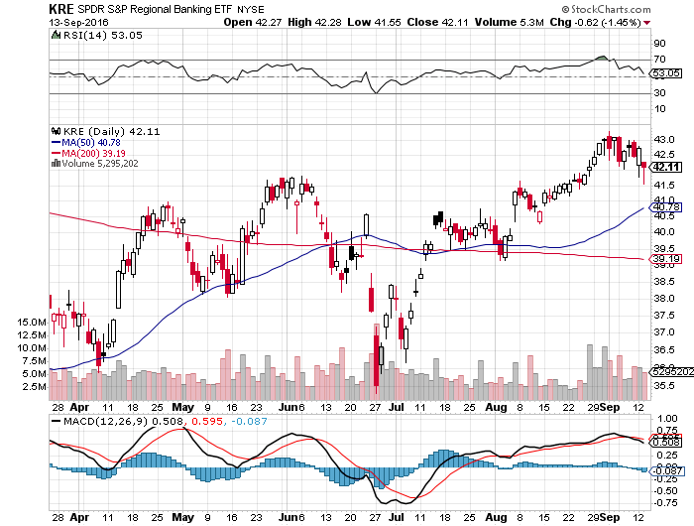
KRE Regional Bank ETF (KRE)- Breakout Came

Slide 41
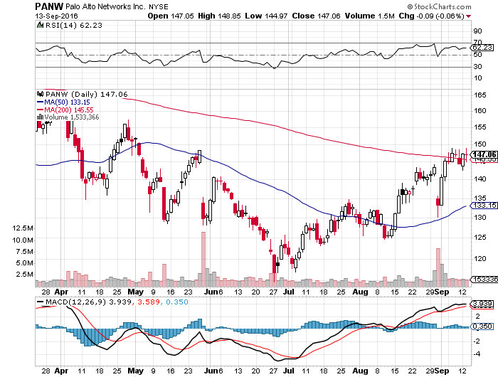
Palo Alto Networks (PANW)- another entry point setting up on conservative guidance- Hacking Isn’t Going Away

Slide 42
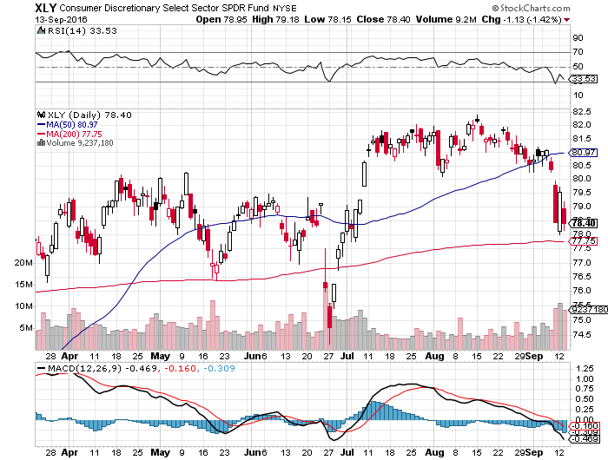
Consumer Discretionary SPDR (XLY) (DIS), (AMZN), (HD), (CMCSA), (MCD), (SBUX) A Major Leader of the Rally

Slide 43
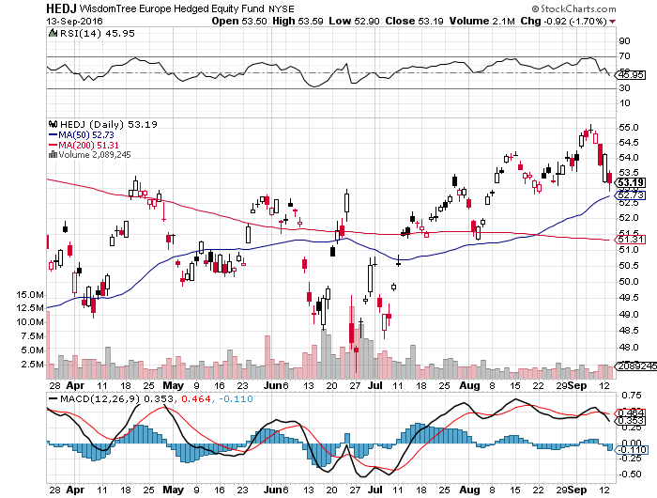
Europe Hedged Equity (HEDJ)-Hedged European Equity

Slide 44
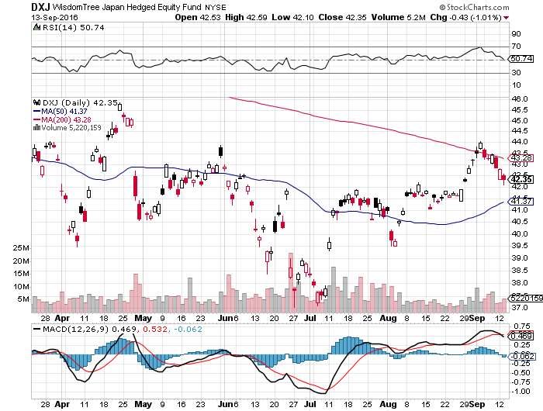
Japan (DXJ)-Hedged Japan Equity

Slide 45
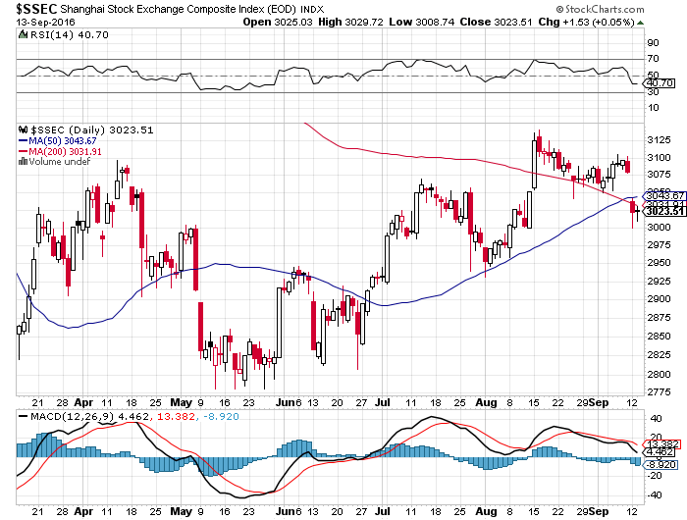
China ($SSEC)-

Slide 46
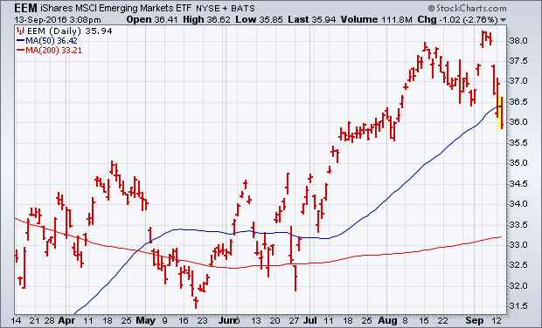
Emerging Markets (EEM)- stopped out of long 10/$33.50-$36.50 call spread

Slide 47
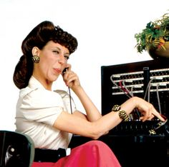
Foreign Currencies-Waiting for the Call
*Fed decision to tell all, no rate rise means dollar dump coming *JGB yield hits 5 month high at -0.01%, take profits on yen shorts *Massive global bond selloff hitting currency markets as well *Oil weakness gives Aussie (FXA) and Loonie (FXC) anxiety *Chinese Yuan (CYB) resumes downtrend

Slide 48
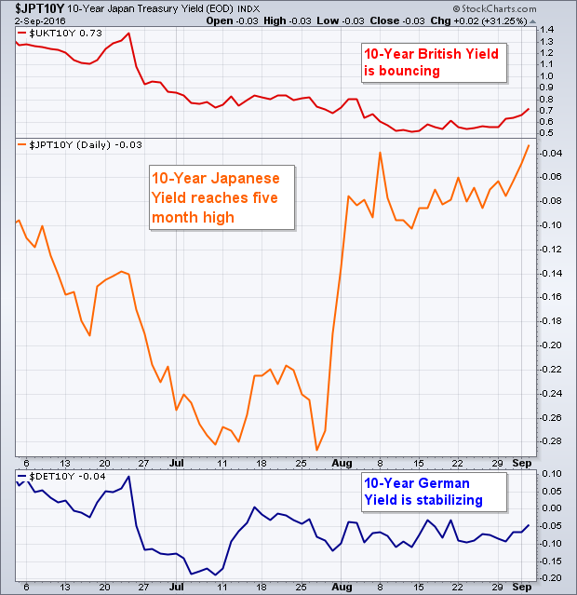

Slide 49
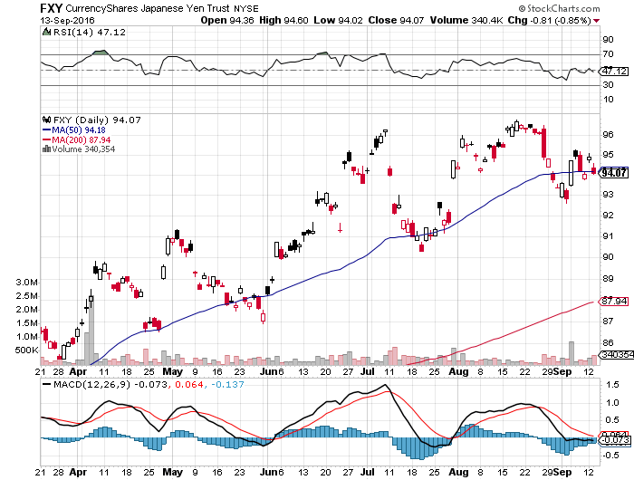
Japanese Yen (FXY)-Rolling Over-Double Top is In took profits on long the 8/$97-100 put spread took profits on long the 9/$99-102 put spread

Slide 50
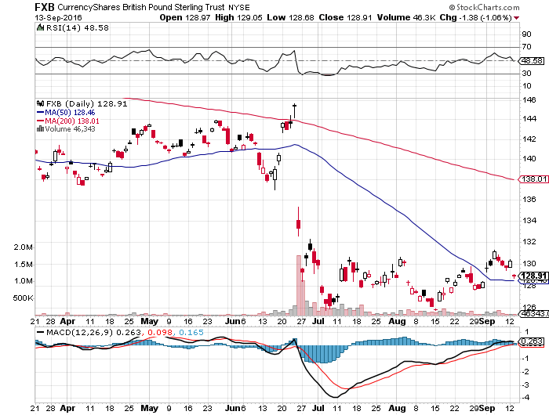
British Pound (FXB)-New Lows on Weakening Economy

Slide 51
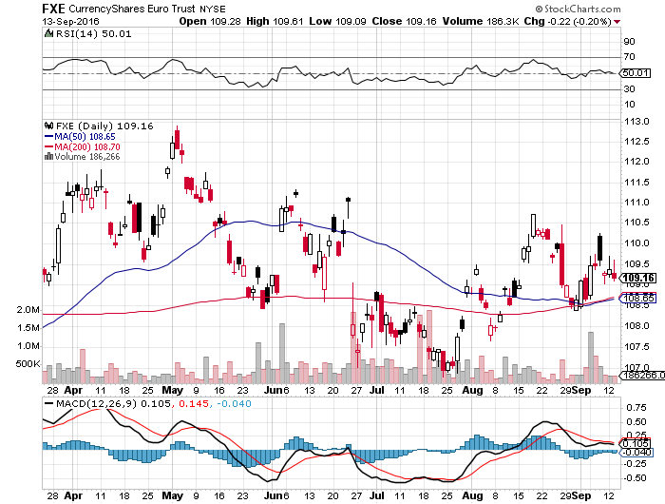
Euro ($XEU), (FXE), (EUO)- Fading Economy took profits on long the 9/$112-$115 vertical bear put spread

Slide 52
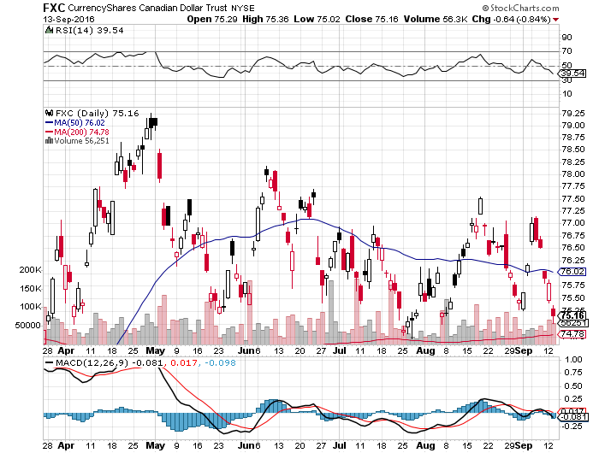
Canadian Dollar (FXC)-Weak Due to Oil Hit

Slide 53
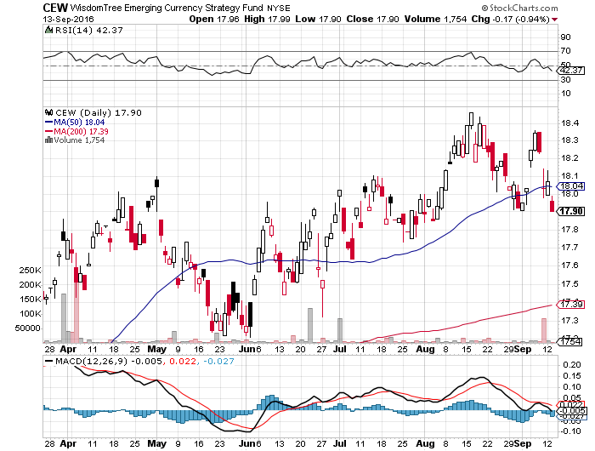
Emerging Market Currencies (CEW)

Slide 54
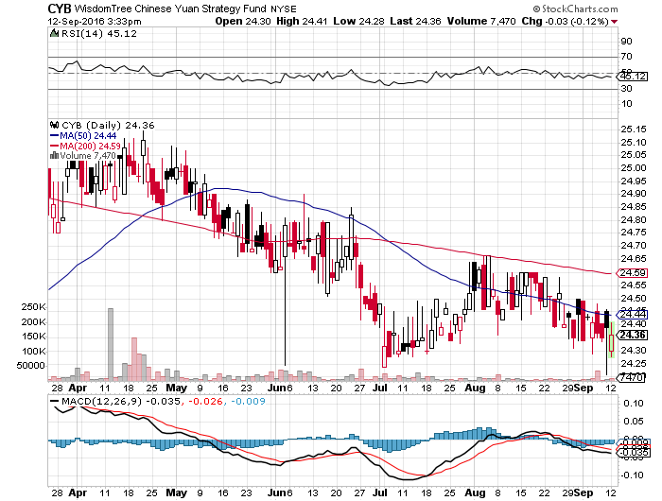
Chinese Yuan- (CYB)-

Slide 55

Energy-
*Still waiting for the Algiers OPEC meeting to deliver nothing and send oil prices falling again *Saudi Arabia still pumping at all time highs, trying to unload it before it becomes worthless *Saudi foreign currency reserves collapse from $746 to $555 billion, is shopping IPO for Aramco with a $1 trillion valuation *US weekly draw on oil inventories hits 21.1 million barrels, the largest weekly draw in history, deliver a 5% pop on crude prices, triggered by Hurricane Hermine *Baker Hughes rig count adds 7 to 414 for 10th gain in 11 weeks *US and Chinese SPR’s will draw down, putting more pressure on prices *Oil still stuck in $40-$52 range, a break takes us to $35 quickly

Slide 56
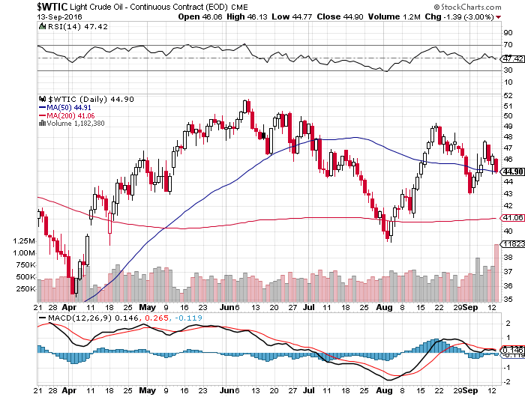
Oil-The Glut Returns

Slide 57
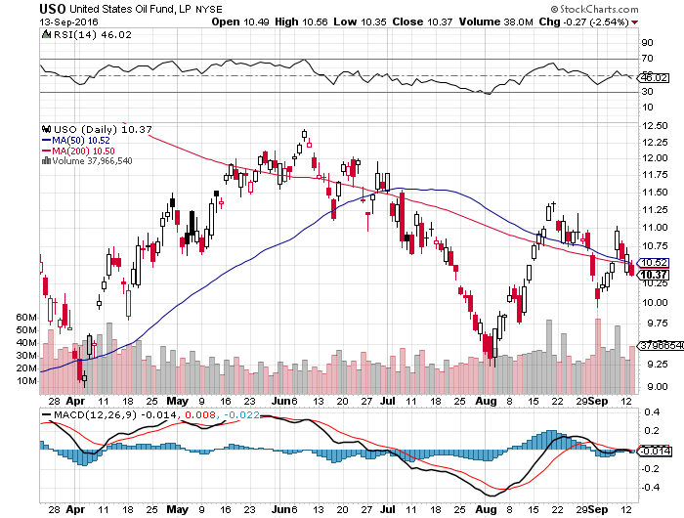
United States Oil Fund (USO)

Slide 58
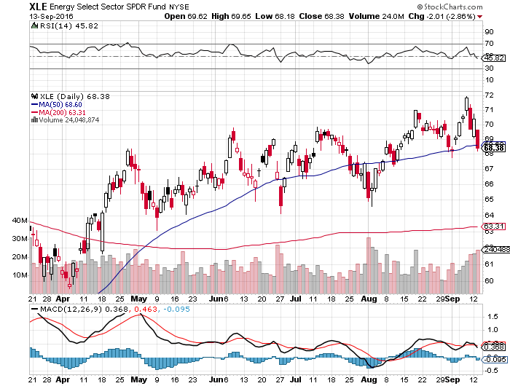
Energy Select Sector SPDR (XLE) (XOM), (CVX), (SLB), (KMI), (EOG), (COP)

Slide 59
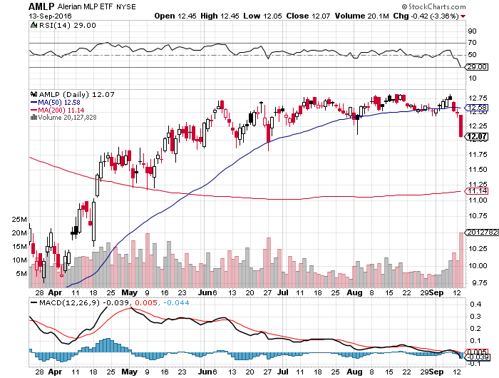
Alerian MLP ETF (AMLP)- Basket Approach is the Only Safe Play here

Slide 60
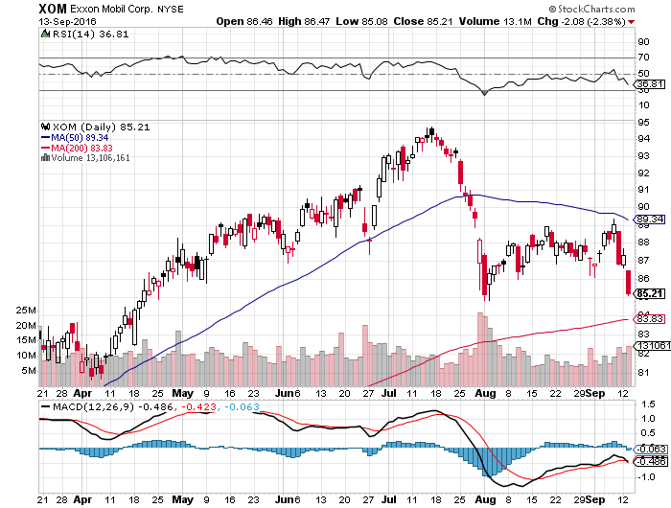
Exxon (XOM)-Dividend is Not Enough

Slide 61
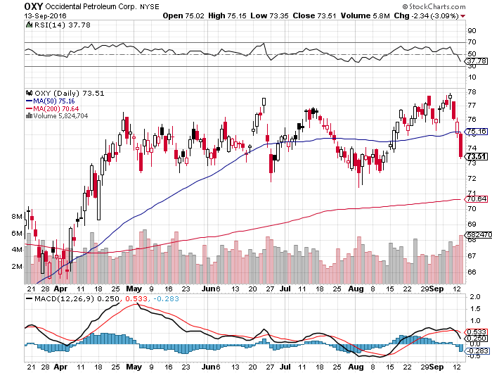
Occidental Petroleum (OXY)-

Slide 62
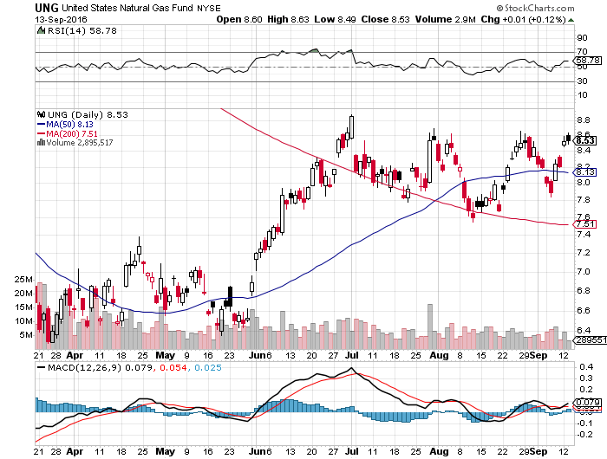
Natural Gas (UNG)-Bumping Against 2016 Highs

Slide 63
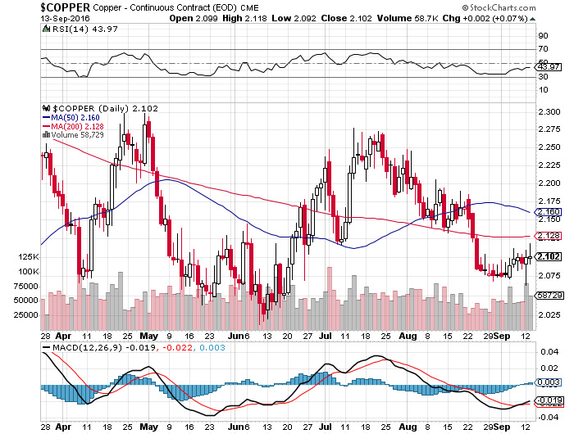
Copper-Capped on Over Supply

Slide 64

Precious Metals-
*Fed talk of rate hikes takes the sizzle out of gold, as rising rates increase the real cost of ownership *Hawkish Fed talk brings gold meltdown, (GDX) takes the biggest hit *Gold utterly fails to provide downside protection on a major “RIK OFF” day on Friday *Looking to buy on a bigger dip *If Fed fails to raise rates in September, look for a new big leg up

Slide 65

Here is the Problem With Gold

Slide 66

Gold (GLD)-

Slide 67

Market Vectors Gold Miners ETF- (GDX)

Slide 68

Silver (SLV)-

Slide 69

Silver Miners (SIL)-

Slide 70

Agriculture-Stay Away!
*Enormous crop forecasts break all ags to new multiyear lows, with wheat at a 10 year low! *Strong dollar allowing Russia to take over America’s share of the global wheat market *Hanjin shipping bankruptcy disrupts the transportation network *Without the subsidy of the federal ethanol program, corn prices would be much lower; the program may get axed next year *Huge carry over crops threaten to spill falling prices into 2017 *No trade, there are NO fish to fry too low to initiate new shorts *My main job here is to keep traders away from this sector this year, and that approach has worked one more time

Slide 71

(CORN) – New Lows!

Slide 72

(WEAT) New Lows!

Slide 73

(SOYB) No Longer the Sole Survivor

Slide 74

Real Estate-Rates, Rates, Rates!
*Bond collapse causes the 30 year fixed mortgage rate to have biggest jump in 2 months to 3.50% *Rising rates put a dent in mortgage applications, up only 0.9% last week *July Pending Home Sales rose +1.3% *Sales of $2 million plus homes suddenly slow because of a glut on the market *Millennials shifting from renting to owning big time *June Case Shiller -0.1% to 5.1% YOY, down second month in a row

Slide 75

April S&P 500/Case–Shiller Home Price Index +5.0% YOY, Portland, Seattle, Denver leaders

Slide 76

General Growth Properties (GGP) Yield Play Profit Taking

Slide 77

US Home Construction Index (ITB) (DHI), (LEN), (PHM), (TOL), (NVR) Another Rising Rate Victim

Slide 78

Trade Sheet So What Do We Do About All This?
*Stocks- stand aside-wait for a bigger dip to buy *Bonds-sell rallies on rate hike risk *Commodities-stand aside *Currencies- sell Yen and Euro on rallies *Precious Metals –stand aside *Volatility-sell short spikes over $25, buy dips to $12 *The Ags –stand aside *Real estate-stand aside

Slide 79

To buy lunch tickets, please click http://members.madhedgefundtrader.com/category/luncheons/usa/ and select the city of your choice Next Strategy Webinar 12:00 EST Wednesday, September 28, 2016 San Francisco, CA
Good Luck and Good Trading!
Notes:
*

