Slide 1
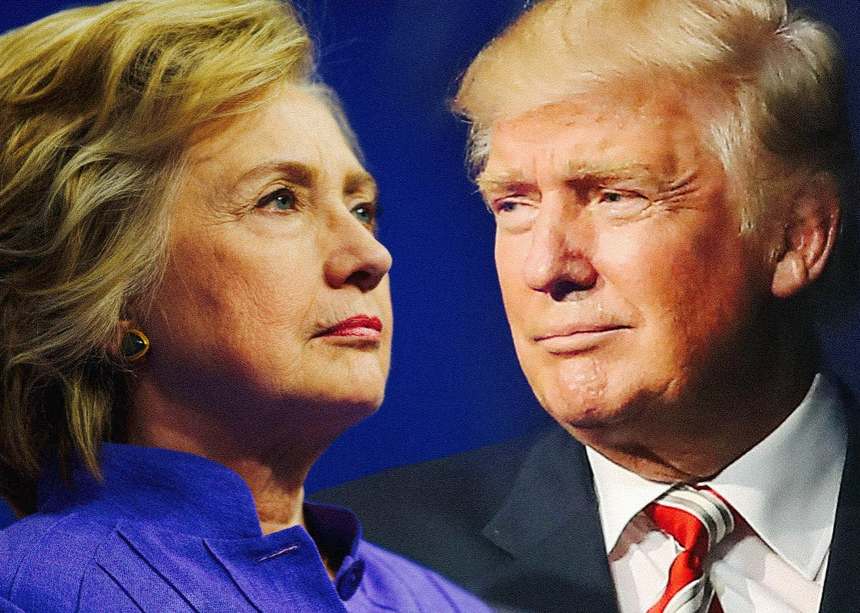
The Mad Hedge Fund Trader
“The Election is Over”
With John Thomas
from San Francisco, CA, September 28, 2016
www.madhedgefundtrader.com
Notes:
*

Slide 2

In the Store
Now for $49
Sectors and stocks that
will lead the market for
the next 20 years
https://members.madhedgefundtrader.com/roaring-twenties-book/

Slide 3
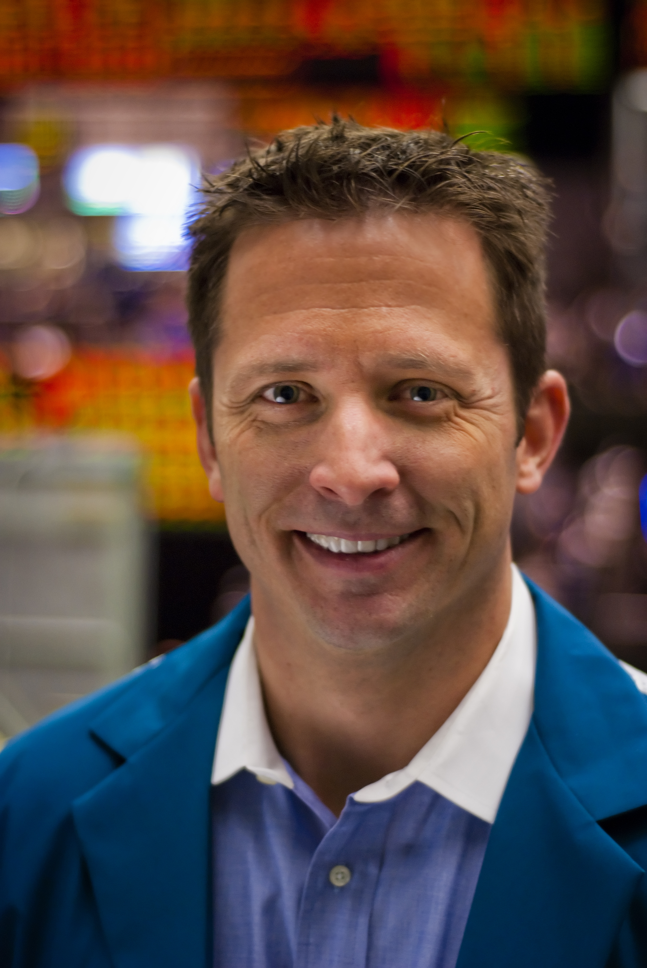
Mad Options Trader
*Net Trading Profits are up 28% in August on the weekly options
*Demand for the new $1,500 a year service
has been overwhelming
*Email Nancy at
support@madhedgefundtrader.com to add Mad
Options Trader to your subscription.

Slide 4
MHFT Global Strategy Luncheons
Buy tickets at http://members.madhedgefundtrader.com/category/luncheons/usa/
Incline Village, Nevada
October 7

Slide 5
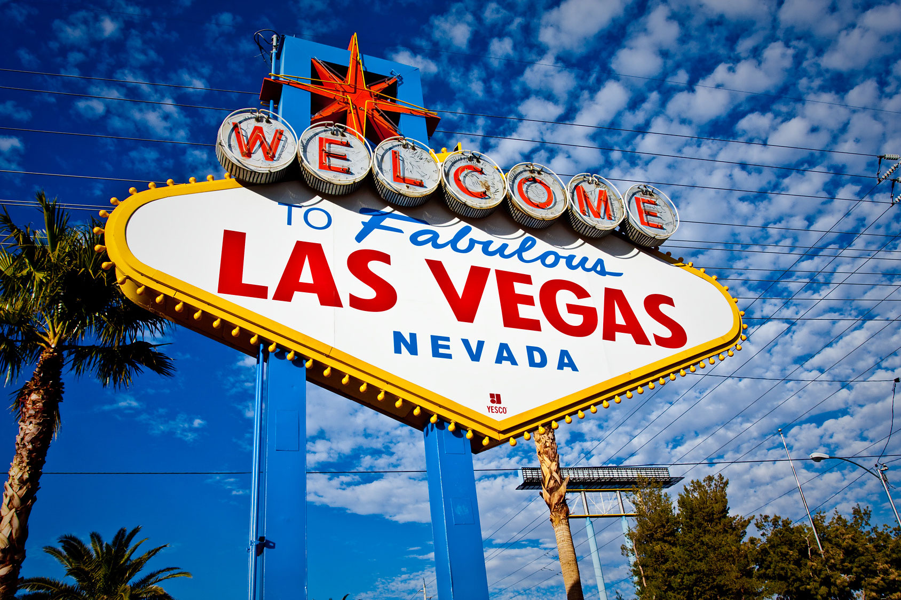
MHFT Global Strategy Luncheons
Buy tickets at http://members.madhedgefundtrader.com/category/luncheons/usa/
San Francisco, CA
October 21
Las Vegas, Nevada
November 18

Slide 6

Trade Alert Performance
New All Time High!!
*January +1.23% Final *July +0.67% Final
*February +4.50% Final *August +7.52% Final
*March -2.42% Final *September +0.47% MTD
*April -2.10% Final *October -6.19% Final
*May +4.38% Final *November 5.78% Final
*June -0.56% Final *December -4.94% Final
*2016 Year to Date +13.76%
compared to 4.7% for the Dow Average
*Trailing 1 year return +23.95%, +205.44% since inception,
2.46% short of an all time high
*Average annualized return of 35.21%

Slide 7
Portfolio Review
Running a small tech long, 90% cash
Mad Hedge Fund Trader
Model Trading Book
Asset Class Breakdown
Risk Adjusted Basis
Current Capital at Risk
Risk On
World is Getting Better
(TLT) 10/$141-$144 puts pread | 10.00%
Risk Off
World is Getting Worse
no positions
total net position | 10.00%
Expiration P&L
14.58%

Slide 8
Paid Subscriber Trailing 12 Month Audited Return

Slide 9
70 Months Since Inception
Daily Audited Performance
Averaged annualized return +35.21%

Slide 10

The Method to My Madness
Leading with my Chin
*Trading a late stage bull market is the most difficult of all
*This is the first one with algorithms and big time short volatility traders
*Throw in a presidential election to further complicate matters
*Staying small, nimble, and tactical, and taking quick
profits, and running very tight stop losses to keep
total returns high
*Buy “RISK ON” assets on every substantial dip,
the rally should resume after the Fed meeting
*The game from here on is to position yourself for
a pre/post US presidential election stock melt up
and a global risk on rally

Slide 11

Short Term Strategy Outlook
*A Clinton debate win captures the entire undecided vote, about 5% of the total, and her lead in the Electoral College is overwhelming
*A Clinton win is very pro risk and pro stock market, institutional investors will load the boat
*However most markets will coil sideways until the election is a done deal
*Volatility finally spikes, there will be more to come, buy dips
for fast trades
*No chance of a rate hike in 2016, but a December rate rise
risk will stay in bond prices
*Oil will trade the $40-$50 range for the rest of 2016
and attempt an upside break out going into yearend
*Stay away from ags, perfect weather to bring new lows.

Slide 12
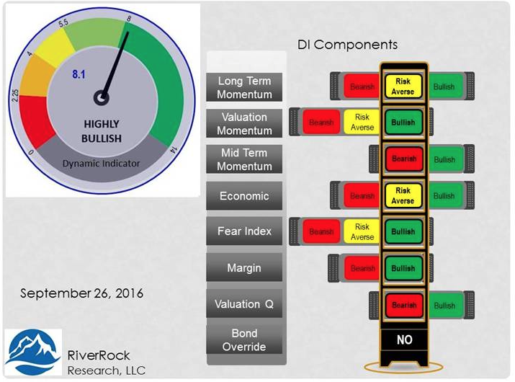
Risk Indicators Showing Neutral

Slide 13
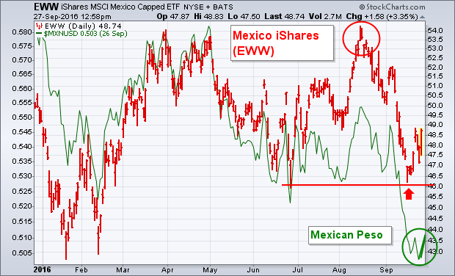
Mexican ETF and Peso

Slide 14

The Global Economy-Ramping Up for 2017
*Fed leaves rates unchanged, as promised by me
*Almost all recent data releases have been surprisingly weak, a December rate hike is slowly falling off the table
*ECB keeps interest rates unchanged,
QE kept at €80 billion a month, German
July Industrial Production 0.20%, a 2 year low
*Bank of Japan takes no action at policy meeting,
QE and interest rates remain unchanged at
¥80 trillion a year, stocks rocket
anyway
*Despite all this, US stocks and bonds are still the
most attractive, highest yielding assets in the
world, both should move to new highs

Slide 15
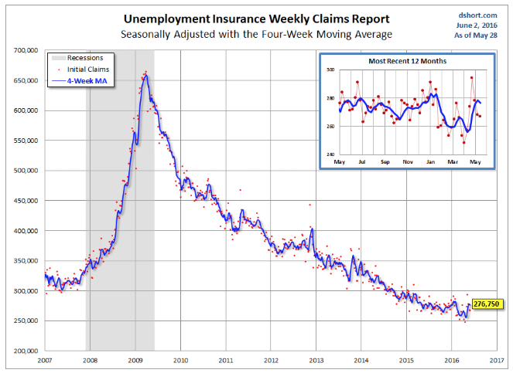
Weekly Jobless Claims –The Most Important Statistic
6,000 to 259,000-Lowest since 1973!
The Downtrend Lives!-Show Me the Recession!

Slide 16

Bonds-Short Covering Rally
*No Fed actions prompts 6 point Treasury bond rally and a 20 bp sell off in yields
*Look for a prolonged sideways move in bonds going into the December Fed meeting, creating good deep in-the-money bear put spread opportunities
*You can work the time decay trade all the way into December
*Avoid all government bonds like the plague,
the most overprices area of debt markets
*German bunds dive to -0.14%,
JGB’s at -0.10%. BOJ vows to cap
bond yields at 0%
*Emerging market debt rallies big
*As do Junk bonds (HYG)

Slide 17
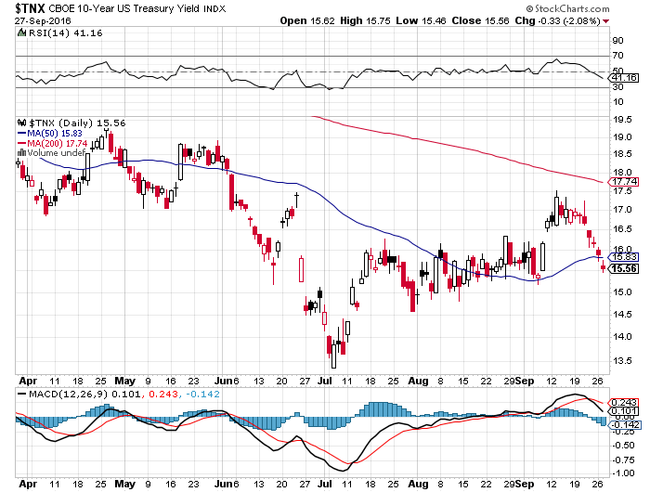
Ten Year Treasury Yield ($TNX) 1.55%
Upside Breakout Fails

Slide 18
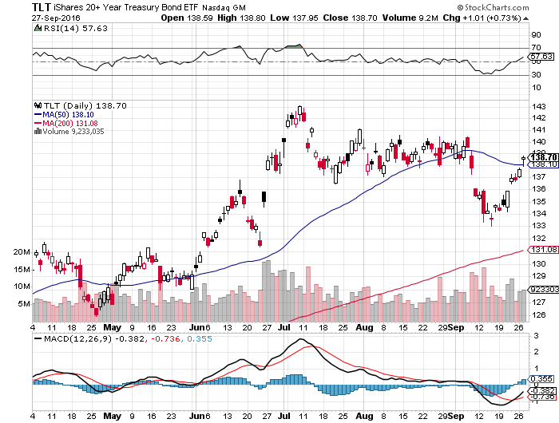
Ten Year Treasury ETF (TLT) 1.55% took profits on long 9/$143-$146 vertical bear put spread took profits on long 9/$142-$145 vertical bear put spread long 10/$141-$144 vertical bear put spread

Slide 19
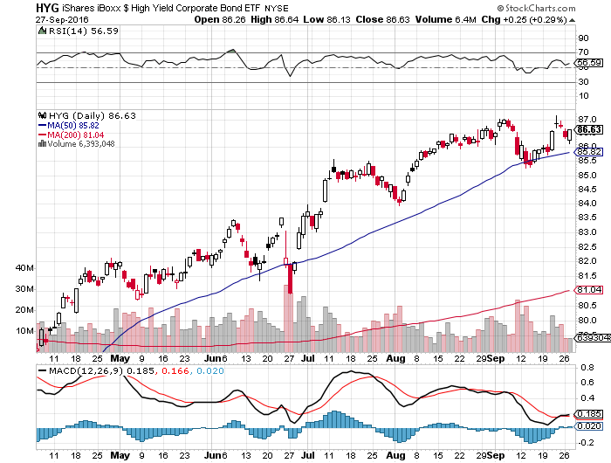
Junk Bonds (HYG) 5.46% Yield
A Great Risk Coincident Indicator-”RISK ON” means new highs, buy all dips

Slide 20
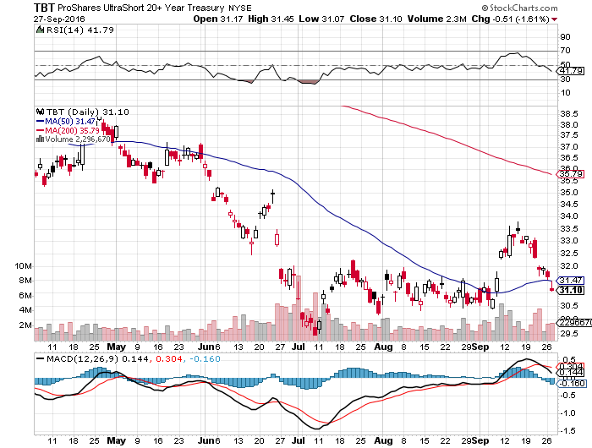
2X Short Treasuries (TBT)-At Last!

Slide 21
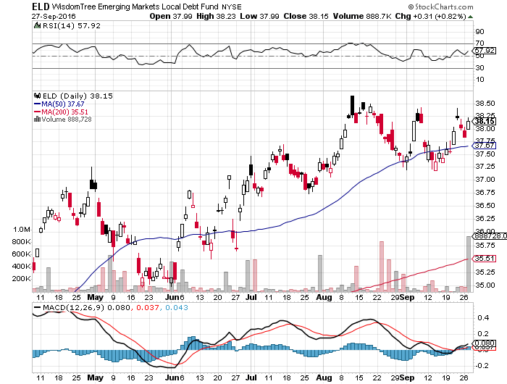
Emerging Market Debt (ELD) 4.65% Yield-

Slide 22
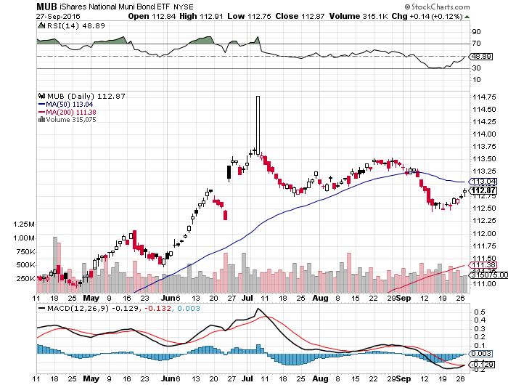
Municipal Bonds (MUB)-1.25% yield-New High
Mix of AAA, AA, and A rated bonds

Slide 23
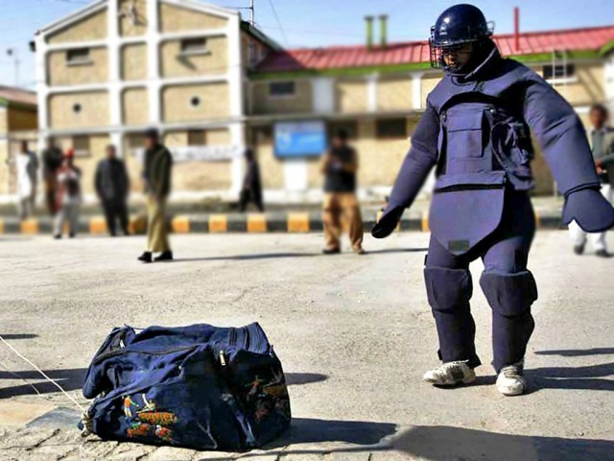
Stocks-Bomb Proof
*Stocks love a Clinton win, but the big move may not come until after the election
*The correction has so far limited to 4%, where will the next downside come from, the next debate in 12 days?
*Be careful chasing volatility here, we could flat line for a month
*FAAA tech stocks are the overwhelming leader, buy on every palpitation
*Emerging markets another leader too
*Banks hold up well as a hedge against rising rates
*The world is looking for a tradable dip to “BUY,”
was September the last chance this year?

Slide 24
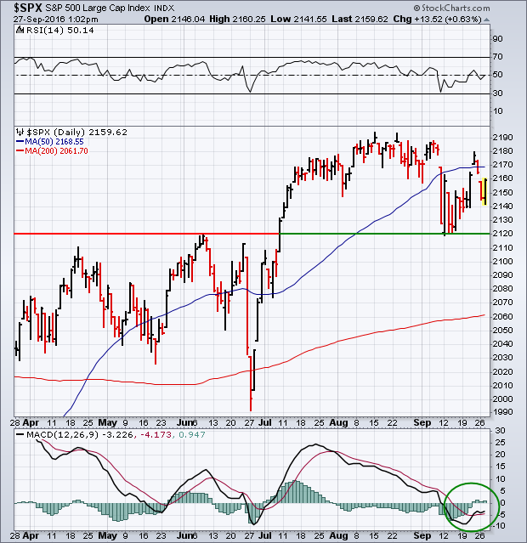
S&P 500-Holding Support
A Sideway Move Going into the November Election followed by an upside breakout

Slide 25
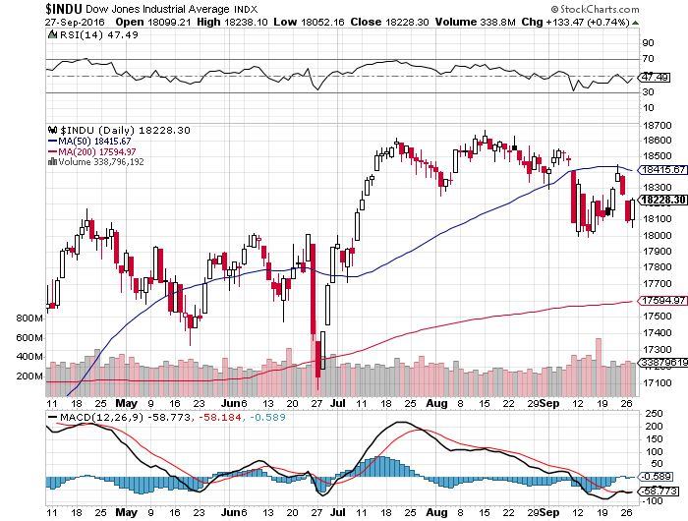
Dow Average-New Highs

Slide 26
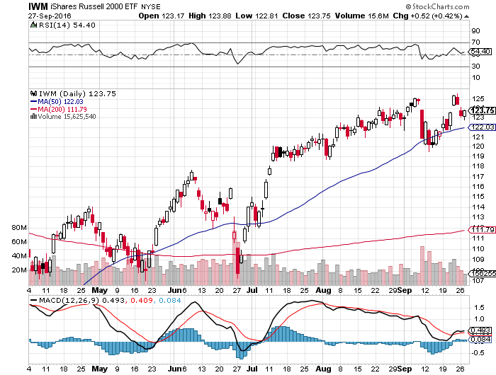
Russell 2000 (IWM)-

Slide 27
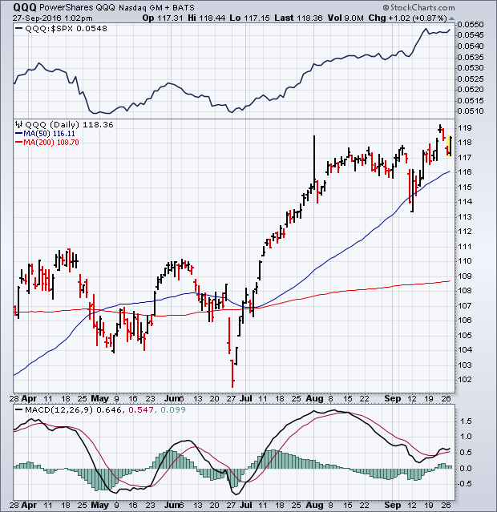
NASDAQ (QQQ)-
Here is Your Leader

Slide 28
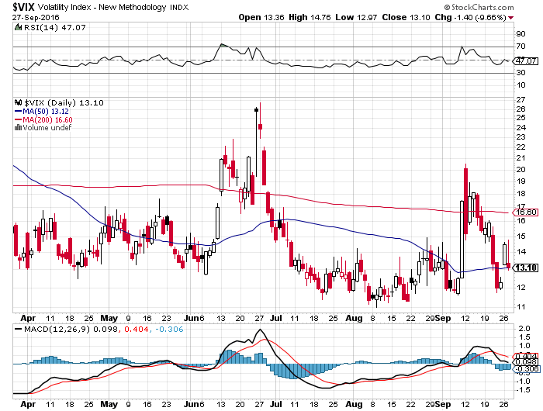
(VIX)-Off to the Races

Slide 29
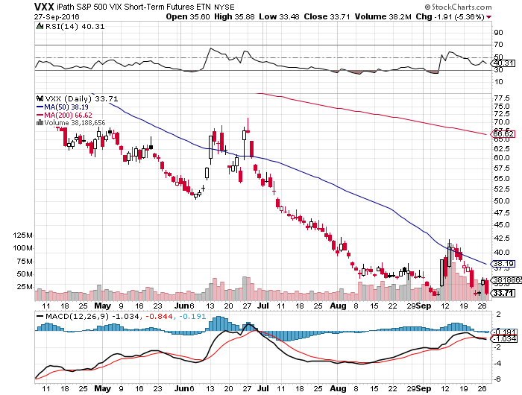
iPath S&P 500 VIX Short Term Futures ETN (VXX) took profits on long 9/$30-$33 vertical bull call spread took profits on long 10/$27-$30 call spread

Slide 30
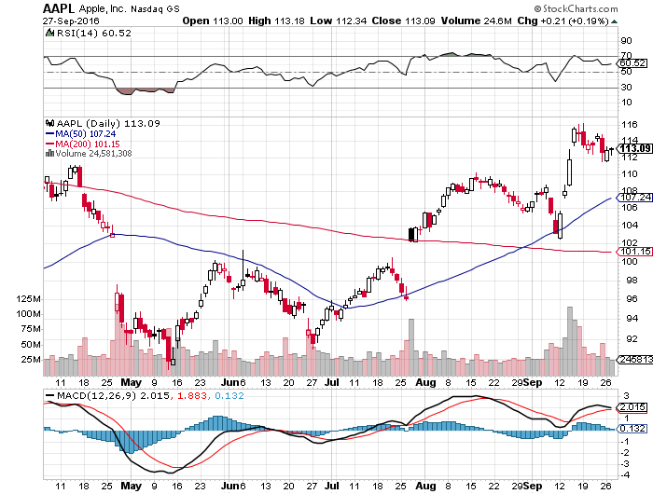
Apple (AAPL) –

Slide 31
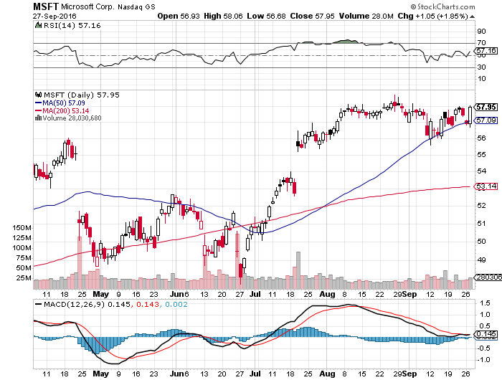
Microsoft (MSFT) announces $40 billion stock buy back, raises dividend by 8%

Slide 32
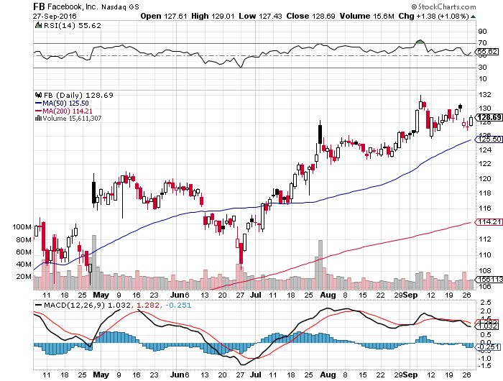
Facebook (FB)- stopped out of long 10/$120-$125 call spread

Slide 33
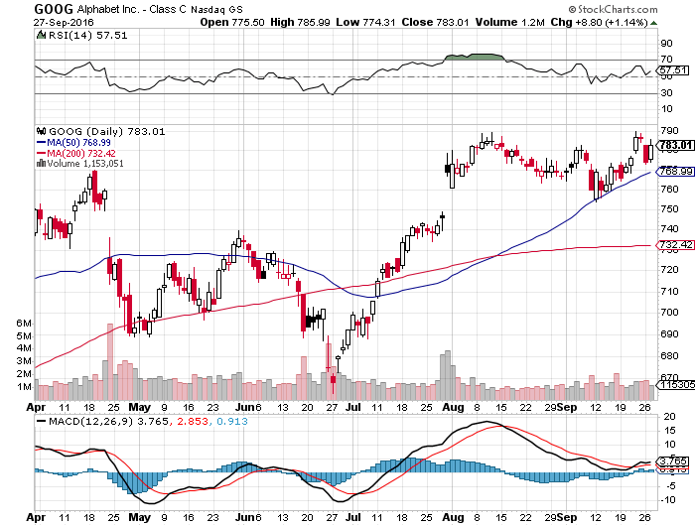
Alphabet (GOOG)- stopped out of long 10/$720-$750 call spread for small loss

Slide 34
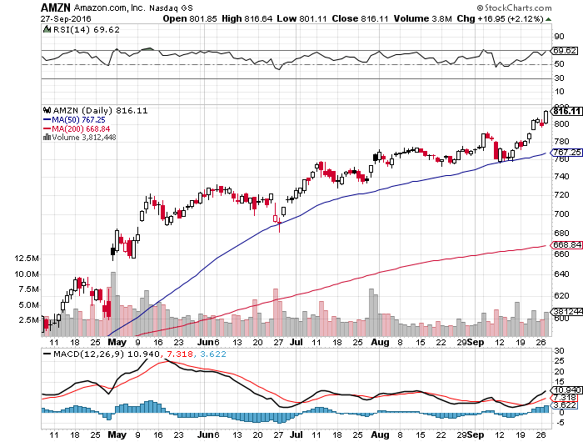
Amazon (AMZN)- stopped out of long 10/$720-$730 call spread

Slide 35
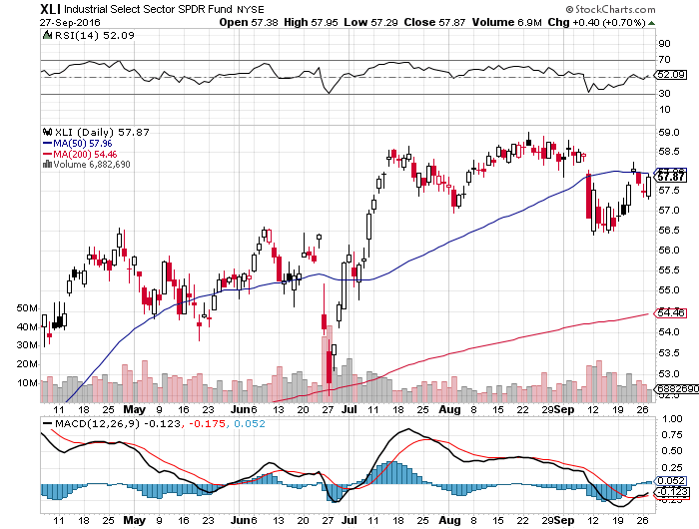
Industrials Sector SPDR (XLI)-Dow Mainstay
(GE), (MMM), (UNP), (UTX), (BA), (HON)

Slide 36
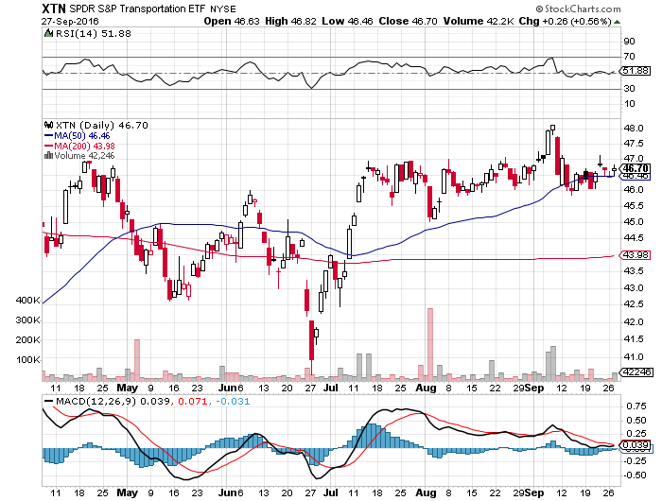
Transports Sector SPDR (XTN)-Upside Breakout Imminent
(ALGT), (ALK), (JBLU), (LUV), (CHRW), (DAL)

Slide 37
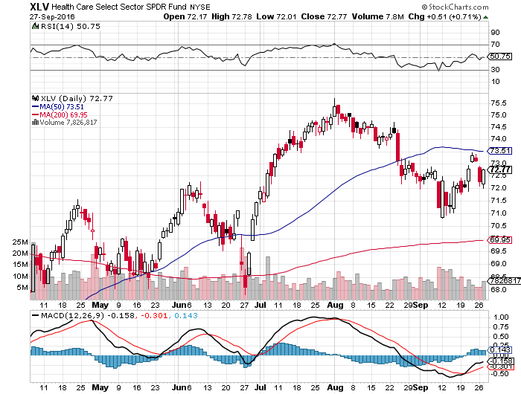
Health Care Sector SPDR (XLV), (RXL)
(JNJ), (PFE), (MRK), (GILD), (ACT), (AMGN)
The Epipen Hit and Hillary Win

Slide 38
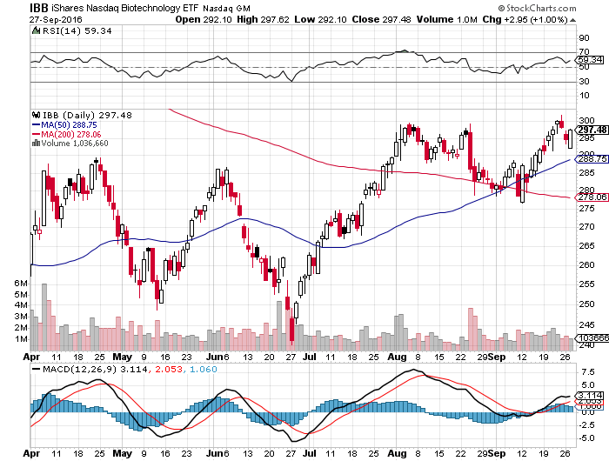
Biotech iShares (IBB)-A Political Football in 2016
Own for 2017

Slide 39
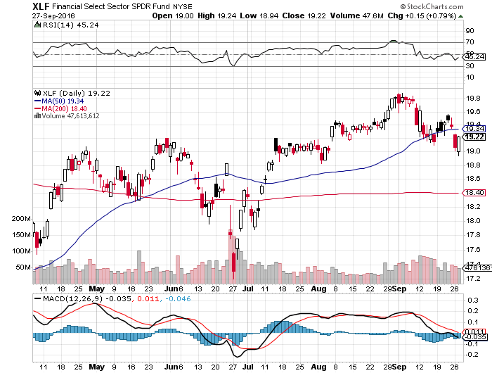
Financial Select SPDR (XLF)-A big Value Play
(BLK/B), (WFC), (JPM), (BAC), (C), (GS)

Slide 40
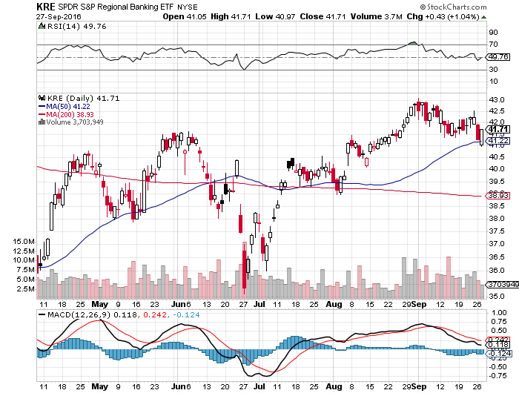
KRE Regional Bank ETF (KRE)-
False Breakout

Slide 41
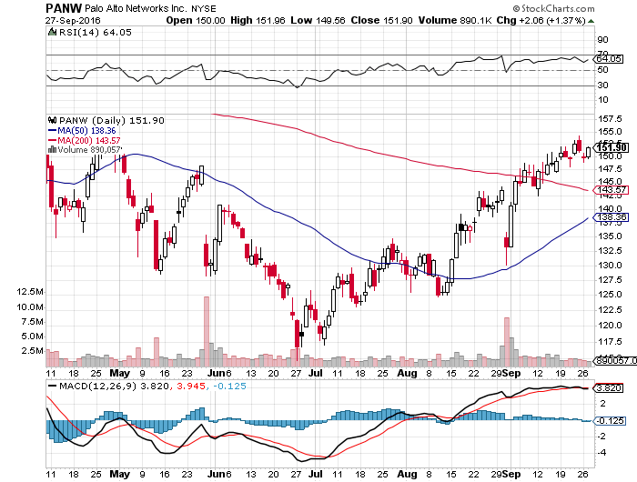
Palo Alto Networks (PANW)-
Hacking Isn’t Going Away

Slide 42
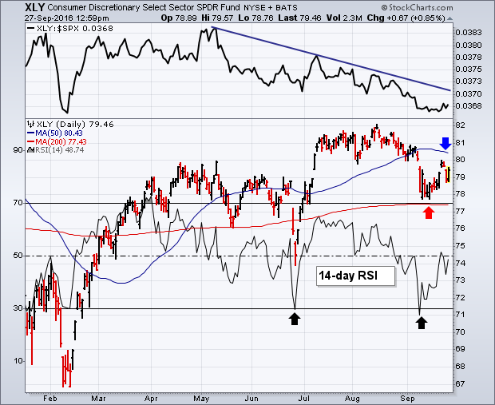
Consumer Discretionary SPDR (XLY)
(DIS), (AMZN), (HD), (CMCSA), (MCD), (SBUX)
A Major Leader of the Rally

Slide 43
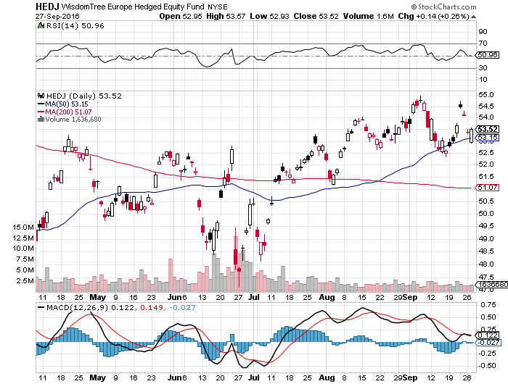
Europe Hedged Equity (HEDJ)-Hedged European Equity

Slide 44
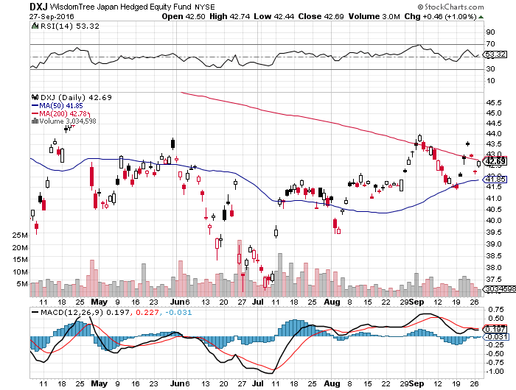
Japan (DXJ)-Hedged Japan Equity

Slide 45
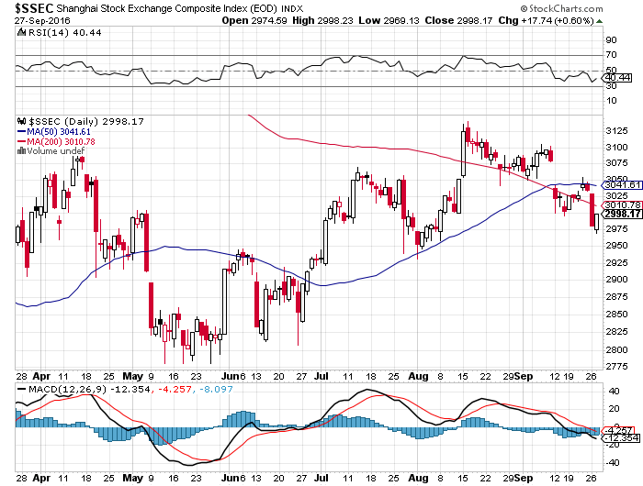
China ($SSEC)-

Slide 46
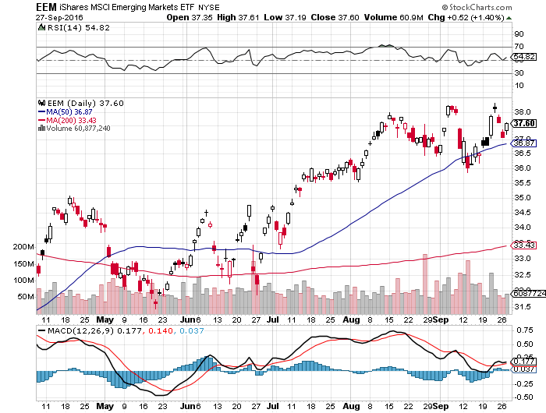
Emerging Markets (EEM)- stopped out of long 10/$33.50-$36.50 call spread

Slide 47
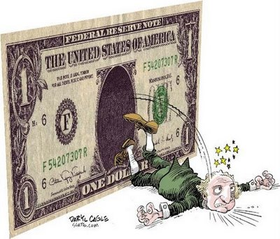
Foreign Currencies-Dollar Dump
*Fed action brings expected dollar weakness, but nothing dramatic so far
*Yen fundamentals are as bad as ever, but charts now risking an upside breakout, you have to respect the charts
*Forex markets have gone dead as money globally moves to cash ahead of the election
*Oil weakness gives Aussie (FXA) and
Loonie (FXC) anxiety attack
*Chinese Yuan (CYB) resumes downtrend

Slide 48
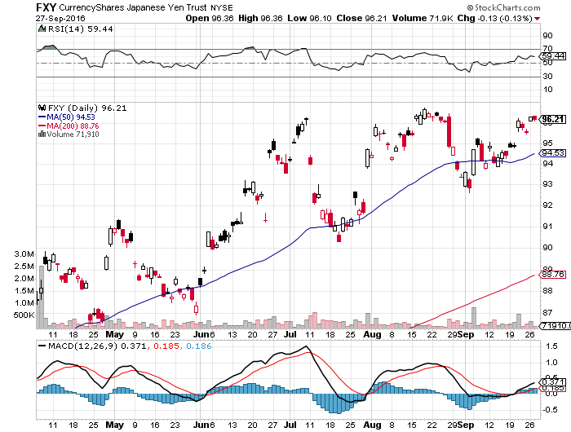
Japanese Yen (FXY)-Chart Says Higher took profits on long the 8/$97-100 put spread took profits on long the 9/$99-102 put spread

Slide 49
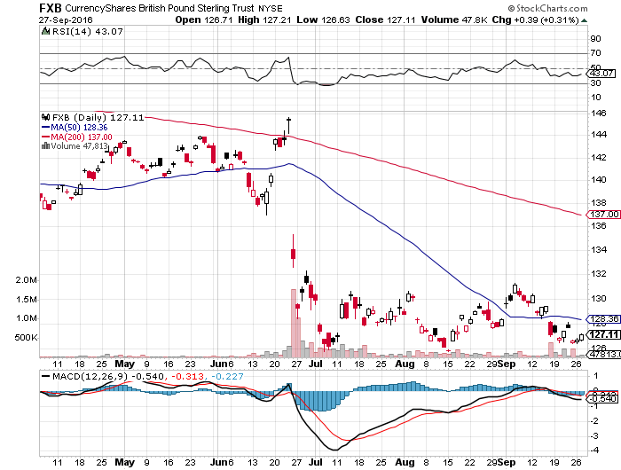
British Pound (FXB)-New Lows on Weakening Economy

Slide 50
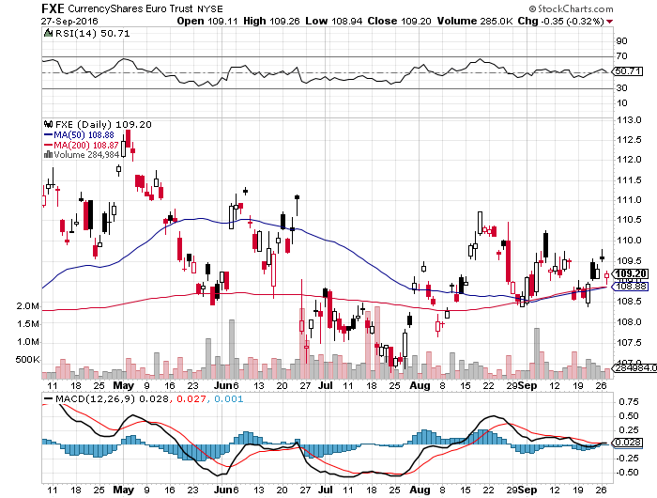
Euro ($XEU), (FXE), (EUO)- Fading Economy took profits on long the 9/$112-$115 vertical bear put spread

Slide 51
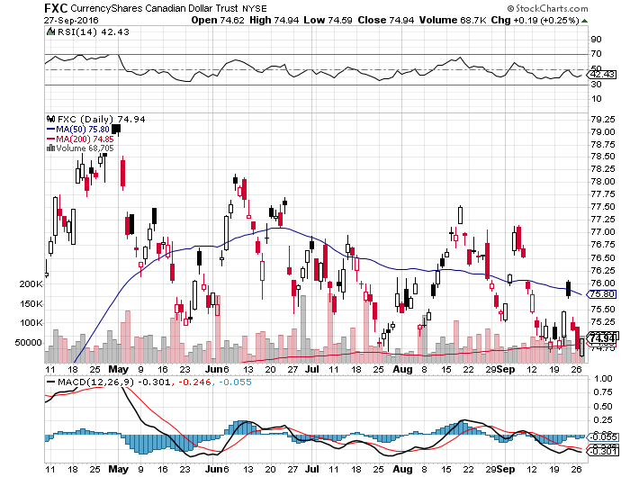
Canadian Dollar (FXC)-Weak Due to Oil Hit

Slide 52
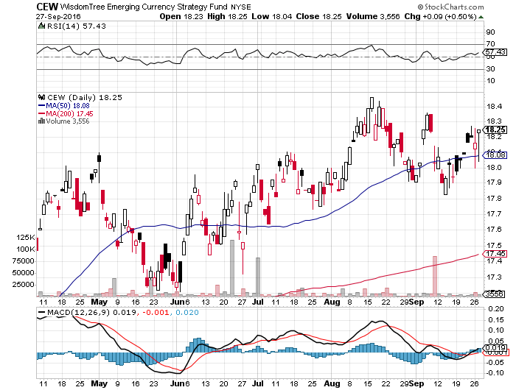
Emerging Market Currencies (CEW)

Slide 53
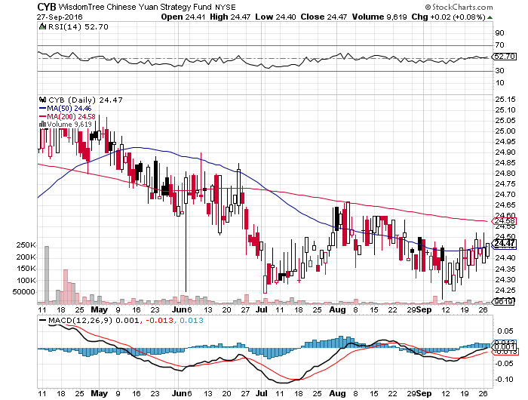
Chinese Yuan- (CYB)-

Slide 54
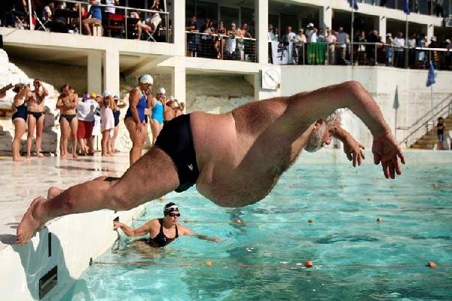
Energy-Algiers Flop
*Algiers OPEC meeting to deliver lots of talk, but no action, sending prices lower
*Saudi Arabia production hits another new all time high in July, up 312,000 b/d YOY
*Kurdish crude is coming back on the market as ISIS loses ground
*Baker Hughes rig count adds 5 to 511 for 12th gain in 11 weeks
*Oil still stuck in $40-$52 range, the next downside test is near
a break takes us to $35 quickly
*Poor oil stocks say a downside break
is coming
*Exxon gets hit with multiple law suits on
reserve valuation and global warming,
is biggest factor in the (XLE)

Slide 55
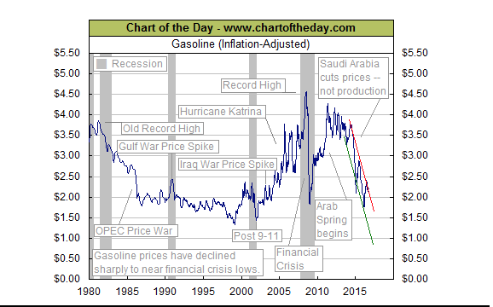
Gasoline Close to 20 Year Low

Slide 56
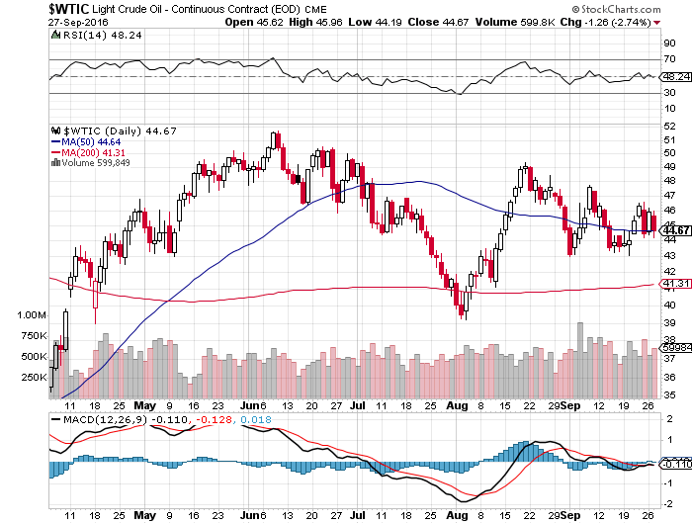
Oil-The Glut Returns

Slide 57
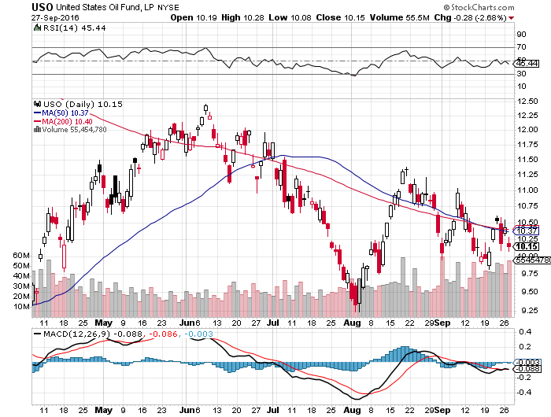
United States Oil Fund (USO)

Slide 58
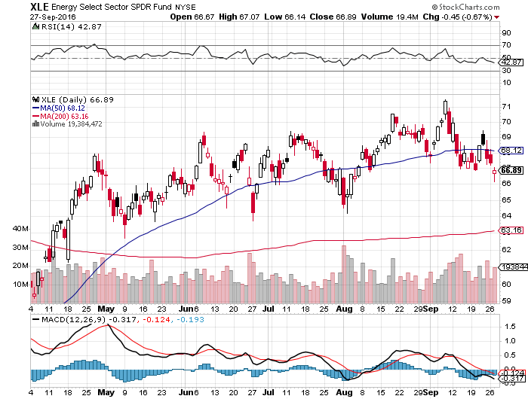
Energy Select Sector SPDR (XLE)
(XOM), (CVX), (SLB), (KMI), (EOG), (COP)

Slide 59
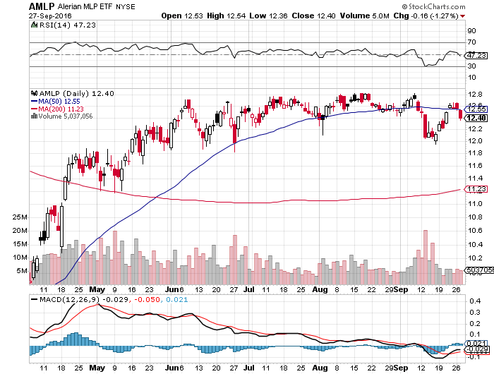
Alerian MLP ETF (AMLP)-
Basket Approach is the Only Safe Play here

Slide 60
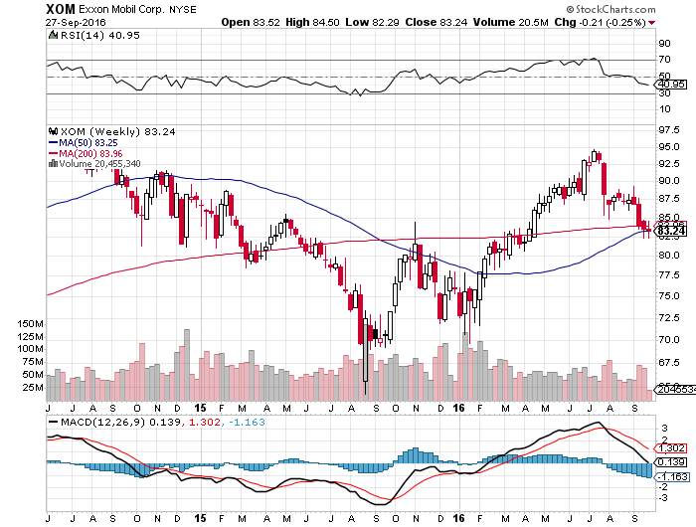
Exxon (XOM)-Dividend is Not Enough global warming + reserve valuation = ouch!

Slide 61

Occidental Petroleum (OXY)-

Slide 62

Natural Gas (UNG)-Bumping Against 2016 Highs

Slide 63

Copper-Capped on Over Supply

Slide 64

Precious Metals-
*Despite all the action in interest rates, up and down, gold is still in a sideways pattern
*Is this the path for all assets going into the election?
*No rate rise in September, and maybe into 2017 is medium term bullish
*Zero rates give gold a big advantage in a
negative rate world
*Looking to buy on a washout

Slide 65

Gold (GLD)-

Slide 66

Market Vectors Gold Miners ETF- (GDX)

Slide 67

Silver (SLV)-

Slide 68

Silver Miners (SIL)-

Slide 69

Agriculture-Still Awful
*Enormous crop forecasts break all ags to new multiyear lows, with wheat at a 10 year low!
*Strong dollar allowing Russia to take over America’s share of the global wheat market
*Failure to rally off of decade lows bodes ill for prices
*Huge carry over crops threaten to spill
falling prices into 2017
*No trade, there are NO fish to fry
too low to initiate new shorts
*My main job here is to keep traders
away from this sector this year, and
that approach has worked one more time

Slide 70

(CORN) – Testing New Lows!

Slide 71

(WEAT) New Lows!

Slide 72

(SOYB) No Longer the Sole Survivor

Slide 73
Real Estate-Stalling
*August new home sales up +7.6%, August Homebuilder Sentiment surge 6 points to 65
*August Housing starts down -5.8%, Permits 0.40%
*Rising costs limiting new projects
*Mortgage applications tank, down 7.3% on rising rates, 30 year mortgage hits 3 month high at 3.70%
*Existing Home Sales 533,000, Median Home Prices up 5.1% YOY to $240,200,
only 4.6 months of inventory
*First time buyers now only 31% of the market, high prices pushing them out
*July Case Shiller -0.0% to 5.1% YOY, holding steady

Slide 74

April S&P 500/Case–Shiller Home Price Index
+5.0% YOY, Portland, Seattle, Denver leaders

Slide 75

General Growth Properties (GGP)
Yield Play Profit Taking

Slide 76

US Home Construction Index (ITB)
(DHI), (LEN), (PHM), (TOL), (NVR)
Another Rising Rate Victim

Slide 77

Trade Sheet
So What Do We Do About All This?
*Stocks- stand aside-wait for a bigger dip to buy
*Bonds-sell rallies on rate hike risk
*Commodities-stand aside
*Currencies-stand aside on breakout risk
*Precious Metals–stand aside
*Volatility-sell short spikes over $25, buy dips to $12
*The Ags –stand aside
*Real estate-stand aside

Slide 78

To buy lunch tickets, please click http://members.madhedgefundtrader.com/category/luncheons/usa/ and select the city of your choice
Next Strategy Webinar
12:00 EST Wednesday, October 12, 2016
San Francisco, CA
Good Luck and Good Trading!
Notes:
*

