Slide 1
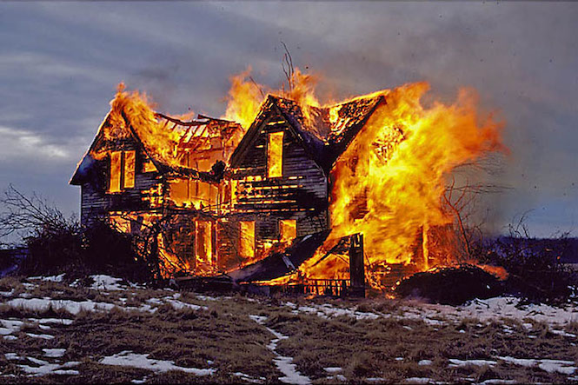
The Mad Hedge Fund Trader “There Goes the House”
With John Thomas from San Francisco, CA, October 12, 2016 www.madhedgefundtrader.com
Notes:
*

Slide 2

In the Store Now for $49
Sectors and stocks that will lead the market for the next 20 years
https://members.madhedgefundtrader.com/roaring-twenties-book/

Slide 3
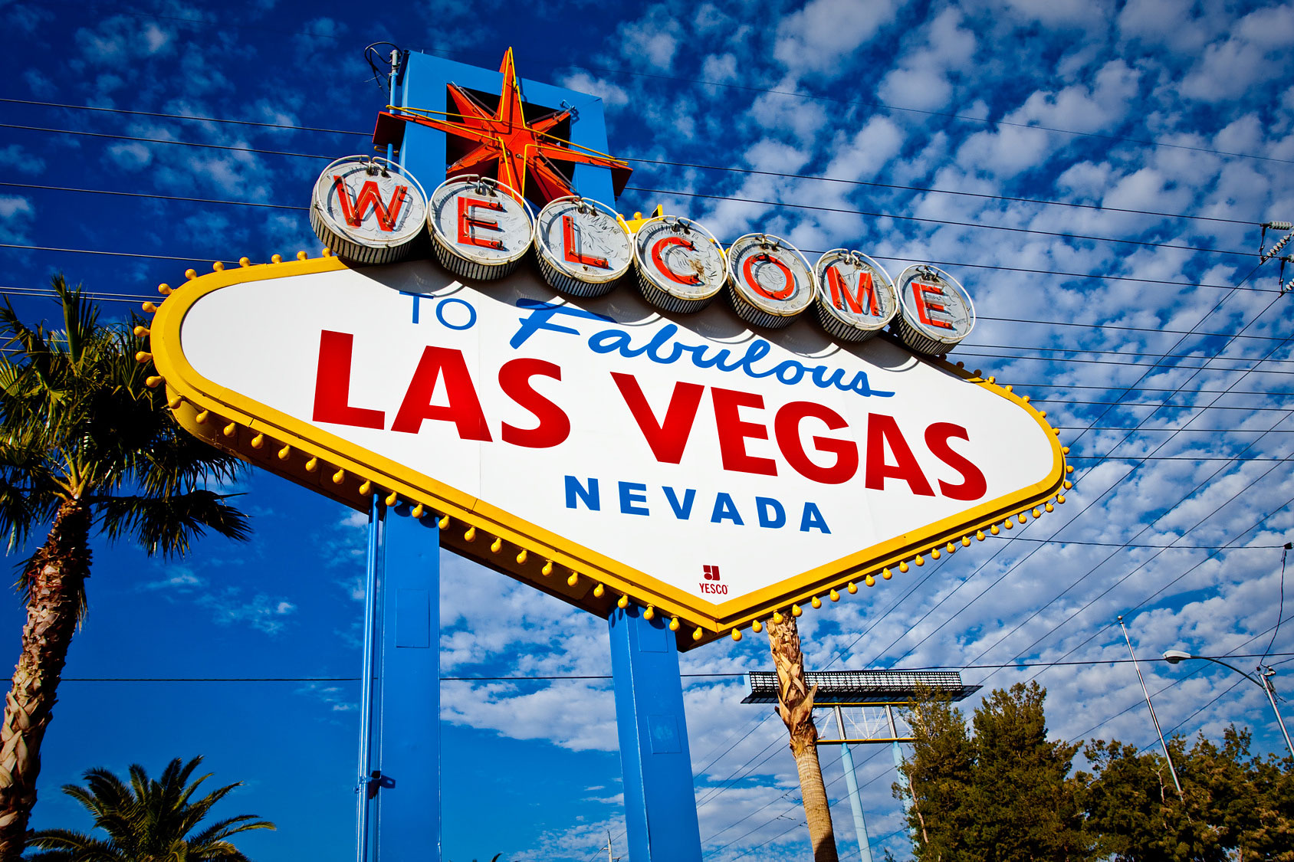
MHFT Global Strategy Luncheons Buy tickets at http://members.madhedgefundtrader.com/category/luncheons/usa/
San Francisco, CA October 21
Las Vegas, Nevada November 18

Slide 4

Trade Alert Performance New All Time High!!
*January +1.23% Final *July +0.67% Final *February +4.50% Final *August +7.52% Final *March -2.42% Final *September +0.27% Final *April -2.10% Final *October -0.91% MTD *May +4.38% Final *November 5.78% Final *June -0.56% Final *December -4.94% Final *2016 Year to Date +14.45% compared to 4.5% for the Dow Average *Trailing 1 year return +16.33%, +206.13% since inception, 1.77% short of an all time high *Average annualized return of 35.33%

Slide 5
Portfolio Review Aggressive “NEUTRAL” Hedged position
Current Capital at Risk
Risk On
World is Getting Better
(SPY) 10/$207-$210 call spread | 10.00%
(SPY) 11/$203-$208 call spread | 10.00%
(TLT) 10/$129-$132 call spread | 10.00%
(TLT) 11/$127-$130 call spread | 10.00%
Risk Off
World is Getting Worse
(SPY) 10/$219-$222 put spread | -10.00%
(USO) 11/$12.50-$14.00 put spread | -10.00%
(GLD) 11/$112-$115 call spread | -10.00%
Total Net Position | 10.00%
Expiration P&L 24.32%

Slide 6
Paid Subscriber Trailing 12 Month Audited Return

Slide 7
70 Months Since Inception Daily Audited Performance Averaged annualized return +35.33%

Slide 8
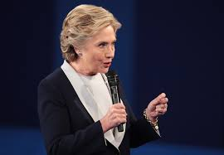
Election Update
*Clinton is clearly running away with a landslide *Trump has irretrievably fractured the republican Party *The House is now in play, with a 60% chance of a Democratic takeover, 32 seats needed to win control of 218 seats, need to run the table *Markets love gridlock and Washington inaction *A Democratic takeover of all branches of government is short term market negative *Brings high taxes for the wealthy, more regulation *Is what this week’s weakness is all about *The 5% correction could become a 10% one before new all time highs

Slide 9
A Clinton Triple Play Brings in the Next Two Years
*The next three Supreme Court nominations, creating a liberal court for 40 years *Higher taxes for the wealthy *More regulation of banks through an updated Dodd Frank *Regulation of Pharmaceuticals through an Obamacare upgrade *Limited gun control (full autos, large magazine, silencers, enhanced registration for the no fly list and the mentally ill) *An End to Citizens United Permitting unlimited anonymous corporate campaign donations *Voter rights will be expanded *Women’s health rights expanded *Globalization, with TPP by another name

Slide 10
The Bill Davis View A $1,500 Upgrade for the Mad Day Trader Service
Buys:
Costco Corp (COST) $150 Target to $165
Amazon, Inc (AMZN) $812 Target to $860
US Steel (X) $14 Target to $22
FireEye (FEYE) $12 Target to $16
Facebook (FB) $125 Target to $140
Western Digital (WDC) $50 Target to $62
Sells:
Buffalo Wild Wings (BWLD) $152 Target to $120
Harman Intl (HAR) $84 Target to $75
Express Scripts (ESRX) $70 Target to $62
Alexion Pharm (ALXN) $125 Target to $112
Valeant (VRX) $24 Target to $19
L Brands (LB) $72 Target to $56

Slide 11

The Method to My Madness
*Running large “RISK OFF” position with an 8 day view *3 of 5 positions expire Friday next week *No doubt that the rising chance of a Democratic win is increasing volatility *A Clinton win was pricing into the market, but not a landslide or a House win *Buy “RISK ON” assets on every substantial dip, especially tech *Rising bond rates suggest that traders believe a December rate rise is more likely than it actually is

Slide 12

Short Term Strategy Outlook
*The election outcome is no longer unknown, only the magnitude *However, most markets will coil sideways until the election is a done deal, but now in a broader range with the house in play, keep selling rallies and buying dips *Keep trading Volatility for quick in and out profits *No chance of a rate hike in 2016, but a December rate rise risk will stay in bond prices *Oil will trade the $40-$52 range until the November OPEC meeting in Vienna *Gold trying to bottom here off of imminent rate peak *Stay away from ags, perfect weather to bring new lows.

Slide 13
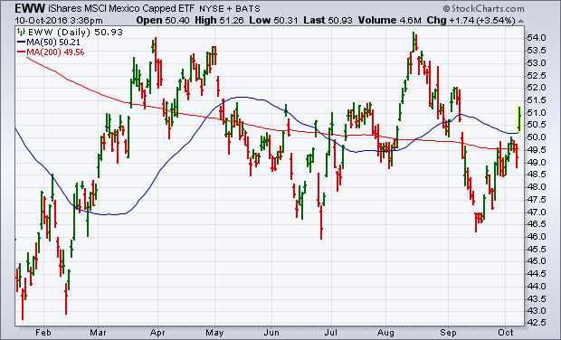

Slide 14
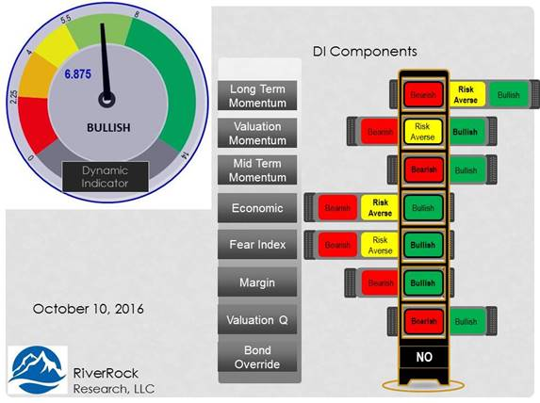
Risk Indicators Showing Neutral

Slide 15

The Global Economy-Heating Up
*Final read on US Q2 GDP comes in at a higher 1.4%, big jump in September Services ISM from 51.4 to 57.1, Non Manufacturing 51.14 to 60.3, August Capital Goods up 0.9%, second best number of the year *Almost all recent data suddenly turn hot, prompting a Treasury bond yield spike and a strong dollar. *ECB keeps interest rates unchanged, QE kept at €80 billion a month *Bank of Japan also keeps QE unchanged *Despite all this, US stocks and bonds are still the most attractive, highest yielding assets in the world, both should move to new highs *Gearing up for a post election earnings recovery

Slide 16
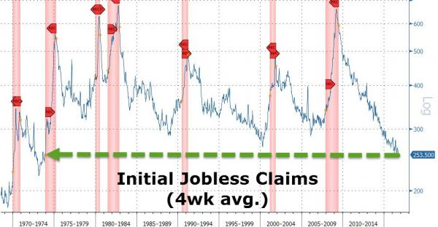
Weekly Jobless Claims –The Most Important Statistic -5,000 to 249,000-Lowest since 1973! The Downtrend Lives!-Show Me the Recession!

Slide 17
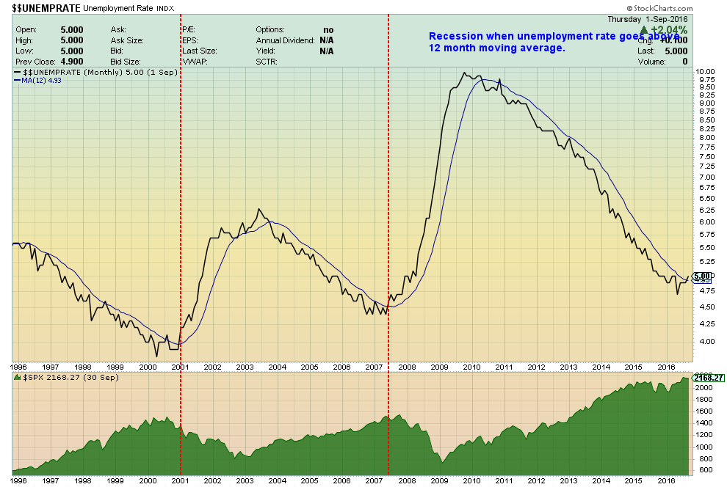

Slide 18

Bonds-Hot Data Hit
*Sudden heating up of economic data leads to major bond market selloff, 10 year Treasury yields pop from 1.50% to 1.78% *House risk also feeding into bond selling *If data cools expect a sudden (TLT) short covering rally *A December Fed interest rate hike is now fully priced in *The next thing to happen for a rate hike to get unpriced, hence the double long (TLT) position *That said, discipline requires that we are close to a stop out on the (TLT) 10/$129-$132 vertical bull call spread expiring in 7 trading days *German bunds recover to +0.06%, JGB’s at -0.07%. BOJ vows to cap bond yields at 0%

Slide 19
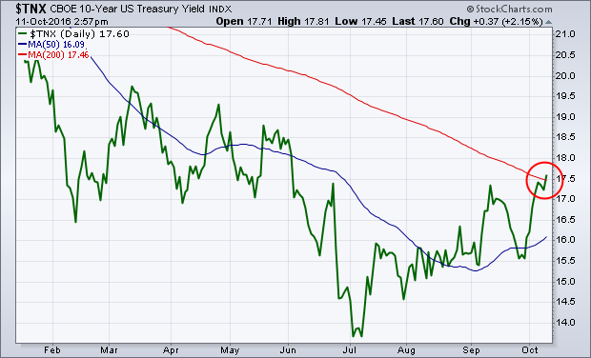
Ten Year Treasury Yield ($TNX) 1.77% Upside Breakout Test

Slide 20
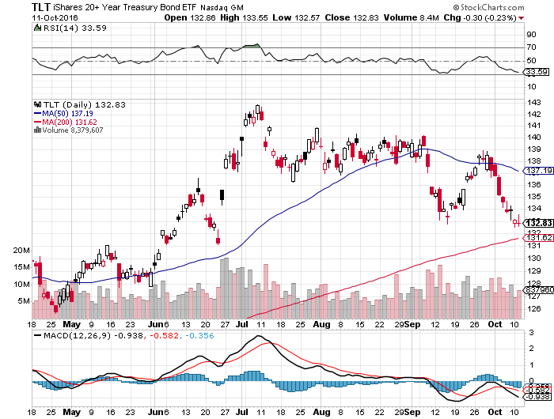
Ten Year Treasury ETF (TLT) 1.77% long 10/$129-$132 vertical bull call spread long 11/$127-$130 vertical bull call spread

Slide 21
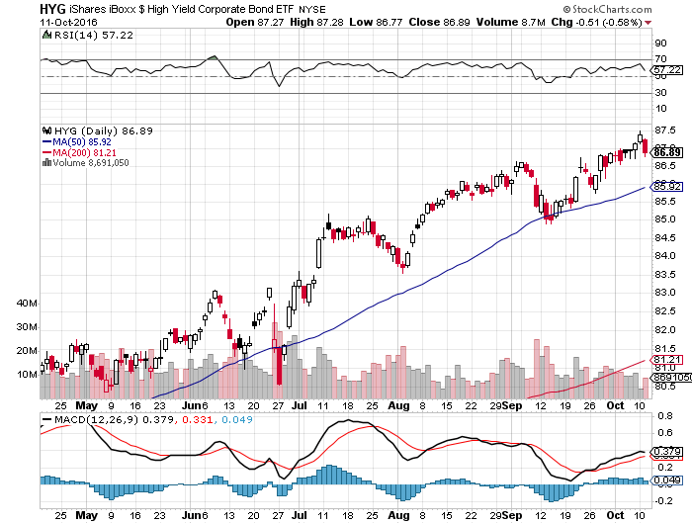
Junk Bonds (HYG) 5.46% Yield A Great Risk Coincident Indicator-”RISK ON” means new highs, buy all dips

Slide 22
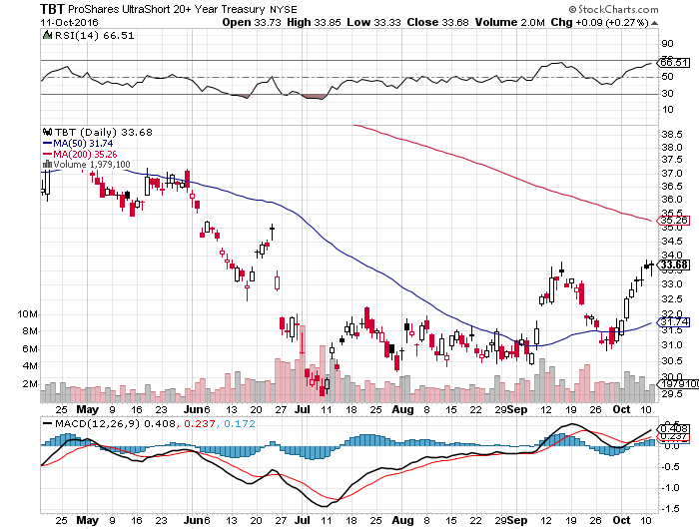
2X Short Treasuries (TBT)-At Last!

Slide 23
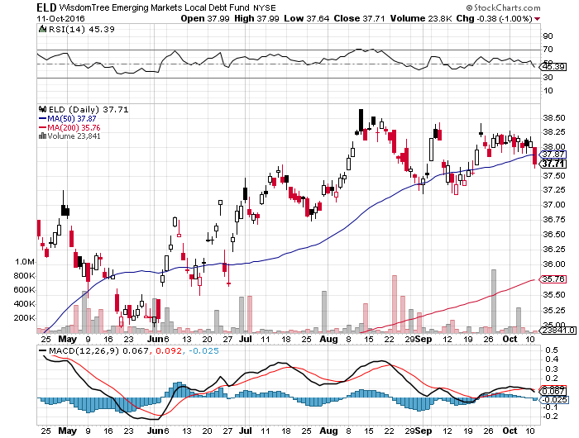
Emerging Market Debt (ELD) 4.65% Yield-

Slide 24
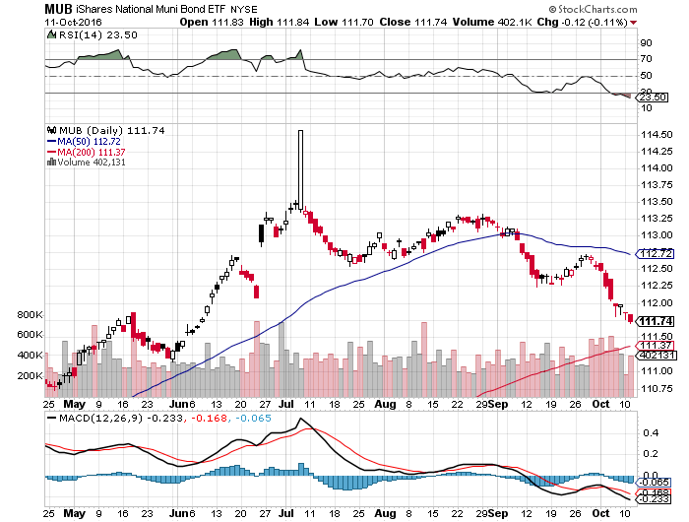
Municipal Bonds (MUB)-1.25% yield-New High Mix of AAA, AA, and A rated bonds

Slide 25

Stocks-Gridlock Gone?
*Possible end of gridlock in Washington scares stocks, rising rates is another buzz kill *The 5% correction could become a 10% correction *The longer term focus is still positive, looking for an earnings recovery in 2017 *Look for tech to lead any rally *Rally in financials and interest sensitive's may be about to roll over once a Fed rate hike is fully discounted, which is close *The world is looking for a tradable dip to “BUY,” another one may be becoming

Slide 26
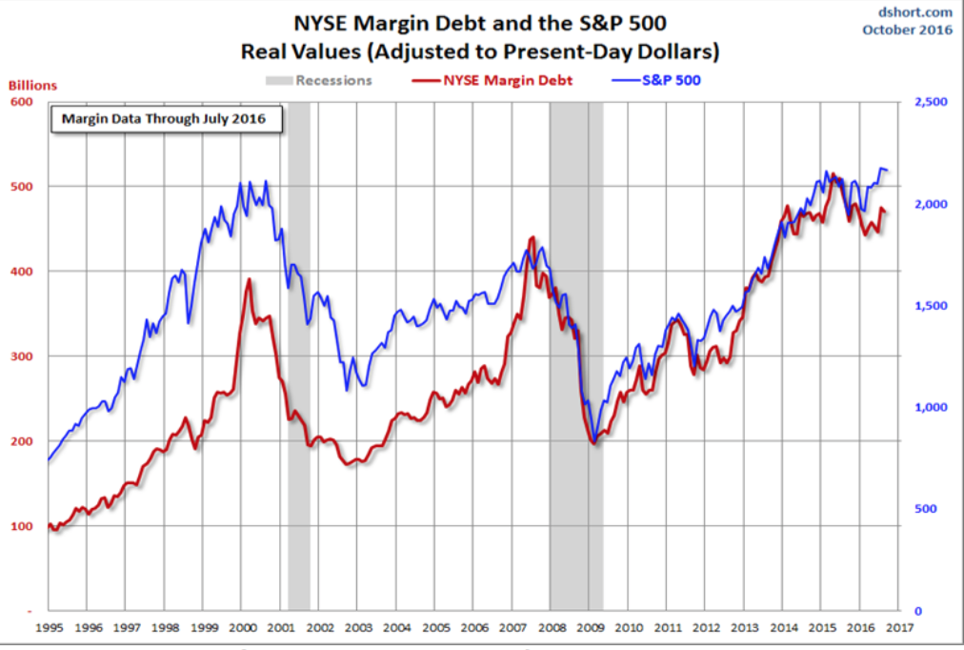

Slide 27
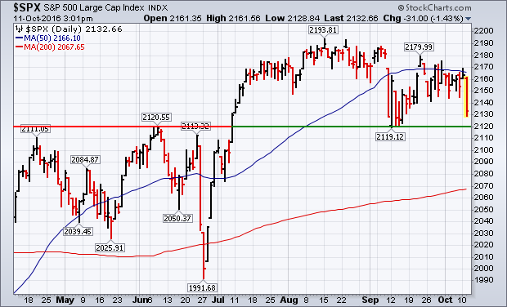
S&P 500-Holding Support A Sideway Move Going into the November Election followed by an upside breakout long 10/$207-$210 call spread-expires in 7 days long 11/$203-$208 call spread-expires in 27 days

Slide 28
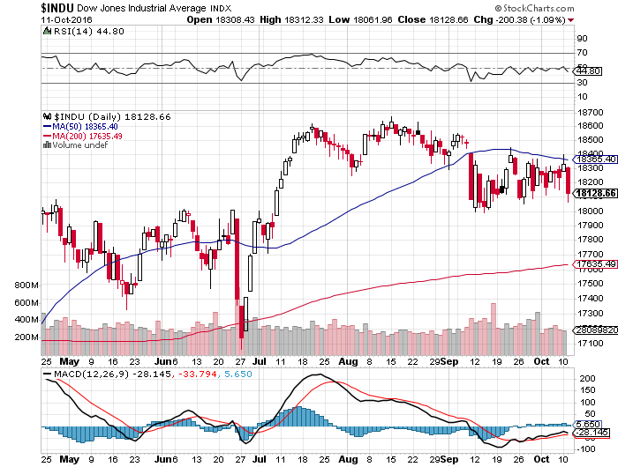
Dow Average-Rangebound

Slide 29
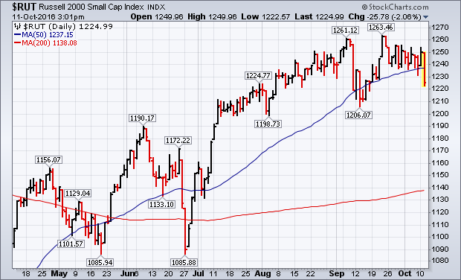
Russell 2000 (IWM)-50 Day MA Gone!

Slide 30
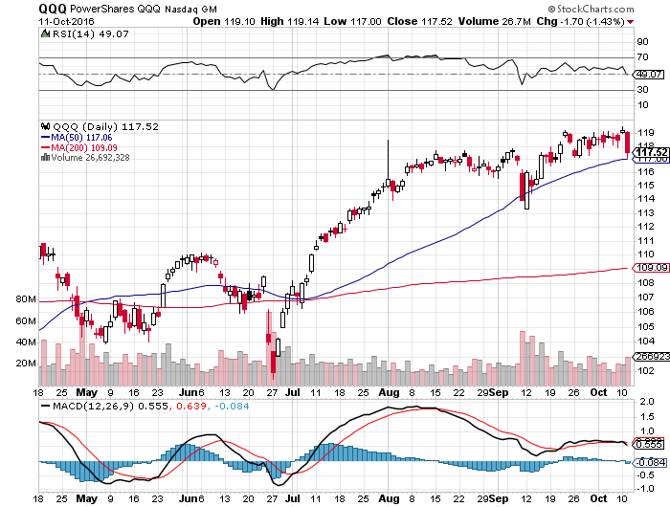
NASDAQ (QQQ)- Here is Your Leader

Slide 31
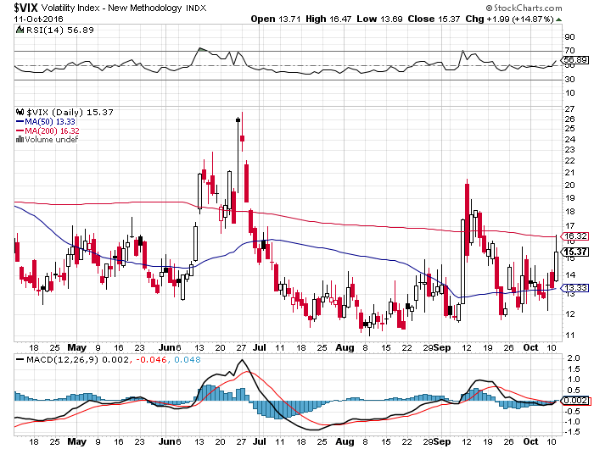
(VIX)-Off to the Races

Slide 32
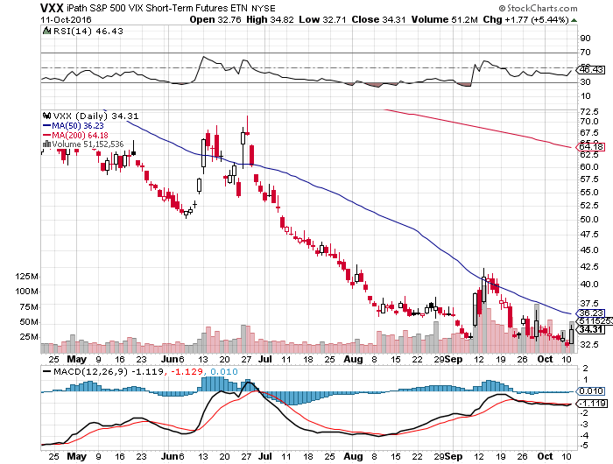
iPath S&P 500 VIX Short Term Futures ETN (VXX) took profits on long 9/$30-$33 vertical bull call spread took profits on long 10/$27-$30 call spread

Slide 33
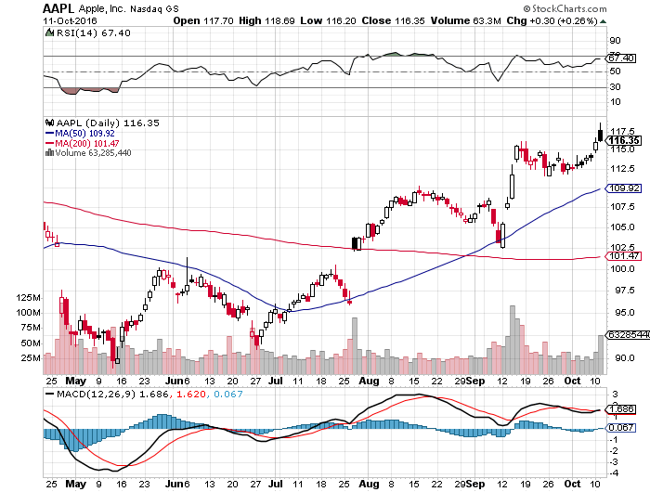
Apple (AAPL) –Samsung Gift

Slide 34
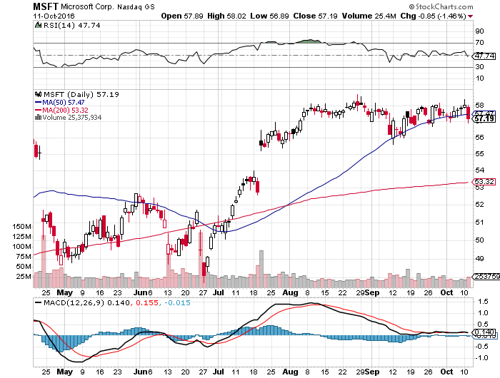
Microsoft (MSFT) announces $40 billion stock buy back, raises dividend by 8% Samsung 7 blow up a huge assist

Slide 35
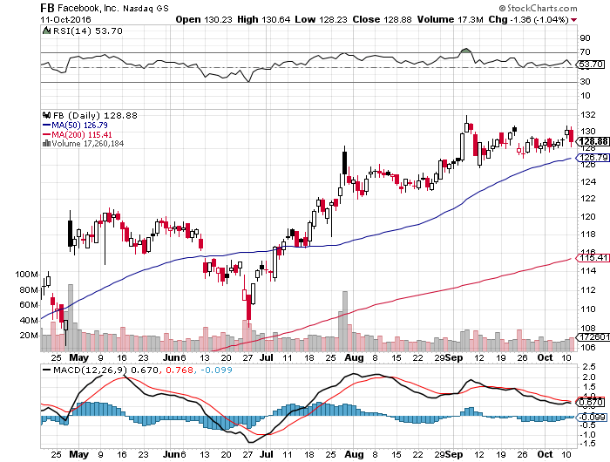
Facebook (FB)-

Slide 36
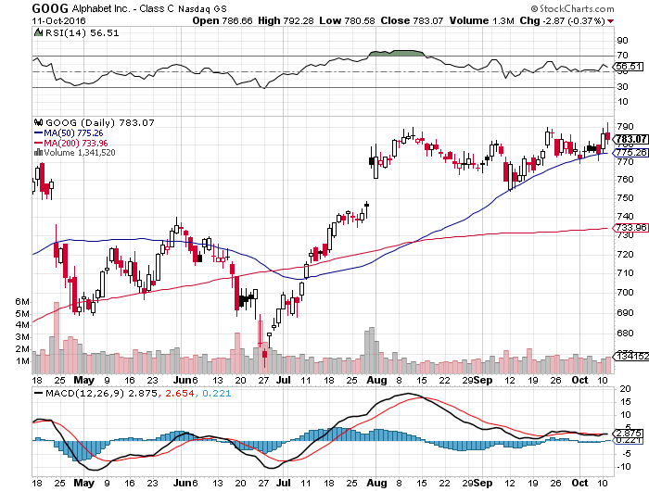
Alphabet (GOOG)-

Slide 37
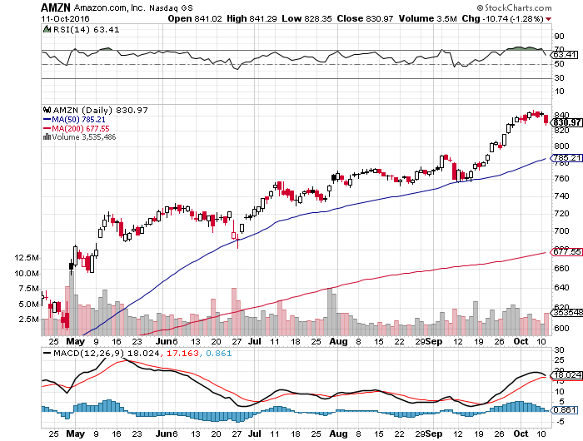
Amazon (AMZN)-

Slide 38
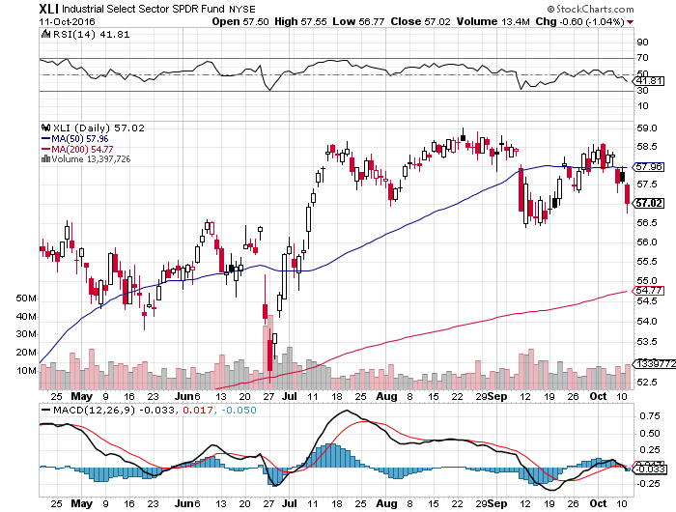
Industrials Sector SPDR (XLI)-Dow Mainstay (GE), (MMM), (UNP), (UTX), (BA), (HON)

Slide 39
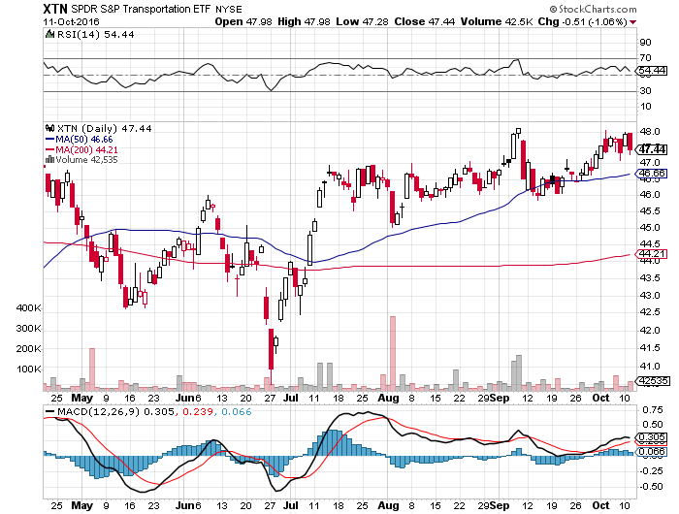
Transports Sector SPDR (XTN)-Upside Breakout Imminent (ALGT), (ALK), (JBLU), (LUV), (CHRW), (DAL)

Slide 40
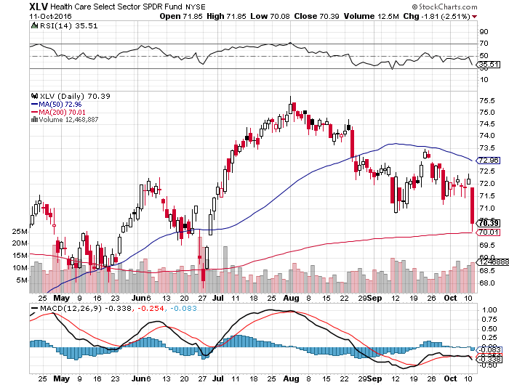
Health Care Sector SPDR (XLV), (RXL) (JNJ), (PFE), (MRK), (GILD), (ACT), (AMGN) The Epipen Hit and Hillary Win

Slide 41
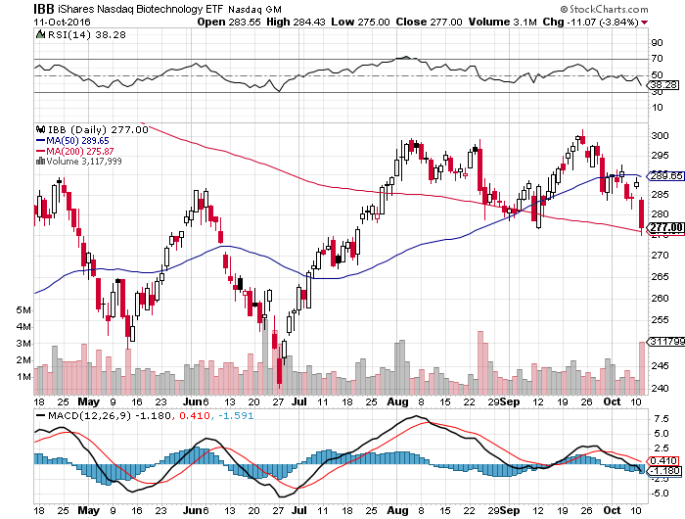
Biotech iShares (IBB)-A Political Football in 2016 Own for 2017

Slide 42
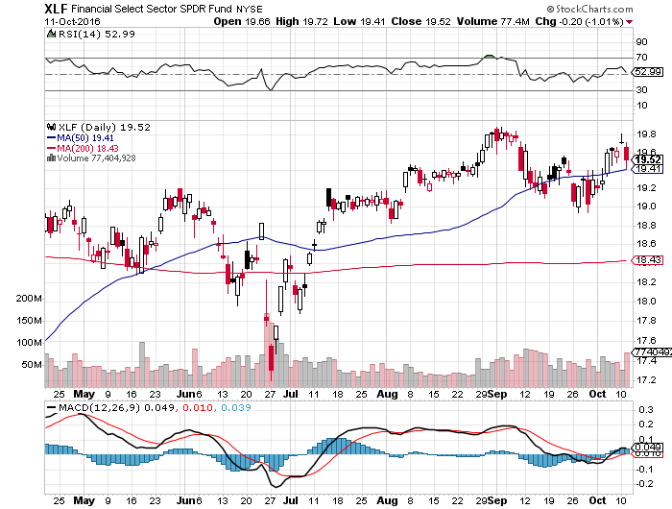
Financial Select SPDR (XLF)-A big Value Play (BLK/B), (WFC), (JPM), (BAC), (C), (GS)

Slide 43
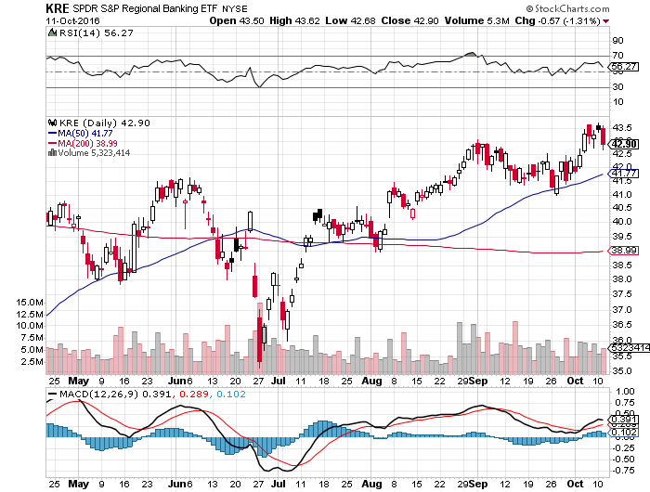
KRE Regional Bank ETF (KRE)-

Slide 44
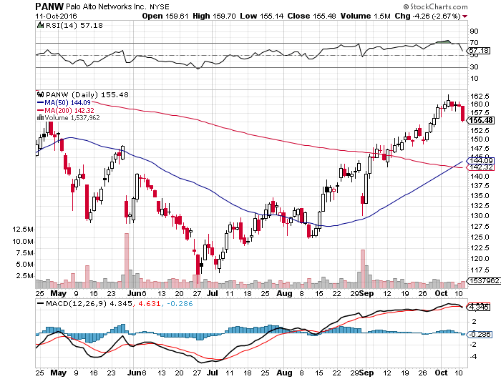
Palo Alto Networks (PANW)- Hacking Isn’t Going Away

Slide 45
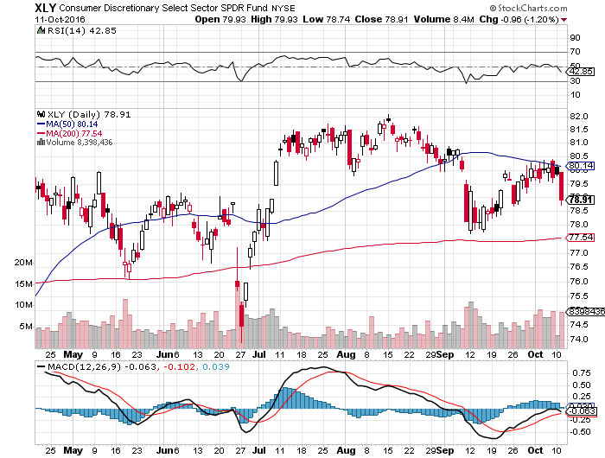
Consumer Discretionary SPDR (XLY) (DIS), (AMZN), (HD), (CMCSA), (MCD), (SBUX) A Major Leader of the Rally

Slide 46
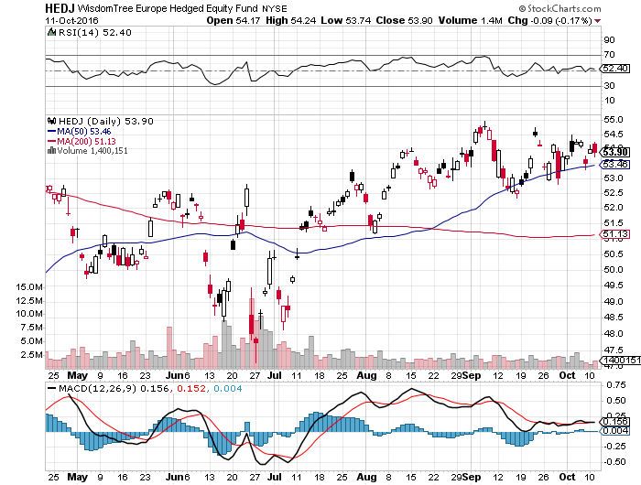
Europe Hedged Equity (HEDJ)-Hedged European Equity

Slide 47
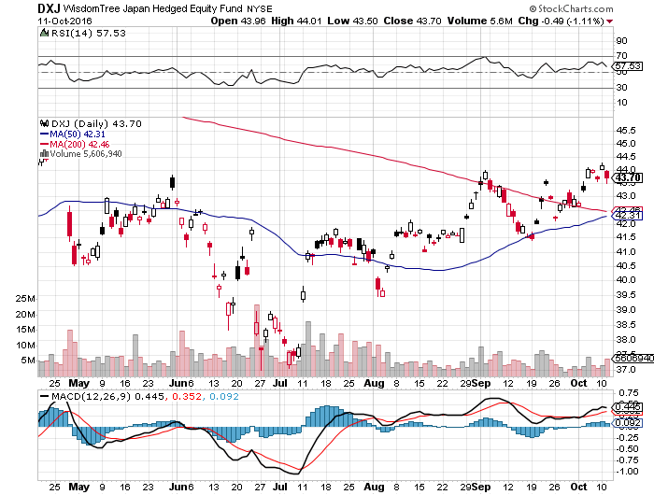
Japan (DXJ)-Hedged Japan Equity

Slide 48
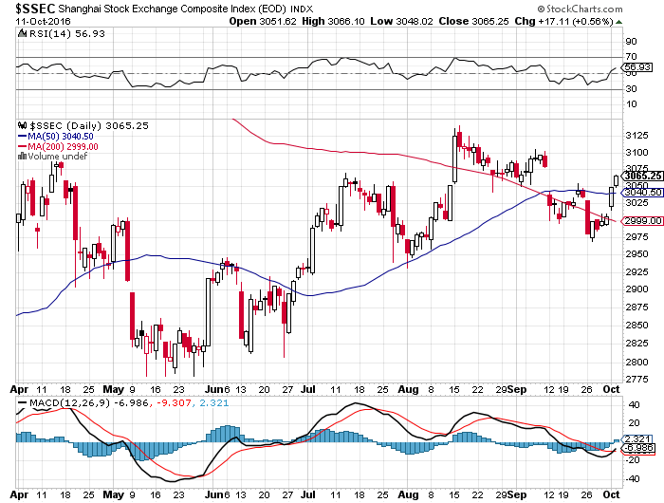
China ($SSEC)-

Slide 49
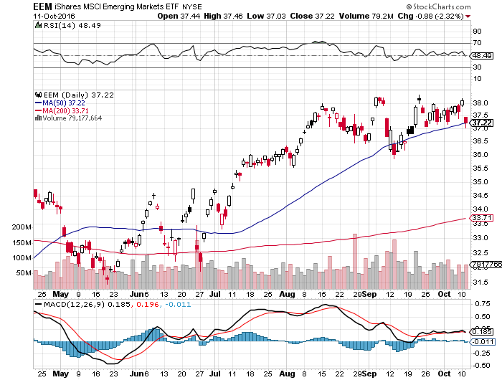
Emerging Markets (EEM)-

Slide 50

Foreign Currencies-Dollar Surge
*Rising rate prospects cause US$ to hit a multiyear high *Yen fundamentals are as bad as ever, but charts now showing a chance of a long term breakdown, as Japan will be the last country in the world to raise rates *British pound hits new 31 year low as “Hard Brexit” talks speeded up, could eventually hit parity and also become the first country to see inflation *Oil strength can’t offset US$ strength, giving no help to Aussie (FXA) and Loonie (FXC) *Chinese Yuan (CYB) testing lows

Slide 51
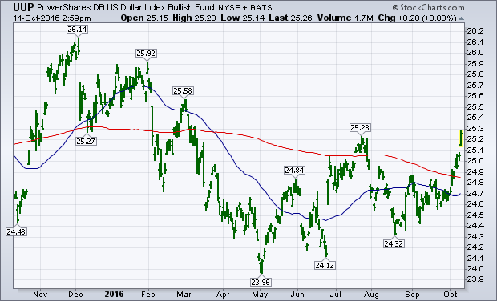
(UUP) Dollar Hits 8 Month High

Slide 52
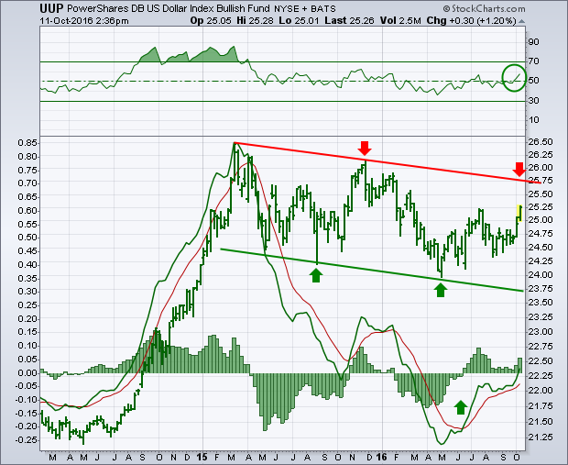
(UUP) 3 Year-More to Run

Slide 53
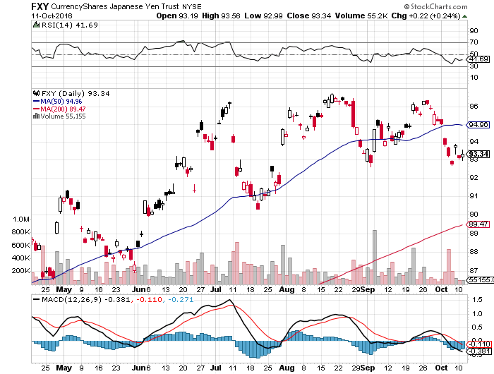
Japanese Yen (FXY)-Chart Says Higher took profits on long the 8/$97-100 put spread took profits on long the 9/$99-102 put spread

Slide 54
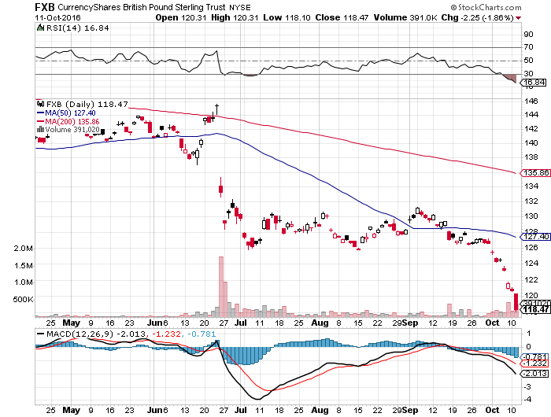
British Pound (FXB)-New Lows on Weakening Economy

Slide 55
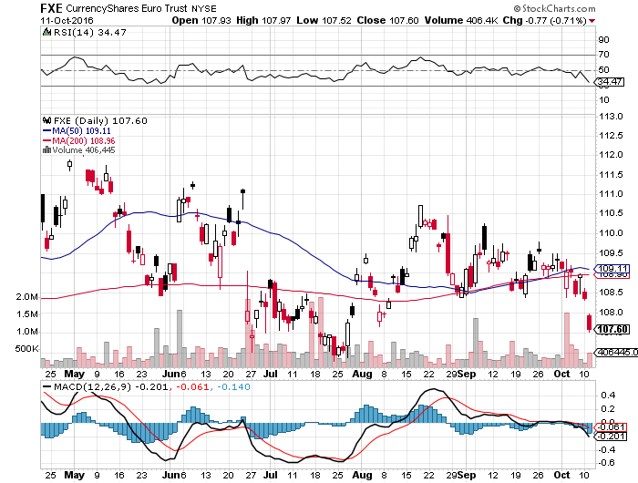
Euro ($XEU), (FXE), (EUO)- Fading Economy took profits on long the 9/$112-$115 vertical bear put spread

Slide 56
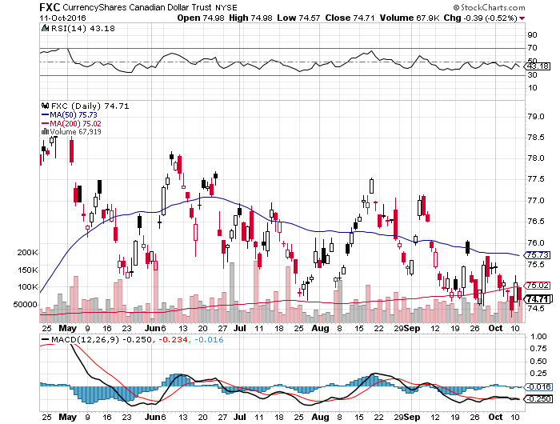
Canadian Dollar (FXC)-No Help from Oil

Slide 57
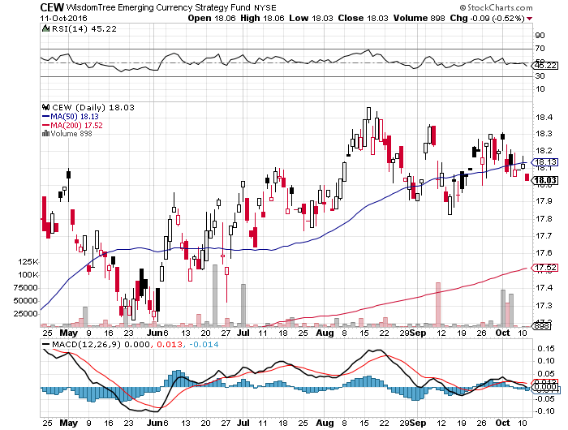
Emerging Market Currencies (CEW)

Slide 58
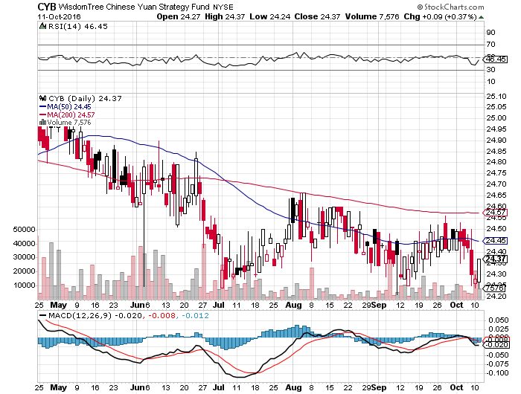
Chinese Yuan- (CYB)-

Slide 59

Energy-Short Squeeze
*Tentative OPEC deal to cap production creates 25% short covering rally, now what? *Big surprise draws in inventories give the rally a second leg *Hurricane Matthew delivers third up leg thanks to supply disruptions, shutdown of offshore production *Baker Hughes rig count adds 5 to 511 for 13th gain in 14 weeks *Oil still stuck in $40-$52 range, but we are now testing the upside *Contangos narrowing give market a bullish tilt

Slide 60
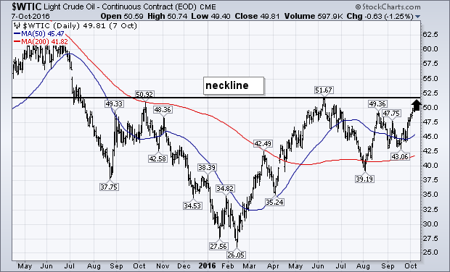
Oil-The Glut Returns

Slide 61
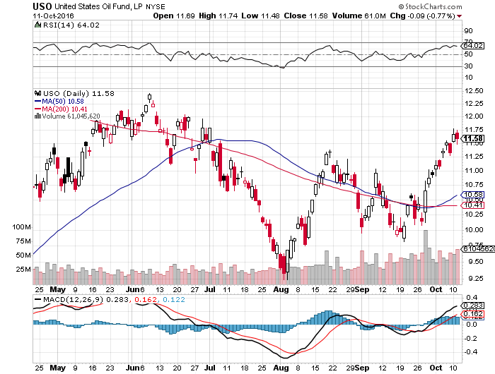
United States Oil Fund (USO) long the (USO) 11/$12.50-$14.00 vertical bear put spread

Slide 62
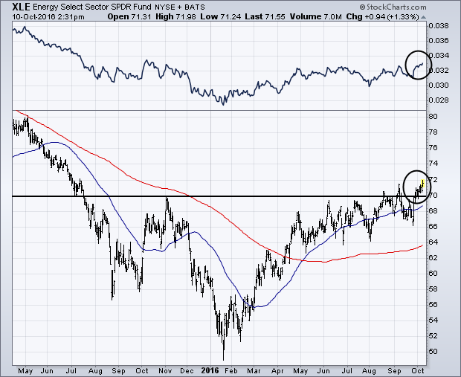
Energy Select Sector SPDR (XLE) (XOM), (CVX), (SLB), (KMI), (EOG), (COP)

Slide 63
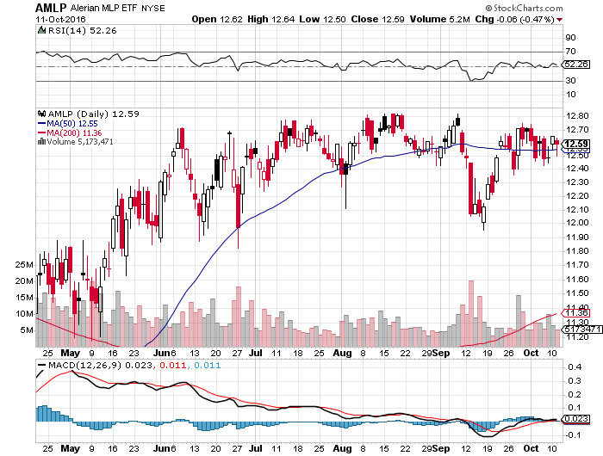
Alerian MLP ETF (AMLP)- Basket Approach is the Only Safe Play here

Slide 64
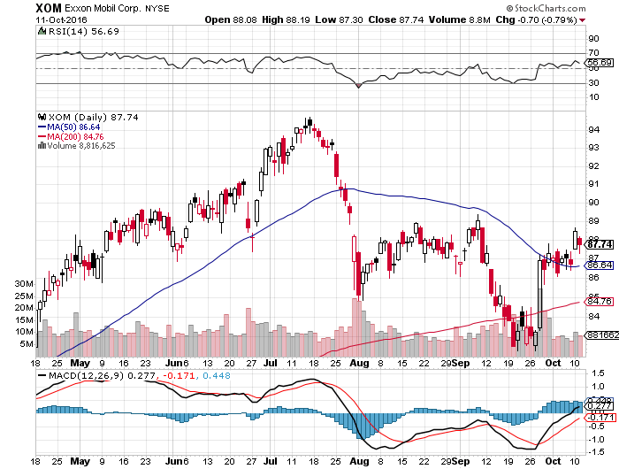
Exxon (XOM)-Dividend is Not Enough global warming + reserve valuation = ouch!

Slide 65

Occidental Petroleum (OXY)-

Slide 66

Natural Gas (UNG)-Bumping Against 2016 Highs

Slide 67

Copper-Capped on Over Supply

Slide 68

Precious Metals-
*The entire bull market in gold this year has been driven by negative interest rates in Europe *Overnight Euro rates at -.40% and gold at zero gives gold a real positive 0.40% return *Yesterday, rumors hit Europe that the ECB would cut QE from 80 billion a month to zero, ending negative interest rates *This triggered the biggest down day in gold in 3 years, off $43 *Gold traders went into this black swan with the biggest net long in futures in history, accelerating the downturn *I don’t think the QE rumor is true, so a “BUY” is setting up lower down *Wait for the final capitulation to step in

Slide 69

Gold (GLD)-Searching for a Bottom long 11/$112-$115 vertical bull call spread

Slide 70

Market Vectors Gold Miners ETF- (GDX)

Slide 71

Silver (SLV)-

Slide 72

Silver Miners (SIL)-

Slide 73

Agriculture-Still Awful
*Brazil announces record corn crop, kills nascent rally in prices, same to happen with soybeans *Hedge funds running heavy shorts in most ags *Prices are so low it is encouraging some bottom fishing *Failure to rally off of decade lows bodes ill for prices *Huge carry over crops threaten to spill falling prices into 2017 *No trade, there are NO fish to fry too low to initiate new shorts *My main job here is to keep traders away from this sector this year, and that approach has worked one more time

Slide 74

(CORN) – Testing New Lows!

Slide 75

(WEAT) New Lows!

Slide 76

(SOYB)-Bouncing Along the Bottom

Slide 77

Real Estate-Still Stalling
*August pending home sales down -2.4%, down third month in a row, thanks to shortage of supply *August home prices up 6.2% YOY, biggest jump in 11 years, with Washington, Oregon, and Colorado showing biggest gains *Investment funds continuing to pour into the market, but San Francisco is now over valued *Appraiser shortage forcing closing delays across the country *Refi’s pop on briefly falling rates *July Case Shiller -0.0% to 5.1% YOY, holding steady

Slide 78

April S&P 500/Case–Shiller Home Price Index +5.0% YOY, Portland, Seattle, Denver leaders

Slide 79

General Growth Properties (GGP) Yield Play Profit Taking

Slide 80

US Home Construction Index (ITB) (DHI), (LEN), (PHM), (TOL), (NVR) Another Rising Rate Victim

Slide 81

Trade Sheet So What Do We Do About All This?
*Stocks- stand aside-wait for a bigger dip to buy *Bonds-sell rallies on rate hike risk *Commodities-stand aside *Currencies- stand aside *Precious Metals –buy on big selloff days *Volatility-sell short spikes over $25, buy dips to $12 *The Ags –stand aside *Real estate-stand aside

Slide 82

To buy lunch tickets, please click http://members.madhedgefundtrader.com/category/luncheons/usa/ and select the city of your choice Next Strategy Webinar 12:00 EST Wednesday, October 26, 2016 San Francisco, CA
Good Luck and Good Trading!
Notes:
*

