Slide 1
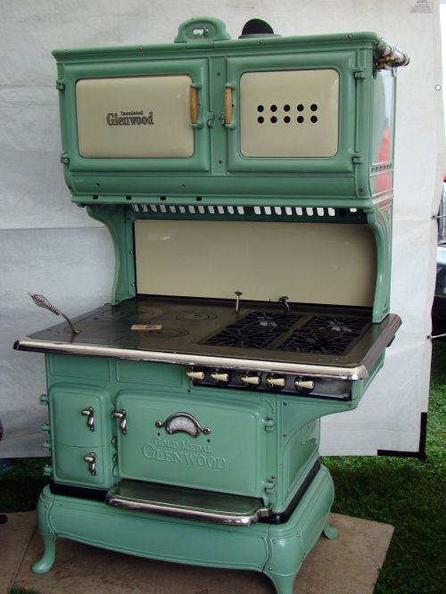
The Mad Hedge Fund Trader “Range Bound”
With John Thomas from San Francisco, CA, October 26, 2016 www.madhedgefundtrader.com
Notes:
*

Slide 2

In the Store Now for $49
Sectors and Stocks that Will Lead the Market for the Next 20 Years
https://members.madhedgefundtrader.com/roaring-twenties-book/

Slide 3

MHFT Global Strategy Luncheons Buy tickets at http://members.madhedgefundtrader.com/category/luncheons/usa/
Las Vegas, Nevada November 18

Slide 4

Trade Alert Performance Best 2 Weeks of the Past 12 months-New All Time High!!
*January +1.23% Final *July +0.67% Final *February +4.50% Final *August +7.52% Final *March -2.42% Final *September +0.27% Final *April -2.10% Final *October +8.87% MTD *May +4.38% Final *November 5.78% Final *June -0.56% Final *December -4.94% Final *2016 Year to Date +22.41% compared to 4.5% for the Dow Average *Trailing 1 year return +24.50%, +214.09% since inception, *Average annualized return of 36.58%

Slide 5
Portfolio Review Aggressive “NEUTRAL” Hedged Position
Risk On
World is Getting Better
(SPY) 11/$203-$208 call spread | 10.00%
(TLT) 11/$127-$130 call spread | 10.00%
Risk Off
World is Getting Worse
(SPY) 11/$220-$223 put spread | -10.00%
(TLT) 11/$137-$140 put spread | -10.00%
(IWM) 11/$125-$128 put spread | -10.00%
Total Net Position | -10.00%
Expiration P&L 28.99%

Slide 6
Paid Subscriber Trailing 12 Month Audited Return 24.00%

Slide 7
70 Months Since Inception Daily Audited Performance Averaged Annualized Return +36.58%

Slide 8

The Method to My Madness
*Running large, aggressive market “NEUTRAL” position with a 17 day view *”RISK ON” nearly balancing out “RISK OFF” *Democratic win is in the price *Buy “RISK ON” assets on every substantial dip, especially tech, the breakout is coming *A quarter point rate hike is in the price, keep working the range in (TLT) *Looking to cash in on big wins and go into cash ahead of the election, booking another great year

Slide 9

Short Term Strategy Outlook
*The election outcome is no longer unknown, only the magnitude *However, most markets will coil sideways until the election is a done deal, but now in a broader range with the House of Representatives in play, keep selling rallies and buying dips *Keep trading Volatility for quick in and out profits, buy every dip to $12 *A December rate rise will stay in bond prices *Oil will trade the $40-$52 range until the November OPEC meeting in Vienna *Gold trying to bottom here off of imminent rate peak *Although ags look awful, corn is looking temping

Slide 10

Mad Options Trader
*3 Huge consecutive trading months in the weekly options *Demand for the new $2,000 a year service has been overwhelming *Email Nancy in Customer Support at support@madhedgefundtrader.com and put “MOT Upgrade” in the subject line to add the service *Nancy will calculate a pro rata credit for the balance of your remaining subscription, and then bill you for your new subscription + MOT

Slide 11
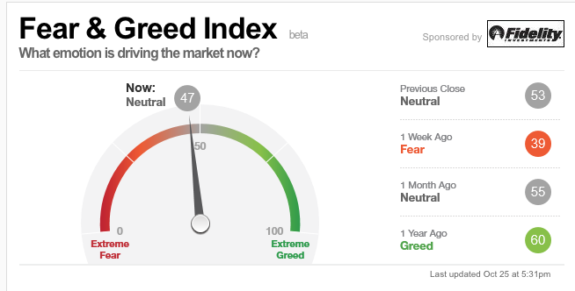
Risk Indicators Showing Neutral

Slide 12

The Day After the Election The Market Could Go Either Way
*With a Clinton win likely, will November 9 bring in billions of dollars of new equity allocations? *Or will it be a “Buy the rumor, sell the news”, with the election triggering a round of profit taking from a fully discounted event. *If it’s the latter, buy the post election 5% correction for a year end rally, with the focus on lagging sectors like banks, energy, and emerging markets *The outlier is a Trump win, with a 1% chance, would deliver a 10% down day in stocks on November 9th *The worst case is no conclusion, with the election thrown into the courts as happened in 2000, with the House of Representatives ultimately delivering a Republican win

Slide 13

The Global Economy-Earnings Bounce
*Fed Beige Book says economy continues at a modest pace from August to October, will continue, with an uptick in retail spending, strong dollar hurting exports, new construction mixed, energy stabilizing, 2017 will improve *Getting big earnings upside surprise is most tech stocks *Chinese Q3 GDP of 6.7% is pro growth, putting a 2017 global synchronized recovery back on the table *No move on ECB rates craters the Euro, German Consumer Confidence falls *Bank of Japan also keeps QE unchanged, but yen is topping here *Despite all this, US stocks and bonds are still the most attractive, highest yielding assets in the world, both should move to new highs *Gearing up for a post election earnings recovery and yearend stock market rally

Slide 14
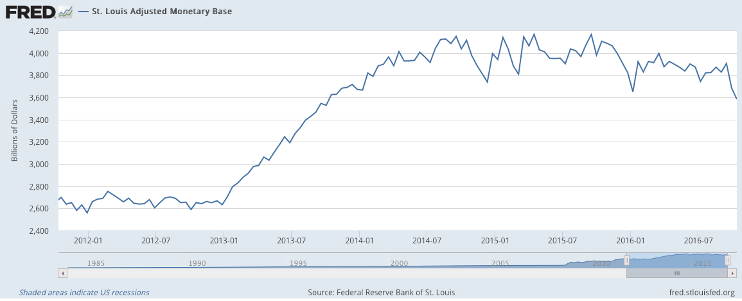
St. Louis Fed Adjusted Monetary Base

Slide 15
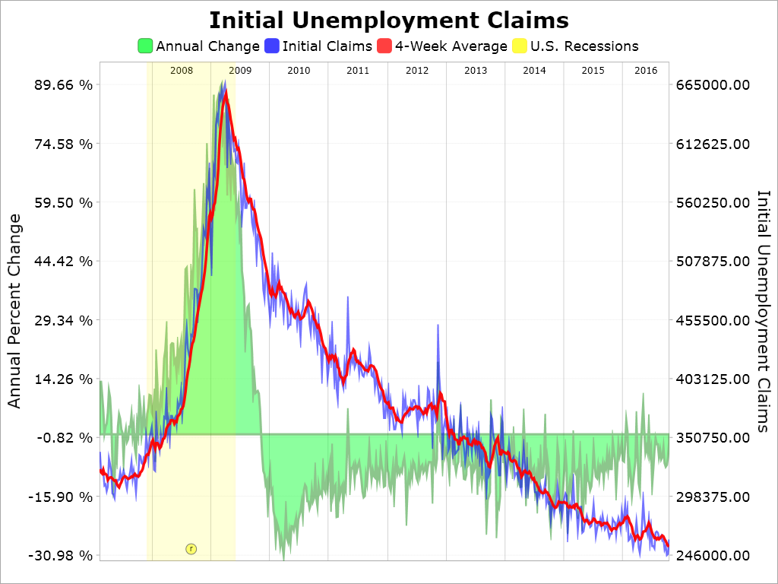
Weekly Jobless Claims –The Most Important Statistic +13,000 to 260,000-Lowest since 1973! The Downtrend Lives!-Show Me the Recession!

Slide 16

Bonds-Testing Top of the Range
*Bond selloff stalls at four month low, allowing us to bracket the new 1.54%-1.80% range with a short strangle and big profits *US Rates the highest in the developed world and increasing its lead *However, decent US corporate earnings are muting the rate rally *A December Fed interest rate hike is now fully priced in, so we should stall from here *German bunds recover to +0.03%, JGBs at -0.07%. BOJ vows to cap bond yields at 0% *All high beta fixed income now coiling sideways *Lower for longer view prevails globally

Slide 17
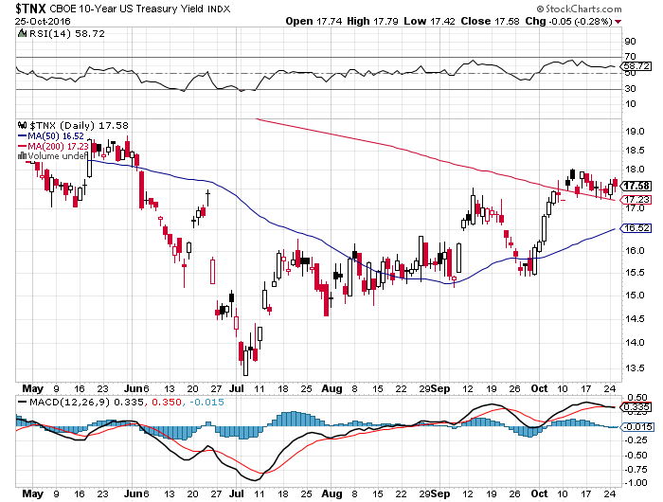
Ten Year Treasury Yield ($TNX) 1.76% Upside Breakout Fail

Slide 18
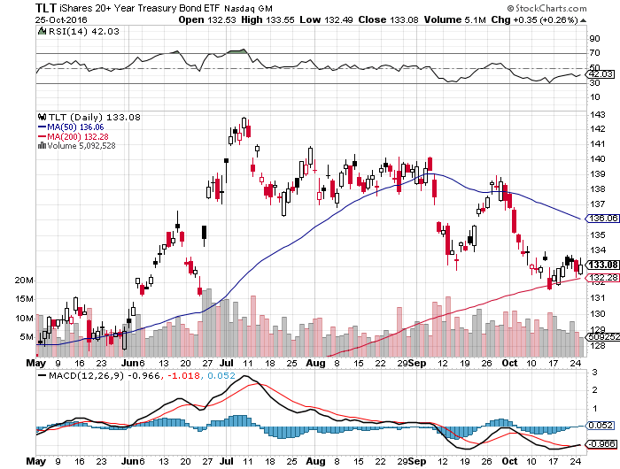
Ten Year Treasury ETF (TLT) 1.77% long 11/$137-$140 vertical bear put spread long 11/$127-$130 vertical bull call spread

Slide 19
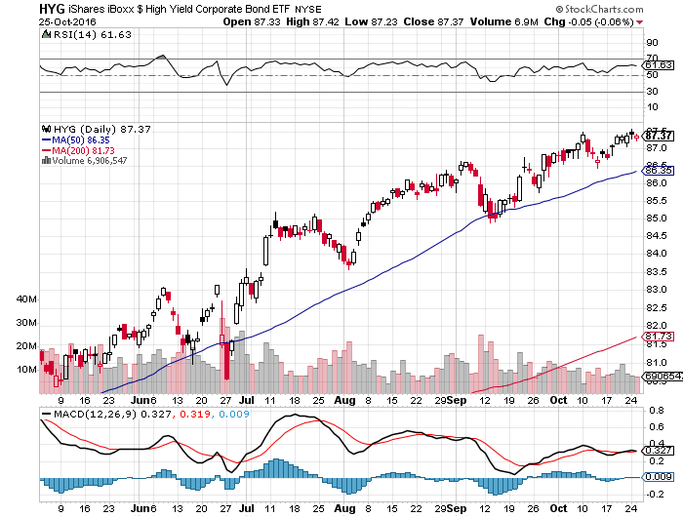
Junk Bonds (HYG) 5.46% Yield A Great Risk Coincident Indicator-”RISK ON” means new highs, buy all dips

Slide 20
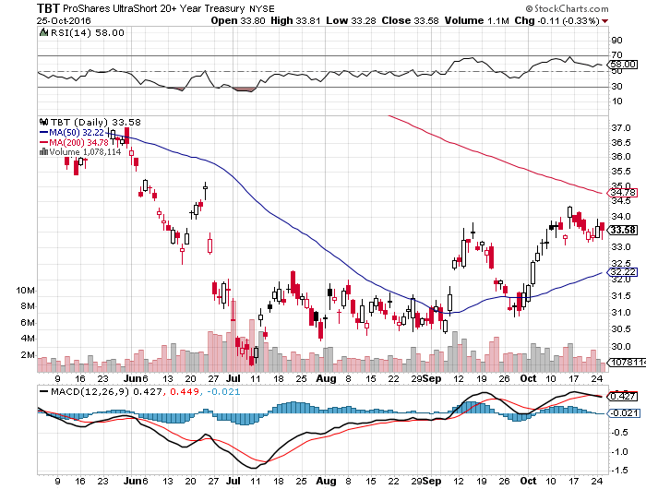
2X Short Treasuries (TBT)-At Last!

Slide 21
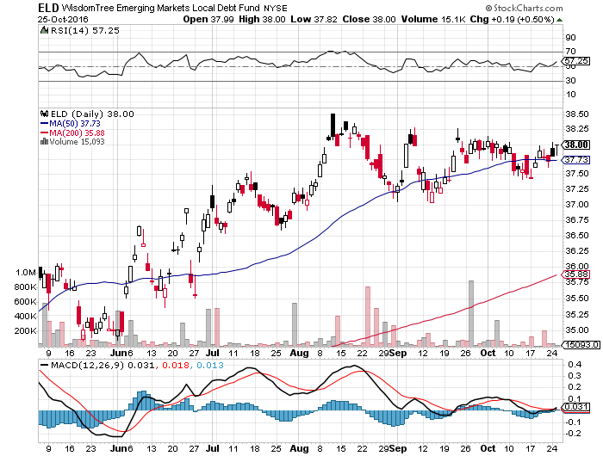
Emerging Market Debt (ELD) 4.65% Yield-

Slide 22
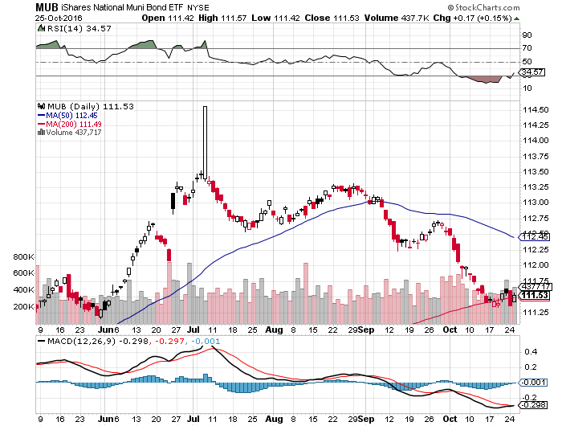
Municipal Bonds (MUB)-1.25% yield-New High Mix of AAA, AA, and A rated bonds

Slide 23

Stocks-Waiting Game
*Stocks are waiting for the Hillary win to come as promised, then will make their move *Despite bad news and repeated attempts to break down last week, the major indexes held *The 5% correction never became a 10% correction *The longer term focus is still positive, looking for an earnings recovery in 2017 *Look for tech to lead any rally *Homebuilders offering deep value ahead of a big demographic push *Commodity stocks breaking out across the board *The world is looking for a tradable dip to “BUY,” another one may be coming

Slide 24
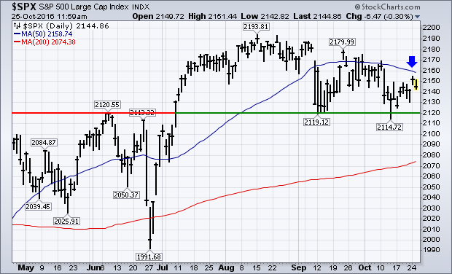
S&P 500-Holding Support A Sideways Move Going into the November Election followed by an upside breakout long 11/$220-$223 put spread-expires in 17 days long 11/$203-$208 call spread-expires in 17 days

Slide 25
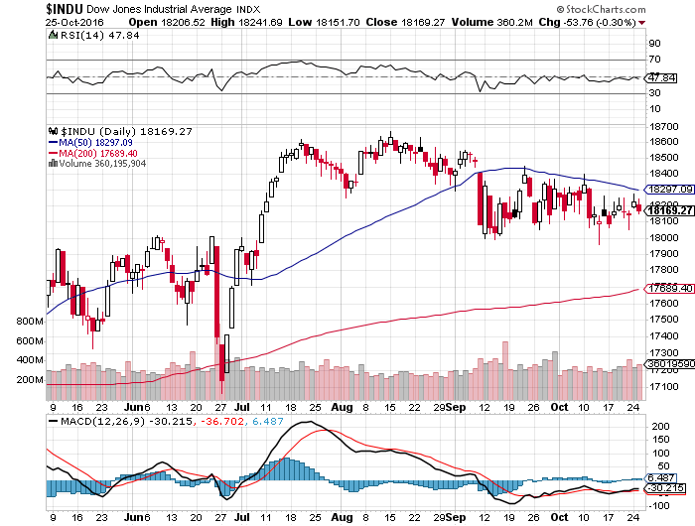
Dow Average-Range Bound

Slide 26
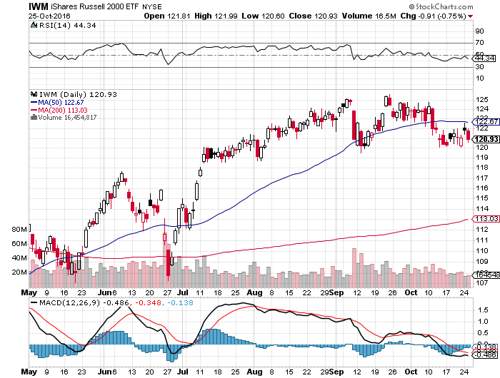
Russell 2000 (IWM)-The Glass Ceiling Long 11/$125-$128 vertical bear put spread-Expires in 17 days

Slide 27
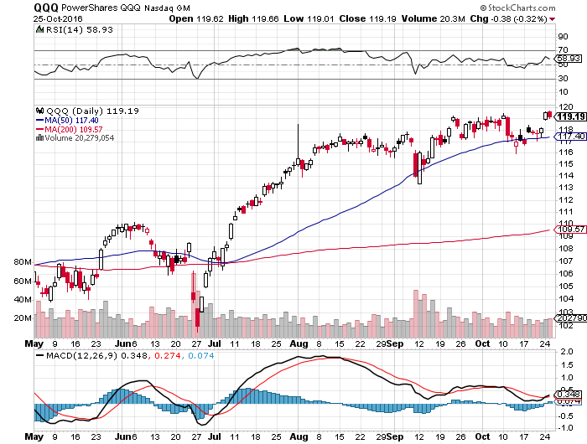
NASDAQ (QQQ)- Here is Your Leader

Slide 28
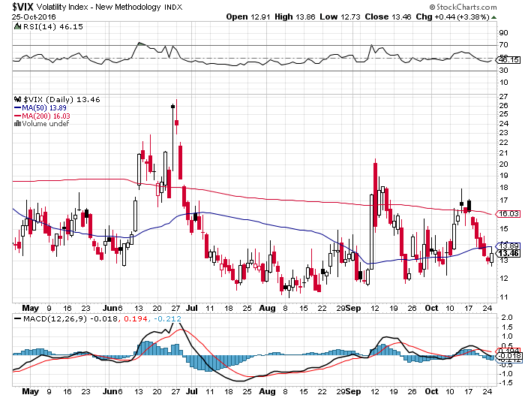
(VIX)-Quieting Down

Slide 29
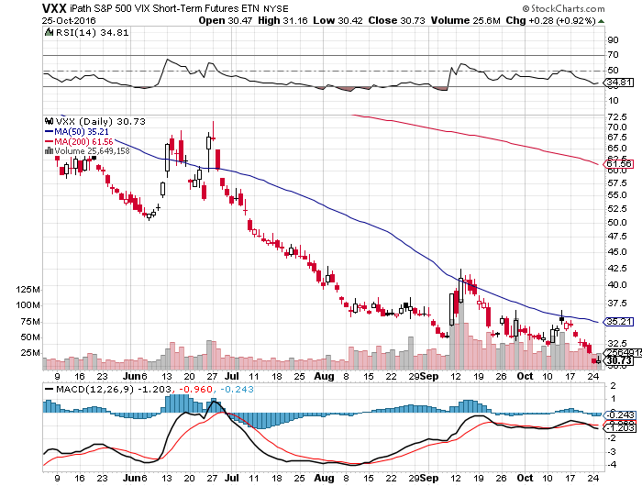
iPath S&P 500 VIX Short Term Futures ETN (VXX) took profits on long 9/$30-$33 vertical bull call spread took profits on long 10/$27-$30 call spread

Slide 30
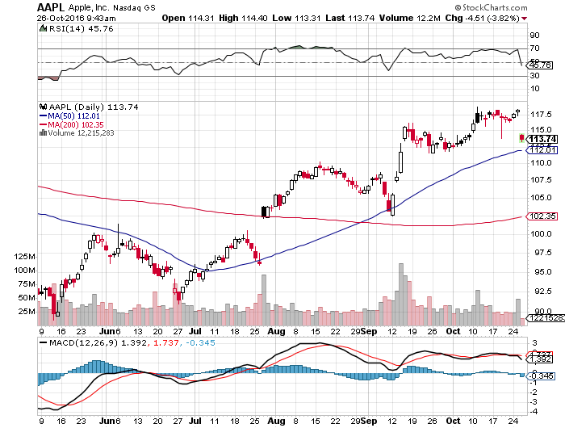
Apple (AAPL) –Buy the Rumor, Sell the News

Slide 31
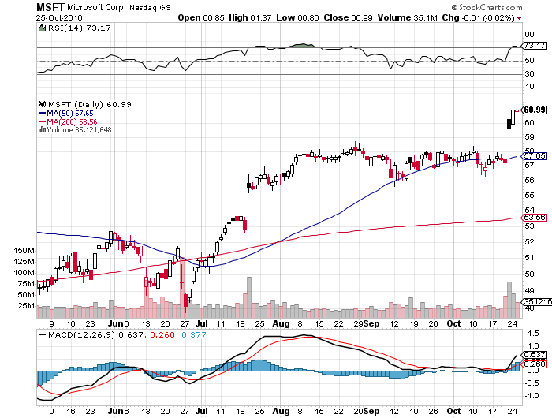
Microsoft (MSFT) Big Earnings Beat

Slide 32
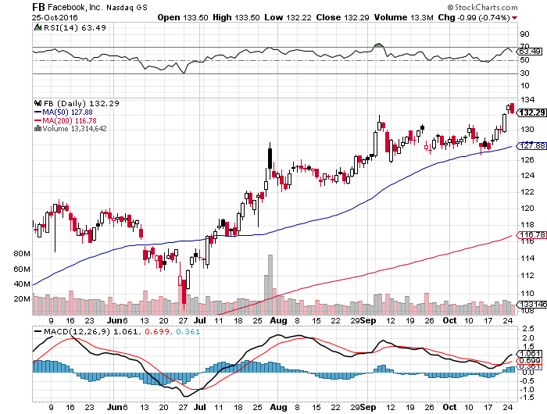
Facebook (FB)-

Slide 33
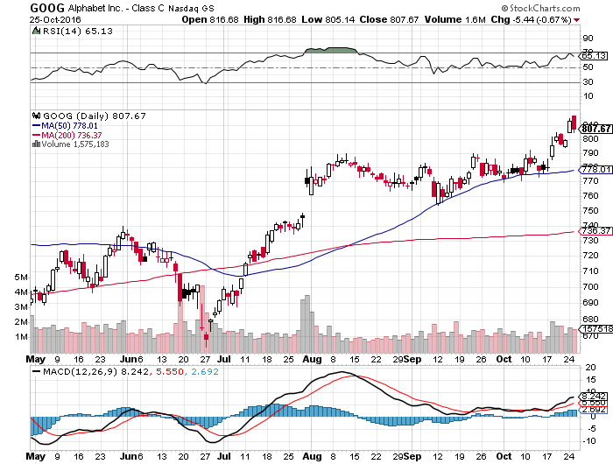
Alphabet (GOOG)-

Slide 34
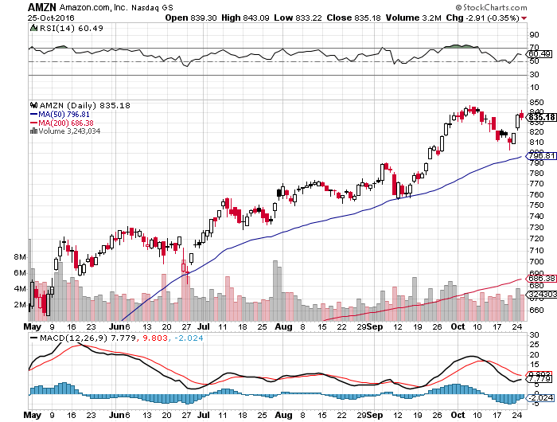
Amazon (AMZN)-

Slide 35
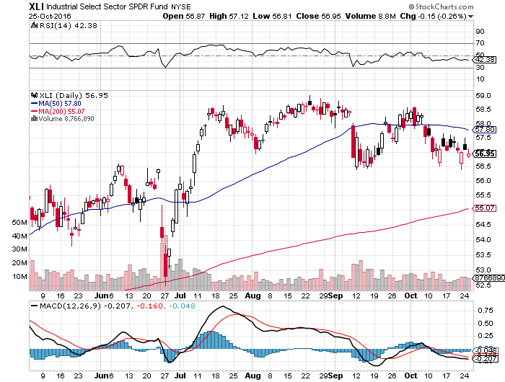
Industrials Sector SPDR (XLI)-Dragging (GE), (MMM), (UNP), (UTX), (BA), (HON)

Slide 36
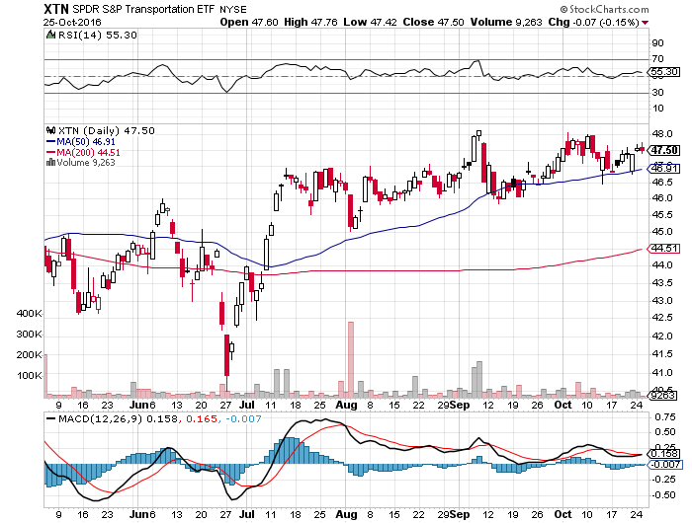
Transports Sector SPDR (XTN)-Upside Breakout Imminent (ALGT), (ALK), (JBLU), (LUV), (CHRW), (DAL)

Slide 37
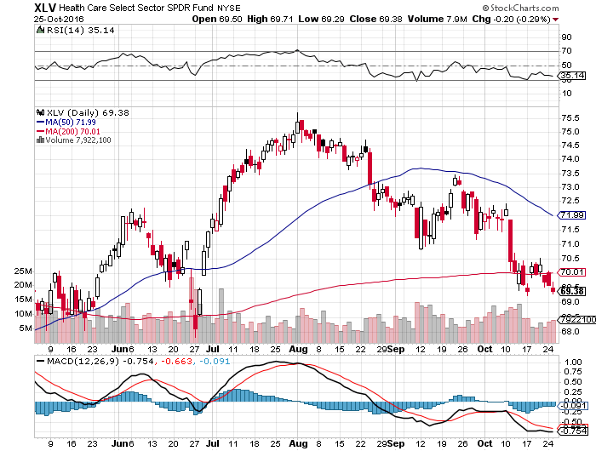
Health Care Sector SPDR (XLV), (RXL) (JNJ), (PFE), (MRK), (GILD), (ACT), (AMGN) November 8th Bottom?

Slide 38
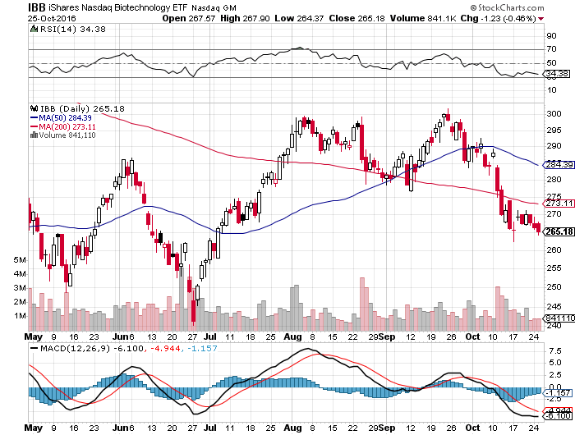
Biotech iShares (IBB)-A Political Football in 2016 Own for 2017

Slide 39
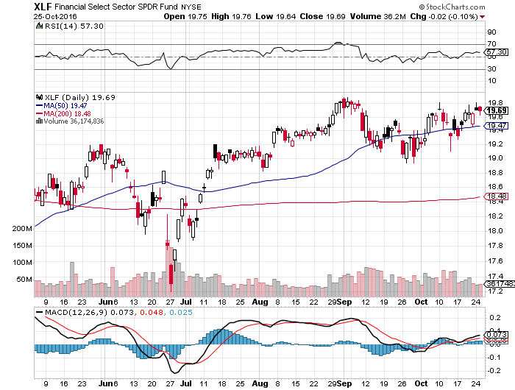
Financial Select SPDR (XLF)-Waiting for a Rate Rise (BLK/B), (WFC), (JPM), (BAC), (C), (GS)

Slide 40
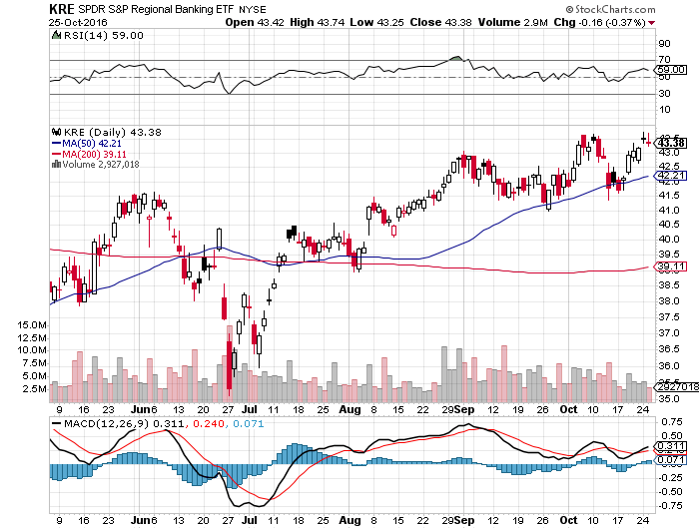
KRE Regional Bank ETF (KRE)-

Slide 41
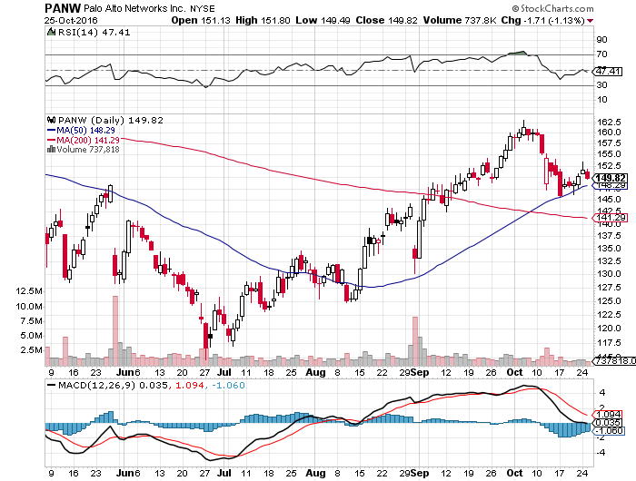
Palo Alto Networks (PANW)- Hacking Isn’t Going Away

Slide 42
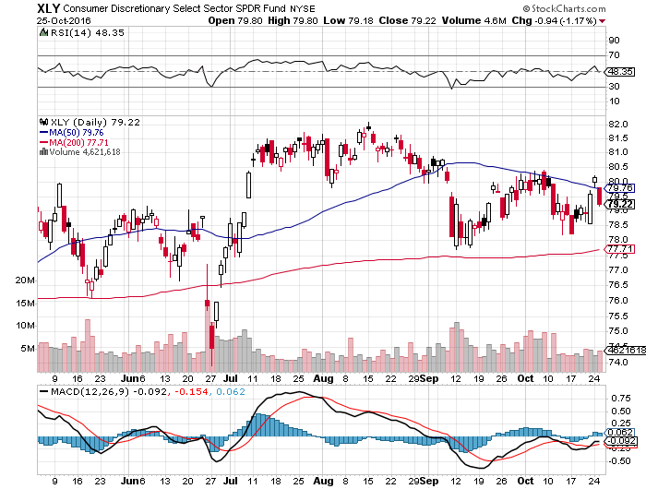
Consumer Discretionary SPDR (XLY) (DIS), (AMZN), (HD), (CMCSA), (MCD), (SBUX) A Major Leader of the Rally

Slide 43
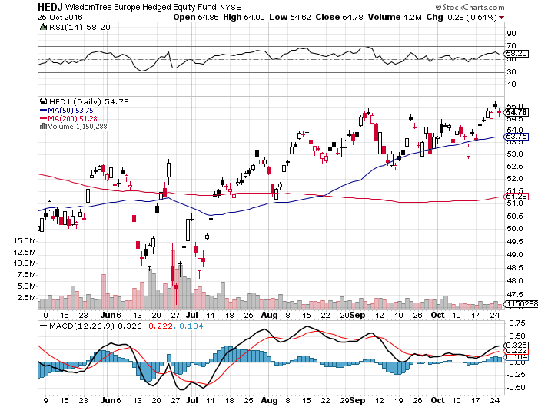
Europe Hedged Equity (HEDJ)-Cheap Euro Boost

Slide 44
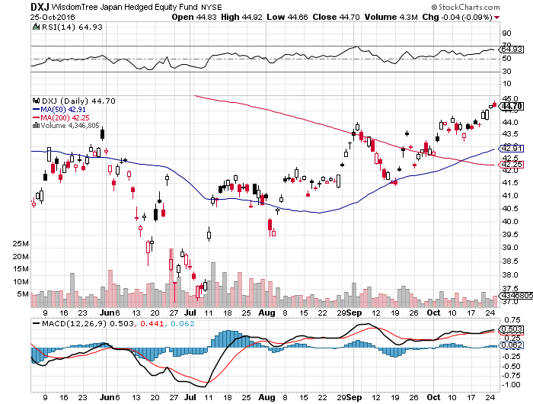
Japan (DXJ)-Cheap Yen Breakout

Slide 45
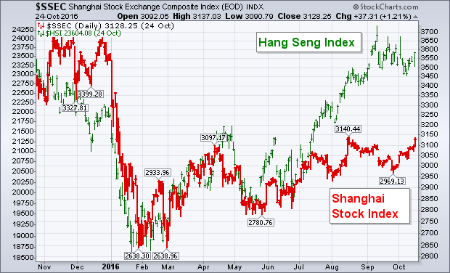
China ($SSEC)-Up Trend Says Global “RISK ON”

Slide 46
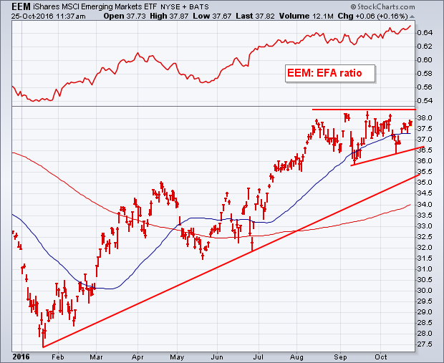
Emerging Markets (EEM)-Upside Breakout Coming

Slide 47

Foreign Currencies-Dollar Rally Continues
*Rising rate prospects cause $US to hit another new high *Yen fundamentals are as bad as ever, but charts now showing a chance of a long term breakdown, as Japan will be the last country in the world to raise rates *British pound hits new 31 year low as “Hard Brexit” talks speed up, could eventually hit parity and also become the first country to see inflation *Oil strength can’t offset $US strength, giving no help to Aussie (FXA) and Loonie (FXC), with failed EU trade agreement adding pain to (FXC) *Chinese Yuan (CYB) break to new lows

Slide 48
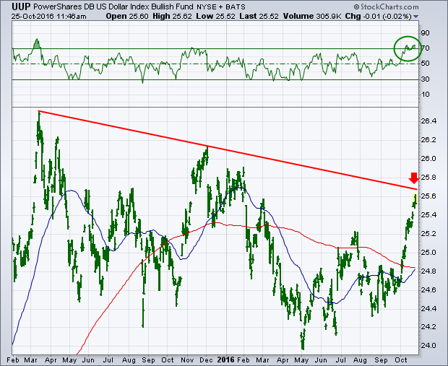
(UUP) Dollar Hits 8 Month High

Slide 49
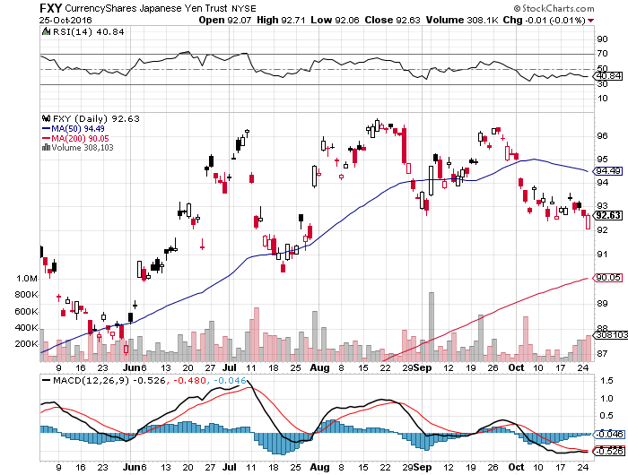
Japanese Yen (FXY)-Is This the Big One? took profits on long the 8/$97-100 put spread took profits on long the 9/$99-102 put spread

Slide 50
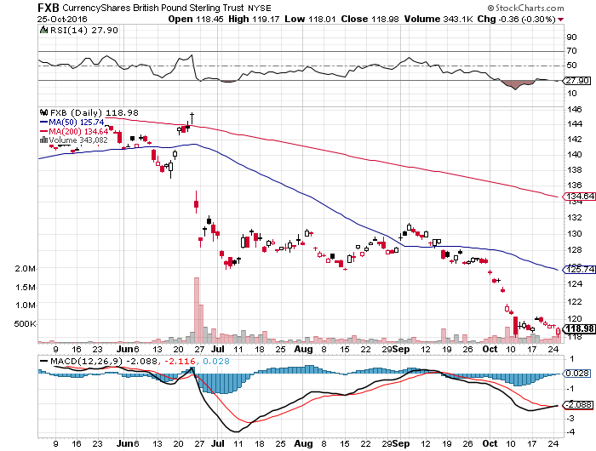
British Pound (FXB)-New Lows on Weakening Economy

Slide 51
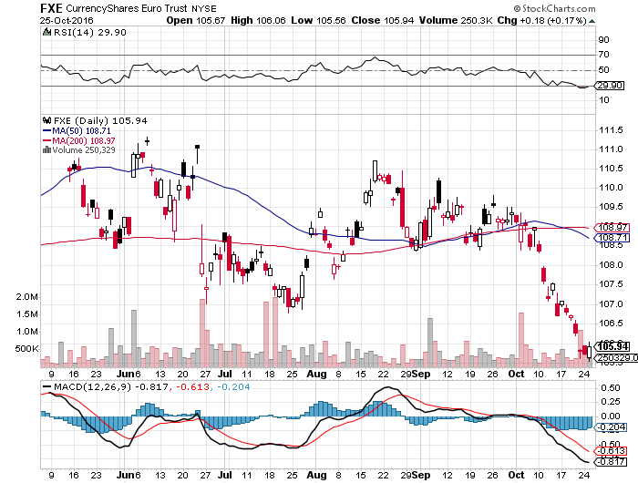
Euro ($XEU), (FXE), (EUO)- Bombs Away took profits on long the 9/$112-$115 vertical bear put spread

Slide 52
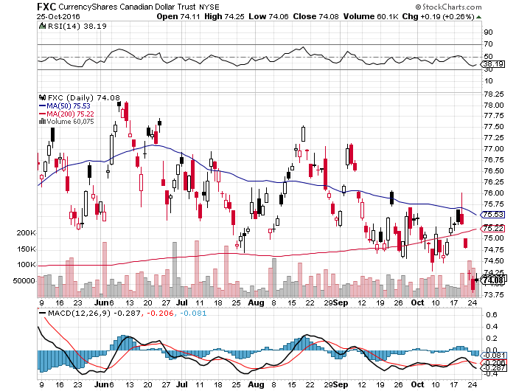
Canadian Dollar (FXC)-No Help from Oil

Slide 53
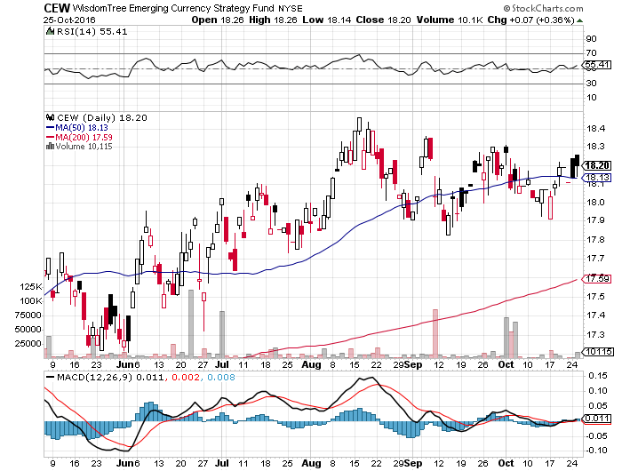
Emerging Market Currencies (CEW)

Slide 54
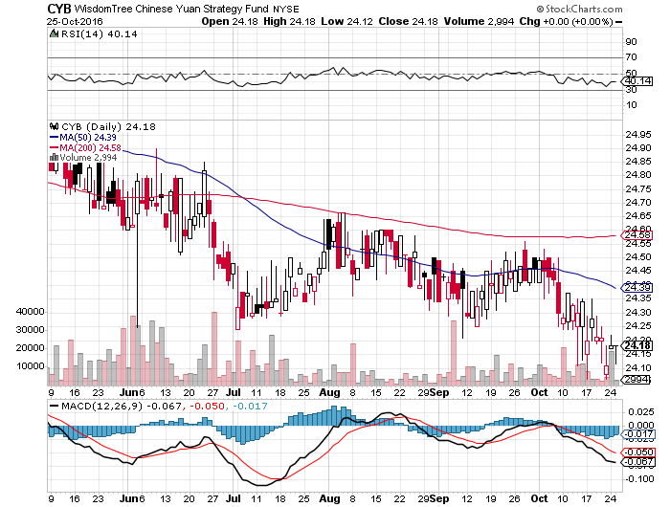
Chinese Yuan- (CYB)-Breakdown at Last

Slide 55

Energy-Cheap Talk
*Despite all the cheap talk, OPEC is still producing at record levels, with no sign of a pull back *Surprise inventory draw down of 5.3 million barrels when build was expected spikes prices temporarily *Chinese Q3 GDP growth of 6.7% also helps the supply demand picture *Contangos widening as producers bid for storage, signaling short term market top *Iran rushing to bring production up to 1970s peak of 4 million b/d before any negotiated caps kick in, now 3.9 million b/d, double sanctions levels *Baker Hughes rig count adds 5 to 511 for 16th gain in 17 weeks, fracker breakeven has fallen from $65 to $50 *Oil still stuck in $40-$52 range, but we are now testing the upside

Slide 56
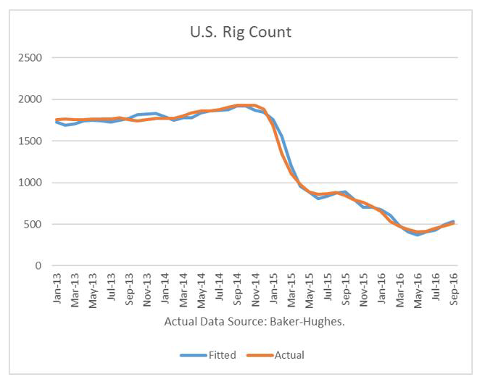

Slide 57
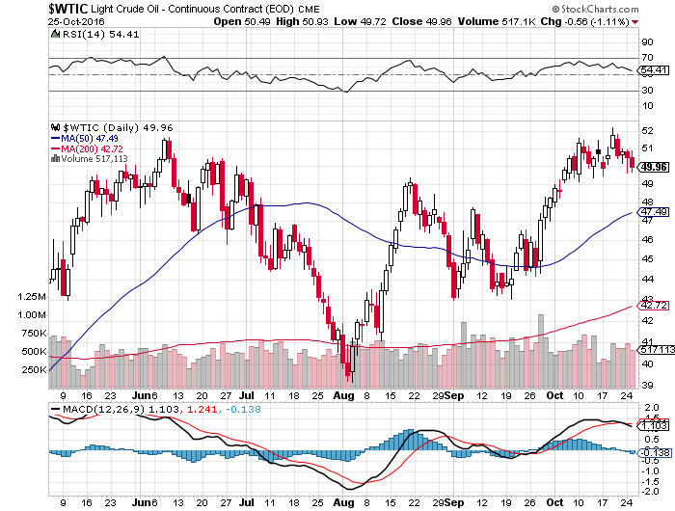
Oil-The Glut Returns

Slide 58
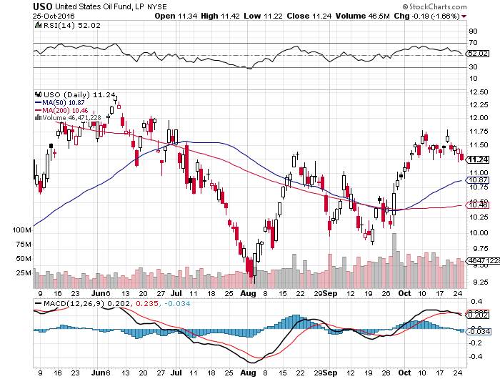
United States Oil Fund (USO) took profits on long the (USO) 11/$12.50-$14.00 vertical bear put spread

Slide 59
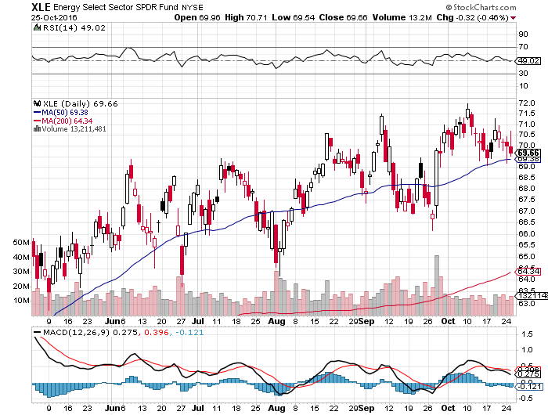
Energy Select Sector SPDR (XLE) (XOM), (CVX), (SLB), (KMI), (EOG), (COP)

Slide 60
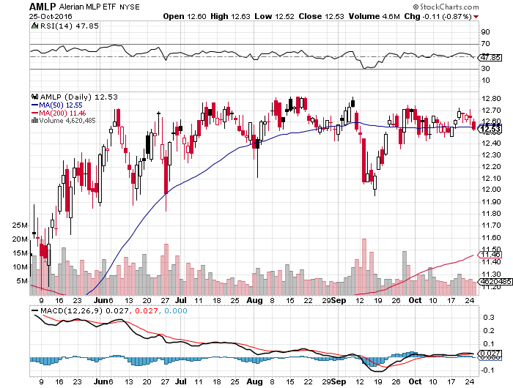
Alerian MLP ETF (AMLP)- Basket Approach is the Only Safe Play here

Slide 61
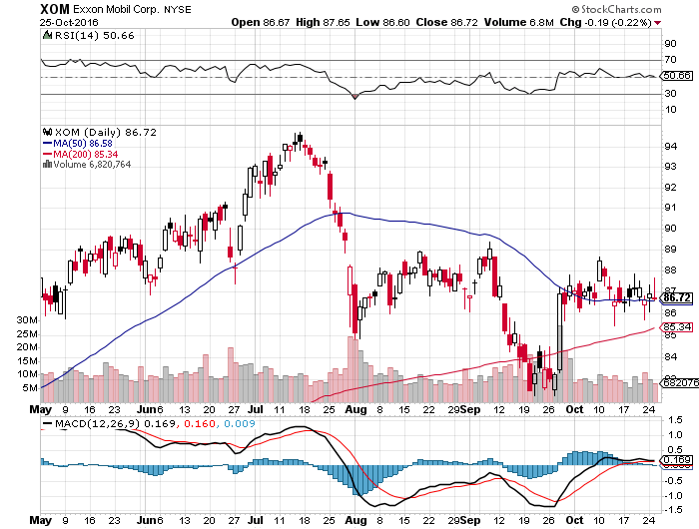
Exxon (XOM)-Dividend is Not Enough global warming + reserve valuation = ouch!

Slide 62
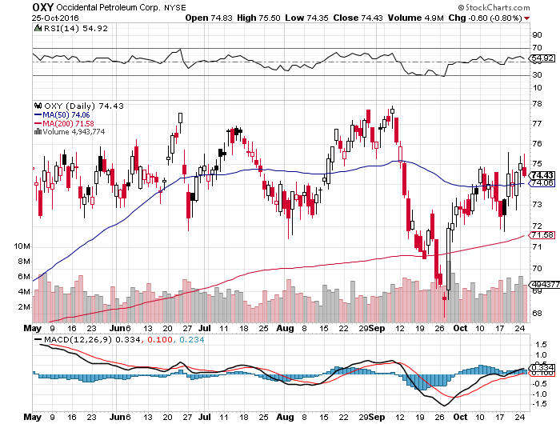
Occidental Petroleum (OXY)-

Slide 63
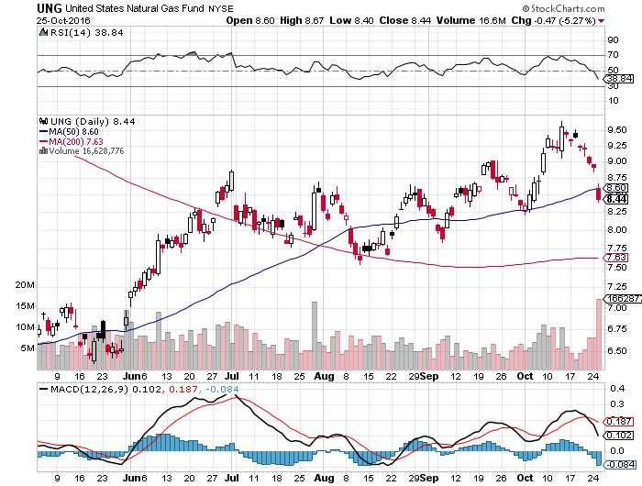
Natural Gas (UNG)-Bumping Against 2016 Highs

Slide 64
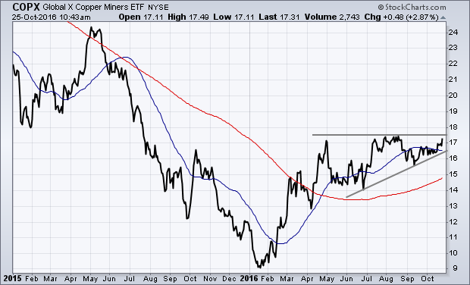
Copper (COPX)-Upside Breakout Candidate

Slide 65
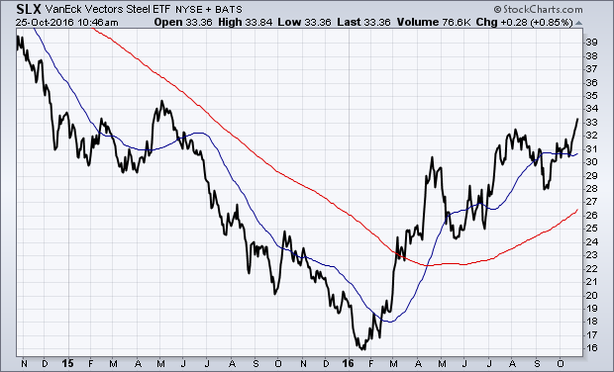
Van Eck Vectors Steel ETF (SLX)-Upside Done!

Slide 66

Precious Metals-
*Chinese and Indian buyers step into the gold market at last, Indian imports double to 65 million tonnes in one month *Gold rallies, but the move is so far unimpressive *Overnight Euro rates at -.40% and gold at zero gives gold a real positive 0.40% return *Gold is essentially acting as a bond now, as interest rate differentials are now the largest price driver, is a rare event in precious metals *Wait for the for another capitulation day to step in, gold is the “classic stairs up, elevator down” asset

Slide 67

Gold (GLD)-Searching for a Bottom took profits on long 11/$112-$115 vertical bull call spread

Slide 68

Market Vectors Gold Miners ETF- (GDX)

Slide 69

Silver (SLV)-

Slide 70

Silver Miners (SIL)-

Slide 71

Agriculture-Hints of a Bottom
*Rains finally put a dent in a huge fall harvest, boosting corn prices *Corn charts hinting at medium term bottom, time to buy? *Corn harvest now at 61%, 1% below 5 year average *Winter wheat plantings 1% below 5 year average helping prices there *Huge carry over crops threaten to spill falling prices into 2017 *As Ag prices are primarily weather driven, they usually are totally uncorrelated with financial assets, making them a great portfolio hedge

Slide 72

(CORN) – Shall We Buy?

Slide 73

(WEAT) New Lows!

Slide 74

(SOYB)-Bouncing Along the Bottom

Slide 75

Real Estate-Still Stalling
*September Existing Home Sales up +3.2%, up 0.6% YOY *Only 2.4 million homes for sale, down -6.8% YOY, creating a severe shortage, normally rises in the fall, and predicts a very hot market in the spring *Median home price up +5.6% YOY *Sales of homes over $1 million up 12% YOY *First time buyers see biggest jump in four years to 34%, still low by historical standards *Millennials ramping up buying make the homebuilders a huge buy long term *Refis plunged on sharply rising rates *August Case Shiller -0.0% to 5.1% YOY, holding steady

Slide 76


Slide 77

April S&P 500/Case–Shiller Home Price Index +5.0% YOY, Portland, Seattle, Denver leaders

Slide 78

General Growth Properties (GGP) Yield Play Profit Taking

Slide 79

US Home Construction Index (ITB) (DHI), (LEN), (PHM), (TOL), (NVR) Another Rising Rate Victim-But Becoming a favorite Sector to Buy

Slide 80

Trade Sheet So What Do We Do About All This?
*Stocks- keep working the range *Bonds-sell rallies on rate hike risk *Commodities-buy dips *Currencies- stand aside *Precious Metals –buy on big selloff days *Volatility-sell short spikes over $25, buy dips to $12 *The Ags –stand aside *Real estate-stand aside

Slide 81

To buy lunch tickets, please click http://members.madhedgefundtrader.com/category/luncheons/usa/ and select the city of your choice Next Strategy Webinar 12:00 EST Wednesday, November 9, 2016 San Francisco, CA
Good Luck and Good Trading!
Notes:
*

