Slide 1
Mad Day Trader
Bill Davis
Webinar – November 16, 2016

Slide 2
Indexes

Slide 3
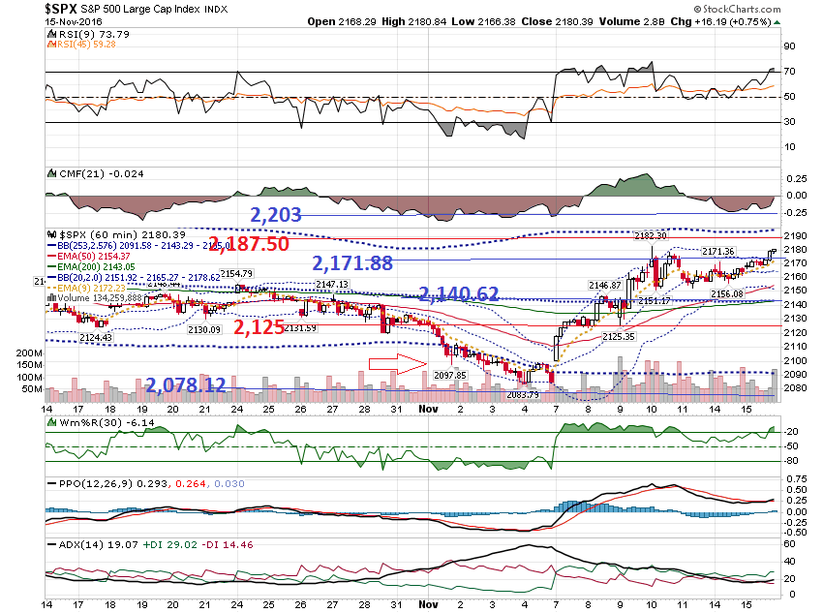

Slide 4
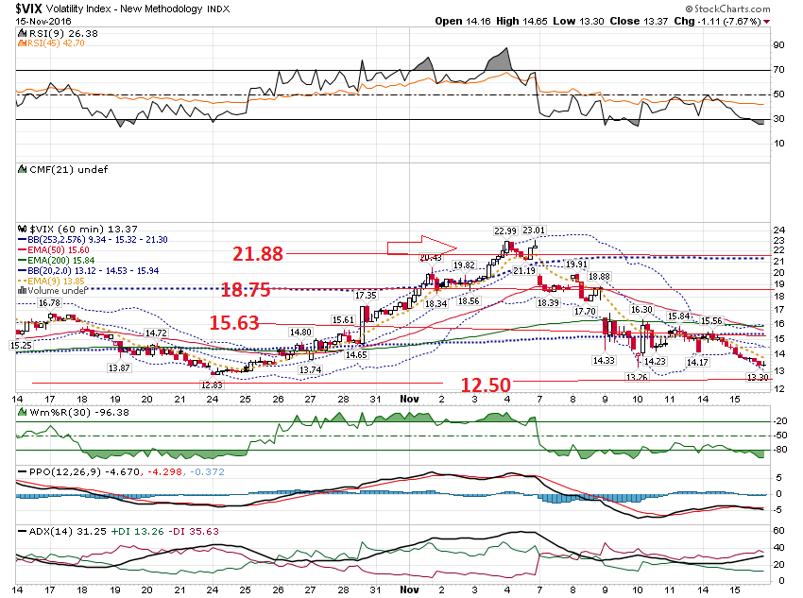

Slide 5
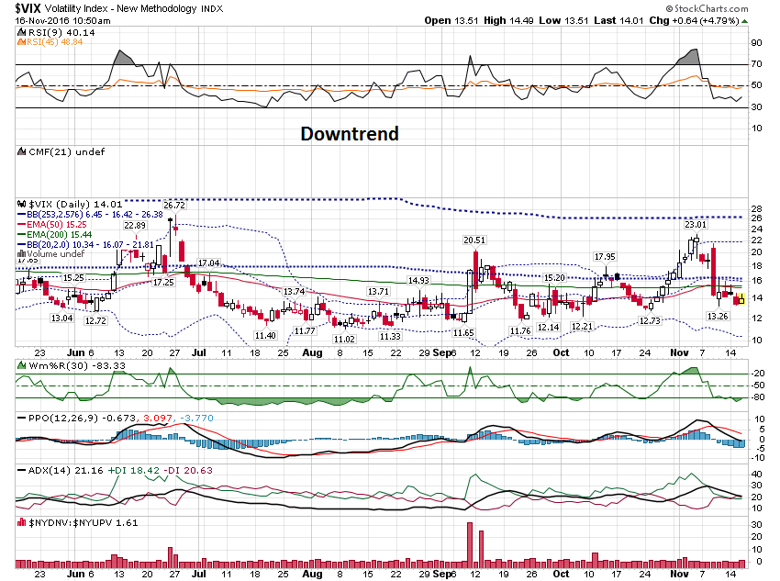

Slide 6
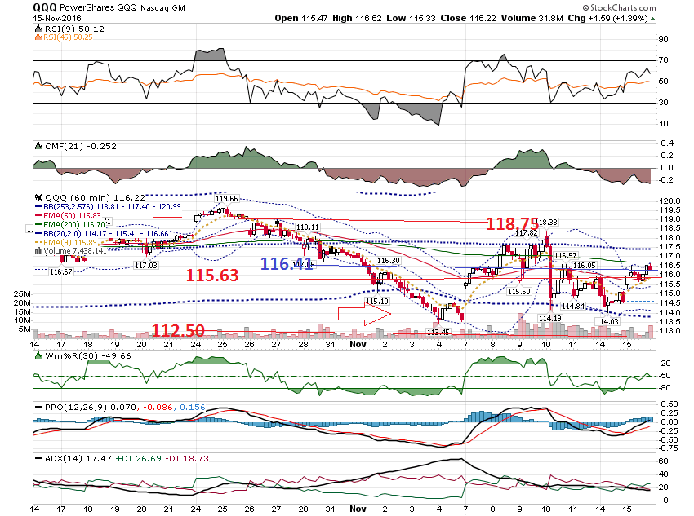

Slide 7
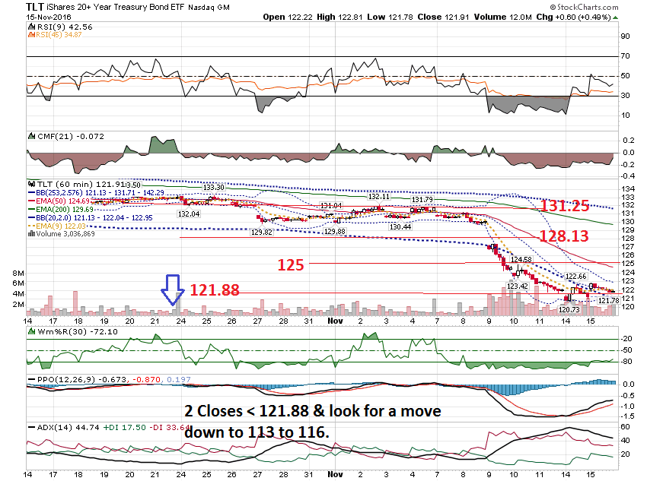

Slide 8
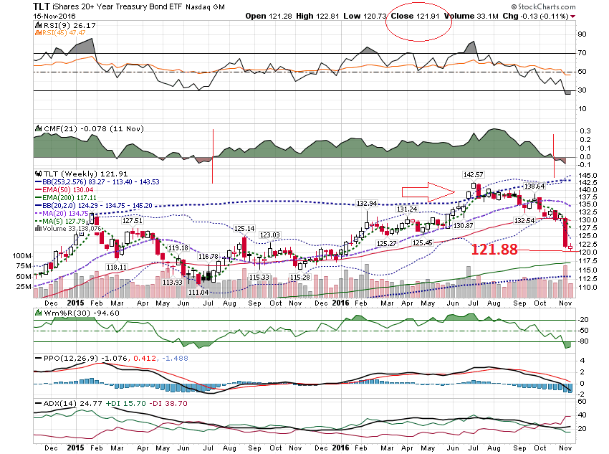

Slide 9
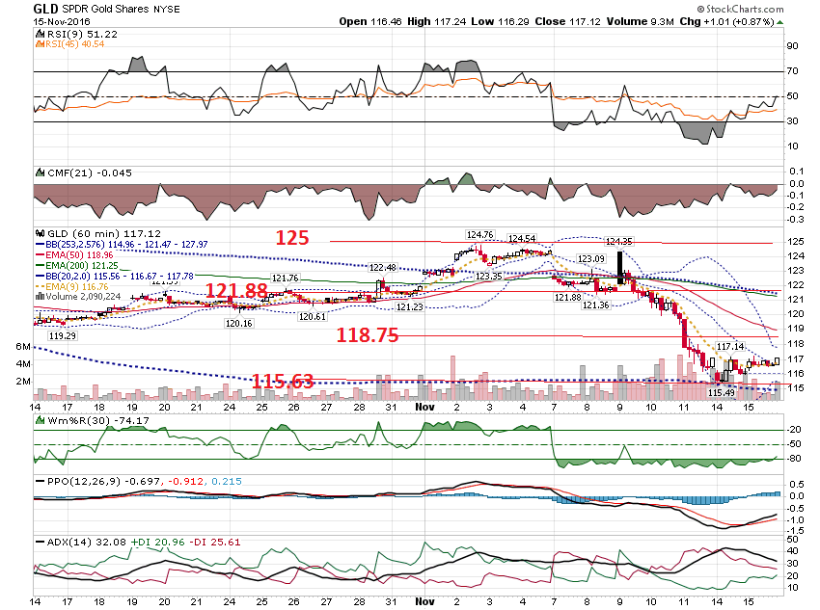

Slide 10
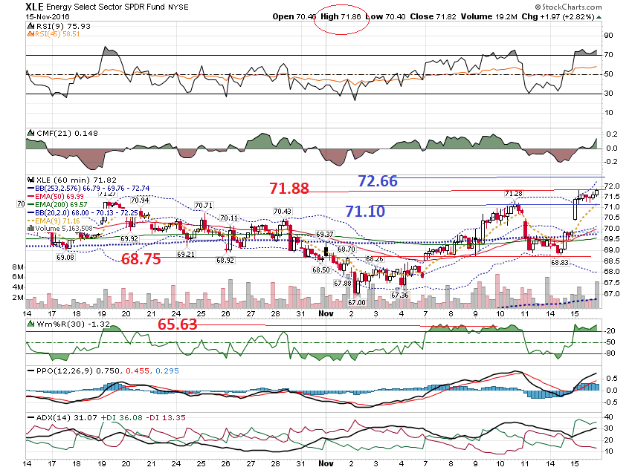

Slide 11
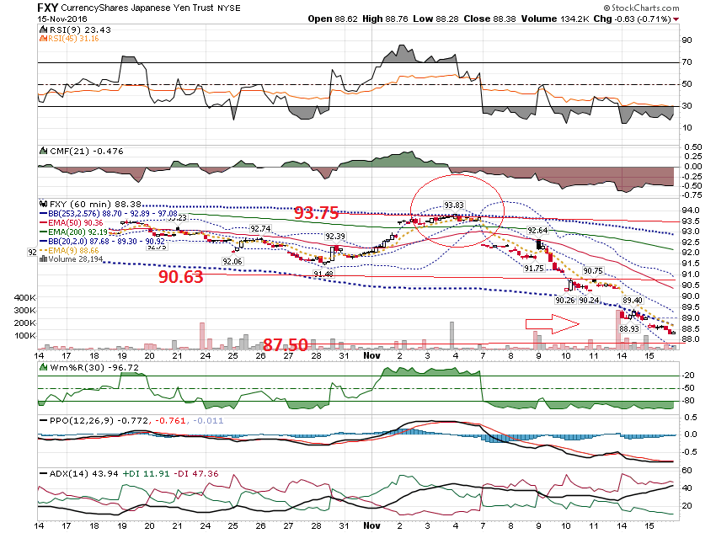

Slide 12
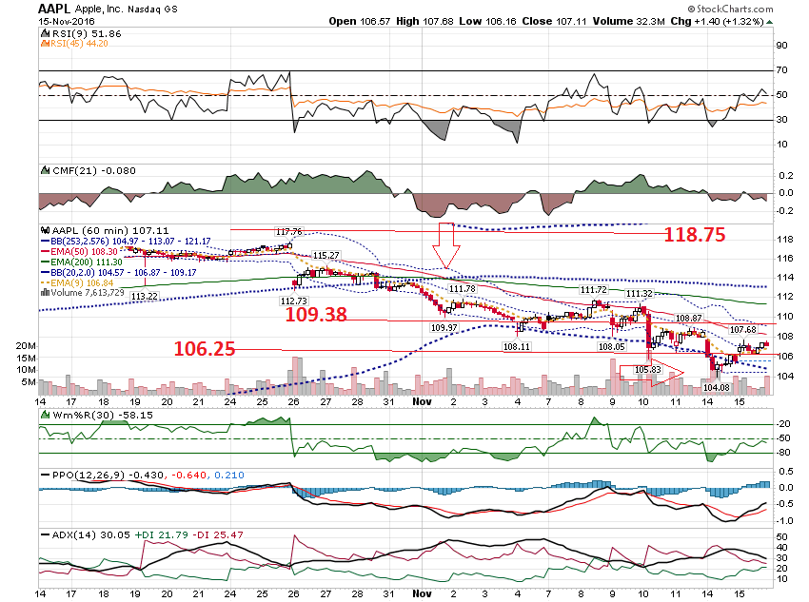

Slide 13
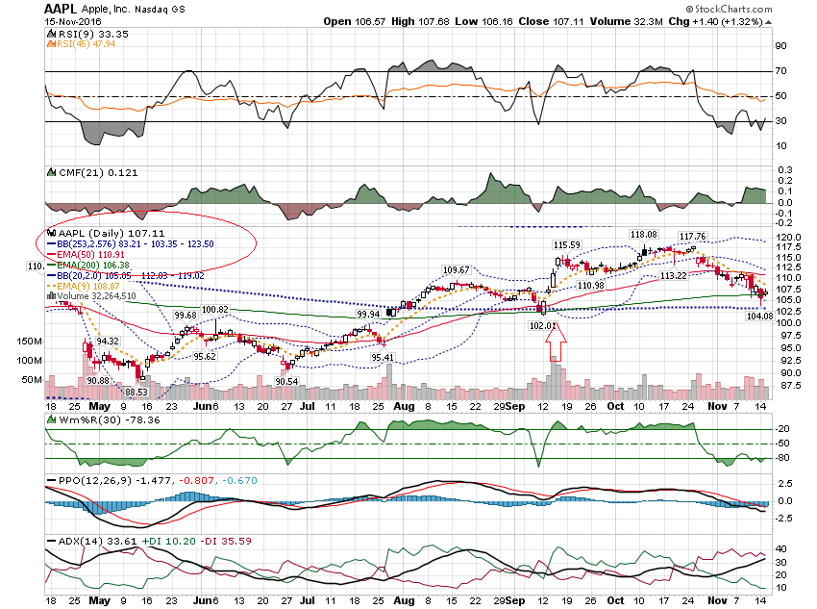

Slide 14
This came from a fellow member: “Could you sum up your essential key pattern directives in 2 or 3 short key statements that give very promising clues to the best signs that warn or indicate coming direction.”

Slide 15
I am going to answer this by sharing high probability set ups over the next few webinars.

Slide 16
First set up: Price exceeds the Upper Extreme Bollinger Band

Slide 17
A violation of the upper band shows EXTREME Strength and a retest is usually expected.

Slide 18
The EXCEPTION to this is if the HIGHER timeframe is in a downtrend. If that is the situation, then shorting ABOVE the upper band on the LOWER timeframe is worth the risk.

Slide 19
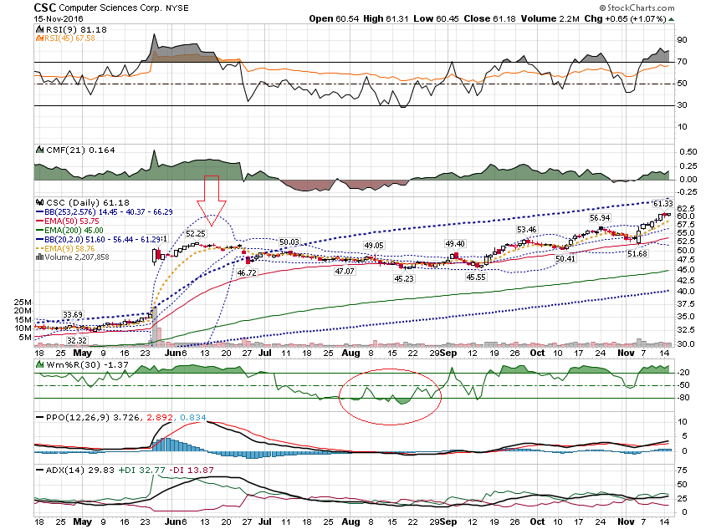

Slide 20
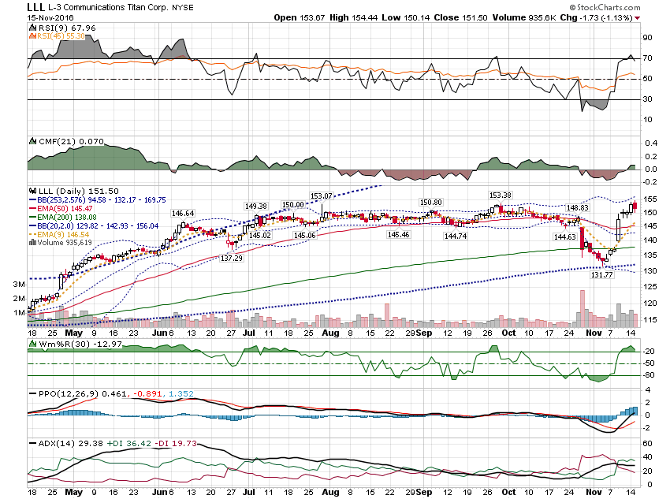

Slide 21
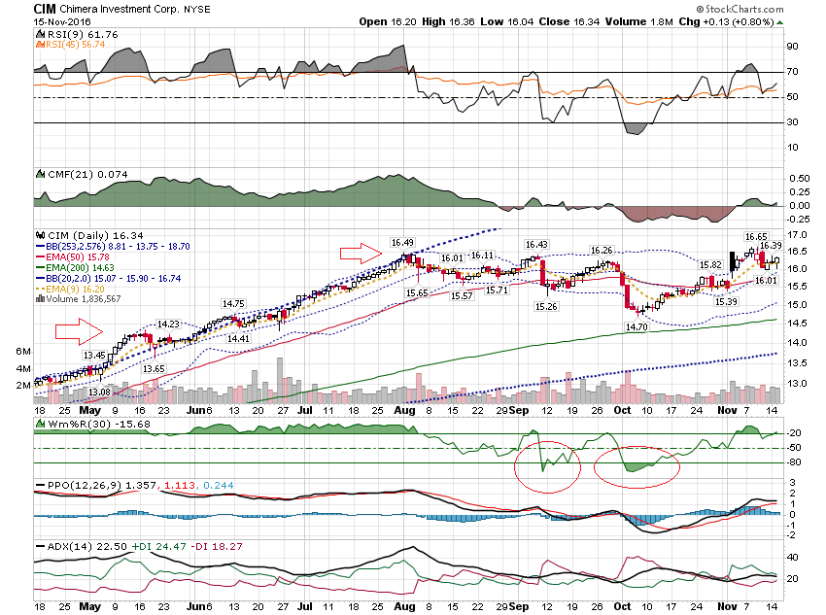

Slide 22
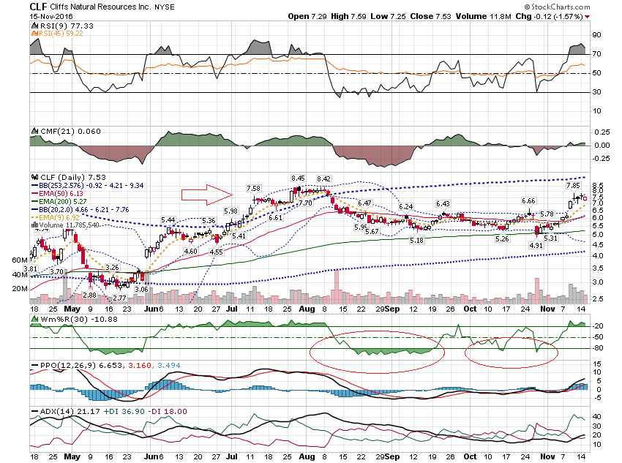

Slide 23
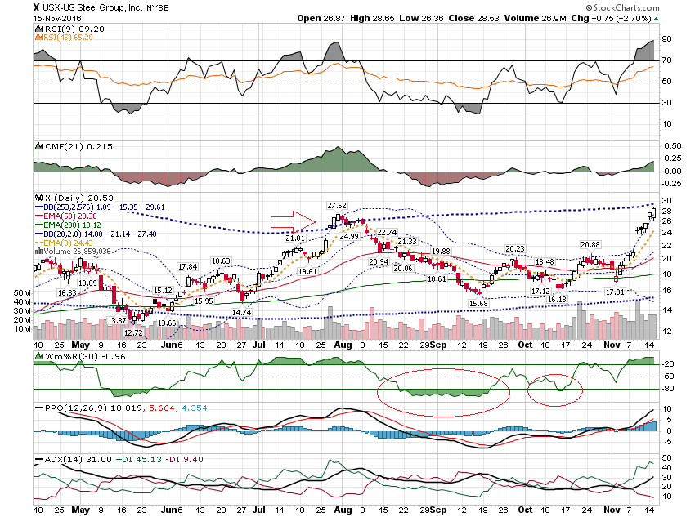

Slide 24
Let’s look at some other stocks …

Slide 25
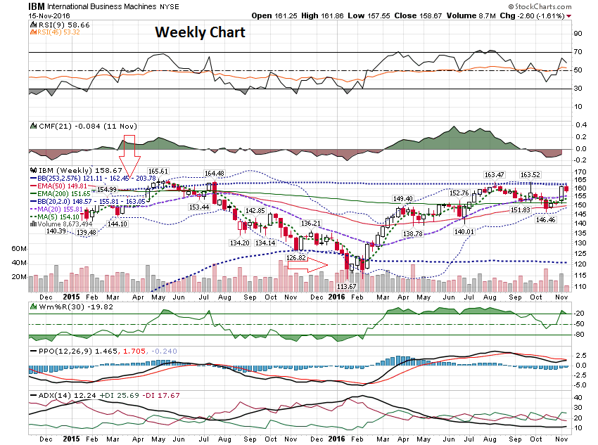

Slide 26
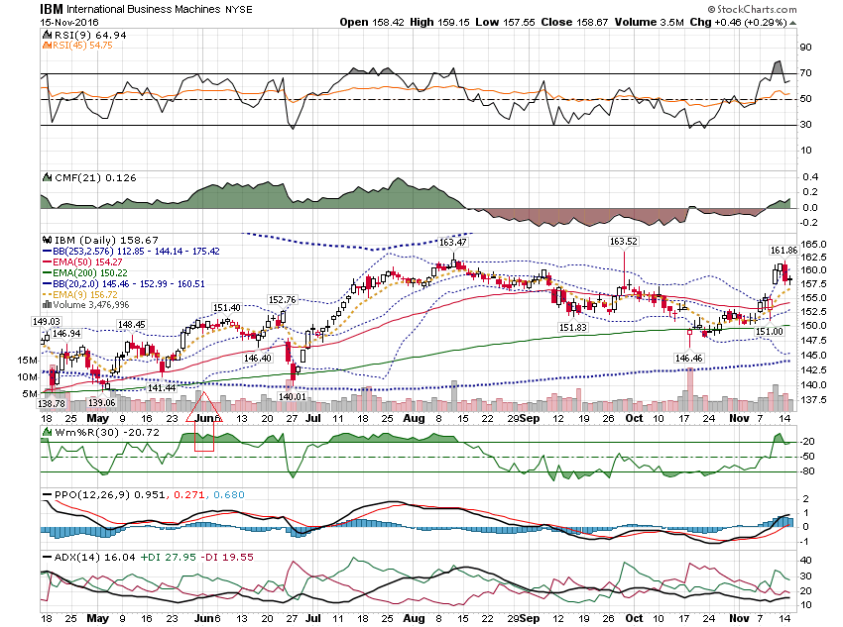

Slide 27
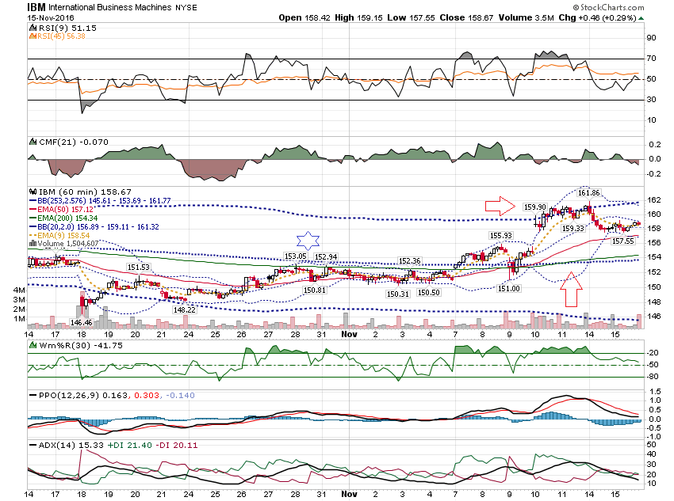

Slide 28
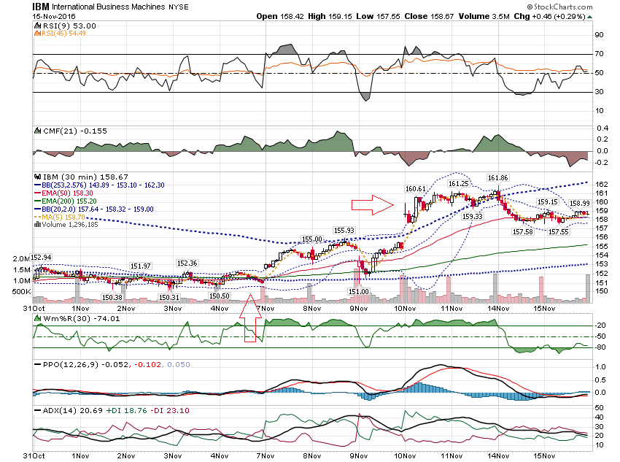

Slide 29
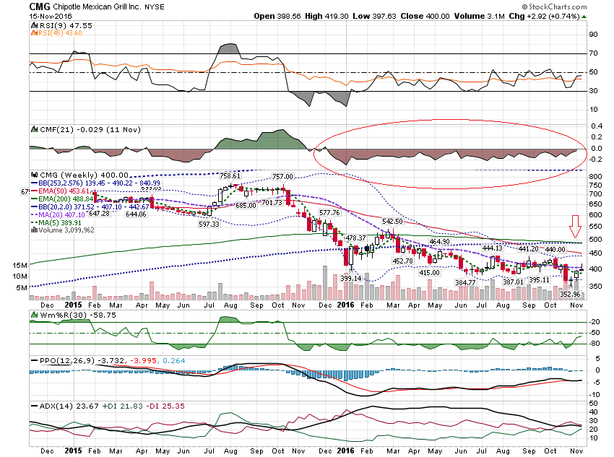

Slide 30
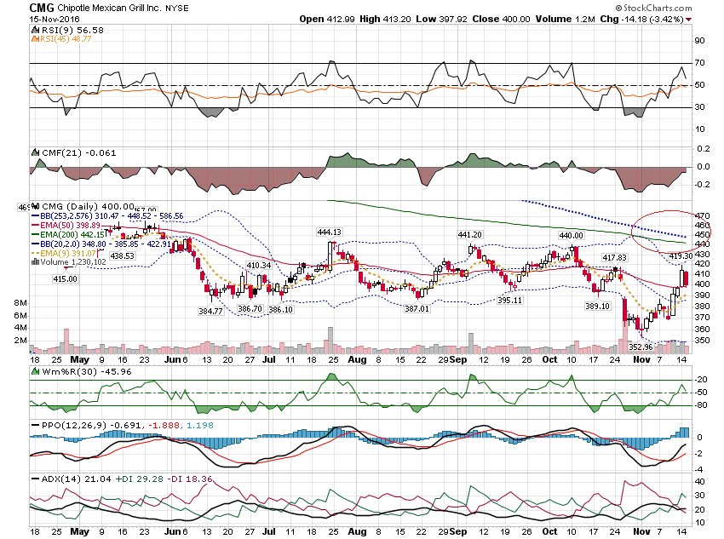

Slide 31
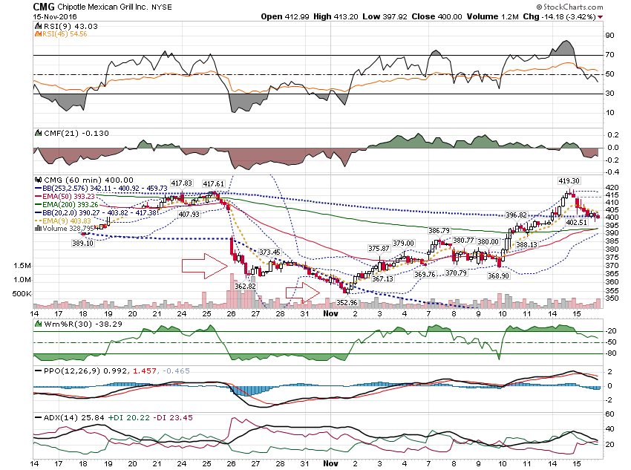

Slide 32
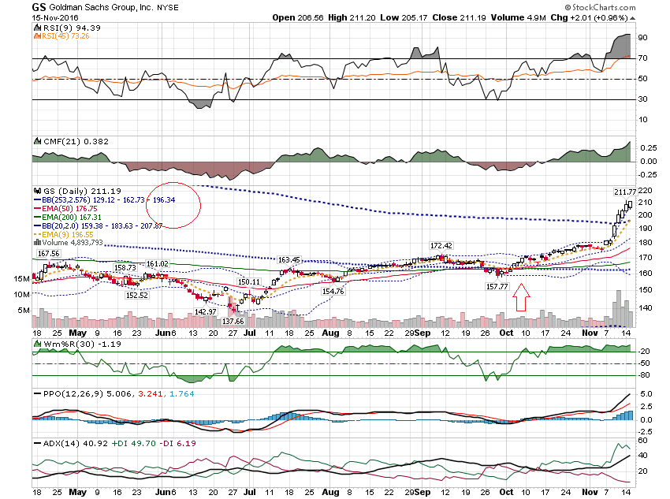

Slide 33
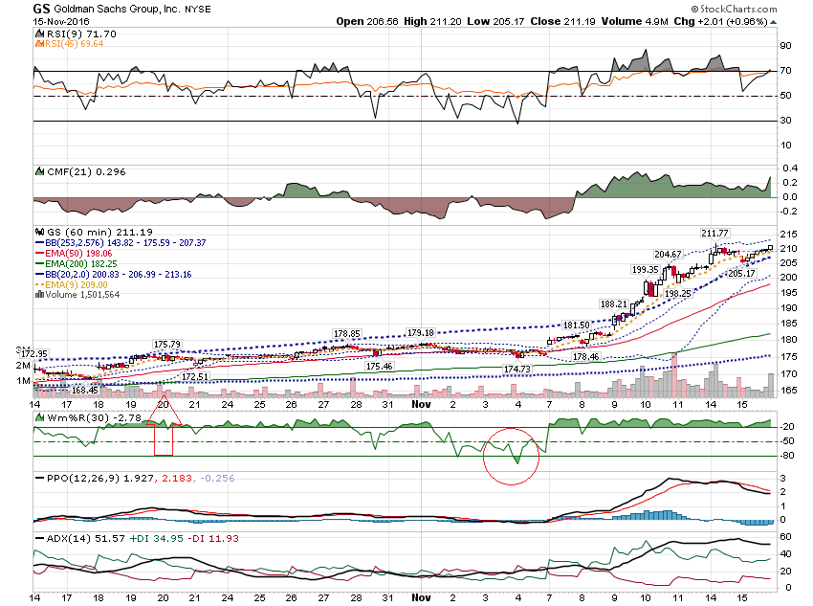

Slide 34
Thanks for watching! Bill Davis Mad Day Trader November 16, 2016 davismdt@gmail.com

