Slide 1
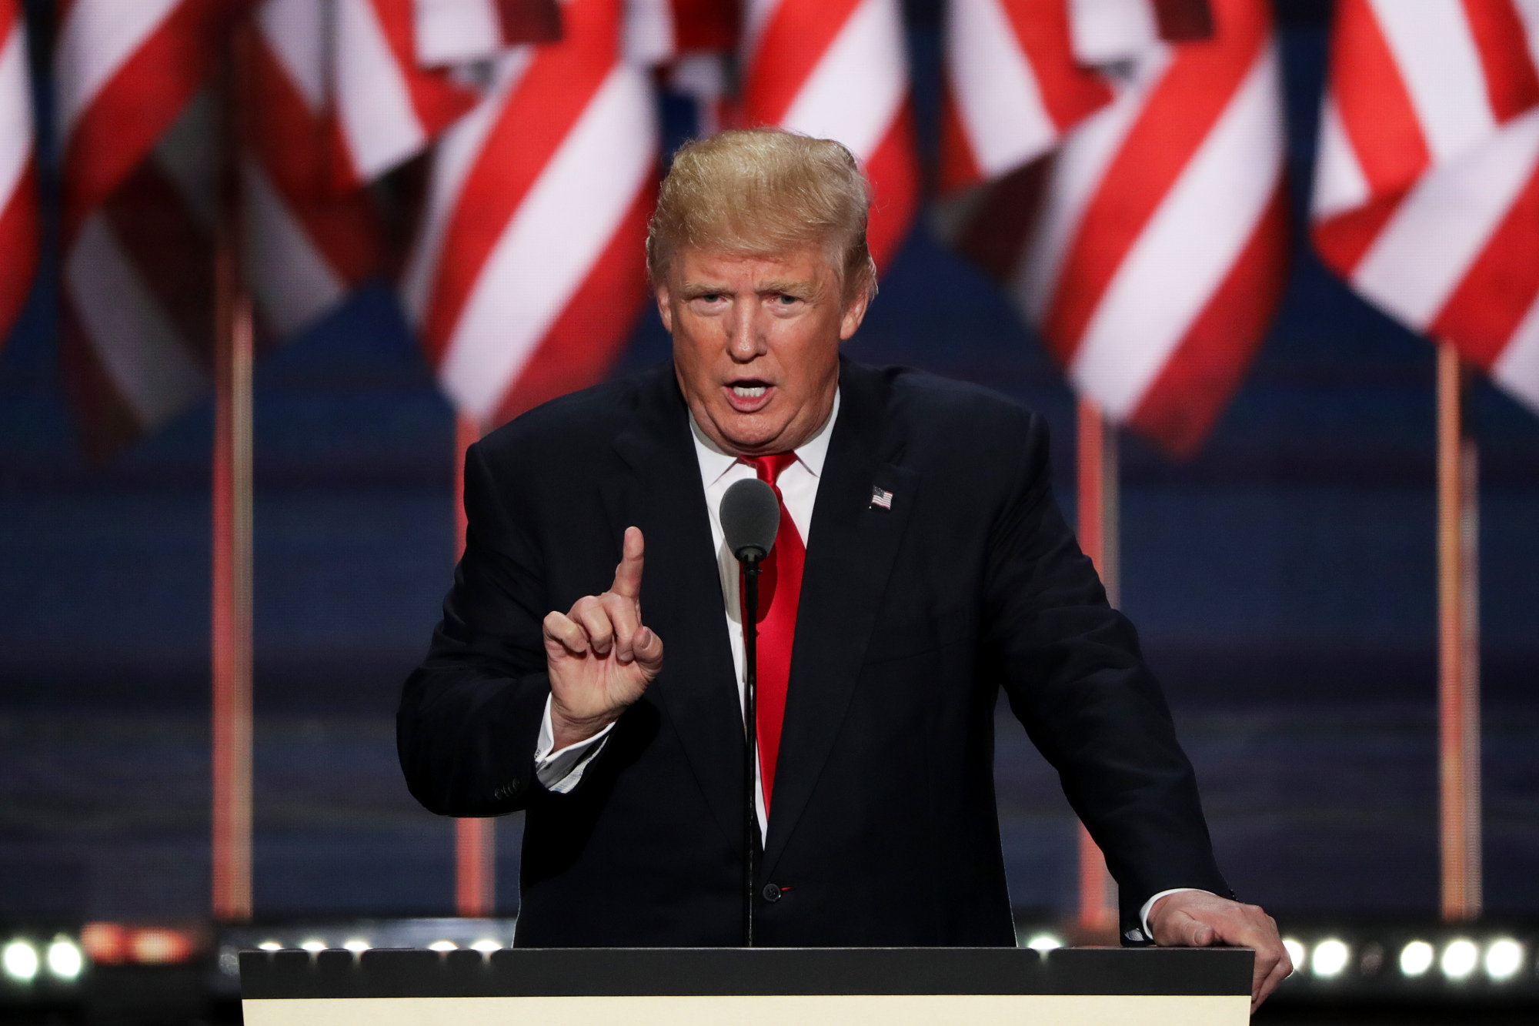
The Mad Hedge Fund Trader “Black Swan”
With John Thomas from San Francisco, CA, November 9, 2016 www.madhedgefundtrader.com
Notes:
*

Slide 2

In the Store Now for $49
Sectors and Stocks that Will Lead the Market for the Next 20 Years
https://members.madhedgefundtrader.com/roaring-twenties-book/

Slide 3
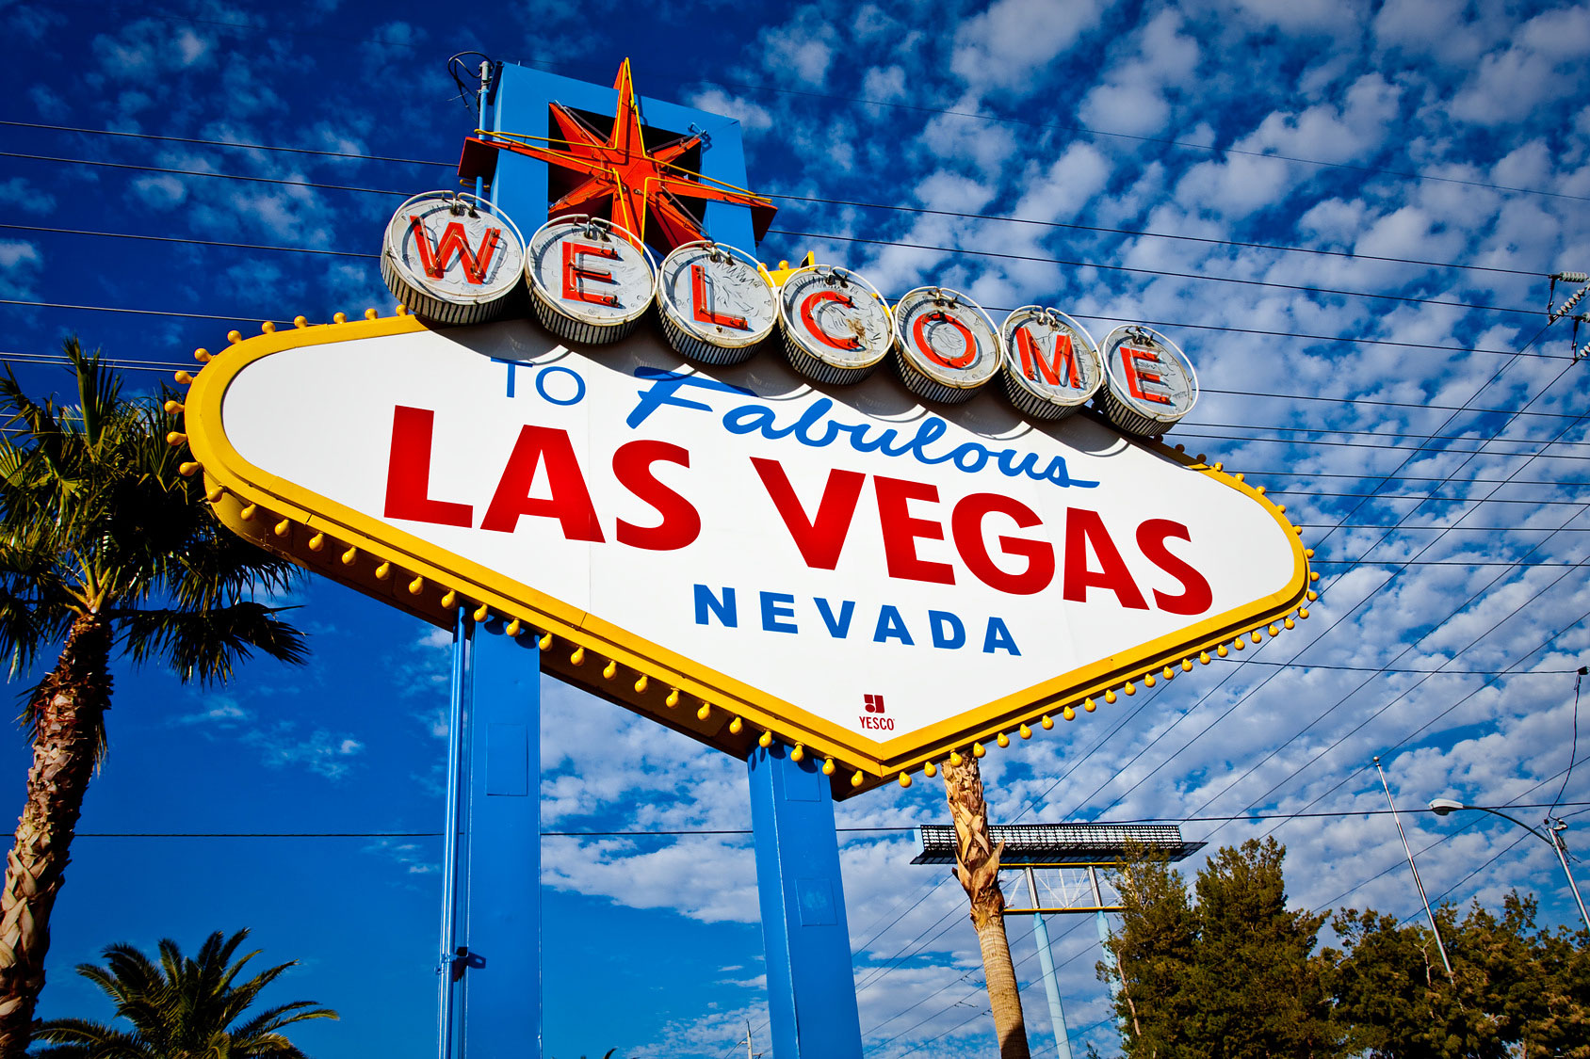
MHFT Global Strategy Luncheons Buy tickets at http://members.madhedgefundtrader.com/category/luncheons/usa/
Las Vegas, Nevada November 18

Slide 4

Trade Alert Performance Best 2 Weeks of the Past 12 months-New All Time High!!
*January +1.23% Final *July +0.67% Final *February +4.50% Final *August +7.52% Final *March -2.42% Final *September +0.27% Final *April -2.10% Final *October +8.13% Final *May +4.38% Final *November 3.55% MTD *June -0.56% Final *December -4.94% Final *2016 Year to Date +25.22% compared to 5.3% for the Dow Average *Trailing 1 year return +23.69%, +216.90% since inception, *Average annualized return of 36.58%

Slide 5
Portfolio Review Aggressive “LONG” Unhedged Position on Clinton Win
Current Capital at Risk
Risk On
(XIV) | 5.00%
(FB) 11/$114-$117 call spread | 10.00%
(FXE) 11/$110-$113 put spread | 10.00%
(AMZN) 11/$720-$750 call spread | 10.00%
No Positions
Risk Off
World is Getting Worse
No Positions
Total Net Position | 35.00%
Expiration P&L 27.79%

Slide 6
Paid Subscriber Trailing 12 Month Audited Return 23.69%

Slide 7
70 Months Since Inception Daily Audited Performance Averaged Annualized Return +37.18%

Slide 8

The Method to My Madness
*Ran small net long for a post election rally *Would have run a larger more aggressive long, but but the “black swan” risk was present *Will now try to work out of existing positions and see which way the wind blowing *Stand aside and wait until the dust settles

Slide 9

The Day After the Election Shocker!!!
*Clinton won the popular vote, but Trump won 277 votes in the Electoral College *67,000 rural votes in Pennsylvania out of 5.5 million made the difference *Trumps campaign was so far off the grid that his support couldn’t be measured by Democrats or Republicans *No one was more surprised by the win than Donald Trump *The FBI and Russian hacking were factors *We only know what Trump said, not what he will do *No policy details were ever elicited on any matter.

Slide 10
How to be Wrong
*Went into election with 65% cash *All positions short dated with 7 trading days to expiration *Only 2 equity positions hedged by a foreign exchange position IN (FXE) *NET NET IS THAT I MANAGED TO GET OUT OF AN “AMEREXIT” IN ONE PIECE

Slide 11
TRUMP WINNERS AND LOSERS
Winners *Banks *Pharmaceuticals *Big oil *US Dollar *Infrastructure *Commodities *Business
*The Wealthy *Russian Ruble *The Midwest
Losers *Alternative Energy *Solar *Bonds *Emerging Markets *Technology *Large Multinationals *Poor *Euro and Yen *The Coasts

Slide 12
The Bill Davis View A $1,500 Upgrade for the Mad Day Trader Service
Buys:
Harmon Intl Ind (HAR) $81 Target to $89
FireEye (FEYE) $12 Target to $16
Goldman Sachs (GS) $175 Target to $185
3M Co. (MMM) $165 Target to $175
Harley Davidson (HOG) $55 Target to $62
Sells:
Baidu, Inc. (BIDU) $175 Target to $156
First Solar Inc. (FSLR) $37 Target to $28
Allergan, Inc. (AGN) $210 Target to $174
Tableau Software, Inc. $49 Target to $41
Costco Wholesale (COST) $149 Target to $138
Tesoro Petroleum (TSO) $82 Target to $77

Slide 13

Short Term Strategy Outlook
*Shocking election result will keep volatility high *Gone flat waiting for dust to settle *Bonds collapse on coming explosion in government borrowing and inflation return *Institutions will hold off waiting to see which way the wind is blowing *A December rate rise is now off the table as uncertainty reigns supreme *Gold moving out of favor for the short term and a flight to safety brings $50 rally *Although ags look awful, corn is looking temping

Slide 14
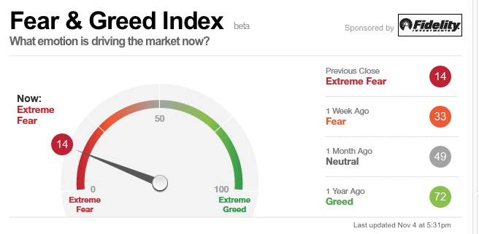
Friday Was the Best Day of the Year to Add Risk Bought the (XIV)-A Short Volatility Bet

Slide 15
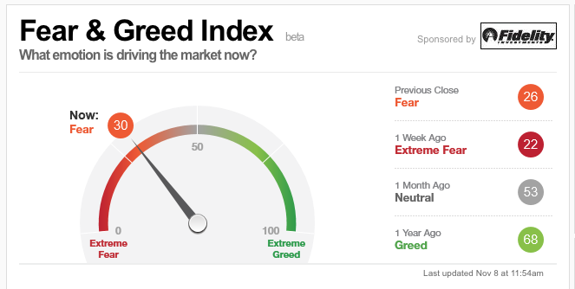
What a Difference a Day Makes!

Slide 16

The Global Economy-Election Relief
*Economic recovery is halted in its tracks as business adopts a wait and see attitude *US Q3 GDP bounced back from 1.4% to 2.9% on huge increase in exports, October Nonfarm Payroll a snore at 161,000, headline unemployment at 4.9% *But the jump in hourly earnings to 2.8% YOY, and the plunge in the U-6 structural long term unemployment rate to 9.5% is big *A huge amount of economic activity world wide has been held back pending the US election result, will now be stalled *Emerging markets are now at risk on trade fears *UK High Court says Parliament must vote on Brexit, effectively killing it

Slide 17
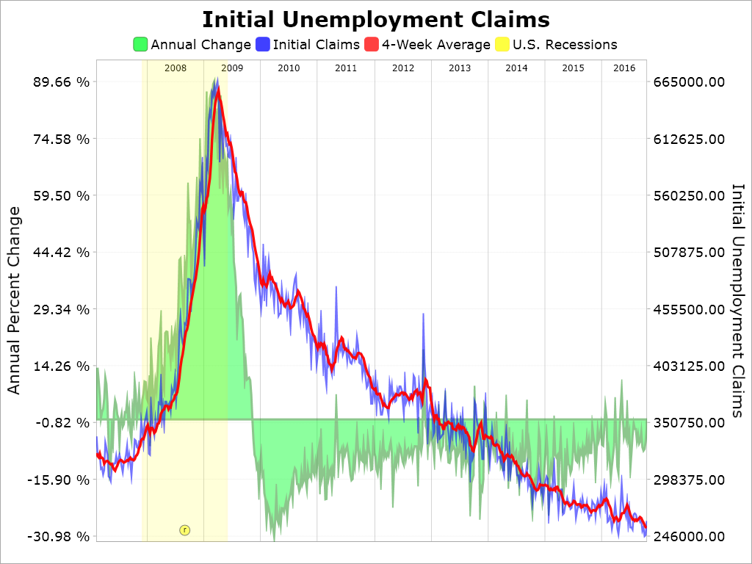
Weekly Jobless Claims –The Most Important Statistic +7,000 to 265,000-Lowest since 1973! The Downtrend Lives!-Show Me the Recession!

Slide 18

Bonds-Swan Dive
*Did you really mean $10 trillion in new debt? *Prospect of huge deficit financing crushes all yield plays *British gilt selloff triggers major worldwide bond selloff, yields pop from 0.90% to 1.31%, German bunds jump from 0.03% to 0.10% *Will inflation make a comeback on fiscal stimulus? *US Rates the highest in the developed world and increasing its lead *German bunds recover to +0.18%, JGBs at -0.08%. BOJ vows to cap bond yields at 0%

Slide 19
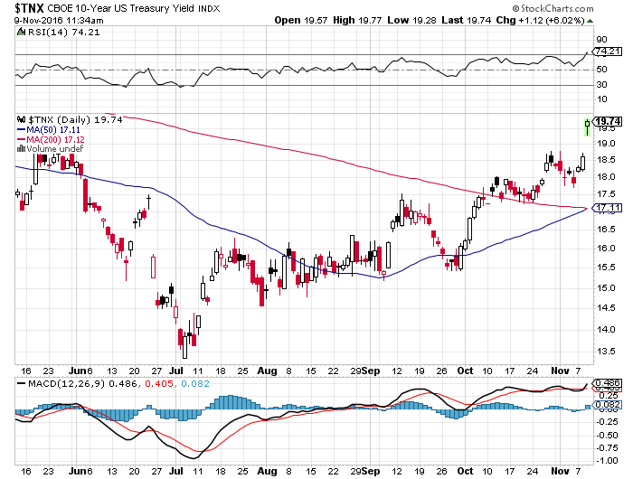
Ten Year Treasury Yield ($TNX) 1.97% Upside Breakout

Slide 20
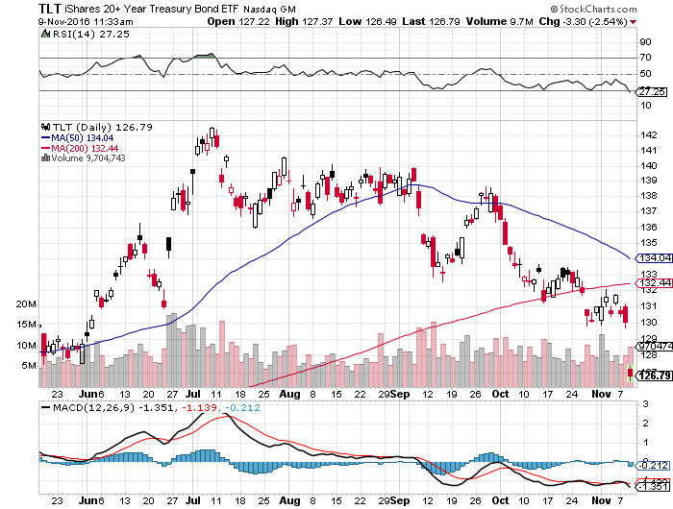
Ten Year Treasury ETF (TLT) 1.86% took profits on long 11/$137-$140 vertical bear put spread stopped out of long 11/$127-$130 vertical bull call spread for small loss

Slide 21
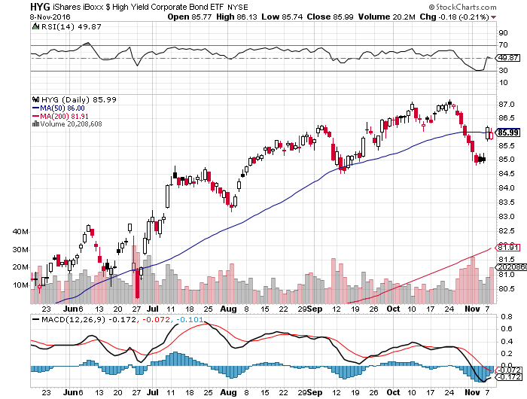
Junk Bonds (HYG) 5.46% Yield A Great Risk Coincident Indicator-”RISK ON” means new highs, buy all dips

Slide 22
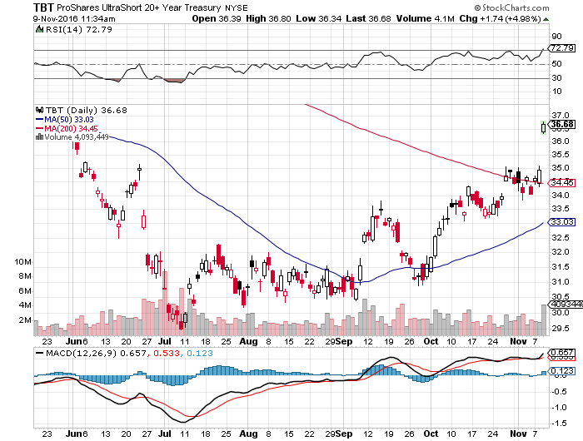
2X Short Treasuries (TBT)-At Last!

Slide 23
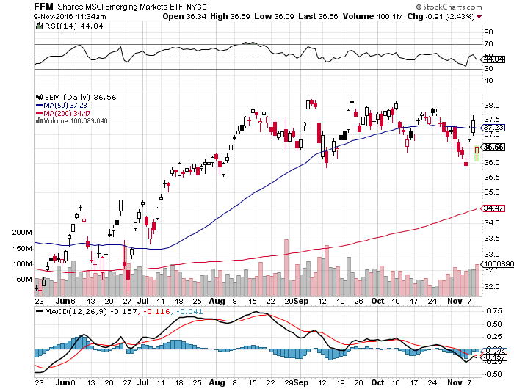
Emerging Market Debt (ELD) 4.65% Yield-

Slide 24
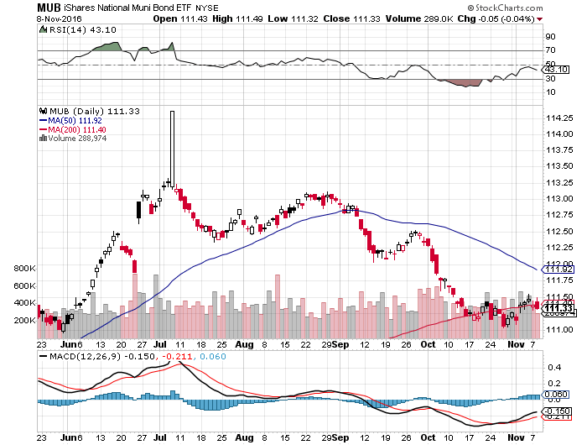
Municipal Bonds (MUB)-1.25% yield-New High Mix of AAA, AA, and A rated bonds

Slide 25

Stocks-Now What?
*After down -$800 overnight, stocks recover to up +$150 *First nine months of 2016 saw $73 billion pulled out of equity mutual funds and ETF’s during the first nine months, compared to an inflow of $87 billion during the same period of 2015, for a net swing of $160 billion. *Will Trump winners offset the losers? *Since the new winners are all cheap (banks, energy, pharmaceuticals) the net net could be a rising market *The world was looking for a tradable dip to “BUY,” Last night was a big one *Finally getting some yield competition from bonds

Slide 26
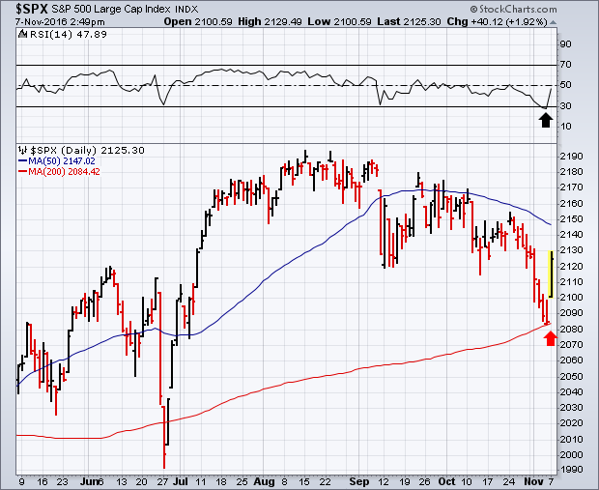
S&P 500-Holding Support A Sideways Move Going into the November Election followed by an upside breakout took profits on long 11/$220-$223 put spread stopped out of long 11/$203-$208 call spread

Slide 27
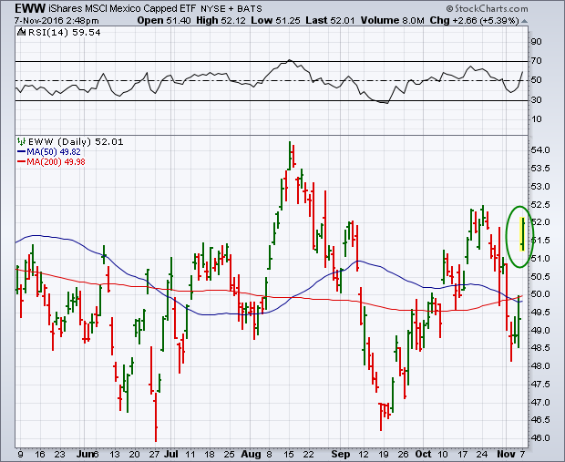
iShares MSCI Mexico ETF (EWW)

Slide 28
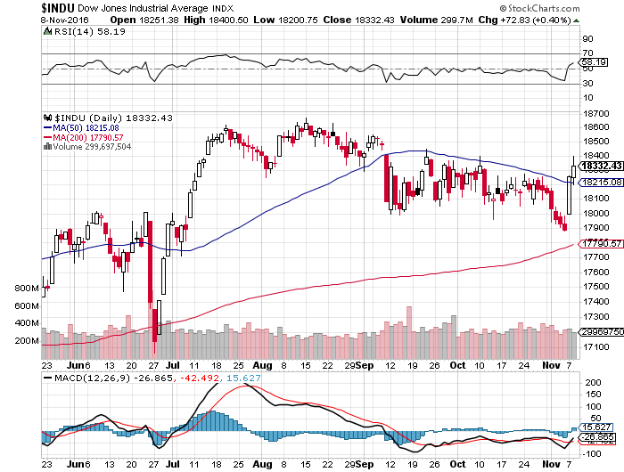
Dow Average-Range Bound

Slide 29
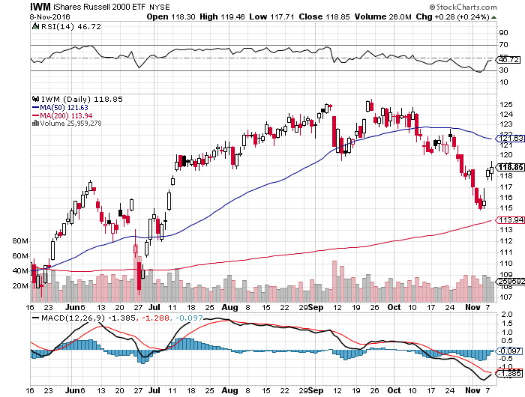
Russell 2000 (IWM)-The Glass Ceiling took profits on long 11/$125-$128 vertical bear put spread

Slide 30
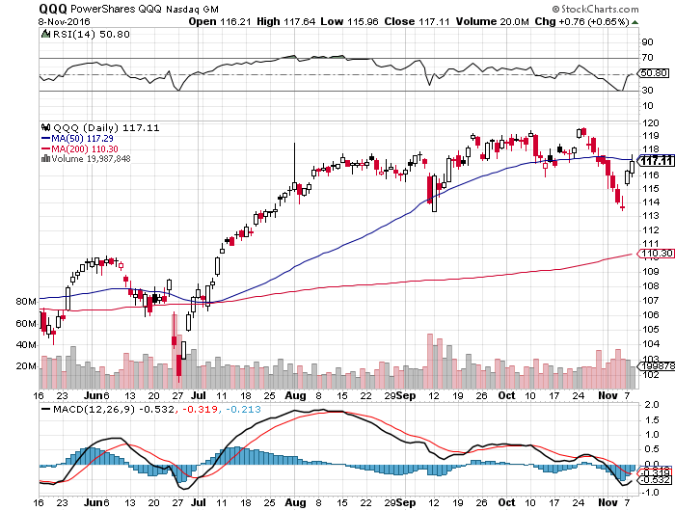
NASDAQ (QQQ)- Here is Your Leader

Slide 31
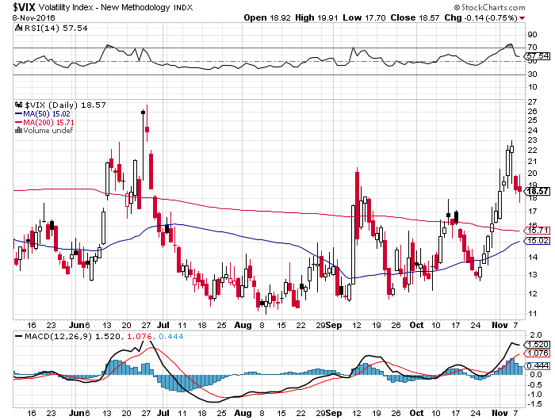
(VIX)-

Slide 32
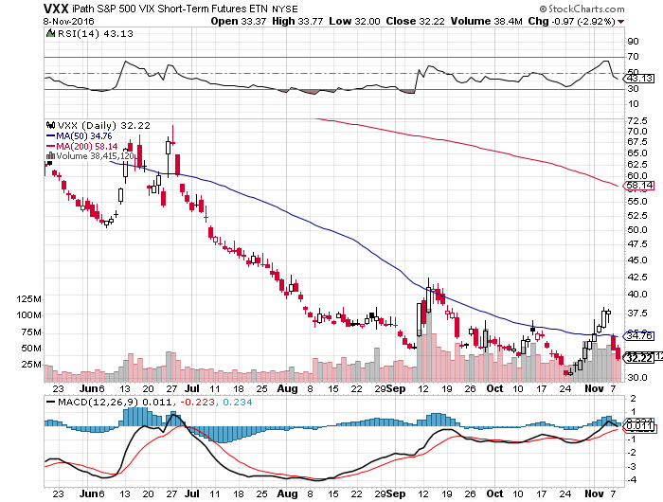
iPath S&P 500 VIX Short Term Futures ETN (VXX) took profits on long 9/$30-$33 vertical bull call spread took profits on long 10/$27-$30 call spread

Slide 33
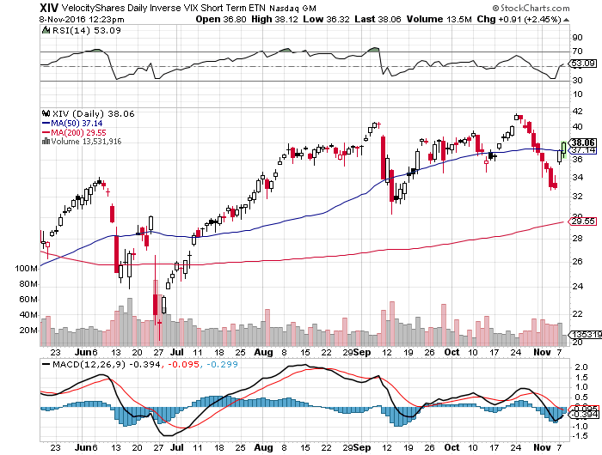
Velocity Shares Daily Inverse VIX Short Term ETN (XIV) took profits on long shares at $32.91 one of the most instantly profitable trades of 2016

Slide 34
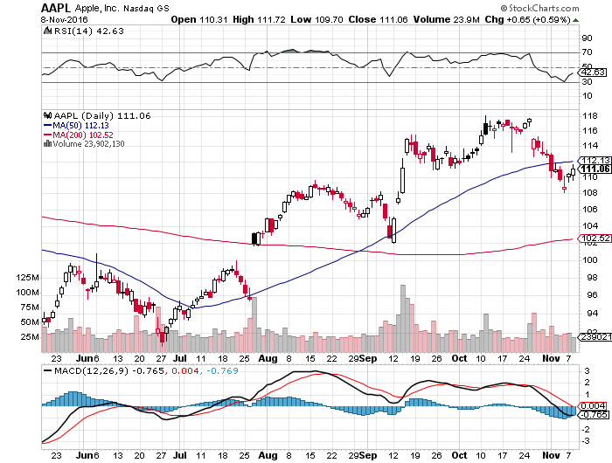
Apple (AAPL) –Buy the Rumor, Sell the News

Slide 35
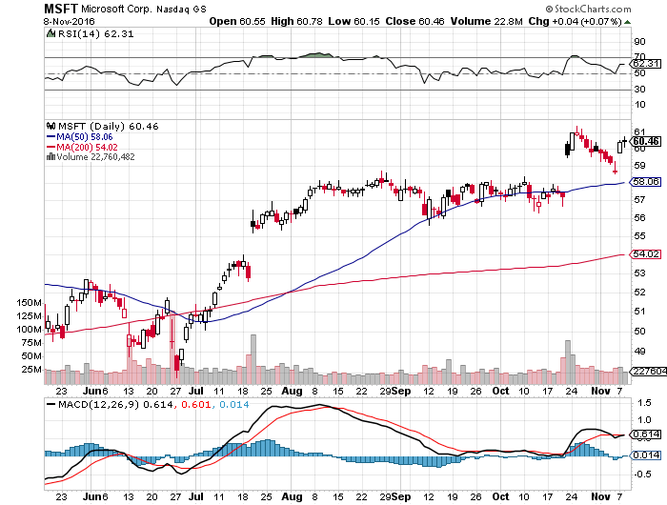
Microsoft (MSFT) Big Earnings Beat

Slide 36
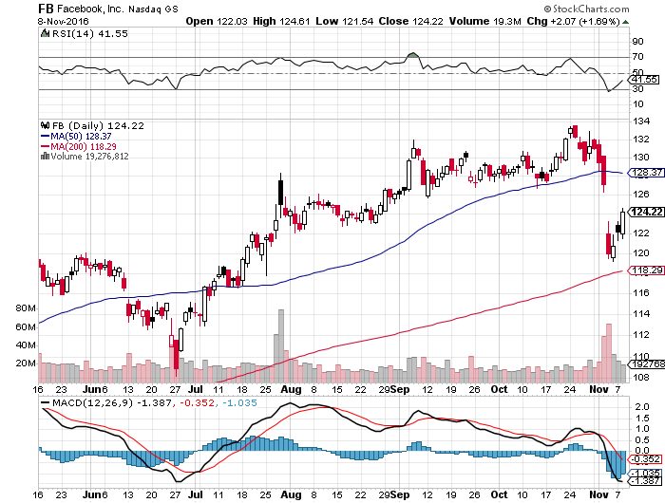
Facebook (FB)- took profits on long the 11/$114-$117 vertical bull call spread sell on news plus volatility spike created a perfect high return low risk entry point

Slide 37
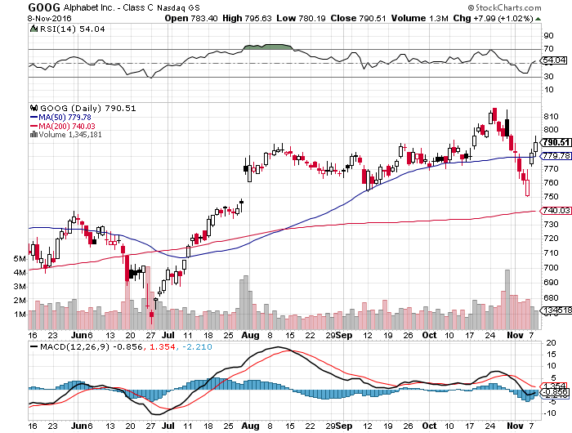
Alphabet (GOOG)-

Slide 38
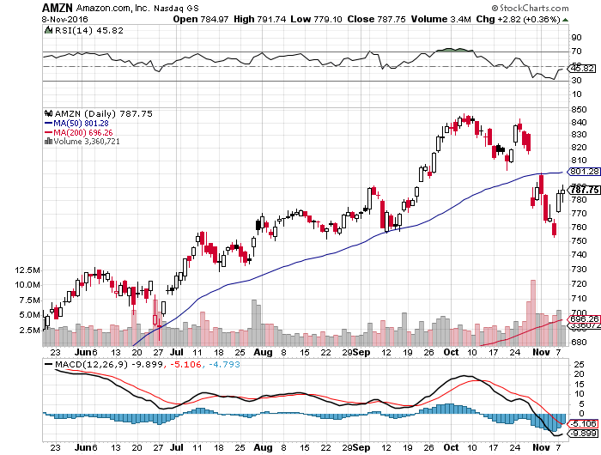
Amazon (AMZN)-

Slide 39
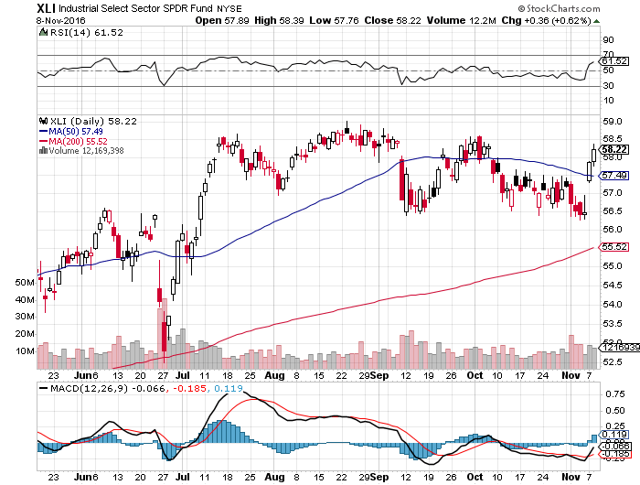
Industrials Sector SPDR (XLI)-Dragging (GE), (MMM), (UNP), (UTX), (BA), (HON)

Slide 40
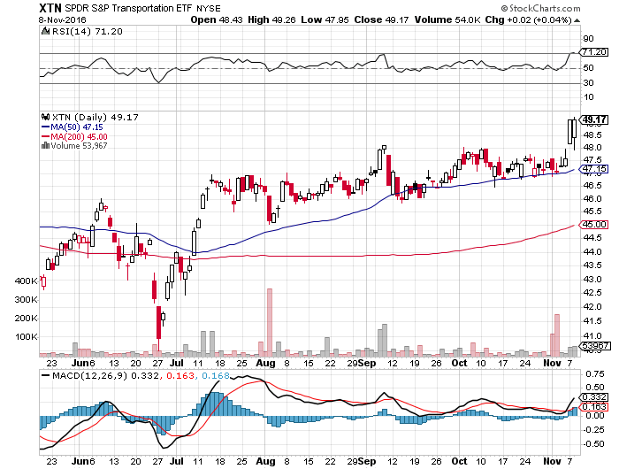
Transports Sector SPDR (XTN)-Upside Breakout Imminent (ALGT), (ALK), (JBLU), (LUV), (CHRW), (DAL)

Slide 41
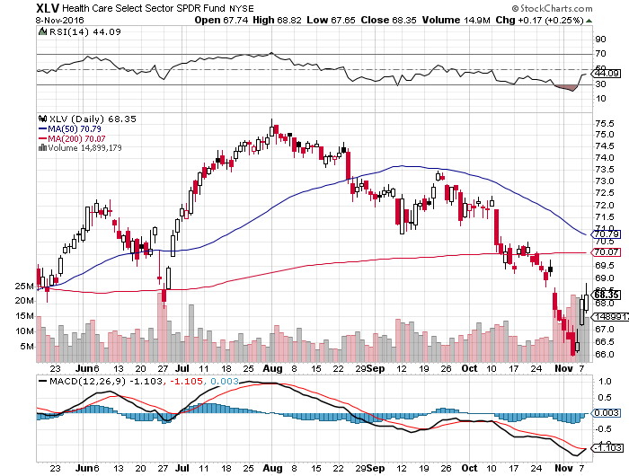
Health Care Sector SPDR (XLV), (RXL) (JNJ), (PFE), (MRK), (GILD), (ACT), (AMGN) November 8th Bottom?

Slide 42
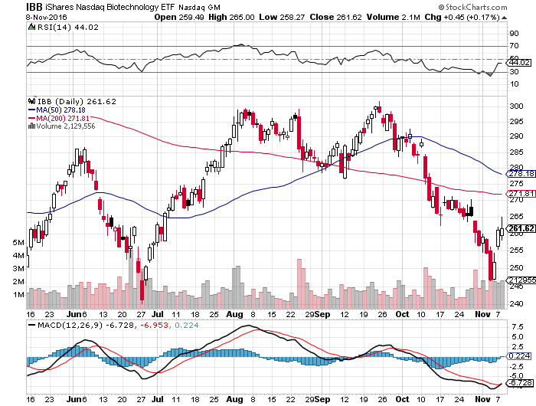
Biotech iShares (IBB)-A Political Football in 2016 Own for 2017

Slide 43
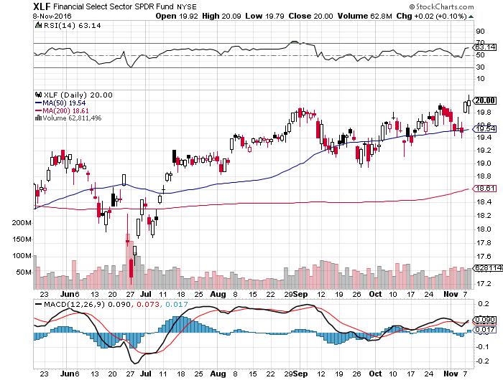
Financial Select SPDR (XLF)-Waiting for a Rate Rise (BLK/B), (WFC), (JPM), (BAC), (C), (GS)

Slide 44
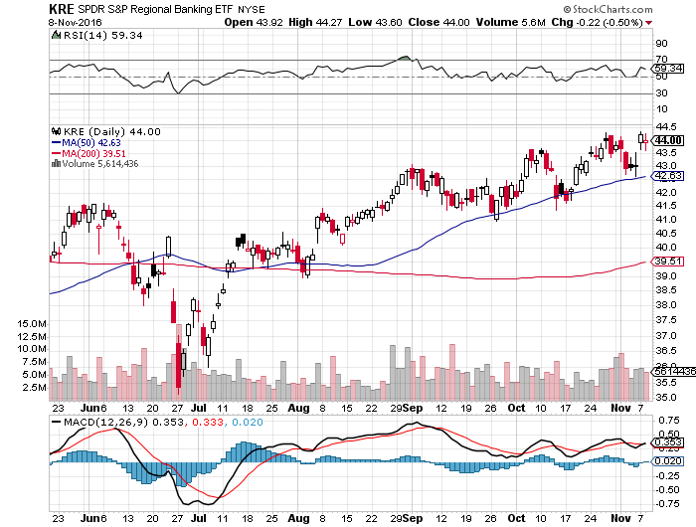
KRE Regional Bank ETF (KRE)-

Slide 45
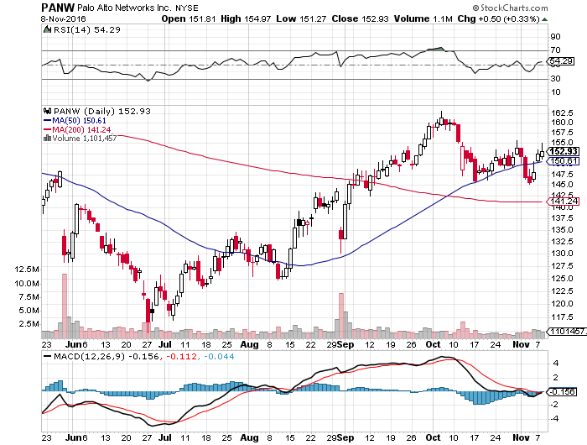
Palo Alto Networks (PANW)- Hacking Isn’t Going Away

Slide 46
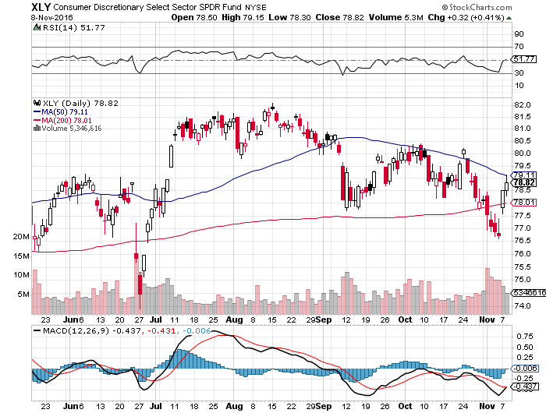
Consumer Discretionary SPDR (XLY) (DIS), (AMZN), (HD), (CMCSA), (MCD), (SBUX) A Major Leader of the Rally

Slide 47
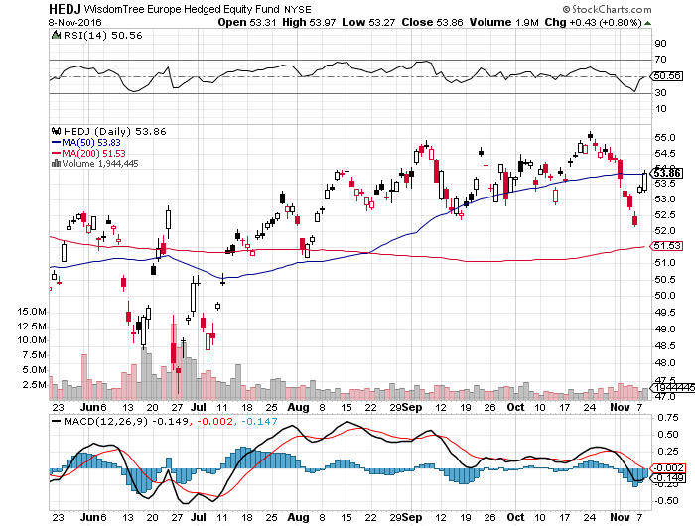
Europe Hedged Equity (HEDJ)-Cheap Euro Boost

Slide 48
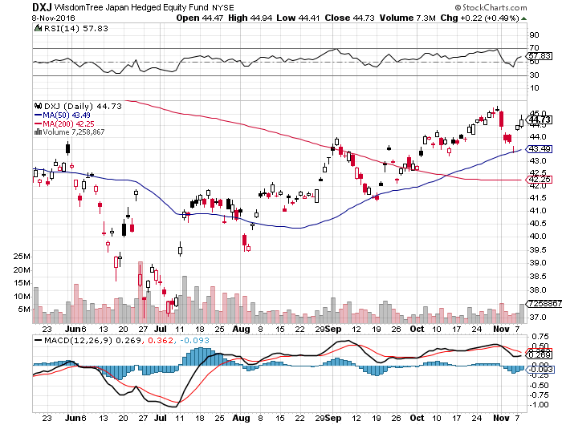
Japan (DXJ)-Cheap Yen Breakout

Slide 49
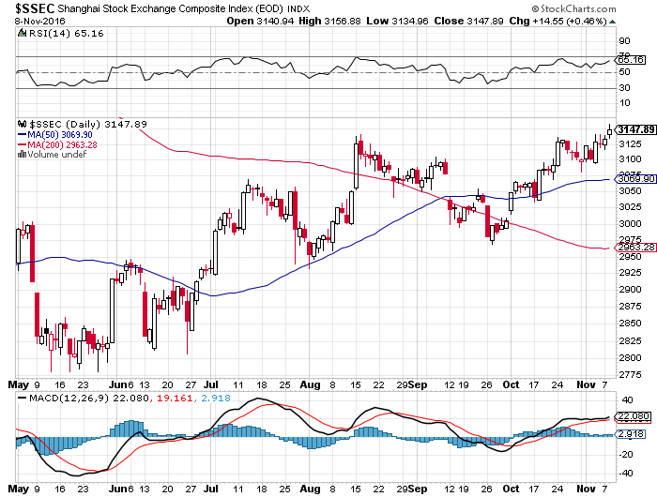
China ($SSEC)-Up Trend Says Global “RISK ON”

Slide 50
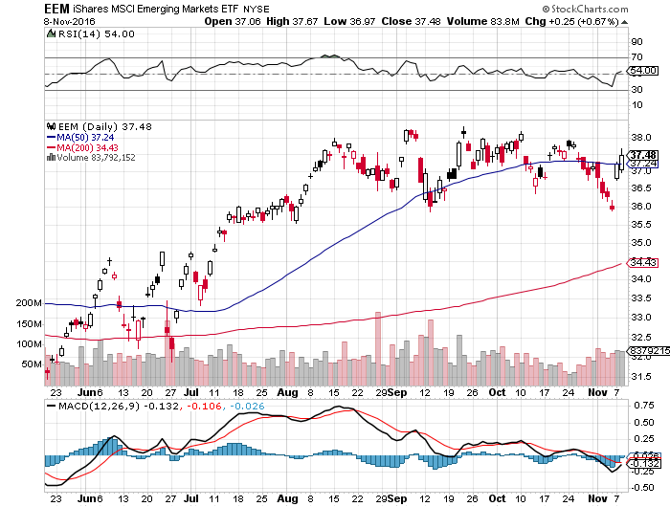
Emerging Markets (EEM)-Upside Breakout Coming

Slide 51
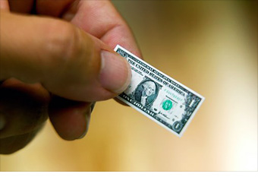
Foreign Currencies-Dollar Rocket on Election Outcome
*Rising bond rates pouring money into US dollar *Euro is crushed, thank you very much *Buy the dollar on any dips *Future Euro is dependent on an EC breakup, or not, but sell the rally for now *Short covering and lower oil prices a huge yen positive *British pound bouncing on “Brexit” rollback, Parliamentary vote will kill it

Slide 52
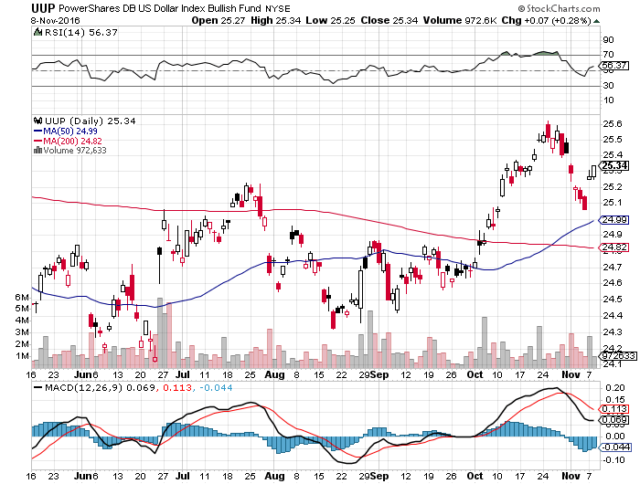
(UUP) Dollar Hits 8 Month High

Slide 53
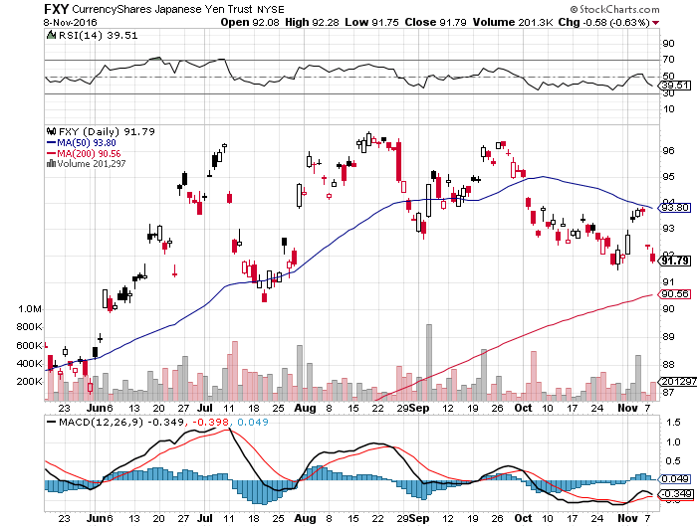
Japanese Yen (FXY)-Is This the Big One? took profits on long the 8/$97-100 put spread took profits on long the 9/$99-102 put spread

Slide 54
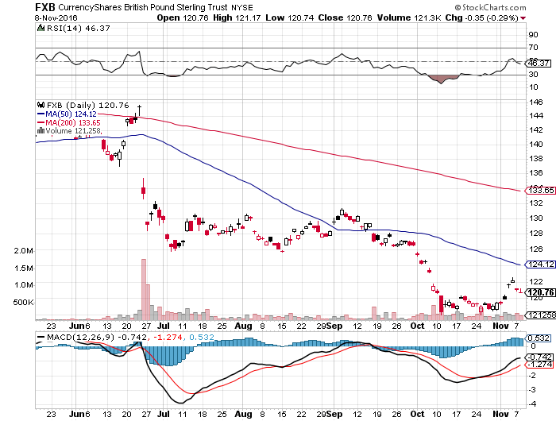
British Pound (FXB)-New Lows on Weakening Economy

Slide 55
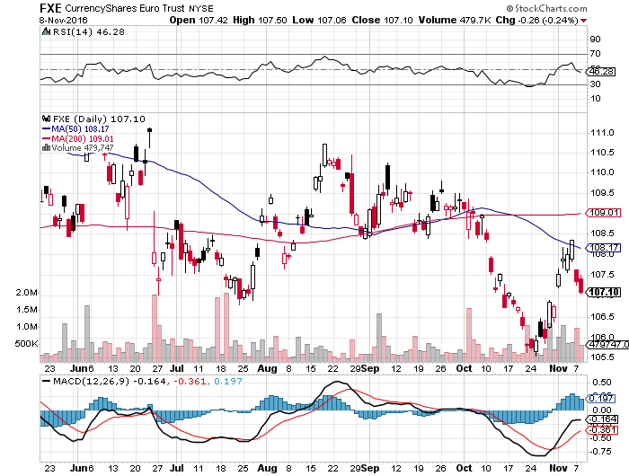
Euro ($XEU), (FXE), (EUO)- Bombs Away took profits on long the 9/$112-$115 vertical bear put spread long $11/$110-$113 vertical bear put spread

Slide 56
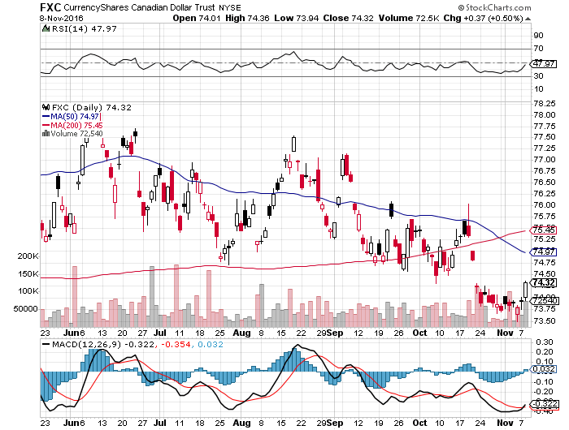
Canadian Dollar (FXC)-

Slide 57
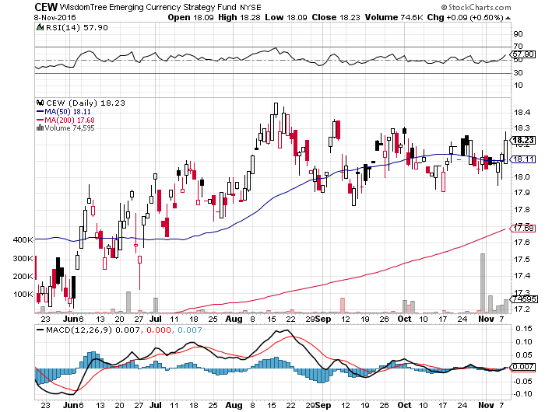
Emerging Market Currencies (CEW)

Slide 58
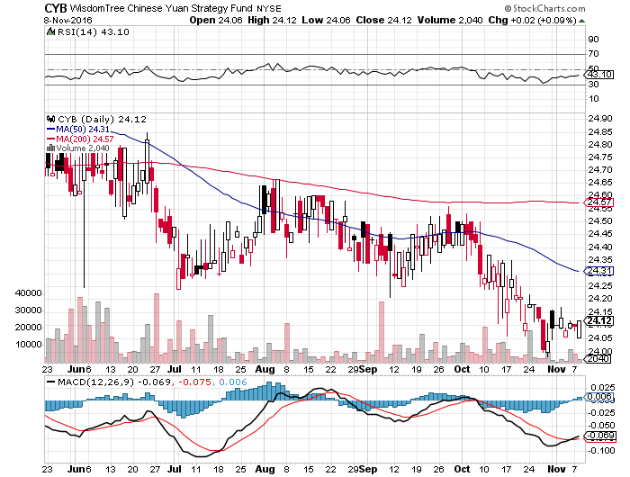
Chinese Yuan- (CYB)-Breakdown at Last

Slide 59
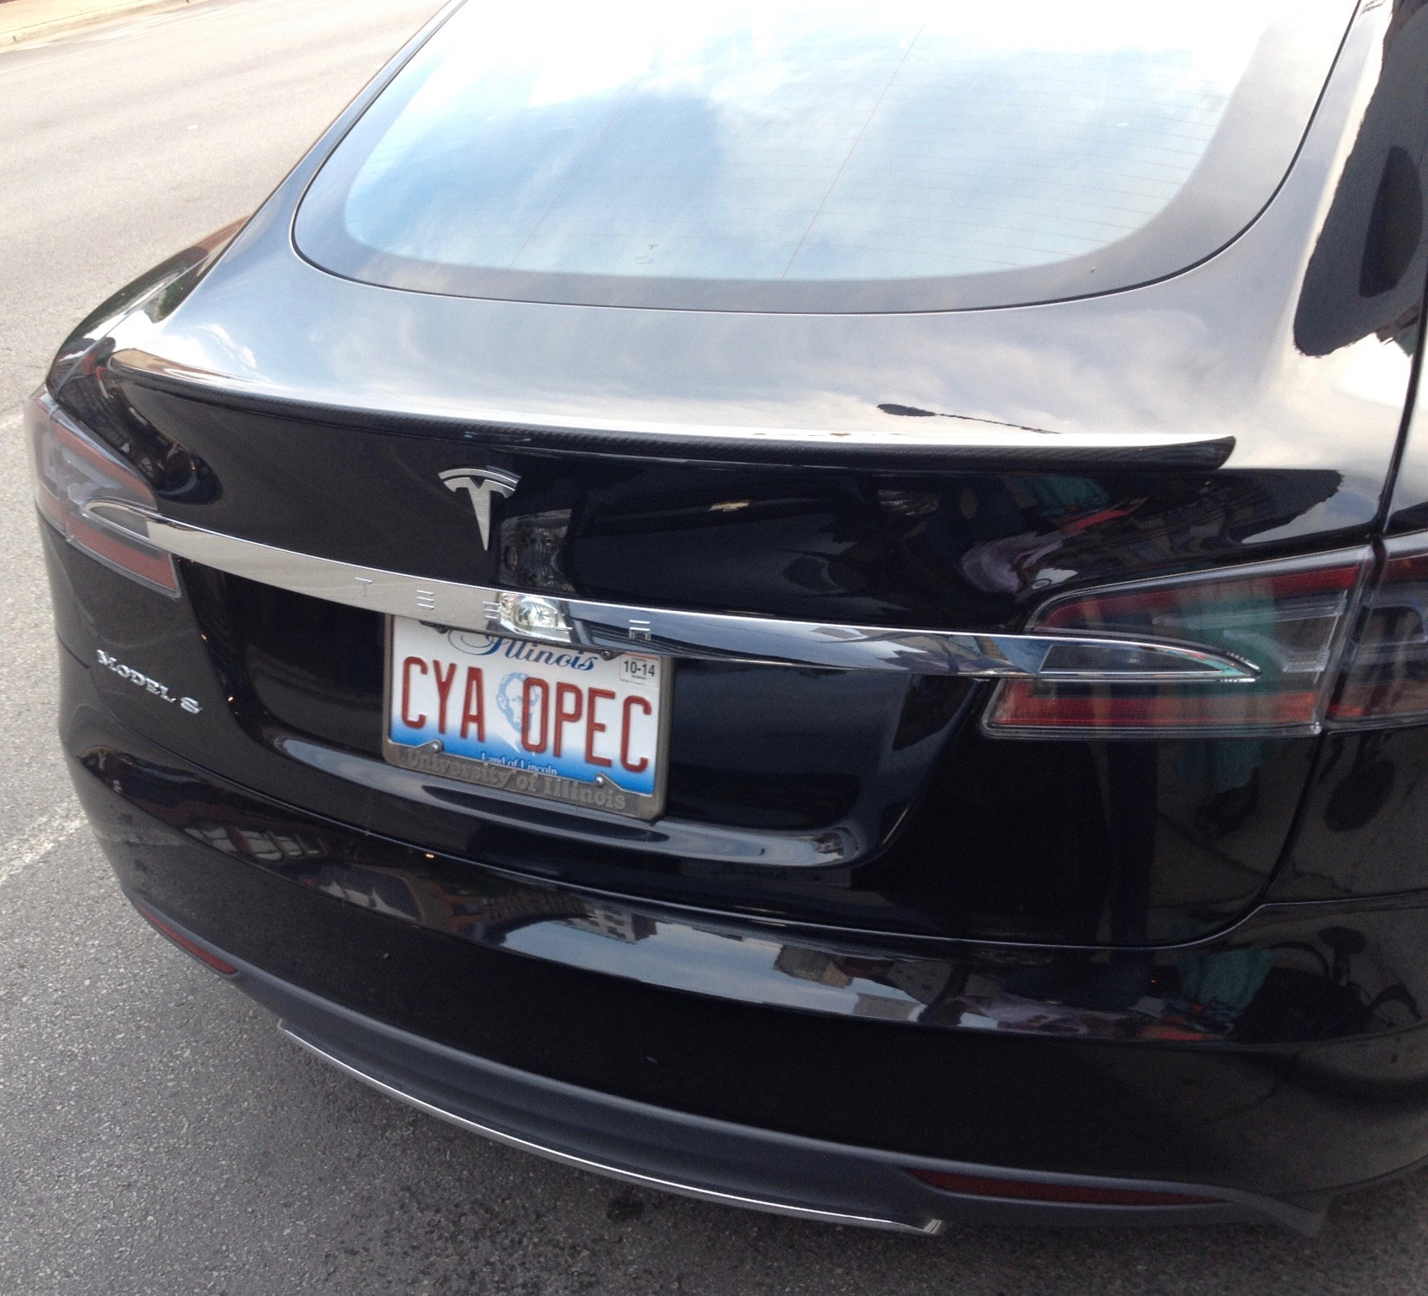
Energy-The Rally Fails
*Huge energy oversupply continues, with contagos widening, global growth fears take oil down 4% overnight *Trade war risk with China could dent long term demand *Inventories rocket to record levels *All hangs on the OPEC November 30 meeting *All members ramping up production going into the meeting *Weak energy stocks will be a drag on the overall stock market *Baker Hughes rig count adds still rising *Oil still stuck in $40-$52 range, but we are now testing the downside *Natgas collapses

Slide 60
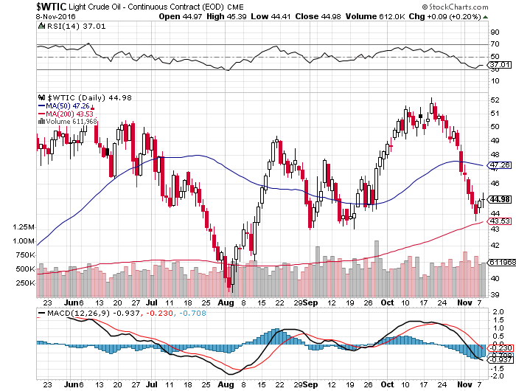
Oil-The Glut Returns

Slide 61
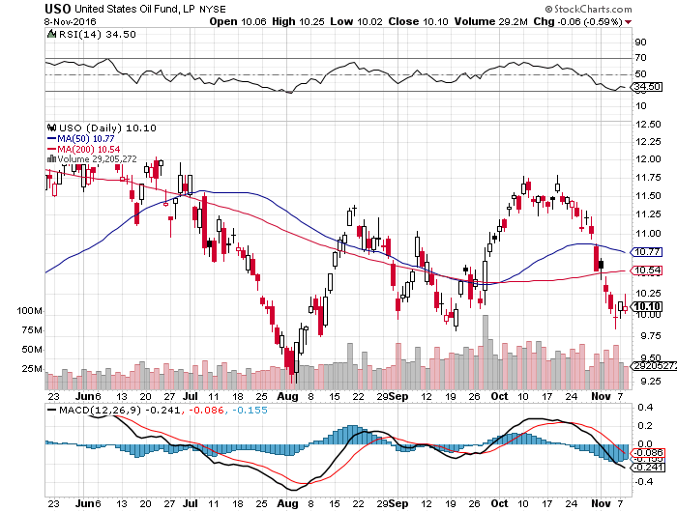
United States Oil Fund (USO) took profits on long the (USO) 11/$12.50-$14.00 vertical bear put spread

Slide 62
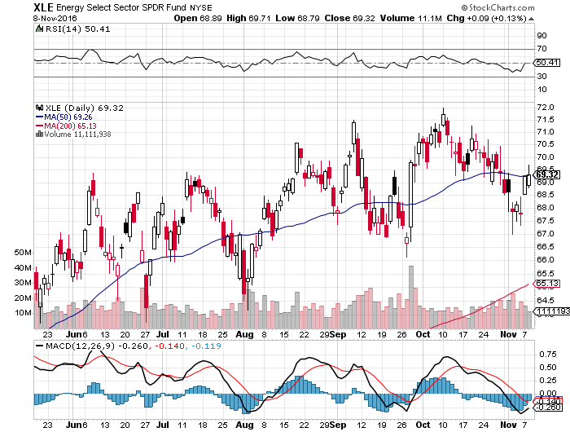
Energy Select Sector SPDR (XLE) (XOM), (CVX), (SLB), (KMI), (EOG), (COP)

Slide 63
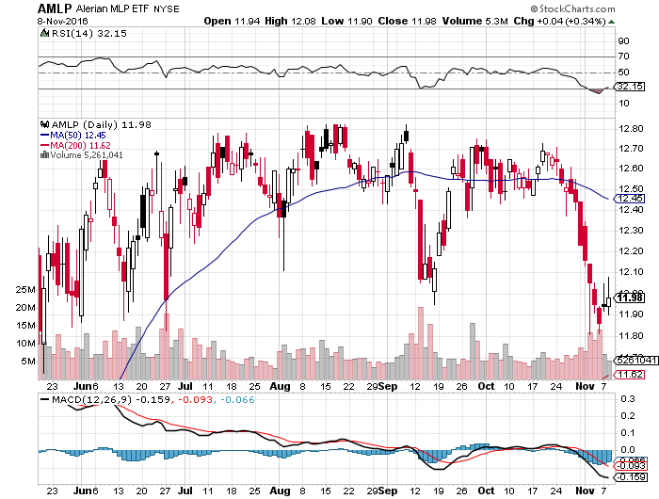
Alerian MLP ETF (AMLP)- Basket Approach is the Only Safe Play here

Slide 64
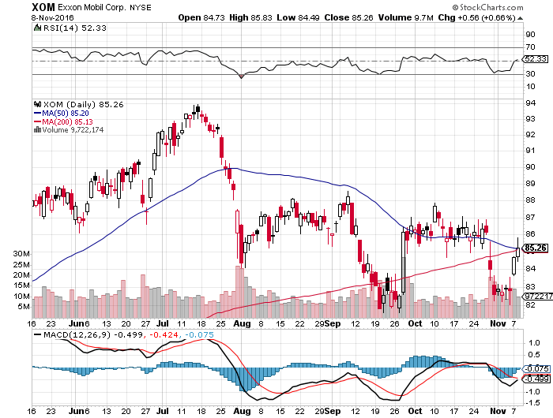
Exxon (XOM)-Dividend is Not Enough global warming + reserve valuation = ouch!

Slide 65

Occidental Petroleum (OXY)-

Slide 66

Natural Gas (UNG)-Bumping Against 2016 Highs

Slide 67

Copper (COPX)-Upside Breakout Candidate

Slide 68

Van Eck Vectors Steel ETF (SLX)-Upside Done!

Slide 69

Precious Metals-No More Flight to Safety
*Trump gives huge boost to gold *Cheap oil prices forcing Russia to unload gold, has been one of the biggest buyers over the last two years to sidestep economic sanctions *Diwali festival knocks Indian buyers out of the market for a week, the world’s largest buyers *Overnight Euro rates at -.40% and gold at zero gives gold a real positive 0.40% return *Gold is essentially acting as a bond now, as interest rate differentials are now the largest price driver, is a rare event in precious metals *Wait for the for another capitulation day to step in, gold is the “classic stairs up, elevator down” asset

Slide 70

Gold (GLD)-Searching for a Bottom took profits on long 11/$112-$115 vertical bull call spread

Slide 71

Market Vectors Gold Miners ETF- (GDX)

Slide 72

Silver (SLV)-

Slide 73

Silver Miners (SIL)-

Slide 74

Agriculture-Hints of a Bottom
*Drought returns to Texas, Kansas, and Oklahoma, helping prices *Corn charts hinting at medium term bottom, now is attempting a breakout, time to buy? *As Ag prices are primarily weather driven, they usually are totally uncorrelated with financial assets, making them a great portfolio hedge

Slide 75

(CORN) – Shall We Buy?

Slide 76

(WEAT)-No Bounce

Slide 77

(SOYB)-Bouncing Along the Bottom

Slide 78

Real Estate-Still Stalling
*Clinton will will keep the real estate market percolating for several more years *September New home sales up 3.1% MOM and, signed contracts up 1.5%, 13% YOY, inventories a very short 4.8 months of supply *Average new home price now $377,000 *US home ownership bouncing back to 63.5% from 50 year low *Alternative online financing sources starting to have a big impact on residential real estate *Millennials ramping up buying make the homebuilders a huge buy long term *August Case Shiller -0.0% to 5.1% YOY, holding steady

Slide 79

April S&P 500/Case–Shiller Home Price Index +5.0% YOY, Portland, Seattle, Denver leaders

Slide 80

General Growth Properties (GGP) Yield Play Profit Taking

Slide 81

US Home Construction Index (ITB) (DHI), (LEN), (PHM), (TOL), (NVR) Another Rising Rate Victim-But Becoming a favorite Sector to Buy

Slide 82

Trade Sheet So What Do We Do About All This?
*Stocks- stand aside *Bonds-sell rallies on government borrowing risk *Commodities-buy dips *Currencies- sell rallies *Precious Metals –buy on big selloff days *Volatility-stand aside *The Ags –stand aside *Real estate-stand aside

Slide 83

To buy lunch tickets, please click http://members.madhedgefundtrader.com/category/luncheons/usa/ and select the city of your choice Next Strategy Webinar 12:00 EST Wednesday, November 23, 2016 San Francisco, CA
Good Luck and Good Trading!
Notes:
*

