Slide 1
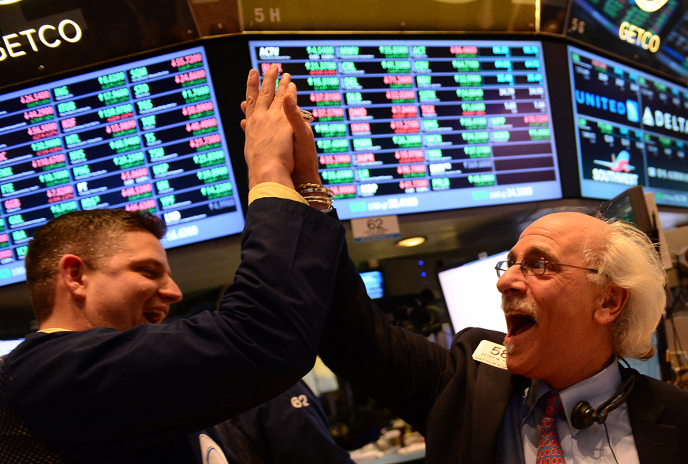
The Mad Hedge Fund Trader “New Highs!”
With John Thomas from San Francisco, CA, November 23, 2016 www.madhedgefundtrader.com
Notes:
*

Slide 2

In the Store Now for $149
Sectors and Stocks that Will Lead the Market for the Next 20 Years
https://members.madhedgefundtrader.com/roaring-twenties-book/

Slide 3

Trade Alert Performance Best 4 Weeks of the Past 12 months-New All Time High!!
*January +1.23% Final *July +0.67% Final *February +4.50% Final *August +7.52% Final *March -2.42% Final *September +0.27% Final *April -2.10% Final *October +8.13% Final *May +4.38% Final *November 3.24% MTD *June -0.56% Final *December -4.94% Final *2016 Year to Date +24.91% compared to 9.45% for the Dow Average *Trailing 1 year return +21.36%, +216.59% since inception, *Average annualized return of 36.09%

Slide 4
Portfolio Review Aggressive “LONG” Unhedged Position on Clinton Win
Current Capital at Risk
Risk On
World is Getting Better
(TLT) 12/$127-$130 put spread | 20.00%
Risk Off
World is Getting Worse
(VXX) 12/$24-$27 call spread | -10.00%
Total Net Position | 10.00%
Expiration P&L 30.03%

Slide 5
Paid Subscriber Trailing 12 Month Audited Return 21.36%

Slide 6
72 Months Since Inception Daily Audited Performance Averaged Annualized Return +36.09%

Slide 7

The Method to My Madness
*Running a small hedged book with performance at all time highs on top of monster market moves *Looking to get into New World Order stocks on any pullback *Trading December is always tricky, with multiple yearend effects

Slide 8
The Bill Davis View A $1,500 Upgrade for the Mad Day Trader Service
Buys:
United Parcel Serv (UPS) $112 Target to $125
Facebook (FB) $118 Target to $131
Celgene (CELG) $120 Target to $132
Western Digital (WDC) $57 Target to $65
Netflix, Inc. (NFLX) $108 Target to $120
Harmon Intl Ind (HAR) $81 Target to $89
(From Last Webinar - Hope you caught it)
Sells:
Edwards Lifesciences (EW) $86 Target to $75
First Solar Inc. (FSLR) $34 Target to $26
Allergan, Inc. (AGN) $195 Target to $170
TripAdvisor (TRIP) $58 Target to $45
SodaStream (SODA) $38 Target to $27

Slide 9

Short Term Strategy Outlook
*Market is still digesting shocking election result *Volatility is putting a bottom in here going into the Thanksgiving holidays *Sell all bonds on any rally *Institutions to a man were caught with the wrong positions, will take months to years to rebalance *A December rate rise is now guaranteed

Slide 10
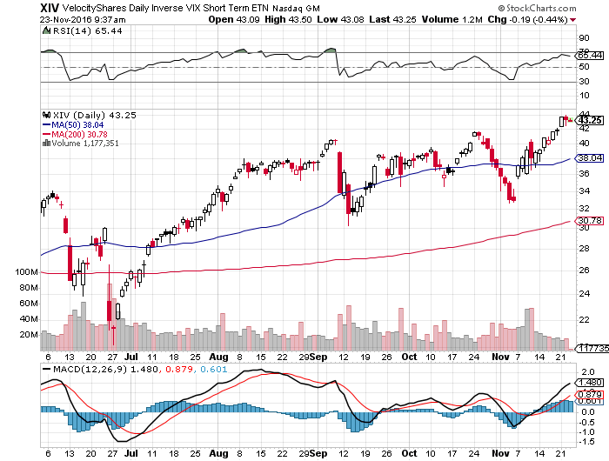
Friday Nov 8 Was the Best Day of the Year to Add Risk Bought the (XIV)-A Short Volatility Bet at $32.90

Slide 11

The Global Economy-Confusion
*US economy was clearly accelerating going into the election. October Retails Sales up +0.8%, Business Sales up +0.7%, Q3 GDP jumping from from 1.4% to 2.9% on huge increase in exports. *All economic data is now useless, as it predates the election *Japanese Q3 GDP jumps a surprise 2.2% *Emerging markets discounting another recession *Collapsing currencies will be a positive for Japan and Europe, will accelerate *The causes of the next US recession are now in view: high inflation and an interest rate spike triggered by massive new government deficit spending

Slide 12
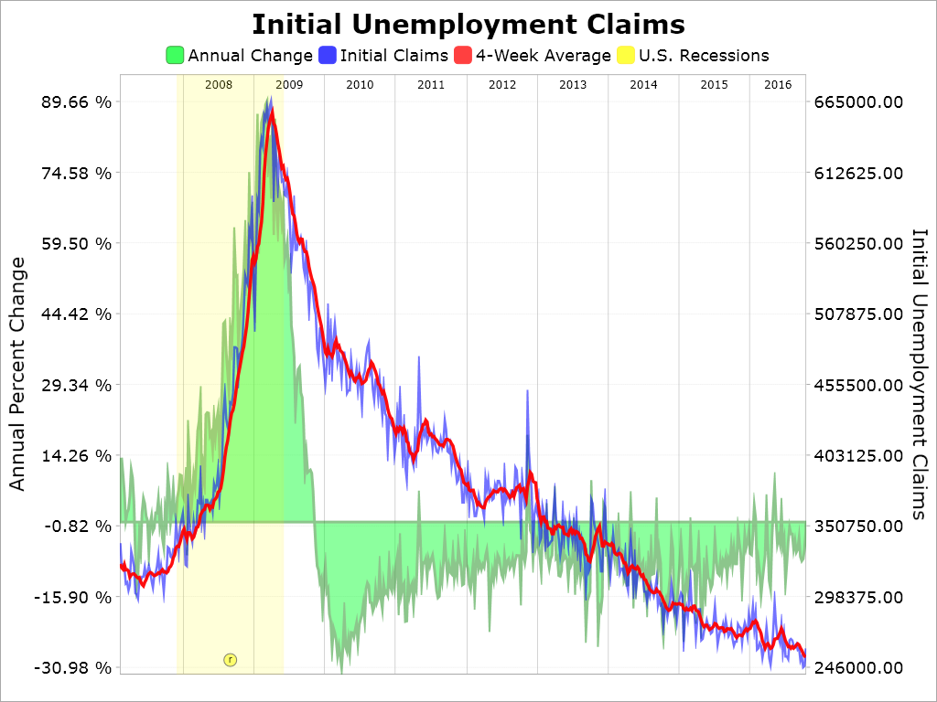
Weekly Jobless Claims –The Most Important Statistic -19,000 to 235,000-Lowest since 1973! The Downtrend Lives!-Show Me the Recession!

Slide 13

Bonds-No Hope
*No concrete deficit plans have been announced, but markets are expecting the worst *Dire circumstances spurred me to add a rare double short position *Did you really mean $10 trillion in new debt? *Prospect of huge deficit financing crushes all yield plays *Major jobs program with weekly jobless claims at all time lows is hugely inflationary *Will career deficit hawks in congress play along?

Slide 14
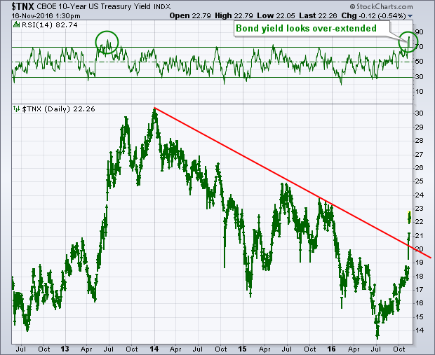
Ten Year Treasury Yield ($TNX) 2.38% Upside Breakout

Slide 15
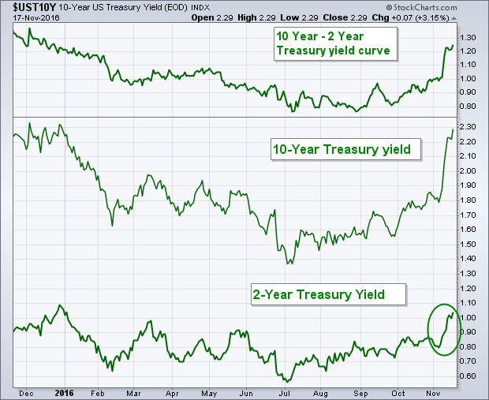
Ten Year Treasury Yield ($TNX) 2.38% Upside Breakout

Slide 16
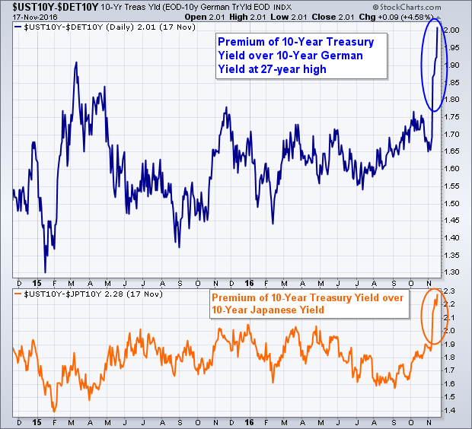
Ten Year Treasury Yield ($TNX) 2.38% Upside Breakout

Slide 17
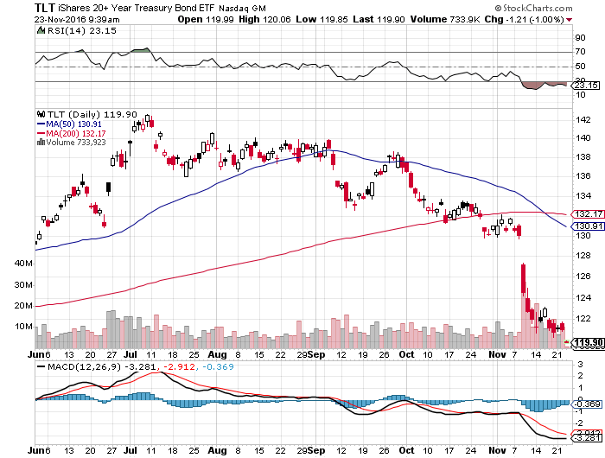
Ten Year Treasury ETF (TLT) 2.38% took profits on long 11/$137-$140 vertical bear put spread double position in on long 12/$127-$130 vertical bear put spread

Slide 18
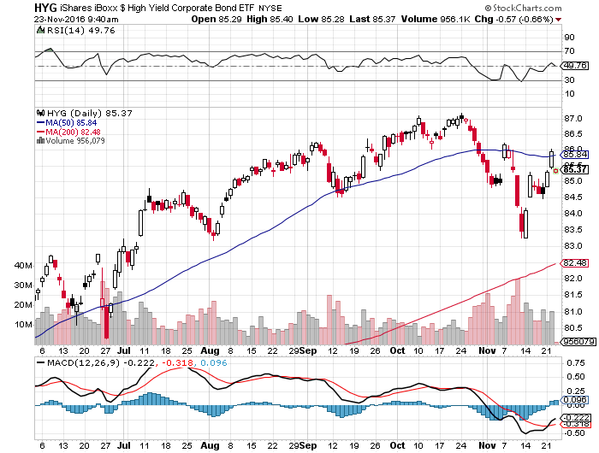
Junk Bonds (HYG) 5.46% Yield A Great Risk Coincident Indicator-”RISK ON” means new highs, buy all dips

Slide 19
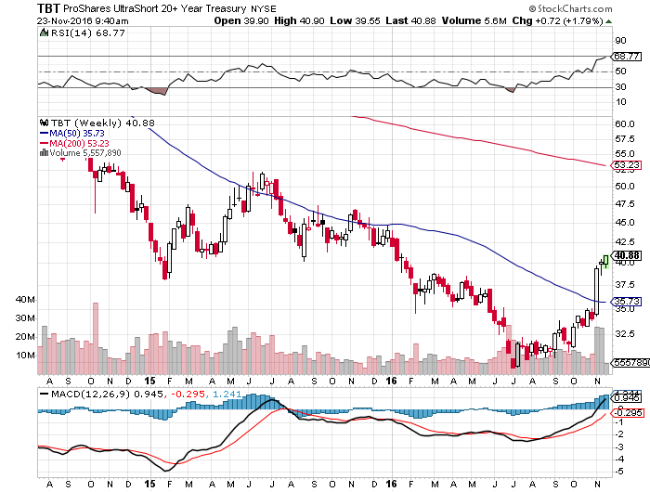
2X Short Treasuries (TBT)-At Last!

Slide 20
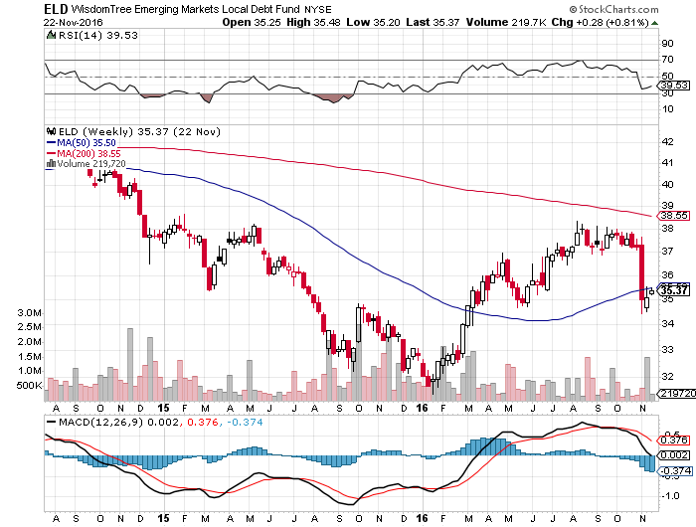
Emerging Market Debt (ELD) 4.65% Yield-

Slide 21
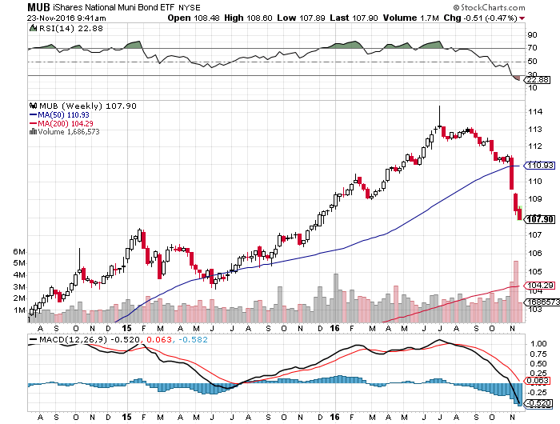
Municipal Bonds (MUB)-1.25% yield-New High Mix of AAA, AA, and A rated bonds

Slide 22

Stocks-Rapid Rotation
*Trump election has triggered a massive sector rotation that will take months, if not years to unfold, after longest losing streak in 40 years, we get the biggest winning streak in 13 years *No new money will enter the market until next year, so we are seeing frantic rotation only until then *Out of technology growth *Into value banks, energy, pharmaceuticals, defense, materials, construction *The world is looking for a tradable dip to “BUY,” *Finally getting some yield competition from bonds *MY prediction that stocks would go to new all time highs came true, we just got there a different way

Slide 23
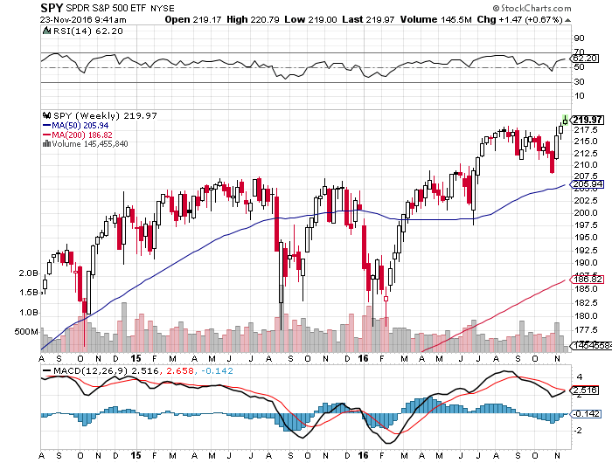
S&P 500-New All Time High A Sideways Move Going into the November Election followed by an upside breakout took profits on long 11/$220-$223 put spread

Slide 24
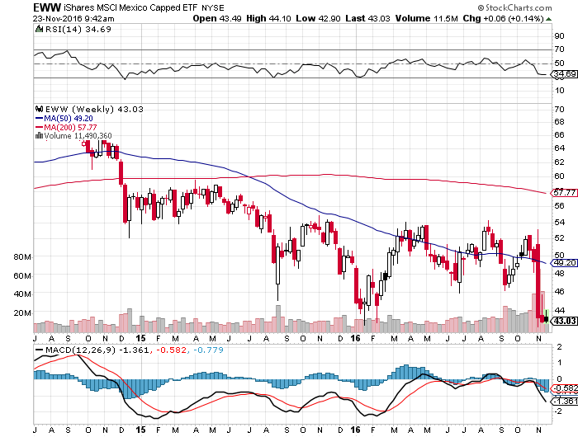
iShares MSCI Mexico ETF (EWW)=Crushed

Slide 25
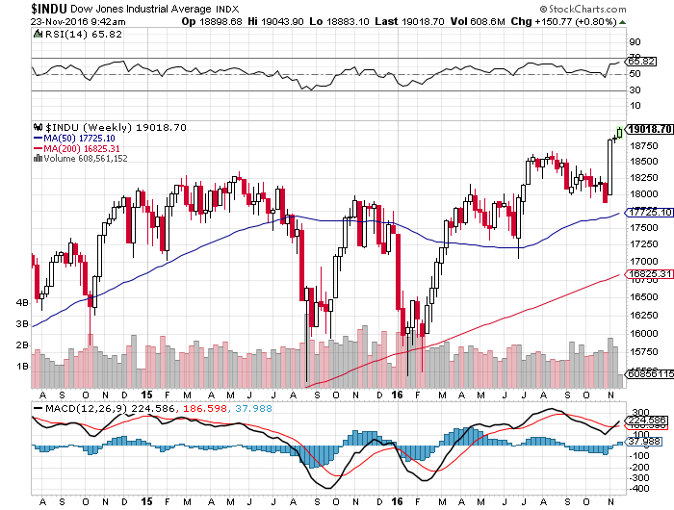
Dow Average-Range Bound

Slide 26
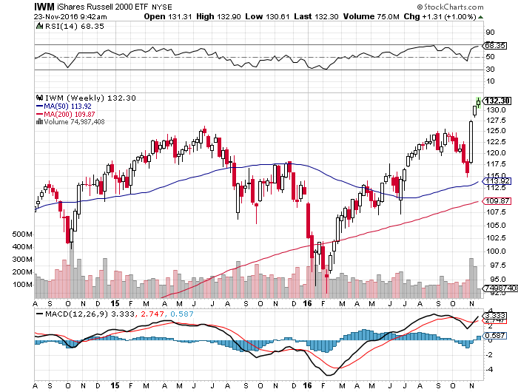
Russell 2000 (IWM)-All Time High took profits on long 11/$125-$128 vertical bear put spread

Slide 27
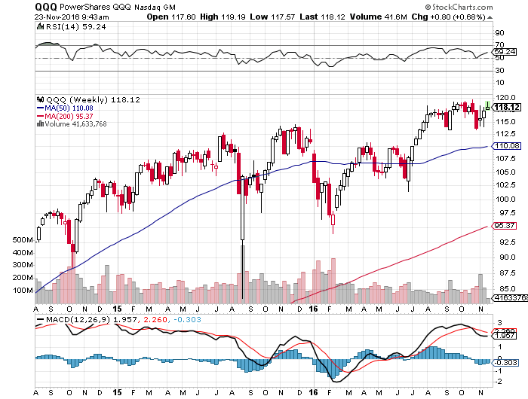
NASDAQ (QQQ)- Last Year’s Leader

Slide 28
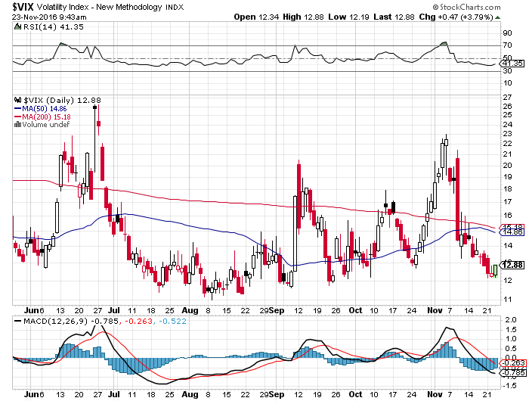
(VIX)-6 week lows, Ripe for a rebound

Slide 29
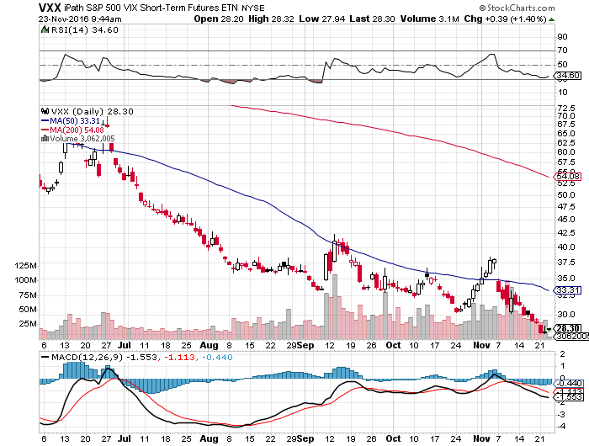
iPath S&P 500 VIX Short Term Futures ETN (VXX) took profits on long 9/$30-$33 vertical bull call spread took profits on long 10/$27-$30 call spread long 12/$24-$27 vertical bull call spread

Slide 30
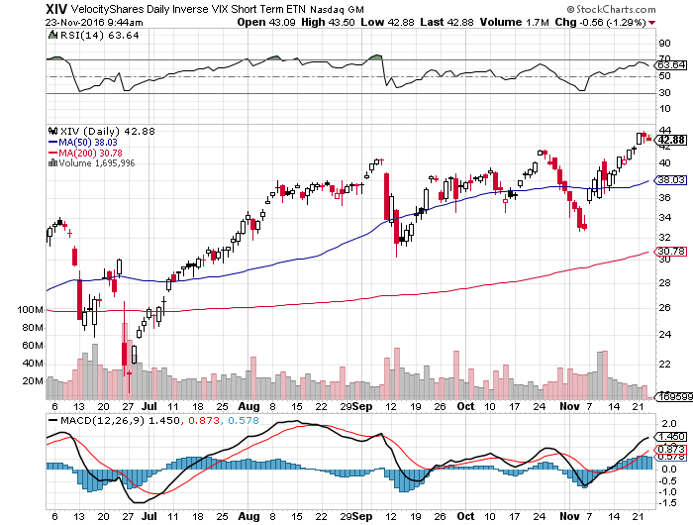
Velocity Shares Daily Inverse VIX Short Term ETN (XIV) took profits on long shares at $32.91 one of the most instantly profitable trades of 2016

Slide 31
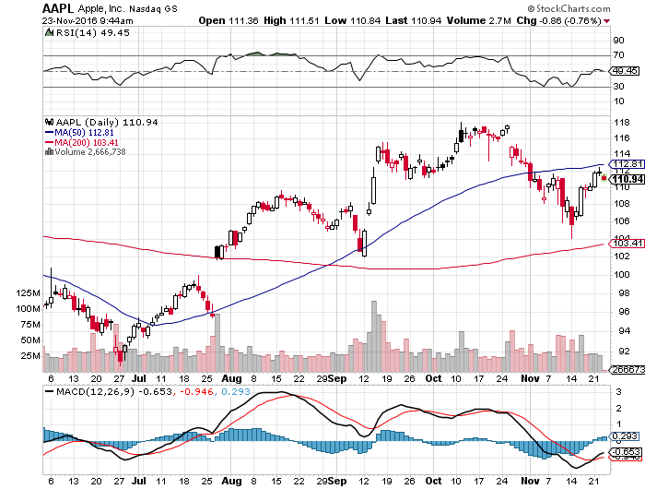
Apple (AAPL) –Buy the Rumor, Sell the News

Slide 32
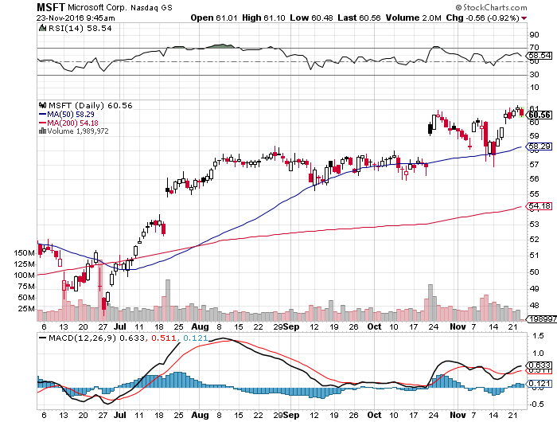
Microsoft (MSFT) In the Wong Boat

Slide 33
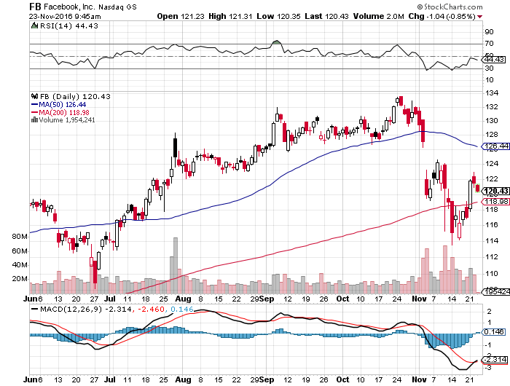
Facebook (FB)- took profits on long the 11/$114-$117 vertical bull call spread

Slide 34
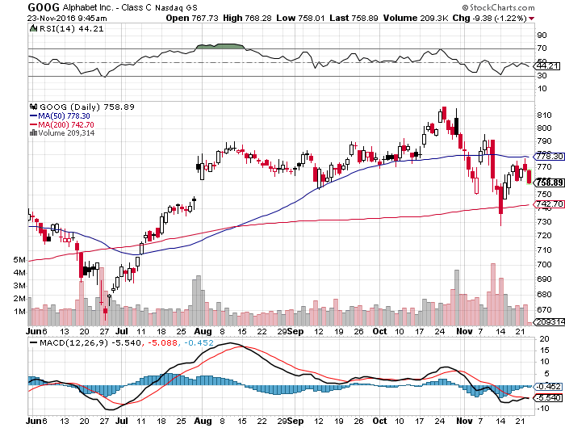
Alphabet (GOOG)-

Slide 35
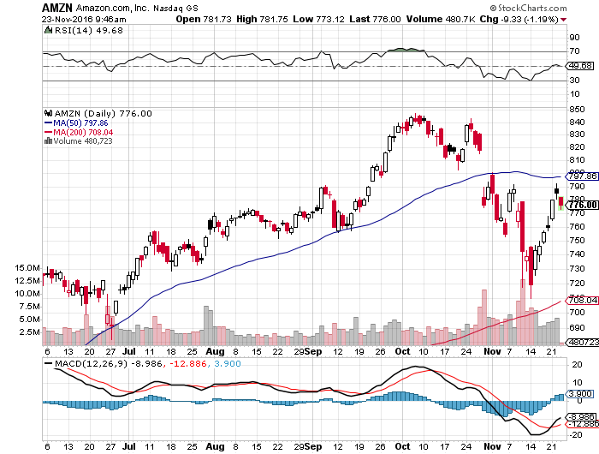
Amazon (AMZN)-

Slide 36
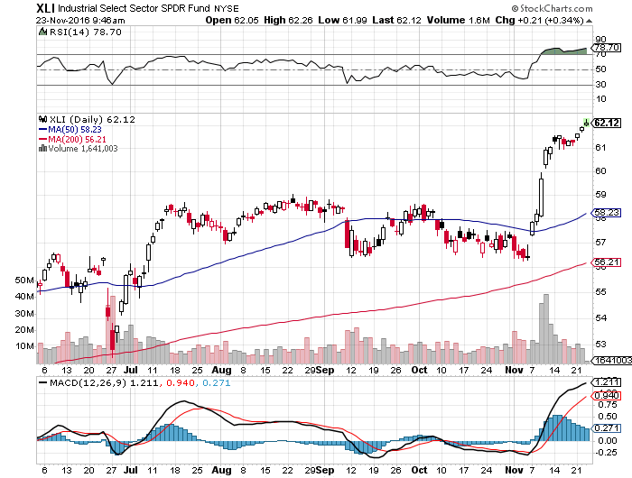
Industrials Sector SPDR (XLI)-Breakout (GE), (MMM), (UNP), (UTX), (BA), (HON)

Slide 37
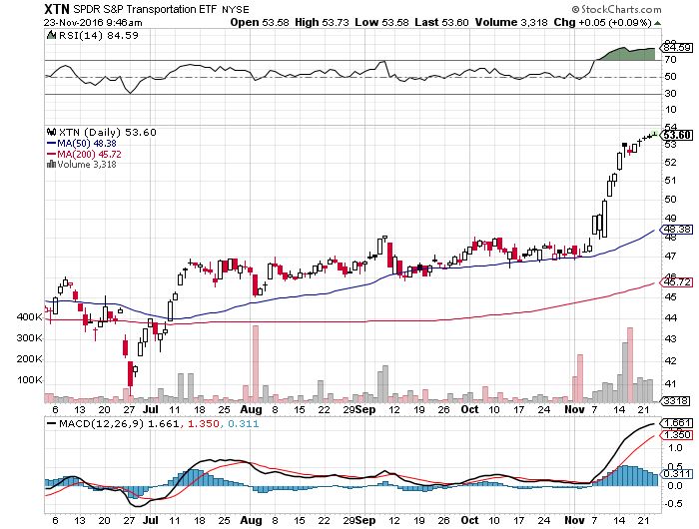
Transports Sector SPDR (XTN)- Breakout-Buffet’s New Favorite (ALGT), (ALK), (JBLU), (LUV), (CHRW), (DAL)

Slide 38
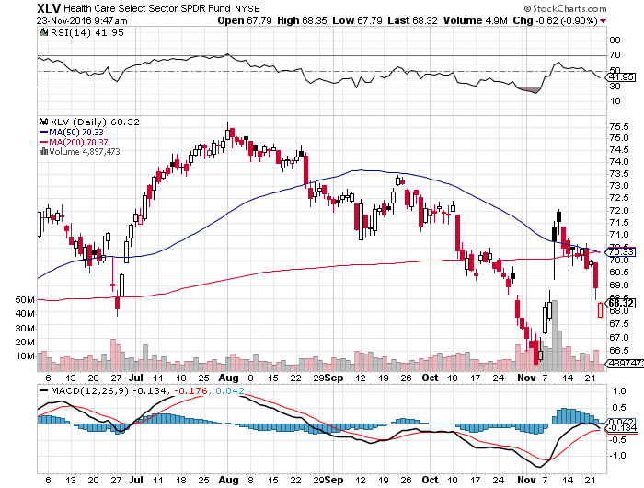
Health Care Sector SPDR (XLV), (RXL) (JNJ), (PFE), (MRK), (GILD), (ACT), (AMGN) November 8th Bottom!!

Slide 39
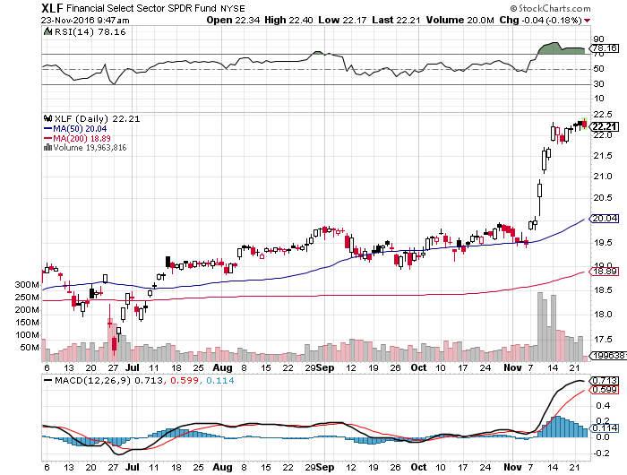
Financial Select SPDR (XLF)-The New Nirvana (BLK/B), (WFC), (JPM), (BAC), (C), (GS)

Slide 40
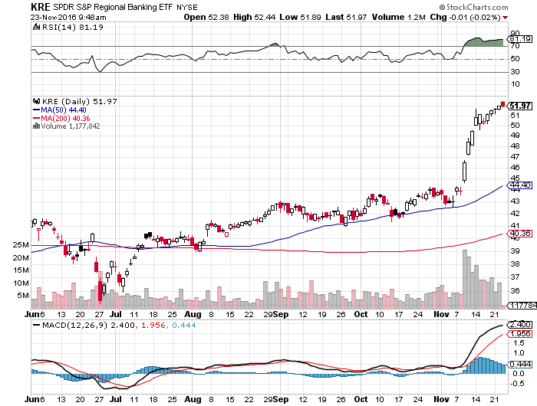
KRE Regional Bank ETF (KRE)-

Slide 41
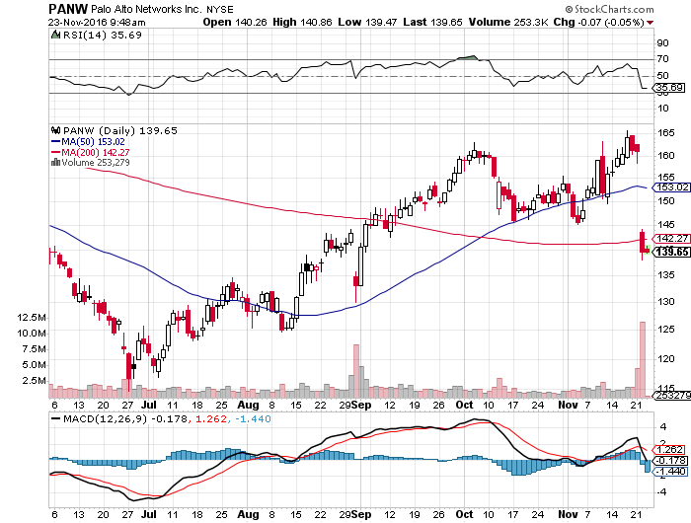
Palo Alto Networks (PANW)- Slaughtered with the rest of technology

Slide 42
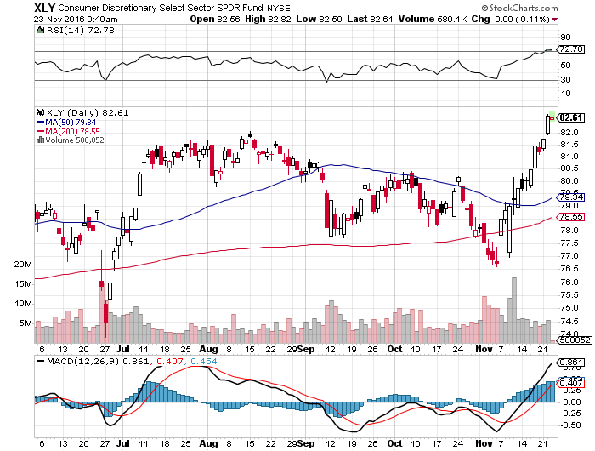
Consumer Discretionary SPDR (XLY) (DIS), (AMZN), (HD), (CMCSA), (MCD), (SBUX)

Slide 43
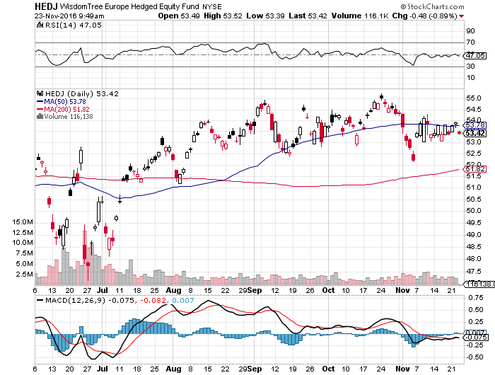
Europe Hedged Equity (HEDJ)-Cheap Euro Boost

Slide 44
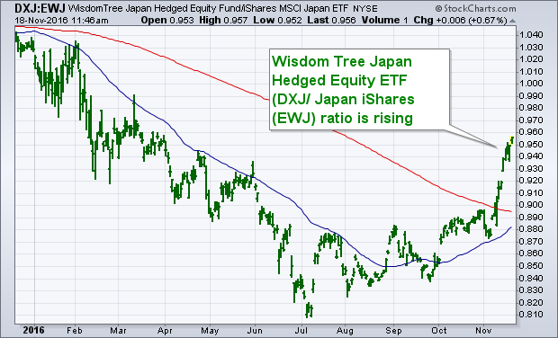
Japan (DXJ)-Cheap Yen Breakout

Slide 45
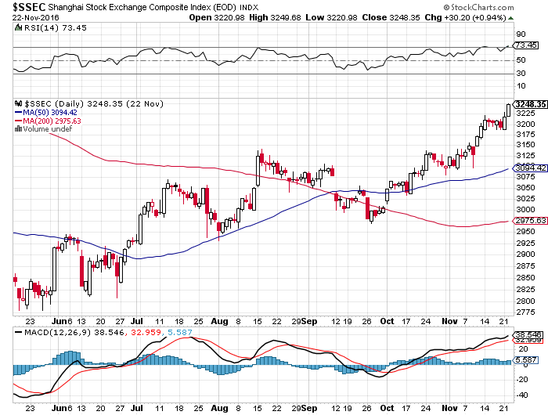
China ($SSEC)- No Trade War?

Slide 46
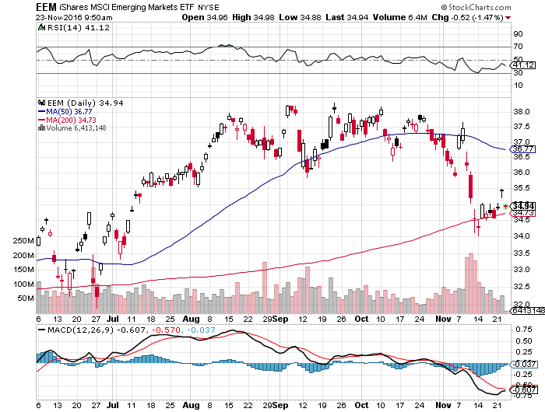
Emerging Markets (EEM)-Trashed in New World Order

Slide 47
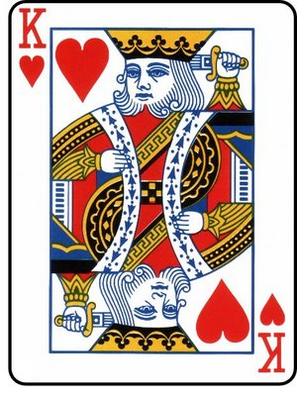
Foreign Currencies-King Dollar
*Rising US interest rates pouring money into US dollar *Euro is crushed, thank you very much *Buy the dollar on any dips *Euro now threatening parity *Short covering and lower oil prices a huge yen positive *Standing aside awaiting a better entry point, especially against the yen

Slide 48
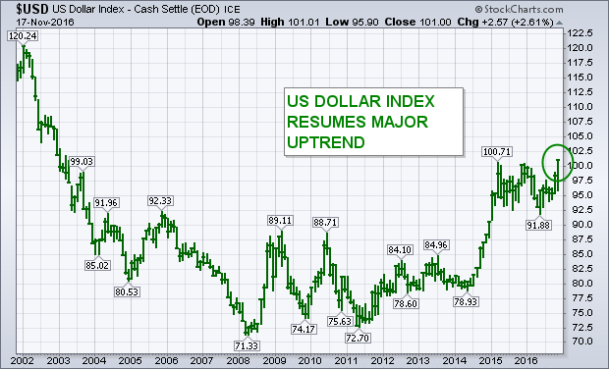
(UUP) Dollar Hits 8 Month High

Slide 49
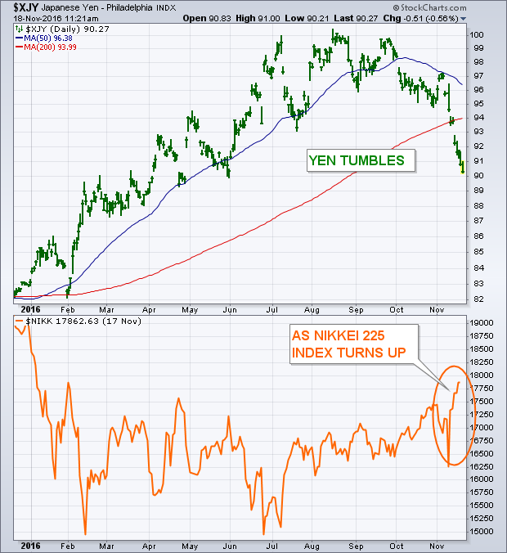
Japanese Yen (FXY)-Is This the Big One? took profits on long the 8/$97-100 put spread took profits on long the 9/$99-102 put spread

Slide 50
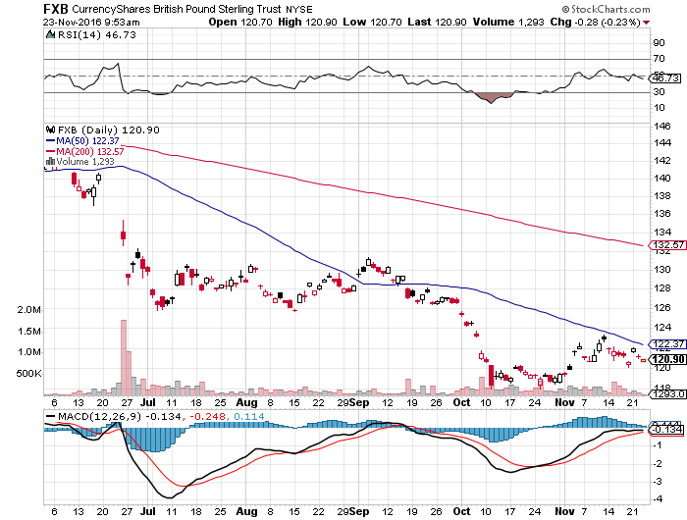
British Pound (FXB)-

Slide 51
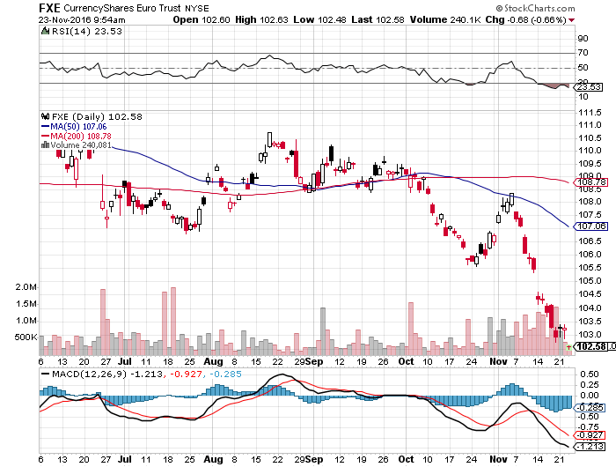
Euro ($XEU), (FXE), (EUO)- Bombs Away took profits on long the 9/$112-$115 vertical bear put spread took profits on long $11/$110-$113 vertical bear put spread

Slide 52
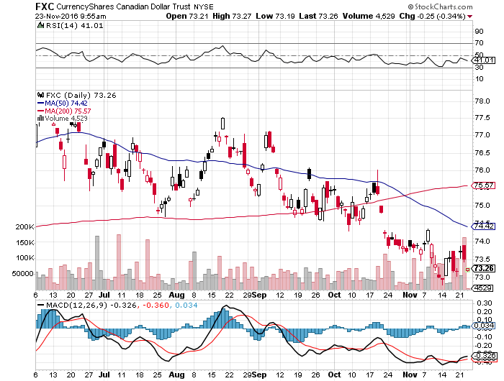
Canadian Dollar (FXC)-

Slide 53
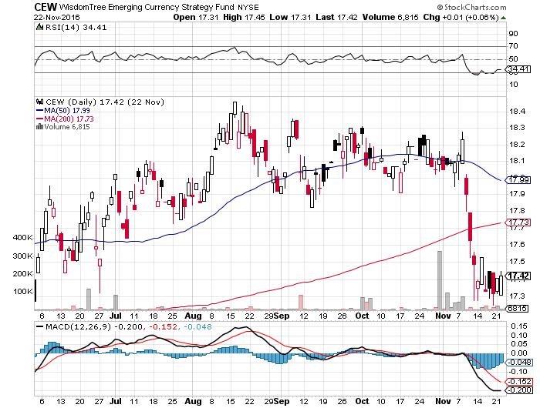
Emerging Market Currencies (CEW)

Slide 54
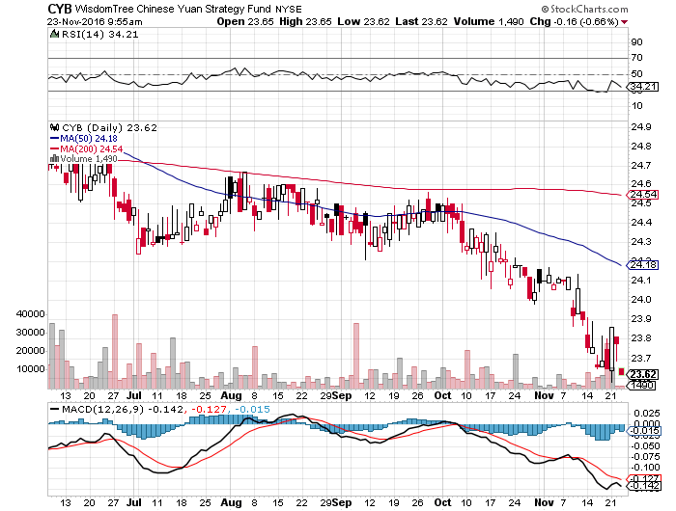
Chinese Yuan- (CYB)-Breakdown at Last

Slide 55
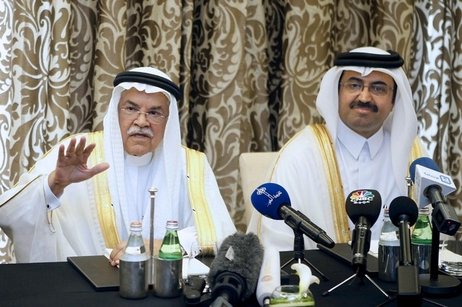
Energy-Let’s Have a Meeting!
*All hangs on the OPEC November 30 meeting, pre meeting rally puts us in the middle of the recent trading range going in *Confidence is low, so a surprise agreement, at least on paper , will send oil back to the $52 top *Trade war risk with China could dent long term demand *Inventories rocket to record levels, up 3.6 million barrels on the week *All members ramping up production going into the meeting *Oil still stuck in $40-$52 range, but we are now testing the downside

Slide 56
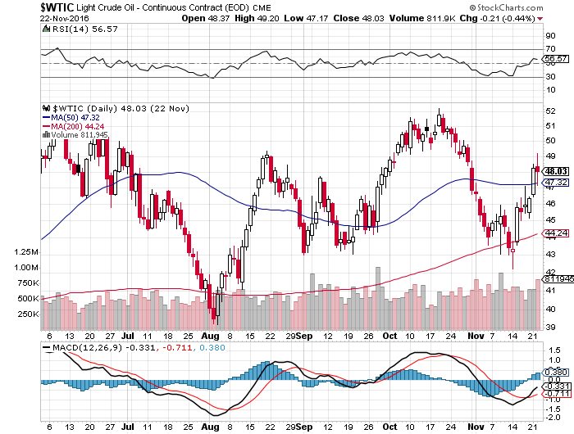
Oil-Trading of Leaks

Slide 57
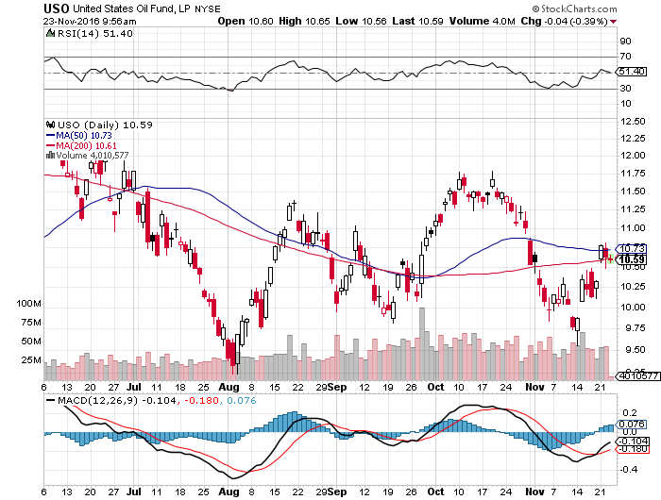
United States Oil Fund (USO) took profits on long the (USO) 11/$12.50-$14.00 vertical bear put spread

Slide 58
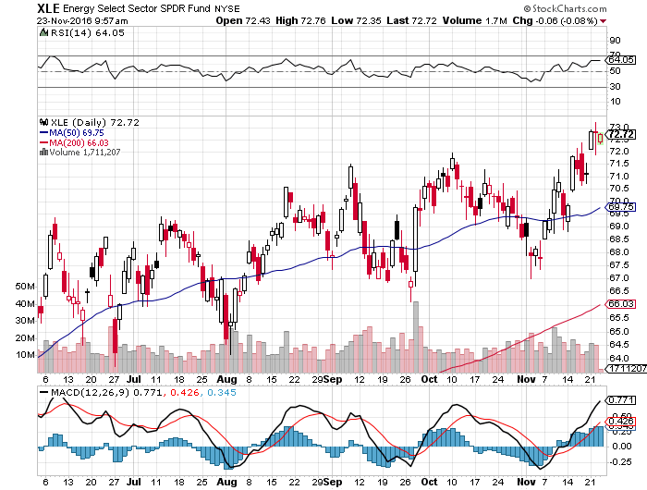
Energy Select Sector SPDR (XLE) (XOM), (CVX), (SLB), (KMI), (EOG), (COP)

Slide 59
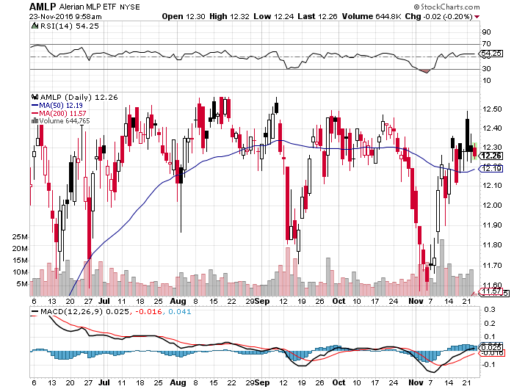
Alerian MLP ETF (AMLP)- Basket Approach is the Only Safe Play here

Slide 60
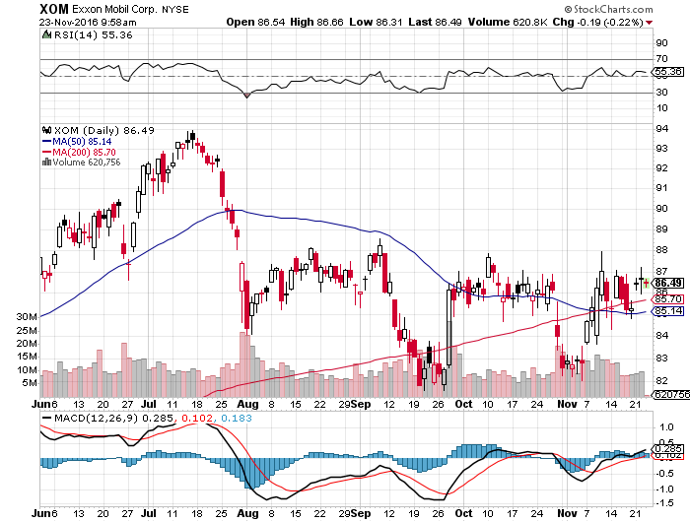
Exxon (XOM)-

Slide 61
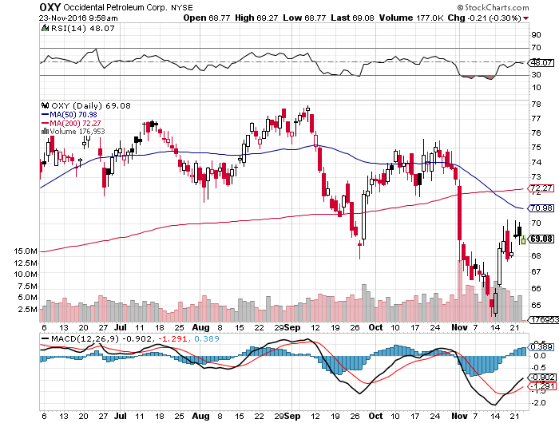
Occidental Petroleum (OXY)-

Slide 62

Natural Gas (UNG)-Bumping Against 2016 Highs

Slide 63

Copper (COPX)-Upside Breakout Candidate

Slide 64

US Steel (X)-Upside Done!

Slide 65

UnPrecious Metals-The Elevator Down
*Rising interest rate outlook could demolish gold for the foreseeable future *India’s withdrawal of two largest currency denominations to fight money laundering has triggered forced selling of gold by the world’s largest buyer *Indian government considering banning gold imports *The only good news is the gold longs in the futures market have already been dramatically shrunk *Gold may have to revisit $1,050 before the carnage is over

Slide 66

Gold (GLD)-Searching for a Bottom took profits on long 11/$112-$115 vertical bull call spread

Slide 67

Market Vectors Gold Miners ETF- (GDX)

Slide 68

Silver (SLV)-

Slide 69

Silver Miners (SIL)-

Slide 70

Agriculture-Hints of a Bottom
*Drought returns to Texas, Kansas, and Oklahoma, helping prices *Corn charts hinting at medium term bottom, now is attempting a breakout, time to buy? *As Ag prices are primarily weather driven, they usually are totally uncorrelated with financial assets, making them a great portfolio hedge

Slide 71

(CORN) – Shall We Buy?

Slide 72

(WEAT)-No Bounce

Slide 73

(SOYB)-Bouncing Along the Bottom

Slide 74

Real Estate-Pop, but then What?
*October housing starts up an amazing 255 to 1.32 million units, but is pre election data *October New Home Sales at 563,000, down -1.9% *Will the building boom continue in the face of rapidly rising interest rates? Not for years *Home mortgage rates rocket, up from 3.75% to 4.0% in a week *Home prices will accelerate first as buyers rush to beat rate rises, then eventually bring and end to this cycle *August Case Shiller -0.0% to 5.1% YOY, holding steady

Slide 75

April S&P 500/Case–Shiller Home Price Index +5.0% YOY, Portland, Seattle, Denver leaders

Slide 76

General Growth Properties (GGP) Yield Play Profit Taking

Slide 77

US Home Construction Index (ITB) (DHI), (LEN), (PHM), (TOL), (NVR) Another Rising Rate Victim-But Becoming a favorite Sector to Buy

Slide 78

Trade Sheet So What Do We Do About All This?
*Stocks- Buy dips in New Order stocks *Bonds-sell rallies on government borrowing risk *Commodities-buy dips *Currencies- sell rallies, especially yen *Precious Metals –stand aside *Volatility-buy the dip *The Ags –stand aside *Real estate-buy the dip

Slide 79

Next Strategy Webinar 12:00 EST Wednesday, December 7, 2016 San Francisco, CA Last One of the Year!
Good Luck and Good Trading!
Notes:
*

