Slide 1
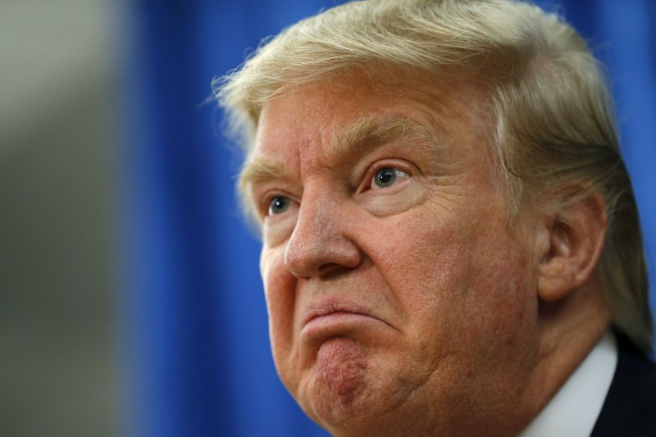
The Mad Hedge Fund Trader “The Anti Trump Trade”
With John Thomas from San Francisco, CA, January 18, 2017 www.madhedgefundtrader.com
Notes:
*

Slide 2


Slide 3

Second Edition
Is Out!
In the Store Now for $49
Sectors and Stocks that Will Lead the Market for the Next 20 Years
https://members.madhedgefundtrader.com/roaring-twenties-book/

Slide 4

Trade Alert Performance Best 4 Weeks of the Past 12 months-New All Time High!!
*January +5.77% MTD *July +0.67% Final *February +4.50% Final *August +7.52% Final *March -2.42% Final *September +0.27% Final *April -2.10% Final *October +8.13% Final *May +4.38% Final *November 4.37% Final *June -0.56% Final *December +.84% Final *2016 Year End +26.88%, *2017 Year to Date 5.77% compared to 0% for the Dow Average *Trailing 1 year return +38.54%, +224.33% since inception, *Average annualized return of 36.90%

Slide 5
Portfolio Review Small Unhedged Portfolio on top of big market moves 80% Cash
Current Capital at Risk
Risk On
World is Getting Better
(TLT) 1/$123-$126 put spread | 10.00%
(TLT) 2/$126-$129 put spread | 10.00%
(IWM) 1/$129-$$132 call spread | 10.00%
(FXY) 2/$88-$91 put spread | 10.00%
Risk Off
World is Getting Worse
Total Net Position | 40.00%
Expiration P&L 8.80%

Slide 6
Paid Subscriber Trailing 12 Month Audited Return 38.54%-Best New Year Opening Since Inception

Slide 7
73 Months Since Inception Daily Audited Performance Averaged Annualized Return +36.90%

Slide 8

The 30,000 Foot View The Really Simple Big Picture
*All assets traded “TRUMP ON” until the last trading day of 2016, stocks, the dollar, and commodities rallied *All assets have traded “TRUMP OFF” since the first trading day of 2017, bonds, gold, and yield plays have been strong *Is this a temporary sideways time correction in Trump assets? *Or is it the start of a bigger correction reflecting concerns over the viability of Trump policies?

Slide 9

Mad Options Trader
*3 Huge consecutive trading months in the weekly options *Demand for the new $2,000 a year service has been overwhelming *Email Nancy in Customer Support at support@madhedgefundtrader.com and put “MOT Upgrade” in the subject line to add the service *Nancy will calculate a pro rata credit for the balance of your remaining subscription, and then bill you for your new subscription + MOT

Slide 10

The Method to My Madness
*Running an aggressive unhedged long book into the Friday options expiration *Keeping two very deep in-the-money yen and bond February put spreads *All markets are still stagnating on top of gigantic one way moves *Looking to get into New World Order stocks on any pullback, especially financials, energy, and health care, sell short bonds, Euro, Japanese yen *Tax loss selling carry over from 2016 is almost done *Buy the election, sell the inauguration? *Swinging for singles, not home runs, don’t let the new world order make you greedy

Slide 11
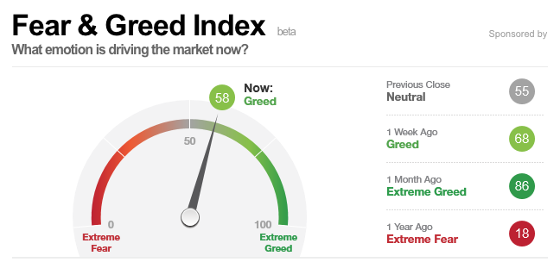
Risk is High

Slide 12
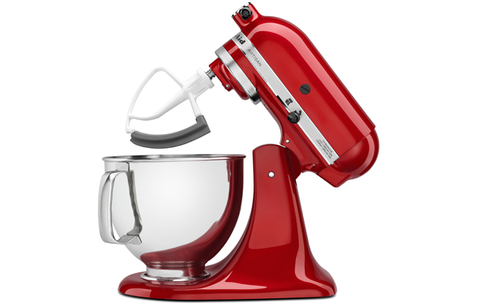
The Global Economy-Going Mixed
*December Nonfarm Payroll Report comes in neutral at 156,000, but inflation indicators show sharp uptick, with wages at a four year high *Small Business Owners Optimism surges from 12% to 50% *December Auto Sales come in at a blockbuster 18 million units annualized *Deflation still rampant in Europe, bodes well for the dollar *Collapsing currencies will be a positive for Japan and Europe, economies will accelerate, stocks will rise *The causes of the next US recession are now in view: high inflation and an interest rate spike triggered by massive new government deficit spending, but may be 2-3 years off

Slide 13
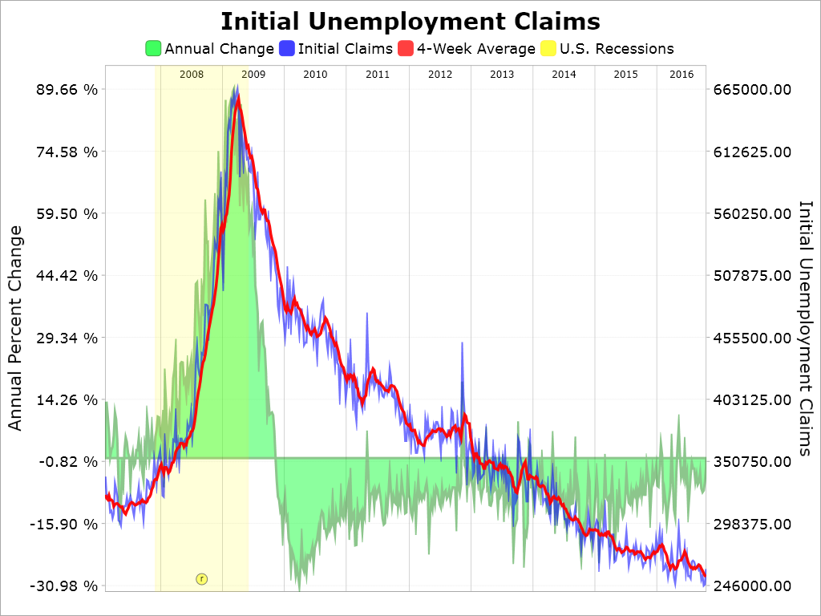
Weekly Jobless Claims –The Most Important Statistic +10,000 to 247,000- After hitting new all time low of 235,000 the week earlier

Slide 14

Bonds-Bear Market Takes a Break
*Bonds rally from the first trading day of 2017, knocking off 25 basis points in yield off the ten year Treasury *New Year portfolio reallocations into bonds should finish shortly, giving us another leg to the bear market *2.65% is a key upside resistance point, targeting 3.0%, but could take months to unfold *Super strong dollar is also providing some bond support *We are six months into a 10-20 year bear market in bonds, (TLT) should drop from $120 to under $100 in 2017 *Flight to junk taking place as bond investors hide out in the stock market *Emerging debt still punished as risk of trade war looms

Slide 15
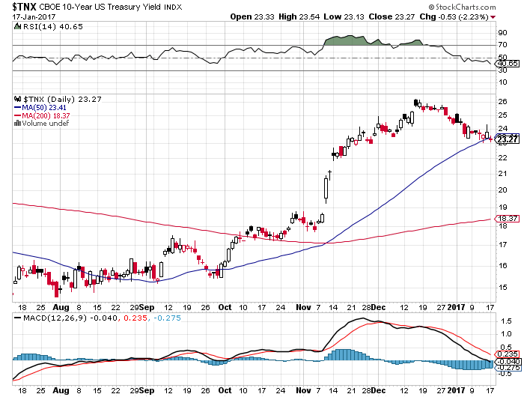
Ten Year Treasury Yield ($TNX) 2.46% Correction

Slide 16
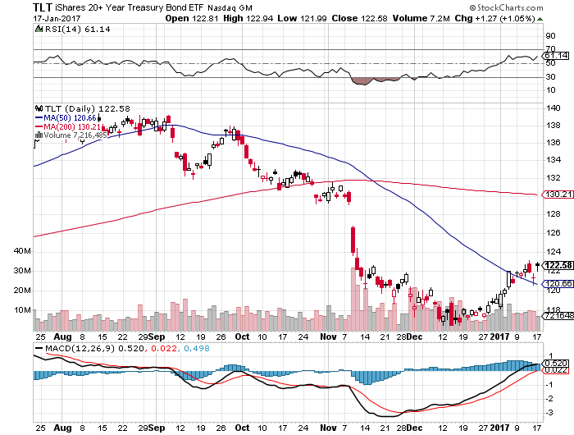
Ten Year Treasury ETF (TLT) 2.46% long 2/$126-$129 vertical bear put spread long 1/$123-$126 vertical bear put spread-expires in 2 days

Slide 17
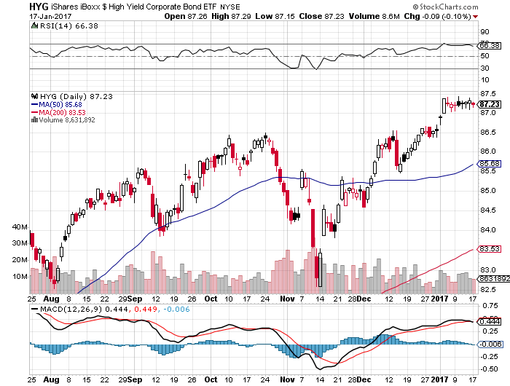
Junk Bonds (HYG) 5.46% Yield A Great Risk Coincident Indicator- “RISK ON” means new highs, buy all dips

Slide 18
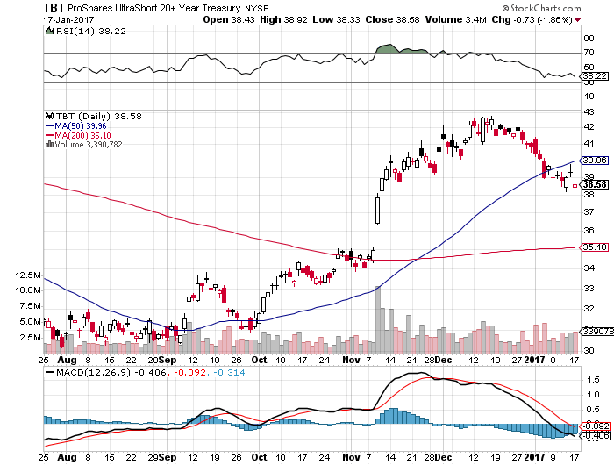
2X Short Treasuries (TBT)

Slide 19
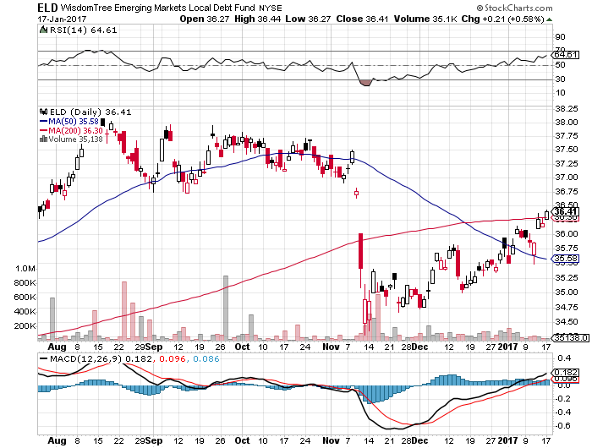
Emerging Market Debt (ELD) 7.13% Yield- crawling back with the anti-Trump trade

Slide 20
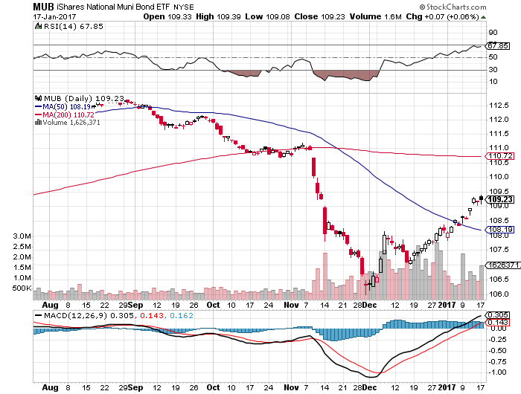
Municipal Bonds (MUB)-2.14% yield-almost doubled Mix of AAA, AA, and A rated bonds

Slide 21

Stocks-The Anti Trump Trade Makes a Comeback
*Market is carrying out a sideways correction with an eventual upside breakout to a new high *Technology makes a big comeback since the New Year, with dip buyers emerging en masse, are major beneficiaries of repatriation and lower corporate tax rates *Trump leaders, financials and energy, pause, thanks to the bond market rally and weaker oil prices *Seven Trump words knock $100 billion off of value pharma and health cares stocks *It will take years for pension and mutual funds to rebalance weighting to reflect the new political reality, look for (SPX) $2,500 by yearend *All price gains since November 8 have been from multiple expansion, creates a very high risk market *Nirvana has S&P 500 earnings soaring from $123 to $140 a share

Slide 22
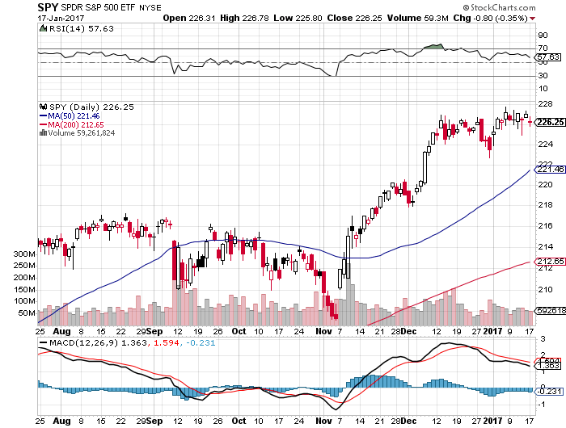
S&P 500-New All Time High Deferred 2016 Tax Loss Selling Kicking in took profits on long 11/$220-$223 put spread took profits on long 1/$219-$222 call spread

Slide 23
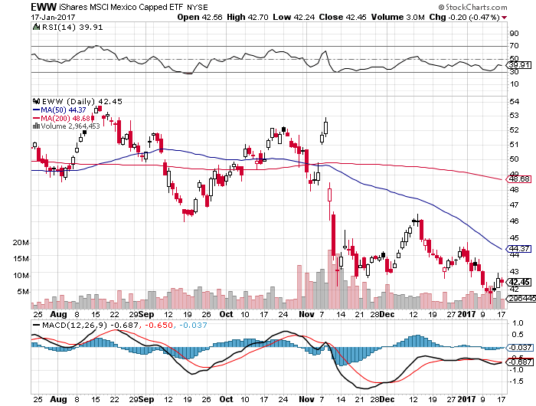
iShares MSCI Mexico ETF (EWW)-Trump Policy Benchmark

Slide 24
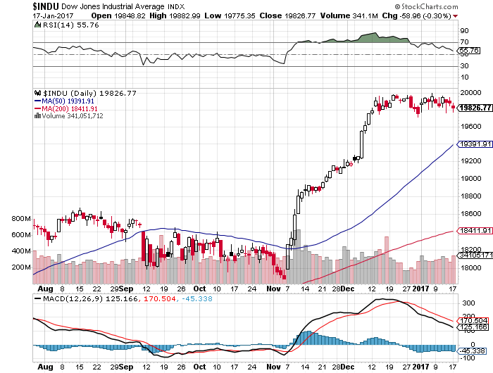
Dow Average-Break Out

Slide 25
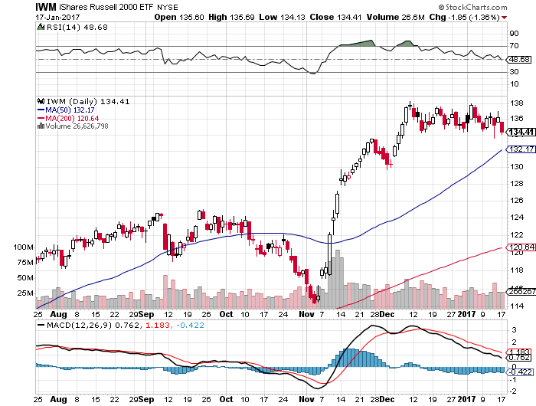
Russell 2000 (IWM)-All Time High took profits on long 11/$125-$128 vertical bear put spread

Slide 26
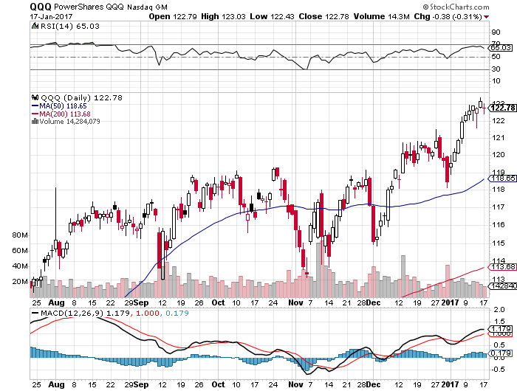
NASDAQ (QQQ)- Last Year’s Leader

Slide 27
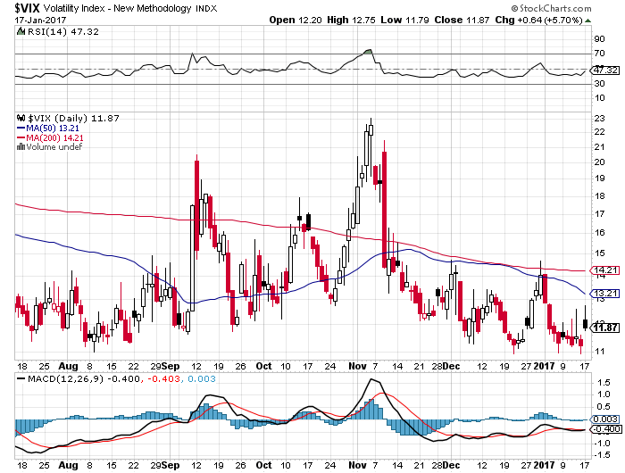
(VIX)-6 week lows-Holiday Drag

Slide 28
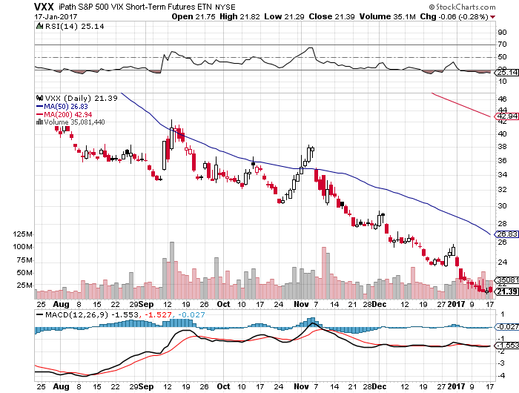
iPath S&P 500 VIX Short-Term Futures ETN (VXX) took profits on long 10/$27-$30 call spread stopped out of long 12/$24-$27 vertical bull call spread

Slide 29
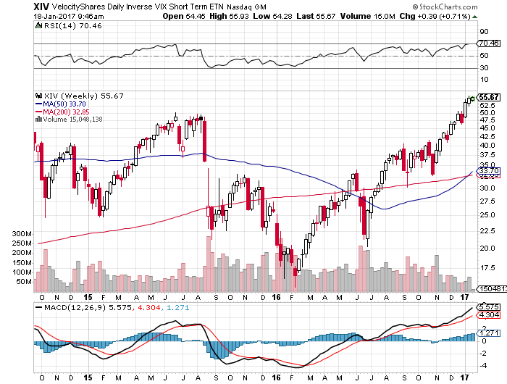
Velocity Shares Daily Inverse VIX Short Term ETN (XIV) took profits on long shares at $32.91 one of the most instantly profitable trades of 2016

Slide 30
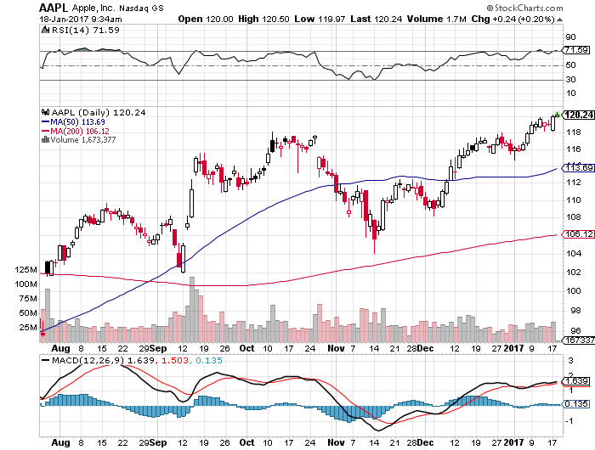
Apple (AAPL) –Back in Fashion took profits on long 1/$111-$114 call spread

Slide 31
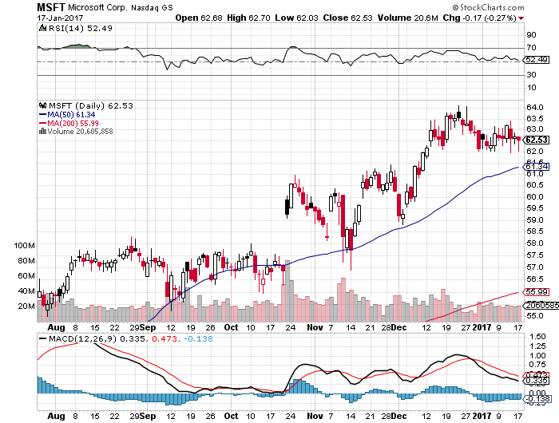
Microsoft (MSFT)

Slide 32
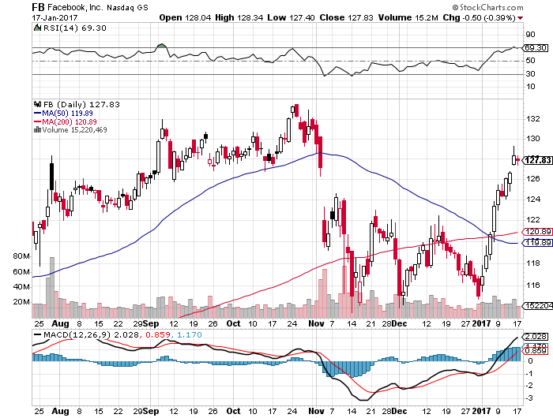
Facebook (FB)- took profits on long 11/$114-$117 vertical bull call spread

Slide 33
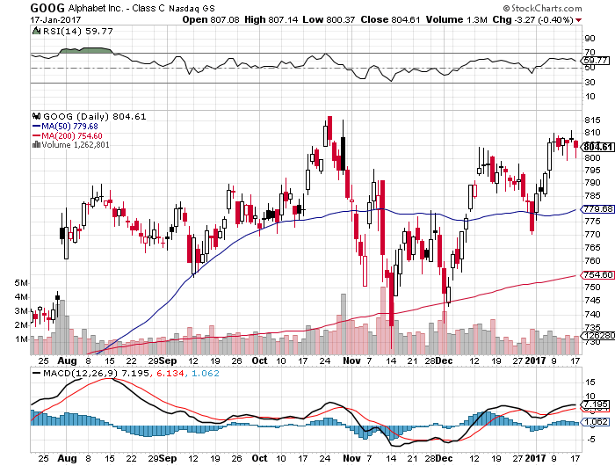
Alphabet (GOOG)-

Slide 34
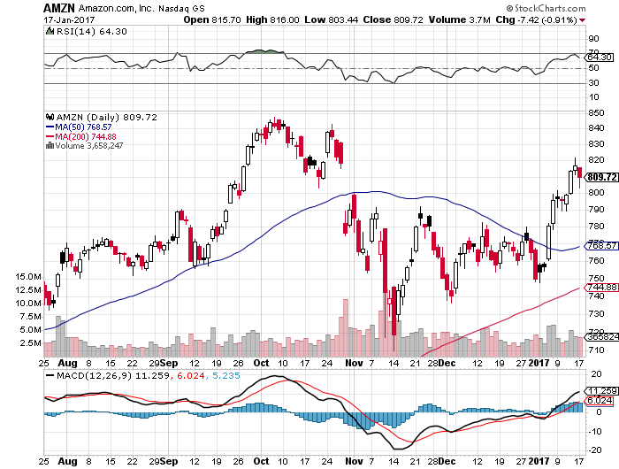
Amazon (AMZN)- took profits on long the 1/$740-$760 vertical bull call spread

Slide 35
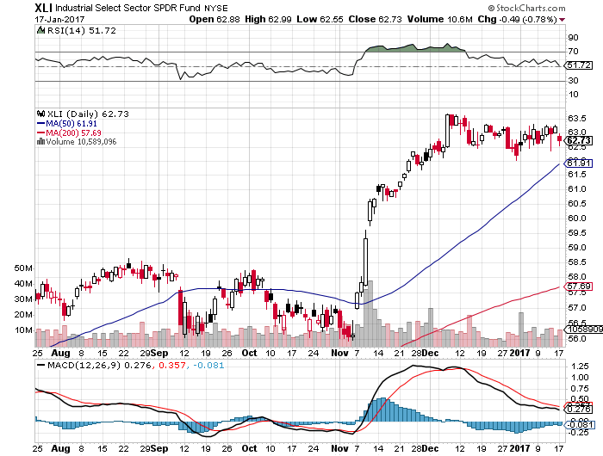
Industrials Sector SPDR (XLI)-Breakout (GE), (MMM), (UNP), (UTX), (BA), (HON)

Slide 36
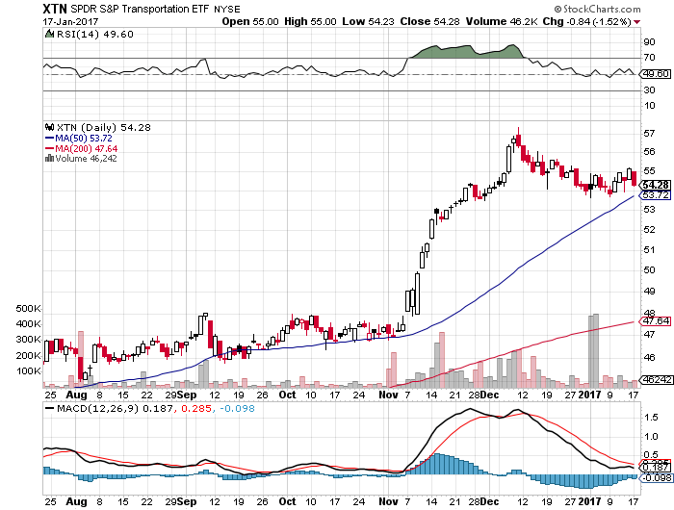
Transports Sector SPDR (XTN)- Breakout-Buffet’s New Favorite (ALGT), (ALK), (JBLU), (LUV), (CHRW), (DAL)

Slide 37
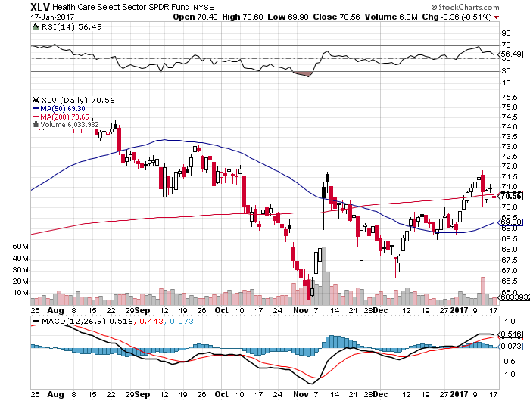
Health Care Sector (XLV), (RXL) (JNJ), (PFE), (MRK), (GILD), (ACT), (AMGN) November 8th Bottom!!

Slide 38
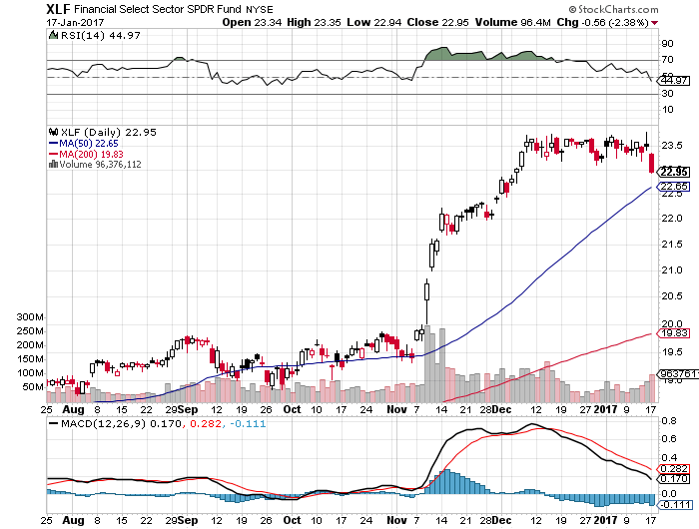
Financial Select SPDR (XLF)-Buy the Rumor, Sell the News (BLK/B), (WFC), (JPM), (BAC), (C), (GS)

Slide 39
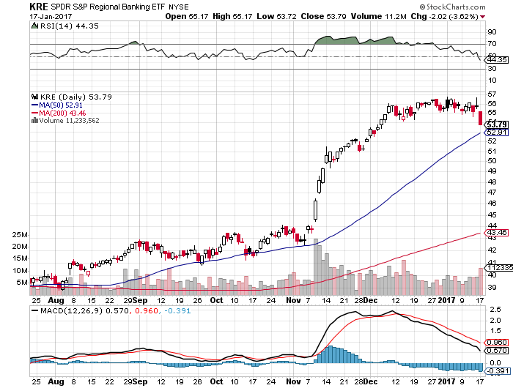
KRE Regional Bank ETF (KRE)-

Slide 40
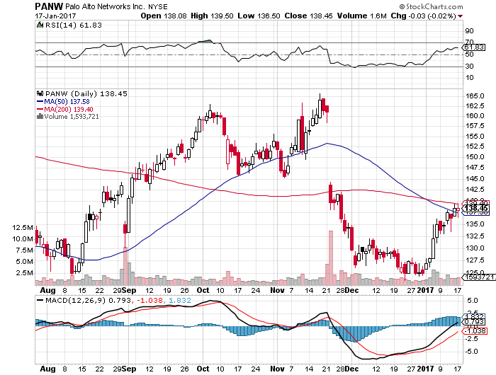
Palo Alto Networks (PANW)- took profits on long 1/$126-$129 all spread

Slide 41
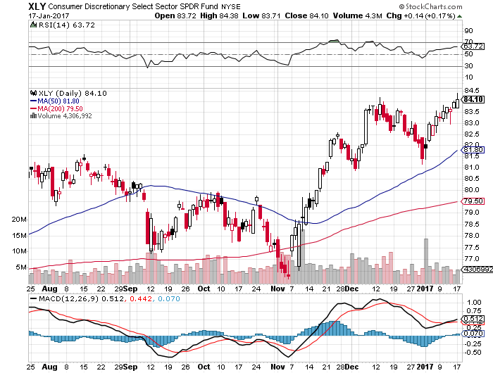
Consumer Discretionary SPDR (XLY) (DIS), (AMZN), (HD), (CMCSA), (MCD), (SBUX)

Slide 42
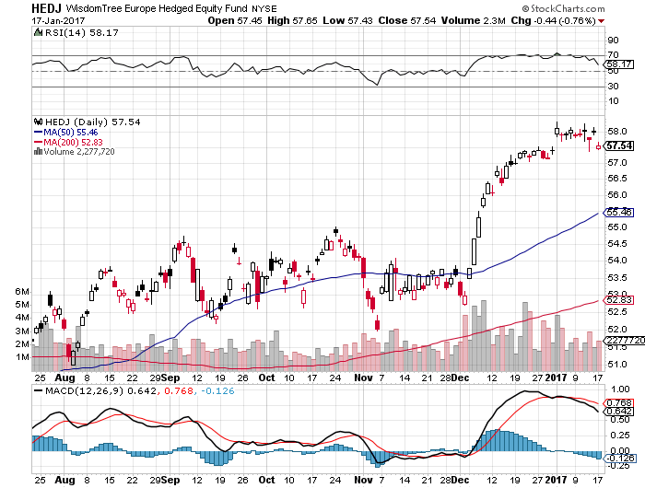
Europe Hedged Equity (HEDJ)-Cheap Euro Boost

Slide 43
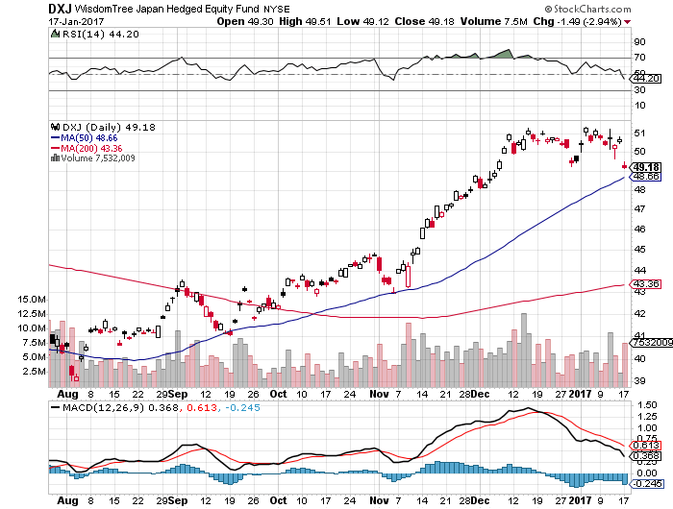
Japan (DXJ)-Cheap Yen Breakout

Slide 44
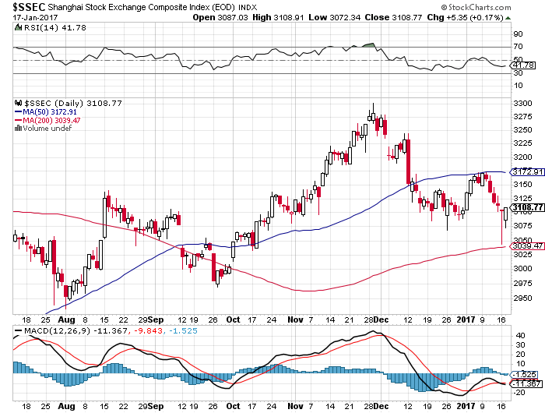
China ($SSEC)- Trade War is Back

Slide 45
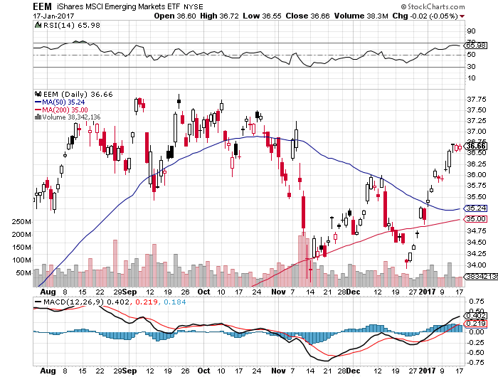
Emerging Markets (EEM)-Love Those Rising Rates

Slide 46

Foreign Currencies-It’s All Politics
*Trump Tweets that the dollar is too high, triggering an immediate correction *Also argues that Republican cross border tax plan is too complicated, favoring straight tariffs. *Falling bond interest rates add fuel to the fire *Interest rate differentials will overwhelmingly favor the dollar for two more years *Buy the dollar on any dips, next leg up could come with the Feb Fed meeting *Got a great entry point for the yen and went short

Slide 47
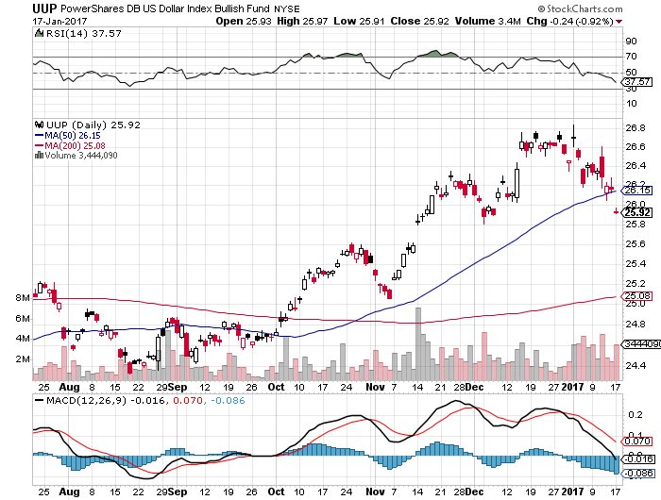
US Dollar Basket-(UUP)

Slide 48
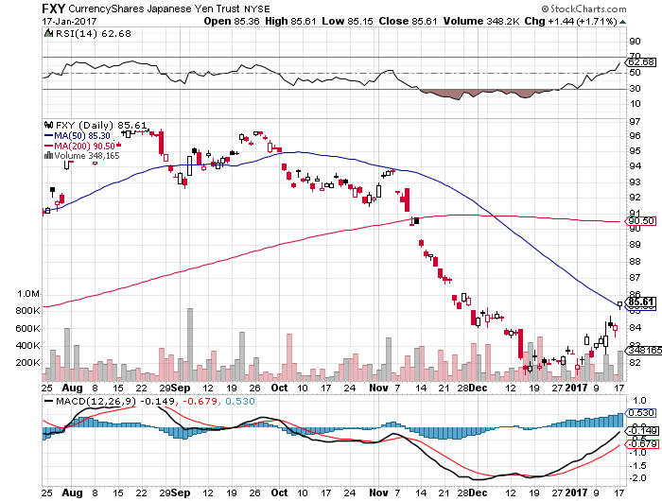
Japanese Yen (FXY)-Is This the Big One? long the 2/$88-$91 put spread

Slide 49
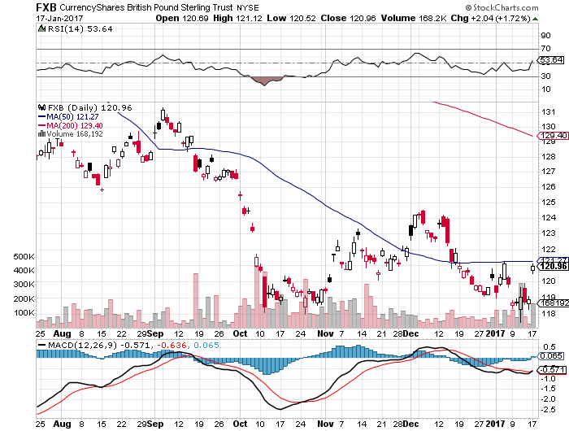
British Pound (FXB)- hard Brexit speech triggers monster melt up

Slide 50
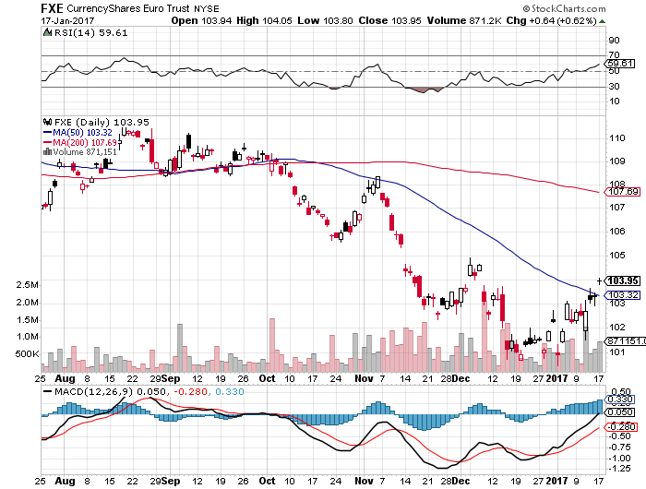
Euro ($XEU), (FXE), (EUO)- Bombs Away took profits on long the 9/$112-$115 vertical bear put spread took profits on long $11/$110-$113 vertical bear put spread

Slide 51
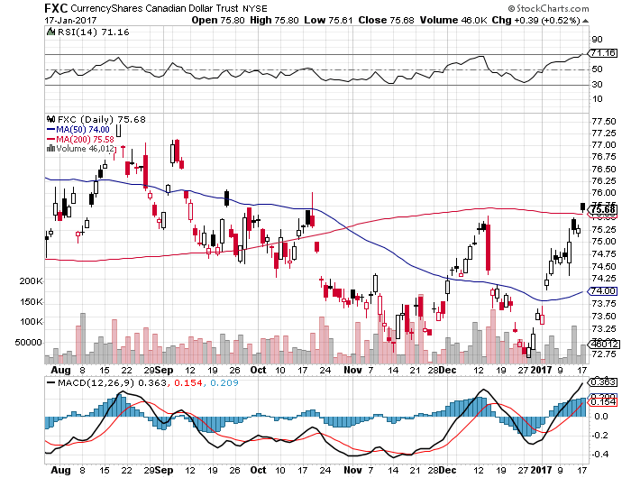
Canadian Dollar (FXC)-

Slide 52
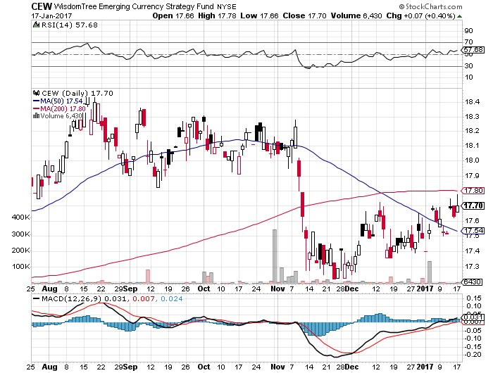
Emerging Market Currencies (CEW)

Slide 53
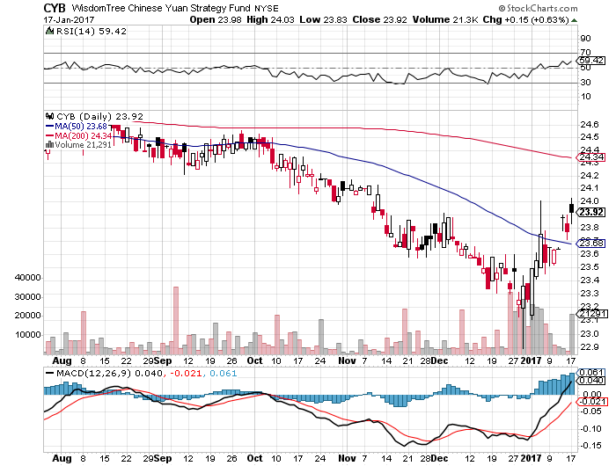
Chinese Yuan- (CYB)-Bounce at Last

Slide 54
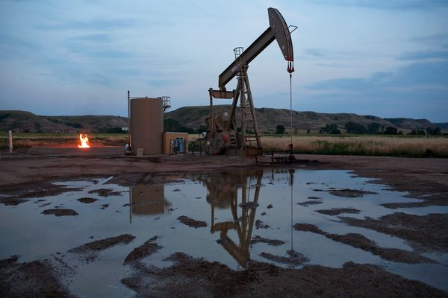
Energy-Topping Out
*Another round of OPEC quota cuts is in the works, as the first round worked so well, US tax selling on 2016 profit carry over holding back prices *Higher oil is discounting a stronger global recovery and an extremely pro energy incoming US administration *US rig count has been rising weekly for nine months now, will weigh on prices *Frigid US temperatures have been another help *Strong dollar has yet to hit oil prices, will do so shortly *Oil still stuck in $45-$65 range, but we are now testing $54 *Energy stocks are already discounting $65

Slide 55
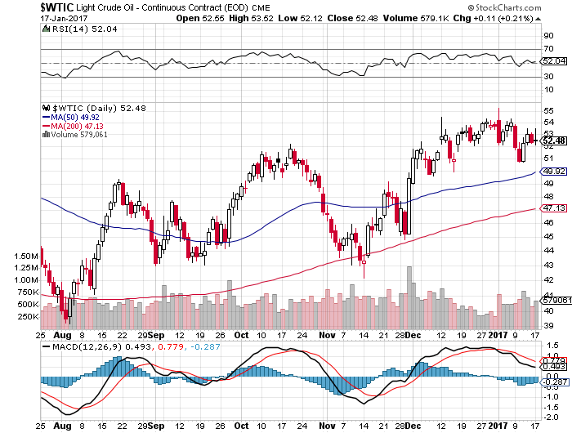
Oil-Top of Range-Topping Out

Slide 56
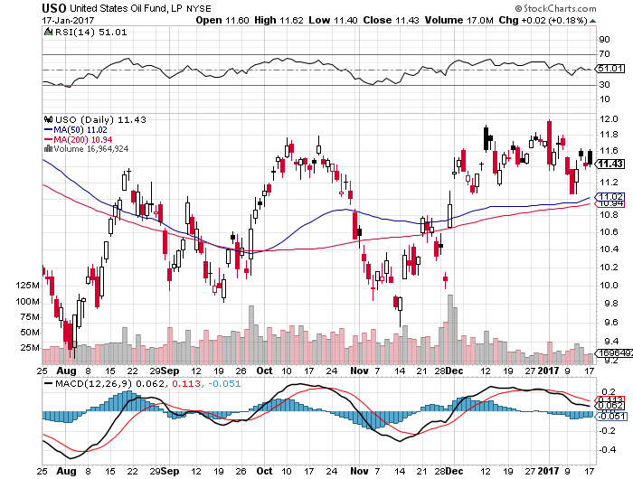
United States Oil Fund (USO) took profits on long the (USO) 11/$12.50-$14.00 vertical bear put spread

Slide 57
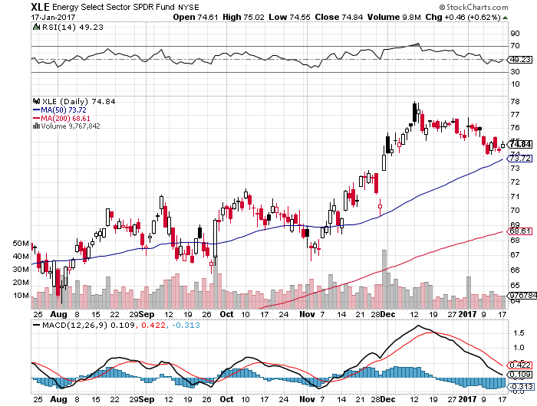
Energy Select Sector SPDR (XLE) (XOM), (CVX), (SLB), (KMI), (EOG), (COP)

Slide 58
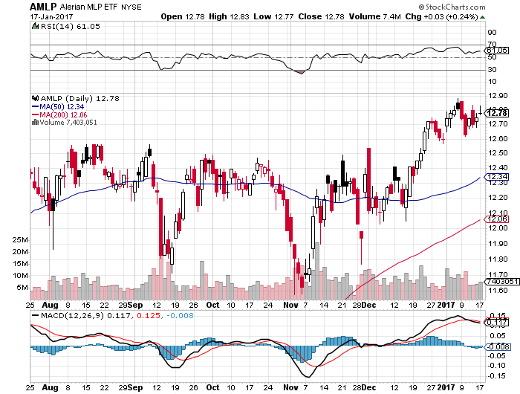
Alerian MLP ETF (AMLP)- Basket Approach is the Only Safe Play here

Slide 59
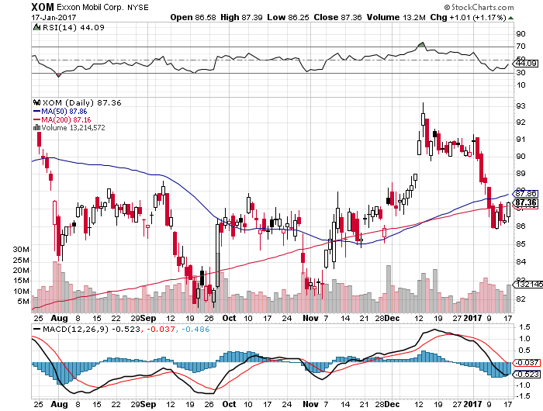
Exxon (XOM)-

Slide 60
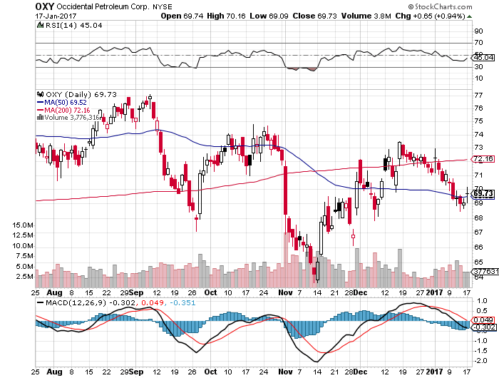
Occidental Petroleum (OXY)-

Slide 61
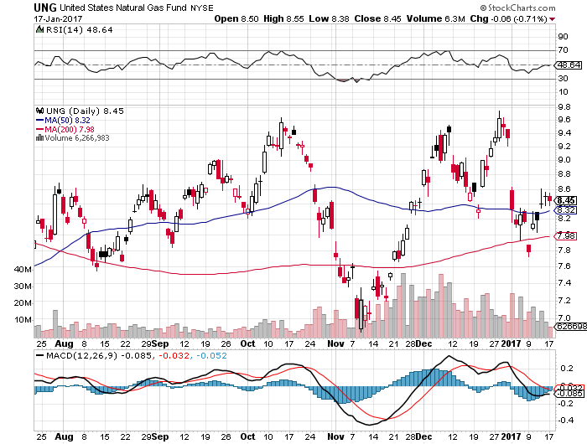
Natural Gas (UNG)-Bumping Against 2016 Highs down 13% on first day of the year

Slide 62
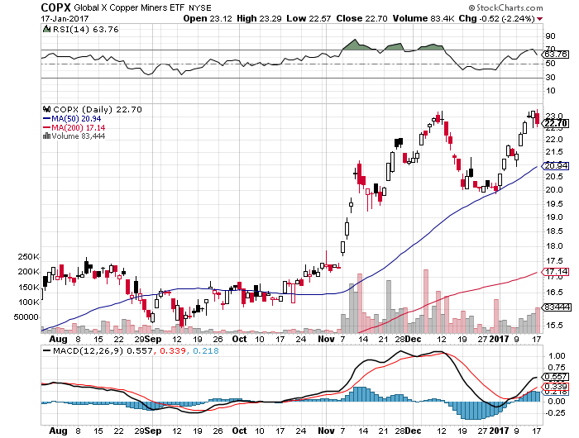
Copper (COPX)-Double TOP?

Slide 63

US Steel (X)-Upside Breakout!

Slide 64

Precious Metals-New Life!
*Anti- Trump trade gives gold a new lease on life *$1,000 holds up again *Many technical chart services say the bull market has resumed *Speculative positions in gold starting to rebuild, and producers cutting back hedges *White metals very strong on December 18 million car production annual rate *The new flight to safety trade is now Bitcoins and not gold

Slide 65

Gold (GLD)-Searching for a Bottom took profits on long 11/$112-$115 vertical bull call spread

Slide 66

Palladium ETF- (PALL) - Used for catalytic converters

Slide 67

Market Vectors Gold Miners ETF- (GDX)

Slide 68

Silver (SLV)-

Slide 69

Silver Miners (SIL)-

Slide 70

Agriculture-More New Reasons to Fall
*Huge cold wave across the US finally gives a bounce in prices *Heavy rains in Brazil and Argentina also helping prices *Don’t chase, this is not a new bull market *Low prices prompting massive shift out of corn into soybeans, some 2-7 million acres in plantings *USDA Supply & Demand Report predicts large scale cuts in all crops in 2017 due to weak prices *Massive rains in California helping west coast crops *Stay away

Slide 71

(CORN) – Shall We Buy?

Slide 72

(WEAT)-Weak Dollar and bad weather

Slide 73

(SOYB)-Bouncing Along the Bottom

Slide 74

Real Estate-The Grind Up Continues
*2017 bond rally and interest rate dip creates a refi window, mortgage applications up 5.8% in latest week *Homebuilder confidence down 2 points as post election euphoria wanes *The building boom will continue in the face of rapidly rising interest rates for years *Billions in new home equity spilling over into rising consumer spending *Home prices will accelerate first as buyers rush to beat rate rises, then eventually bring an end to this cycle *Homes are the best place to hide during an inflation surge

Slide 75

October S&P 500/Case–Shiller Home Price Index +5.0% YOY, Portland, Seattle, Denver leaders

Slide 76

General Growth Properties (GGP) Not Buying the Rally in Yields

Slide 77

US Home Construction Index (ITB) (DHI), (LEN), (PHM), (TOL), (NVR) Another Rising Rate Victim-But Becoming a favorite Sector to Buy

Slide 78

Trade Sheet So What Do We Do About All This?
*Stocks- Buy dips in New World Order stocks *Bonds-sell rallies on government deficit risk *Commodities-buy dips *Currencies- sell rallies, especially yen *Precious Metals –stand aside *Volatility-buy the dip *The Ags –stand aside *Real estate-buy the dip

Slide 79

Next Strategy Webinar 12:00 EST Wednesday, February 1, 2017 San Francisco, CA
Good Luck and Good Trading!
Notes:
*

