Slide 1
The Mad Hedge Fund Trader “Happy New Year!”
With John Thomas from San Francisco, CA, January 4, 2017 www.madhedgefundtrader.com
Notes:
*

Slide 3
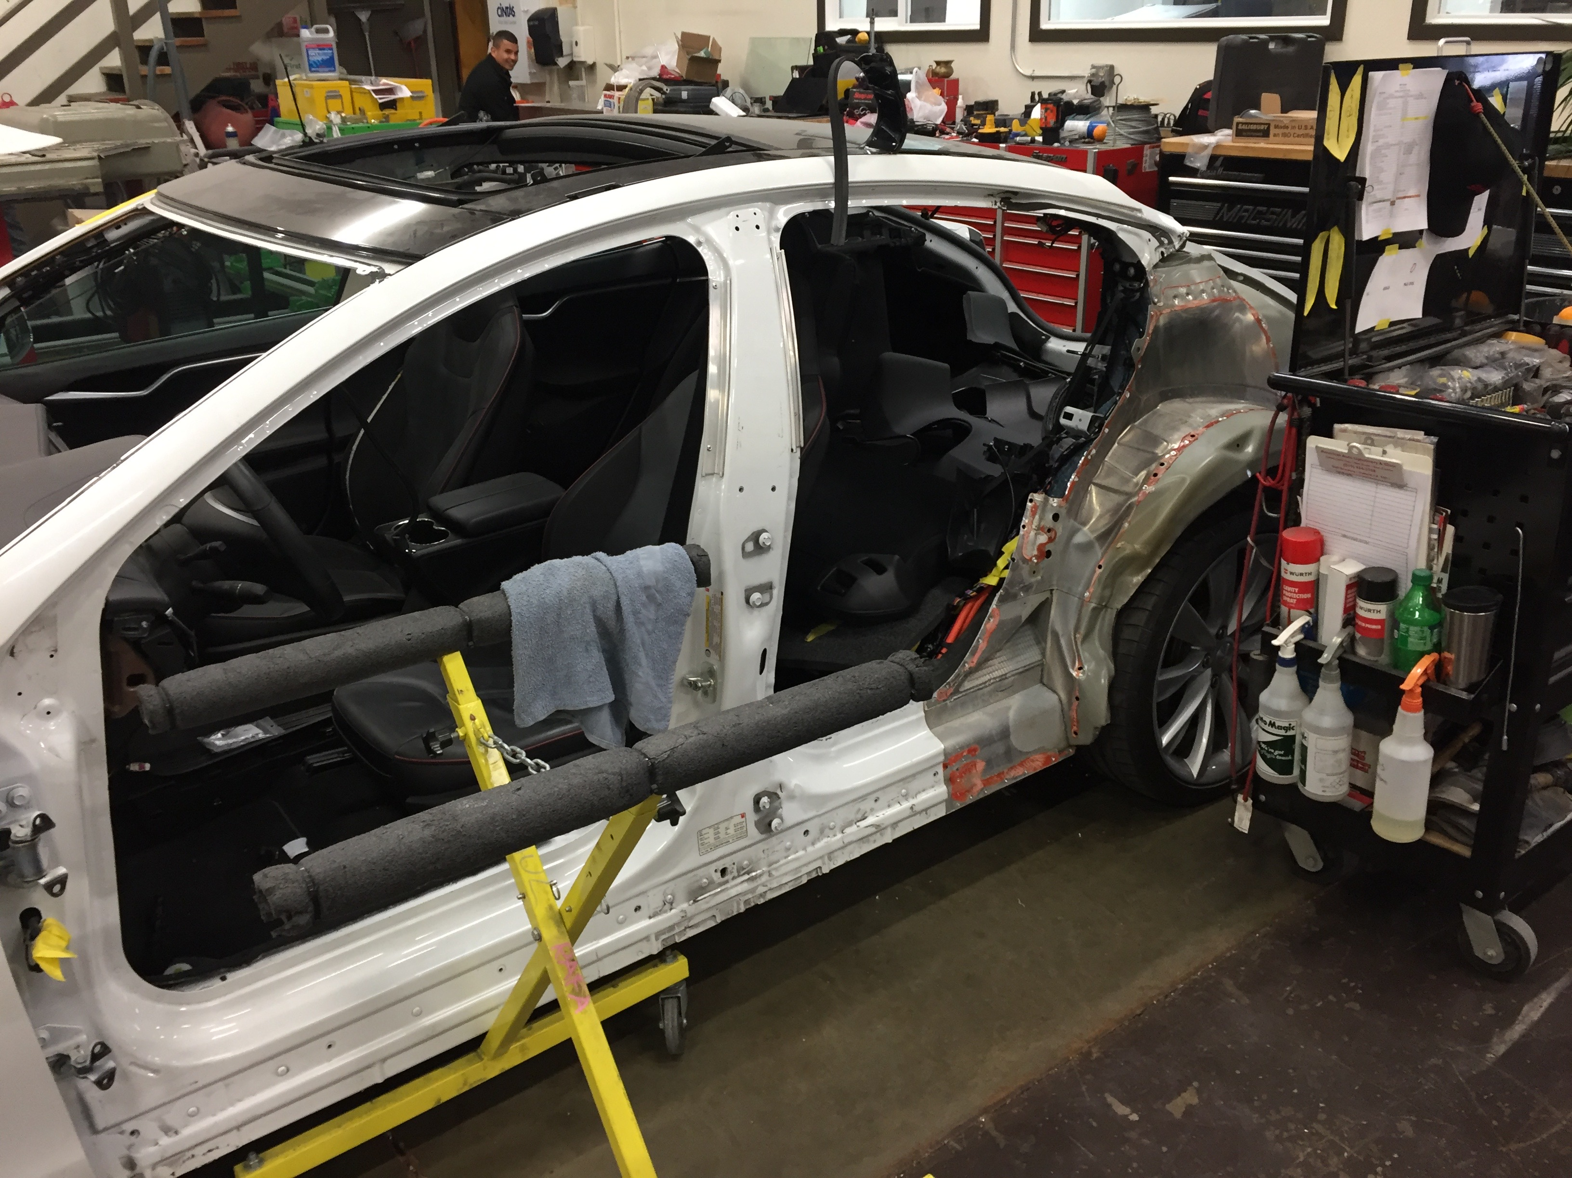

Slide 4
Second Edition
Is Out!
In the Store Now for $49
Sectors and Stocks that Will Lead the Market for the Next 20 Years
https://members.madhedgefundtrader.com/roaring-twenties-book/

Slide 5
Trade Alert Performance Best 4 Weeks of the Past 12 months-New All Time High!!
*January +0.65% MTD *July +0.67% Final *February +4.50% Final *August +7.52% Final *March -2.42% Final *September +0.27% Final *April -2.10% Final *October +8.13% Final *May +4.38% Final *November 4.37% Final *June -0.56% Final *December +.84% MTD *2016 Year End +26.88%, *2017 Year to Date 0.65% compared to 10.43% for the Dow Average *Trailing 1 year return +26.88%, +218.56% since inception, *Average annualized return of 35.92%

Slide 6
Portfolio Review Small Unhedged Portfolio on top of big market moves 80% Cash
Current Capital at Risk
Risk On
World is Getting Better
(SPY) 1/$219-$222 call spread | 10.00%
(TLT) 1/$123-$126 put spread | 10.00%
Risk Off
World is Getting Worse
Total Net Position | 20.00%
Expiration P&L 3.08%

Slide 7
Paid Subscriber Trailing 12 Month Audited Return 26.88%-Best 6 Month Run Since Inception

Slide 8
73 Months Since Inception Daily Audited Performance Averaged Annualized Return +35.92%

Slide 9
The Method to My Madness
*Running a small unhedged book with performance at all time highs on top of monster market moves *All markets are stagnating on top of gigantic one way moves *Looking to get into New World Order stocks on any pullback, especially financials, energy, and health care, sell short bonds, Euro, Japanese yen *Tax loss selling carry over from 2016 is overhanging the market, should clear out this week *Buy the election, sell the inauguration? *Swinging for singles, not home runs, don’t let the new world order make you greedy

Slide 10
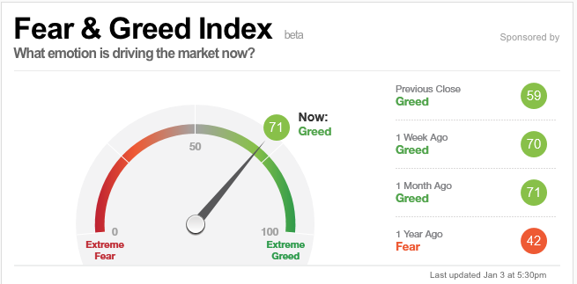
Risk is High

Slide 11
The Bill Davis View An $1,500 Upgrade for the Mad Day Trader Service
Buys:
Apple, Inc (AAPL) $116 Target to $125
Workday, Inc (WDAY) $70 Target to $80
CNO Financial (CNO) $18 Target to $22
Monster Beverage (MNST) $44 Target to $58
Western Digital (WDC) $65 Target to $87
Beazer Homes (BZH) $12 Target to $17
Sells:
Tractor Supply (TSCO) $83 Target to $58
Dollar Tree, Inc. (DLTR) $84 Target to $73
Verisign, Inc (VRSN) $82 Target to $67
VF Corp (VFC) $59 Target to $50
Chipotle Mexican (CMG) $385 Target to $358

Slide 12
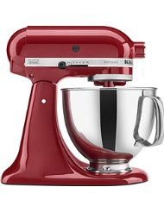
The Global Economy-Going Mixed
*US economy starting to turn from strong to mixed, Consumer Spending dropped from 0.3% to 0.2%, consumer incomes down, inflation at 1.4% YOY, Durable Goods down 4.6%, November Inventories up a strong 0.9%, December nonfarm payroll will tell all *Deflation still rampant in Europe, bodes well for the dollar *China PMI came in strong *Collapsing currencies will be a positive for Japan and Europe, economies will accelerate, stocks will rise *The causes of the next US recession are now in view: high inflation and an interest rate spike triggered by massive new government deficit spending, but may be 2-3 years off

Slide 13
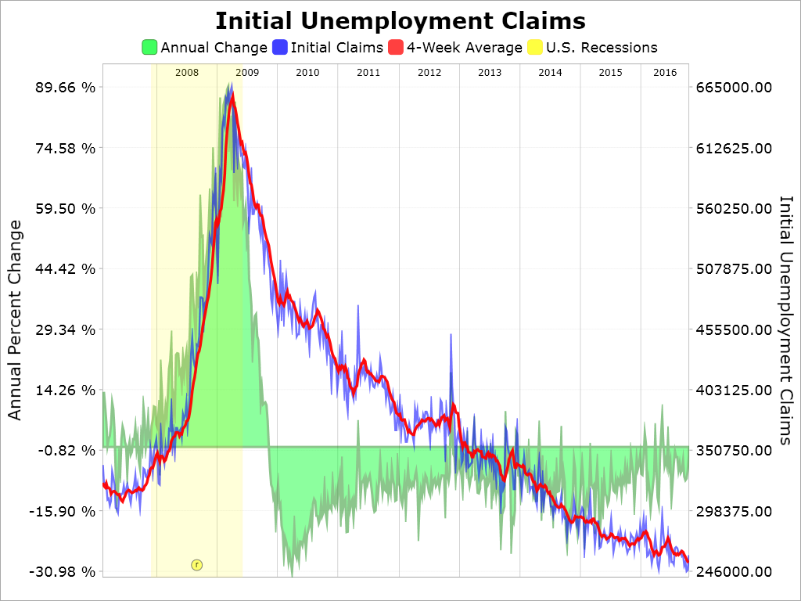
Weekly Jobless Claims –The Most Important Statistic +21,000 to 275,000-Sharp uptick for last week of the year

Slide 14
Bonds-Bear Market Takes a Break
*The bond crash takes a pause as big funds rebalance the huge Q4 moves by buying bonds and selling stocks *That should finish by the first half of January, and then take another leg down *Super strong dollar is also providing some bond support *We are six months into a 10-20 year bear market in bonds, (TLT) should drop from$120 to under $100 in 2017 *Flight to junk taking place as bond investors hide out in the stock market *Emerging debt still punished as risk of trade war looms

Slide 15
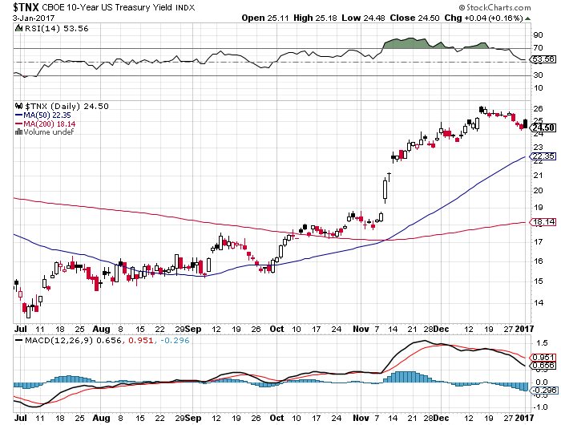
Ten Year Treasury Yield ($TNX) 2.46% Sideways Correction

Slide 16
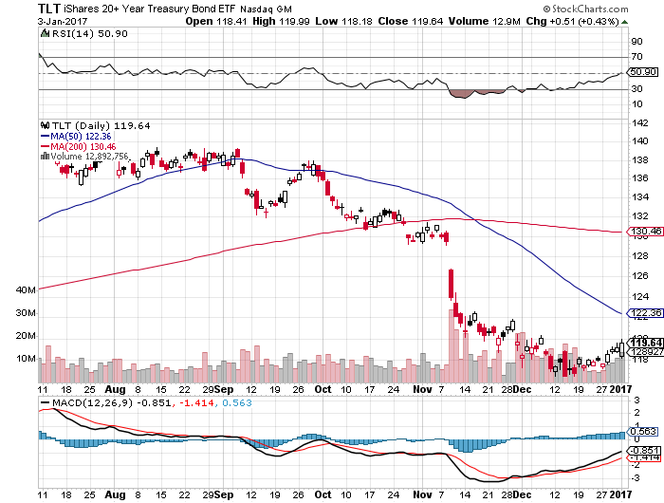
Ten Year Treasury ETF (TLT) 2.46% took profits on long 1/$125-$128 vertical bear put spread long 1/$123-$123 vertical bear put spread

Slide 17
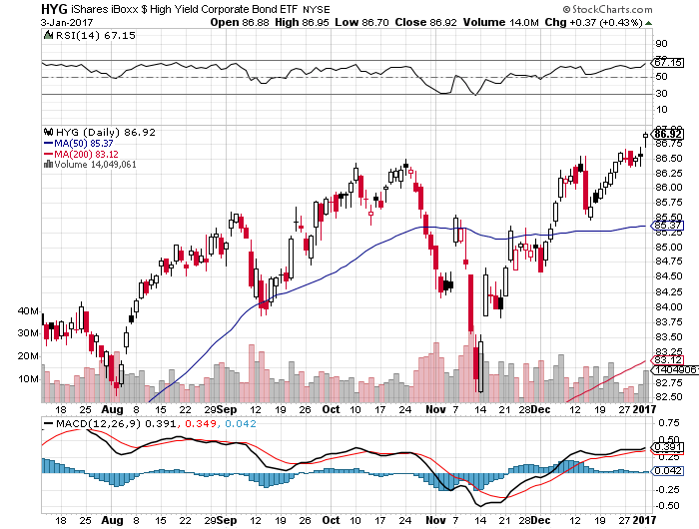
Junk Bonds (HYG) 5.46% Yield A Great Risk Coincident Indicator-”RISK ON” means new highs, buy all dips

Slide 18
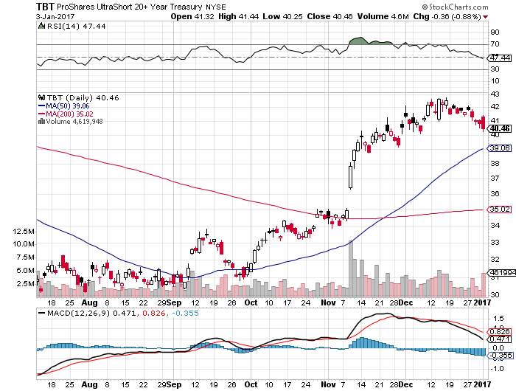
2X Short Treasuries (TBT)

Slide 19
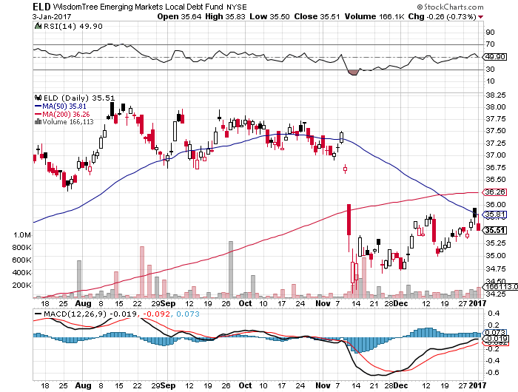
Emerging Market Debt (ELD) 7.13% Yield-

Slide 20
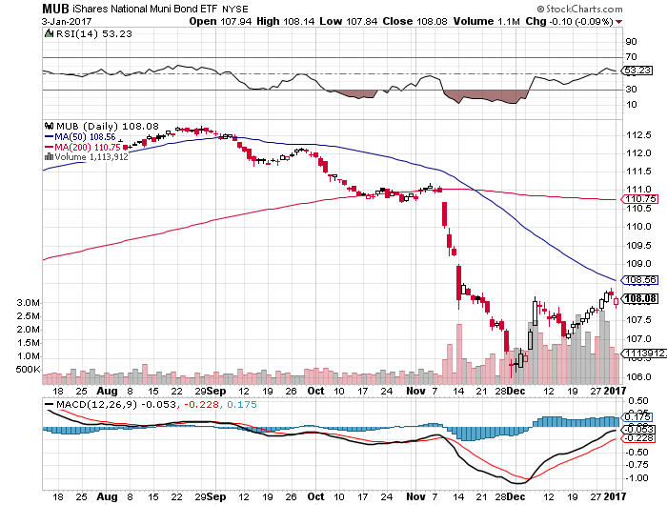
Municipal Bonds (MUB)-2.14% yield-almost doubled Mix of AAA, AA, and A rated bonds

Slide 21
Stocks-Rebalancing
*The world is overweight technology growth and underweight domestic value *Market is carrying out a sideways correction with an eventual upside breakout to a new high *Trump rally has been confined largely to two sectors, banks and energy, everything else is now flat or down *It will take years for pension and mutual funds to rebalance weighting to reflect the new political reality, look for (SPX) $2,500 by yearend *All selling has been postponed until 2017 to take advantage of new lower capital gains taxes, is capping market now *Funds are picking up cheap tech stocks on the dips *Into value banks, energy, pharmaceuticals, materials, construction

Slide 22
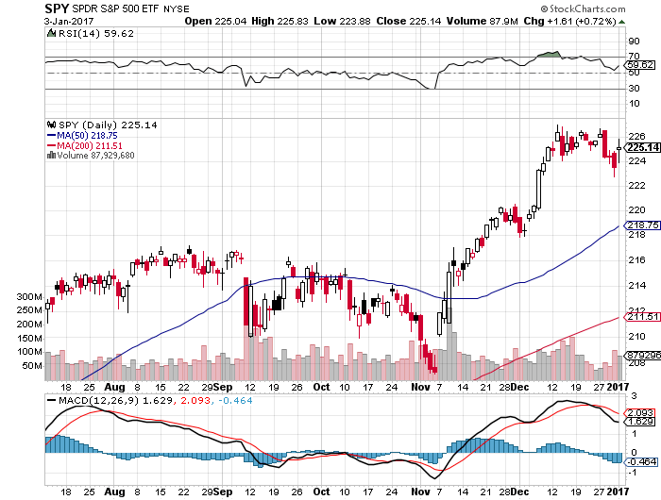
S&P 500-New All Time High Deferred 2016 Tax Loss Selling Kicking in took profits on long 11/$220-$223 put spread long 1/$219-$222 call spread

Slide 23
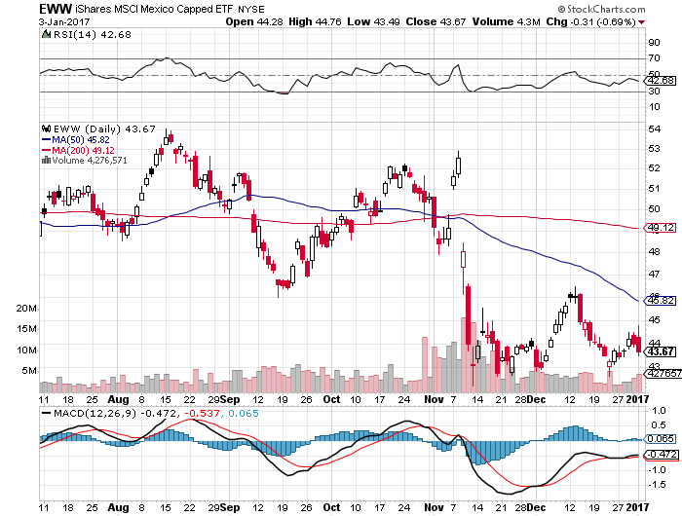
iShares MSCI Mexico ETF (EWW)-Trump Policy Benchmark

Slide 24
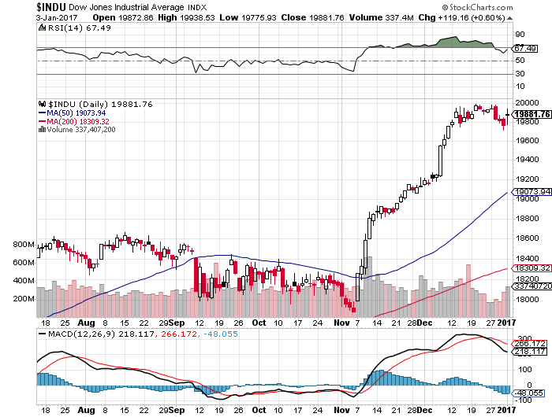
Dow Average-Break Out

Slide 25
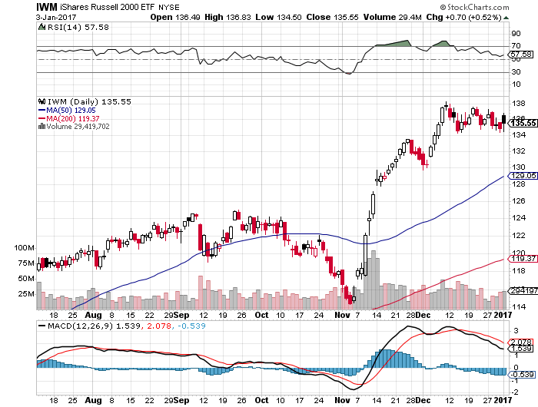
Russell 2000 (IWM)-All Time High took profits on long 11/$125-$128 vertical bear put spread

Slide 26
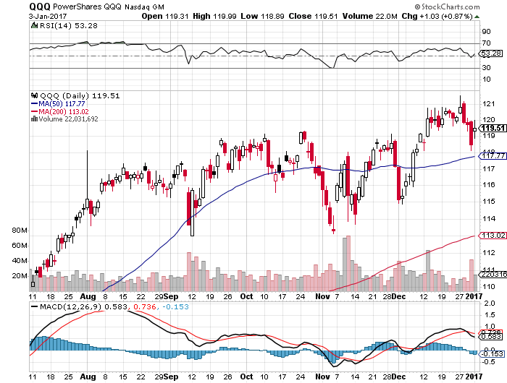
NASDAQ (QQQ)- Last Year’s Leader

Slide 27
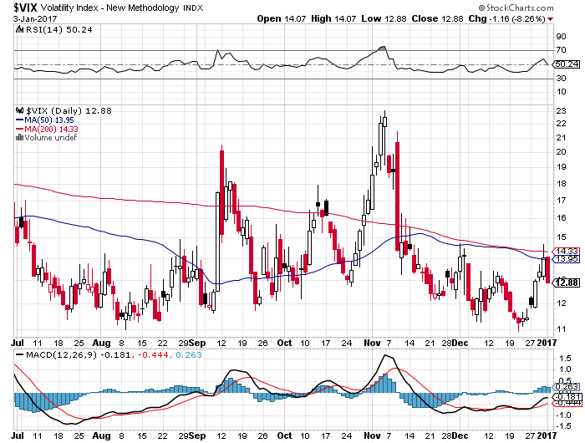
(VIX)-6 week lows-Holiday Drag

Slide 28
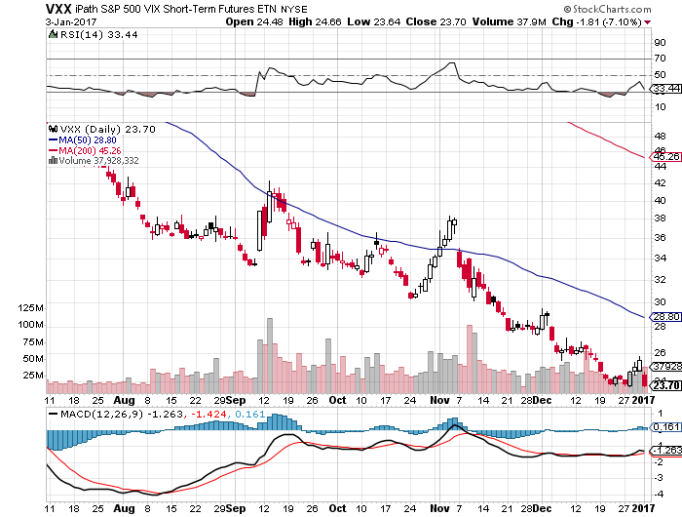
iPath S&P 500 VIX Short-Term Futures ETN (VXX) took profits on long 10/$27-$30 call spread stopped out of long 12/$24-$27 vertical bull call spread

Slide 29
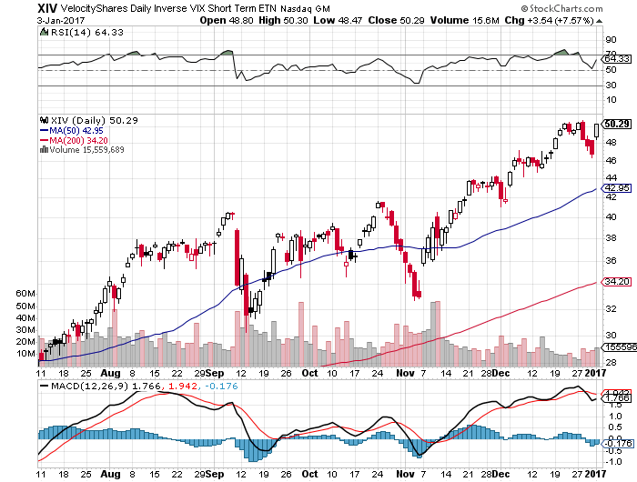
Velocity Shares Daily Inverse VIX Short Term ETN (XIV) took profits on long shares at $32.91 one of the most instantly profitable trades of 2016

Slide 30
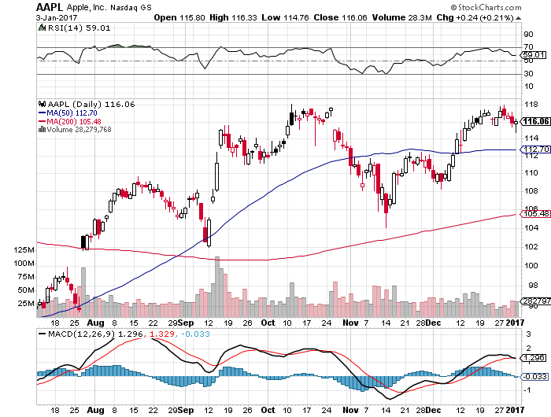
Apple (AAPL) –Buy the Rumor, Sell the News the wrong stock in the wrong sector at the wrong time

Slide 31
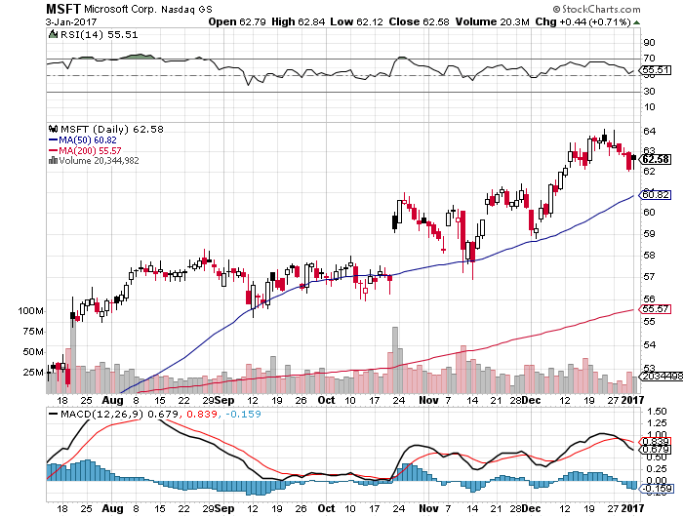
Microsoft (MSFT)

Slide 32
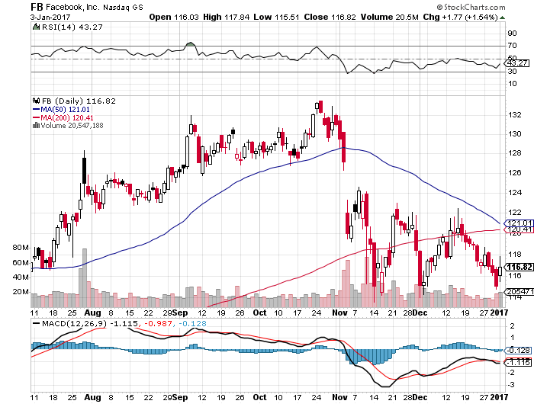
Facebook (FB)- took profits on long 11/$114-$117 vertical bull call spread wrong time to be long tech-Not exactly a Trump stock

Slide 33
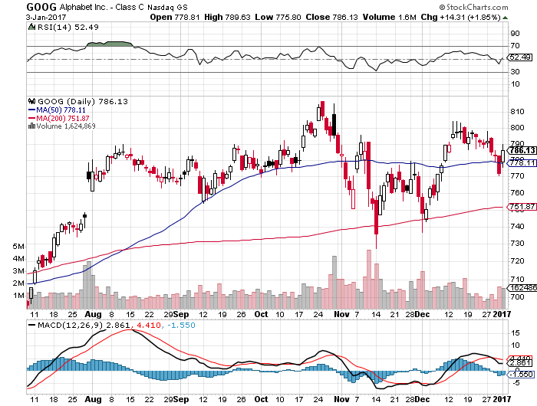
Alphabet (GOOG)-

Slide 34
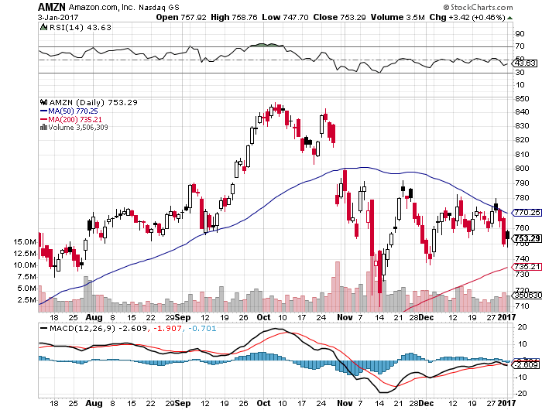
Amazon (AMZN)-

Slide 35
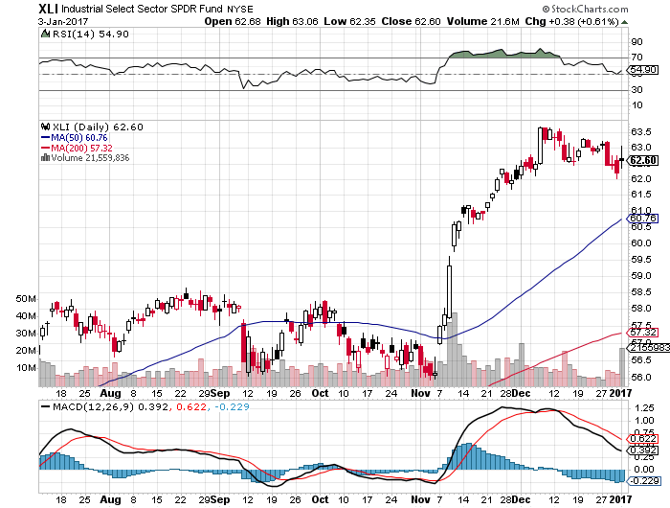
Industrials Sector SPDR (XLI)-Breakout (GE), (MMM), (UNP), (UTX), (BA), (HON)

Slide 36
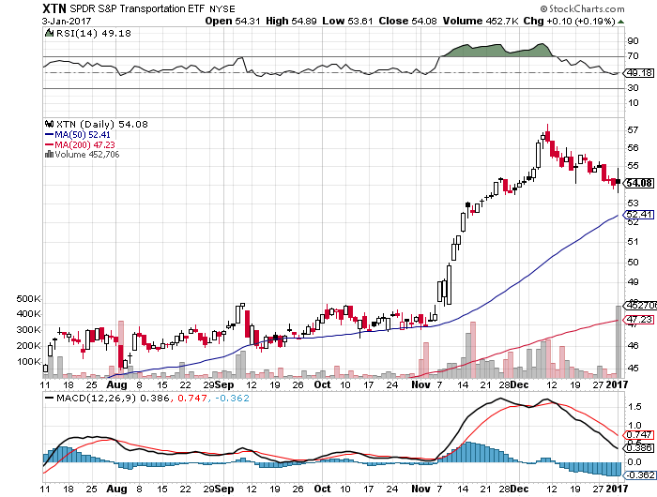
Transports Sector SPDR (XTN)- Breakout-Buffet’s New Favorite (ALGT), (ALK), (JBLU), (LUV), (CHRW), (DAL)

Slide 37
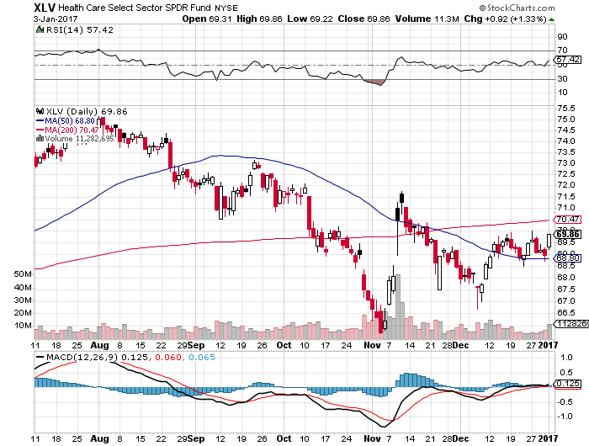
Health Care Sector (XLV), (RXL) (JNJ), (PFE), (MRK), (GILD), (ACT), (AMGN) November 8th Bottom!!

Slide 38
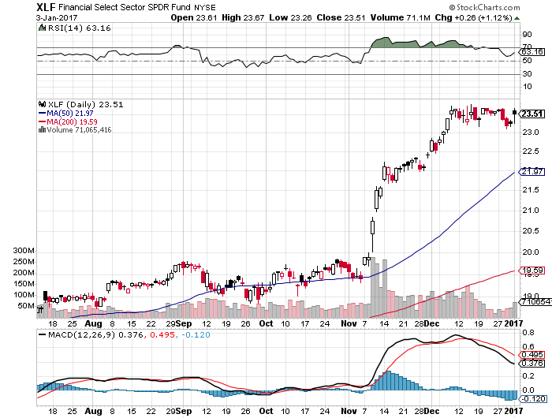
Financial Select SPDR (XLF)-The New Nirvana (BLK/B), (WFC), (JPM), (BAC), (C), (GS)

Slide 39
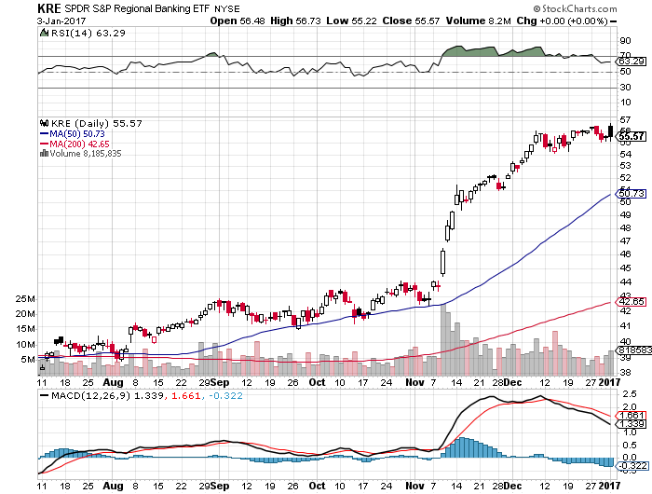
KRE Regional Bank ETF (KRE)-

Slide 40
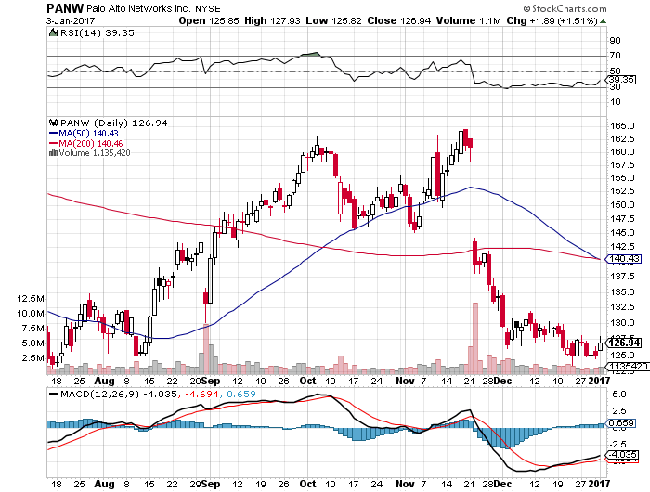
Palo Alto Networks (PANW)- Back to a Buy Range-Profits will still double

Slide 41
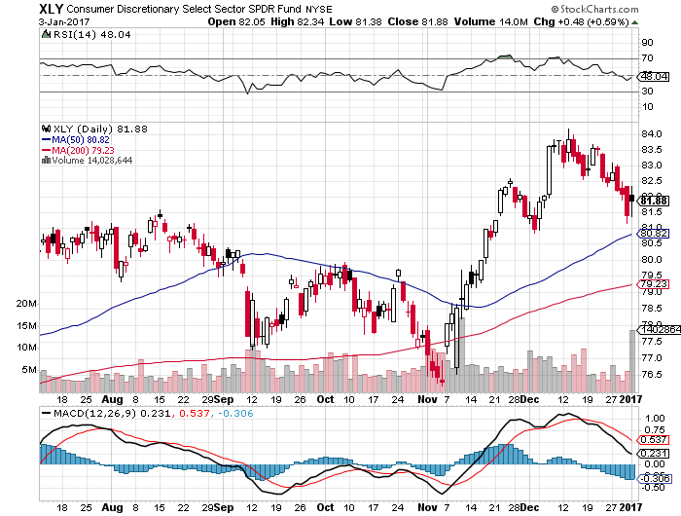
Consumer Discretionary SPDR (XLY) (DIS), (AMZN), (HD), (CMCSA), (MCD), (SBUX)

Slide 42
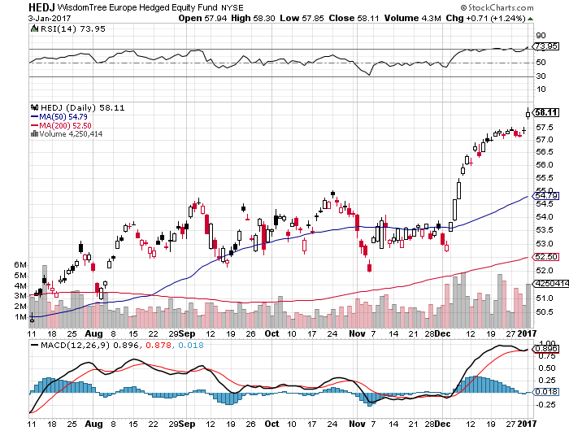
Europe Hedged Equity (HEDJ)-Cheap Euro Boost

Slide 43
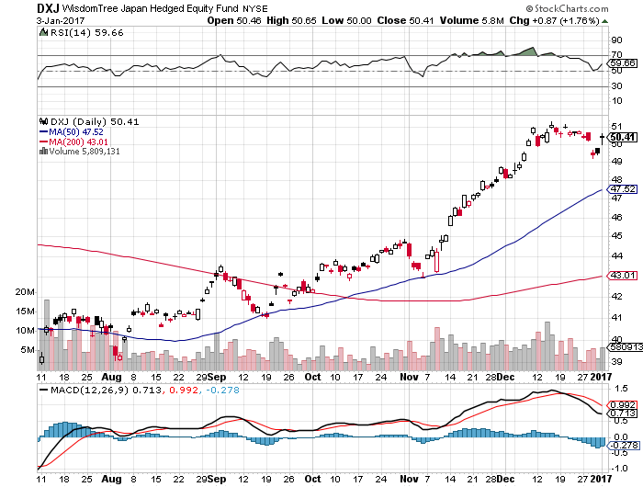
Japan (DXJ)-Cheap Yen Breakout

Slide 44
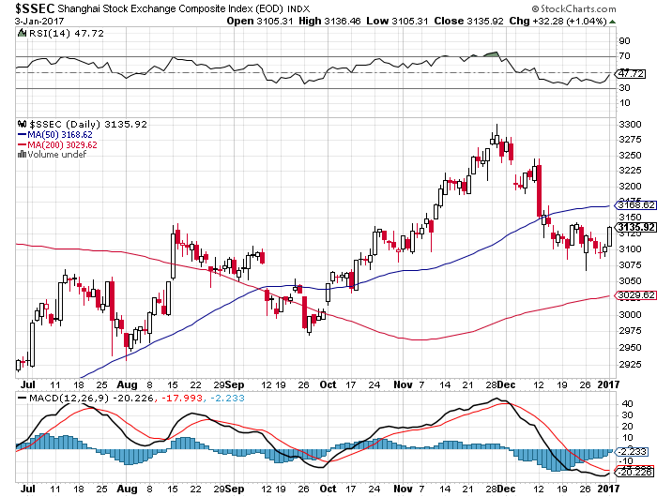
China ($SSEC)- Trade War is Back

Slide 45
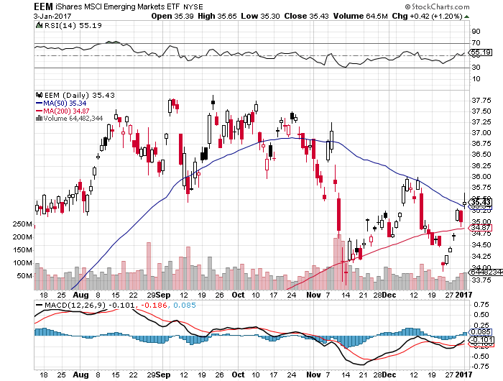
Emerging Markets (EEM)-Trashed in New World Order

Slide 46
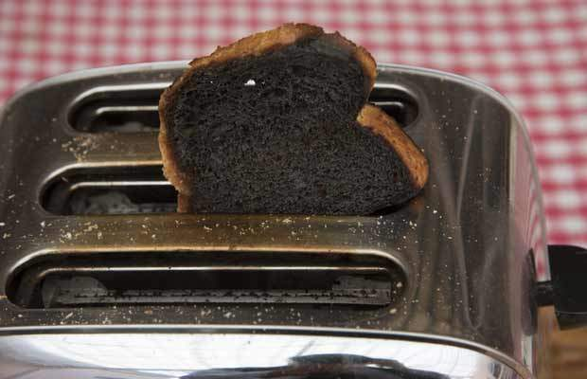
Foreign Currencies-Toast
*With 2-3 Fed interest rate hikes in the pipeline, look for dollar to remain strong all year *Targeting ¥130 in the Japanese yen and 97 cents in the Euro. *Interest rate differentials will overwhelmingly favor the dollar for two more years *Buy the dollar on any dips, next leg up could come with the Feb Fed meeting *Standing aside awaiting a better entry point, especially against the yen

Slide 47
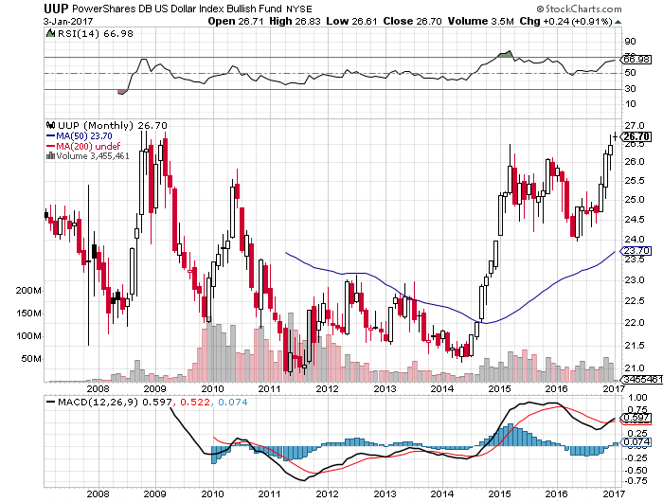
(UUP) Dollar Approaches 10 Year High

Slide 48
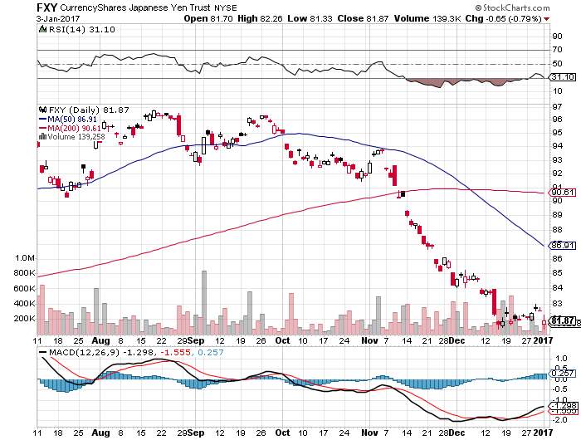
Japanese Yen (FXY)-Is This the Big One? took profits on long the 8/$97-100 put spread took profits on long the 9/$99-102 put spread

Slide 49
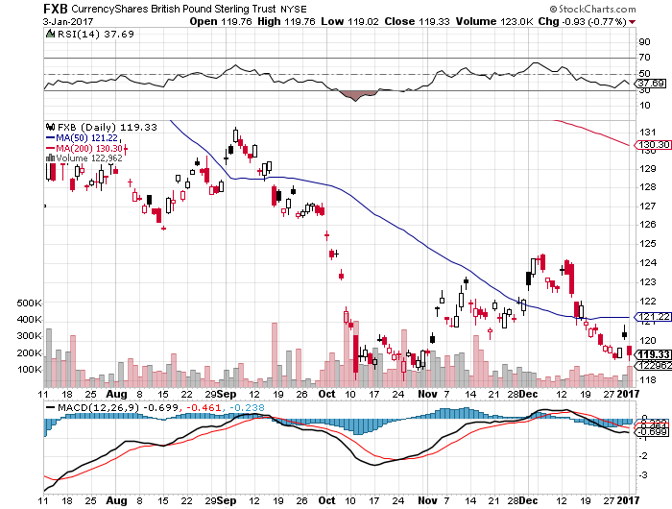
British Pound (FXB)-

Slide 50
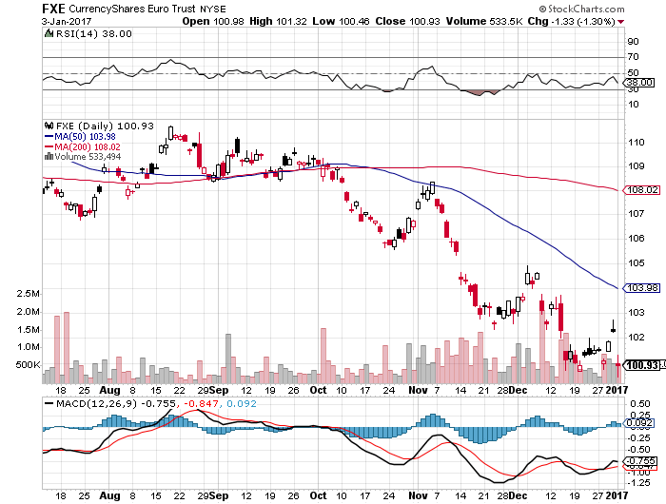
Euro ($XEU), (FXE), (EUO)- Bombs Away took profits on long the 9/$112-$115 vertical bear put spread took profits on long $11/$110-$113 vertical bear put spread

Slide 51
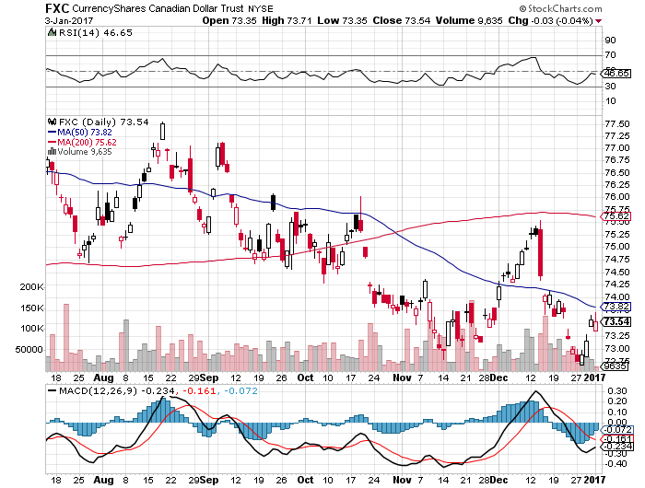
Canadian Dollar (FXC)-

Slide 52
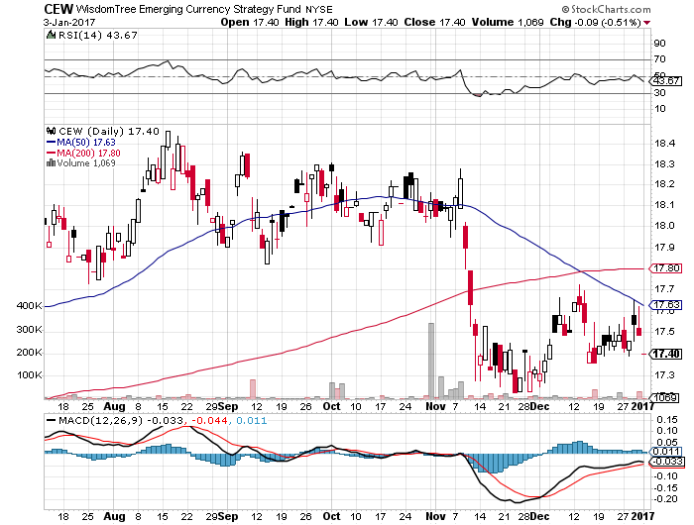
Emerging Market Currencies (CEW)

Slide 53
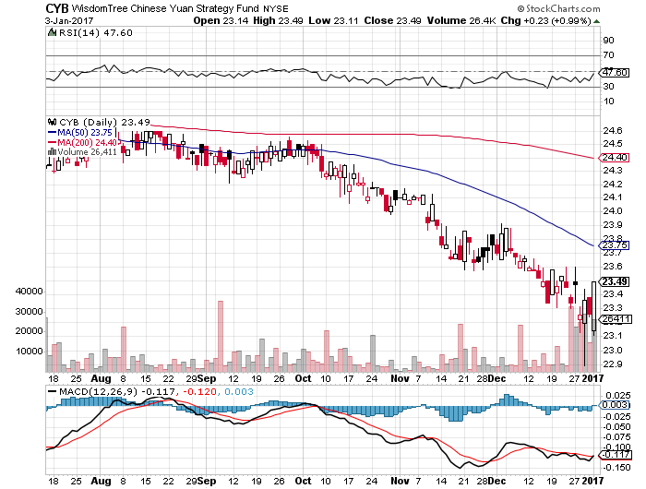
Chinese Yuan- (CYB)-Breakdown at Last

Slide 54
Energy-Topping Out
*Eyes on OPEC looking for quota cheating *US rig count has been rising weekly for nine months now, will weigh on prices *Russia increased production into OPEC meeting, likely won’t cut in sympathy, is too broke to do so *Strong dollar has yet to hit oil prices, will do so shortly *Oil still stuck in $45-$65 range, but we are now testing $54 *Energy stocks are already discounting $65

Slide 55
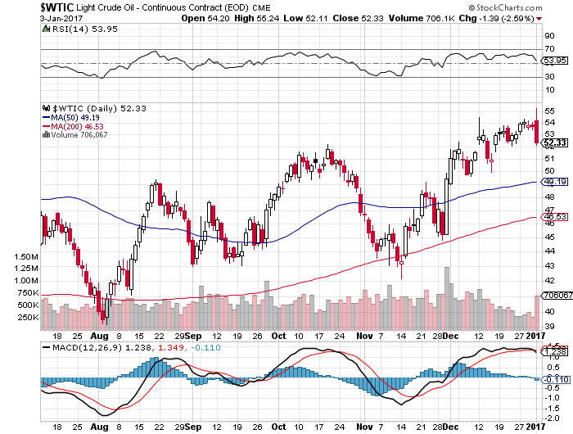
Oil-Top of Range-Has the Cheating Started?

Slide 56
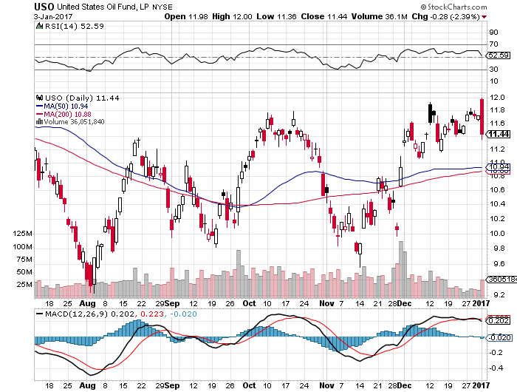
United States Oil Fund (USO) took profits on long the (USO) 11/$12.50-$14.00 vertical bear put spread

Slide 57
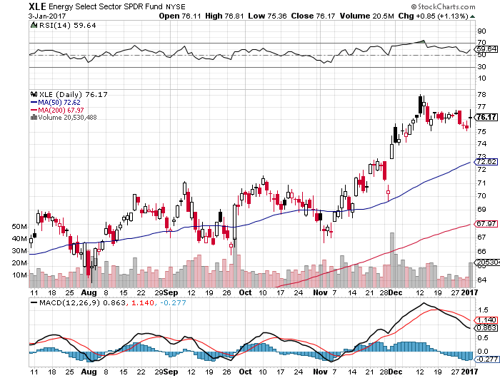
Energy Select Sector SPDR (XLE) (XOM), (CVX), (SLB), (KMI), (EOG), (COP)

Slide 58
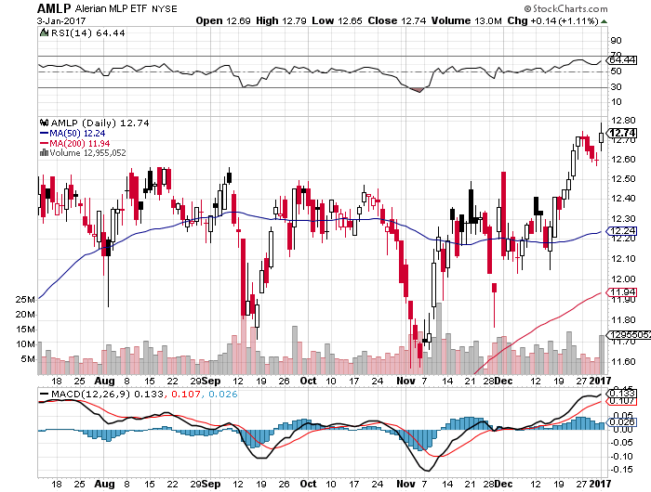
Alerian MLP ETF (AMLP)- Basket Approach is the Only Safe Play here

Slide 59
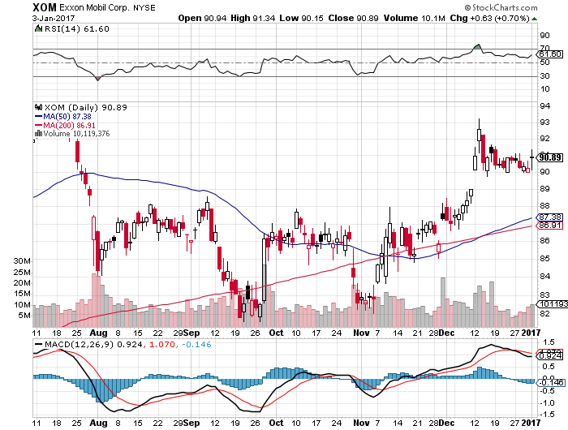
Exxon (XOM)-

Slide 60
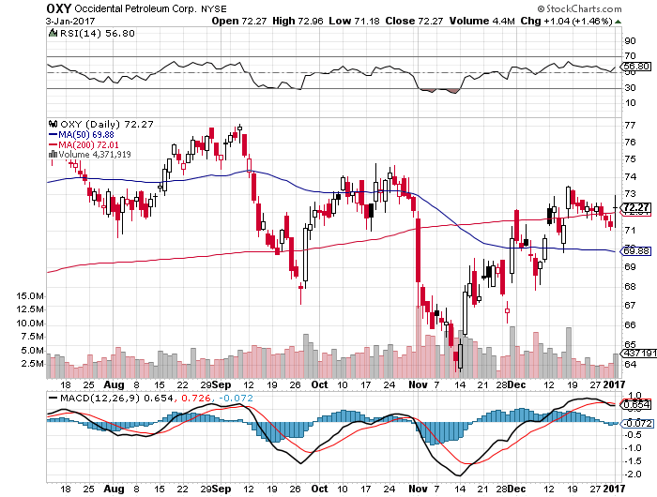
Occidental Petroleum (OXY)-

Slide 61
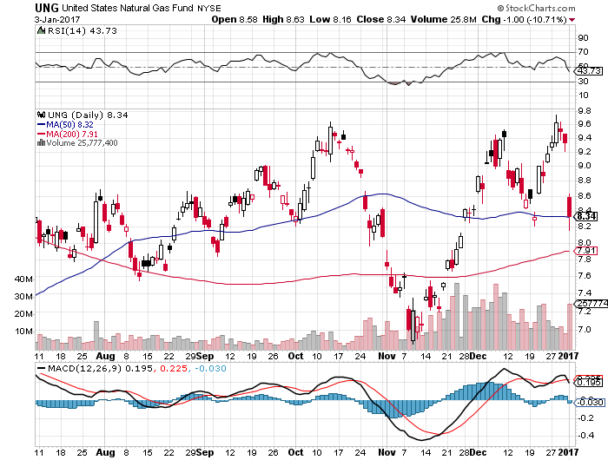
Natural Gas (UNG)-Bumping Against 2016 Highs down 13% on first day of the year

Slide 62
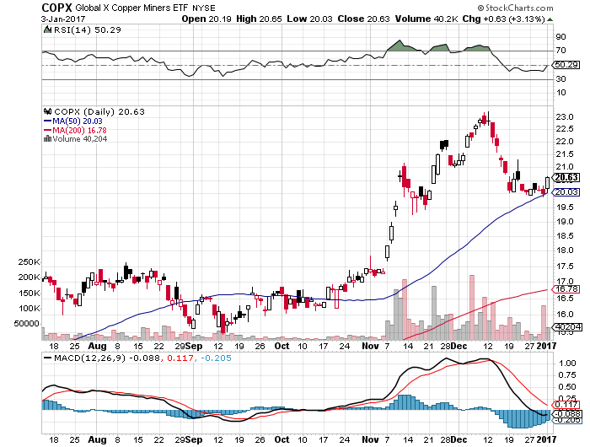
Copper (COPX)-Upside Breakout Candidate

Slide 63
US Steel (X)-Upside Breakout!

Slide 64
UnPrecious Metals-
*Rising interest rate outlook could demolish gold for the foreseeable future *China places curbs on new gold imports to halt capital flight *Indian currency conversion still a drag as gold is sold to meet bills, will last for many months *The only good news is the gold longs in the futures market have already dramatically shrunk *Gold may have to break $1,000 before the carnage is over

Slide 65
Gold (GLD)-Searching for a Bottom took profits on long 11/$112-$115 vertical bull call spread

Slide 66
Market Vectors Gold Miners ETF- (GDX)

Slide 67
Silver (SLV)-

Slide 68
Silver Miners (SIL)-

Slide 69
Agriculture-More New Reasons to Fall
*USDA Supply & Demand Report predicts large scale cuts in all crops in 2017 due to weak prices *Massive rains in California helping west coast crops *However, Ag prices remain weak *Strong dollar paints a grim outlook for ags in 2017 *Stay away

Slide 70
(CORN) – Shall We Buy?

Slide 71
(WEAT)-New Lows on Strong Dollar

Slide 72
(SOYB)-Bouncing Along the Bottom

Slide 73
Real Estate-The Grind Up Continues
*Mortgage applications fall 4% as high rates hit market *Homebuilding sentiment jumps seven points, the most in 20 years *The building boom will continue in the face of rapidly rising interest rates for years *Home mortgage rates rocket, up from 3.75% to 4.375% since election *Home prices will accelerate first as buyers rush to beat rate rises, then eventually bring an end to this cycle *Homes are the best place to hide during an inflation surge *October Case Shiller -0.0% to 5.1% YOY, holding steady, post Trump data not out for one more month, absolute prices hit new all time high

Slide 74
October S&P 500/Case–Shiller Home Price Index +5.0% YOY, Portland, Seattle, Denver leaders

Slide 75
General Growth Properties (GGP) Yield Play Profit Taking

Slide 76
US Home Construction Index (ITB) (DHI), (LEN), (PHM), (TOL), (NVR) Another Rising Rate Victim-But Becoming a favorite Sector to Buy

Slide 77
Trade Sheet So What Do We Do About All This?
*Stocks- Buy dips in New World Order stocks *Bonds-sell rallies on government deficit risk *Commodities-buy dips *Currencies- sell rallies, especially yen *Precious Metals –stand aside *Volatility-buy the dip *The Ags –stand aside *Real estate-buy the dip

Slide 78
Annual Asset Class Review Out Thursday January 5 Next Strategy Webinar 12:00 EST Wednesday, January 18, 2017 San Francisco, CA
Good Luck and Good Trading!
Notes:
*

