Slide 1

The Mad Hedge Fund Trader “On the Edge”
With John Thomas from San Francisco, CA, March 1, 2017 www.madhedgefundtrader.com
Notes:
*

Slide 2
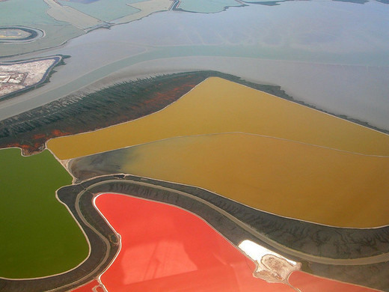

Slide 3

Second Edition
Is Out!
In the Store Now for $49
Sectors and Stocks that Will Lead the Market for the Next 20 Years
https://members.madhedgefundtrader.com/roaring-twenties-book/

Slide 4

Trade Alert Performance Best 4 Weeks of the Past 12 months-New All Time High!!
*January +9.35% Final *July +0.67% Final *February +6.39% FINAL *August +7.52% Final *March -2.42% Final *September +0.27% Final *April -2.10% Final *October +8.13% Final *May +4.38% Final *November 4.37% Final *June -0.56% Final *December +.84% Final *2017 Year to Date 15.74% compared to 5.15% for the Dow Average 8 Consecutive Profitable Months! *Trailing 1 year return +37.87%, +234.30% since inception, *Average annualized return of 37.48%

Slide 5
Portfolio Review 100% Cash Position at a Short Term Market Top When markets go crazy, it’s time for the sidelines
No Positions!

Slide 6
Trailing One-Year Return Daily Audited Performance +37.87%

Slide 7
Seven Year Daily Audited Performance Averaged Annualized Return +37.48%

Slide 8

The 30,000 Foot View The Really Simple Big Picture
*Markets are screaming for tax cuts and deregulation, every hint is worth a new all time high *This is definitely the benefit of the doubt rally, with no substantial selloff in sight, a brief moment of sanity brings Dow 21,000 *Bond yields, the dollar, oil, and gold and silver miners are all on the verge of a major breakdown, signaling imminent stock correction *Markets will go from very overbought to insanely overbought first *Look for more “time” and not “price” corrections, as markets trade between overbought and extremely overbought

Slide 9

The Method to My Madness
*Went into 100% cash to lock in massive profits ahead of the State of the Union *Waiting for the next entry point, be it long or short, in all asset classes *No change in asset class calls *Keep your discipline and don’t chase *”Buy-the-Dippers” left at the station to chase performance *The easy performance for 2017 has been made, now its time to be more selective and stock specific

Slide 10
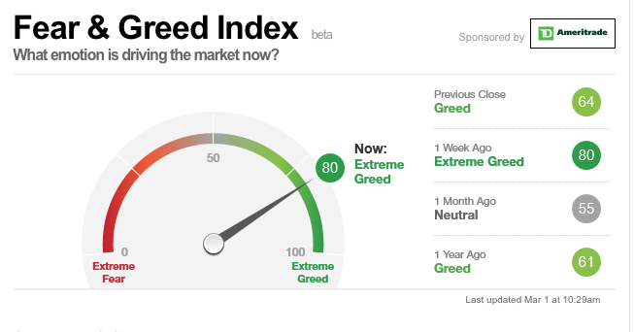
Risk is High- From Overbought back to Extremely Overbought

Slide 11
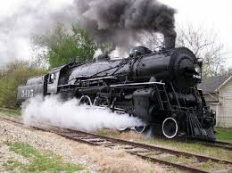
The Global Economy-Recovery on Track
*The global synchronized recovery continues, says buy “RISK ON” *January US Business Sales up +2%, biggest jump since 2011, Chicago PMI at 57.4, a 2 year high, US Q4 GDP a mediocre 1.9%, January Consumer Confidence at 114.8 the highest since 2001, but University of Michigan Consumer Sentiment drops from 98.5 to 96.3 *German Q4 GDP comes in at a weak 1.2% YOY, but is slowly accelerating, Third Greek bailout is in the works, with Germany paying *Chinese reserves fall below $3 trillion, lowest in 5 years as central bank rushes to prevent currency fall, PPI up 7% YOY, where inflation starts

Slide 12
The Bill Davis View A $1,500 Upgrade for the Mad Day Trader Service
Buys:
Apache Corp (APA) $52 Target to $64
Qualcomm Inc (QCOM) $53 Target to $62
Baker Hughes,Inc (BHI) $56 Target to $68
Cabela's Inc. (CAB) $41 Target to $50
Alphabet, Inc (GOOGL) $836 Target to $852
Sells:
Athenahealth, Inc (ATHN) $123 Target to $107
Carter Holdings (CRI) $90 Target to $75
Tractor Supply (TSCO) $68 Target to $55
Lululemon Athletica (LULU) $67 Target to $55
Deckers Outdoor Corp (DECK) $55 Target to $42

Slide 13
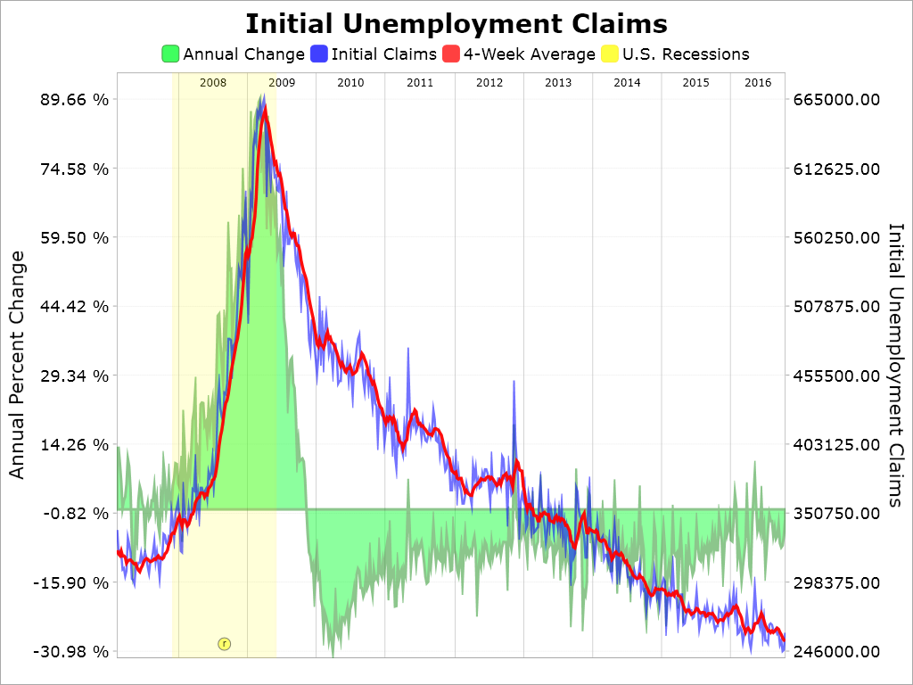
Weekly Jobless Claims –The Most Important Statistic +6,000 to 244,000- Hugging all time lows!

Slide 14
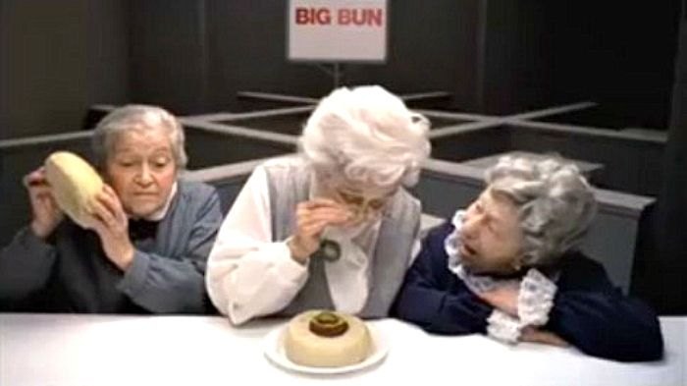
Stocks-Where’s the Beef?
*Market is waiting for administration to show it the beef, needs specifics to sustainably move higher, not words like “beautiful”, “huge”, or “wonderful” *State of the Union triggers short covering rally and chasing by fund managers waiting for a dip, almost all the hot money is out of the market *Look for technology, banks, and energy to lead any rally *Buffett put $20 billion into stocks since the election *Any sign of a slowing economy could have an outsized downside effect on stock prices *All price gains since November 8 have been from price earnings multiple expansion, creates a very high risk market

Slide 15
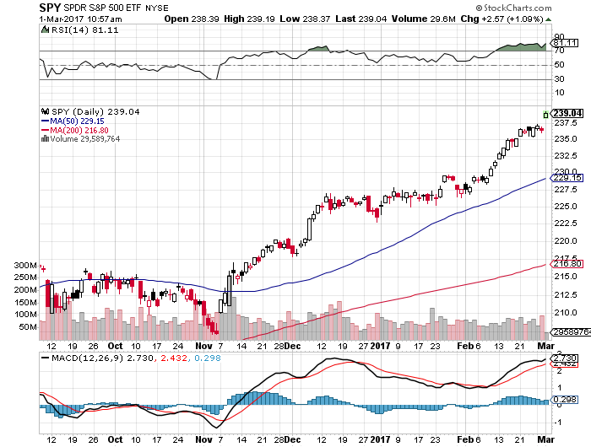
S&P 500- took profits on long 11/$220-$223 bear put spread took profits on long 1/$219-$222 bull call spread

Slide 16
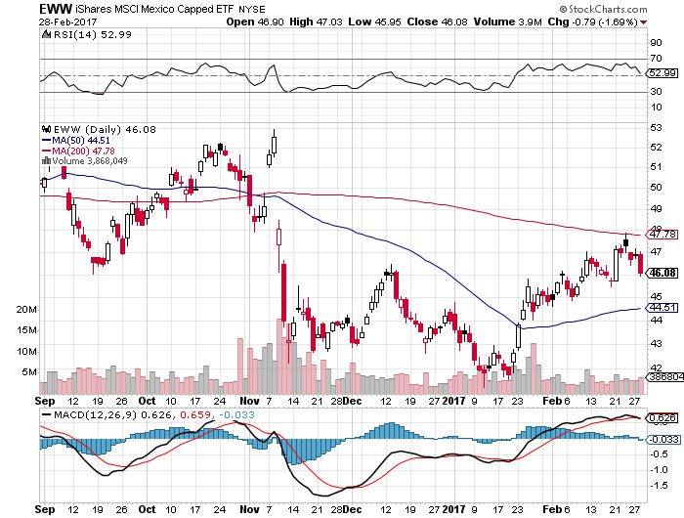
iShares MSCI Mexico ETF (EWW)-Trump Policy Benchmark

Slide 17
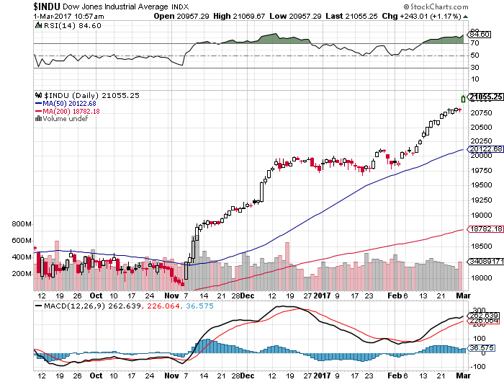
Dow Average-New High!

Slide 18
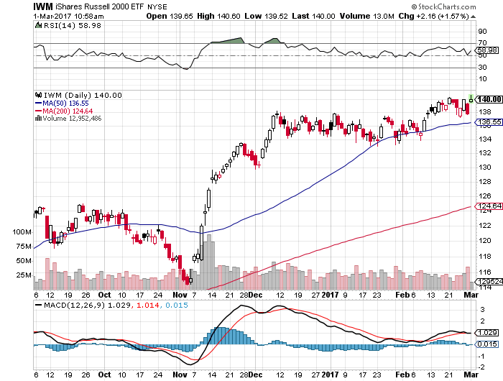
Russell 2000 (IWM)-New High took profits on long 11/$125-$128 vertical bear put spread 1/$129-$132 vertical bull call spread expired at maximum profit

Slide 19
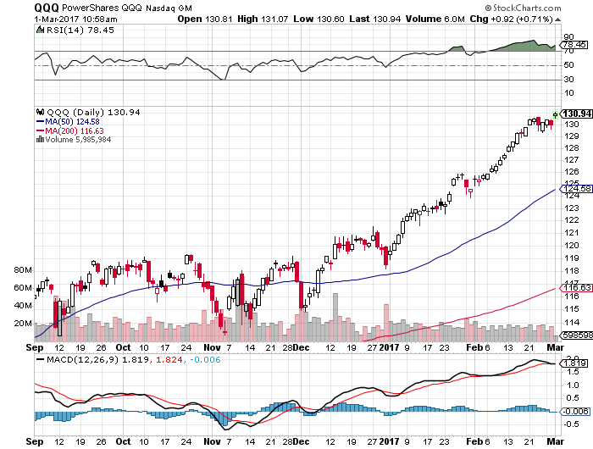
NASDAQ (QQQ)- This Year’s Leader

Slide 20
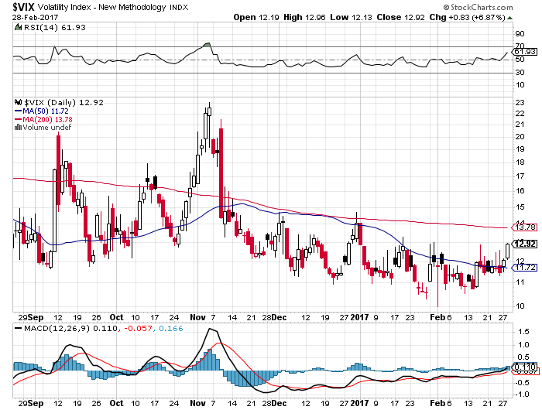
(VIX)-Bouncing of a Bottom

Slide 21
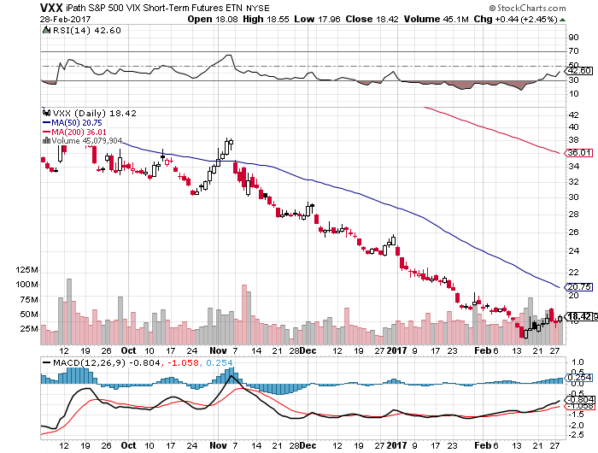
iPath S&P 500 VIX Short-Term Futures ETN (VXX) took profits on long 10/$27-$30 bull call spread

Slide 22
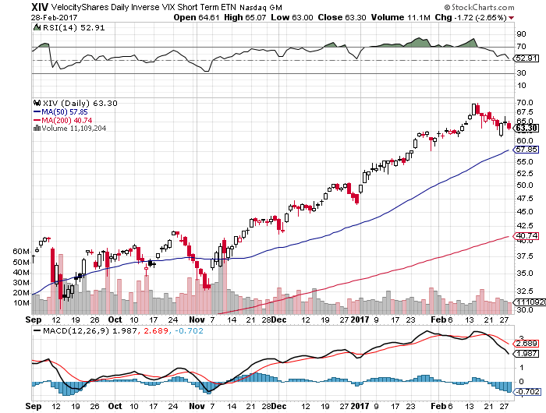
Velocity Shares Daily Inverse VIX Short Term ETN (XIV) took profits on long shares at $32.91 one of the most instantly profitable trades of 2016

Slide 23
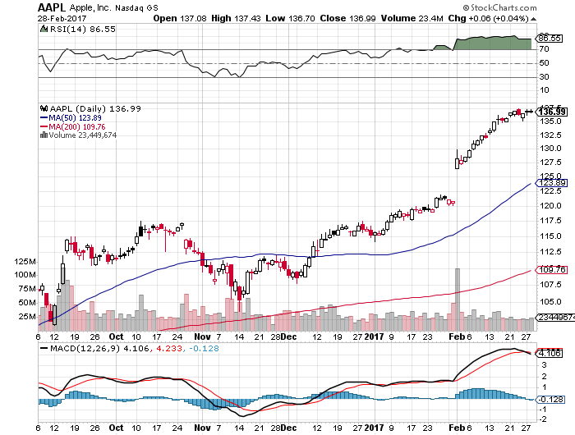
Apple (AAPL) –New High! took profits on long 1/$111-$114 bull call spread Q3 earnings upside surprise, Samsung self destructs, repatriation, at $17 billion is Buffet’s second largest position

Slide 24
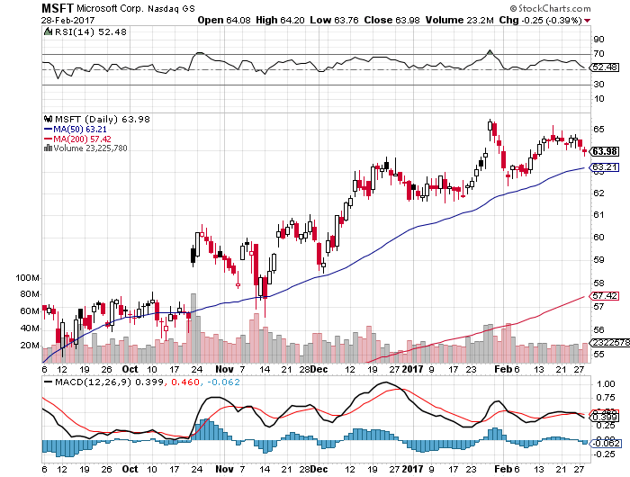
Microsoft (MSFT)

Slide 25
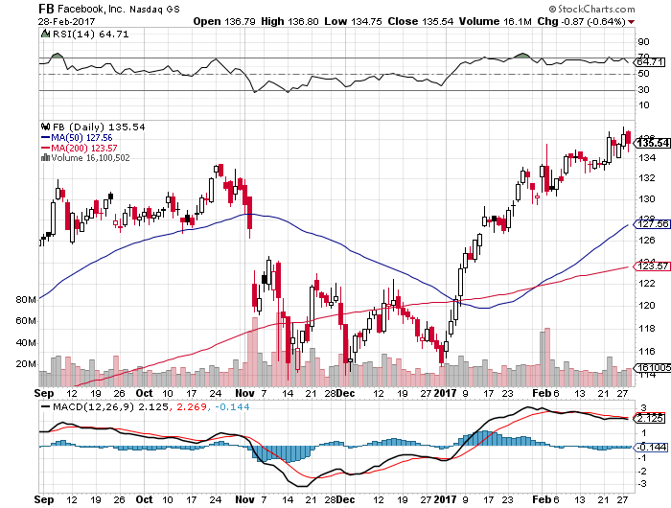
Facebook (FB)- took profits on long 11/$114-$117 vertical bull call spread

Slide 26
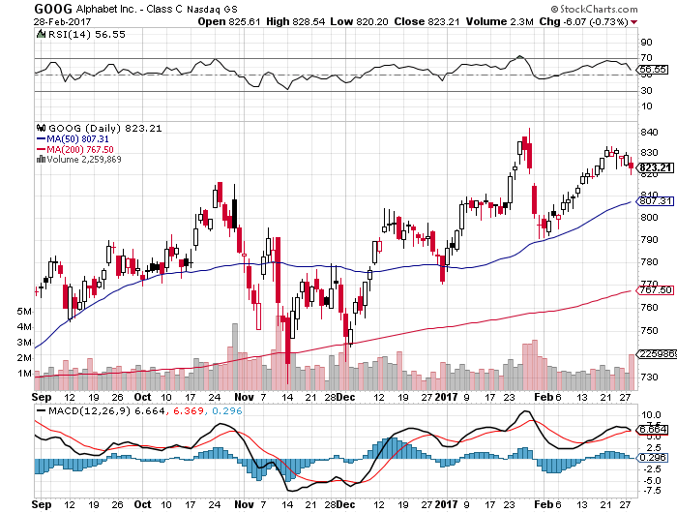
Alphabet (GOOG)-Earnings Shock took profits on long 1/$740-$760 vertical bull call spread

Slide 27
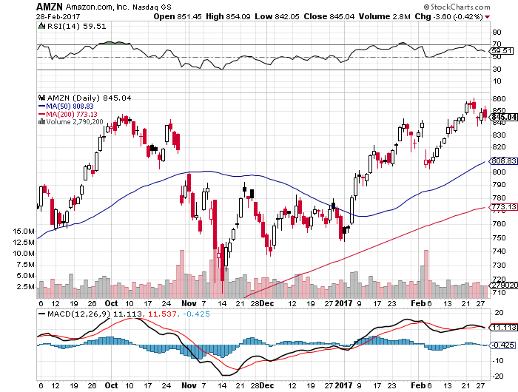
Amazon (AMZN)- took profits on long 1/$740-$760 vertical bull call spread

Slide 28
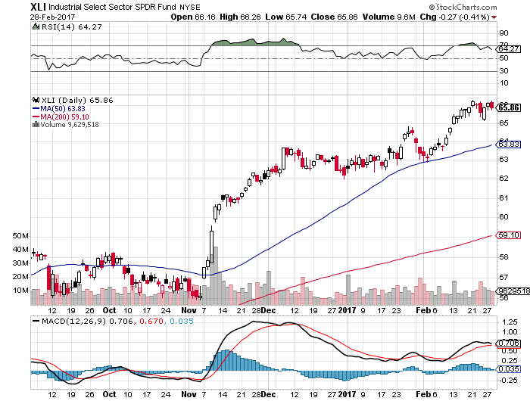
Industrials Sector SPDR (XLI)-Breakout (GE), (MMM), (UNP), (UTX), (BA), (HON)

Slide 29
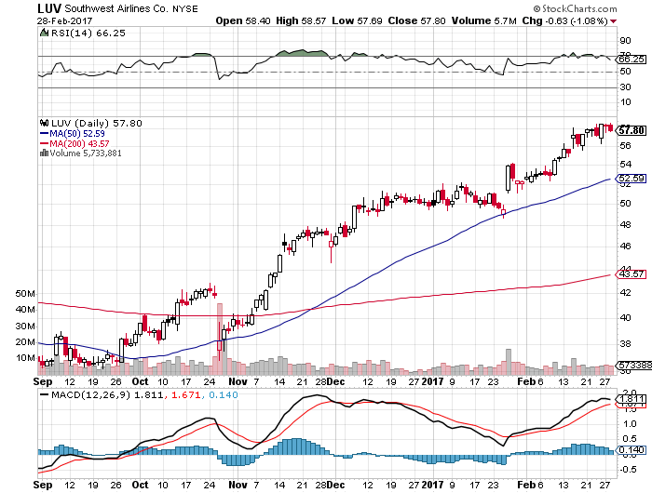
Southwest Airlines (LUV)- Warren Buffett’s Favorite Airline

Slide 30
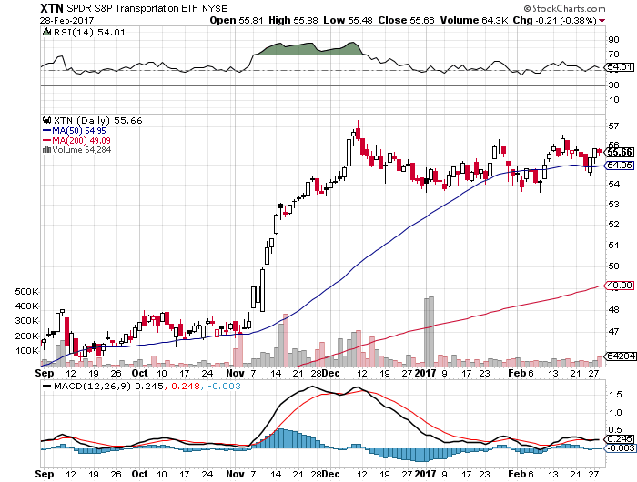
Transports Sector SPDR (XTN)- (ALGT), (ALK), (JBLU), (LUV), (CHRW), (DAL)

Slide 31
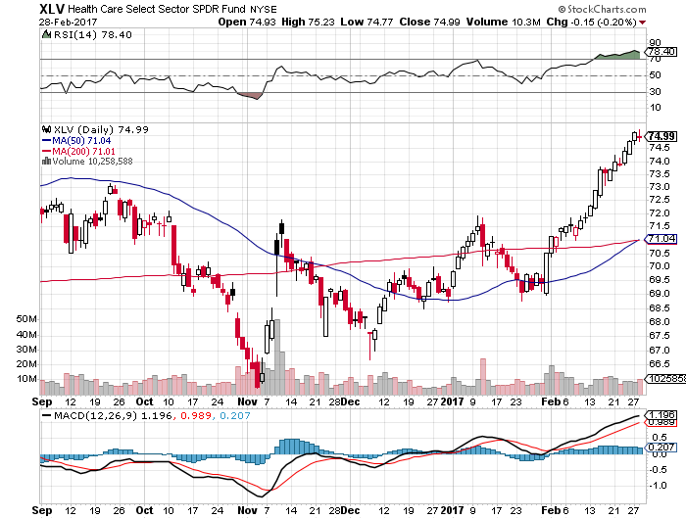
Health Care Sector (XLV), (RXL) (JNJ), (PFE), (MRK), (GILD), (ACT), (AMGN) “Getting away with murder”

Slide 32
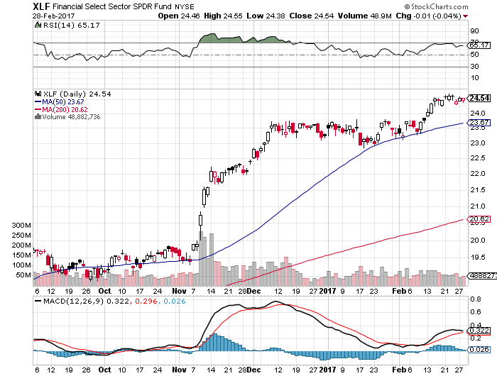
Financial Select SPDR (XLF)- (BLK/B), (WFC), (JPM), (BAC), (C), (GS)

Slide 33
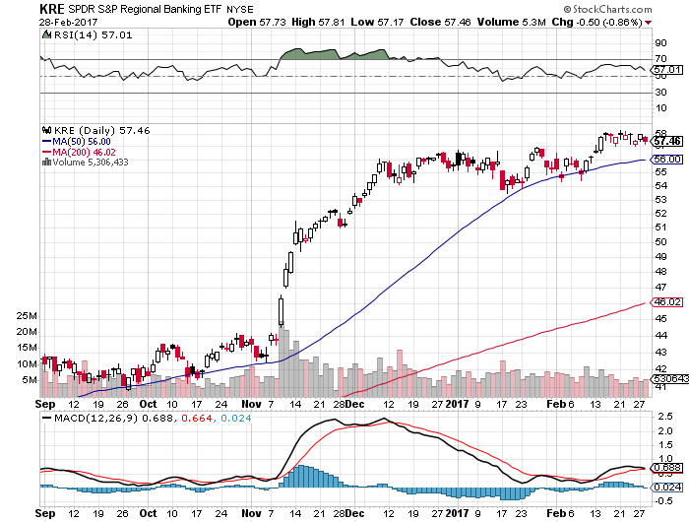
KRE Regional Bank ETF (KRE)-

Slide 34
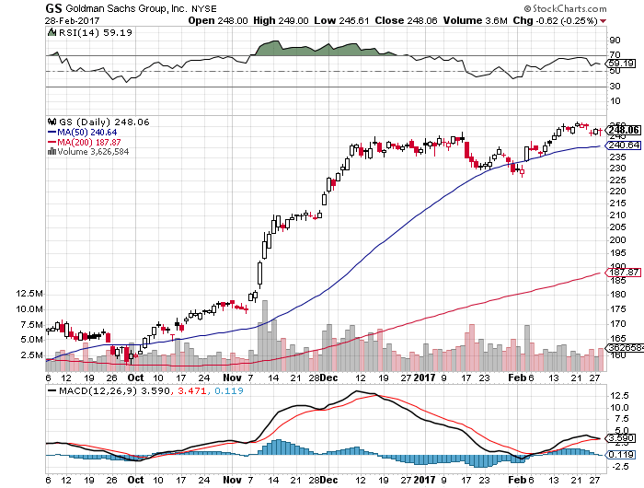
Goldman Sachs (GS)- took profits on long 2/$222.50-$227.50 vertical bull call spread most profitable trade of 2017

Slide 35
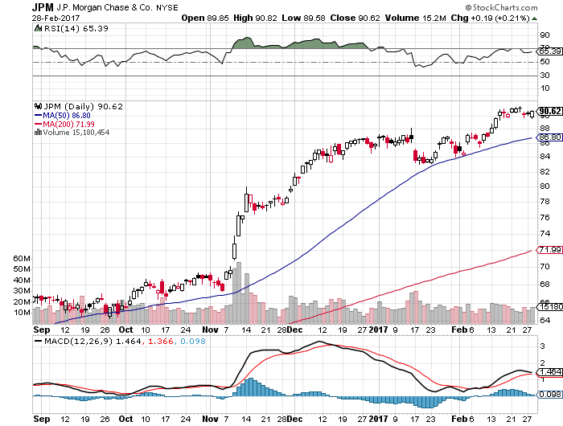
JP Morgan (JPM)-

Slide 36
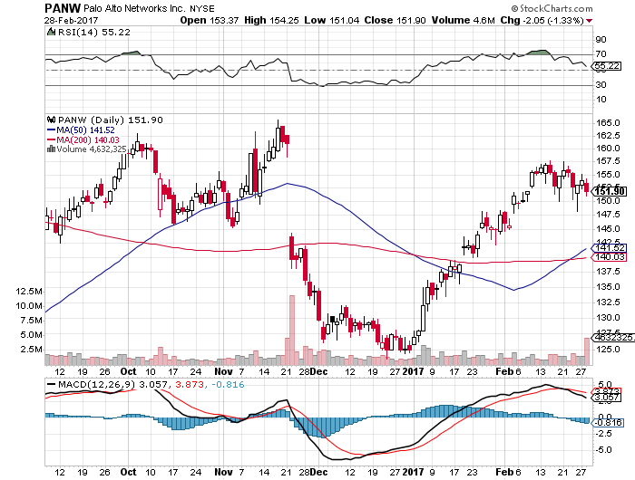
Palo Alto Networks (PANW)- took profits on long 1/$126-$129 bull call spread

Slide 37
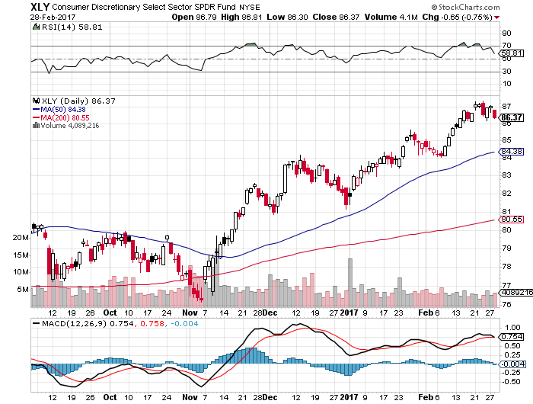
Consumer Discretionary SPDR (XLY) (DIS), (AMZN), (HD), (CMCSA), (MCD), (SBUX)

Slide 38
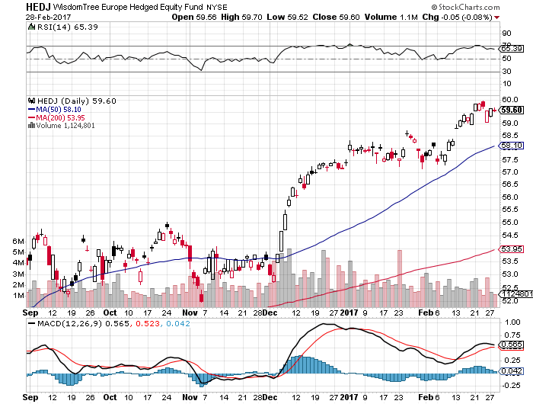
Europe Hedged Equity (HEDJ)-Euro Rally Headache

Slide 39
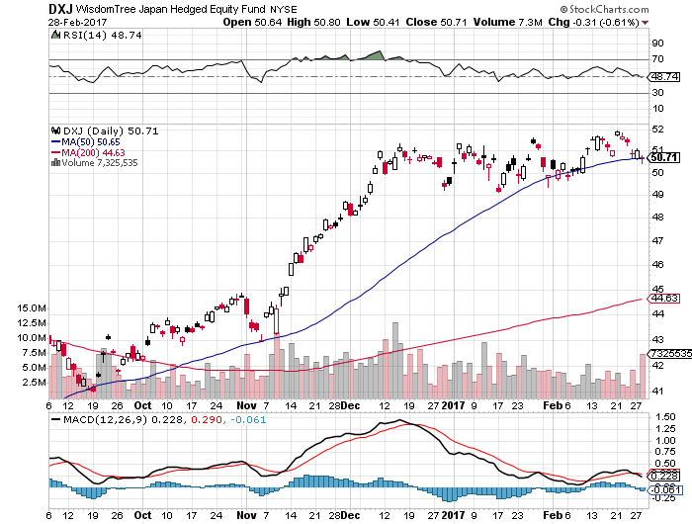
Japan (DXJ)-Yen Rally Headache

Slide 40
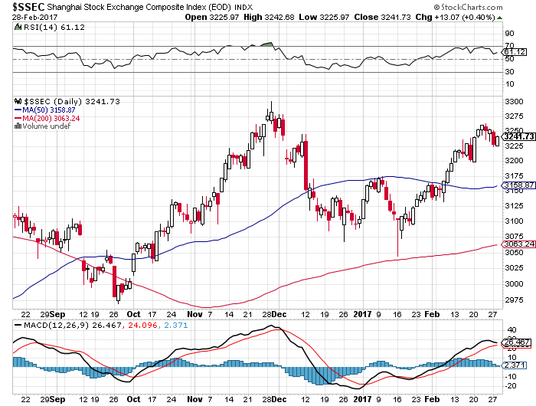
China ($SSEC)- Trade War Focus is Now on Mexico

Slide 41
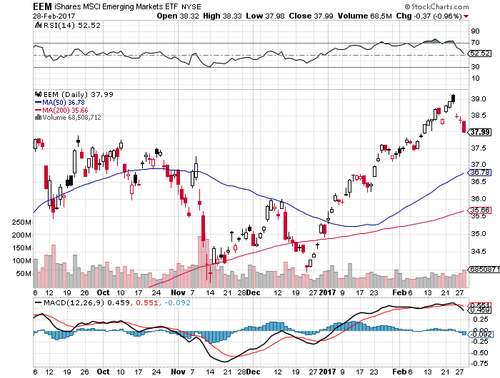
Emerging Markets (EEM)- Big Anti Trump Rally

Slide 42

Bonds-Not Drinking the Kool-Aid
*Bond markets not buying the Trump economic miracle, with US Treasury bond prices pushing against a triple top, yields at 2.32% triple bottom *Problem: the bond market is always right *State of the Union takes probability of a March rate hike from 20% to 70% *If you buy bonds now at 2.45%, you are paying 40 times earnings for a stream that can’t grow *2.65% is a key upside resistance point, targeting 3.0%, but could take many months to unfold *We are six months into a 10-20 year bear market in bonds, (TLT) should drop from $120 to under $100 in 2017

Slide 43
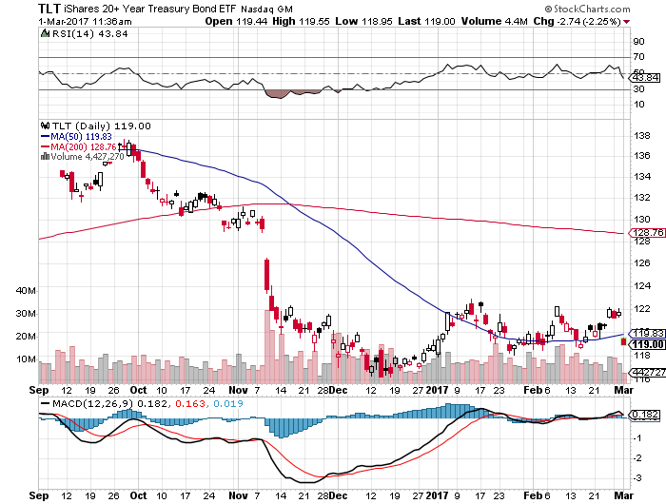
Twenty Year Treasury ETF (TLT) 2.45% took profits on long 2/$126-$129 vertical bear put spread rolled forward and then took profits on the 3/$126-$129 vertical bear put spread

Slide 44
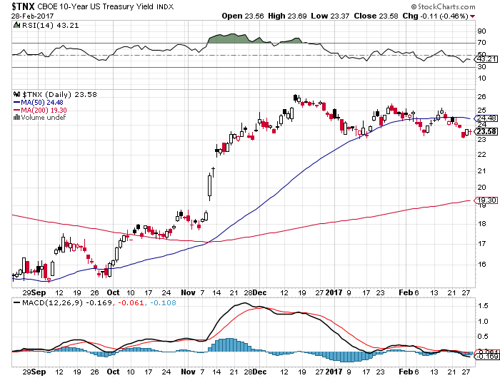
Ten Year Treasury Yield ($TNX) 2.35%

Slide 45
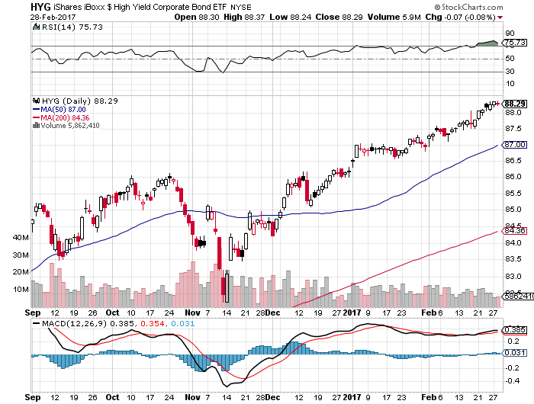
Junk Bonds (HYG) 5.19% Yield A Great Risk Coincident Indicator- Long Term “RISK ON” means new highs, buy all dips

Slide 46
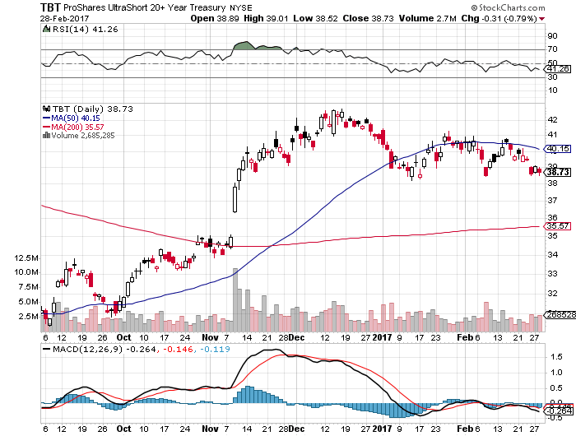
2X Short Treasuries (TBT)

Slide 47
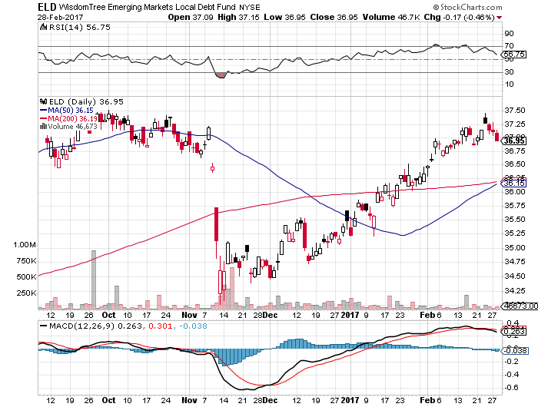
Emerging Market Debt (ELD) 5.77% Yield- crawling back with the anti-Trump trade

Slide 48
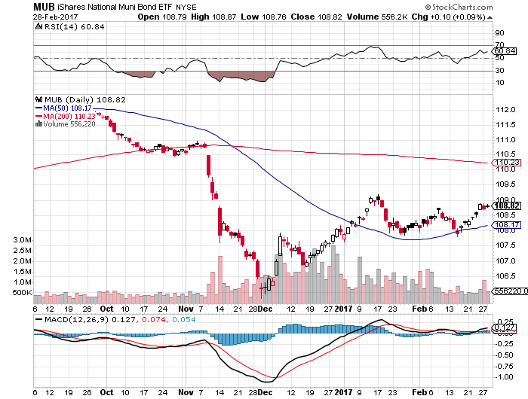
Municipal Bonds (MUB)-2.14% yield-almost doubled Mix of AAA, AA, and A rated bonds

Slide 49

Foreign Currencies-New Strength
*Treasury Secretary Steve Mnuchin finally says that the strong dollar is a good thing signaling strength of the US economy, but yen thinks otherwise *Surprise improvement in Euro trade balance delivers a short term Euro pop *Winding down of Euro QE from €80 to €60 billion a month on April 1 is also providing support *Will Japan follow with a curtailing of JGB purchases? *Buy the dollar on any dips

Slide 50
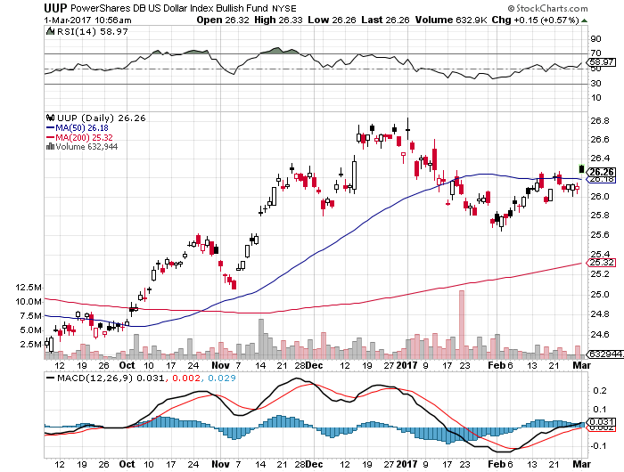
US Dollar Basket-(UUP)

Slide 51
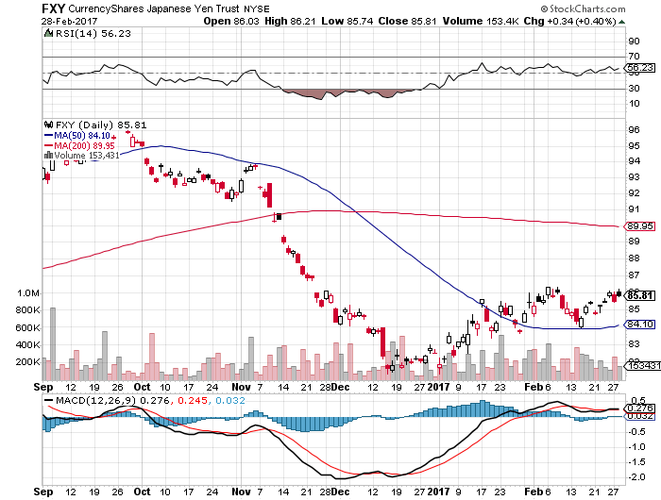
Japanese Yen (FXY)-Taking a Break Took profits on long 2/$88-$91 bear put spread

Slide 52
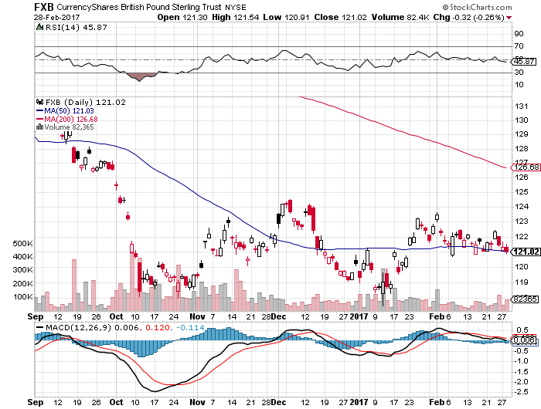
British Pound (FXB)-

Slide 53
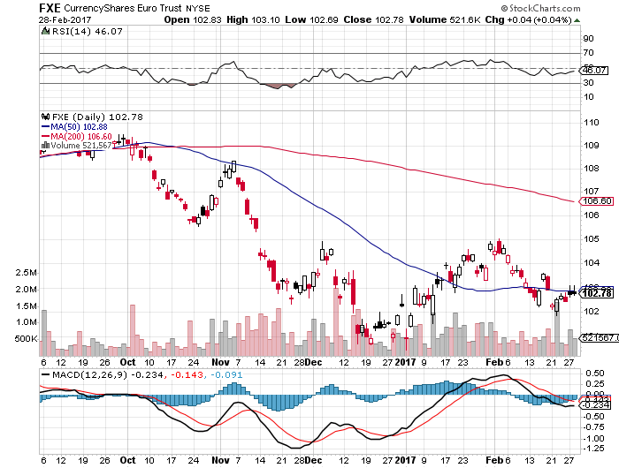
Euro ($XEU), (FXE), (EUO)- Bombs Away took profits on long 9/$112-$115 vertical bear put spread took profits on long 11/$110-$113 vertical bear put spread

Slide 54
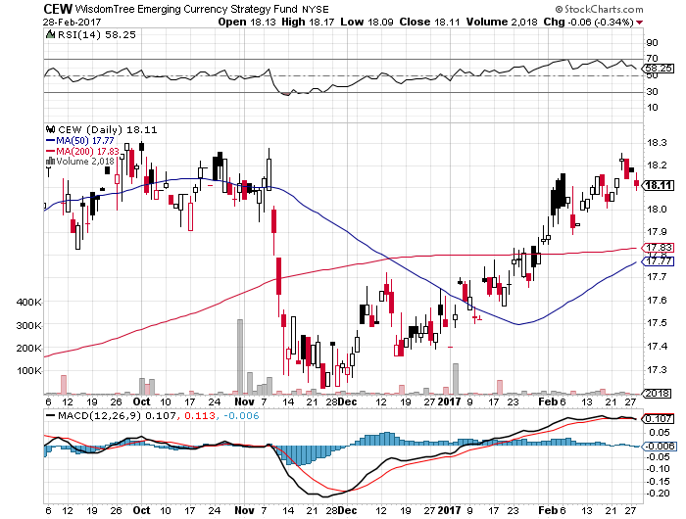
Emerging Market Currencies (CEW)

Slide 55
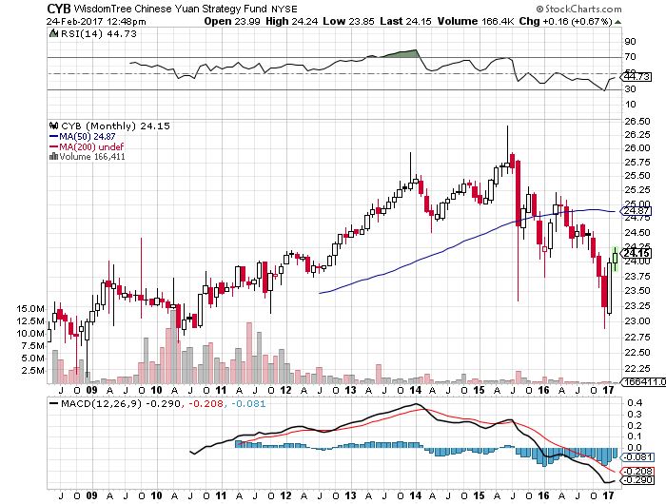
Chinese Yuan- (CYB)- Trump Says China is devaluing, but only if you hold the chart upside down, massive government efforts to support the currency underway, up 5.4% since election

Slide 56
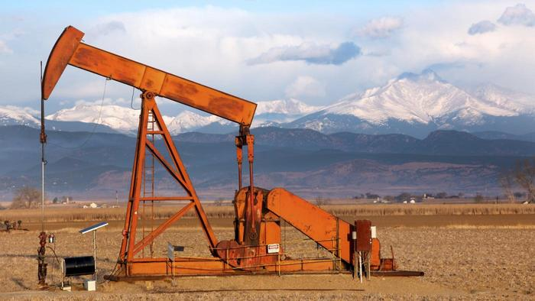
Energy-Topping Out
*The big surprise is that the new OPEC quotas are working better than expected, but for how long? *Is keeping 1.2 million b/d off the market, along with another 560,000 b/d from non OPEC countries *May be extended after June deadline *US oil production tops 9 million b/d, highest in a year, as fracking comes back on line *200 new US fracking wells added in the past 12 months, taking production up over 9 million b/d again *Gasoline glut is the worst in 27 years *Oil still stuck in $45-$60 2017 likely range, nothing to do dead in the middle of the range

Slide 57
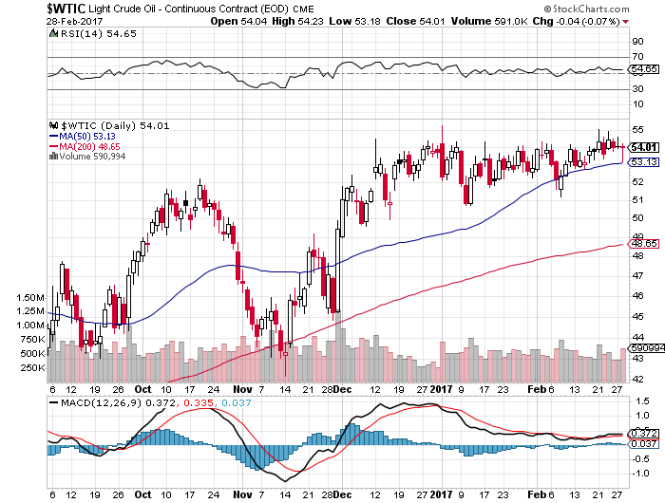
Oil-Top of Range-Topping Out

Slide 58
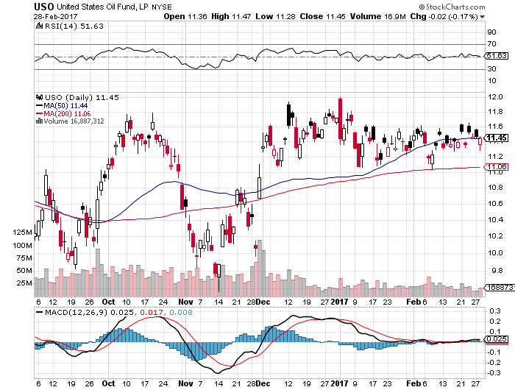
United States Oil Fund (USO) took profits on long (USO) 11/$12.50-$14.00 vertical bear put spread

Slide 59
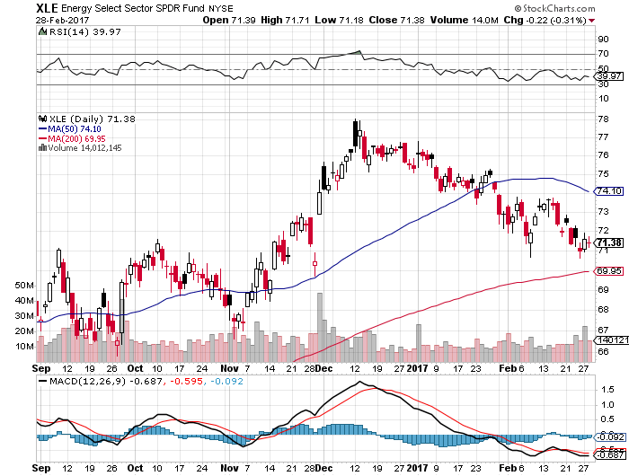
Energy Select Sector SPDR (XLE) (XOM), (CVX), (SLB), (KMI), (EOG), (COP)

Slide 60
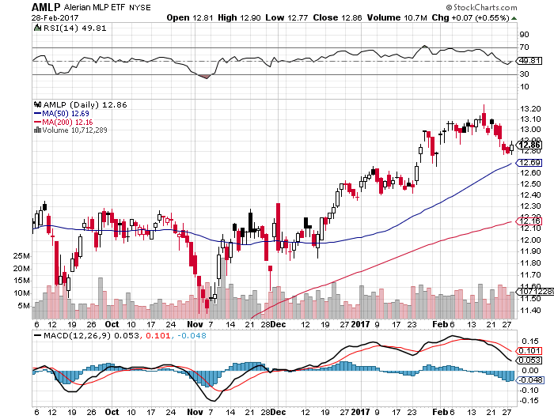
Alerian MLP ETF (AMLP)- Basket Approach is the Only Safe Play Here

Slide 61
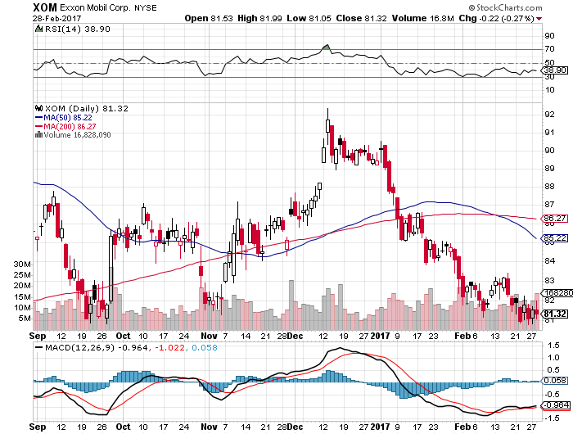
Exxon (XOM)-

Slide 62

Occidental Petroleum (OXY)-

Slide 63

Natural Gas (UNG)-Back to Bottom

Slide 64

Copper (COPX)-

Slide 65

US Steel (X)-Upside Breakout!

Slide 66

Precious Metals-Risk is Rising
*Hedge fund longs in gold hit new all time high, cash pouring into the (GLD) on a daily basis *Gold hits 200 day moving average at $1,264, Silver breaks through $18.50 *Precious metals getting extra lease on life due to stagnating US interest rates *Speculative positions in gold back at new all time highs, especially with hedge funds *Weakness in gold miners during gold strength hints at imminent stock market correction

Slide 67

Gold (GLD)- took profits on long 11/$112-$115 vertical bull call spread took profits on long 2/$108-$111 vertical bull call spread

Slide 68

Market Vectors Gold Miners ETF- (GDX)

Slide 69

Silver (SLV)-

Slide 70

Silver Miners (SIL)-

Slide 71

Agriculture-The Russia Play
*Trump election win sparks huge Russian Ruble rally, making their exports much more expensive *As a result, the US is about to reclaim its position as the world’s largest wheat exporter *The harsh reality of huge 2017 forecasts cause all ags to give up recent gains
*Only severe flooding is stopping prices from hitting new lows *Trade war risks still high, look for multiple limit down moves if it happens *Stay away

Slide 72

Russian Ruble-Up 20% Since the Election

Slide 73

(CORN) –

Slide 74

(WEAT)-

Slide 75

(SOYB)-

Slide 76

Real Estate-The Bull Lives
*January existing home sales up +3.3% to 5.69 million units, December revised up, strongest in ten years, pending home sales down -2.8% due to lack of supply *Median Home Sales up 7.1% YOY to $228,900, with the west leading *Spring looking to see prices rocket *Home price appreciation beating wage growth by a large margin *Shortage of supply the big driver, with only 3.9 months of inventory *Homes are the best place to hide during an inflation surge *Case-Shiller accelerates to 5.8%, with absolute prices hitting new all time high, your home equity could be the best investment of the year….again

Slide 77

November S&P 500/Case–Shiller Home Price Index +5.6% YOY, Seattle (+10.8%), Portland (10.0%), Denver (8.9%) still leaders absolute prices hit new all time high

Slide 78

General Growth Properties (GGP) Not Buying the Rally in Yields

Slide 79

US Home Construction Index (ITB) (DHI), (LEN), (PHM), (TOL), (NVR) Another Rising Rate Victim-But Becoming a Favorite Sector to Buy

Slide 80

Trade Sheet-The Complete Opposite So What Do We Do About All This?
*Stocks- buy dips, especially tech, energy, and financials *Bonds-sell rallies, buy a bigger dip to 2.10% *Commodities-buy dips, copper *Currencies-sell yen and Euro *Precious Metals –buy gold and silver *Volatility-buy the dip to single digits *The Ags –stand aside *Real estate-stand aside

Slide 81

Next Strategy Webinar 12:00 EST Wednesday, March 15, 2017 San Francisco, CA
Good Luck and Good Trading!
Notes:
*

