Slide 1

The Mad Hedge Fund Trader
“Summer Doldrums”
With John Thomas
from Silicon Valley, CA, June 21, 2017
www.madhedgefundtrader.com
Notes:
*

Slide 2


Slide 3


Slide 4

Second Edition
Is Out!
In the Store
Now for $49
Sectors and Stocks that
Will Lead the Market for
the Next 20 Years
https://members.madhedgefundtrader.com/roaring-twenties-book/

Slide 5
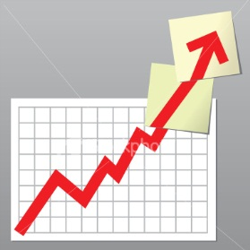
Trade Alert Performance
New All Time High!!
*January +9.35% Final *July +0.67% Final
*February +6.39% FINAL *August +7.52% Final
*March +4.87% Final *September +0.27% Final
*April +1.84% Final *October +8.13% Final
*May -0.45% Final *November 4.37% Final
*June +1.25% MTD *December +.84% Final
*2017 Year to Date 23.25%
compared to 8.0% for the Dow Average
11 of 12 Consecutive Profitable Months!
*Trailing 1 year return +45.05%, +241.81% since inception,
*Average annualized return of 32.07%

Slide 6
Portfolio Review
Cautious “RISK ON” with 90% Cash Position
Playing a Range
Current Capital at Risk
Risk On
World is Getting Better
(AAPL) 7/$135-$138 call spread | 10.00%
Risk Off
World is Getting Worse
No positions
Total Net Position | 10.00%
Expiration P&L
24.39%

Slide 7
Trailing One-Year Return
Daily Audited Performance
+45.05%

Slide 8
Seven Year Daily Audited Performance
Averaged Annualized Return +31.88%

Slide 9


Slide 10

The 30,000 Foot View
The Really Simple Big Picture
*Washington gridlock continues
*Tax cuts, deregulation, and infrastructure spending are all now delayed until 2018
*Leadership rotates from technology to biotech, as leading techs sell off 10%
*Higher bonds, and lower oil and commodities suggest a recession is coming
*Fed June 13 rate hike is done, is it the last one of 2017 with a slowing economy?
*3% growth in 2017 now impossible, and
even 2% is now unlikely
*Looking like a narrow trading range
for the next four months

Slide 11

The Method to My Madness
*Now 90% cash in extremely overbought market
*VIX under $10 gives all options based strategies an unfavorable risk/reward ratio, only buy VIX under $10
*Summer doldrums are setting in with a vengeance, with volume collapsing
*Earnings are over, so no major market moving
news until September
*Cut back trading and start building lists of
names to play for the next major market move
*Oil induced gold selloff creates a long entry point
*Keep size small and maturity short as we
are in the high risk time of the year

Slide 12
The Bill Davis View
A $1,500 Upgrade for the Mad Day Trader Service
Buys:
Biogen, Inc. (BIIB) $265 Target to $282
Palo Alto Networks (PANW) $131 Target to $150
ebix.com (EBIX) $52 Target to $66
Gilead Sciences (GILD) $64 Target to $75
Cliffs Natural Res. (CLF) $6 Target to $9
Sells:
Chipotle Mexican (CMG) $438 Target to $408
TripAdvisor (TRIP) $38 Target to $25
Cracker Barrel (CBRL) $56 Target to $48
Costco (COST) $169 Target to $150
Caseys General Stores (CASY) $109 Target to $100

Slide 13
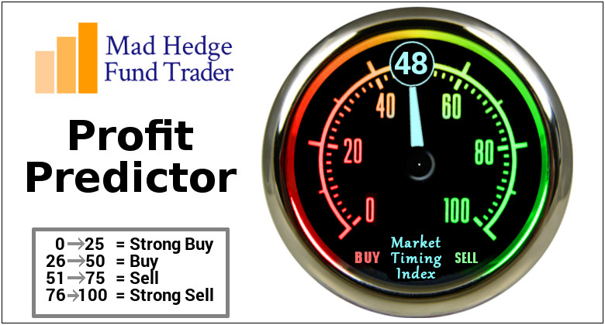
The Mad Hedge Profit Predictor
Market Timing Index
An artificial intelligence driven algorithm that analyzes 30 different economic, technical, and momentum driven indicators

Slide 14
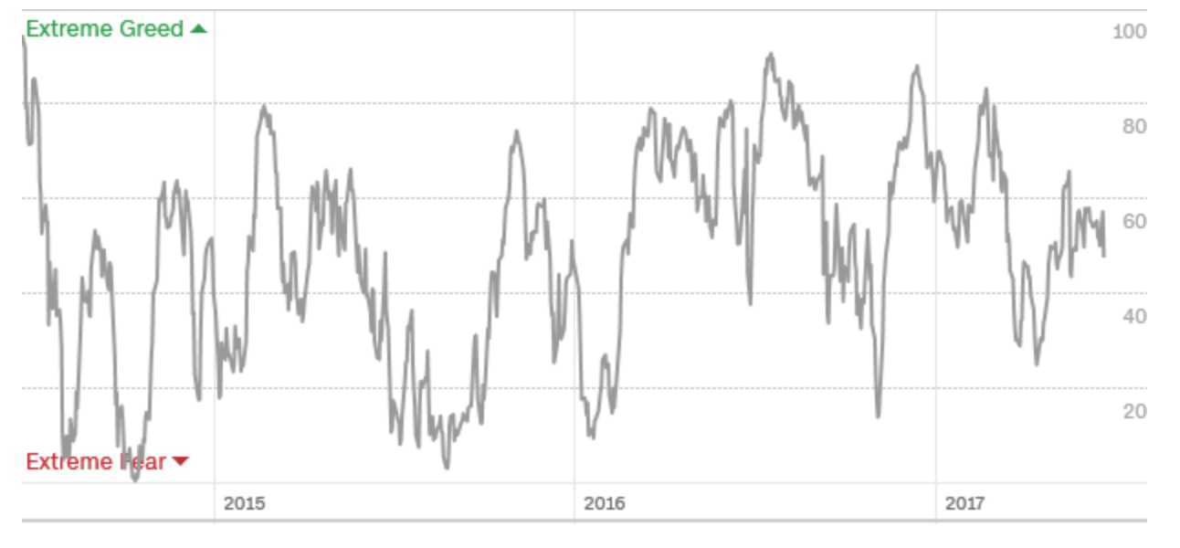
The Mad Hedge Profit Predictor
Market Timing Index
Dead in the Middle Means Do Nothing

Slide 15
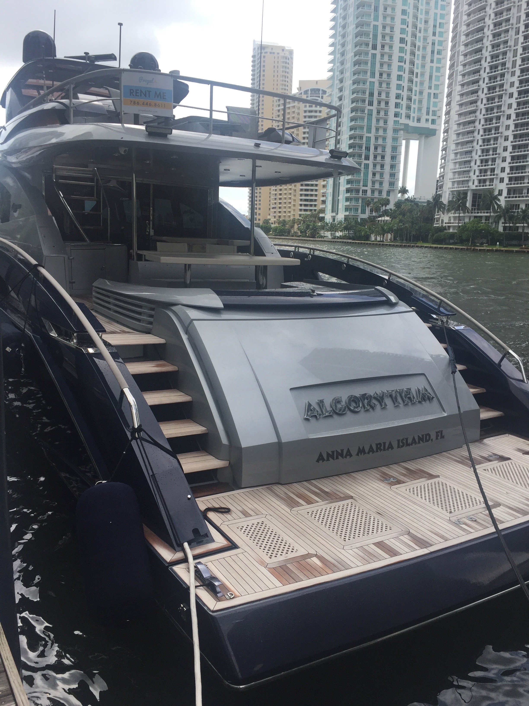

Slide 16

The Global Economy-Stalling
*Fed raises rates ¼%, sees only 2.2% growth in 2018, may be the last rate rise of the year
*Inflation falls for three consecutive months, May Consumer Confidence plunges, from 97.1 to 94.5, finally aligning with the hard data
*LinkedIn says May hiring up 6.2% YOY, hiring broadening out nationwide beyond the coasts, key areas are in tech, web and mobile development, Job Openings hit a record 6 million.
*GM May sales down 1.3% as entire auto industry rolls over
*May ISM Non Manufacturing at a light 56.9
from 57.5, April Durable Goods down a big -0.8%
*May Nonfarm Payroll a tepid 119,000, headline
Unemployment Rate a new decade low at 4.3%

Slide 17
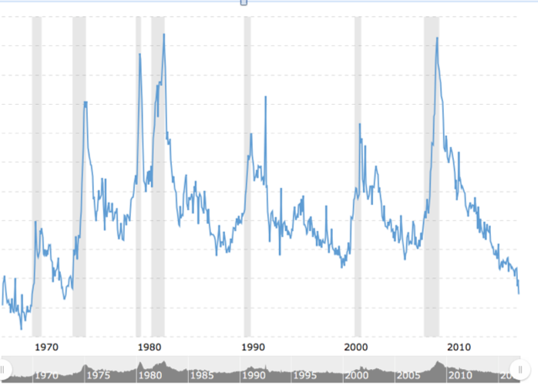
Weekly Jobless Claims –The Most Important Statistic
-8,000 to 237,000, Hugging 43 Year Low

Slide 18
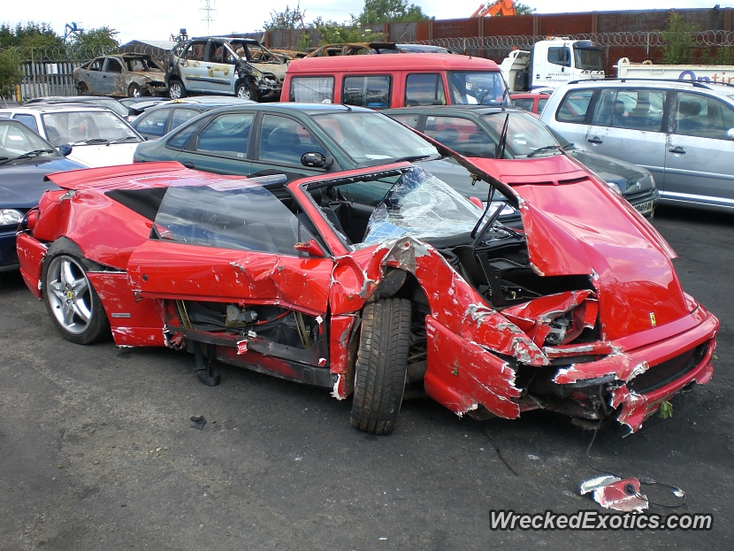
Stocks-Tech Wreck
*Top 5 companies, (FB), (AAPL), (AMZN), (MSFT), (GOOG), now 43% of NASDAQ, were up 70% of days in 2017, a record high-most narrow leadership since 2000 Dotcom bubble top
*Google downgrade puts a second knife in technology is back, but most investors looking for a tradable low
*Chance of no more rate hikes in 2017 are a dead weight on financials
*222 Chinese shares to join MSCI Index, $2.2 billion moves into Chinese stocks in May,
and possibly $10 billion for 2017
*The S&P 500 forward P/E ratio
at 19.5X is the ceiling for now
*But no crash coming, still looking for
10%-12% total return in equities for 2017,
but a 5% correction may have to occur first

Slide 19
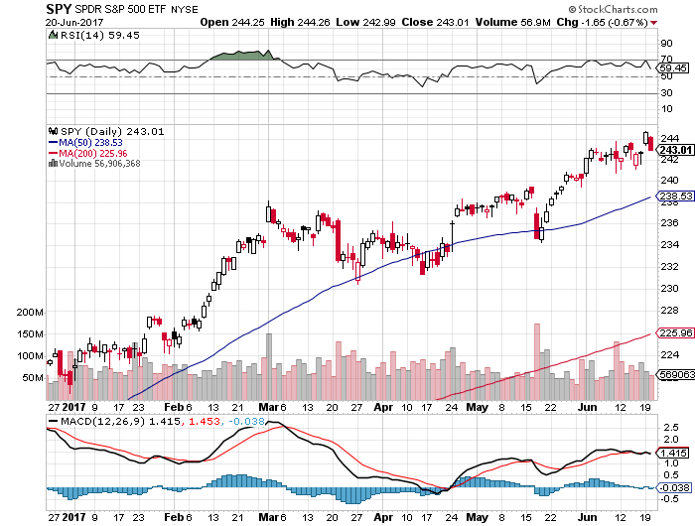
S&P 500-New Highs….But it Does Feel Like it took profits on long 5/$242-$245 bear put spread took profits on long 4/$227-$230 bull call spread and long 4/$239-$242 bear put spread

Slide 20
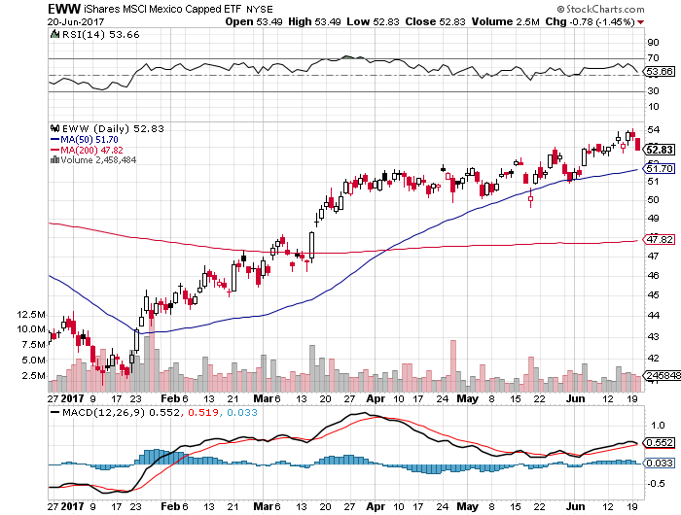
iShares MSCI Mexico ETF (EWW)-Trade War Isn’t Happening

Slide 21
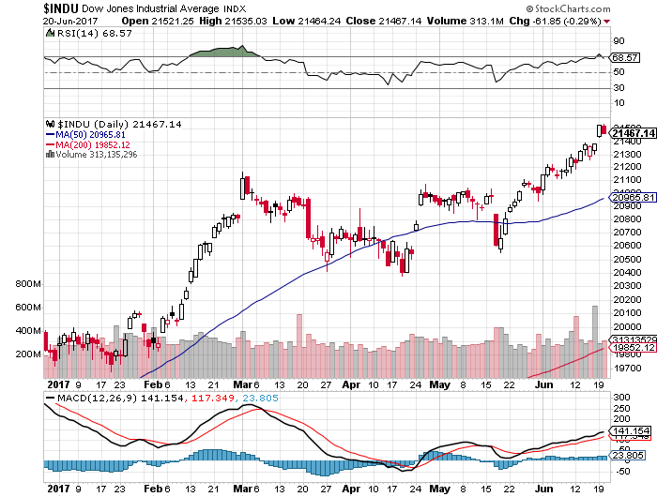
Dow Average-Spike High

Slide 22
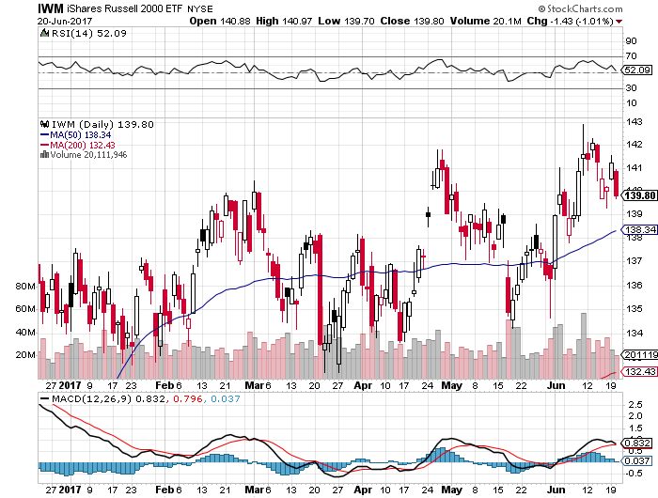
Russell 2000 (IWM)-New High, the Fade

Slide 23
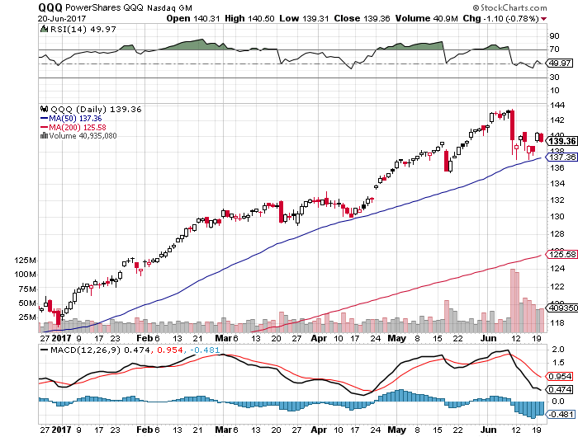
NASDAQ (QQQ)-Correction in a Bull Move

Slide 24
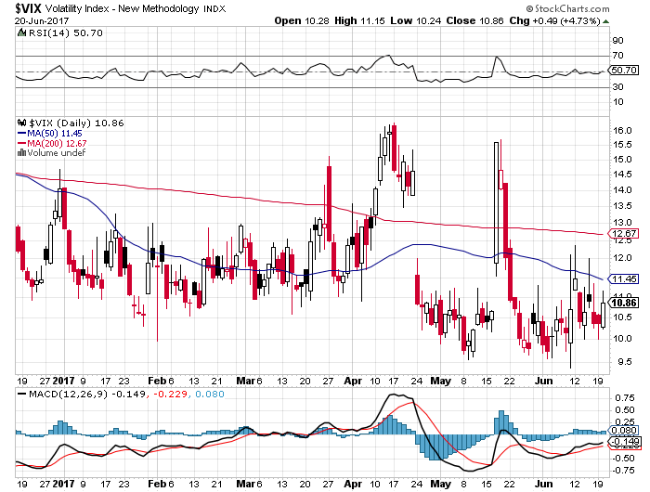
(VIX)-Double Bottom Decade Low!

Slide 25
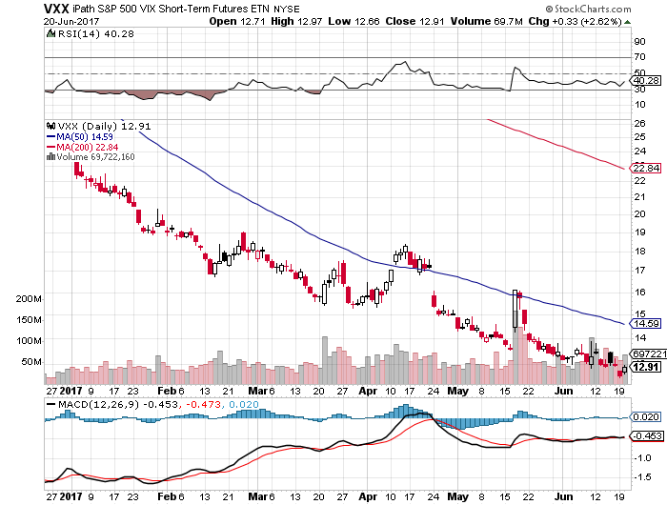
iPath S&P 500 VIX Short-Term Futures ETN (VXX) long 5/$13.00-$13.50 bull call spread stopped long 5/$13.50-$14.00 bull call spread

Slide 26
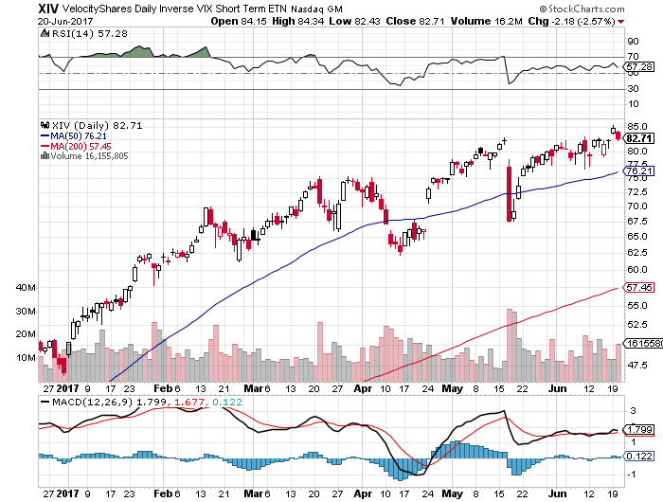
Velocity Shares Daily Inverse VIX Short Term ETN (XIV)
Trend is still up
One of the most instantly profitable trades of 2016….and 2017

Slide 27
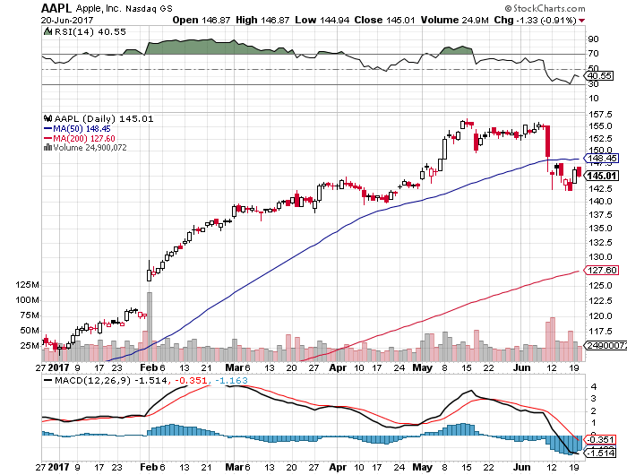
Apple (AAPL) –New Run at the Highs
10% Correction at $17 billion is Buffett’s second largest position

Slide 28
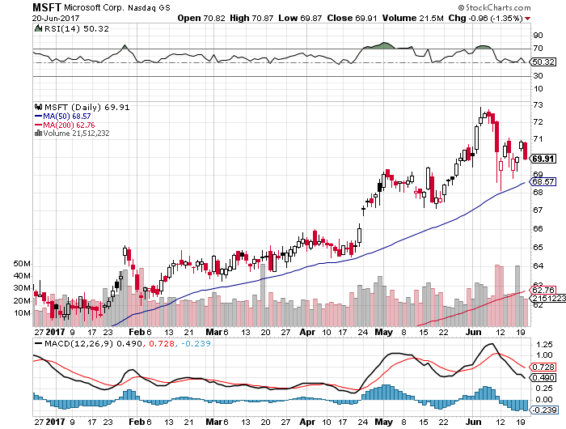
Microsoft (MSFT)

Slide 29
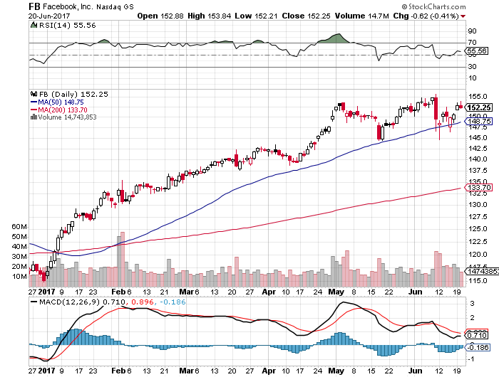
Facebook (FB)-

Slide 30
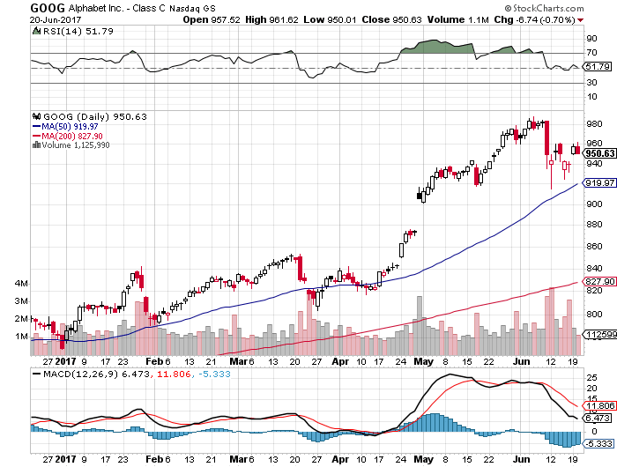
Alphabet (GOOG)-New High

Slide 31
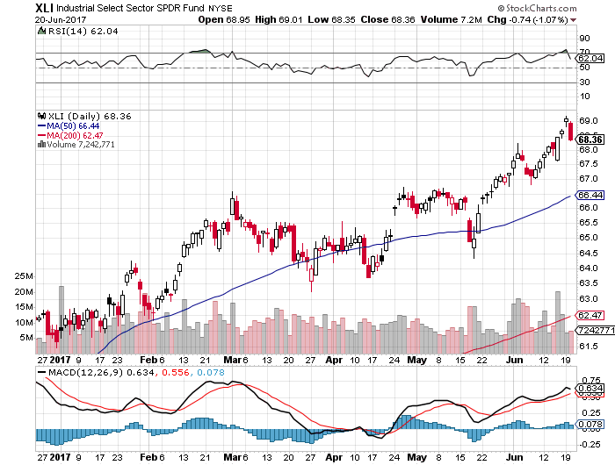
Industrials Sector SPDR (XLI)-Blow Off Top?
(GE), (MMM), (UNP), (UTX), (BA), (HON)

Slide 32
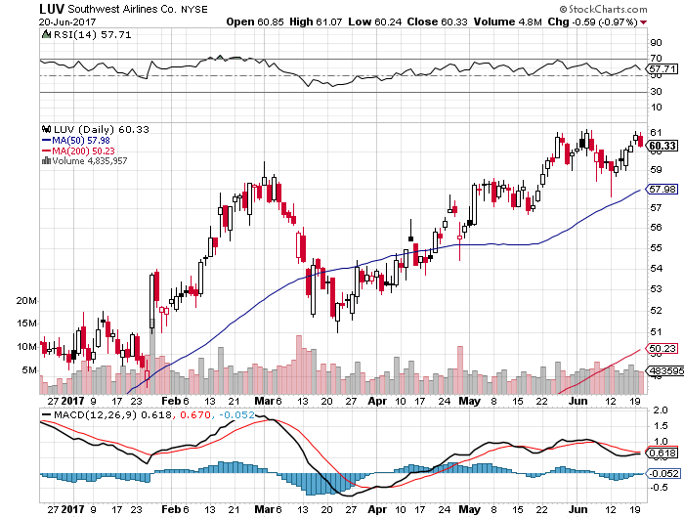
Southwest Airlines (LUV)-
Warren Buffett’s Favorite Airline

Slide 33
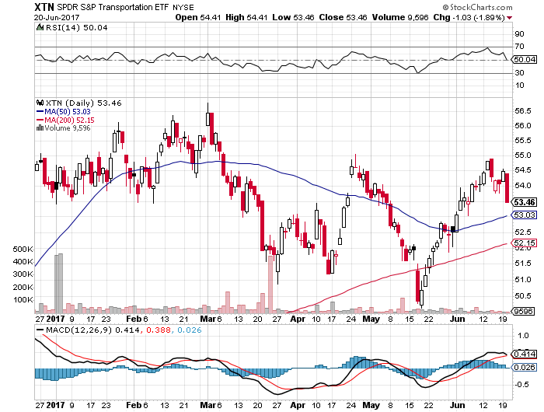
Transports Sector SPDR (XTN)-
(ALGT), (ALK), (JBLU), (LUV), (CHRW), (DAL)

Slide 34
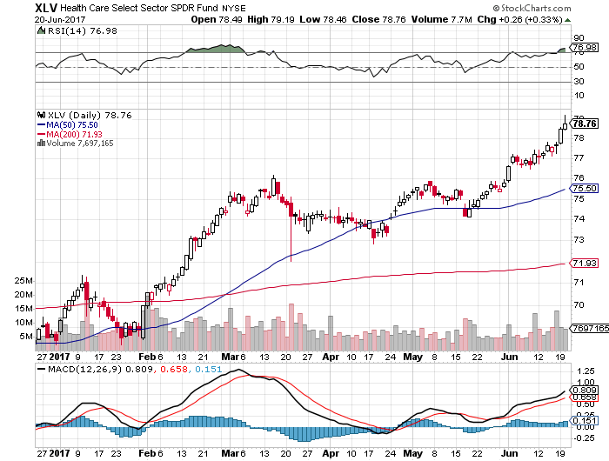
Health Care Sector (XLV), (RXL)-The New FANG?
(JNJ), (PFE), (MRK), (GILD), (ACT), (AMGN)

Slide 35
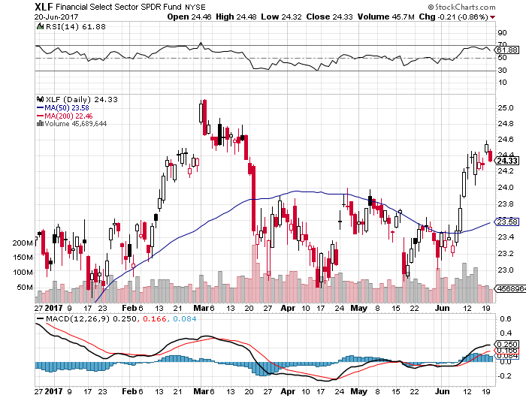
Financial Select SPDR (XLF)-Bouncing Back
(BLK/B), (WFC), (JPM), (BAC), (C), (GS)

Slide 36
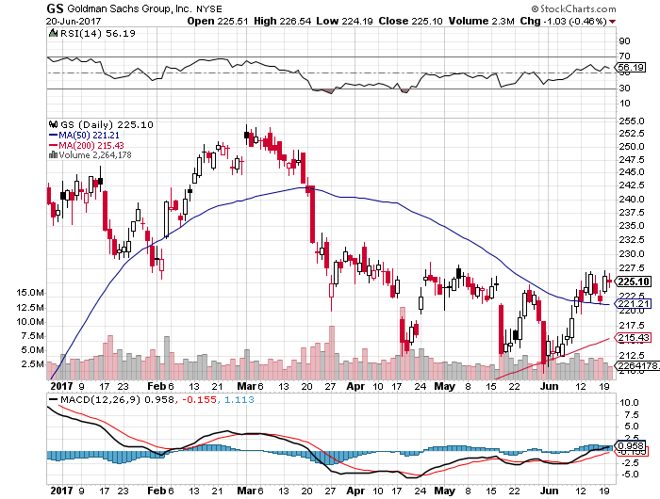
Goldman Sachs (GS)- took profits on long 2/$222.50-$227.50 vertical bull call spread most profitable trade of 2017

Slide 37
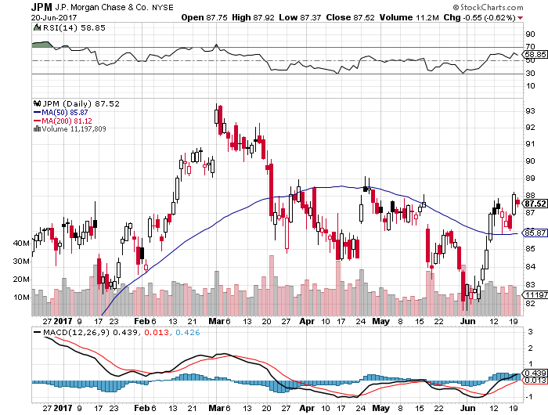
JP Morgan (JPM)-

Slide 38
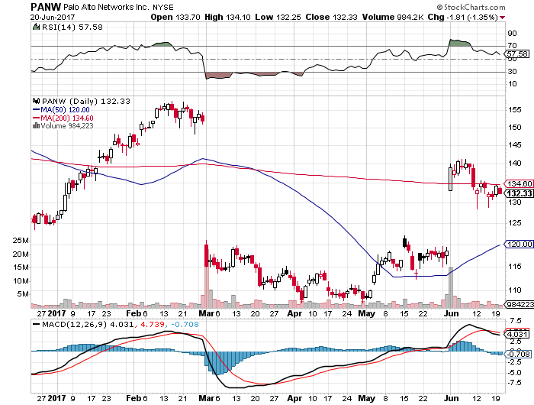
Palo Alto Networks (PANW)-

Slide 39
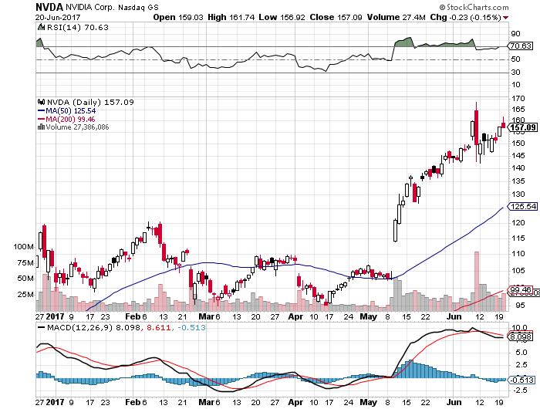
NVIDIA (NVDA)-Another Earnings Spike

Slide 40
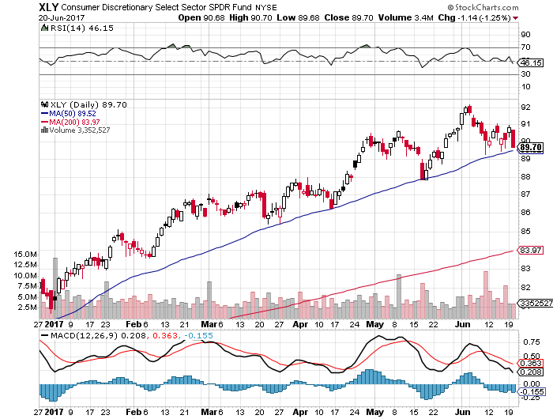
Consumer Discretionary SPDR (XLY)
(DIS), (AMZN), (HD), (CMCSA), (MCD), (SBUX)

Slide 41
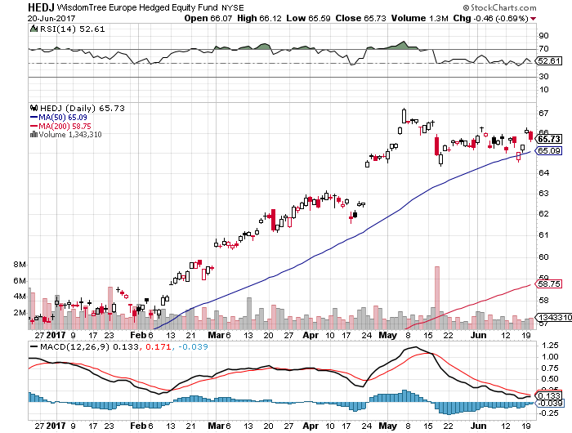
Europe Hedged Equity (HEDJ)-New Highs On French Election

Slide 42
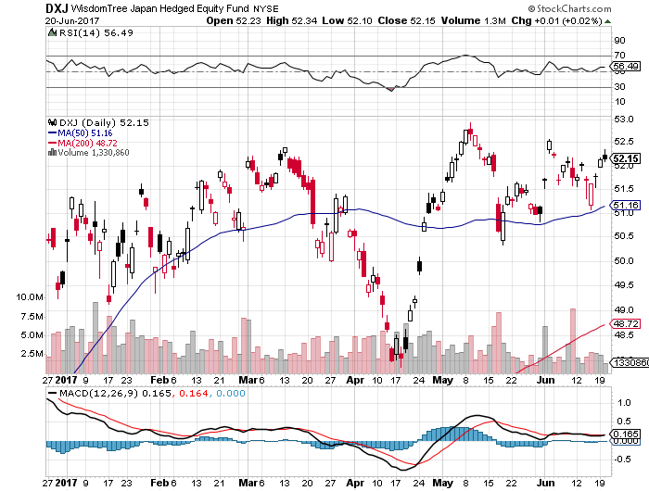
Japan (DXJ)-Sideways Correction

Slide 43
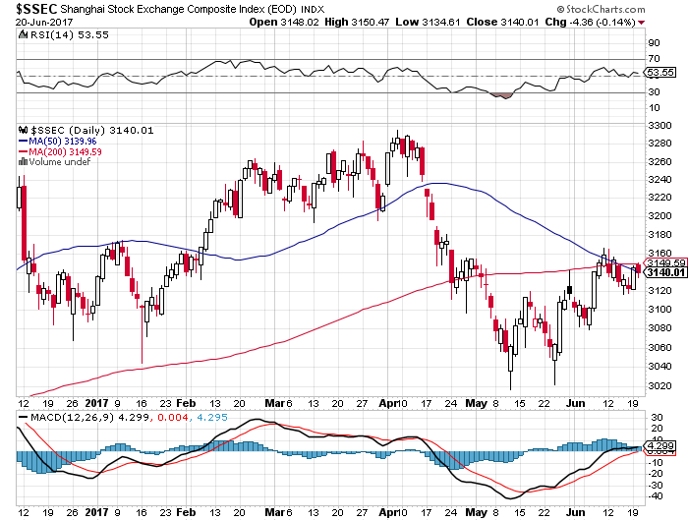
China ($SSEC)-MSCI Boost

Slide 44
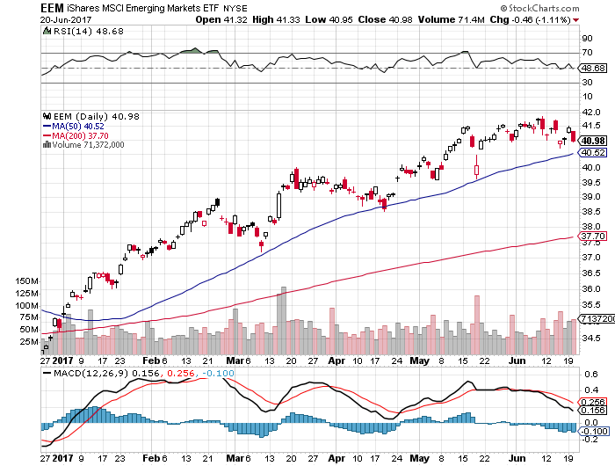
Emerging Markets (EEM)-
On Fire

Slide 45


Slide 46

Bonds-Euphoric
*Prices hit seven month high, yields seven month low going into Fed rate rise
*Possibility of no more rate rises for 2017 is keeping bonds high
*Oil collapse giving a further boost to bonds
*This is despite more Fed details about coming $4 trillion taper
*A near record 4.3% Headline Unemployment Rate makes it even more certain
*Now at top of current trading range, 2.10%-2.40% in 10 year yields
*We are ten months into a 10-20 year
bear market in bonds, now is a great
entry point on the short side

Slide 47
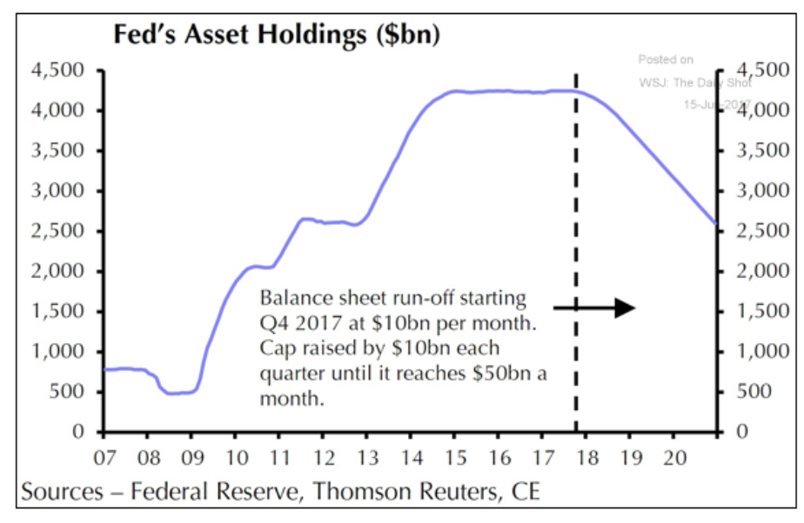

Slide 48
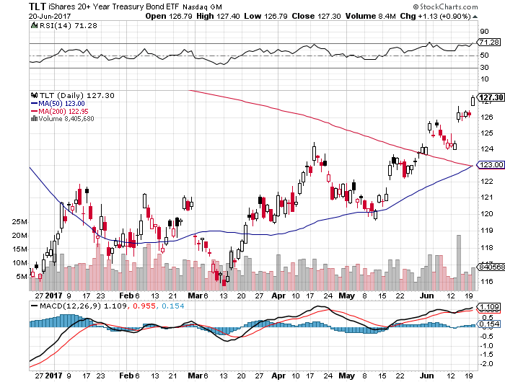
Treasury ETF (TLT) – 2.15%-Upside Breakout took profits long 5/$126-$129 vertical bear put spread took profits long 5/$116-$119 vertical bull call spread

Slide 49
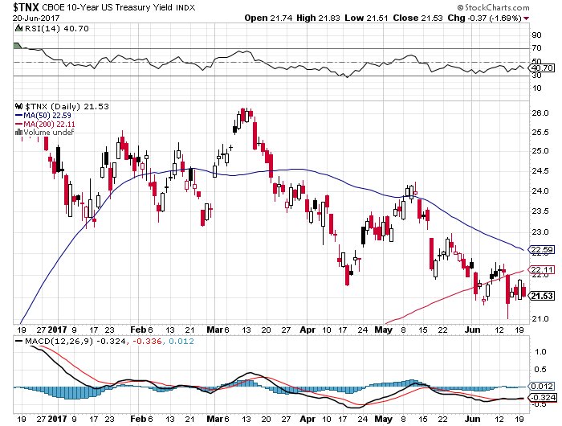
Ten Year Treasury Yield ($TNX) 2.15%

Slide 50
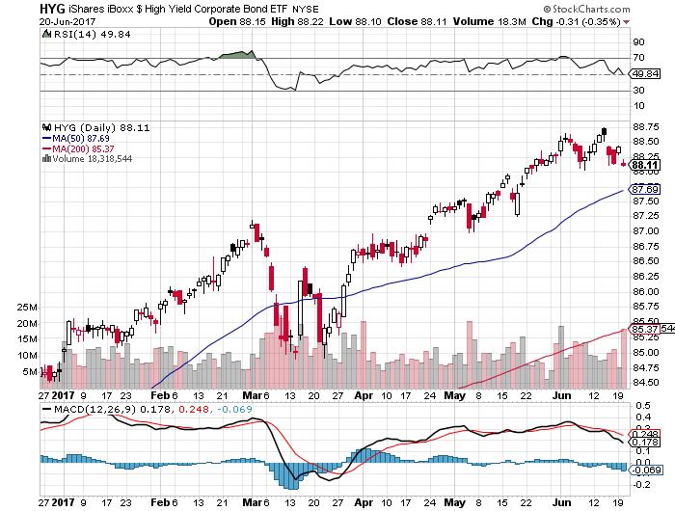
Junk Bonds (HYG) 5.19% Yield
A Great Risk Coincident Indicator- Long Term “RISK ON” means new highs, buy all dips

Slide 51
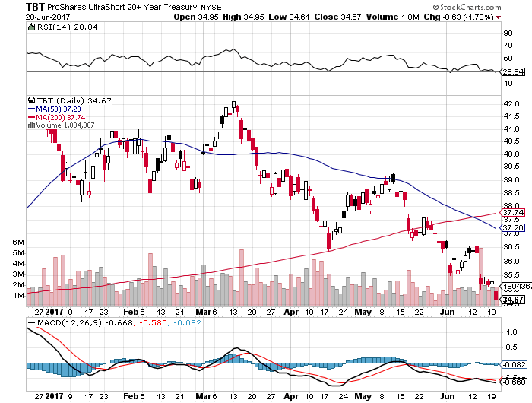
2X Short Treasuries (TBT)-In Screaming “BUY” Territory

Slide 52
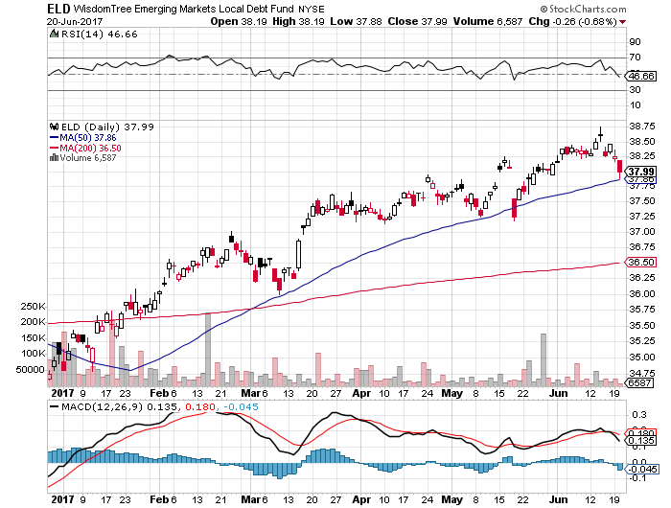
Emerging Market Debt (ELD) 5.77% Yield-

Slide 53
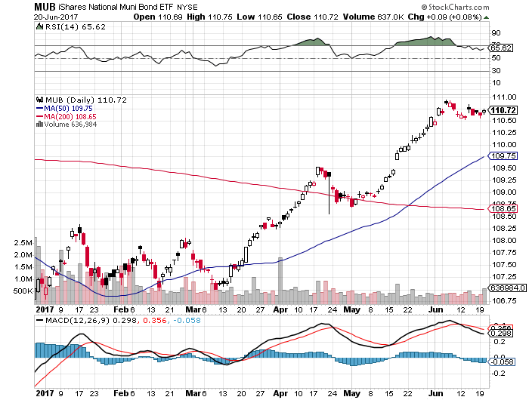
Municipal Bonds (MUB)-2.14%
Mix of AAA, AA, and A rated bonds

Slide 54

Foreign Currencies-Dollar Hanging on
*Yellen’s hawkish statements on rising interest rates put in a bottom for the dollar
*Commodity currencies rally on very hawkish comments by the Bank of Canada, (FXC), (FXA)
*Disastrous election for the conservatives demolish the pound (FXB)
*Interest rate differentials are the
biggest drivers of foreign exchange rates
*Get ready to sell short the yen (FXY) and the
Euro (FXE) on a blow off top, which is
getting close

Slide 55
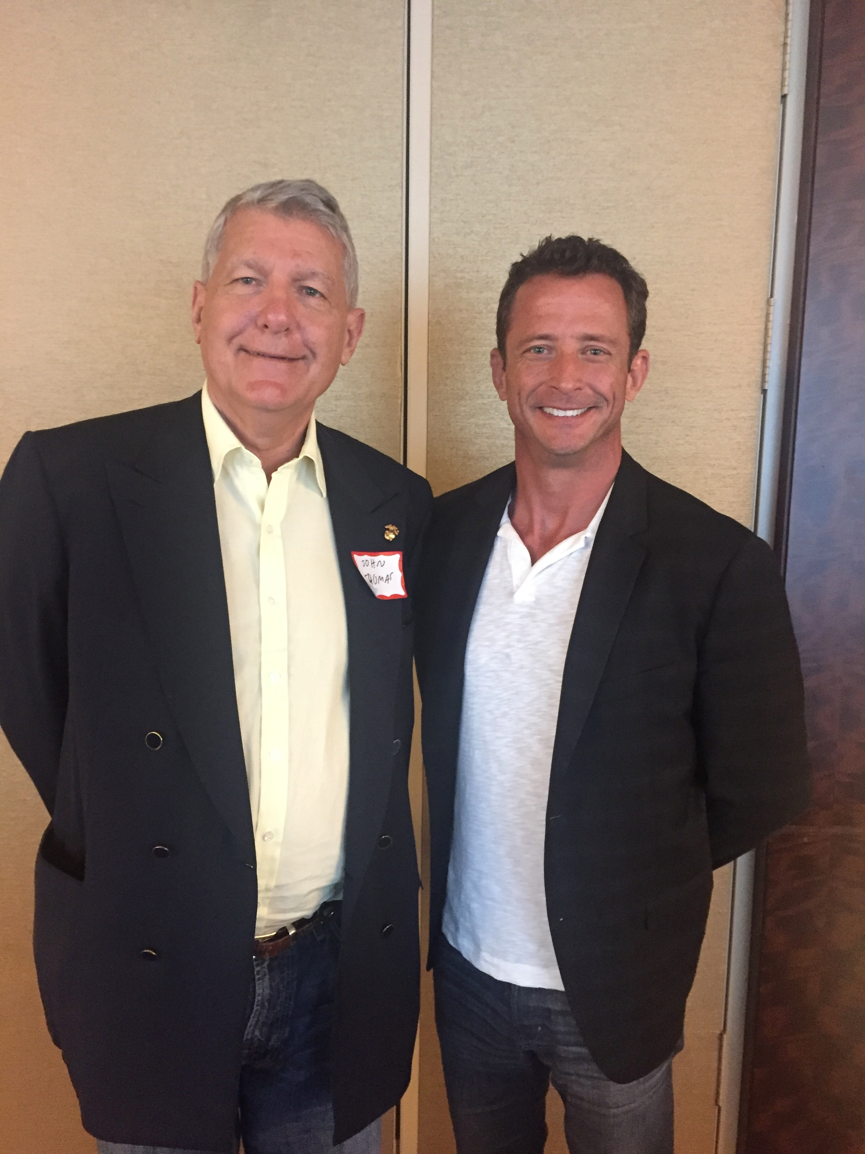

Slide 56
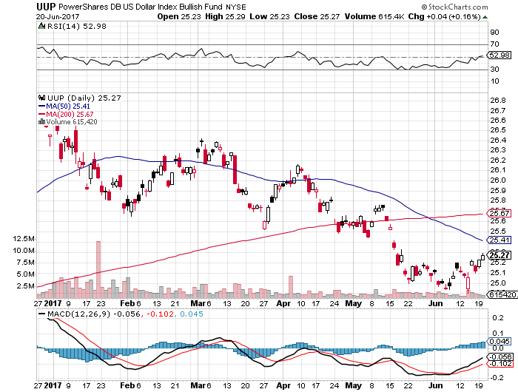
US Dollar Basket-(UUP)

Slide 57
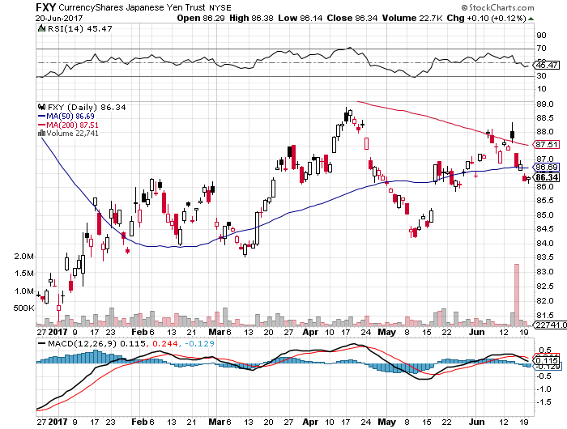
Japanese Yen (FXY)-Run at the Highs

Slide 58
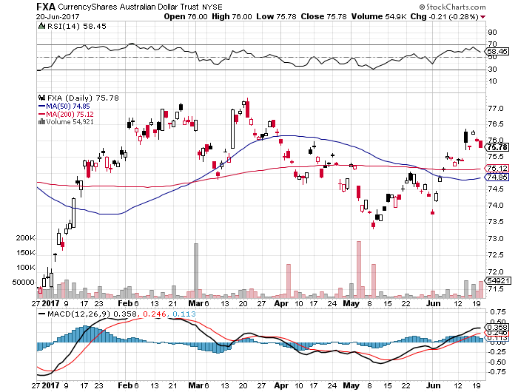
Australian Dollar (FXA)-

Slide 59
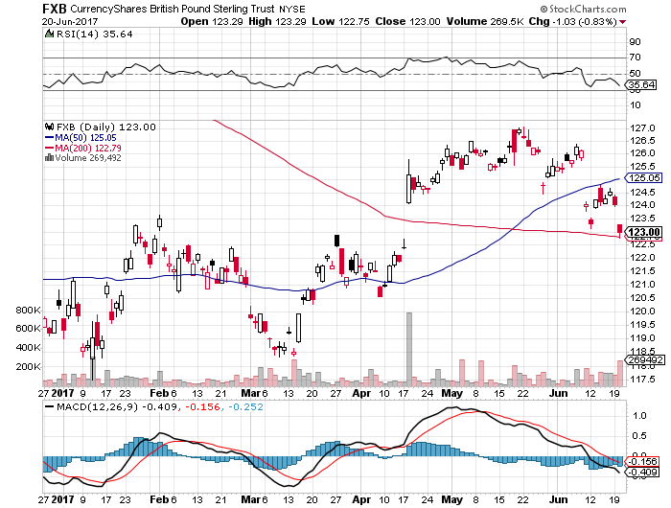
British Pound (FXB)- British Election-May Falters

Slide 60
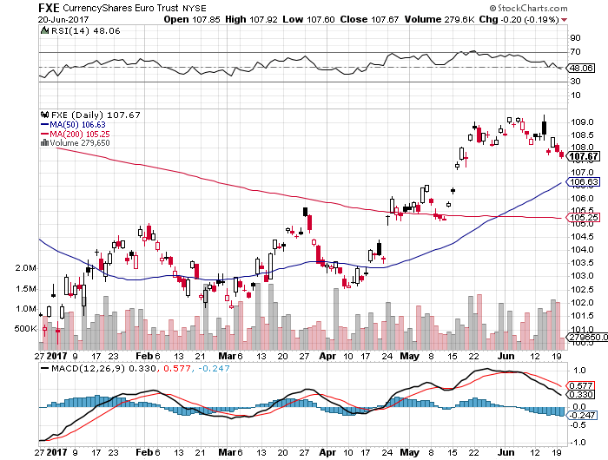
Euro ($XEU), (FXE), (EUO)- Off to the Races

Slide 61
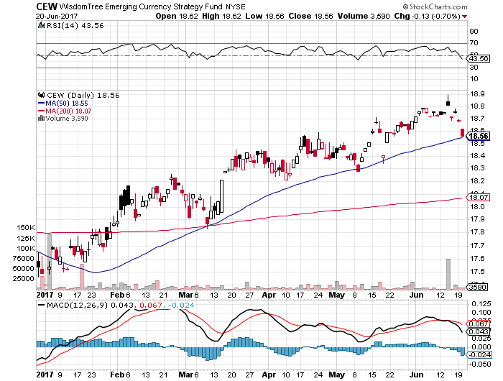
Emerging Market Currencies (CEW)

Slide 62
Chinese Yuan- (CYB)-Stabilizing on Government Support

Slide 63

Energy-Crash!
*Massive inventory numbers destroy oil, up by 11 million barrels when a fall was expected, sending it to new lows for the year
*Prices are collapsing when demand is supposed to be at a peak
*Oil prices fall back to pre quota levels
*Hyper accelerating technology takes Permian Basin costs down to $35/barrel
*Libya and Nigeria ramp up production
faster than expected
*Baker Hughes US Rig Count still
rocketing to new one-year high, up
7 to 910
*Bottom line: a whole lot of supply
is about to hit the market

Slide 64
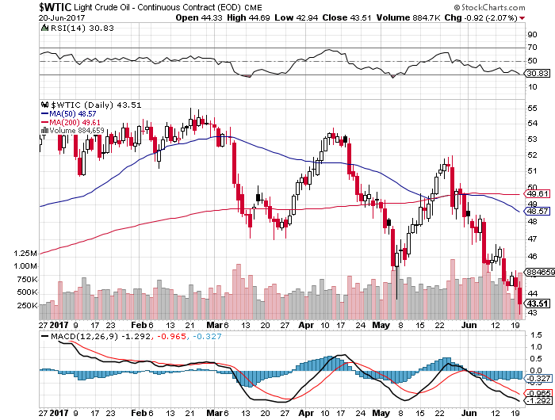
Oil-The Downtrend Is In

Slide 65
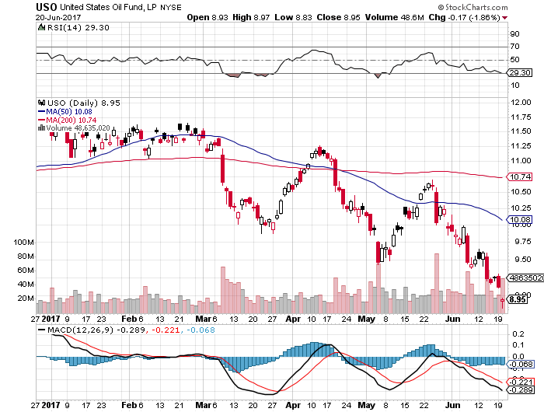
United States Oil Fund (USO) took profits on long (USO) 11/$12.50-$14.00 vertical bear put spread

Slide 66
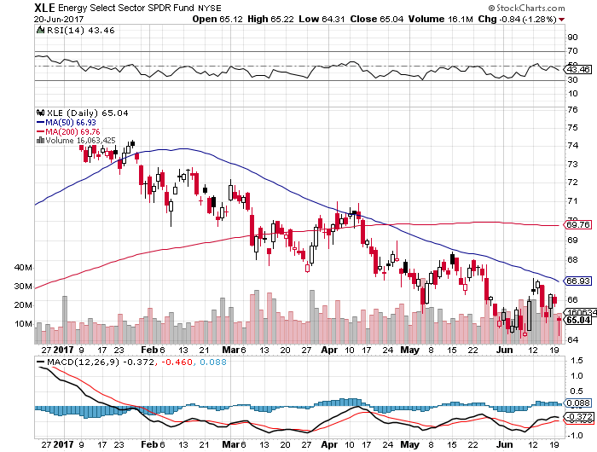
Energy Select Sector SPDR (XLE)
(XOM), (CVX), (SLB), (KMI), (EOG), (COP)

Slide 67
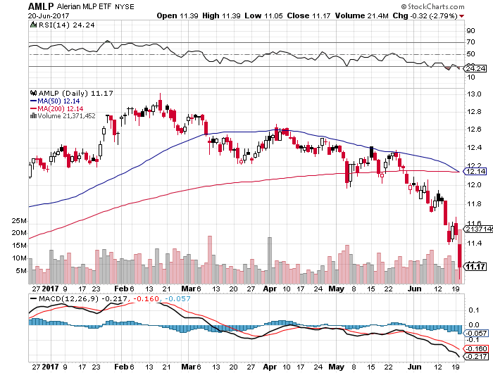
Alerian MLP ETF (AMLP)- Basket Approach is the Only Safe Play Here

Slide 68

Exxon (XOM)-

Slide 69

Occidental Petroleum (OXY)-
Call Spread Setting Up

Slide 70

Natural Gas (UNG)-No Joy

Slide 71

Copper (COPX)-Head and Shoulders Top
No Chinese Recovery

Slide 72

US Steel (X)-25% down in 1 Day on disappointing Earnings

Slide 73


Slide 74

Precious Metals-Bitcoin Bubble
*Gold weakens despite falling US rates
*Record monsoon in India increases purchasing power of world’s largest buyer
*Falling Oil is also a drag on gold prices
*Flight to safety has moved from gold
to Bitcoin
*Bitcoin steals gold’s thunder, goes ballistic
to $2,980 on Chinese buying
*Buying now spilling over into a dozen
other crypto currencies
*Unload all bitcoin if you have any, we are
at a bubble top

Slide 75

Gold (GLD)-Pause in the Uptrend

Slide 76

Market Vectors Gold Miners ETF- (GDX)

Slide 77

Bitcoin-Sell Everything!

Slide 78

Silver (SLV)-

Slide 79

Silver Miners (SIL)-

Slide 80


Slide 81

Agriculture-Bouncing Along a Bottom
*Welcome rains boost ag forecasts and crush the recent rally
*Hedge funds maintaining huge shorts in corn and wheat, setting up a short squeeze
*Record monsoon in India promises record
rice crop, but it is the only ag still rallying
*Trade war risks still high, look for
multiple limit down moves
if it happens
*Stay away

Slide 82

(CORN) –

Slide 83

(WEAT)-Extreme Heat Hits

Slide 84

(SOYB)-New Lows!

Slide 85


Slide 86

Real Estate-Bubbling Up
*Mortgage rates hit the lowest levels since the presidential election, down from 4.49% to 4.14% for the 30 year fixed
*ARM applications rocket as cash strapped buyers use its lower rates to deal with high prices.
*May Housing Starts down a shocking 5.5%, vs. +3.5% expected
*Housing stocks see big multiple expansion in H1
*Downsizing baby boomers colliding with first time buying Millennials, creating extreme shortages for entry level homes, some
142 million in total
*Trump timber tariff is accelerating price increases
*March Case-Shiller accelerates to 5.8%, with
absolute prices hitting new all time high,
your home equity could be the best investment
of the year….again

Slide 87

Home Depot (HD)

Slide 88

March S&P 500/Case–Shiller Home Price Index
+5.8% YOY, Seattle (+12.2%), Portland (9.7%), Dallas (8.8%) still leaders absolute prices hit new all time high

Slide 89

General Growth Properties (GGP)-New Lows
Long Term Downtrend

Slide 90

US Home Construction Index (ITB)
(DHI), (LEN), (PHM), (TOL), (NVR)
A Favorite Sector to Buy

Slide 91


Slide 92


Slide 93

Trade Sheet-The Complete Opposite
So What Do We Do About All This?
*Stocks- buy dips
*Bonds-sell rallies
*Commodities-stand aside
*Currencies-sell yen and Euro when they peak out
*Precious Metals –buy dips
*Volatility-buy the dips to single digits, sell rallies to $12
*The Ags –stand aside
*Real estate-buy dips

Slide 94

Next Strategy Webinar
12:00 EST Wednesday, July 12, 2017
San Francisco, CA
Good Luck and Good Trading!
Notes:
*

