Slide 1

The Mad Hedge Fund Trader
“The Great Rotation”
With John Thomas
from Silicon Valley, CA, July 12, 2017
www.madhedgefundtrader.com
Notes:
*

Slide 2

Second Edition
Is Out!
In the Store
Now for $49
Sectors and Stocks that
Will Lead the Market for
the Next 20 Years
https://members.madhedgefundtrader.com/roaring-twenties-book/

Slide 3
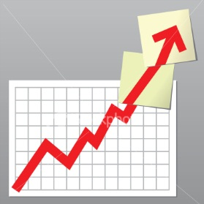
Trade Alert Performance
New All Time High!!
*January +9.35% Final *July +2.72%% MTD
*February +6.39% FINAL *August +7.52% Final
*March +4.87% Final *September +0.27% Final
*April +1.84% Final *October +8.13% Final
*May -0.45% Final *November 4.37% Final
*June +0.70% Final *December +.84% Final
*2017 Year to Date 25.42%
compared to 8.1% for the Dow Average
11 of 12 Consecutive Profitable Months!
*Trailing 1 year return +48.24%, +243.98% since inception,
*Average annualized return of 33.03%

Slide 4
Portfolio Review
Aggressively neutral with a 50% Cash Position
Playing a Range
Current Capital at Risk
Risk On
World is Getting Better
(AAPL) 7/$135-$138 call spread | 10.00%
(GS) 7/$205-$210 call spread | 10.00%
Risk Off
World is Getting Worse
(FB) 7/$160-$162.50 put spread | -10.00%
(SPY) 7/$145-$148 call spread | -10.00%
(AAPL) 7/$152.50-$155 put spread | -10.00%
Total Net Position | -10.00%
Expiration P&L
28.65%

Slide 5
Trailing One-Year Return
Daily Audited Performance
+48.24%

Slide 6
Eight Year Daily Audited Performance
Averaged Annualized Return +33.03%

Slide 7


Slide 8

The Method to My Madness
*Have an aggressively neutral position for a dead market, with only 50% cash,
30% long, 30% short
*I’m betting that big tech has peaked for now, with shorts in (AAPL) and (FB),
while rotating longs into financials
*Running bond shorts all year has been hugely profitable, and I will continue to sell every rally
*Staying away from gold until it finds a new bottom
*Looking to sell short the next big rally in oil
*Staying away from currencies until dollar bottoms
*Earnings are over, so no major market moving
news until end August

Slide 9
The Bill Davis View
A $1,500 Upgrade for the Mad Day Trader Service
Buys:
Tesla, Inc. (TSLA) $320 Target to $375
Splunk, Inc. (SPLK) $57 Target to $64
Disney (DIS) $103 Target to $112
Gilead Sciences (GILD) $69 Target to $75
3D Systems Corp (DDD) $17 Target to $23
Apple, Inc (AAPL) $141 Target to $150
Starbucks Corp (SBUX) $58 Target to $68
Sells:
Express Scripts, Inc (ESRX) $63 Target to $6
Autozone Inc. (AZO) $537 Target to $437
Alexion Pharm (ALXN) $140 Target to $104
Lululemon Athletica (LULU) $62 Target to $47
Costco (COST) $157 Target to $140
Chipotle Mexican (CMG) $420 Target to $390

Slide 10
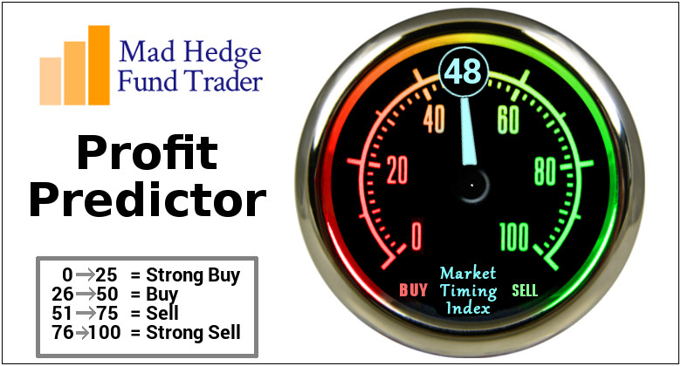
The Mad Hedge Profit Predictor
Market Timing Index
An artificial intelligence driven algorithm that analyzes 30 different economic, technical, and momentum driven indicators

Slide 11
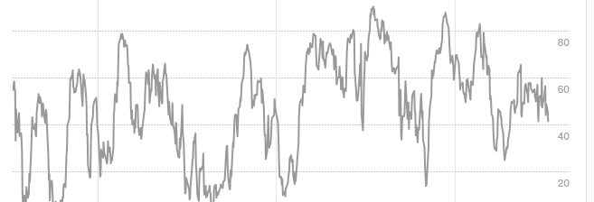
The Mad Hedge Profit Predictor
Market Timing Index
Dead in the Middle Means Do Nothing

Slide 12
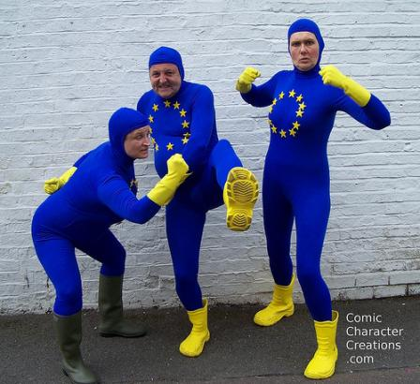
The Global Economy-Strong Europe, Weak US
*June Nonfarm Payroll a robust 222,000, headline Unemployment Rate stays at a low at 4.4%
*May Durable Goods down -1.1% vs. expected 0.40%, May Consumer Confidence rose from 117.6 to 118.9 for the first time in three months
*Commerce Dept. raises Q1 GDP from 1.2% to a still weak 1.4% , and 0.7% earlier, June ISM Manufacturing Index jumps from 54.9 to 57.8, the best in three years as a recovering Europe and Asia ramp up imports
*June China Purchasing Managers Report rises from 51.2 to 51.7, indicating that the Chinese economic recovery is intact, and that the Global Synchronized Recovery is still in play
*Ford June Sales down 5.4% as entire auto industry
continues to roll over
*German May Industrial Production
gains +1.3%, up 5 months in a row

Slide 13
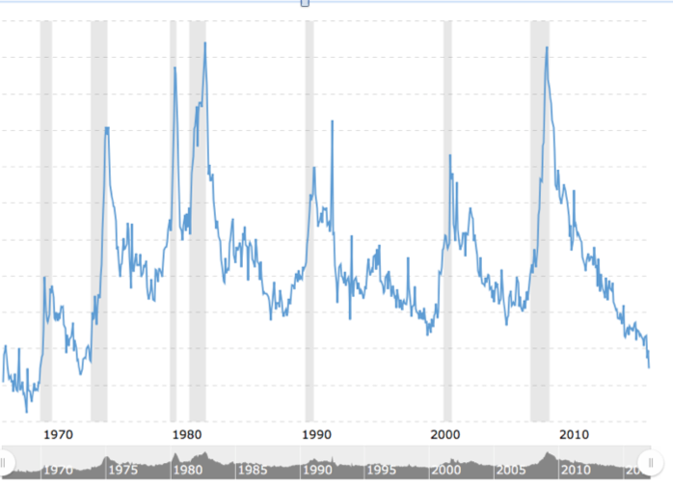
Weekly Jobless Claims –The Most Important Statistic
+4,000 to 248,000, Hugging 43 Year Low

Slide 14

Stocks-The Great Rotation is On!
*Almost all stock markets globally have broken upward sloping trend lines as Q2 earnings downshifts from 14% to 7%, with technology and financials leading
*The Great Rotation continues, with investors taking huge profits on large tech growth stocks and pouring it into value financial stocks
*Shifting out of an up 40% world and into a down 10% world, a lot of this is algorithm driven, which is why the switch became prominent at end H1
*And increasing number of valuation models are showing stocks at century highs
*The S&P 500 forward P/E ratio
at 19.5X is the ceiling for now
*But no crash coming, look for a 10% correction
at most in a long term bull market
*Still looking for 10%-12% total return in equities
for 2017, but a 5%-10% correction may have
to occur first

Slide 15
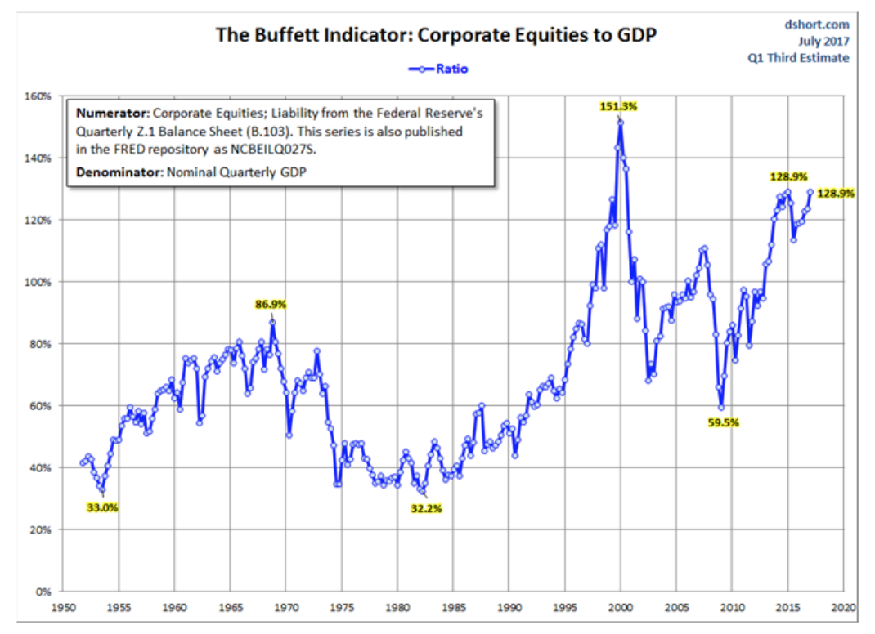

Slide 16
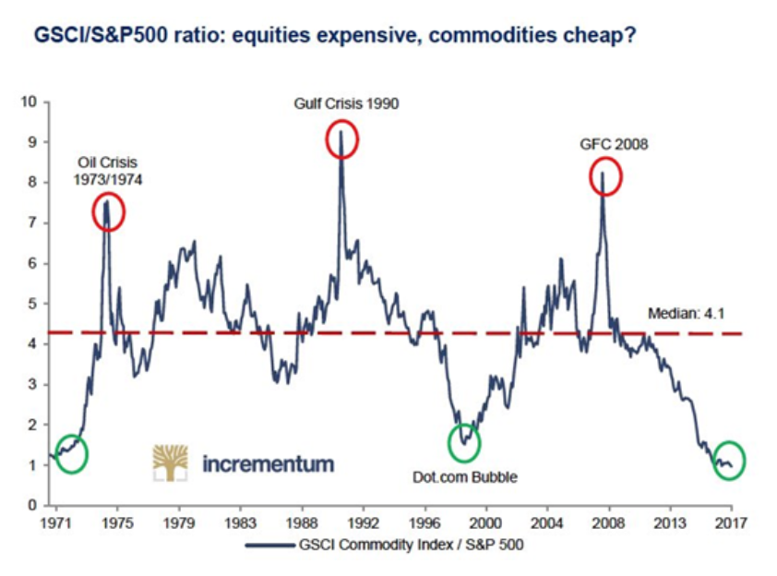

Slide 17
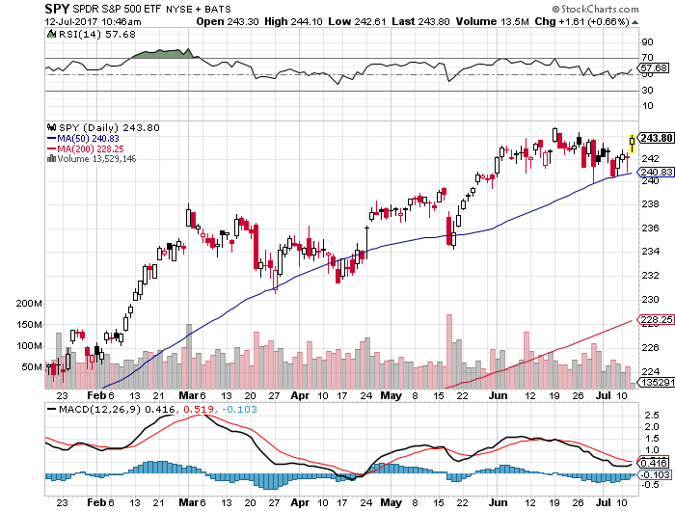
S&P 500-Correction long 7/$245-$248 bear put spread-expires in 7 trading days
Yellen dovish comments take to top end of range

Slide 18
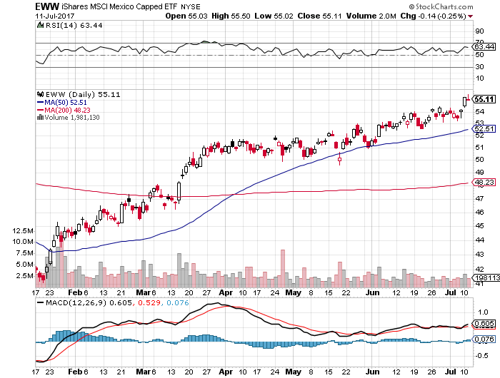
iShares MSCI Mexico ETF (EWW)-Trade War Isn’t Happening

Slide 19
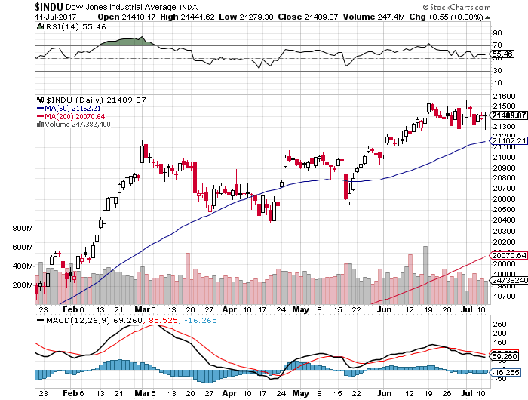
Dow Average-Anvil Top

Slide 20
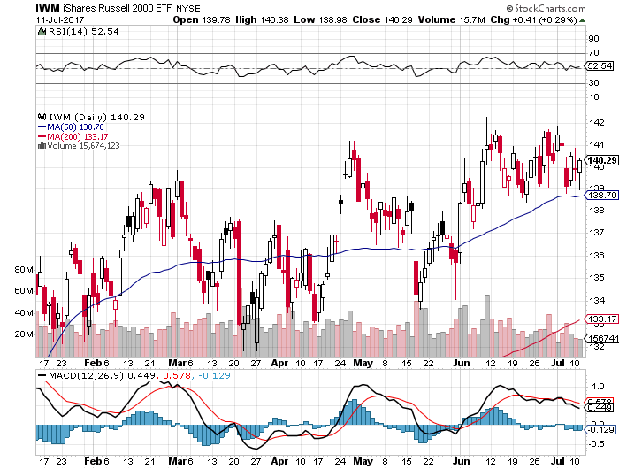
Russell 2000 (IWM)-New High, then Fade

Slide 21
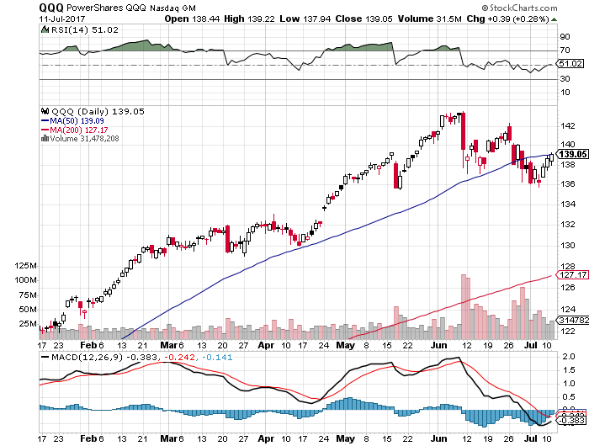
NASDAQ (QQQ)-Correction in a Bull Move

Slide 22
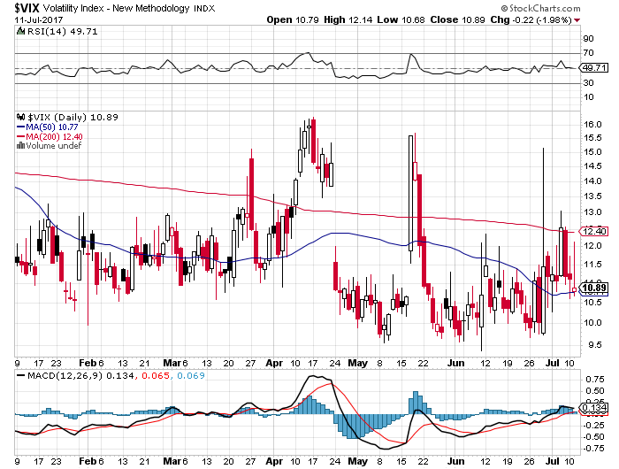
(VIX)-Double Bottom Decade Low!

Slide 23
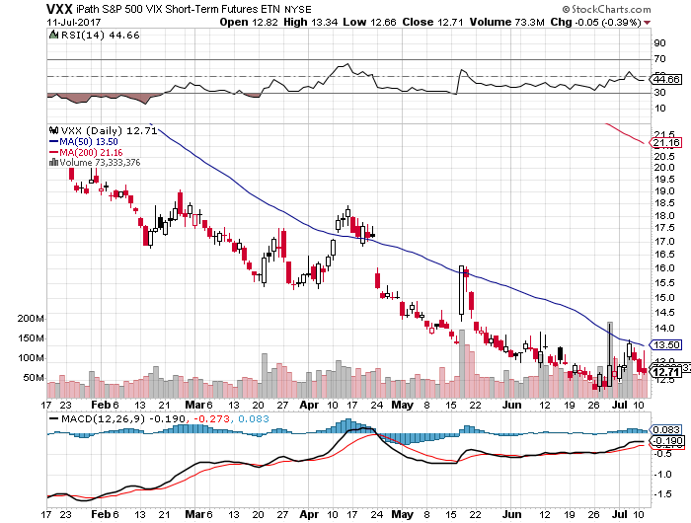
iPath S&P 500 VIX Short-Term Futures ETN (VXX) stopped long 5/$13.50-$14.00 bull call spread

Slide 24
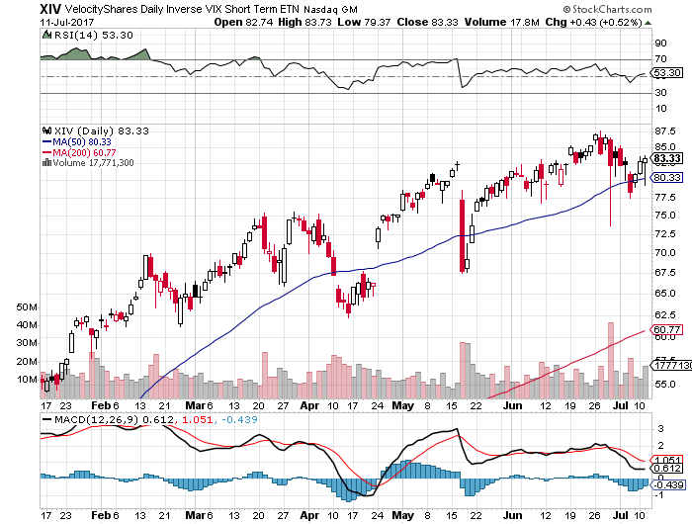
Velocity Shares Daily Inverse VIX Short Term ETN (XIV)
Trend is still up
One of the most instantly profitable trades of 2016….and 2017

Slide 25
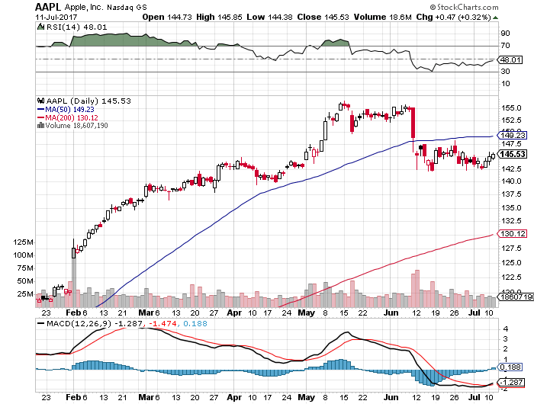
Apple (AAPL) –10% Correction
Iron Condor long 7/$135-$138 bull call spread-expires in 7 trading days long 7/$152.50-$155 bear put spread-expires in 7 trading days

Slide 26
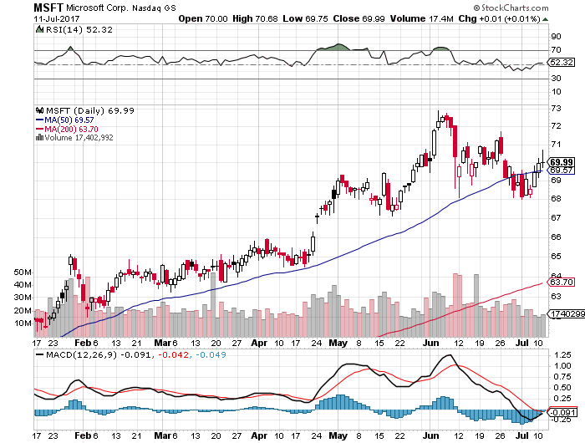
Microsoft (MSFT)

Slide 27
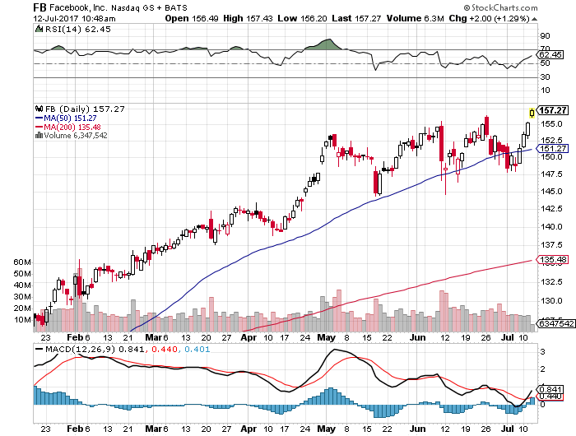
Facebook (FB)-Iron Condor for a Breakeven long 7/$160-$162.50 bear put spread-expires in 7 trading days stopped out of long $145-$140 bull call spread

Slide 28
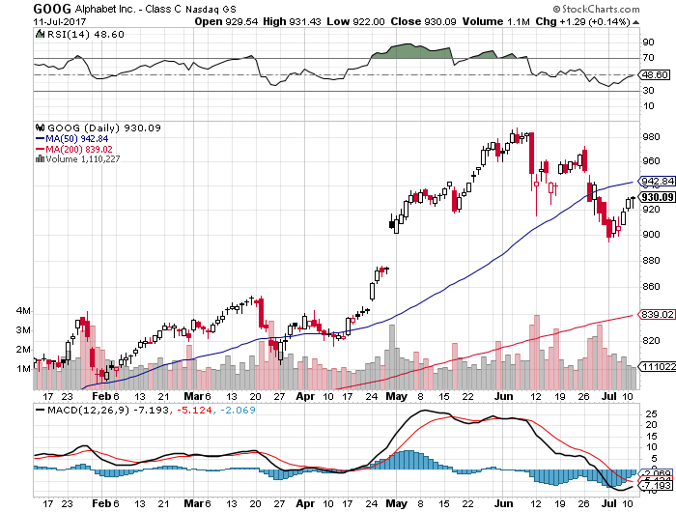
Alphabet (GOOG)-New High

Slide 29
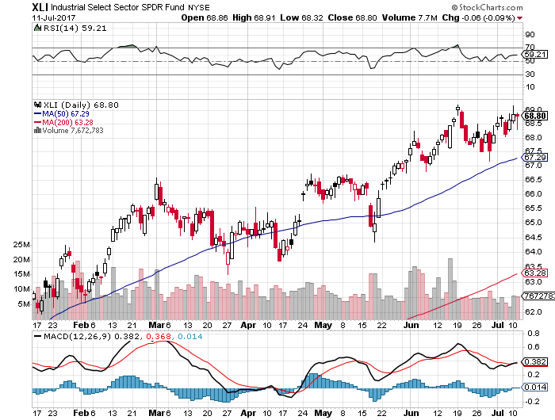
Industrials Sector SPDR (XLI)-
(GE), (MMM), (UNP), (UTX), (BA), (HON)

Slide 30
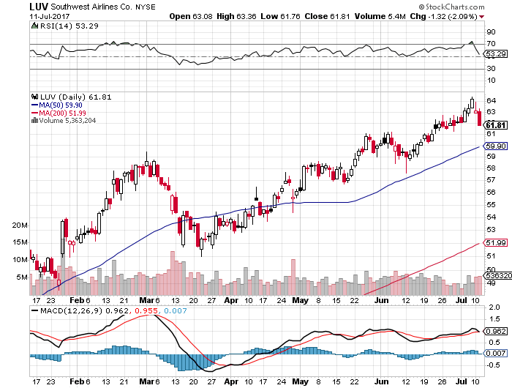
Southwest Airlines (LUV)-
Warren Buffett’s Favorite Airline

Slide 31
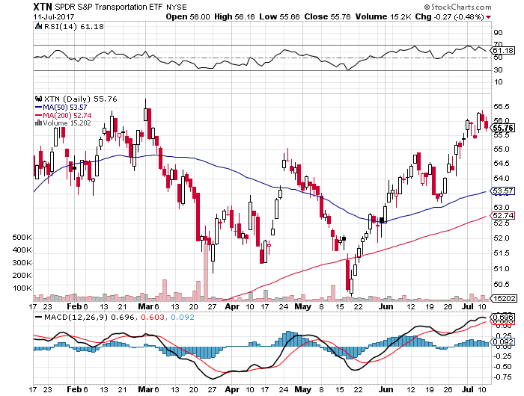
Transports Sector SPDR (XTN)-
(ALGT), (ALK), (JBLU), (LUV), (CHRW), (DAL)

Slide 32
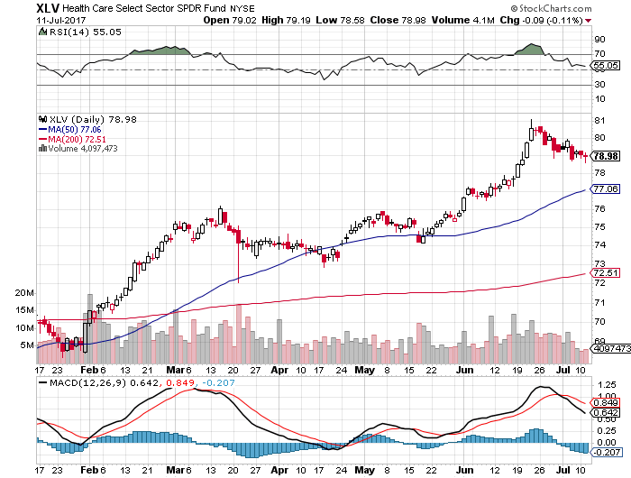
Health Care Sector (XLV), (RXL)-The New FANG?
(JNJ), (PFE), (MRK), (GILD), (ACT), (AMGN)

Slide 33
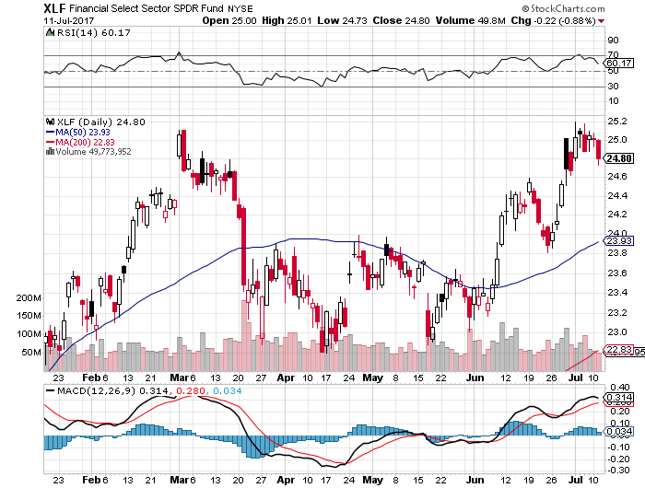
Financial Select SPDR (XLF)-Bouncing Back
(BLK/B), (WFC), (JPM), (BAC), (C), (GS)

Slide 34
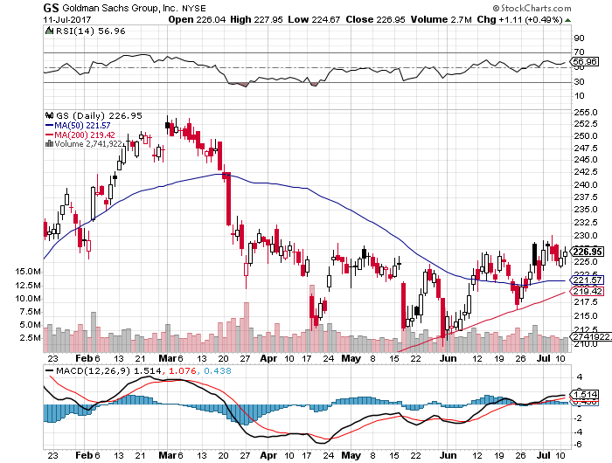
Goldman Sachs (GS)- long 7/$205-$210 vertical bull call spread-expires in 7 trading days

Slide 35
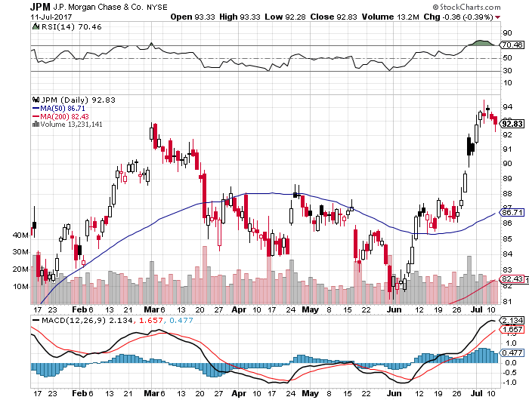
JP Morgan (JPM)-

Slide 36
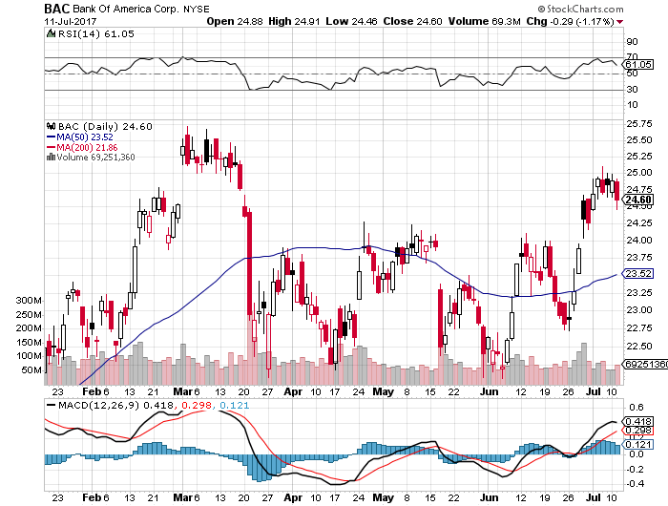
Bank of America (BAC)-
Warren Buffet exercises warrants and buys 700 million shares, with paper profit of $12 billion

Slide 37
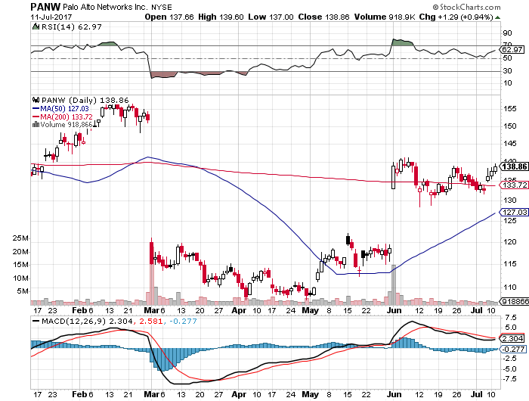
Palo Alto Networks (PANW)-

Slide 38
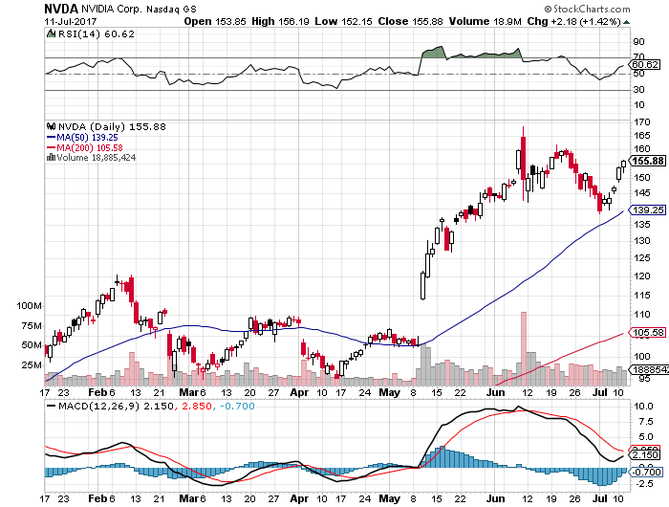
NVIDIA (NVDA)-Another Earnings Spike

Slide 39
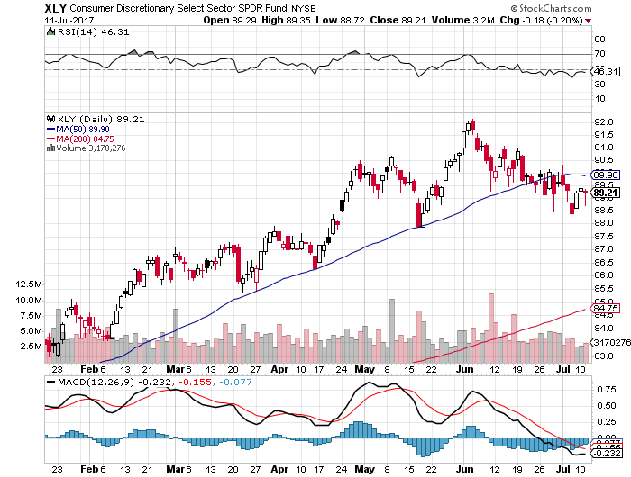
Consumer Discretionary SPDR (XLY)
(DIS), (AMZN), (HD), (CMCSA), (MCD), (SBUX)

Slide 40
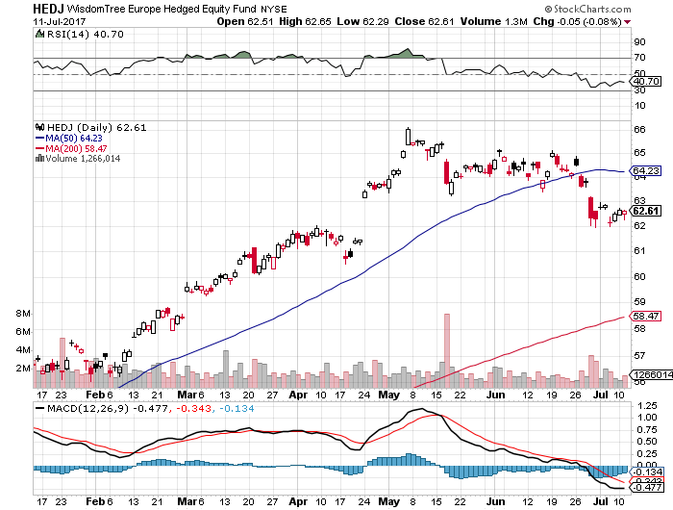
Europe Hedged Equity (HEDJ)-
New Highs On French Election

Slide 41
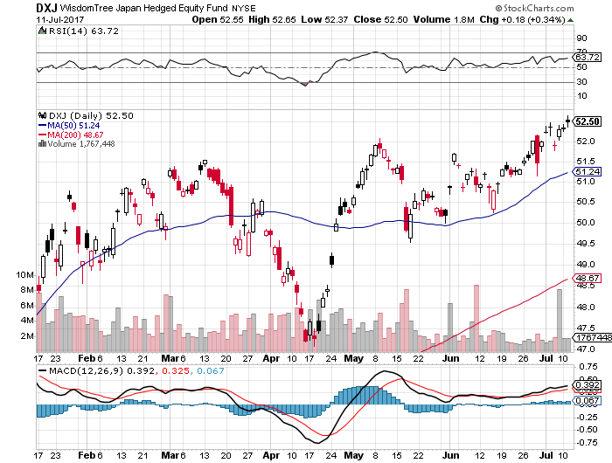
Japan (DXJ)-Breakout to new highs on weak yen

Slide 42
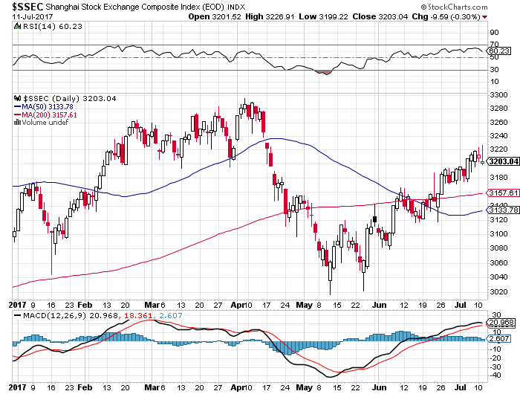
China ($SSEC)-Economic Recovery on Track

Slide 43
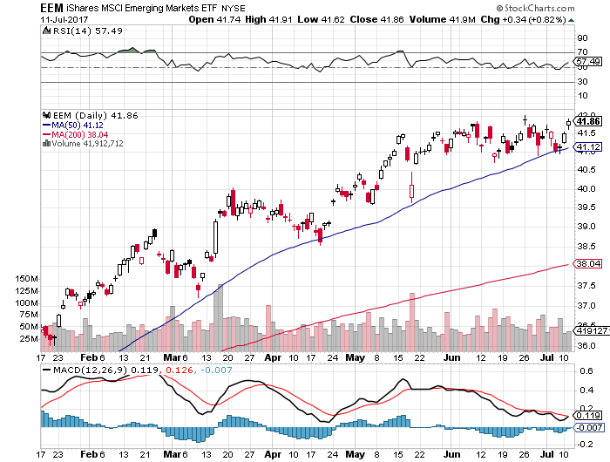
Emerging Markets (EEM)-Still On Fire

Slide 44

Bonds-Time to Pay the Piper
*US Treasury bonds peak for the year, triggering five point selloff, making big bucks for shorts
*The entire high yield space goes with it, including junk bonds, REITS, and MLP’s
*Oil dead cat bounce is another knife in bond backs
*222,000 June nonfarm payroll and 4.4% unemployment rate is more gasoline on the fire
*Any employment gains from here will be
inflationary. The US has run out of workers
*Soon to be tested will be the top of the
2.10%-2.40% range in 10 year yields
*We are ten months into a 10-20 year
bear market in bonds, now is a great
entry point on the short side

Slide 45
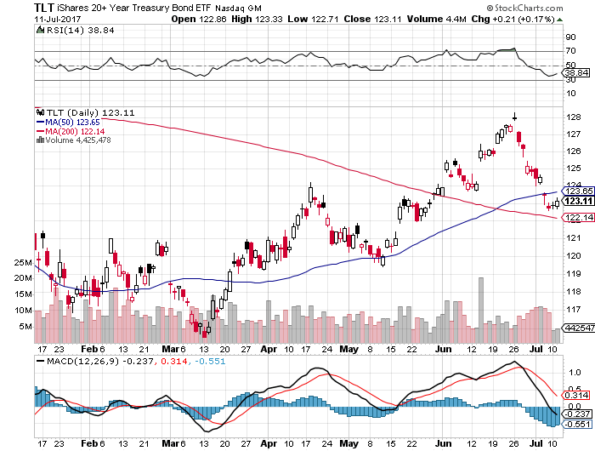
Treasury ETF (TLT) – 2.36%-Trend Breakdown took profits on long 7/$130-$133 vertical bear put spread

Slide 46
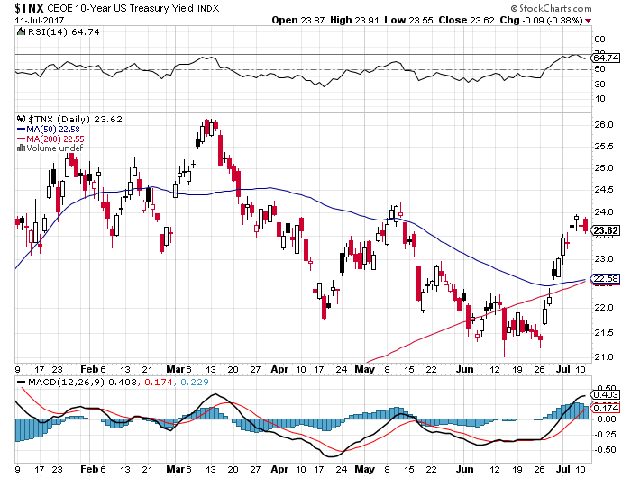
Ten Year Treasury Yield ($TNX) 2.36%

Slide 47
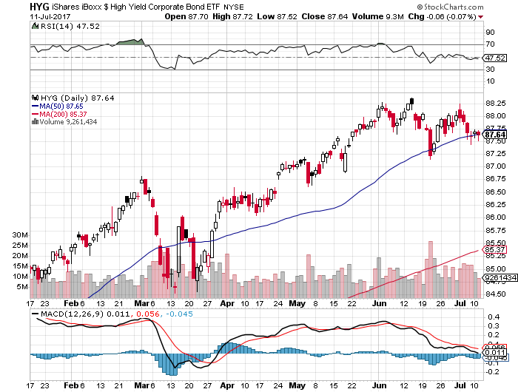
Junk Bonds (HYG) 4.80% Yield
A Great Risk Coincident Indicator-
Long Term “RISK ON” means new highs, buy all dips

Slide 48
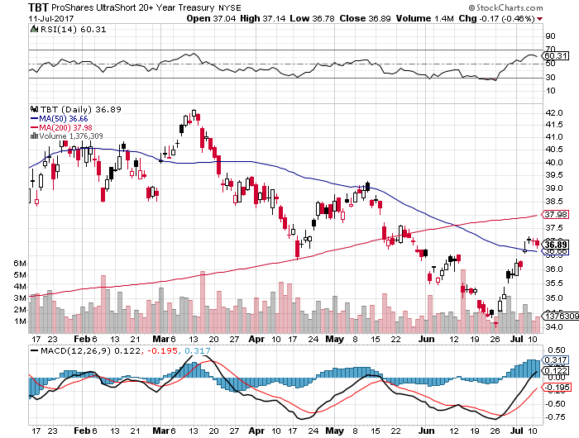
2X Short Treasuries (TBT)-
In Screaming “BUY” Territory

Slide 49
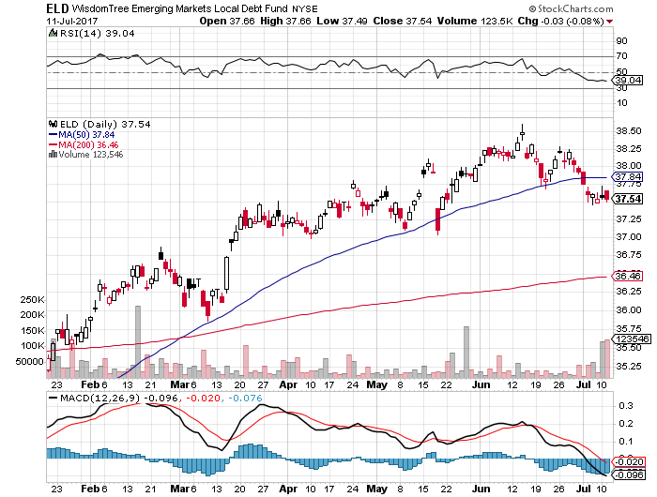
Emerging Market Debt (ELD) 5.77% Yield-

Slide 50
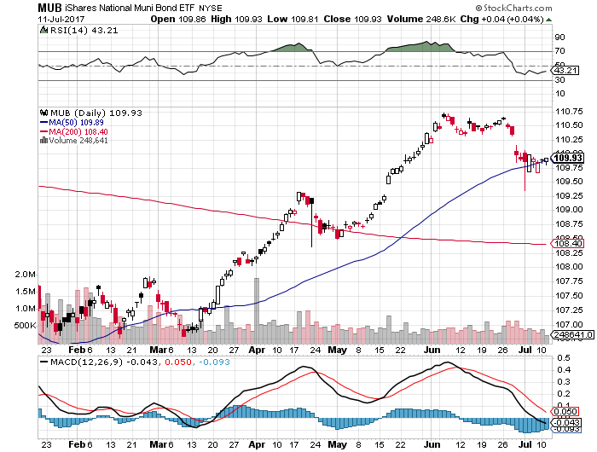
Municipal Bonds (MUB)-2.14%
Mix of AAA, AA, and A rated bonds

Slide 51
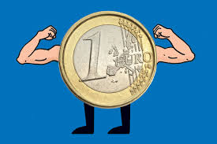
Foreign Currencies-Dollar New Lows
*Weakening US economy, especially autos, and stronger Europe and China, postpone Fed rate raises, sending dollar southward
*No action by Reserve Bank of Australia to raise rates demolishes Aussie
(FXA)
*LDP Loss in Tokyo elections take Japanese yen (FXY) to one month lows in a rare contrary move against the Euro
*Strengthening European economy and rising
rates continue the bid for the Euro (FXE) to
one year highs
*Get ready to sell short the yen (FXY) and the
Euro (FXE) on a blow off top, which will happen
when US rates breakout to the upside

Slide 52
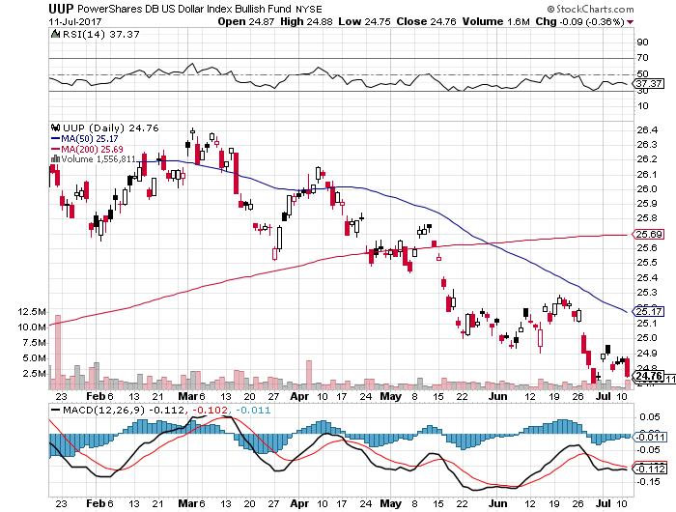
US Dollar Basket-(UUP)

Slide 53
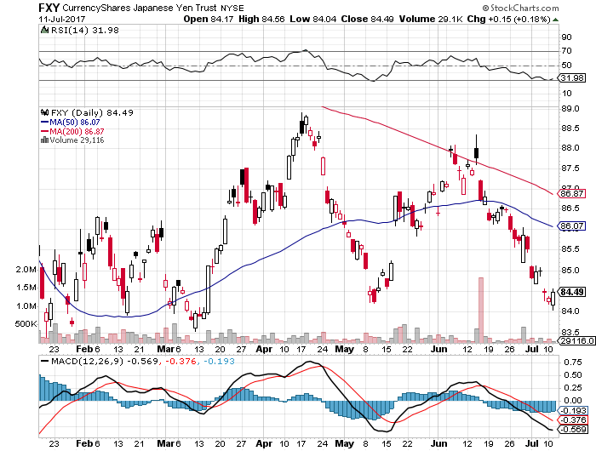
Japanese Yen (FXY)-At a Triple Bottom

Slide 54
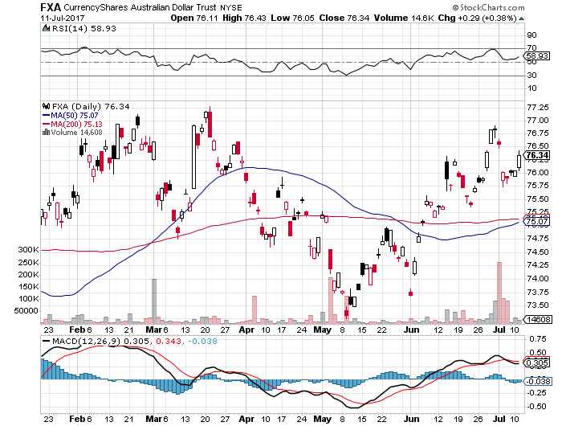
Australian Dollar (FXA)-

Slide 55
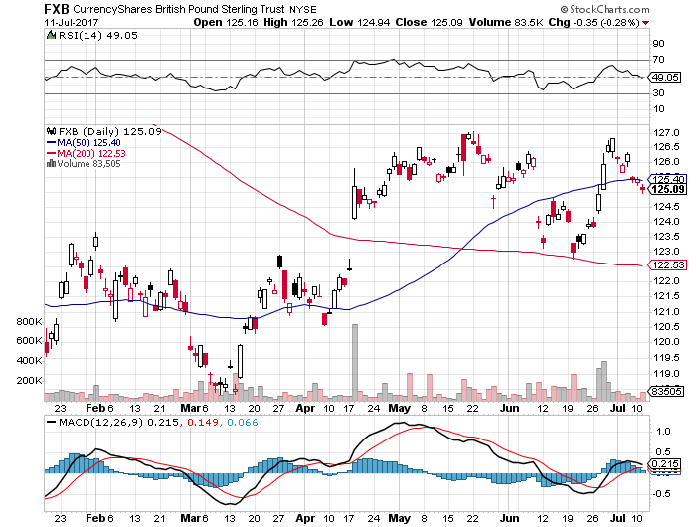
British Pound (FXB)- British Election-May Falters

Slide 56
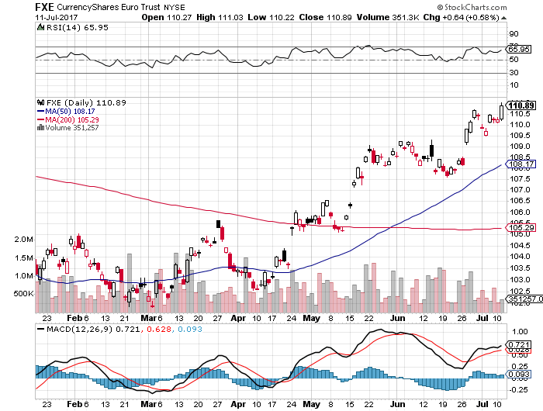
Euro ($XEU), (FXE), (EUO)- Off to the Races

Slide 57
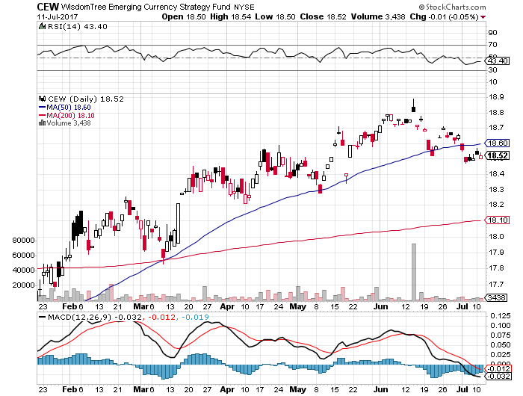
Emerging Market Currencies (CEW)

Slide 58
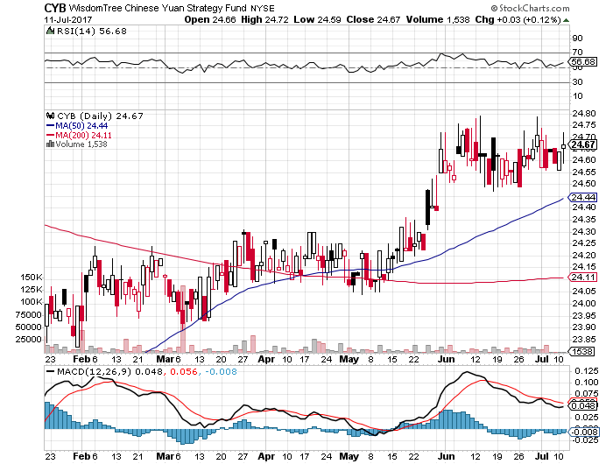
Chinese Yuan- (CYB)-Stabilizing on Government Support

Slide 59
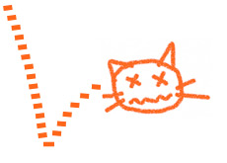
Energy-Dead Cat Bounce
*Now Saudi Arabia is cheating, taking OPEC June production up 500,000 barrels
*Bond market and dollar selloff also helps
*Russia refuses to join quota cuts, adding further pressure on the market
*Baker Hughes US Rig Count still
rocketing to new one-year high, up
7 to 910
*Investment in oil and gas is down 44%
in two years, but is up 55% in shale plays
*Bottom line: a whole lot of supply
is about to hit the market

Slide 60
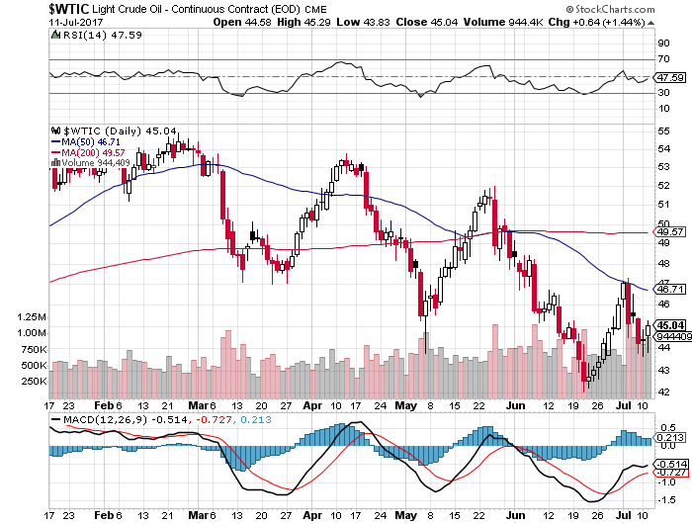
Oil-The Downtrend Is In

Slide 61

United States Oil Fund (USO) took profits on long (USO) 11/$12.50-$14.00 vertical bear put spread

Slide 62

Energy Select Sector SPDR (XLE)
(XOM), (CVX), (SLB), (KMI), (EOG), (COP)

Slide 63

Alerian MLP ETF (AMLP)-
Basket Approach is the Only Safe Play Here

Slide 64

Exxon (XOM)-

Slide 65

Occidental Petroleum (OXY)-
Call Spread Setting Up

Slide 66

Natural Gas (UNG)-No Joy

Slide 67

Copper (COPX)-China Rally

Slide 68

US Steel (X)-Forging a bottom

Slide 69

Precious Metals-No Friends
*Precious metals are focusing on a 20 basis point pop in bond yields, always bad news
*Silver has a flash crash, drops $2.00 on one minute!
*Venezuela is still hamming the gold market with distress sales
*As India adjusts to last year’s currency conversion Indian buyers are stepping back into the gold market
*Flight to safety has moved from gold
to Bitcoin
*Bitcoin steals gold’s thunder, goes ballistic
to $2,980 on Chinese buying

Slide 70

Gold (GLD)-Double Top

Slide 71

Market Vectors Gold Miners ETF- (GDX)

Slide 72

Bitcoin-Sell Everything!

Slide 73

Silver (SLV)-Flash Crash!

Slide 74

Silver Miners (SIL)-

Slide 75

Agriculture-New Bull Market?
*Sudden Midwest drought conditions trigger big short covering rally in wheat and the other grains
*Hedge funds maintaining huge shorts in corn and wheat, setting up a short squeeze
*Biggest move up in four years has traders scrambling to limit losses, with near limit moves
*Missed the big move for now,
but look at the next substantial dip

Slide 76

(CORN) –Breakout!

Slide 77

(WEAT)-Extreme Heat Hits

Slide 78

(SOYB)-Short Squeeze

Slide 79

Real Estate-Powering On
*Sales numbers falling of a cliff due to shortage of supply
*Yield crash trigger a new Refi boom, applications up 9% MOM
*May Pending Home Sales down -0.8%
*May New Homes Sales up 2.9%
*Housing stocks ignore the recent stock market correction, power on to new highs
*April Case-Shiller maintains strong 5.5%, with
absolute prices hitting new all time high,
your home equity could be the best investment
of the year….again

Slide 80


Slide 81

Home Depot (HD)

Slide 82

March S&P 500/Case–Shiller Home Price Index
+5.8% YOY, Seattle (+12.2%), Portland (9.7%), Dallas (8.8%) still leaders absolute prices hit new all time high

Slide 83

General Growth Properties (GGP)-New Lows
Long Term Downtrend

Slide 84

US Home Construction Index (ITB)
(DHI), (LEN), (PHM), (TOL), (NVR)
A Favorite Sector to Buy

Slide 85

Trade Sheet-The Complete Opposite
So What Do We Do About All This?
*Stocks- sell rallies for the short term
*Bonds-sell bigger rallies
*Commodities-stand aside
*Currencies-sell yen and Euro when they peak out
*Precious Metals –buy dips
*Volatility-buy the dips to single digits, sell rallies to $12
*The Ags –stand aside
*Real estate-buy dips

Slide 86

Next Strategy Webinar
12:00 EST Wednesday, July 26, 2017
San Francisco, CA
Good Luck and Good Trading!
Notes:
*

