Slide 1

The Mad Hedge Fund Trader
“Struggling to New Highs”
With John Thomas
from Silicon Valley, CA, July 26, 2017
www.madhedgefundtrader.com
Notes:
*

Slide 2

Second Edition
Is Out!
In the Store
Now for $49
Sectors and Stocks that
Will Lead the Market for
the Next 20 Years
https://members.madhedgefundtrader.com/roaring-twenties-book/

Slide 3
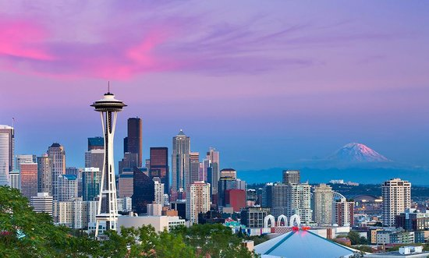
MHFT Global Strategy Luncheons
Buy tickets at www.madhedgefundtrader.com
Seattle, WA
August 2

Slide 4

Mad Hedge/Top Gun Master Mind Investment Conference
Buy tickets at www.madhedgefundtrader.com
November 3-4, Incline Village, NV
Half the Tickets Sold Out in the First Hour!

Slide 5

Trade Alert Performance
New All Time High!!
*January +9.35% Final *July +0.97%% MTD
*February +6.39% FINAL *August +7.52% Final
*March +4.87% Final *September +0.27% Final
*April +1.84% Final *October +8.13% Final
*May -0.45% Final *November 4.37% Final
*June +0.70% Final *December +.84% Final
*2017 Year to Date 23.67%
compared to 9.2% for the Dow Average
11 of 12 Consecutive Profitable Months!
*Trailing 1 year return +44.36%, +243.98% since inception,
*Average annualized return of 31.60%

Slide 6
Portfolio Review
On the Sidelines with a 100% Cash Position
No Positions

Slide 7
Trailing One-Year Return
Daily Audited Performance
+45.36%

Slide 8
Eight Year Daily Audited Performance
Averaged Annualized Return +31.60%

Slide 9

The Method to My Madness
*100% cash awaiting a major asset class and stock sector rotation
*still seeing a big divergence between equities and all other asset classes in RISK signals
*Almost all asset classes and sectors are at extreme ends of 2017 ranges
*Running bond shorts all year has been hugely profitable, and I will continue to sell every rally
*Copper launch give credence to the global
synchronized recovery story
*Staying away from gold until it finds a new bottom
*Looking to sell short the next big rally in oil
*Staying away from currencies until dollar bottoms
on the market

Slide 10
The Bill Davis View
A $1,500 Upgrade for the Mad Day Trader Service
Buys:
Chipotle Mexican (CMG) $332 Target to $372
Apple, Inc (AAPL) $150 Target to $165
Starbucks Corp (SBUX)-X $58 Target to $68
TripAdvisor, Inc. (TRIP) $37 Target to $45
Citrix Systems, Inc (CTXS) $81 Target to $87
Campbell Soup Co. (CPB) $52 Target to 58
Netflix, Inc. (NFLX) $181 Target to $200
Sells:
Internation Bus.Mach (IBM) $156 Target to $143
F5 Networks, Inc (FFIV) $131 Target to $124
Jack in the Box (JACK) $97 Target to $85
Perrigo Co. (PRGO) $77 Target to $71
Lululemon Athetica (LULU) $62 Target to $53

Slide 11
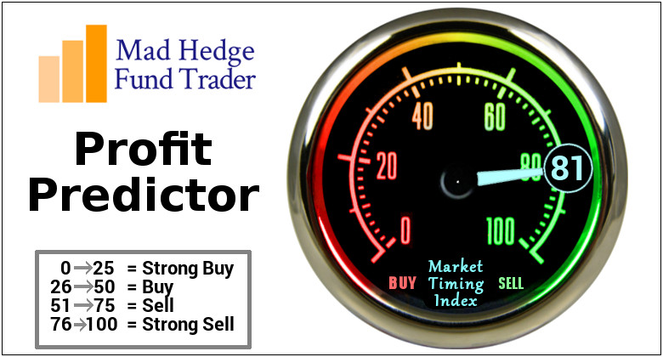
The Mad Hedge Profit Predictor
Market Timing Index
An artificial intelligence driven algorithm that analyzes 30 different economic, technical, and momentum driven indicators
Risk is Approaching New 2017 Highs

Slide 12
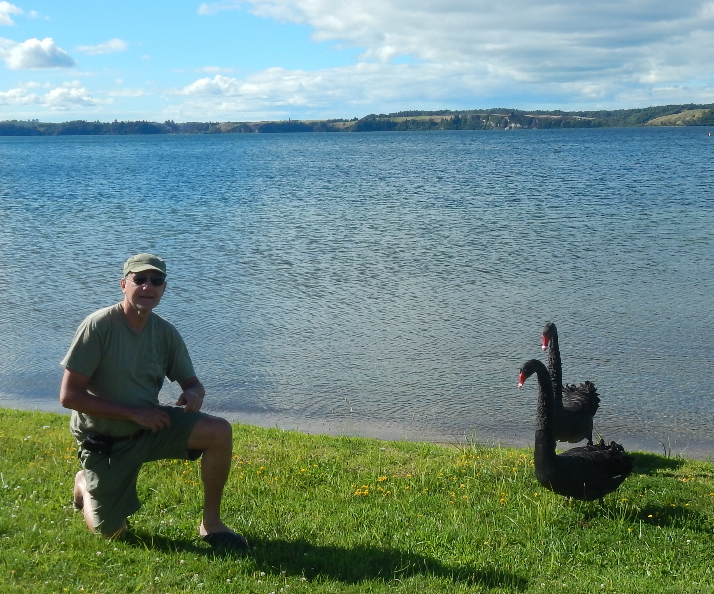
Black Swan Alert
*If Trump fires Attorney General Jeff Sessions, it could be a prelude to firing Special Prosecutor Robert Mueller
*This would trigger a republican revolt, impeachment moves, and a US constitutional crisis
*If it happens in August, stock
market moves would be magnified
*We may finally get our 10%
correction
*But the long term bull market will
remain intact
*Buy the big dip

Slide 13
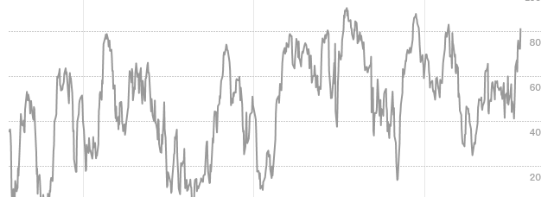
The Mad Hedge Profit Predictor
Market Timing Index
Finally Approaching the Top of the Range

Slide 14

The Global Economy-Global Synchronized Recovery
*IMF cuts 2017 US growth forecast from 2.3% to 2.1%, world kept the same at
3.5%, with US and UK slowing, while Europe China, and Japan speed up
*Copper launch give credence to the global synchronized recovery story, which is gaining strength
*Q2 China GDP hits 6.9%, indicating that the global synchronized recovery is on
*Bank of Japan “Tankan” Report shows continuing
strength in the economy
*German Business confidence highest since
1990 reunification

Slide 15
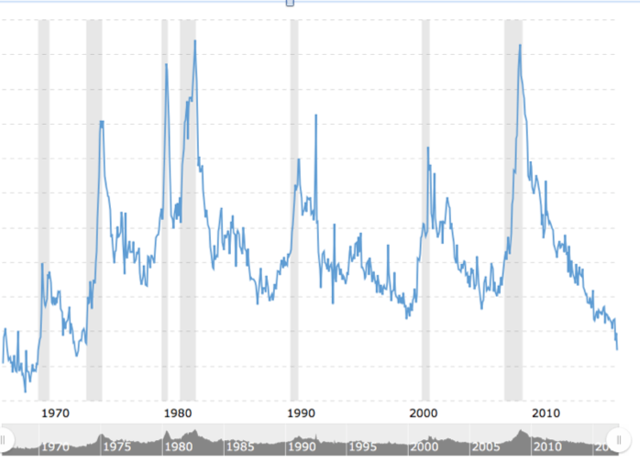
Weekly Jobless Claims –The Most Important Statistic
-3,000 to 241,000, Hugging 43 Year Low

Slide 16

Stocks-Probing the Highs
*Q2 earnings in play, looks like we’ll beat the 7% YOY forecast
*Bank earnings surprise to the upside, but stocks disappoint on poor trading results
*Technology takes another run at the highs, increasing market risk, is (GOOG) the writing on the wall, down $40 in one day?
*Volatility hits another 25 year low, with a massive short position overhanging the market. When the market reverses, the moves will be huge
*The S&P 500 forward P/E ratio
at 19.5X is at the ceiling
*But no crash coming, look for a 10% correction
at most in a long term bull market
*Still looking for 10%-12% total return in equities
for 2017, now at 11.22%, but a 5%-10% correction
may have to occur first

Slide 17
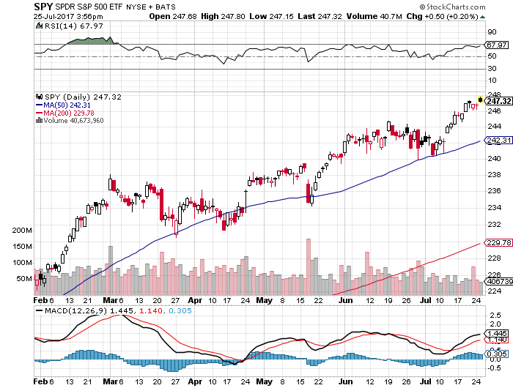
S&P 500-Correction
Yellen dovish comments bring mini upside breakout

Slide 18
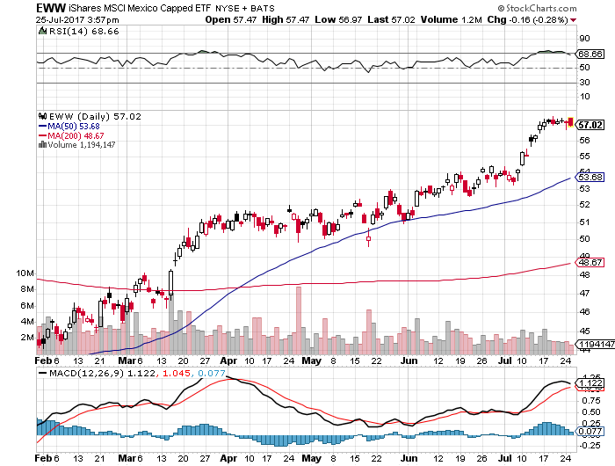
iShares MSCI Mexico ETF (EWW)-Trade War Isn’t Happening

Slide 19
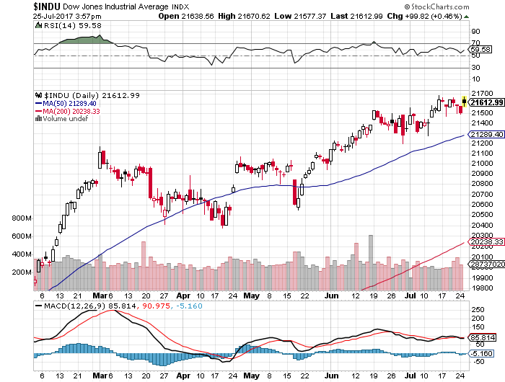
Dow Average-Anvil Top

Slide 20
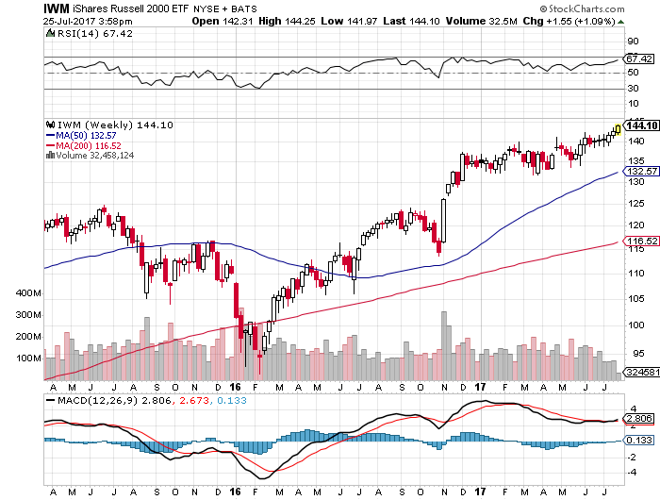
Russell 2000 (IWM)-New Highs

Slide 21
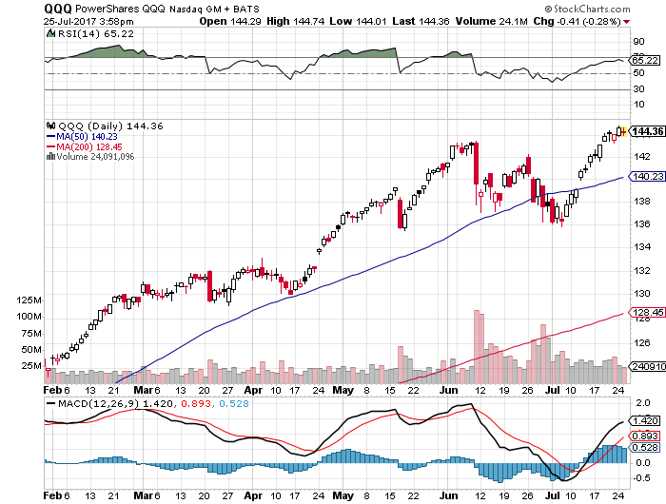
NASDAQ (QQQ)-New Highs

Slide 22
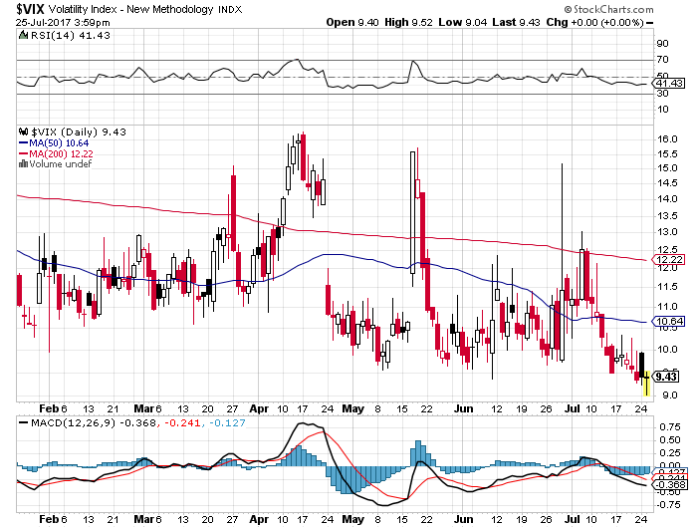
(VIX)-New 25 Year Lows!

Slide 23
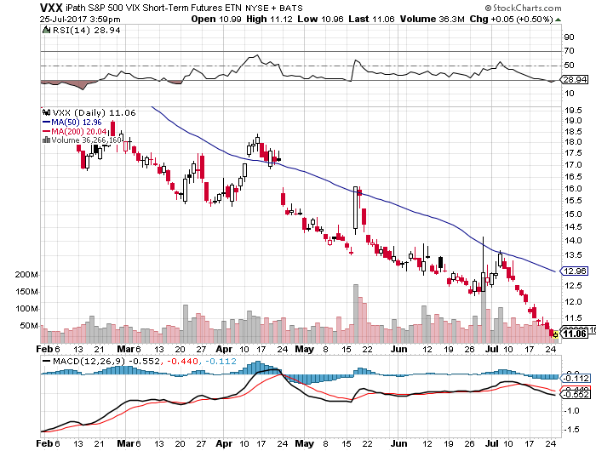
iPath S&P 500 VIX Short-Term Futures ETN (VXX)

Slide 24
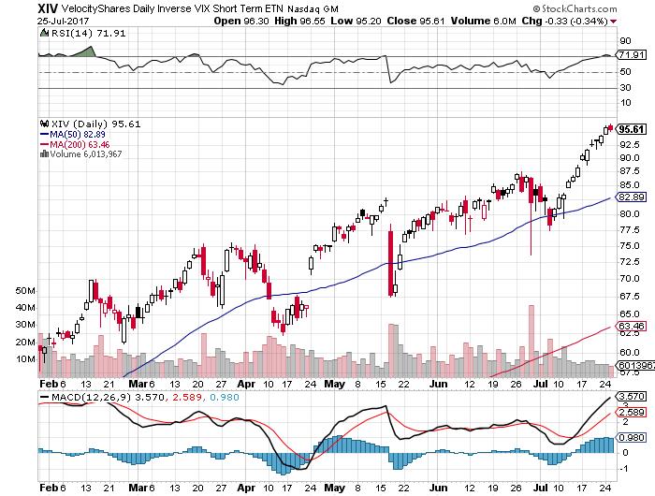
Velocity Shares Daily Inverse VIX Short Term ETN (XIV)
Wow!
One of the most instantly profitable trades of 2016….and 2017

Slide 25
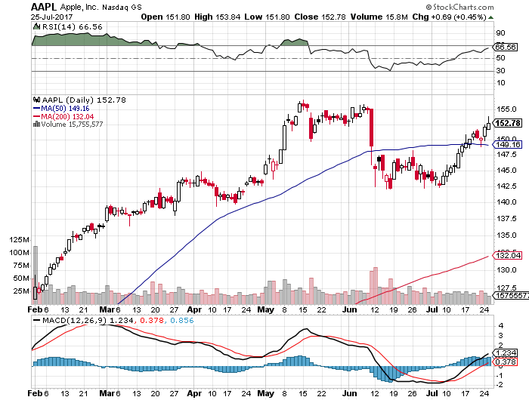
Apple (AAPL)-Range Setting Up? took profits on long 7/$135-$138 bull call spread took profits on long 7/$152.50-$155 bear put spread

Slide 26
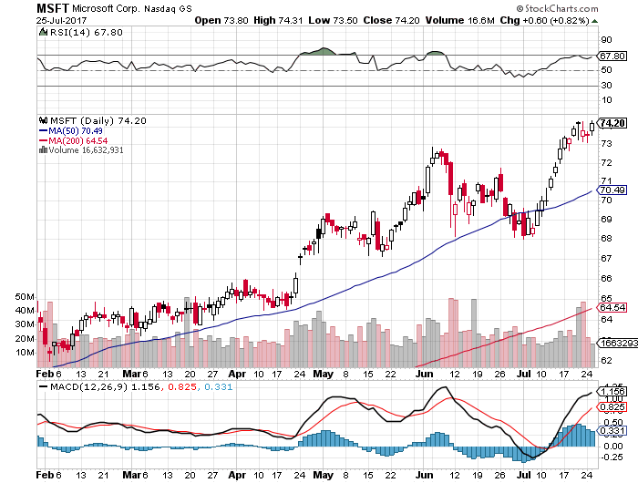
Microsoft (MSFT)

Slide 27
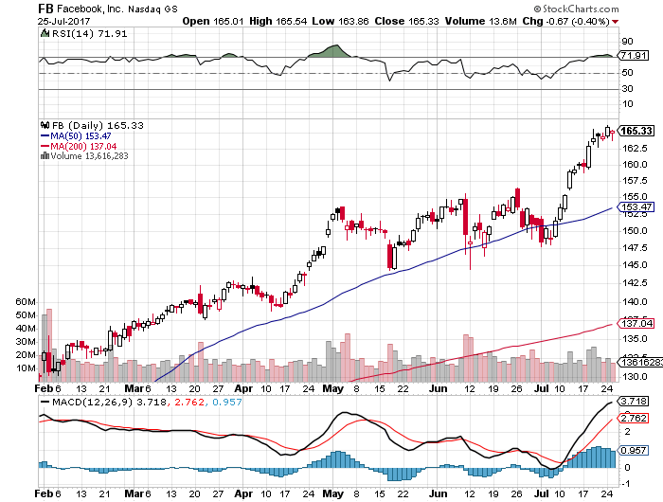
Facebook (FB)-Iron Condor Gone Wrong! stopped out of long 7/$160-$162.50 bear put spread stopped out of long $140-$145 bull call spread

Slide 28
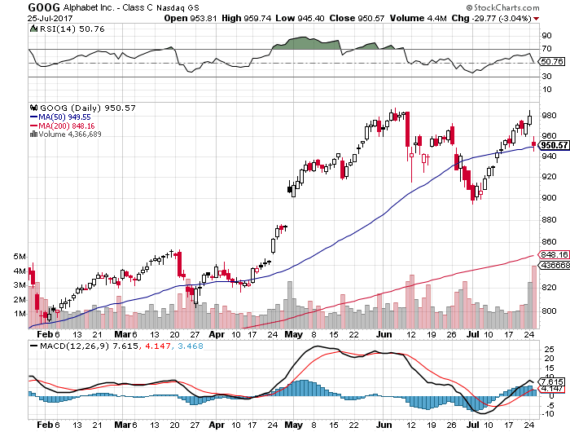
Alphabet (GOOG)-New High

Slide 29
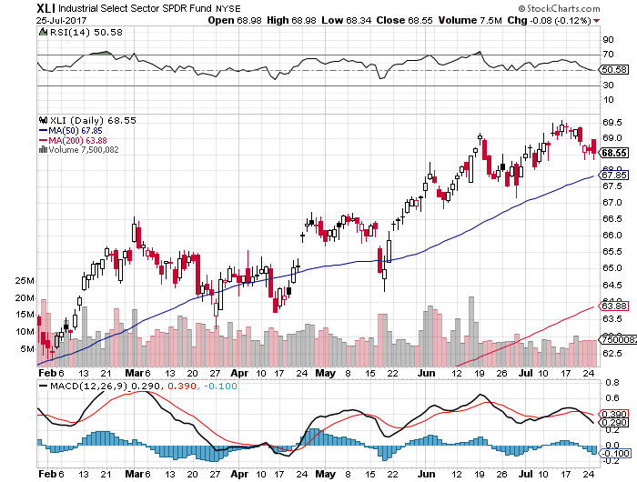
Industrials Sector SPDR (XLI)-
(GE), (MMM), (UNP), (UTX), (BA), (HON)

Slide 30
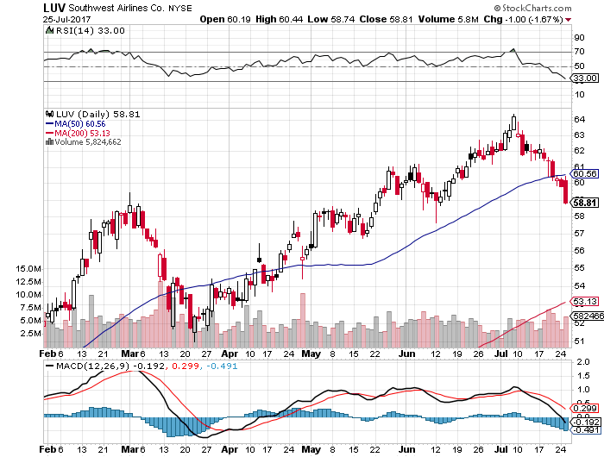
Southwest Airlines (LUV)-
Warren Buffett’s Favorite Airline

Slide 31
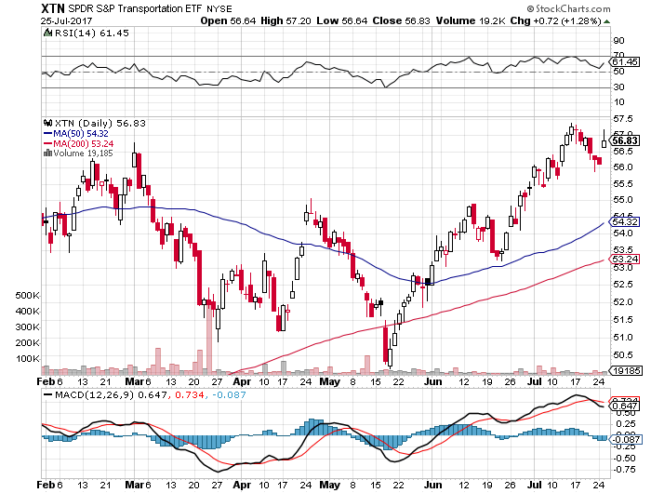
Transports Sector SPDR (XTN)-
(ALGT), (ALK), (JBLU), (LUV), (CHRW), (DAL)

Slide 32
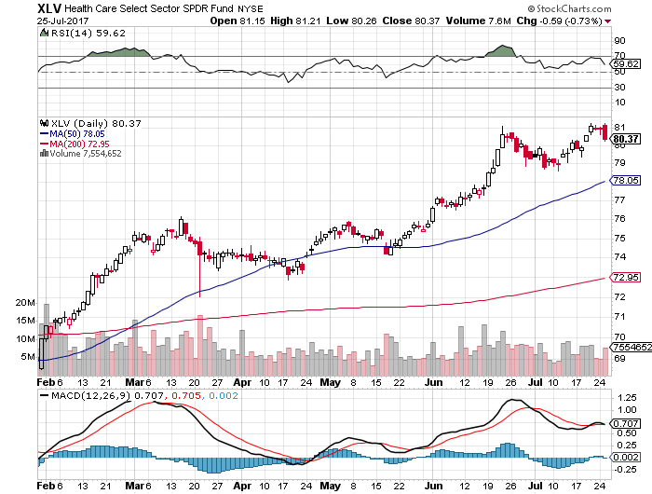
Health Care Sector (XLV), (RXL)-The New FANG?
(JNJ), (PFE), (MRK), (GILD), (ACT), (AMGN)

Slide 33
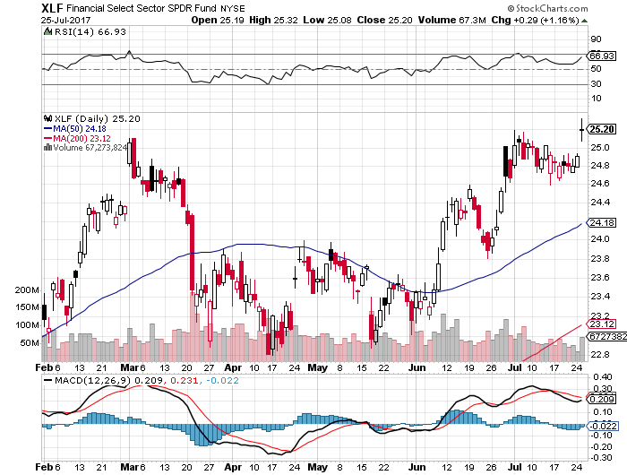
Financial Select SPDR (XLF)-Bouncing Back
(BLK/B), (WFC), (JPM), (BAC), (C), (GS)

Slide 34
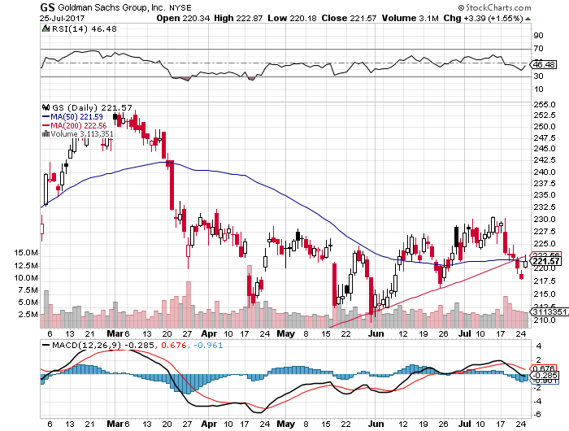
Goldman Sachs (GS)- long 7/$205-$210 vertical bull call spread-expires in 7 trading days

Slide 35
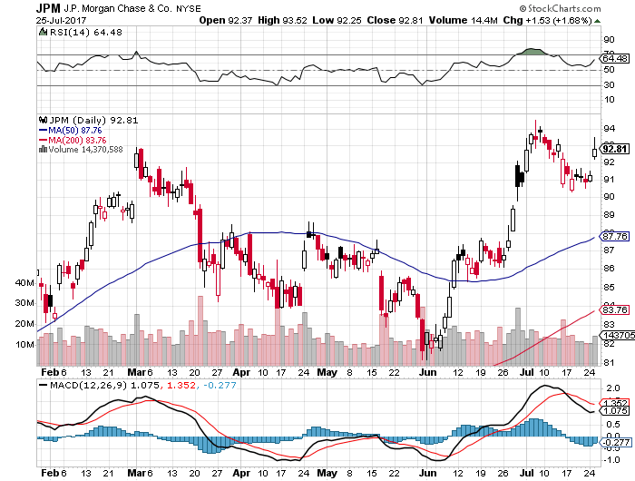
JP Morgan (JPM)-

Slide 36
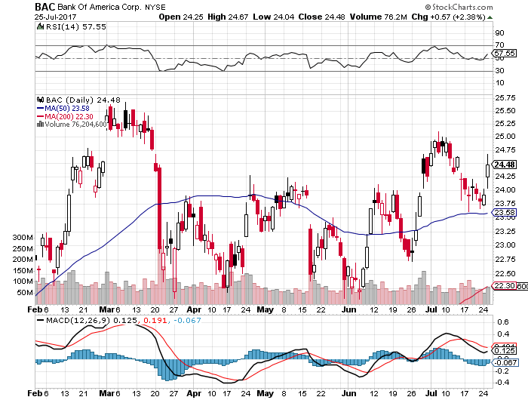
Bank of America (BAC)-
Warren Buffet exercises warrants and buys 700 million shares, with paper profit of $12 billion

Slide 37
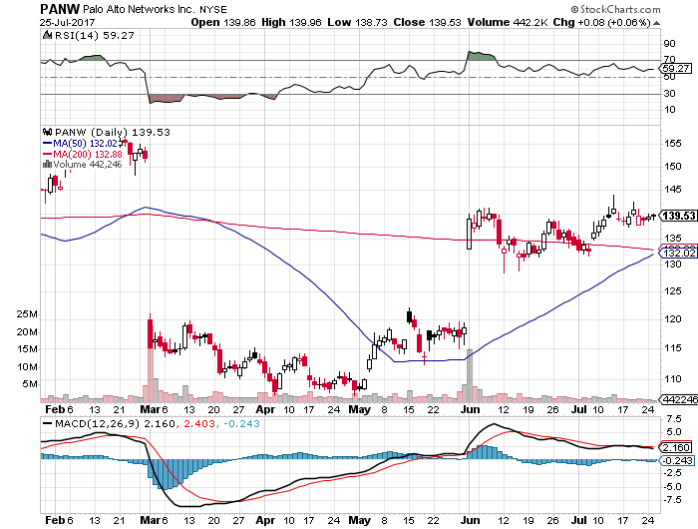
Palo Alto Networks (PANW)-

Slide 38
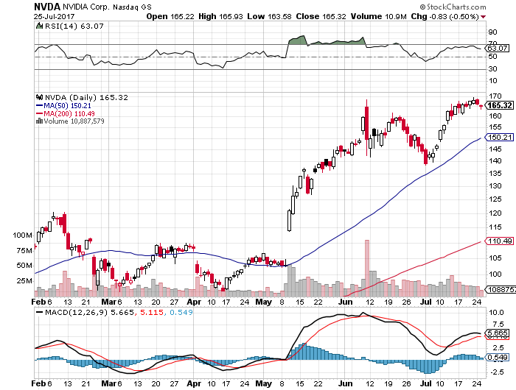
NVIDIA (NVDA)-Another Earnings Spike

Slide 39
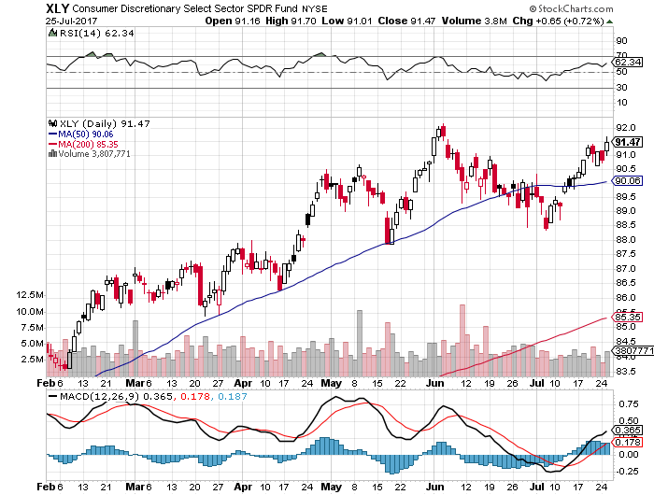
Consumer Discretionary SPDR (XLY)
(DIS), (AMZN), (HD), (CMCSA), (MCD), (SBUX)

Slide 40
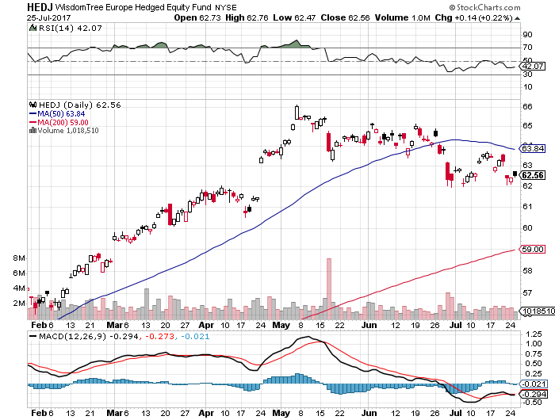
Europe Hedged Equity (HEDJ)-Strong Euro Taking a Toll

Slide 41
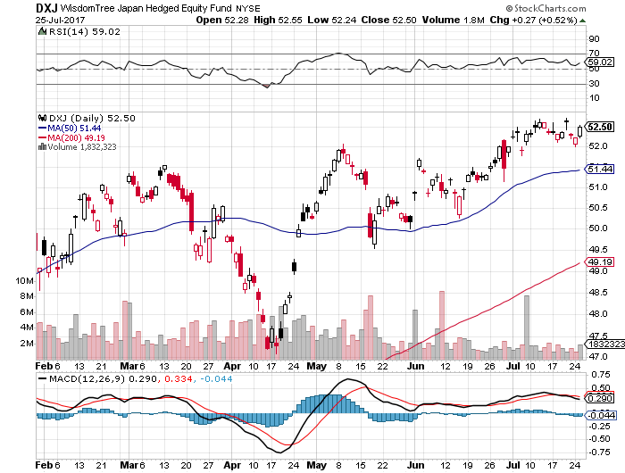
Japan (DXJ)-Breakout to new highs on weak yen

Slide 42
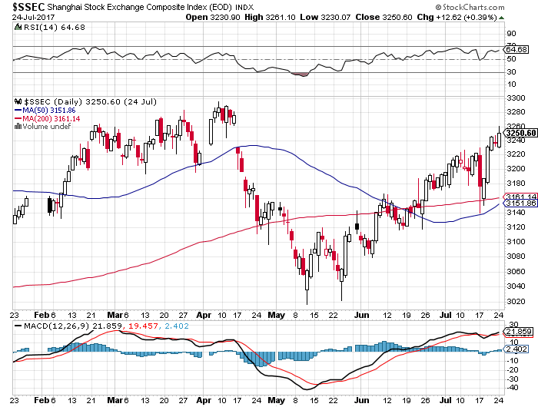
China ($SSEC)-Economic Recovery on Track

Slide 43
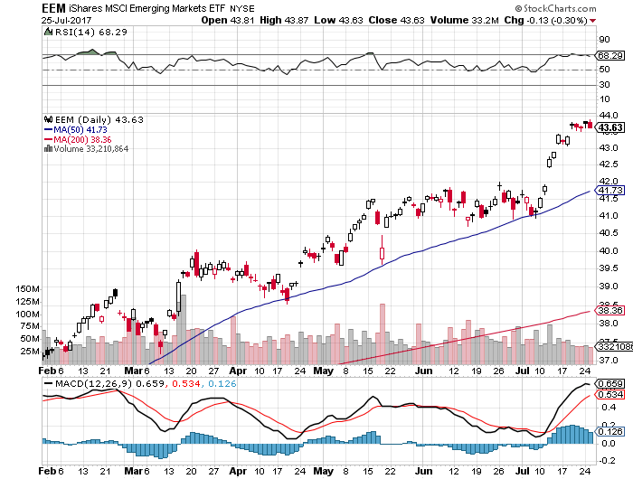
Emerging Markets (EEM)-Still On Fire

Slide 44
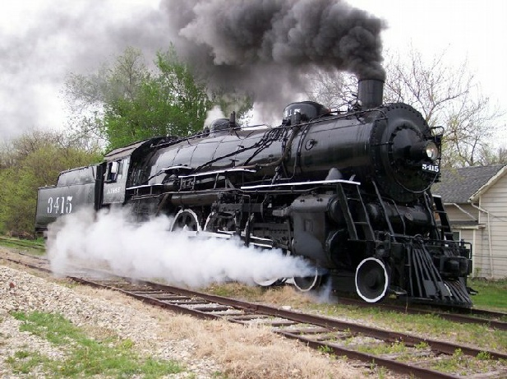
Bonds-The Global Rate Locomotive
*Fed lower for longer message rallies bonds, taking yields back to 2017 lows
*Bonds markets have become globally synchronized, with US pricing the locomotive
*Another nice short sell in bonds setting up
*Any stock market weakness in August will be the short side sweet spot
*Back to the middle of the
2.10%-2.40% range in 10 year yields
*We are ten months into a 10-20 year
bear market in bonds, now is a great
entry point on the short side

Slide 45
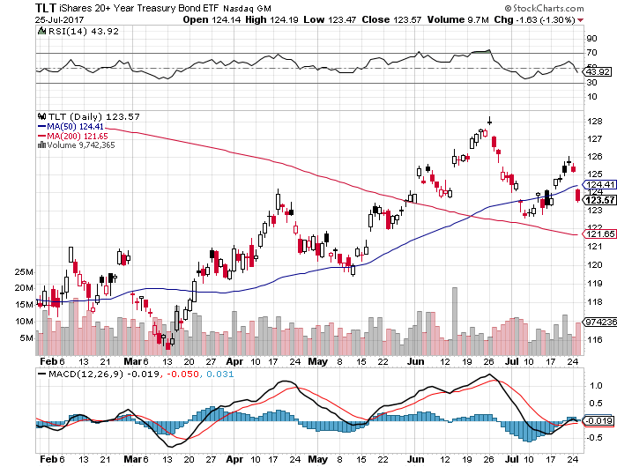
Treasury ETF (TLT) – 2.32%-Trend Breakdown took profits on long 7/$130-$133 vertical bear put spread

Slide 46
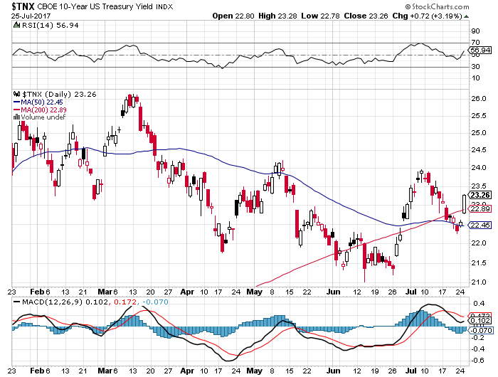
Ten Year Treasury Yield ($TNX) 2.32%

Slide 47
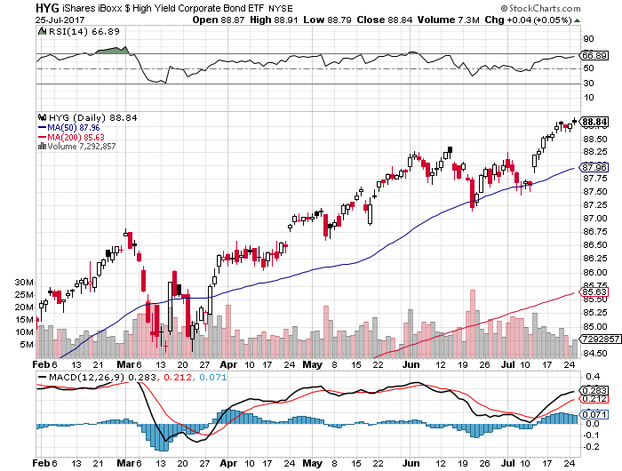
Junk Bonds (HYG) 4.80% Yield
A Great Risk Coincident Indicator- Long Term “RISK ON” means new highs, buy all dips

Slide 48
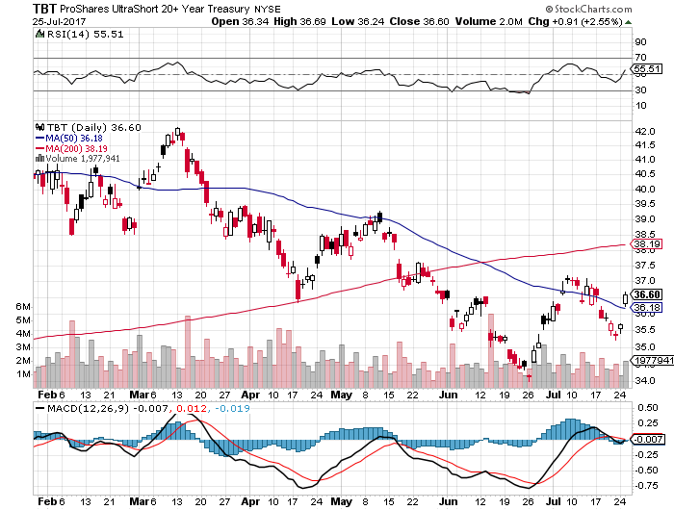
2X Short Treasuries (TBT)-In Screaming “BUY” Territory

Slide 49
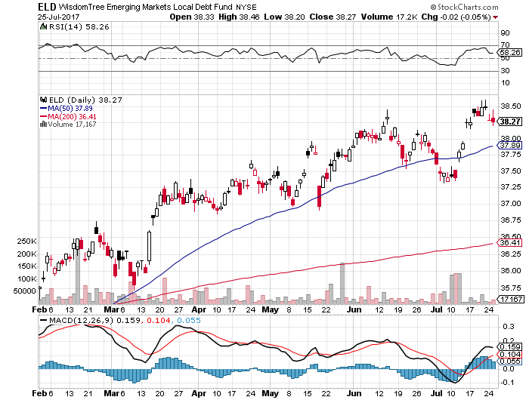
Emerging Market Debt (ELD) 5.77% Yield-

Slide 50
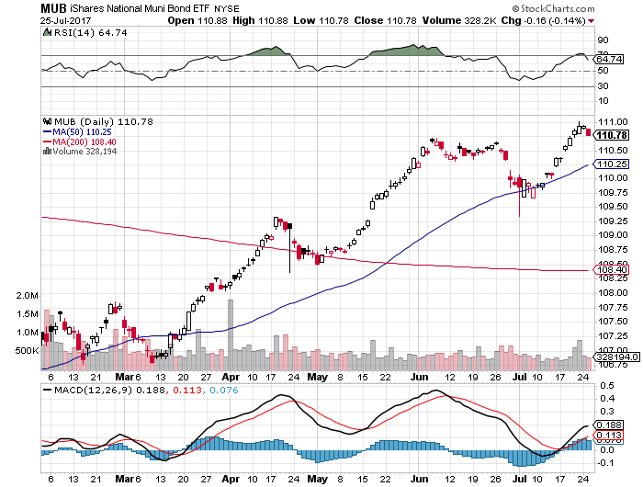
Municipal Bonds (MUB)-2.14%
Mix of AAA, AA, and A rated bonds

Slide 51
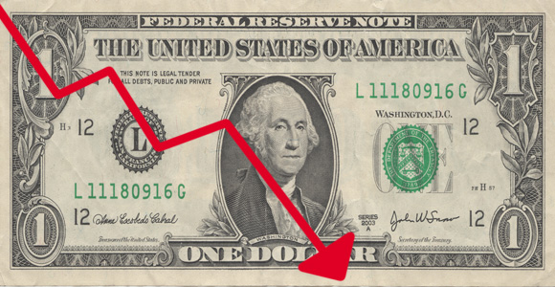
Foreign Currencies-Dollar New Lows
*Widening scandals in Washington starting to drag on the US dollar. DOJ Mueller expanding investigation to all Trump commercial activities over the last decade
*ECB’s Mario Draghi hints that QE will end sooner than expected, sending Euro interest rates much higher and the (FXE) to new one year highs
*Reserve Bank of Australia minutes show economy much stronger than expected, bringing rising rates sooner, and sending the Aussie (FXA) soaring
*Get ready to sell short the yen (FXY) and the
Euro (FXE) on a blow off top, which will happen
when US rates breakout to the upside

Slide 52
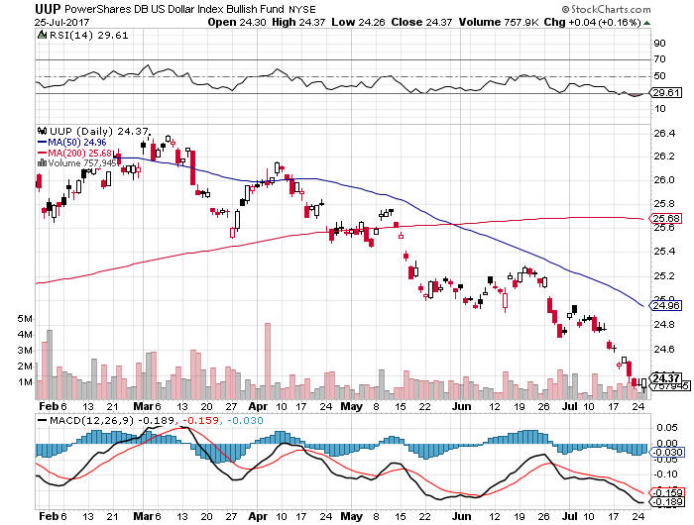
US Dollar Basket-(UUP)

Slide 53
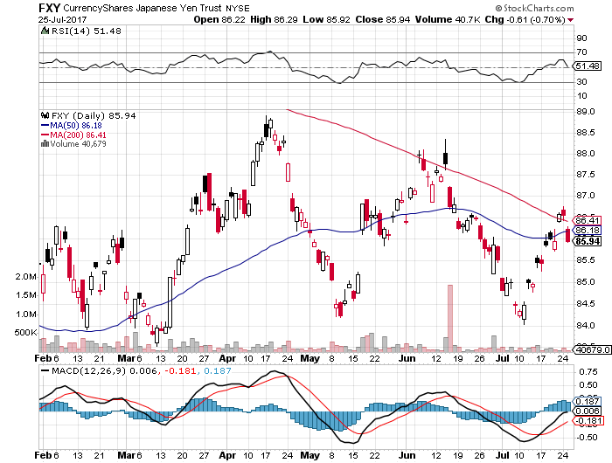
Japanese Yen (FXY)-At a Triple Bottom

Slide 54
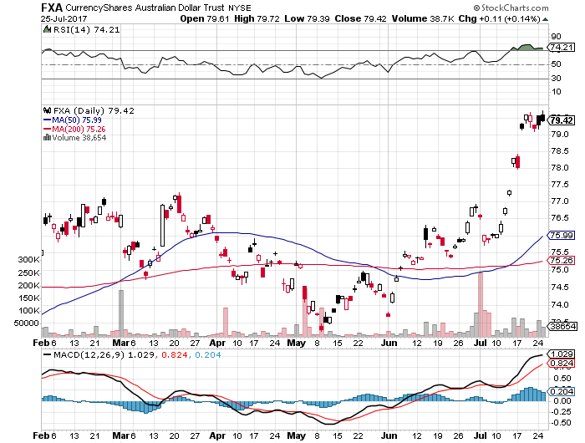
Australian Dollar (FXA)-

Slide 55
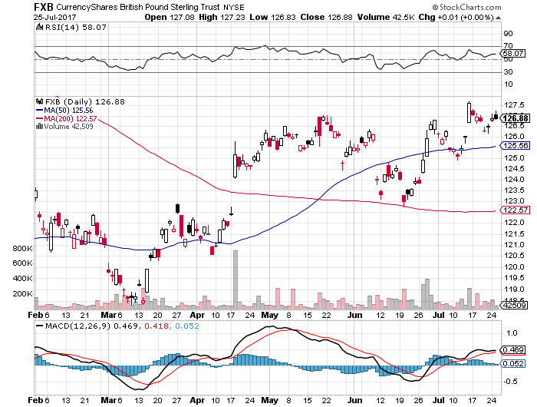
British Pound (FXB)- British Election-May Falters

Slide 56
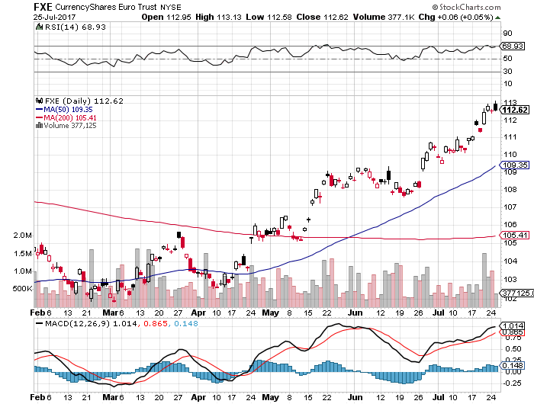
Euro ($XEU), (FXE), (EUO)- Off to the Races

Slide 57
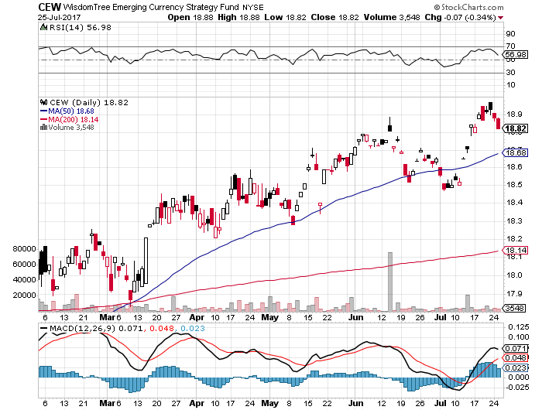
Emerging Market Currencies (CEW)

Slide 58
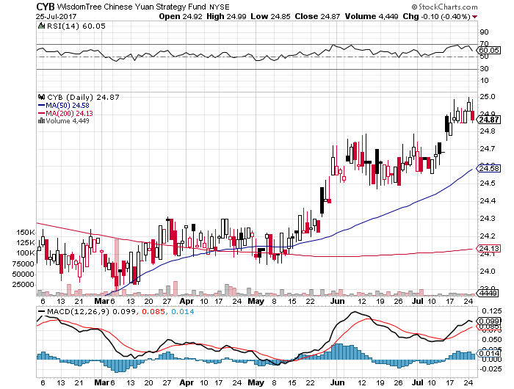
Chinese Yuan- (CYB)-Stabilizing on Government Support

Slide 59

Energy-OPEC Quota Control
*Attempt to reign in OPEC quota charting triggers short covering rally
*Crude and product inventories fall by 11.2 million barrels, giving the rally more distance
*IEA OPEC quota compliance plunges from 97% last year to 78% in June
*Saudi Arabia threatens to cut production by 1 million barrels a day to boost prices
*Libya delivers 1 million barrels/day out of nowhere
*Baker Hughes North American Rig Count
still rocketing to new 18 month high, up
13 to 1,156
*Bottom line: a whole lot of supply
is about to hit the market

Slide 60
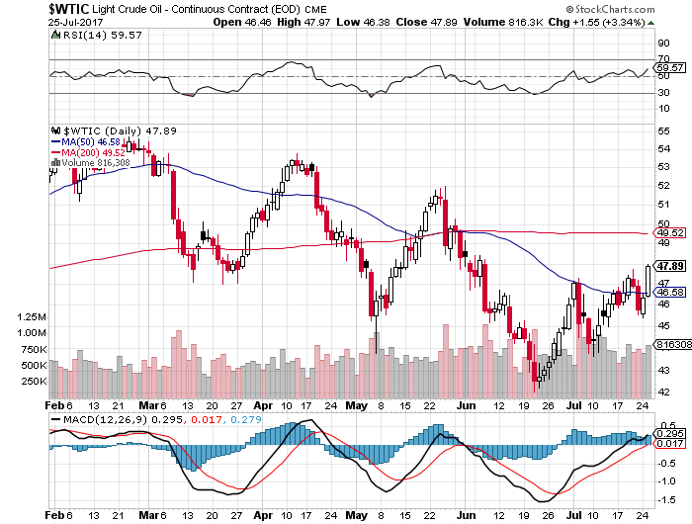
Oil-Back to the Top of a Down Channel

Slide 61
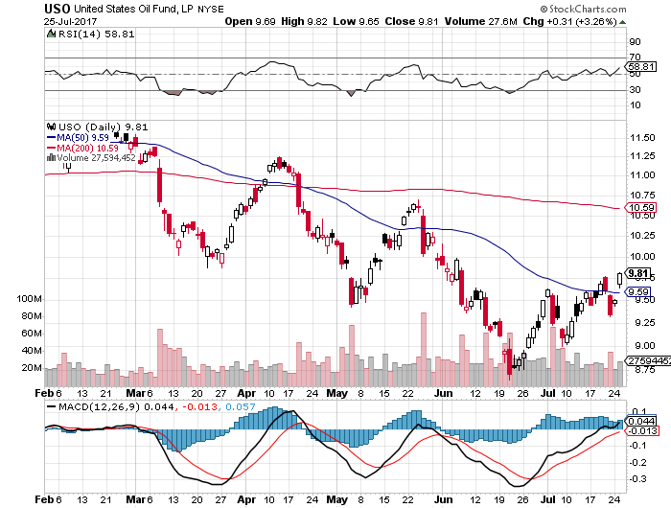
United States Oil Fund (USO) took profits on long (USO) 11/$12.50-$14.00 vertical bear put spread

Slide 62
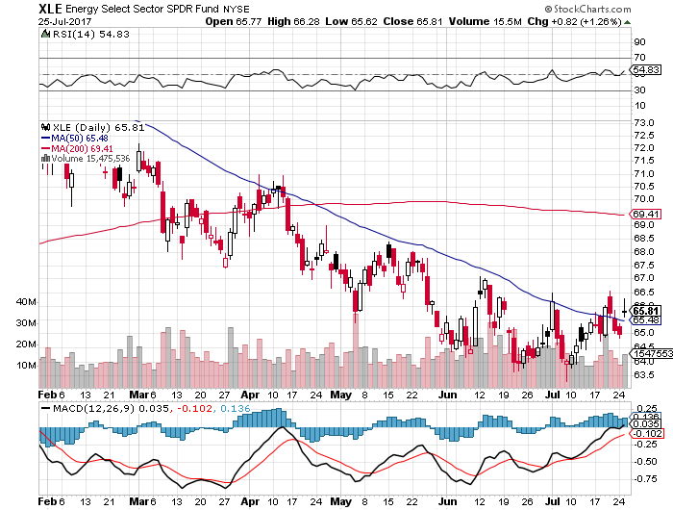
Energy Select Sector SPDR (XLE)
(XOM), (CVX), (SLB), (KMI), (EOG), (COP)

Slide 63

Alerian MLP ETF (AMLP)- Basket Approach is the Only Safe Play Here

Slide 64

Exxon (XOM)-

Slide 65

Occidental Petroleum (OXY)-
Call Spread Setting Up

Slide 66

Natural Gas (UNG)-No Joy

Slide 67

Copper (COPX)-China Rally

Slide 68

US Steel (X)-Forging a bottom

Slide 69

Precious Metals-Back to the Middle of the Range
*Lower for longer on rates is keeping a cap on gold, miners look worse
*Silver downtrend is more pronounced
*Venezuela is still hamming the gold market with distress sales
*Flight to safety has moved from gold
to Bitcoin
*Bitcoin takes another run at new highs
but fails

Slide 70

Gold (GLD)-Middle of Range

Slide 71

Market Vectors Gold Miners ETF- (GDX)
Downtrend Intact

Slide 72

Bitcoin-Sell Everything!

Slide 73

Silver (SLV)-Yikes!

Slide 74

Silver Miners (SIL)-Double Yikes!

Slide 75

Agriculture-Bull Market Failed!
*Drought Scare sends ags to multiyear highs
*One rain causes it to give up most of the rally
*Dept. of Agriculture WASDE report comes out universally bearish delivers another dagger through its heart
*Hedge funds maintaining huge shorts in
corn and wheat, setting up the recent
short squeeze
*Missed the big move for now,
but look at the next substantial dip

Slide 76

(CORN) –Breakout!

Slide 77

(WEAT)-Extreme Heat Hits

Slide 78

(SOYB)-Short Squeeze

Slide 79

Real Estate-Powering On
*Homebuilder Sentiment dives 7 points, the lowest since November, as new lumber tariff hurts affordability, benefiting lumber producers at the expense of producers. Anti trade policies are demolishing confidence
*There are now more renters in the US than at any time since 1965
*Foreigners buy a record number of US homes, some $153 billion in year ending March, up 49% YOY, with Florida, Texas, and California the target markets, is 10% of the dollar value of all US homes sold, Chinese leading the pack, followed by Canada and the UK
*Mortgage Applications up 6.6% WOW
*June new Housing Starts up 6.6%
*April Case-Shiller maintains strong 5.5%, with
absolute prices hitting new all time high,
your home equity could be the best investment
of the year….again

Slide 80


Slide 81

Home Depot (HD)

Slide 82

April S&P 500/Case–Shiller Home Price Index
+5.5% YOY, Seattle (+12.2%), Portland (9.7%), Dallas (8.8%) still leaders absolute prices hit new all time high

Slide 83

General Growth Properties (GGP)-New Lows
Long Term Downtrend

Slide 84

US Home Construction Index (ITB)
(DHI), (LEN), (PHM), (TOL), (NVR)
A Favorite Sector to Buy

Slide 85

Trade Sheet-The Complete Opposite
So What Do We Do About All This?
*Stocks- sell rallies for the short term
*Bonds-sell bigger rallies
*Commodities-buy dips
*Currencies-sell yen and Euro when they peak out
*Precious Metals –stand aside
*Volatility-wait for an $8.5 print
*The Ags –stand aside
*Real estate-buy dips

Slide 86

Next Strategy Webinar
12:00 EST Wednesday, August 16, 2017
San Francisco, CA
Buy lunch and conference tickets at madhedgefundtrader.com
Good Luck and Good Trading!
Notes:
*

