Slide 1
Mad Day Trader
Bill Davis
Webinar – August 23, 2017

Slide 2
Long Term

Slide 3
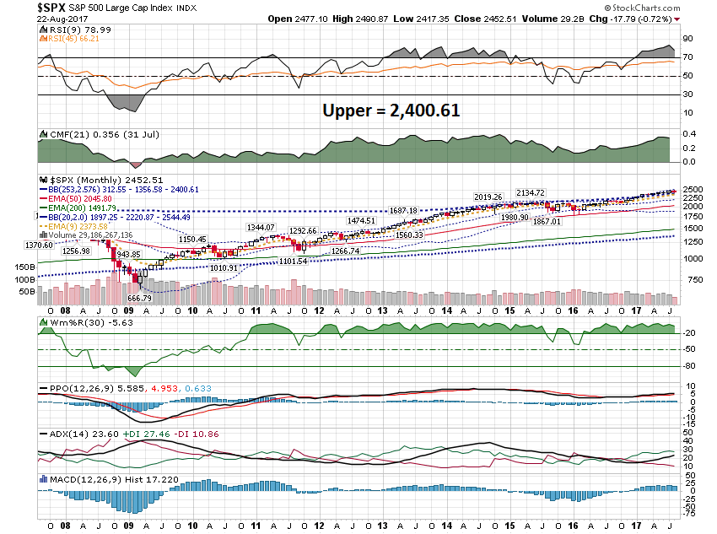

Slide 4
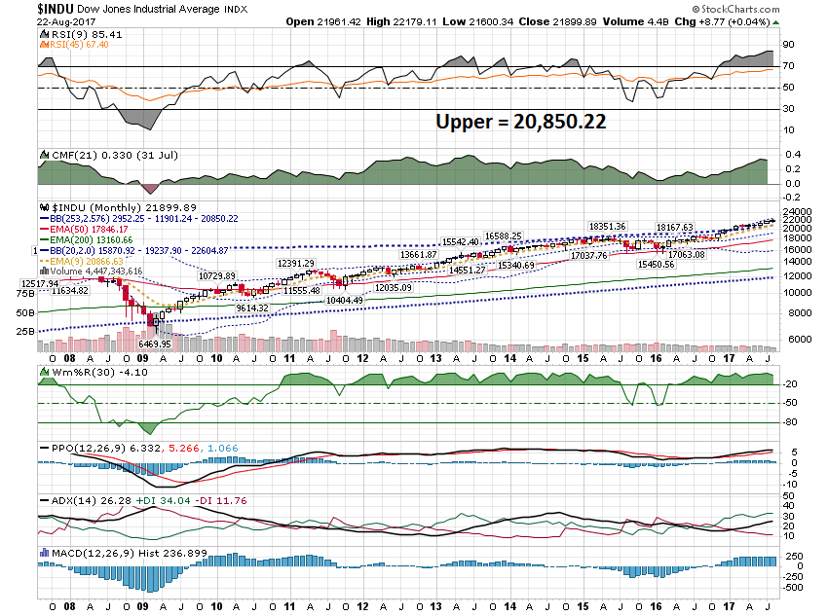

Slide 5
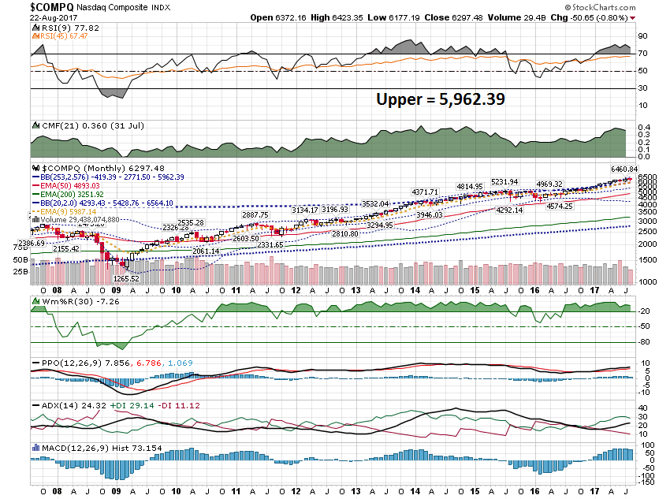

Slide 6
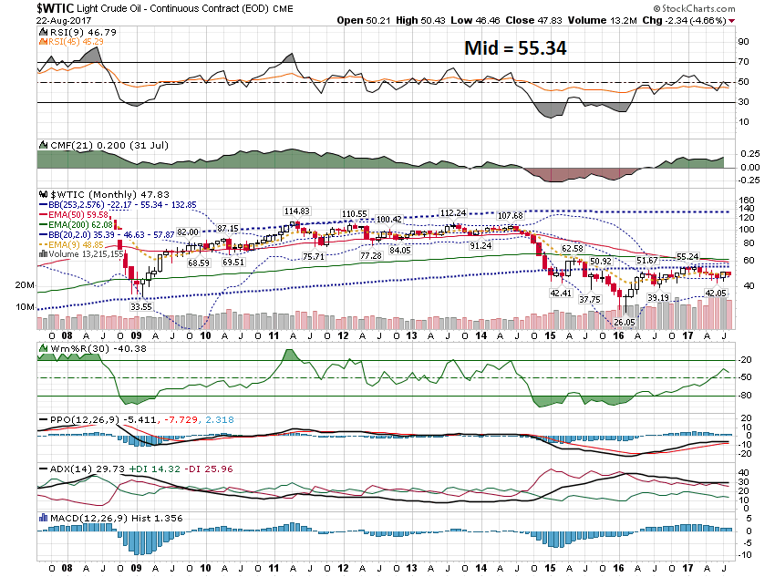

Slide 7
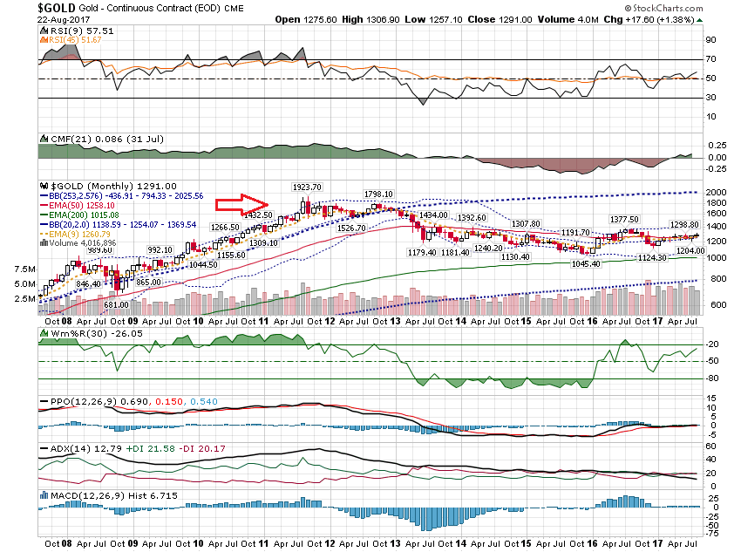

Slide 8
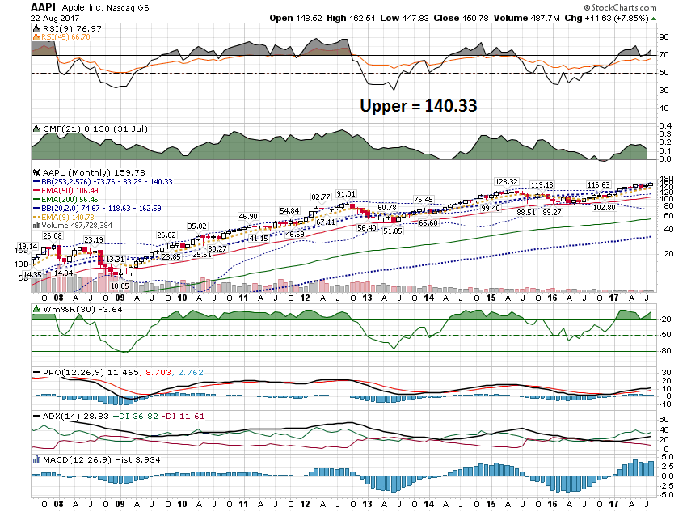

Slide 9
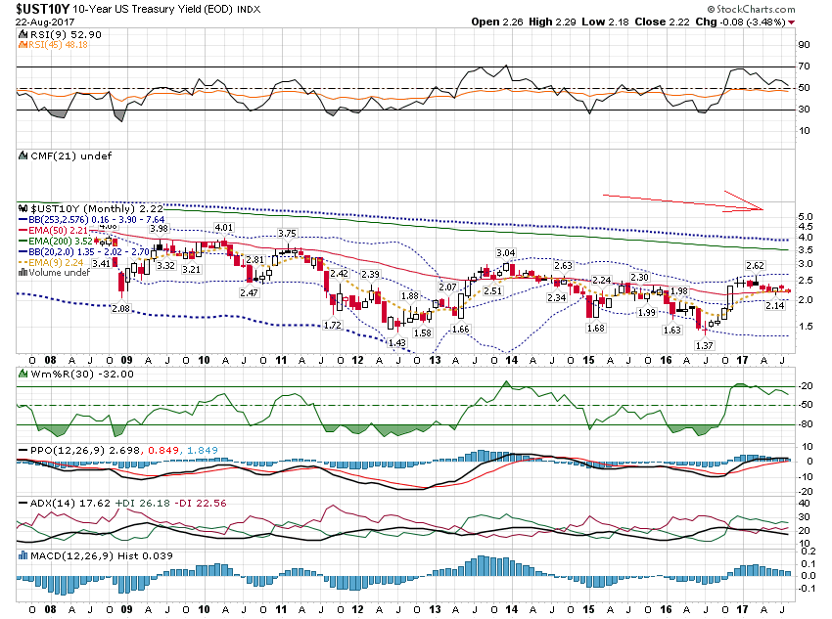

Slide 10
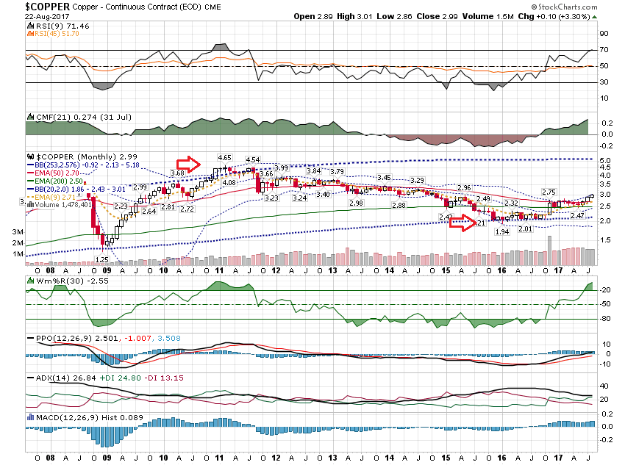

Slide 11
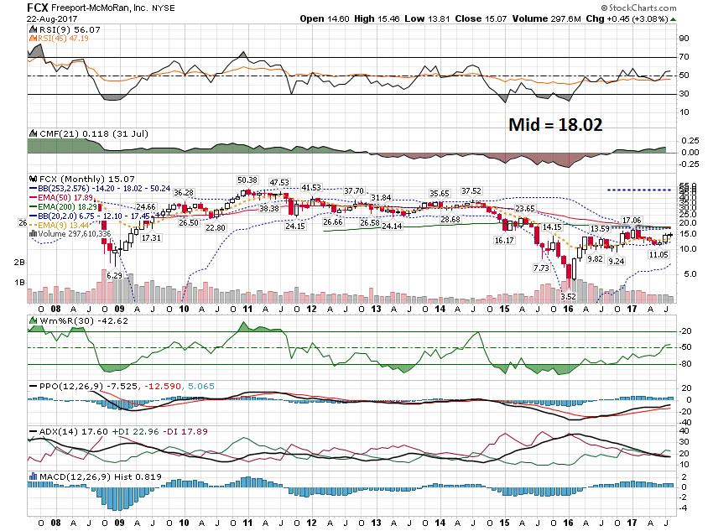

Slide 12
Short Term

Slide 13
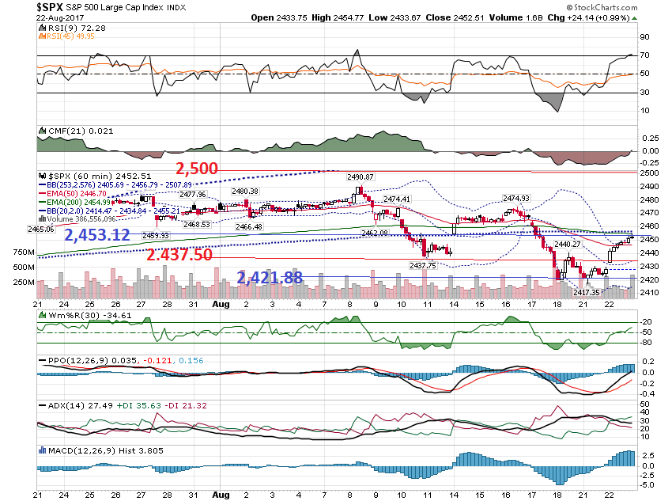

Slide 14
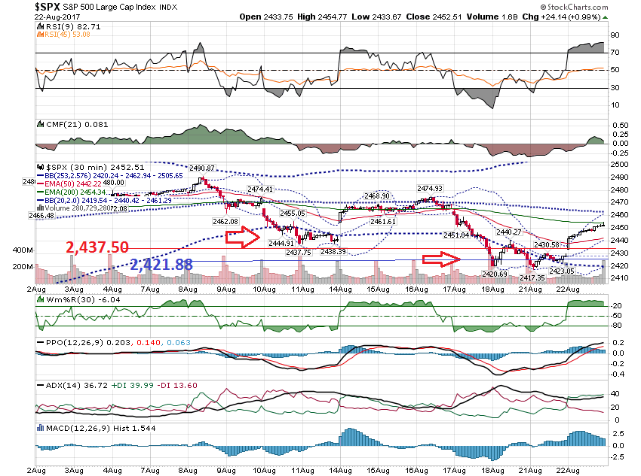

Slide 15
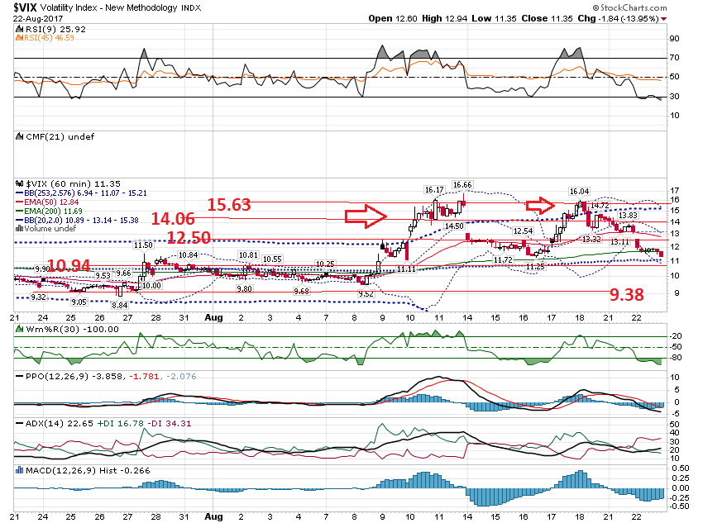

Slide 16
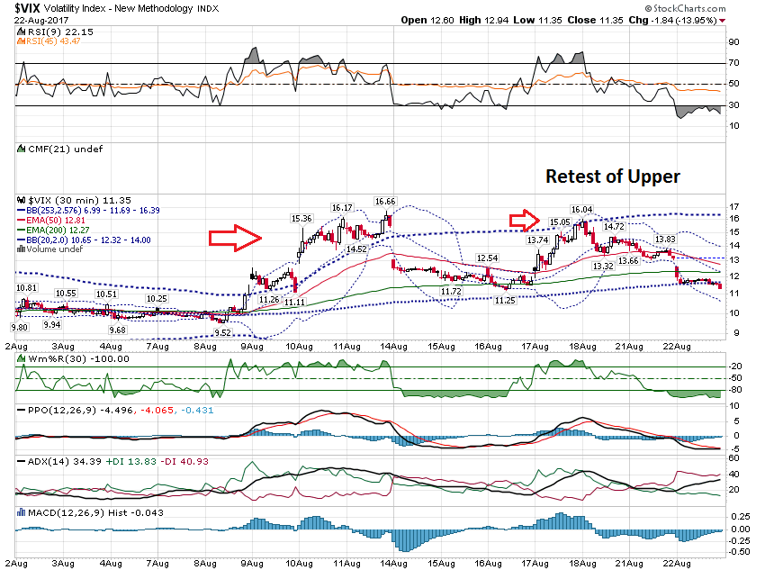

Slide 17
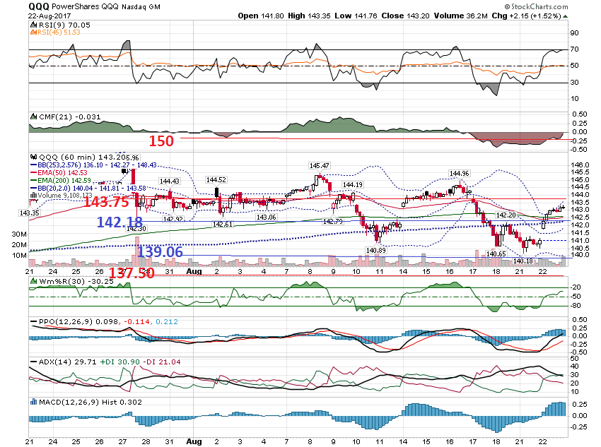

Slide 18
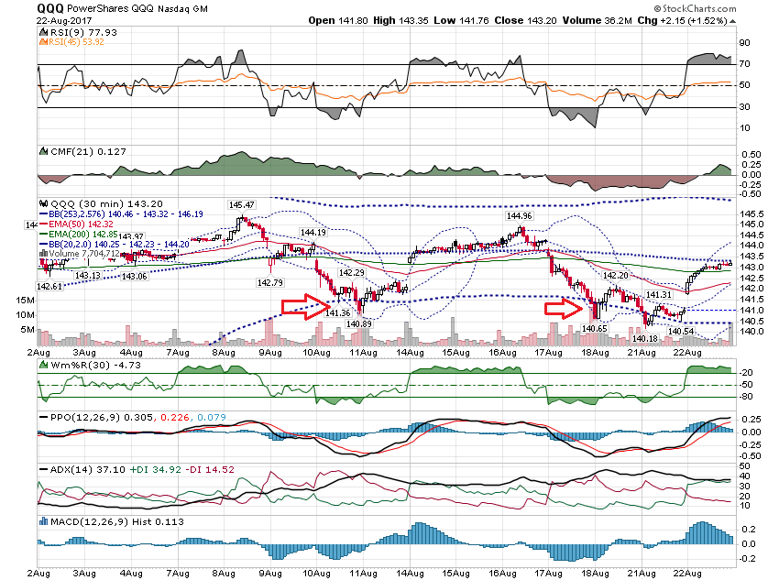

Slide 19
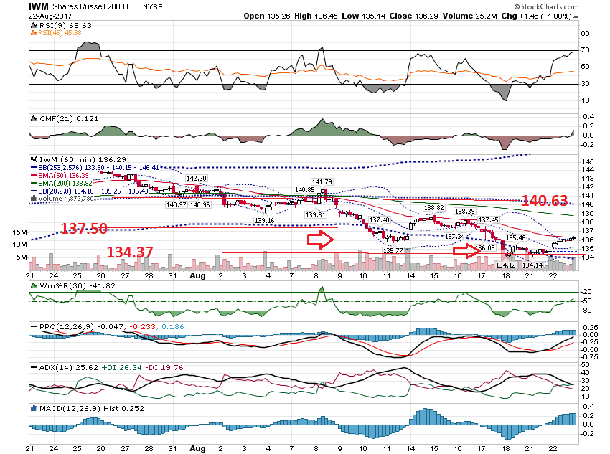

Slide 20
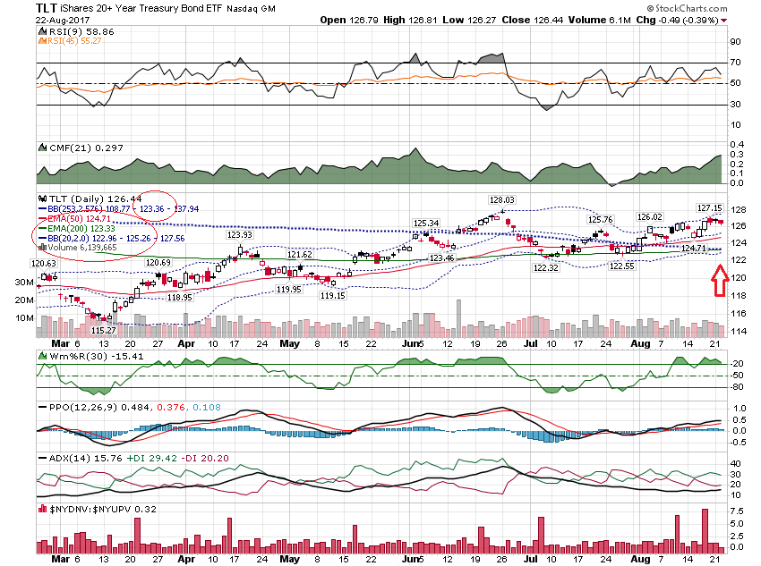

Slide 21
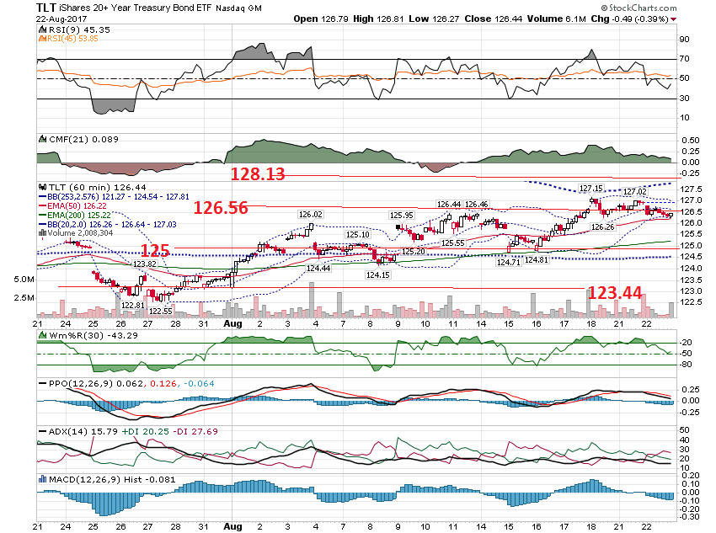

Slide 22
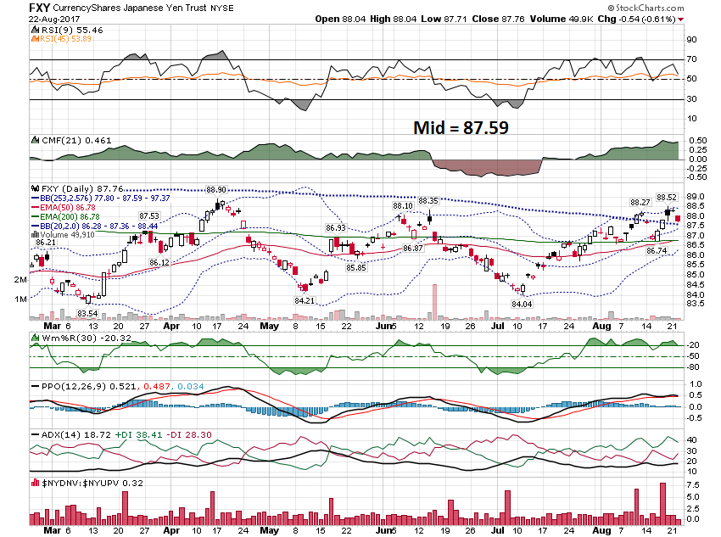

Slide 23
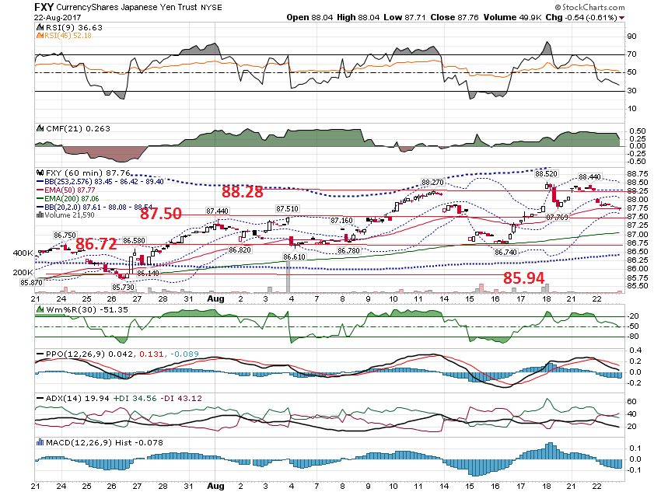

Slide 24
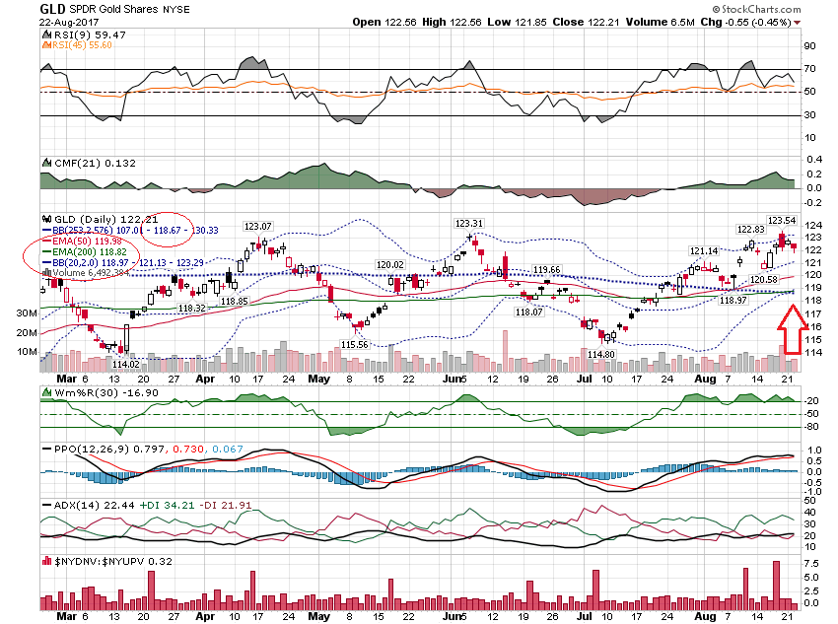

Slide 25
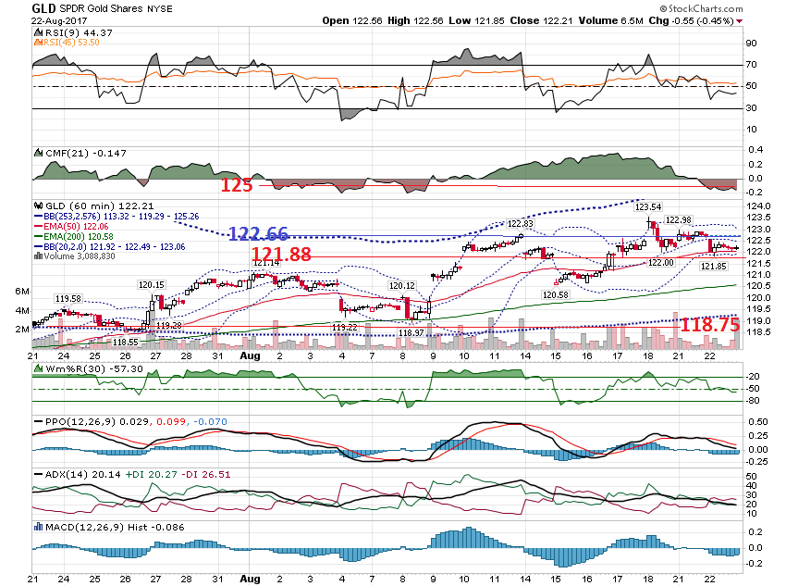

Slide 26
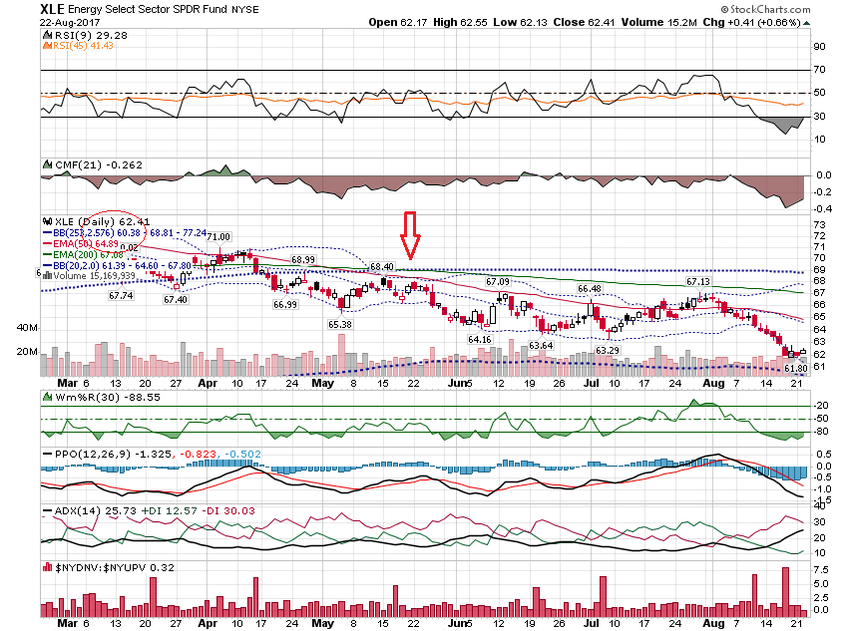

Slide 27
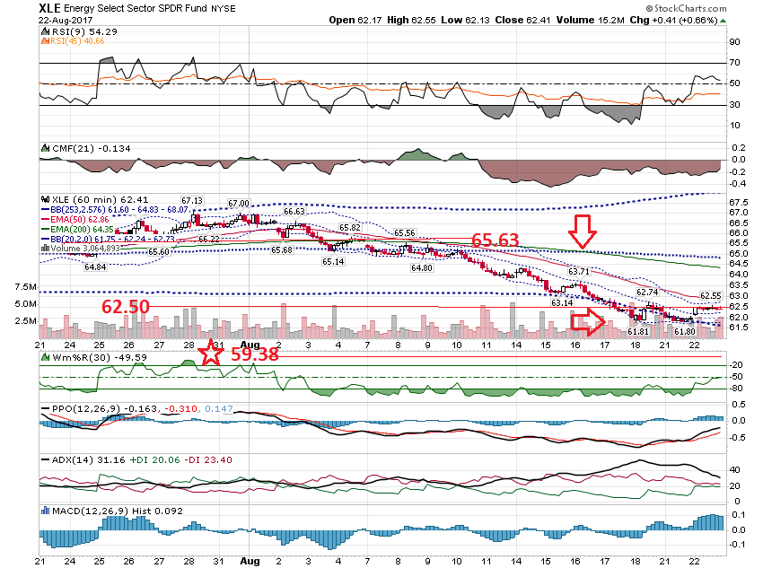

Slide 28
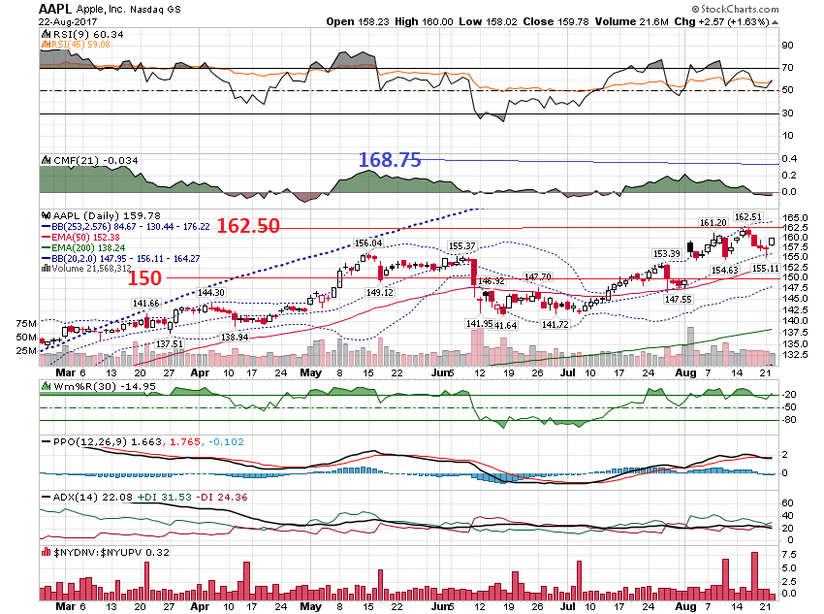

Slide 29
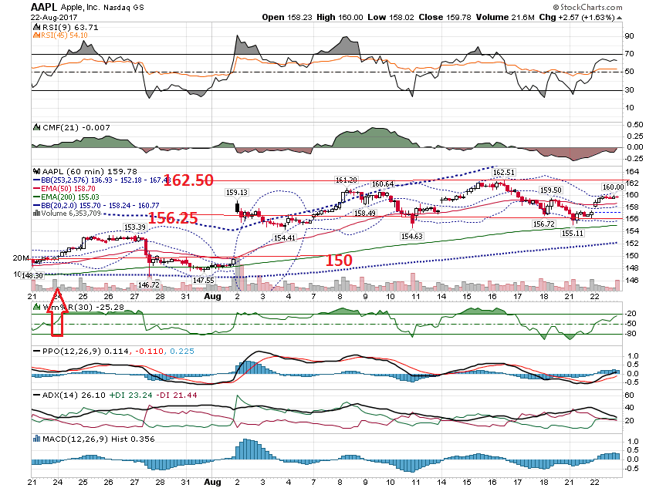

Slide 30
“I was wondering if you could share your criteria for coming up with your list of 'bullish' and 'bearish' stocks on your watch list in your daily email? I was hoping to recreate it on the Finviz screener: https://finviz.com/screener.ashx”

Slide 31
The Bullish / Bearish stocks are based on a technical condition. They are stocks where ALL timeframes are trending in the same direction.

Slide 32
For the Bullish Stocks, it means the Daily, 60 min, 30 min and 10 min charts are all bullish. Bullish is defined by the 200 ema above the 253 day simple avg. Opposite for bearish.

Slide 33
Let’s look at some recent examples as to how you could trade them. From 8/11/17 Update – RTN

Slide 34
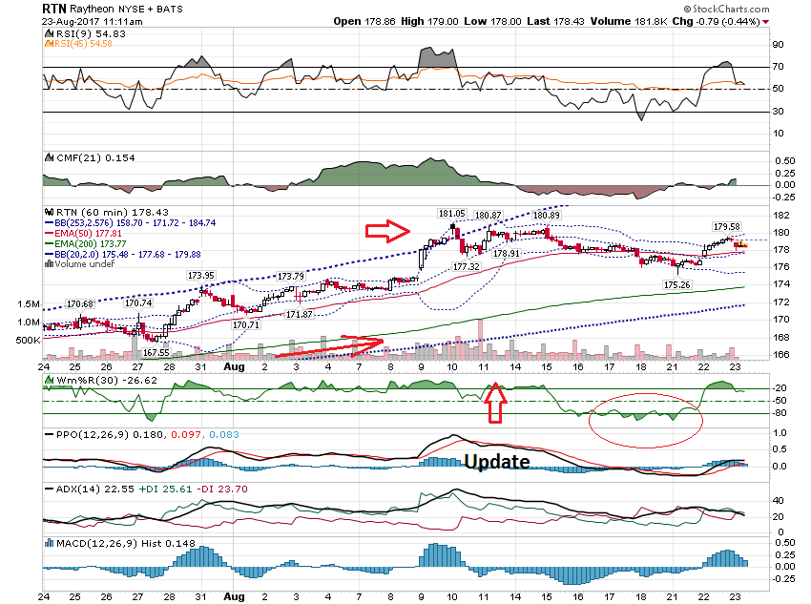

Slide 35
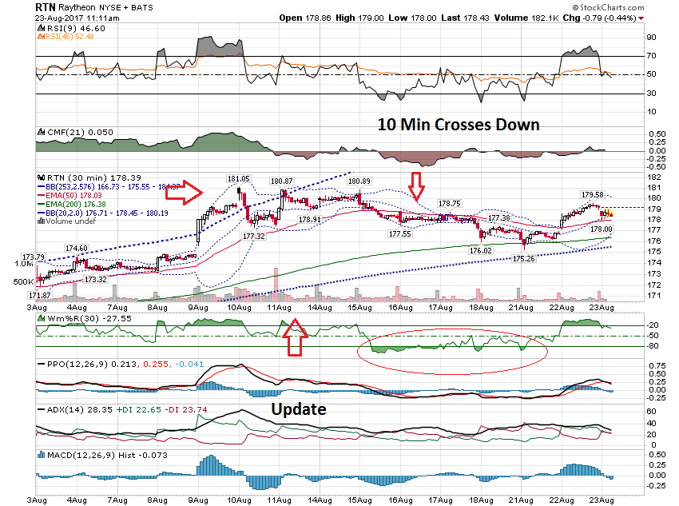

Slide 36
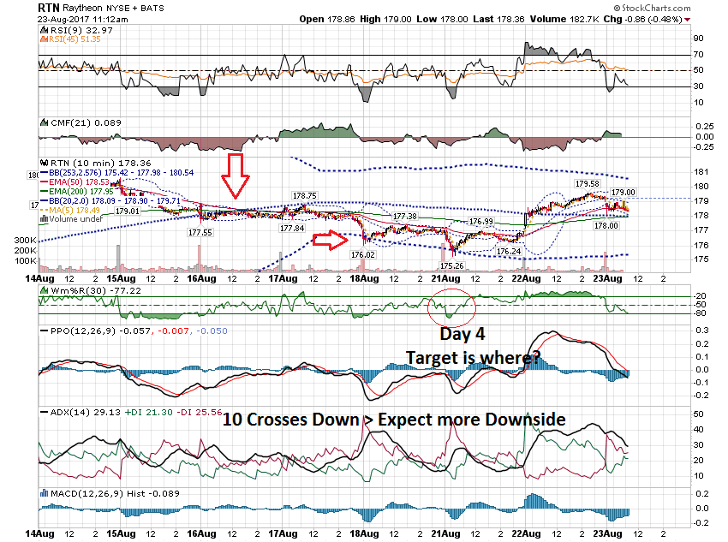

Slide 37
Here is an example from 8/21 – ADBE

Slide 38
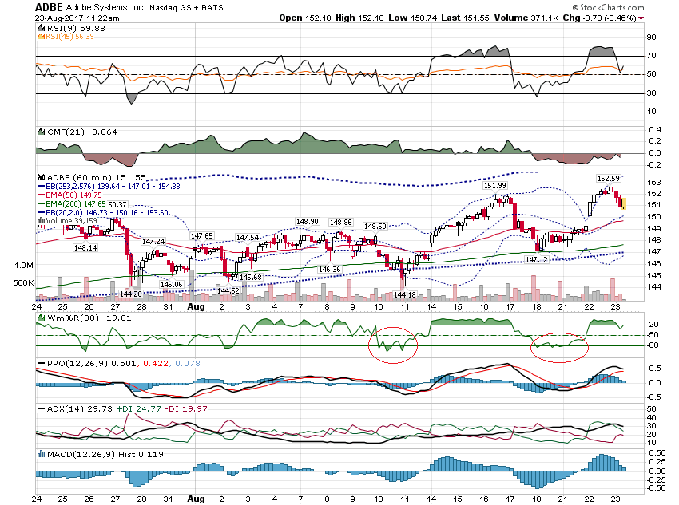

Slide 39
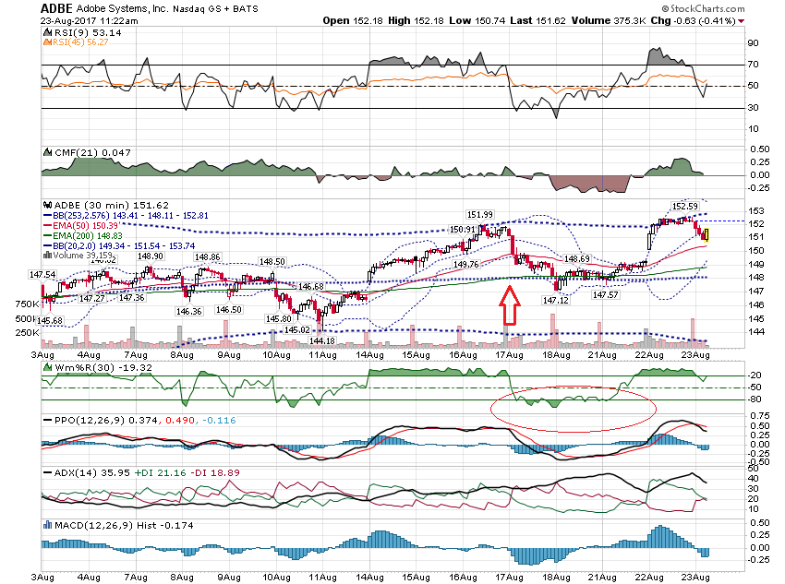

Slide 40
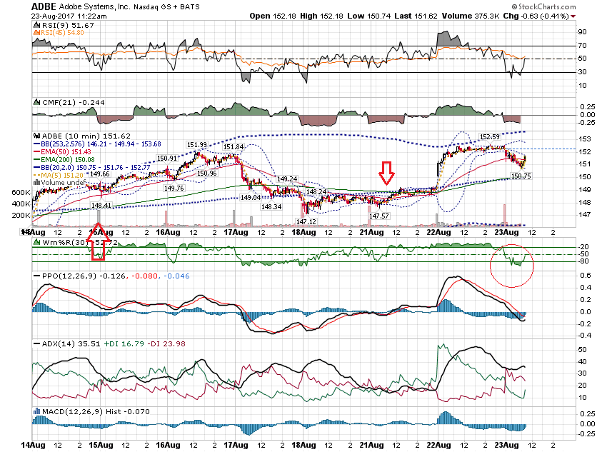

Slide 41
Thanks for watching! Bill Davis Mad Day Trader August 23, 2017 davismdt@gmail.com

