Slide 1

The Mad Hedge Fund Trader
“Duck and Cover”
With John Thomas
from Silicon Valley, CA, August 16, 2017
www.madhedgefundtrader.com
Notes:
*

Slide 2


Slide 3

Second Edition
Is Out!
In the Store
Now for $49
Sectors and Stocks that
Will Lead the Market for
the Next 20 Years
https://members.madhedgefundtrader.com/roaring-twenties-book/

Slide 4

Mad Hedge/Top Gun Master Mind Investment Conference
Buy tickets at www.madhedgefundtrader.com
November 3-4, Incline Village, NV
Only a Few Tickets Left!

Slide 5
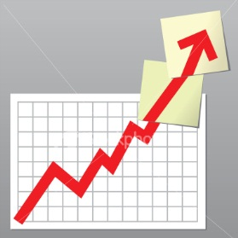
Trade Alert Performance
New All Time High!!
*January +9.35% Final *July +1.95% Final
*February +6.39% FINAL *August +3.90% MTD
*March +4.87% Final *September +0.27% Final
*April +1.84% Final *October +8.13% Final
*May -0.45% Final *November 4.37% Final
*June +0.70% Final *December +.84% Final
*2017 Year to Date 28.55%
compared to 5.8% for the Dow Average
11 of 12 Consecutive Profitable Months!
*Trailing 1 year return +44.56%, +247.11% since inception,
*Average annualized return of 31.60%

Slide 6
Portfolio Review
What’s Changed
Current Capital at Risk
Risk On
World is Getting Better
(TLT) 8/$128-$130 put spread | 10.00%
(X) 9/$21-$22 call spread | 10.00%
Risk Off
World is Getting Worse
(GDX) 9/$20.50-$21.50 call spread | -10.00%
(AAPL) 9/$170-$175 put spread | -10.00%
(ABX) 9/$15-$16 call spread | -10.00%
Total Net Position | -10.00%
Expiration P&L
36.24%

Slide 7
Portfolio Review
What’s Changed
*The Volatility Index (VIX) has just seen the sharpest rise in history
*This has spilled over into the options market and made
all options based strategies much more profitable
*This justifies and much larger and more aggressive trading book
*Going from 100% cash to 40% cash

Slide 8
Trailing One-Year Return
Daily Audited Performance
+44.56%

Slide 9
Eight Year Daily Audited Performance
Averaged Annualized Return +32.17%

Slide 10

The Method to My Madness
*Moved from 100% cash to 50% invested with a 10% net short now that volatility has increased
*”RISK OFF” means buy gold and US Treasury bonds on dips, sell stocks, commodities, and energy on rallies
*Almost all asset classes and sectors are still at extreme end of 2017 ranges
*The world finally wakes up to geopolitical risk, and there is no sign of it ending anytime soon
*FANG will lead the downturn in any stock
market move
*Looking to sell short the next big rally in oil
*Staying away from currencies until dollar bottoms
on the market

Slide 11
The Bill Davis View
A $1,500 Upgrade for the Mad Day Trader Service
Buys: | Entry | Target
Chipotle Mexican (CMG) | $312.00 | $350.00
Amazon.com (AMZN) | $953.00 | $1,090.00
3D Systems Corp (DDD) | $12.50 | $18.75
Alphabet Inc. (GOOGL) | $922.00 | $1,000.00
Netflix, Inc. (NFLX) | $169.00 | $187.00
Walt Disney Cp. (DIS) | $100.00 | $112.00
Sells:
Dillards Inc. (DDS) | $67.00 | $53.00
Mednax Inc (MD) | $50.00 | $31.00
Stericycle, Inc (SRCL) | $75.00 | $62.00
Tupperware Brands (TUP) | $62.00 | $53.00
USANA Health Sciences (USNA) | $56.00 | $50.00

Slide 12
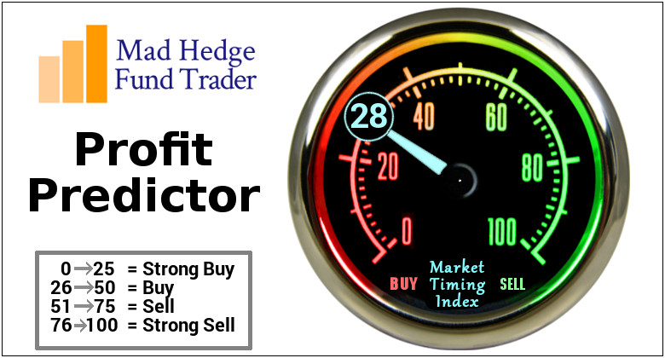
The Mad Hedge Profit Predictor
Market Timing Index
An artificial intelligence driven algorithm that analyzes 30 different economic, technical, and momentum driven indicators
Risk is Approaching New 2017 Lows, but may go lower

Slide 13
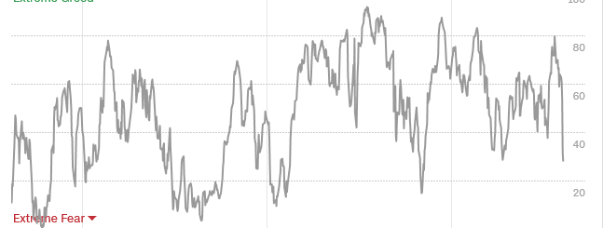
The Mad Hedge Profit Predictor
Market Timing Index
From 81 to 28 in 2 Weeks!

Slide 14

The Global Economy-Still on Track
*July Nonfarm Payroll Report at a robust 209,000, headline Unemployment Rate a new decade low at 4.3%, July ADP at 178,000, JOLTS job openings report rockets by 461,000 to 6.163 million
*US GDP revised up to 2.6% from Q1 1.2%, June Durable Goods up +6.5%, Capital Goods down -0.1%
*US July Producer Prices fall -0/1% MOM and 1.9% YOY, well below the FED target, showing that deflation lives
*July US Consumer Confidence plunges from 95.1 to 93.4, down 5 points since January, the sharpest drop since 2005, as Trump support fades
*Global Inflation hits lowest level since 2009
*Japan GDP up 4%, Machine Tools up 26% MOM
*Germany June Industrial Orders up a strong
1.0% MOM

Slide 15
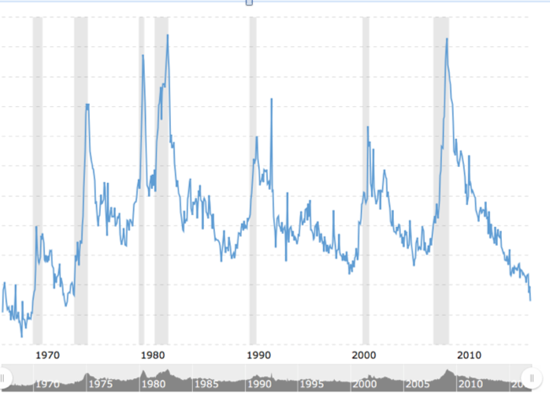
Weekly Jobless Claims –The Most Important Statistic
+3,000 to 244,000, Hugging 43 Year Low

Slide 16


Slide 17
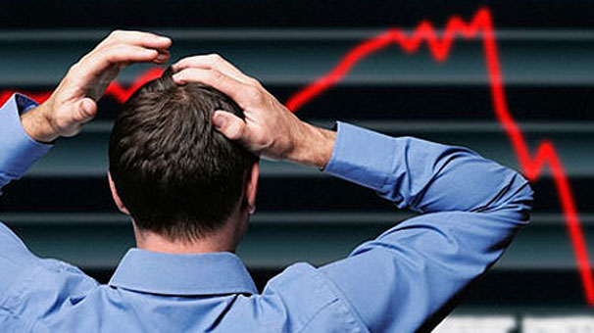
Stocks-The Correction is Here
*Stocks normally get three 5% pullbacks every year, but we haven’t had one for 18 months
*Q2 earnings expected 7% YOY growth buts got 12%, sending indexes to record highs, Q3 earnings now being revised upward
*2017 “Passive” fund inflows hit $128 billion, while “Active” outflows reach $99 billion, pushing indexes higher
*Massive squeeze hits volatility shorts, as predicted here, up 70% in two days
*But no real crash coming as there is nowhere else
to go look for a 10% correction
at most in a long term bull market
*Still looking for 10%-12% total return in equities
for 2017, now at 11.22%, but a 5%-10% correction
may have to occur first

Slide 18

Cash Repatriation Leaders
Cash available for stock buy backs once brought back to the US
If repatriation doesn’t happen, these stocks will get hurt the most
*Apple (AAPL) $246 billion
*Microsoft (MSFT) $106 billion
*Cisco Systems (CSCO) $66 billion
*Alphabet (GOOG) $52 billion

Slide 19
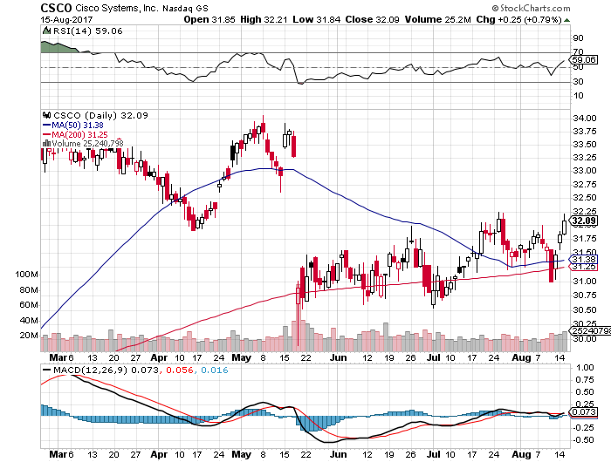
Cisco Systems (CSCO)
Most attractive chart to buy

Slide 20
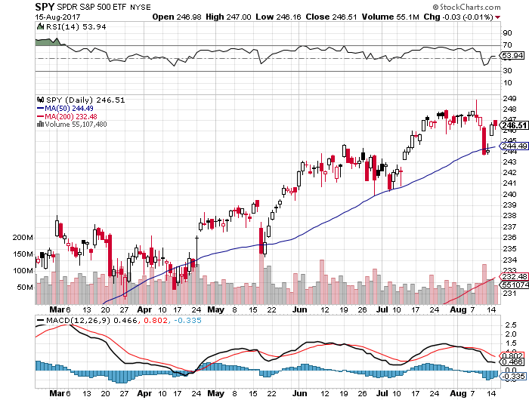
S&P 500-Correction

Slide 21
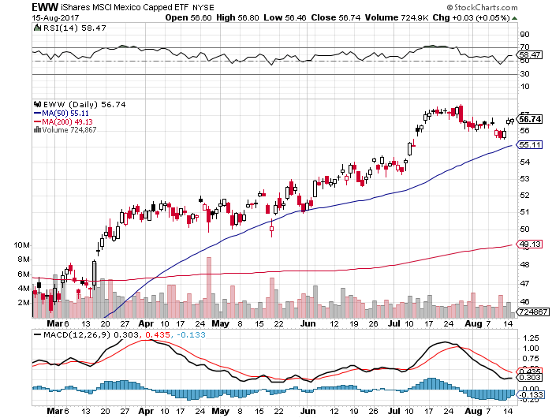
iShares MSCI Mexico ETF (EWW)-
Trade War Isn’t Happening

Slide 22
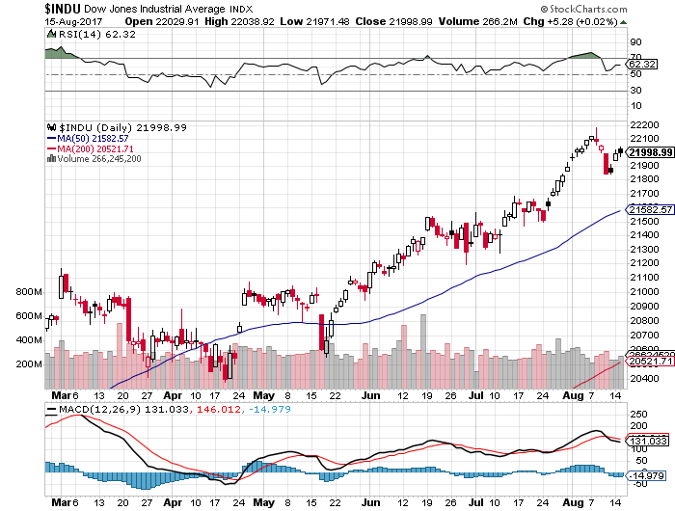
Dow Average-New Highs
Haven’t Retraced to the 50 Day MA since May

Slide 23
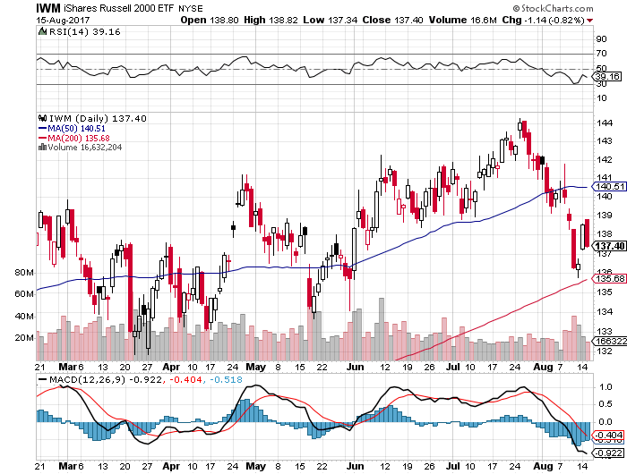
Russell 2000 (IWM)-New Highs

Slide 24
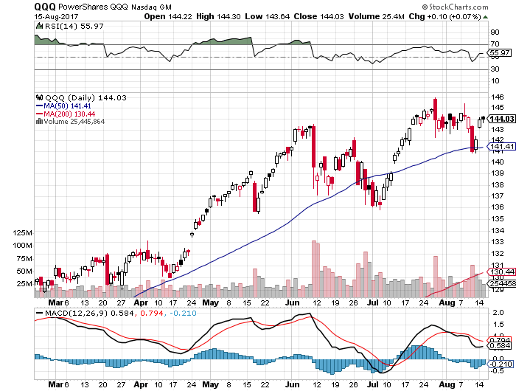
NASDAQ (QQQ)-New Highs

Slide 25
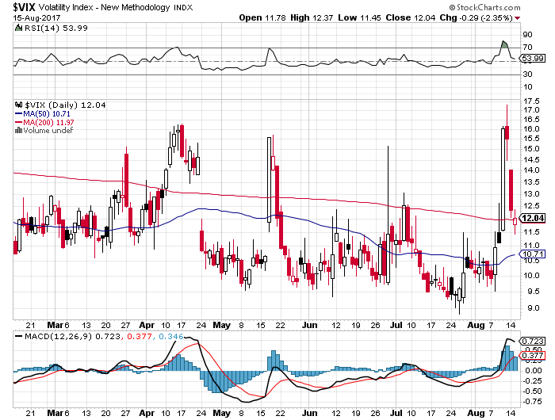
(VIX)-Biggest One Day Move in 6 Years
Biggest two day move in history

Slide 26
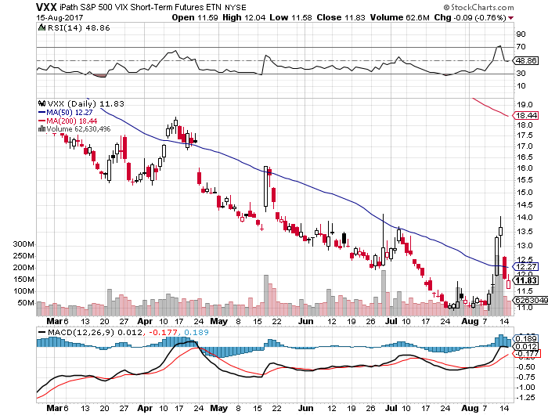
iPath S&P 500 VIX Short-Term Futures ETN (VXX)

Slide 27
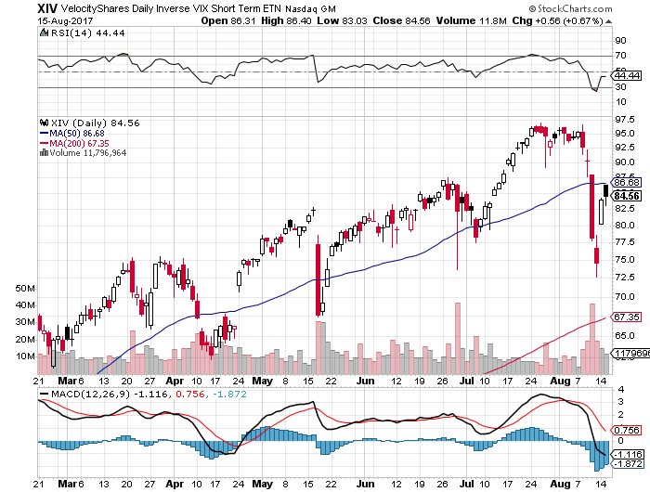
Velocity Shares Daily Inverse VIX Short Term ETN (XIV)
Wow!
One of the most instantly profitable trades of 2016….and 2017

Slide 28
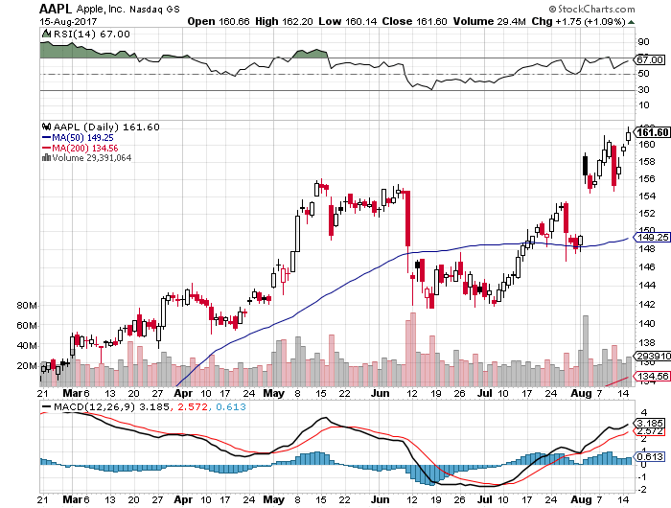
Apple (AAPL)-Range Setting Up?
Short 9/$170-$175 bear Put Spread

Slide 29
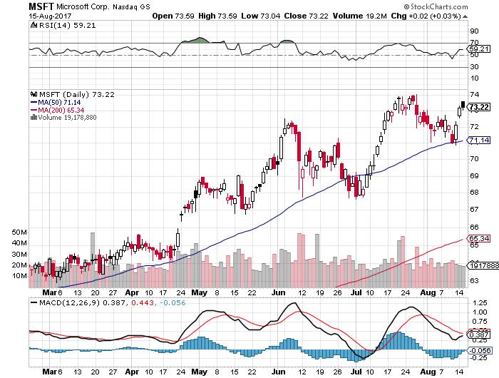
Microsoft (MSFT)

Slide 30
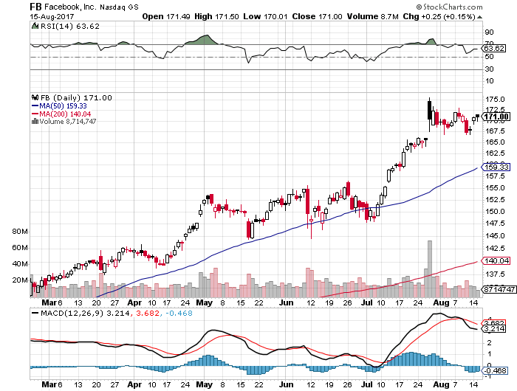
Facebook (FB)-

Slide 31
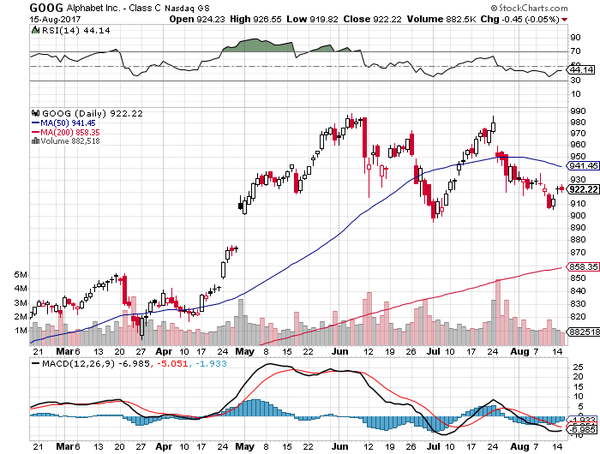
Alphabet (GOOG)-New High

Slide 32
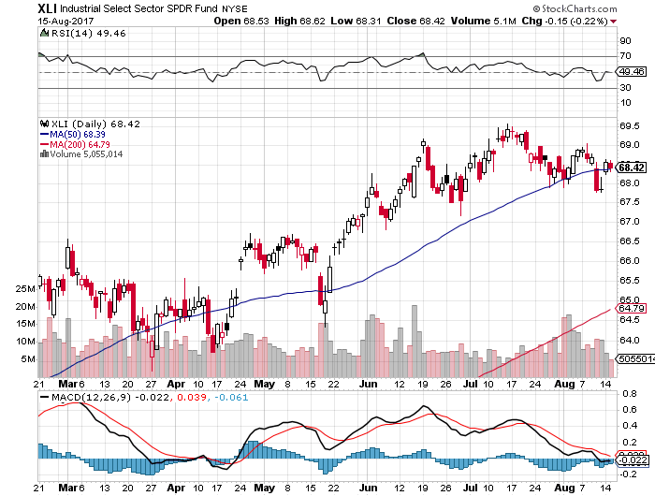
Industrials Sector SPDR (XLI)-
(GE), (MMM), (UNP), (UTX), (BA), (HON)

Slide 33
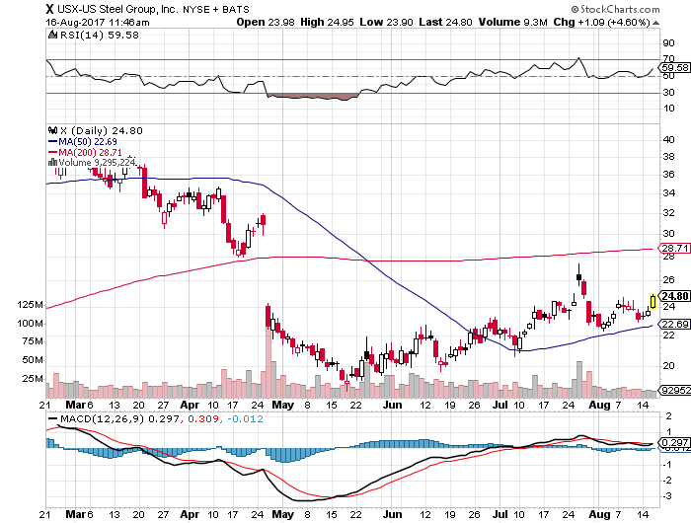
US Steel (X)- long the 9/$21-$22 vertical bull call spread

Slide 34
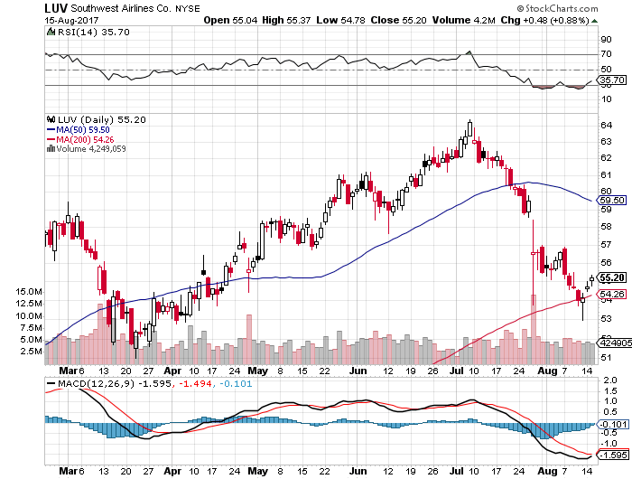
Southwest Airlines (LUV)-
Warren Buffett’s Favorite Airline

Slide 35
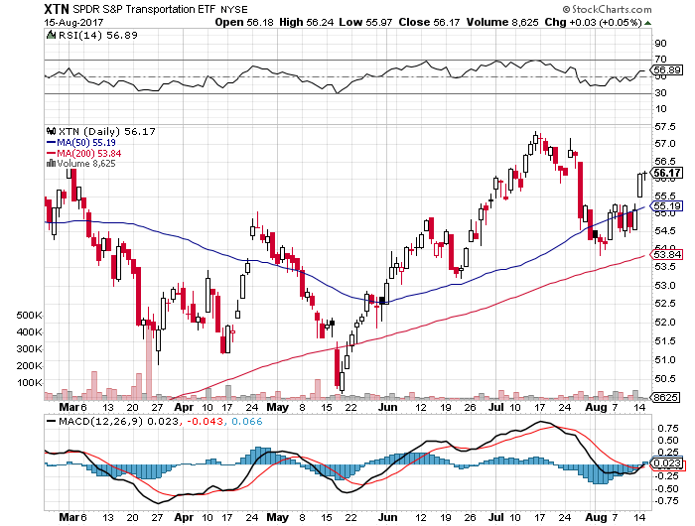
Transports Sector SPDR (XTN)-
(ALGT), (ALK), (JBLU), (LUV), (CHRW), (DAL)

Slide 36
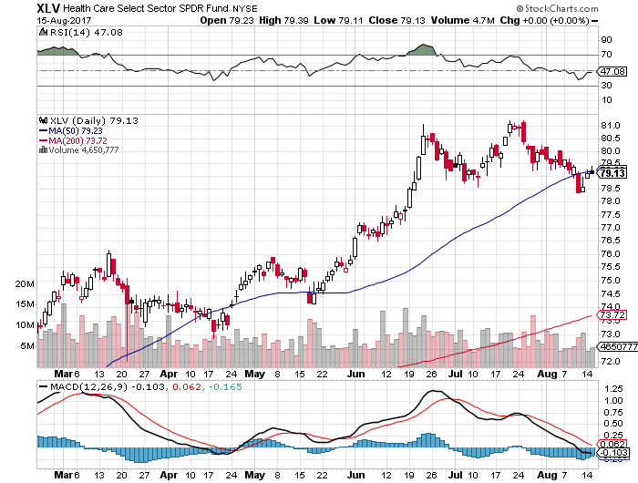
Health Care Sector (XLV), (RXL)-The New FANG?
(JNJ), (PFE), (MRK), (GILD), (ACT), (AMGN)

Slide 37
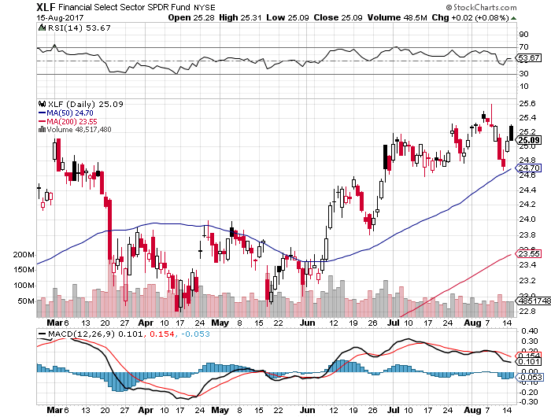
Financial Select SPDR (XLF)-Bouncing Back
(BLK/B), (WFC), (JPM), (BAC), (C), (GS)

Slide 38
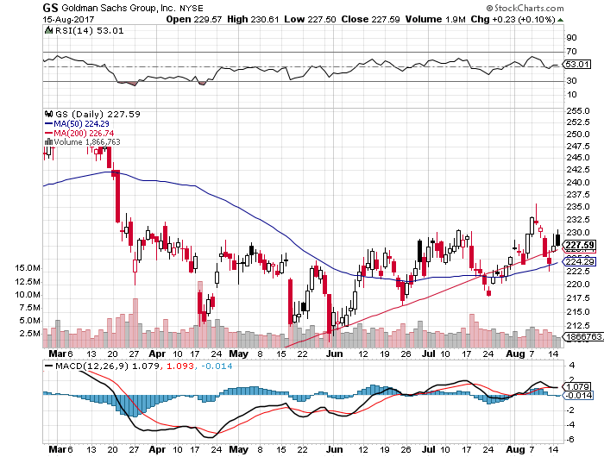
Goldman Sachs (GS)-
7/$205-$210 vertical bull call spread expired at maximum profit

Slide 39
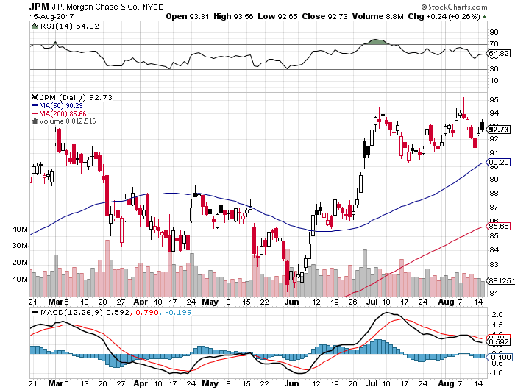
JP Morgan (JPM)-

Slide 40
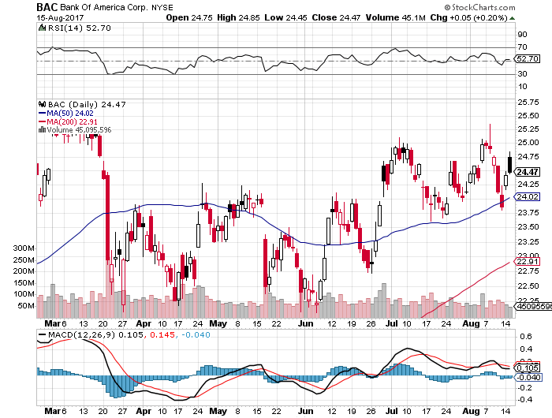
Bank of America (BAC)-
Warren Buffet exercises warrants and buys 700 million shares, with paper profit of $12 billion

Slide 41
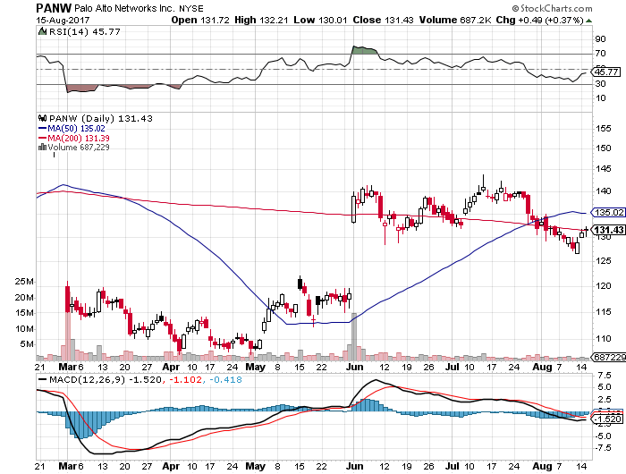
Palo Alto Networks (PANW)-

Slide 42
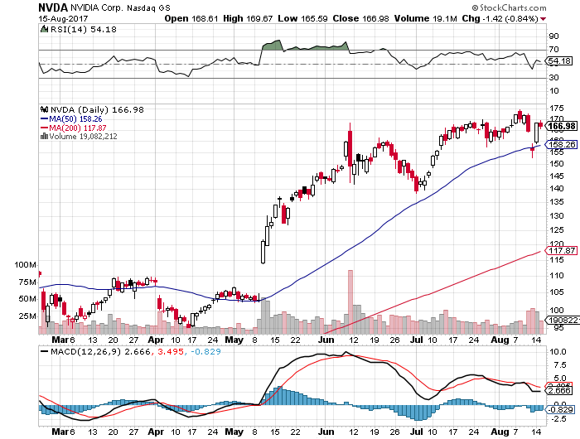
NVIDIA (NVDA)-Q2 $1.02 vs. $0.70 expected

Slide 43
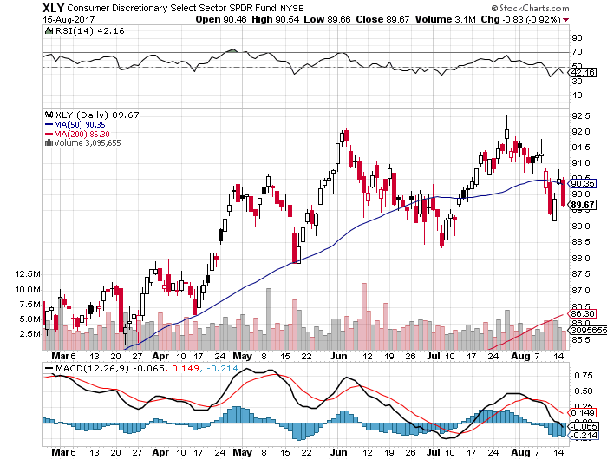
Consumer Discretionary SPDR (XLY)
(DIS), (AMZN), (HD), (CMCSA), (MCD), (SBUX)

Slide 44
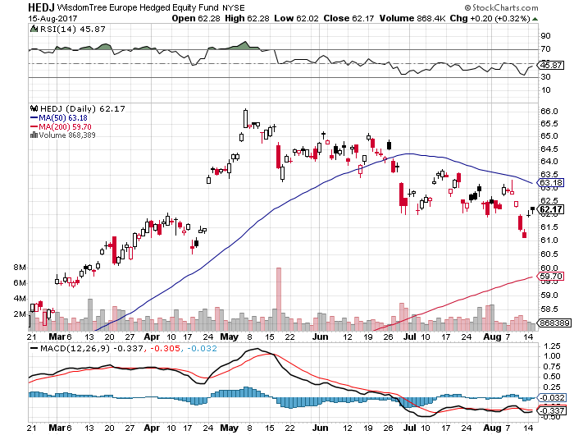
Europe Hedged Equity (HEDJ)-Strong Euro Taking a Toll

Slide 45
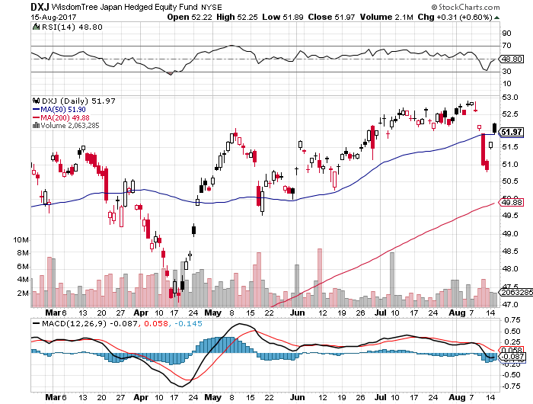
Japan (DXJ)-Yen burst knocks the wind out

Slide 46
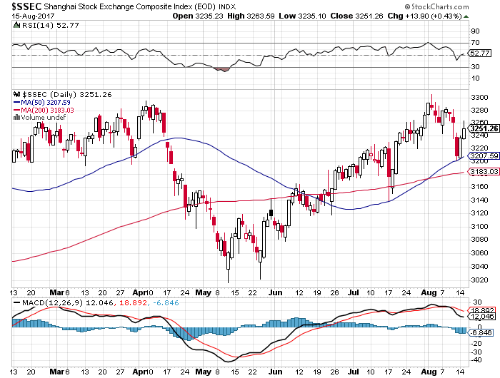
China ($SSEC)-Economic Recovery on Track

Slide 47
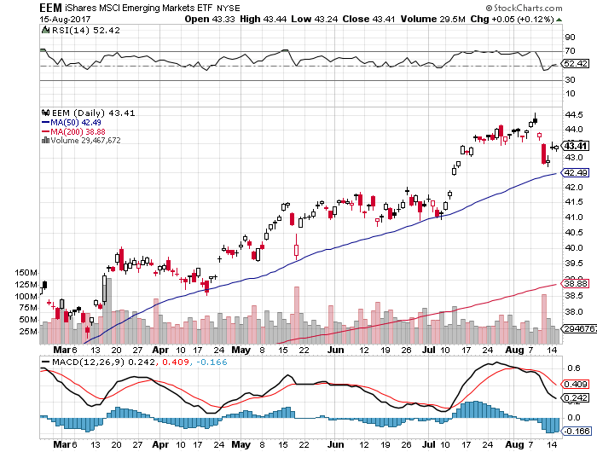
Emerging Markets (EEM)-”RISK OFF” Hit

Slide 48


Slide 49
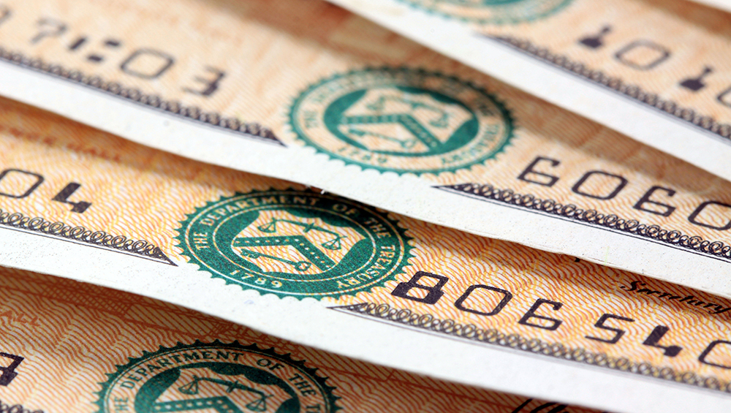
Bonds-Flight to Safety
*Breakdown in global inflation to 8 year low triggers new bond market rally
*Fears of nuclear war send cash from stocks into US Treasury bonds
*Fed’s William Dudley punctures the rally, says that Fed is reader to sell bond hoard
*Another nice short sell in bonds setting up, could be the big trade for the rest of 2017
*Wait for a spike bottom in this stock market correction before shorting any bonds
*Back to the bottom of the 2.10%-2.40%
range in 10 year yields, 2.13 could be
tested this week
*We are ten months into a 10-20 year
bear market in bonds, now is a great
entry point on the short side

Slide 50
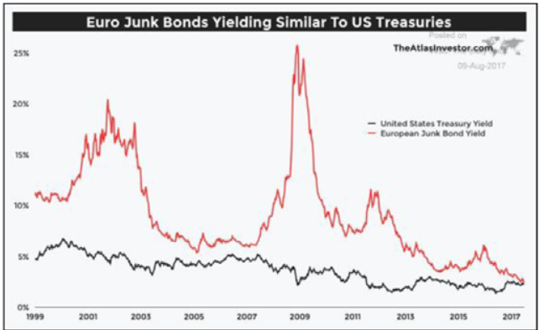

Slide 51
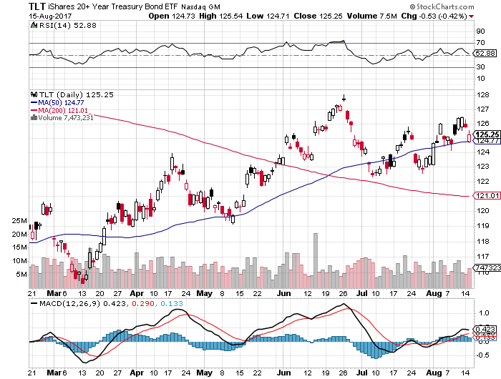
Treasury ETF (TLT) – 2.32%-Trend Breakdown long 8/$128-$130 vertical bear put spread long 9/$129-$132 vertical bear put spread

Slide 52
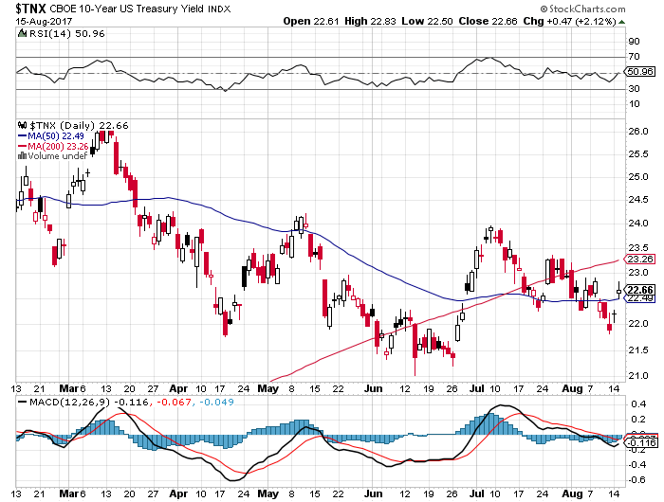
Ten Year Treasury Yield ($TNX) 2.32%

Slide 53
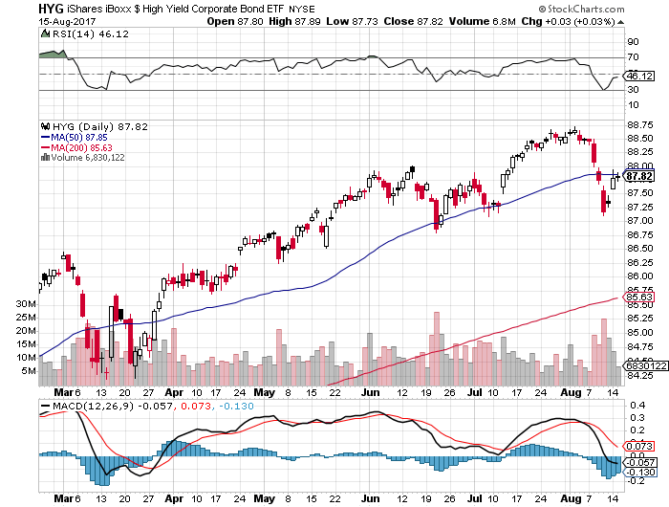
Junk Bonds (HYG) 4.75% Yield
A Great Risk Coincident Indicator- Long Term “RISK ON” means new highs, buy all dips

Slide 54
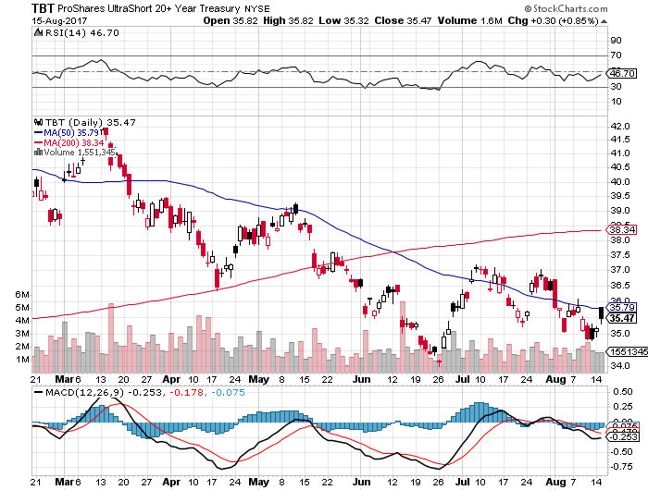
2X Short Treasuries (TBT)-In Screaming “BUY” Territory

Slide 55
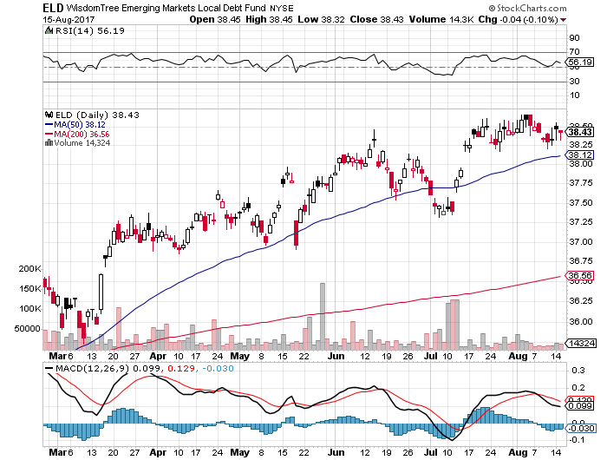
Emerging Market Debt (ELD) 5.70% Yield-

Slide 56
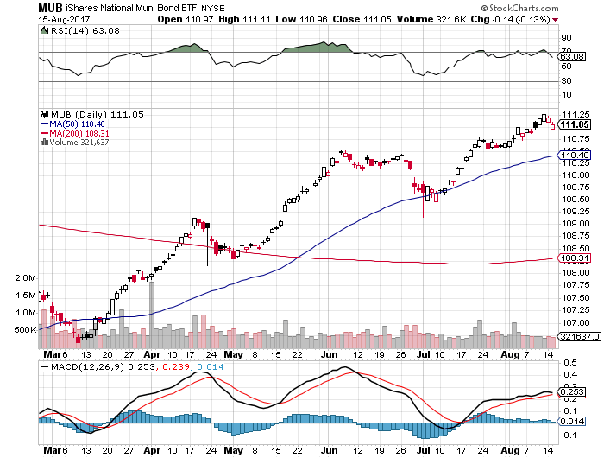
Municipal Bonds (MUB)-1.75%
Mix of AAA, AA, and A rated bonds

Slide 57


Slide 58

Foreign Currencies-Flight to Safety
*Korean war fears finally give a flight to safety bid to the US dollar as traders take huge profits in other currencies
*Profit taking overwhelms any negative effects of lower interest rates
*Japanese yen and Euro take the first serious break of 2017, but there is not conviction
*Get ready to sell short the yen (FXY) and the
Euro (FXE) on a blow off top, which will happen
when US rates breakout to the upside
*However, this whole scenario is on hold
as the stock market correction unfolds

Slide 59
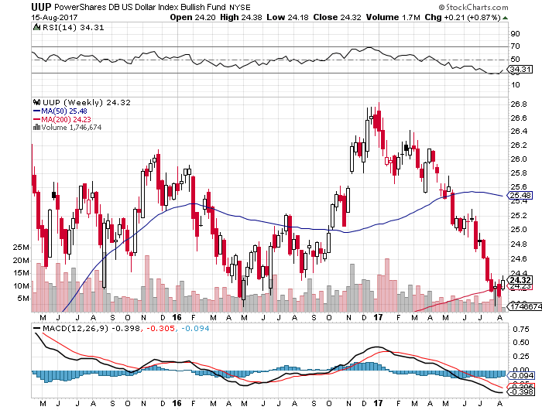
US Dollar Basket-(UUP)-Not Exactly Shorting Territory

Slide 60
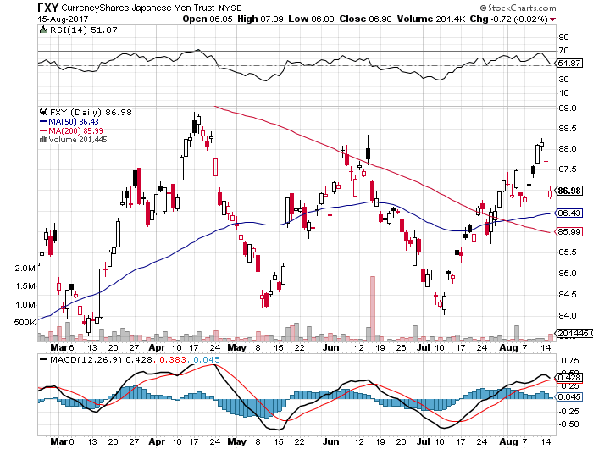
Japanese Yen (FXY)-Flight to Safety Currency

Slide 61
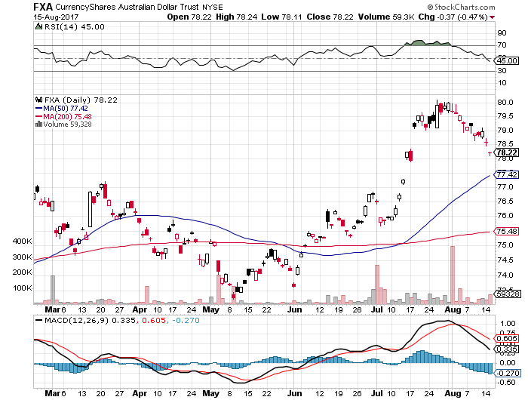
Australian Dollar (FXA)-Blast Off!

Slide 62
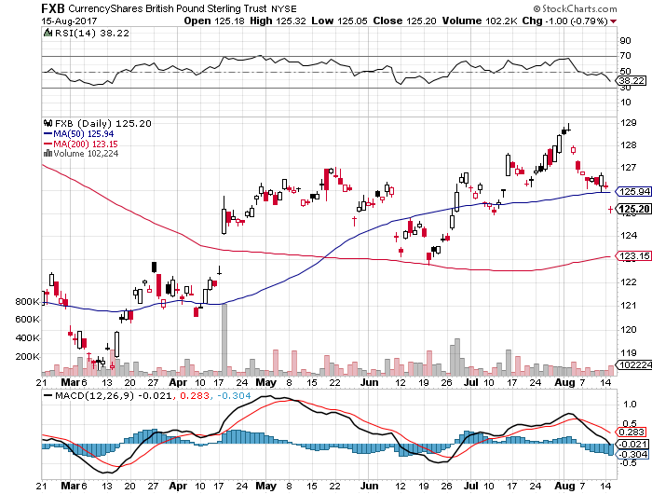
British Pound (FXB)- British Election-May Falters

Slide 63
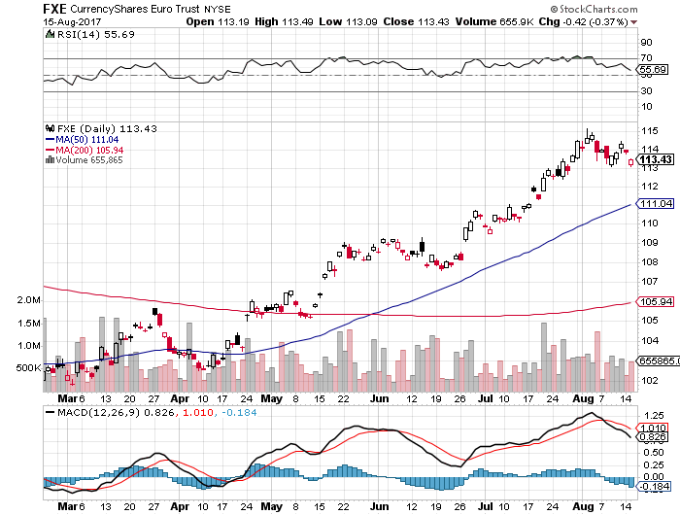
Euro ($XEU), (FXE), (EUO)- Is That a Top?

Slide 64
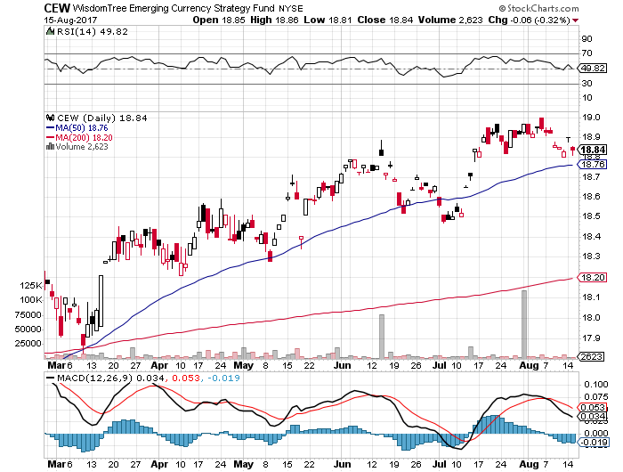
Emerging Market Currencies (CEW)

Slide 65
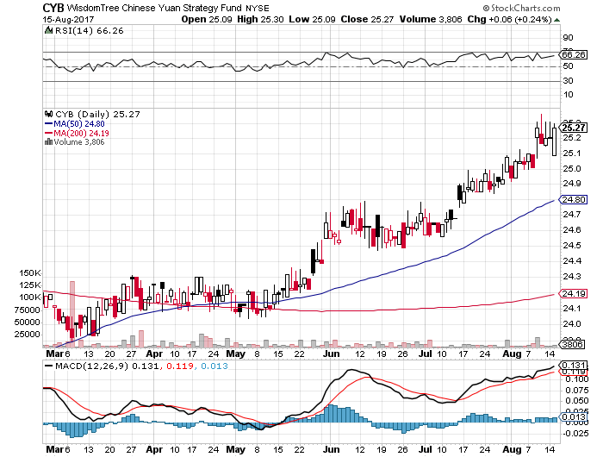
Chinese Yuan- (CYB)-Stabilizing on Government Support

Slide 66


Slide 67

Energy-Top of the Down Channel
*Storage wars end as oil contango shrinks, signaling that prices may remain here for a while, ending the oil short play
*However, much of the recent buying has been short covering, and may have exhausted itself at a channel high
*Chinese oil inventories hit all time high for the marginal new buyer, is price negative
*July OPEC production up +90,000, indicating that quota controls are
all “talk” and no “do”
*Abu Dhabi OPEC/Non-OPEC
meeting generates no real results
*Bottom line: a whole lot of supply
is about to hit the market

Slide 68
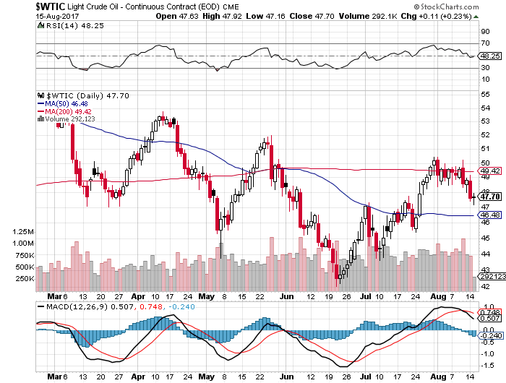
Oil-Back to the Top of a Down Channel

Slide 69

United States Oil Fund (USO)

Slide 70

Energy Select Sector SPDR (XLE)-New Lows!
(XOM), (CVX), (SLB), (KMI), (EOG), (COP)

Slide 71

Alerian MLP ETF (AMLP)- Basket Approach is the Only Safe Play Here

Slide 72

Exxon (XOM)-

Slide 73

Occidental Petroleum (OXY)-

Slide 74

Natural Gas (UNG)-No Joy

Slide 75

Copper (COPX)-China Rally

Slide 76

US Steel (X)-Forging a bottom

Slide 77

Precious Metals-Back in the Spotlight
*The flight to safety bid finally finds gold and other precious metals
*Gold ETF holdings drop 3% in July MOM to 2,245 tonnes, or $91.5 billion, with the US the biggest seller
*Bond rally that lowers interest rates is also gold positive
*Bitcoin bubble hits yet another new all time high and is clearly dragging gold upward
*Time to load up on gold and silver stocks
for at least the next month, as the move
is still only a few days old

Slide 78

Gold (GLD)-Breakout Attempt

Slide 79

Market Vectors Gold Miners ETF- (GDX)
A Triple Bottom long the 9/$20.50-$21.50 bull call spread

Slide 80

Market Vectors Gold Miners ETF- (GDX)
5 Years long the 9/$20.50-$21.50 bull call spread

Slide 81

Bitcoin-Sell Everything!

Slide 82

Silver (SLV)-Yikes!

Slide 83

Silver Miners (SIL)-Double Yikes!

Slide 84

Agriculture-Bull Market Failed!
*Hugely bearish DOA WASDE report crushes all ags, limit down moves in the futures nearly reached
*Inventories hit record highs across the board
*One rain causes it to give up most of the rally
*Hedge funds maintaining huge shorts in
corn and wheat
*Only poor weather in South America
provided any support
*Be thankful we haven’t done an ag
trade for five years

Slide 85

(CORN) –New Lows!

Slide 86

(WEAT)-Rally Gone

Slide 87

(SOYB)-Short Squeeze Gone!

Slide 88

Real Estate-Still Bid
*Home sellers seeing highest profits in a decade, average residence is now 8 years, longest in 20 years
*29% of homes now sell for all cash, up from 27% a year ago
*June New Home Sales up +0.8% to 610,000 annualized, up 9.1% YOY, July Homebuilder Sentiment up 4 points.
*Median Home Price up 51% since 2009
*Bond rally gives the Refi boom another leg
*May S&P 500 Case-Shiller maintains
strong 5.6%, with absolute prices hitting
new all time high,
*Your home equity could be the best
investment of the year….again

Slide 89

Home Depot (HD)-Beat, and then Crash!

Slide 90

May S&P 500/Case–Shiller Home Price Index
+5.6% YOY, Seattle (+13.3%), Portland (8.9%), Denver (7.9%) still leaders absolute prices hit new all time high

Slide 91


Slide 92

General Growth Properties (GGP)-New Lows
Long Term Downtrend

Slide 93

US Home Construction Index (ITB)
(DHI), (LEN), (PHM), (TOL), (NVR)
A Favorite Sector to Buy

Slide 94

Trade Sheet-The Complete Opposite
So What Do We Do About All This?
*Stocks- sell rallies for the short term
*Bonds-sell bigger rallies
*Commodities-stand aside
*Currencies-sell yen and Euro when they peak out
*Precious Metals –buy
*Volatility-stand aside until over $20, or under $10
*The Ags –stand aside
*Real estate-buy dips

Slide 95

Next Strategy Webinar
12:00 EST Wednesday, August 30, 2017
San Francisco, CA
Buy conference tickets at madhedgefundtrader.com
Good Luck and Good Trading!
Notes:
*

