Slide 1
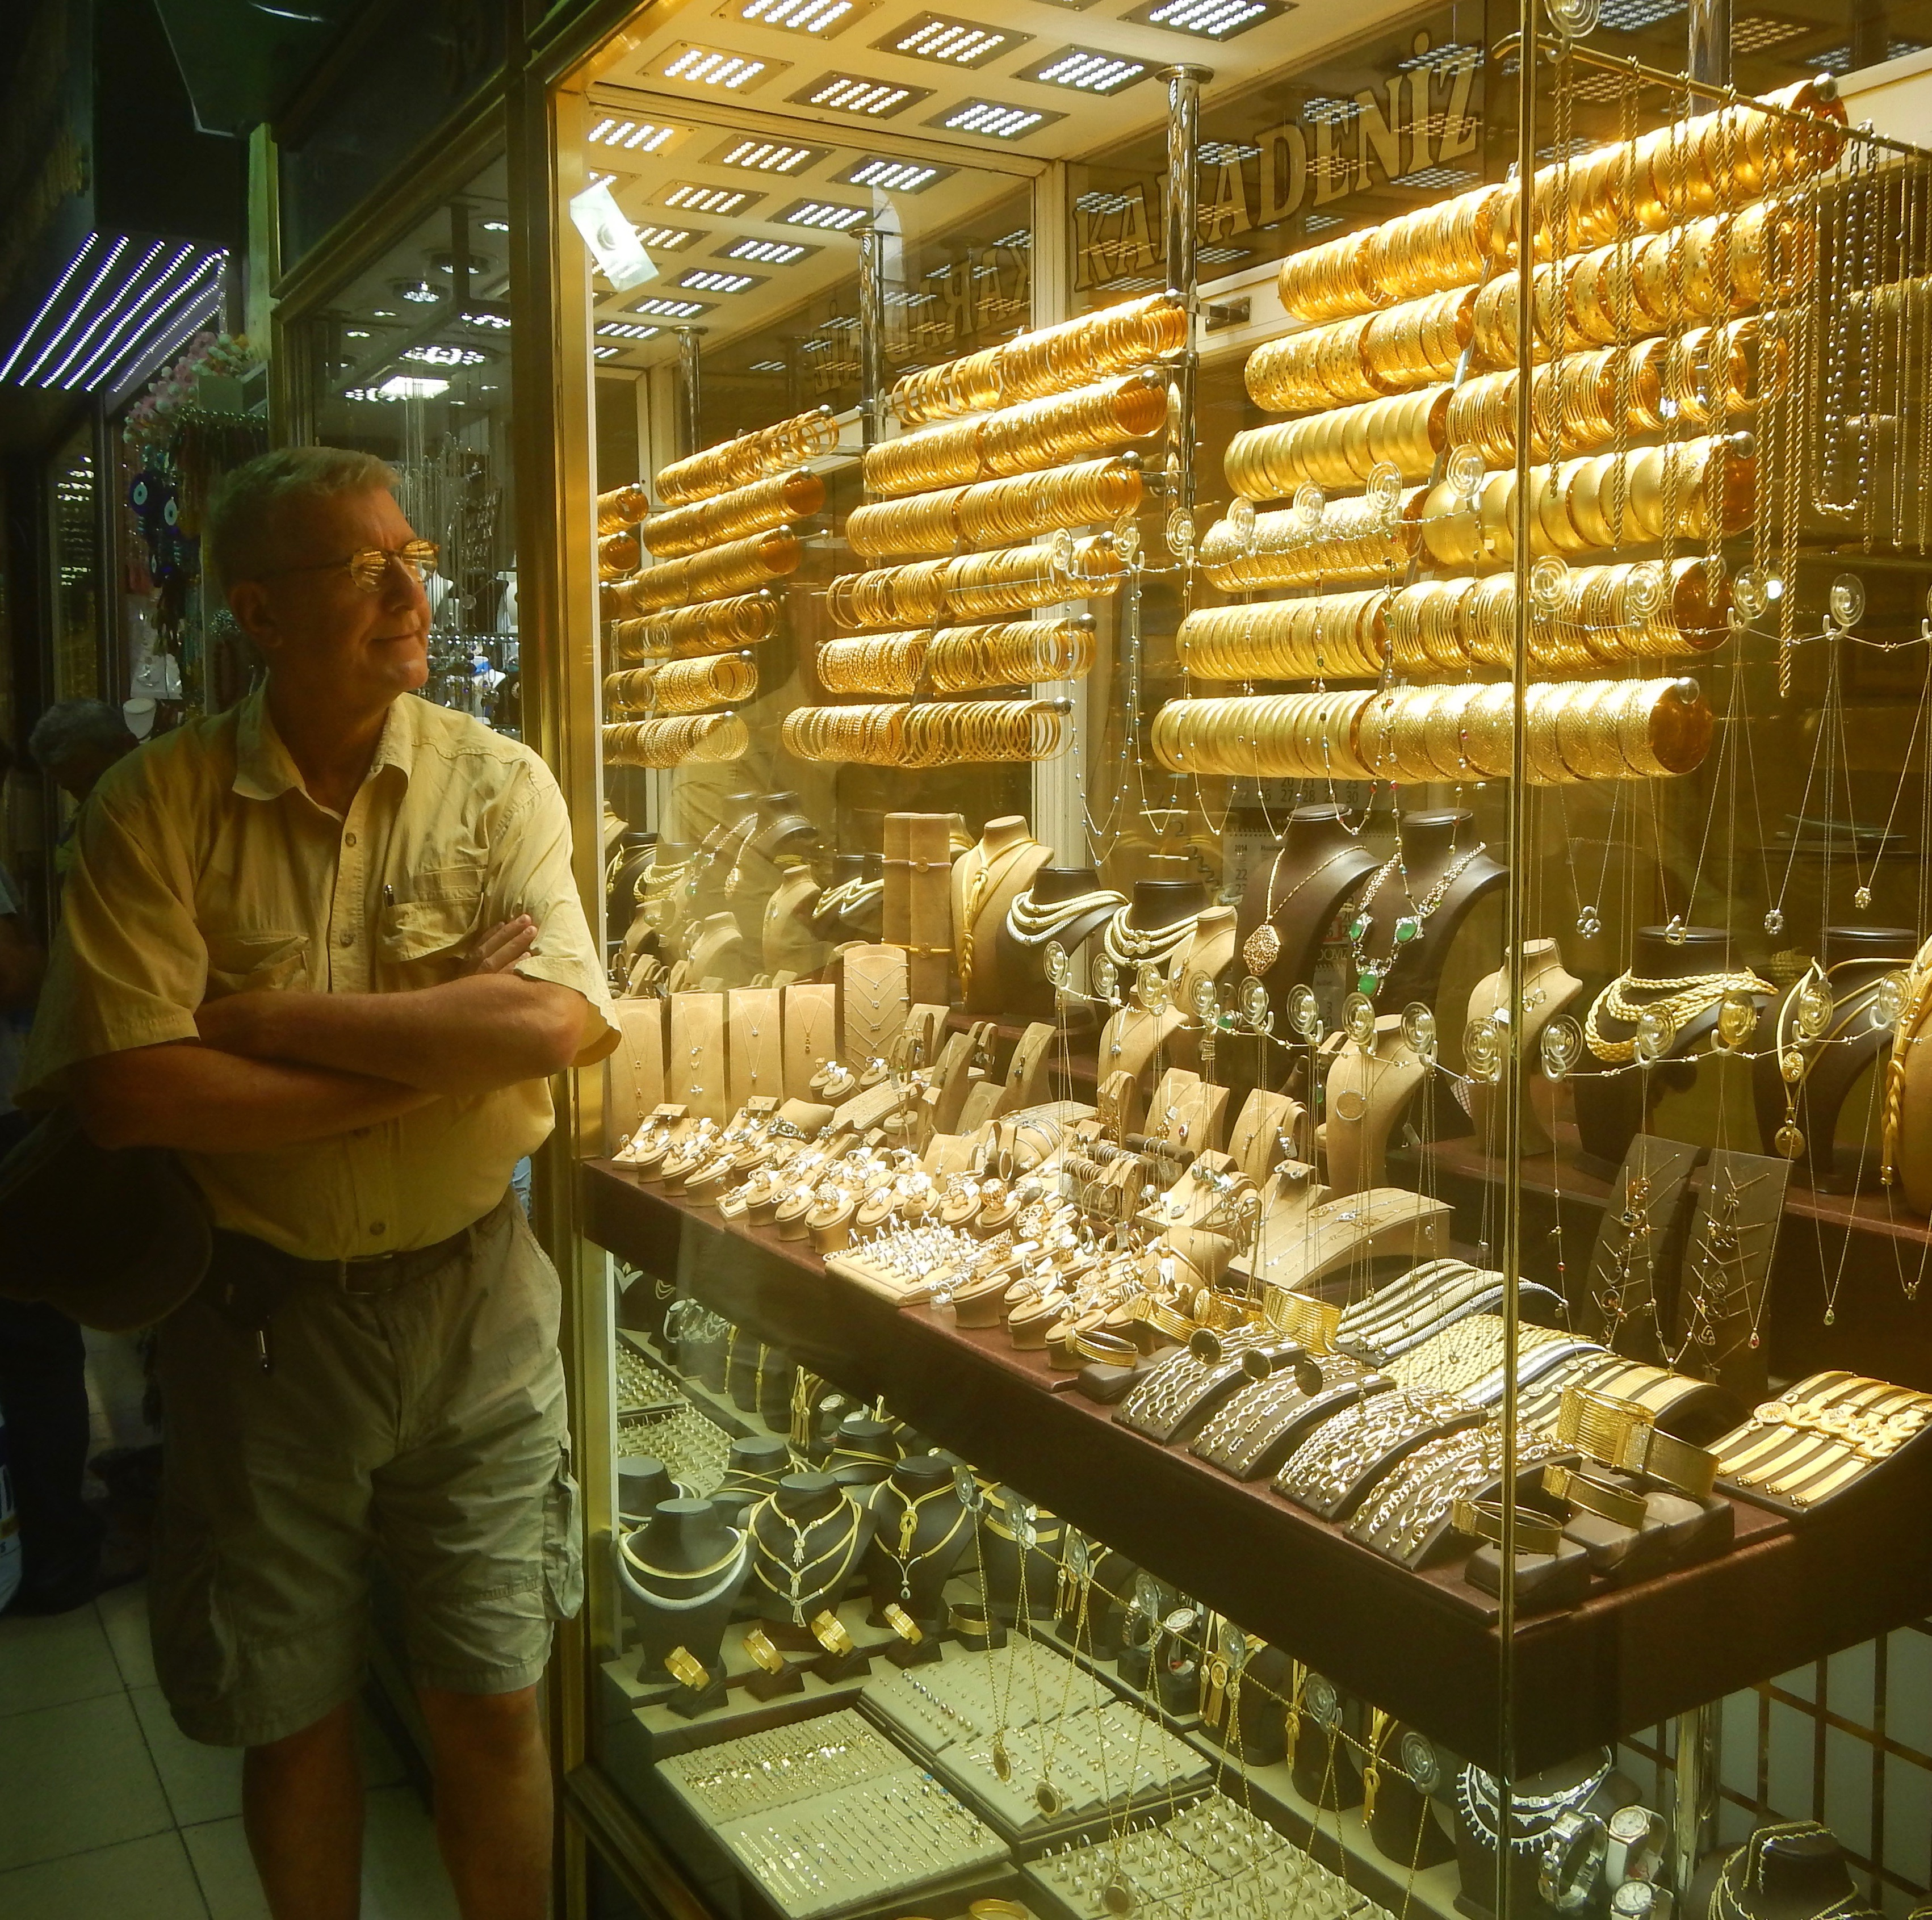
The Mad Hedge Fund Trader
“Golden Days”
With John Thomas
from Silicon Valley, CA, August 30, 2017
www.madhedgefundtrader.com
Notes:
*

Slide 2
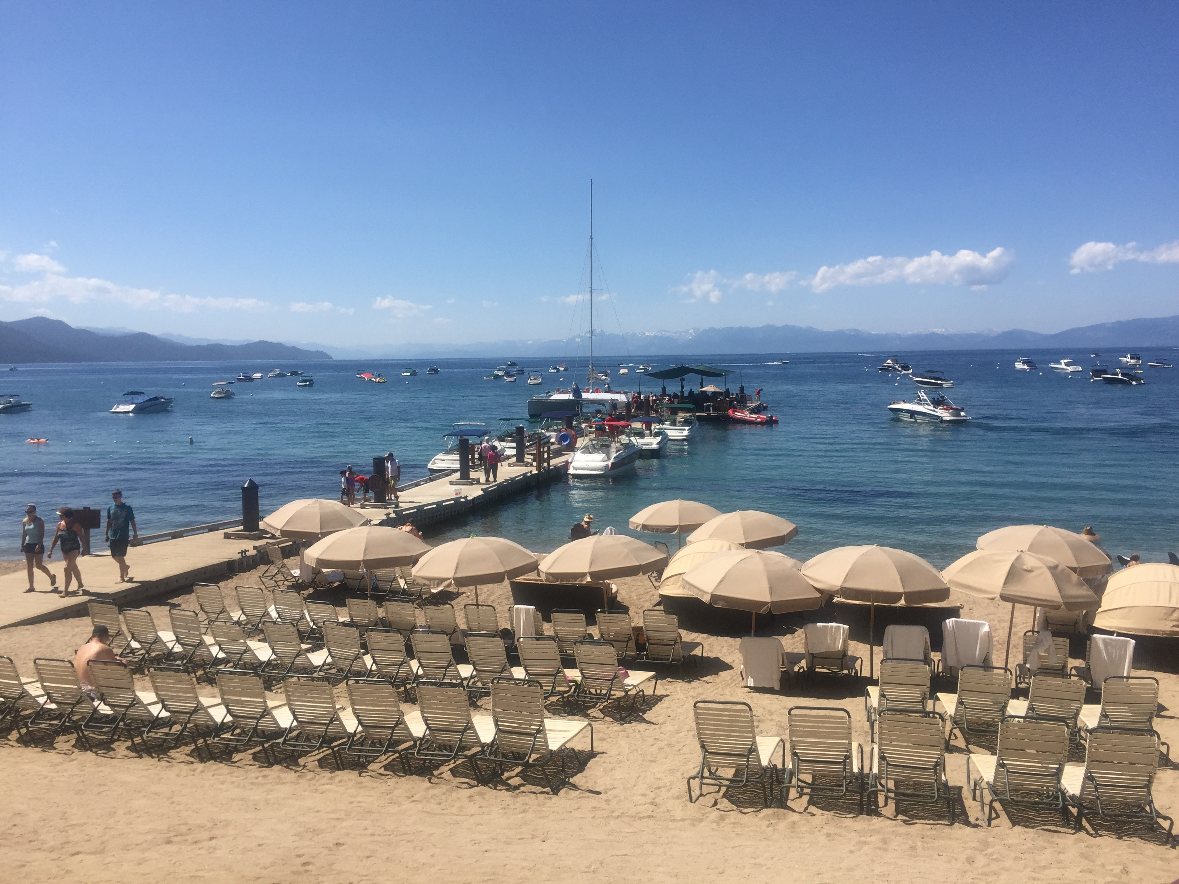
Mad Hedge/Top Gun Master Mind Investment Conference
Buy tickets at www.madhedgefundtrader.com
November 3-4, Incline Village, NV
Only a Few Tickets Left!

Slide 3


Global Strategy Luncheons
Buy tickets at www.madhedgefundtrader.com
Chicago, IL
December 27, 2017
Minneapolis, MN
December 28, 2017

Slide 4
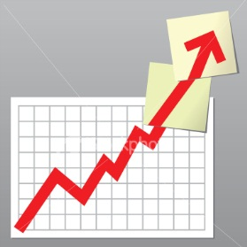
Trade Alert Performance
Biggest Up Month in Ten Years! New All Time High!!
22 Consecutive Profitable Trade Alerts!!
*January +9.35% Final *July +1.95% Final
*February +6.39% FINAL *August +17.43% MTD
*March +4.87% Final *September +0.27% Final
*April +1.84% Final *October +8.13% Final
*May -0.45% Final *November 4.37% Final
*June +0.70% Final *December +.84% Final
*2017 Year to Date 42.08%
compared to 10.16% for the Dow Average
11 of 12 Consecutive Profitable Months!
*Trailing 1 year return +56.40%, +260.64% since inception,
*Average annualized return of 32.10%

Slide 5
Portfolio Review
Aggressive, but market neutral book
Current Capital at Risk
Risk On
World is Getting Better
(GS) 9/$205-$210 call spread | 10.00%
Risk Off
World is Getting Worse
(AAPL) 9/$170-$175 put spread | -10.00%
(NEM) 10/$32-$24 call spread | -10.00%
(SIL) 9/$31-$33 call spread | -10.00%
(GS) 9/$235-$240 put spread | -10.00%
Total Net Position | -30.00%
Expiration P&L
47.62%

Slide 6
Portfolio Review
What’s Changed
*There is a massive shift underway out of FANG and biotech, which we caught early
*Cash is being rotated into gold, silver, metals, industrials, and financials, which we also caught early
*A simple sector rotation that keeps cash in the market leaves no real net change in the major indexes
*We will get a few more shots to trade a very wide VIX range

Slide 7
Trailing One-Year Return
Daily Audited Performance
+56.40%

Slide 8
Eight Year Daily Audited Performance
Averaged Annualized Return +32.10%

Slide 9

The Method to My Madness
*Playing domestics, like industrials, fold, and financials is the best way to ride a global synchronized economic recovery
*Moved from 100% cash to 90% invested with a 10% net short now that volatility has increased
*”RISK OFF” means buy gold and US Treasury bonds on dips, sell stocks, commodities, and energy on rallies
*Almost all asset classes and sectors are still at extreme end of 2017 ranges
*Traders finally wake up to Washington turmoil
*FANG will lead the downturn in any stock
market move until the US dollar strengthens
*Looking to sell short the next big rally in oil
*Staying away from currencies until dollar puts in a
final bottom

Slide 10
The Bill Davis View
A $1,500 Upgrade for the Mad Day Trader Service
Buys: | Entry | Target
Chipotle Mexican (CMG) | $300 | $350
Amazon.com (AMZN) | $938 | $1,060
WW Grainger (GWW) | $150 | $175
Apple (AAPL) | $150 | $200
Netflix, Inc. (NFLX) | $165 | $190
Citrix Systems (CTXS) | $75 | $85
Sells:
Palo Alto Networks (PANW) | $138 | $105
Mednax, Inc. (MD) | $50 | $31
Ambarella, Inc (AMBA) | $56 | $37
Perrigo Co. (PRGO) | $78 | $69
Tupperware Brands (TUP) | $59 | $50
Lulumon Athletics Inc. (LULU) | $62 | $53

Slide 11
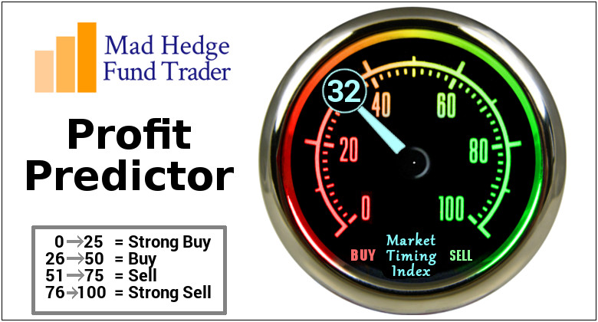
The Mad Hedge Profit Predictor
Market Timing Index
An artificial intelligence driven algorithm that analyzes 30 different economic, technical, and momentum driven indicators
Risk Bounced Hard Off of 2017 Low at 18

Slide 12
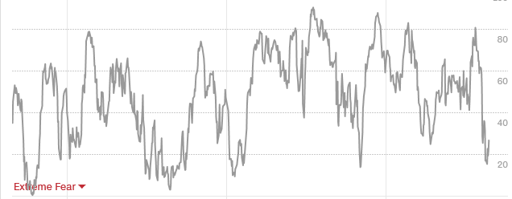
The Mad Hedge Profit Predictor
Market Timing Index
From 81 to 18 in 2 Weeks!

Slide 13

The Global Economy-Global Economy Turning Hot
*The markets are seeing the first synchronized global recovery in more than a decade, its only happened twice since 1950
*US Q2 GDP marked up from 2.6% to a hot 3.0%
*33 of 45 OECD members showing accelerating growth, European PIIGS making a strong rebound, Japan is growing 4% annualized
*There is no doubt that a strong Europe, China, and Japan are staring to pull up US growth
*US Exports up 6% in H1, August Consumer Sentiment jumps from 93.4 to 97.6
*It’s all very market positive, and will limit
the downside to the current correction
*Global Inflation hits lowest level since 2009,
leading to lower for longer on bond yields

Slide 14
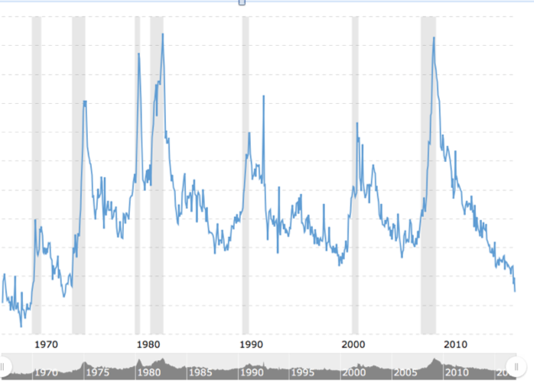
Weekly Jobless Claims –The Most Important Statistic
-5,000 to 234,000, New 43 Year Low

Slide 15
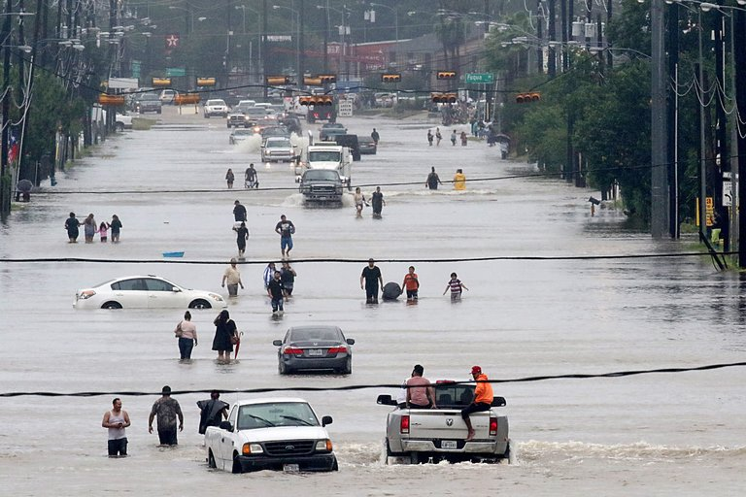
The Hurricane Harvey Effect
*Texas accounts for 8.2% of US GDP, so expect a Q3 GDP growth hit of 20 basis points
*$150 billion of uninsured losses and $20 billion of insured losses
*Economic activity goes to zero first, then bounces back hard for several years
*A $20 billion Harvey relief budget is about to hit Texas
*Most California army and Marine helicopters were sent to Texas before the storm
*CA based search and rescue teams there now
*Massive fund raising efforts underway statewide
to raise money for the Red Cross

Slide 16

Stocks-The Great Rotations Continues
*Stocks trying to correct, 3% so far, but can’t develop any real downside momentum
*Volume is falling off a cliff, from a 2016-2017 daily average of 7.1 billion shares a day, to 6.7 billion in 2017, to 6 billion in August, to 5 billion in recent days
*New focus is still on domestics, is still early days and could run until the end of the year
*Volatility goes quiet 2 points above last low, is the new “normalized” bottom
*But no real crash coming as there is nowhere else
to go, look for a 5% correction
at most in a long term bull market
*Still looking for 10%-12% total return in equities
for 2017, now at 11.22%, but a 5% correction
may have to occur first
*Will a Government shutdown in September finally
bring us our new low?

Slide 17
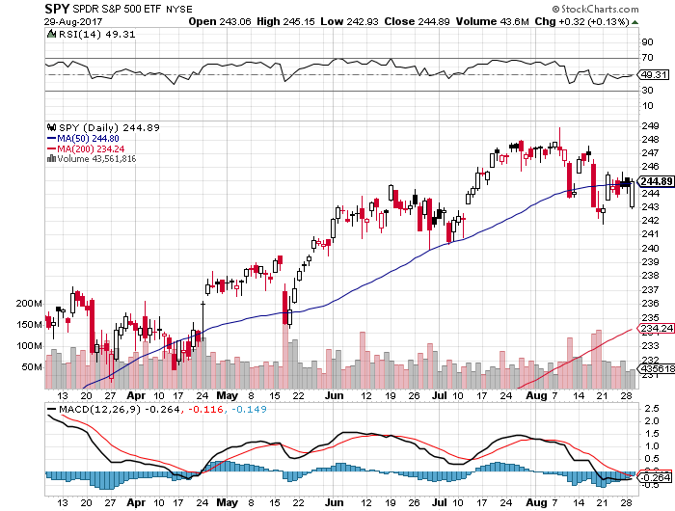
S&P 500-Correction

Slide 18
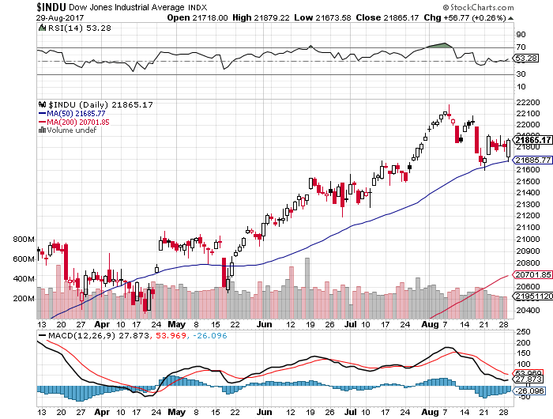
Dow Average-Topping
Haven’t Retraced to the 50 Day MA since May

Slide 19
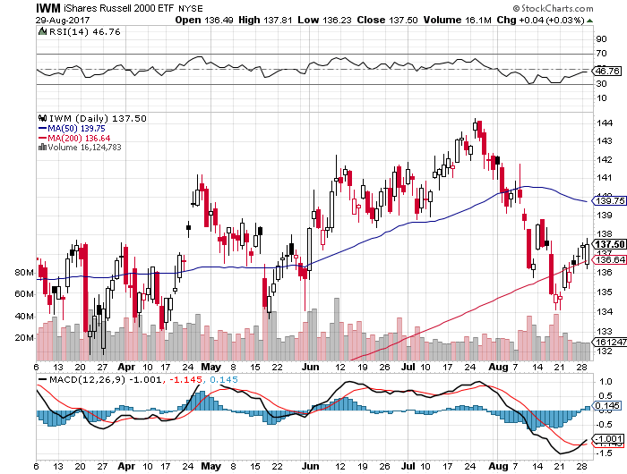
Russell 2000 (IWM)-Back to a Range

Slide 20
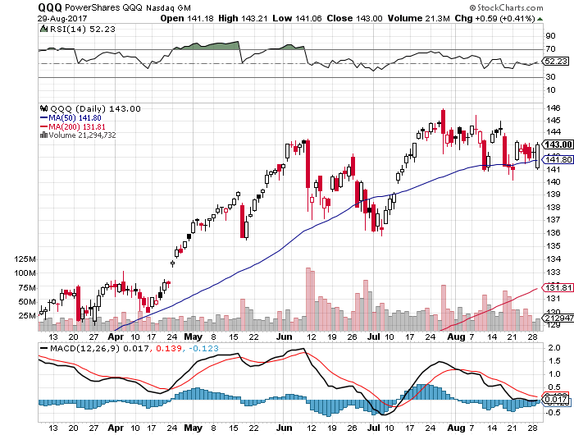
NASDAQ (QQQ)-New Highs

Slide 21
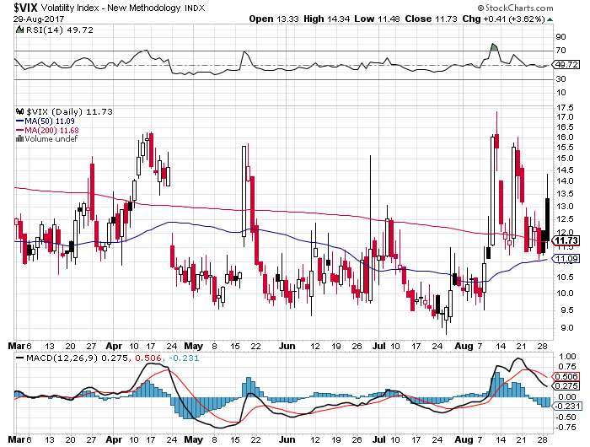
(VIX)-Biggest One Day Move in 6 Years
Biggest two day move in history

Slide 22
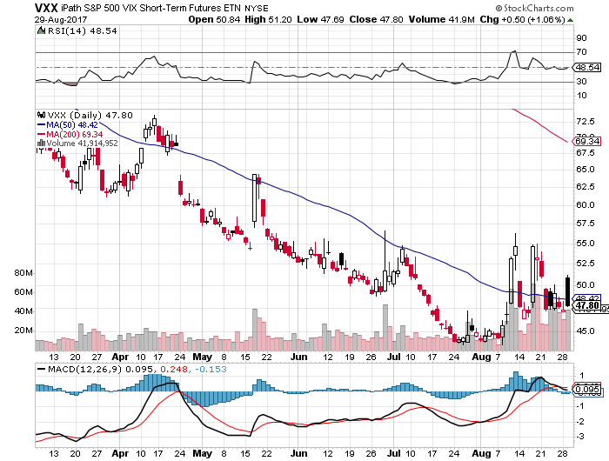
iPath S&P 500 VIX Short-Term Futures ETN (VXX) took profits on long 11/$20 calls

Slide 23
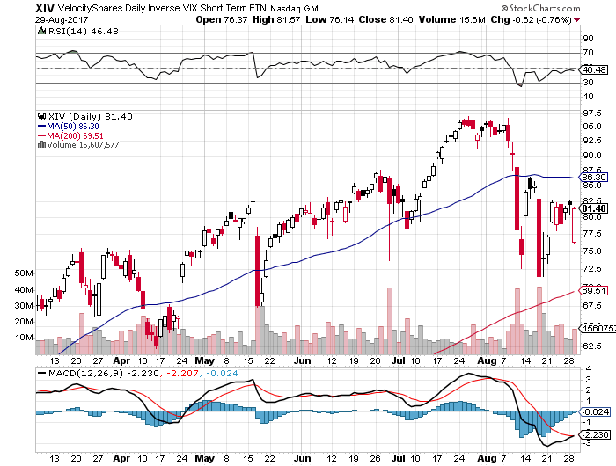
Velocity Shares Daily Inverse VIX Short Term ETN (XIV)
Wow!
One of the most instantly profitable trades of 2016….and 2017 took profits on (XIV) long at $81.45

Slide 24
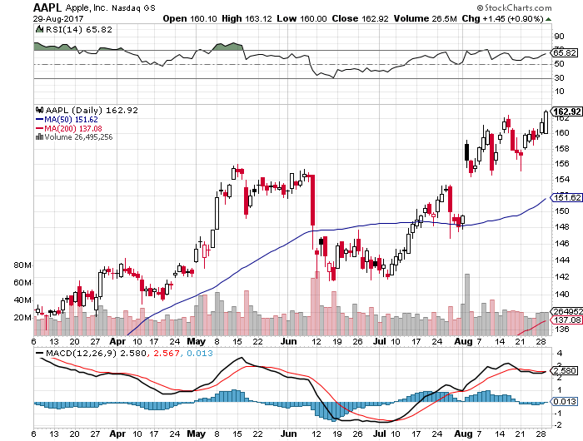
Apple (AAPL)-Run to New Highs
Short 9/$170-$175 bear Put Spread-expires in 11 trading days took profits on long 9/$140-$145 bull call spread to make an iron condor

Slide 25
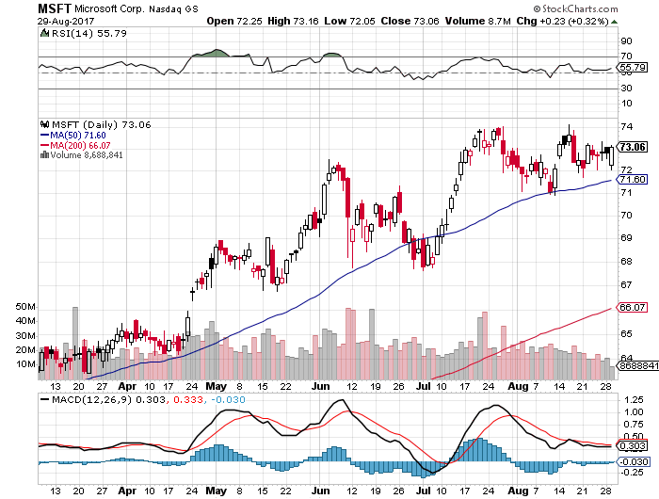
Microsoft (MSFT)

Slide 26
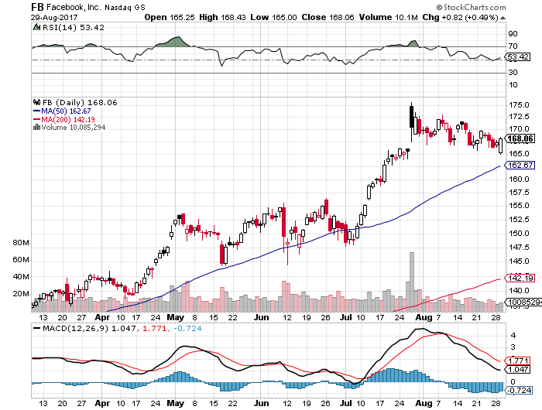
Facebook (FB)-

Slide 27
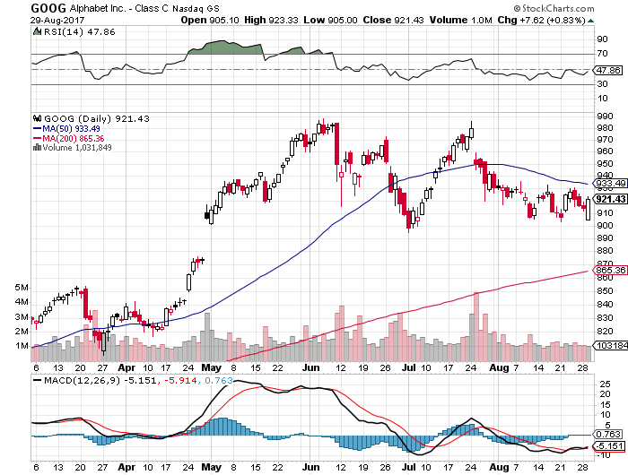
Alphabet (GOOG)-New High

Slide 28
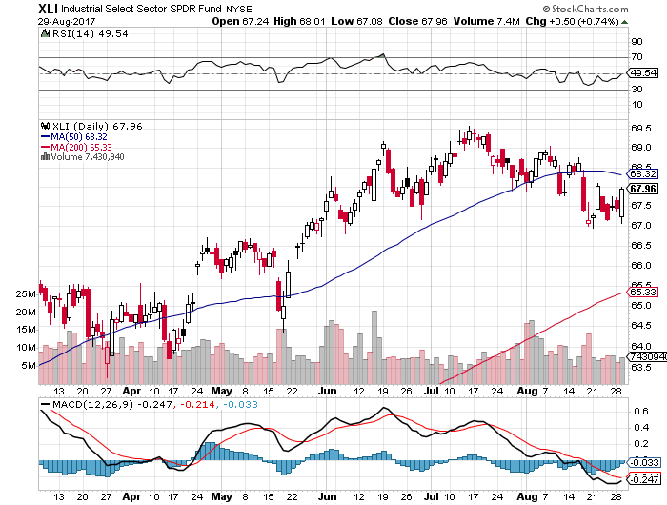
Industrials Sector SPDR (XLI)-
(GE), (MMM), (UNP), (UTX), (BA), (HON)

Slide 29
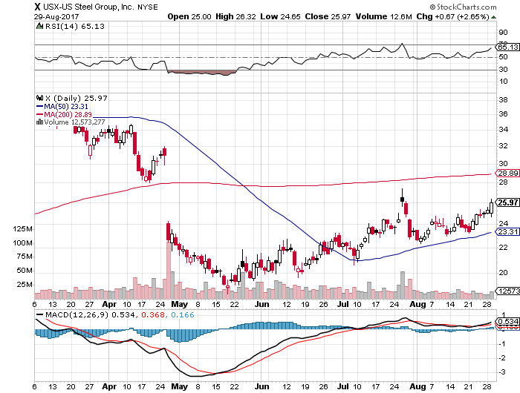
US Steel (X)- took profits on long the 9/$21-$22 vertical bull call spread

Slide 30
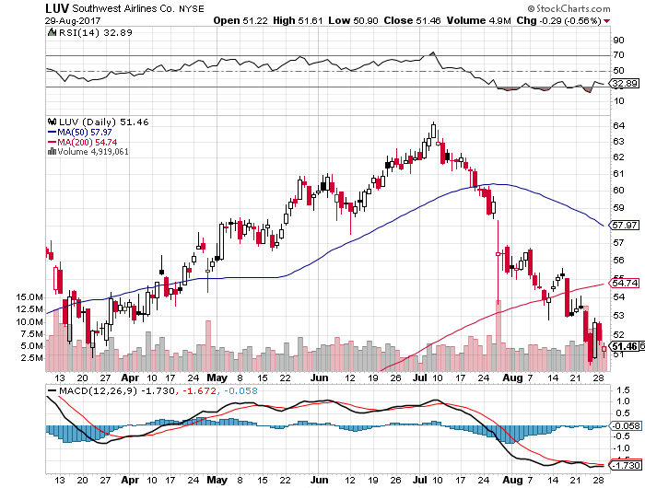
Southwest Airlines (LUV)-
Warren Buffett’s Favorite Airline

Slide 31
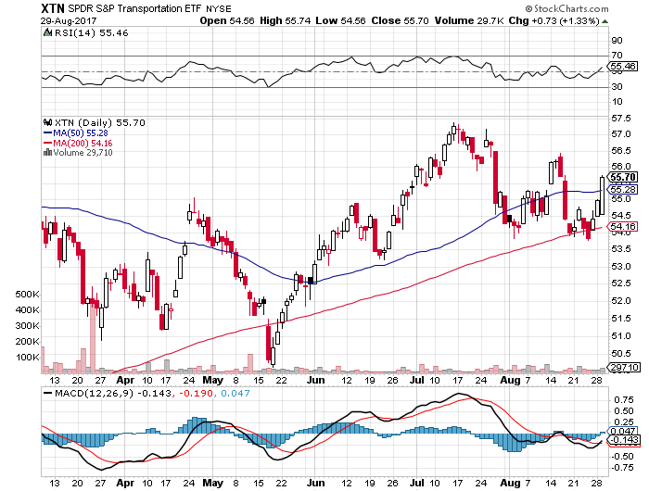
Transports Sector SPDR (XTN)-
(ALGT), (ALK), (JBLU), (LUV), (CHRW), (DAL)

Slide 32
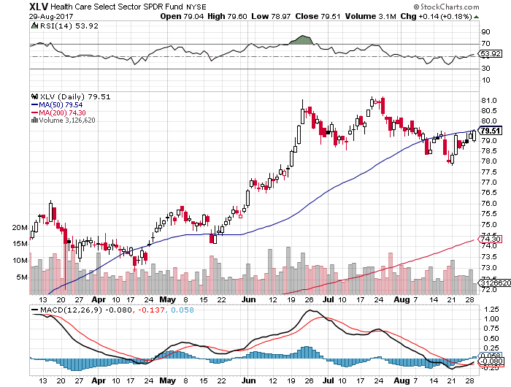
Health Care Sector (XLV), (RXL)-The New FANG?
(JNJ), (PFE), (MRK), (GILD), (ACT), (AMGN)

Slide 33
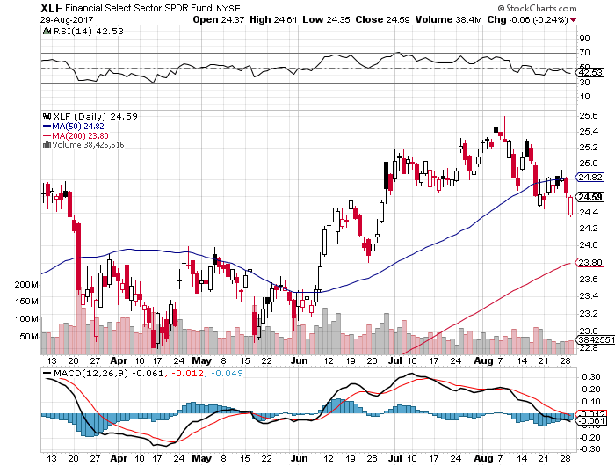
Financial Select SPDR (XLF)-Bouncing Back
(BLK/B), (WFC), (JPM), (BAC), (C), (GS)

Slide 34
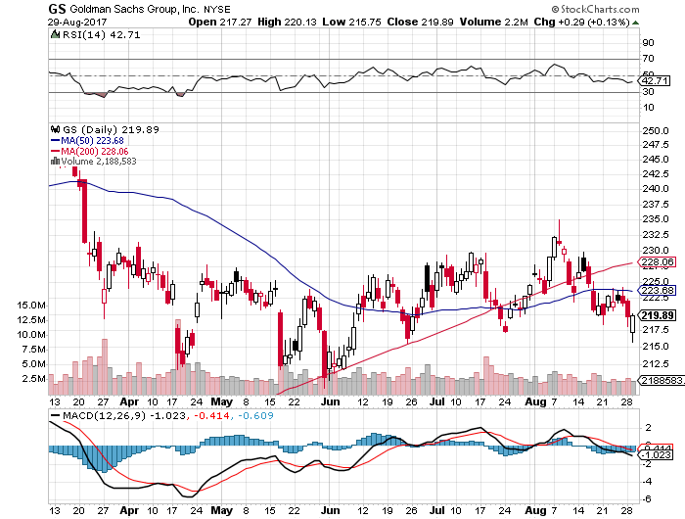
Goldman Sachs (GS)- long 9/$205-$210 vertical bull call spread long 9/$235-$240 vertical bear put spread to make an iron condor expires in 11 trading days

Slide 35
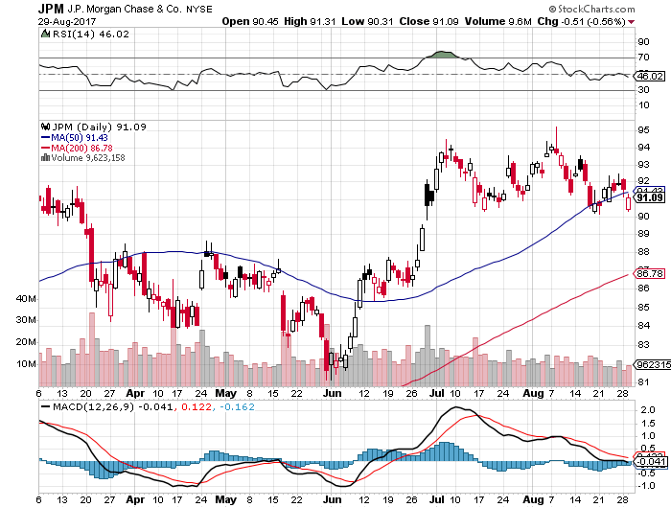
JP Morgan (JPM)-

Slide 36
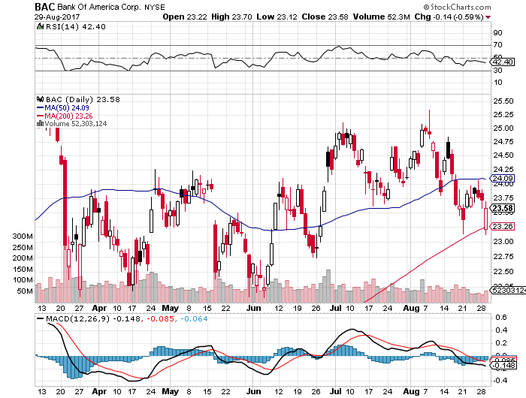
Bank of America (BAC)-
Warren Buffet exercises warrants and buys 700 million shares, with paper profit of $12 billion

Slide 37
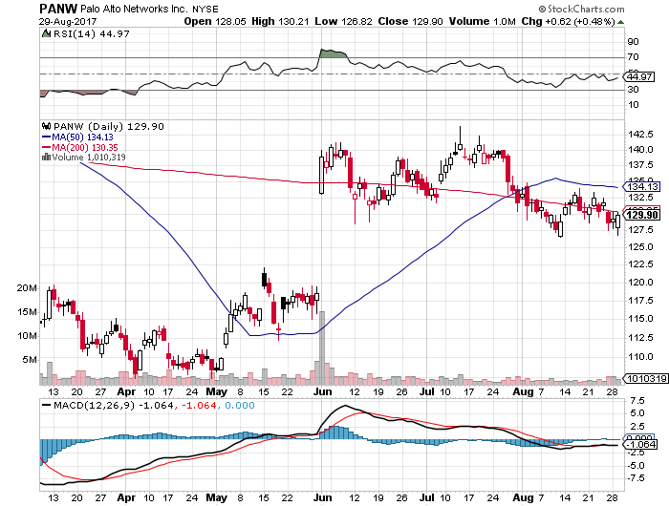
Palo Alto Networks (PANW)-

Slide 38
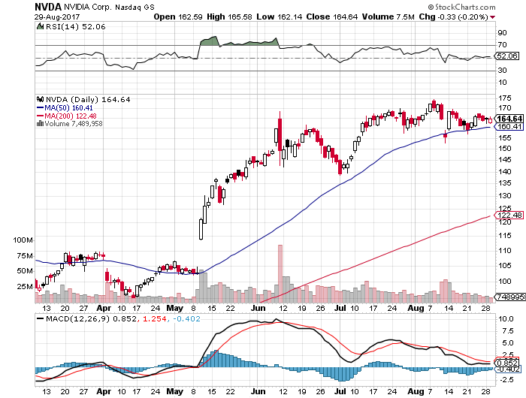
NVIDIA (NVDA)-Q2 $1.02 vs. $0.70 expected

Slide 39
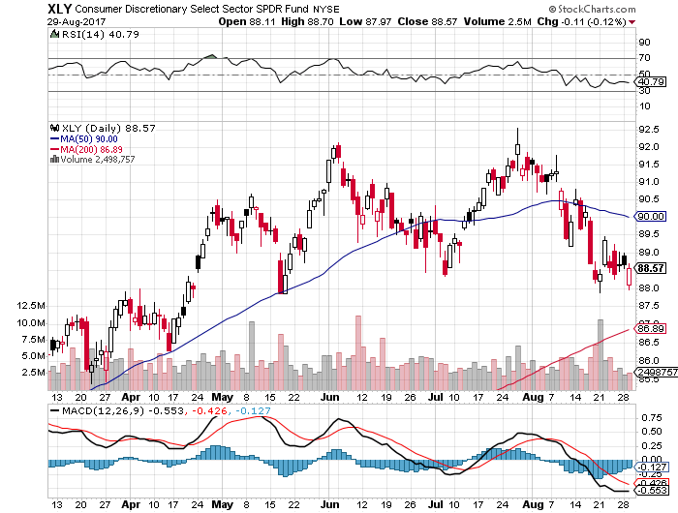
Consumer Discretionary SPDR (XLY)
(DIS), (AMZN), (HD), (CMCSA), (MCD), (SBUX)

Slide 40
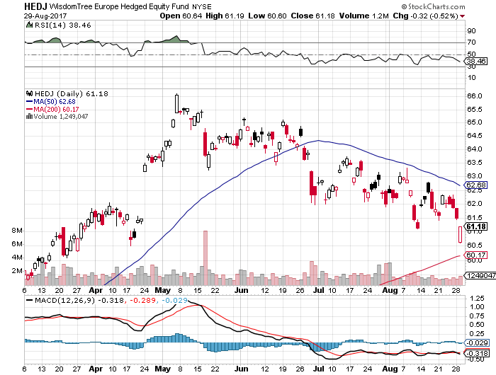
Europe Hedged Equity (HEDJ)-Strong Euro Taking a Toll

Slide 41
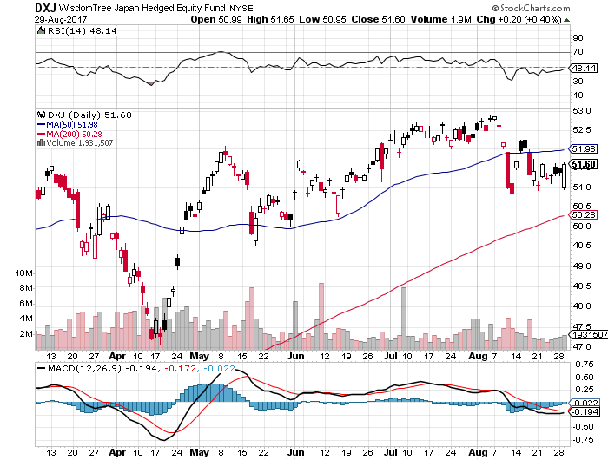
Japan (DXJ)-Yen burst knocks the wind out

Slide 42
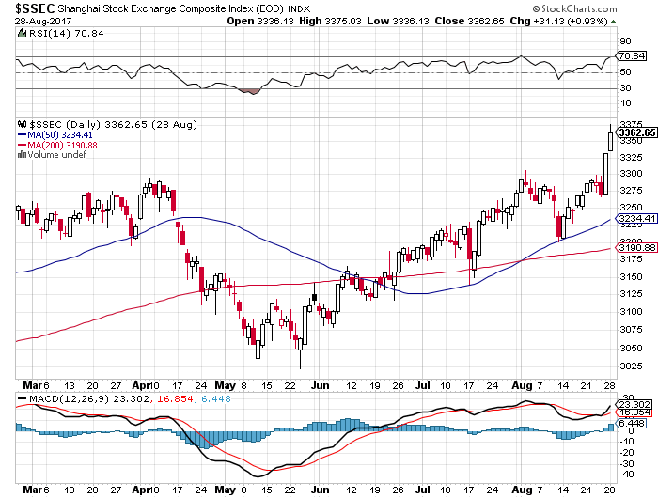
China ($SSEC)-Economic Recovery on Track

Slide 43
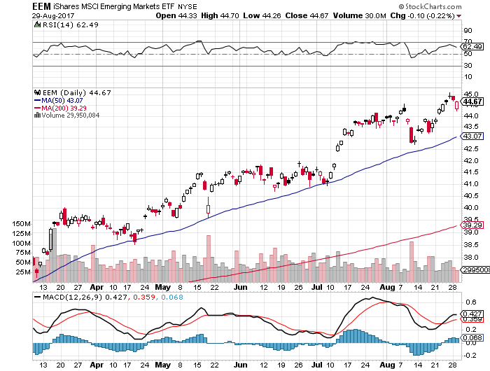
Emerging Markets (EEM)- New High

Slide 44
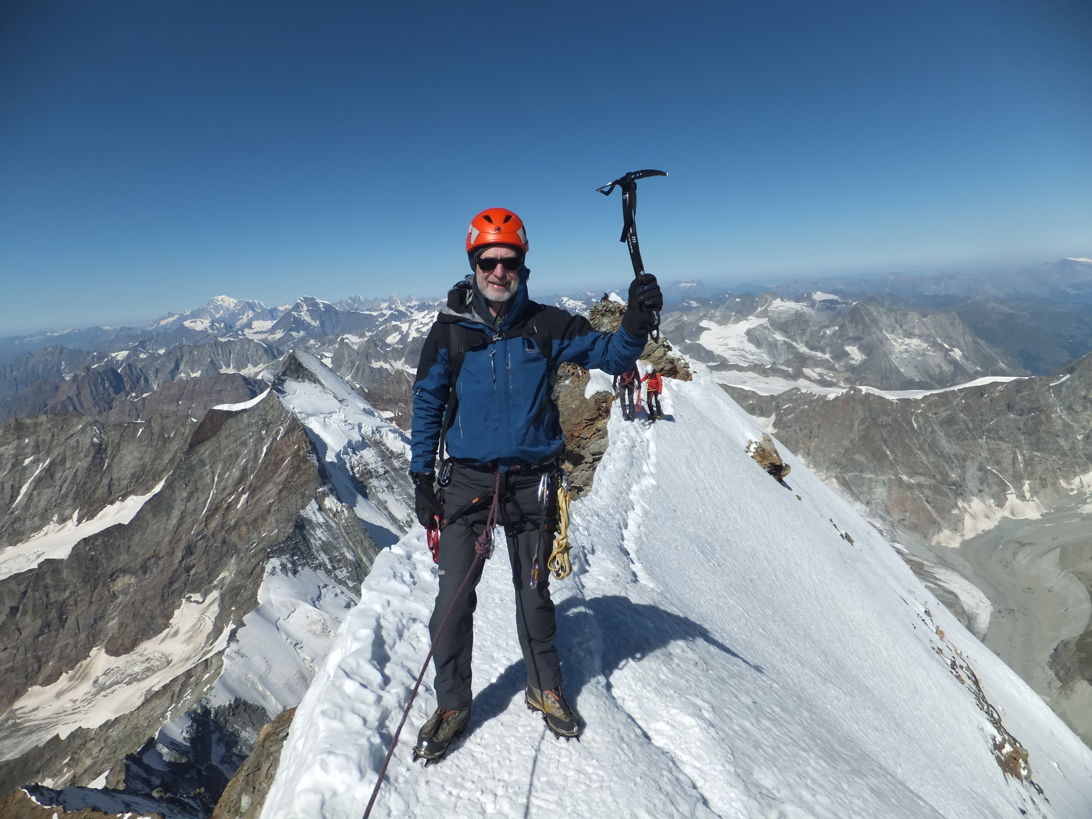
Bonds-New Highs
*Fed OMC Notes show that fear of asset bulling is in the forefront of Fed thoughts, meaning that we are still on track for 25 basis point rate rises every quarter
*Risk spreads are narrowing, while volatility is falling
*October paper now trading at big discounts as Trump threatens a US debt default and a government shut down
*Wait for a spike bottom in this stock market correction before shorting any bonds, which is coming soon
*Back to the bottom of the 2.10%-2.40%
range in 10 year yields, 2.13 could be
tested this week
*We are ten months into a 10-20 year
bear market in bonds, now is a great
entry point on the short side

Slide 45
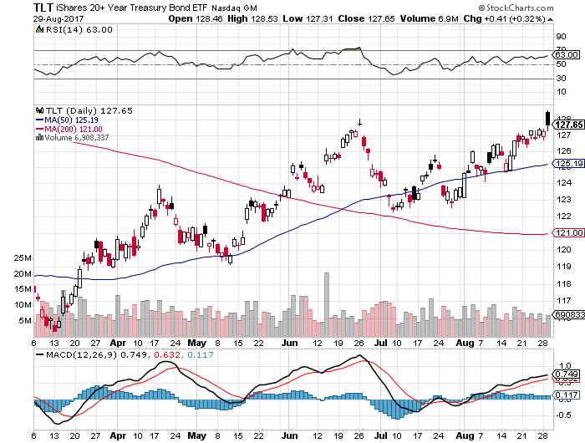
Treasury ETF (TLT) – 2.09%-New High took profits on long 8/$128-$130 vertical bear put spread took profits on long 9/$129-$132 vertical bear put spread

Slide 46
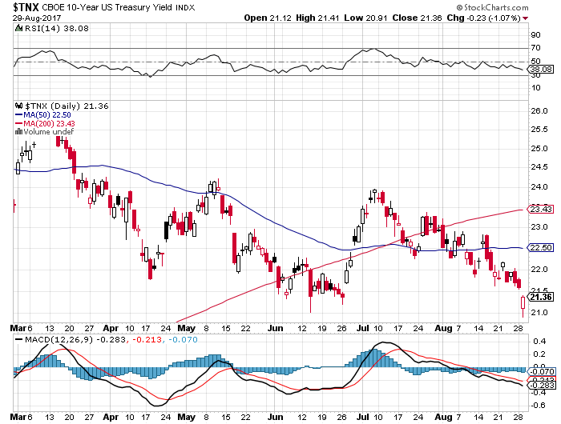
Ten Year Treasury Yield ($TNX) 2.14%

Slide 47
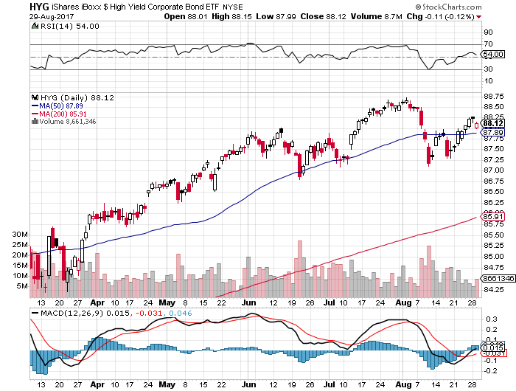
Junk Bonds (HYG) 4.89% Yield
A Great Risk Coincident Indicator- Long Term “RISK ON” means new highs, buy all dips

Slide 48
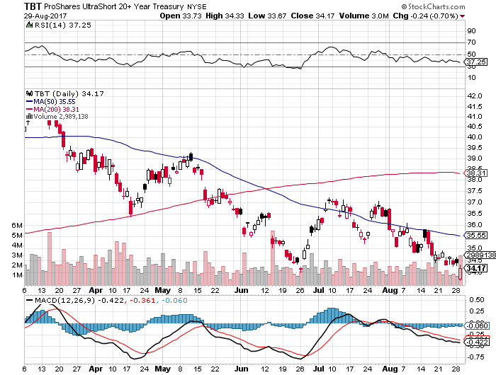
2X Short Treasuries (TBT)-In Screaming “BUY” Territory

Slide 49
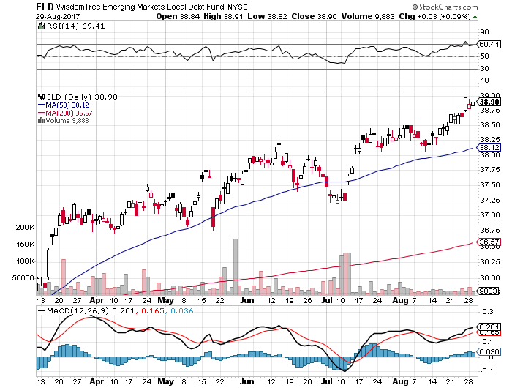
Emerging Market Debt (ELD) 5.70% Yield-

Slide 50
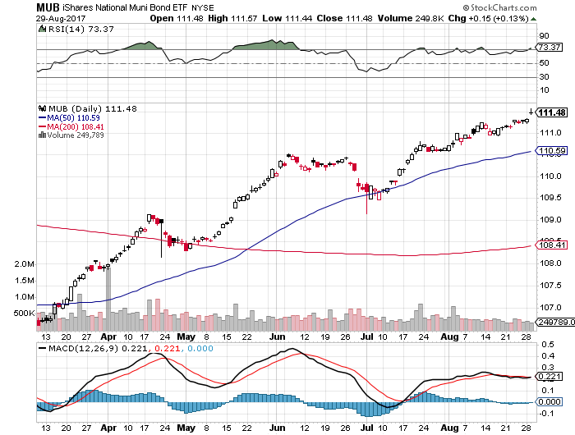
Municipal Bonds (MUB)-1.62%-Gap Up
Mix of AAA, AA, and A rated bonds

Slide 51

Foreign Currencies-New USD Lows
*US Dollars plumbs new lows, but yen and Euro are looking tired
*Here’s the outlier: a new Fed government in January could lead to a much more aggressive interest raising cycle
*This means that the dollar bear market may have only four months to run
*Get ready to sell short the yen (FXY) and the
Euro (FXE) on a blow off top, which will happen
when US rates breakout to the upside
*However, this whole scenario is on hold
as the stock market correction unfolds

Slide 52
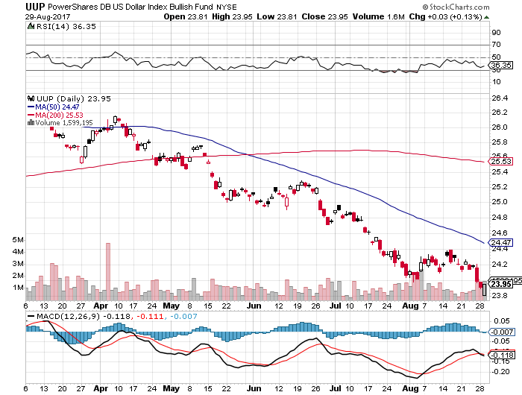
US Dollar Basket-(UUP)-Not Exactly Shorting Territory

Slide 53
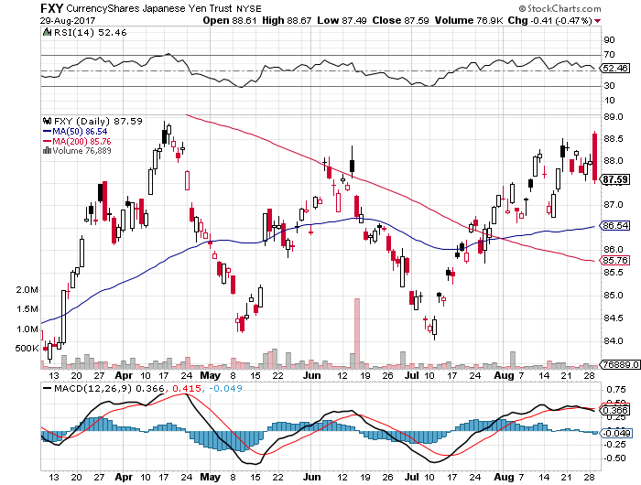
Japanese Yen (FXY)-Flight to Safety Currency

Slide 54
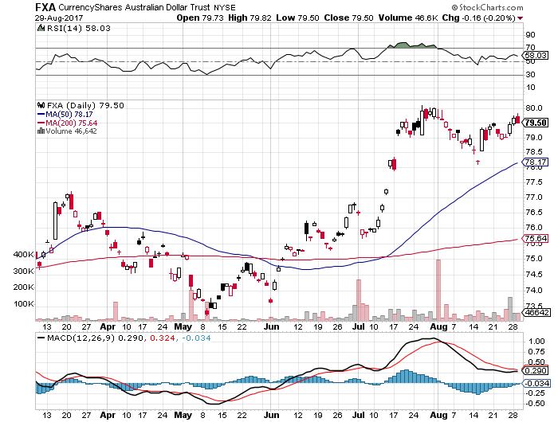
Australian Dollar (FXA)-Blast Off!

Slide 55
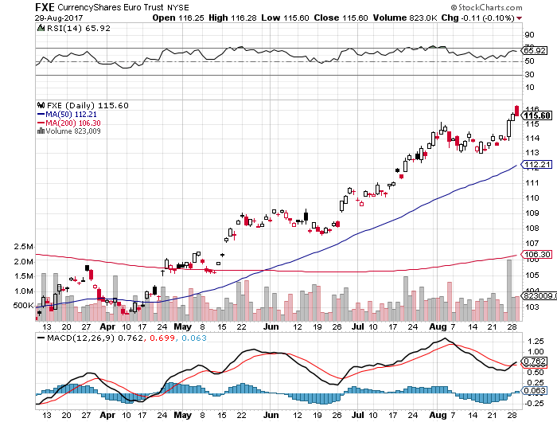
Euro ($XEU), (FXE), (EUO)- New Highs

Slide 56
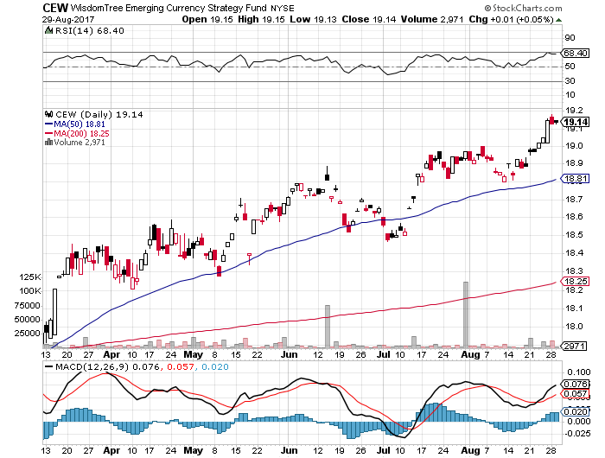
Emerging Market Currencies (CEW)

Slide 57
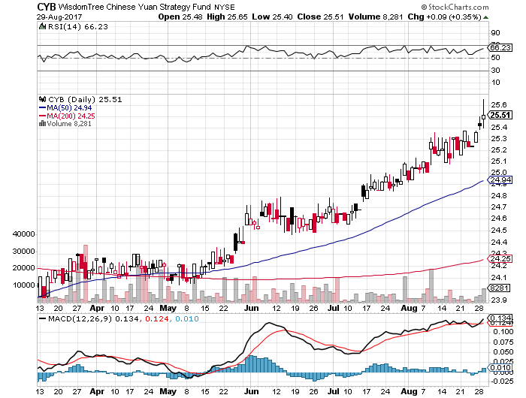
Chinese Yuan- (CYB)-Stabilizing on Government Support

Slide 58
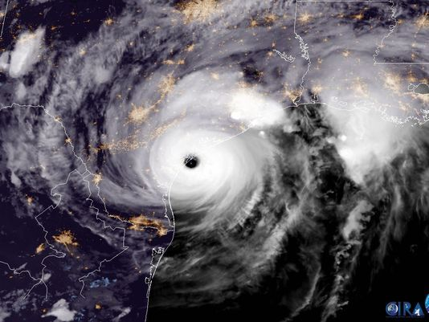
Energy-Hurricane Boost
*Hurricane Harvey will give a short term boost to all energy prices until the Gulf Coast can recover
*Next OPEC Meeting Scheduled for September 22
*As summer driving season ends, refiners will shut down for maintenance, depressing oil demand
*China overbuilt on refining capacity,
so it is importing oil but is a net exporter
of products depressing prices-deflation
in Asian gasoline
*Closure of the Sharara field from
rebel attacks takes 280,000 b/d off
the market

Slide 59
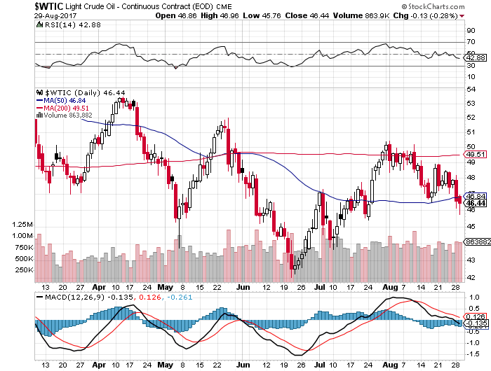
Oil-Back to the Top of a Down Channel

Slide 60
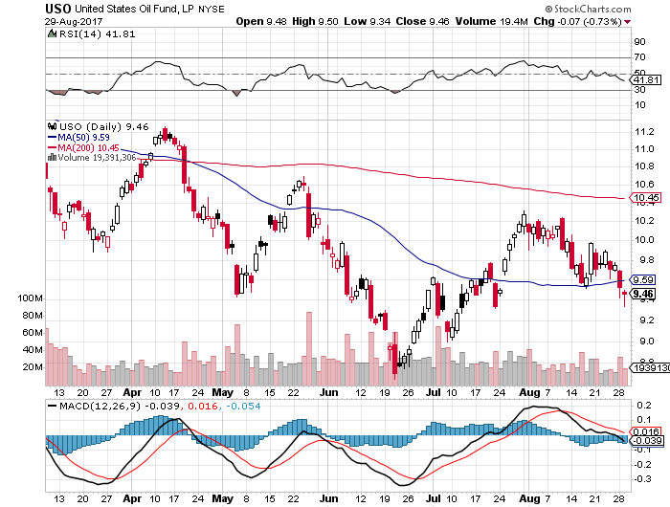
United States Oil Fund (USO)

Slide 61

Energy Select Sector SPDR (XLE)-New Lows!
(XOM), (CVX), (SLB), (KMI), (EOG), (COP)

Slide 62

Alerian MLP ETF (AMLP)- Basket Approach is the Only Safe Play Here

Slide 63

Exxon (XOM)-New Lows

Slide 64

Natural Gas (UNG)-No Joy

Slide 65

Copper (COPX)-China Infrastructure Build Out

Slide 66
Precious Metals-A Major Long Play
*The flight to safety bid finally finds gold and other precious metals
*India also reemerges as a major buyer
*Watch the perfect inverse correlation between FANG’s and gold, making the barbarous relic the perfect hedge for long technology portfolios
*A decisive break of $1,300/ounce could take
on another $50 very quickly
*Bond rally that lowers interest rates is also gold
positive
*Bitcoin bubble peaks, leading to a sharp sell off
*Time to load up on gold and silver stocks
for at least the next month, as the move
is still only a few weeks old

Slide 67

Gold (GLD)-Finally, a Big Breakout!

Slide 68

Market Vectors Gold Miners ETF- (GDX)
Breakout!
Took profits on long the 9/$20.50-$21.50 bull call spread

Slide 69

Barrick Gold (ABX) took profits on long 9/$15-16 call spread

Slide 70

Newmont Mining- (NEM)-Breakout long the 9/$32-$34 bull call spread expires in 11 trading days

Slide 71
Bitcoin-Sell Everything!

Slide 72

Platinum- (PPLT)-Breakout!

Slide 73

Palladium- (PALL)-Breakout!

Slide 74

Agriculture-Disaster!
*Huge crop still emerging from the US Midwest, with yields per acre in corn up an eye-popping 10%
*Ukraine’s corn crop drops 8%, while Argentina falls 5%, thanks to poor, dry weather
*Weak dollar allows the US to reenter the international wheat market for the first time in a year
*Massive flooding his Kansas, but prices
barely move, not a good sign
*Hedge funds maintaining huge shorts in
corn and wheat
*Be thankful we haven’t done an ag
trade for five years

Slide 75

(CORN) –New Lows!

Slide 76

(WEAT)-Major Breakdown

Slide 77

(SOYB)-Toast!

Slide 78

Real Estate-Summer Slowdown
*July housing starts down an amazing 4.8% to an annualized rate of 1.15 million units, mostly in apartment buildings
*July New Home Sales down -9.4%, home inventories jump from 5.4 to 5.8 months, Existing Home Sales down -1.3% on huge inventory shortage
*Fannie Mae and Freddie Mac are starting to waive appraisals on some purchased home loans
*Average home price up 6.3% YOY to $313,000
*Bond rally gives the Refi boom another leg
*June S&P 500 Case-Shiller maintains
strong 5.8%, with absolute prices hitting
new all time high
*Your home equity could be the best
investment of the year….again

Slide 79

Home Depot (HD)-Double Bottom + Hurricane Harvey took profits on long $9/$141-$144 vertical bull call spread

Slide 80

June S&P 500/Case–Shiller Home Price Index
+5.8% YOY, Seattle (+13.4%), Portland (8.2%), Dallas (7.7%) still leaders absolute prices hit new all time high

Slide 81

General Growth Properties (GGP)-New Lows
Long Term Downtrend-From Rising Rates to Mall Destruction

Slide 82

US Home Construction Index (ITB)
(DHI), (LEN), (PHM), (TOL), (NVR)
A Favorite Sector to Buy

Slide 83

Trade Sheet-The Complete Opposite
So What Do We Do About All This?
*Stocks- sell rallies for the short term
*Bonds-sell bigger rallies
*Commodities-buy industrials
*Currencies-sell yen and Euro when they peak out
*Precious Metals –buy
*Volatility-stand aside until over $16, or under $10
*The Ags –stand aside
*Real estate-buy dips

Slide 84

Next Strategy Webinar
12:00 EST Wednesday, September 13, 2017
San Francisco, CA
Buy conference and lunch tickets at madhedgefundtrader.com
Good Luck and Good Trading!
Notes:
*

