Slide 1

The Mad Hedge Fund Trader
“The Silver Lining Behind the Cloud”
With John Thomas
from Silicon Valley, CA, September 13, 2017
www.madhedgefundtrader.com
Notes:
*

Slide 2

Mad Hedge/Top Gun Master Mind Investment Conference
Buy tickets at www.madhedgefundtrader.com
November 3-4, Incline Village, NV
Only a Few Tickets Left!

Slide 3


Global Strategy Luncheons
Buy tickets at www.madhedgefundtrader.com
Chicago, IL
December 27, 2017
Minneapolis, MN
December 28, 2017

Slide 4

Trade Alert Performance
Biggest Up Month in Ten Years! New All Time High!!
22 Consecutive Profitable Trade Alerts!!
*January +9.35% Final *July +1.95% Final
*February +6.39% FINAL *August +18.38% Final
*March +4.87% Final *September +3.23% MTD
*April +1.84% Final *October +8.13% Final
*May -0.45% Final *November 4.37% Final
*June +0.70% Final *December +.84% Final
*2017 Year to Date 46.23%
compared to 10.16% for the Dow Average
23 consecutive profitable trade alerts
*Trailing One year return +62.46%, +264.82% since inception,
*Average annualized return of 34.14%

Slide 5
Portfolio Review
Back to 90% Cash, 10% Long Financials
Current Capital at Risk
Risk On
World is Getting Better
(GS) 9/$205-$210 call spread | 10.00%
Risk Off
World is Getting Worse
Total Net Position | 10.00%
Expiration P&L
46.35%

Slide 6
Trailing One-Year Return
Daily Audited Performance
+62.46%

Slide 7
Eight Year Daily Audited Performance
Averaged Annualized Return +34.14%

Slide 8

The Method to My Madness
*Trump deal with Dems eliminates US debt default and may have killed off the September correction
*Failure of markets to correct means they could go straight up for the year of the year to (SPY) 2,575 by year end
*The dream scenario: 5% market rise and then a tax cut, bringing in a total six month gain in stocks of 15%
*Keep buying ”RISK OFF” assets like gold and US Treasury bonds on dips,
as a hedge against brief bouts of profit taking in stocks
*FANG’s come back to life, but upside is limited
*Buy every North Korean missile launch
*Stay away from bond shorts until we see a double
bottom in yields
*Staying away from currencies until dollar puts in a
final bottom

Slide 9

Hurricane Impact-Negative….Then Big Positive
*Total boost to the economy will be over $400 billion, or 2% of GDP
*Texas and Florida are 14% of the US economy
*Expect a modest dip first, then an additional 25 basis points in growth per quarter for the next two years
*All government economic data will be useless for the next 3-6 months
*500,000 used and 120,000 new cars destroyed, think of it as a new “Cash for Clunkers” as used car industry goes from an oversupply to a shortage
*Most affected sectors:
oil & gas
construction
retailing
insurance
autos
home construction
materials

Slide 10
The Bill Davis View
A $1,500 Upgrade for the Mad Day Trader Service
Buys: | Entry | Target
Tesoro, Inc. (TSRO) | $112.00 | $150.00
Priceline.com Inc. (PCLN) | $1,812.00 | $1,940.00
3 D Systems (DDD) | $12.00 | $17.00
Las Vegas Sands (LVS) | $62.00 | $69.00
Starbucks Corp (SBUX) | $53.00 | $57.00
Amazon.com (AMZN) | $969.00 | $1,000.00
Sells:
Walt Disney Co. (DIS) | $100.00 | $90.00
Mednax, Inc. (MD) | $50.00 | $31.00
Tupperware Brands (TUP) | $59.00 | $50.00
Lulumon Athletics Inc. (LULU) | $62.00 | $53.00
Alnylam Pharm, Inc. (ALNY) | $82.00 | $72.00

Slide 11
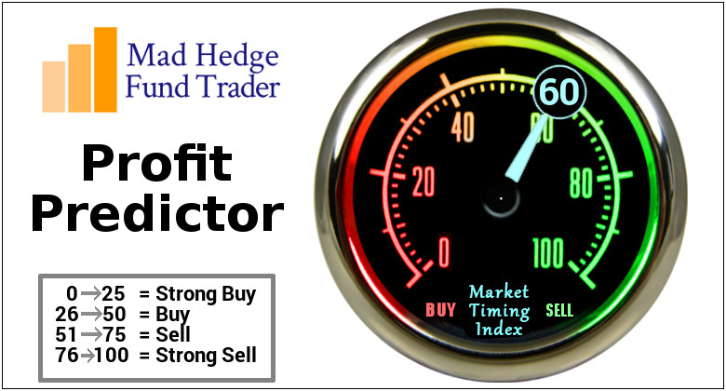
The Mad Hedge Profit Predictor
Market Timing Index
An artificial intelligence driven algorithm that analyzes 30 different economic, technical, and momentum driven indicators
Risk Bounced Hard Off of 2017 Low at 18

Slide 12
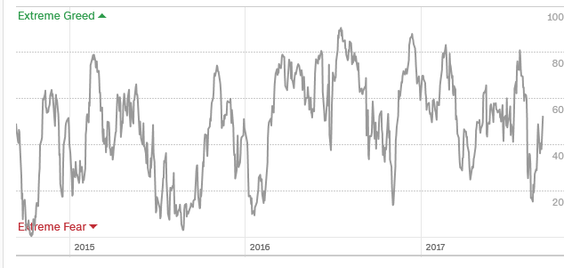
The Mad Hedge Profit Predictor
Market Timing Index
From 81 to 18 in 2 Weeks!
Back to Middle
of the
Range

Slide 13

The Global Economy-Rebounding
*The markets are seeing the first synchronized global recovery in more than a decade, its only happened twice since 1950
*Fed Beige Book comes in complete neutral, not too hot, not too cold, US is now the drag on the global economy
*The September 18 Fed 25 basis point rate hike is still on, but December is a “Maybe”
*August ISM Service Sector jumps from 53.9 to 55.3
*It’s all very market positive, and severely limited
the downside to the last correction
*Global Inflation hits lowest level since 2009,
leading to lower for longer on bond yields

Slide 14
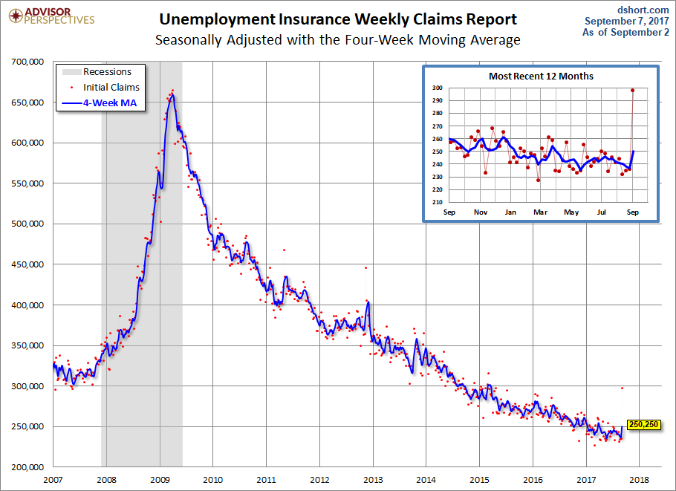
Weekly Jobless Claims –The Most Important Statistic
+62,000 to 298,000, Biggest Jump Since 9/11 !!

Slide 15
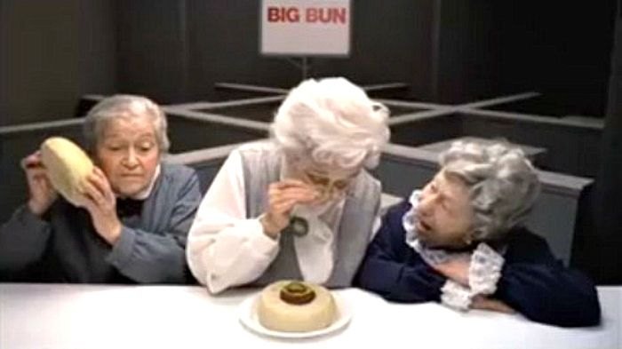
Stocks-Where’s the Correction?
*Failure to fall on a ton of bad news means that stocks will rise for the rest of 2017….the global bull market continues
*New hurricane reconstruction will add another 5%-10% to stocks
*A tax cut package will add $10/share to stocks, from $135 to $145
*If interest rates stay near lows, PE multiples of 25, or even 30, are eventually possible
*Volatility (VIX) crashes again
*Low rates keep a cap on banks
*FANG’s recover, but upside is limited on
a 45% move on top of only a 20% net
earnings growth
*Bottom line: There is nothing else to buy

Slide 16
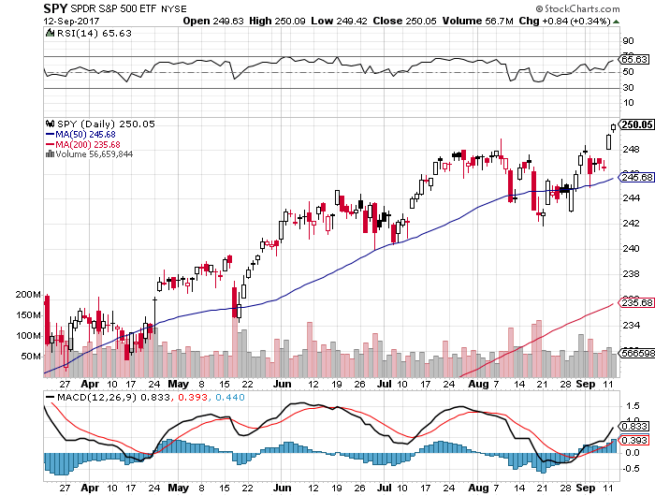
S&P 500-Correction

Slide 17
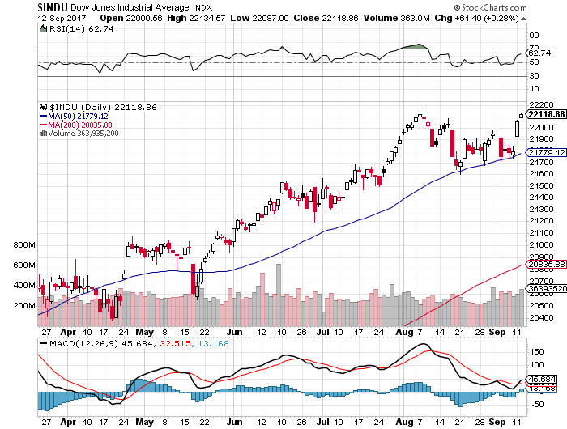
Dow Average-Topping
Haven’t Retraced to the 50 Day MA since May

Slide 18
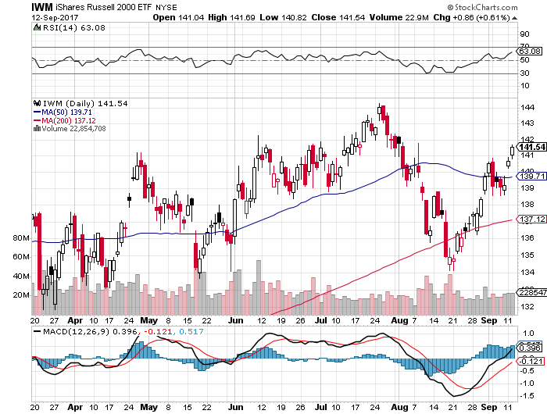
Russell 2000 (IWM)-Back to a Range

Slide 19
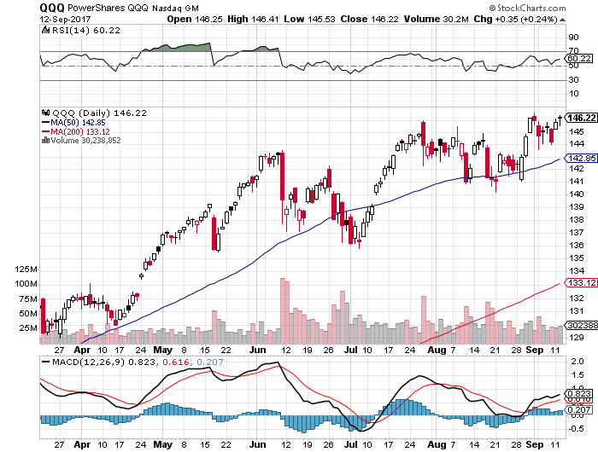
NASDAQ (QQQ)-New Highs

Slide 20
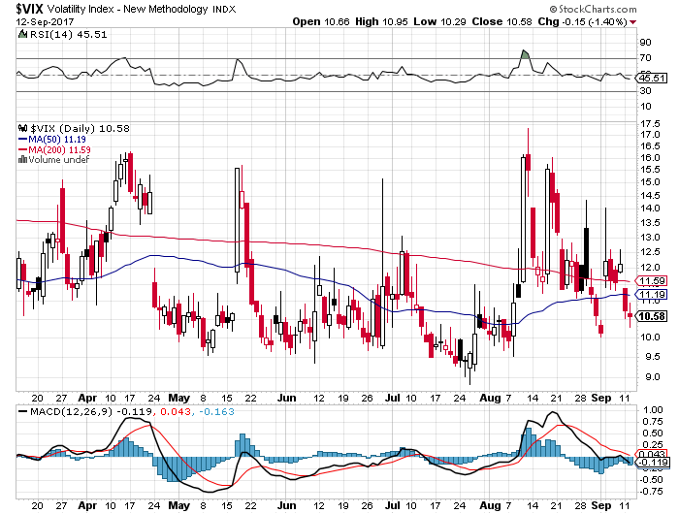
(VIX)-Back to the Bottom

Slide 21
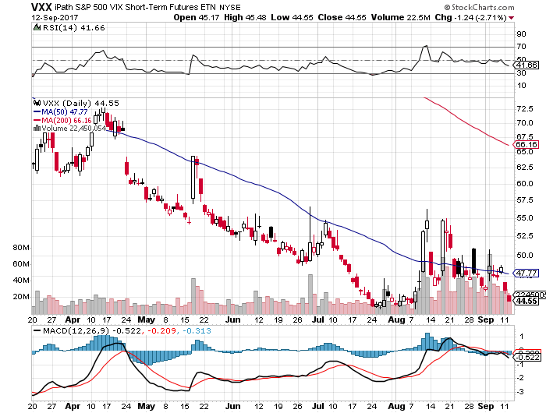
iPath S&P 500 VIX Short-Term Futures ETN (VXX)
Begging for New Lows took profits on long 11/$20 calls

Slide 22
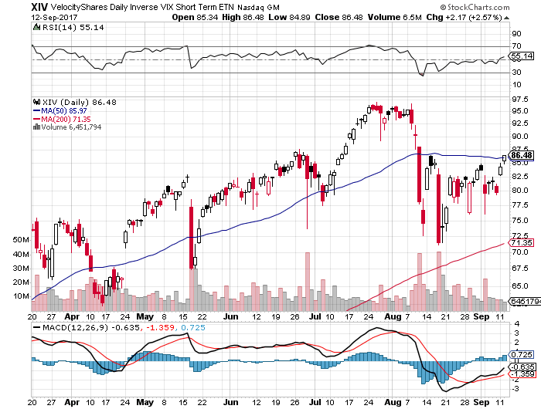
Velocity Shares Daily Inverse VIX Short Term ETN (XIV)
One of the most instantly profitable trades of 2016….and 2017 took profits on (XIV) long at $81.45

Slide 23
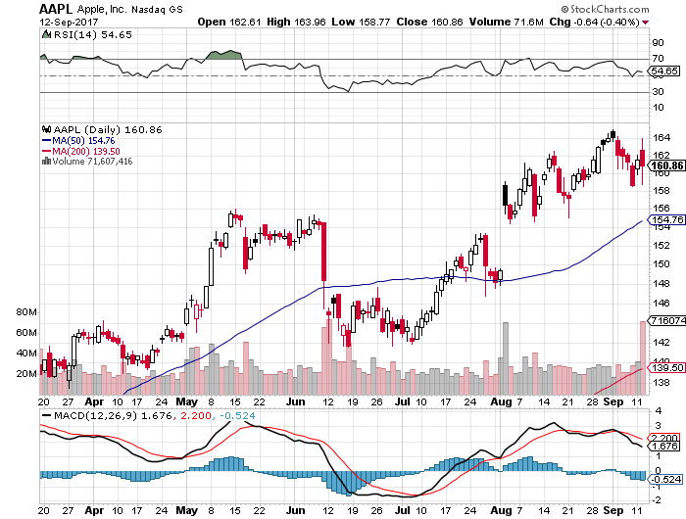
Apple (AAPL)-IPhone X is Out! took profits on short 9/$170-$175 bear Put Spread took profits on long 9/$140-$145 bull call spread to make an iron condor

Slide 24
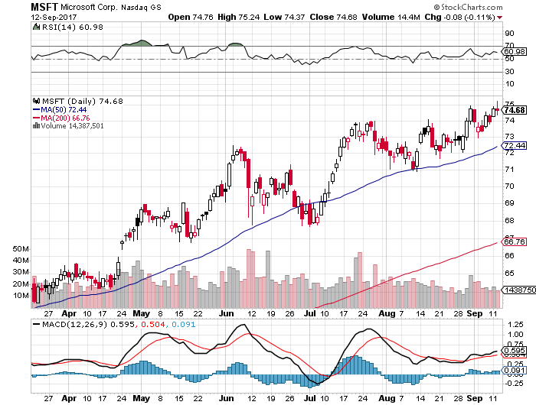
Microsoft (MSFT)

Slide 25
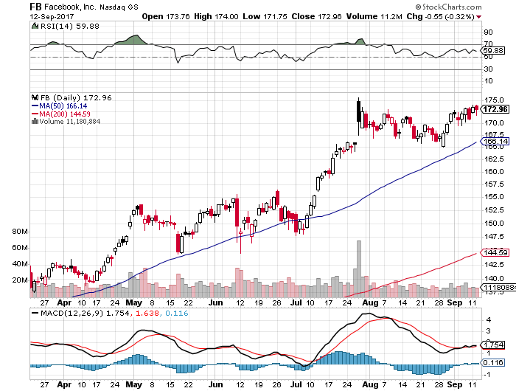
Facebook (FB)-

Slide 26
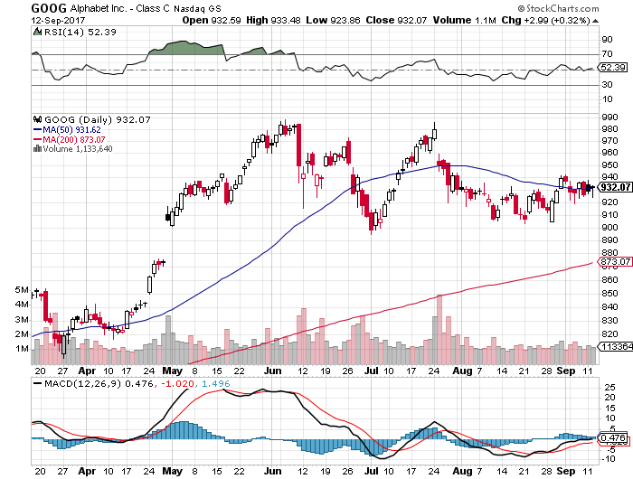
Alphabet (GOOG)-New High

Slide 27
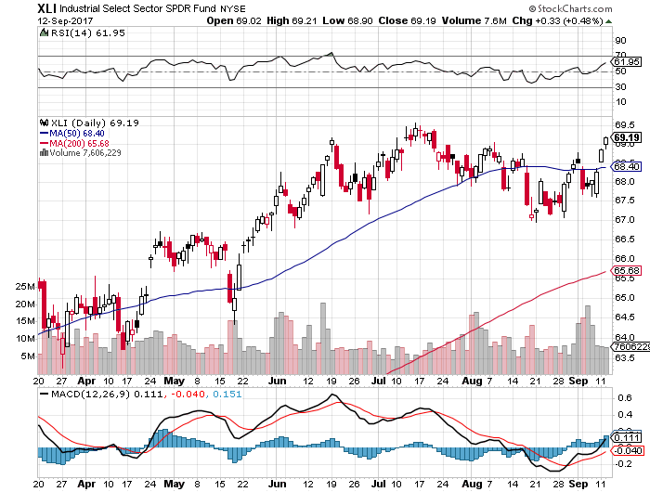
Industrials Sector SPDR (XLI)-
(GE), (MMM), (UNP), (UTX), (BA), (HON)

Slide 28
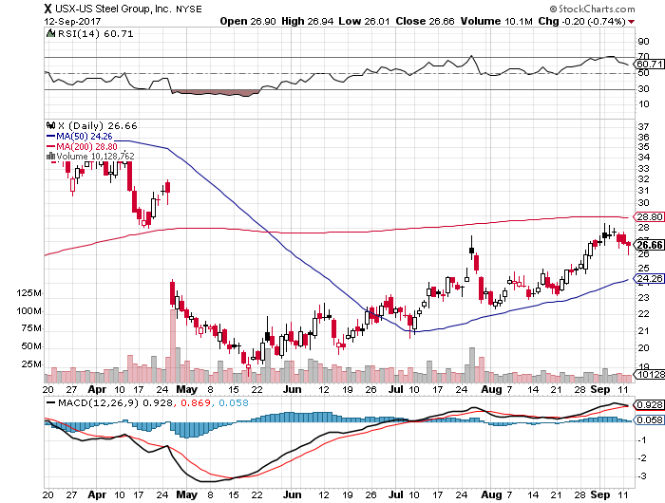
US Steel (X)- took profits on long the 9/$21-$22 vertical bull call spread

Slide 29
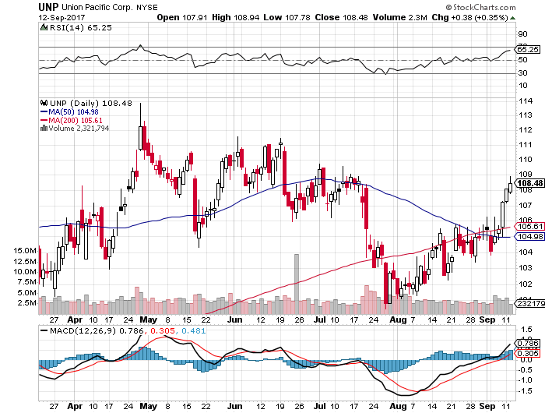
Union Pacific Railroad (UNP)- took profits on long the 9/$100-$102 vertical bull call spread

Slide 30
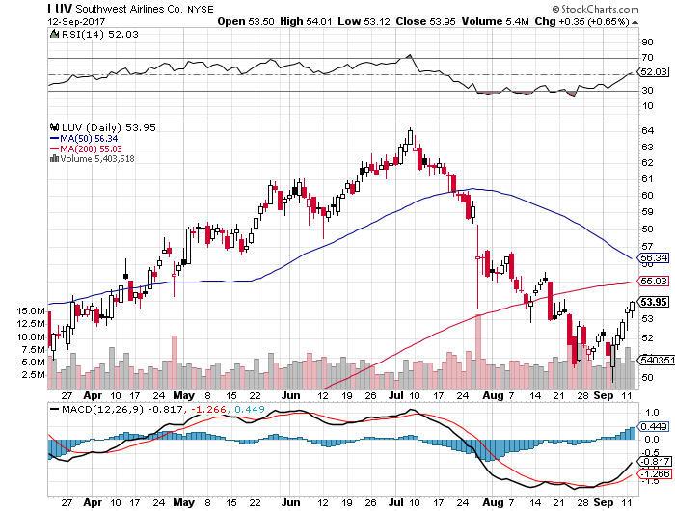
Southwest Airlines (LUV)-
Warren Buffett’s Favorite Airline

Slide 31
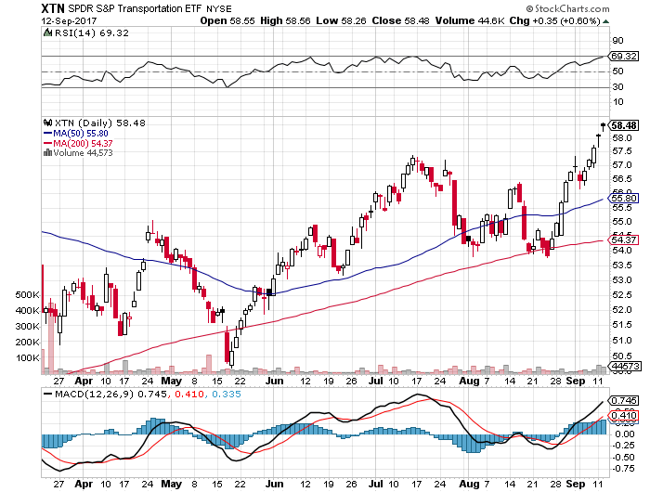
Transports Sector SPDR (XTN)-
(ALGT), (ALK), (JBLU), (LUV), (CHRW), (DAL)

Slide 32
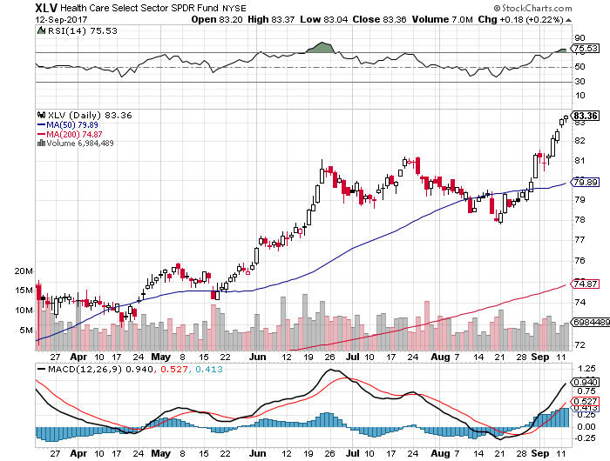
Health Care Sector (XLV), (RXL)-The New FANG?
(JNJ), (PFE), (MRK), (GILD), (ACT), (AMGN)

Slide 33
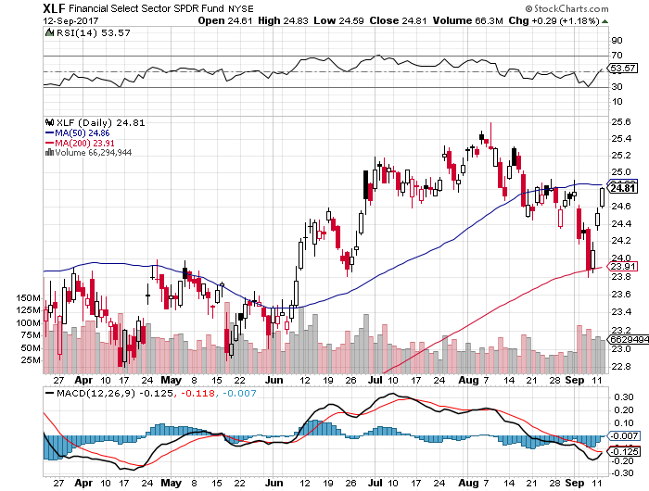
Financial Select SPDR (XLF)-Bouncing Back
(BLK/B), (WFC), (JPM), (BAC), (C), (GS)

Slide 34
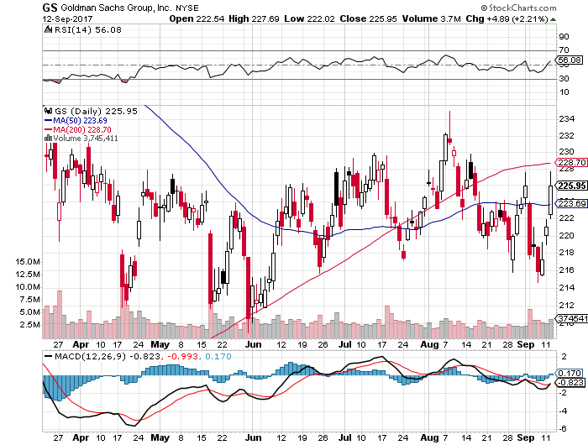
Goldman Sachs (GS)- long 9/$205-$210 vertical bull call spread took profits on long 9/$235-$240 vertical bear put spread initially set up as an iron condor-expires in 2 trading days

Slide 35
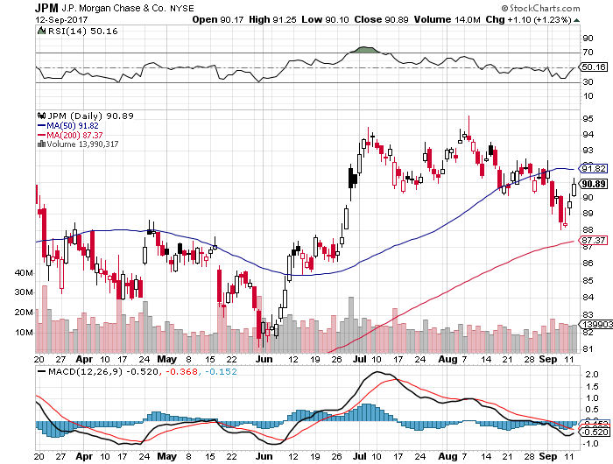
JP Morgan (JPM)-

Slide 36
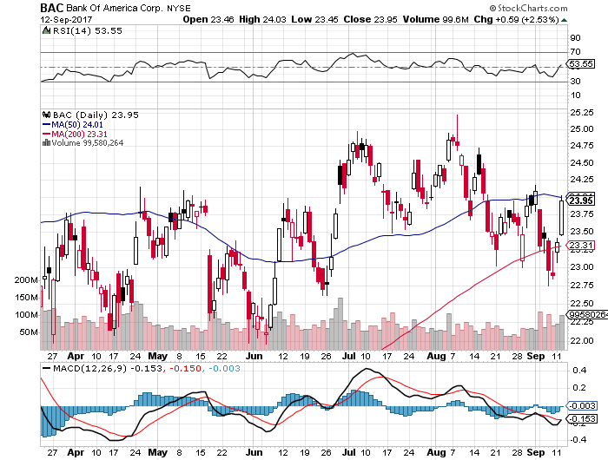
Bank of America (BAC)-
Warren Buffet exercises warrants and buys 700 million shares, with paper profit of $12 billion

Slide 37
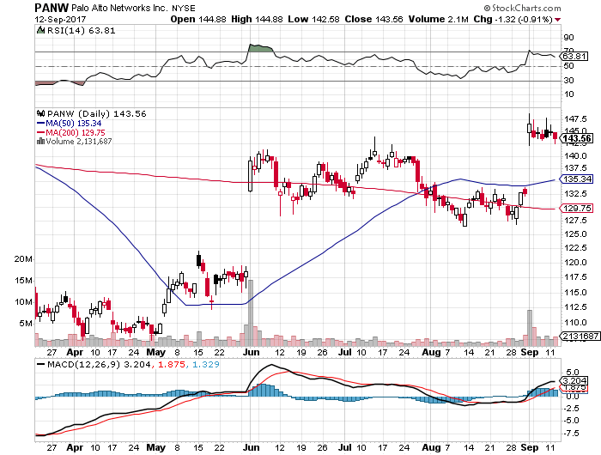
Palo Alto Networks (PANW)-

Slide 38
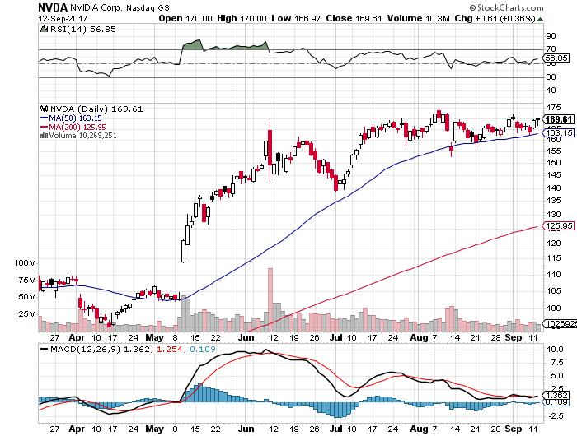
NVIDIA (NVDA)-Q2 $1.02 vs. $0.70 expected

Slide 39
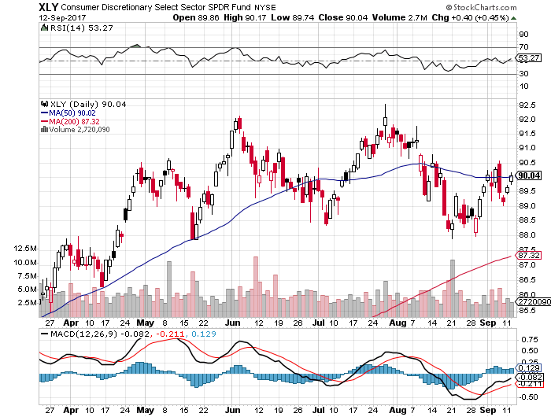
Consumer Discretionary SPDR (XLY)
(DIS), (AMZN), (HD), (CMCSA), (MCD), (SBUX)

Slide 40
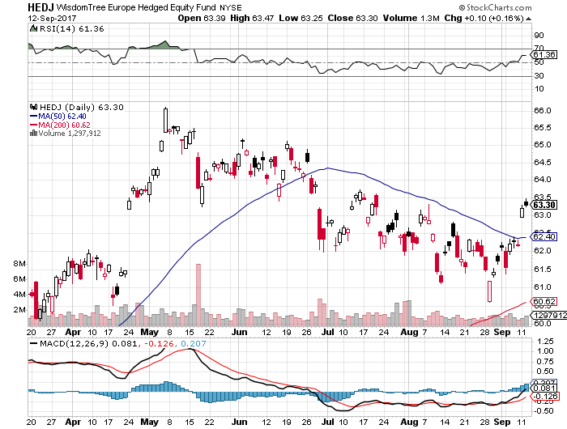
Europe Hedged Equity (HEDJ)-Strong Euro Taking a Toll

Slide 41
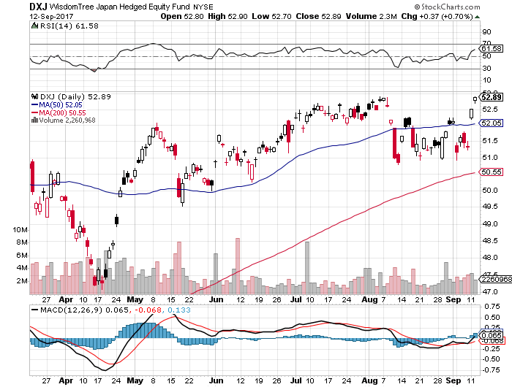
Japan (DXJ)-Yen burst knocks the wind out

Slide 42
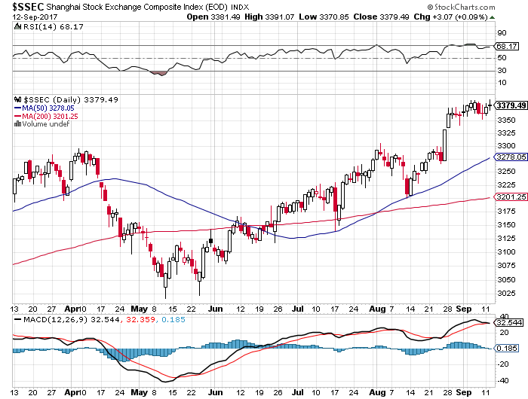
China ($SSEC)-Economic Recovery on Track

Slide 43
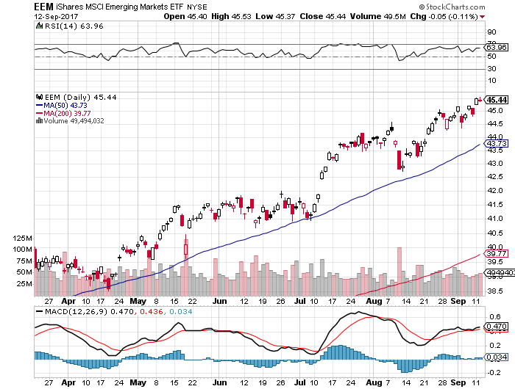
Emerging Markets (EEM)- New High

Slide 44
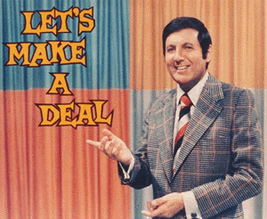
Bonds-Debt Service Deal!
*Surprise deal between president and Democrats eliminates default risk for three more months
*Bond prices soared going into the deal, yields crashing down to 2017 lows at 2.02%, the back up to 2.17% on the agreement
*Should make an interim top in prices, bottom in yields
*Failure of inflation to show puts a floor under bond prices
*False breakdown from the bottom
of the 2.10%-2.40% range in 10 year yields,
so is the next move back up to 2.40%?
*We are one year into a 10-20 year
bear market in bonds, now is a great
entry point on the short side

Slide 45
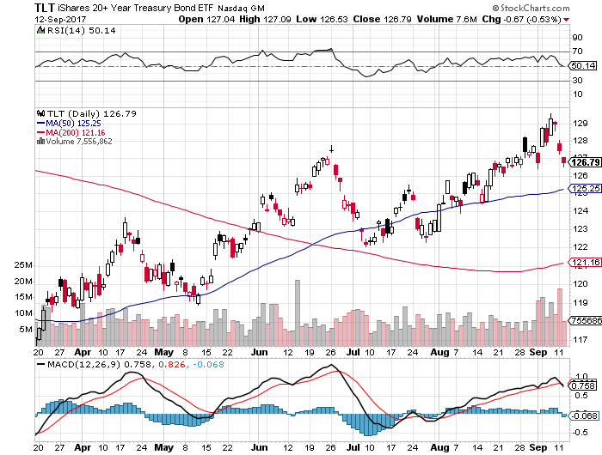
Treasury ETF (TLT) – 2.02%-New High in Prices! took profits on long 8/$128-$130 vertical bear put spread took profits on long 9/$129-$132 vertical bear put spread

Slide 46
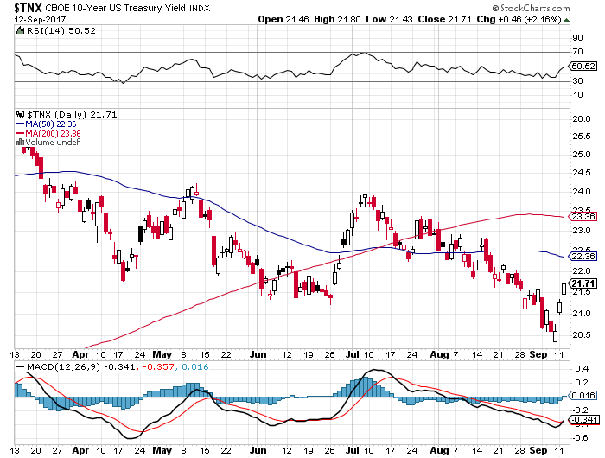
Ten Year Treasury Yield ($TNX) 2.17%

Slide 47
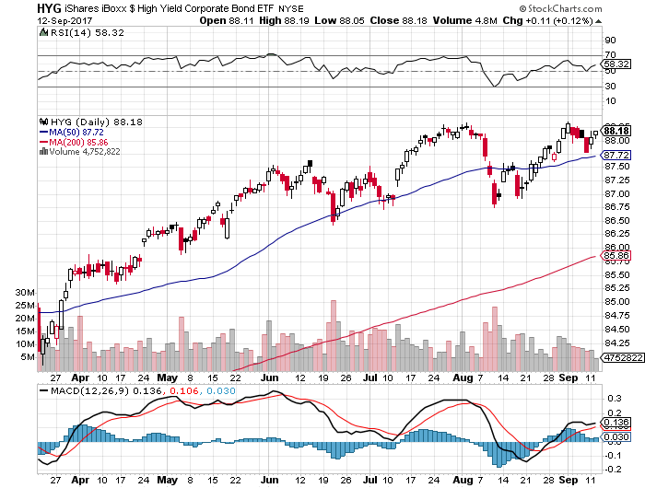
Junk Bonds (HYG) 4.89% Yield
A Great Risk Coincident Indicator- Long Term “RISK ON” means new highs, buy all dips

Slide 48
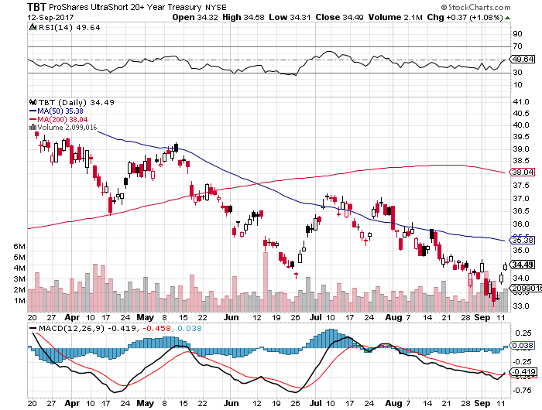
2X Short Treasuries (TBT)-In Screaming “BUY” Territory

Slide 49
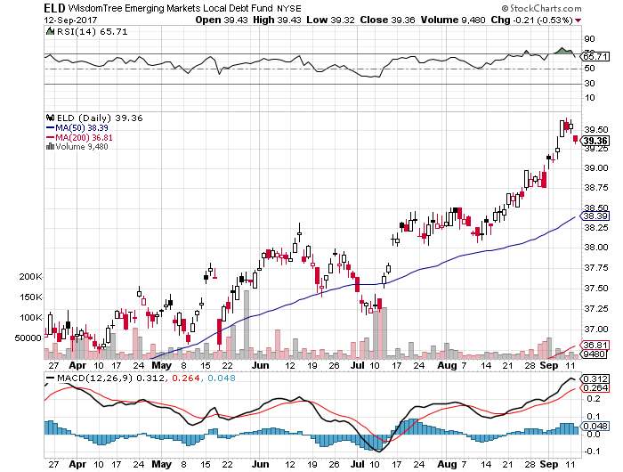
Emerging Market Debt (ELD) 5.70% Yield-

Slide 50
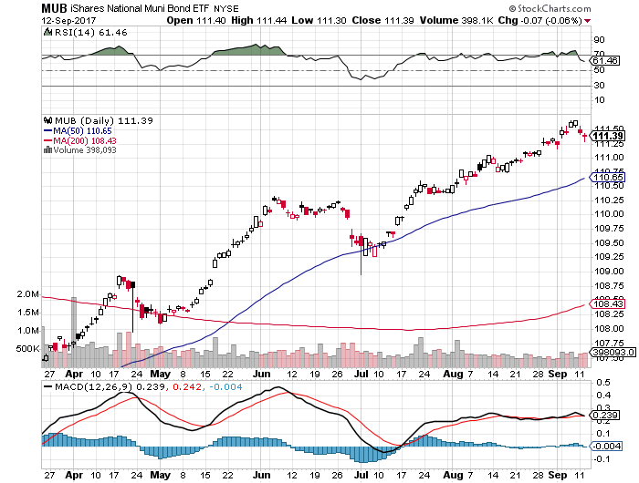
Municipal Bonds (MUB)-1.62%-Gap Up
Mix of AAA, AA, and A rated bonds

Slide 51

Foreign Currencies-Dollar Knocked Out
*Bond yield crash causes US Dollar to plumb new 2017 lows
*Canada raises rates, causing (FXC) to soar
*Aussie (FXA) hits new high on commodities boom
*Japanese yen (FXY) trying to triple top, meaning “RISK OFF” may be over
*This means that the dollar bear market may have months to run
*Despite the short term bounce, the
long term bear trend is still in play
*Stay away until US interest rates sort
themselves out, its too late to sell the
US dollar short

Slide 52
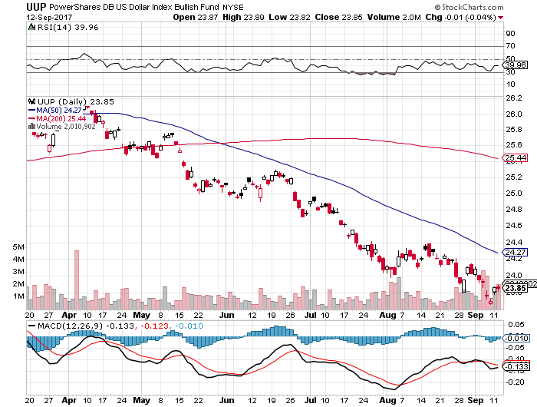
US Dollar Basket-(UUP)-Not Exactly Shorting Territory

Slide 53
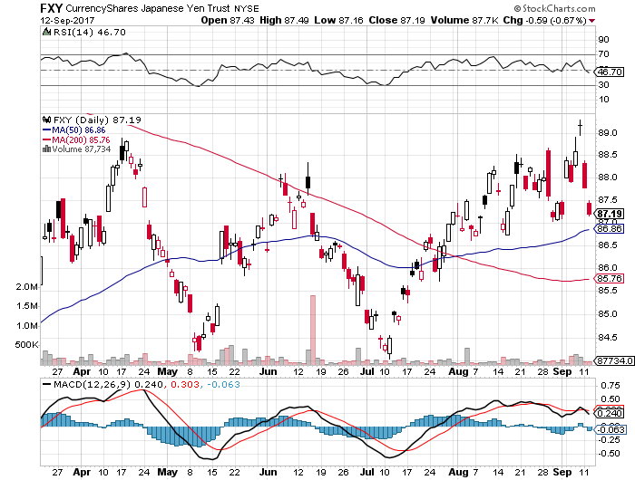
Japanese Yen (FXY)-Flight to Safety Currency

Slide 54
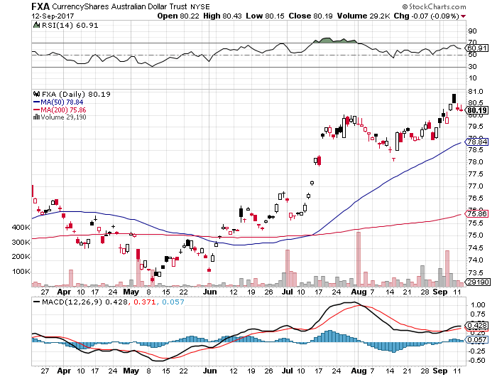
Australian Dollar (FXA)-Blast Off!

Slide 55
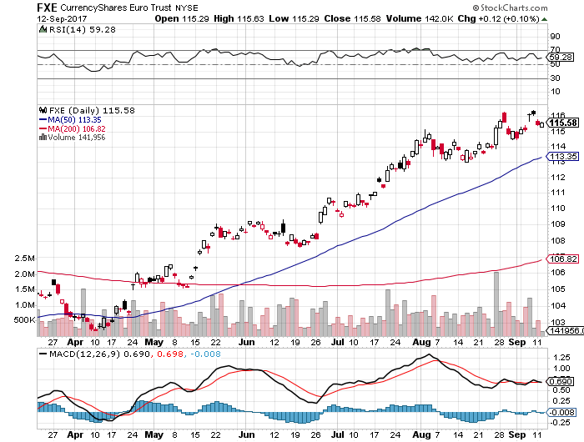
Euro ($XEU), (FXE), (EUO)- New Highs

Slide 56
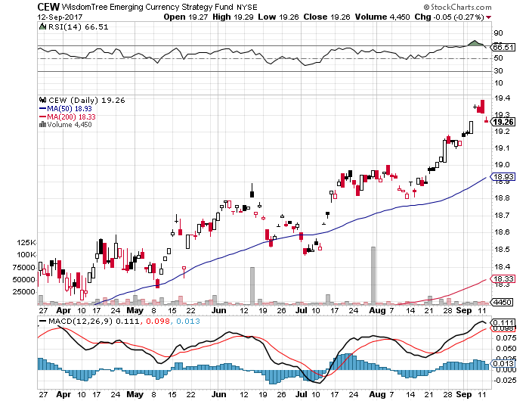
Emerging Market Currencies (CEW)

Slide 57
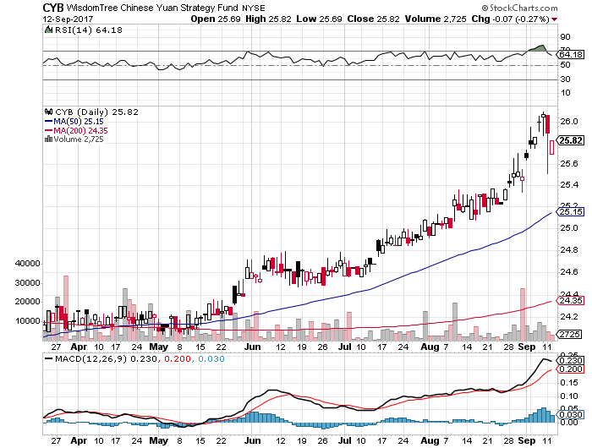
Chinese Yuan- (CYB)-Stabilizing on Government Support

Slide 58
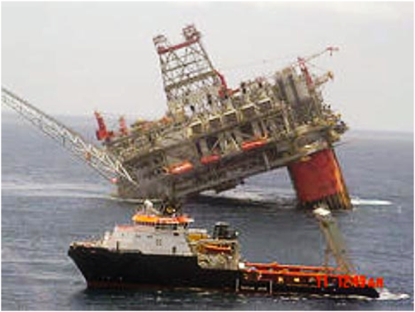
Energy-Hurricane Boost
Is the Bottom IN?
*Twin hurricanes boost Brent premium to near record levels
*Next OPEC Meeting Scheduled for September 22, will attempt to cut quotas again after small production fall in August, compliance jumps from 84% to 89% in a month
*Contangos have moved very bullishly
*Chaos caused by twin hurricanes will take months to unwind
*Russia’s Rosneft head, world’s second
largest producer, says that
oil could be stuck in $45-$55
range for “years”

Slide 59
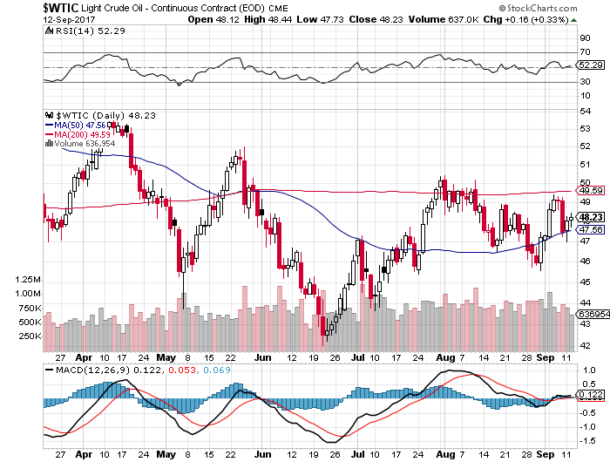
Oil-Back to the Top of a Down Channel

Slide 60
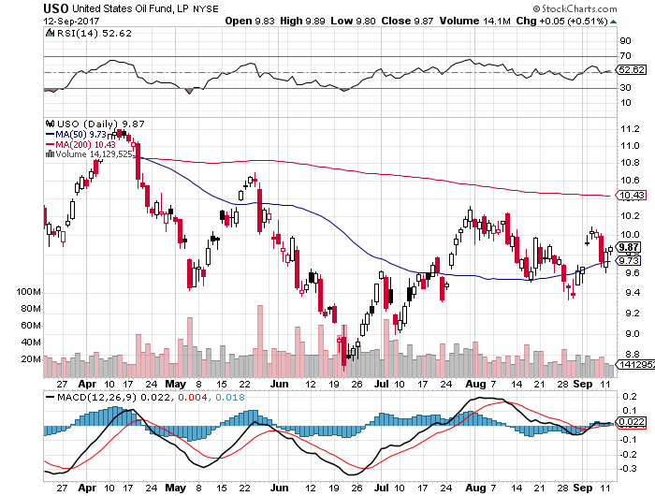
United States Oil Fund (USO)

Slide 61
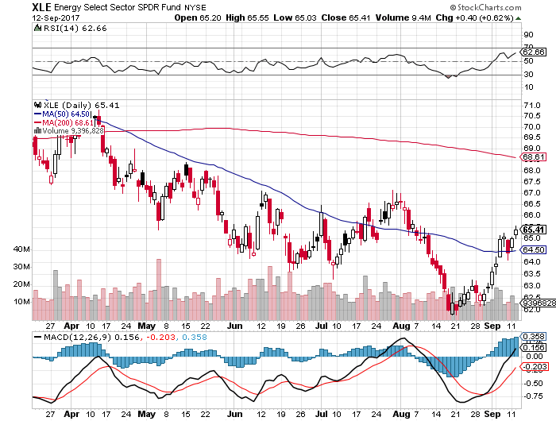
Energy Select Sector SPDR (XLE)-New Lows!
(XOM), (CVX), (SLB), (KMI), (EOG), (COP)

Slide 62
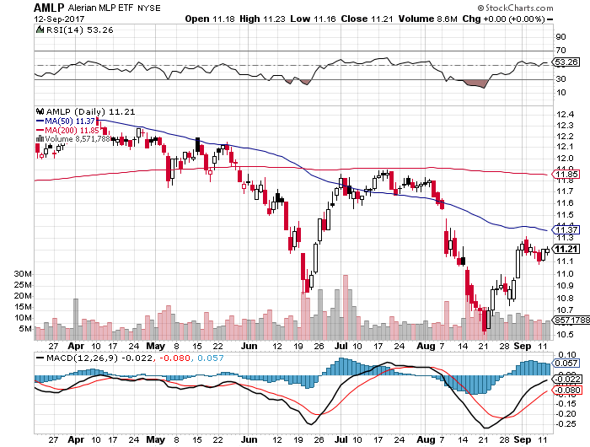
Alerian MLP ETF (AMLP)- Basket Approach is the Only Safe Play Here

Slide 63

Exxon (XOM)-New Lows

Slide 64

Natural Gas (UNG)-No Joy

Slide 65

Copper (COPX)-China Infrastructure Build Out

Slide 66

Precious Metals-Profit Taking
*First time in six years that gold outperforms the S&P 500
*China bans bitcoin and ethereum purchases, causing buying to shift to gold
*A decisive break of $1,300/ounce caused gold to add on another $50 very quickly, as predicted
*Took profits on all precious metals positions as they approached overbought territory and major resistance points on charts
*Bond rally that lowers interest rates is also gold
positive
*Buy gold and silver stocks
on the next dip, as the move
is still only a few weeks old

Slide 67

Gold (GLD)-Finally, a Big Breakout!

Slide 68

Market Vectors Gold Miners ETF- (GDX)
Breakout!
Took profits on long the 9/$20.50-$21.50 bull call spread

Slide 69

Barrick Gold (ABX) took profits on long 9/$15-16 call spread

Slide 70

Newmont Mining- (NEM)-Breakout took profits on long the 9/$32-$34 bull call spread

Slide 71

Global X Silver Miners ETF- (SIL)-Breakout took profits on long the 9/$31-$33 bull call spread

Slide 72

Bitcoin-Modern Day Tulips!

Slide 73

Platinum- (PPLT)-Breakout!

Slide 74

Palladium- (PALL)-Breakout!

Slide 75

Agriculture-No Help
*Even crop destroying hurricanes can’t help prices
*Corn, wheat, and soybeans mostly grown in the Midwest and north outside the range of hurricanes
*However, the big storms did damage port distribution facilities, creating a backup in the supply chain
*Weak dollar allows the US to reenter the international wheat market for the first time in a year
*Hedge funds maintaining huge shorts in
corn and wheat
*Be thankful we haven’t done an ag
trade for five years

Slide 76

(CORN) –New Lows!

Slide 77

(WEAT)-Major Breakdown

Slide 78

(SOYB)-Toast!

Slide 79

Real Estate-Short Squeeze!
*Housing data will also be a mess in the wake of the hurricanes
*August pending home sales down 0.8% on supply shortage
*Inventory shortages causing home sales figures to fall off a cliff, so prices can only rise
*CoreLogic says that 46% of all US homes now overvalued
*New low in rates gives the Refi boom another leg
*June S&P 500 Case-Shiller maintains
strong 5.8%, with absolute prices hitting
new all time high
*Your home equity could be the best
investment of the year….again

Slide 80

Home Depot (HD)-Double Bottom + Twin Hurricane Help took profits on long $9/$141-$144 vertical bull call spread

Slide 81

June S&P 500/Case–Shiller Home Price Index
+5.8% YOY, Seattle (+13.4%), Portland (8.2%), Dallas (7.7%) still leaders absolute prices hit new all time high

Slide 82

General Growth Properties (GGP)-New Lows
Long Term Downtrend-From Rising Rates to Mall Destruction

Slide 83

US Home Construction Index (ITB)
(DHI), (LEN), (PHM), (TOL), (NVR)
A Favorite Sector to Buy

Slide 84

Trade Sheet-The Complete Opposite
So What Do We Do About All This?
*Stocks- sell rallies for the short term, buy for long term
*Bonds-sell bigger rallies
*Commodities-buy industrials
*Currencies-sell yen and Euro when they peak out
*Precious Metals –buy dips
*Volatility-stand aside until over $16, or under $10
*The Ags –stand aside
*Real estate-buy dips

Slide 85

Next Strategy Webinar
12:00 EST Wednesday, September 27, 2017
San Francisco, CA
Buy conference and lunch tickets at madhedgefundtrader.com
Good Luck and Good Trading!
Notes:
*

