Slide 1
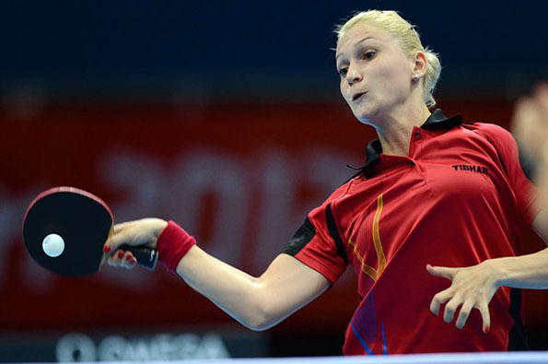
The Mad Hedge Fund Trader
“The Ping Pong Market”
With John Thomas
from Silicon Valley, CA, September 27, 2017
www.madhedgefundtrader.com
Notes:
*

Slide 2

Mad Hedge/Top Gun Master Mind Investment Conference
Buy tickets at www.madhedgefundtrader.com
November 3-4, Incline Village, NV
The Snow is Falling!

Slide 3


Global Strategy Luncheons
Buy tickets at www.madhedgefundtrader.com
Chicago, IL
December 27, 2017
Minneapolis, MN
December 28, 2017

Slide 4
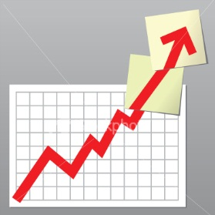
Trade Alert Performance
Biggest Up Month in Ten Years! New All Time High!!
22 Consecutive Profitable Trade Alerts!!
*January +9.35% Final *July +1.95% Final
*February +6.39% FINAL *August +18.38% Final
*March +4.87% Final *September +5.31% MTD
*April +1.84% Final *October +8.13% Final
*May -0.45% Final *November 4.37% Final
*June +0.70% Final *December +.84% Final
*2017 Year to Date 48.34%
compared to 12.5% for the Dow Average
26 of 25 consecutive profitable trade alerts
*Trailing One year return +63.21%, +266.90% since inception,
*Average annualized return of 34.30%

Slide 5
Portfolio Review
Back to 80% Cash
Mad Hedge Fund Trader
Model Trading Book
Asset Class Breakdown
Risk Adjusted Basis
Current Capital at Risk
Risk On
World is Getting Better
(TLT)/10$129-$131 puts spread | 10.00%
(AAPL) 10/$140-$145 call spread | 10.00%
Risk Off
World is Getting Worse
No positions
Total Net Position | 20.00%
Expiration P&L
49.81% YTD

Slide 6
Trailing One-Year Return
Daily Audited Performance
+63.21%

Slide 7
Eight Year Daily Audited Performance
Averaged Annualized Return +34.30%

Slide 8

The Method to My Madness
*The Ping-Pong market has us rapidly rotating between FANG and deep value domestic stocks
*Sell every bond rally….Janet put the top in with bond hoard liquidation
*Look for main indexes to grind up for the rest of 2017
*Keep buying ”RISK OFF” assets like gold dips,
as a hedge against brief bouts of profit taking in stocks
*FANG’s come back to life, but upside is limited
*Buy oil dips to $55 a barrel
*Staying away from currencies until dollar puts in a
final bottom

Slide 9
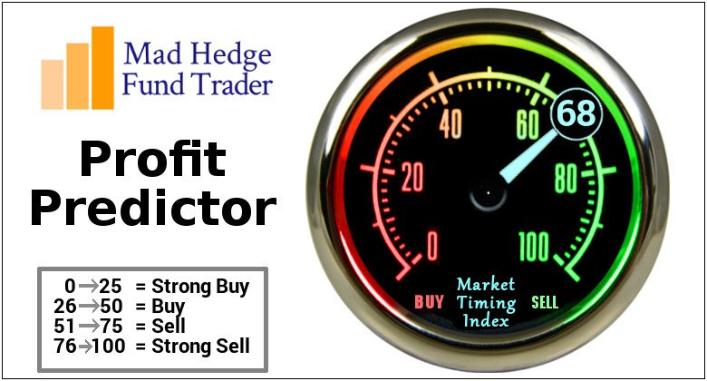
The Mad Hedge Profit Predictor
Market Timing Index
An artificial intelligence driven algorithm that analyzes 30 different economic, technical, and momentum driven indicators
Risk Bounced Hard Off of 2017 Low at 18

Slide 10
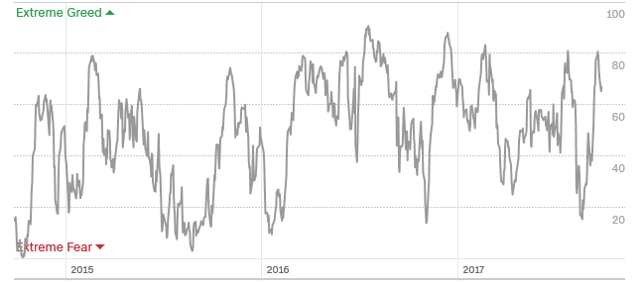
The Mad Hedge Profit Predictor
Market Timing Index
From 81 to 18 in 2 Weeks!
Peaking Out

Slide 11
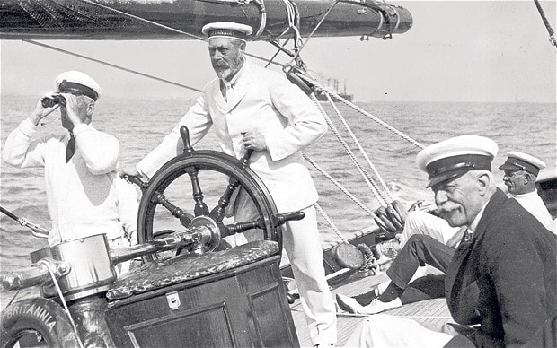
The Global Economy-Steady as She Goes
*US August CPI comes in at a hot 0.4%, hurricanes will add to this
*JOLTS hits a new all time high at 6.17 million, up 54,000 in July
*The December Fed rate hike is now a certainty after the September pass
*August Consumer Confidence 119.3 to 119.8
*Japanese snap election will prolong Japanese QE
*It’s all very market positive, and severely
limited the downside to the last correction
*Global Inflation hits lowest level since 2009,
leading to lower for longer on bond yields

Slide 12
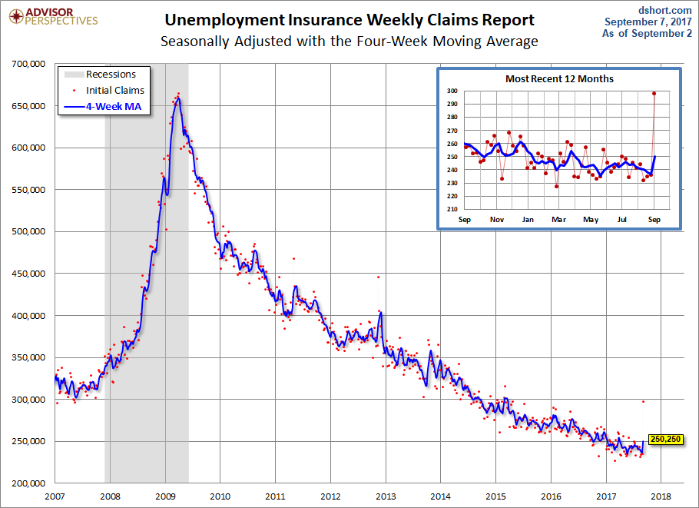
Weekly Jobless Claims –The Most Important Statistic
-23,000 to 259,000, Biggest Jump Since 9/11 !!

Slide 13

Stocks-Classic Late Cycle Market
*8 ½ years into this bull market makes it the second longest in history, But how long can it stay late?
*17% annualized return on stocks plus dividends since market 2009 bottom, the answer is a while longer
*10 bear markets since 1900….you need a real recession to get one, but none are in sight
*Apple is the highest added value stock in history, enriching stockholders by $1 trillion in 20 years, Exxon is no. 2, but took 100 years to do it
*Volatility (VIX) barely moved on latest NK threats
*Rotation out of FANG’s and into banks and
domestics continues, now two months old
*Oil and legacy semiconductors have joined
the laggard plays

Slide 14
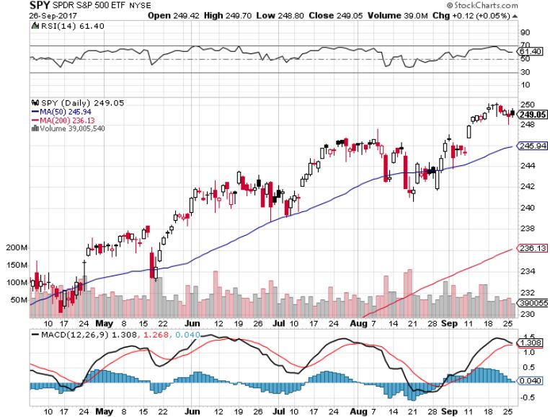
S&P 500-Correction

Slide 15
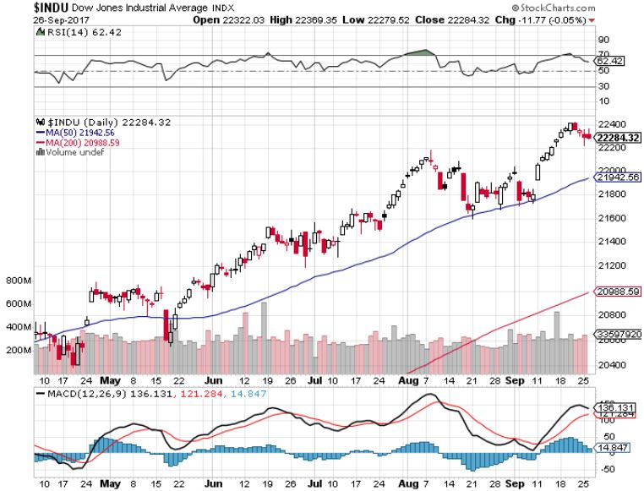
Dow Average-Topping
Still Haven’t Retraced to the 50 Day MA since May

Slide 16
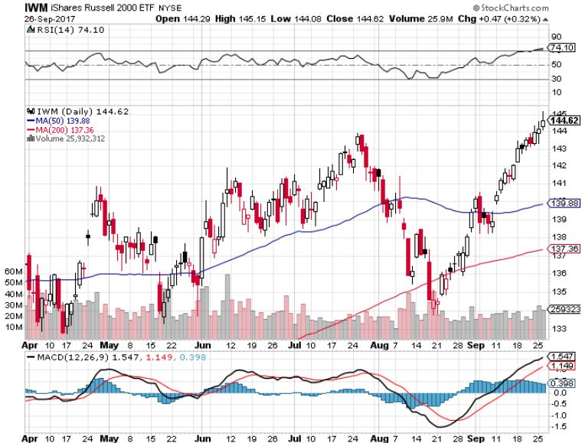
Russell 2000 (IWM)-Off to the Races

Slide 17
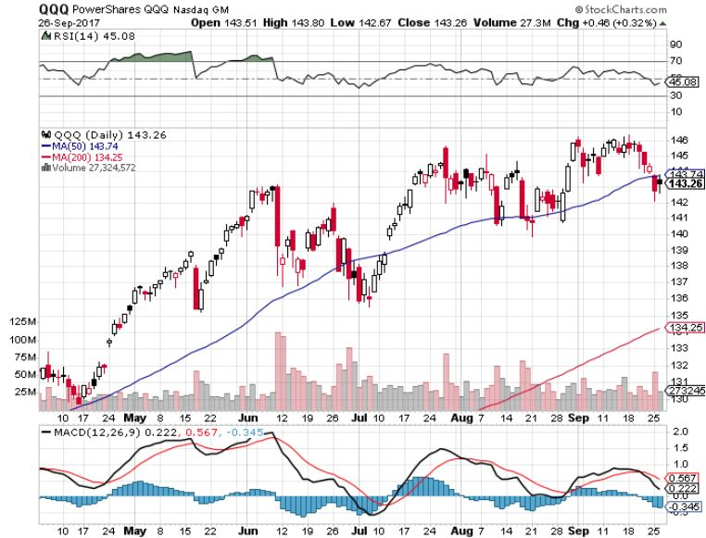
NASDAQ (QQQ)-Rotation Out

Slide 18
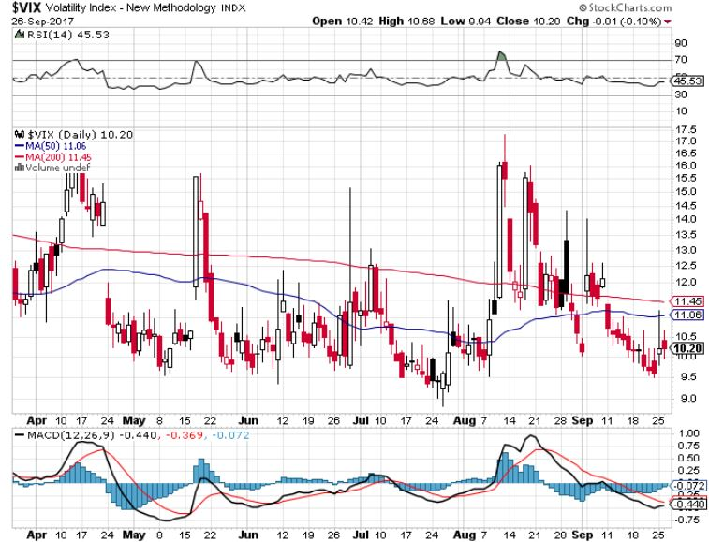
(VIX)-Back to the Bottom took profits on long 11/$20 calls

Slide 19

Mad Options Trader
*6 Huge consecutive trading months in the weekly options
*Demand for the new $2,000 a year service has been overwhelming
*Email Nancy in Customer Support at
support@madhedgefundtrader.com and put
“MOT Upgrade” in the subject line
to add the service
*Nancy will calculate a pro rata credit for
the balance of your remaining subscription,
and then bill you for your new subscription
+ MOT

Slide 20
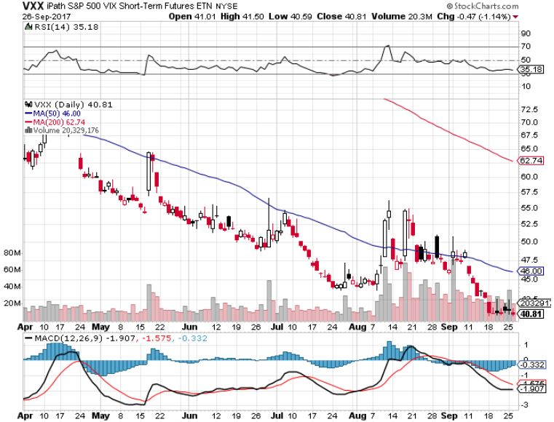
iPath S&P 500 VIX Short-Term Futures ETN (VXX)
Begging for New Lows

Slide 21
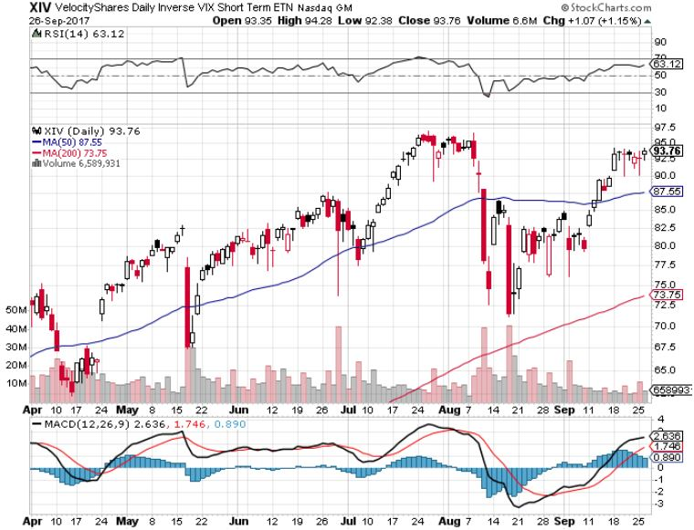
Velocity Shares Daily Inverse VIX Short Term ETN (XIV)
One of the most instantly profitable trades of 2016….and 2017 took profits on (XIV) long at $81.45

Slide 22
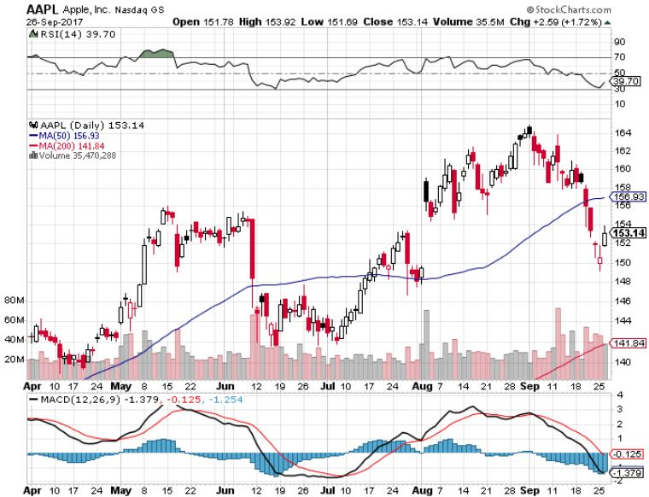
Apple (AAPL)-IPhone X is Out!
Long 10/$140-$145 bull call spread took profits on short 9/$170-$175 bear Put Spread took profits on long 9/$140-$145 bull call spread to make an iron condor

Slide 23
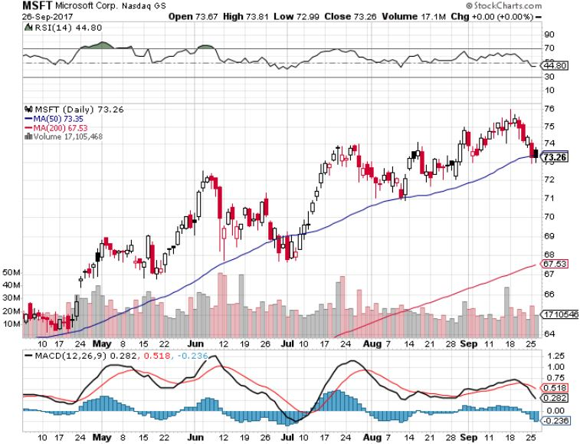
Microsoft (MSFT)

Slide 24
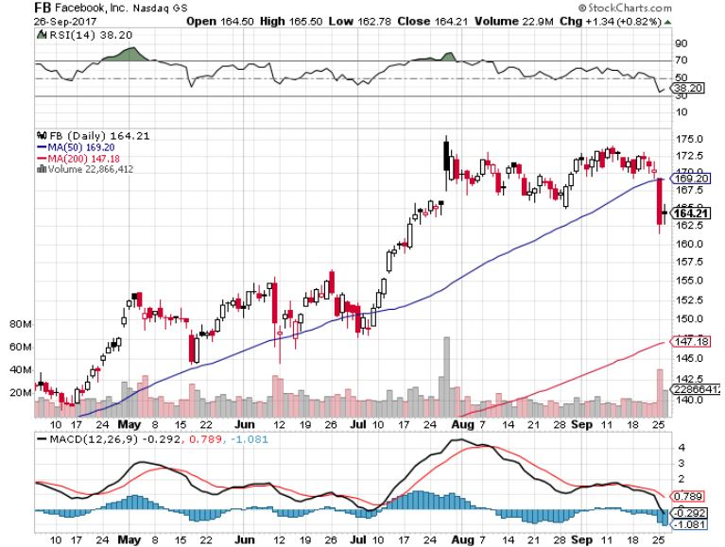
Facebook (FB)-Ouch!

Slide 25
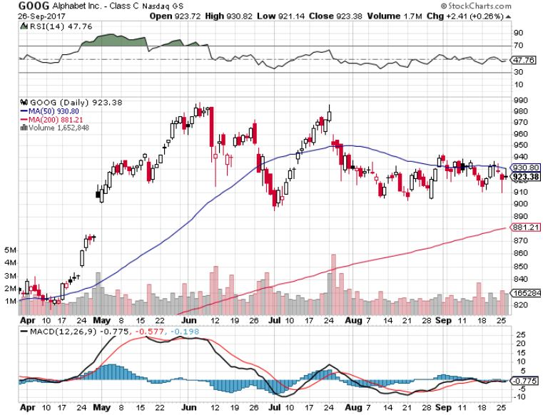
Alphabet (GOOG)-New High

Slide 26
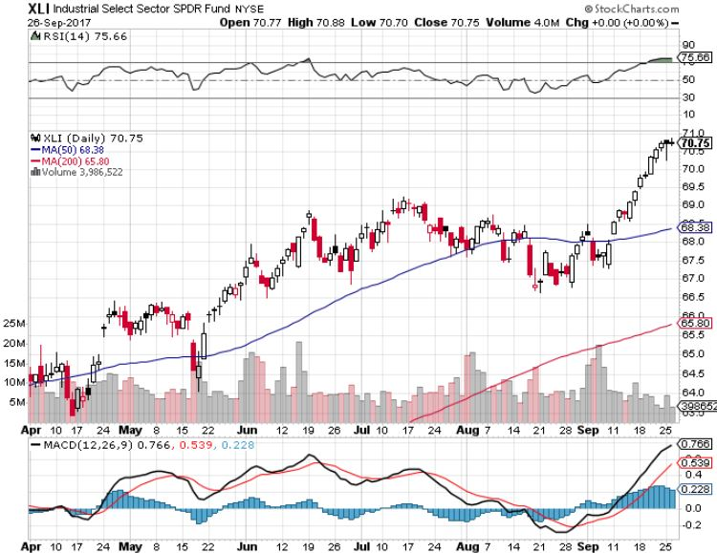
Industrials Sector SPDR (XLI)-
(GE), (MMM), (UNP), (UTX), (BA), (HON)

Slide 27
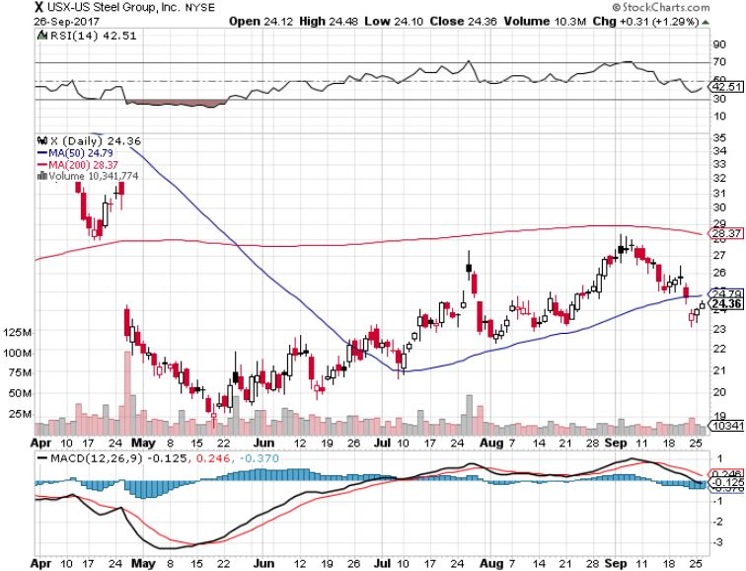
US Steel (X)-Time to Go Back In took profits on long the 9/$21-$22 vertical bull call spread

Slide 28
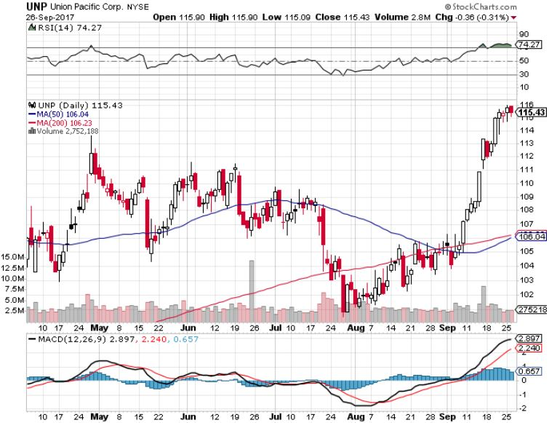
Union Pacific Railroad (UNP)-Rocket Ship took profits on long the 9/$100-$102 vertical bull call spread

Slide 29
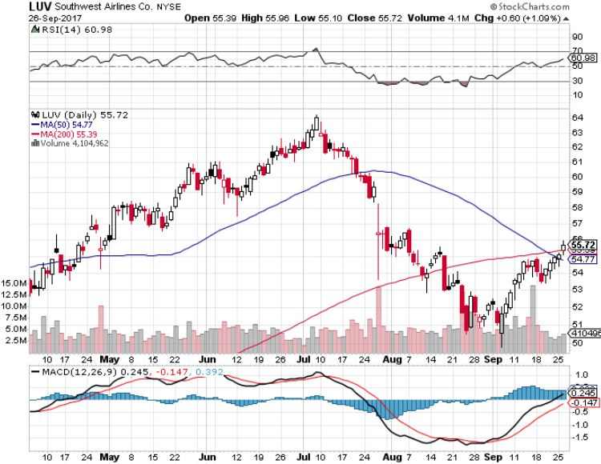
Southwest Airlines (LUV)-
Warren Buffett’s Favorite Airline

Slide 30
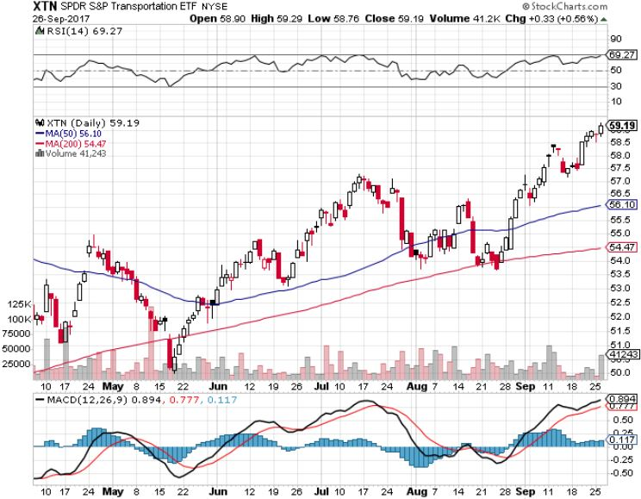
Transports Sector SPDR (XTN)-
(ALGT), (ALK), (JBLU), (LUV), (CHRW), (DAL)

Slide 31
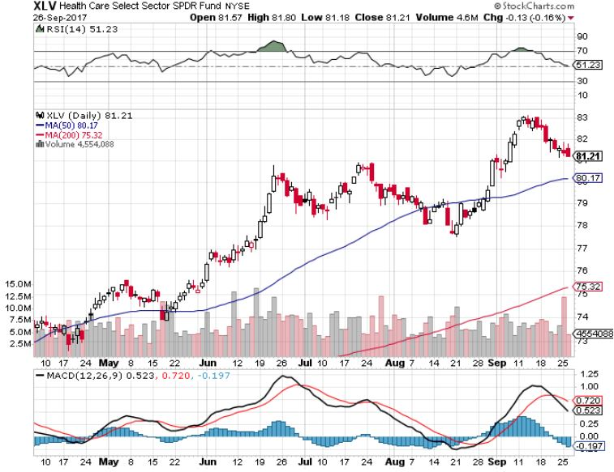
Health Care Sector (XLV), (RXL)-The New FANG?
(JNJ), (PFE), (MRK), (GILD), (ACT), (AMGN)

Slide 32
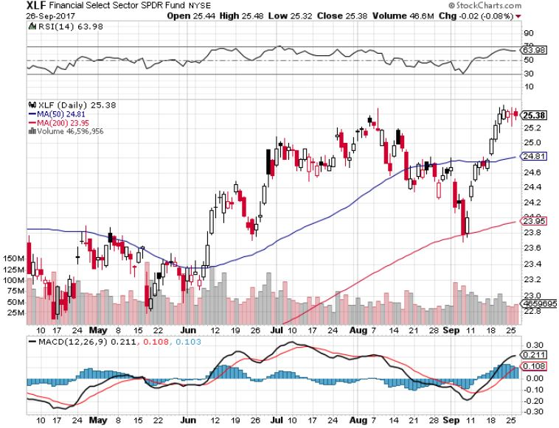
Financial Select SPDR (XLF)-Bouncing Back
(BLK/B), (WFC), (JPM), (BAC), (C), (GS)

Slide 33
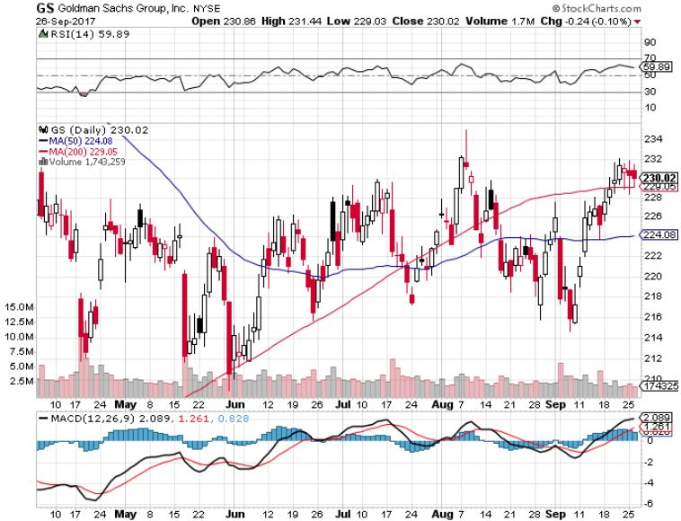
Goldman Sachs (GS)- took profits on long 9/$205-$210 vertical bull call spread took profits on long 9/$235-$240 vertical bear put spread to close the iron condor

Slide 34
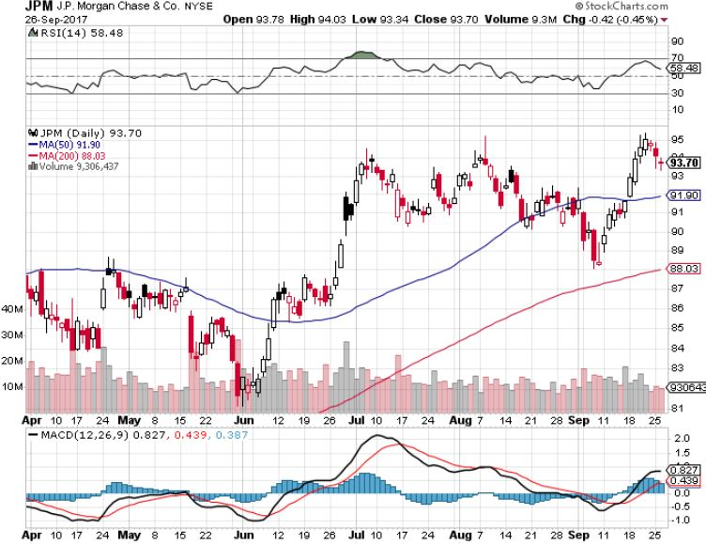
JP Morgan (JPM)-

Slide 35
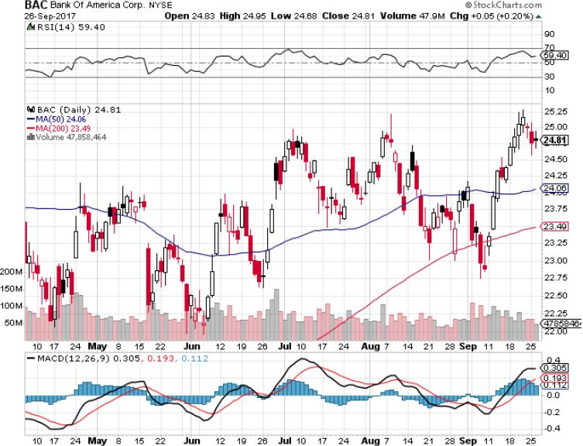
Bank of America (BAC)-
Warren Buffet exercises warrants and buys 700 million shares, with paper profit of $12 billion

Slide 36
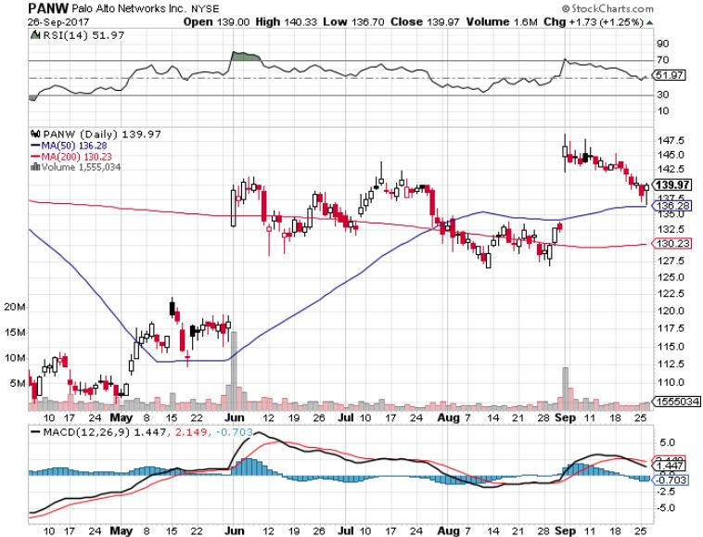
Palo Alto Networks (PANW)-

Slide 37
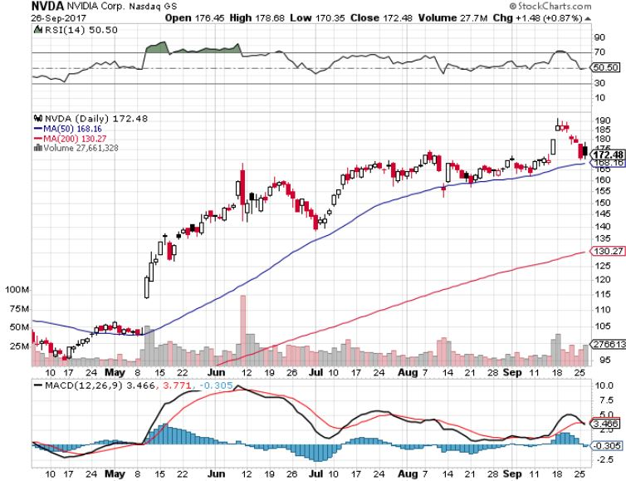
NVIDIA (NVDA)-Q2 $1.02 vs. $0.70 expected

Slide 38
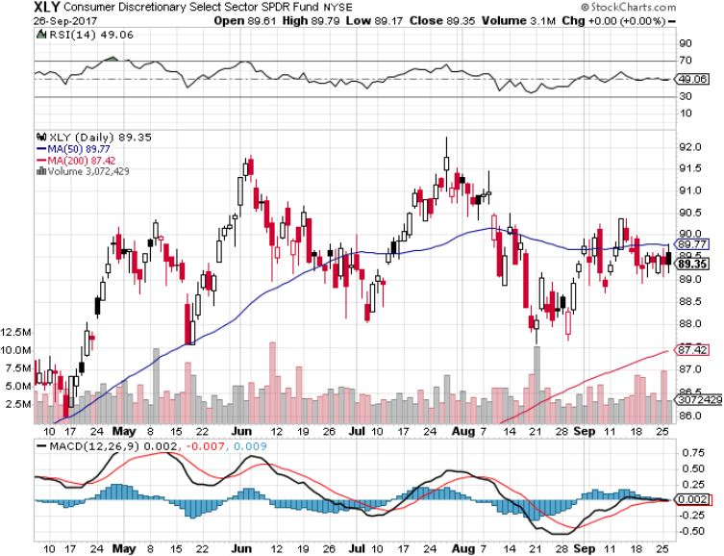
Consumer Discretionary SPDR (XLY)
(DIS), (AMZN), (HD), (CMCSA), (MCD), (SBUX)

Slide 39
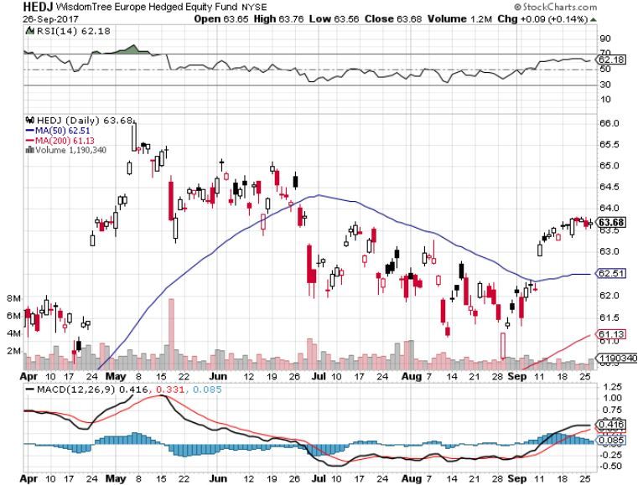
Europe Hedged Equity (HEDJ)-

Slide 40
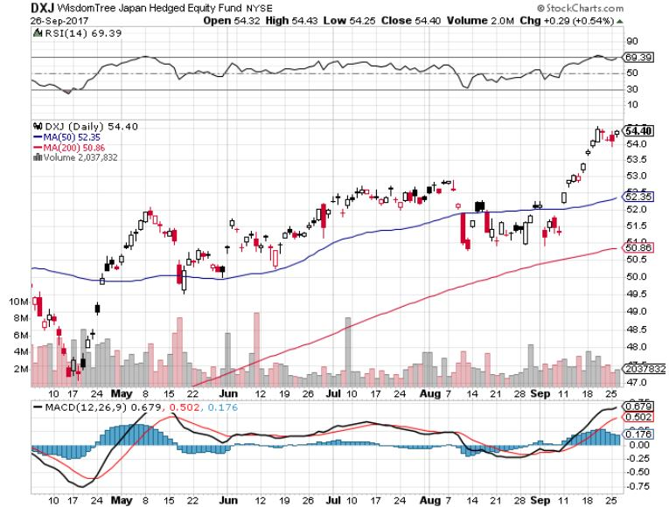
Japan (DXJ)-Election Boost

Slide 41
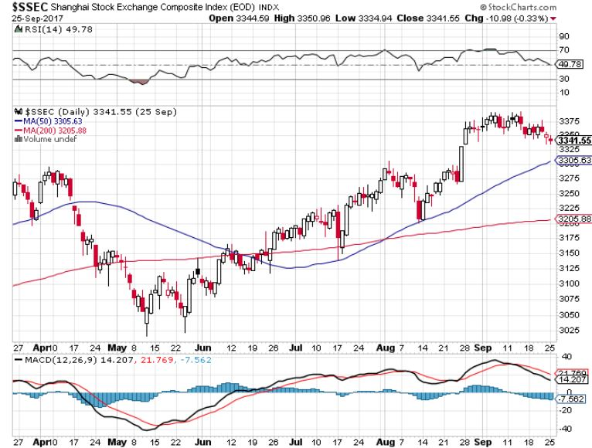
China ($SSEC)-Economic Recovery on Track

Slide 42
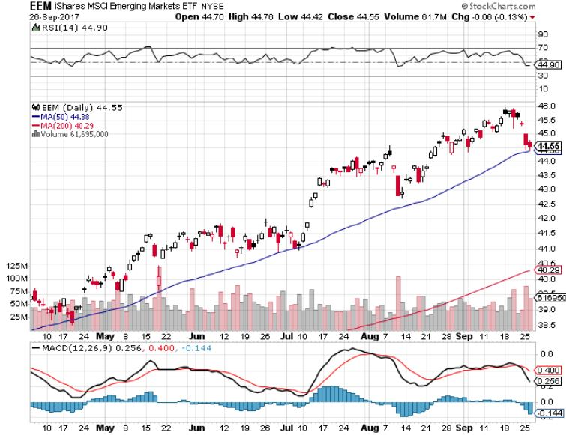
Emerging Markets (EEM)- New High

Slide 43
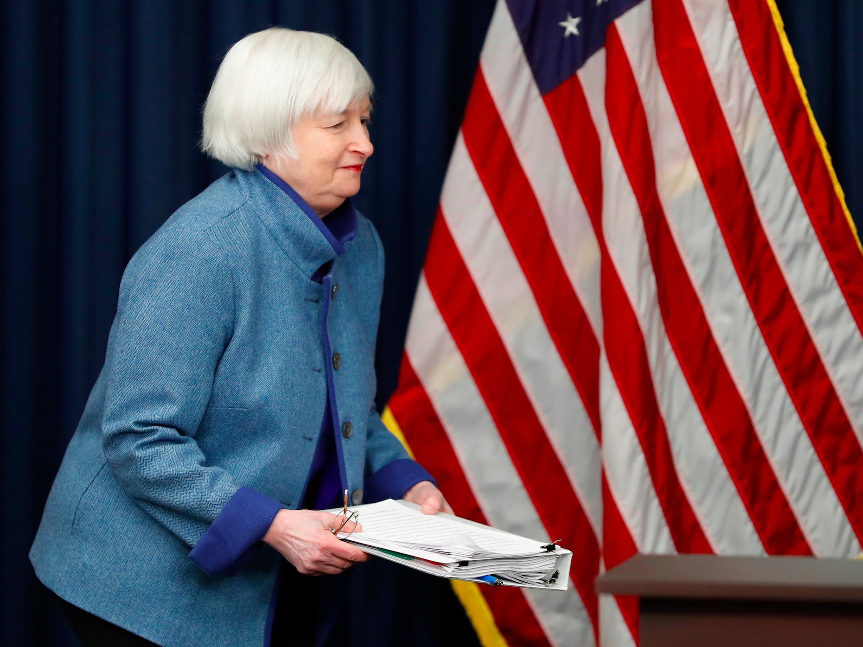
Bonds-Fed Surprise
*Janet drops a bombshell, promises $6 billion a month, or $200 million a day in bond sales to start soon and go on for 10 years
*Puts a price cap on bonds at $129, and a yield bottom at 2.02%, for the rest of 2017
*Bonds are now unchanged on the year, as Janet fails to raise rates in September
*Failure of inflation to show puts
a floor under bond prices
*Here is an excellent entry point
for the (TBT)
*We are one year into a 10-20 year
bear market in bonds, now is a great
entry point on the short side

Slide 44
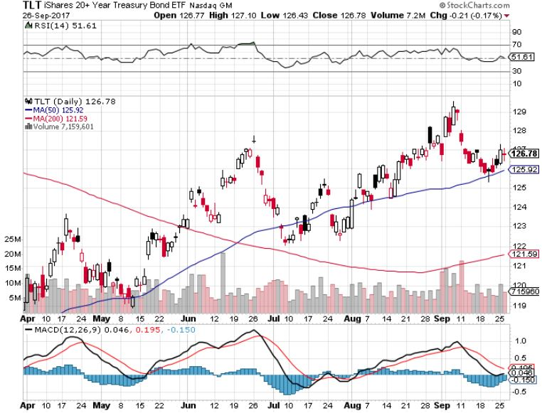
Treasury ETF (TLT) – 2.02%-My Rich Uncle Trade! long 10/$129-$131 vertical bear put spread took profits on long 8/$128-$130 vertical bear put spread took profits on long 9/$129-$132 vertical bear put spread

Slide 45
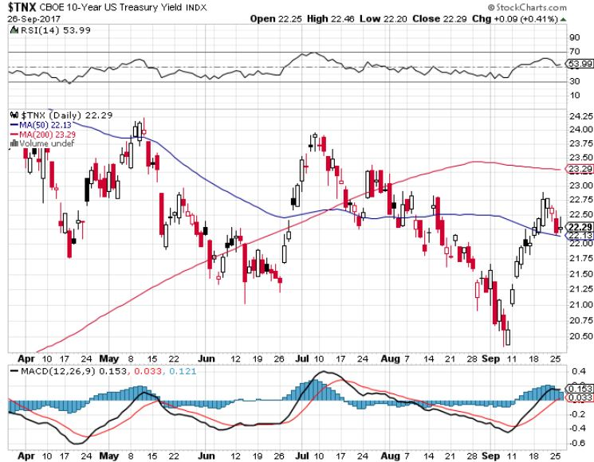
Ten Year Treasury Yield ($TNX) 2.22%

Slide 46
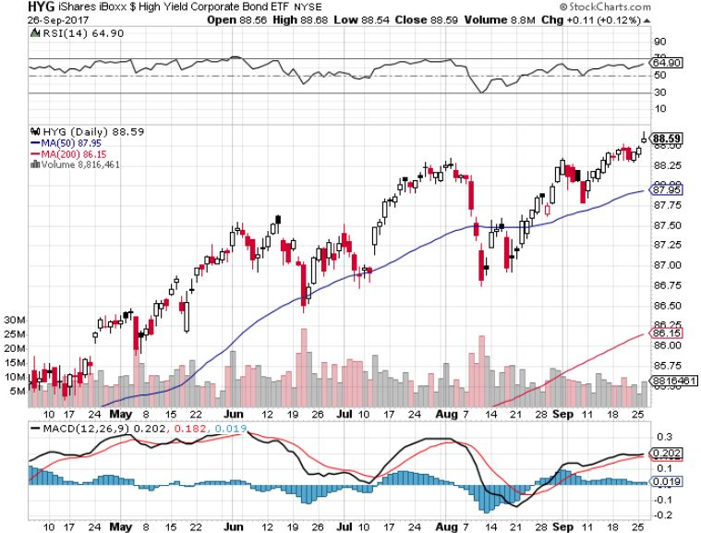
Junk Bonds (HYG) 4.89% Yield
A Great Risk Coincident Indicator- Long Term “RISK ON” means new highs, buy all dips

Slide 47
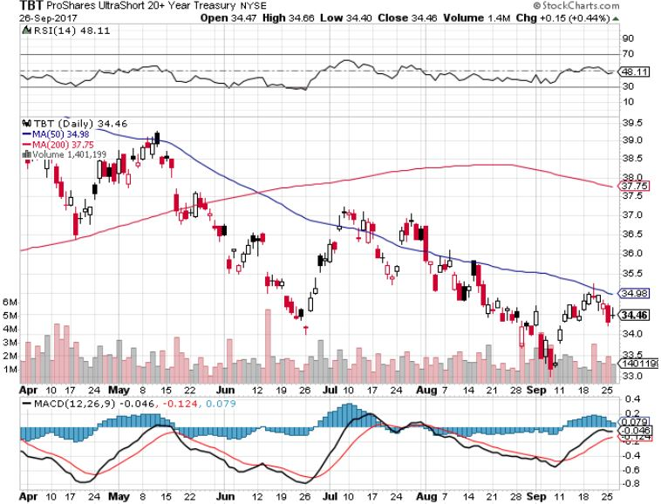
2X Short Treasuries (TBT)-In Screaming “BUY” Territory

Slide 48
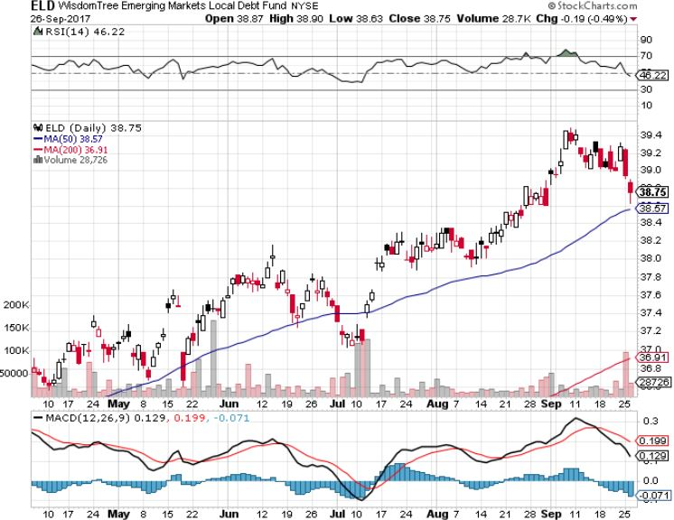
Emerging Market Debt (ELD) 5.63% Yield-

Slide 49
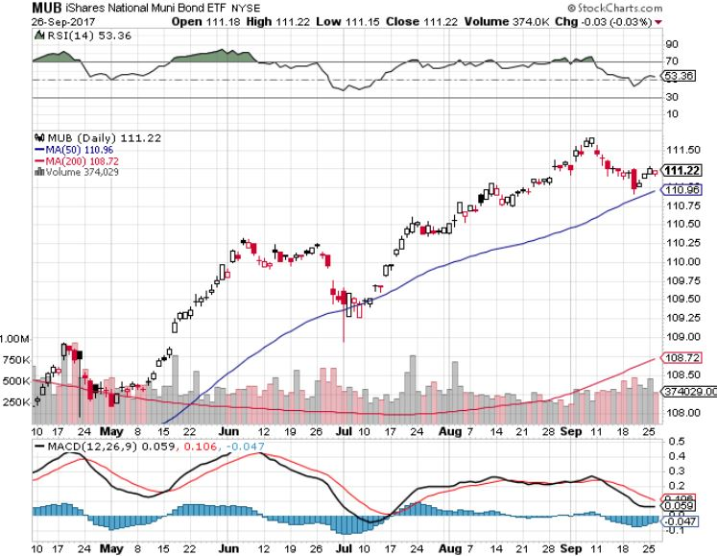
Municipal Bonds (MUB)-1.59%-Gap Up
Mix of AAA, AA, and A rated bonds

Slide 50
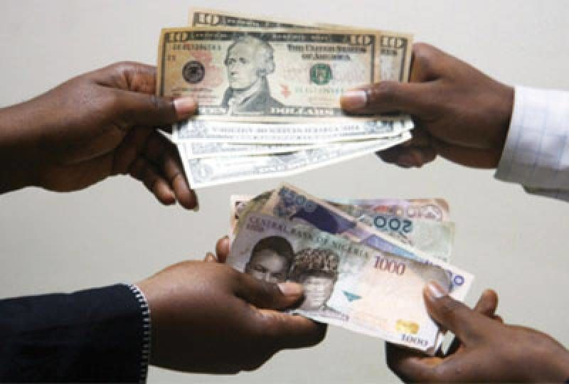
Foreign Currencies-Dollar Bounce
*Janet bond hoard scare boosts rates and brings the believers back into the US dollar
*Is this the final dollar bottom, or just a a brief short covering rally
*Japanese yen (FXY) says it’s the former, the Euro (FXE) says it’s the latter
*Every North Korea threat triggers a
bond short covering rally….sell into
every one
*It all highlights a time for confusion
for forex traders
*Stay away until US interest rates sort
themselves out, its too late to sell the
US dollar short

Slide 51
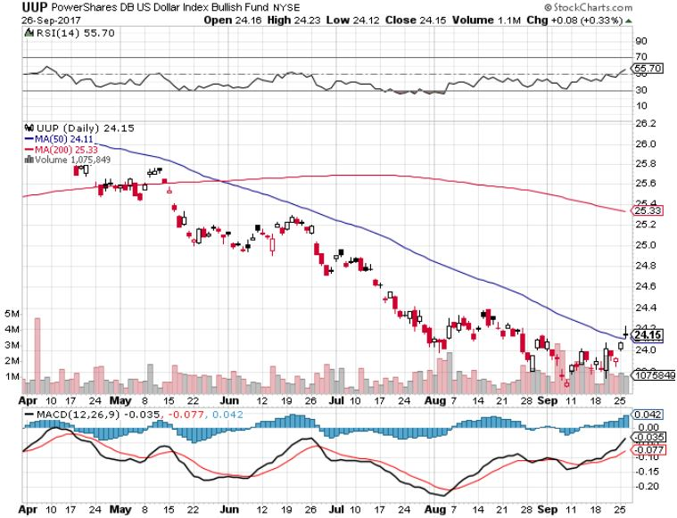
US Dollar Basket-(UUP)-Head & Shoulders Bottom?

Slide 52
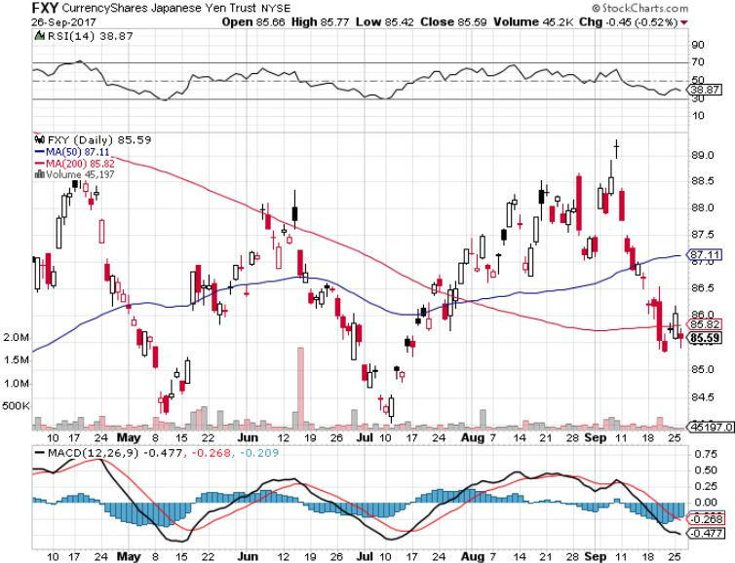
Japanese Yen (FXY)-Flight to Safety Currency

Slide 53
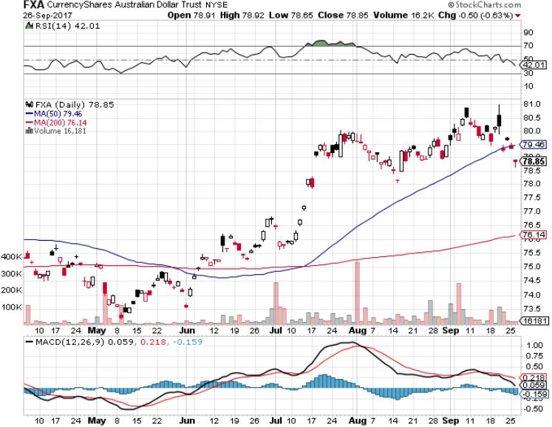
Australian Dollar (FXA)-Double Top

Slide 54
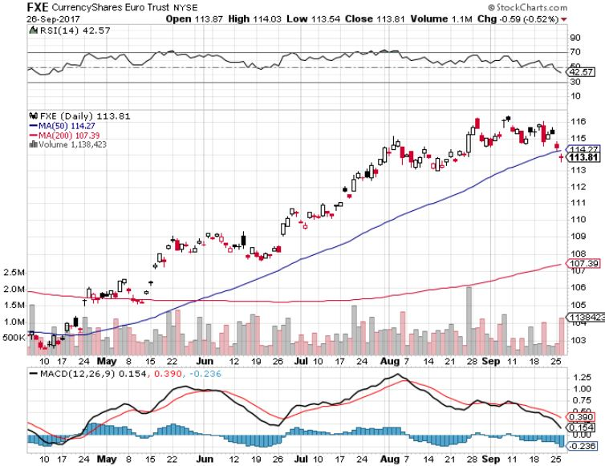
Euro ($XEU), (FXE), (EUO)- Triple Top

Slide 55
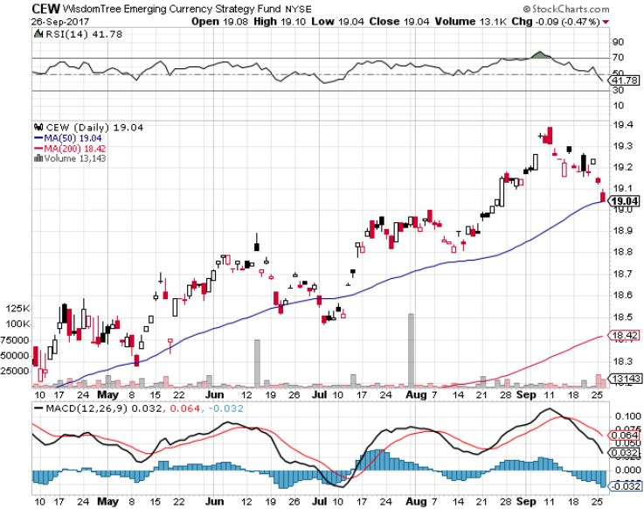
Emerging Market Currencies (CEW)

Slide 56
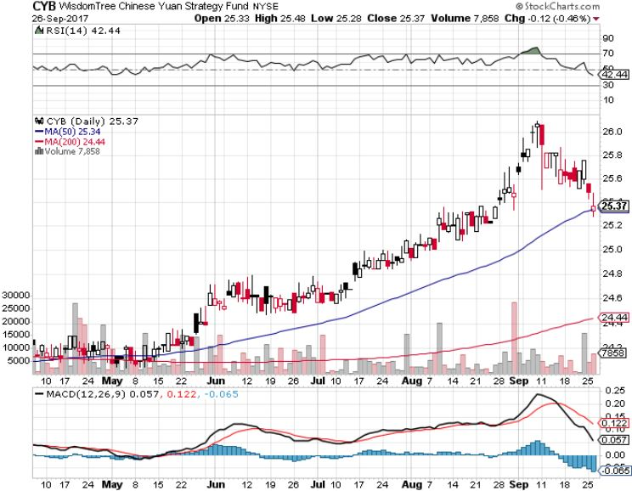
Chinese Yuan- (CYB)-

Slide 57

Energy-Breakout!
*Oil breaks out to a new four month high, and is now targeting $55
*Global oil demand is reaccelerating, thanks to increased China demand
*Contangos have moved very bullishly, then narrowed
*Chaos caused by twin hurricanes will take months to unwind, causing higher prices
*Fracking supply is not coming on as
fast as once thought
*However, 1,000 DUC (Drilled but Uncompleted)
wells will cap the rally at $55

Slide 58
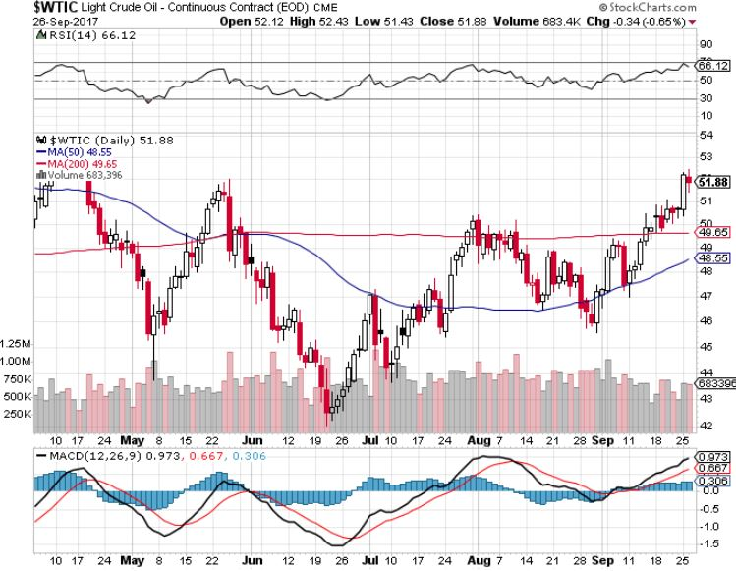
Oil-Breakout!

Slide 59
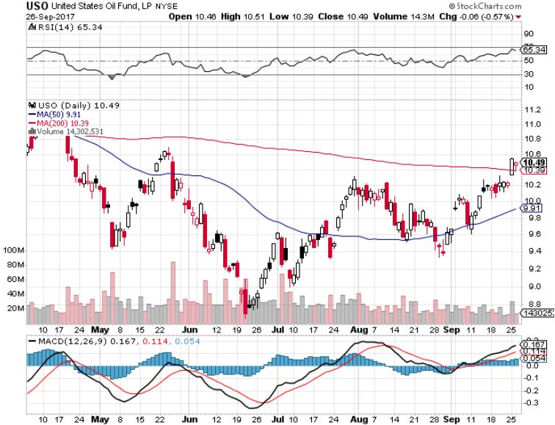
United States Oil Fund (USO)

Slide 60

Energy Select Sector SPDR (XLE)-New Lows!
(XOM), (CVX), (SLB), (KMI), (EOG), (COP)

Slide 61

Alerian MLP ETF (AMLP)- Basket Approach is the Only Safe Play Here

Slide 62

Exxon (XOM)-The Bottom is In

Slide 63

Schlumberger (SLB)-Lower Risk Service Play

Slide 64

Halliburton (HAL)-Service Play

Slide 65

Natural Gas (UNG)-No Joy

Slide 66

Copper (COPX)-China Infrastructure Build Out

Slide 67

Precious Metals-Profit Taking
*Fed threat to sell bond hoard knocks the stuffing out of precious metals
*Higher interest rates increase the opportunity cost of holding gold
*50 day moving average support holds at $1,290
*North Korean threats take the downside pressure off
*Took profits on all precious metals positions
as they approached overbought territory and
major resistance points on charts
*Buy gold and silver stocks
on the next dip, as the move
is still only a few months old

Slide 68

Gold (GLD)-Back to Old Resistance

Slide 69

Market Vectors Gold Miners ETF- (GDX)
Took profits on long the 9/$20.50-$21.50 bull call spread

Slide 70

Barrick Gold (ABX) took profits on long 9/$15-16 call spread

Slide 71

Newmont Mining- (NEM)-Breakout took profits on long the 9/$32-$34 bull call spread

Slide 72

Global X Silver Miners ETF- (SIL)-Breakout took profits on long the 9/$31-$33 bull call spread

Slide 73

Bitcoin-Modern Day Tulips!

Slide 74

Platinum- (PPLT)-Gave Up Entire Move

Slide 75

Palladium- (PALL)-

Slide 76

The Best Trade in 50 Years!
Long Gold/Short Bonds
*Buy gold 2 years into a 20 year bull market
*Sell short bonds close to a 35 year high
*Both sides will work, gold will rise and bond fall
*1:1 ratio today is worth a 77.67% non leveraged return in five years, gold at $1,922, (TLT) at $91, or a 776.7% total return with 10X leverage
*Drivers are:
returning inflation
rising interest rates
continued strong us economy
EEM accumulation of gold reserves
Declining gold supplies
Rising Chinese retail demand

Slide 77

Agriculture-Sitting on a Bottom
*Midwest weather is expected dry for the next two weeks, allowing for a record crop to harvest
*50% appreciation of Russian Ruble is backing Russia out of export markets
*Cheap US dollar enabling Egypt, the world’s largest wheat buyer, to consider the US once again for the first time in more than a year
*New USDA report hugely bearish
*Hedge funds maintaining huge shorts in
corn and wheat
*China adds 10% ethanol requirement
for gasoline, up corn 1.77 billion bushels?
*Be thankful we haven’t done an Ag
trade for five years

Slide 78

(CORN) –New Lows!

Slide 79

(WEAT)-Major Breakdown

Slide 80

(SOYB)-Toast!

Slide 81

Real Estate-Short Squeeze!
*August US Housing Starts down -0.8%, up from -2.2% in July, Building Permits up +5.7% from -3.5% in July, August New Home Sales -3.4%
*August Existing Home Sales only 5.35 million, up only 0.2% YOY
*Inventory shortages causing home sales figures to fall off a cliff, so prices can only rise
*New home construction continuing at only half 2006 peak levels, meaning home shortage will continue for Many years
and prices will keep rising
*Fed move to unwind bond hoard means this
may be the last chance to get 3.5% 30 year loans
*June S&P 500 Case-Shiller maintains
strong 5.8%, with absolute prices hitting
new all time high
*Your home equity could be the best
investment of the year….again

Slide 82

Home Depot (HD)-Double Bottom + Twin Hurricane Help took profits on long $9/$141-$144 vertical bull call spread

Slide 83

June S&P 500/Case–Shiller Home Price Index
+5.8% YOY, Seattle (+13.4%), Portland (8.2%), Dallas (7.7%) still leaders absolute prices hit new all time high

Slide 84

General Growth Properties (GGP)-New Lows
Long Term Downtrend-From Rising Rates to Mall Destruction

Slide 85

US Home Construction Index (ITB)
(DHI), (LEN), (PHM), (TOL), (NVR)
A Favorite Sector to Buy

Slide 86

Trade Sheet-The Complete Opposite
So What Do We Do About All This?
*Stocks- sell rallies for the short term, buy for long term, play the rotation game
*Bonds-sell all rallies
*Commodities-buy industrials, energy
*Currencies-sell yen and Euro when they peak out
*Precious Metals –buy dips
*Volatility-stand aside until over $16,
or under $10
*The Ags –stand aside
*Real estate-buy dips

Slide 87

Next Strategy Webinar
12:00 EST Wednesday, October 11, 2017
San Francisco, CA
Buy conference and lunch tickets at madhedgefundtrader.com
Good Luck and Good Trading!
Notes:
*

