Slide 1

Mad Day Trader
Bill Davis
Webinar – October 18, 2017

Slide 2
Long Term

Slide 3
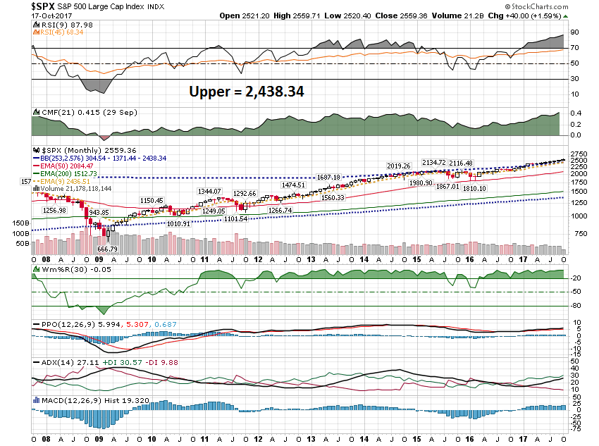

Slide 4
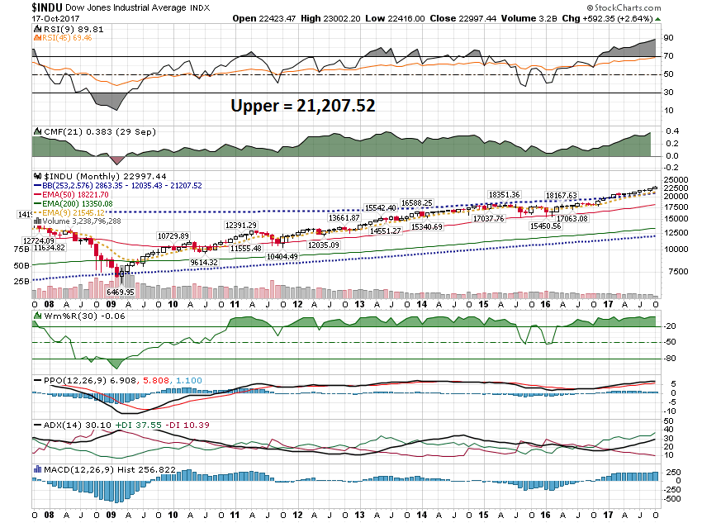

Slide 5
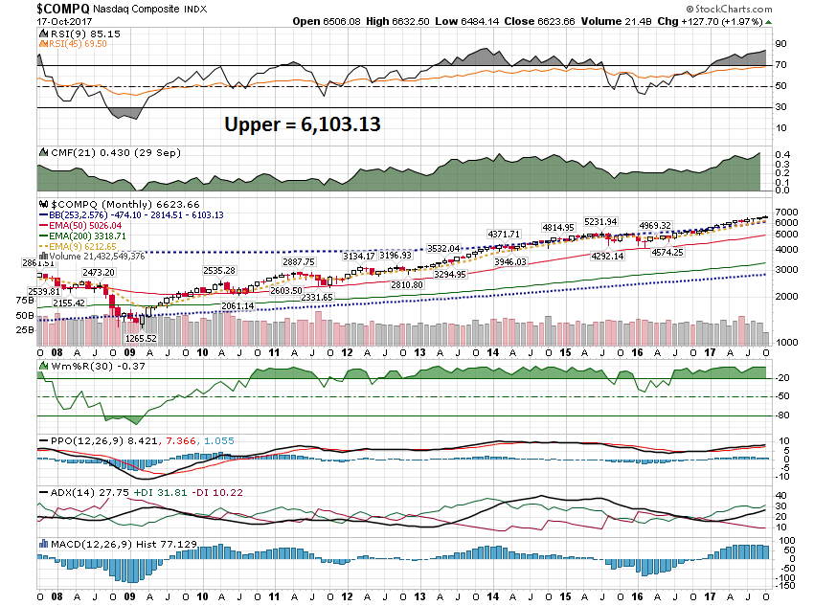

Slide 6
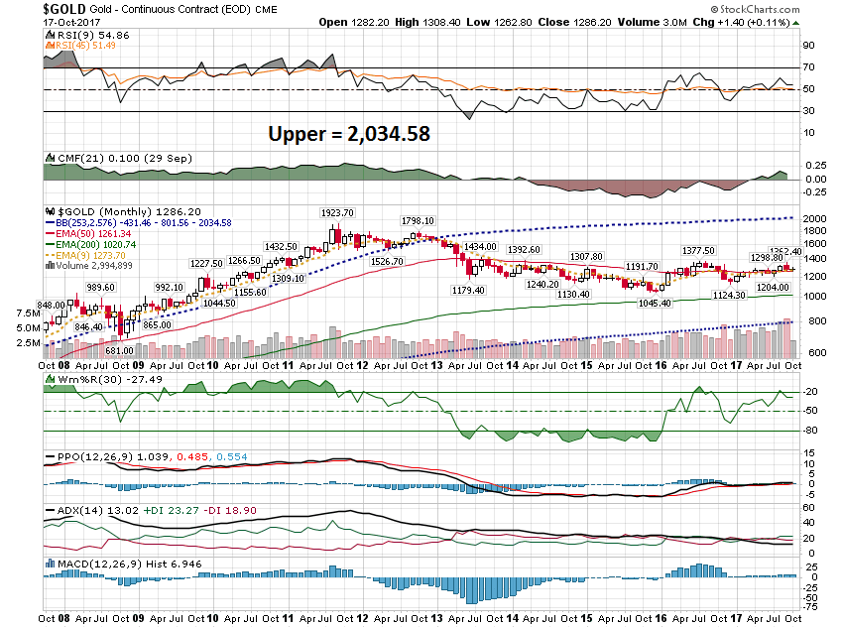

Slide 7
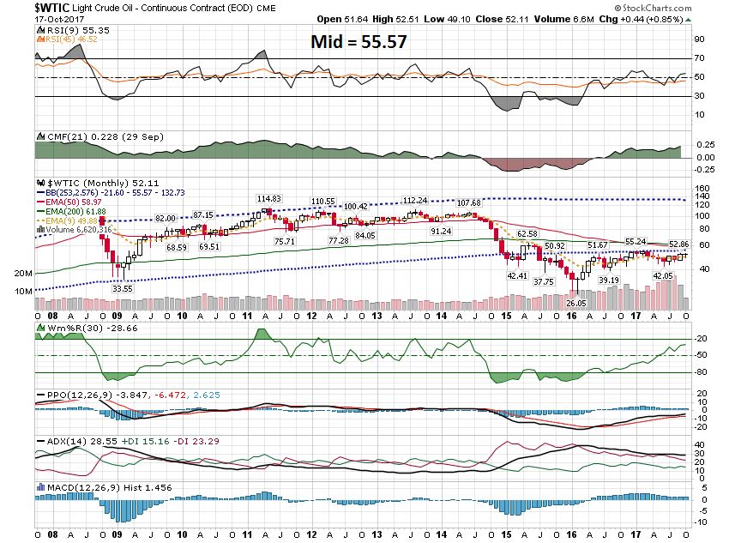

Slide 8
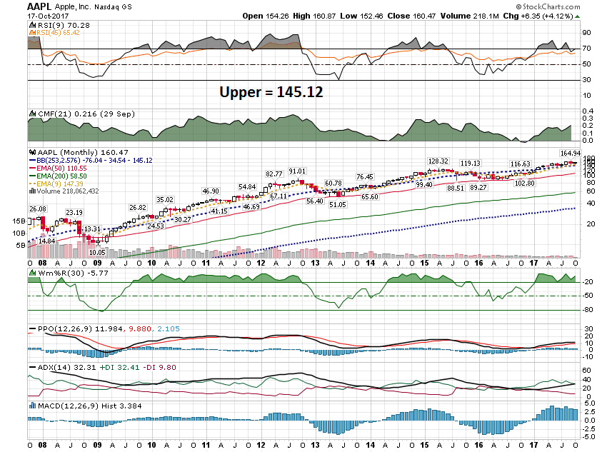

Slide 9
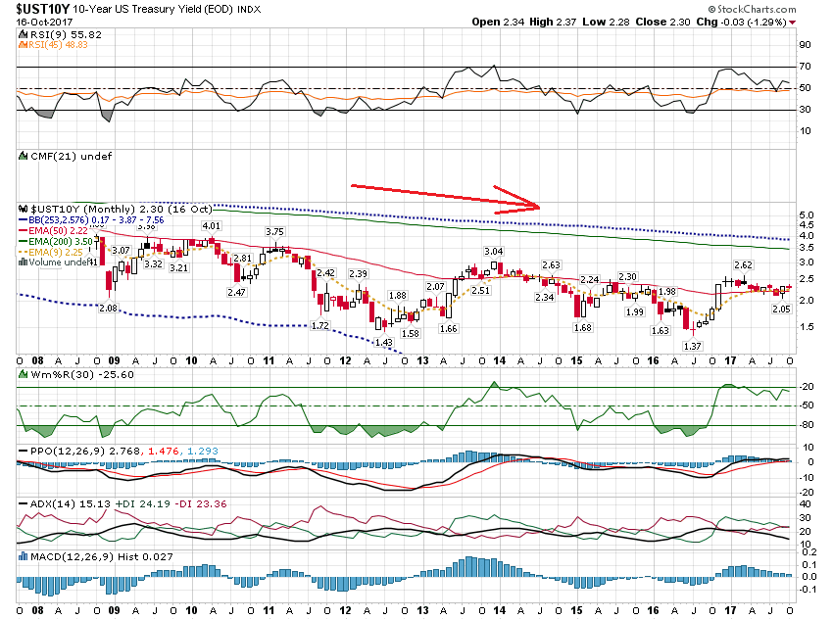

Slide 10
Short Term

Slide 11
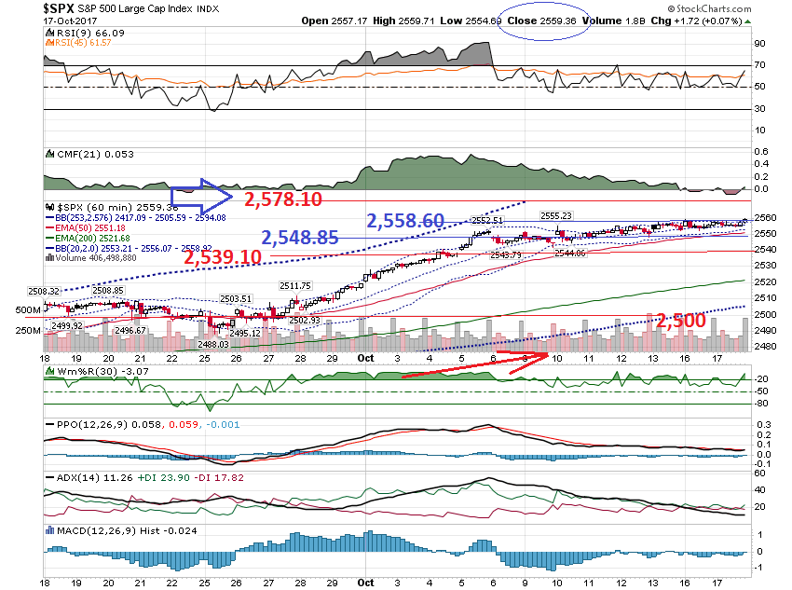

Slide 12
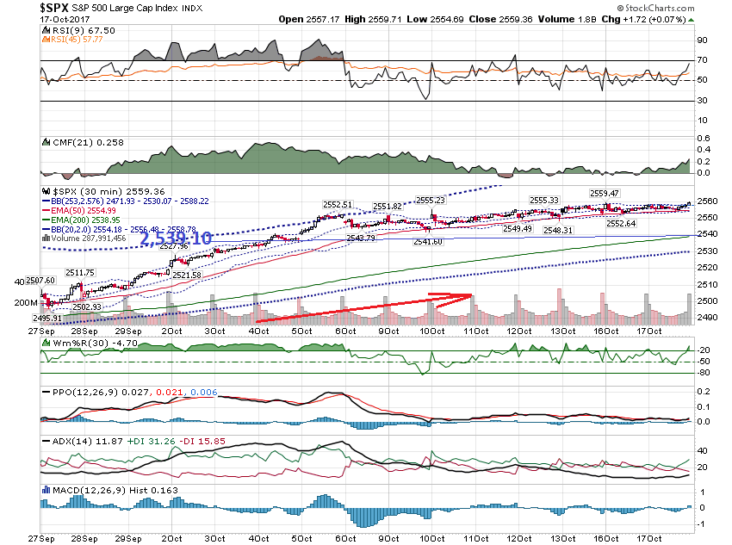

Slide 13
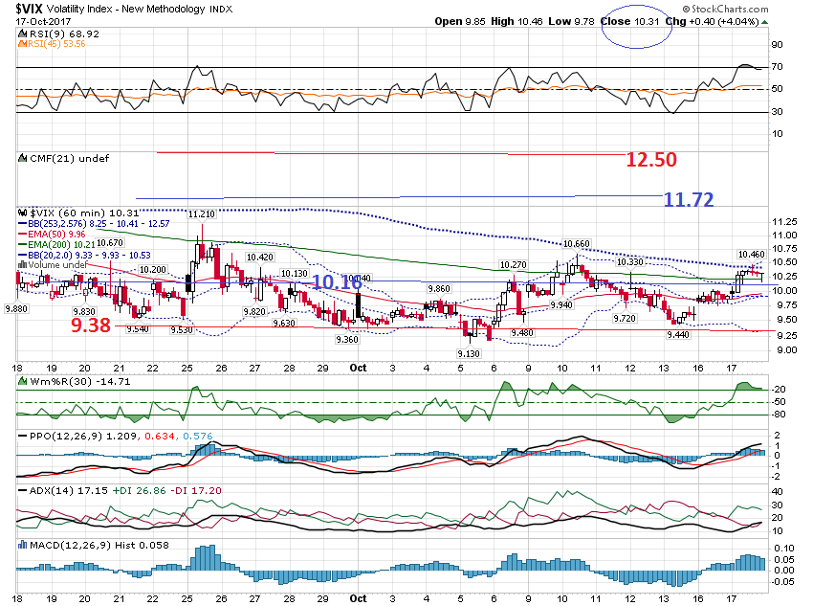

Slide 14
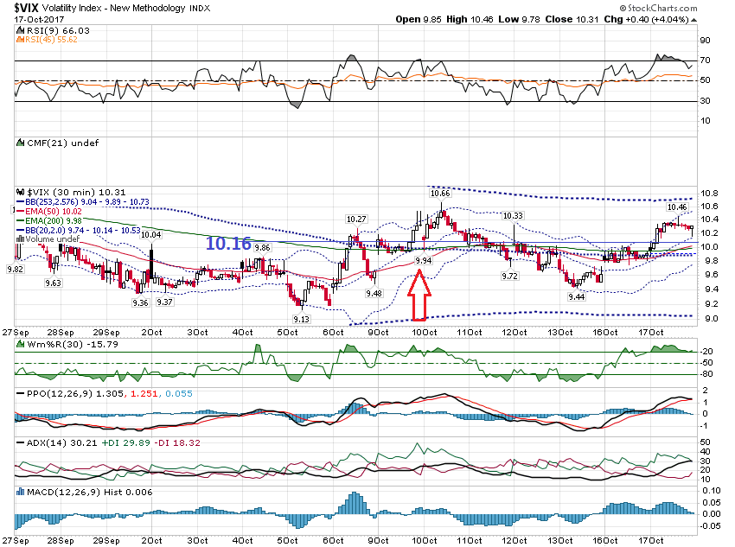

Slide 15
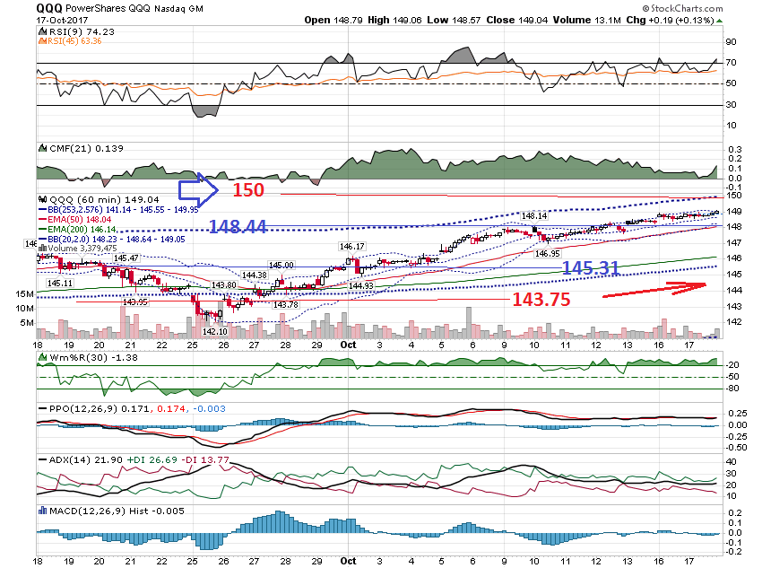

Slide 16
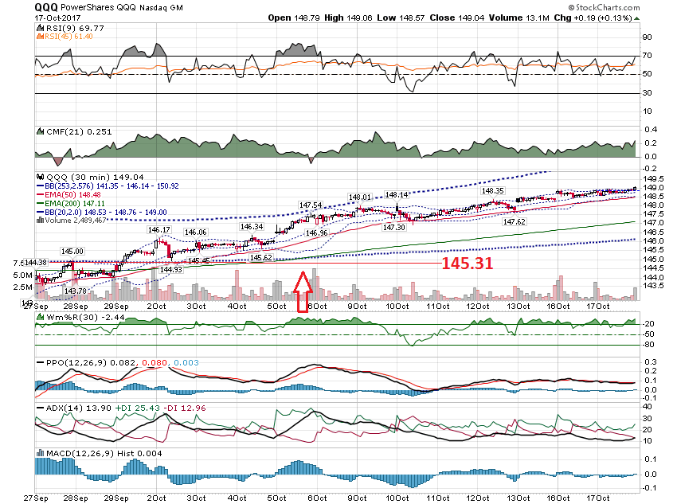

Slide 17
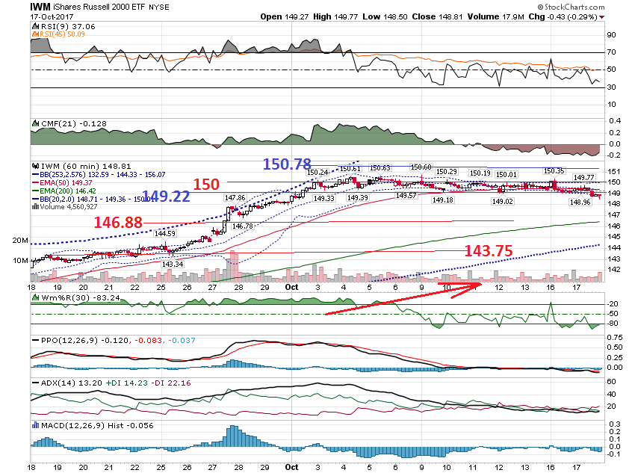

Slide 18
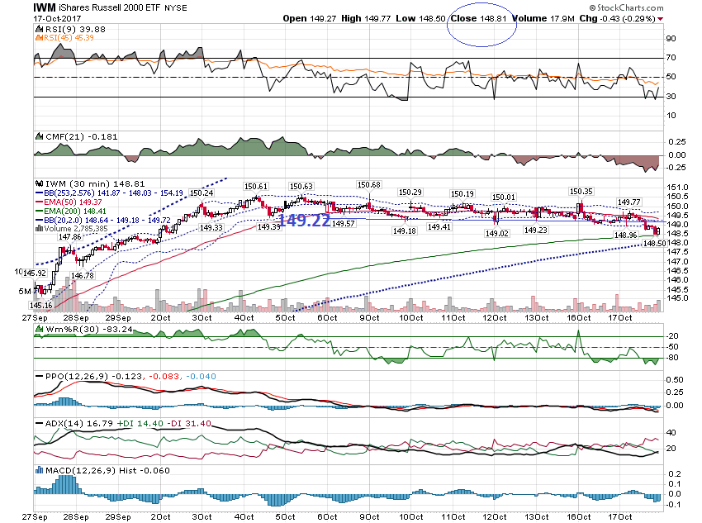

Slide 19
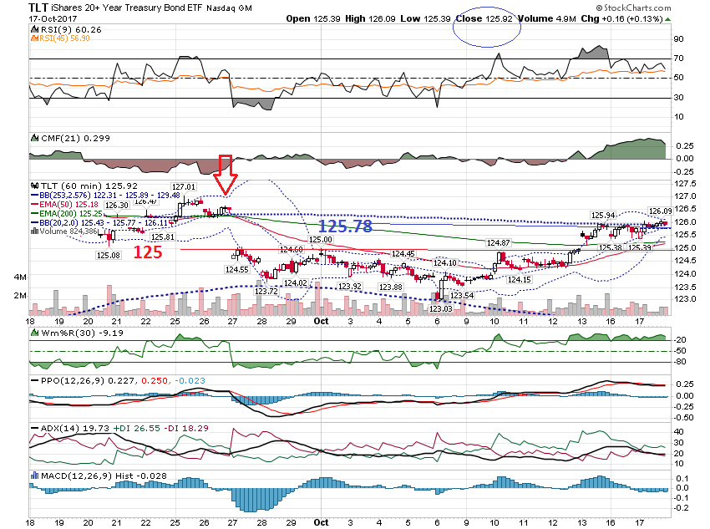

Slide 20
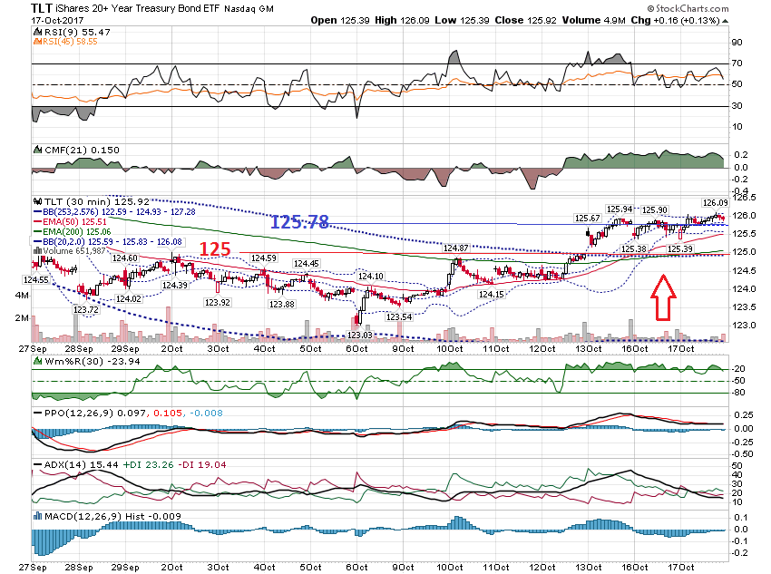

Slide 21
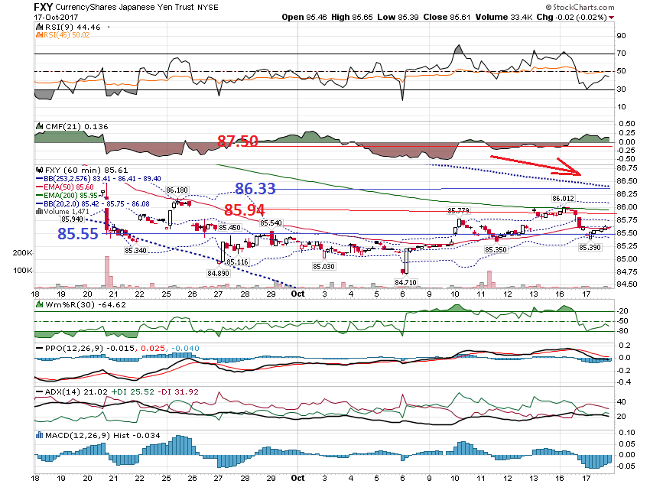

Slide 22
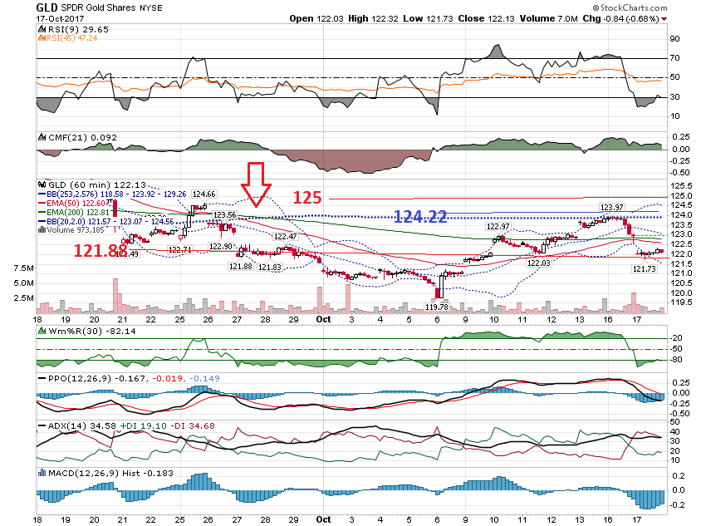

Slide 23
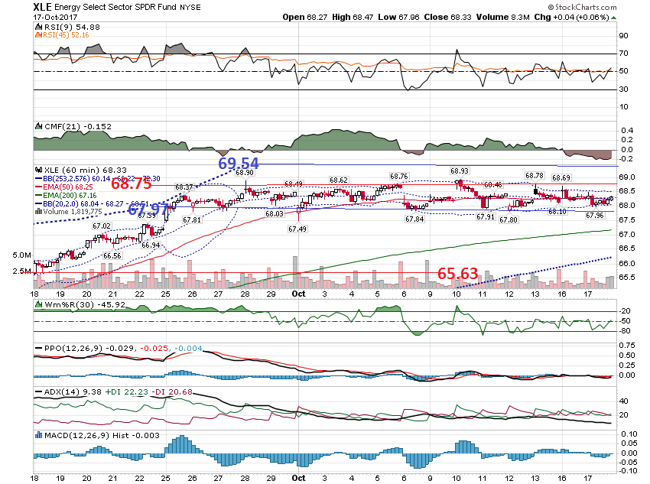

Slide 24
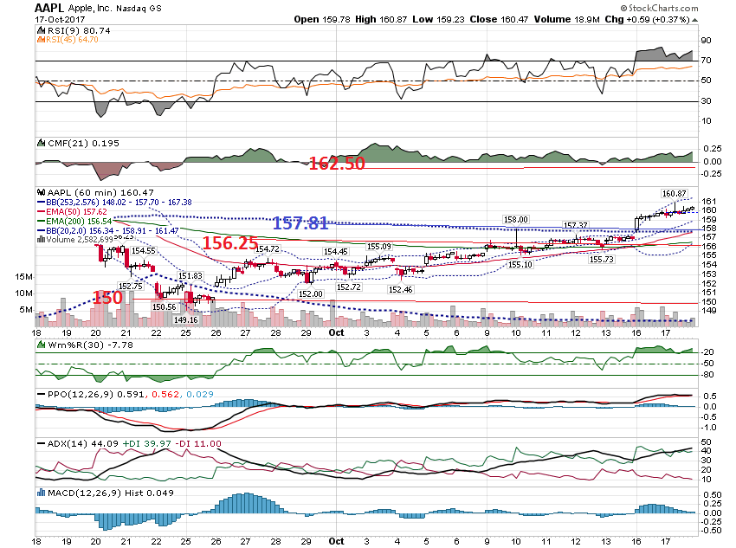

Slide 25
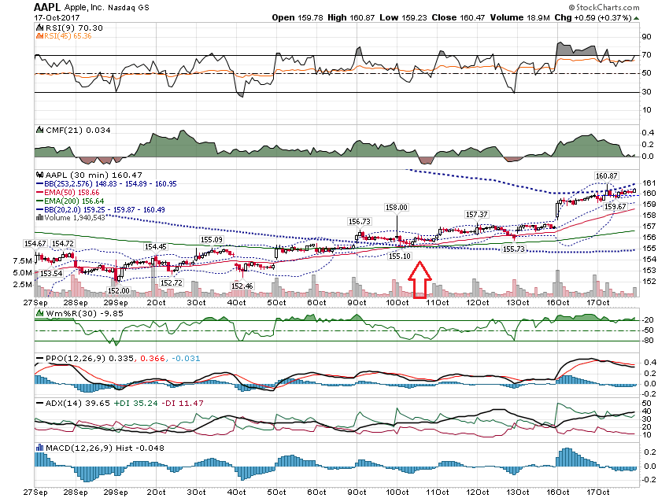

Slide 26
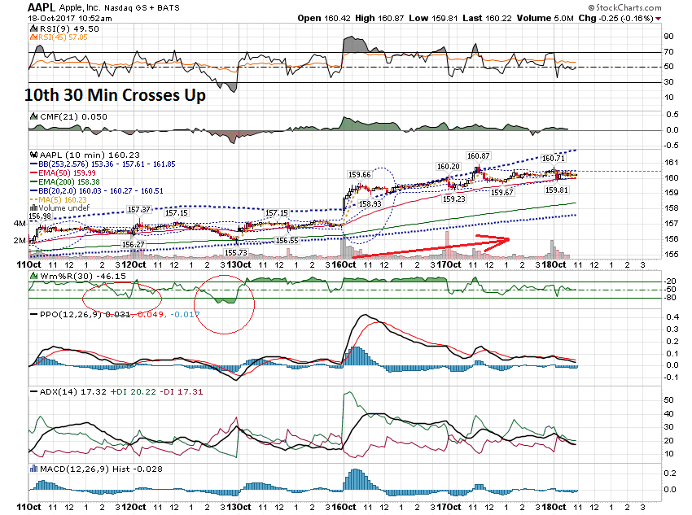

Slide 27
Additional Charts

Slide 28
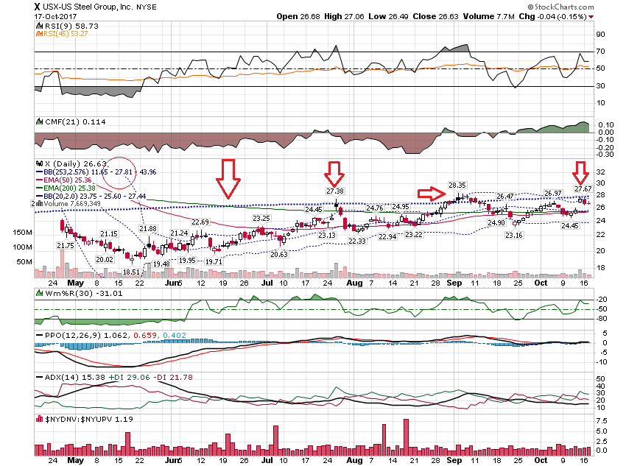

Slide 29
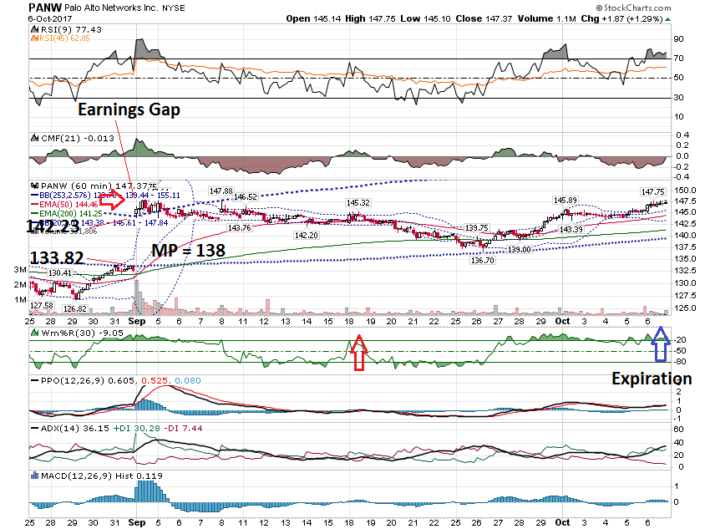

Slide 30
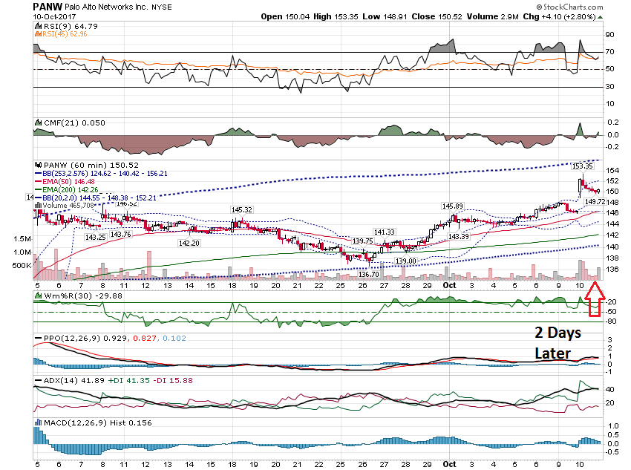

Slide 31
Options Quesiton:
Do you have 'rules of thumb' where you would look first... at the money, just out of the money...

Slide 32
At the moment, I have been buying 0.8 delta, 4 month+ dated calls along the lines of what Matt Buckley recommended in his series of live webinars in September 2016. These are 'ín the money' and maybe not as profitable (although very happy with the results so far) as options ATM or OTM.

Slide 33
Thanks for watching!
Bill Davis
Mad Day Trader
October 18, 2017 davismdt@gmail.com

