Slide 1

The Mad Hedge Fund Trader “Complacency Boom”
With John Thomas from Silicon Valley, CA, October 11, 2017 www.madhedgefundtrader.com
Notes:
*

Slide 2
The Northern California Fires
*20 wildfires totally out of control, fanned by high winds and ultra low humidity *Too big to put out, just have to get out of the way, melting steel and glass, turning all infrastructure into ashes *17 dead, 200 missing, 30,000 evacuated, most with only 10 minutes notice *130,000 acres burned destroying 3,000 houses, causing $50 billion in damage *Many historic vineyards destroyed, including Chalk Hill, Silverado, Stags Leap

Slide 3
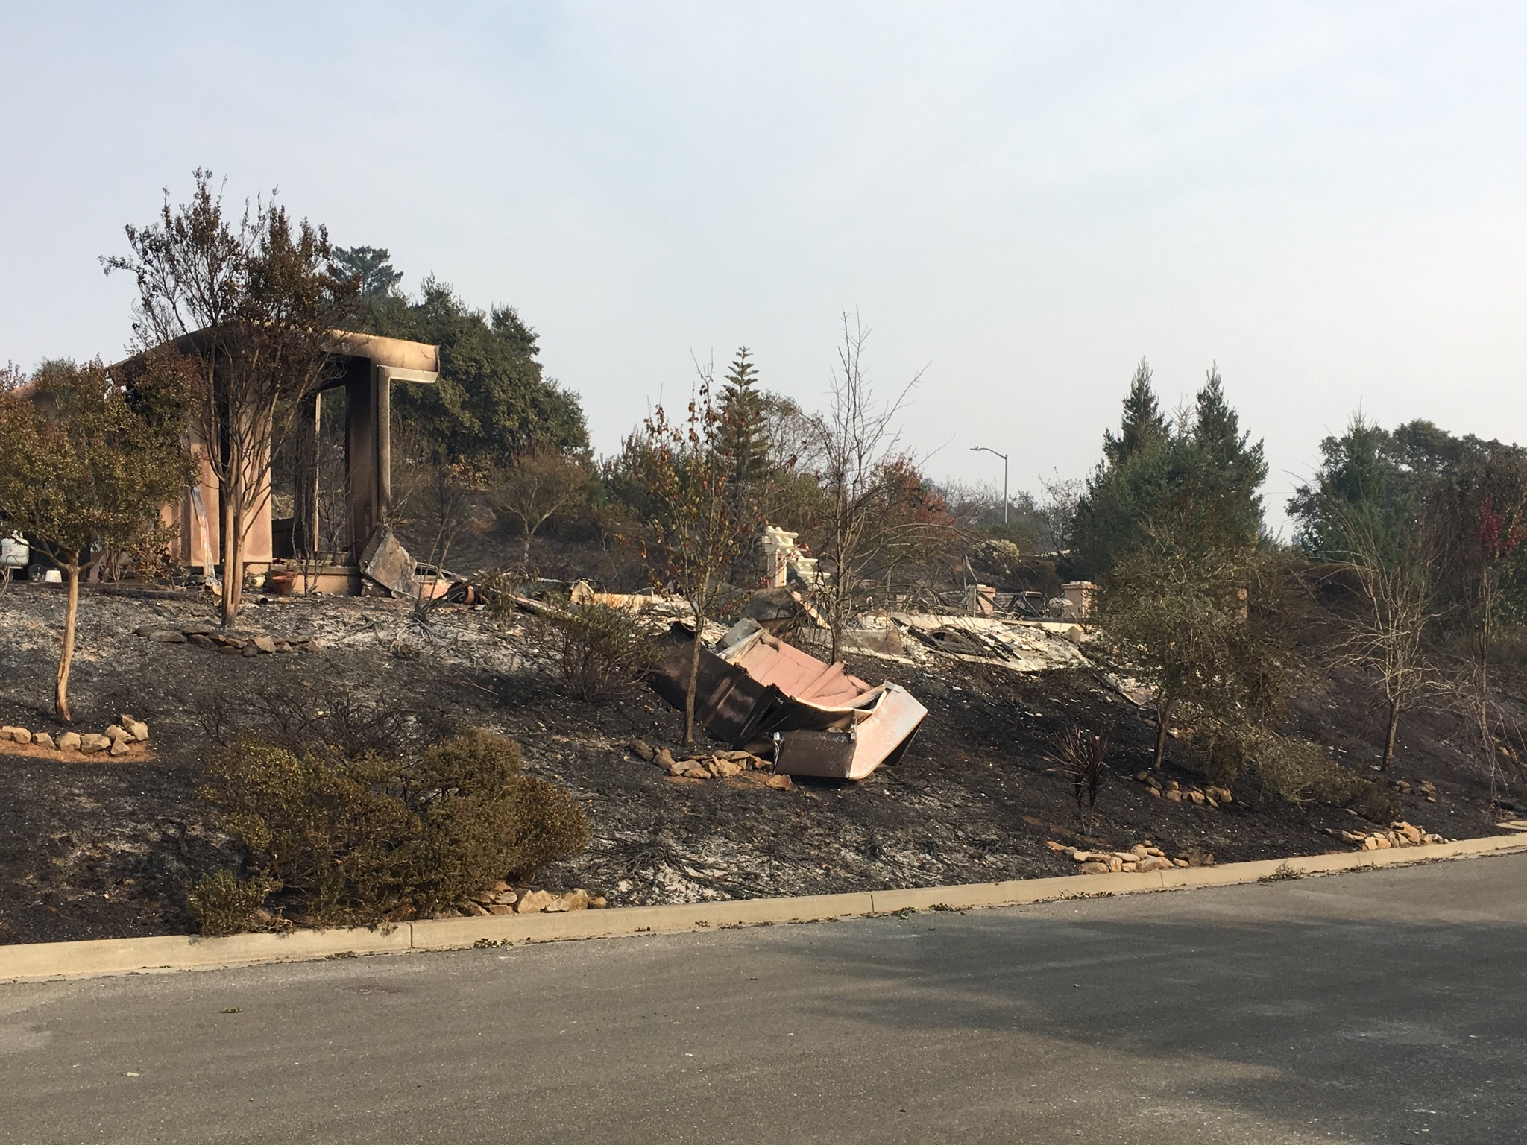

Slide 4


Slide 5

Mad Hedge/Top Gun Master Mind Investment Conference Buy tickets at www.madhedgefundtrader.com
November 3-4, Incline Village, NV The Snow Melted!

Slide 6


Global Strategy Luncheons Buy tickets at www.madhedgefundtrader.com
Chicago, IL December 27, 2017
Minneapolis, MN December 28, 2017

Slide 7

Trade Alert Performance Biggest Up Month in Ten Years! New All Time High!! 22 Consecutive Profitable Trade Alerts!!
*January +9.35% Final *July +1.95% Final *February +6.39% FINAL *August +18.38% Final *March +4.87% Final *September +7.65% Final *April +1.84% Final *October +1.82% MTD *May -0.45% Final *November 4.37% Final *June +0.70% Final *December +.84% Final *2017 Year to Date 52.50% compared to 15% for the Dow Average 31 of 32 consecutive profitable trade alerts *Trailing One year return +64.93%, +271.06% since inception, *Average annualized return of 34.60%

Slide 8
Portfolio Review Aggressive long position with small hedge
Current Capital at Risk
Risk On
World is Getting Better
(AAPL) 10/$140-$145 call spread | 10.00%
(GS) 10/$220-$225 call spread | 10.00%
(GS) 10/$227.50-$232.50 call spread | 10.00%
(TLT) 10/$127-$129 put spread | 10.00%
(TLT) 10/$126-$128 put spread | 10.00%
Risk Off
World is Getting Worse
(VXX) 1/$60 calls | -5.00%
Total Net Position | 45.00%
Expiration P&L 55.36% YTD

Slide 9
Trailing One-Year Return Daily Audited Performance +64.93%

Slide 10
Eight Year Daily Audited Performance Averaged Annualized Return +34.60%

Slide 11

The Method to My Madness Cashing out of all positions over the next 5 trading days
*Global stock markets melt up on tax cut hopes, with all sectors moving *Expect a flat line going into Q3 earnings, then another run into yearend
*Sell every bond rally….Janet put the top in with $4 T bond hoard liquidation *Look for main indexes to grind up for the rest of 2017 *Keep buying ”RISK OFF” assets like gold dips, as a hedge against brief bouts of profit taking in stocks *Same with ultra low Volatility, but keep size small *Avoid FANG’s, the game is in domestic laggards and reflation plays *Buy oil stocks on dips *Sell currencies on any new rallies, top is in

Slide 12
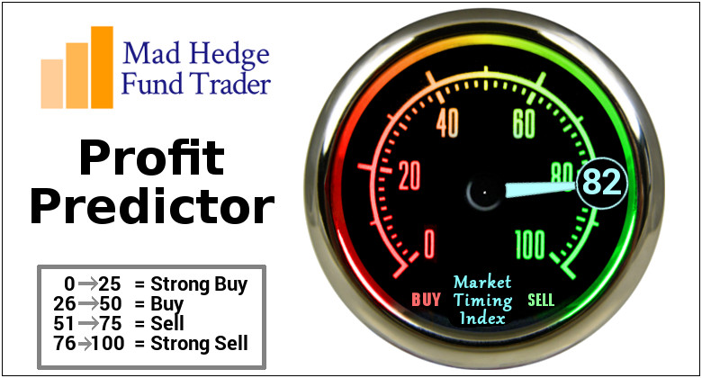
The Mad Hedge Profit Predictor Market Timing Index An artificial intelligence driven algorithm that analyzes 30 different economic, technical, and momentum driven indicators All Time Highs at 95 on Thursday!

Slide 13
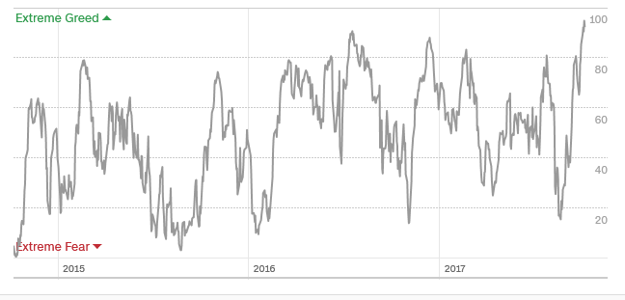
The Mad Hedge Profit Predictor Market Timing Index Risk at All Time High!

Slide 14
The Bill Davis View A $1,500 Upgrade for the Mad Day Trader Service
Buys: | Entry | Target
Regeneron Phar (REGN) | $455.00 | $480.00
Goldman Sachs (GS) | $240.00 | $252.00
General Dynamics (GD) | $210.00 | $225.00
3 M Co. (MMM) | $214.00 | $220.00
Salesforce.com (CRM) | $95.00 | $100.00
F 5 Networks (FFIV) | $112.00 | $137.00
Sells:
Core Labs (CLB) | $97.00 | $85.00
Celgene Corp (CELG) | $142.00 | $127.00
Kansas City So (KSU) | $107.00 | $95.00
Papa John's (PZZA) | $73.00 | $55.00
Tractor Supply (TSCO) | $62.00 | $47.00

Slide 15
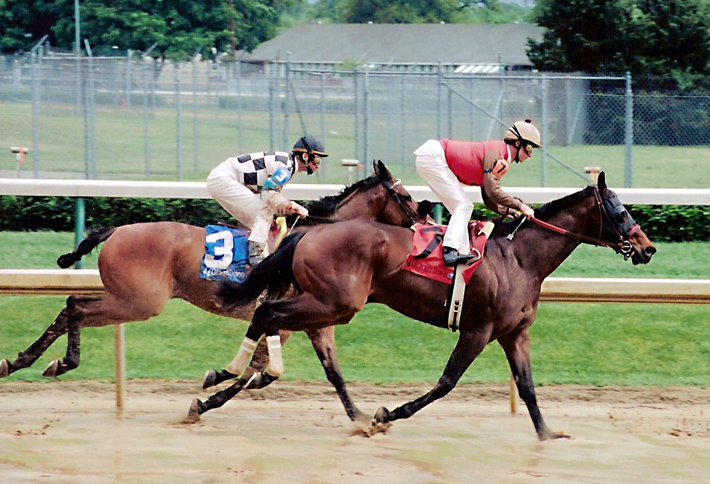
The Global Economy-Off to the Races
*September Nonfarm Payroll shows a loss at -33,000, the first in many years, headline unemployment at 4.2%, a 13 year low, ADP private sector jobs at 135,000 as the hurricanes totally muddle the data *Economic data have turned from mixed to hot, with September PMI rocketing to 61.3%, Non Manufacturing Business Activity at 61.3%, and New Orders Index up 5.9% to 63.0% *US Q2 GDP bumps up to 3.1%, a two year high, August Durable Goods jump1.7%, *Carmakers announce blockbuster September Auto Sales in hurricane wake, GM and Toyota both up 8.7% *Japanese October 22 election will prolong Japanese QE for four more years
*It’s all very market positive, and severely limited the downside to the last correction

Slide 16
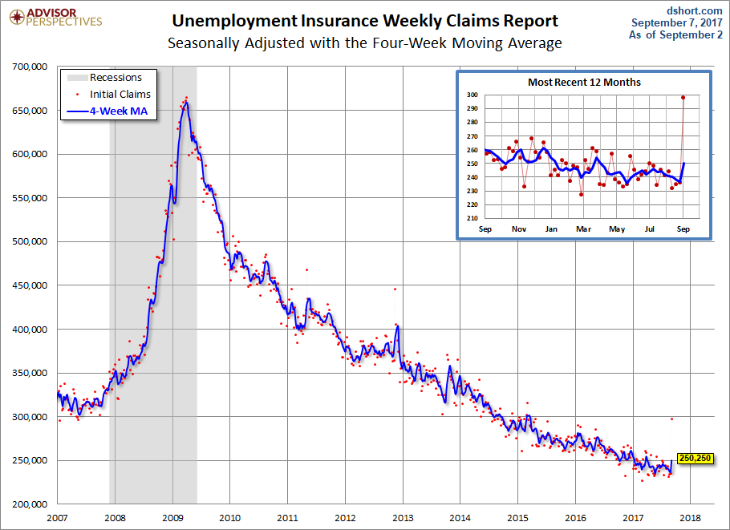
Weekly Jobless Claims –The Most Important Statistic -12,000 to 265,000 as hurricane effects abate

Slide 17

Stocks-Complacency Running Rampant
*While stocks have been on a tear, earnings multiples have remained stable at 18X all year, the market is just catching up with earnings, only FANG multiples rising *Stepped up tax cut talk triggered the latest melt up, but can’t happen any earlier that 2018, watch out for disappointments, 50% is already priced in *Almost all index gains in 2018 thanks to two sectors, technology and energy *$2 trillion has moved from active to passive (index) managed *New 3 year low in the Volatility Index (VIX) *Rotation out of FANG’s and into banks and domestics continues, now two months old *Oil and legacy semiconductors have joined the laggard plays *Look for (SPY) $260 by yearend

Slide 18
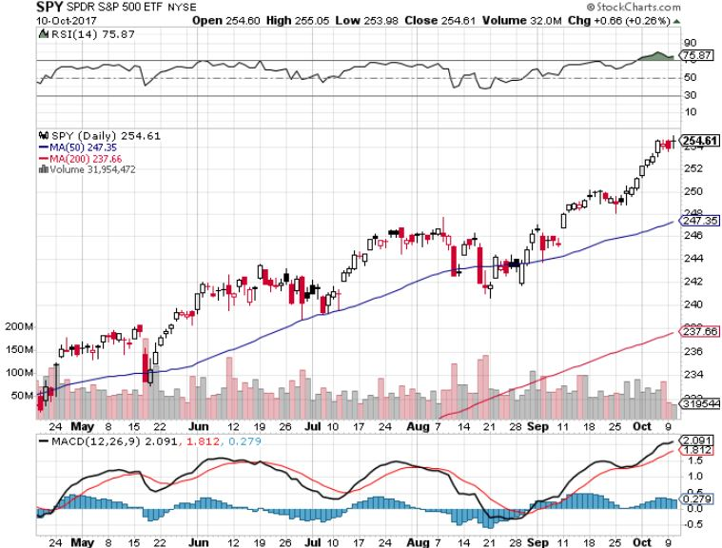
S&P 500-New Highs

Slide 19
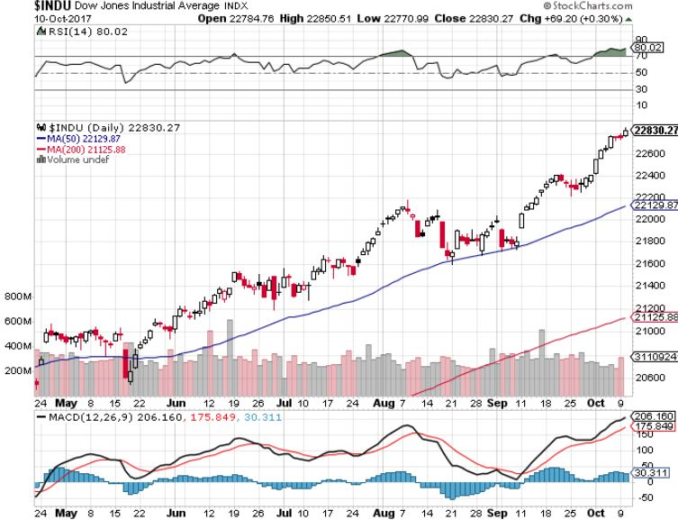
Dow Average-New Highs Haven’t Retraced to the 50 Day MA since May-Very High Risk

Slide 20
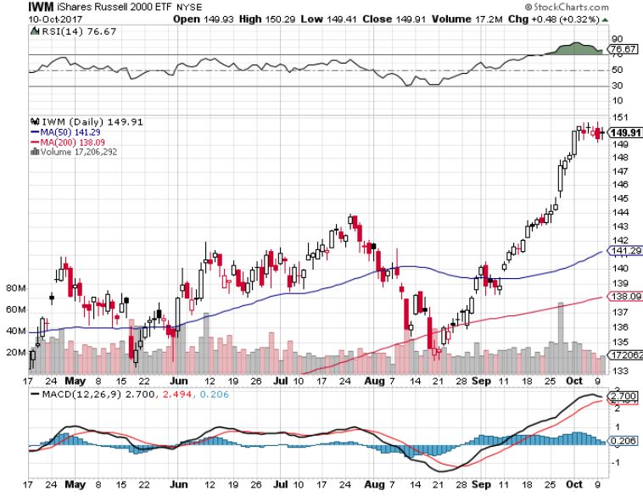
Russell 2000 (IWM)-New Highs Even Higher Risk

Slide 21
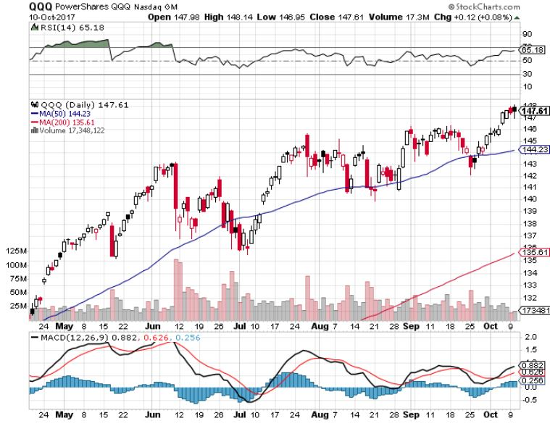
NASDAQ (QQQ)-New Highs

Slide 22
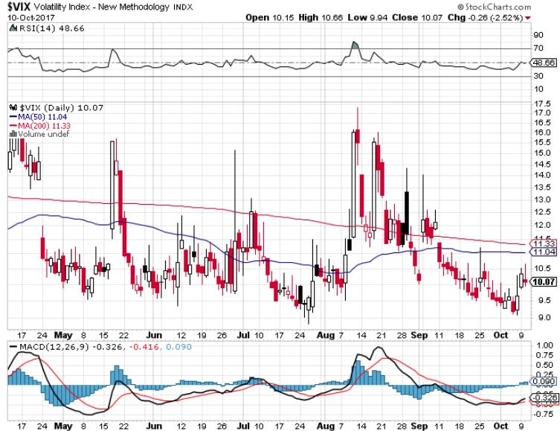
(VIX)-Just Missed New Lows

Slide 23
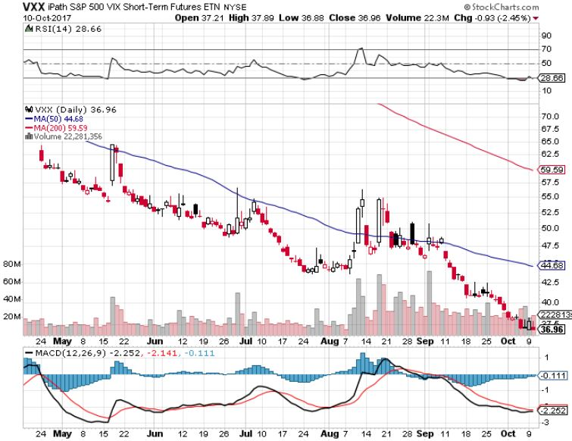
iPath S&P 500 VIX Short-Term Futures ETN (VXX) Begging for New Lows long 1/$20 calls as a hedge for rest of portfolio profits on long 11/$20 calls

Slide 24
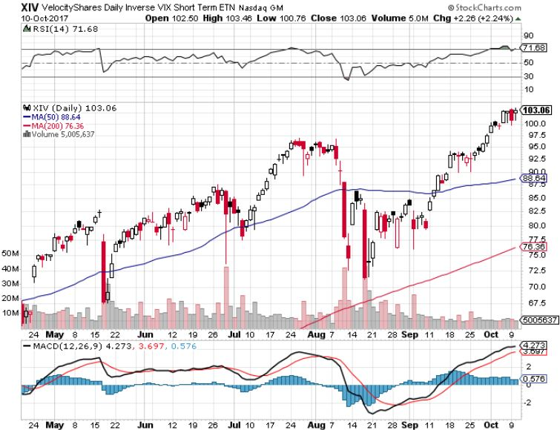
Velocity Shares Daily Inverse VIX Short Term ETN (XIV) One of the most instantly profitable trades of 2016….and 2017 took profits on (XIV) long at $81.45

Slide 25
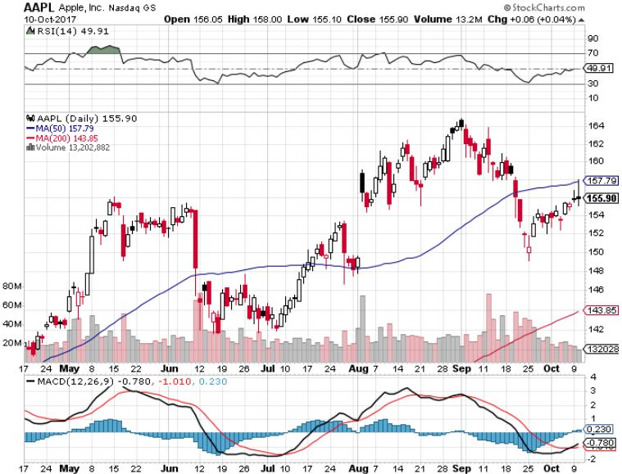
Apple (AAPL)-IPhone X is Out! long 10/$140-$145 bull call spread-expires in 8 days took profits on short 9/$170-$175 bear Put Spread took profits on long 9/$140-$145 bull call spread

Slide 26
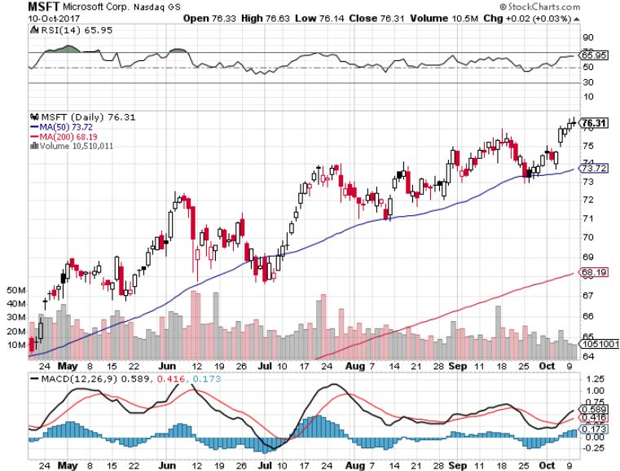
Microsoft (MSFT)

Slide 27
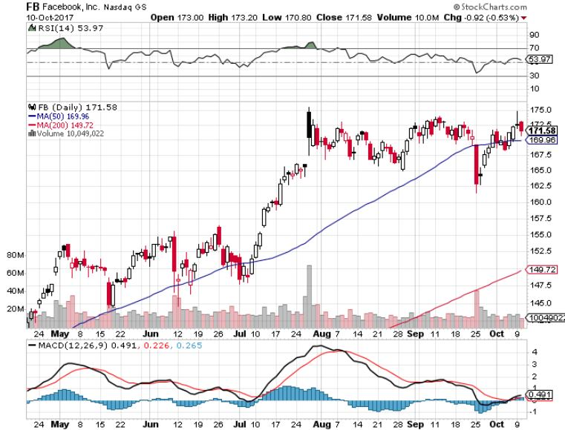
Facebook (FB)-

Slide 28
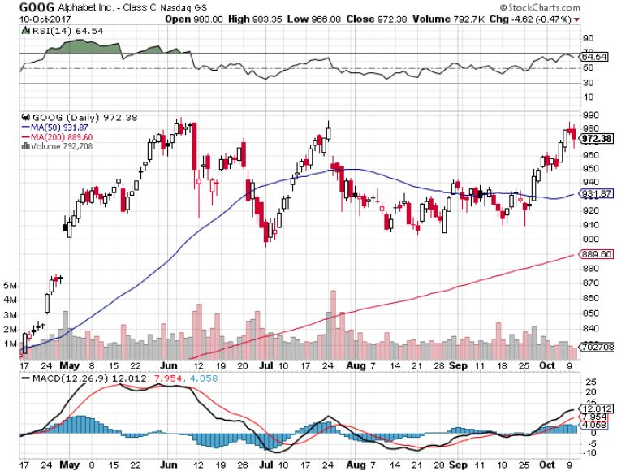
Alphabet (GOOG)-New High

Slide 29
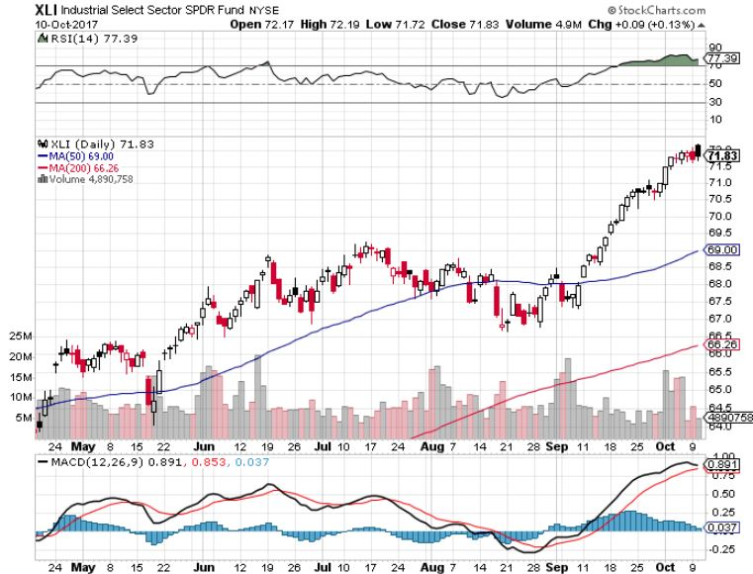
Industrials Sector SPDR (XLI)- (GE), (MMM), (UNP), (UTX), (BA), (HON)

Slide 30
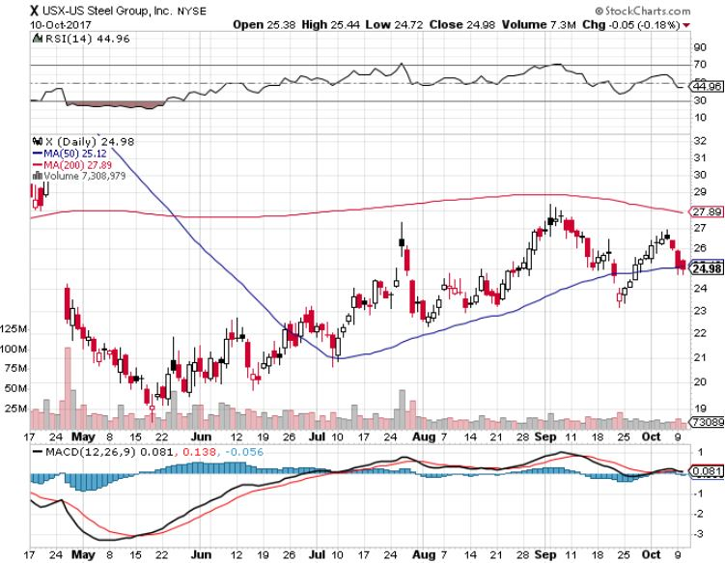
US Steel (X)- took profits on long the 9/$21-$22 vertical bull call spread

Slide 31
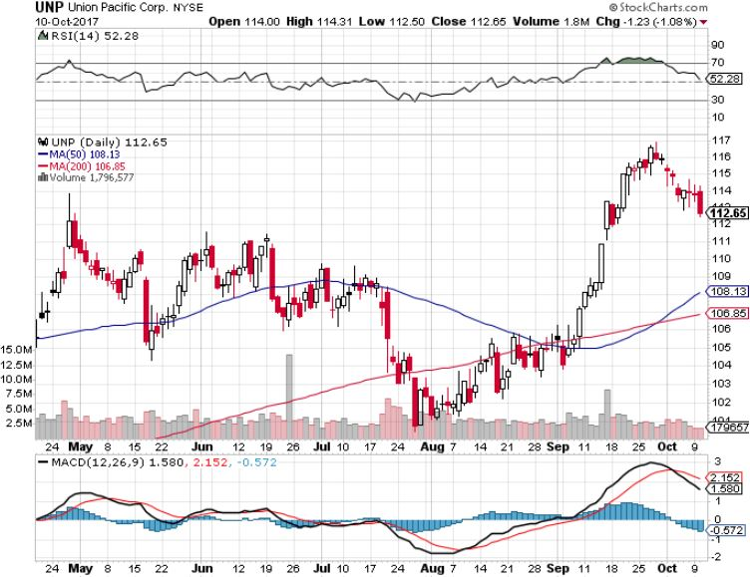
Union Pacific Railroad (UNP)- took profits on long the 9/$100-$102 vertical bull call spread

Slide 32
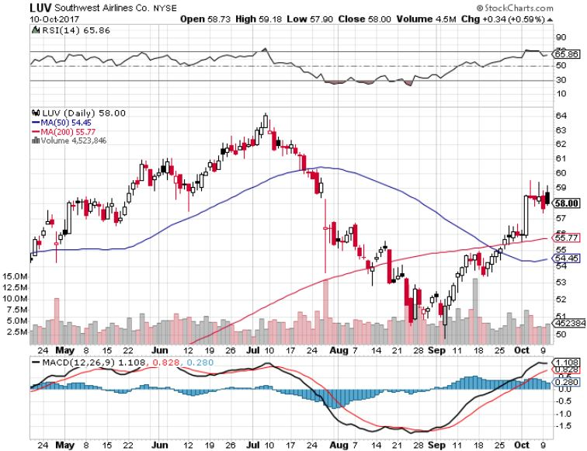
Southwest Airlines (LUV)- Warren Buffett’s Favorite Airline

Slide 33
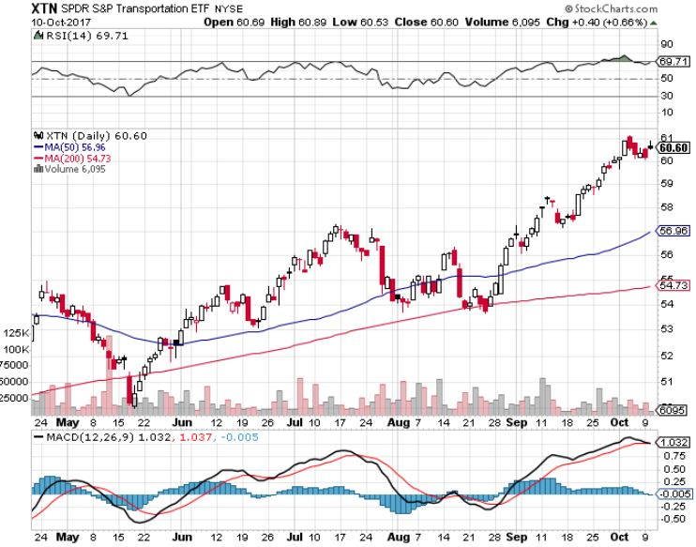
Transports Sector SPDR (XTN)- (ALGT), (ALK), (JBLU), (LUV), (CHRW), (DAL)

Slide 34
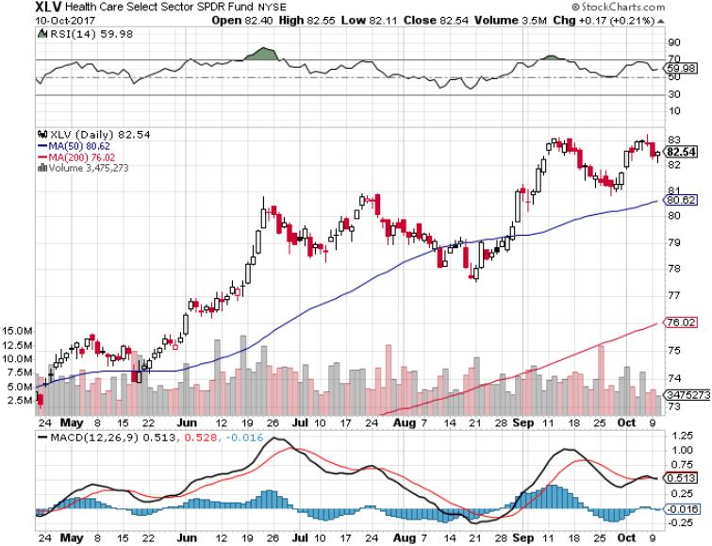
Health Care Sector (XLV), (RXL)-The New FANG? (JNJ), (PFE), (MRK), (GILD), (ACT), (AMGN)

Slide 35
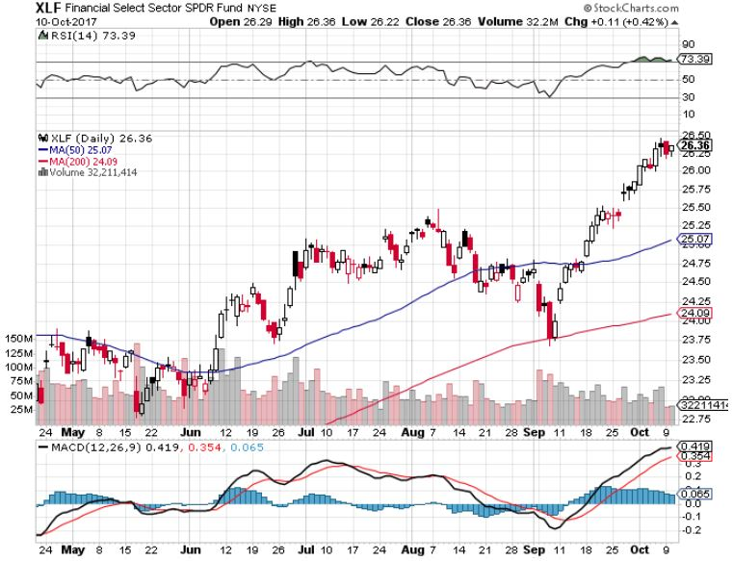
Financial Select SPDR (XLF)-New Highs (BLK/B), (WFC), (JPM), (BAC), (C), (GS)

Slide 36
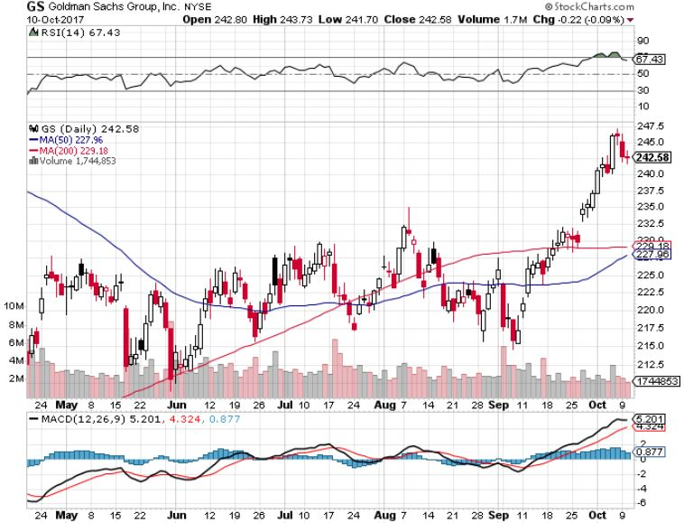
Goldman Sachs (GS)-October 17 earnings long 10/$220-$225 vertical bull call spread-expires in 8 days long 10/$227.50-$232.50 vertical bull call spread-expires in 8 days took profits on long 9/$205-$210 vertical bull call spread took profits on long 9/$235-$240 vertical bear put spread

Slide 37
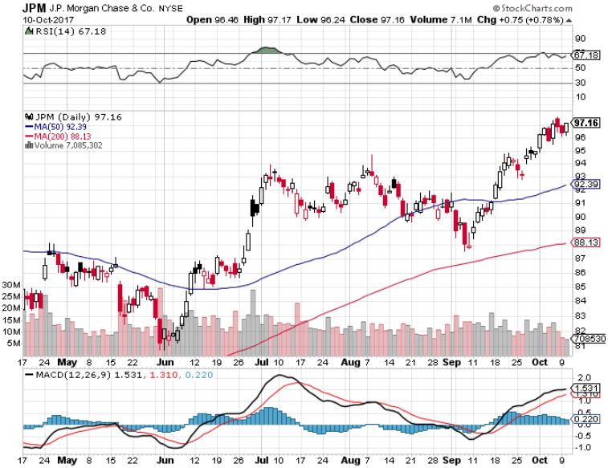
JP Morgan (JPM)-

Slide 38
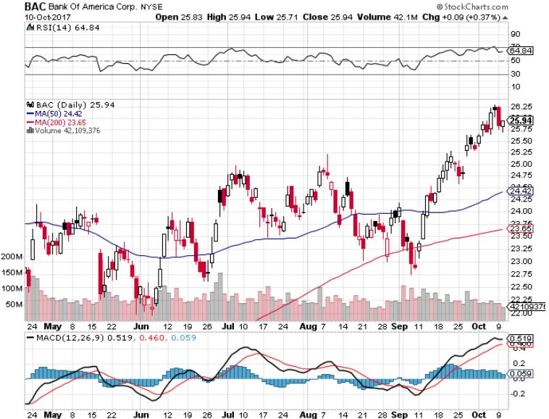
Bank of America (BAC)- Warren Buffet exercises warrants and buys 700 million shares, with paper profit of $12 billion

Slide 39
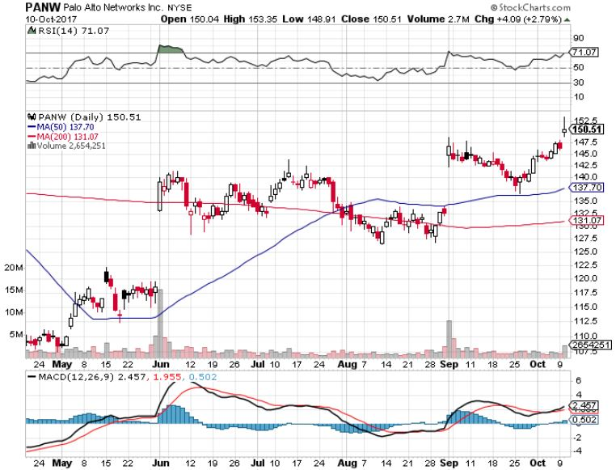
Palo Alto Networks (PANW)-

Slide 40
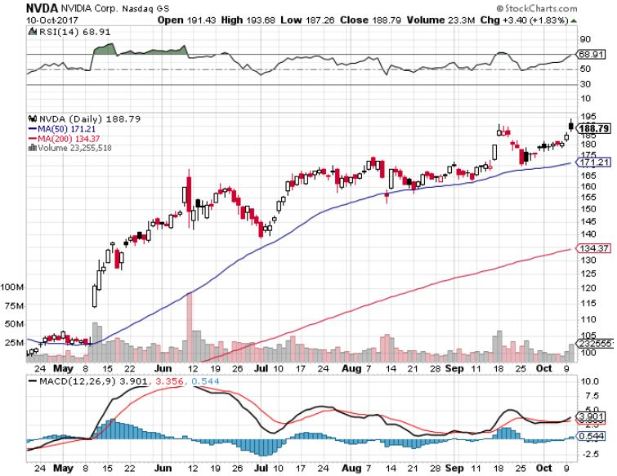
NVIDIA (NVDA)-New Highs

Slide 41
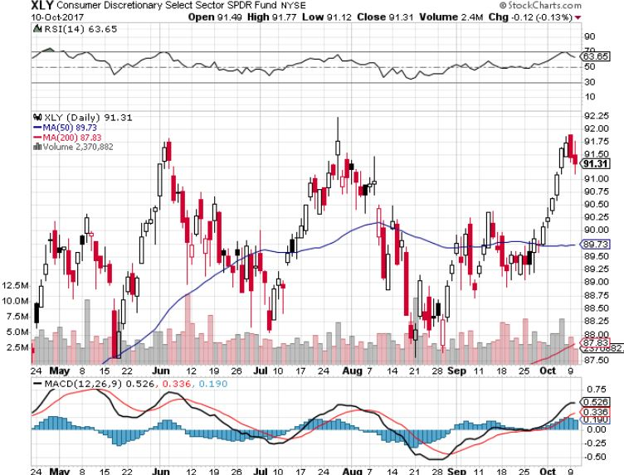
Consumer Discretionary SPDR (XLY) (DIS), (AMZN), (HD), (CMCSA), (MCD), (SBUX)

Slide 42
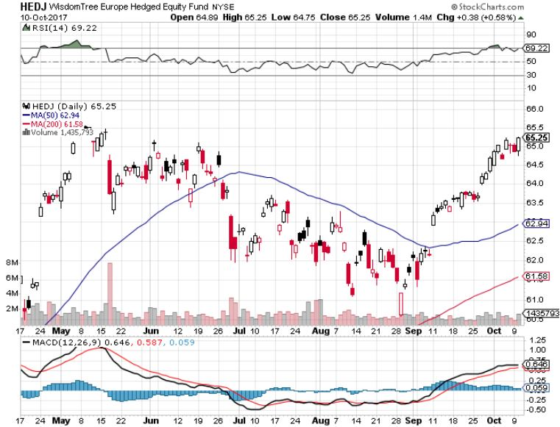
Europe Hedged Equity (HEDJ)-Global Rally

Slide 43
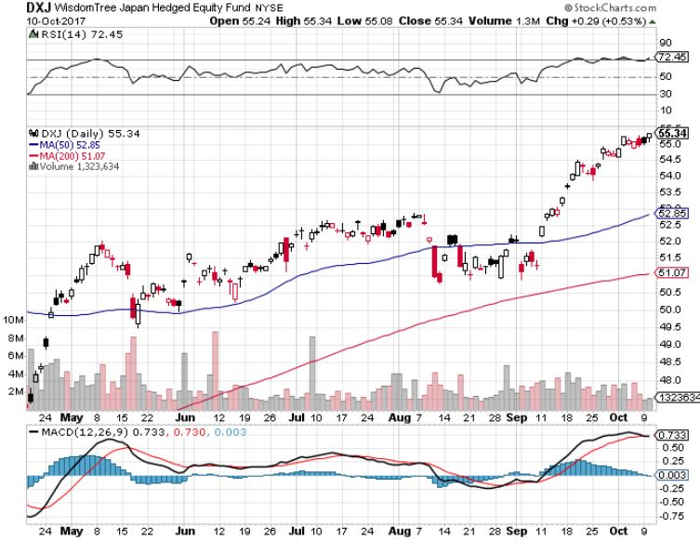
Japan (DXJ)-More Global Rally on Yen Weakness

Slide 44
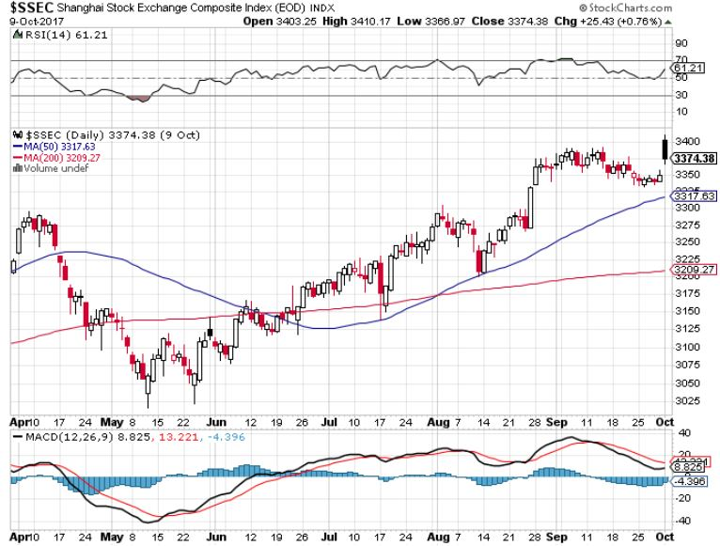
China ($SSEC)-Economic Recovery on Track

Slide 45
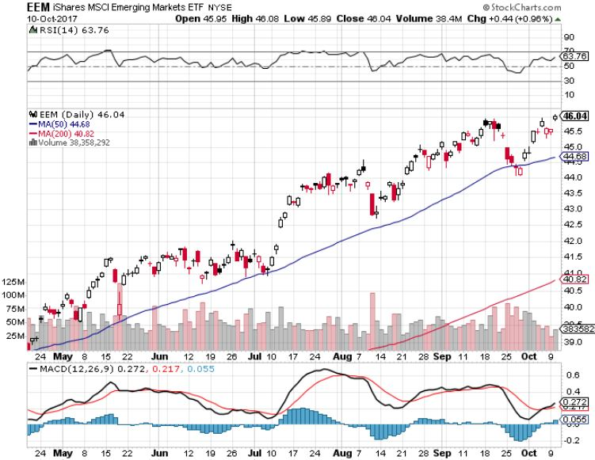
Emerging Markets (EEM)- New High

Slide 46

Bonds-Breakdown!
*The December rate hike is now a certainty after the September pass *Ten year Treasury (TLT) yield of 2.64% now just a matter of time *Global central banks are still creating $114 billion a month in new liquidity through QE, Japan, Europe, and Switzerland *$6 billion a month, or $200 million a day in bond sales to start soon and are overhanging the market *Puts a price cap on bonds at $129, and a yield bottom at 2.02%, for the rest of 2017 *Puerto Rico bonds are now worthless, with no ability to repay, trading at 32 cents on the dollar, or over a 30% yield *We are one year into a 10-20 year bear market in bonds, now is a great entry point on the short side

Slide 47
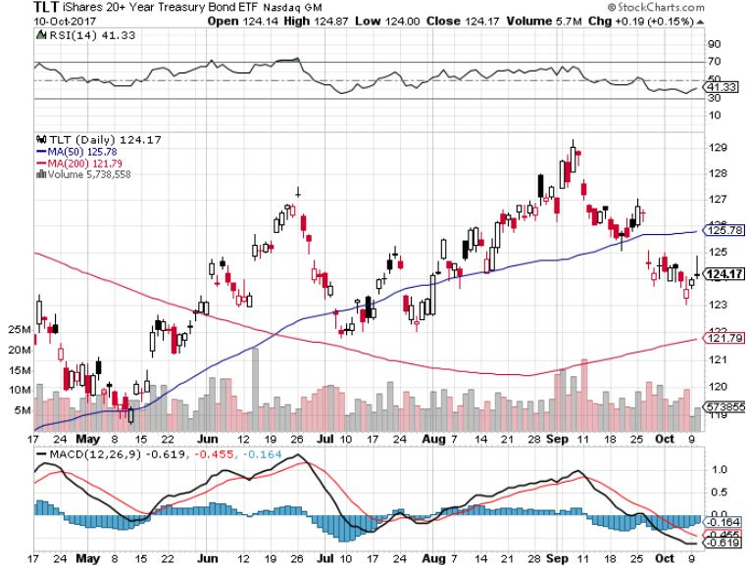
Treasury ETF (TLT) – 2.32%-My Rich Uncle Trade! long 10/$126-$128 vertical bear put spread-expires in 8 days long 10/$127-29 vertical bear put spread-expires -expires in 8 days took profits on long 10/$129-$131 vertical bear put spread took profits on long 8/$128-$130 vertical bear put spread took profits on long 9/$129-$132 vertical bear put spread

Slide 48
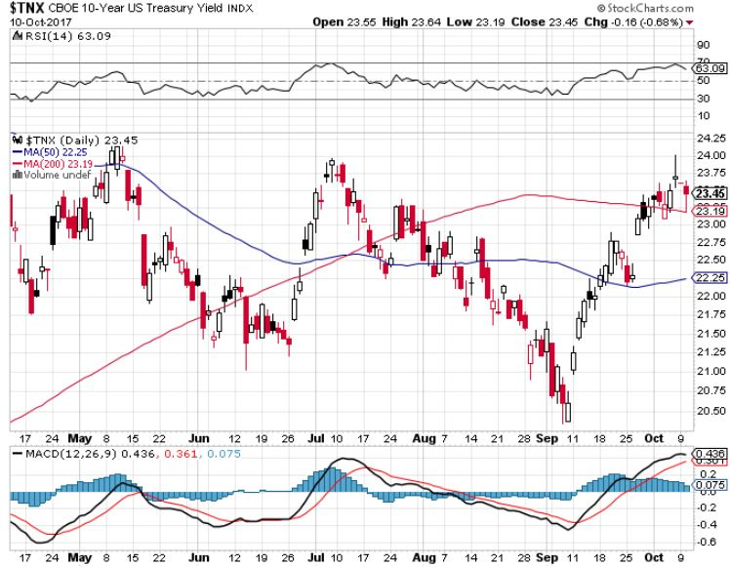
Ten Year Treasury Yield ($TNX) 2.34% Breakdown!

Slide 49
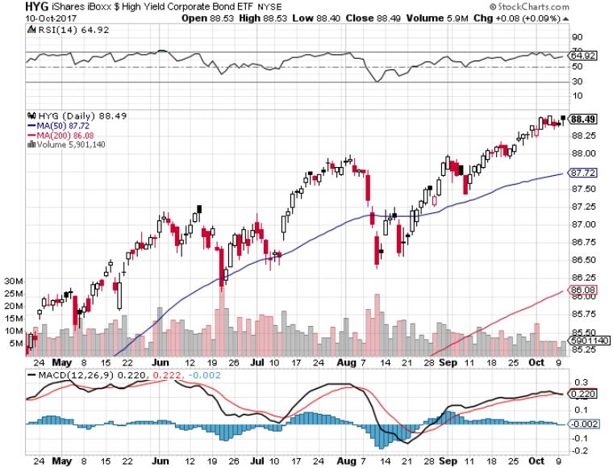
Junk Bonds (HYG) 4.89% Yield A Great Risk Coincident Indicator- Long Term “RISK ON” means new highs, buy all dips

Slide 50
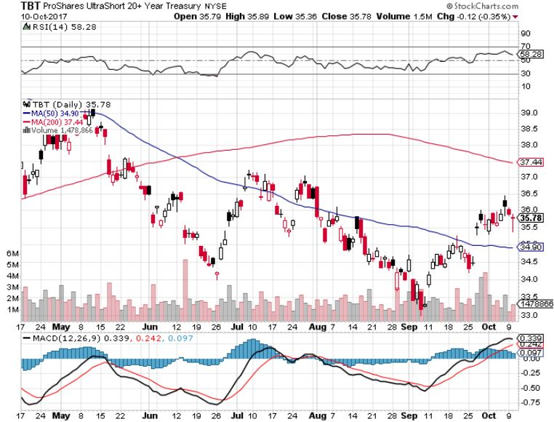
2X Short Treasuries (TBT)-In Screaming “BUY” Territory

Slide 51
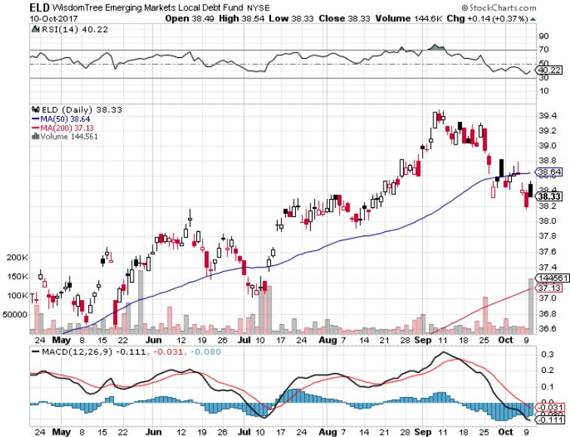
Emerging Market Debt (ELD) 5.63% Yield-

Slide 52
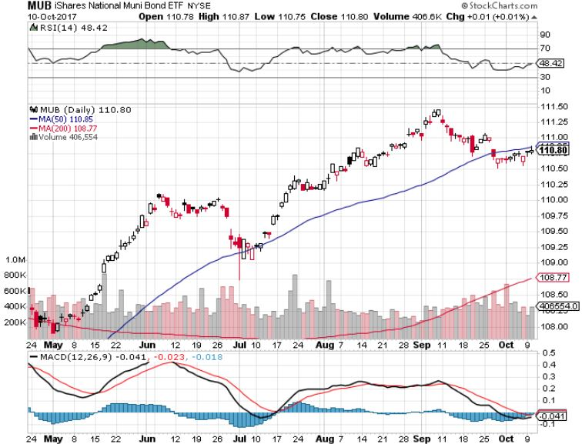
Municipal Bonds (MUB)-1.59%-Gap Up Mix of AAA, AA, and A rated bonds

Slide 53

Foreign Currencies-Dollar Trend
*As US interest rates rise, it looks like the dollars lows for 2017 are in, will continue for months *Rising US rates break the back of the Euro (FXE), “head and shoulder” top is now clearly in, sell every rally *With four more US rate rises schedule for 2018, the final bottom is in for the dollar *Catalan independence votes causes further Euro weakness *Strong US rates kill off Loonie (FXC) and Aussie (FXA) as well

Slide 54
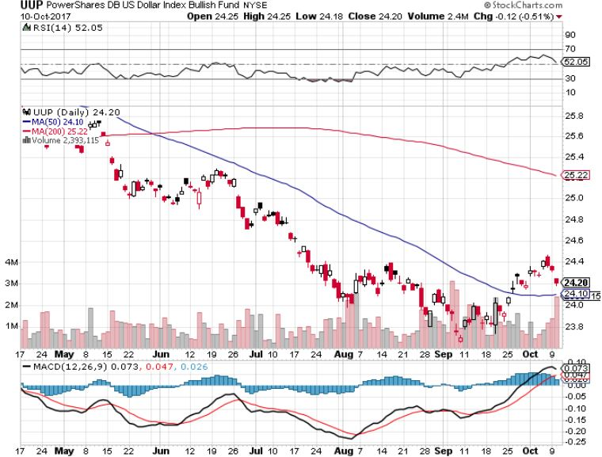
US Dollar Basket-(UUP)-Double Bottom is in

Slide 55
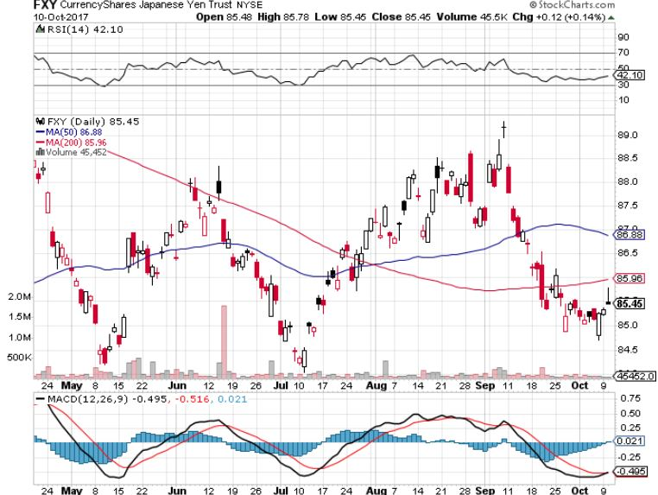
Japanese Yen (FXY)-

Slide 56
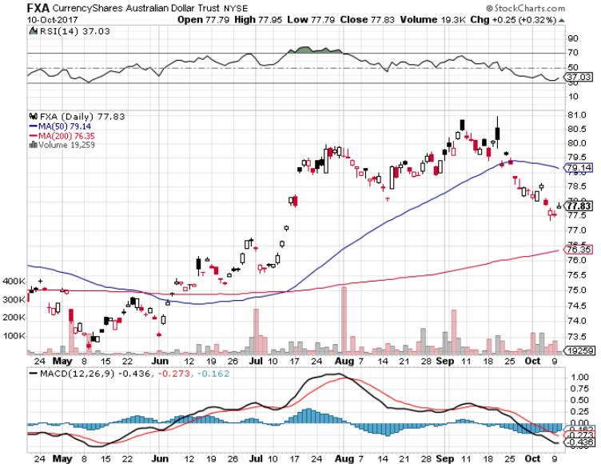
Australian Dollar (FXA)-Game is Over

Slide 57
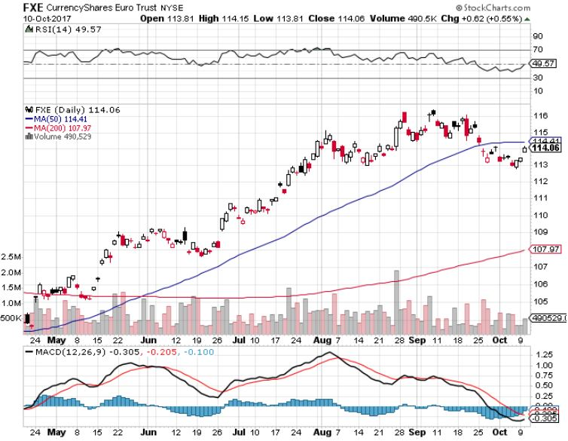
Euro ($XEU), (FXE), (EUO)- Head and Shoulders Top

Slide 58
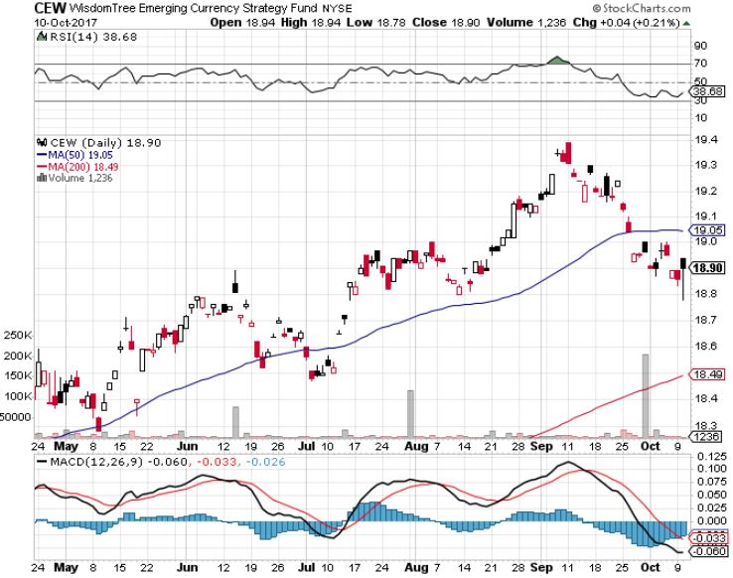
Emerging Market Currencies (CEW)

Slide 59
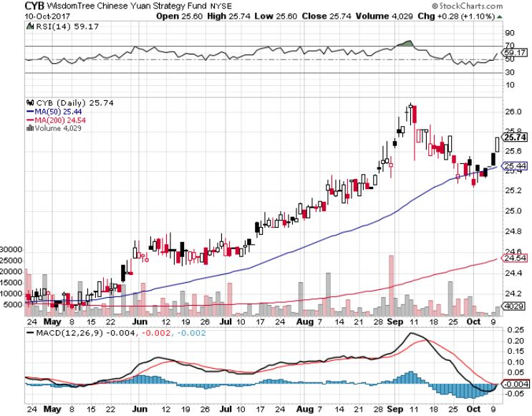
Chinese Yuan- (CYB)-Stabilizing on Government Support

Slide 60
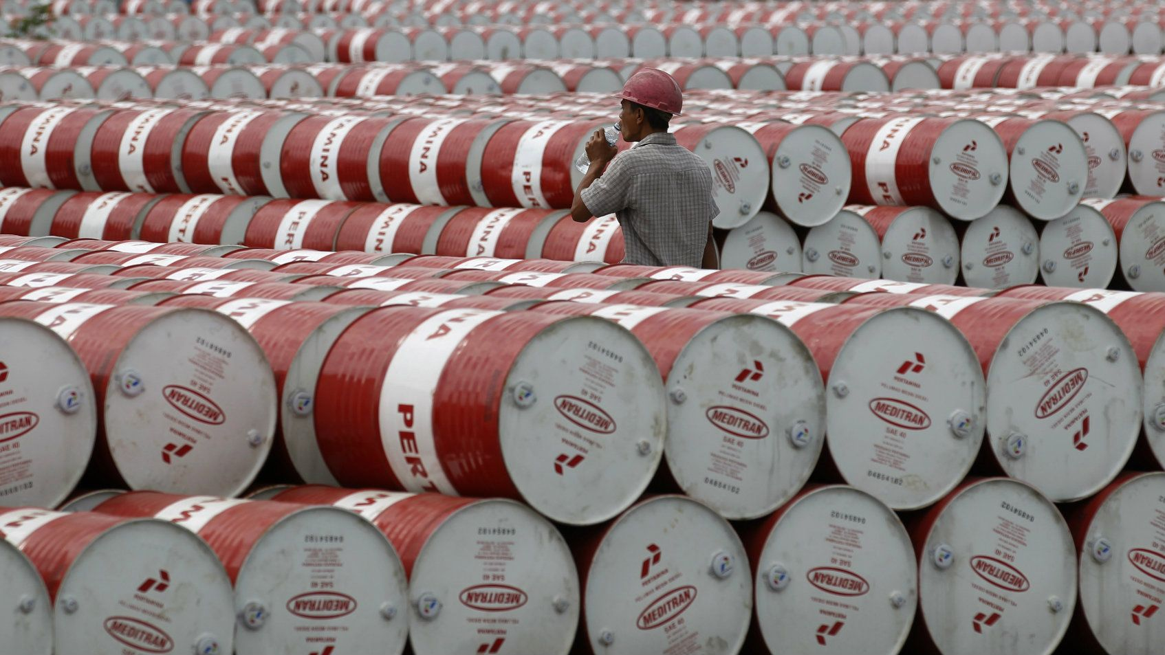
Energy-Breakout!
*Putin meets Saudi king for the first time, presages more cooperation of production targets *Oil breaks out to a new four month high, and is now targeting $55 *Global oil demand is reaccelerating, thanks to increased China demand *OPEC quotas expended to March 2018, could be extended to end 2018, and Russia is joining in *But increasing supplies from Iraq on ISIS defeat, and Libya will limit gains *Chaos caused by twin hurricanes still unwinding *Fracking supply is leveling off *Buy the dips in energy stocks

Slide 61
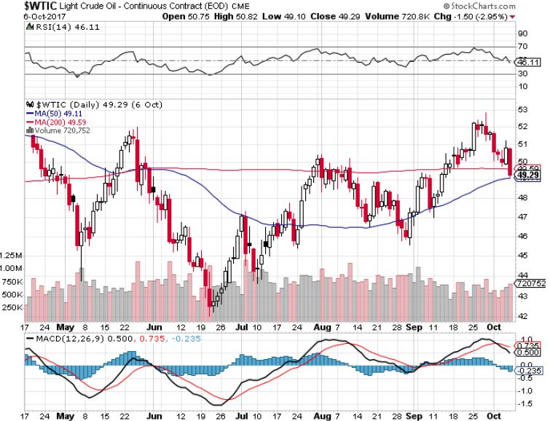
Oil-Breakout!

Slide 62
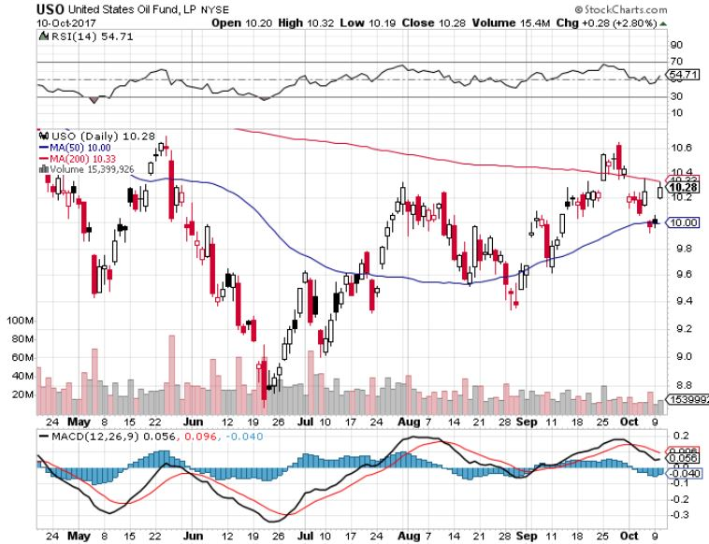
United States Oil Fund (USO)

Slide 63
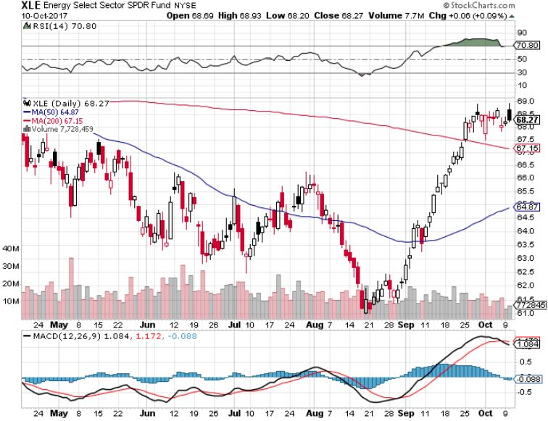
Energy Select Sector SPDR (XLE)-New Lows! (XOM), (CVX), (SLB), (KMI), (EOG), (COP)

Slide 64
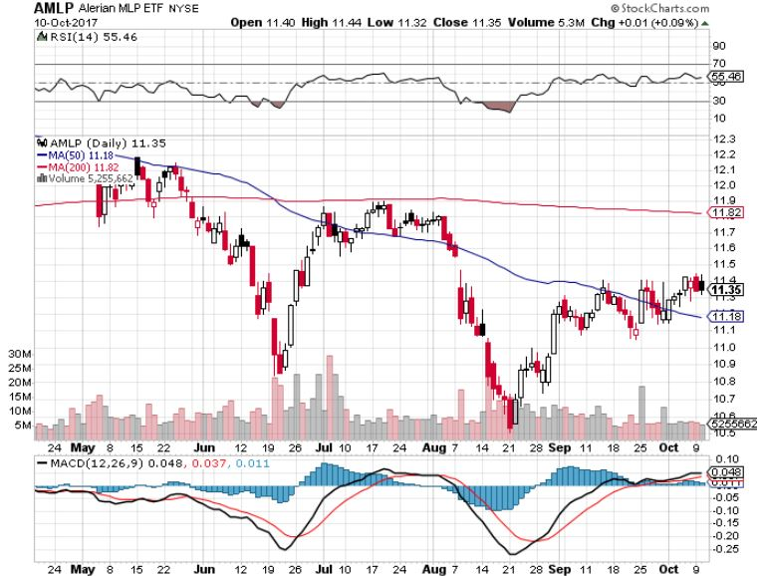
Alerian MLP ETF (AMLP)- Basket Approach is the Only Safe Play Here

Slide 65

Exxon (XOM)-The Bottom is In

Slide 66

Schlumberger (SLB)-Lower Risk Service Play

Slide 67

Halliburton (HAL)-Service Play

Slide 68

Natural Gas (UNG)-No Joy

Slide 69

Copper (COPX)-China Infrastructure Build Out

Slide 70

Precious Metals-Out of Favor
*Gold backed ETF holdings like (GLD) soar by 24.2 metric tonnes in September to 2,357t, with North America as the only buyer *With “RISK” assets rising every day, who need a gold hedge? *Higher interest rates increase the opportunity cost of holding gold *Gold coins sales hit 11 year low *Chinese holidays back many buyers away from gold *Palladium rises above for price of platinum for the first time in a decade as electric cars catch up with traditional vehicles, cutting catalytic converter demand *Buy gold and silver stocks on the next big dip, as the move is still only a few months old

Slide 71

Gold (GLD)-Retest of the Trend hedging trades starting to move again

Slide 72

Market Vectors Gold Miners ETF- (GDX) Took profits on long the 9/$20.50-$21.50 bull call spread

Slide 73

Barrick Gold (ABX) took profits on long 9/$15-16 call spread-stopped out too soon

Slide 74

Newmont Mining- (NEM)-Breakout took profits on long the 9/$32-$34 bull call spread

Slide 75

Global X Silver Miners ETF- (SIL)-Breakout took profits on long the 9/$31-$33 bull call spread

Slide 76

Bitcoin-Modern Day Tulips!

Slide 77

Platinum- (PPLT)-Crash!

Slide 78

Palladium- (PALL)-Breakout!

Slide 79

Agriculture-Still Sitting on a Bottom
*Strong US dollar killing off nascent rally in the ags *Low river levels causing transportation for ags, especially corn, as barges struggle to avoid sand banks *Weather drying out in the Midwest, but no impact on prices yet *Hedge funds maintaining huge shorts in corn and wheat *Be thankful we haven’t done an Ag trade for five years

Slide 80

(CORN) –New Lows!

Slide 81

(WEAT)-Major Breakdown

Slide 82

(SOYB)-Dead in the Water

Slide 83

Real Estate-No Homes For Sale
*Real estate market effectively grinds to a halt as extreme shortage of supply causes prices to rocket beyond the means of new buyers *Now a new problem: uncertainty of deductibility of real estate taxes will overhang market for the next 3-6 months *August Pending Home Sales down a poor -2.6%, Mortgage Applications down 24% YOY, thanks to higher rates and much higher prices *Fed move to unwind bond hoard means this may be the last chance to get 3.5% 30 year loans *July S&P 500 Case-Shiller maintains strong 5.9%, with absolute prices hitting new all time high

Slide 84

Home Depot (HD)-Double Bottom + Twin Hurricane Help took profits on long $9/$141-$144 vertical bull call spread

Slide 85

July S&P 500/Case–Shiller Home Price Index +5.9% YOY, Seattle (+13.5%), Portland (7.6%), Las Vegas (7.4%) still leaders price rises accelerating

Slide 86

General Growth Properties (GGP)-New Lows Long Term Downtrend-From Rising Rates to Mall Destruction

Slide 87

US Home Construction Index (ITB) (DHI), (LEN), (PHM), (TOL), (NVR) A Favorite Sector to Buy

Slide 88

Trade Sheet-The Complete Opposite So What Do We Do About All This?
*Stocks- buy dips until proven otherwise *Bonds-sell any and all rallies *Commodities-buy industrials, energy *Currencies-sell yen and Euro on any rallies *Precious Metals –buy dips *Volatility-stand aside until over $16, or under $10 *The Ags –stand aside *Real estate-buy dips

Slide 89

Next Strategy Webinar 12:00 EST Wednesday, October 25, 2017 San Francisco, CA Buy conference and lunch tickets at madhedgefundtrader.com
Good Luck and Good Trading!
Notes:
*

