Slide 1
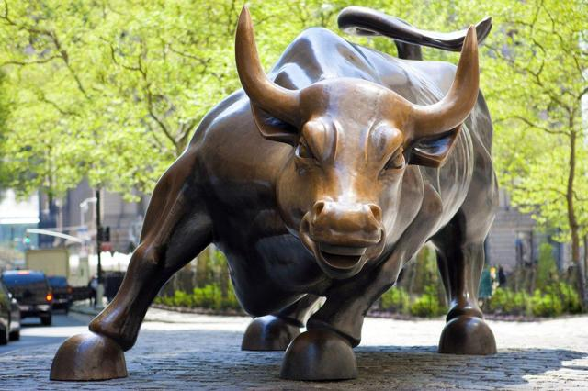
The Mad Hedge Fund Trader
“The Melt Up Continues”
With John Thomas
from Silicon Valley, CA, October 25, 2017
www.madhedgefundtrader.com
Notes:
*

Slide 2

Mad Hedge/Top Gun Master Mind Investment Conference
Buy tickets at www.madhedgefundtrader.com
November 3-4, Incline Village, NV
Only 9 Days More Days Left!

Slide 3


Global Strategy Luncheons
Buy tickets at www.madhedgefundtrader.com
Chicago, IL
December 27, 2017
Minneapolis, MN
December 28, 2017

Slide 4

Trade Alert Performance
Biggest Up Month in Ten Years! New All Time High!!
22 Consecutive Profitable Trade Alerts!!
*January +9.35% Final *July +1.95% Final
*February +6.39% FINAL *August +18.38% Final
*March +4.87% Final *September +7.65% Final
*April +1.84% Final *October +1.12% MTD
*May -0.45% Final *November 4.37% Final
*June +0.70% Final *December +.84% Final
*2017 Year to Date 51.80%
compared to 15% for the Dow Average
31 of 34 consecutive profitable trade alerts
*Trailing One year return +56.81%, +270.36% since inception,
*Average annualized return of 34.49%

Slide 5
Portfolio Review
No “sweet spot” entry points
Risk/Reward is out of balance
Risk is at all time highs
No Positions

Slide 6
Trailing One-Year Return
Daily Audited Performance
+56.81%
RUN!

Slide 7
Eight Year Daily Audited Performance
Averaged Annualized Return +34.49%
RUN
Faster!

Slide 8

Sellers Strike!
*If you sell your stocks now you’ll get hit with a backbreaking 39% tax rate (and 55% in California)
*If you wait only two months, that tax rate could drop to 20%, 15%, or to nothing at all.
*So why sell now?
*Investors are maxing out 2017
pension fund contributions to
minimize this year’s taxes, and
all the money is pouring into
stock index funds, creating the
melt up

Slide 9
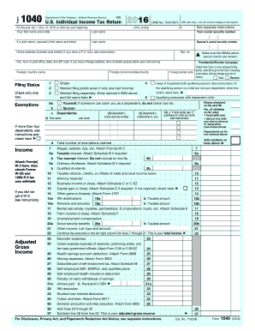
Gaming Your Taxes
Take Maximum Advantage of the Coming Tax Changes
*Roll as much income as possible into 2018 to cut your 2017 tax bill
*2018 taxes are not payable until April 15, 2019
*Defer capital gains until next year
*Accelerate all deductions into 2017
*Max out any pension fund contribution in 2017
*Pay local real estate taxes and mortgage
interest in advance in case these
deductions are eliminated
*Pay Your 2017 employee bonuses
this year

Slide 10

The Method to My Madness
*Global stock market melt up has taken stocks to record valuation and momentum highs, Great Q3 earnings adding fuel to the fire
*Look for the tax bill to introduce volatility. It’s not going to be all a big kumbaya
*Sell every bond rally….Janet put the top in with $4 T bond hoard liquidation
*Look for main indexes to grind up for the rest of 2017
*Keep buying ”RISK OFF” assets like gold on dips
as a hedge against brief bouts of profit taking in stocks
*Avoid FANG’s, the game is in domestic laggards
and reflation plays and banks
*Buy oil stocks on dips
*Sell currencies on any new rallies, top is in

Slide 11
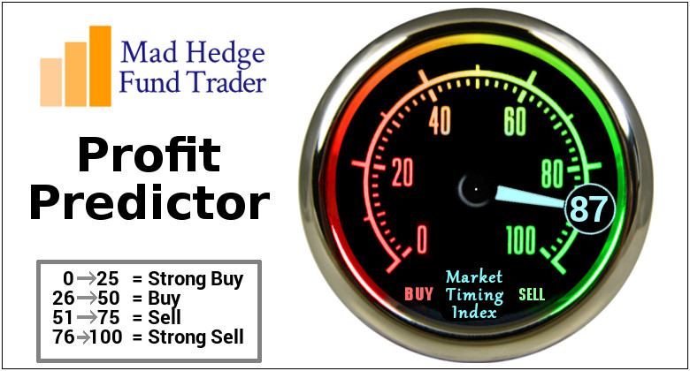
The Mad Hedge Profit Predictor
Market Timing Index
An artificial intelligence driven algorithm that analyzes 30 different economic, technical, and momentum driven indicators
Risk Still at Multi Year Highs!

Slide 12
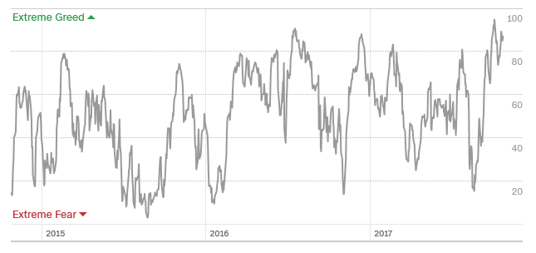
The Mad Hedge Profit Predictor
Market Timing Index
Risk at All Time High!

Slide 13
The Bill Davis View
A $1,500 Upgrade for the Mad Day Trader Service
Buys: | Entry | Target
Beckton Dickinson (BDX) | $200.00 | $218.00
Buffalo Wild Wings (BWLD) | $100.00 | $140.00
Celgen Corp (CELG) | $100.00 | $125.00
Starbucks Corp (SBUX) | $55.00 | $63.00
US Steel (X) | $28.00 | $38.00
Amazon.com, Inc. (AMZN) | $953.00 | $1,000.00
Sells:
Genuine Parts Co (GPC) | $91.00 | $79.00
Concho Resources (CXO) | $128.00 | $107.00
WEX Inc (WEX) | $123.00 | $98.00
Mineral Technologies (MTX) | $74.00 | $62.00
A. Shulman, Inc. (SHLM) | $38.00 | $30.00

Slide 14

The Global Economy-Firing on All Cylinders
*Fed says all 12 districts showing moderate growth, shortages of skilled workers in construction and health care workers, price pressures non-existent
*US real estate markets are exploding, creating an ATM effect for the main economy
*Empire State Manufacturing Index takes a big jump
*China reports 6.8% Q3 GDP, but central bank warns of potential asset market crash, the “Minsky moment”
*Europe is firing on all cylinders and is
outperforming the US
*Abe election win promises Japanese
QE for four more years
*It’s all very market positive, and severely
limited the downside to the last correction

Slide 15
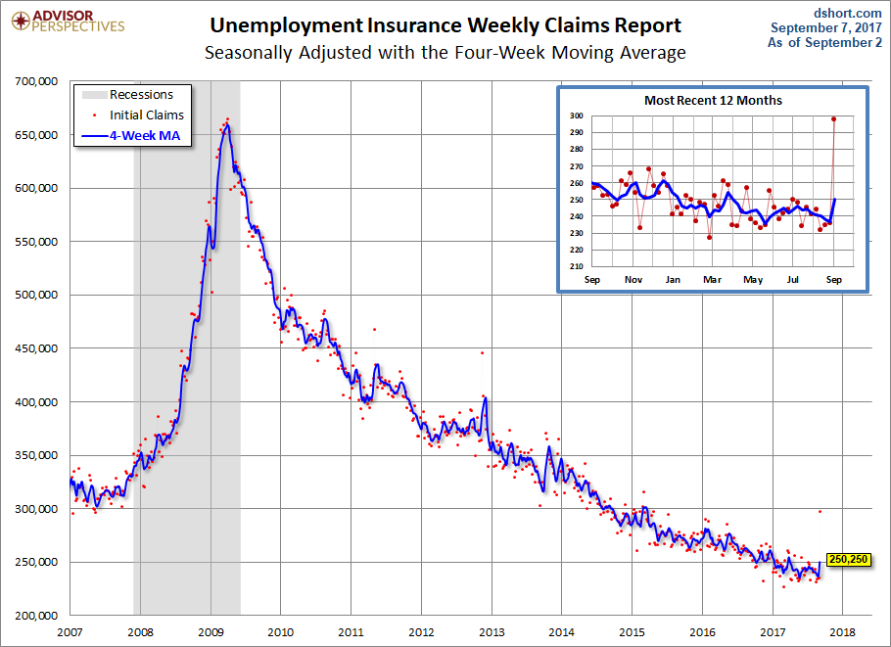
Weekly Jobless Claims –The Most Important Statistic
-22,000 to 222,000 as hurricane effects abate
New 43 Year Low!

Slide 16

Stocks-Exhaustion
*Stocks are approaching a short term exhaustion point after one of the most relentless moves up in history
*Individual stepping up pension fund contributions this year to defer net income into a lower tax 2018, and it is all pouring into stock index funds
*The Seller’s strike continues
* A synchronized global economic recovery, artificially low interest rates, and the prospect of once a generation tax cuts are a lot to sell against.
*Volatility Index (VIX) crushed again
*Rotation out of FANG’s and into banks and
domestics continues, now three months old
*Look for (SPY) $260 by yearend

Slide 17

This Time It’s Different!
*Past market tops were defined by interest rate or oil price hikes
*This time, the shear weight of asset prices may mark the end
*The next recession is likely to start in 2020
*That means stocks could rally for 19 more months
*Dow 28,000 here we come
*When the end comes, the downside
will be more ferocious than in the past
thanks to new technology

Slide 18
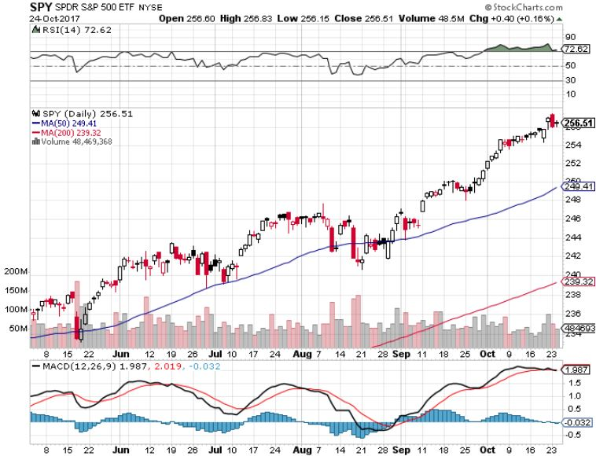
S&P 500-New Highs

Slide 19
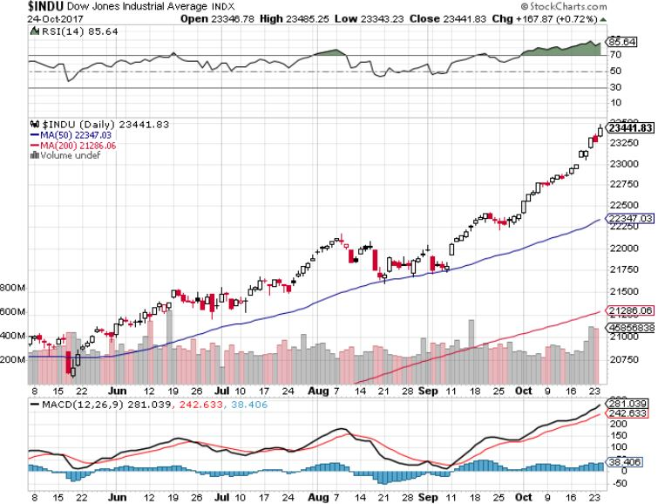
Dow Average-New Highs
Haven’t Retraced to the 50 Day MA since May-Very High Risk

Slide 20
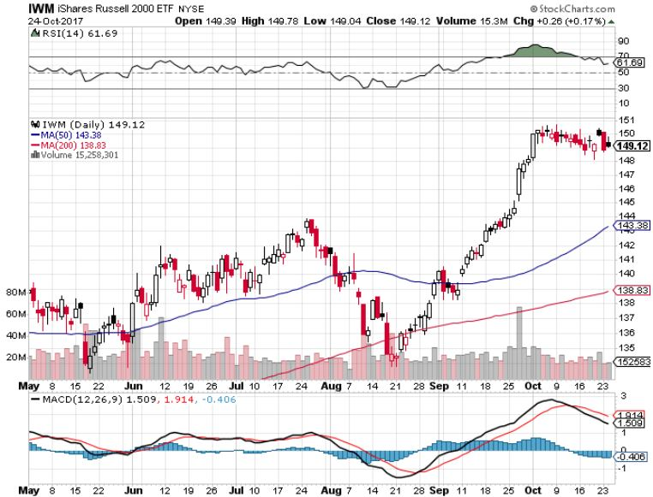
Russell 2000 (IWM)-New Highs
Even Higher Risk

Slide 21
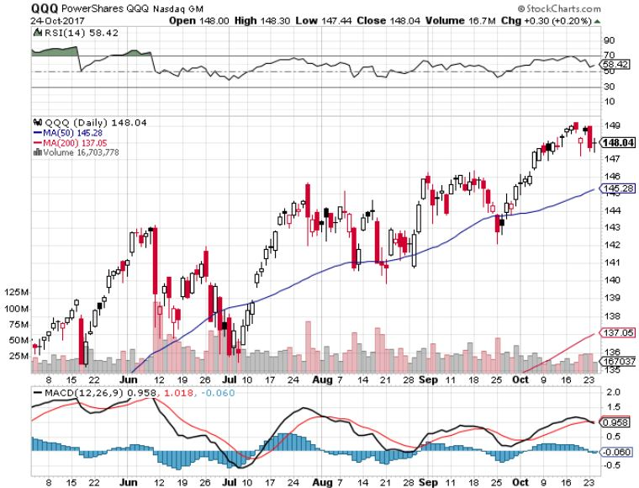
NASDAQ (QQQ)-New Highs

Slide 22
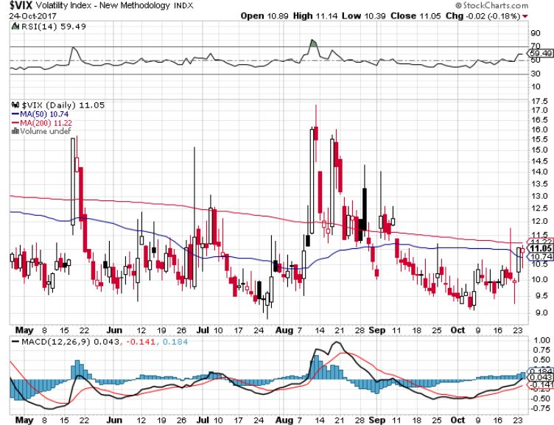
(VIX)-

Slide 23
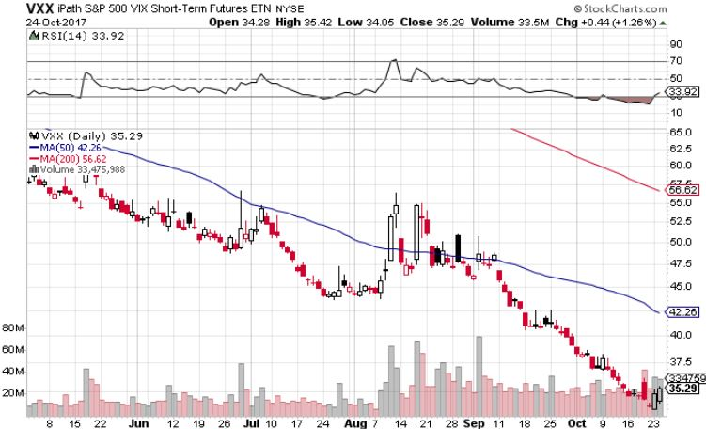
iPath S&P 500 VIX Short-Term Futures ETN (VXX)
Begging for New Lows long 1/$60 calls as a hedge for rest of portfolio took profits on long 11/$20 calls

Slide 24
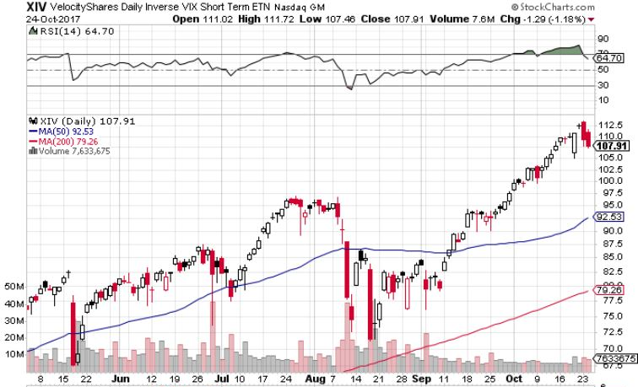
Velocity Shares Daily Inverse VIX Short Term ETN (XIV)
One of the most instantly profitable trades of 2016….and 2017 took profits on (XIV) long at $81.45

Slide 25
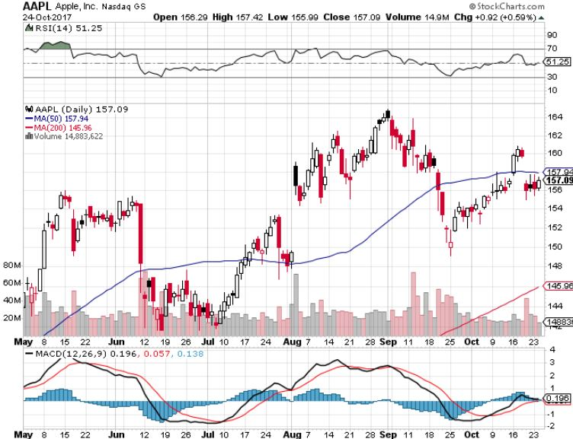
Apple (AAPL)-IPhone X is Out!
Took profits on long 10/$140-$145 bull call spread took profits on short 9/$170-$175 bear Put Spread took profits on long 9/$140-$145 bull call spread

Slide 26
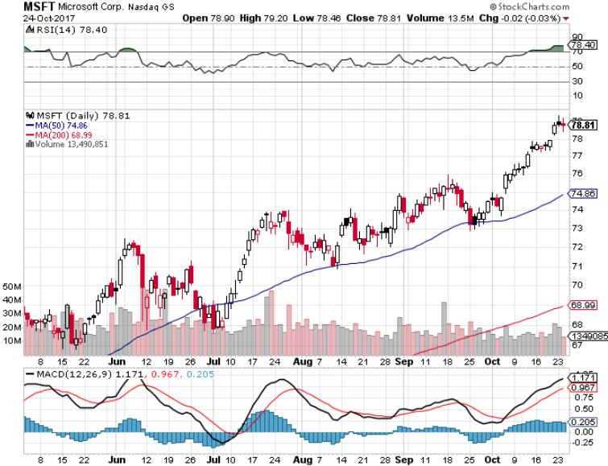
Microsoft (MSFT)

Slide 27
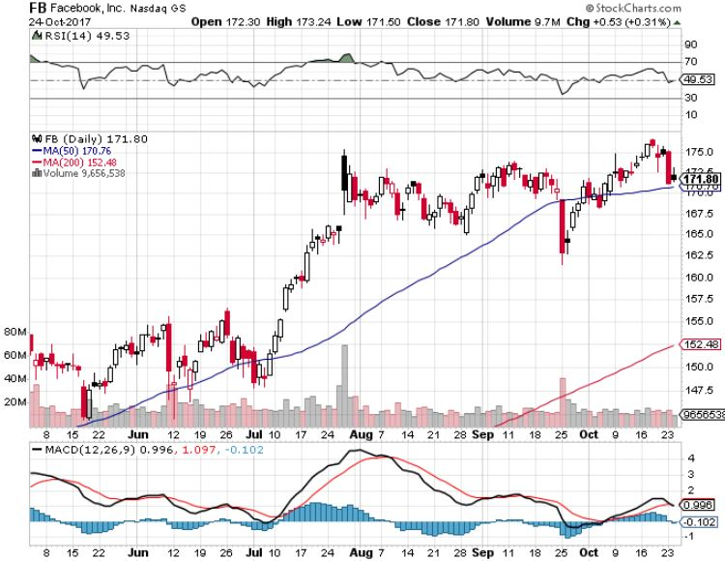
Facebook (FB)-

Slide 28
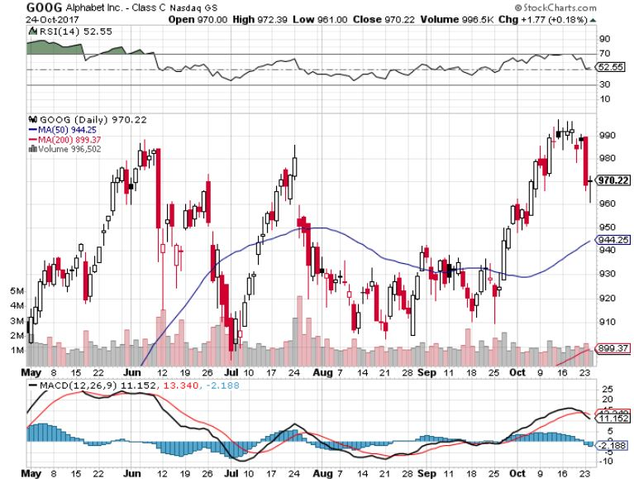
Alphabet (GOOG)-New High

Slide 29
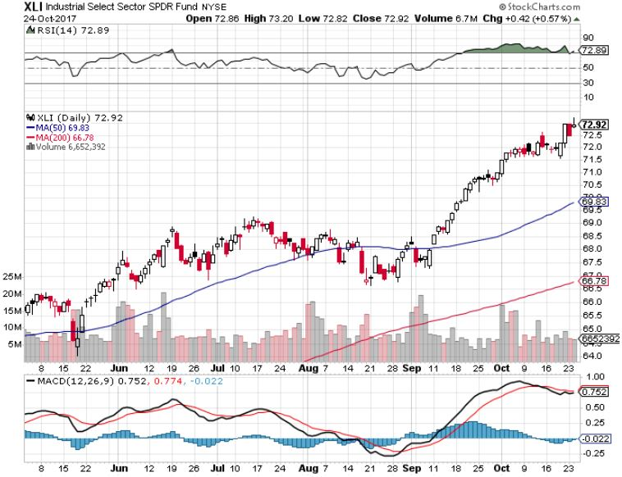
Industrials Sector SPDR (XLI)-
(GE), (MMM), (UNP), (UTX), (BA), (HON)

Slide 30
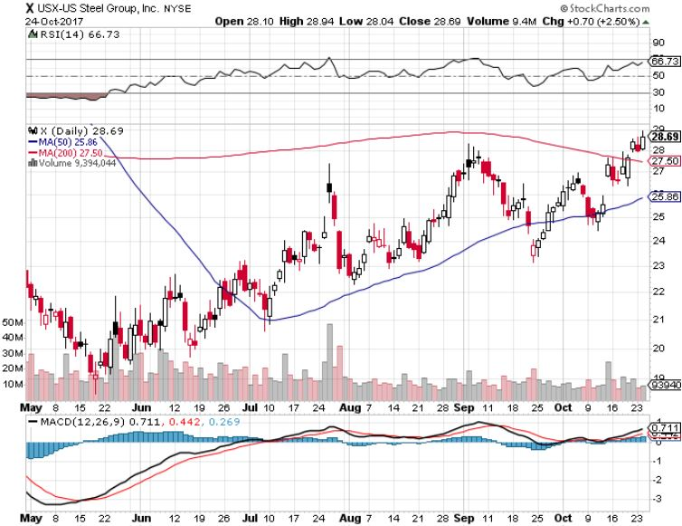
US Steel (X)- took profits on long the 9/$21-$22 vertical bull call spread

Slide 31
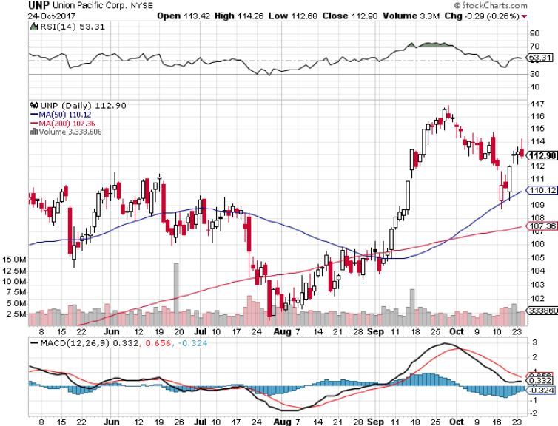
Union Pacific Railroad (UNP)- took profits on long the 9/$100-$102 vertical bull call spread

Slide 32
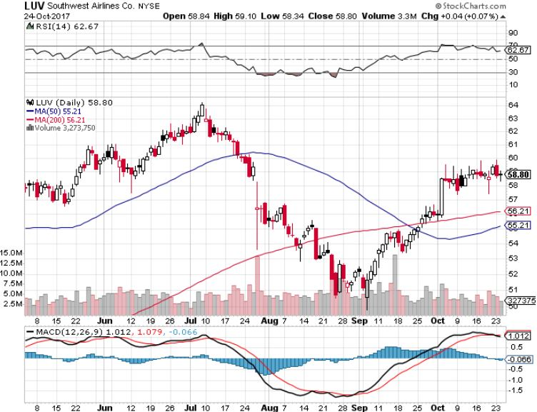
Southwest Airlines (LUV)-
Warren Buffett’s Favorite Airline

Slide 33
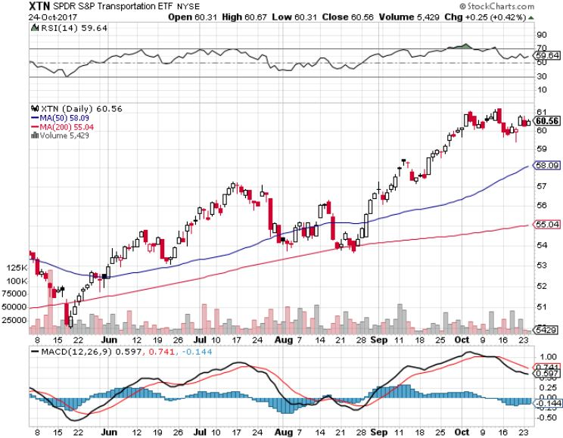
Transports Sector SPDR (XTN)-
(ALGT), (ALK), (JBLU), (LUV), (CHRW), (DAL)

Slide 34
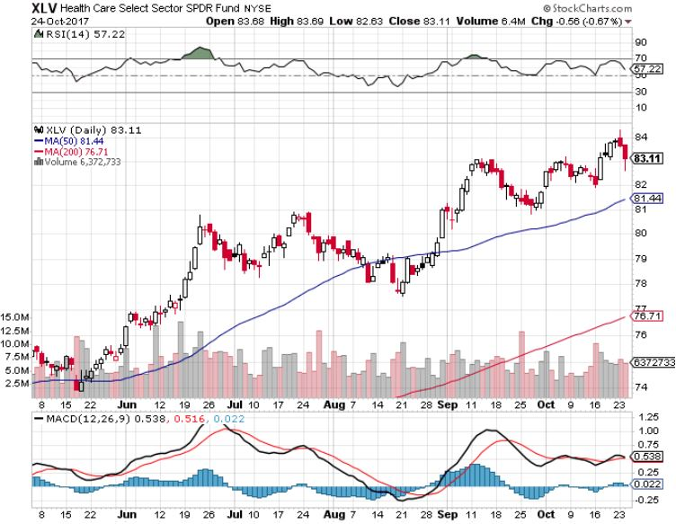
Health Care Sector (XLV), (RXL)-The New FANG?
(JNJ), (PFE), (MRK), (GILD), (ACT), (AMGN)

Slide 35
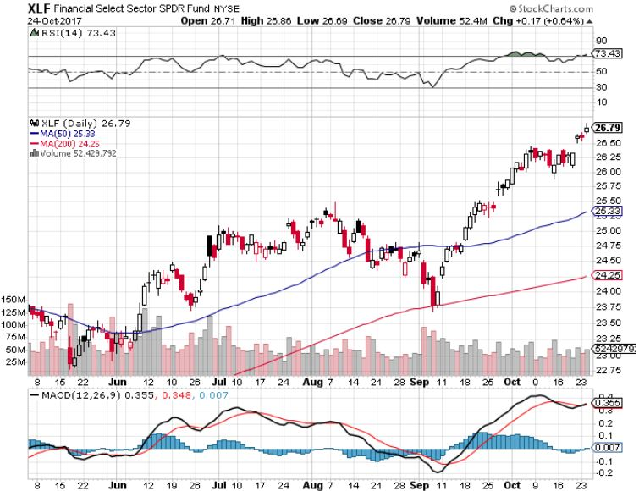
Financial Select SPDR (XLF)-New Highs
(BLK/B), (WFC), (JPM), (BAC), (C), (GS)

Slide 36
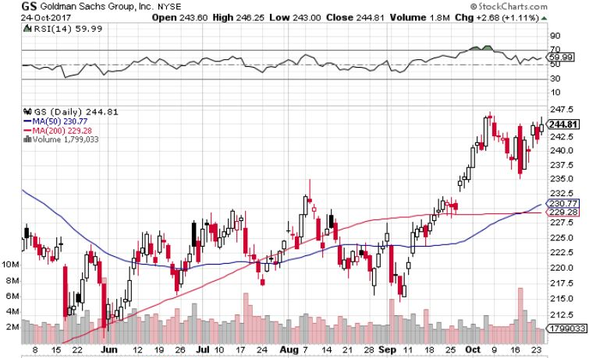
Goldman Sachs (GS)-October 17 earnings stopped out of long 10/$220-$225 vertical bull call spread took profits on long 10/$227.50-$232.50 vertical bull call spread took profits on long 9/$205-$210 vertical bull call spread took profits on long 9/$235-$240 vertical bear put spread

Slide 37
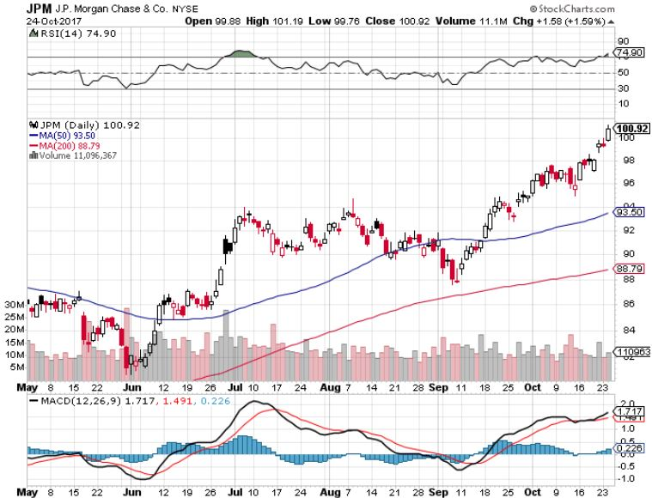
JP Morgan (JPM)-

Slide 38
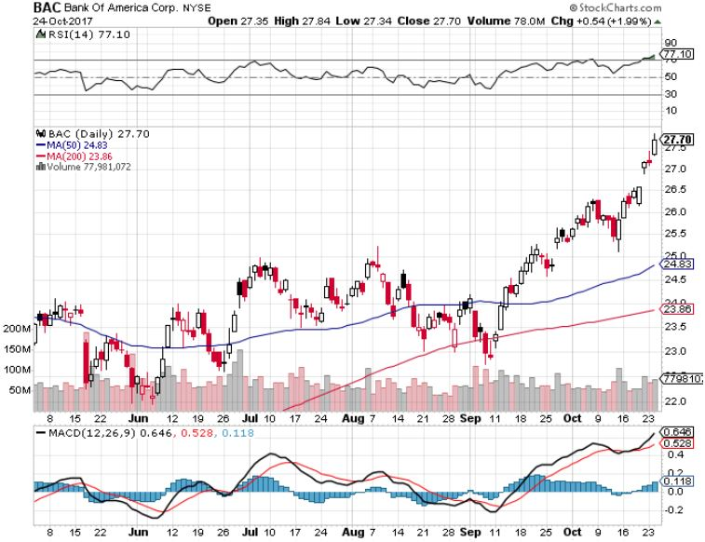
Bank of America (BAC)-
Warren Buffet exercises warrants and buys 700 million shares, with paper profit of $12 billion

Slide 39
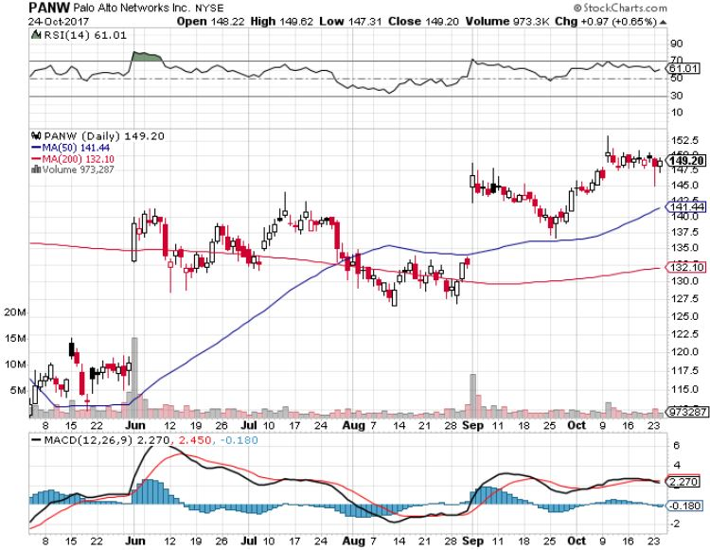
Palo Alto Networks (PANW)-

Slide 40
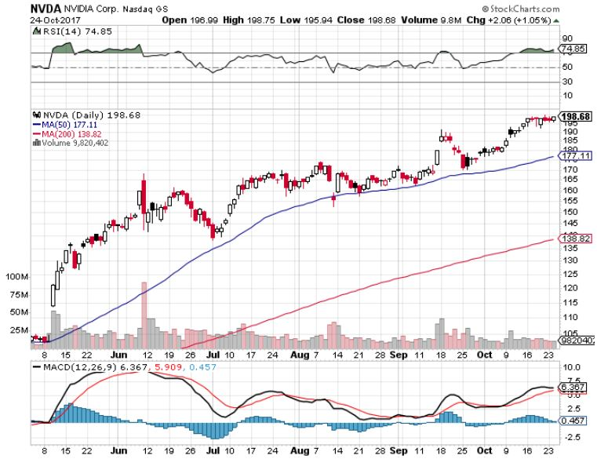
NVIDIA (NVDA)-New Highs
$200 target hit!

Slide 41
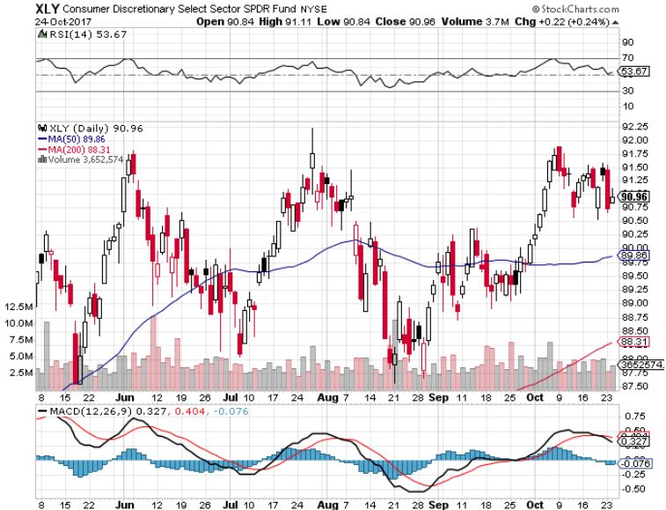
Consumer Discretionary SPDR (XLY)
(DIS), (AMZN), (HD), (CMCSA), (MCD), (SBUX)

Slide 42
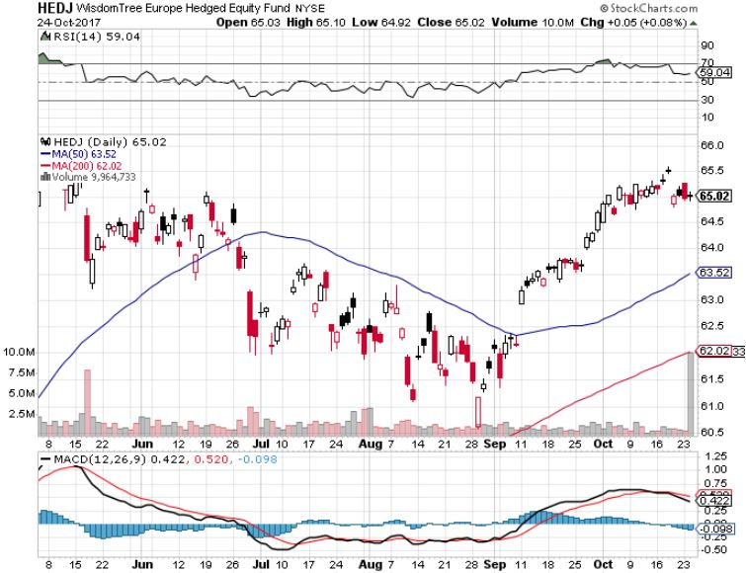
Europe Hedged Equity (HEDJ)-Global Rally

Slide 43
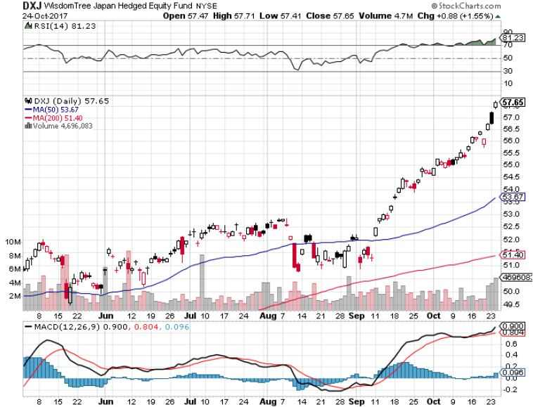
Japan (DXJ)-More Global Rally on Yen Weakness and Abe Election win

Slide 44
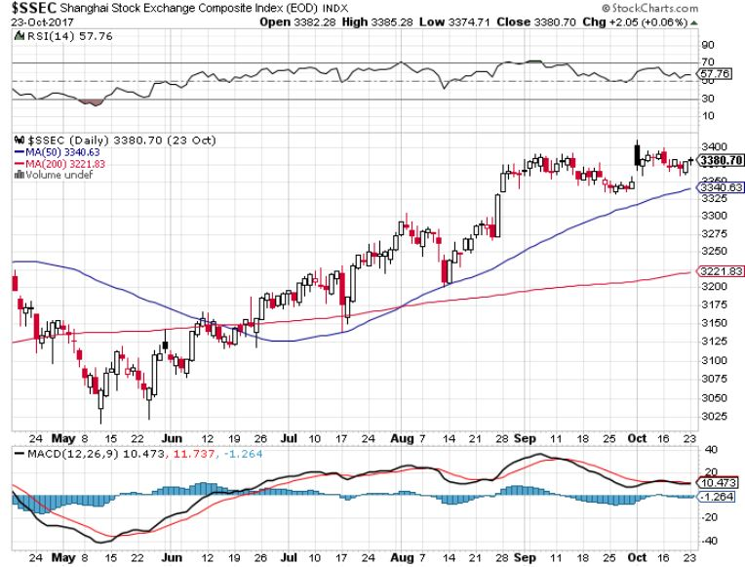
China ($SSEC)-Economic Recovery on Track

Slide 45
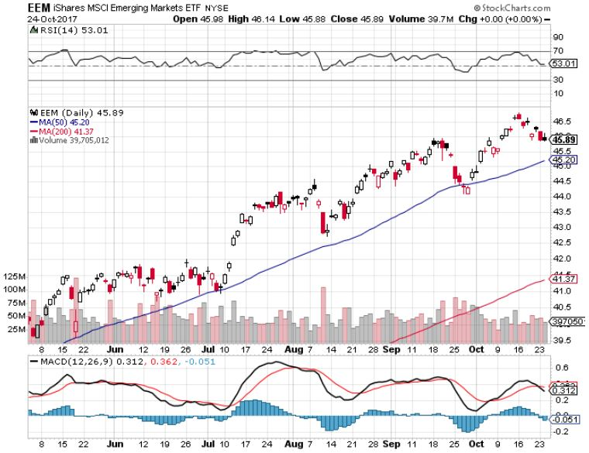
Emerging Markets (EEM)- New High

Slide 46
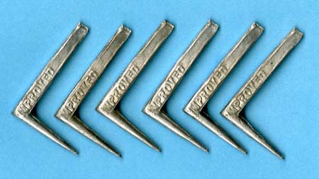
Bonds-On Tenterhooks
*Bonds hit a 5 month high in yields at 2.43%, low in prices, my 2.50% yearend target is fast approaching
*Bonds are at a key juncture awaiting Trump decision on new Fed governor
*Sell every bond rally and go longer dated….Janet put the top in with $4 trillion bond hoard liquidation
*A dove (Powell) drives a 5 point rally, a hawk (Taylor) brings a 5 points dump
*$6 billion a month, or $200 million a day in bond sales to start soon and are overhanging the market
*We are one year into a 10-20 year
bear market in bonds, now is a great
entry point on the short side

Slide 47
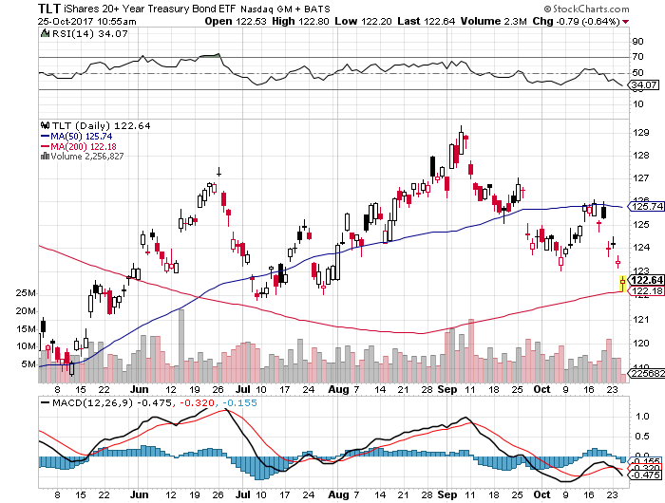
Treasury ETF (TLT) – 2.44%-My Rich Uncle Trade! long 11/$129-$131 vertical bear put spread
Took profits on long 10/$126-$128 vertical bear put spread took profits on long 10/$127-29 vertical bear put spread took profits on long 10/$129-$131 vertical bear put spread took profits on long 9/$129-$132 vertical bear put spread

Slide 48
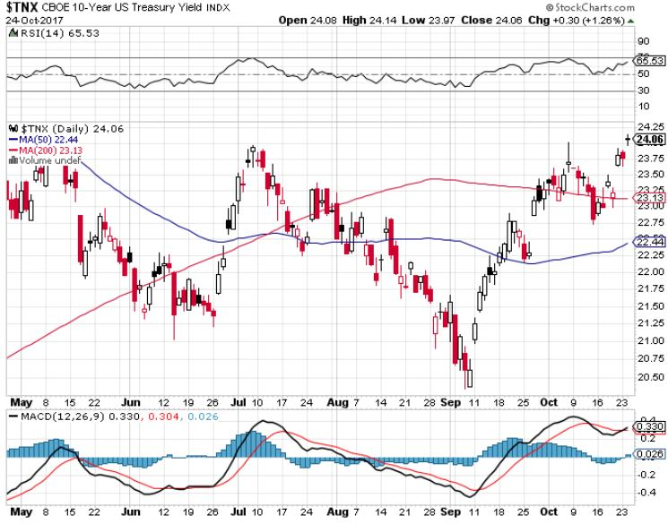
Ten Year Treasury Yield ($TNX) 2.44%
Breakdown!

Slide 49
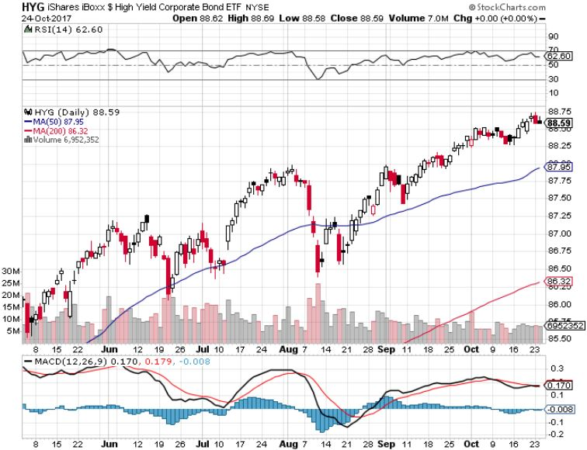
Junk Bonds (HYG) 4.71% Yield
A Great Risk Coincident Indicator- Long Term “RISK ON” means new highs, buy all dips

Slide 50
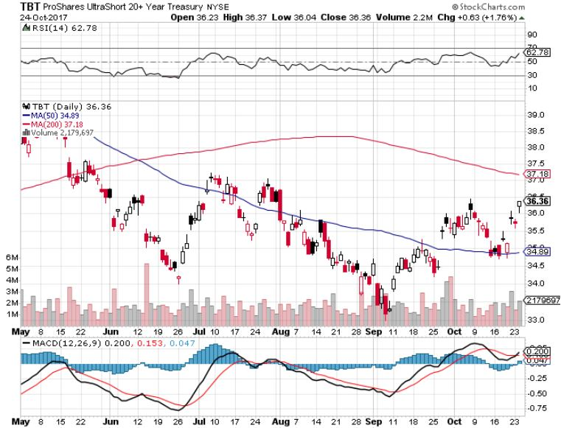
2X Short Treasuries (TBT)-Was In Screaming “BUY” Territory

Slide 51
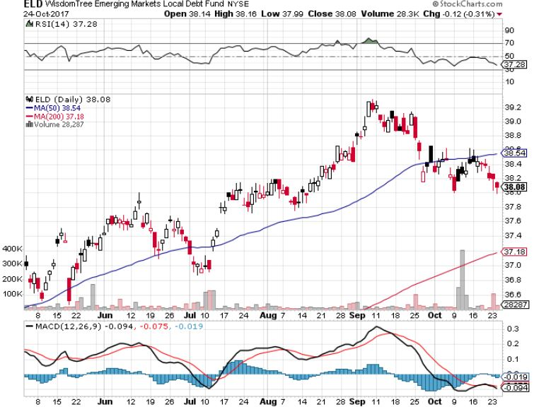
Emerging Market Debt (ELD) 5.66% Yield-

Slide 52
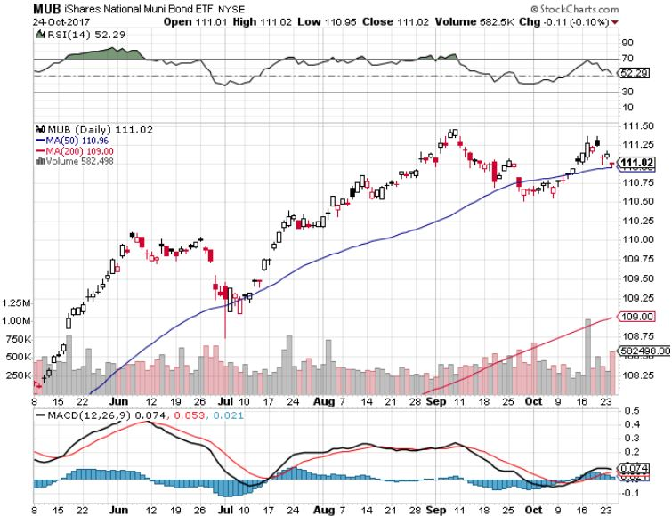
Municipal Bonds (MUB)-1.69%-Gap Up
Mix of AAA, AA, and A rated bonds

Slide 53
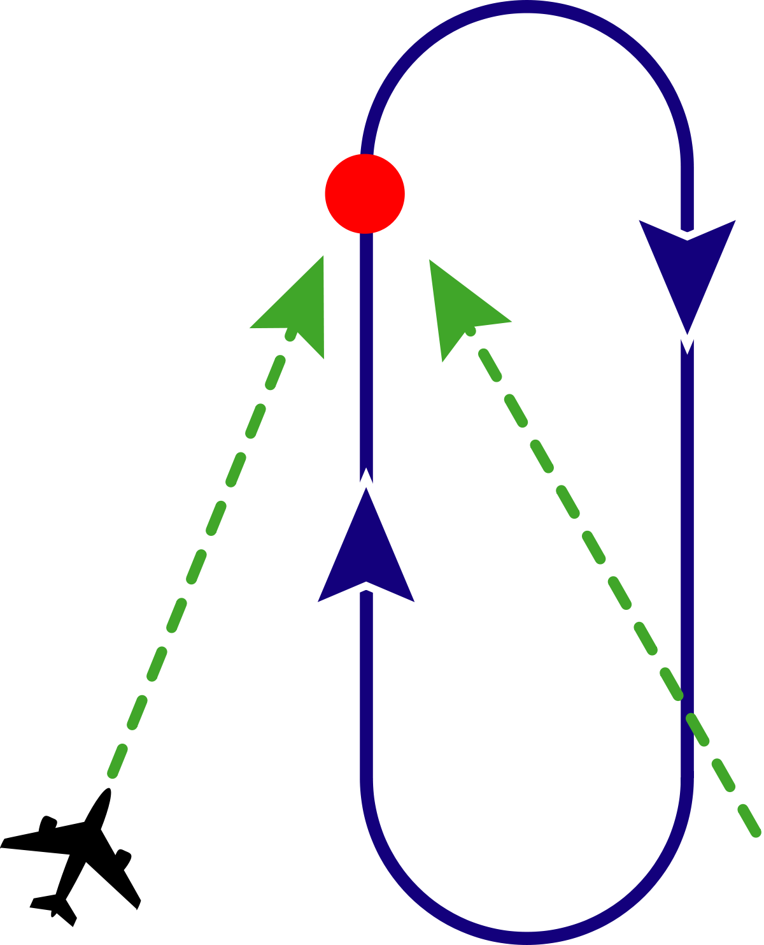
Foreign Currencies-Holding Pattern
*Foreign currencies are awaiting a bond market breakdown….or not
*A bond breakdown brings higher interest rates and a lower dollar
*Rising US rates break the back of the Euro (FXE), “head and shoulder” top is now clearly in, sell every rally
*Catalan independence votes still causing further Euro weakness
*Abe win in Japan promises four more years
of zero interest rates, crushing the yen
*Strong US rates kill off Loonie (FXC)
and Aussie (FXA) as well

Slide 54
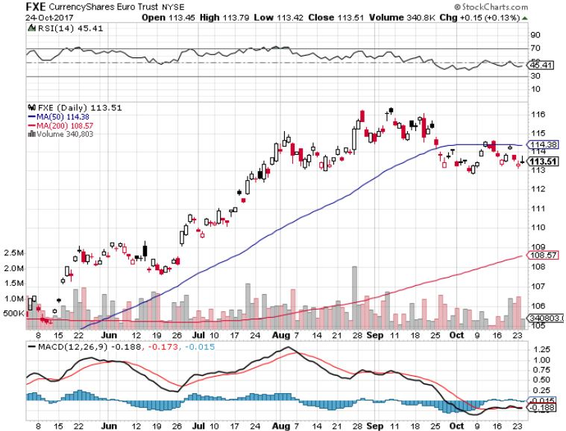
Euro ($XEU), (FXE), (EUO)- Head and Shoulders Top

Slide 55
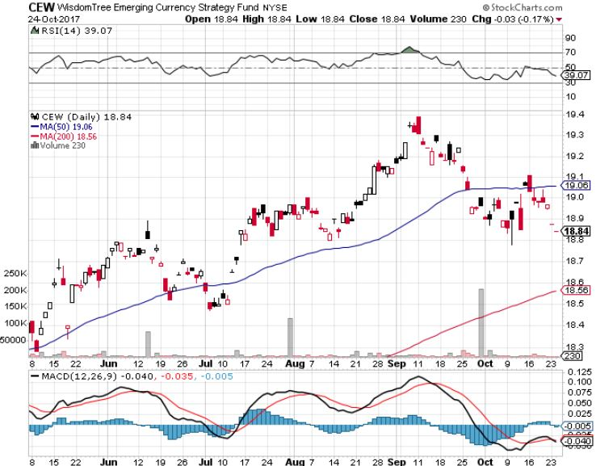
Emerging Market Currencies (CEW)

Slide 56
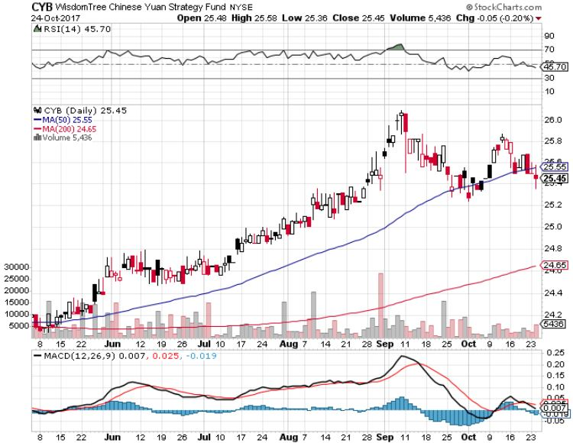
Chinese Yuan- (CYB)-Stabilizing on Government Support

Slide 57

Energy-IPO Fever
*Synchronized economic recovery is pushing oil prices up along with everything else
*Aramco IPO is ramping up, looking to raise $100-$200 billion in the largest IPO in history
When Saudi Arabia gets out of the oil business, so should you, will maintain the $50 handle with production cutbacks until the deal is done
*Iraqi government takes full control of
Kirkuk oil fields from ISIS, will ramp
up production
*Fracking supply is leveling off,
with Baker Hughes turning negative
*Buy the dips in energy stocks

Slide 58
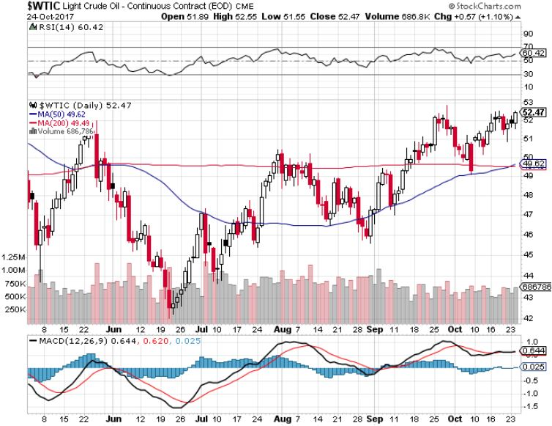
Oil-Breakout!

Slide 59
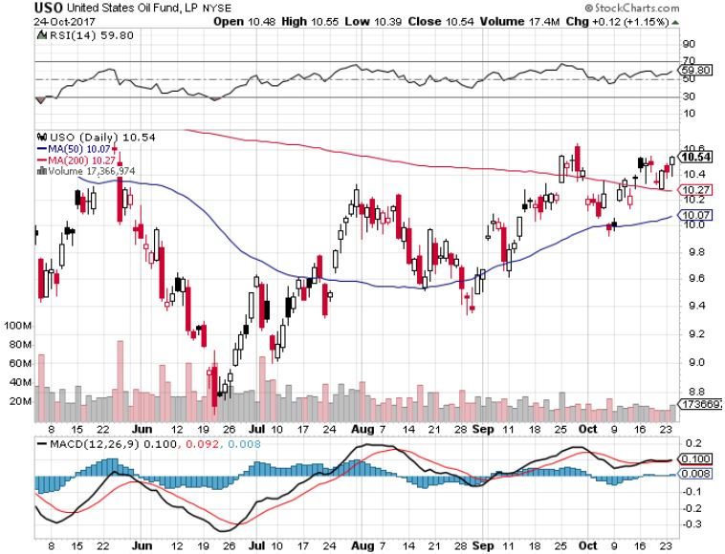
United States Oil Fund (USO)

Slide 60
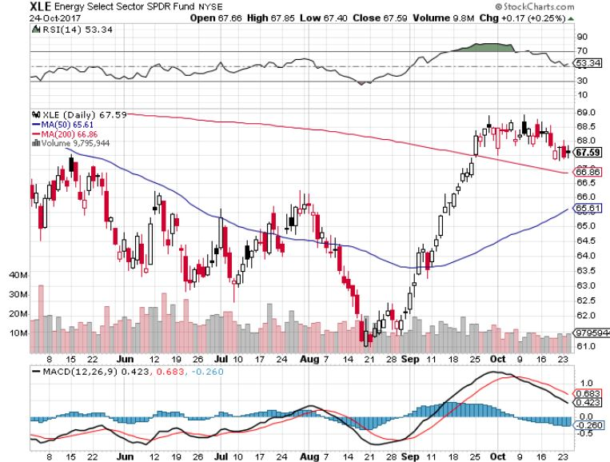
Energy Select Sector SPDR (XLE)-New Lows!
(XOM), (CVX), (SLB), (KMI), (EOG), (COP)

Slide 61
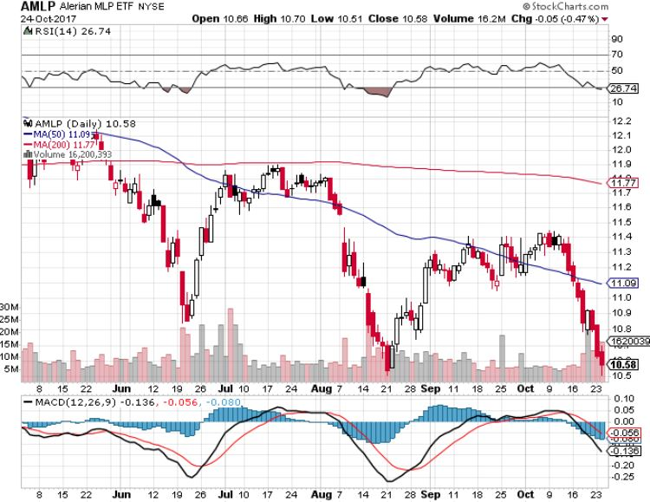
Alerian MLP ETF (AMLP)- Basket Approach is the Only Safe Play Here

Slide 62
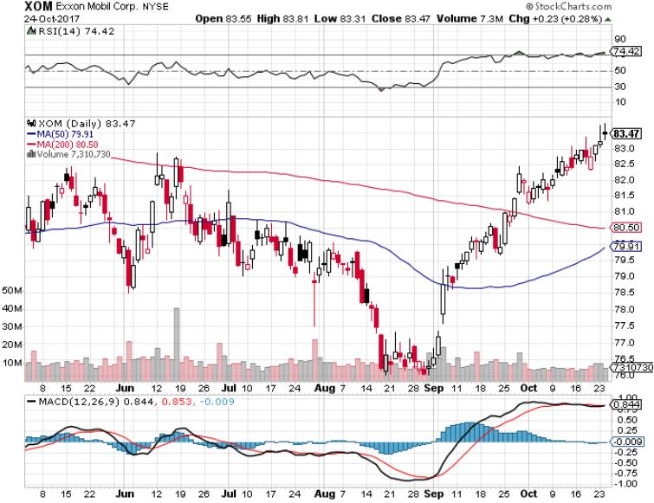
Exxon (XOM)-The Bottom is In

Slide 63
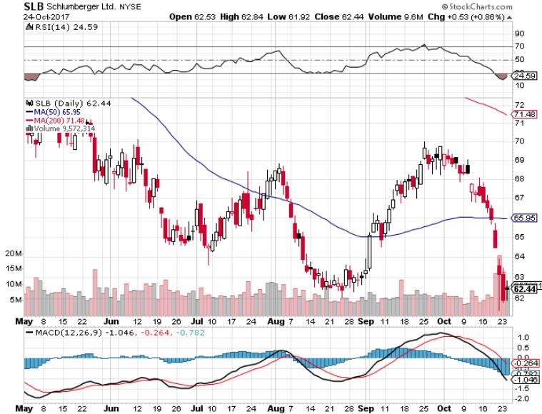
Schlumberger (SLB)-Killed by Fracking Cutbacks

Slide 64

Halliburton (HAL)-Ditto

Slide 65

Natural Gas (UNG)-No Joy

Slide 66

Copper (COPX)-China Infrastructure Build Out

Slide 67

Precious Metals-The Unloved Hedge
*Stock Melt up triggers a melt down in precious metals, as well as all other hedges
*When stocks peak, look for a major gap up in all precious metals
*Potential interest rate breakout further weighs on the yellow metal
*Venezuela liquidation still weighing on market
*Palladium stays strong on reflation
play
*Buy gold and silver stocks
on the next big dip, as the move
is still only a few months old

Slide 68

Gold (GLD)-Retest of the Trend hedging trades starting to move again

Slide 69

Market Vectors Gold Miners ETF- (GDX)
Took profits on long the 9/$20.50-$21.50 bull call spread

Slide 70

Barrick Gold (ABX) stopped out of long 9/$15-16 call spread

Slide 71

Newmont Mining- (NEM)-Breakout took profits on long the 9/$32-$34 bull call spread

Slide 72

Global X Silver Miners ETF- (SIL)-Breakout took profits on long the 9/$31-$33 bull call spread

Slide 73

Bitcoin-Modern Day Tulips!

Slide 74

Agriculture-Still No Friends
*Latest WASDE report hugely negative for corn and wheat
*Strong US dollar killed off nascent rally in the ags
*Prices flat lining in the bottom, not a good sign
*Hedge funds maintaining huge shorts in
corn and wheat
*Another disastrous year in ags
coming to and end, the 5th in a row
*Be thankful we haven’t done an Ag
trade for five years

Slide 75

(CORN) –New Lows!

Slide 76

(WEAT)-Major Breakdown

Slide 77

(SOYB)-Dead in the Water

Slide 78

Real Estate-Nothing for Sale
*September Existing Home Sales up 0.7%, 5.35 million units, down 1.7% YOY,
New Home Sales up a stunning 19.9%, most since October, 2007
*Inventories only at 1.9 million units, a 4.2 month supply, the lowest on record
*Now a new problem: uncertainty of deductibility of real estate taxes will overhang market for the next 3-6 months
*October Homebuilder Sentiment jumps from 64 to 68
*Fed move to unwind bond hoard means this
may be the last chance to get 3.5% 30 year
loans
*July S&P 500 Case-Shiller maintains
strong 5.9%, with absolute prices hitting
new all time high

Slide 79

Home Depot (HD)-Double Bottom + Twin Hurricane Help took profits on long $9/$141-$144 vertical bull call spread

Slide 80

July S&P 500/Case–Shiller Home Price Index
+5.9% YOY, Seattle (+13.5%), Portland (7.6%), Las Vegas (7.4%) still leaders price rises accelerating

Slide 81

General Growth Properties (GGP)-New Lows
Long Term Downtrend-From Rising Rates to Mall Destruction

Slide 82

US Home Construction Index (ITB)
(DHI), (LEN), (PHM), (TOL), (NVR)
A Favorite Sector to Buy

Slide 83

Trade Sheet-
So What Do We Do About All This?
*Stocks- stand aside
*Bonds-sell any and all rallies
*Commodities-buy industrials, energy
*Currencies-sell yen and Euro on any rallies
*Precious Metals –buy dips
*Volatility-stand aside until over $16
*The Ags –stand aside
*Real estate-buy dips

Slide 84

Next Strategy Webinar
12:00 EST Wednesday, November 8, 2017
San Francisco, CA
Buy conference and lunch tickets at madhedgefundtrader.com
Good Luck and Good Trading!
Notes:
*

