Slide 1

The Mad Hedge Fund Trader
“Tax Jitters”
With John Thomas
from Silicon Valley, CA, November 8, 2017
www.madhedgefundtrader.com
Notes:
*

Slide 2


Global Strategy Luncheons
Buy tickets at www.madhedgefundtrader.com
Chicago, IL
December 27, 2017
Minneapolis, MN
December 28, 2017

Slide 3

Trade Alert Performance
Biggest Up Month in Ten Years! New All Time High!!
22 Consecutive Profitable Trade Alerts!!
*January +9.35% Final *July +1.95% Final
*February +6.39% FINAL *August +18.38% Final
*March +4.87% Final *September +7.65% Final
*April +1.84% Final *October +1.39% Final
*May -0.45% Final *November -0.67% MTD
*June +0.70% Final *December +.84% Final
*2017 Year to Date 53.93%
compared to 15% for the Dow Average
31 of 34 consecutive profitable trade alerts
*Trailing One year return +51.40%, +269.96% since inception,
*Average annualized return of 34.10%

Slide 4
Portfolio Review
No “sweet spot” entry points
Risk/Reward is out of balance, 80% cash
Risk is at all time highs. So My Positions Are At All Time Lows
Current Capital at Risk
Risk On
World is Getting Better
(TLT) 11/$127-$129 put spread | 10.00%
(TLT) 12/$129-$132 put spread | 10.00%
Risk Off
World is Getting Worse
No positions
Total Net Position | 20.00%
55.12 % Expiration
P&L

Slide 5
Trailing One-Year Return
Daily Audited Performance

Slide 6
Eight Year Daily Audited Performance
Averaged Annualized Return +34.10%

Slide 7

The Method to My Madness
*Global stock market melt up has taken stocks to record valuation an momentum highs, Great Q3 earnings adding fuel to the fire
*Two big tax overhangs for the market: uncertainty over what will get through in 2018, and delayed tax loss selling bunching up in January
*Sell every bond rally….Janet put the top in with $4 T bond hoard liquidation
*Look for main indexes to grind up for the rest of 2017
*Keep buying ”RISK OFF” assets like gold on dips
as a hedge against brief bouts of profit taking in stocks
*Avoid FANG’s, the game is in domestic laggards
and reflation plays and banks
*Buy oil stocks on dips
*Sell currencies on any new rallies, top is in

Slide 8
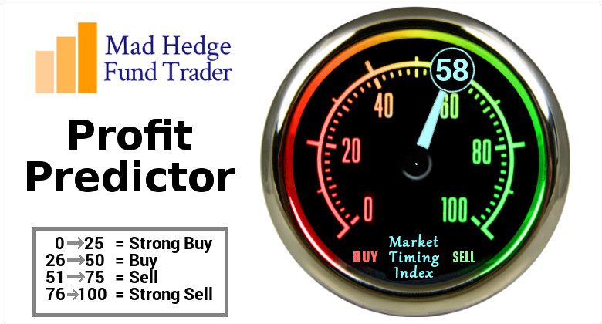
The Mad Hedge Profit Predictor
Market Timing Index
An artificial intelligence driven algorithm that analyzes 30 different economic, technical, and momentum driven indicators

Slide 9
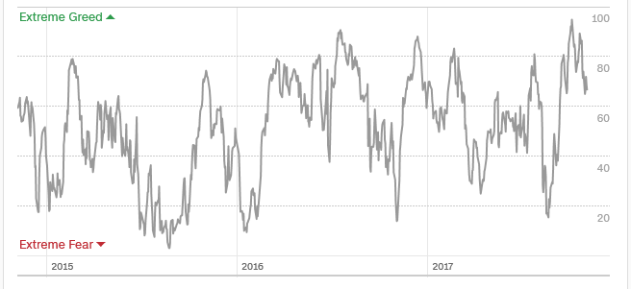
The Mad Hedge Profit Predictor
Market Timing Index
The Multi Month Top
January?

Slide 10
The Bill Davis View
A $1,500 Upgrade for the Mad Day Trader Service
Buys: | Entry | Target
Buffalo Wild Wings (BWLD) | $110.00 | $125.00
Celgene Corp (CELG) | $100.00 | $125.00
CME Group Inc. (CME) | $137.00 | $145.00
Gilead Sciences (GILD) | $72.00 | $81.00
National Beverage (FIZZ) | $92.00 | $112.00
Kinder Morgam (KMI) | $18.00 | $22.00
Sells:
Signature Bank (SBNY) | $128.00 | $115.00
Mineral Technologies (MTX) | $74.00 | $62.00
Lulumon Athletics (LULU) | $61.00 | $54.00
Seagate Technologies (STX) | $38.00 | $26.00
MicroStrategy Inc.(MSTR) | $135.00 | $105.00

Slide 11

The Global Economy-Punching Its Weight
*FOMC leaves interest funds rate unchanged at 1.25%-1.50%
*US data turning hot, October Chicago PMI at 66.2 vs 60 expected, Consumer Confidence at 125.9, a 17 year high, Durable Goods up a hot 2.2%
*US real estate markets are exploding, creating an ATM effect for the main economy, SF Bay area up +13% YOY
*ECB scales back QE, cutting monthly bond purchases from E60 to E30 billion a month, but extended the time frame
*It’s all very market positive, and severely
limited the downside to the last correction

Slide 12
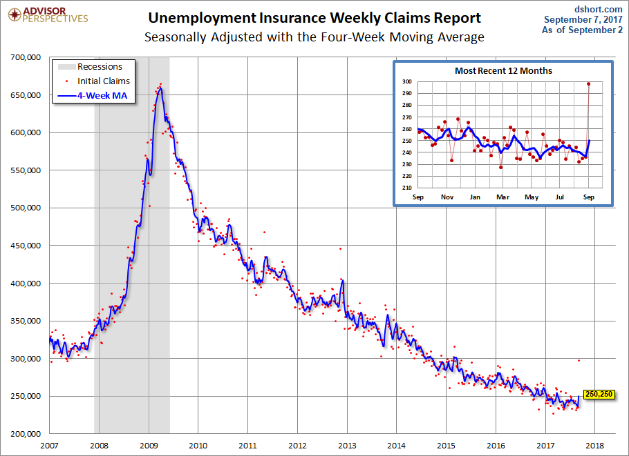
Weekly Jobless Claims –The Most Important Statistic
-5,000 to 229,000 as hurricane effects abate
New 43 Year Low!

Slide 13

Stocks-Running Out the Clock
*Only four actual trading weeks left in 2017, sector rotation has been fierce
*Market enters six months of seasonal strength with a bang, but tax worries starting to drag on the market
*October ETF inflows of $56 billion, YTD $388 billion to total of $3.2 trillion
*100% of the market gains in October were due to the five FANG stocks. Without their contribution, the S&P 500 would have been down for the month.
*92% of all corporate profits being returned to shareholders through stock buy backs and dividends, makes stocks more valuable, especially relative to bonds
* A synchronized global economic recovery,
artificially low interest rates, and the prospect
of once a generation tax cuts are a lot to sell against.
*Volatility Index (VIX) crushed again
*Look for (SPY) $260 by yearend

Slide 14
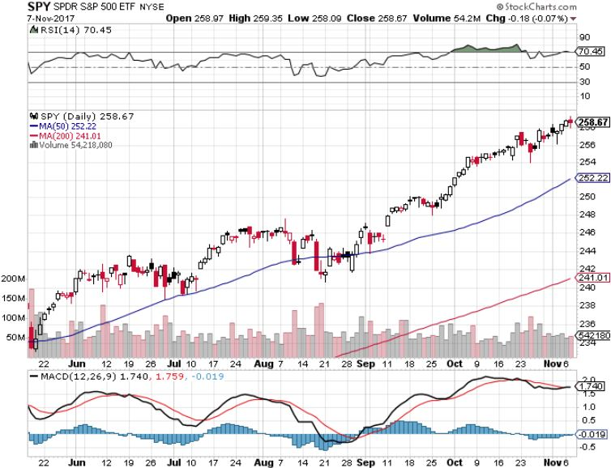
S&P 500-New Highs

Slide 15
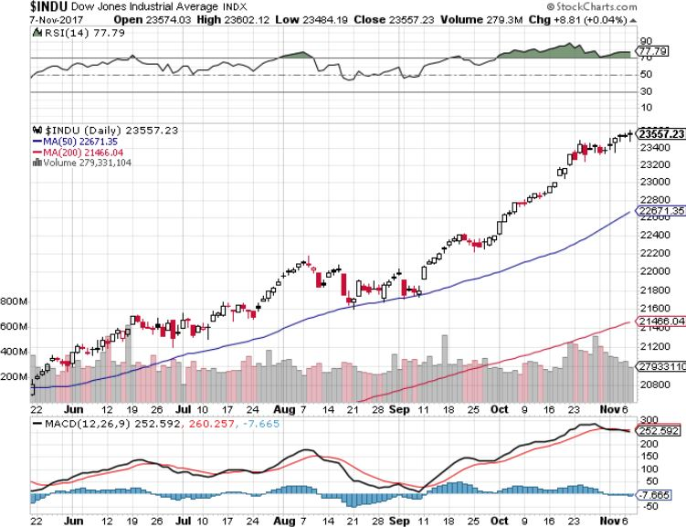
Dow Average-New Highs
Haven’t Retraced to the 50 Day MA since May-Very High Risk

Slide 16
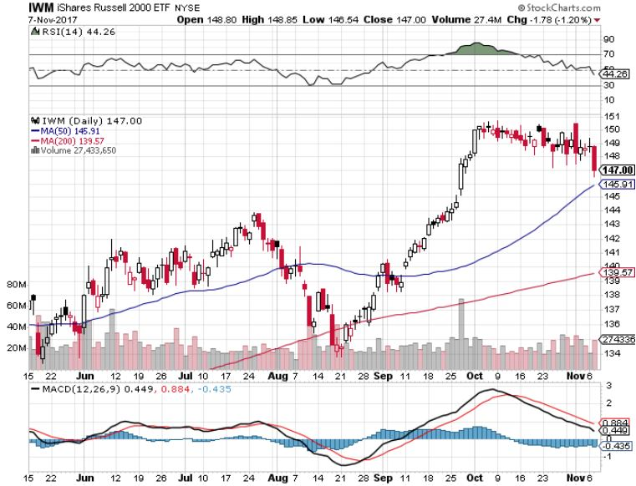
Russell 2000 (IWM)-Peaked Out
Even Higher Risk

Slide 17
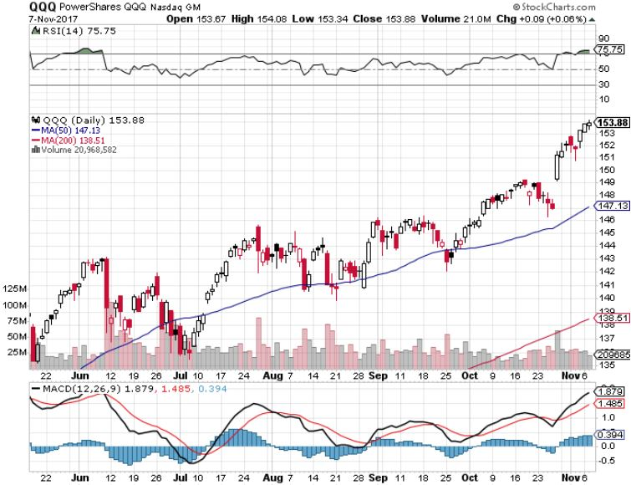
NASDAQ (QQQ)-New Highs

Slide 18
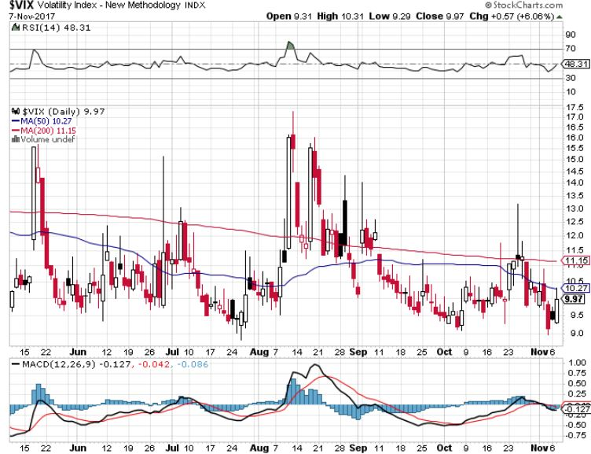
(VIX)-New Low

Slide 19
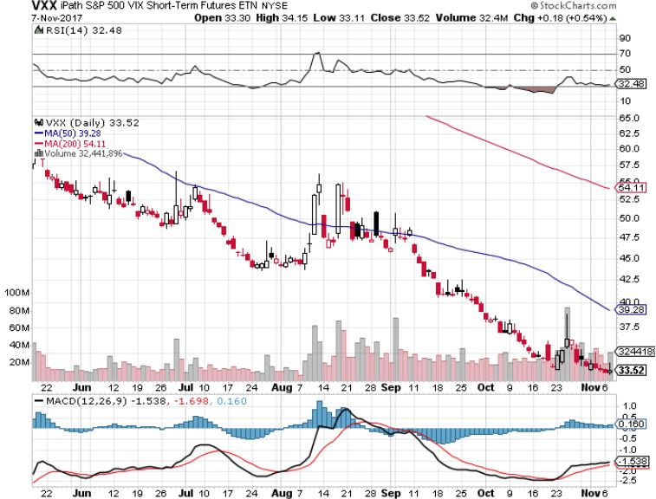
iPath S&P 500 VIX Short-Term Futures ETN (VXX)
Begging for New Lows stopped out of long 1/$60 calls as a hedge for rest of portfolio took profits on long 11/$20 calls

Slide 20
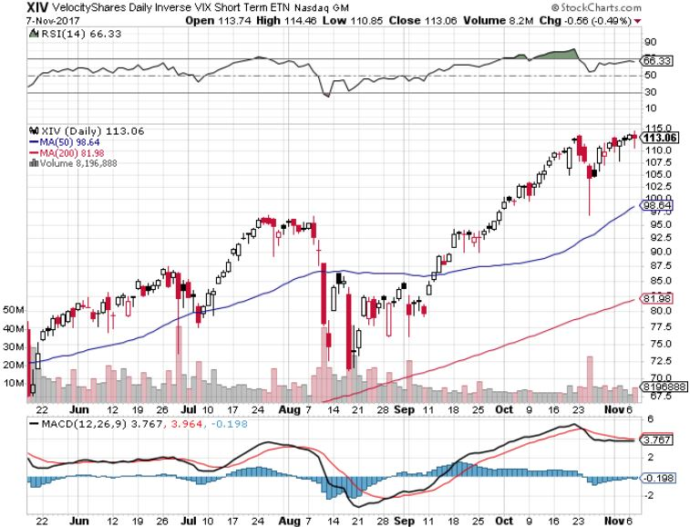
Velocity Shares Daily Inverse VIX Short Term ETN (XIV)
One of the most instantly profitable trades of 2016….and 2017 took profits on (XIV) long at $81.45

Slide 21
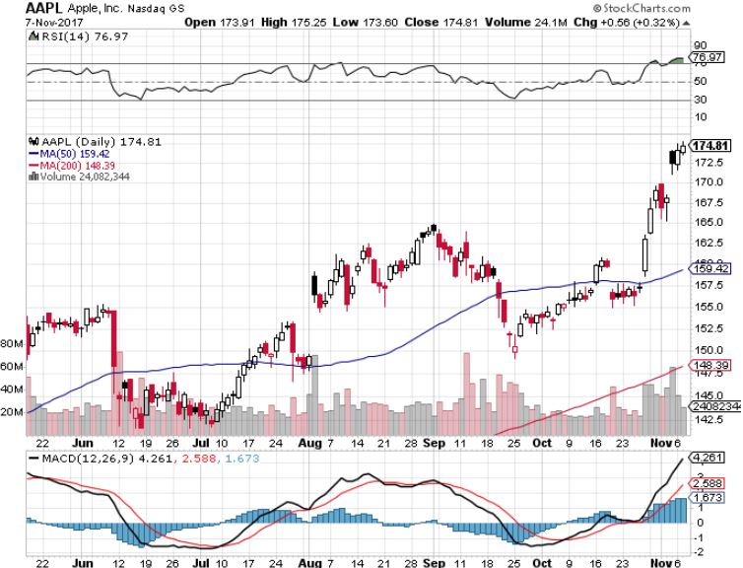
Apple (AAPL)-IPhone X is Out!
Took profits on long 10/$140-$145 bull call spread took profits on short 9/$170-$175 bear Put Spread took profits on long 9/$140-$145 bull call spread

Slide 22
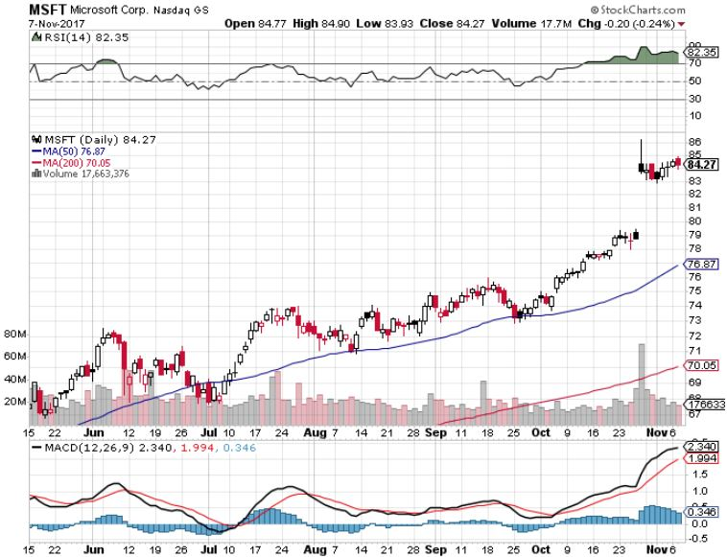
Microsoft (MSFT)

Slide 23
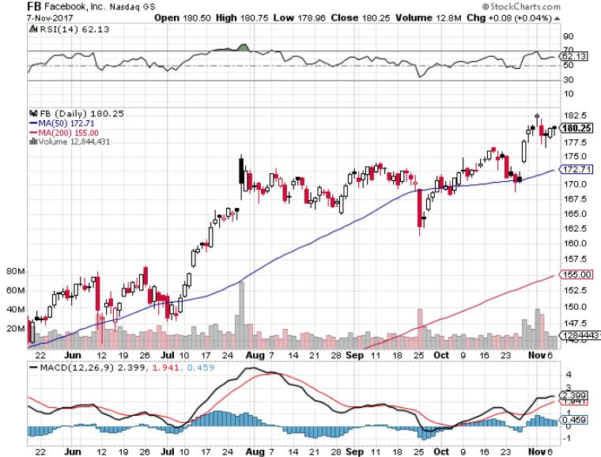
Facebook (FB)-

Slide 24
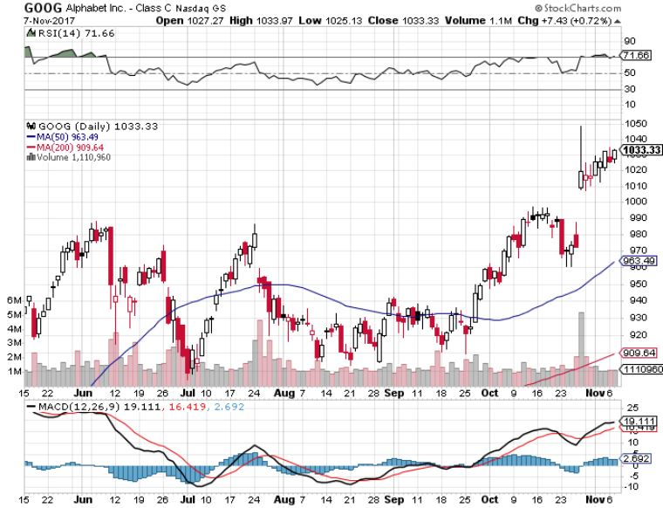
Alphabet (GOOG)-New High

Slide 25
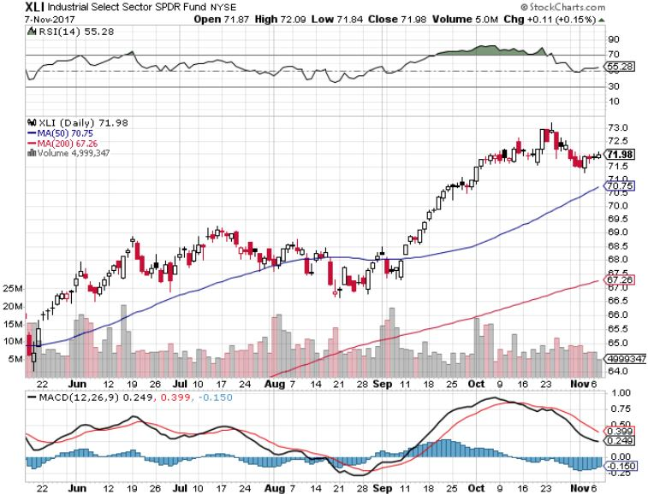
Industrials Sector SPDR (XLI)-
(GE), (MMM), (UNP), (UTX), (BA), (HON)

Slide 26
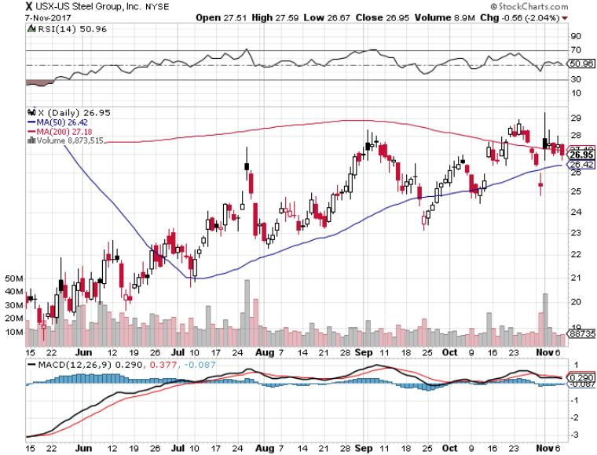
US Steel (X)- took profits on long the 9/$21-$22 vertical bull call spread

Slide 27
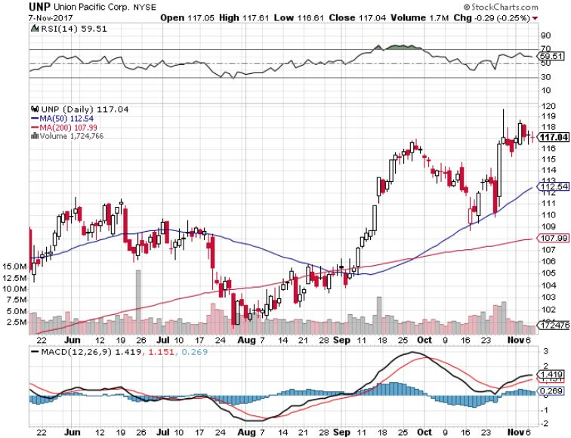
Union Pacific Railroad (UNP)- took profits on long the 9/$100-$102 vertical bull call spread

Slide 28
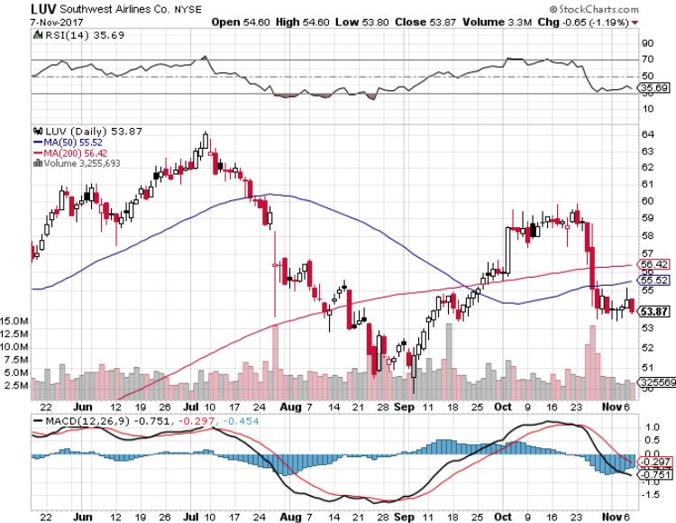
Southwest Airlines (LUV)-
Warren Buffett’s Favorite Airline

Slide 29
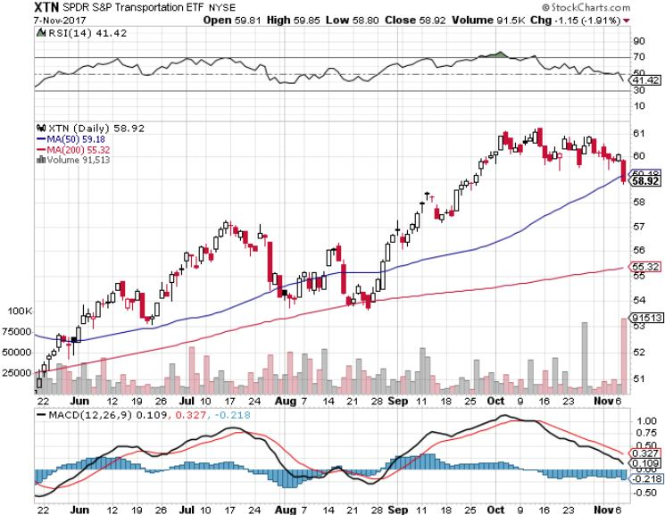
Transports Sector SPDR (XTN)-
(ALGT), (ALK), (JBLU), (LUV), (CHRW), (DAL)

Slide 30
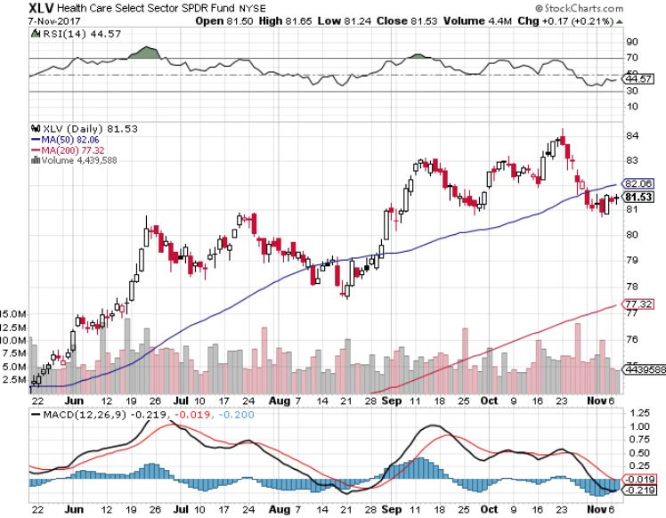
Health Care Sector (XLV), (RXL)-The New FANG?
(JNJ), (PFE), (MRK), (GILD), (ACT), (AMGN)

Slide 31
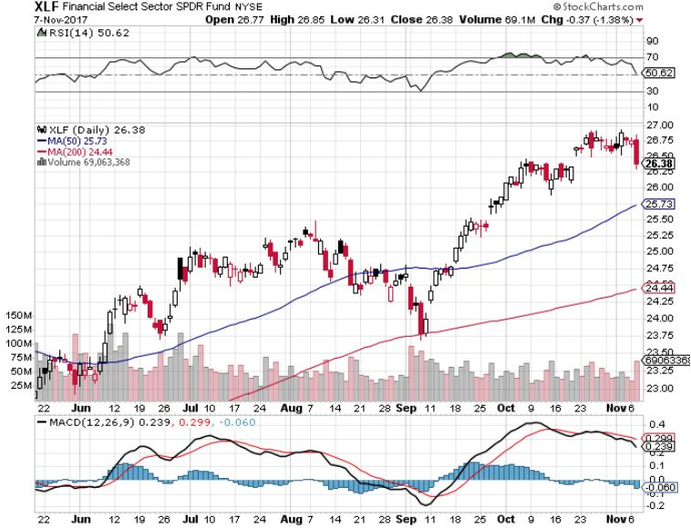
Financial Select SPDR (XLF)-New Highs
(BLK/B), (WFC), (JPM), (BAC), (C), (GS)

Slide 32
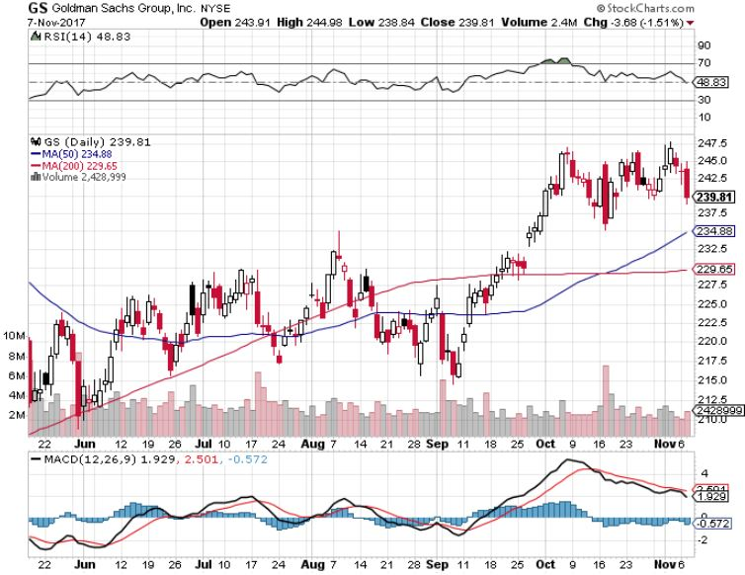
Goldman Sachs (GS)-Interest Rate Drag stopped out of long 10/$220-$225 vertical bull call spread took profits on long 10/$227.50-$232.50 vertical bull call spread took profits on long 9/$205-$210 vertical bull call spread took profits on long 9/$235-$240 vertical bear put spread

Slide 33
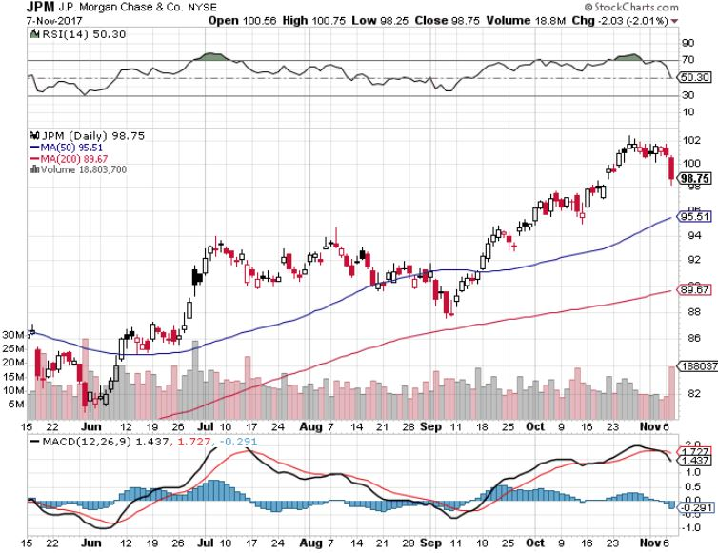
JP Morgan (JPM)-

Slide 34
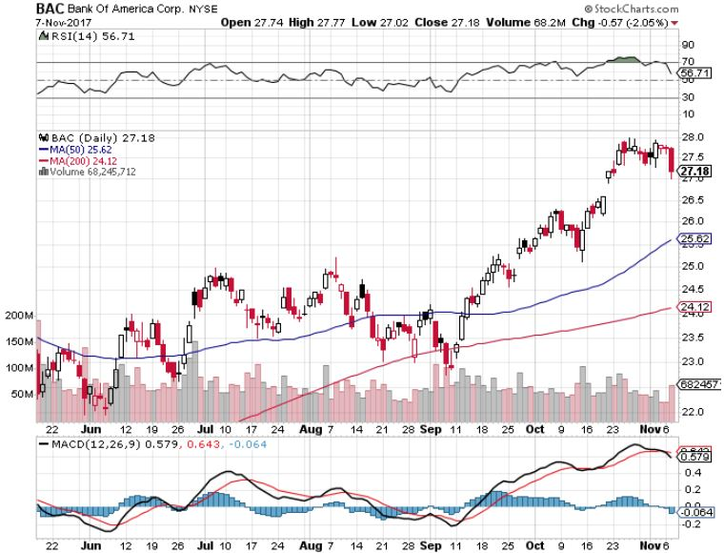
Bank of America (BAC)-
Warren Buffet exercises warrants and buys 700 million shares, with paper profit of $12 billion

Slide 35
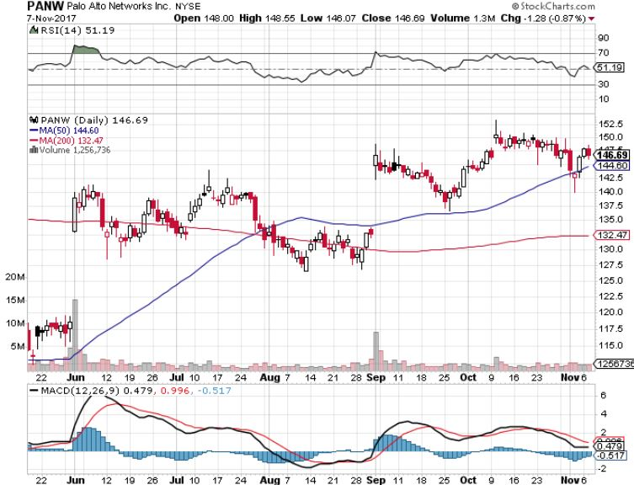
Palo Alto Networks (PANW)-

Slide 36
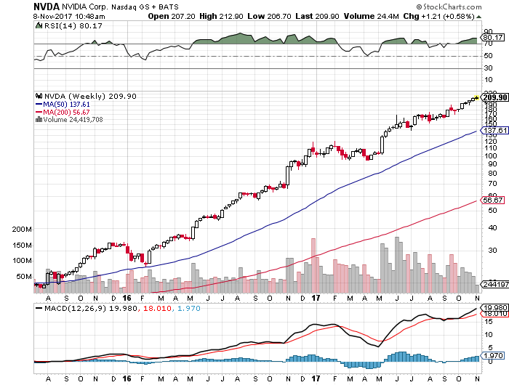
NVIDIA (NVDA)-New Highs
$200 target hit!-An official triple!

Slide 37
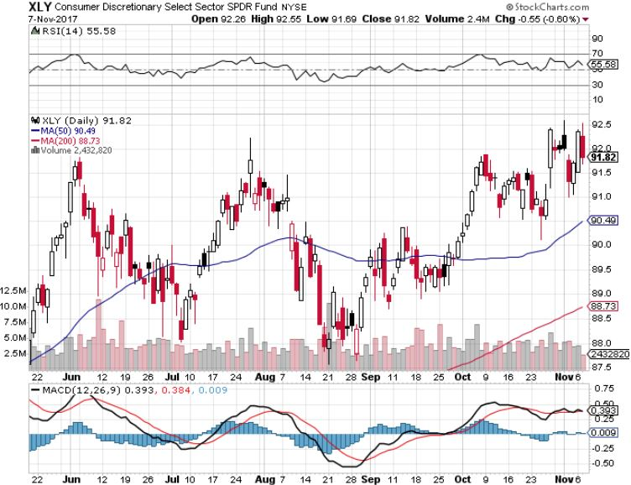
Consumer Discretionary SPDR (XLY)
(DIS), (AMZN), (HD), (CMCSA), (MCD), (SBUX)

Slide 38
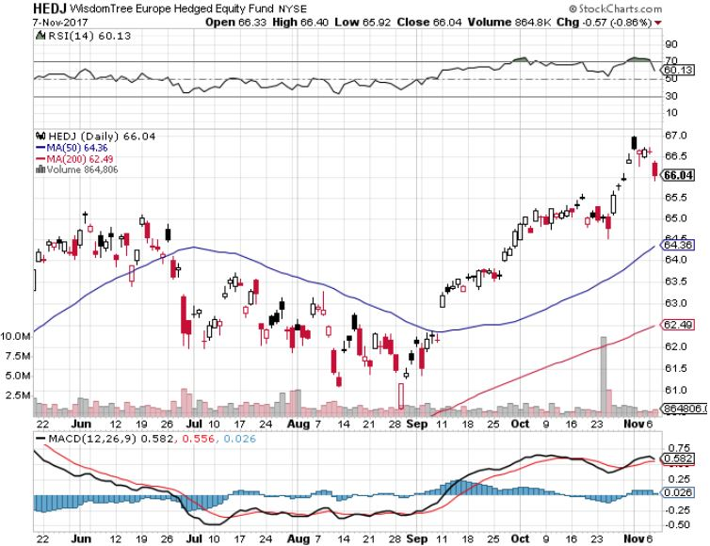
Europe Hedged Equity (HEDJ)-Global Rally

Slide 39
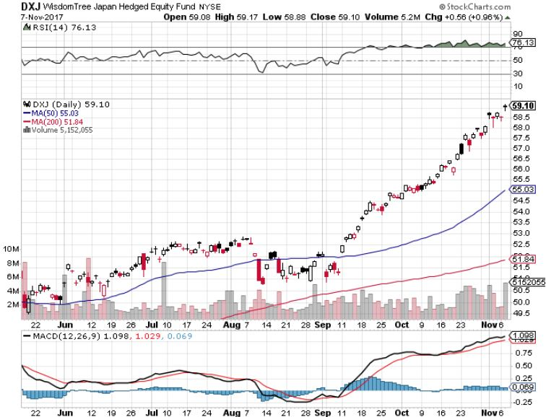
Japan (DXJ)-More Global Rally on Yen Weakness and Abe Election win

Slide 40
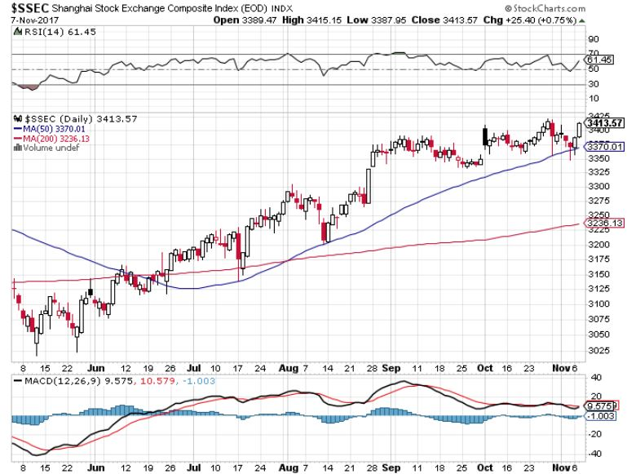
China ($SSEC)-Economic Recovery on Track

Slide 41
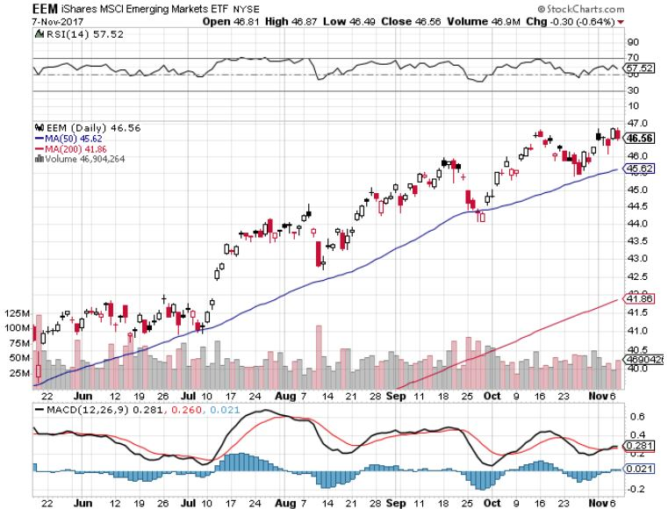
Emerging Markets (EEM)- New High

Slide 42
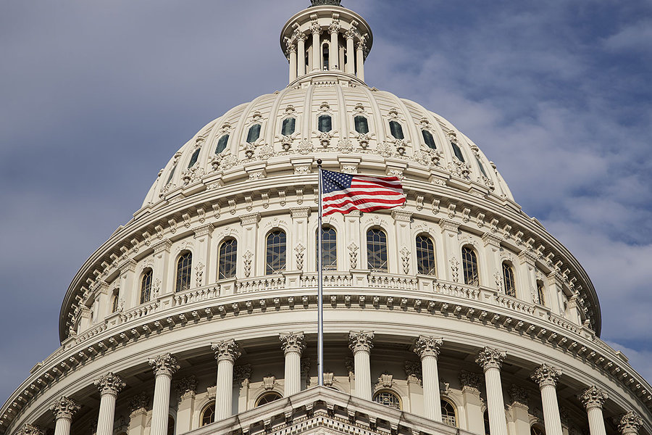
Bonds-The Tax Plan Failure Play
*Fears that the tax cuts will fail are pushing bond prices up, yields down, from 2.46% to 2.30%, but something will get through eventually
*The Federal Open Market Committee came and went with no action, as expected. The federal funds rate stands at a 1.25%-1.50% range.
*Don’t expect the same at the December meeting
*Bonds hit a 5 month high in yields at 2.44%, low in prices, my 2.50% yearend target is fast approaching
*$6 billion a month, or $200 million a day in bond sales to start soon and are overhanging the market
*Global central bank QE unwind does
not start to pull liquidity out of the financial
system until October, 2018 at the earliest
*Bonds are at a key juncture awaiting Trump
decision on new Fed governor

Slide 43
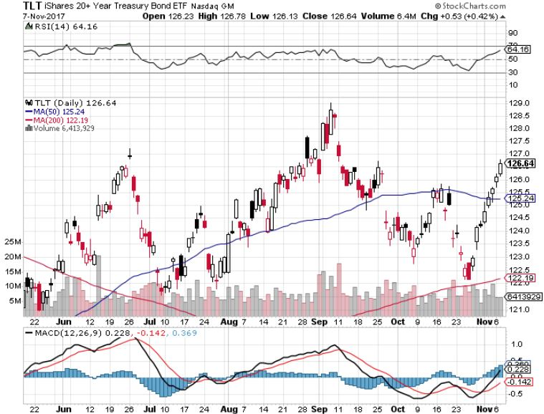
Treasury ETF (TLT) – 2.31%-My Rich Uncle Trade! long 12/$129-$132 vertical bear put spread long 11/$127-$129 vertical bear put spread took profits on long 10/$126-$128 vertical bear put spread took profits on long 10/$127-29 vertical bear put spread

Slide 44
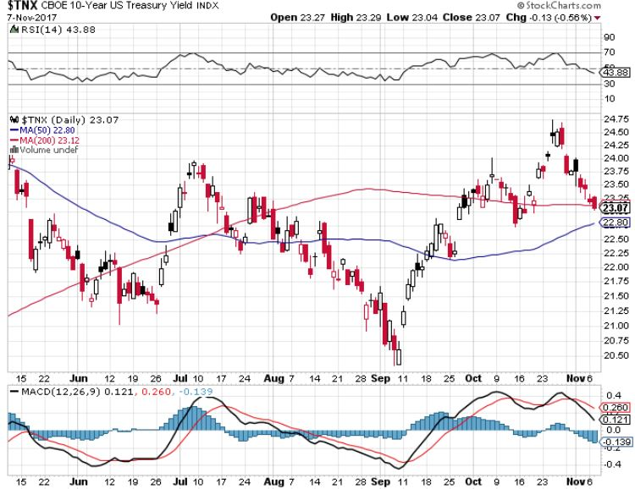
Ten Year Treasury Yield ($TNX) 2.31%
Breakdown, Now major Support

Slide 45
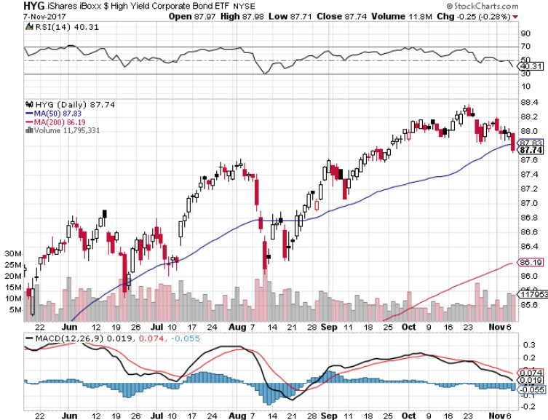
Junk Bonds (HYG) 4.71% Yield
A Great Risk Coincident Indicator- Long Term “RISK ON” means new highs, buy all dips

Slide 46
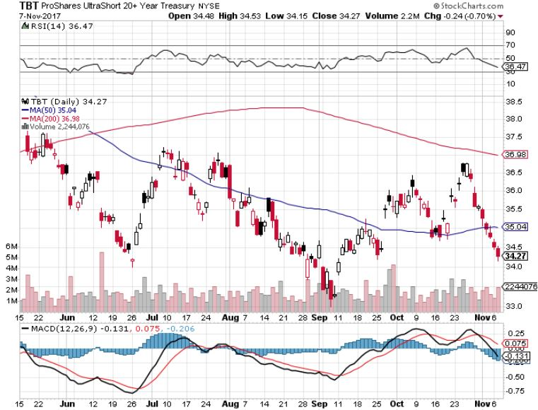
2X Short Treasuries (TBT)-Back In Screaming “BUY” Territory

Slide 47
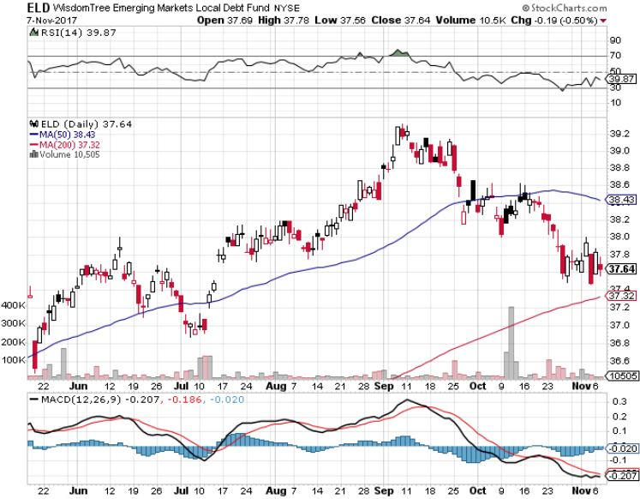
Emerging Market Debt (ELD) 5.66% Yield-

Slide 48
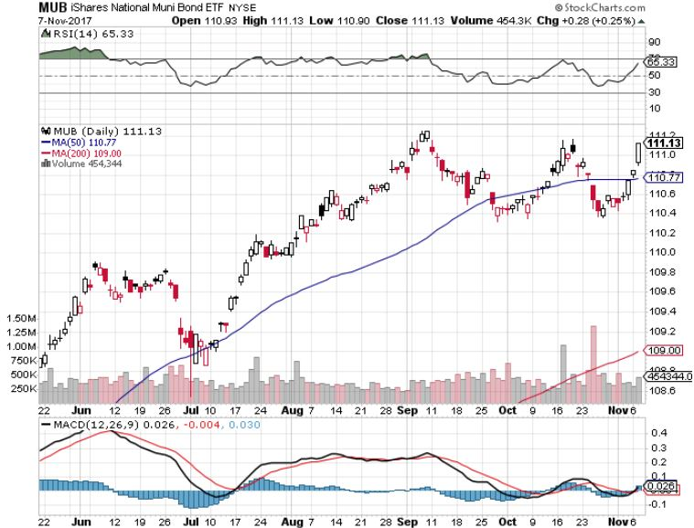
Municipal Bonds (MUB)-1.69%-Gap Up
Mix of AAA, AA, and A rated bonds

Slide 49

Foreign Currencies-Strong Dollar
*ECB tightening through fewer bond buy backs crushes the Euro
*Raising rates promises lower Japanese yen (FXY), Euro (FXE), and Aussie (FXA)
*Fed rate rise promises to knock the stuffing out of the currencies
*Accelerating US growth is also underpinning the greenback
*Continued weakness in the Japanese yen (FXY) says the “RISK OFF” are over
*This means that the new dollar
bull market may have years to run
*Dollar gains will increase into yearend
*The bottom is in for US rates

Slide 50
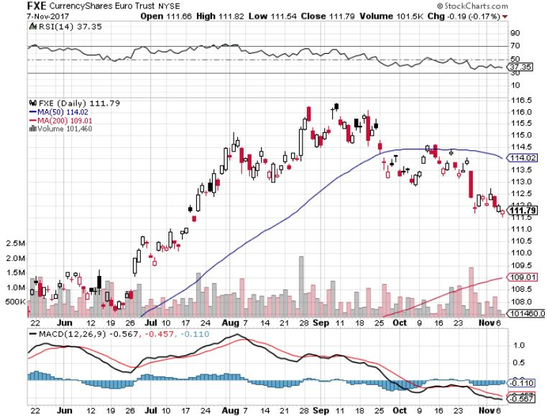
Euro ($XEU), (FXE), (EUO)- Head and Shoulders Top

Slide 51
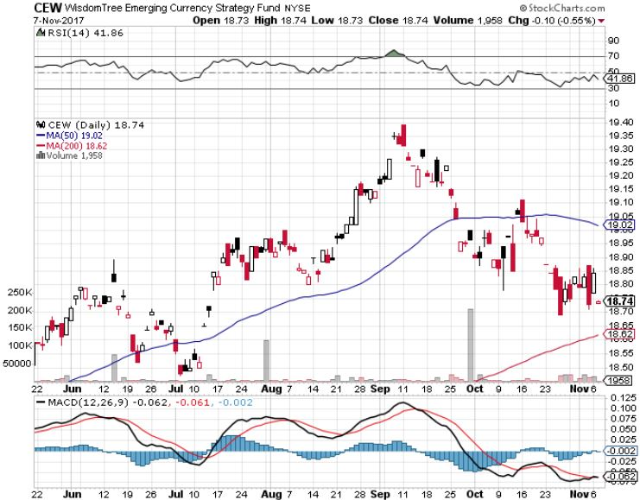
Emerging Market Currencies (CEW)

Slide 52
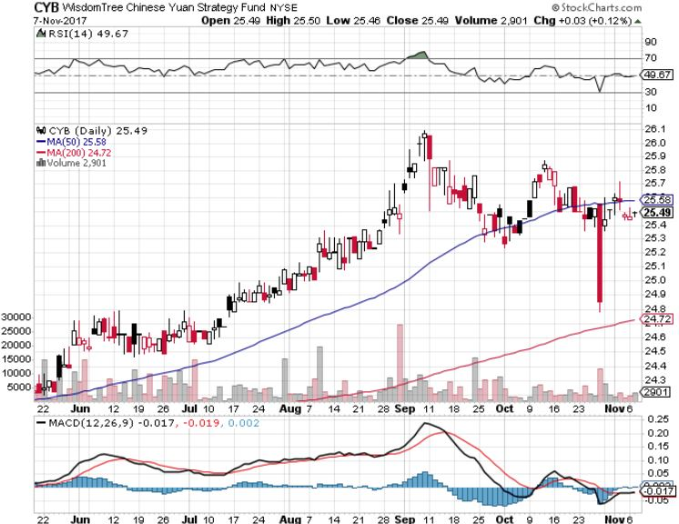
Chinese Yuan- (CYB)-Stabilizing on Government Support

Slide 53
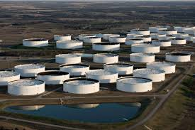
Energy-Major Breakout!
*Very large counter seasonal draws engineer a major upside breakout for oil prices, down a staggering 15.9 million barrels in one week
*Synchronized economic recovery is pushing oil prices up along with everything else
*Saudi mass arrests on a corruption campaign add fuel to the fire
*Fracking supply is falling sharply,
with Baker Hughes down 11 to 898
*Buy the dips in energy stocks

Slide 54
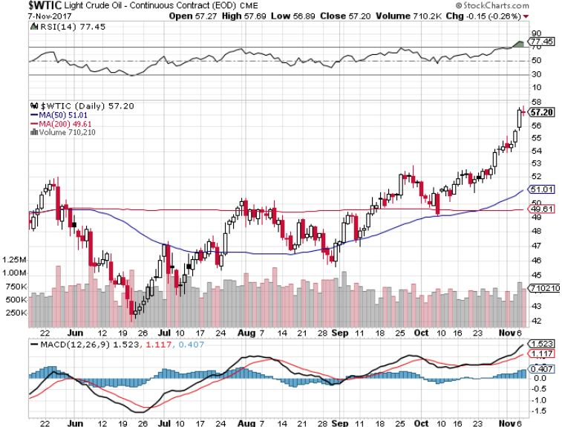
Oil-Breakout!

Slide 55
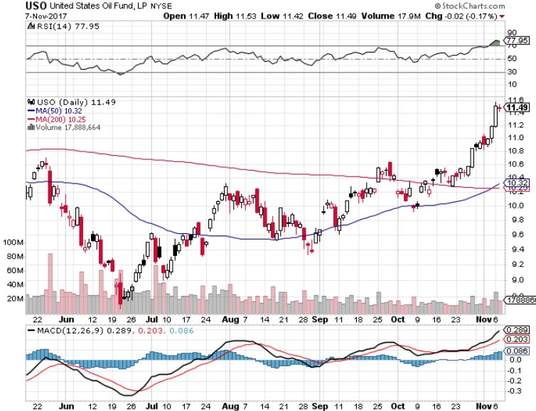
United States Oil Fund (USO)

Slide 56
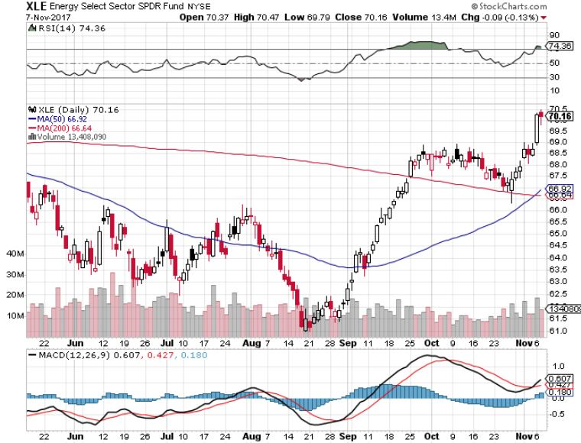
Energy Select Sector SPDR (XLE)-New Lows!
(XOM), (CVX), (SLB), (KMI), (EOG), (COP)

Slide 57
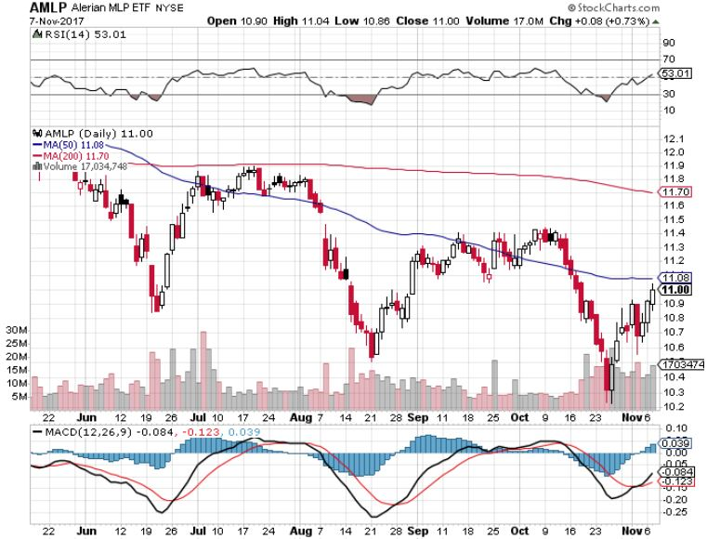
Alerian MLP ETF (AMLP)-
Basket Approach is the Only Safe Play Here

Slide 58
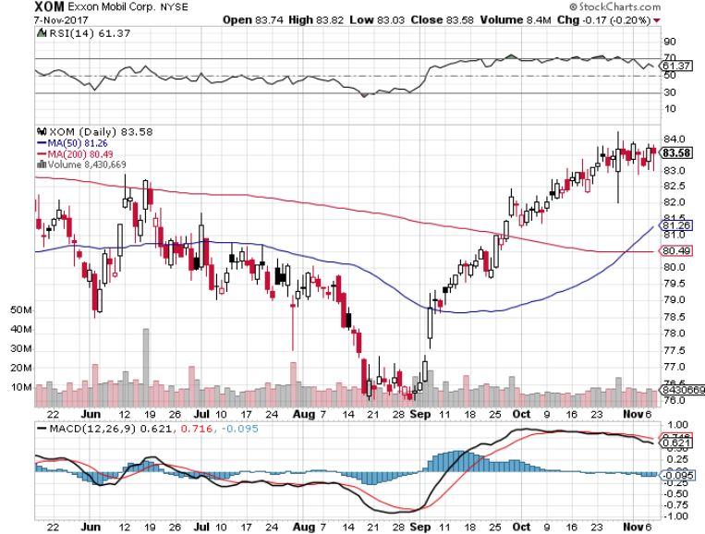
Exxon (XOM)-The Bottom is In

Slide 59
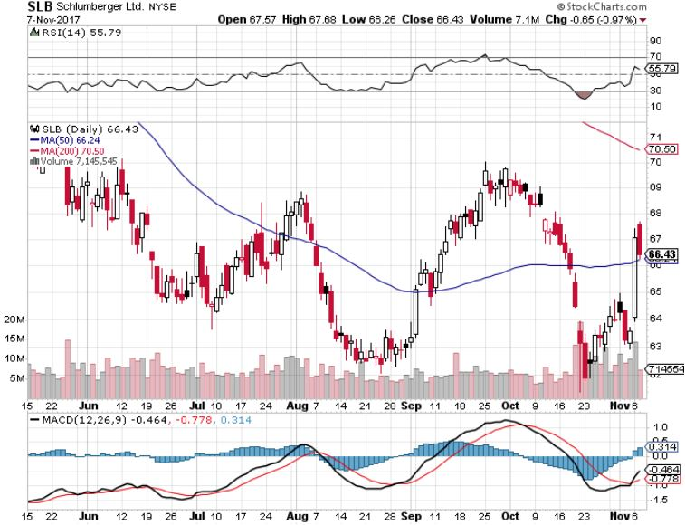
Schlumberger (SLB)-Hard Bounce Back

Slide 60
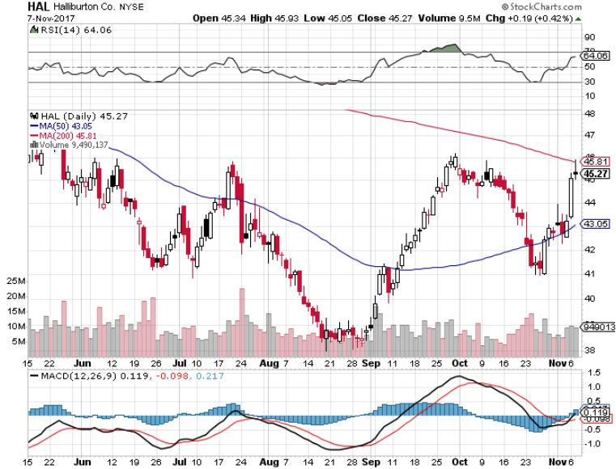
Halliburton (HAL)-Ditto

Slide 61
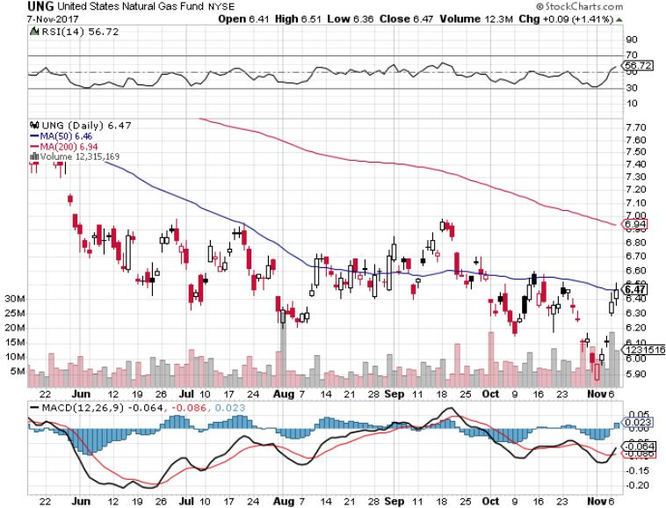
Natural Gas (UNG)-No Joy

Slide 62

Copper (COPX)-China Infrastructure Build Out

Slide 63

Precious Metals-Playing Dead
*No love for the barbarous relic in a melt up stock market
*When stocks peak, look for a major gap up in all precious metals
*Even falling rates can’t help gold
*Hedge funds have started to dip their toes back in the water
*Buy gold and silver stocks
on the next big dip, as the move
is still only a few months old

Slide 64

Gold (GLD)-Retest of the Trend hedging trades starting to move again

Slide 65

Market Vectors Gold Miners ETF- (GDX)
Took profits on long the 9/$20.50-$21.50 bull call spread

Slide 66

Barrick Gold (ABX) stopped out of long 9/$15-16 call spread

Slide 67

Newmont Mining- (NEM)-Breakout took profits on long the 9/$32-$34 bull call spread

Slide 68

Global X Silver Miners ETF- (SIL)-Breakout took profits on long the 9/$31-$33 bull call spread

Slide 69

Bitcoin-Modern Day Tulips!

Slide 70

Agriculture-Nary a Pulse
*60% chance that this will be a “La Nina” winter, bringing harsh weather that could boost prices
*Last time this happened 2016, the major weather event never showed, crushing prices
*Ocean freight rates to China jumped 50% on global economic recovery, putting US exporters at a further disadvantage
*Hedge funds turning to long side
*Another disastrous year in ags
coming to and end, the 5th in a row
*Be thankful we haven’t done an Ag
trade for five years

Slide 71

(CORN) –New Lows!

Slide 72

(WEAT)-Major Breakdown

Slide 73

(SOYB)-Dead in the Water

Slide 74

Real Estate-Goodbye Deductions
*Residential real estate will take a massive hit on the new proposed tax bill, no mortgage interest deductions over $500,000, no real estate tax deduction of $100,000, loss of net income for the upper middle class will overhang the entire country
*Too early to see any market impact, but agents are concerned
*High prices shutting out the entry level buyer
*Homebuilder stocks get whacked
*The mansion shortage: Number of homes
for sale priced over $1 million
down 18% YOY
*July S&P 500 Case-Shiller maintains
strong 6.1%, with absolute prices hitting
new all time high

Slide 75

Home Depot (HD)-Double Bottom + Twin Hurricane Help took profits on long $9/$141-$144 vertical bull call spread

Slide 76

August S&P 500/Case–Shiller Home Price Index
+6.1% YOY, Seattle (+13.2%), Las Vegas (+8.6%), San Diego (+7.8%) still leaders price rises accelerating

Slide 77

General Growth Properties (GGP)-New Lows
Brookfield (BAM) takeover rumors

Slide 78

US Home Construction Index (ITB)
(DHI), (LEN), (PHM), (TOL), (NVR)
A Favorite Sector to Buy

Slide 79

Trade Sheet-
So What Do We Do About All This?
*Stocks- stand aside
*Bonds-sell any and all rallies
*Commodities-buy industrials, energy
*Currencies-sell yen and Euro on any rallies
*Precious Metals –buy big dip
*Volatility-stand aside until over $16
*The Ags –stand aside
*Real estate-buy dips

Slide 80

Next Strategy Webinar
12:00 EST Wednesday, November 22, 2017
San Francisco, CA
Buy conference and lunch tickets at madhedgefundtrader.com
Good Luck and Good Trading!
Notes:
*

