Slide 1

The Mad Hedge Fund Trader “Melt Up Mania”
With John Thomas from Silicon Valley, CA, November 22, 2017 www.madhedgefundtrader.com
Notes:
*

Slide 2


Global Strategy Luncheons Buy tickets at www.madhedgefundtrader.com
Chicago, IL December 27, 2017
Minneapolis, MN December 28, 2017

Slide 3

Trade Alert Performance Biggest Up Month in Ten Years! New All Time High!! 22 Consecutive Profitable Trade Alerts!!
*January +9.35% Final *July +1.95% Final *February +6.39% FINAL *August +18.38% Final *March +4.87% Final *September +7.65% Final *April +1.84% Final *October +1.39% Final *May -0.45% Final *November +2.24% MTD *June +0.70% Final *December +.84% Final *2017 Year to Date 53.95% compared to 18% for the Dow Average 31 of 35 consecutive profitable trade alerts *Trailing One year return +51.40%, +269.96% since inception, *Average annualized return of 34.10%

Slide 4
Portfolio Review No “sweet spot” entry points Risk/Reward is out of balance, 70% cash
Mad Hedge Fund Trader
Model Trading Book
Asset Class Breakdown
Risk Adjusted Basis
Current Capital at Risk
Risk On
World is Getting Better
(TLT) 12/$129-$132 put spread | 10.00%
(FXE) 12/$116-$118 put spread | 10.00%
Risk Off
World is Getting Worse
(GLD) 12/$116-$119 call spread | -10.00%
Total Net Position | 10.00%
56.00 % Expiration P&L

Slide 5
Trailing One-Year Return Daily Audited Performance

Slide 6
Eight Year Daily Audited Performance Averaged Annualized Return +34.62%

Slide 7

The Method to My Madness
*Risk/reward for stocks right now is atrocious, 5% of upside versus 20%-30% downside, is a classic “Picking up the pennies in front of a steam roller” market *Sharply flattening yield curve shows that the long term topping process has begun, but we could have 18 months to run with rising volatility
*Sell every bond rally….Janet put the top in with $4 T bond hoard liquidation, buy $5 trillion in new QE in Japan and Europe is halting decline *Look for main indexes to grind up for the rest of 2017 *Avoid FANG’s, the game is in domestic laggards and reflation plays and banks *Buy oil stocks on dips *Sell currencies on any new rallies, top is in

Slide 8
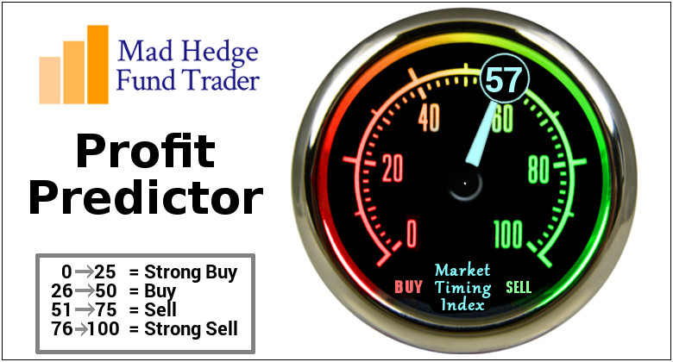
The Mad Hedge Profit Predictor Market Timing Index An artificial intelligence driven algorithm that analyzes 30 different economic, technical, and momentum driven indicators

Slide 9
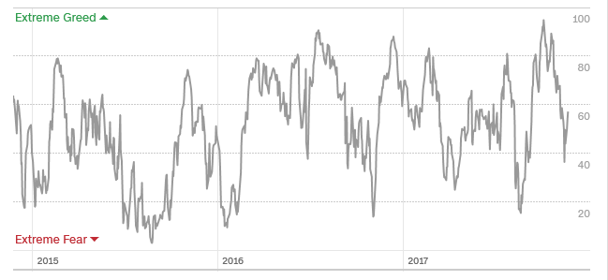
The Mad Hedge Profit Predictor Market Timing Index The Multi Month Top

Slide 10
The Bill Davis View A $1,500 Upgrade for the Mad Day Trader Service
Buys: | Entry | Target
Expedia, Inc. (EXPE) | $125.00 | $145.00
Owens & Minor, Inc. (OMI) | $18.00 | $24.00
Teva Pharmaceuticals (TEVA) | $12.00 | $16.00
Genesco, Inc (GCO) | $28.00 | $37.00
Range Resources (RRC) | $17.00 | $22.00
F5 Networks, Inc. (FFIV) | $120.00 | $132.00
Sells:
Williams Sonoma (WSM) | $48.00 | $32.00
Andarko Petroleum (APC) | $49.00 | $44.00
Devon Energy (DVN) | $38.00 | $29.00
Williams Company (WMB) | $29.00 | $25.00
MicroStrategy Inc.(MSTR) | $155.00 | $130.00

Slide 11

The Global Economy-Running Hot
*US October Producer Price Index up a hot 0.4%, Leading Economic Indicators a 10 year high at 1.2% *Europe now growing at a 3.2% annual rate, compared to 2.3% for the US, Germany just reports an 0.8% Q3 *China Industrial Production up a hot 6.2%, GDP probably growing at7% or better *ECB scales back QE, cutting monthly bond purchases from 60 to 30 billion a month, but extended the time frame *Poland has best quarter in five years
*It’s all very market positive, and severely limited the downside to the last correction

Slide 12
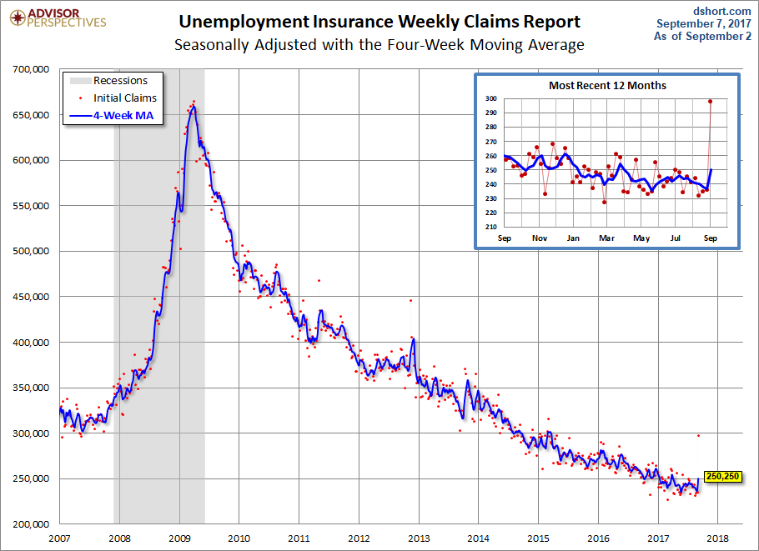
Weekly Jobless Claims –The Most Important Statistic -13,000 to 239,000 as hurricane effects abate New 43 Year Low!

Slide 13

Stocks-Biding Time
*The US is now the most highly priced major stock market in the world *62 weeks since 2% correction, the longest since 1965 *Flat line sideways “time” correction now one month old, upside breakout coming eventually *Mad Hedge Market Timing Index has gone from extremely overbought to neutral, hoping for an oversold reading to get back in on long side *Tax uncertainty capping markets for a month, and resolution will pave the way for the next upside breakout….or 5% correction if it fails *Volatility Index (VIX) makes a one day visit to $14, then gets crushed again * A synchronized global economic recovery, artificially low interest rates, and the prospect of once a generation tax cuts are a lot to sell against.

Slide 14
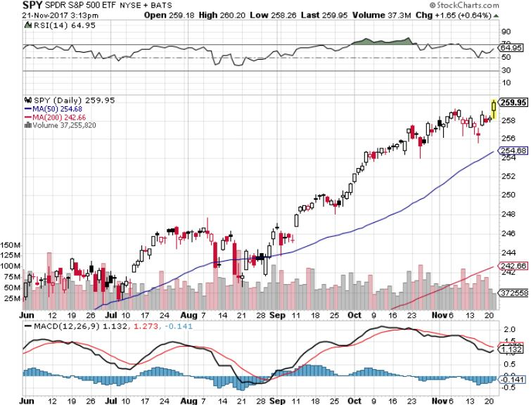
S&P 500-New Highs

Slide 15
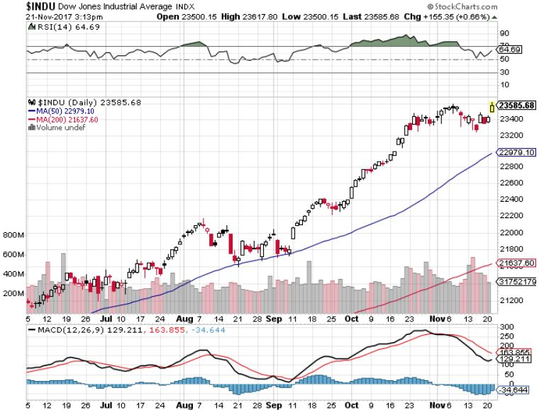
Dow Average-New Highs Haven’t Retraced to the 50 Day MA since May-Very High Risk

Slide 16
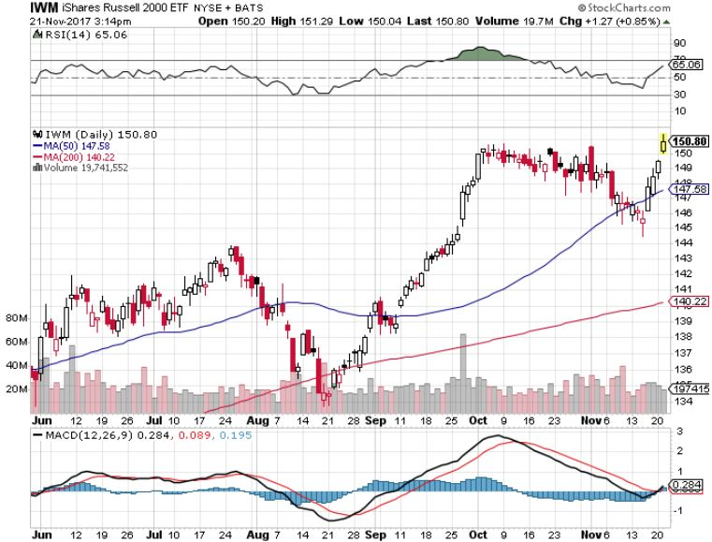
Russell 2000 (IWM)-Peaked Out stopped out of long the (IWM) 12/$152-$155 bear put spread

Slide 17
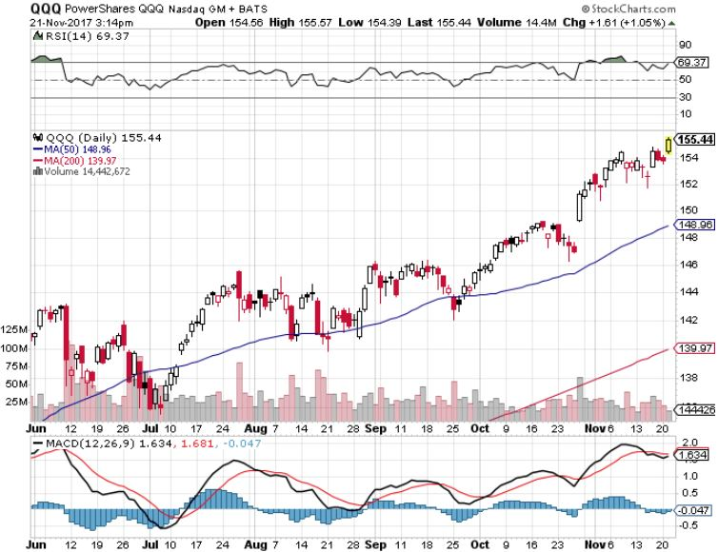
NASDAQ (QQQ)-New Highs

Slide 18
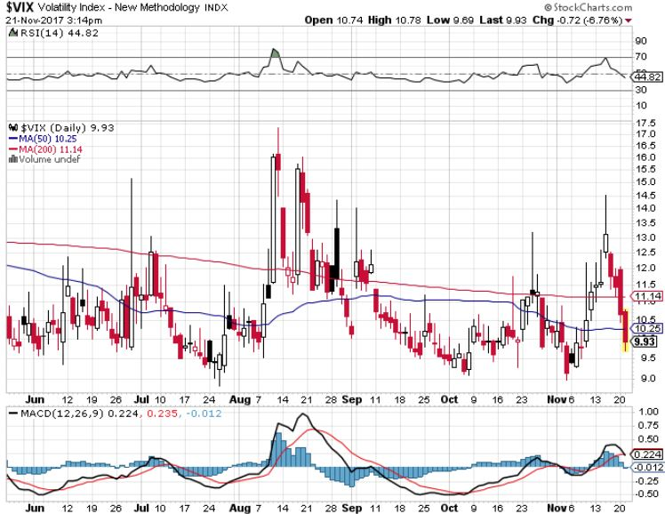
(VIX)-New Low

Slide 19
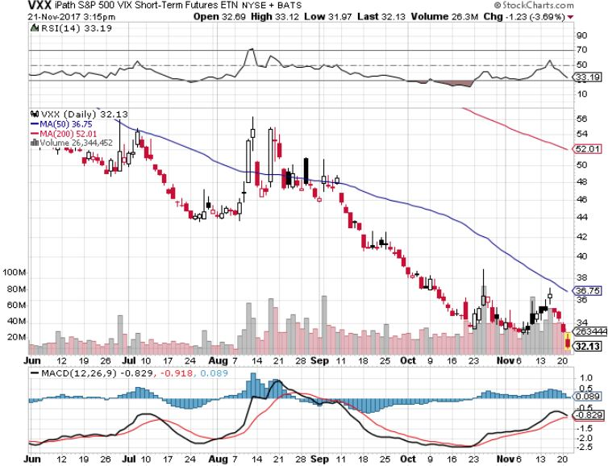
iPath S&P 500 VIX Short-Term Futures ETN (VXX) Begging for New Lows stopped out of long 1/$60 calls as a hedge for rest of portfolio took profits on long 11/$20 calls

Slide 20
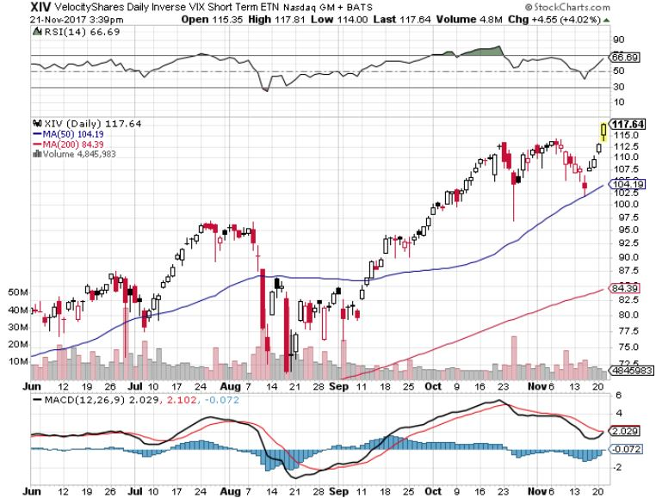
Velocity Shares Daily Inverse VIX Short Term ETN (XIV) One of the most instantly profitable trades of 2016….and 2017 took profits on (XIV) long at $81.45

Slide 21
Velocity Shares Daily Inverse VIX Short Term ETN (XIV) One of the most instantly profitable trades of 2016….and 2017 took profits on (XIV) long at $81.45

Slide 22
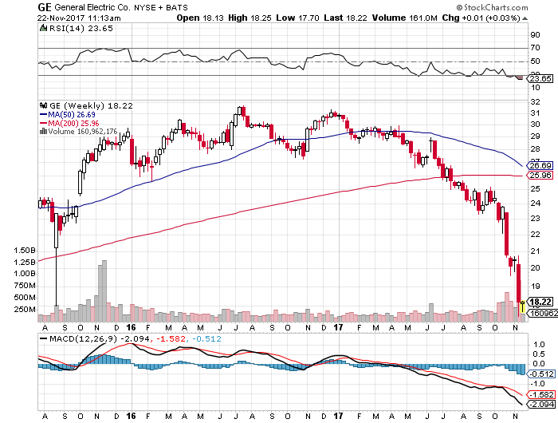
Stock of the Week General Electric (GE)

Slide 23
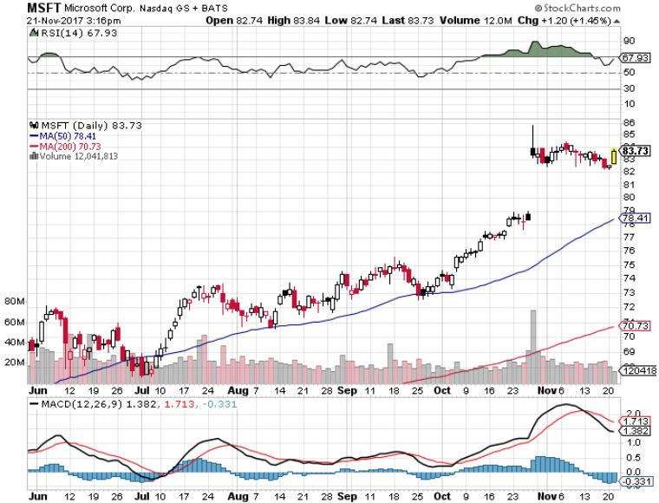
Microsoft (MSFT)

Slide 24
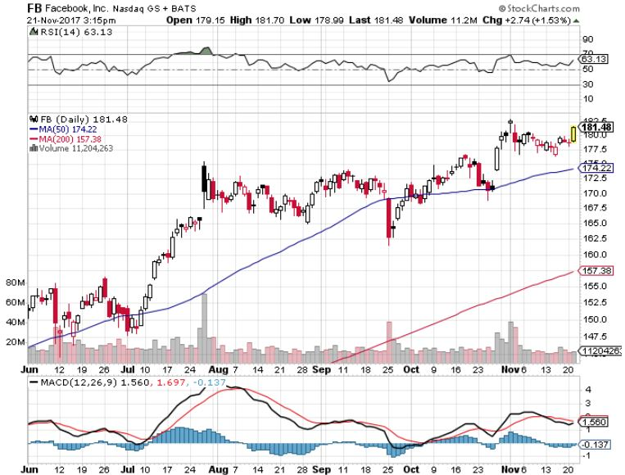
Facebook (FB)-

Slide 25
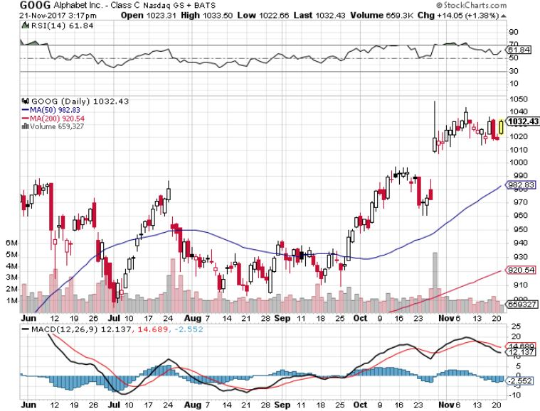
Alphabet (GOOG)-New High

Slide 26
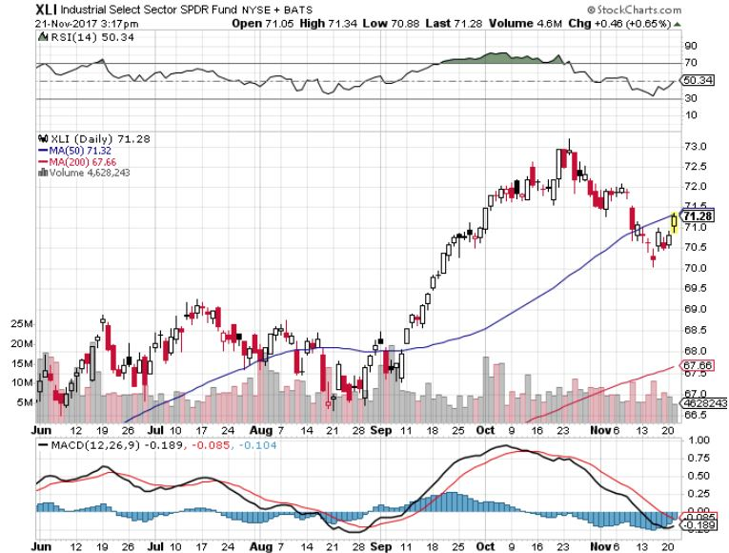
Industrials Sector SPDR (XLI)- (GE), (MMM), (UNP), (UTX), (BA), (HON)

Slide 27
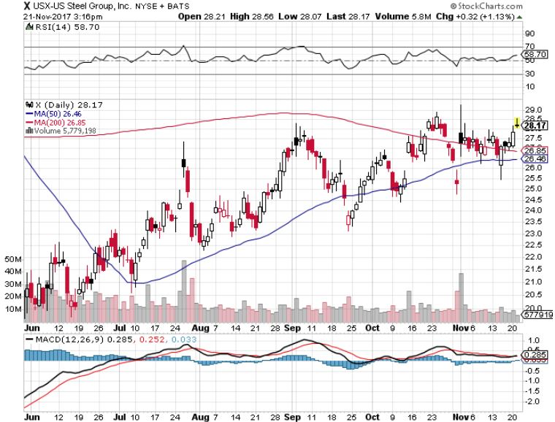
US Steel (X)- took profits on long the 9/$21-$22 vertical bull call spread

Slide 28
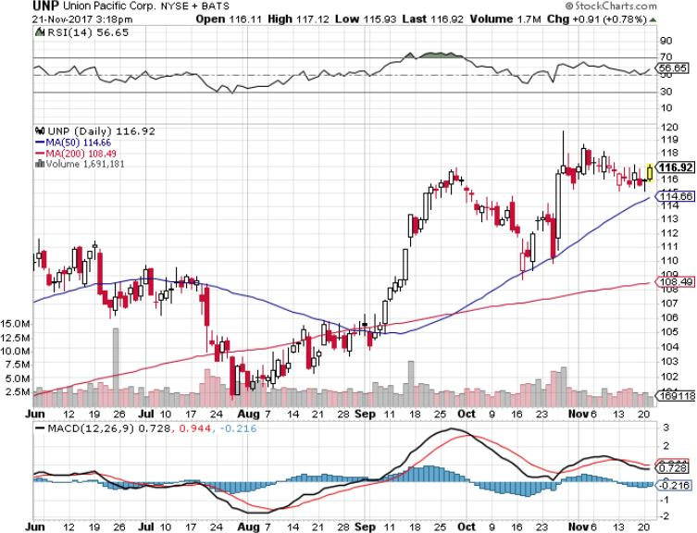
Union Pacific Railroad (UNP)- took profits on long the 9/$100-$102 vertical bull call spread

Slide 29
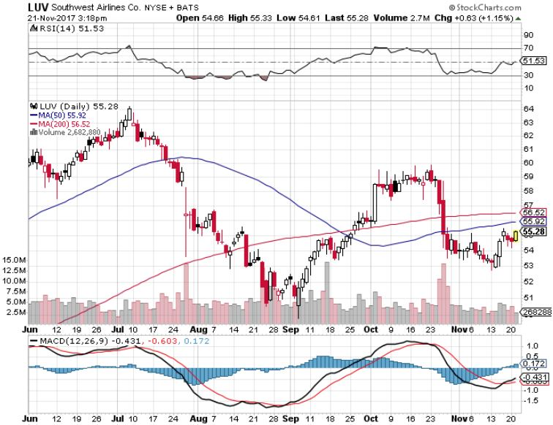
Southwest Airlines (LUV)- Warren Buffett’s Favorite Airline

Slide 30
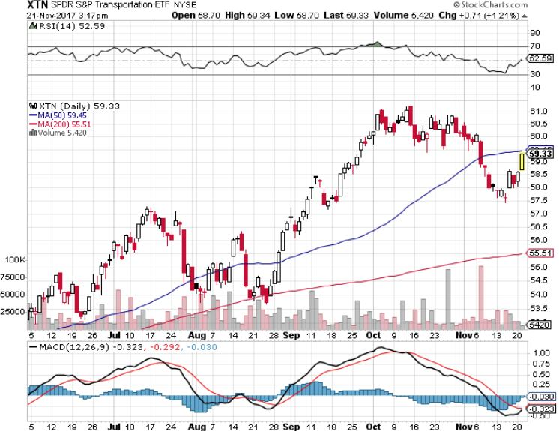
Transports Sector SPDR (XTN)- (ALGT), (ALK), (JBLU), (LUV), (CHRW), (DAL)

Slide 31
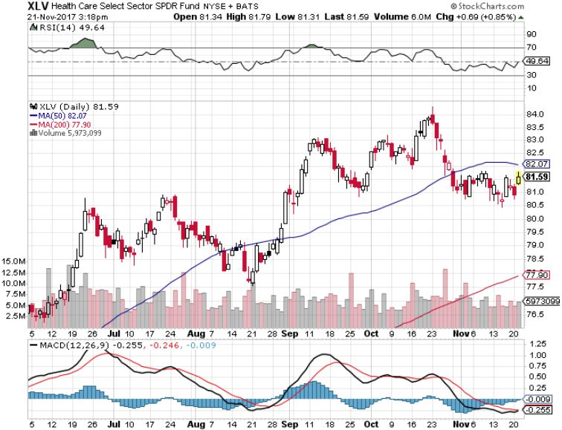
Health Care Sector (XLV), (RXL)-The New FANG? (JNJ), (PFE), (MRK), (GILD), (ACT), (AMGN)

Slide 32
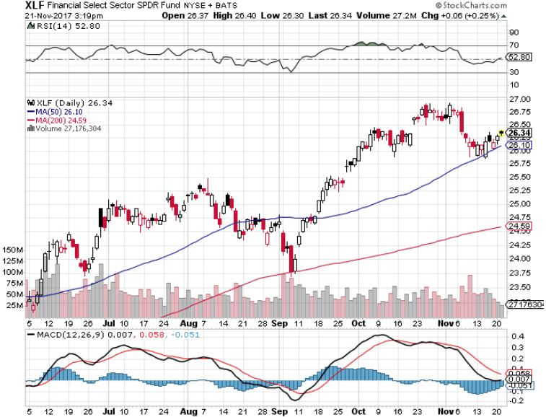
Financial Select SPDR (XLF)-New Highs (BLK/B), (WFC), (JPM), (BAC), (C), (GS)

Slide 33
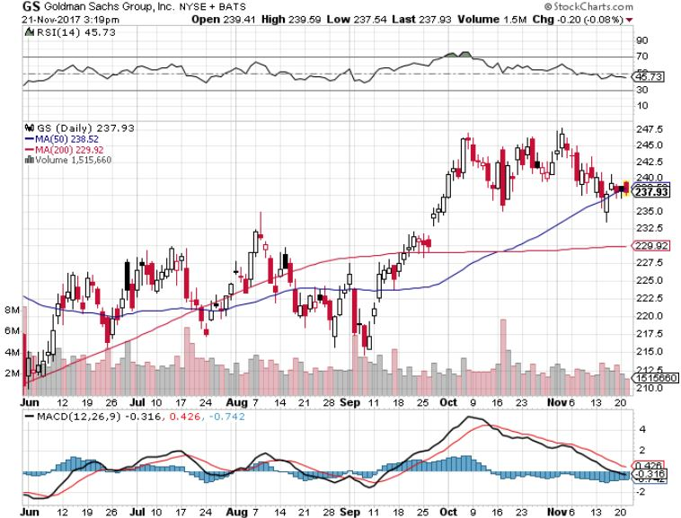
Goldman Sachs (GS)-Interest Rate Drag stopped out of long 10/$220-$225 vertical bull call spread took profits on long 10/$227.50-$232.50 vertical bull call spread took profits on long 9/$205-$210 vertical bull call spread took profits on long 9/$235-$240 vertical bear put spread

Slide 34
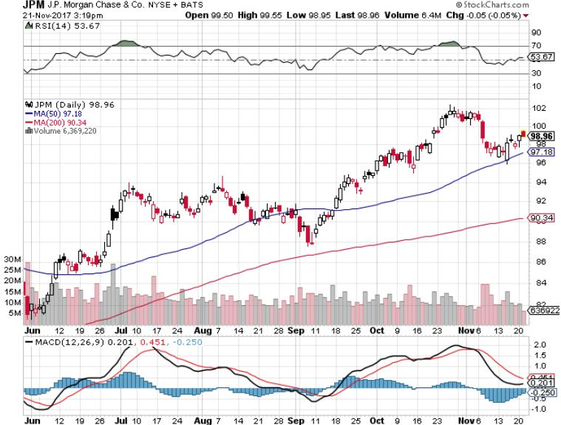
JP Morgan (JPM)-

Slide 35
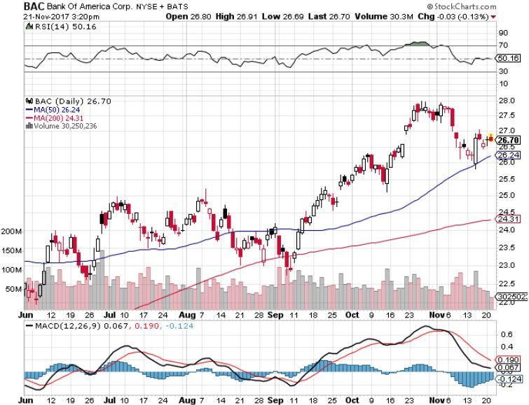
Bank of America (BAC)- Warren Buffet exercises warrants and buys 700 million shares, with paper profit of $12 billion

Slide 36
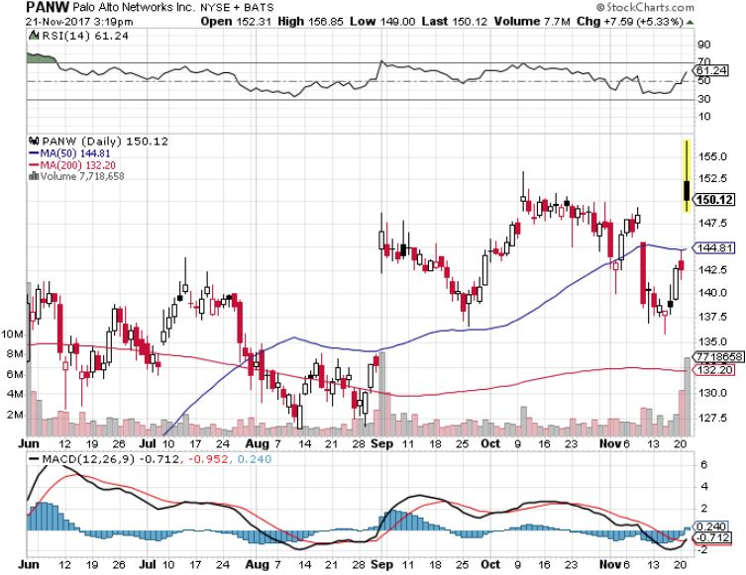
Palo Alto Networks (PANW)-

Slide 37
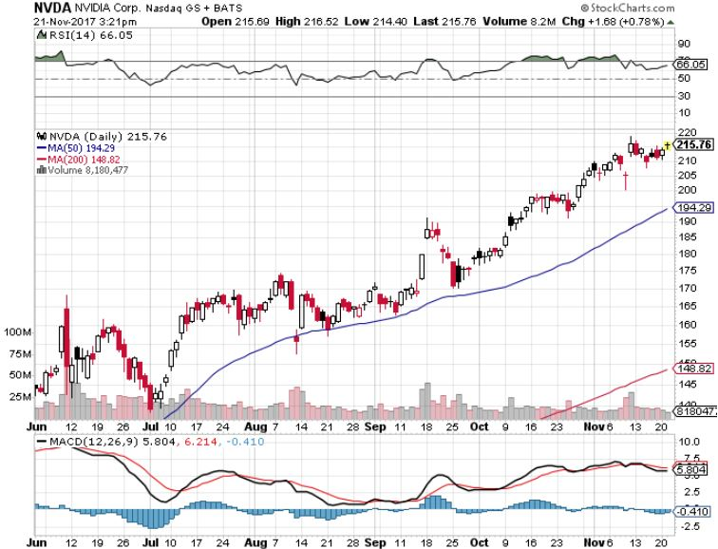
NVIDIA (NVDA)-New Highs $200 target hit!-An official triple!

Slide 38
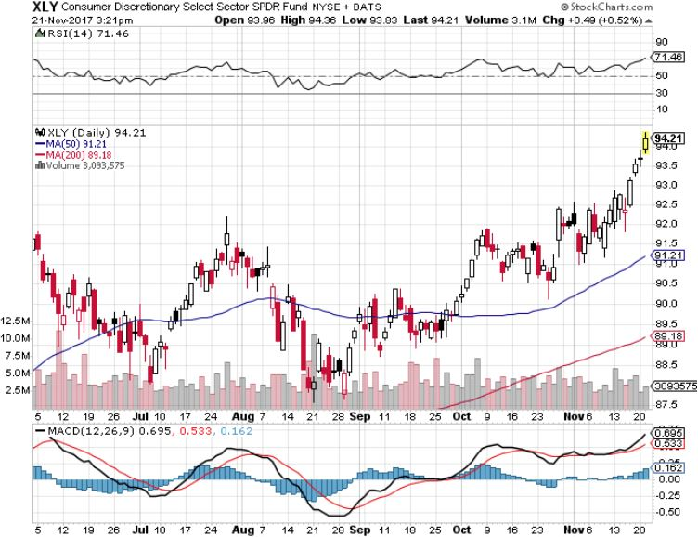
Consumer Discretionary SPDR (XLY) (DIS), (AMZN), (HD), (CMCSA), (MCD), (SBUX)

Slide 39
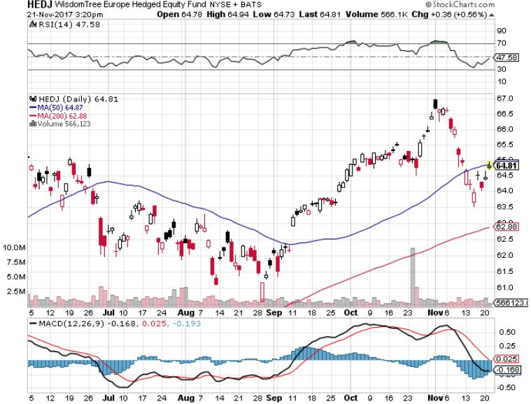
Europe Hedged Equity (HEDJ)-Global Rally

Slide 40
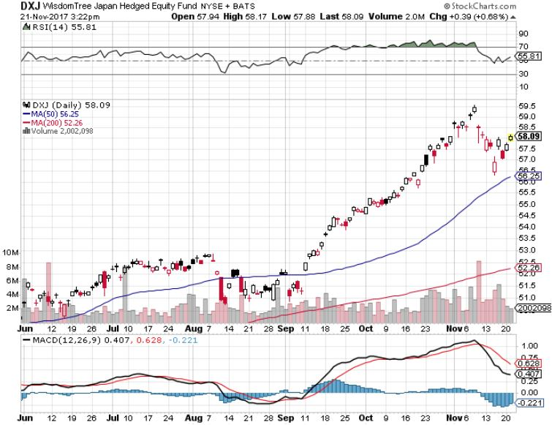
Japan (DXJ)-More Global Rally on Yen Weakness and Abe Election win

Slide 41
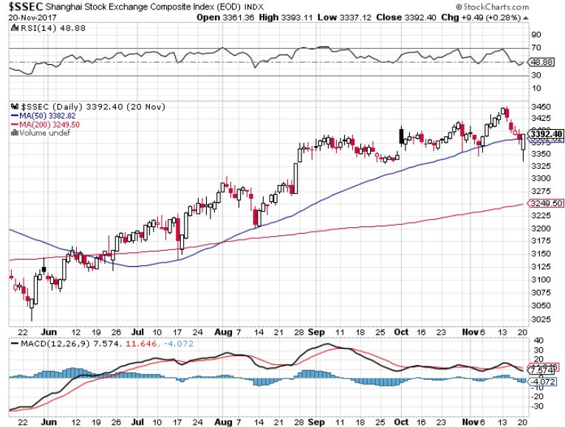
China ($SSEC)-Economic Recovery on Track

Slide 42
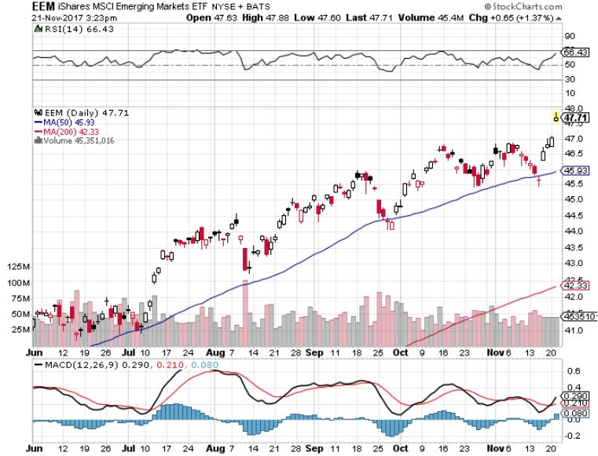
Emerging Markets (EEM)- New High

Slide 43

Bonds-Going Nowhere
*Bonds trapped in narrow 15 basis point range awaiting progress on taxes, Fed rate hikes, or anything *Markets now giving a 97% probability of a 25 basis point Fed rate hike on December 13, will be the last big event of the year *Huge curve flattening dominating the markets, 2 year-10 year spread has plunged from 150 to 50 basis points in 2017 *I’m still looking for one more bond selloff in 2017 to take yields to 2.50% by yearend, will be triggered by the next stock dump *$6 billion a month, or $200 million a day in bond sales to start soon and are overhanging the market *Junk takes monster hit *Non economic buying by central banks will continue until October, 2018, so the bid underlying the market will remain = NO CRASH, just a short trade

Slide 44
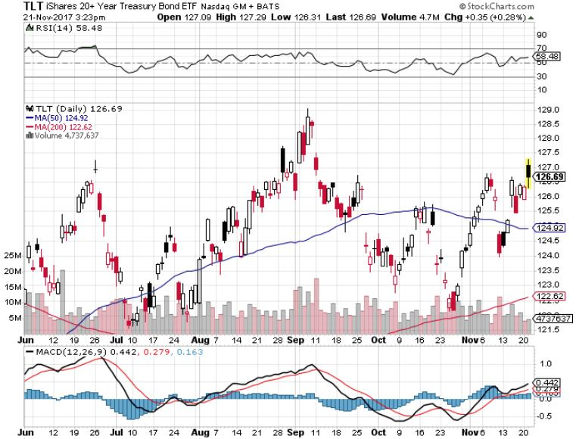
Treasury ETF (TLT) – 2.36%-My Rich Uncle Trade! long 12/$129-$132 vertical bear put spread long 11/$127-$129 vertical bear put spread expired at max profit took profits on long 10/$126-$128 vertical bear put spread took profits on long 10/$127-29 vertical bear put spread

Slide 45
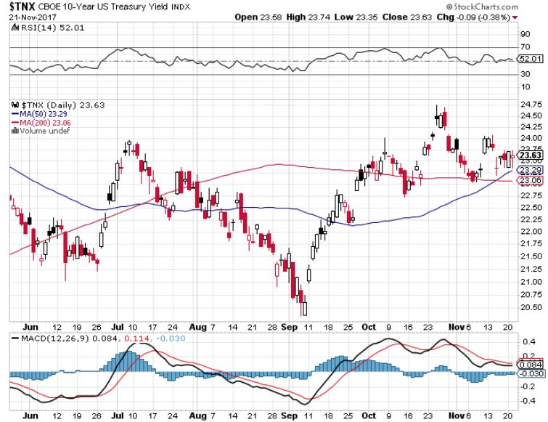
Ten Year Treasury Yield ($TNX) 2.36% Breakdown, Now major Support

Slide 46
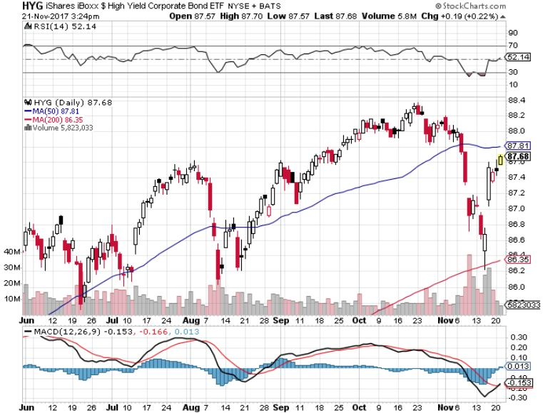
Junk Bonds (HYG) 4.71% Yield A Great Risk Coincident Indicator- Long Term “RISK ON” means new highs, buy all dips

Slide 47
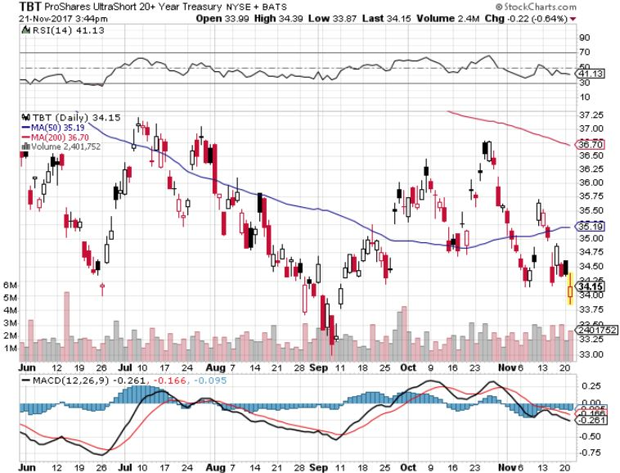
2X Short Treasuries (TBT)-Back In Screaming “BUY” Territory

Slide 48
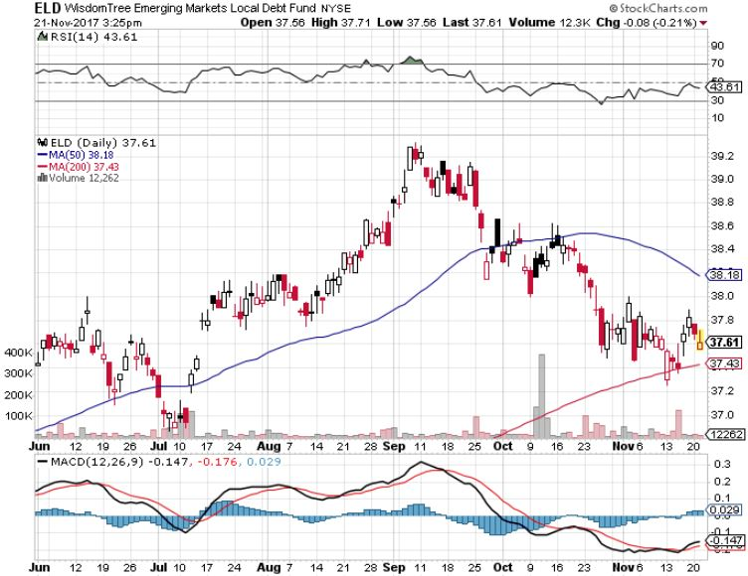
Emerging Market Debt (ELD) 5.66% Yield-

Slide 49
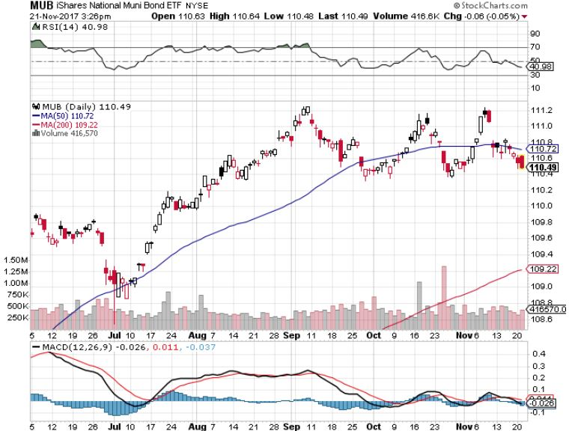
Municipal Bonds (MUB)-1.69%-Gap Up Mix of AAA, AA, and A rated bonds

Slide 50
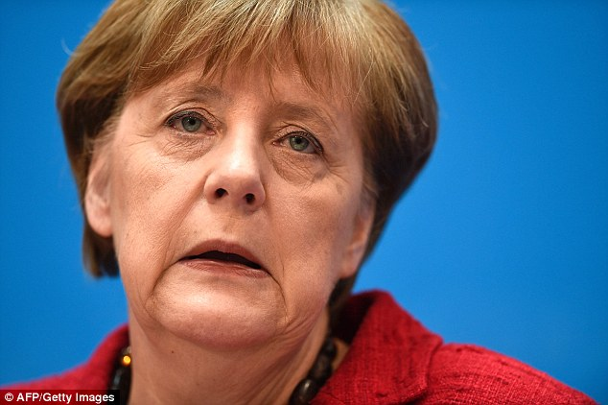
Foreign Currencies-Political Crisis
*Failure of Merkel to form a government in Germany triggers a political crisis and knocks the stuffing out of the Euro (FXE) *Rising rates promises lower Japanese yen (FXY), Euro (FXE), and Aussie (FXA) *A series of hot economic data showing accelerating US growth is underpinning the greenback *This means that the new dollar bull market may have years to run *Dollar gains will increase into yearend *The bottom is in for US rates

Slide 51
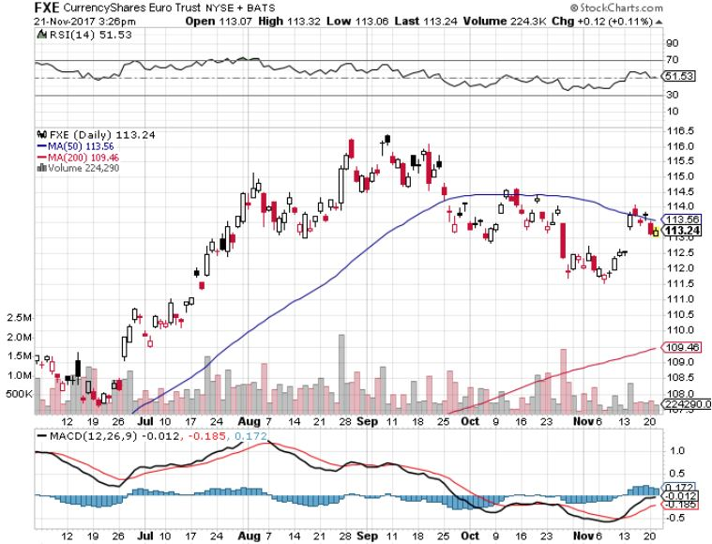
Euro ($XEU), (FXE), (EUO)- Head and Shoulders Top long (FXE) 12/$116-$118 vertical bear put spread

Slide 52
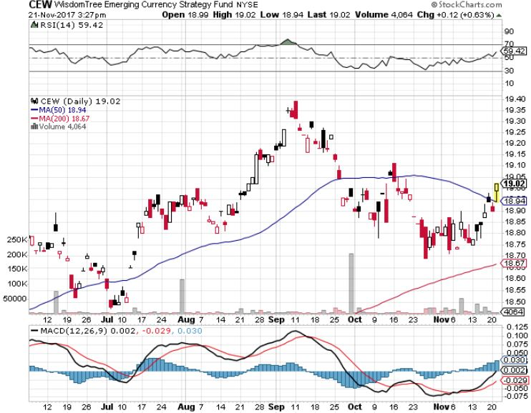
Emerging Market Currencies (CEW)

Slide 53
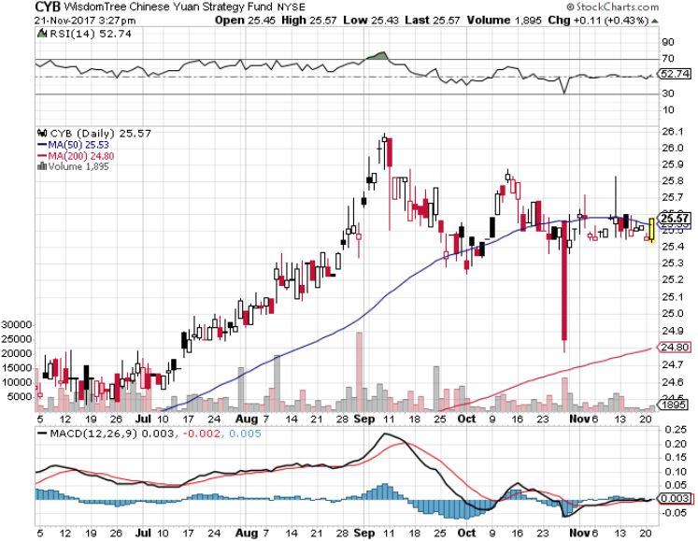
Chinese Yuan- (CYB)-Stabilizing on Government Support

Slide 54

Energy-Keystone Hangover
*Keystone pipeline approval opens way for more Canadian oil to enter the US knocking down prices *Synchronized economic recovery is pushing oil prices up along with everything else *Mexico’s Pemex discover huge new field, Ixachi-1, with 350 million barrels of recoverable reserves *Fracking supply is on the rebound, with Baker Hughes up 8 to 915 *Buy the dips in energy stocks

Slide 55
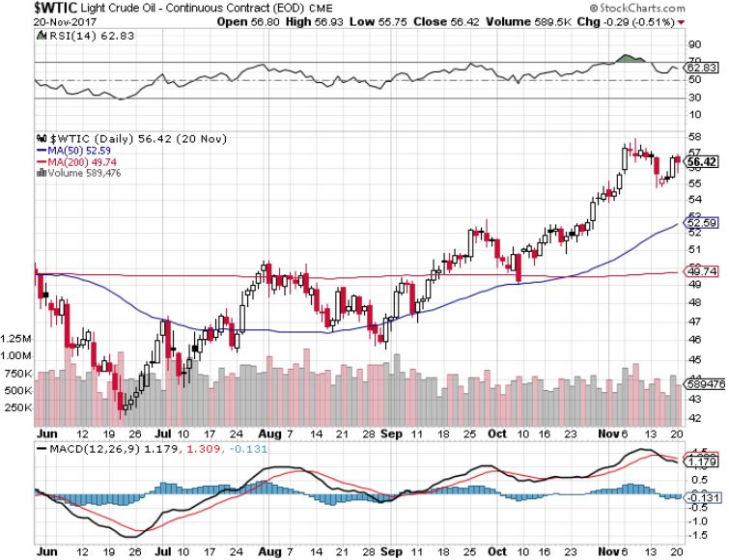
Oil-Breakout!

Slide 56
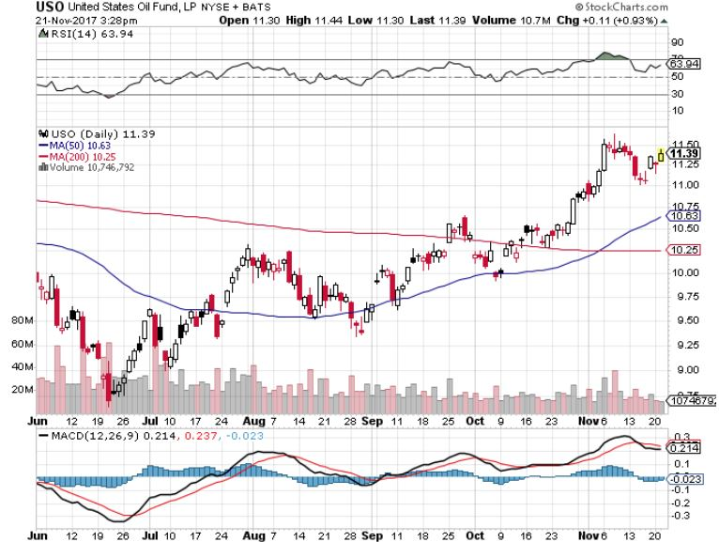
United States Oil Fund (USO)

Slide 57
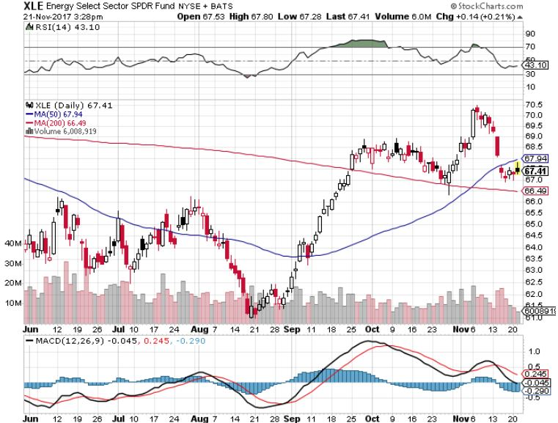
Energy Select Sector SPDR (XLE)-New Lows! (XOM), (CVX), (SLB), (KMI), (EOG), (COP)

Slide 58
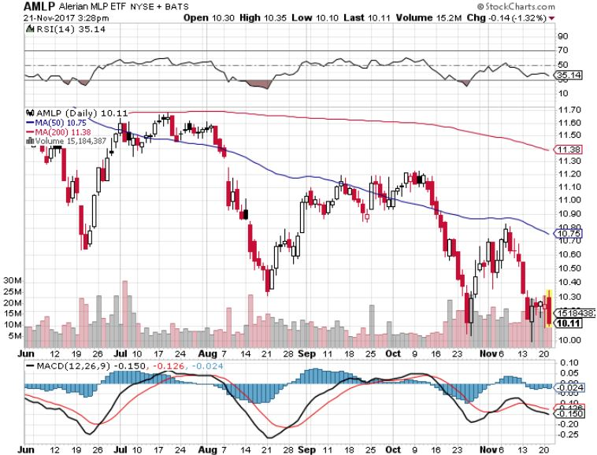
Alerian MLP ETF (AMLP)- Basket Approach is the Only Safe Play Here

Slide 59
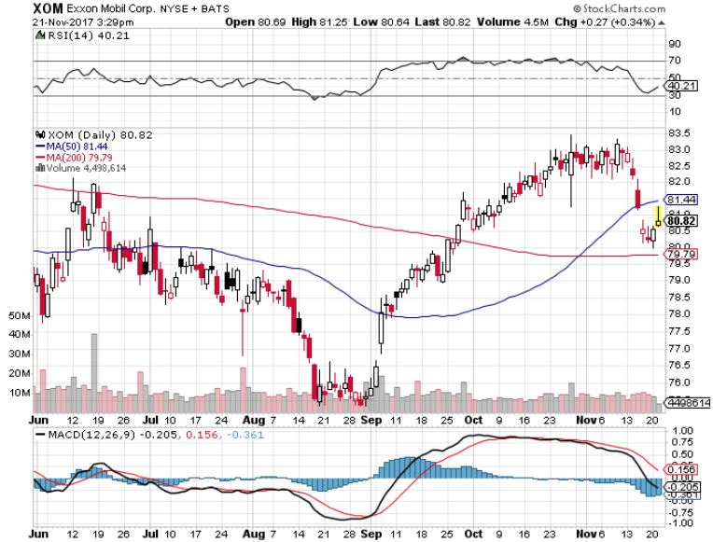
Exxon (XOM)-The Bottom is In

Slide 60
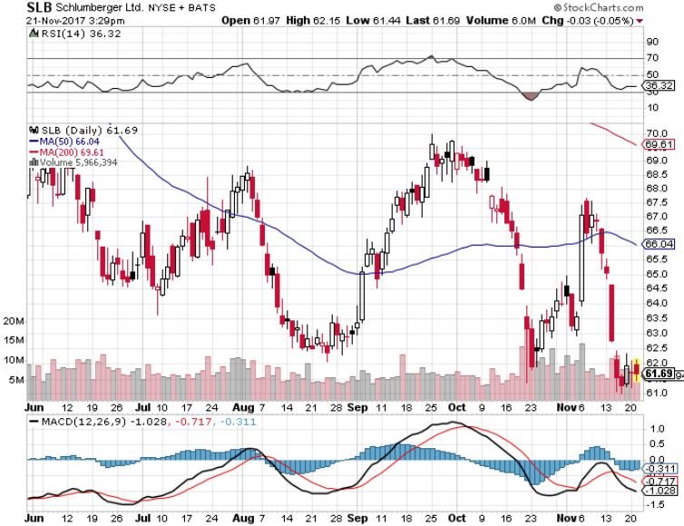
Schlumberger (SLB)-Hard Bounce Back

Slide 61
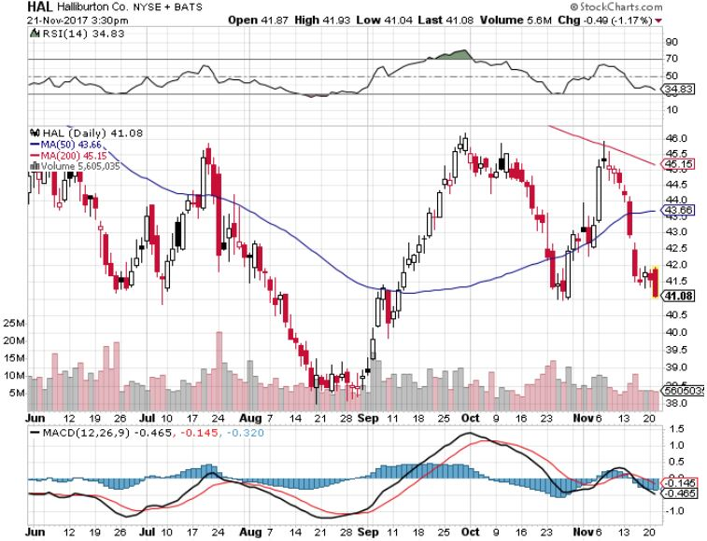
Halliburton (HAL)-Ditto

Slide 62
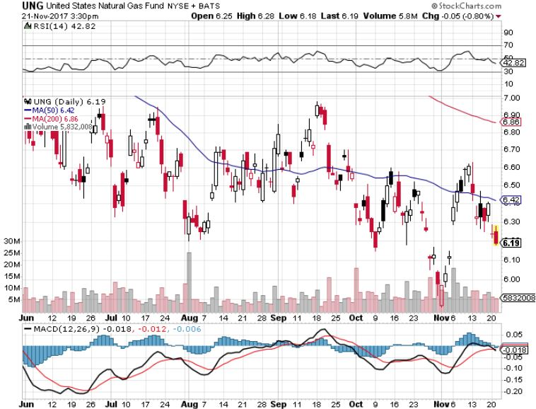
Natural Gas (UNG)-No Joy

Slide 63
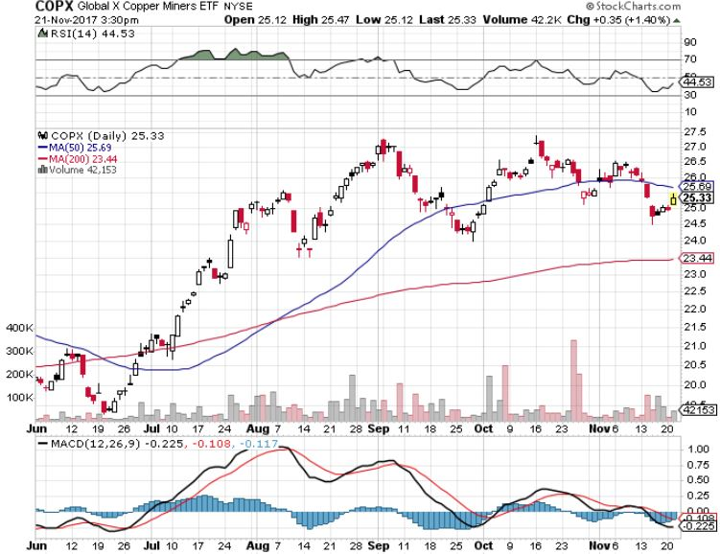
Copper (COPX)-China Infrastructure Build Out

Slide 64

Precious Metals-Forming a Bottom
*Gold desperately trying to put in a bottom, with three false upside breakouts in a month *When stocks peak, look for a major gap up in all precious metals *Hedge funds have started to dip their toes back in the water *Bitcoin is definitely stealing away from gold volatility *Buy gold and silver stocks on the next big dip, as the move is still only a few months old

Slide 65

Gold (GLD)-Retest of the Trend hedging trades starting to move again long (GLD) $12/$116-$119 bull call spread

Slide 66

Market Vectors Gold Miners ETF- (GDX) Took profits on long the 9/$20.50-$21.50 bull call spread

Slide 67

Barrick Gold (ABX) stopped out of long 9/$15-16 call spread

Slide 68

Newmont Mining- (NEM)-Breakout took profits on long the 9/$32-$34 bull call spread

Slide 69

Global X Silver Miners ETF- (SIL)-Breakout took profits on long the 9/$31-$33 bull call spread

Slide 70

Bitcoin-Modern Day Tulips! A new $31 million hack on top of a $280 million one Battling for CFTC futures trading approval

Slide 71

Agriculture-New Lows!
*New 2018 crop forecasts knock all ags for a loop *One of the five largest corn crops in history is coming in at 14.38 billion bushels *Strong dollar returns as a major headwind This on top of one of the largest crop carry overs in history, at 2.487 billion bushels, augurs poorly for prices *American farmer now producing a record 175 bushels an acre *Be thankful we haven’t done an Ag trade for five years

Slide 72

(CORN) –New Lows!

Slide 73

(WEAT)-Major Breakdown

Slide 74

(SOYB)-Dead in the Water

Slide 75

Real Estate-Nothing for Sale
*November Homebuilder Confidence hits 8 month high, Existing Home Sales up 2.0% to 5.48 million units, Inventory drops to 3.9 months, the lowest ever *October Housing Starts up a blockbuster 13.7% to an annual rate of 1.29 million units as hurricane disruptions fade into the rear view mirror *Markets are still awaiting the final news on tax hits from Congress, will “grandfathering” trigger a seller’s strike?
*Look for home prices to continue power upward through 2018, 10% on the coasts and 5% in the heartland *July S&P 500 Case-Shiller National Home Price Index maintains strong 6.1%, with absolute prices hitting new all time high

Slide 76

Home Depot (HD)-Double Bottom + Twin Hurricane Help took profits on long $9/$141-$144 vertical bull call spread

Slide 77

August S&P 500/Case–Shiller Home Price Index +6.1% YOY, Seattle (+13.2%), Las Vegas (+8.6%), San Diego (+7.8%) still leaders price rises accelerating

Slide 78

General Growth Properties (GGP)-New Lows Brookfield (BAM) takeover rumors

Slide 79

US Home Construction Index (ITB) (DHI), (LEN), (PHM), (TOL), (NVR) A Favorite Sector to Buy

Slide 80

Trade Sheet- So What Do We Do About All This?
*Stocks- stand aside *Bonds-sell any and all rallies *Commodities-buy industrials, energy *Currencies-sell yen and Euro on any rallies *Precious Metals –buy big dip *Volatility-stand aside until over $16 *The Ags –stand aside *Real estate-buy dips

Slide 81

Next Strategy Webinar 12:00 EST Wednesday, December 6, 2017 San Francisco, CA Buy conference and lunch tickets at madhedgefundtrader.com
Good Luck and Good Trading!
Notes:
*

