Slide 1

The Mad Hedge Fund Trader
“The Great Rotation is On”
With John Thomas
from Silicon Valley, CA, December 6, 2017
www.madhedgefundtrader.com
Notes:
*

Slide 2


Global Strategy Luncheons
Buy tickets at www.madhedgefundtrader.com
Chicago, IL
December 27, 2017
Minneapolis, MN
December 28, 2017

Slide 3
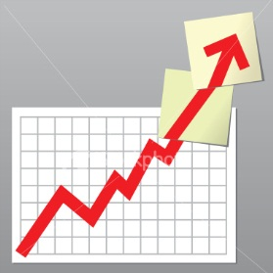
Trade Alert Performance
Biggest Up Month in Ten Years! New All Time High!!
22 Consecutive Profitable Trade Alerts!!
*January +9.35% Final *July +1.95% Final
*February +6.39% FINAL *August +18.38% Final
*March +4.87% Final *September +7.65% Final
*April +1.84% Final *October +1.39% Final
*May -0.45% Final *November +2.08% Final
*June +0.70% Final *December +3.24% MTD
*2017 Year to Date 57.39%
compared to 18% for the Dow Average
31 of 35 consecutive profitable trade alerts
*Trailing One year return +55.66%, +275.95% since inception,
*Average annualized return of 34.50%

Slide 4
Portfolio Review
No “sweet spot” entry points
Risk/Reward is out of balance, 70% cash
Current Capital at Risk
Risk On
World is Getting Better
(FXE) 12/$111-$113 call spread | 10.00%
(TLT) 12/$129-$131 put spread | 10.00%
(BAC) 12/$25-$26.50 call spread | 10.00%
Risk Off
World is Getting Worse
(FXE) 12/$116-$118 put spread | -10.00%
(GLD) 12/$116-$119 call spread | -10.00%
Total Net Position | 10.00%
60.80 % Expiration
P&L

Slide 5
Trailing One-Year Return
Daily Audited Performance

Slide 6
Eight Year Daily Audited Performance

Slide 7

The Method to My Madness
*All current positions expire in seven days
*Looking to go all cash in December 15 options expiration
*We have booked the best year in the ten year history of the Mad Hedge Fund Trade and I want to keep it that way, sit back and smell the roses
*An unusual numbers of negatives shaping up for January, so I want to start the New Year with all cash and an open mind
*Still looking for the bull market to continue for
17 more months, but with increased volatility
*Looking for major bond selloff in 2018
*US dollar will remain strong, powered by rising rates
*Sell currencies on any new rallies, top is in

Slide 8
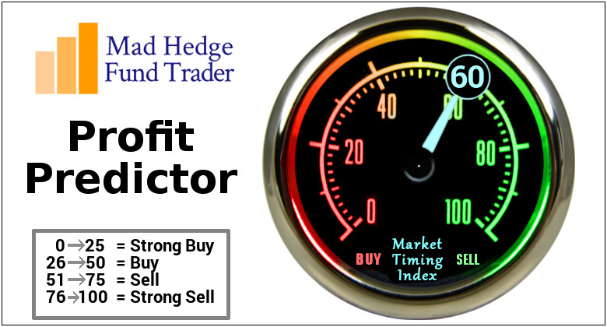
The Mad Hedge Profit Predictor
Market Timing Index
An artificial intelligence driven algorithm that analyzes 30 different economic, technical, and momentum driven indicators

Slide 9
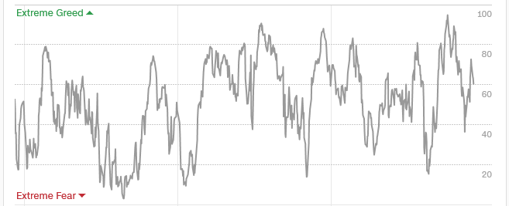
The Mad Hedge Profit Predictor
Market Timing Index
The Multi Month Top

Slide 10
The Bill Davis View
A $1,500 Upgrade for the Mad Day Trader Service
Buys: | Entry | Target
Expedia, Inc. (EXPE) | $125.00 | $145.00
Owens & Minor, Inc. (OMI) | $18.00 | $24.00
Stamps.com Inc. (STMP) | $170.00 | $230.00
Applied Materials (AMAT) | $50.00 | $60.00
Lam Research (LRCX) | $185.00 | $220.00
United Parcel Service (UPS) | $116.00 | $125.00
Sells:
Momo Inc. (MOMO) | $28.00 | $16.00
Overstock (OSTK) | $54.00 | $40.00
Western Digital (WDC) | $87.00 | $75.00
Signet Jewelers (SIG) | $62.00 | $44.00
Carmax Inc. (KMX) | $70.00 | $62.00

Slide 11

The Global Economy-A Signals Go
*Fed Beige Book says all parts of the country are expanding modestly, severe shortages of technical workers worsening, November Chicago PMI up an incredible hot 63.9, Q3 GDP revised up from 3.0% to 3.3%
*November Consumer Confidence sees its biggest jump in a decade, 126 to 130
*Cyber Monday now bigger than Black Friday, up 18% YOY, visits to stores down a recessionary 4%, 50% of all online sales now through Amazon (AMZN)
*Canada delivers blockbuster November
employment report of 79,000
*It’s all very market positive, and severely
limited the downside to the last correction

Slide 12
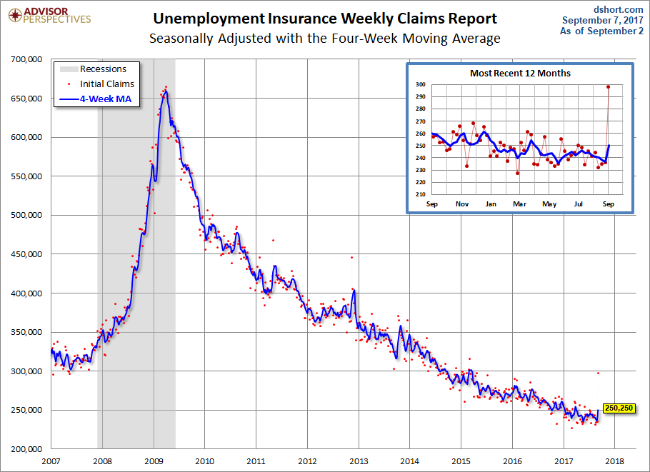
Weekly Jobless Claims –The Most Important Statistic
-2,000 to 238,000 going into Christmas Hiring
New 43 Year Low!

Slide 13
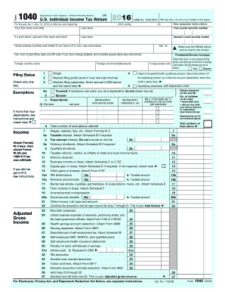
Trading the Tax New Bill
*Out of growth and into value
*Out of large companies, and into small ones
*Out of Fangs, into financials, industrials, and energy
*Out of international companies and into domestic ones
*Bond yields stay lower for longer
*Long term investors punished at the expense of short term ones through loss of FIFO
Highest Effective Tax Rates Over the Past Five Years
35% Energy
33% Telecom
32% Industrial
31% Utilities
30% Consumer Discretionary
30% Consumer Staples
28% Financials
27% Materials
26% Health Care
24% Technology

Slide 14
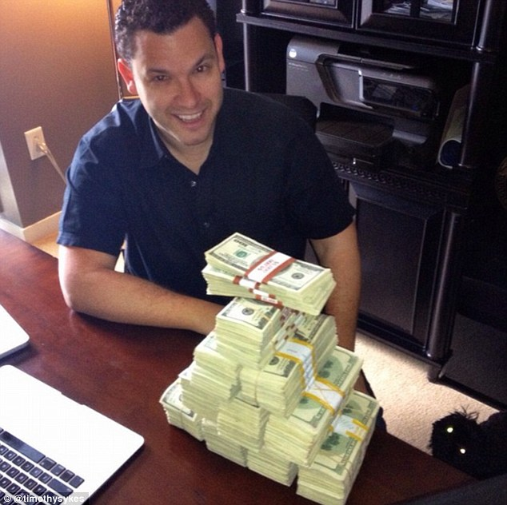
Stocks-Break Out!
*Friday brought the most volatile day of 2017 as Washington rears it its ugly ahead, is a preview of how 2018 will play out
*We bought into the dip, buying (BAC) as the sellers strike is still in force, and will remain so for the rest of 2017
*Sector leadership rotates from FANG’s to financials & industrials, the market leaders of 2018
*The bull market loses an important leg, with share buybacks slowing to a five year low, a major driver of share prices
*Flat line sideways “time” correction now over, major upside breakout ensues, as predicted
*Volatility Index (VIX) makes a one day visit
to $14.50, then gets crushed again
* A synchronized global economic recovery,
artificially low interest rates, and the prospect
of once a generation tax cuts are a lot to sell against.

Slide 15
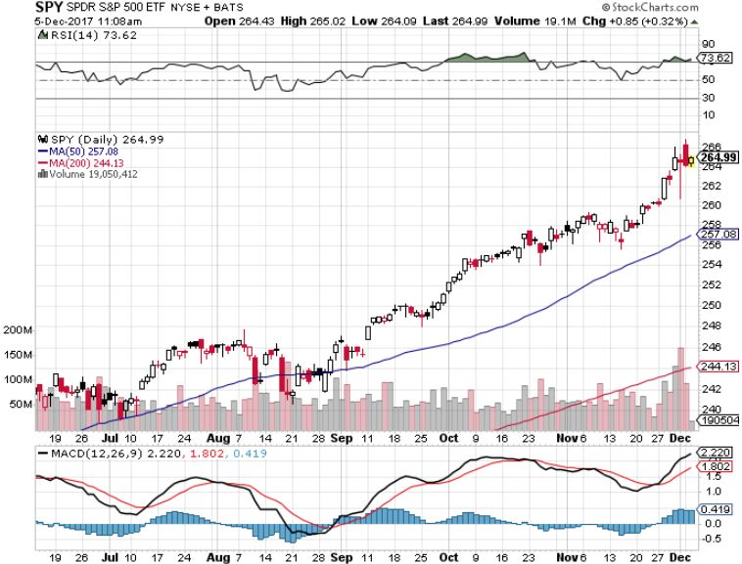
S&P 500-New Highs

Slide 16
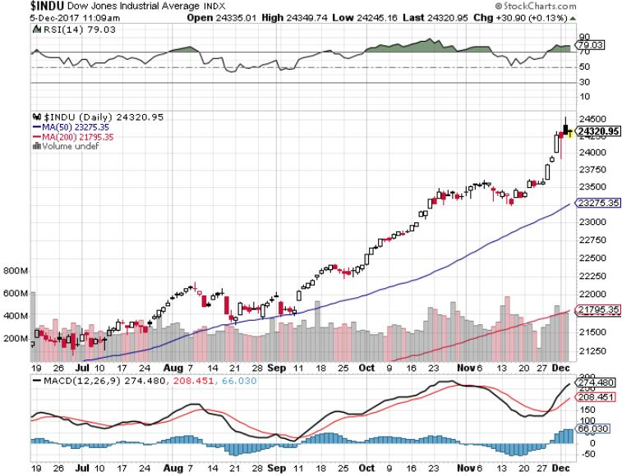
Dow Average-New Highs
Haven’t Retraced to the 50 Day MA since May-Very High Risk

Slide 17
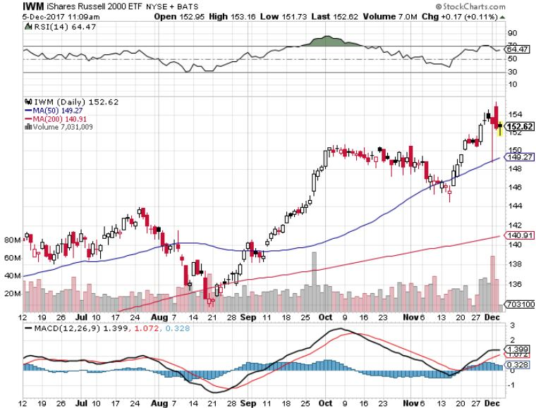
Russell 2000 (IWM)-Peaked Out stopped out of long the (IWM) 12/$152-$155 bear put spread

Slide 18
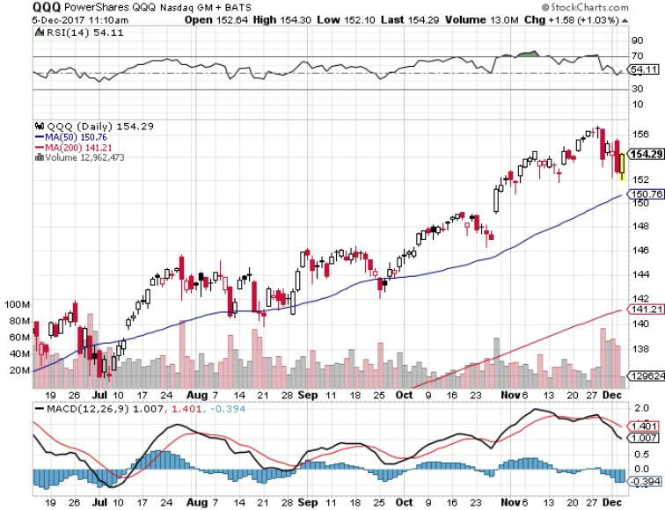
NASDAQ (QQQ)-New Highs

Slide 19
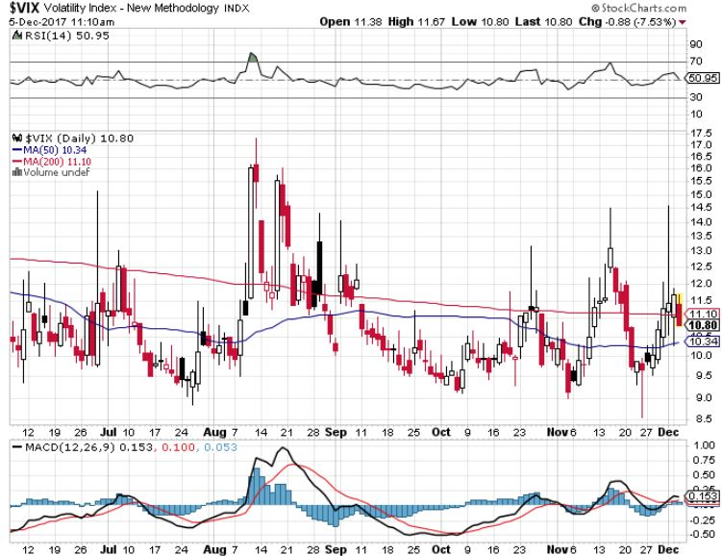
(VIX)-New Low

Slide 20
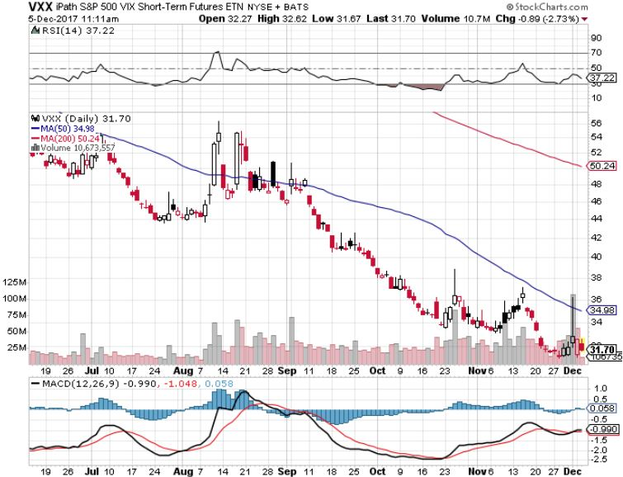
iPath S&P 500 VIX Short-Term Futures ETN (VXX)
Begging for New Lows stopped out of long 1/$60 calls as a hedge for rest of portfolio took profits on long 11/$20 calls

Slide 21
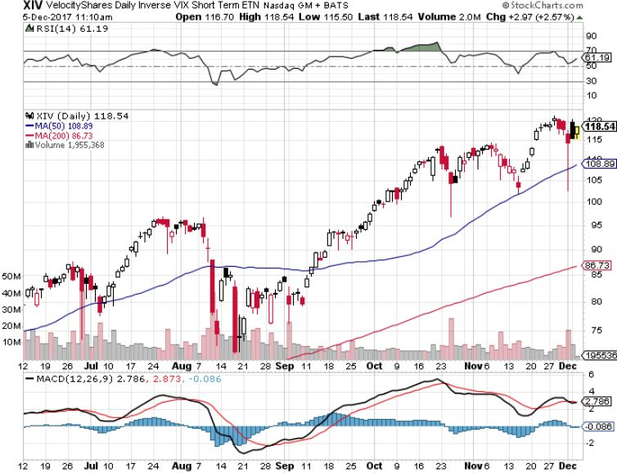
Velocity Shares Daily Inverse VIX Short Term ETN (XIV)
One of the most instantly profitable trades of 2016….and 2017 took profits on (XIV) long at $81.45

Slide 22
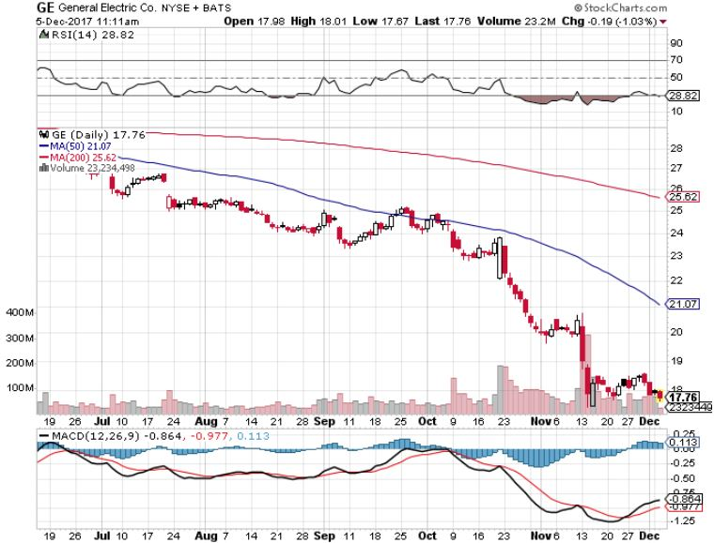
General Electric (GE)-No Recovery

Slide 23
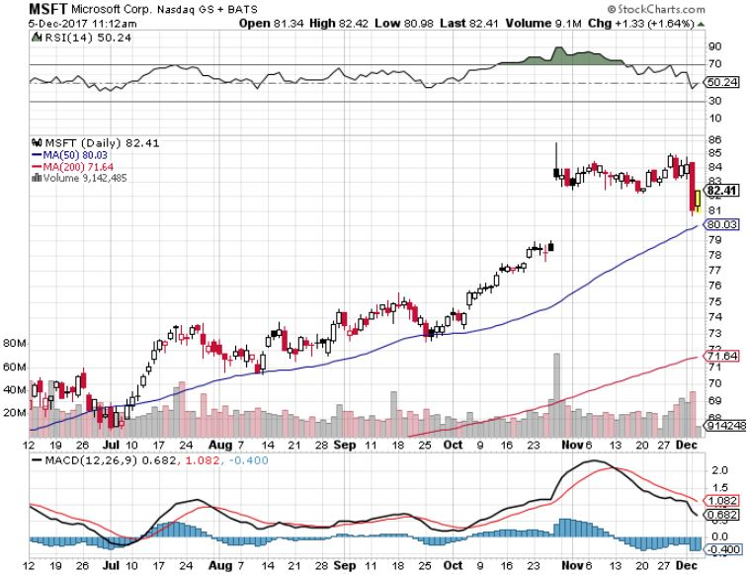
Microsoft (MSFT)

Slide 24
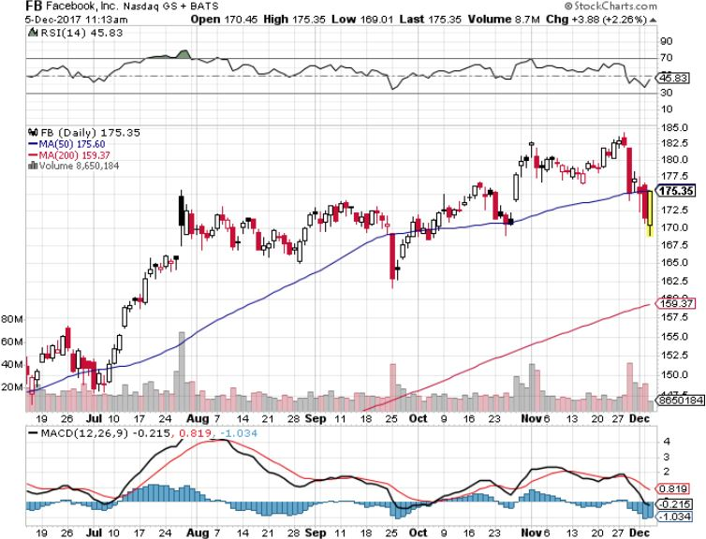
Facebook (FB)-

Slide 25
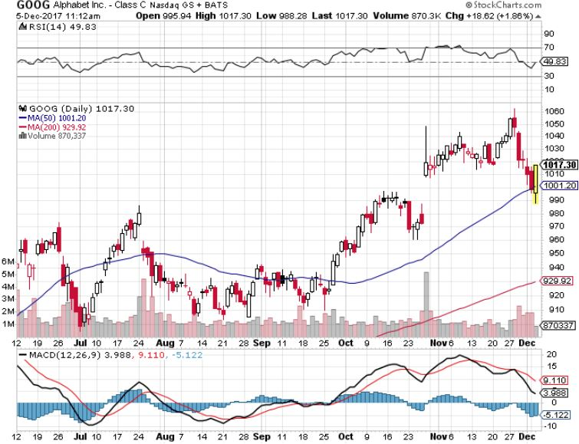
Alphabet (GOOG)-New High

Slide 26
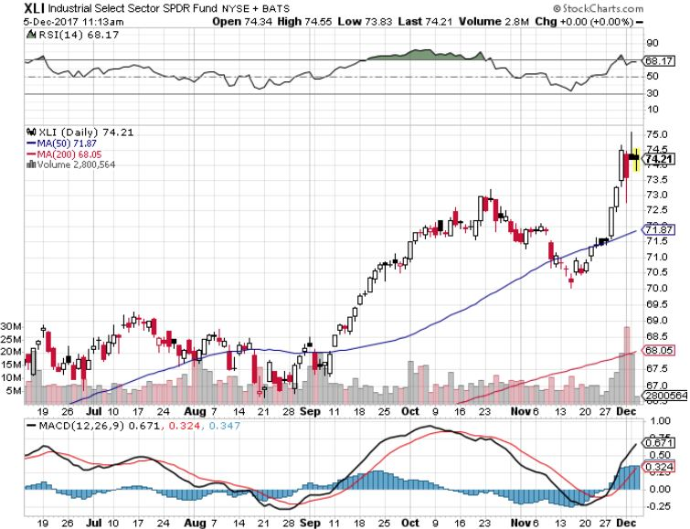
Industrials Sector SPDR (XLI)-
(GE), (MMM), (UNP), (UTX), (BA), (HON)

Slide 27
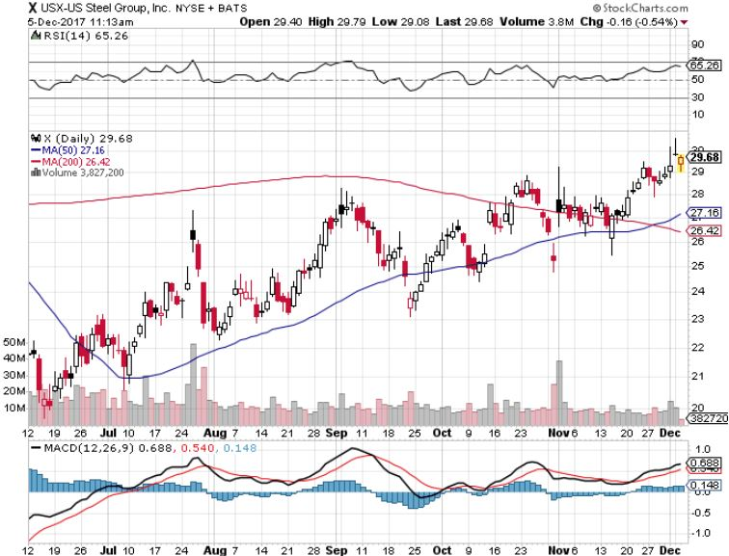
US Steel (X)- took profits on long the 9/$21-$22 vertical bull call spread

Slide 28
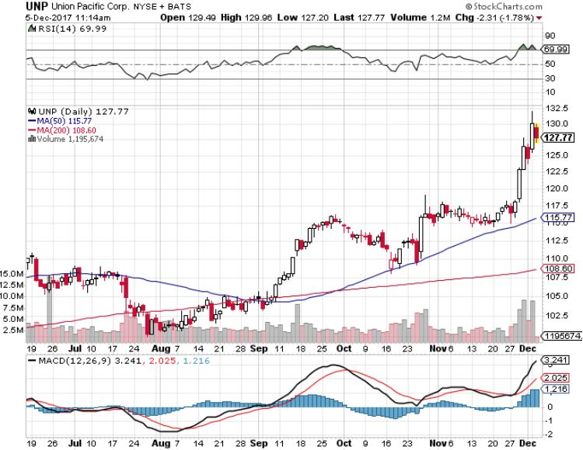
Union Pacific Railroad (UNP)- took profits on long the 9/$100-$102 vertical bull call spread

Slide 29
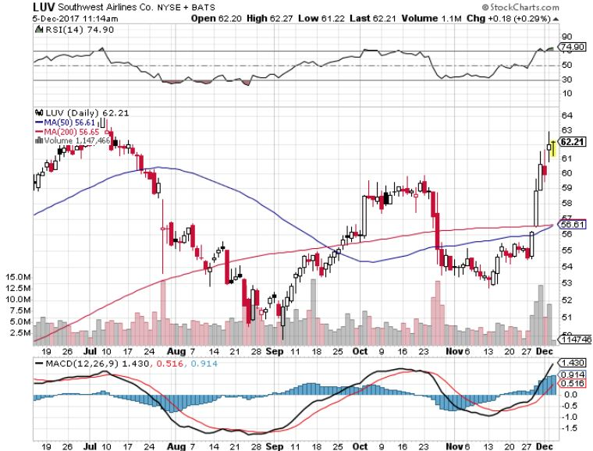
Southwest Airlines (LUV)-
Warren Buffett’s Favorite Airline

Slide 30
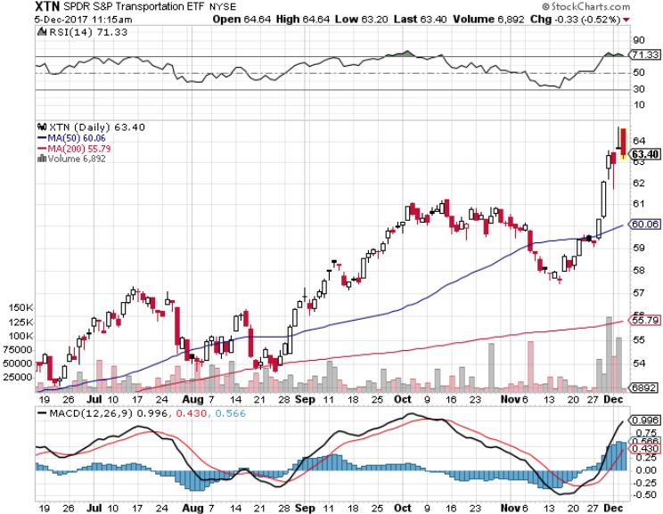
Transports Sector SPDR (XTN)-
(ALGT), (ALK), (JBLU), (LUV), (CHRW), (DAL)

Slide 31
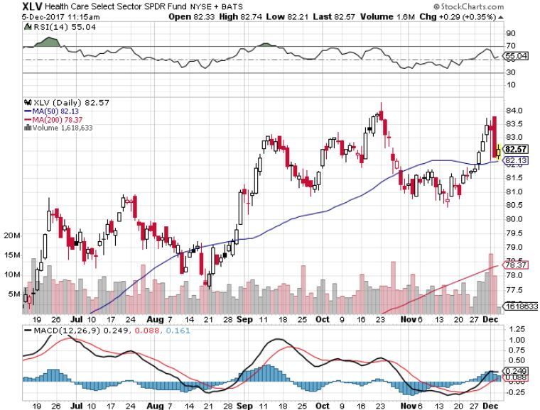
Health Care Sector (XLV), (RXL)-The New FANG?
(JNJ), (PFE), (MRK), (GILD), (ACT), (AMGN)

Slide 32
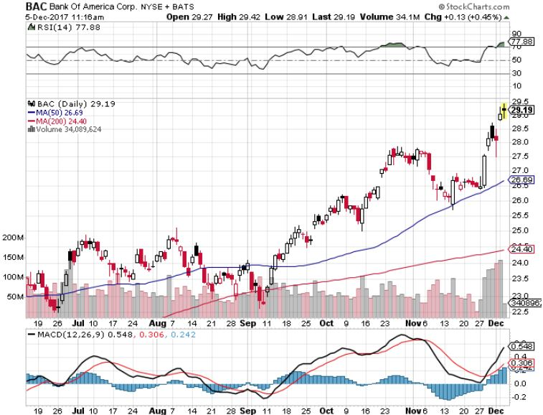
Bank of America (BAC)-New Highs
(BLK/B), (WFC), (JPM), (BAC), (C), (GS) long 12/$25.50-$27 bull call spread-expires in 7 trading days

Slide 33
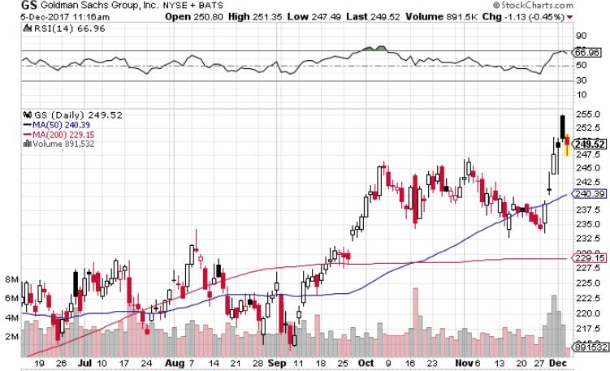
Goldman Sachs (GS)-Interest Rate Drag stopped out of long 10/$220-$225 vertical bull call spread took profits on long 10/$227.50-$232.50 vertical bull call spread took profits on long 9/$205-$210 vertical bull call spread took profits on long 9/$235-$240 vertical bear put spread

Slide 34
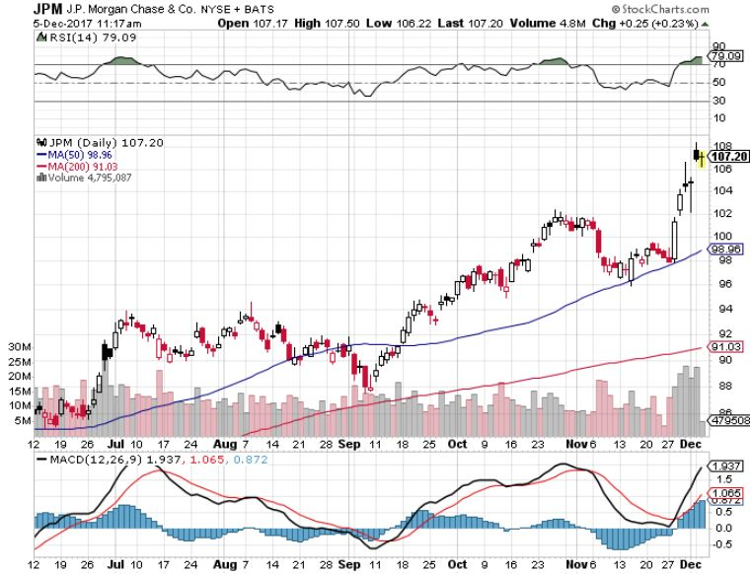
JP Morgan (JPM)-

Slide 35
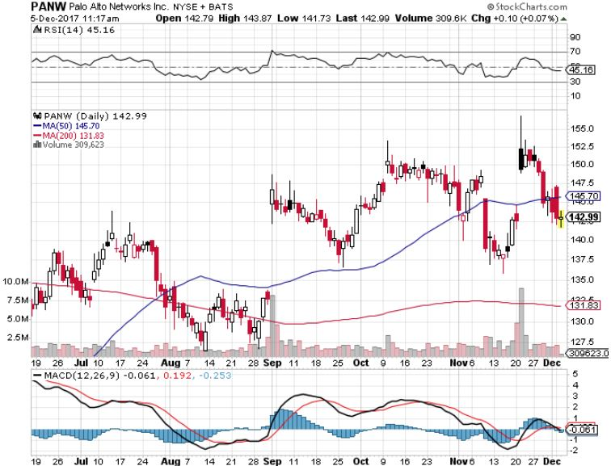
Palo Alto Networks (PANW)-

Slide 36
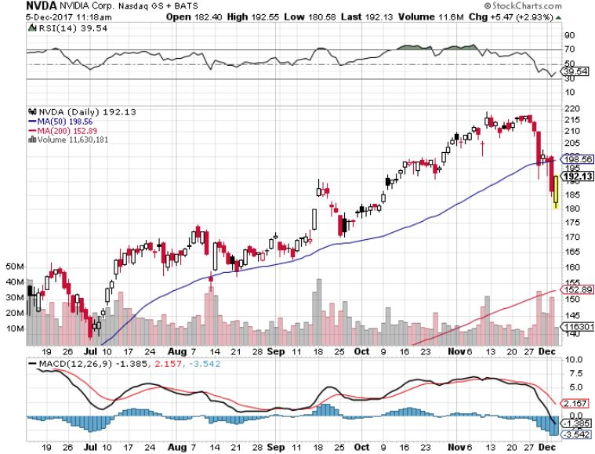
NVIDIA (NVDA)-Rolling Over

Slide 37
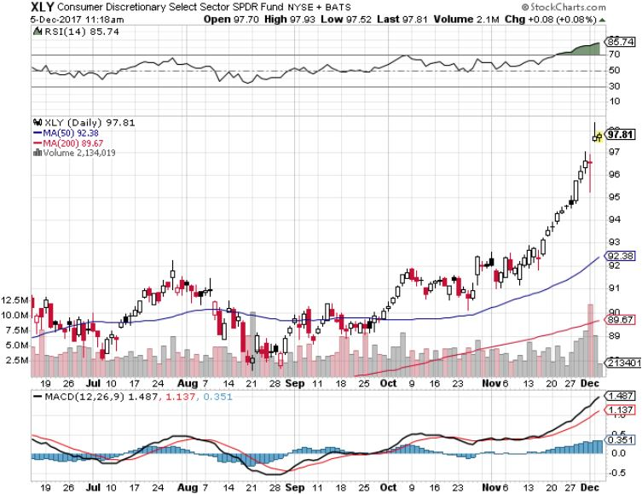
Consumer Discretionary SPDR (XLY)
(DIS), (AMZN), (HD), (CMCSA), (MCD), (SBUX)

Slide 38
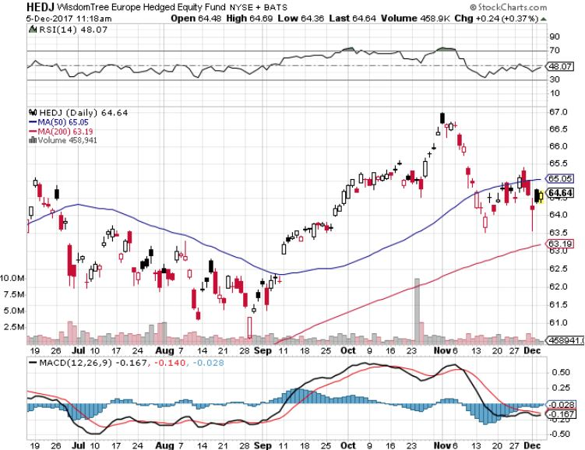
Europe Hedged Equity (HEDJ)-Global Rally

Slide 39
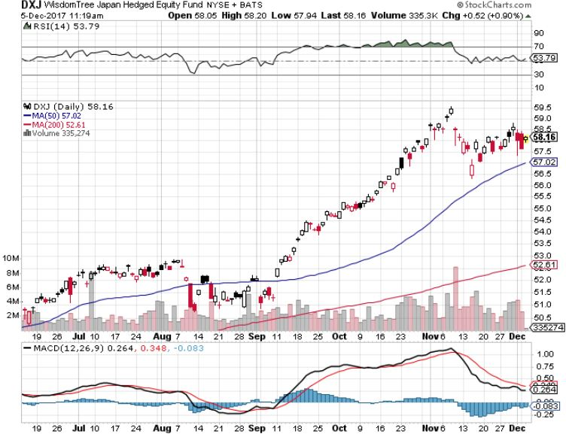
Japan (DXJ)-More Global Rally on Yen Weakness and Abe Election win

Slide 40
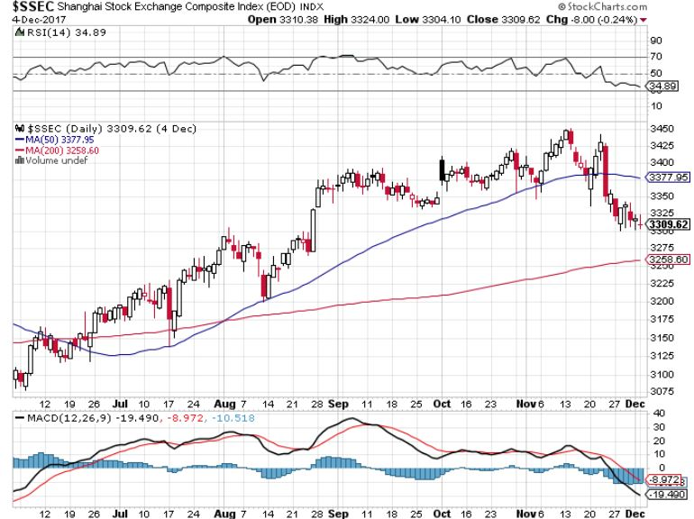
China ($SSEC)-Economic Recovery on Track

Slide 41
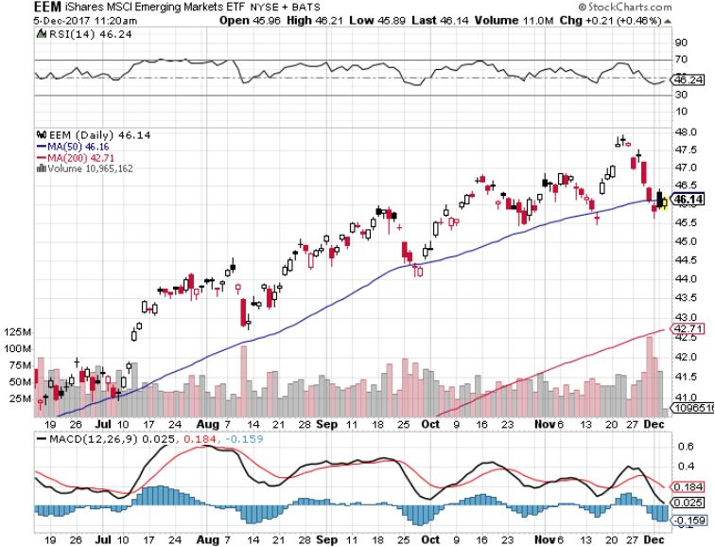
Emerging Markets (EEM)- New High

Slide 42

Bonds-Increased Volatility in Same Range
*New tax bill promises to demolish the bond market, but it may take some time
*Budget deficit now climbing sharply from an Obama low of $450 billion to $700 billion now on its way to $1 trillion
*Markets now giving a 100% probability of a 25 basis point Fed rate hike on December 13, will be the last big event of the year
*Huge curve flattening dominating the markets, 38 basis point spread between ten and 30 year bonds, is you early pre recession warning
*I’m still looking for one more bond
selloff in 2017 to take yields to 2.50%
by yearend, will be triggered by the
next stock dump
*$6 billion a month, or $200 million a day
in bond sales to start soon and are
overhanging the market

Slide 43
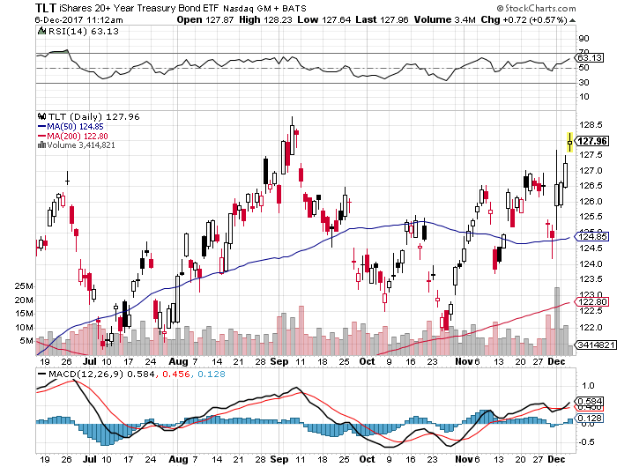
Treasury ETF (TLT) – 2.32%-Double Topping?
Long 12/$129-$131 vertical bear put spread-expires in 7 trading days
Took profits on long 12/$129-$132 vertical bear put spread long 11/$127-$129 vertical bear put spread expired at max profit took profits on long 10/$126-$128 vertical bear put spread took profits on long 10/$127-29 vertical bear put spread

Slide 44
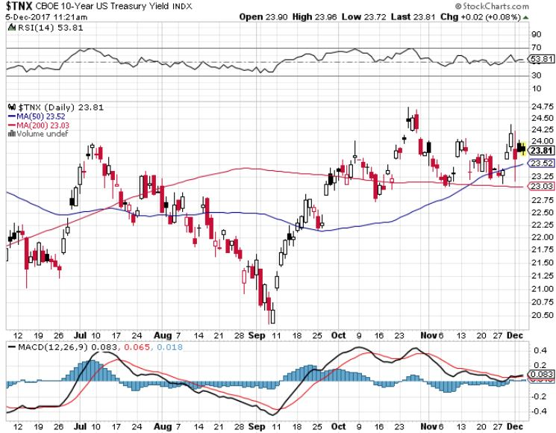
Ten Year Treasury Yield ($TNX) 2.36%
Breakdown, Now major Support

Slide 45
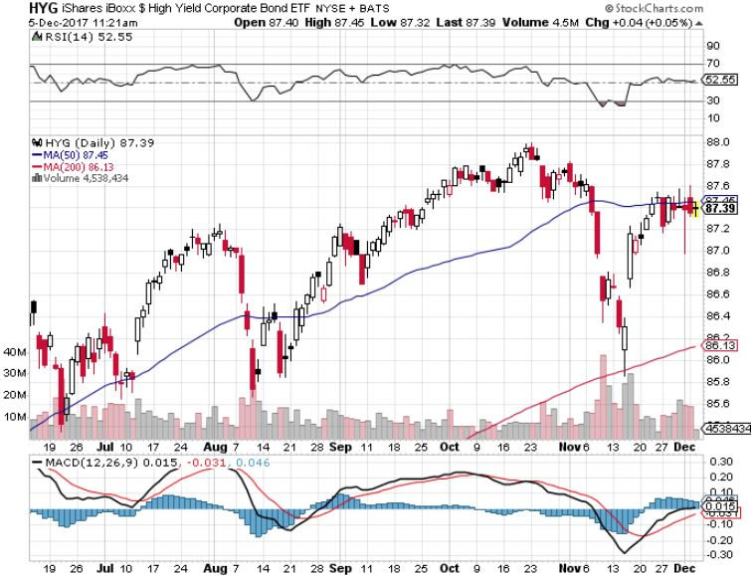
Junk Bonds (HYG) 4.71% Yield
A Great Risk Coincident Indicator-
Long Term “RISK ON” means new highs, buy all dips

Slide 46
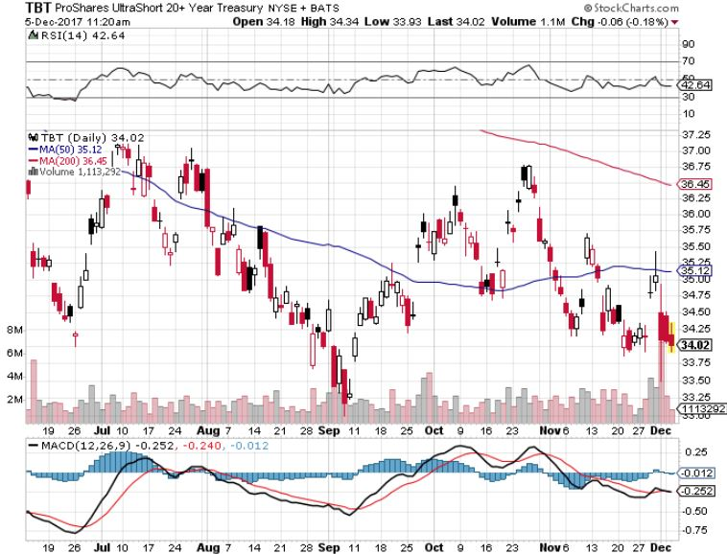
2X Short Treasuries (TBT)-
Back In Screaming “BUY” Territory

Slide 47
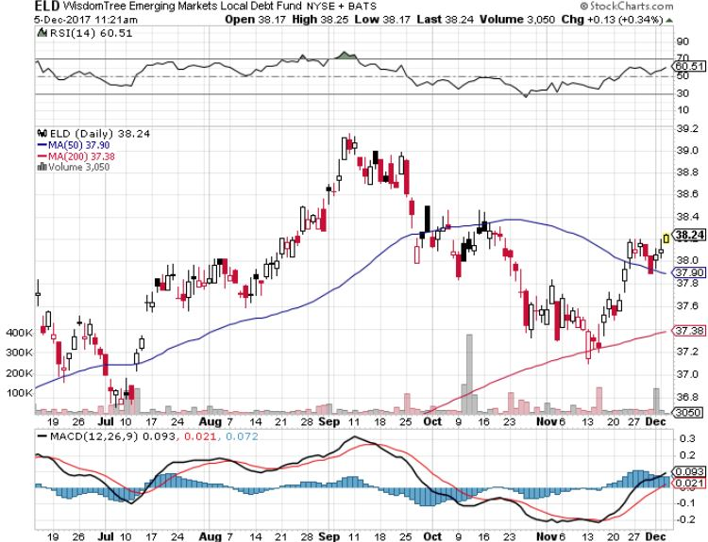
Emerging Market Debt (ELD) 5.66% Yield-

Slide 48
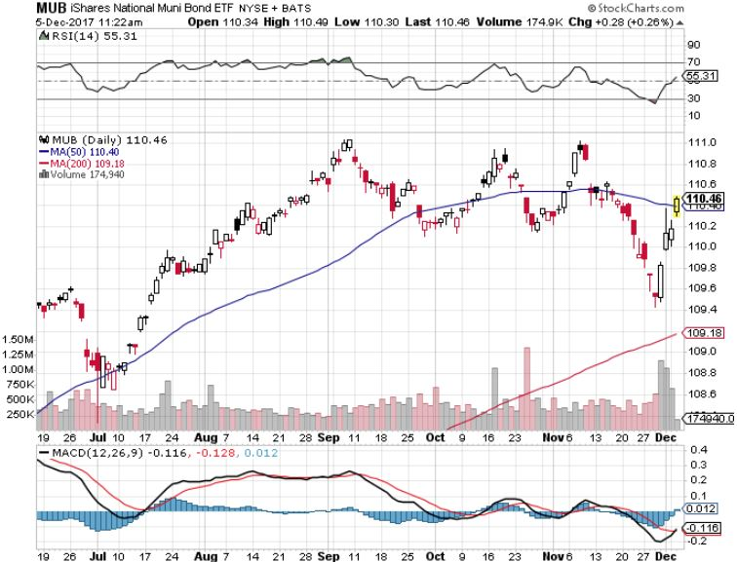
Municipal Bonds (MUB)-1.69%-Gap Up
Mix of AAA, AA, and A rated bonds

Slide 49
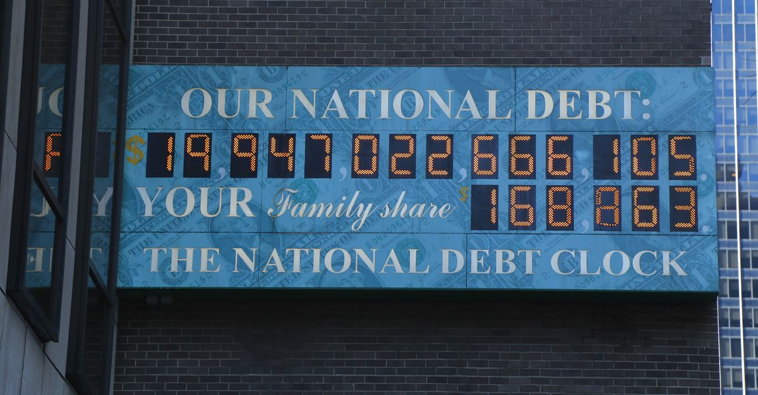
Foreign Currencies-Range Bound
*Prospects of huge US deficits now driving the foreign exchange markets
*Rising rates promises lower Japanese yen (FXY), Euro (FXE), and Aussie (FXA)
*Huge Canadian November Nonfarm Payroll report, the US equivalent of 743,000 new jobs in the US, boosts Loonie (FXC)
*A series of hot economic data showing accelerating US growth is underpinning the greenback
*Political instability still weighing on
Germany and the Euro
*This means that the new dollar
bull market may have years to run
*BOJ says QE to continue indefinitely
*The bottom is in for US rates

Slide 50
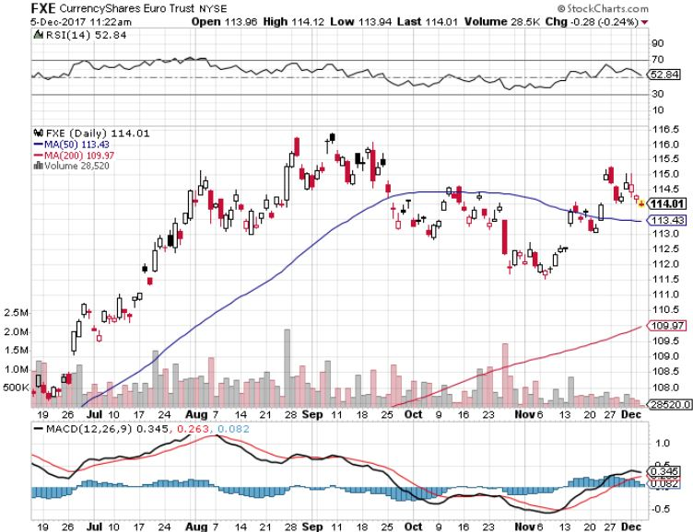
Euro ($XEU), (FXE), (EUO)- Bracketing the Range long (FXE) 12/$116-$118 vertical bear put spread-expires in 7 trading days long (FXE) 12/$111-$113 vertical bull call spread-expires in 7 trading days

Slide 51
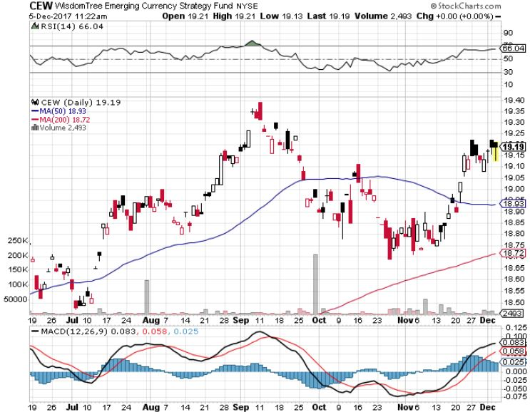
Emerging Market Currencies (CEW)

Slide 52
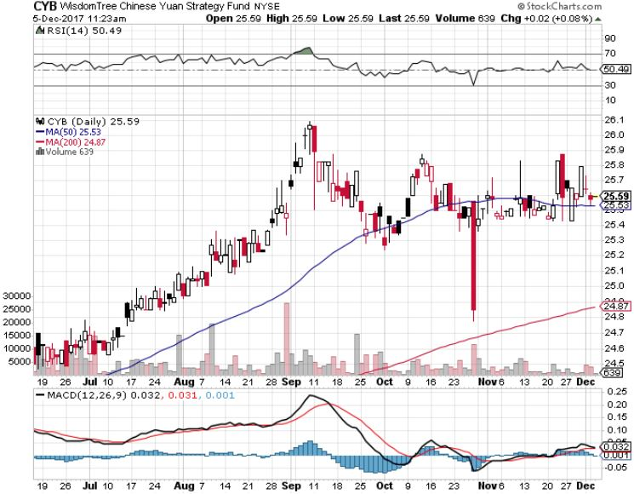
Chinese Yuan- (CYB)-
Stabilizing on Government Support

Slide 53
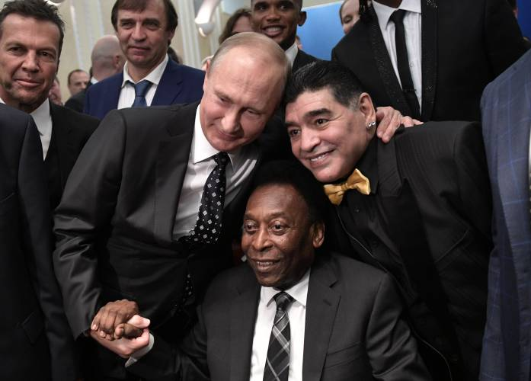
Energy-Hitting a Ceiling
*OPEC extends production curbs to the end of 2018, sending oil to new 2018 high, Russia joining in on curbs, who with Saudi Arabia will cut production by 1.8 million barrels/day, is a huge win for Russia
*Is a green light to frackers to move full speed ahead, unleashes a new energy boom in the US
*Synchronized economic recovery is pushing oil prices up along with everything else
*Fracking supply is on the rebound,
with Baker Hughes up 2 to 917, but
export much faster growth next
*Buy the dips in energy stocks

Slide 54
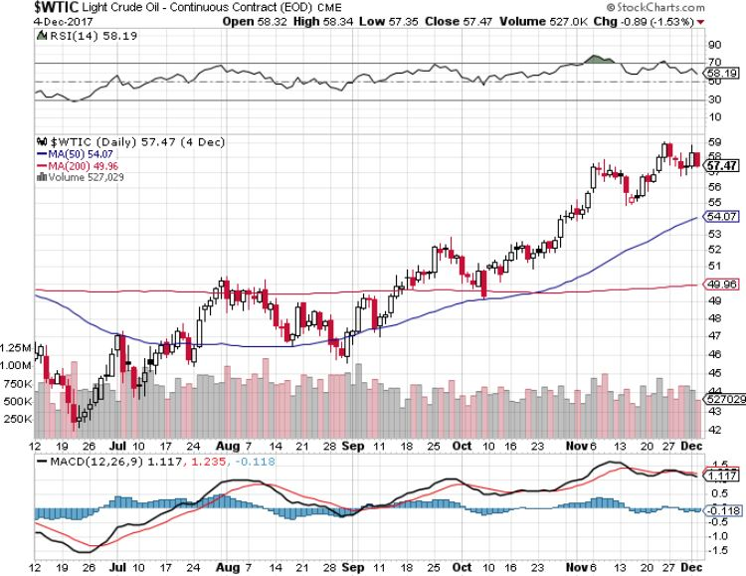
Oil-Topping Out

Slide 55
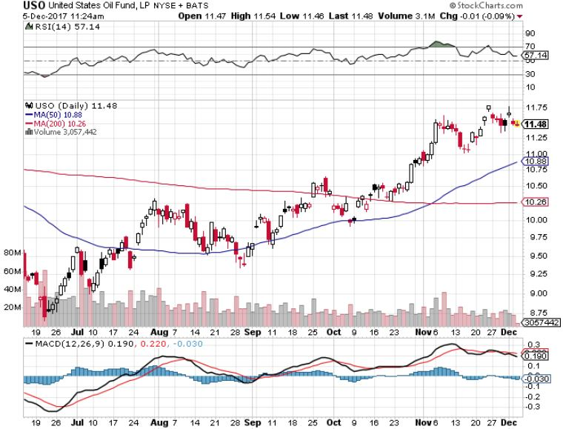
United States Oil Fund (USO)

Slide 56
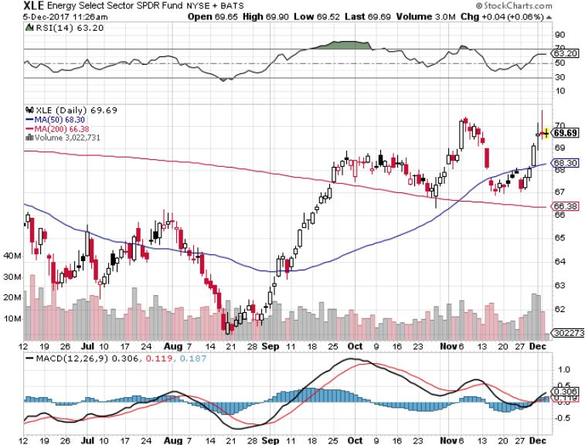
Energy Select Sector SPDR (XLE)-New Lows!
(XOM), (CVX), (SLB), (KMI), (EOG), (COP)

Slide 57
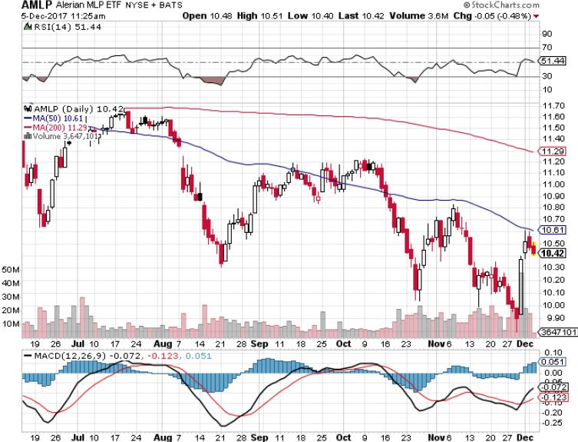
Alerian MLP ETF (AMLP)-
Basket Approach is the Only Safe Play Here

Slide 58
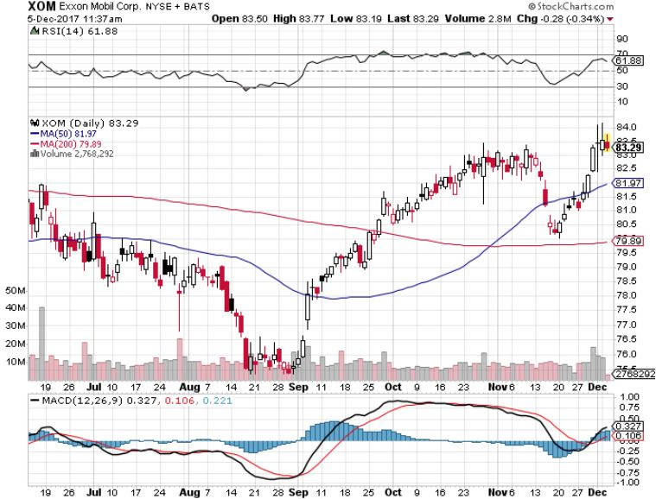
Exxon (XOM)-The Bottom is In

Slide 59
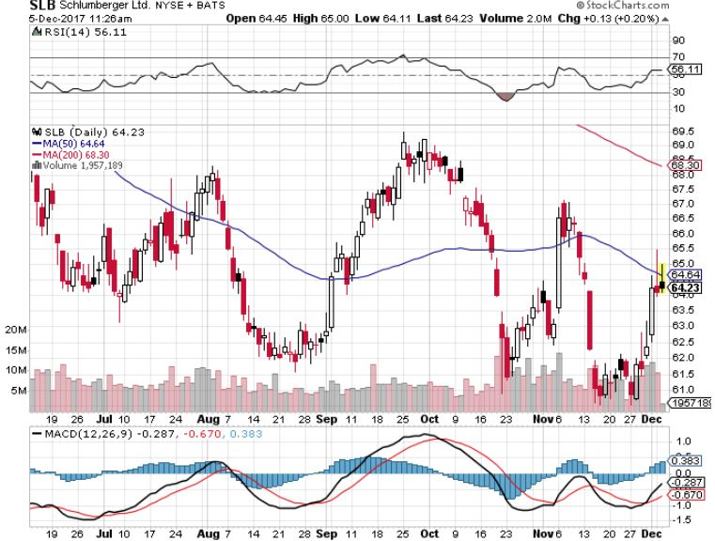
Schlumberger (SLB)-Hard Bounce Back

Slide 60

Halliburton (HAL)-Ditto

Slide 61

Natural Gas (UNG)-No Joy

Slide 62

Copper (COPX)-China Infrastructure Build Out

Slide 63

Precious Metals-Holding On
*Gold still holding in, despite huge “RISK OFF” bias in global markets
*Getting ready for a big jump in January when the sellers’ strike ends?
*Continued buying by the Russian Central Bank is putting upward pressure on gold
*Global gold ETF’s see 9.1 metric tonnes of inflows, Europe buys, the US sells
*Bitcoin is definitely stealing away
from gold volatility, watch for gold
to take off when Bitcoin collapses
*Buy gold and silver stocks
on the next big dip, as it is
still early days for the bull market

Slide 64

Gold (GLD)-Retest of the Trend hedging trades starting to move again long (GLD) $12/$116-$119 bull call spread-expires in 7 trading days

Slide 65

Market Vectors Gold Miners ETF- (GDX)
Took profits on long the 9/$20.50-$21.50 bull call spread

Slide 66

Barrick Gold (ABX) stopped out of long 9/$15-16 call spread

Slide 67

Newmont Mining- (NEM)-Breakout took profits on long the 9/$32-$34 bull call spread

Slide 68

Global X Silver Miners ETF- (SIL)-Breakout took profits on long the 9/$31-$33 bull call spread

Slide 69

Bitcoin-Modern Day Tulips!
A new $31 million hack on top of a $280 million one
Battling for CFTC futures trading approval

Slide 70

Agriculture-New Lows!
*2017 looks to close on the lows, ending another disastrous year
*Russia ramping up grain production to take advantage of low currency, the equivalent of 1.1 billion bushels, all will be exported
*Strong dollar returns as a major headwind
*Massive Chinese buying of corn, some 800,000 metric tonnes, and ethanol fail to support prices
*American farmer now producing a
record 175 bushels an acre
*Be thankful we haven’t done an Ag
trade for five years

Slide 71

(CORN) –New Lows!

Slide 72

(WEAT)-Major Breakdown

Slide 73

(SOYB)-Dead in the Water

Slide 74

Real Estate-Closed for the Year
*Money is now pouring out of the coasts inland looking for inventory and lower prices
*October New Home Sales up 6.2%, a new decade high at 685,000 units
*Markets are still awaiting the final news on tax hits from Congress still an unknown, but new blue state homebuyers will get shut out of the market
*Look for home prices to continue power
upward through 2018, 10% on the coasts
and 5% in the heartland
*July S&P 500 Case-Shiller National Home
Price Index maintains strong 5.5%, with
absolute prices hitting
new all time high

Slide 75

Home Depot (HD)-Double Bottom + Twin Hurricane Help took profits on long $9/$141-$144 vertical bull call spread

Slide 76

August S&P 500/Case–Shiller Home Price Index
+5.5% YOY, Seattle (+11.0%), Portland (+10.9%), Denver (+8.7%) still leaders price rises accelerating

Slide 77

General Growth Properties (GGP)-New Lows
Brookfield (BAM) takeover rumors

Slide 78

US Home Construction Index (ITB)
(DHI), (LEN), (PHM), (TOL), (NVR)
A Favorite Sector to Buy

Slide 79

Trade Sheet-
So What Do We Do About All This?
*Stocks- buy dips
*Bonds-sell any and all rallies
*Commodities-buy industrials, energy
*Currencies-sell yen and Euro on any rallies
*Precious Metals –buy big dip
*Volatility-stand aside until over $16
*The Ags –stand aside
*Real estate-buy dips

Slide 80

Next Strategy Webinar
12:00 EST Wednesday, January 3, 2018
San Francisco, CA
Buy lunch tickets at madhedgefundtrader.com
Good Luck and Good Trading!
Notes:
*

