Slide 1
Mad Day Trader
Bill Davis
Webinar – January 10, 2018

Slide 2
Long Term

Slide 3
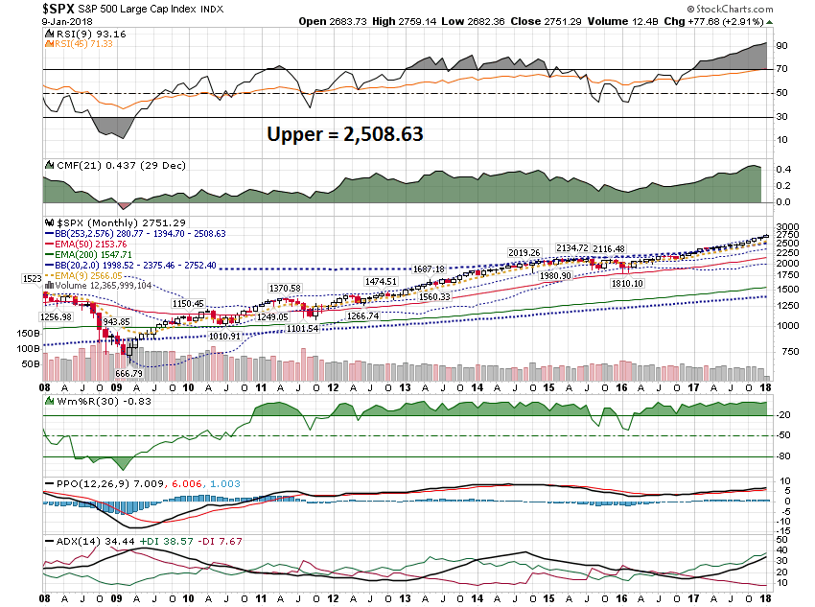

Slide 4
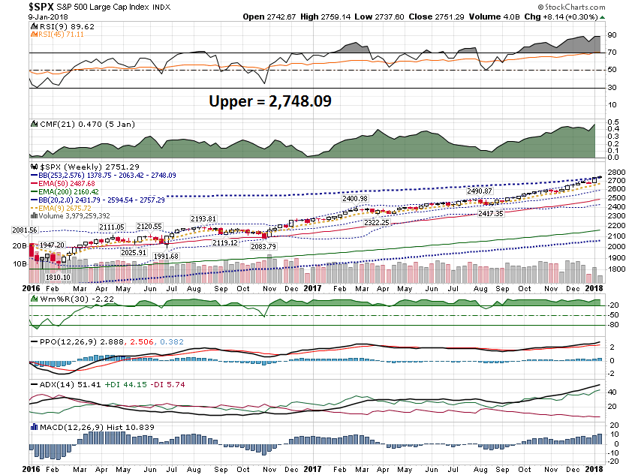

Slide 5
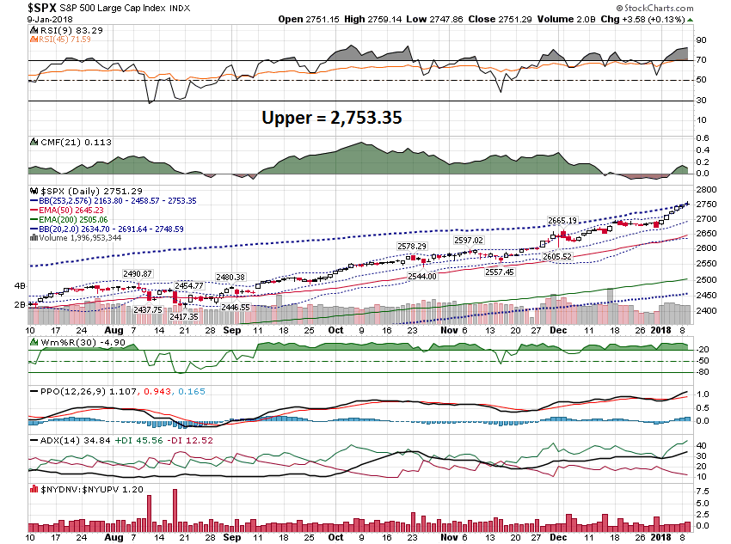

Slide 6
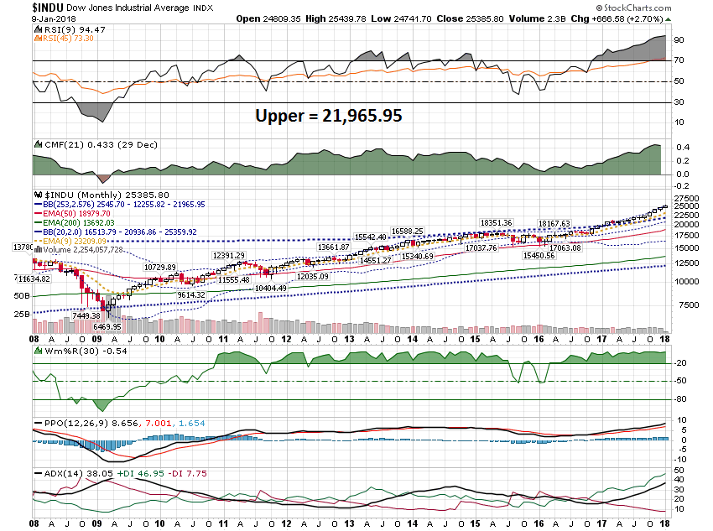

Slide 7
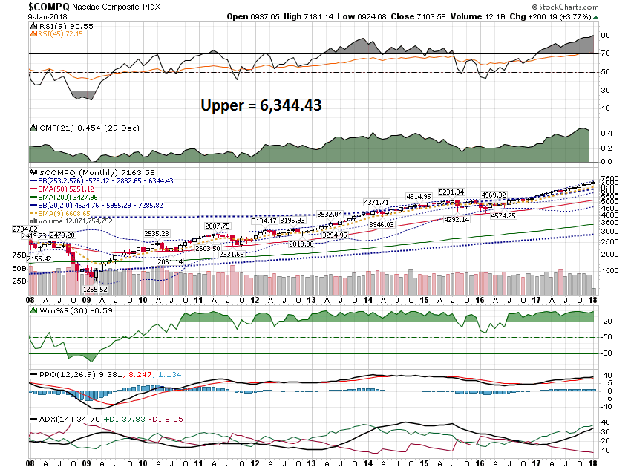

Slide 8
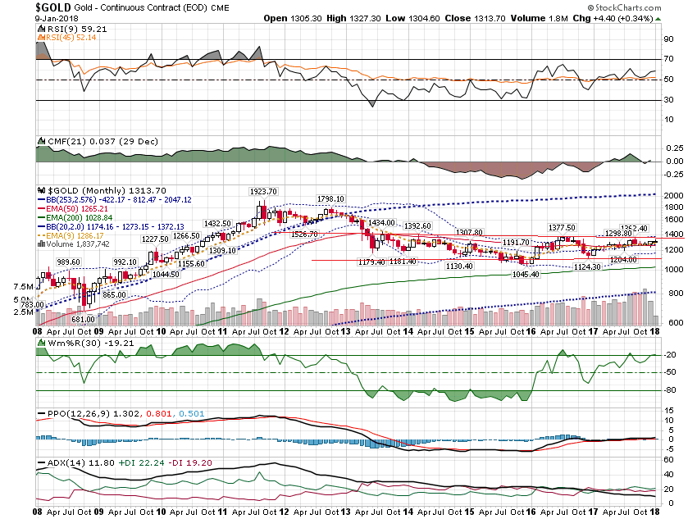

Slide 9
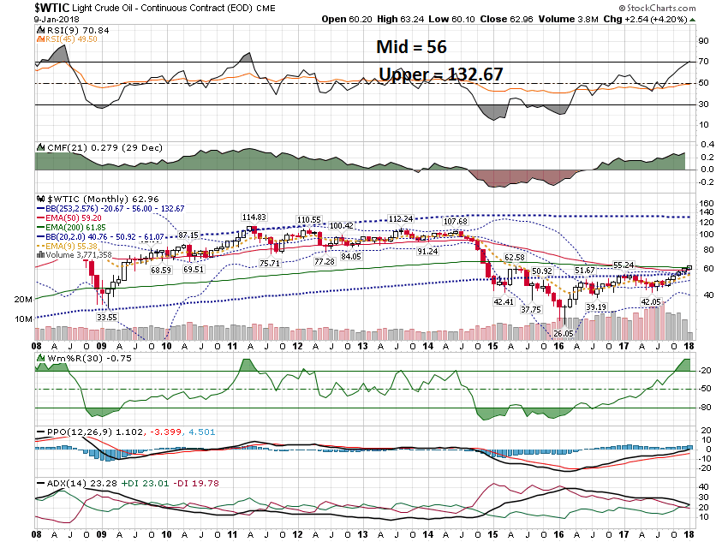

Slide 10
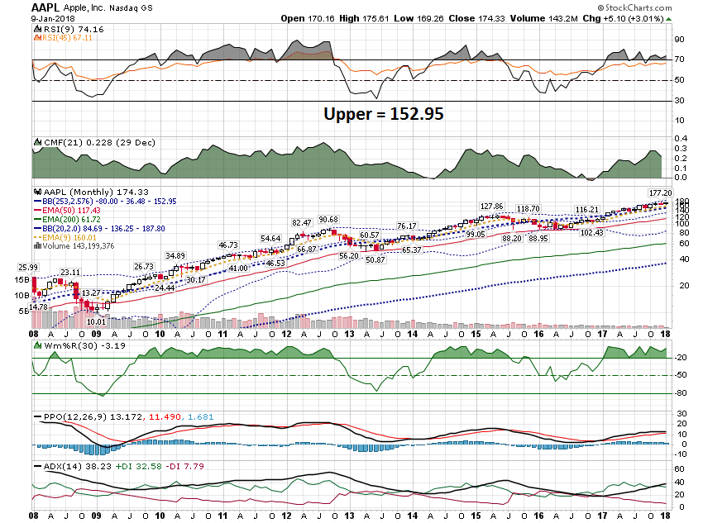

Slide 11
Short Term

Slide 12
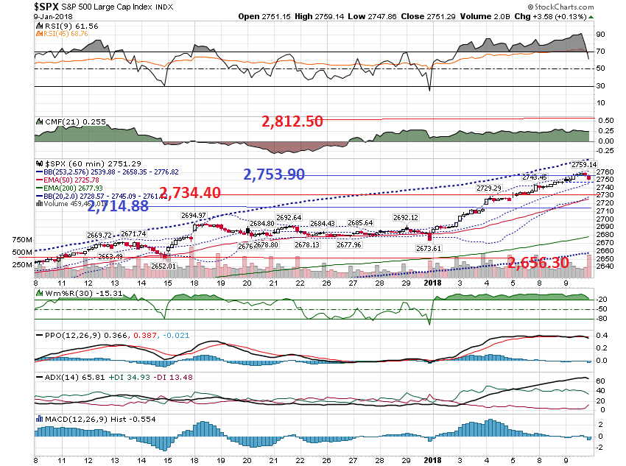

Slide 13
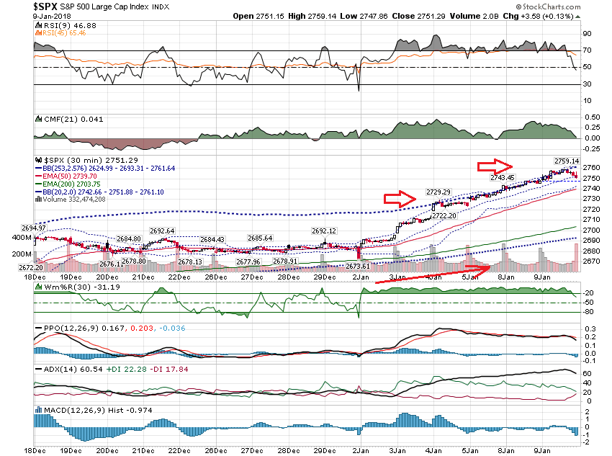

Slide 14
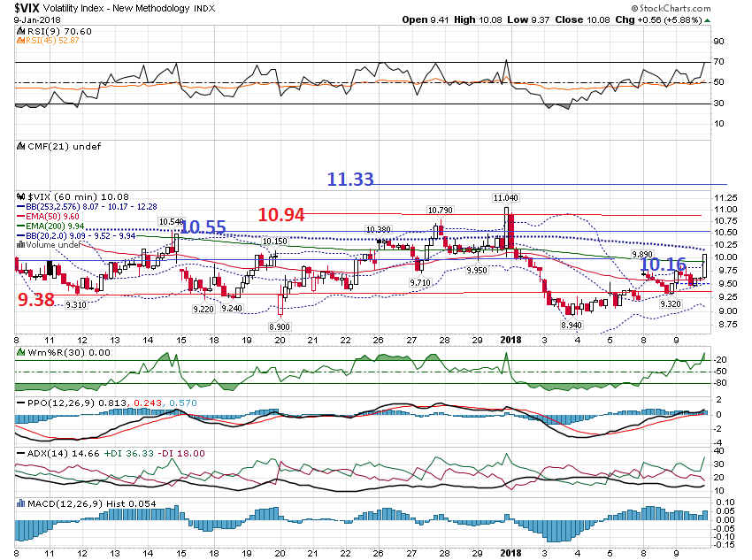

Slide 15
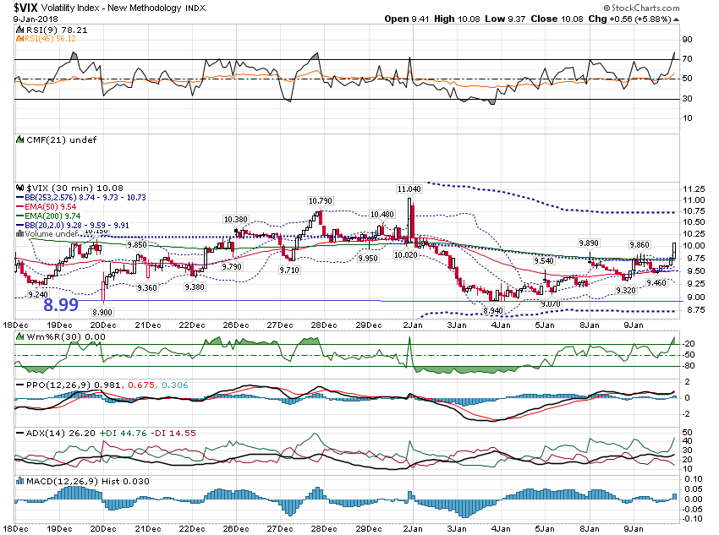

Slide 16
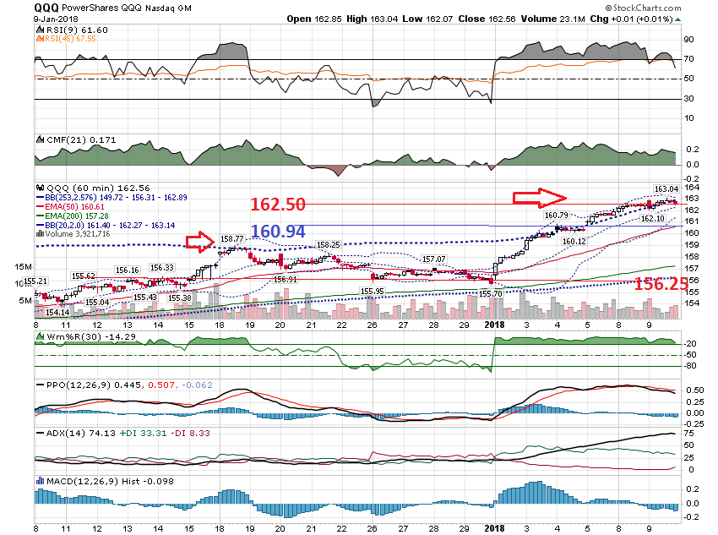

Slide 17
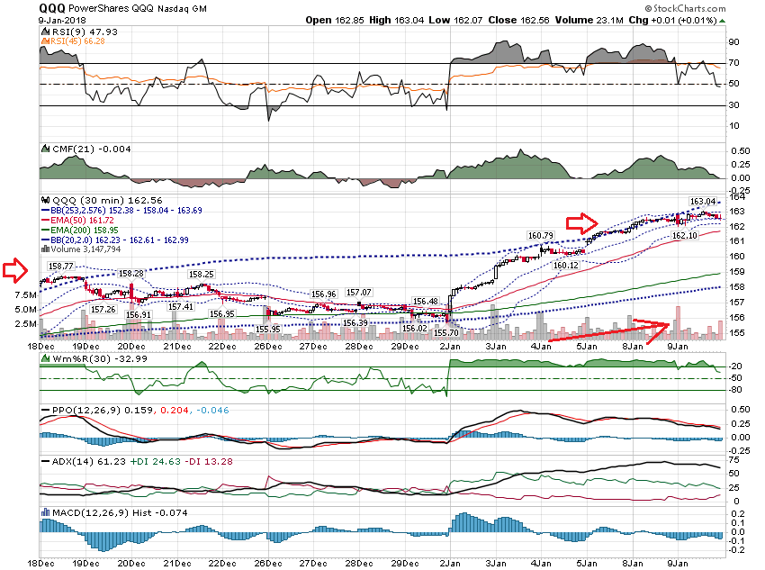

Slide 18
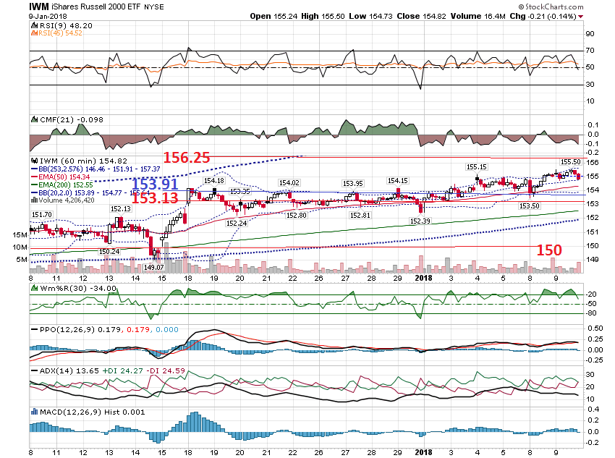

Slide 19
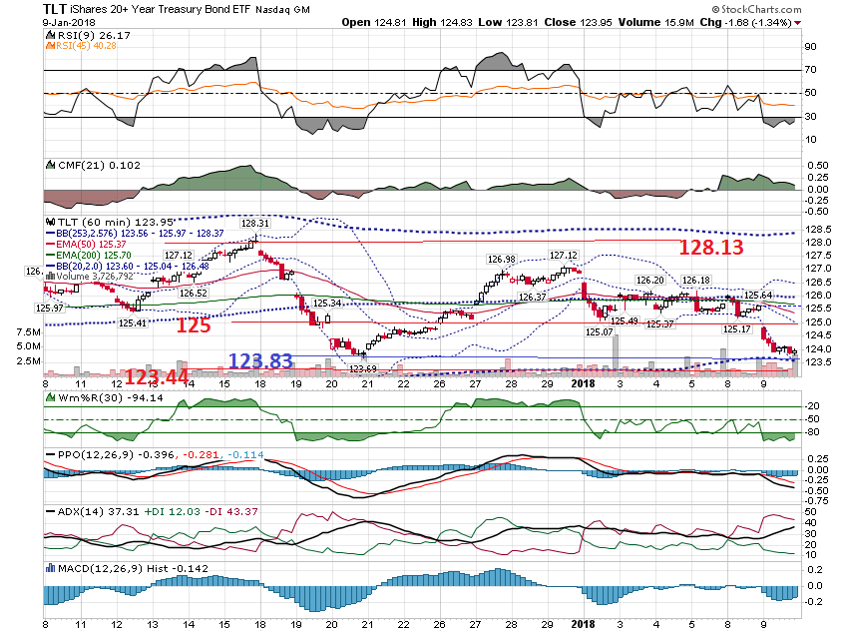

Slide 20
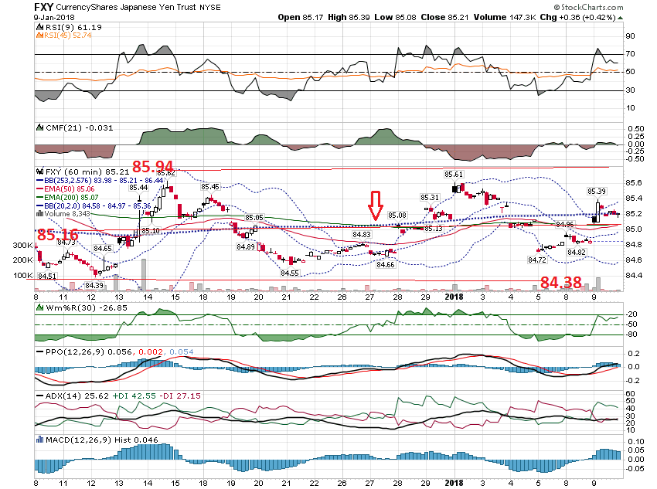

Slide 21
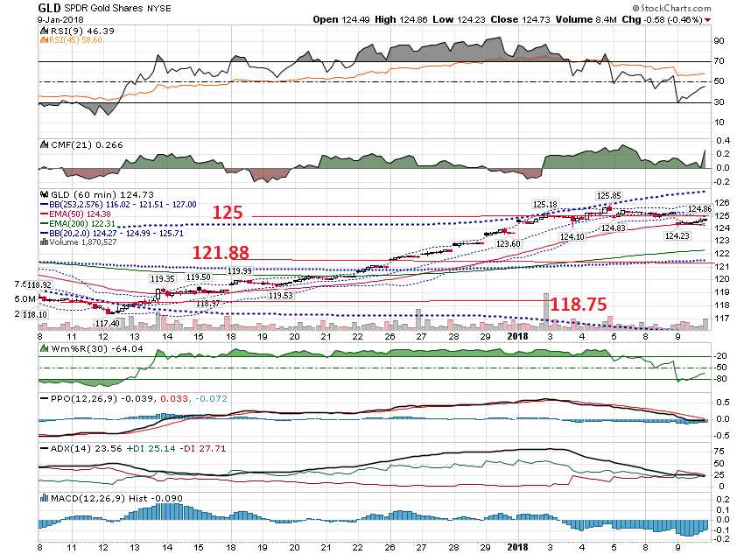

Slide 22
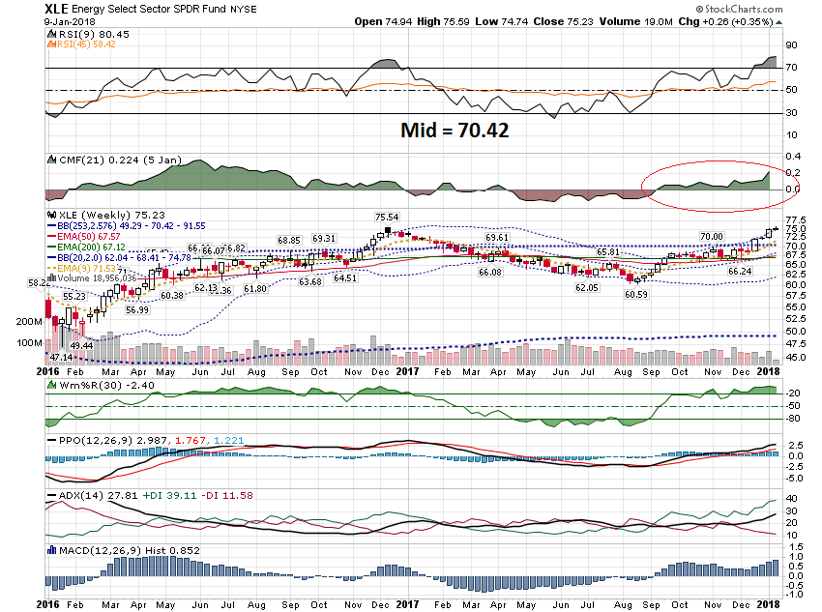

Slide 23
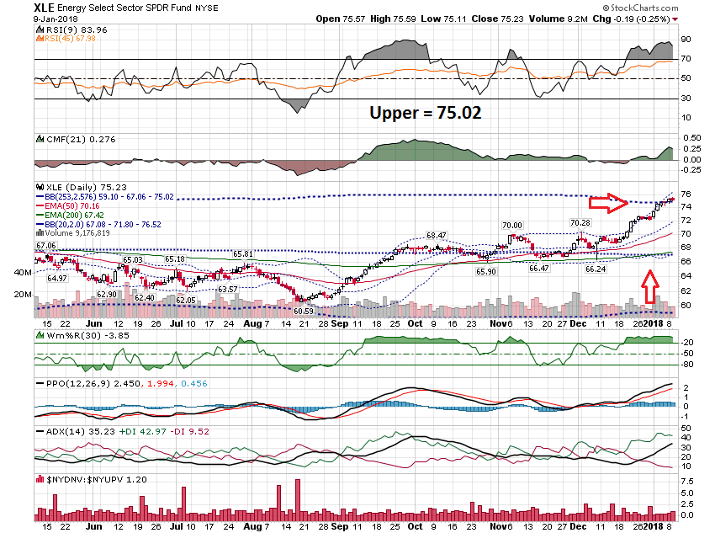

Slide 24
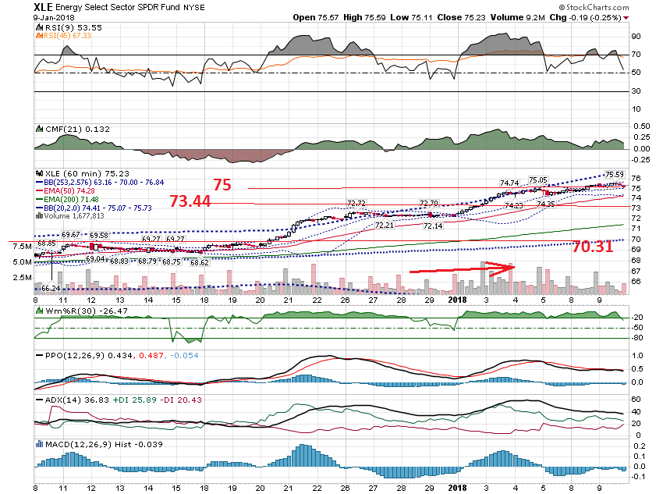

Slide 25
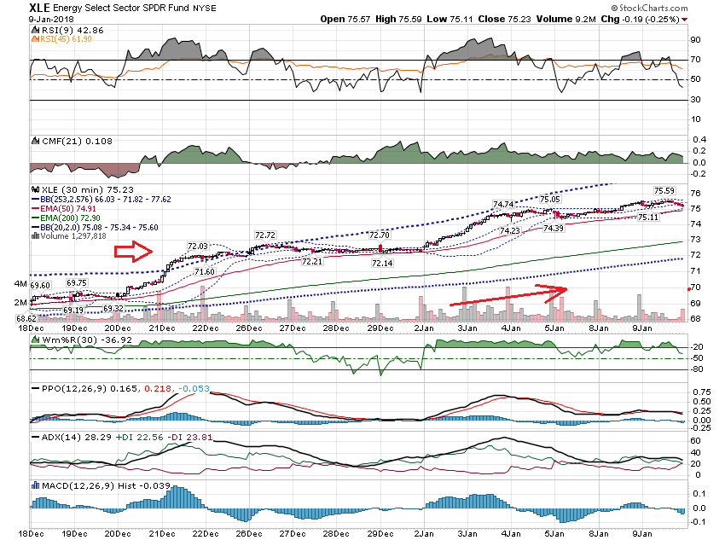

Slide 26
Short term Calls

Slide 27
Just as a learning experience, I am interested in managing FCX and
others like it. I am long term bullish Copper and its miners. When I bought FCX I planned on holding it long term and selling calls against it. I was hoping for about 25% return the first year but we are already over 30%. That does not matter. I have been wondering when the charts will give me a good signal that it is time to sell calls again. How do you assess the beginning of a consolidation or pullback?
R

Slide 28
Generally, when I sell call options, I like to receive 25 cents per week. This is a general Rule of thumb.

Slide 29
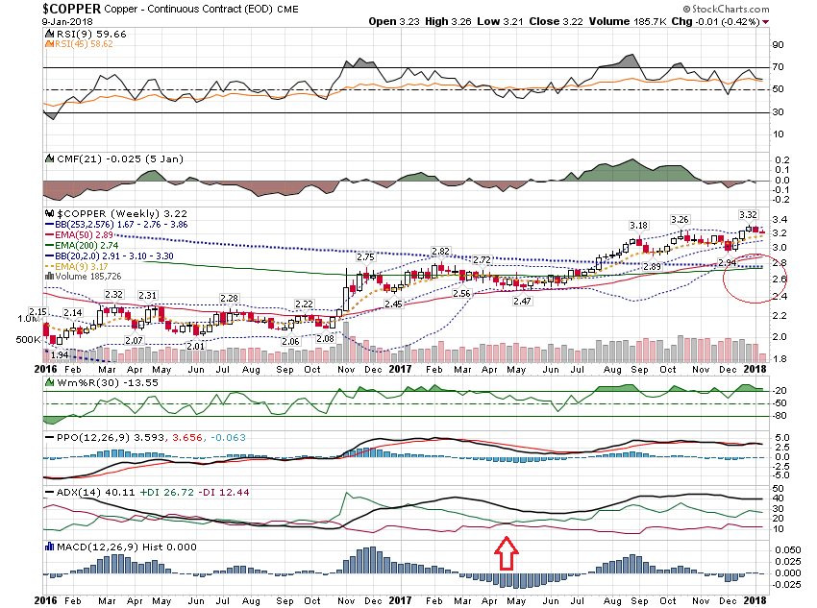

Slide 30
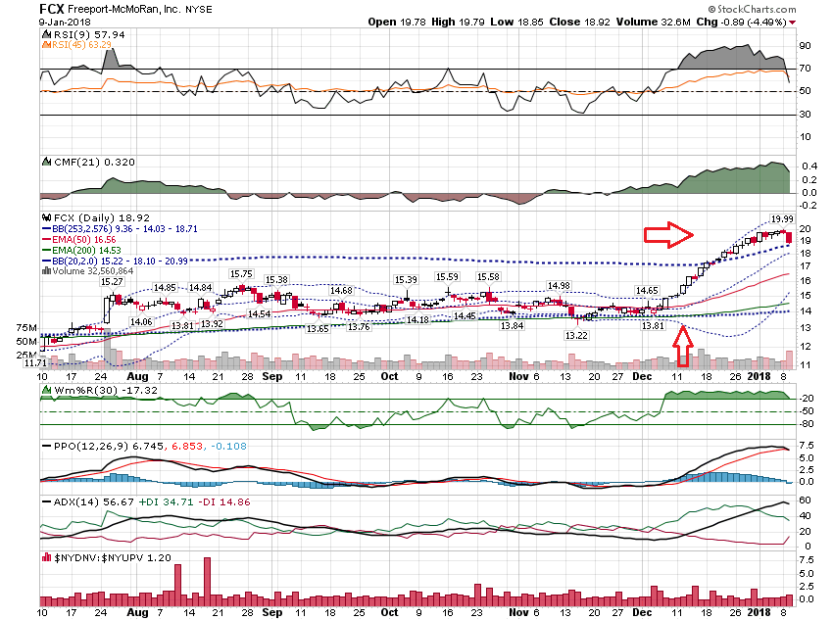

Slide 31
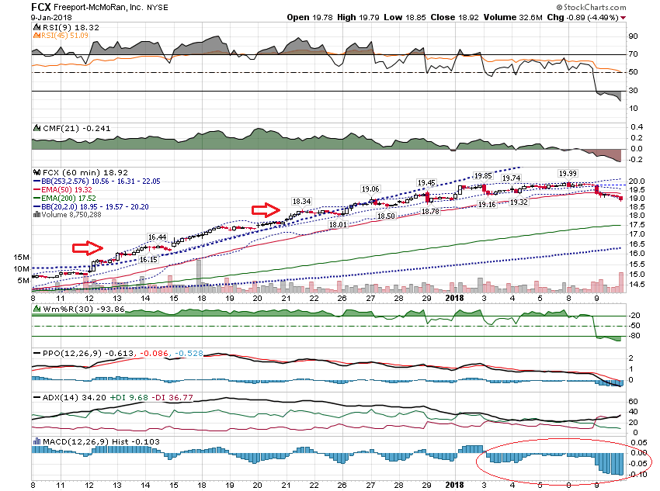

Slide 32
Bottoming Formation

Slide 33
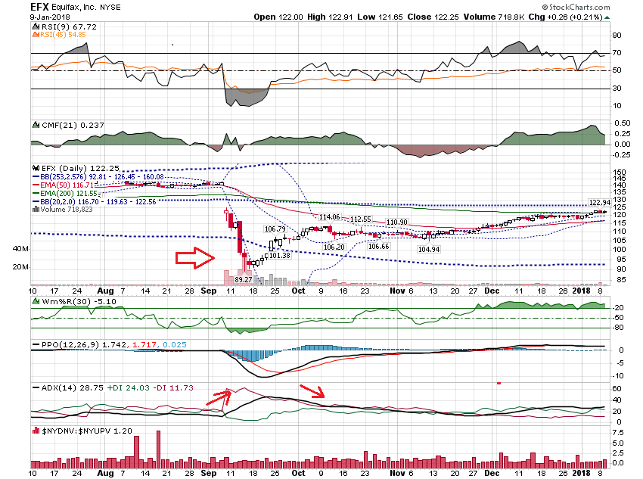

Slide 34
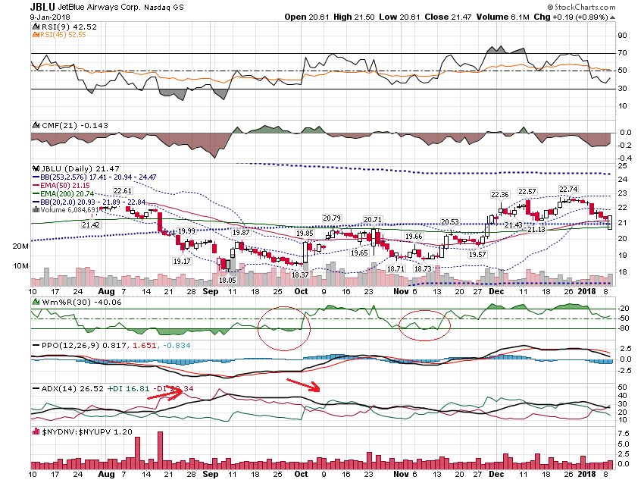

Slide 35
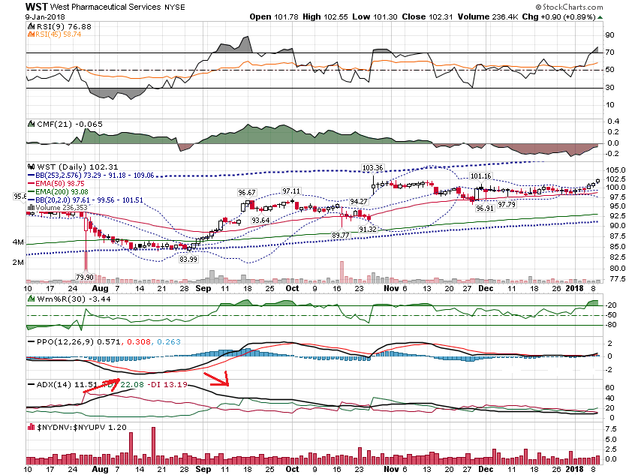

Slide 36
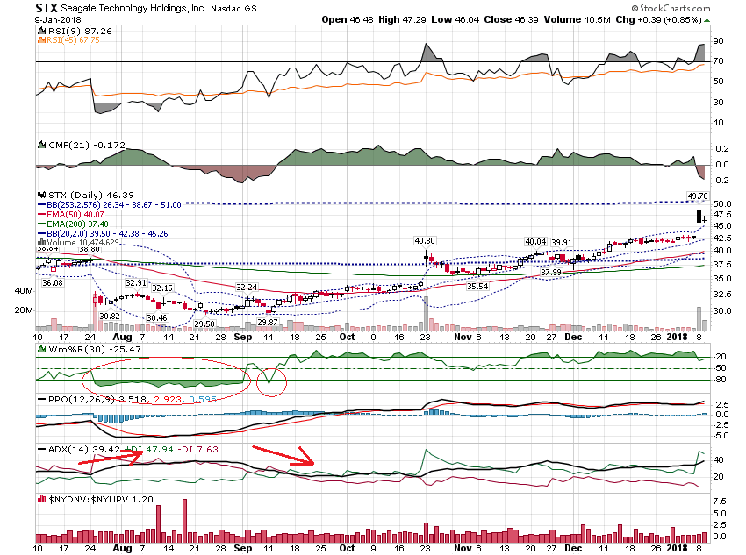

Slide 37
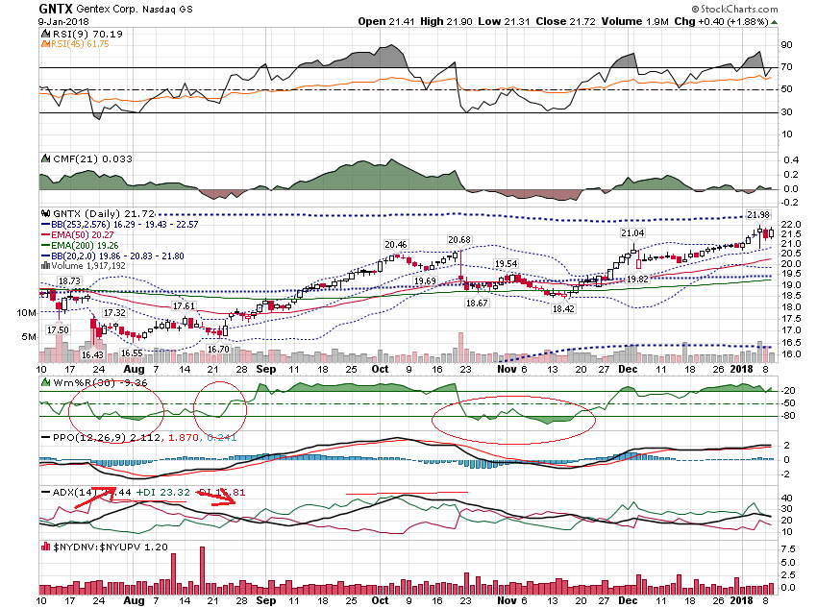

Slide 38
Thanks for watching! Bill Davis Mad Day Trader January 10, 2018 davismdt@gmail.com

