Slide 1

The Mad Hedge Fund Trader
“Enter the Dumb Money”
With John Thomas
from Silicon Valley, CA, January 17, 2017
www.madhedgefundtrader.com
Notes:
*

Slide 2

Trade Alert Performance
New All Time High!!
*January 0.40% MTD *July +1.95% Final
*February +6.39% FINAL *August +18.38% Final
*March +4.87% Final *September +7.65% Final
*April +1.84% Final *October +1.39% Final
*May -0.45% Final *November +2.08% Final
*June +0.70% Final *December +3.76% Final
*2017 Year to Date 0.40%
compared to 19% for the Dow Average
*Trailing One year return +56.91%, +276.87% since inception,
*Average annualized return of 34.25%

Slide 3
Portfolio Review
No “sweet spot” entry points
Risk/Reward is out of balance, 90% cash
Current Capital at Risk
Risk On
World is Getting Better
(TLT) 2/$127-$130 put spread | 10.00%
Risk Off
World is Getting Worse
None
Total Net Position | 10.00%

Slide 4
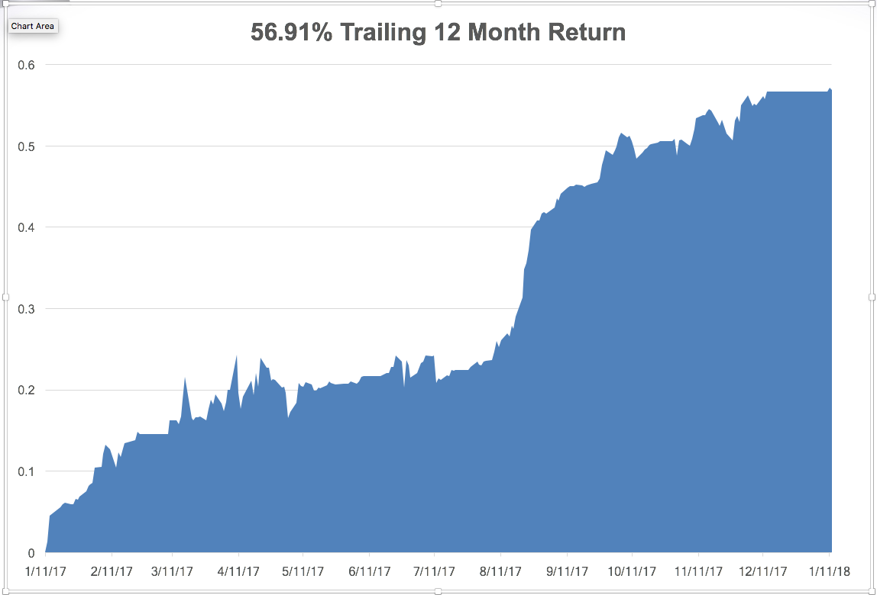
Daily Audited Performance

Slide 5
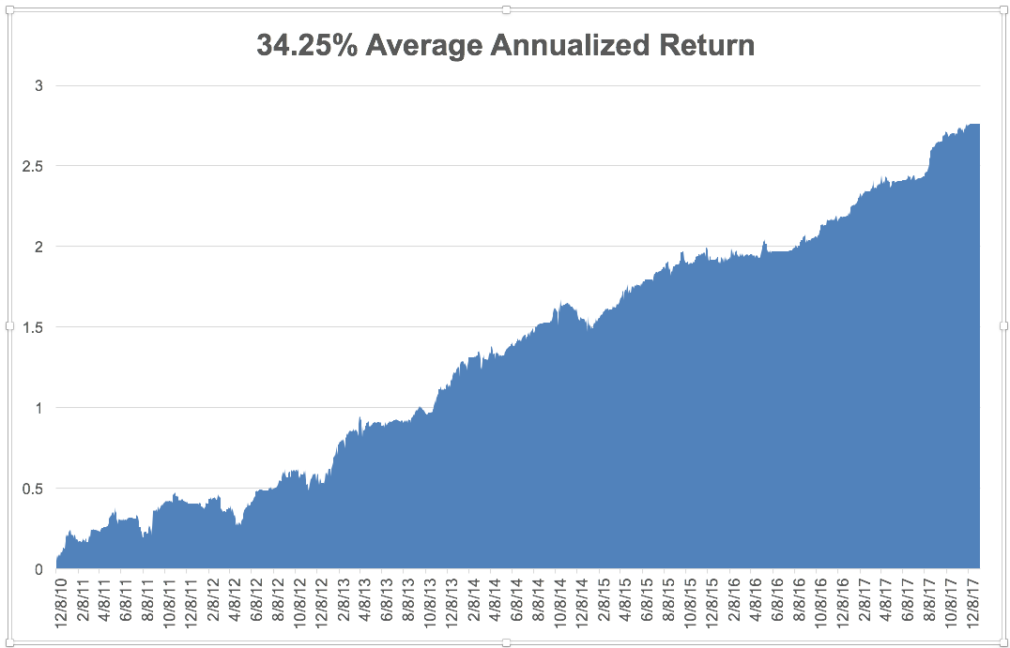
Eight Year Daily Audited Performance

Slide 6

Introducing the Mad Hedge Technology Letter!
The One Sector You Absolutely Must Follow on a Daily Basis
Inaugural Subscriptions Offered on February 1
*A daily read of the most important developments in technology giving you the best stock plays
*Includes its own separate Trade Alert service
*Written by John Thomas, a 50 year technology market veteran
*Researched by a new dedicated technology analyst based in Silicon Valley
*A $2,500 Upgrade to your existing Global trading Dispatch Service
*Will send you immediately actionable trading and investment ideas on:
Artificial Intelligence
Cloud based application
Autonomous driving cars
Big data applications for biotech
Microprocessors and GPU’s
Smart Phones and their Aps
Blockchain technology
Online marketing
Internet infrastructure
Social media

Slide 7

The Method to My Madness
*Global stock market melt up has taken stocks to Record Valuation and Momentum Highs, Great Q4 earnings could give us another leg
*Sell every bond rally….The Fed is now engaged in major Quantitative Tightening (QT?)
*Look for a stair step market in 2018, gaps up followed by long pauses
*Keep buying ”RISK OFF” assets, like gold, on dips
as a hedge against brief bouts of profit taking in stocks
*Keep the FANG’s, and trade against the laggards,
reflation plays, industrials, energy, and banks
*Buy oil stocks on dips, commodities to outperform
stocks in 2018
*Stand aside on currencies, a countertrend move
is unfolding

Slide 8
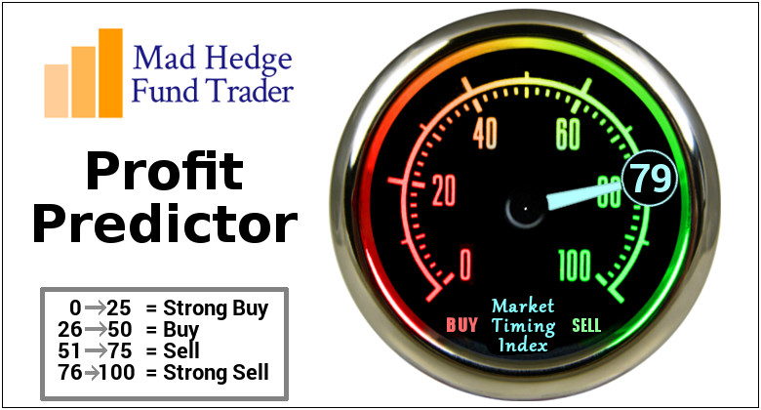
The Mad Hedge Profit Predictor
Market Timing Index
An artificial intelligence driven algorithm that analyzes 30 different economic, technical, and momentum driven indicators

Slide 9
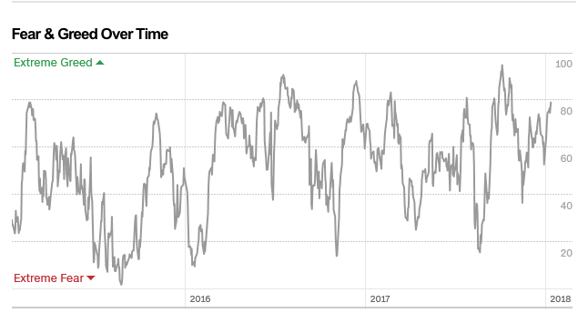
The Mad Hedge Profit Predictor
Looking Rich But There Are No Sellers
RICH

Slide 10

The Global Economy-Hot as a Pistol
*December ADP comes out at a red hot 250,000, December Nonfarm Payroll Report at a disappointing 148,00, headline Unemployment Rate at 4.1%, 3% handle is looming, a record 6 million job openings in the US
*Retail Jobs plunge by a shocking -20,000 in December, -67,000 YOY
*Master Card saw the largest sales growth increase since 2008, up 4.0%
*A second US Polar Vortex having a big
impact on the economy, driving up oil,
commodity, and grain prices
*It’s all very market positive, and
severely limited the downside to
any pullbacks

Slide 11
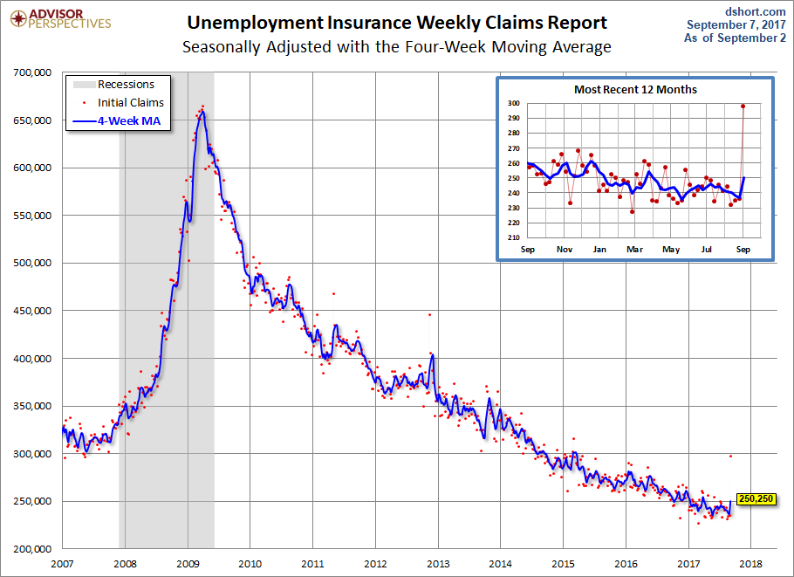
Weekly Jobless Claims –The Most Important Statistic
-2,000 to 245,000 coming out of Christmas Hiring
New 43 Year Low!

Slide 12

Stocks-Raising My Targets
*The year is unfolding exactly as I expected, just a lot faster
*Raising my 2018 targets to Dow $30,000 and S&P 500 $3,200, the momentum is enormous
*Oil stocks, emerging markets, Europe, small caps, industrials, and gold lead, big tech, transports, and rails looking very healthy
*Companies are front running their own buy backs with large purchases in early 2018, spurred on by repatriation prospects
*Retail money is also pouring in, primarily into Index ETF;s focusing buying on the largest companies
*Flat line sideways “time” corrections will be followed by
substantial upside breakouts ahead of every quarterly earnings period
*Volatility Index (VIX) rises 27% to $11.70
* A synchronized global economic recovery,
artificially low interest rates, and the prospect
of once a generation tax cuts are a lot to sell against.

Slide 13
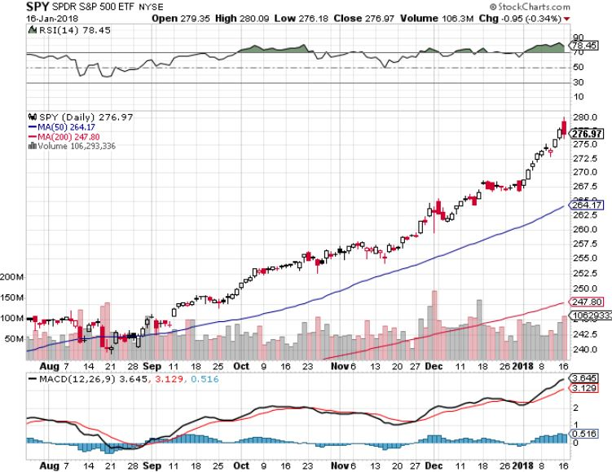
S&P 500-New Highs

Slide 14
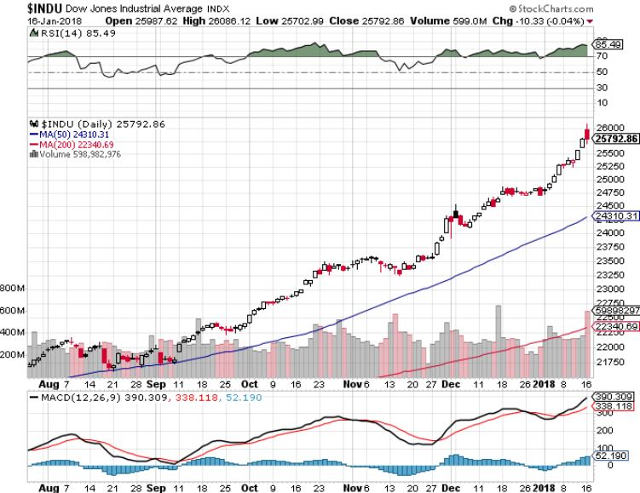
Dow Average-New Highs
Haven’t Retraced to the 50 Day MA since May-Very High Risk

Slide 15
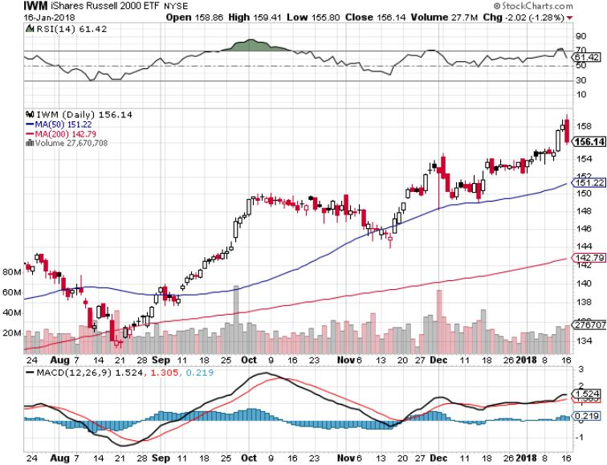
Russell 2000 (IWM)-Peaked Out stopped out of long the (IWM) 12/$152-$155 bear put spread

Slide 16
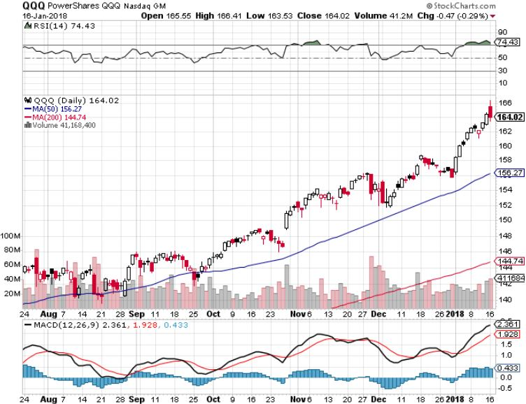
NASDAQ (QQQ)-New Highs

Slide 17
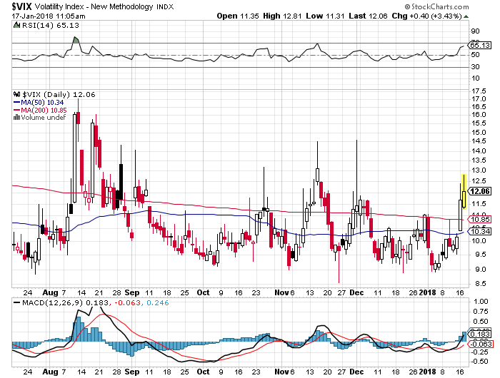
(VIX)-New Low

Slide 18
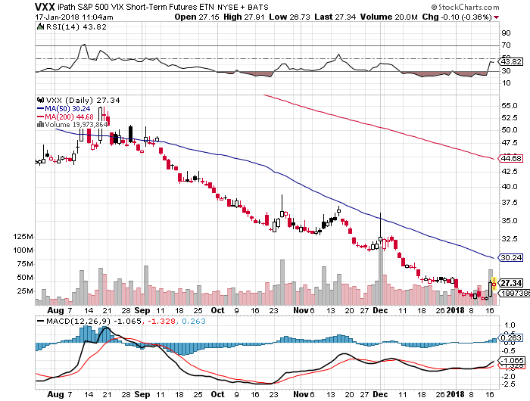
iPath S&P 500 VIX Short-Term Futures ETN (VXX)
Begging for New Lows stopped out of long 1/$60 calls as a hedge for rest of portfolio took profits on long 11/$20 calls

Slide 19
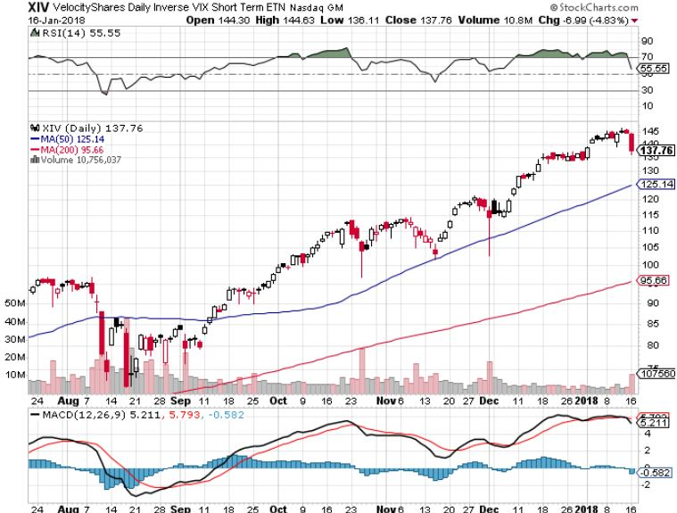
Velocity Shares Daily Inverse VIX Short Term ETN (XIV)
One of the most instantly profitable trades of 2016….and 2017 took profits on (XIV) long at $81.45

Slide 20
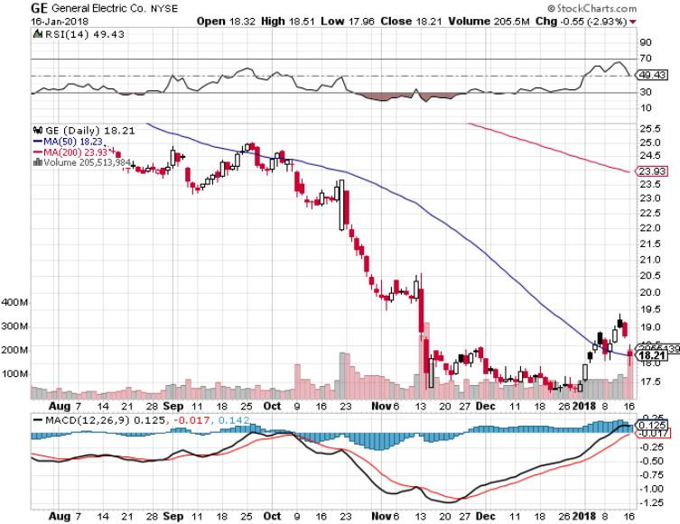
General Electric (GE)-No Recovery

Slide 21
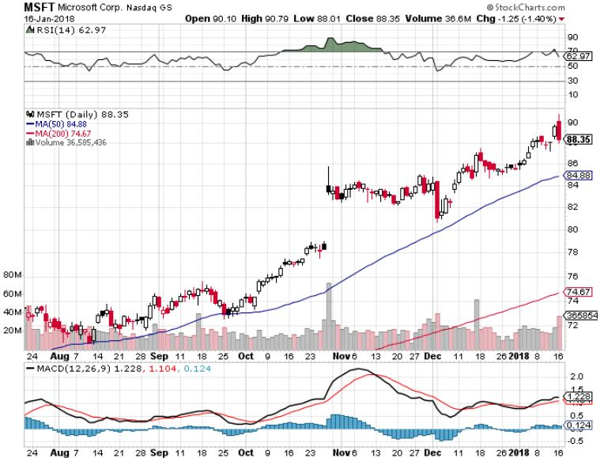
Microsoft (MSFT)

Slide 22
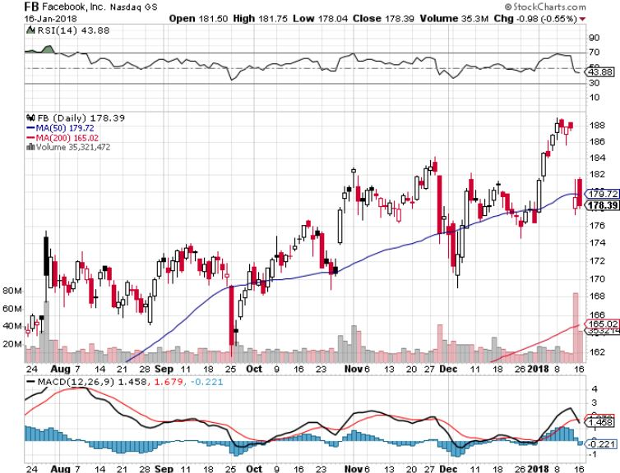
Facebook (FB)-

Slide 23
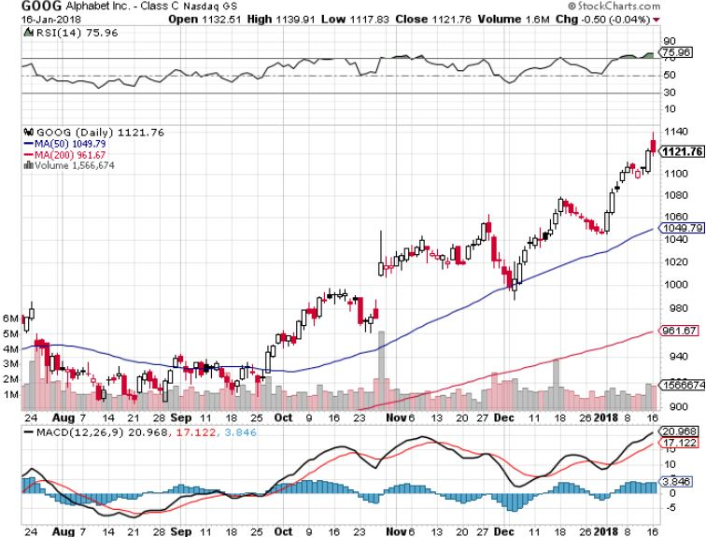
Alphabet (GOOG)-New High

Slide 24
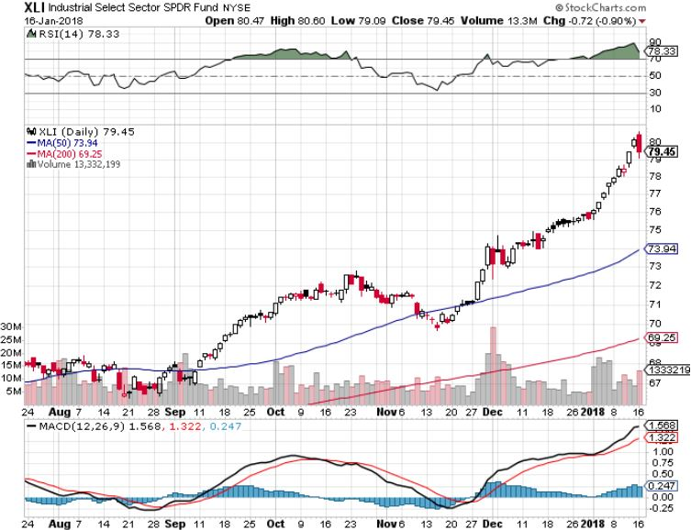
Industrials Sector SPDR (XLI)-
(GE), (MMM), (UNP), (UTX), (BA), (HON)

Slide 25
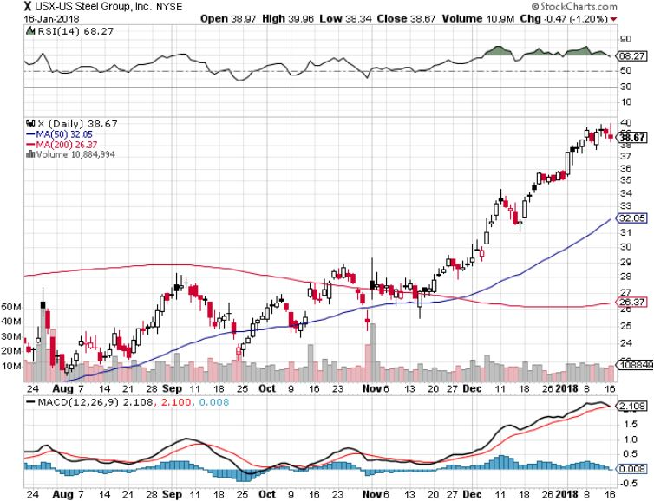
US Steel (X)- took profits on long the 9/$21-$22 vertical bull call spread

Slide 26
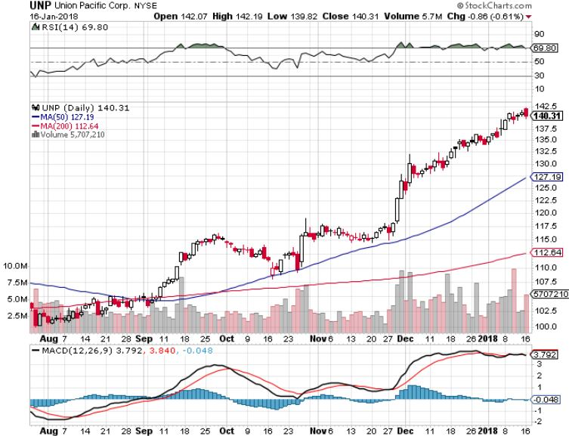
Union Pacific Railroad (UNP)- took profits on long the 9/$100-$102 vertical bull call spread

Slide 27
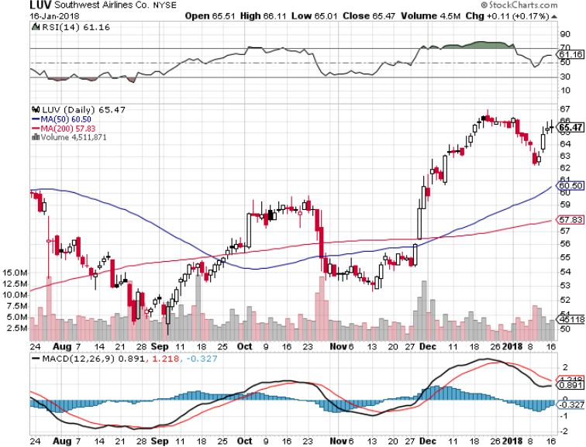
Southwest Airlines (LUV)-
Warren Buffett’s Favorite Airline

Slide 28
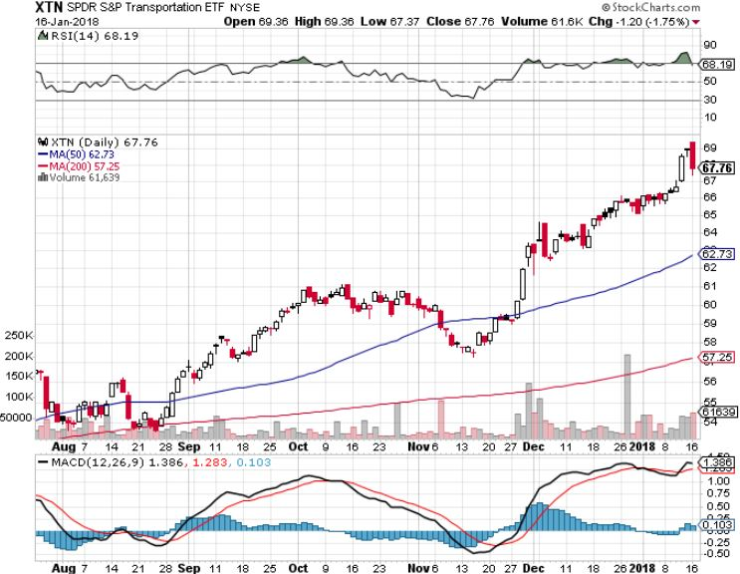
Transports Sector SPDR (XTN)-
(ALGT), (ALK), (JBLU), (LUV), (CHRW), (DAL)

Slide 29
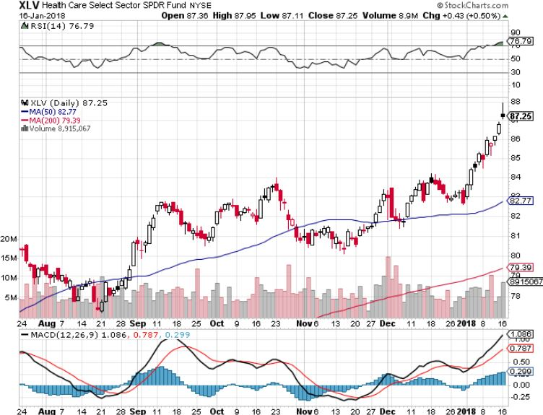
Health Care Sector (XLV), (RXL)-The New FANG?
(JNJ), (PFE), (MRK), (GILD), (ACT), (AMGN)

Slide 30
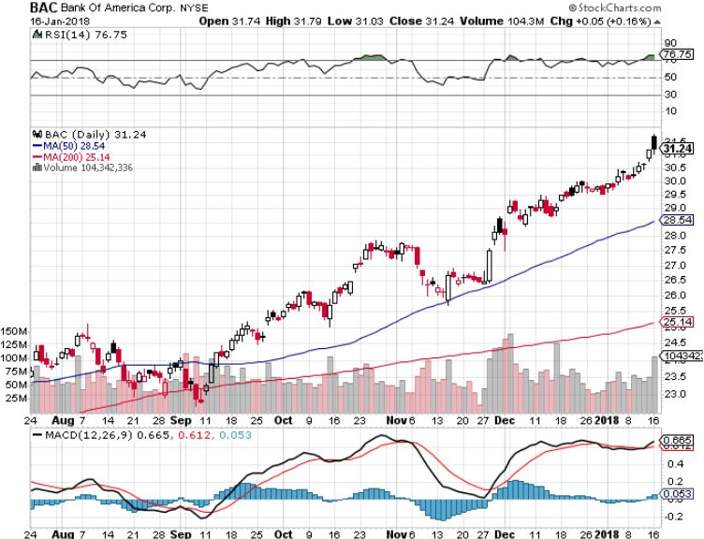
Bank of America (BAC)-New Highs
(BLK/B), (WFC), (JPM), (BAC), (C), (GS) long 12/$25.50-$27 bull call spread-expires in 7 trading days

Slide 31
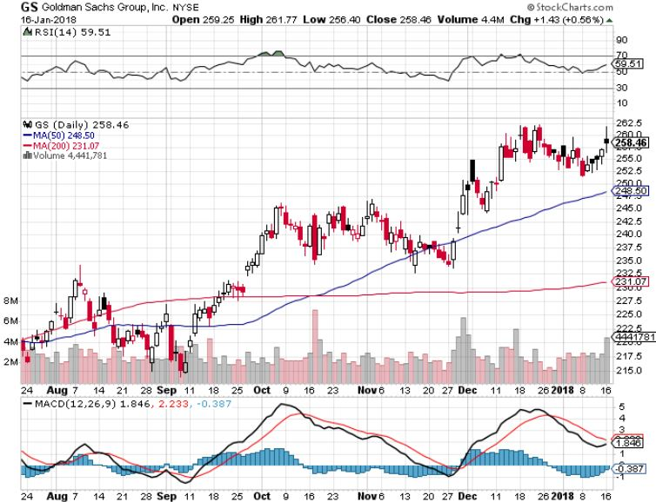
Goldman Sachs (GS)-Interest Rate Boost stopped out of long 10/$220-$225 vertical bull call spread took profits on long 10/$227.50-$232.50 vertical bull call spread took profits on long 9/$205-$210 vertical bull call spread took profits on long 9/$235-$240 vertical bear put spread

Slide 32
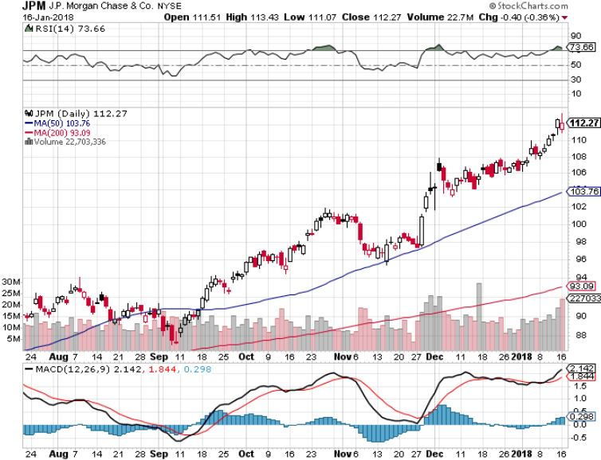
JP Morgan (JPM)-

Slide 33
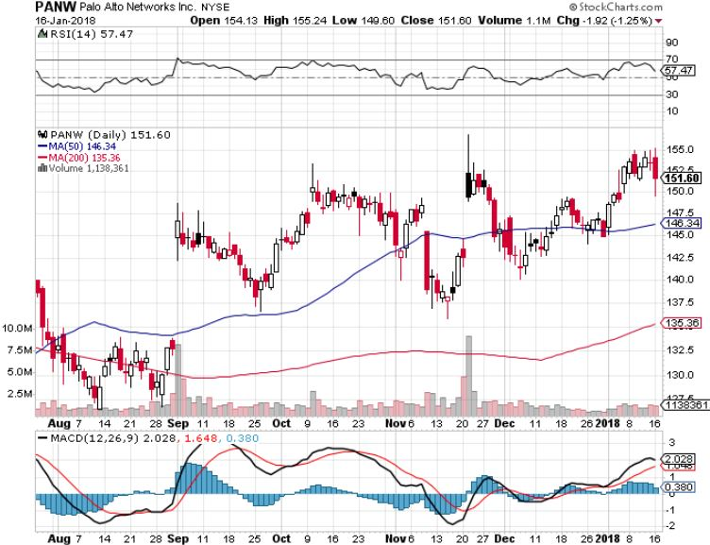
Palo Alto Networks (PANW)-

Slide 34
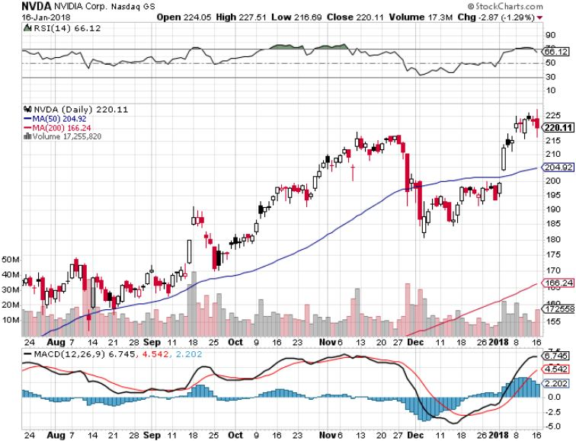
NVIDIA (NVDA)-New Highs

Slide 35
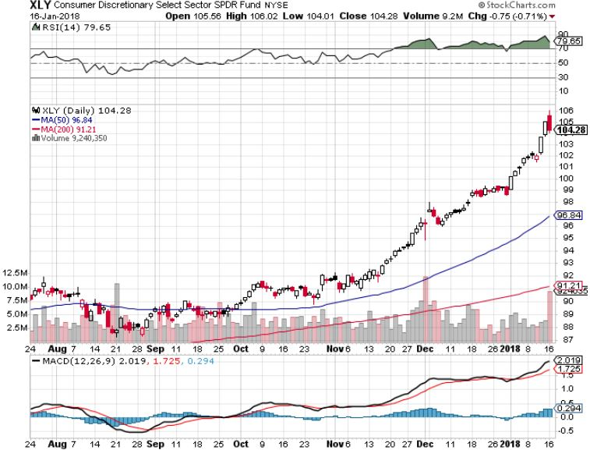
Consumer Discretionary SPDR (XLY)
(DIS), (AMZN), (HD), (CMCSA), (MCD), (SBUX)

Slide 36
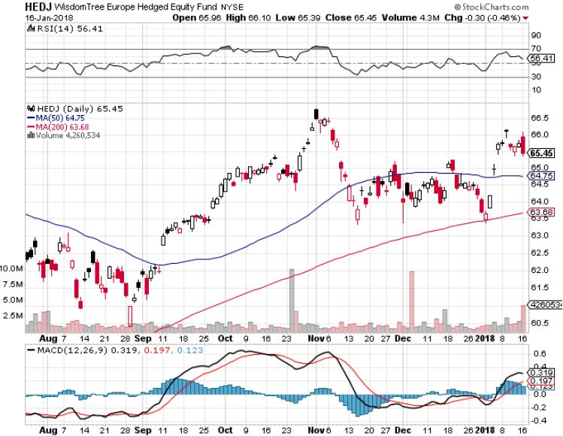
Europe Hedged Equity (HEDJ)-Global Rally

Slide 37
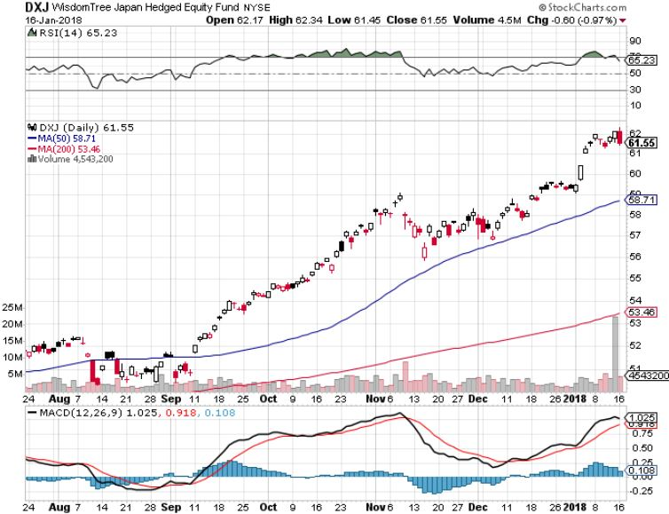
Japan (DXJ)-More Global Rally

Slide 38
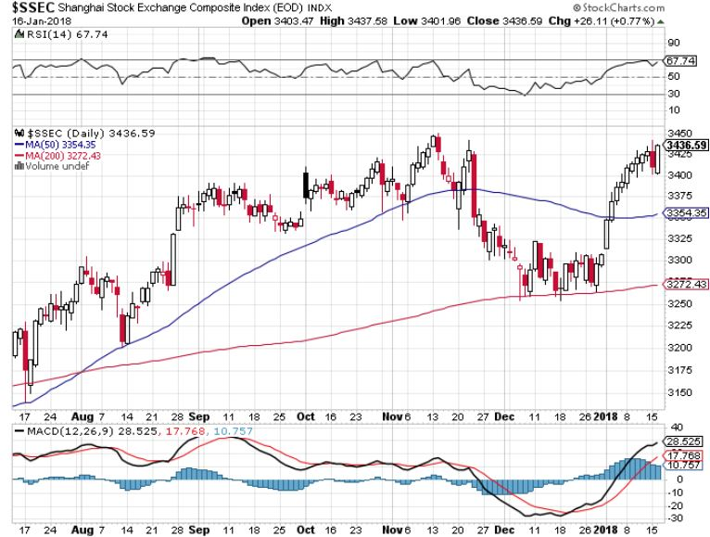
China ($SSEC)-Economic Recovery on Track

Slide 39
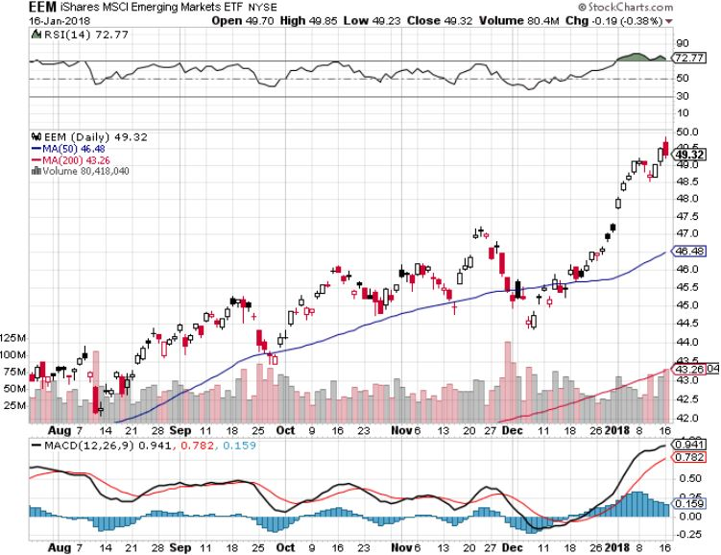
Emerging Markets (EEM)- New High

Slide 40

Bonds-The Fat Lady is Singing
*Major technical damage on the long term charts heralding a new leg down in the bear market
*The two and ten year bond charts have broken 25 year trend lines to the downside
*Budget deficit now climbing sharply from an Obama low of $450 billion to $700 billion now on its way to $1.2 trillion
*Markets now looking for three 25 basis point interest rate hikes in 2018
*I’m still looking for a bond selloff in 2018
to take yields to 3.50% by yearend
*The Fed’s QT, or “quantitative tightening”
to remove $6 billion a month, or $200
million a day worth of liquidity

Slide 41
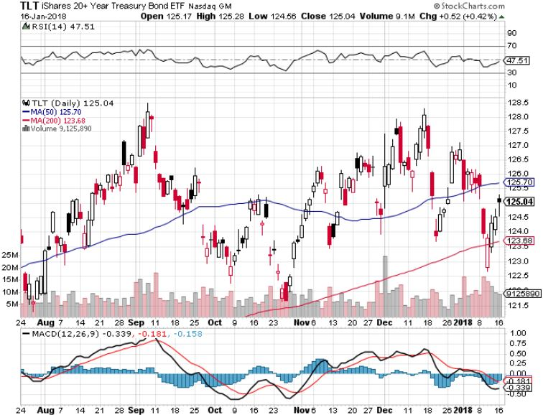
Treasury ETF (TLT) – 2.57-New Down Leg
Long the (TLT) 2/$127-$130 put spread
Took profits on long (TLT) 12/$129-$131 vertical bear put spread
Took profits on long (TLT) 12/$129-$132 vertical bear put spread

Slide 42
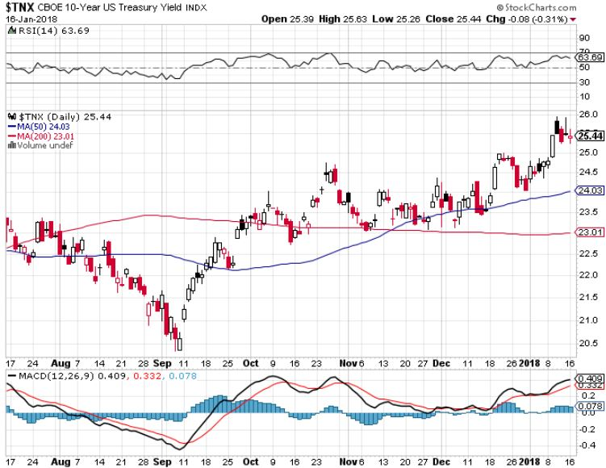
Ten Year Treasury Yield ($TNX) 2.57%
Breakdown, Now major Support

Slide 43
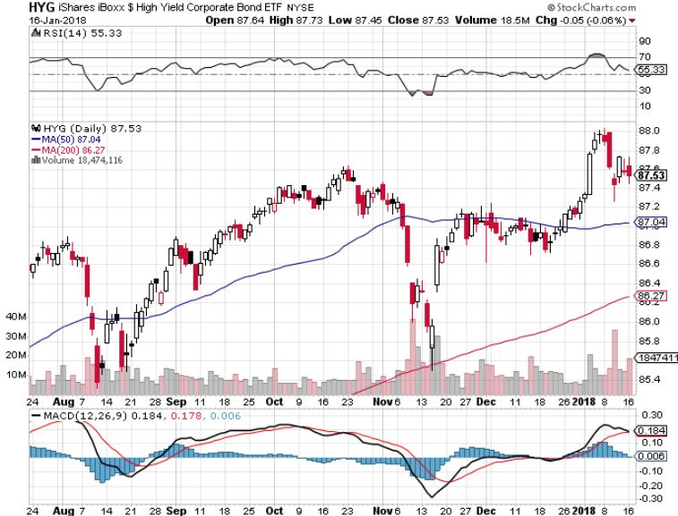
Junk Bonds (HYG) 4.71% Yield
A Great Risk Coincident Indicator- Long Term “RISK ON”

Slide 44
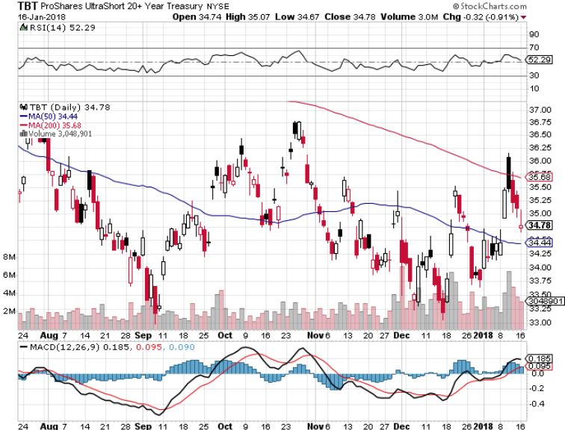
2X Short Treasuries (TBT)-10% Rally

Slide 45
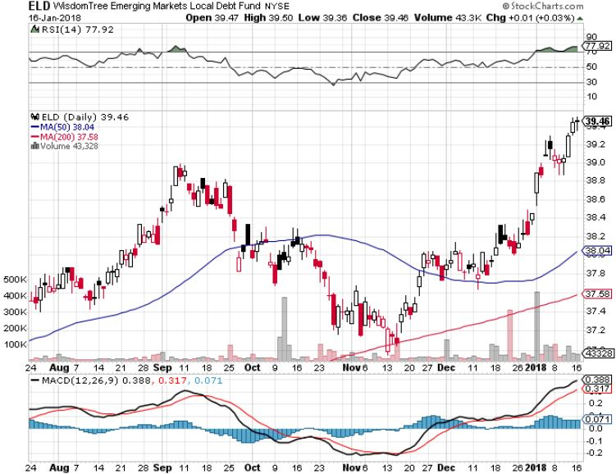
Emerging Market Debt (ELD) 5.66% Yield-

Slide 46
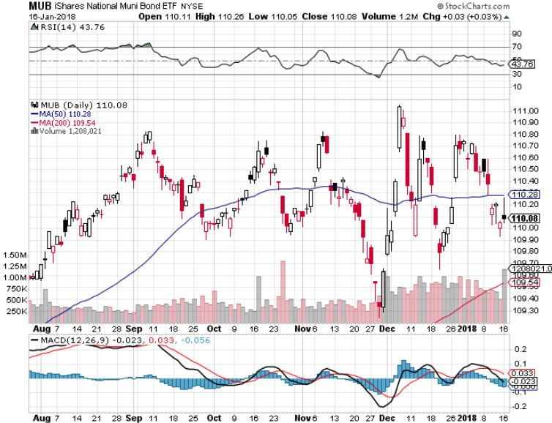
Municipal Bonds (MUB)-1.69%
Mix of AAA, AA, and A rated bonds

Slide 47

Foreign Currencies-Buy the New “Exiters”
*Japan finally says it might cut back QE, making it the newest “Exiter”
*Countries newly exiting are shifting from an easing to a tightening monetary cycle, making their currencies stronger
*Rebounding commodity prices are boosting commodity currencies of the Australian dollar (FXA) and the Canadian dollar (FXC)
*Higher than US growth rates supporting the Euro (FXE)
*Ditto for the Chinese Yuan (CYB), which is
also bringing in stronger economic data
*Bitcoin down, Etherium up, go figure,
it will all end badly

Slide 48
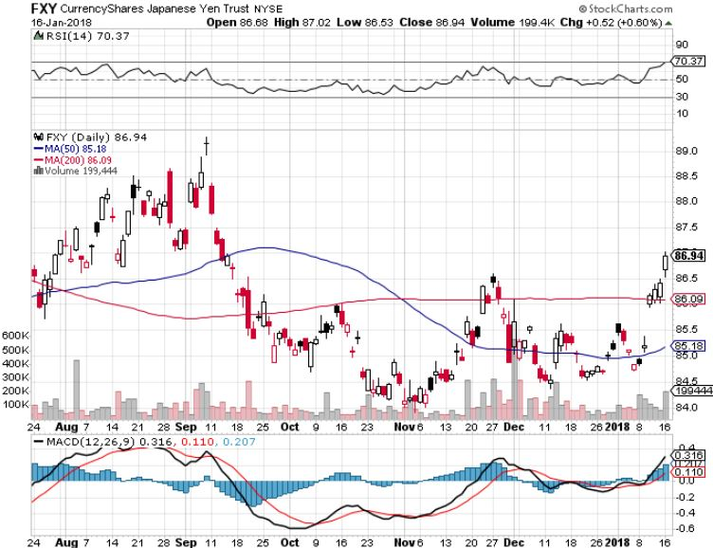
Japanese Yen (FXY), (YCS)

Slide 49
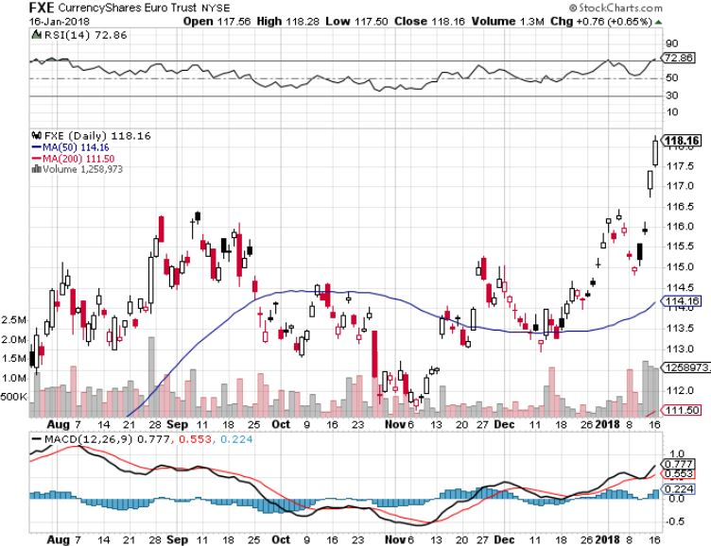
Euro ($XEU), (FXE), (EUO)- Breakout! took profits on long (FXE) 12/$116-$118 vertical bear put spread took profits on long (FXE) 12/$111-$113 vertical bull call spread

Slide 50
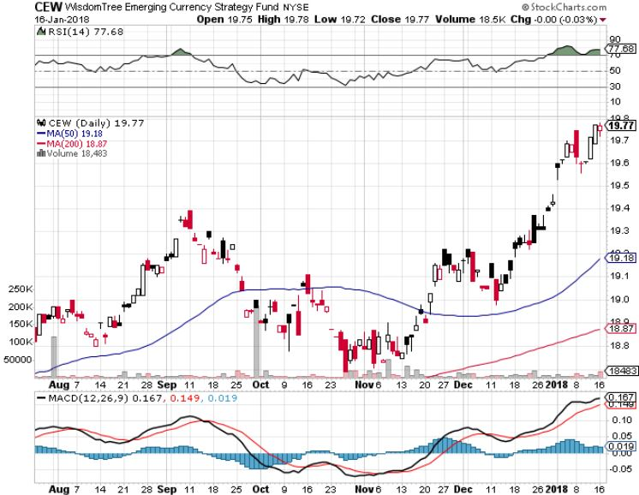
Emerging Market Currencies (CEW)

Slide 51
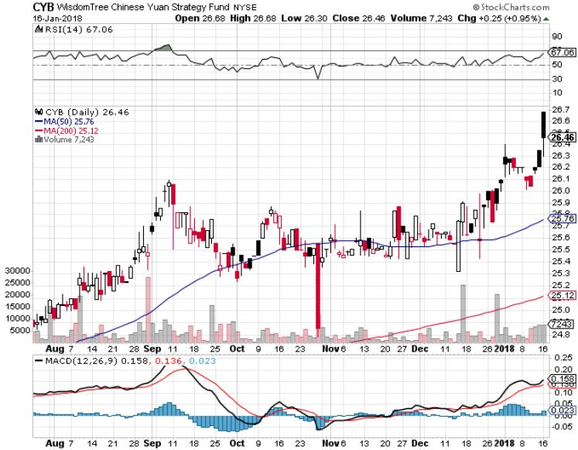
Chinese Yuan- (CYB)-
Stabilizing on Government Support

Slide 52
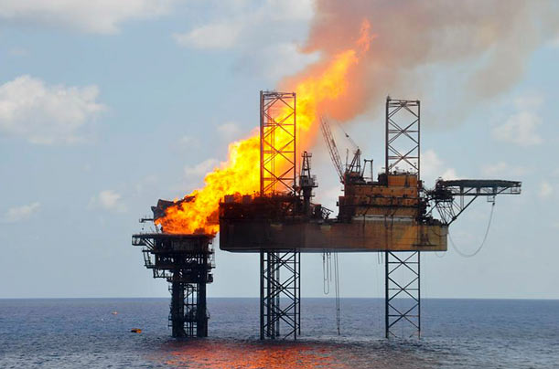
Energy-Oil On Fire
*If OPEC production curbs last to the end of 2018, we may see oil reach $80 by yearend
*Fire at Nigerian pipeline cuts supplies
*Look for commodity prices to beat stocks in 2018, pulling up oil
*More Extreme cold weather gives natural gas a short term bounce
*Fracking supply is on the rebound,
Baker Hughes US Rig Count surges
by 15 to 939
*Buy the dips in energy stocks

Slide 53
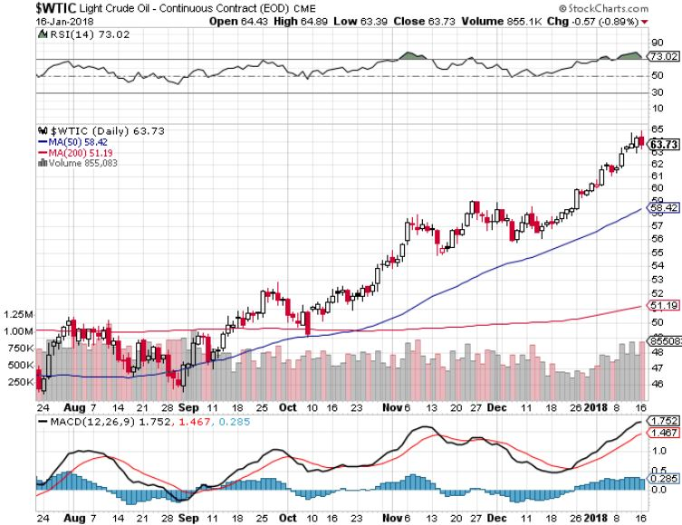
Oil-New Highs!

Slide 54
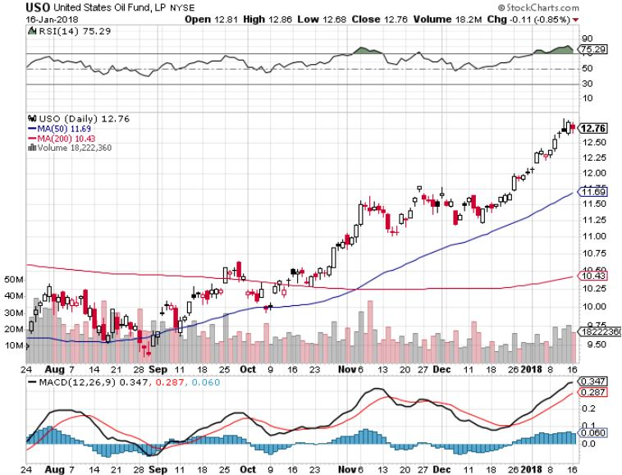
United States Oil Fund (USO)

Slide 55
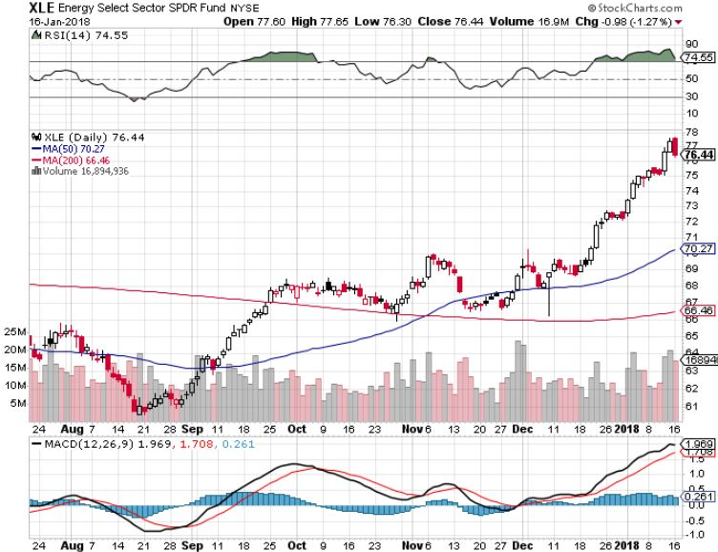
Energy Select Sector SPDR (XLE)-Flavor of the Day
(XOM), (CVX), (SLB), (KMI), (EOG), (COP)

Slide 56
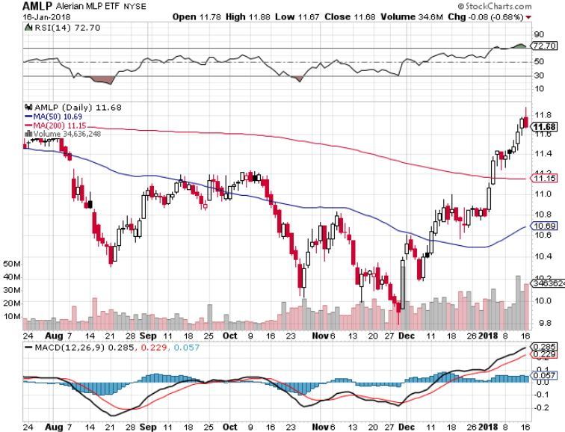
Alerian MLP ETF (AMLP)- Basket Approach

Slide 57
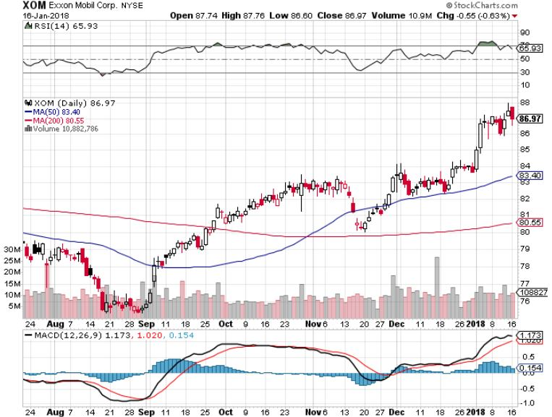
Exxon (XOM)-The Bottom is In

Slide 58
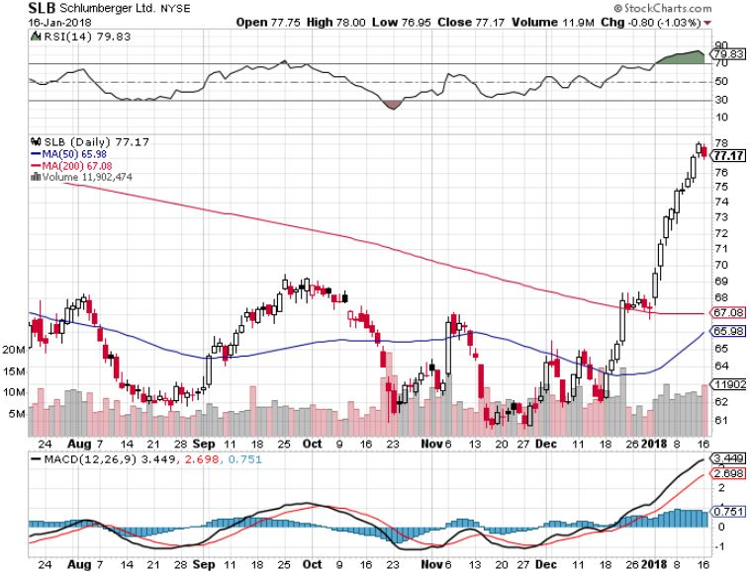
Schlumberger (SLB)-Hard Bounce Back

Slide 59
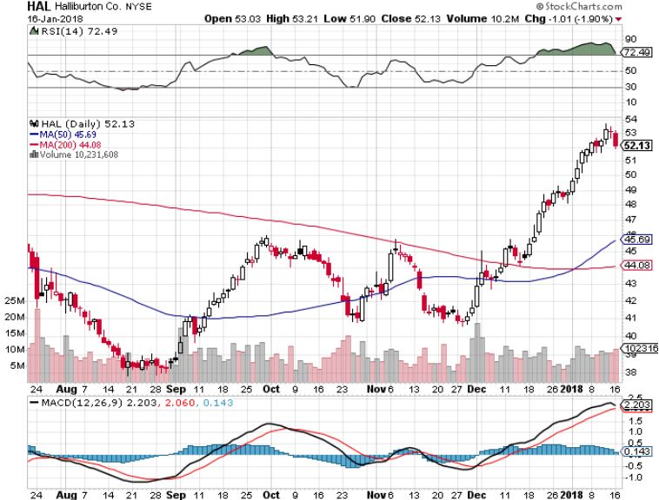
Halliburton (HAL)-Ditto

Slide 60

Natural Gas (UNG)-Finally Caught a Cold

Slide 61

Here’s Your Bull Case for Gold
Global Gold ETF Fund Flows

Slide 62

Copper (COPX)-China Infrastructure Build Out

Slide 63

Precious Metals-Joining the Parade
*A wealth effect is pushing gold up to new one year highs
*Gold ETF’s added 197.5 metric tonnes in 2017, look for a much bigger increase in 2018, with 75% going into Europe based funds and the rest into US funds
*Getting ready for a big jump in January when the stock sellers’ strike ends?
*A general rotation in commodities and a generically weak dollar are also helping the barbarous relic
*Buy gold and silver stocks
on the next big dip, as it is
still early days for the bull market

Slide 64

Gold (GLD)-New One Year High took profits on long (GLD) $12/$116-$119 bull call spread

Slide 65

Market Vectors Gold Miners ETF- (GDX)
Took profits on long the 9/$20.50-$21.50 bull call spread

Slide 66

Barrick Gold (ABX) stopped out of long 9/$15-16 call spread

Slide 67

Newmont Mining- (NEM)-Breakout took profits on long the 9/$32-$34 bull call spread

Slide 68

Global X Silver Miners ETF- (SIL)-Breakout took profits on long the 9/$31-$33 bull call spread

Slide 69

Bitcoin-Modern Day Tulips!
Now banned in China and South Korea

Slide 70

Real Estate-New Highs
*US Home Equity hits a new all time high after 12 year break
*Sales have gone quiet due to extreme weather, but look for a 10% price gain in major markets this year
*Remodeling Spending hit $152 billion in 2017, will go much higher in 2018
*Cash out Refi’s on the upswing, with the money going into stocks and Bitcoin
*Blue states converting real estate taxes to charitable contributions to keep their federal deductibility
*S&P 500 Case-Shiller maintains
strong 6.2%, with absolute prices
hitting new all time high,
*Your home equity could be the best
investment of the year….again

Slide 71

October S&P7500/Case–Shiller Home Price Index
+6.2% YOY, Seattle (+12.0%), Las Vegas (+10.2%), San Diego (+8.1%) still leaders price rises accelerating

Slide 72

Simon Property Group (SPG)-
Rebounding on Stronger Economy

Slide 73

US Home Construction Index (ITB)
(DHI), (LEN), (PHM), (TOL), (NVR)
A Favorite Sector to Buy

Slide 74

Trade Sheet-
So What Do We Do About All This?
*Stocks- buy dips
*Bonds-sell any and all rallies
*Commodities-buy industrials, energy
*Currencies-stand aside
*Precious Metals –buy dips
*Volatility-stand aside until over $16
*Real estate-buy dips

Slide 75

Next Strategy Webinar
12:00 EST Wednesday, January 31, 2018
San Francisco, CA madhedgefundtrader.com
Good Luck and Good Trading!
Notes:
*

