Slide 1
The Mad Hedge Fund Trader “Welcome to the Crash of 2018”
With John Thomas from Silicon Valley, CA, February 14, 2017 www.madhedgefundtrader.com
Notes:
*

Slide 2
Co-Host Dean Jenkins FollowMeTrades.com
*20 years of investing and trading experience *Specializes in equities and equity options *Coaches traders around the world *Focuses on several technical strategies, including Elliot Wave, Ichimoku Cloud *Former Intel engineer

Slide 3
Trade Alert Performance New All Time High!!
*January 4.09% MTD *July +1.95% Final *February +4.41% MTD *August +18.38% Final *March +4.87% Final *September +7.65% Final *April +1.84% Final *October +1.39% Final *May -0.45% Final *November +2.08% Final *June +0.70% Final *December +3.76% Final *2018 Year to Date 8.50% compared to 0% for the Dow Average *Trailing One year return +54.88%, +284.97% since inception, *Average annualized return of 34.89%

Slide 4
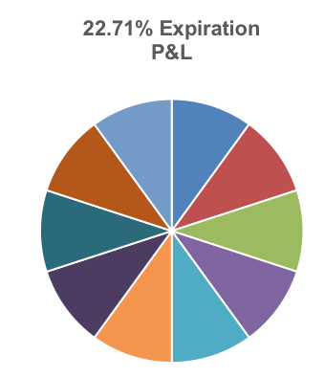
Portfolio Review 100% Invested in Balanced Long/Short Portfolio with heavy long technology weighting
Risk On
World is Getting Better
(AAPL) 6/$130-$140 call spread | 10.00%
(AAPL) 3/$140-$145 calls | 10.00%
(AMZN) 3/$1200-$1250 call spread | 10.00%
(FB) 3/$155-$165 call spread | 10.00%
(TLT) 3/$124-$127 put spread | 10.00%
(VXX) 3/$60-$65 put spread | 10.00%
Risk Off
(TLT) 2/$114-$117 call spread | -10.00%
(SPY) 3/$275-$280 put spread | -10.00%
(AAPL) 3/$170-$175 put spread | -10.00%
(FB) 3/190-$195 puts spread | -10.00%
Total Net Position | 20.00%

Slide 5
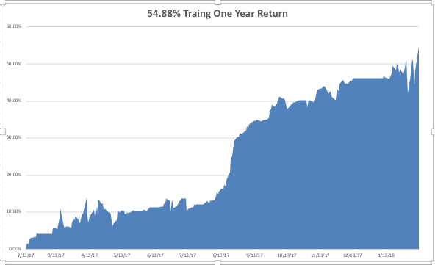
Daily Audited Performance

Slide 6
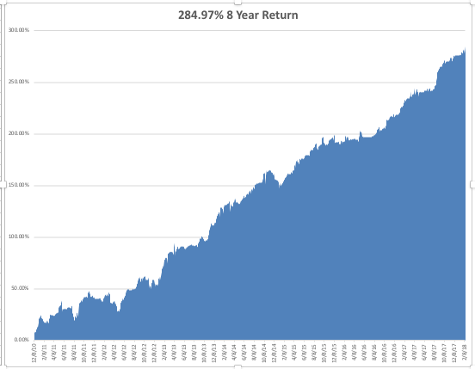
Eight Year Daily Audited Performance

Slide 7
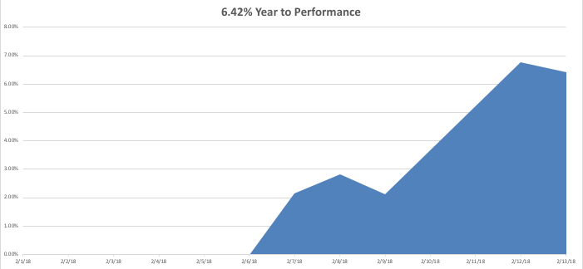
Mad Hedge Technology Letter Performance

Slide 8
Mad Hedge Technology Letter Portfolio
Current Capital at Risk
Risk On
World is Getting Better
(AAPL) 3/$140-$145 calls | 10.00%
(AMZN) 3/$1200-$1250 call spread | 10.00%
(FB) 3/$155-$165 call spread | 10.00%
(MU) 3/$34-$37 call spread | 10.00%
(CRM) 3/$90-$95 call spread | 10.00%
(AAPL) 6/$130-$140 calls | 10.00%
Risk Off
(AAPL) 3/$170-$175 put spread | -10.00%
(FB) 3/190-$195 puts spread | -10.00%
Total Net Position | 40.00%
16.07% Expiration P&L

Slide 9
Introducing the Mad Hedge Technology Letter! The One Sector You Absolutely Must Follow on a Daily Basis 6.78% Month to Date Performance!
*A daily read of the most important developments in technology giving you the best stock plays *Includes its own separate Trade Alert service *Written by John Thomas, a 50 year technology market veteran *Researched by a new dedicated technology analyst based in Silicon Valley *A $2,500 Upgrade to your existing Global trading Dispatch Service *Will send you immediately actionable trading and investment ideas on: Artificial Intelligence Cloud based application Autonomous driving cars Big data applications for biotech Microprocessors and GPU’s Smart Phones and their Aps Blockchain technology Online marketing Internet infrastructure Social media

Slide 10
The Method to My Madness The Fake Bear Market-Not Justified by Fundamentals
*Went into crash with a heavy gold position, which barely moved *Once downturn accelerated, I started dumping risk as fast as I could *Used every morning rally to stop out of near money short dated long positions *Used every 1,000 point swoon to buy very deep-in-the-money March and June long positions *Sold short VIX at the $39 top *Sell every bond rally….The Fed is now engaged in major Quantitative Tightening (QT?) *Keep the FANG’s, and trade against the laggards, reflation plays, industrials, energy, and banks *Stand aside on currencies, a countertrend move is unfolding

Slide 11
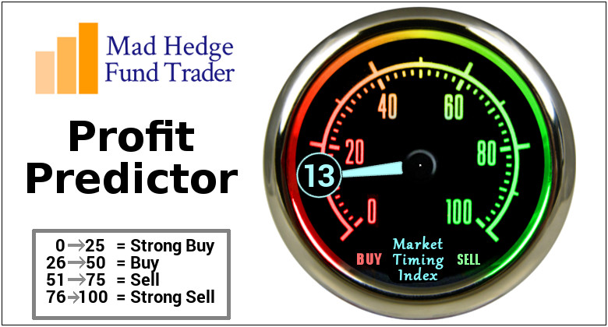
The Mad Hedge Profit Predictor Market Timing Index An artificial intelligence driven algorithm that analyzes 30 different economic, technical, and momentum driven indicators

Slide 12
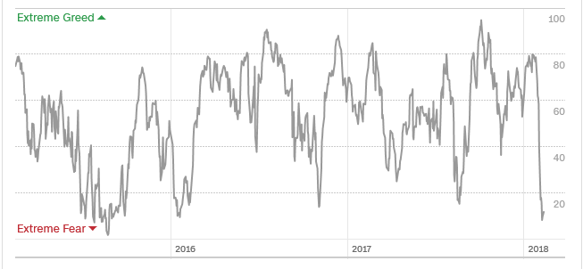
The Mad Hedge Profit Predictor A 9 Year Low!

Slide 13
The Global Economy-Recession fears
*January CPI comes in at a red hot 0.5%, 2.1% YOY, but the news is already on the bond market *All major countries now growing in synchronized recovery, the US is now one of the weakest growers with the weakest currency *January ADP comes out at a red hot 250,000, December Nonfarm Payroll Report at a disappointing 148,00, headline Unemployment Rate at 4.1%, 3% handle is looming, a record 6 million job openings in the US *US Q4 GDP a moderate 2.6%, no hyper growth yet, California unemployment hits an all time low at 4.3%, December Industrial Production up +0.9%, double expected, US aircraft sales are surging, new home construction is exploding *While fears of a recession mount, it’s nowhere in the data

Slide 14
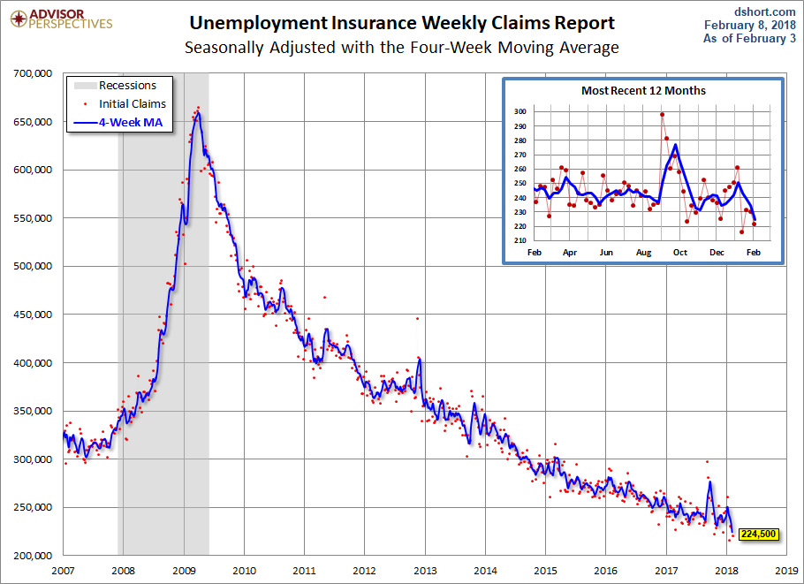
Weekly Jobless Claims –The Most Important Statistic -9,000 to 221,000 at 44 Year Low!

Slide 15
Stocks-Margin Call!
*Rising rates, rising inflation, and political instability in Washington team up to break the market’s upside momentum *VIX explodes from $9 to $52.50, wiping out the entire short volatility industry in one night *Traders pounded with margin calls leading to a massive capitulation on Friday afternoon *I called the bottom at (SPY) 200-day moving average at $252, or Price earnings multiple of 16X *Watch the market trade between the 200-day ($252) and 50-day moving average ($271) for the next few weeks *Bull market is not dead, but resting, went from a long overdue correction to a correction that became overdone

Slide 16
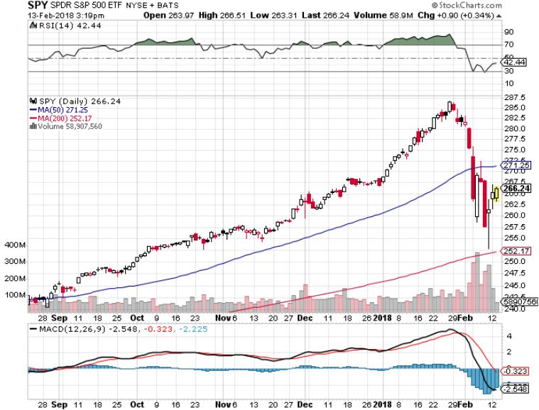
S&P 500-New Highs Long 3/$275-$280 bear put spread

Slide 17
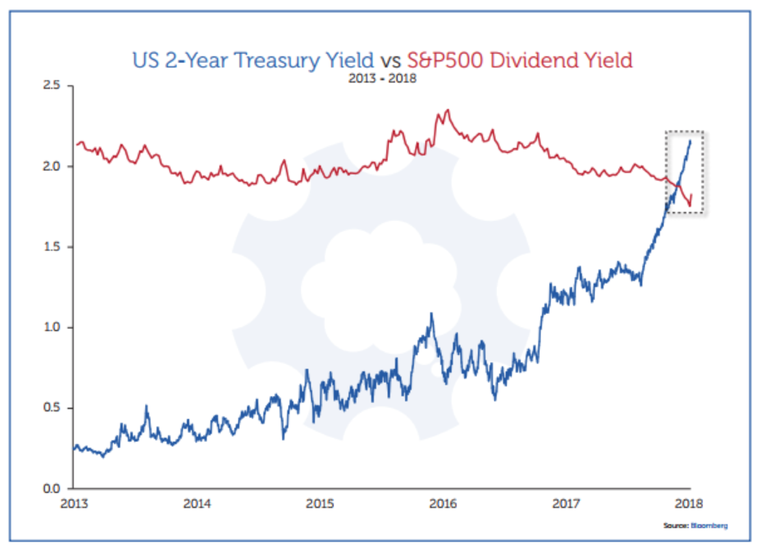
Here’s the Problem

Slide 18
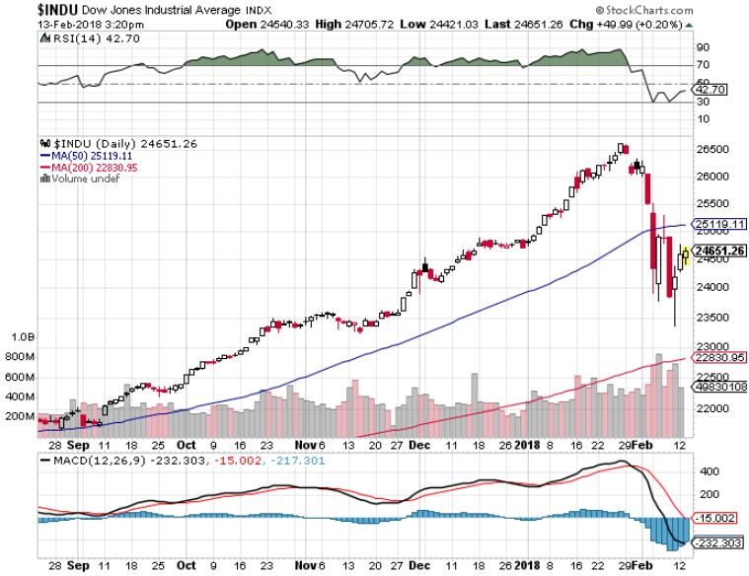
Dow Average-13.33% Correction

Slide 19
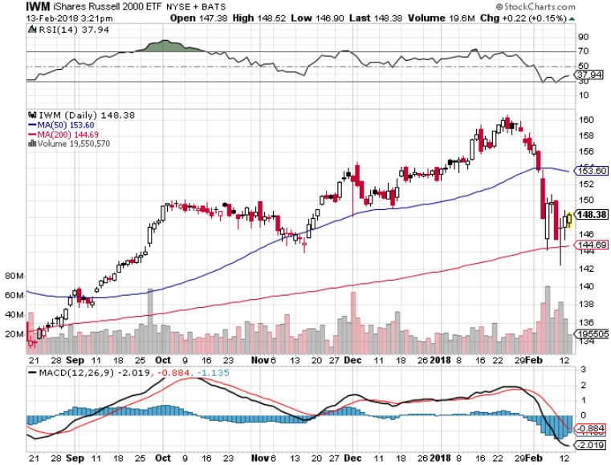
Russell 2000 (IWM)-Peaked Out stopped out of long the (IWM) 12/$152-$155 bear put spread

Slide 20
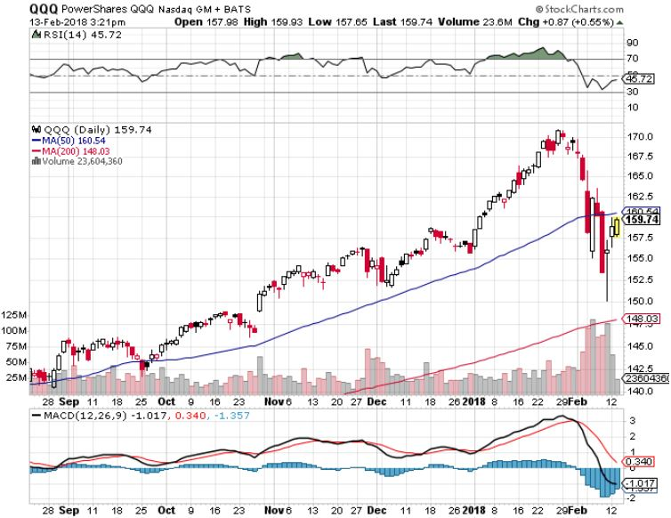
NASDAQ (QQQ)-Crushed

Slide 21
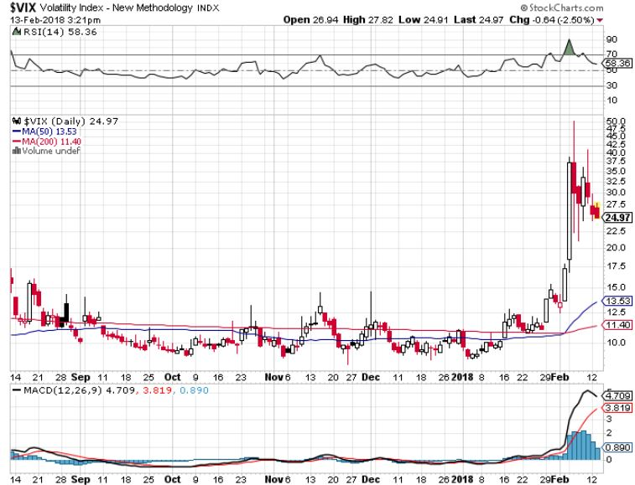
(VIX)-Nine Year High

Slide 22
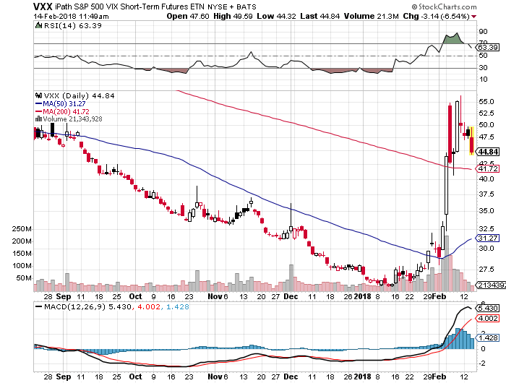
iPath S&P 500 VIX Short-Term Futures ETN (VXX) long 3/$60-$65 bear put spread-puts staying at artificially high levels took profits on long 11/$20 calls

Slide 23
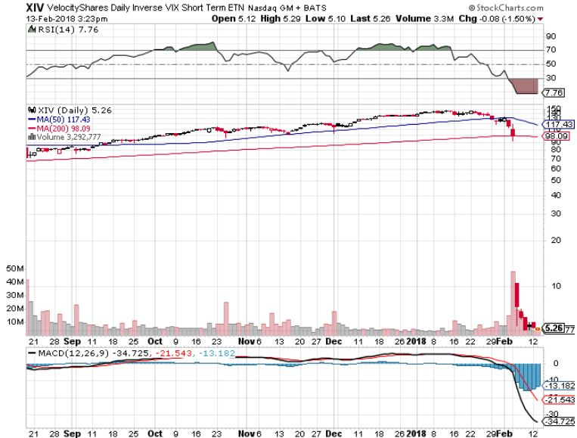
Velocity Shares Daily Inverse VIX Short Term ETN (XIV) Gone to Money Heaven

Slide 24
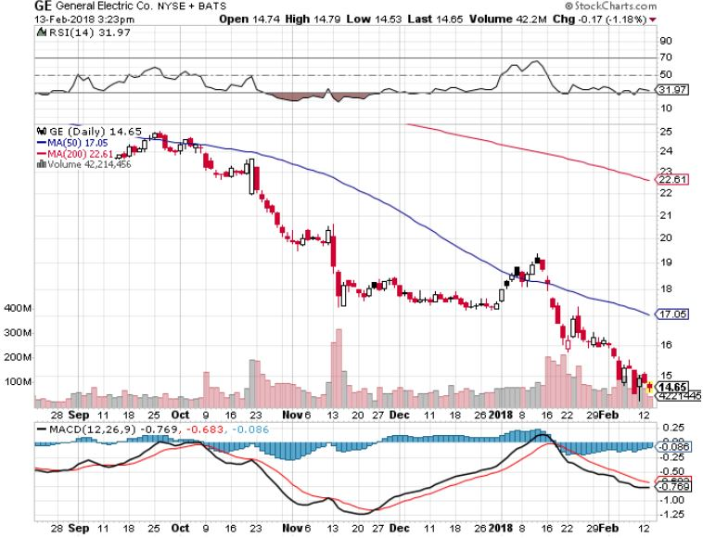
General Electric (GE)-No Recovery Breakup Value is $15

Slide 25
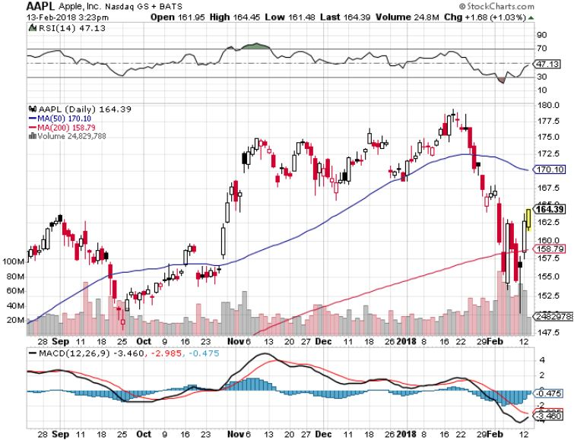
Apple (AAPL)-Waiting for Buy Backs long 3/$140-$145 calls long 3/$170-$175 put spread long June $130-$140 calls spread

Slide 26
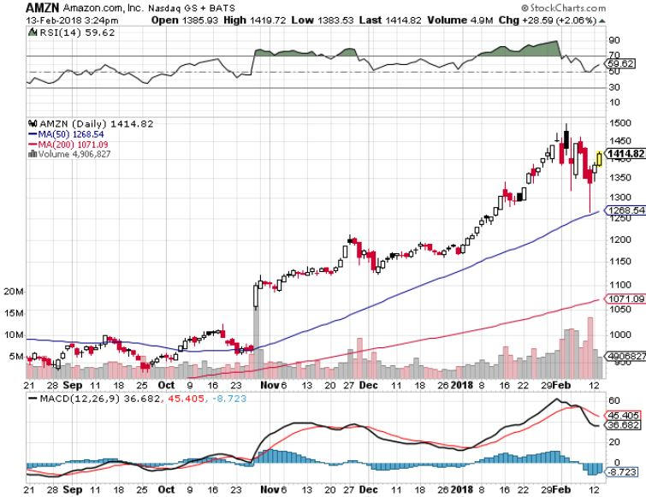
Amazon (AMZN) long 3/$1200-$1250 call spread

Slide 27
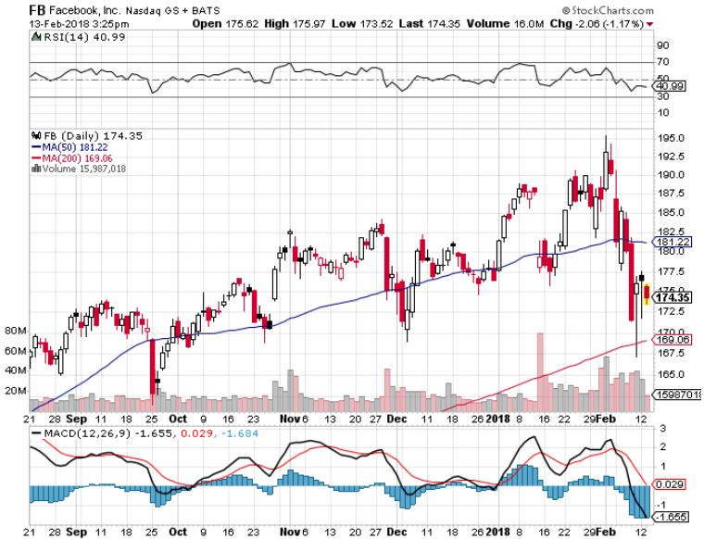
Facebook (FB)- long 3/$155-$165 bull call spread Long 3/$190-$195 bear put spread

Slide 28
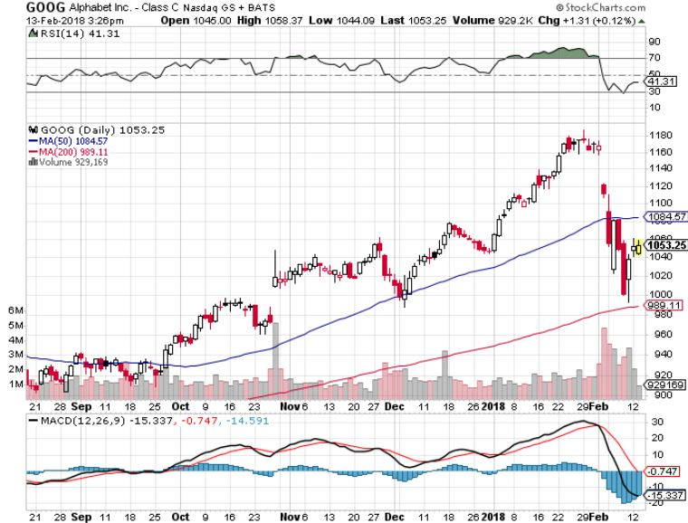
Alphabet (GOOG)-New High

Slide 29
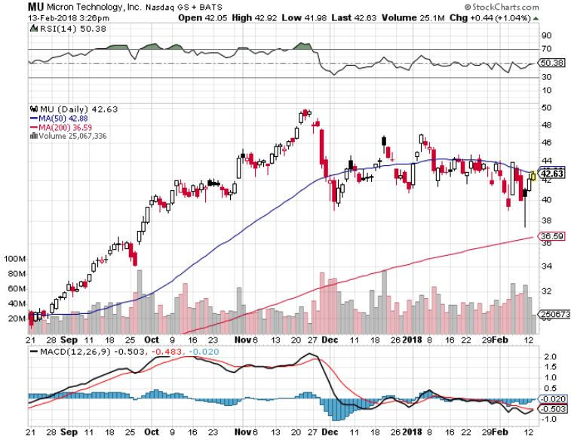
Micron Technology (MU)-Awaiting Earnings long 3/$34-$37 bull call spread in Mad Hedge Technology Letter Only

Slide 30
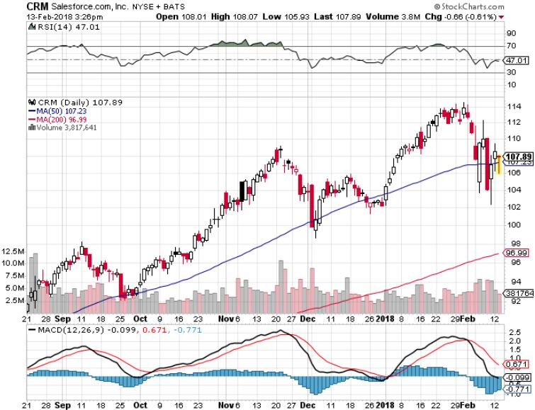
Salesforce (CRM)- long 3/$90-$95 bull call spread in Mad Hedge Technology Letter Only

Slide 31
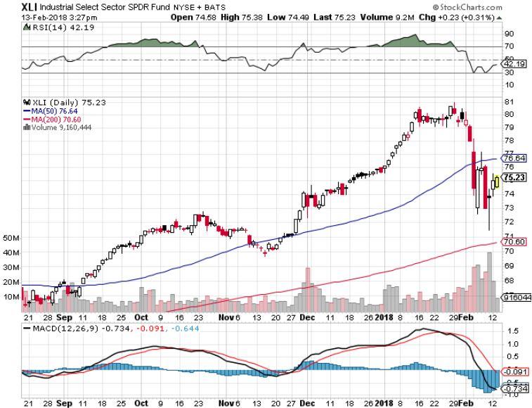
Industrials Sector SPDR (XLI)- (GE), (MMM), (UNP), (UTX), (BA), (HON)

Slide 32
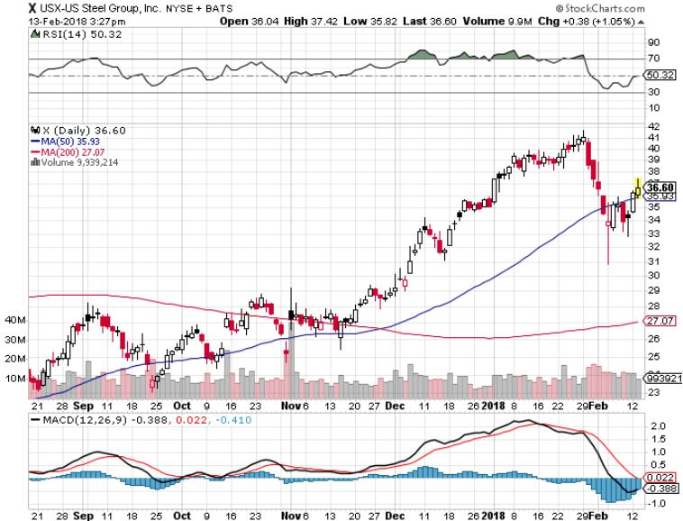
US Steel (X)- took profits on long the 9/$21-$22 vertical bull call spread

Slide 33
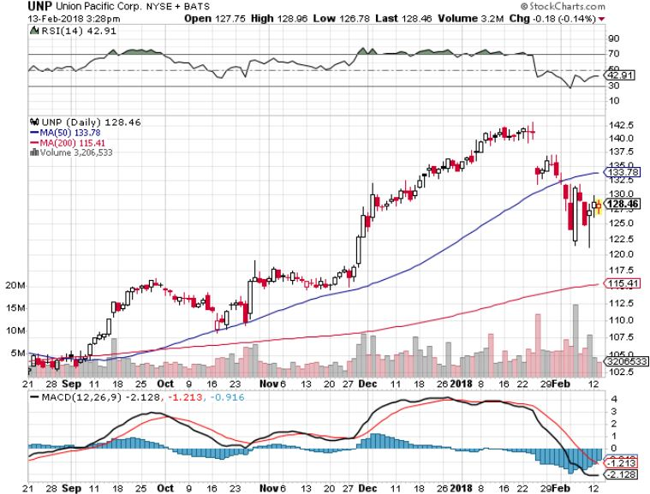
Union Pacific Railroad (UNP)- took profits on long the 9/$100-$102 vertical bull call spread

Slide 34
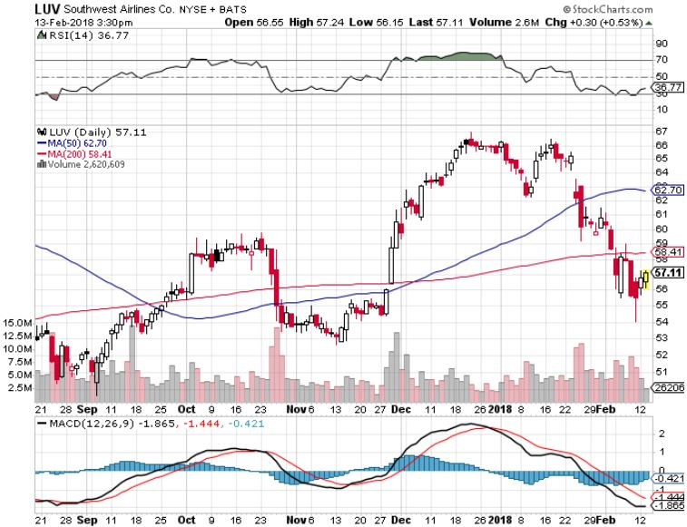
Southwest Airlines (LUV)- Warren Buffett’s Favorite Airline

Slide 35
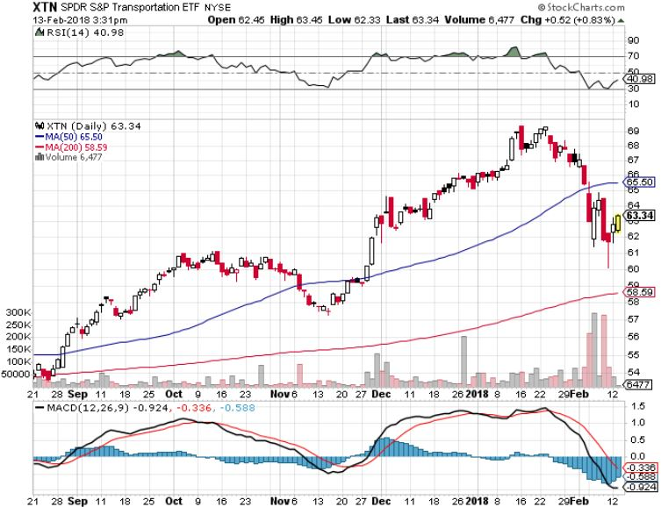
Transports Sector SPDR (XTN)- (ALGT), (ALK), (JBLU), (LUV), (CHRW), (DAL)

Slide 36
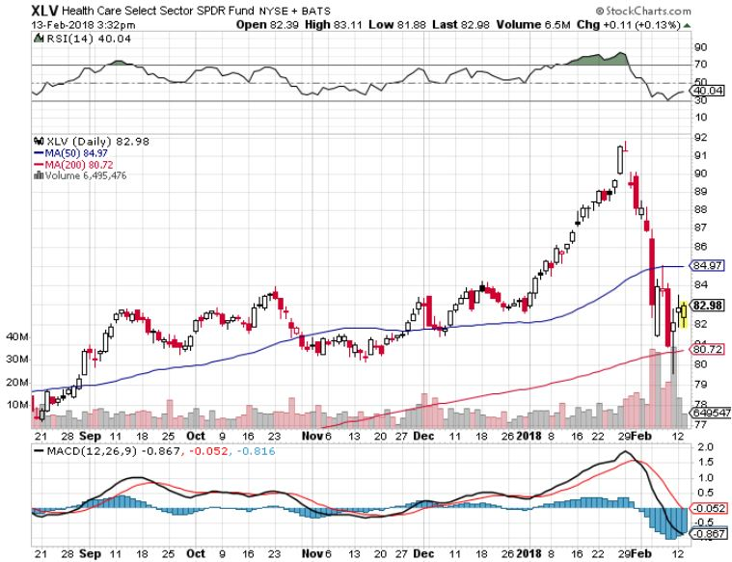
Health Care Sector (XLV), (RXL)-The New FANG? (JNJ), (PFE), (MRK), (GILD), (ACT), (AMGN)

Slide 37
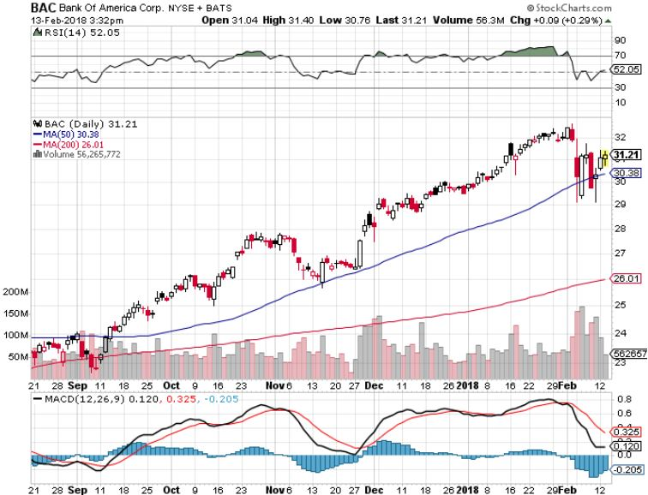
Bank of America (BAC)-New Highs (BLK/B), (WFC), (JPM), (BAC), (C), (GS) long 12/$25.50-$27 bull call spread-expires in 7 trading days

Slide 38
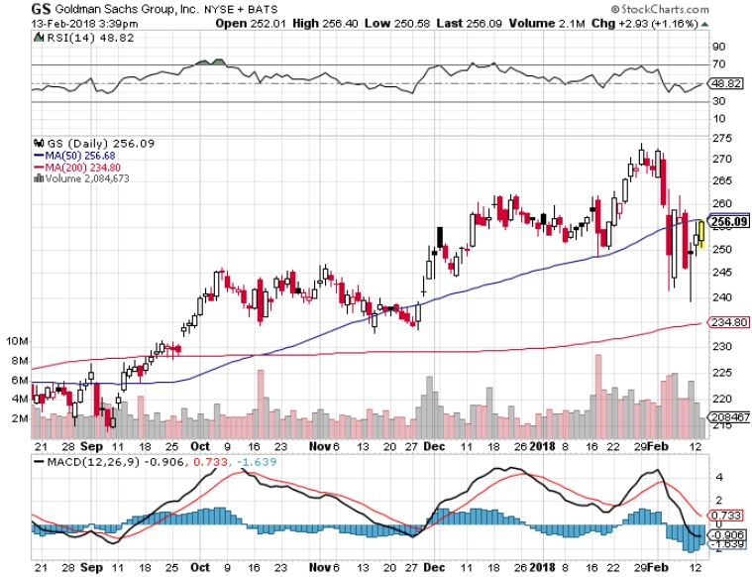
Goldman Sachs (GS)-Earnings Disappointment on bond losses stopped out of long 10/$220-$225 vertical bull call spread took profits on long 10/$227.50-$232.50 vertical bull call spread

Slide 39
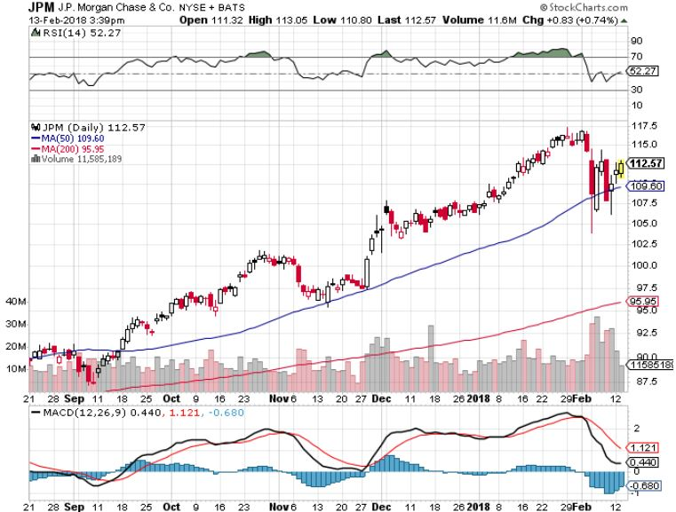
JP Morgan (JPM)-

Slide 40
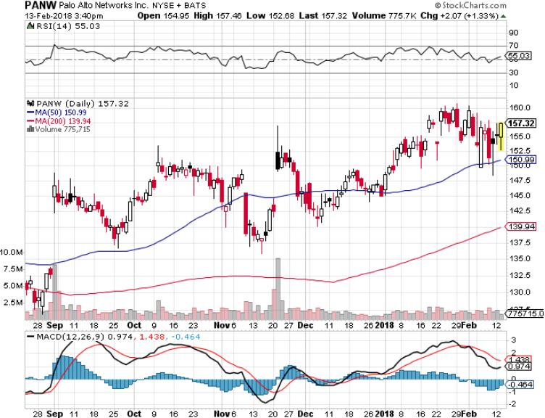
Palo Alto Networks (PANW)-

Slide 41
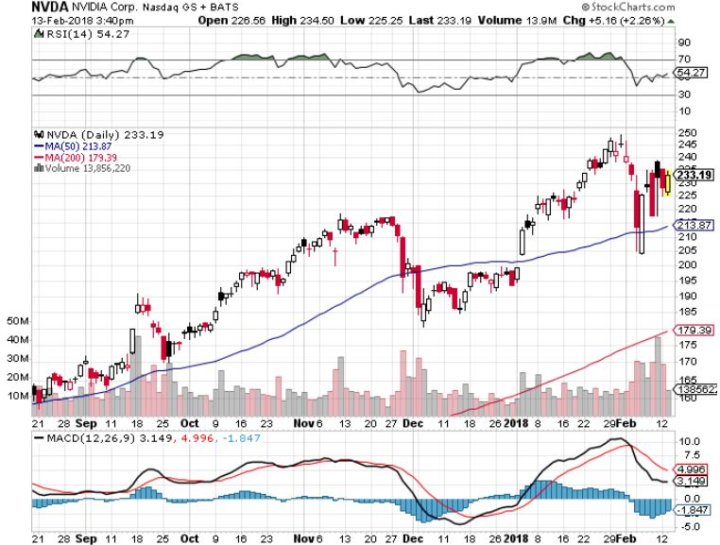
NVIDIA (NVDA)-Fabulous Earnings

Slide 42
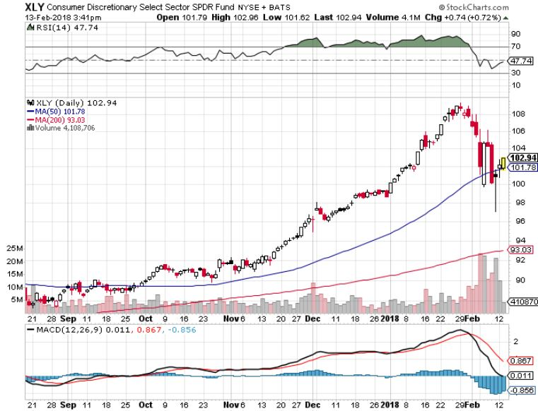
Consumer Discretionary SPDR (XLY) (DIS), (AMZN), (HD), (CMCSA), (MCD), (SBUX)

Slide 43
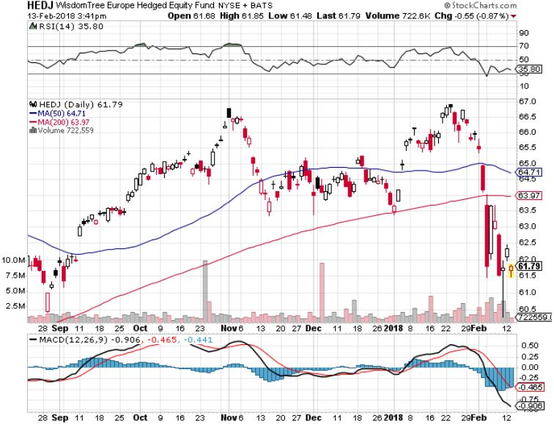
Europe Hedged Equity (HEDJ)-Global Rally

Slide 44
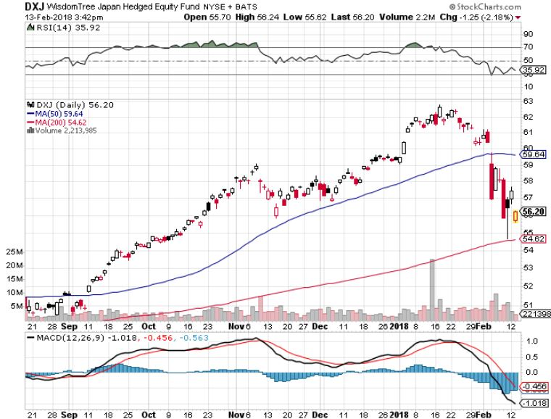
Japan (DXJ)-More Global Rally

Slide 45
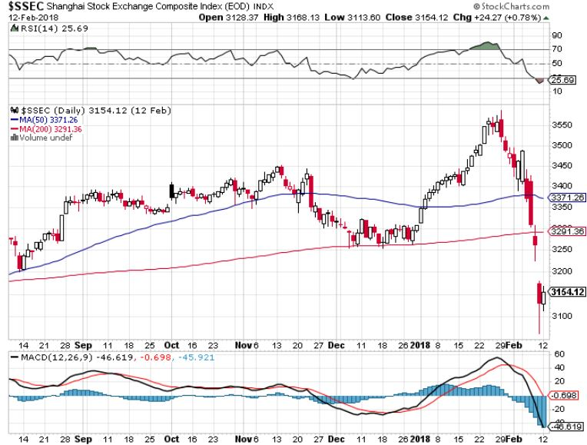
China ($SSEC)-Economic Recovery on Track

Slide 46
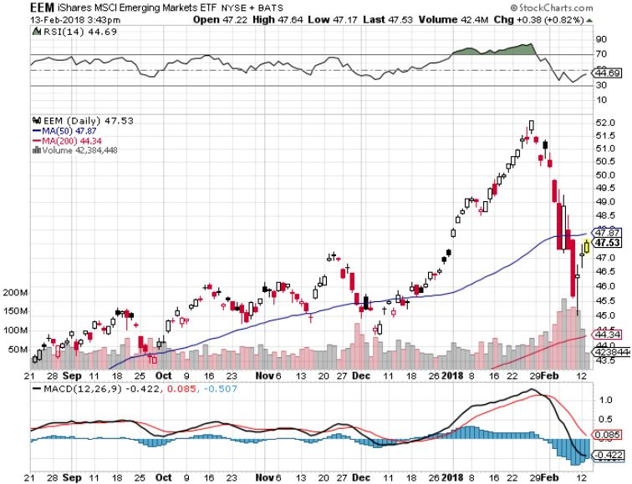
Emerging Markets (EEM)- New High

Slide 47
Bonds-The Fat Lady Takes a Rest
*Bonds reaching the tag ends of an eight month, 87 basis point move to a four year high in rates *While the rest of the world was panicking over rising interest rates, in fact rates barely moved last week Look for rates to stall around here, supporting stocks *Still looking for 3.25%-3.5% ten year US Treasury yield by yearend *$1.2 trillion budget deficit for 2018 still provide a terrible backdrop for bonds *Markets now looking for three 25 basis point interest rate hikes in 2018 *The Fed’s QT, or “quantitative tightening” to remove $6 billion a month, or $200 million a day worth of liquidity

Slide 48
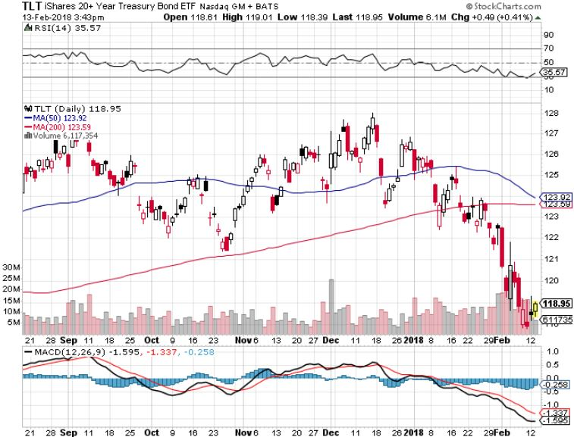
Treasury ETF (TLT) – 2.55-New Down Leg long 2/$114-$117 bull call spread long 3/$124-$127 bear put spread Took profits on long the (TLT) 2/$127-$130 vertical bear put spread Took profits on long (TLT) 12/$129-$131 vertical bear put spread Took profits on long (TLT) 12/$129-$132 vertical bear put spread

Slide 49
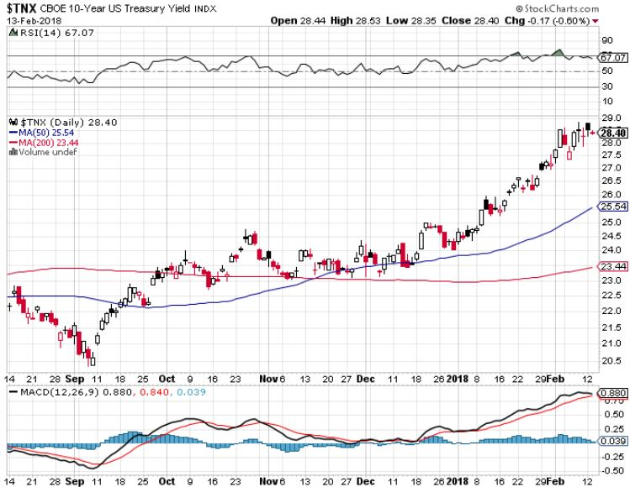
Ten Year Treasury Yield ($TNX) 2.85% Breakdown, Now major Support

Slide 50
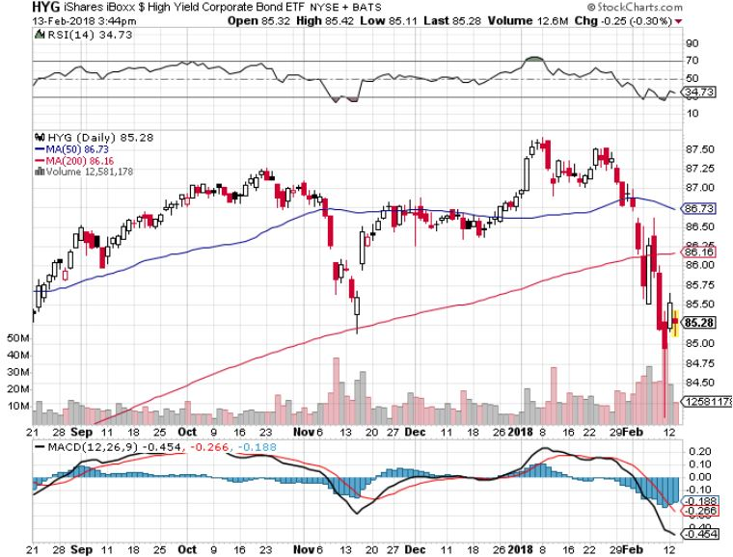
Junk Bonds (HYG) 5.39% Yield 60 basis point pop in yield on stock crash

Slide 51
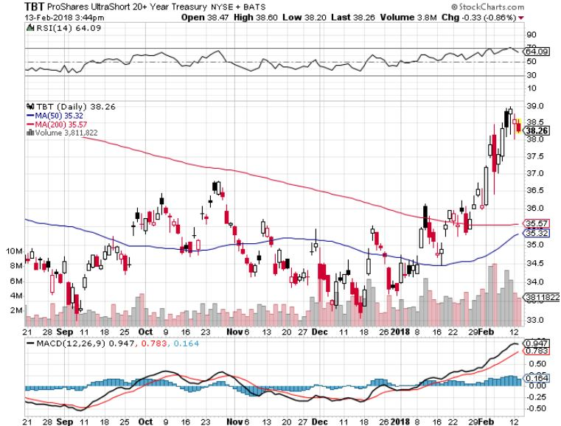
2X Short Treasuries (TBT)-

Slide 52
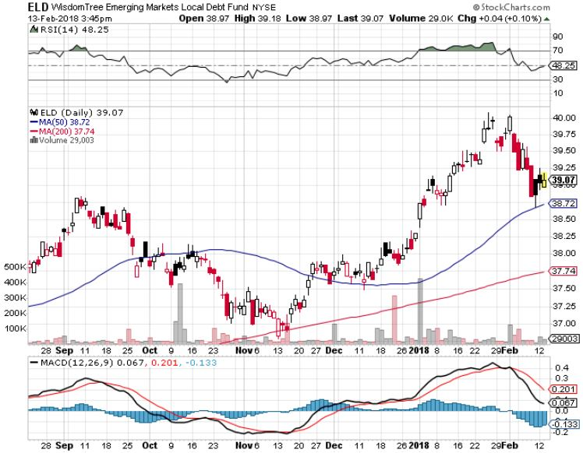
Emerging Market Debt (ELD) 5.58% Yield-

Slide 53
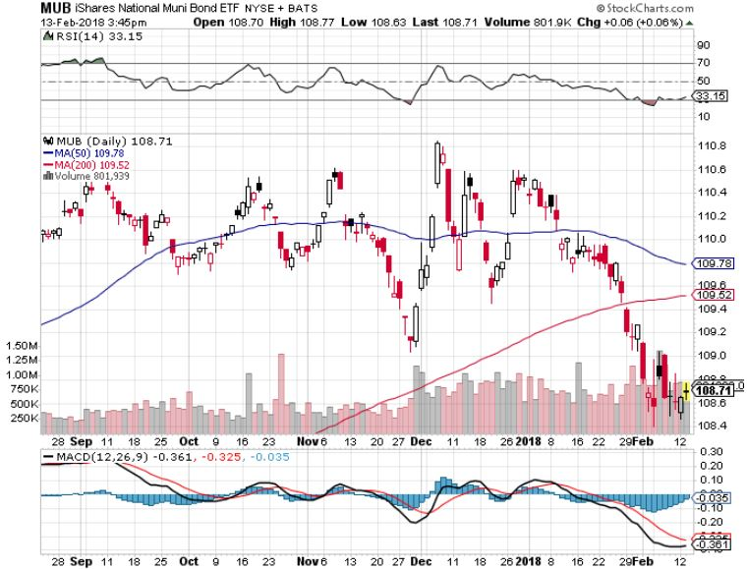
Municipal Bonds (MUB)-2.08% Mix of AAA, AA, and A rated bonds Huge 40 basis point yield pop on tax bill

Slide 54
Foreign Currencies-Flight to Safety
*Stock market crash brings major “flight to safety” bid for the US dollar *Suddenly weak commodities demolish commodity currencies of Aussie (FXA) and Loonie (FXC) *Renminbi futures start trading, opening the way for broader use of the Chinse currency *Dumping risk also hits the Chinese currency (CYB) *Bitcoin crashes too, down from $20,000 to $6,000, correlation with US stocks continues

Slide 55
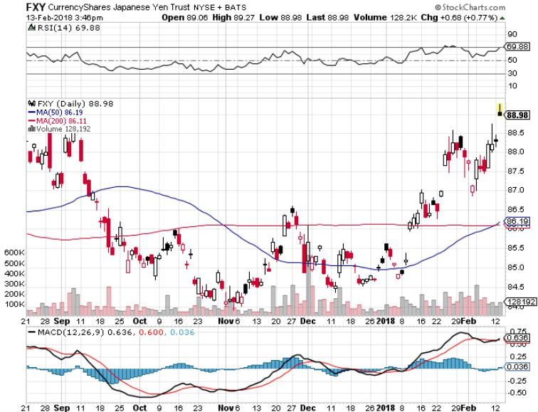
Japanese Yen (FXY), (YCS)

Slide 56
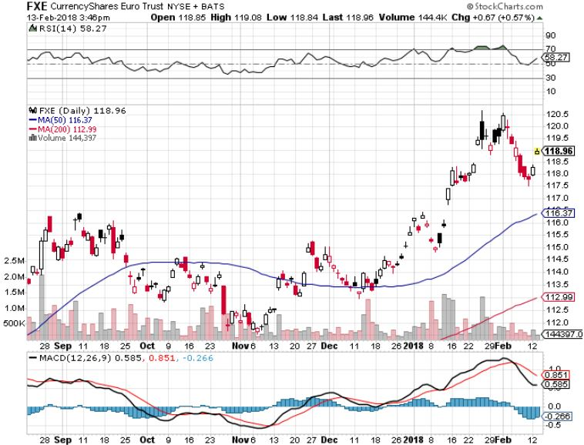
Euro ($XEU), (FXE), (EUO)- Breakout! took profits on long (FXE) 12/$116-$118 vertical bear put spread took profits on long (FXE) 12/$111-$113 vertical bull call spread

Slide 57
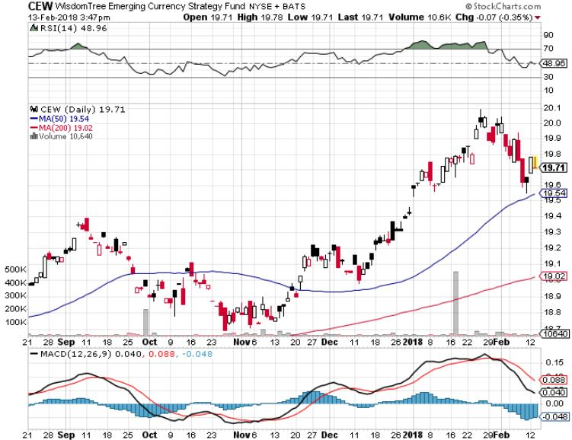
Emerging Market Currencies (CEW)

Slide 58
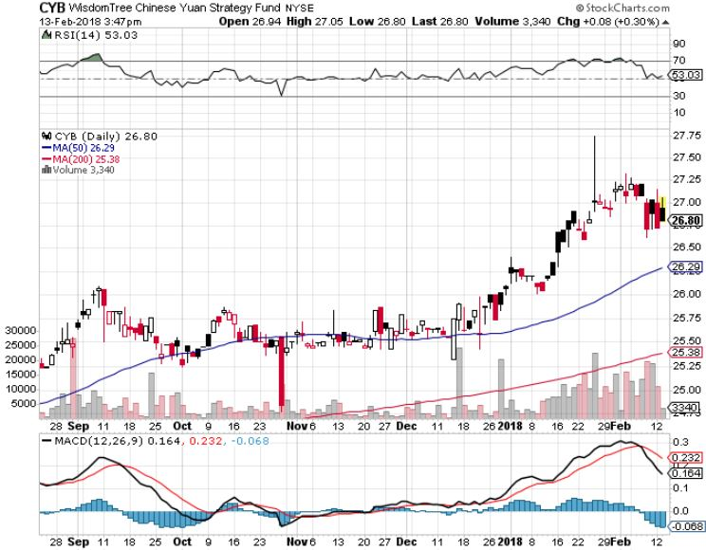
Chinese Yuan- (CYB)-Stabilizing on Government Support

Slide 59
Energy-Setback
*Global stock selling panic spills into oil, giving up all 2018 gain *US oil production tops 10 million barrels/day for the first time since 1970 *Hedge fund oil longs now at all time highs *The US will soon be producing over 10 million barrels a day, making it the second largest driller after Russia *Saudi Arabia is restricting supplies to keep prices up going into the Aramco pricing, costing it market share *Fracking supply is on the rebound, Baker Hughes US Rig Count surges by a huge 29 to 975 *Buy the dips in energy stocks

Slide 60
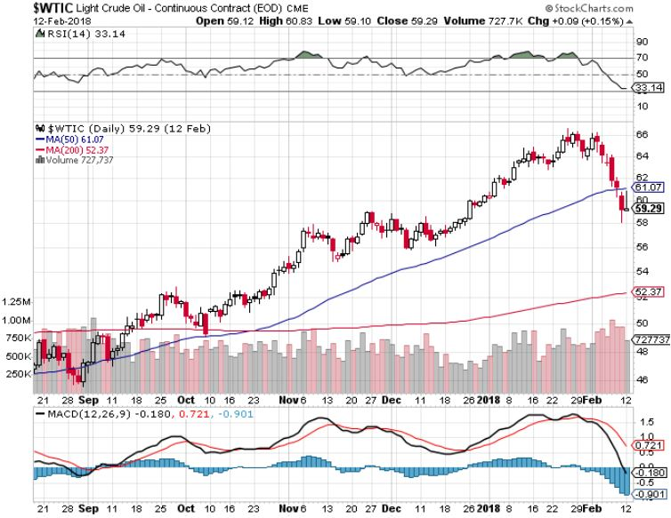
Oil-New Highs!

Slide 61
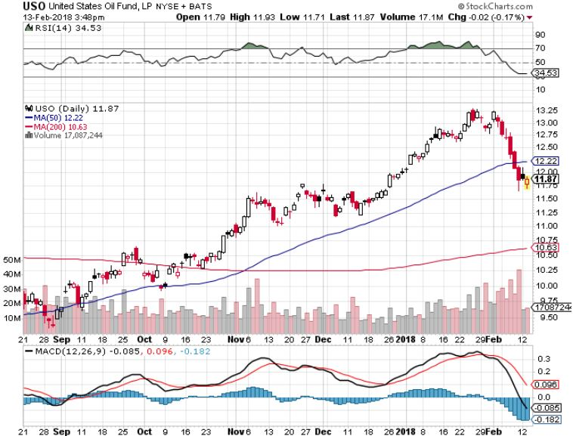
United States Oil Fund (USO)

Slide 62
Energy Select Sector SPDR (XLE)- (XOM), (CVX), (SLB), (KMI), (EOG), (COP)

Slide 63
Alerian MLP ETF (AMLP)- Basket Approach

Slide 64
Exxon (XOM)-

Slide 65
Schlumberger (SLB)-

Slide 66
Halliburton (HAL)-

Slide 67
Natural Gas (UNG)-

Slide 68
Copper (COPX)-

Slide 69
Precious Metals-Taking a Break
*Margin calls on stocks hit the gold market as investors liquidate all other assets to pay for stock losses *A collapsing US dollar against the Rupee has brought Indian buyers back into the gold market in a major way *Gold back ETF add 27.6 metric tonnes in January, growing assets by 5%, with ¾ bought by Americans *Buy gold and silver stocks on the next big dip, as it is still early days for the bull market

Slide 70
Gold (GLD)-New One Year High Stopped out of 2/$122-$125 bull call spread for small loss took profits on long (GLD) $12/$116-$119 bull call spread

Slide 71
Here’s Your Bull Case for Gold Global Gold ETF Fund Flows

Slide 72
Market Vectors Gold Miners ETF- (GDX) Took profits on long the 9/$20.50-$21.50 bull call spread

Slide 73
Barrick Gold (ABX) stopped out of long 9/$15-16 call spread

Slide 74
Newmont Mining- (NEM)-Breakout stopped out of 2/$36-$39 bull call spread for small loss took profits on long the 9/$32-$34 bull call spread

Slide 75
Global X Silver Miners ETF- (SIL)-Breakout took profits on long the 9/$31-$33 bull call spread

Slide 76
Bitcoin-Modern Day Tulips! Now banned in China and South Korea

Slide 77
Real Estate-Rate Knock
*December Existing Home Sales down 3.6% to 5.57 million units annualized, New Homes down -9.3% to 625,000 as end of year doldrums hit, Pending Home Sales up +0.5% *Median Home Sales hit a new high of $335,400, up 3.6% YOY *Value of home ownership as inflation hedge is rising *Rising rates demolish the REFI industry, an employer of 450,000 *With 30 year mortgage interest rates at four year high we have a new drag on the mark *S&P 500 Case-Shiller maintains strong 6.2%, with absolute prices hitting new all time high,

Slide 78
November S&P7500/Case–Shiller Home Price Index +6.2% YOY, Seattle (+12.0%), Las Vegas (+10.2%), San Diego (+8.1%) still leaders price rises accelerating

Slide 79
Simon Property Group (SPG)-

Slide 80
US Home Construction Index (ITB) (DHI), (LEN), (PHM), (TOL), (NVR)

Slide 81
Trade Sheet- So What Do We Do About All This?
*Stocks- buy dips *Bonds-sell any and all rallies *Commodities-buy industrials, energy *Currencies-stand aside *Precious Metals –buy dips *Volatility-go short on runs up to $35 *Real estate-buy dips

Slide 82
Co-Host Dean Jenkins FollowMeTrades.com
*20 years of investing and trading experience *Specializes in equities and equity options *Coaches traders around the world *Focuses on several technical strategies, including Elliot Wave, Ichimoku Cloud,

Slide 83
Next Strategy Webinar 12:00 EST Wednesday, February 28, 2018 San Francisco, CA madhedgefundtrader.com
Good Luck and Good Trading!
Notes:
*

